Slide 1
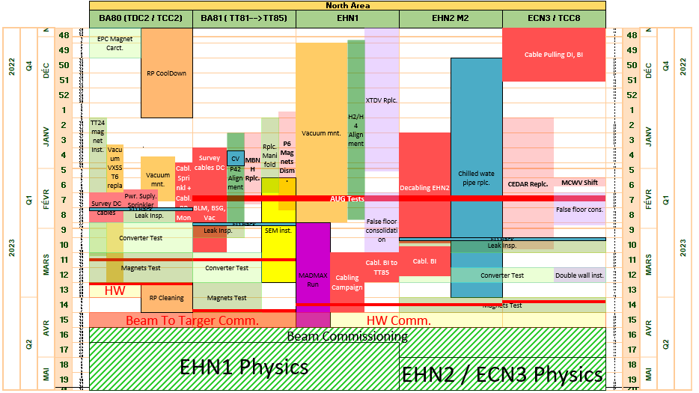
North Area Linear Planning

Slide 2
North Area (1/2)
Task Name | Duration | Start | Finish | Groups
NA run 2022 | 162 days | Wed 06.04.22 | Mon 28.11.22
EPC mesure caractéristique aimant in TCC2 | 10 days | Mon 28.11.22 | Fri 09.12.22 | SY-EPC
Magnet patrol TT81, TT82, EHN1, EHN2, ECN3: magnet on, restricted access | 2 days | Mon 28.11.22 | Tue 29.11.22 | EN-CV,TE-MSC
Magnet patrol TT83, TT84, TT85, TCC8: magnet on, restricted access 183524 | 2 days | Wed 30.11.22 | Thu 01.12.22 | EN-CV,TE-MSC
Magnet leak Inspection all zones (inc TCC2) | 2 days | Mon 12.12.22 | Tue 13.12.22 | BE-EA,EN-CV,TE-MSC
Test normal secours - 06h00-06h30 (No access all zones) | 1 day? | Wed 11.01.23 | Wed 11.01.23 | EN-EL
Test AUG North Area (No access all zones) | 2 days | Tue 14.02.23 | Wed 15.02.23 | EN-EL
Remplacement Fusible sur EOD210/BA82 (Coupure 15x10min EHN2 + ECN3) | 1 day | Mon 13.02.23 | Mon 13.02.23 | EN-EL
Cooling tower off for maintenance | 7.1 wks | Thu 15.12.22 | Thu 16.02.23 | EN-CV
ED cooling stations maintenance BA80, BA81 & BA82 / EB BA81 | 1.8 wks | Mon 06.02.23 | Thu 16.02.23 | EN-CV
Soft start cons BA81 | 4 wks | Thu 05.01.23 | Wed 01.02.23 | EN-CV
Cooling Tower CT2 start | 0 wks | Mon 20.02.23 | Mon 20.02.23 | EN-CV
ED cooling start BA80 | 0 wks | Mon 20.02.23 | Mon 20.02.23 | EN-CV
ED cooling start BA81 | 0 wks | Mon 27.02.23 | Mon 27.02.23 | EN-CV
ED cooling start BA82 | 0 wks | Mon 06.03.23 | Mon 06.03.23 | EN-CV
Eau glacee & mixte stop | 9.4 wks | Thu 15.12.22 | Fri 03.03.23 | EN-CV
Inspection Fuite Aimant BA80 | 1 wk | Mon 20.02.23 | Fri 24.02.23 | TE-MSC
Inspection Fuite Aimant BA81 | 1 wk | Mon 27.02.23 | Fri 03.03.23 | TE-MSC
Inspection Fuite Aimant BA82 | 1 wk | Mon 06.03.23 | Fri 10.03.23 | TE-MSC
Test accss system global BA81/BA81/TCC8/ECN3 (no Access all day) | 1 day | Tue 28.02.23 | Tue 28.02.23 | EN-AA

Slide 3
North Area(2/2)
Task Name | Duration | Start | Finish | Groups
HW Commissioning | 35 days | Mon 27.02.23 | Fri 14.04.23
Test alim BA80 | 2 wks | Mon 27.02.23 | Fri 10.03.23 | SY-EPC
Test alim BA81 | 2 wks | Mon 13.03.23 | Fri 24.03.23 | SY-EPC
Test alim BA82 | 1 wk | Mon 20.03.23 | Fri 24.03.23 | SY-EPC
North Transfert Tests | 20 days | Mon 13.03.23 | Fri 07.04.23
Test Magnets BA80 | 2 wks | Mon 13.03.23 | Fri 24.03.23 | TE-MSC
Test Magnets BA81 | 2 wks | Mon 27.03.23 | Fri 07.04.23 | TE-MSC
Test Magnets BA82 | 1 wk | Mon 27.03.23 | Fri 31.03.23 | TE-MSC
TCC2 HWC | 5 days | Mon 27.03.23 | Fri 31.03.23 | BE-EA
HWC rest of NA | 5 days | Mon 10.04.23 | Fri 14.04.23 | BE-EA
DSO tests BA80 + BA81 (North Transfert) no access | 1 day | Wed 15.03.23 | Wed 15.03.23 | BE-ASR
DSO tests TCC8 + ECN3 no access | 1 day | Tue 04.04.23 | Tue 04.04.23 | BE-ASR
DSO tests EHN1 + EHN2 (BA82) no access | 1 day | Wed 05.04.23 | Wed 05.04.23 | BE-ASR
BA80 (TCC2/TDC2) Closed | 0 days | Mon 27.03.23 | Mon 27.03.23
RP Cleaning TDC2 TCC2 (BA80 closed) | 2 wks | Mon 27.03.23 | Fri 07.04.23 | HSE-RP
Beam Commissioning | 15 days | Fri 07.04.23 | Fri 28.04.23
BA81 (TT81+TT82+TT83+TT84+TT85) Closed | 0 wks | Fri 07.04.23 | Fri 07.04.23 | BE-OP
North Transfert Closed | 0 days | Fri 07.04.23 | Fri 07.04.23 | BE-OP
SPS TT20 Beam Commissioning | 1 wk | Mon 10.04.23 | Fri 14.04.23 | BE-OP
SY-BI Equipment Commissioning with beam | 5 days | Mon 17.04.23 | Fri 21.04.23 | SY-BI
NA setup | 2 wks | Mon 17.04.23 | Fri 28.04.23 | BE-OP
EHN1 NA physique (Protons and Ions) | 136 days | Mon 24.04.23 | Mon 30.10.23 | BE-OP
EHN2 ECN3 NA physique (Protons) | 108 days | Mon 01.05.23 | Wed 27.09.23 | BE-OP

Slide 4
MADMAX Planning
Task Name | Duration | Start | Finish | Groups
MADMAX Run | 48 days | Mon 20.02.23 | Wed 26.04.23
Circuit piping conditioning | 3 days | Mon 20.02.23 | Wed 22.02.23 | TE-CRG
conditining of proccess | 1 wk | Thu 23.02.23 | Wed 01.03.23 | TE-CRG
MURPOGO Cooldown | 3 wks | Mon 06.03.23 | Fri 24.03.23 | TE-CRG
Morpugo raised to 1.6 T | 1 wk | Mon 27.03.23 | Fri 31.03.23 | TE-CRG
Prepare Downstreamm Floor and nistall He Dewar | 17 days | Mon 06.03.23 | Tue 28.03.23
DAQ Installation + RUN preparation | 3 days | Tue 21.03.23 | Thu 23.03.23
MADMAX Run Log run at 1.6T | 10 days | Mon 03.04.23 | Fri 14.04.23
Desinstall DAQ | 3 days | Mon 17.04.23 | Wed 19.04.23
G10 Tests | 5 days | Thu 20.04.23 | Wed 26.04.23

Slide 5
No Access by Zones
All North Area
  Tests Normal Secours (6h-6h30) → 11.01.23
  AUG Test → 14.02.23 – 15.02.23
  Test access system global → 28.02.23 → EHN1 and EHN2 not concern
BA80 (TCC2)
  Maintenance access system (0.5 day) → 22.02.23
  DSO test :
    15.03.23
    04.04.23 – 05.04.23
  CLOSURE → 27.03.23

Slide 6
No Access by Zones
BA81 (TT81, TT82, TT83, TT84, TT85)
  Maintenance access system (0.5 day) → 22.02.23
  DSO test :
    15.03.23
    04.04.23 – 05.04.23
  CLOSURE → 07.04.23
EHN1 + EHN2
  DSO test → 05.04.23
  CLOSURE → 14.04.23
TCC8 + ECN3
  Maintenance access system (0.5 day) → 27.02.23
  DSO tests → 04.04.23
  CLOSURE → 14.04.23

