Slide 1
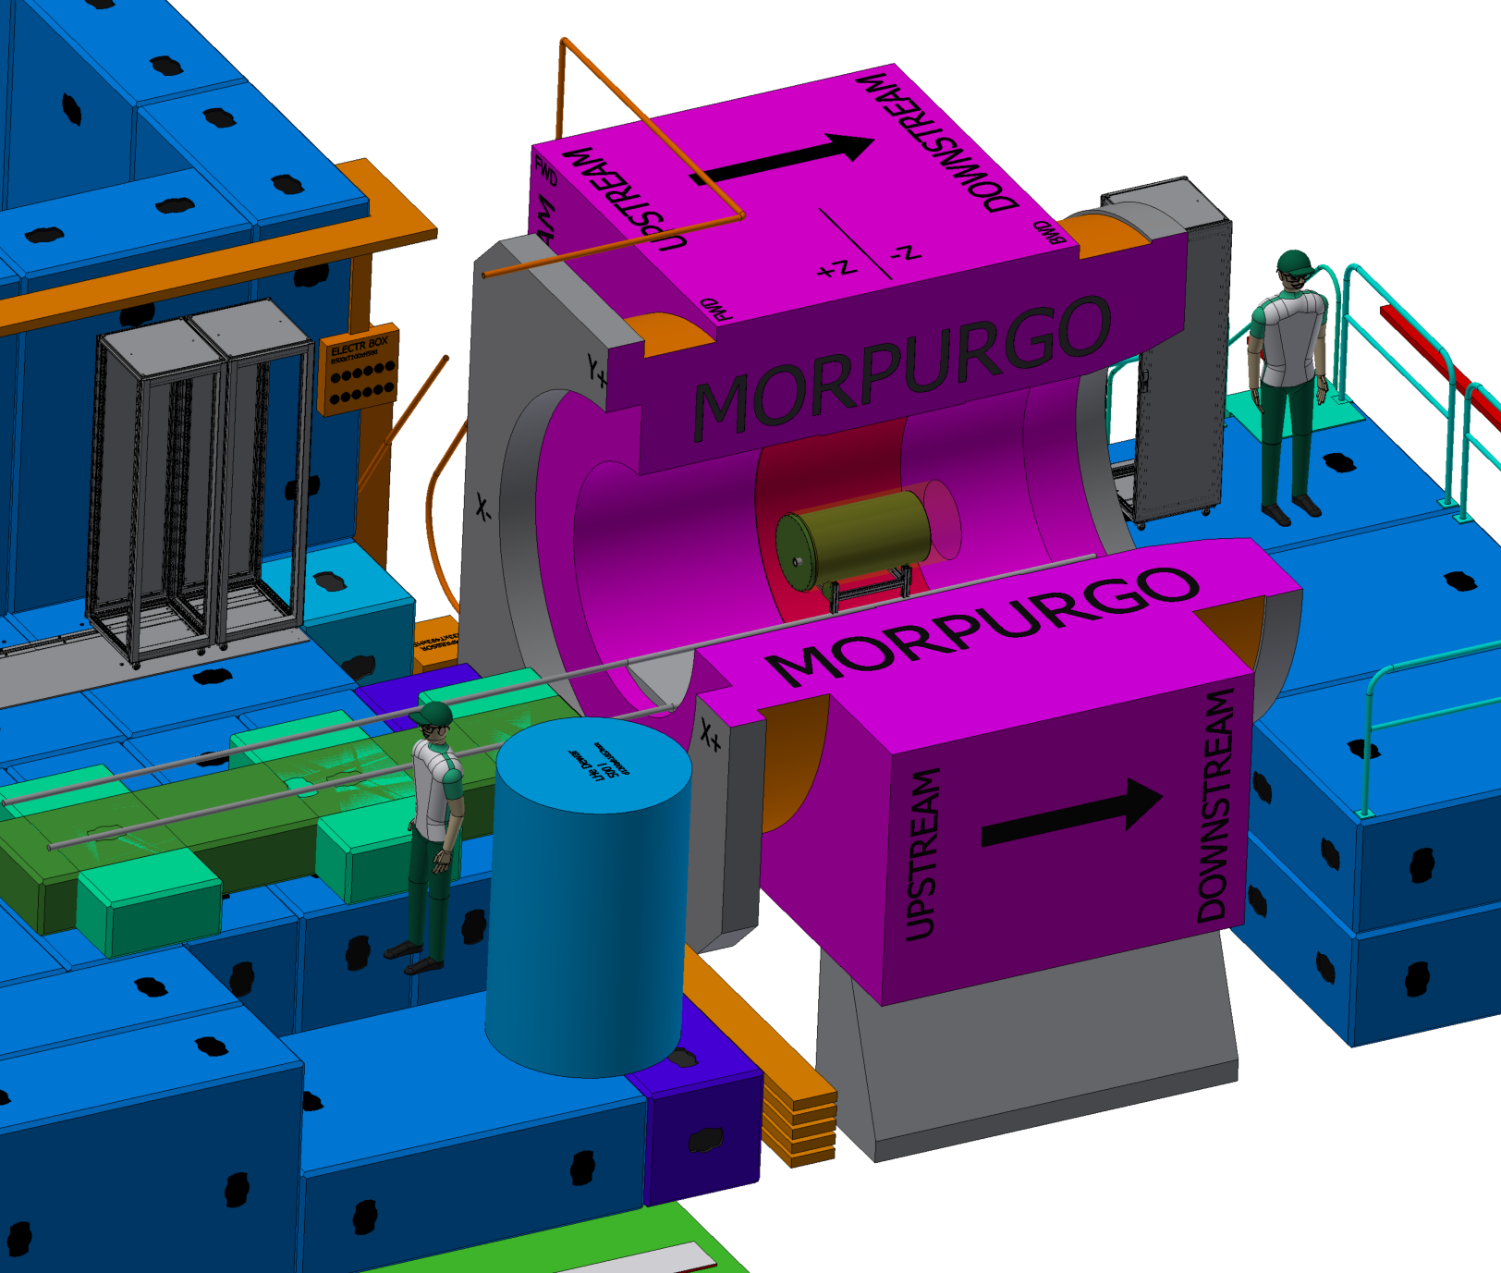
G10 cryostat → Plans for Morpurgo
Tentative plan→ to operate from upstream platform
Need to remove some concrete blocks
Transport He dewar, etc. to morpurgo area
cables
Transfer line
Lakeshore
He transport
dewar
2023 → Commissioning run monitoring temperature of the setup using Cernox (LakeShore) T sensors
2024 → Physics run - ALPs search

Slide 2
G10 cryostat → Plans for Morpurgo
Tentative schedule
Date | Action | Duration (weeks)
16.12.2022 | G10 parts ordered | 9
20.02.2023 | Delivery in Munich → send to CERN | 1
27.02.2023 | Delivery at CERN
27.02.2023 | Installation, commissioning in Cryolab | 5
03.04.2023 | Move to Morpurgo area | 1
11.04.2023 | Commissioning in the magnetic field | 1
15.04.2023 | End of the 2023 run at Morpurgo

Slide 3
Questions from last meeting (Dec 14th):
  He dewar
  Transport of He dewar between Meyrin and Prevessin
  He return line
  Safety unit

