Slide 1
US Contributions to FCC
FCC-US Workshop
Tor Raubenheimer
April 24, 2023
SPACE FOR ADDITIONAL LOGOS

Slide 2
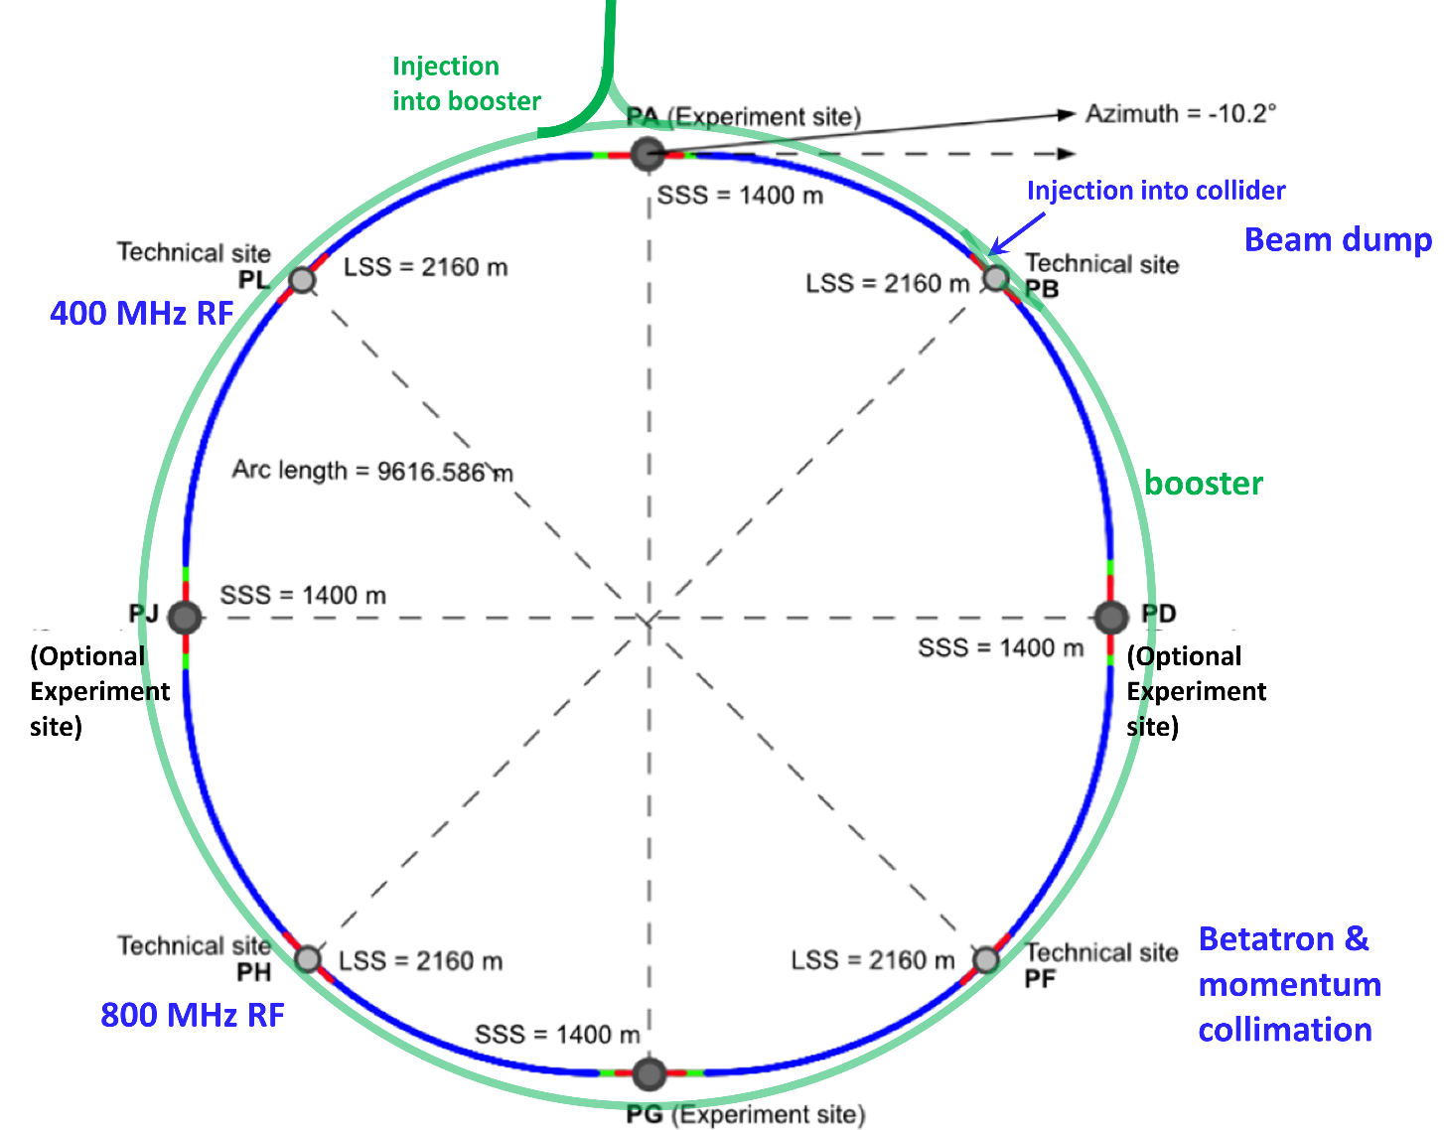
FCC-ee Layout
Double ring e+e- collider with 91 km circ.
Common footprint with FCC-hh, except around IPs
Perfect 4-fold superperiodicity allowing 2 or 4 IPs; large horizontal crossing angle 30 mrad, crab-waist collision optics
Synchrotron radiation power 50 MW/beam at all beam energies
Top-up injection scheme for high luminosity Requires booster synchrotron in collider tunnel and 20 GeV e+/e- source and linac
Or MR RF?
Or Booster RF?

Slide 3
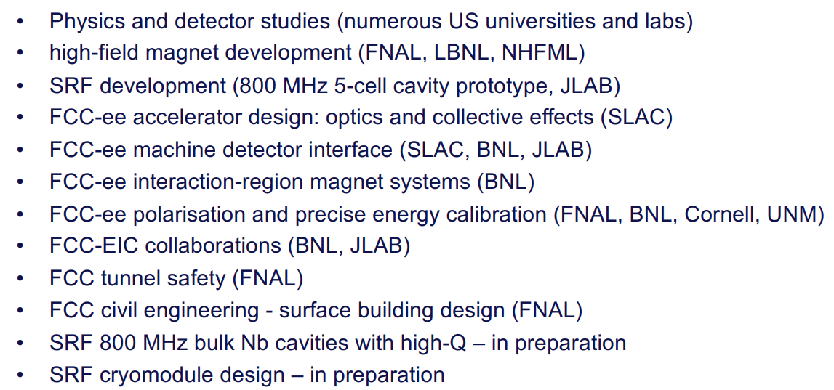
Present US Engagement in FCC Accelerator

Slide 4
Opportunities for increased engagement
Some R&D topics match to unique US technical expertise: bulk Nb SRF, compact SC IR magnets, …
Many other topics leverage US capabilities: beam physics, RF power sources, waveguides, and couplers, power convertors, HTS magnets, beam instrumentation and feedback, controls, ….
Other topics could engage US industry: 270 km vacuum chamber and associated components, dipole magnets for main ring and booster, supports and girders, ….

Slide 5
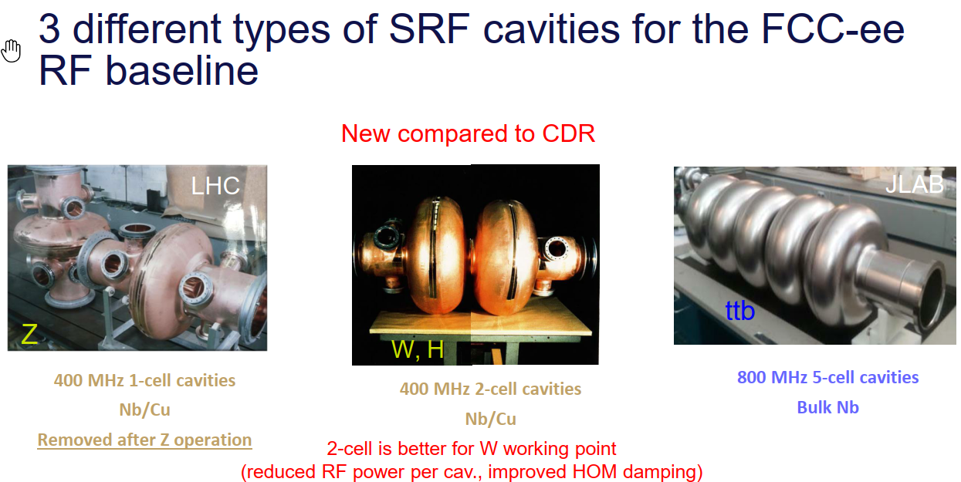
F. Peauger and O. Brunner

Slide 6
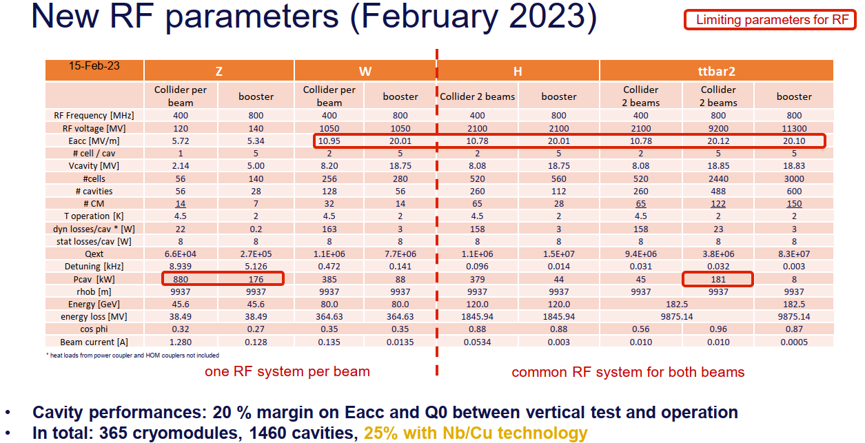
F. Peauger and O. Brunner

Slide 7
FCC-ee SRF R&D
400 MHz Cu/Nb cavities with Q₀ of >3e9 at 12 MV/m and 4.5K
  Require strong damping of single-cell cavities to reduce HOMs at Amp-level current
  Coupler design for ~MW RF power
  Compact cryomodule design for W, Zh, and t-tbar
800 MHz Nb cavities with Q₀ of >3e10 at 25 MV/m and 2K
  Require strong damping of HOMs in 5-cell cavities for 100 mA
  Recently increased Q₀ spec from 2e10 to >3e10
  Coupler design for 250 kW RF power
  Compact cryomodule design for t-tbar

Slide 8
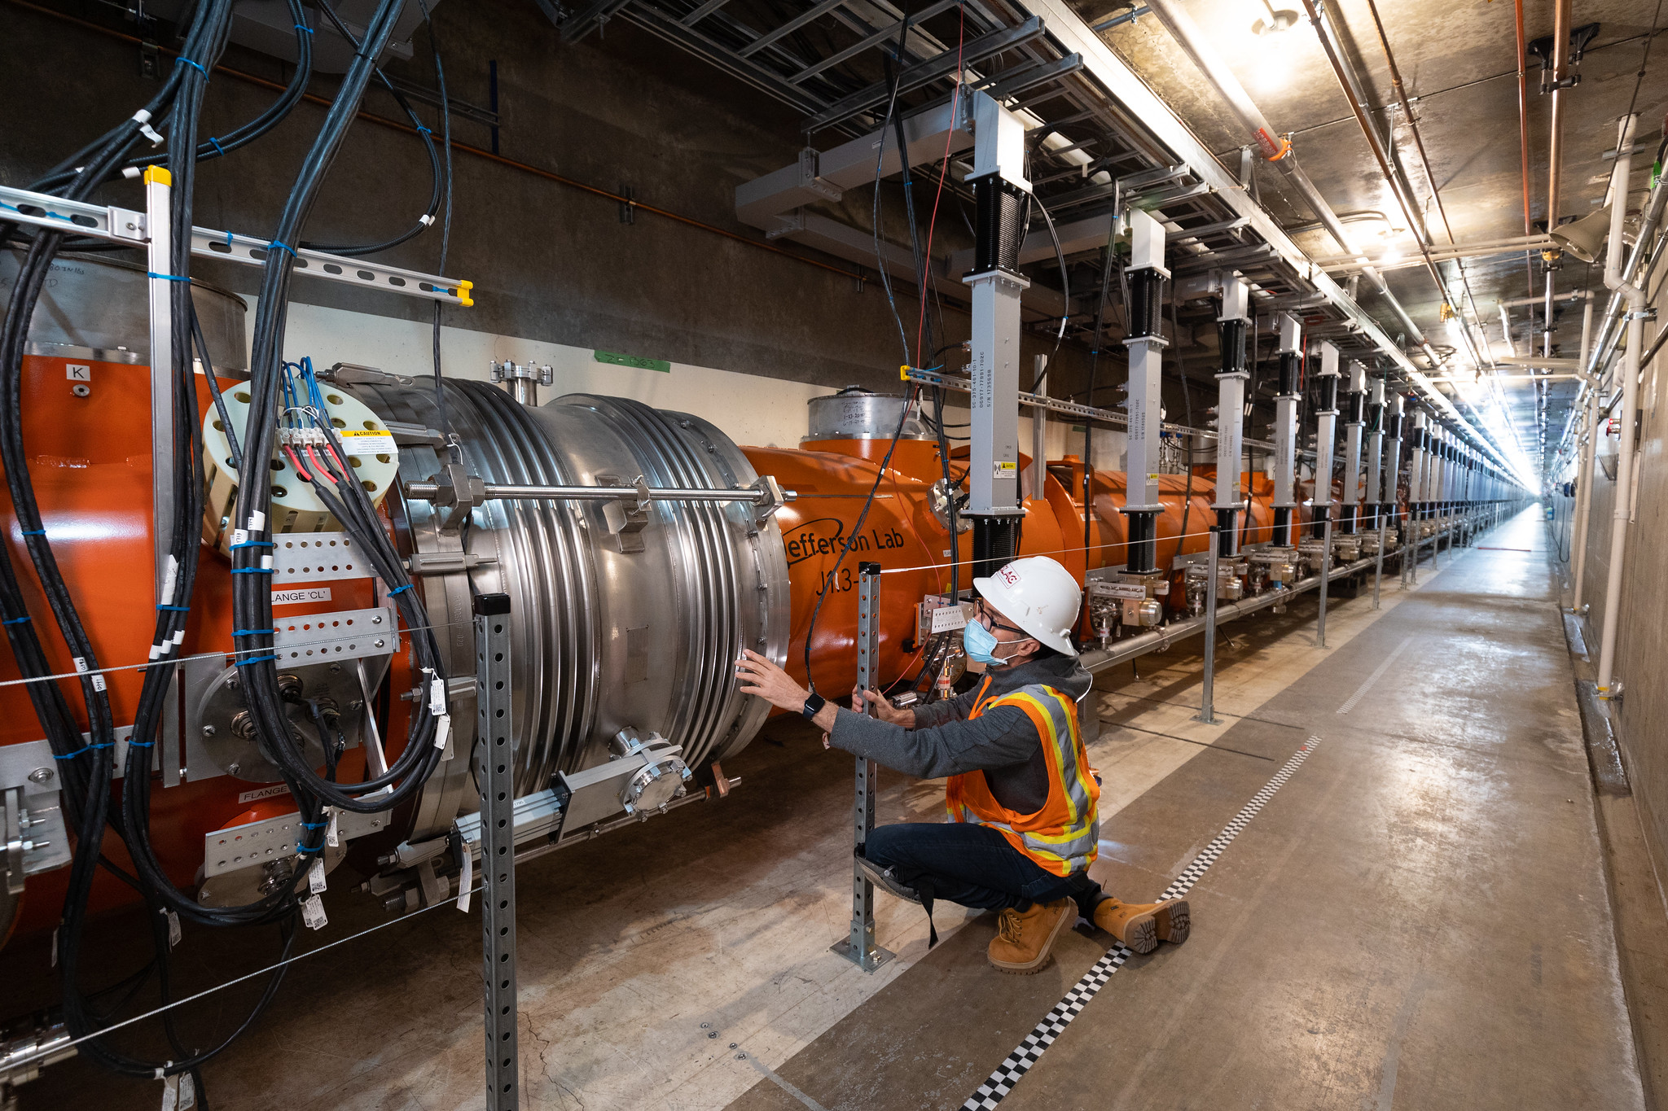
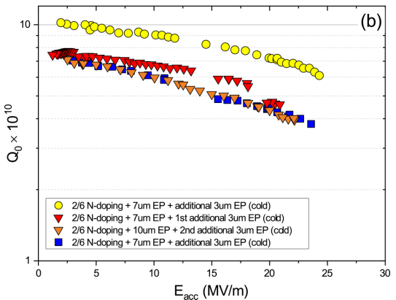
High Q₀ SRF Systems – US expertise
LCLS-II developed new N₂ doping approach → is operating cryomodules at 1.3 GHz with Q₀ = 2.7x10¹⁰ at 16 MV/m
PIP-II is developing high Q
cavities at 650 MHz
PIP-II
LCLS-II
LCLS-II-HE will build 23 cryomodules
with Q0 = 2.7x10¹⁰ and >21 MV/m

Slide 9
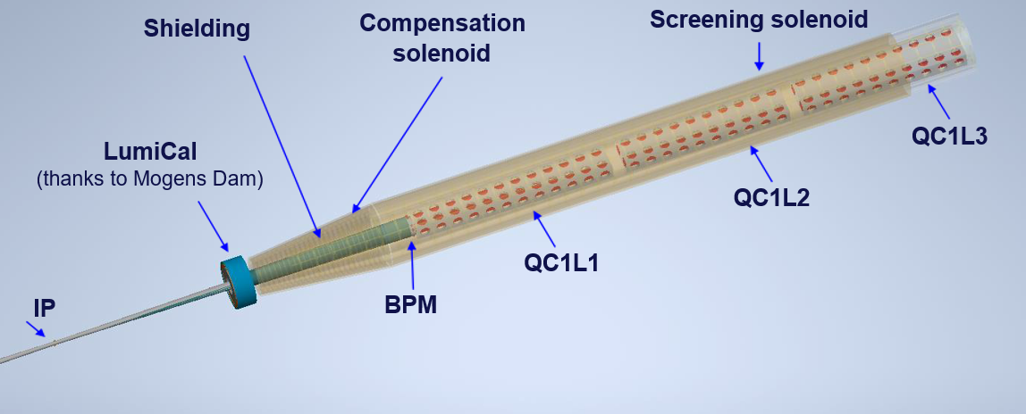
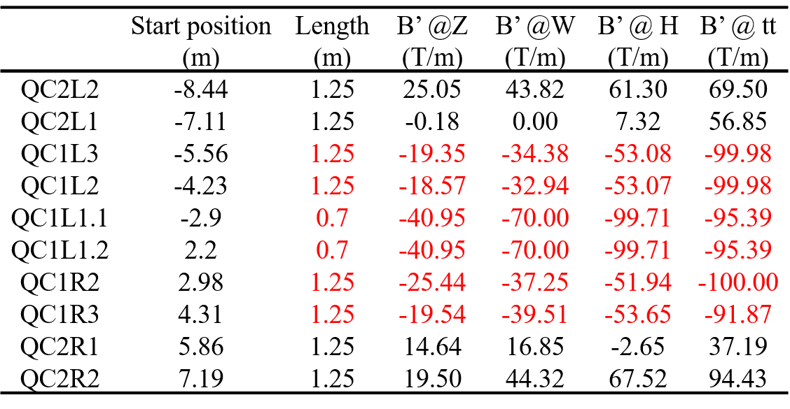
FCC-ee IR Magnet R&D
Complicated integration with SC quadrupoles, solenoids, IR chamber, LumiCal, shielding, and diagnostics
M. Boscolo, M. Koratzinos, B. Parker
Quadrupoles
thanks to M. Koratzinos

Slide 10
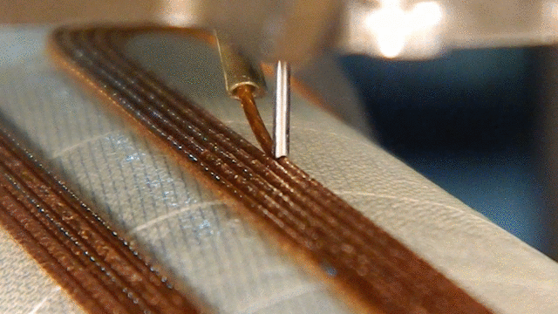
IR Magnets
Challenging IR
magnets embedded
in the detector with
2.2 meter L*
Similar requirements
to Linear Colliders
Small aperture with
modest pole-tip field
Design and requirements have significant impact on detectors
BNL Direct Wind in Action Closeup View

Slide 11
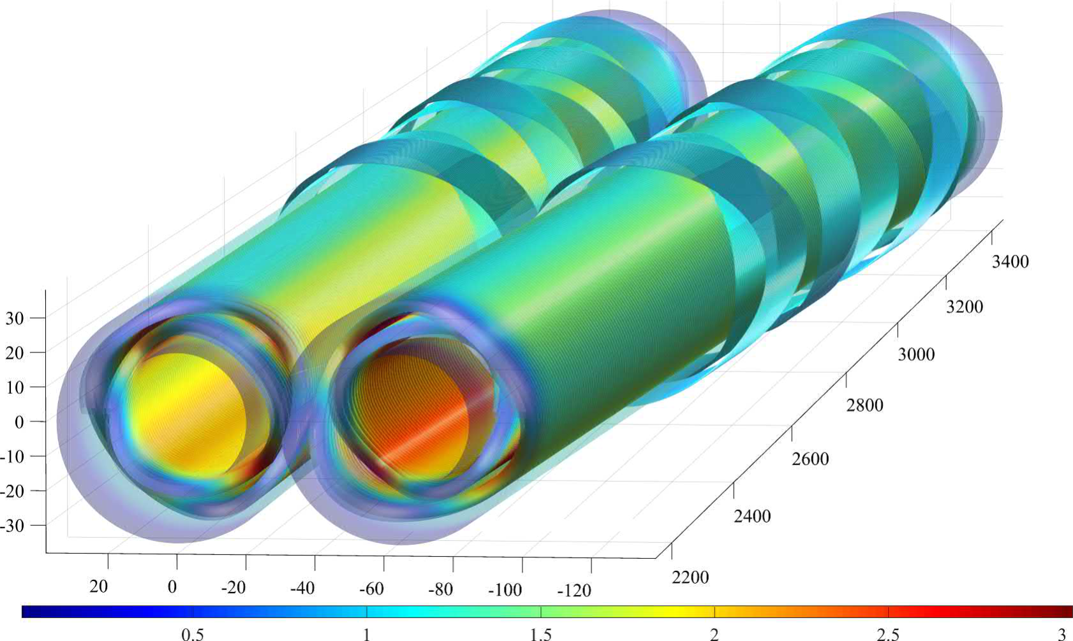
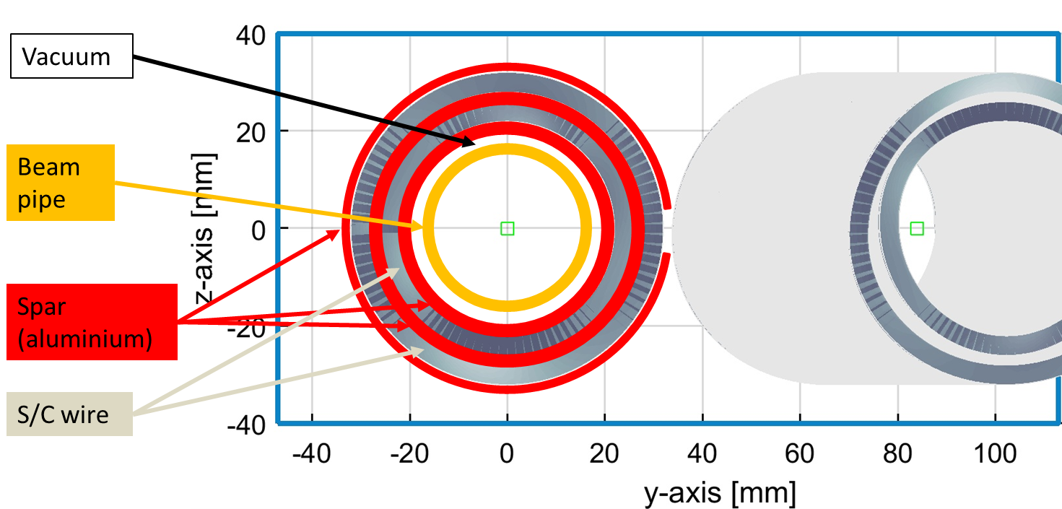
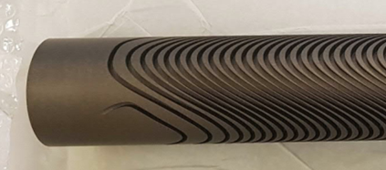

EIC Tapered Quadrupole R&D Example
FCC-ee IR Magnet R&D
Many similarities with EIC IR
Double Helical $≡$ CCT
H. Witte
Direct Wind Tapered Double Helical Coil
FCC R&D CCT Magnet
M. Koratzinos
Grooved Double Helical Coil Support
Baseline FCC-ee Coils and Beam Pipe

Slide 12
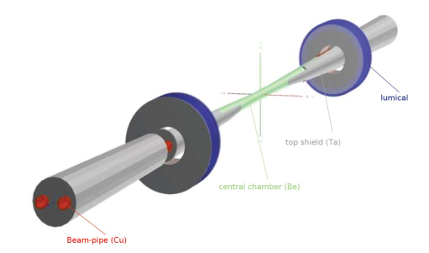





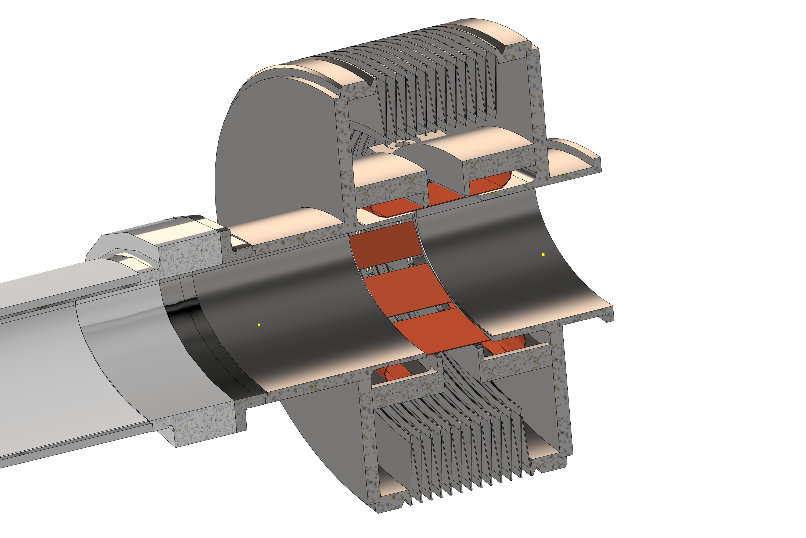
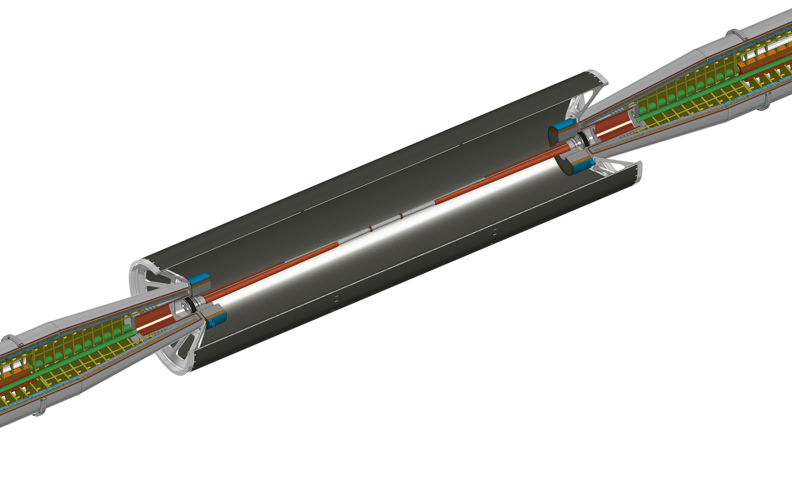
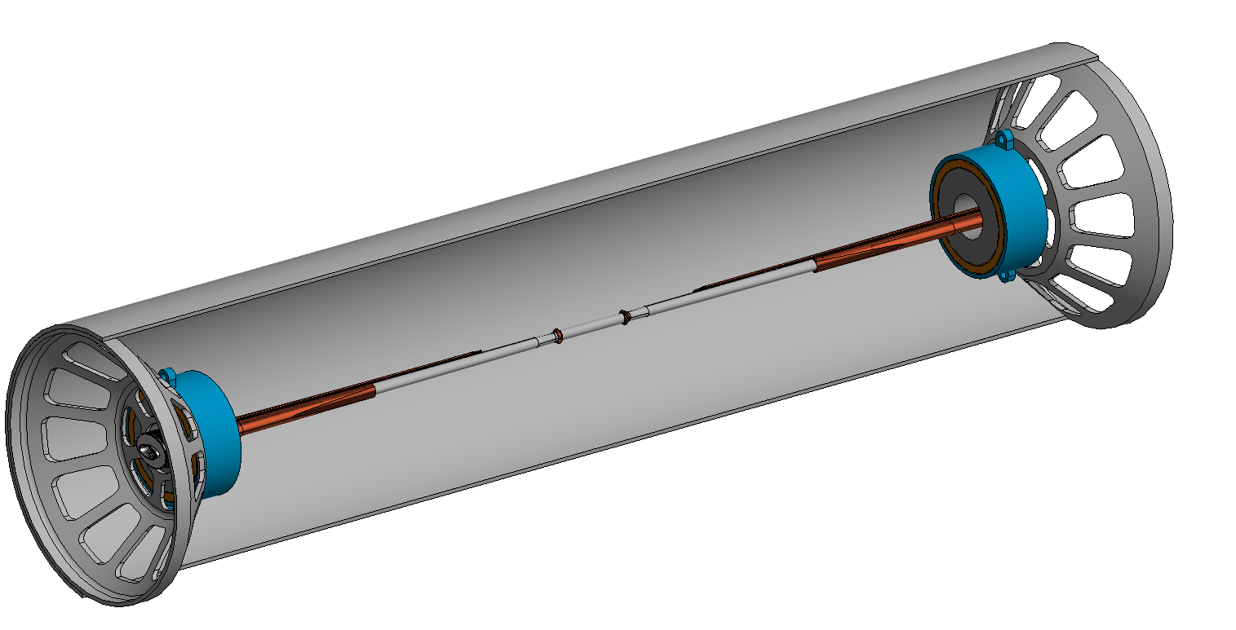
FCC-ee IR Mockup
IP chamber: critical for performance, MDI
1) Central IP vacuum chamber (test cooling and vacuum systems), AlBeMet162 & steel transition (shape of transition, EBW process), Bellows (vacuum and thermal tests), Welding (EBW for elliptical geometry), C-fibre support structure
2) Elliptical vacuum chamber with remote vacuum connection, first quadrupole QC1, cryostat, beam pipe and quadrupole and cryostat support, vibration & alignment sensors
M. Boscolo,
F. Fransesini,
F. Palla, et al.
bellows assembly
support tube with carbon fiber cylinder

Slide 13
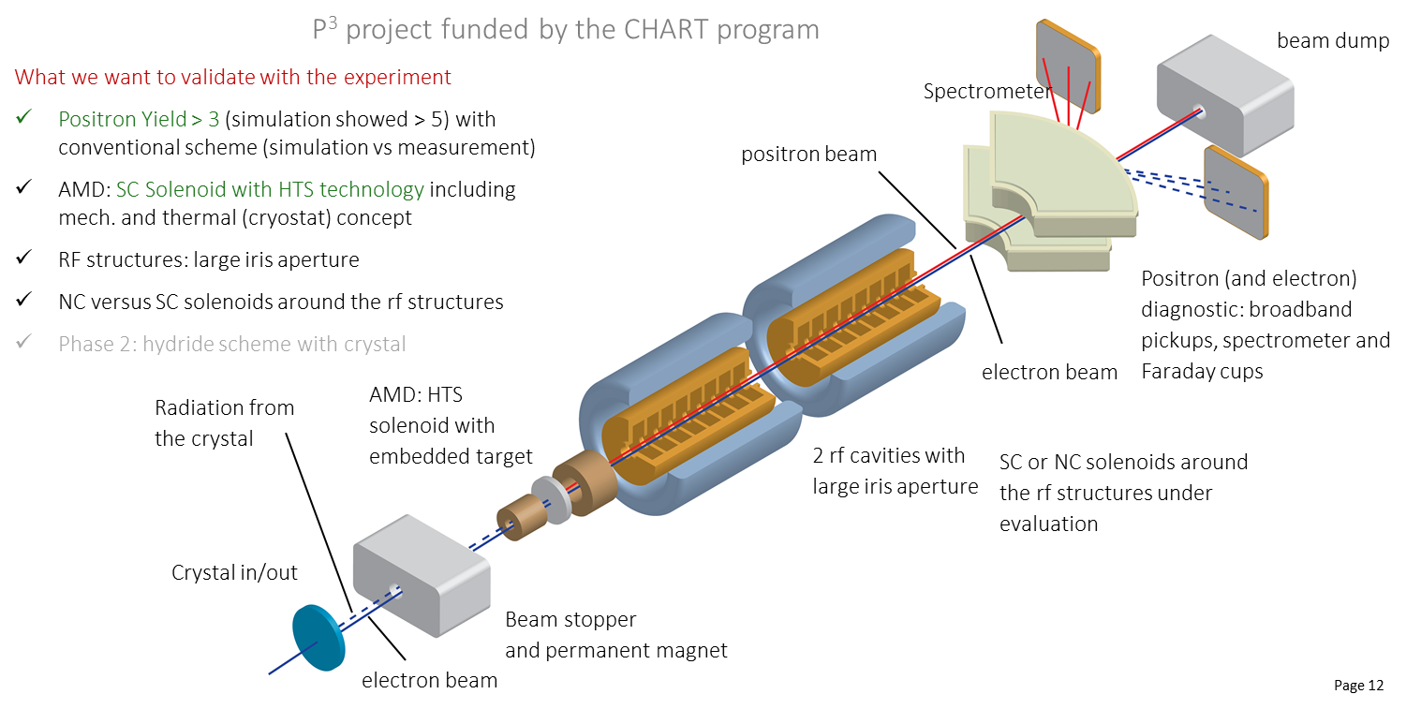
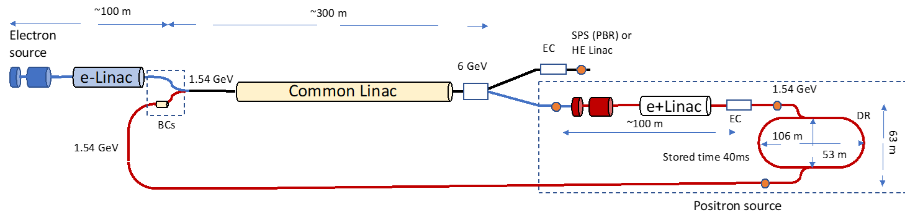
FCC-ee Pre-Injector R&D
Collaboration between PSI and CERN with external partners: CNRS-IJCLab (Orsay), INFN-LNF (Frascati), KEK/SuperKEKB as observer, INFN-Ferrara – radiation from crystal
e+ requirements ~2x SLC
P³: PSI e⁺ production experiment with HTS solenoid at SwissFEL
planned for 2024/25
Latest FCC-ee pre-injector layout
20 GeV linac to Booster
P. Craievich, A. Grudiev, C. Milardi, A. De Santis, et al.

Slide 14
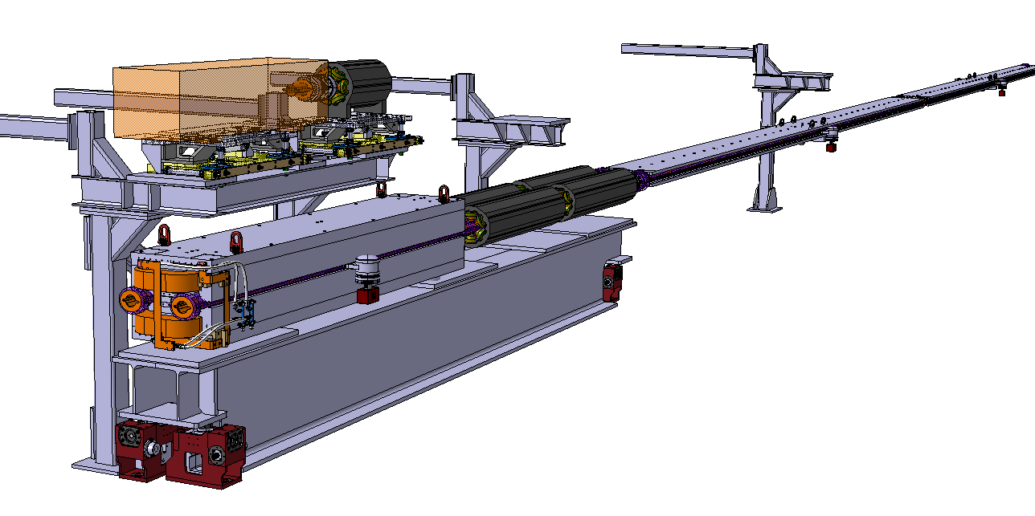
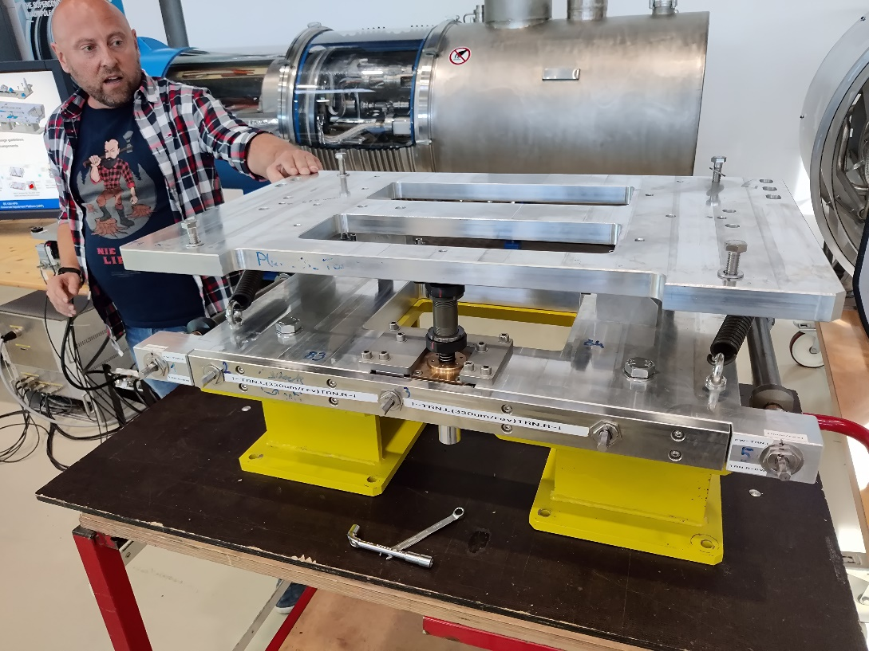
FCC-ee Accelerator Layout
The arc cells are repeated 2000 times around the ring
  Critical to understand and optimize the layout for cost, installation, alignment, operation, and maintenance
  Includes placement of the
  main rings and the Booster
  6000 11-meter twin-bore
  dipoles and 3000 3-meter
  twin-bore quadrupoles plus
  the booster
Common support for booster’s quadrupoles & sextupoles
Preliminary single cantilever dipole supports
F. Carra et al
C. Tetrault
Common girder for main collider quadrupoles & sextupoles
HL-LHC 2t Universal Adjustment Platform (UAP)
HL-LHC jacks

Slide 15
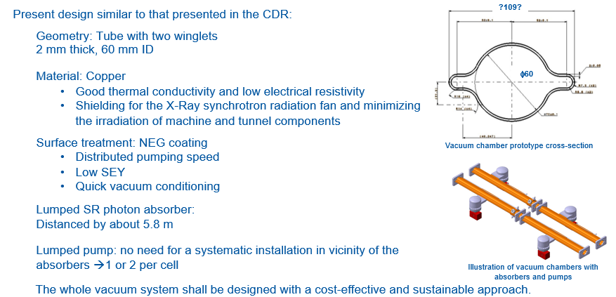
FCC-ee Vacuum System

Slide 16
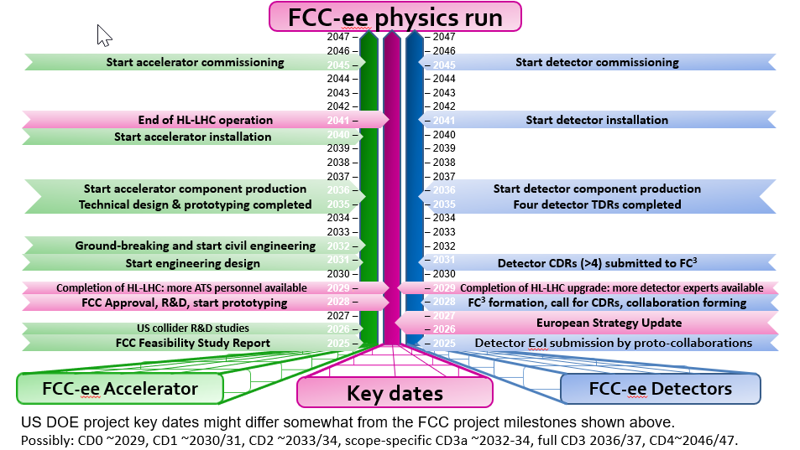
FCC-ee Vacuum System
The arc cells are repeated 2000 times around the ring
  Critical to understand and optimize the layout for cost, installation, alignment, operation, and maintenance
  Includes placement of the
  main rings and the Booster
  6000 11-meter twin-bore
  dipoles and 3000 3-meter
  twin-bore quadrupoles plus
  the booster
Common support for booster’s quadrupoles & sextupoles
Preliminary single cantilever dipole supports
F. Carra et al
C. Tetrault
Common girder for main collider quadrupoles & sextupoles
HL-LHC 2t Universal Adjustment Platform (UAP)
HL-LHC jacks

Slide 17
Planning US Engagement
Working to develop an R&D budget request for P5
  Expect that OHEP will establish a funding path for FCC-ee accelerator and detector R&D and we’re developing a placeholder to provide guidance
FCC-US meeting is an opportunity to start thinking about details
  Focus on technologies other than SRF right now: IR magnets, collimation, backgrounds, beam physics, ….
Lots more detail will be discussed at FCC Week 2023
  Join us there!

Slide 18
FCC-ee US Engagement Summary
US has been engaged in the FCC-ee design
Many opportunities for engagement in R&D stage which will continue into 2030’s – many synergies with EIC
A decision on FCC-ee will be presumably made on 2027 timescale → increased engagement with R&D, engineering, and fabrication
Assuming the project moves ahead, the US contribution could be B$-scale

Slide 19
Thank you for your attention.
Date / Name of the event
Name of the speaker/author
SPACE FOR ADDITIONAL LOGOS
19

Slide 20
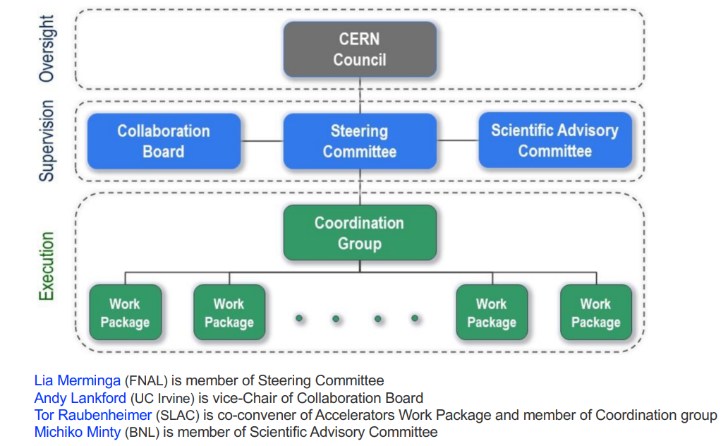
Management and Advisory

