Slide 1

FCC-ee IR Magnets and MDI: Some Challenges and New Opportunities
Brett Parker, BNL SMD/ATRO
https://indico.cern.ch/event/1244371/timetable/

Slide 2
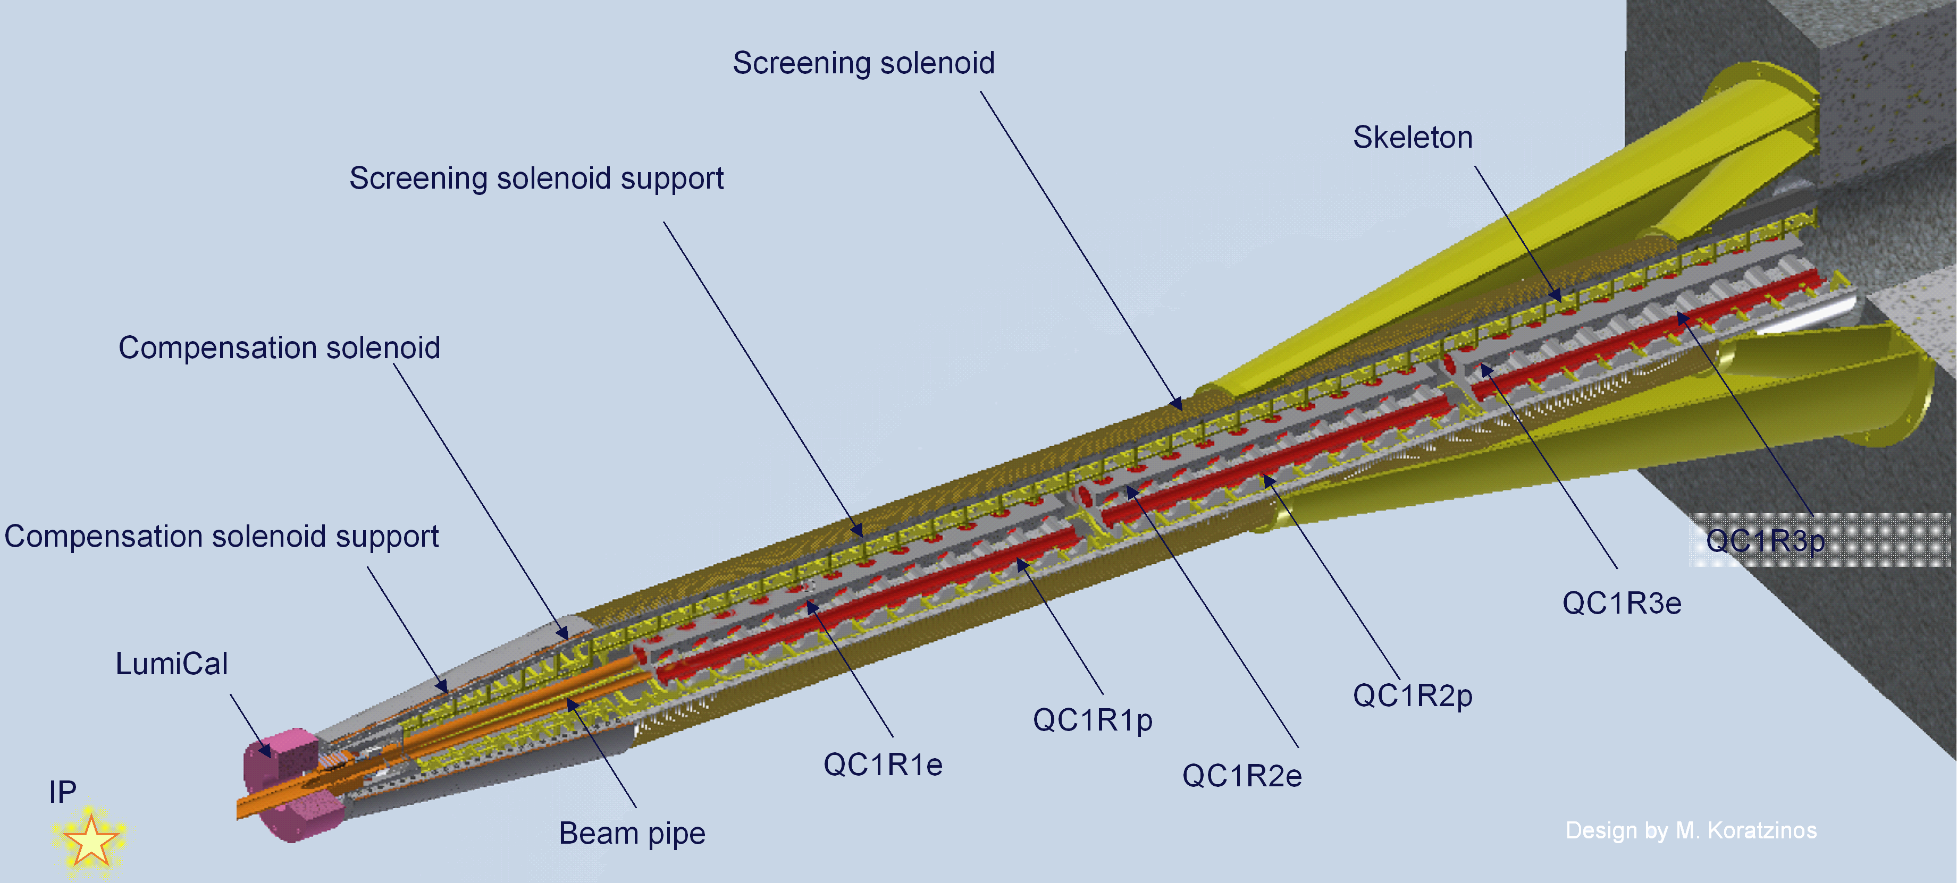
Present FCC-ee IR Baseline Concept
M. Koratzinos, Status Update of the FCC-ee IR Magnet Design, presentation at eeFACT2022.
Present FCC-IR Design Summary

Slide 3
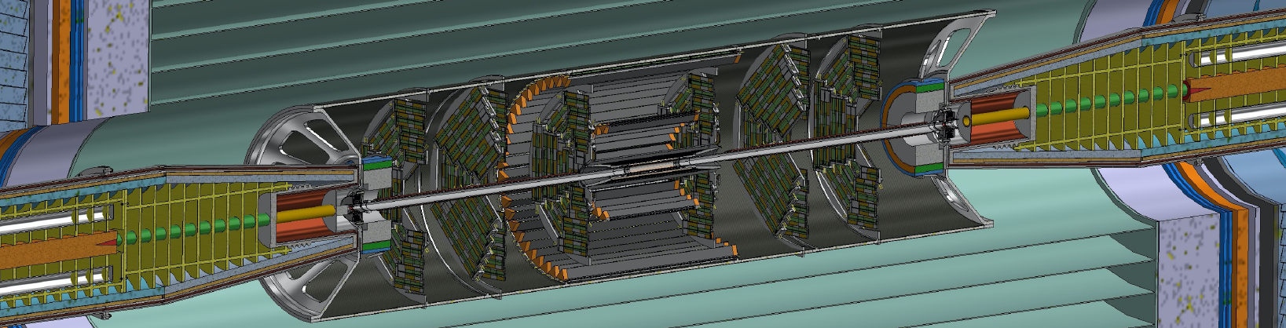
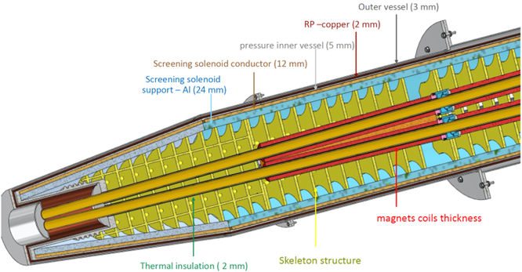
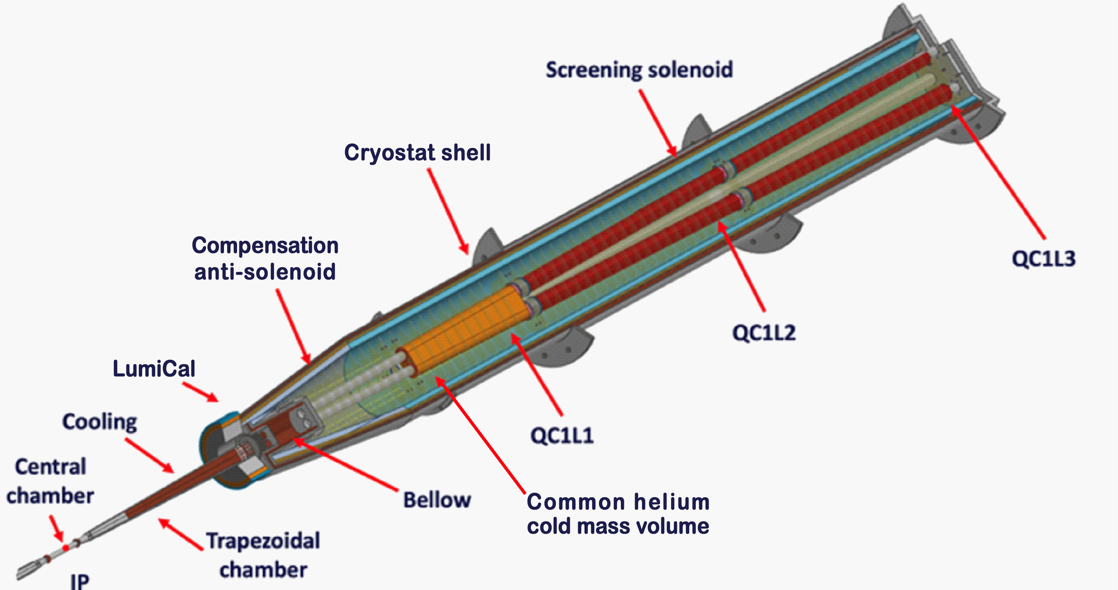
Half-length of the detector ~5.2 m
Side-by-side quadrupole coils designed with field crosstalk (local) compensation.
Have anti-solenoid plus screening solenoid.
1.9 K cooling but with warm beam pipes.
Challenges: Anti-solenoid gives 300kN (30Ton) longitudinal force (warm-to-cold?); need more space for heat shields; common helium with internal space-frame limits access to warm BPMs (cables and laser position monitoring); all cryogen feeds, relief valves, current leads diagnostics must exit back of cryostat; and cryostat support attachment to detector’s endcap dramatically impacts opening up detector for access to central region.
Present FCC-IR Design Summary

Slide 4
Present Baseline FCC-ee IR Magnet Design:
Machine Requirements:
Basic optics for each CM Energy (strengths, acceptance and “tapering”)
Full or partial anti-solenoid (solenoid compensation vs eigen rotation)
Corrector coils (multipolarities, locations/numbers and field quality)
Beam pipe (assume warm, but what cooling, vacuum and bakeout)
Beam Diagnostics (BPMs: access/interface and position monitoring)
Position Stability (laser-based reference(?) and vibration stability meas.)
Misc. (synrad, beam energy deposition and collimation/protection)
Detector Requirements:
Detector acceptance coverage (cryostat/support clear opening angle)
Beampipe connection interface (esp. installation/routine maintenance)
Interface with central detector support structure (esp. lumi-monitor)
Magnet utility interfaces (cryogenic/lead/instrumentation... chimney?)
Cryostat support interface (attach to detector yoke or outside cantilever)
Central detector access (flux return transvers split or simple pushes back)
Alignment (relative to detector network and/or solenoid field)
Magnetic Design Implementation:
Coil Configuration (keep side-by-side, mutually-compensating double helical)
Conductor choice (NbTi or other, 4.5 or 1.9 K operating temperature)
Field quality (field harmonics, crosstalk and powering scheme choice)
Correction coils (multipolarity/number/locations, main coil integration)
Anti-solenoid and compensating solenoid design (conductor/configuration)
Coil forces (anti-/compensating solenoid longitudinal and main coil Lorentz)
Misc. (quench protection, operating margin and machine fault scenarios)
Cryostat Design (Cryogenic, Support, Access, and Stability):
Keep to outer cryostat and support envelope requirements
Pressure vessel design (cryostat and cold mass wall thickness, relief access)
Internal design (inner/outer heat shield, common/separate helium volume)
Interface to BPMs (with assumed warm beam pipe, how to align with quads)
Warm-to-cold transitions (esp. handling the very large solenoid coil force)
Utilities (cryogenic/magnet leads/diagnostics, out back or some via chimney)
Installation/maintenance (cryostat infrastructure remains in place or moves)
Grouped considerations for evolving an improved FCC-ee IR baseline

Slide 5
Accelerator Systems
Detector Systems
Functional specification of FCC-ee IR magnet system: Accelerator, Detector and Magnet Systems analyze FCC-ee IR baseline design configuration and provide feedback to address design challenges as they arise. It is anticipated that multiple iterations will likely be needed before there is general agreement on a complete set of functional requirements.
IR Magnet Systems Development Flow
MDI
Preliminary design of IR magnet system: As the many functional requirements for the magnet system are finalized, the preliminary IR magnet design is developed and reviewed. Some design exploration consequences (such as from adding heat shields or satisfying cryostat space challenges) must be fed back into the functional specifications for practical, reliable and realizable magnet solutions.
Magnet Systems
Scope for P5 Review
Manufacture and testing of magnet assembly prototypes: Before committing to the final magnets systems technical design, we will test the performance of critical subsystems including the main magnet coils and correctors and the desired anti-solenoid and compensation solenoid coils. Goal: demonstrate close to “final” system performance / integration and retire any major design risks.
Early feedback from subsequent stages informs final decisions at a given development stage.
Detailed design and manufacture of IR magnet system: At this final stage the IR system functional requirements are frozen, and the experience gained from prototype production and testing is incorporated into producing final design layouts, component drawings and preparing production / vendor specifications. During this time, we expect to entertain multiple levels of design review.
Time (arbitrary units)
Schematic FCC-ee Project IR Magnet and MDI Workflow Timeline

Slide 6
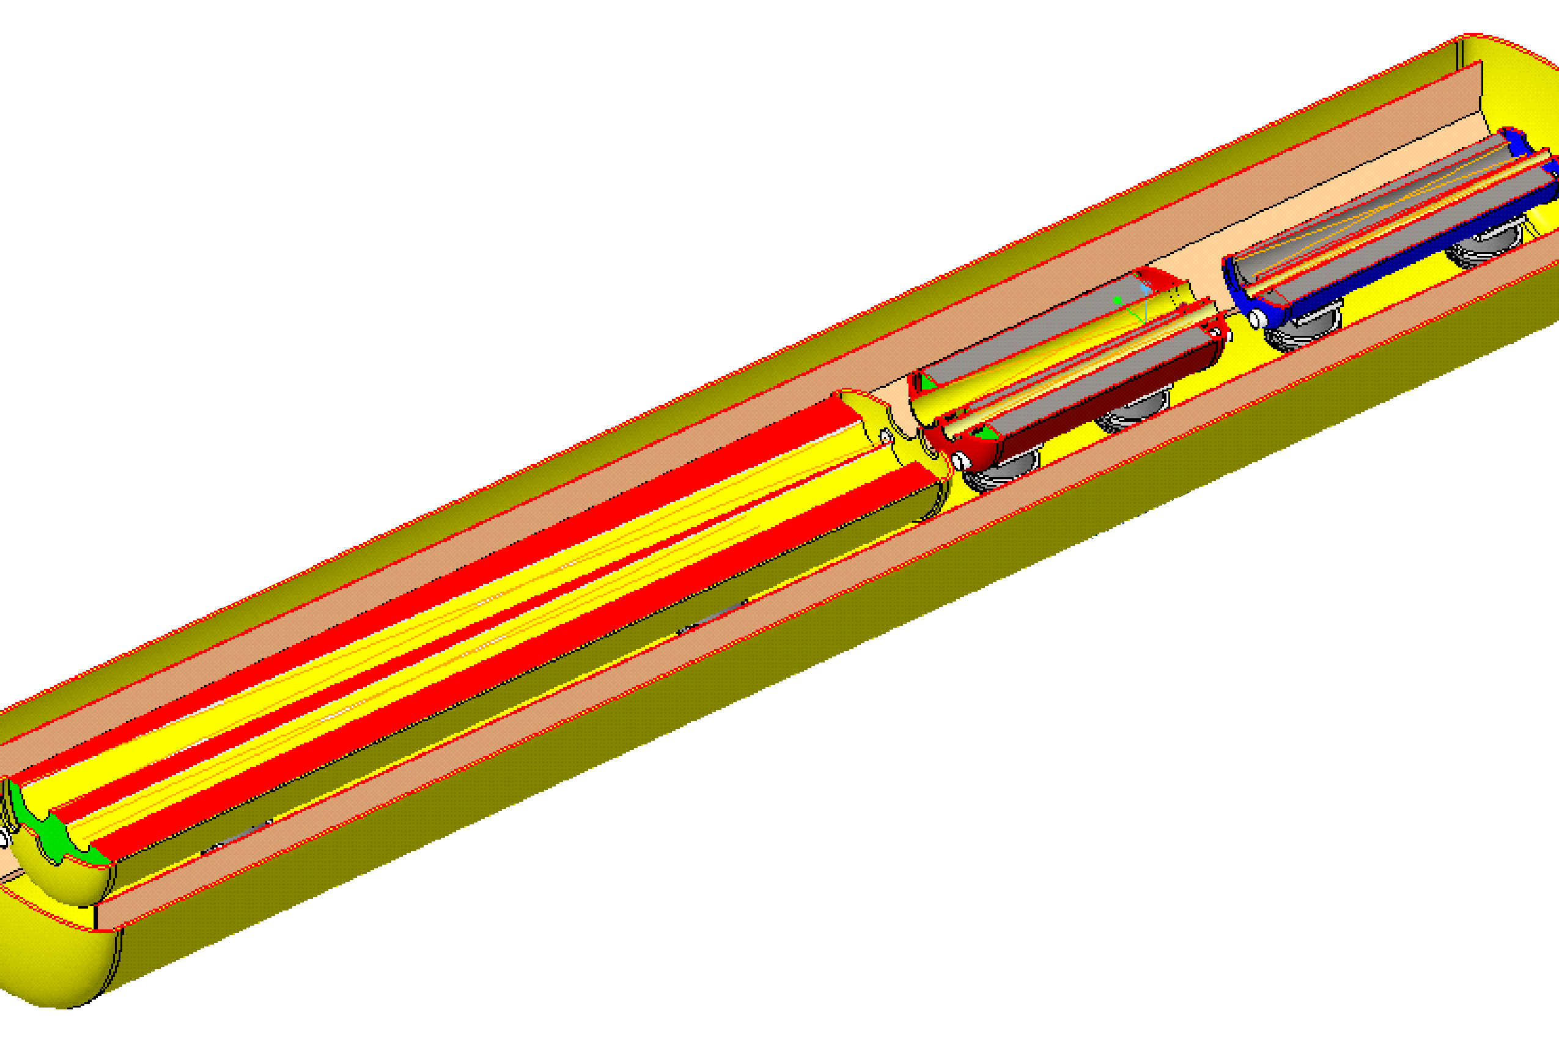
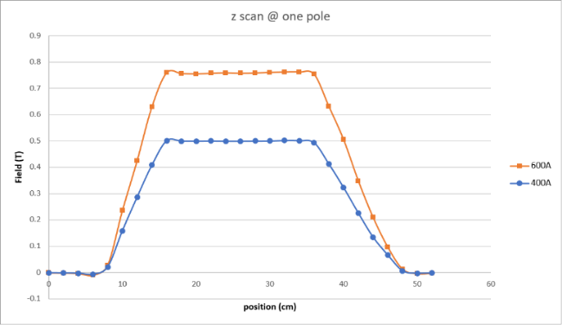
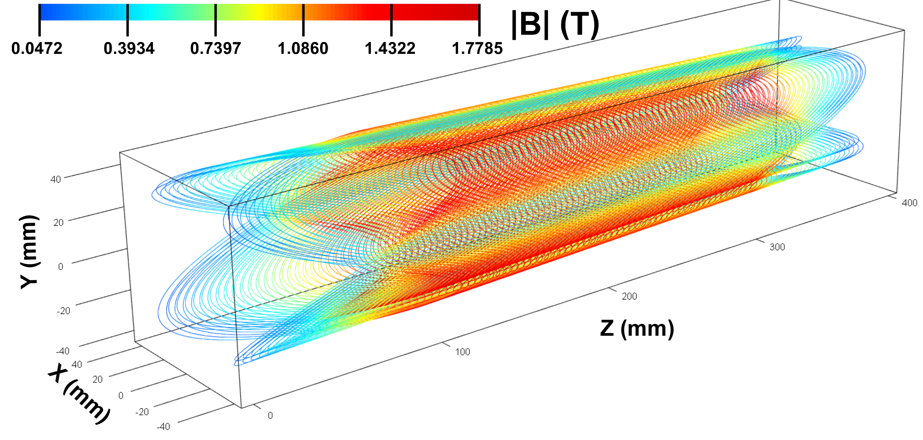
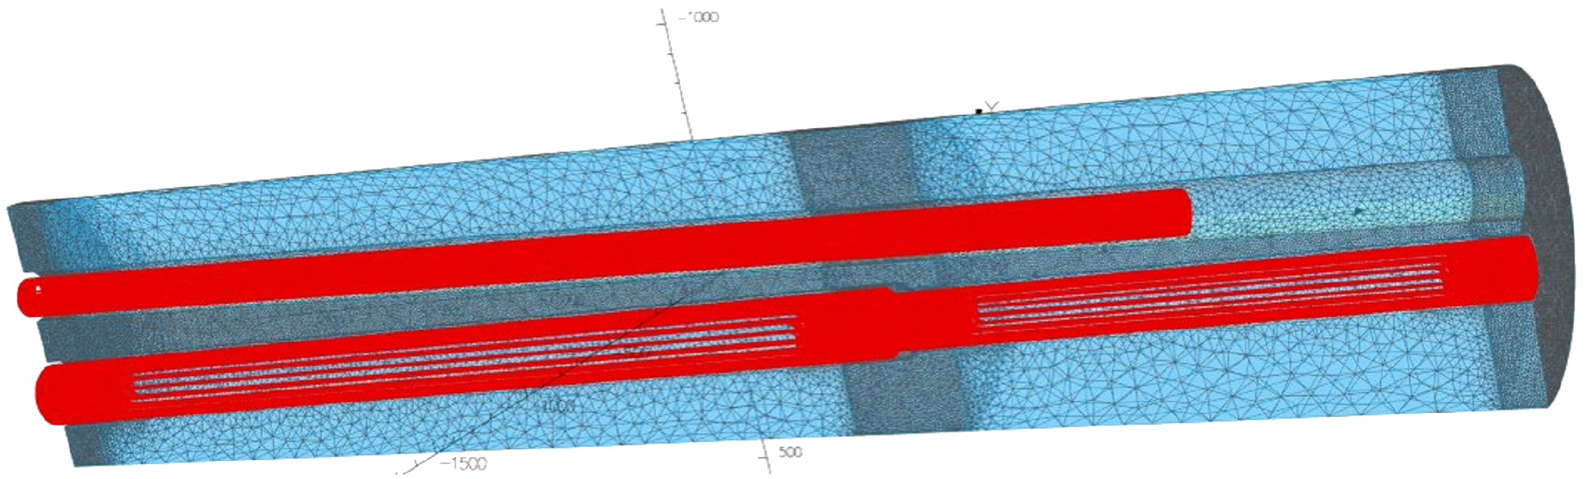
EIC Rear Cryostat with Side-By-Side Hadron and Electron Beamlines
EIC Direct Wind, Double Helical, Tapered Constant Gradient Quadrupole Coil R&D
Near IP End
Field Measurements
Common Q2PR – B2AER/B2BER Cold Mass
Electron Beam with Synrad
Hadron Beam
EIC’s IR design uses a mix of Serpentine and Double Helical (CCT) Direct Wind magnet coils.
Electron Side
Hadron Side
Q2PR and B2AER / B2BER Coils in Their Common Yoke
Calculated Coil Field
EIC Rear Side Magnets with Direct Wind Coils in Separate Cold Masses

Slide 7
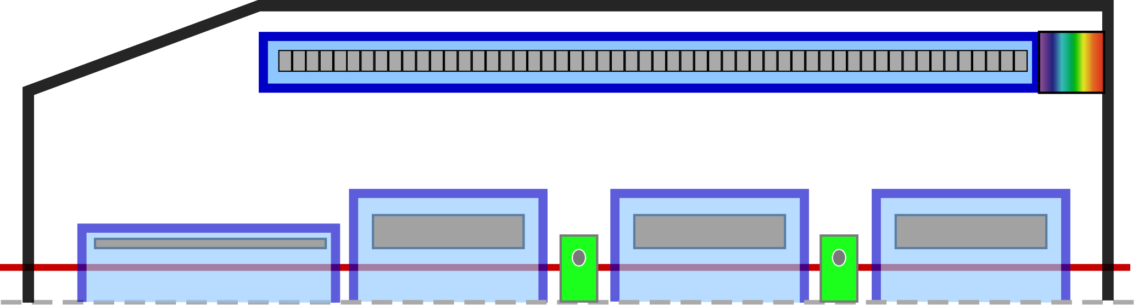
Cryostat housing
Simplified NbTi compensation solenoid is housed in its own cold mass structure at 4.5K and acts as the outer heat shield for all the 1.9K inner magnet structure.
Insulating vacuum
4.5K
Quads with integrated skew-quad correction windings cooled at 1.9K and housed inside smaller cold masses (a dream???)
Cold-to-warm
Warm beam pipe
1.9K
1.9K
1.9K
(4.5 or 1.9K here?)
We may be able to eliminate the very strong “anti-solenoid nose” do dramatically reduce solenoid peak field and longitudinal force; in place we need some weak orbit correctors before the quads and skew-quads to handle an (energy dependent) eigen plane rotation.
Access inside insulating vacuum to BPMs etc.
Heat leak to 1.9K reduced thanks to “4.5K heat shield” and not having to pass large axial forces from 1.9K out to warm support.
P. Raimondi
Cartoon Outline of an Updated Cryostat & MDI Concept Proposal

Slide 8
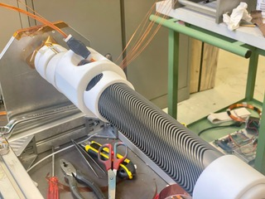
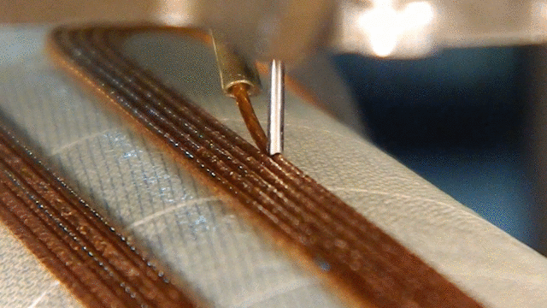
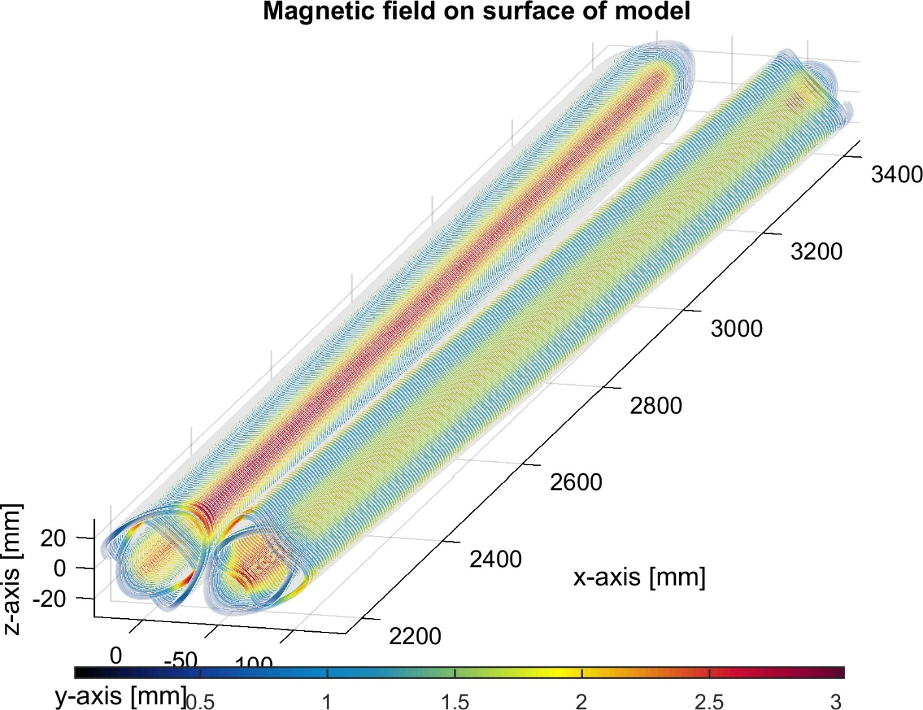
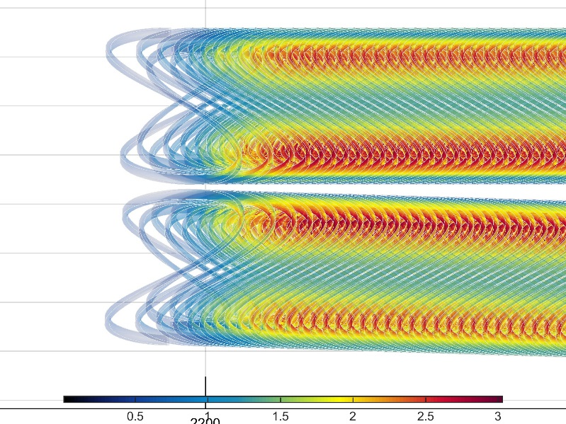

First FCC IR Prototype
M. Koratzinos
BNL Direct Wind in Action: Closeup View
B. Parker
In addition to main quad coils, we need a slew of correctors (b₁, a₁, a₂...).
BNL Direct Wind process is natural for making the necessary correctors.
All coil designs must take into account the mutual external field cross talk.
EIC Tapered Quadrupole R&D Example
Double Helical $≡$ CCT
H. Witte
Direct Wind Tapered Double Helical Coil
Some FCC-ee IR Magnet Coil Production Technology Possibilities

Slide 9
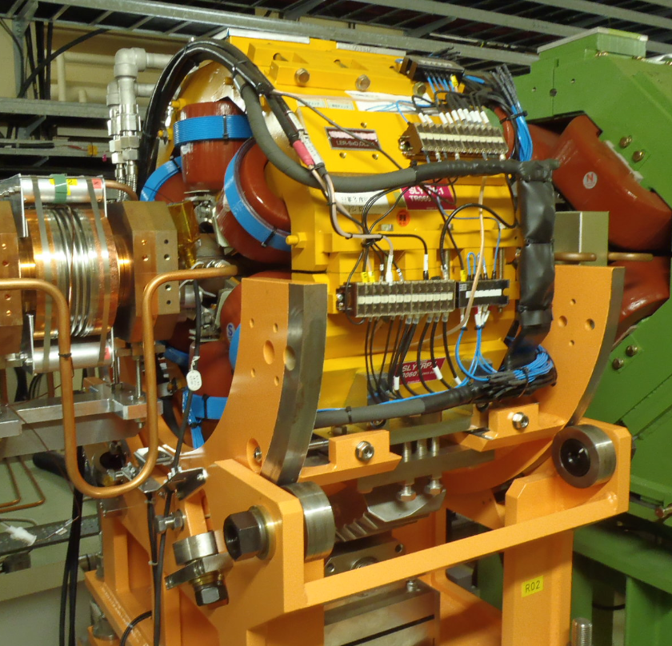
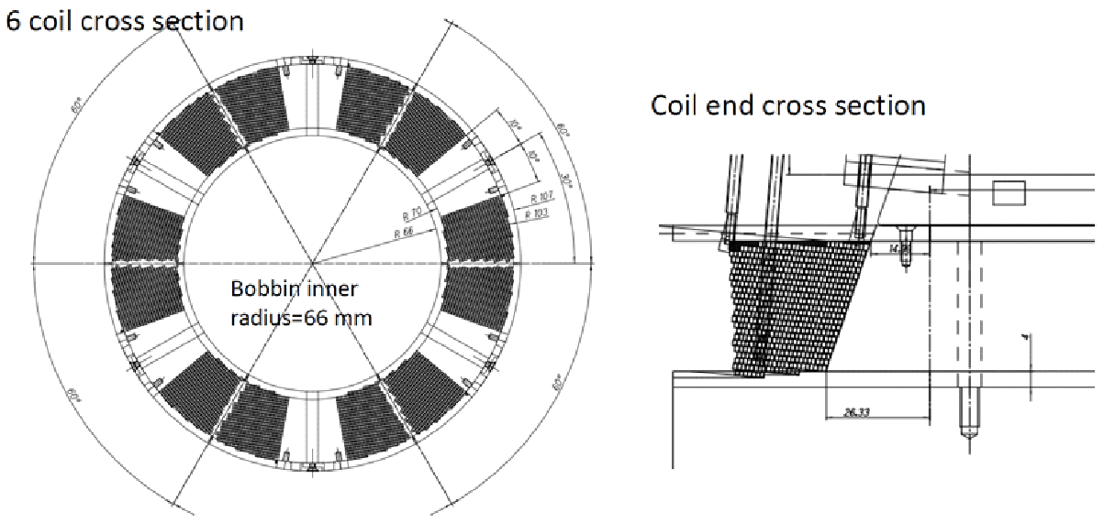
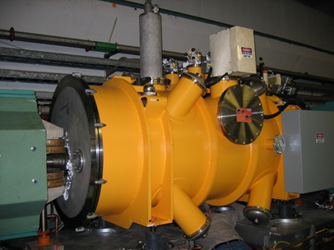
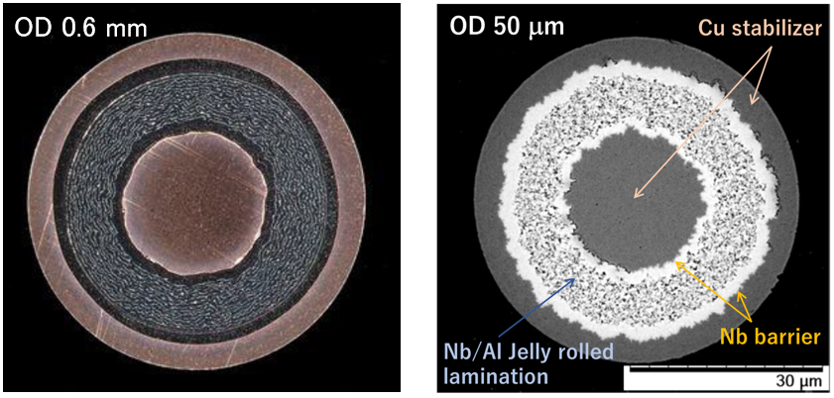
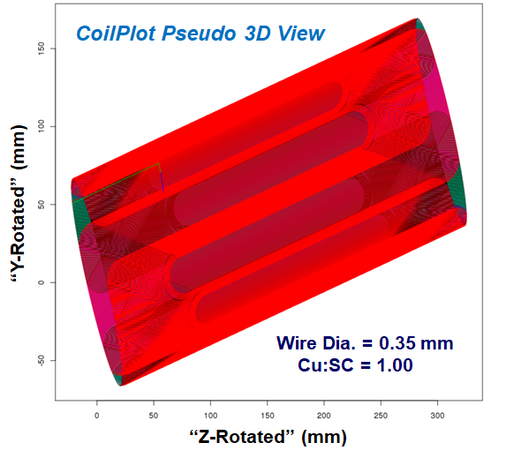
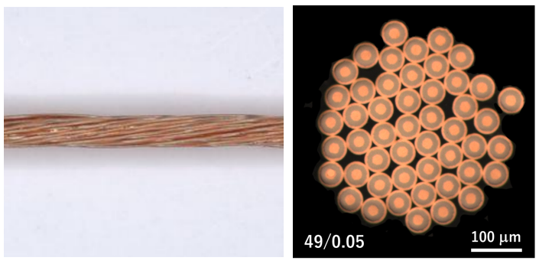
New Proposed NbTi Sextupole Coil
FCC-ee needs a few, very strong Crab Waist sextupoles distant from planned cryogenic feed points. There is synergy with ongoing US/Japan collaboration R&D to develop Crab Waist (also resonance compensating) sextupoles for KEK’s SuperKEKB. We plan to use NbTi for the LER, but depending upon the vacuum beam pipe size, we may need to use higher performance superconductor for HER (see below).
Present SuperKEKB Rotatable Warm Sextupole for the LER
Nb₃Al strand drawing process
(Nb/Al Jerry-roll method）
Inner Corrector Coils
AGS Snake Cryostat Example
Direct Wind Skew-Sextupole Corrector
US/Japan R&D
Nb₃Al cable of 49 φ50μm strands
US/Japan R&D
No nearby cryogenics, so use a local cryocooler / cryostat much like the AGS snake shown above.
a₃, b₂ and a₂ corrector coils give controlled field offset and rotation.
One Special “IR Related” Magnet: The FCC-ee Crab Waist Sextupole

Slide 10
FCC-ee Scope of Work
To confirm with the FCC-ee optics and detector teams the physics specifications and the IR access requirements in the IR magnet system. To perform an analysis of tolerance requirements for various subsystems and to collaborate on a complete set of functional IR magnets specification, drawings including all requirements from physics and interfaces.
Develop an overall, integrated conceptual design for the complete IR FF Quadrupole magnets, (complete 3D magnetic model supported by beam dynamics analysis, interaction operating loads, magnet load line and cross talk compensation, concept of protection, assembly steps and integration study) within the FCC-ee magnet systems working group.
Determine the necessary associated R&D work-packages and prototypes for advancing double helical magnet production via both “superconductor in slots” and the Direct Wind conductor technologies to meet the IR FF quad nominal requirements. Consider novel mitigation techniques
Build and test prototype(s) (preliminary impregnated prototype, integrated twin aperture quad, assembly into a prototype test cryostat )
FCC-ee Scope of Work

Slide 11
FCC-ee Work Objectives
Design a complete magnet system with quadrupoles, correctors and solenoids that meet requirements of field strength, field quality as function of the different FCC-ee beam energy operation scenarios.
Perform integrated cryostat design that includes, twin side-by-side quadrupoles, integrated correctors and any required solenoids (magnetic field configuration model, forces, mechanical support, thermal loads, field quality errors…).
Establish quench performance achieved of the first quadrupole prototype with the test of its protection scheme according to an appropriate test plan.
Measurement of the main field quality with design multipole compensation along with correction coil performance, adequacy and adjustability.
Construction and test of an IR in-cryostat mock-up including a minimal system of integrated magnets to be representative off and validate the final design requirements.
FCC-ee Work Objectives

Slide 12
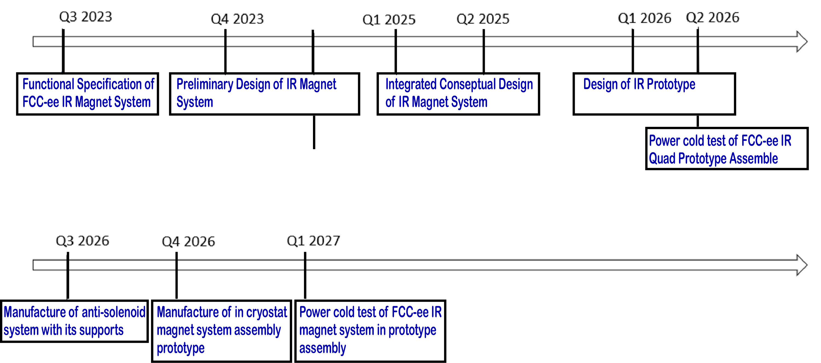
Timeline Example for FCC-ee IR Magnet System
Timeline Example for FCC-ee IR Magnet System

Slide 13
Backup Material
Backup Material

Slide 14
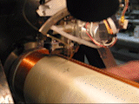
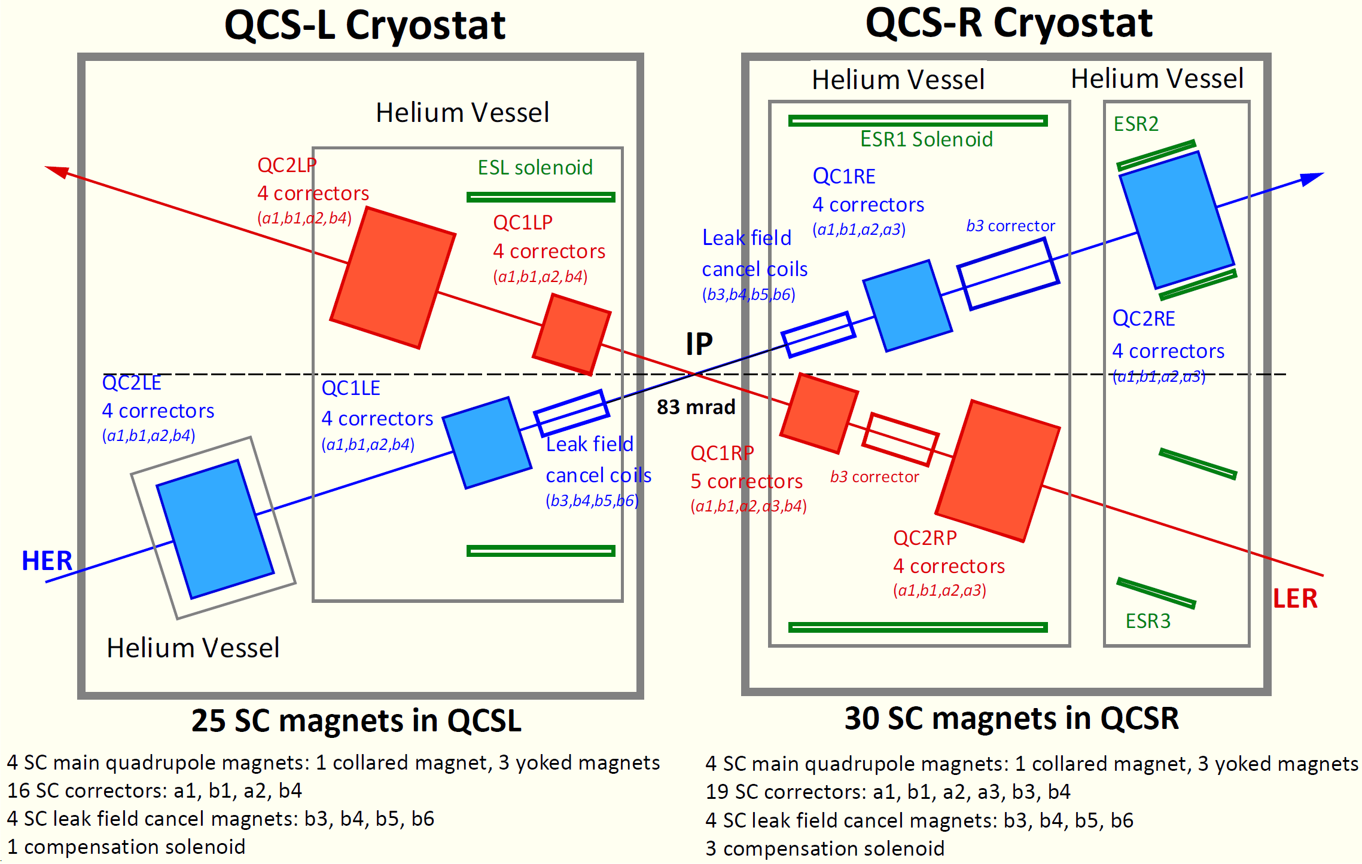
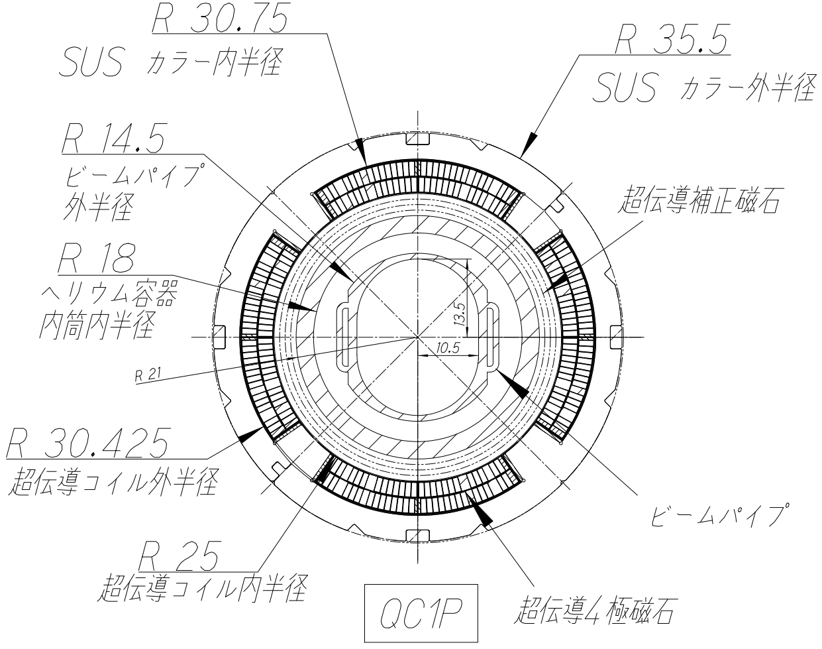
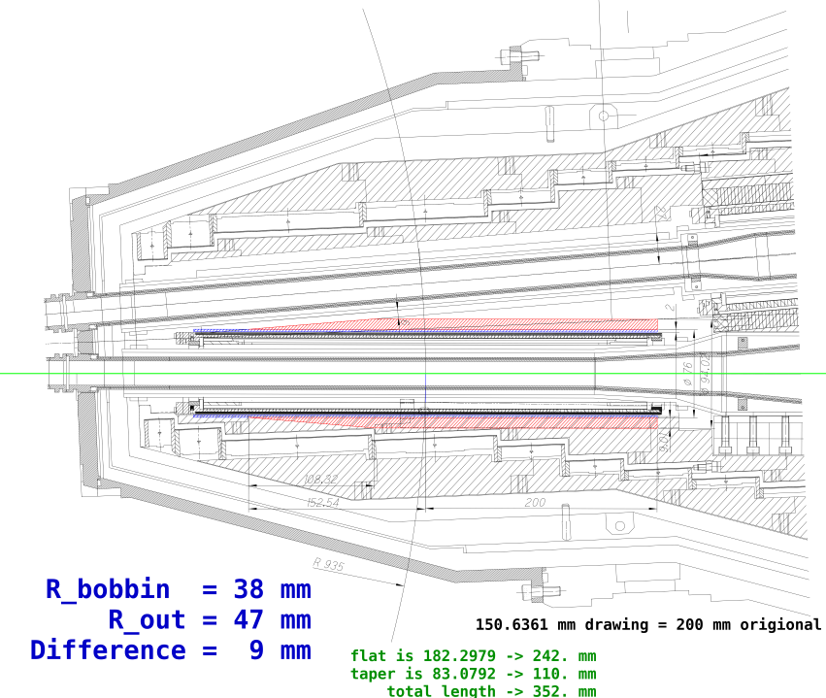
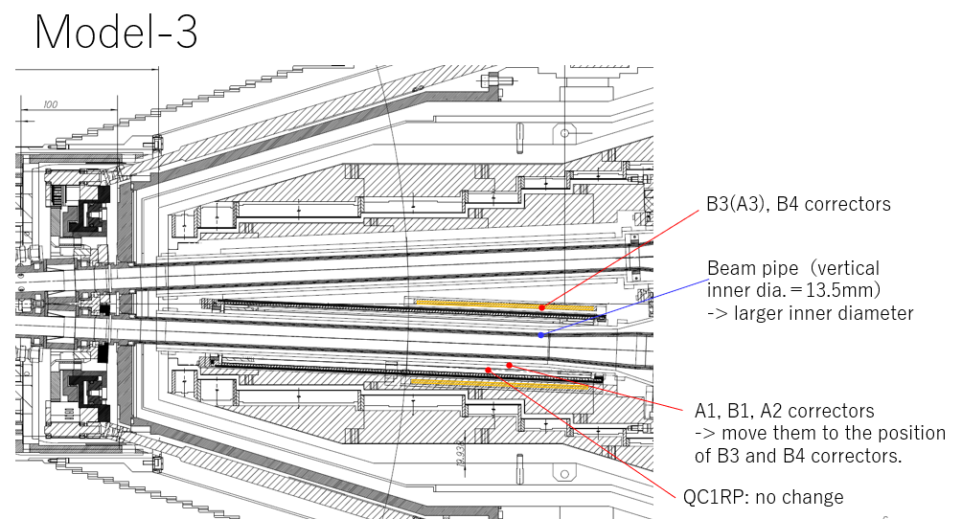
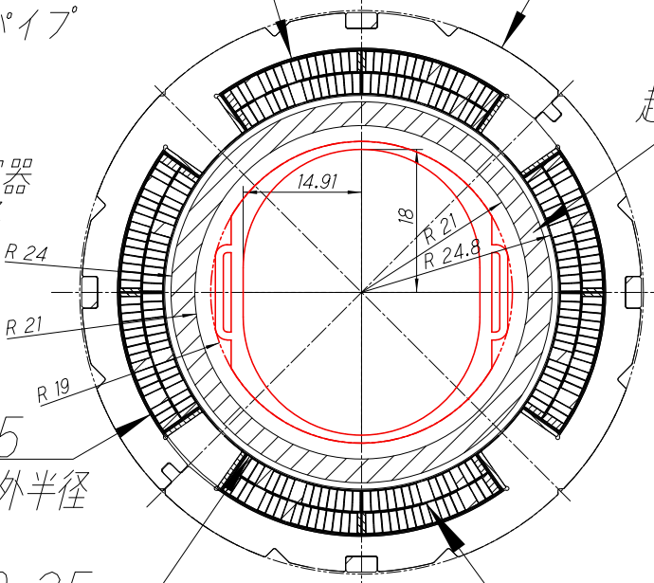
Direct Wind Corrector for the SuperKEKB IR
Direct Wind Corrector for the SuperKEKB IR
BNL wound the 43 corrector and cancel coils for the SuperKEKB Upgrade.
Have US/Japan collaboration funding to explore increasing IR aperture at a critical point with a new corrector package and to wind correction coils for a possible new superconducting LER Crab Waist sextupole.
Study of Remodeling QCS (#3)
Status of SuperKEKB Upgrade, Past and Future #1

Slide 15
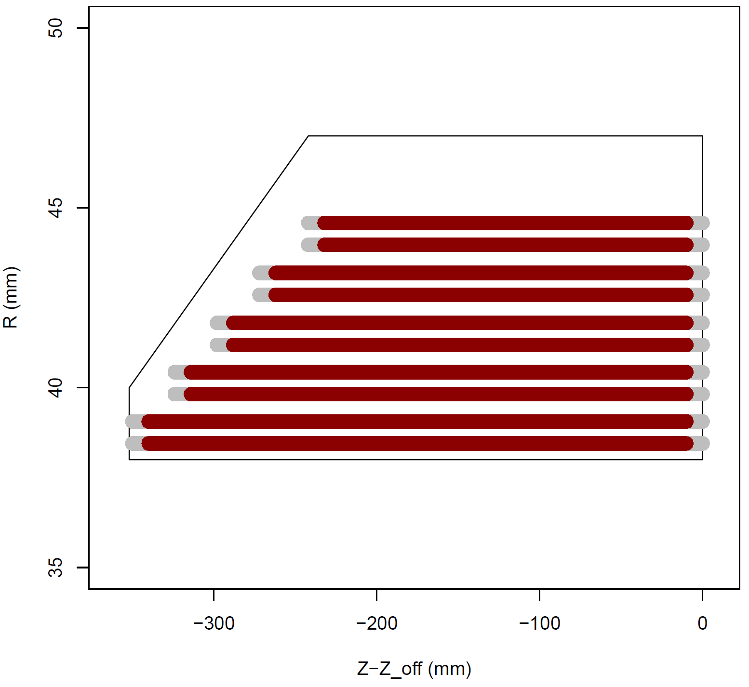
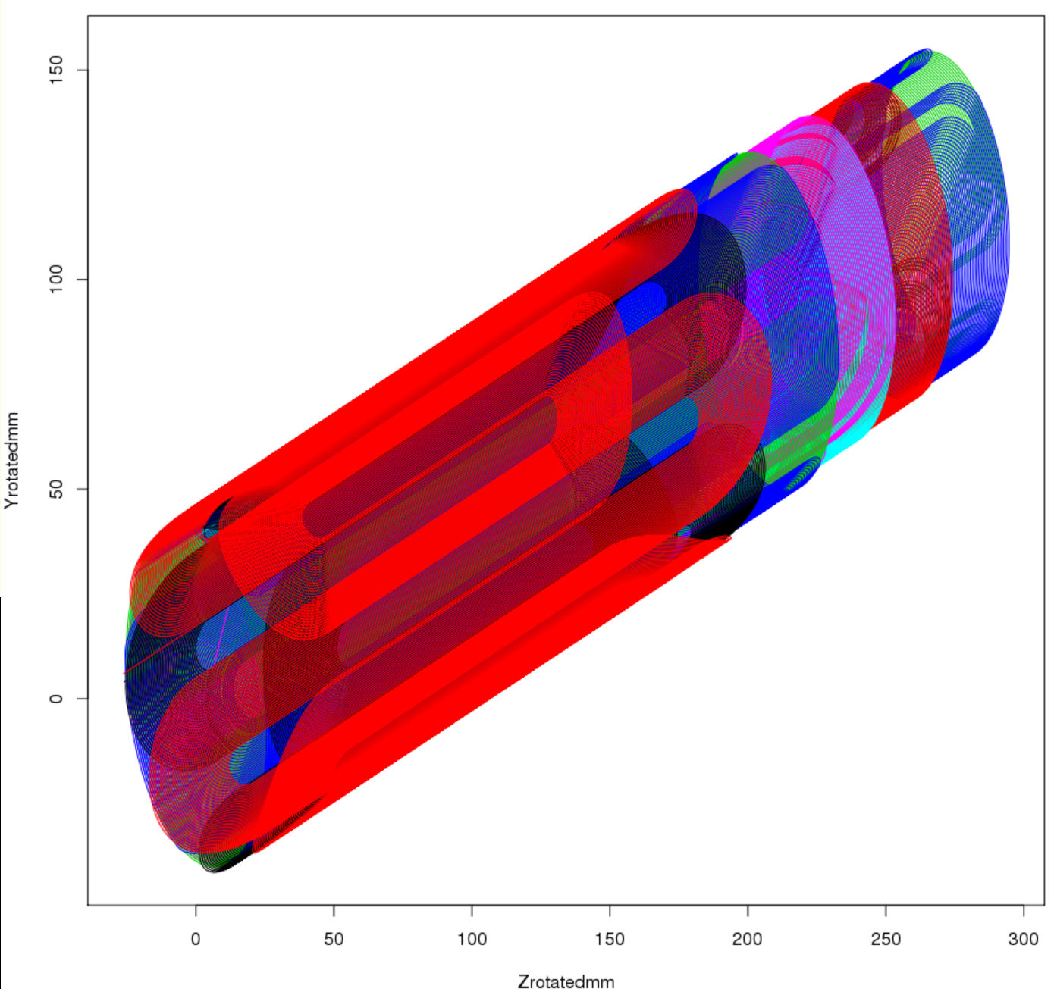
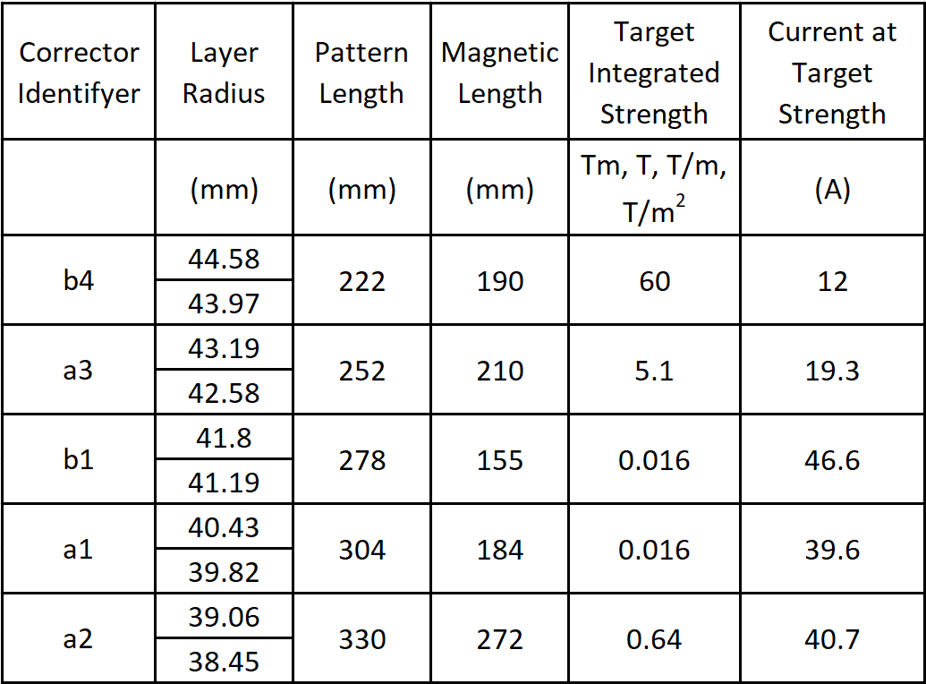
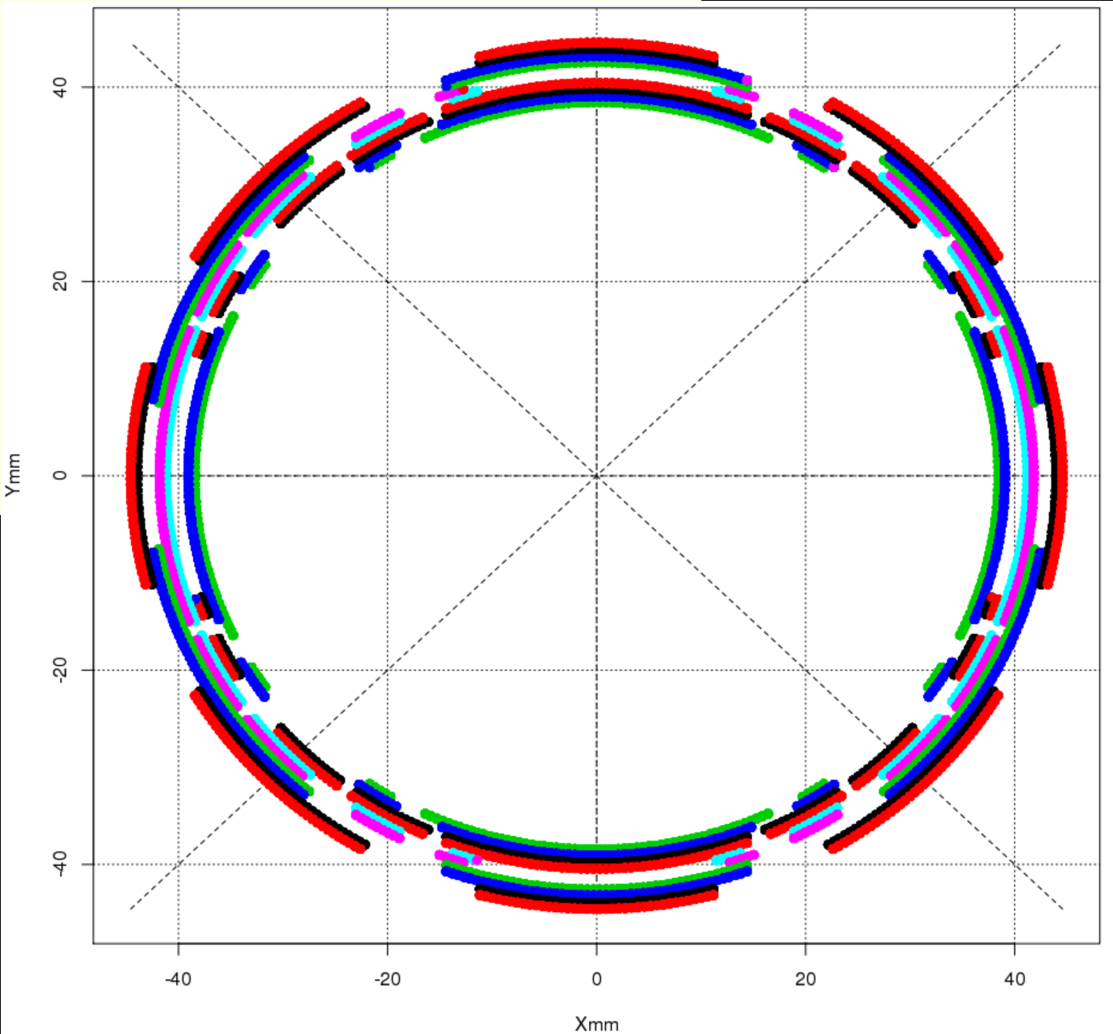
SC corrector magnet study by BNL in 2021
110 mm
242 mm
CoilPlot Pseudo 3D View
b4
a3
“Y-Rotated” (mm)
b1
a1
a2
Wire Dia. = 0.35 mm
Cu:SC = 1.00
Coil Layout To Fit Available Space
“Z-Rotated” (mm)
Z (mm)
Another part of the US/Japan work is to design new superconducting sextupole units with Direct Wind (b₂, a₂ and a₃) correctors to control field rotation and center offset. These new coils replace existing warm sextupoles and are housed in self-contained cryostats with cryocoolers much like we need for spin rotators for Chiral Belle (“Crab Waist”).
Coil Radial Buildup
Y (mm)
New Corrector Parameters
X (mm)
Status of SuperKEKB Upgrade, Past and Future #2

Slide 16
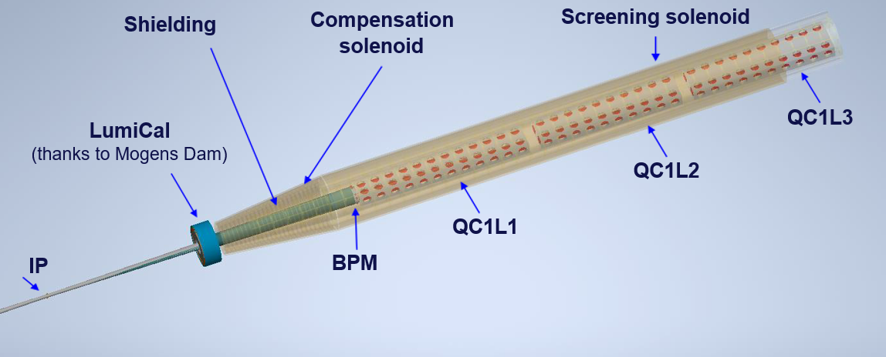
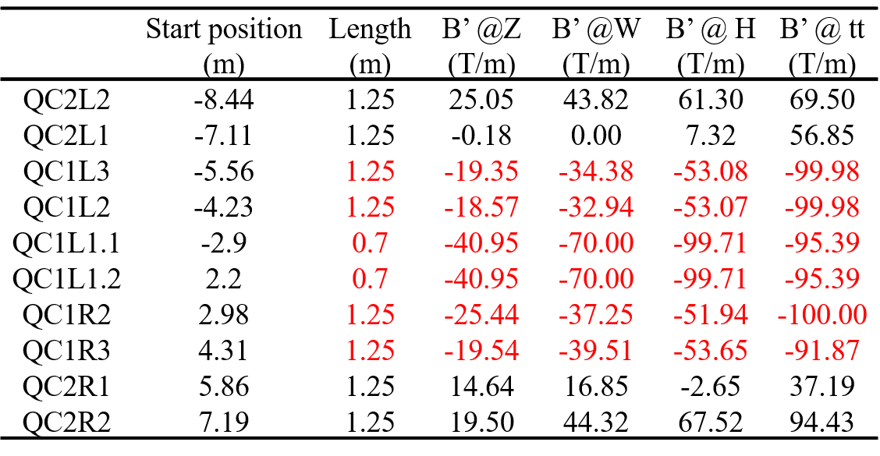
Complicated integration with SC quadrupoles, solenoids, IR chamber, LumiCal, shielding, and diagnostics
M. Boscolo, M. Koratzinos, B. Parker
Quadrupoles
thanks to M. Koratzinos
FCC-ee IR Magnet Parameter Table

Slide 17
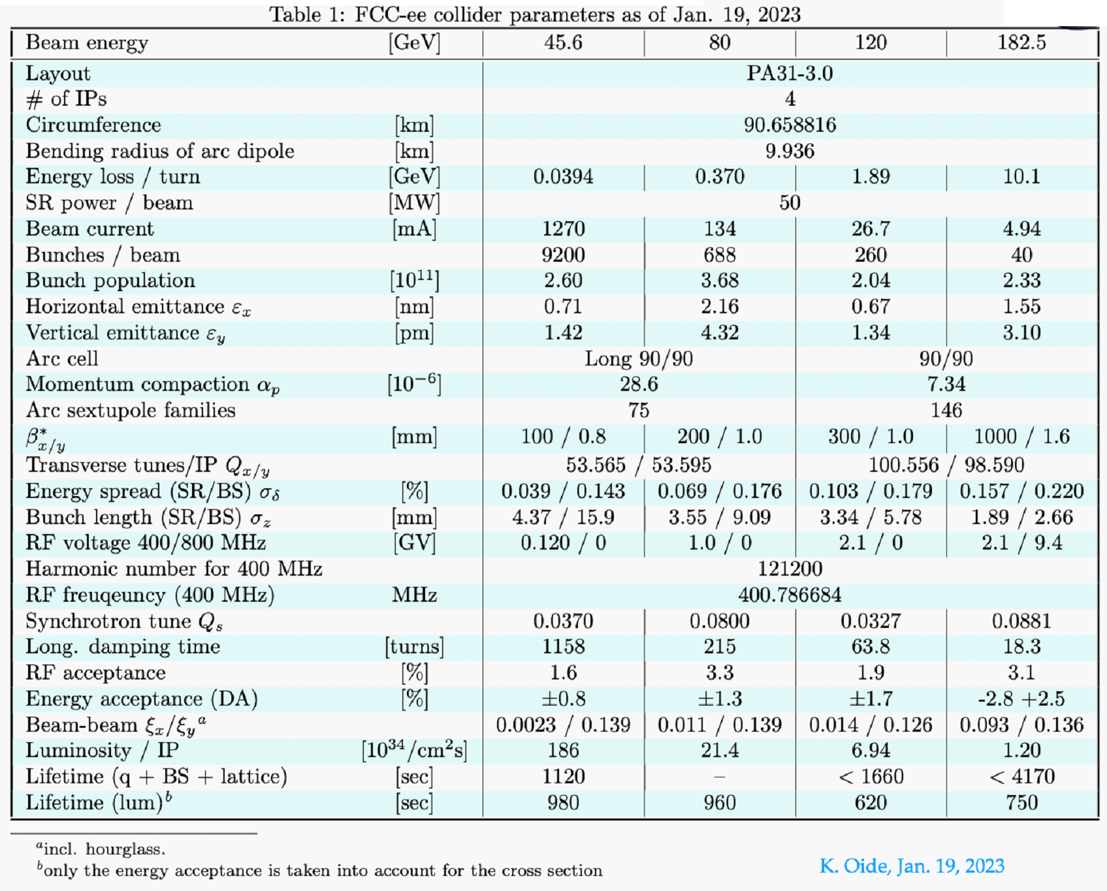
FCC-ee Collider Parameter Table

Slide 18
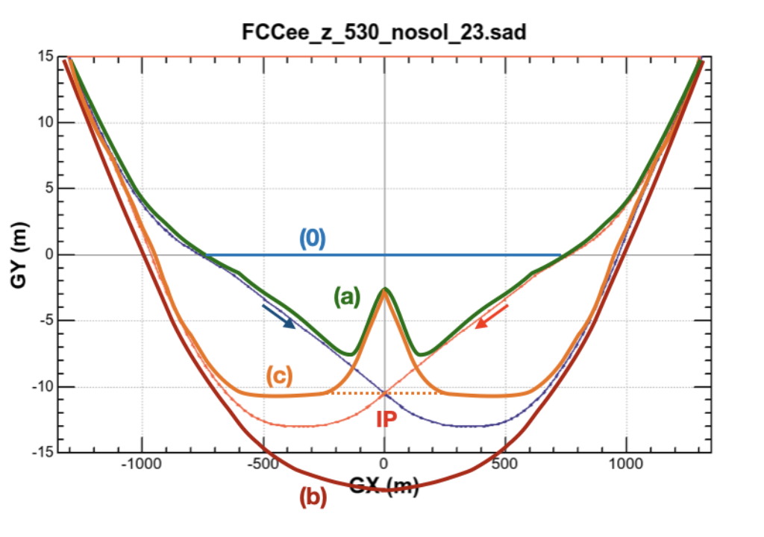
(0) Layout line
Possibilities for location of booster
(a) stay inside of the inner collider ring with a bypass chicane within about ±200 m of the IP.
(b) going outside of the detector
(c) follow the FCC-hh beam line with a bypass chicane.
Some FCC-ee IR Geometry Considerations

