Slide 1
EIC Collimation Studies
Matthieu Valette (BNL)
in collaboration with :
A. Drees, G. Robert-Demolaize
J. Bellon, A. Blednyk, C. Hetzel,
S. Seletskiy, N. Tsoupas
US FCC Workshop

Slide 2
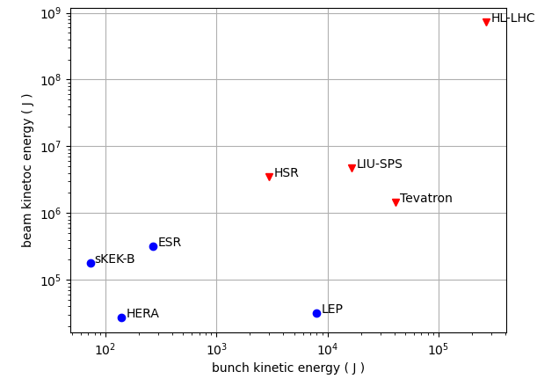
Context
The EIC will feature powerful beams
  10x the stored energy of RHIC
  2x Super KEK-B target stored energy in the ESR with 1/2 the bunches
Collimators accomplish 2 main missions
  Beam cleaning to reduce radiation & backgrounds from lost particles
  Machine & Detector protection from
  accidental beam loses
  (CCs, kickers,
  instabilities, …)
Constraints
  Impedance budget
  Beam lifetime
  $ budget
Light Sources

Slide 3
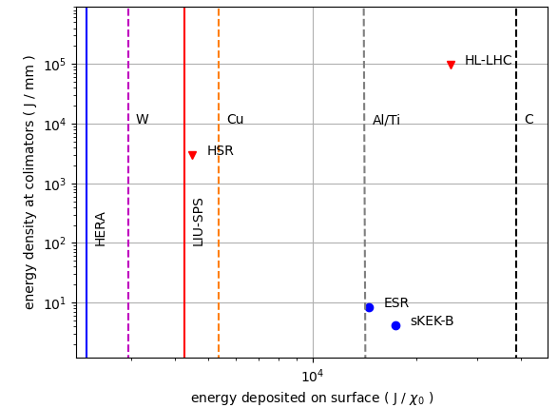
Introduction
The e⁻ bunches will be
very dense (0.5 mm²)
and melt metals in case
of normal impact.
The p⁺ beam will
have similar parameters as the post-LIU SPS.
Other complexes have reported issues limiting performance:
  Super KEK-B experienced instabilities causing collimator damage and limiting beam currents.
  HL-LHC will switch to coated collimators (MoGr) to reduce impedance.
Assuming SKEKB-like tails

Slide 4
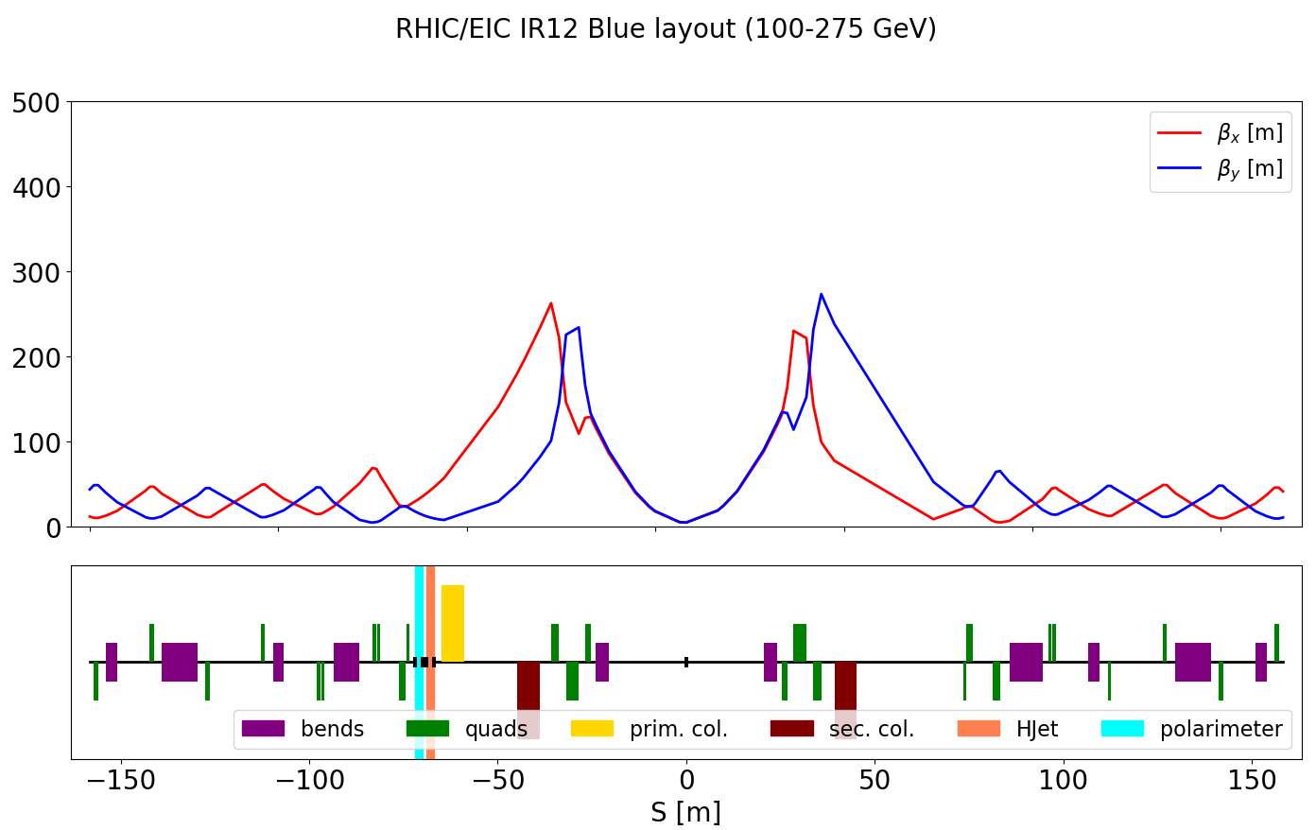
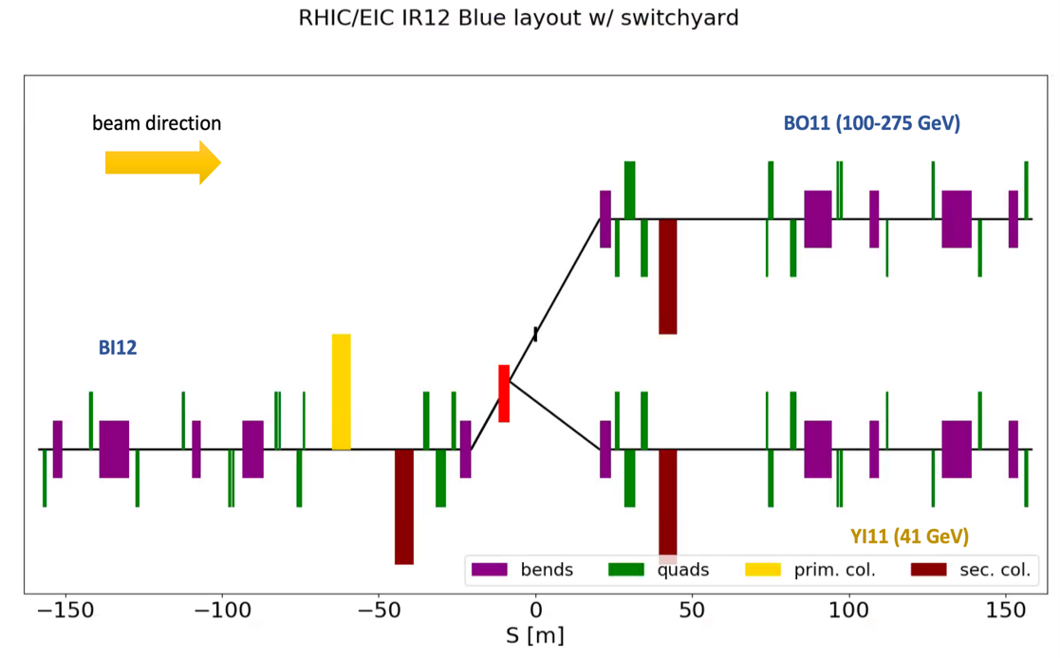
HSR Collimators
Special constraints:
  Different loss behavior for protons/ions
  Cold ring requires good cleaning efficiency in the arcs
  More flexibility on the optics
We can benefit from RHIC and LHC experience.
Planned in IR12 :
  issues with other users due to radiation
  switchyard doubles the second secondary
Momentum collimators are planned for the sector 12 ”D7” dummy.
Courtesy of G. Robert-Demolaize

Slide 5
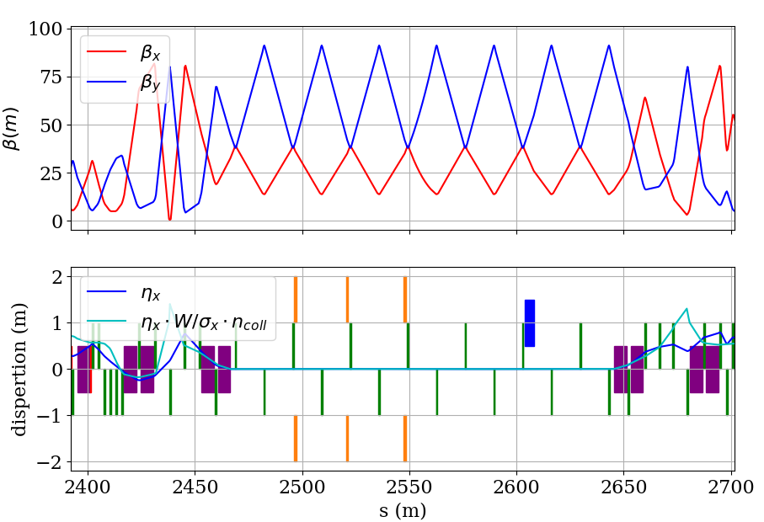
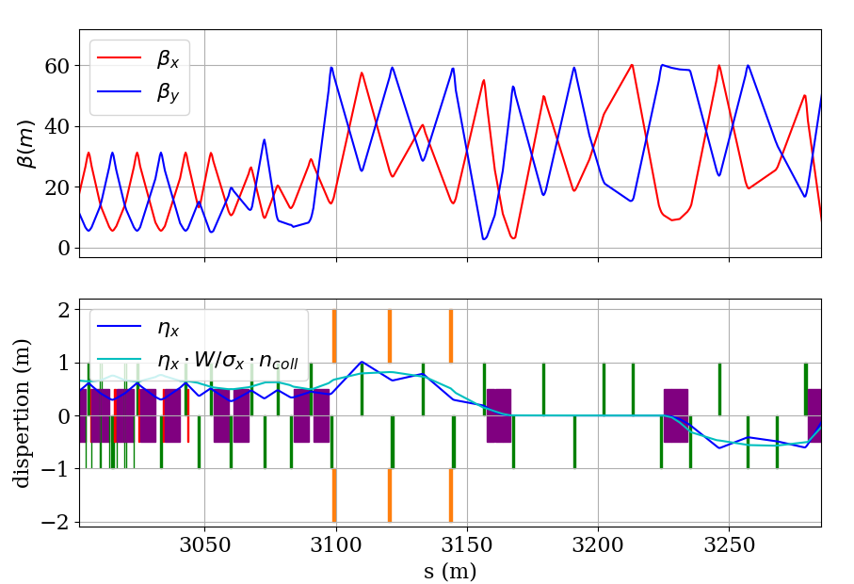
ESR collimation
IR2 - Horizontal
Focus on the 10 GeV case with the most stored energy.
Planned in IR2 & 4 :
  1 double-sided primary
  2 double-sided secondary for cleaning and flexibility with phase advances and optics
  Possibility to double each set for redundancy and extra flexibility
IR4 – Vertical
Collimators Quadrupoles
Dipoles
Dump kickers & Lambertson
HSR crossover

Slide 6
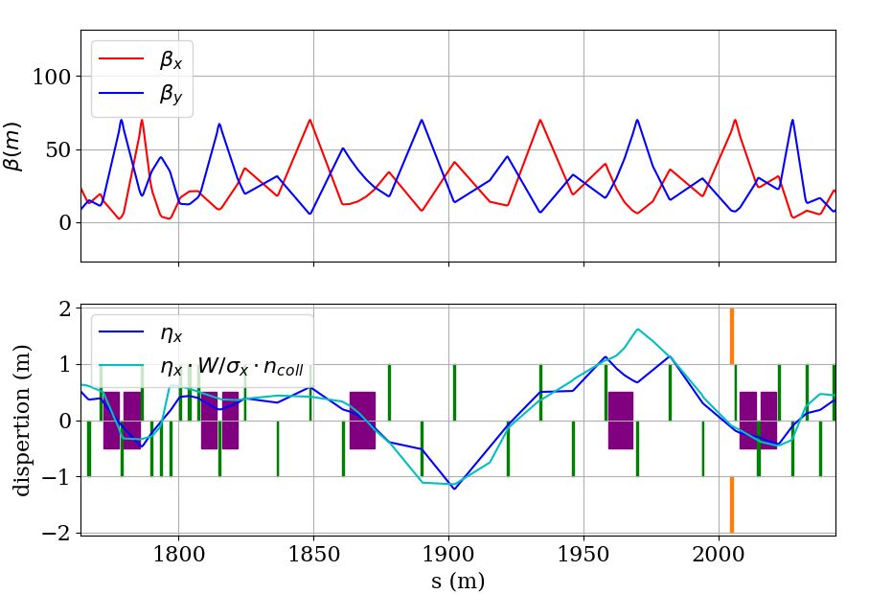
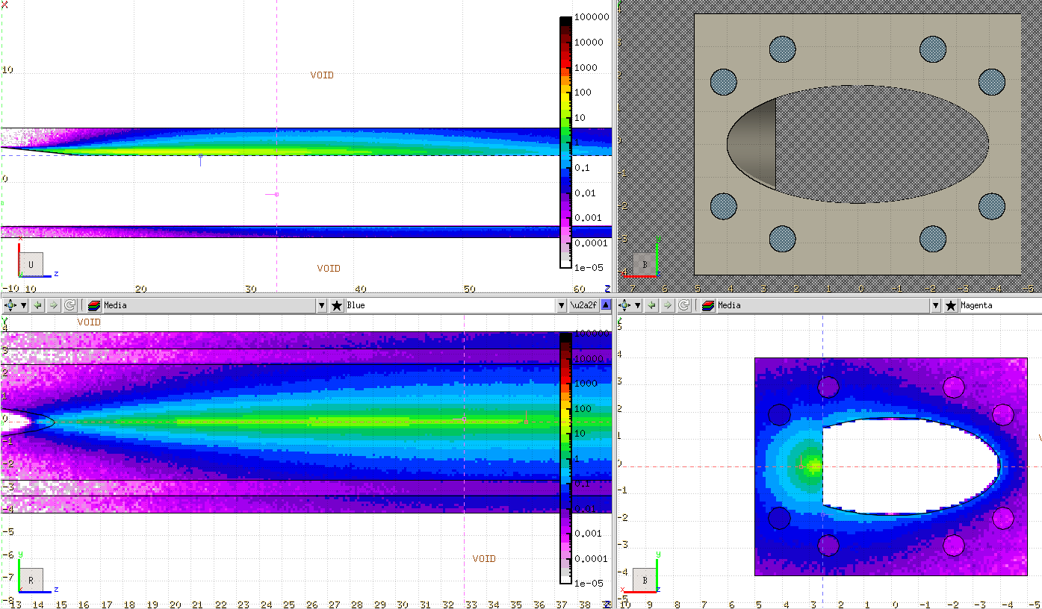
ESR collimation (continued)
Electron bunches have a short polarization lifetime (~35 min) and will be replaced every 10 minutes. The ~250 J of the used bunch will be absorbed in-vacuum.
The Titanium transfer-absorber will be in IR12
with 2 jaws for injection failure cases.
IR12 is also the location with the largest dispersion and the most suitable for momentum collimation.
IR12 – Injection protection

Slide 7
Collimation hierarchy
IR2
18 GeV optics
primary
secondary
secondary
Arc
Triplet
Exp. detector
Imposed by squeezed optics in the IRs
Retraction from prim -> sec -> aperture based on orbit stability
Arc is tighter than experiment in the horizontal plane
Masks upstream of IRs will prevent losses into the focusing quads from showering to the detectors
48σ
45σ
Horizontal
14σ
17σ
13σ
e⁻ beam
Masks
17σ
primary
19σ
25σ
secondary
secondary
70σ
Triplet
63σ
Vertical
Exp. detector
Arc
IR4

Slide 8
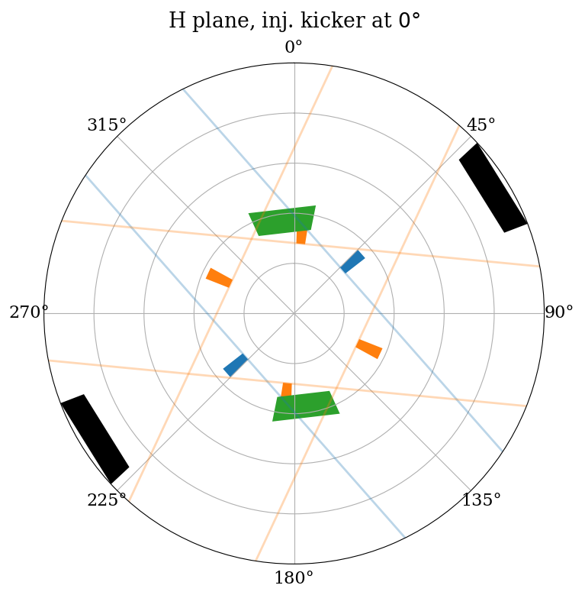
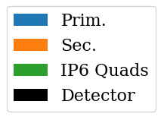
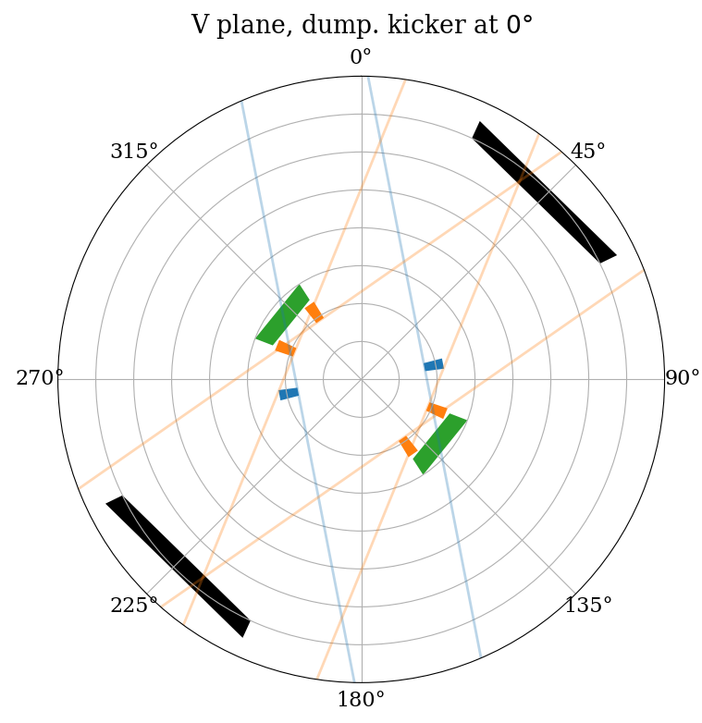
Optics considerations
Phase advances :
  key to protect against kicker failures
  important to ensure cleaning efficiency with secondaries
  Orbit/optics will have to be monitored
  to ensure protection/cleaning
Orbit stability, β-beat, errors, … will affect collimations hierarchy and retraction margins.
Failure case simulations are needed once powering circuits are being finalized.
We are following developments at KEK-B closely to learn from their experience.

Slide 9
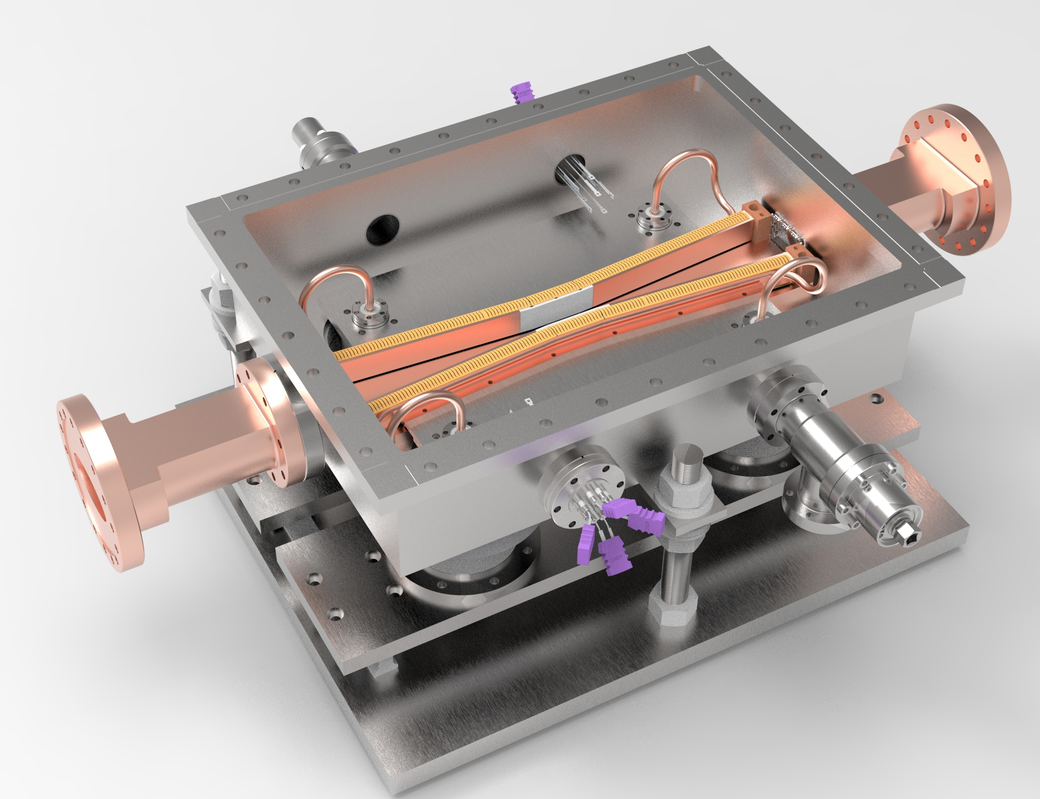
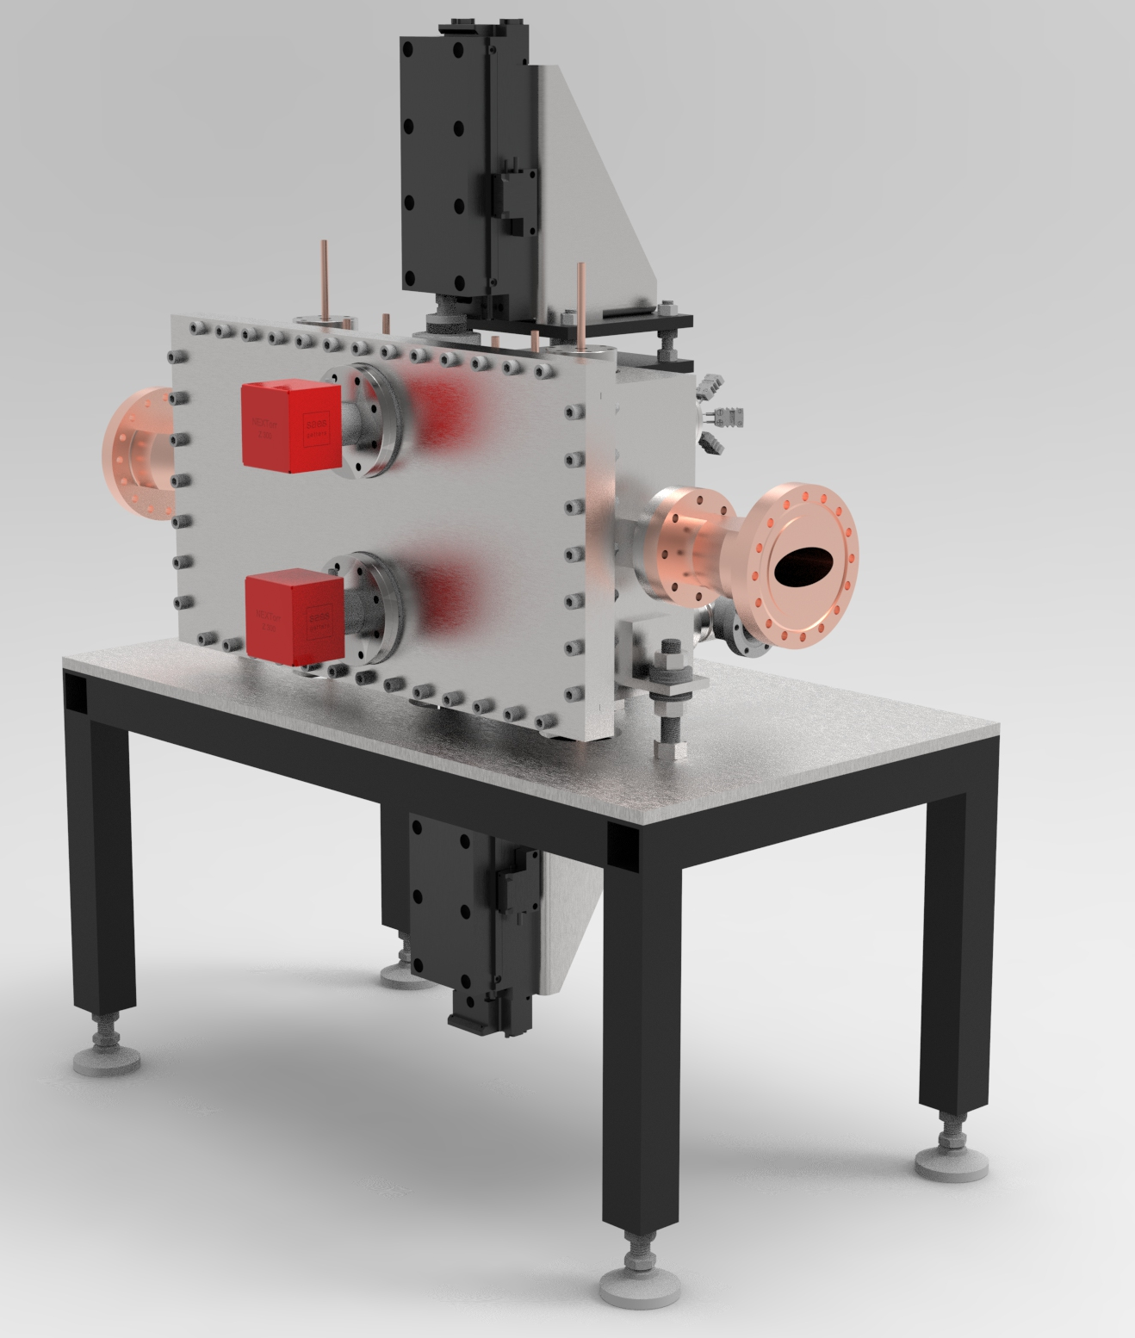
Mechanical design
The HSR will feature long LHC-like collimators.
  The jaws will be several meters long and made of amorphous Carbon
The ESR will feature short KEKB-like collimators.
  Coated Carbon would benefit energy absorption and impedance.
  Composite materials are also under consideration (MoGr).
  All collimators will feature the same design for replaceability.
Horizontal e-col
Vertical e-col

Slide 10
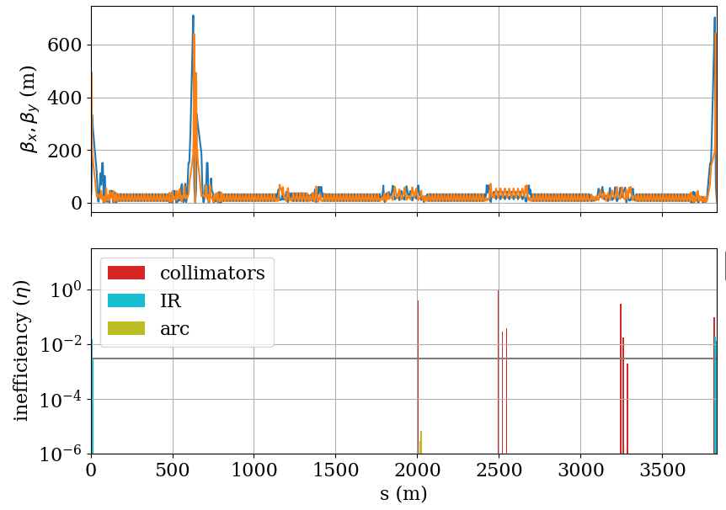
Tracking simulations
Xsuite + BDSIM used as a tracking tool.
Sample loss maps for the ESR are ready and allow design validation.
  More elaborated simulations will follow, including SR,
  beam-gas and generation of secondary particles.
Special thanks go to CERN’s collimation team : Frederik, Andrey, Pablo and Stefano for their help.

Slide 11
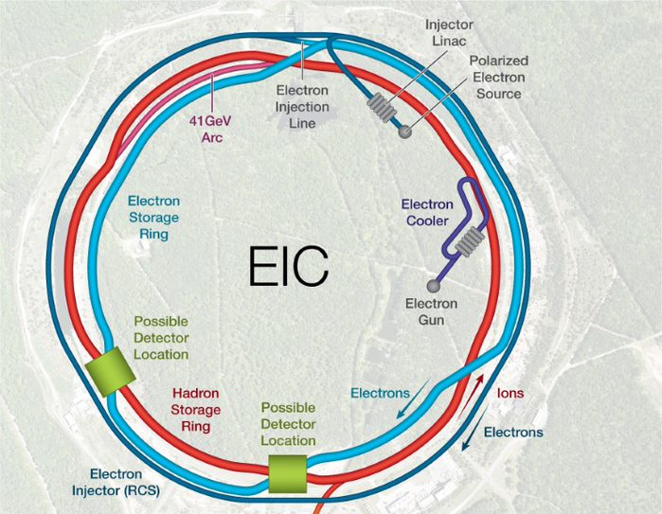
Summary
IR12 e Injection absorbers
Sector 12 H Momentum Collimation (D7 ‘dummy’)
Sector 12 H Betatron Collimation (both planes)
IR2 e Horizontal Collimation
& Abort System
Hadron Abort System (already there)
Masks
electron : 6 collimators
Hadrons : 8+1 collimators
+absorbers and masks
IR4 e Vertical Collimation
H Injection protection
(note: not actual inj. location)

Slide 12
Conclusion & Outlook
Collimation system design :
  Space, impedance and budget constrains are included to ensure background reduction and protection from failure cases.
  Global/Local optics requirements are defined for the lattice integrators.
  IR4 optics are being finalized and moveable mask location conflict need to be ironed-out.
Tracking simulations :
  ESR : preliminary loss maps are ready, more detailed studies on cleaning inefficiency and errors are next
  HSR : pending software functionalities
  A dedicated simulation sever is being purchased
Failure simulations will follow once some design parameters are settled.

