Slide 1

Hadronic Cross-Section at the Z-pole
Marina Malta Nogueira, Tim Neumann

Slide 2
Our approach
We have been studying Z → qq decays and extracting cross-section uncertainties. We started by comparing our simulation with the L3 experiment and then moving on to optimizing cut selections for the improved detector. Our goal is to minimize systematic uncertainties so that we can take full advantage of FCC statics.

Slide 3
REPRODUCING A LEP RESULT
L3 Experiment

Slide 4
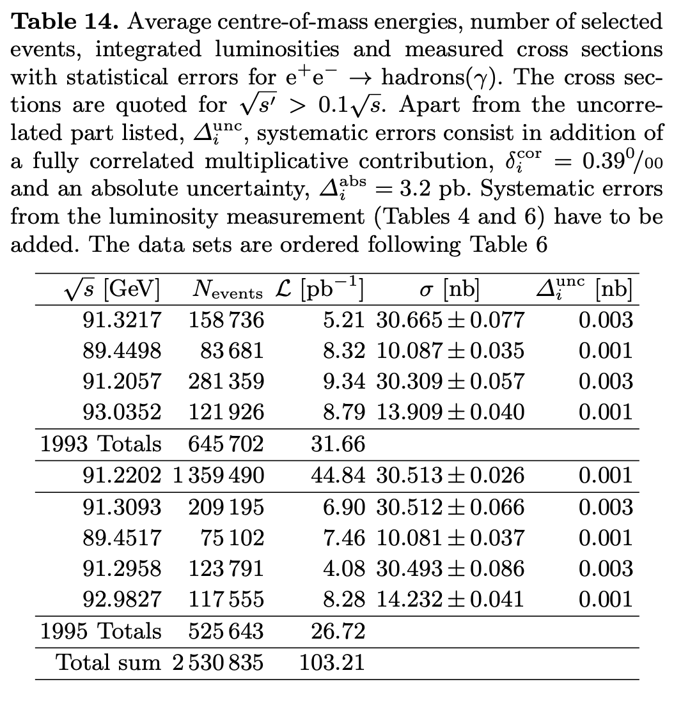
L3 Data Taking
Here we are going to focus on the data taken in 1994 to reproduce the plots presented in the paper. The analysis was performed on peak with luminosity of 44.84 pb⁻¹ which we are going to be adopting for our simulations of the L3 results.
The L3 Collaboration., Acciarri et al., M. Measurements of cross sections and forward-backward asymmetries at the Z resonance and determination of electroweak parameters. Eur. Phys. J. C 16, 1–40 (2000). https://doi.org/10.1007/s100520050001

Slide 5
FCC Simulation Details
Sample | Event Generator | Cross-Section (pb) | Events Generated
kkmee_uu_ecm91p2 | KKMC | 5353.597 | 2×10⁶
kkmc_ee_dd_ecm91p2 | KKMC | 6752.078 | 2×10⁶
kkmc_ee_cc_ecm91p2 | KKMC | 5325.479 | 2×10⁶
kkmc_ee_ss_ecm91p2 | KKMC | 6763.653 | 2×10⁶
kkmc_ee_bb_ecm91p2 | KKMC | 6586.846 | 2×10⁶
wzp6_ee_mumu_ecm91p2 | Whizard | 1717.852 | 2×10⁷
wzp6_ee_tautau_ecm91p2 | Whizard | 1716.135 | 8.45×10⁶
wzp6_gaga_qq_5_ecm91p2 | Whizard | 11367.36 | 4×10⁶
p8_ee_Zee_ecm91 | Pythia | 1462.09 | 1×10⁷
In our analysis no distinction was made between the different quark flavours and the five samples were treated as one.
The event generation was done with the nominal FCC parameters for the Beam Energy Spread (0.132 %) and Bunch dimensions
The detector simulation was done using the IDEA detector with Delphes (Winter 2023 campaign).

Slide 6
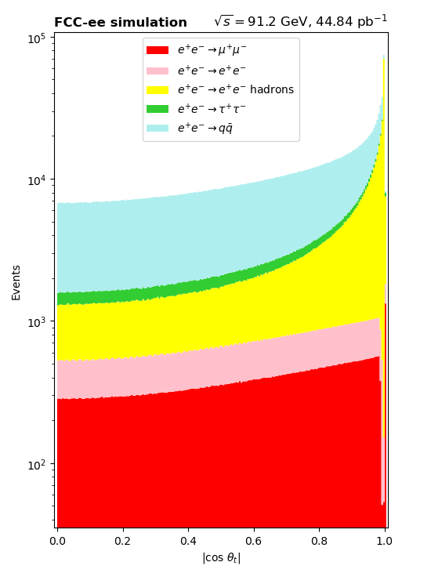
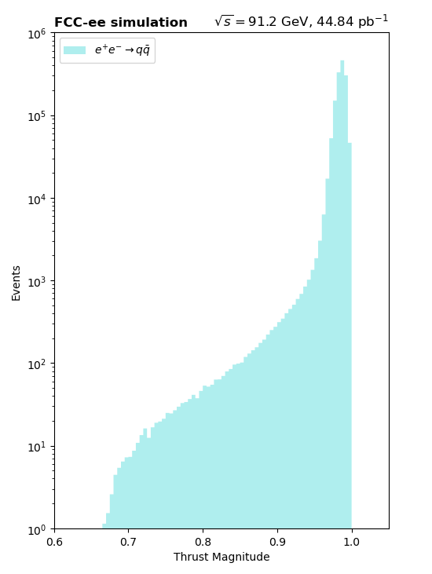
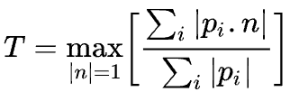
Calculating the thrust and Cos 𝛉_{t}
Cos 𝛉_{t} is the cosine of the angle between the z axis and the thrust axis.
The unit vector n of the thrust axis is the one which maximizes the value of thrust. This represents the direction in which particles are most aligned.

Slide 7
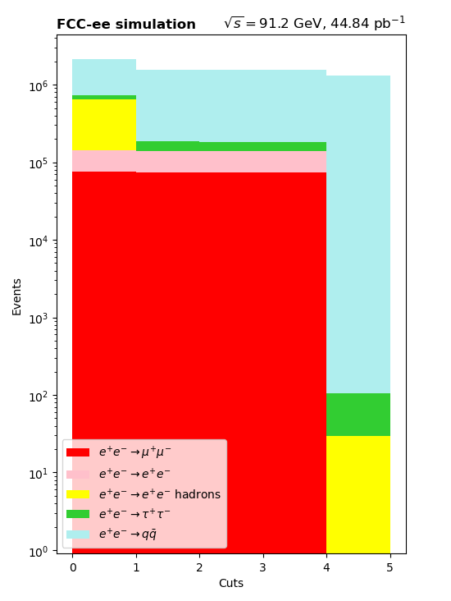
Cuts Utilized
The total energy observed in the detector, Evis, normalised to the centre-of-mass energy must satisfy 0.5 < Evis/√s < 2.0;
. The energy imbalance along the beam direction, E∥, must satisfy |E∥|/Evis < 0.6;
The transverse energy imbalance, E⊥, must satisfy E⊥/Evis < 0.6;
The number of particles per event, Nparticles, is required to be:
  Nparticles ≥13 for |cosθ_{t}| ≤0.74 (barrel region),
  Nparticles ≥ 17 for | cos θ_{t} | > 0.74 (end-cap region), where θt is the polar angle of the event thrust axis.
The last cut differs from L3 as they used the number of clusters from energy depositions in the calorimeter while we used the number of particles reconstructed from the tracker, the calorimeter and the muon chamber.
0.5 < Evis/√s < 2.0
|E∥|/Evis < 0.6
E⊥/Evis < 0.6
Nparticles ≥13 for |cosθt| ≤0.74
Nparticles ≥ 17 for |cos θt | > 0.74
Sample/ Cut | Hadrons | 𝛍⁺𝛍⁻ | e⁺e⁻ | 𝛕⁺𝛕⁻ | e⁺e⁻ hadrons
Initial | 1380249 | 75779 | 65560 | 76228 | 509712
Cut 1 | 1370027 | 74295 | 65042 | 45661 | 50
Cut 2 | 1368423 | 74184 | 64891 | 44947 | 29
Cut 3 | 1365306 | 74132 | 64824 | 43336 | 29
Cut 4 | 1298973 | 0 | 1 | 75 | 28

Slide 8
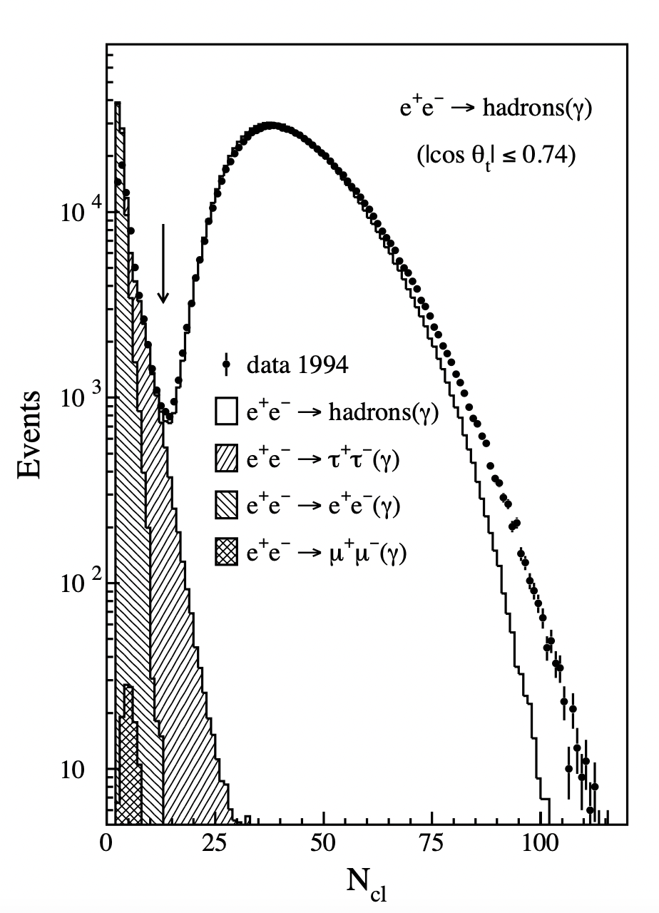
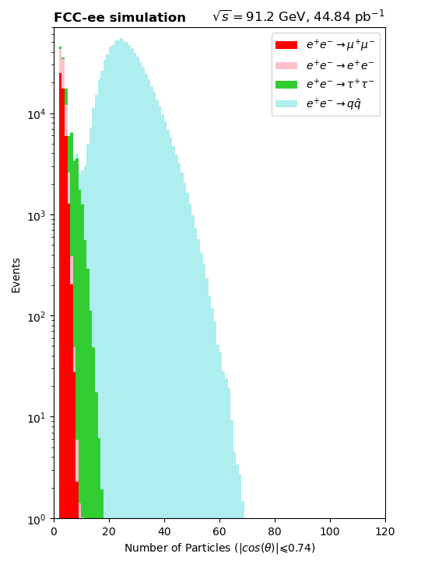
Number of Particles/Clusters (Barrel Region, N-1 Plot)
The difference in the physical quantities being plotted are apparent. Since we are also collecting information from the tracker and muon chambers the number of muons is much greater in the FCC simulation than in L3.
You can also note how hadrons and taus present significant less number of particle than clusters.

Slide 9
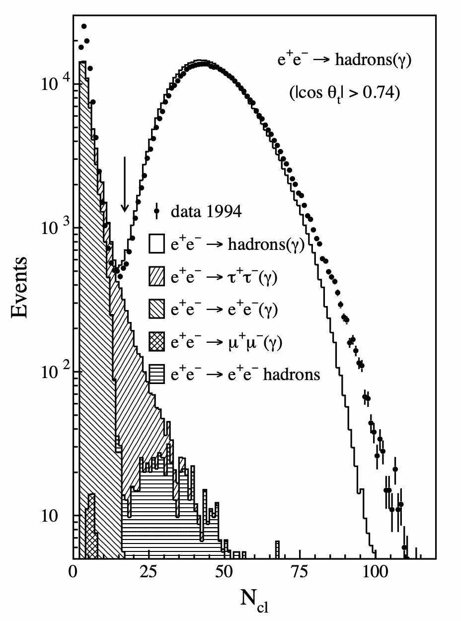
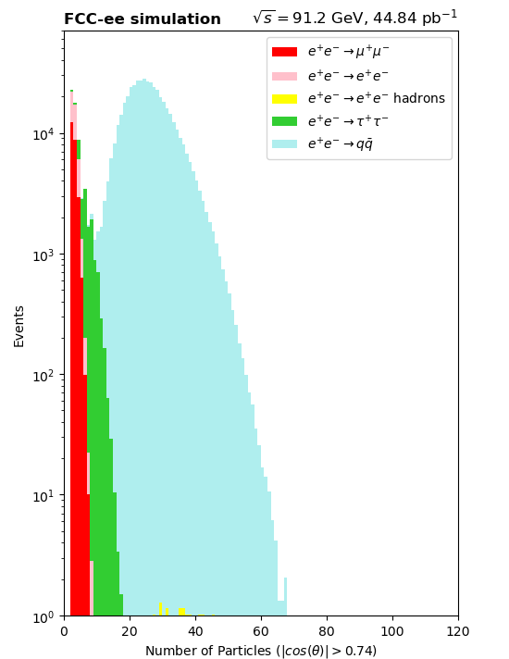
Number of Particles/Clusters (End-Cap Region, N-1 Plot)
The difference in the physical quantities being plotted are apparent. Here you can see that the two photon background is being affected by some other cut.

Slide 10
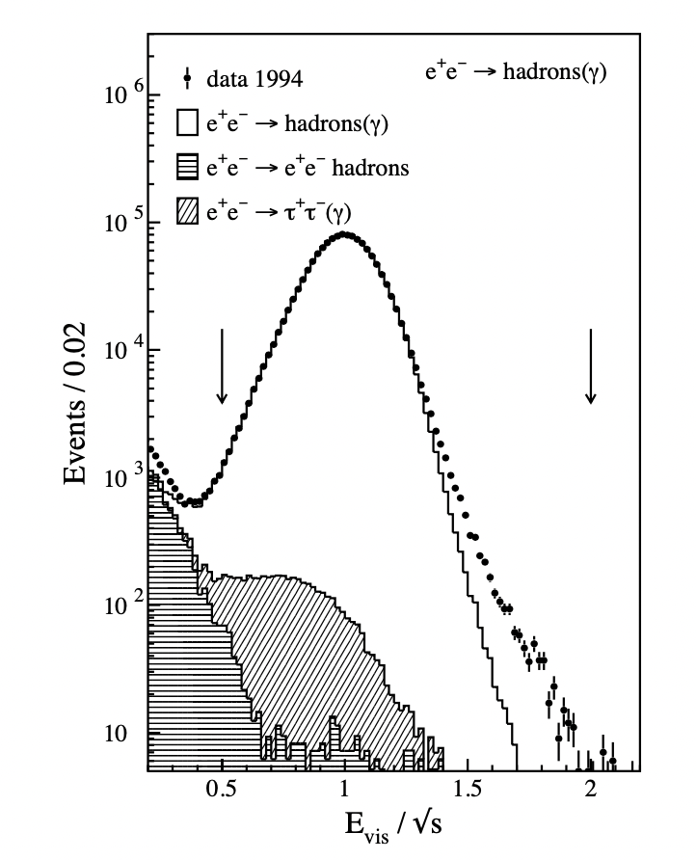
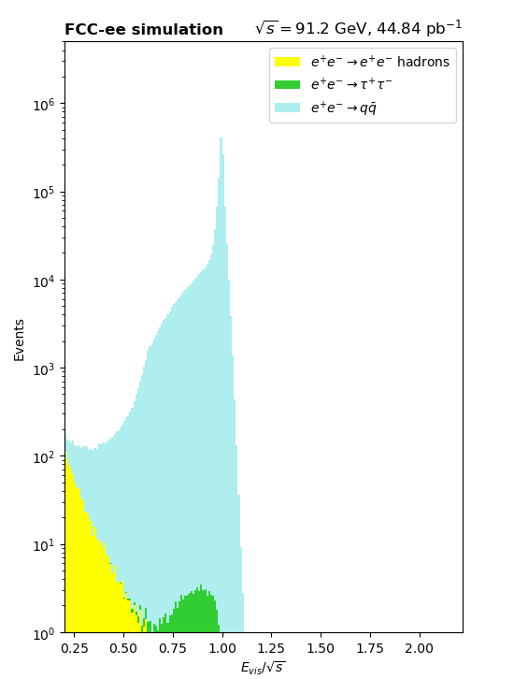
Normalized Scalar Energy (N-1 Plot)
Almost all the two photon background does not satisfies the relation 0.5 < Evis/√s, which explains the discrepancy in the previous plot.
You can also see the effect the difference between Ncl and Nparticles had in the number of taus.
The sharp peak instead of a smooth curve is due to improvements in the detector. The energy resolution of the IDEA detector is much better than L3.

Slide 11
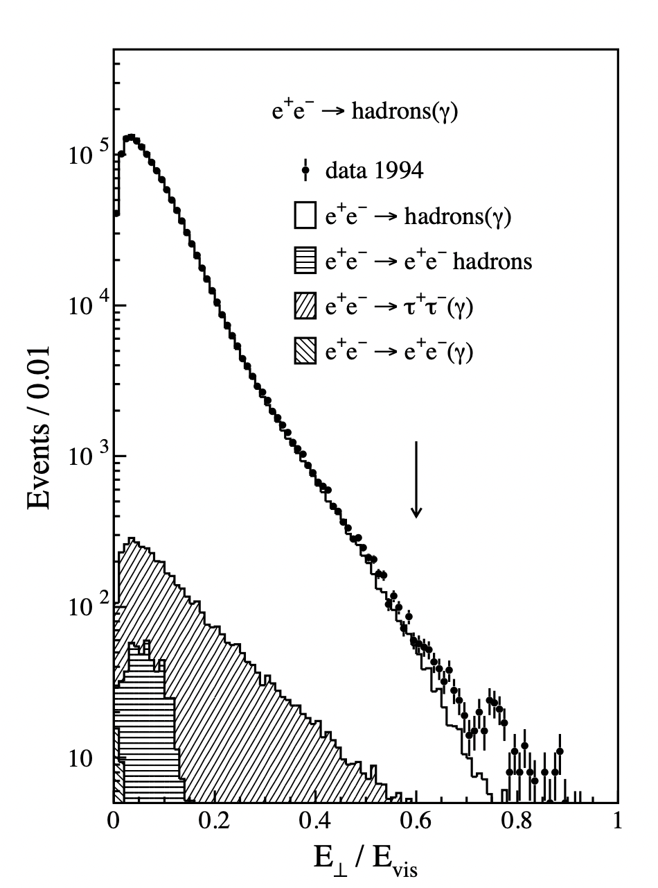
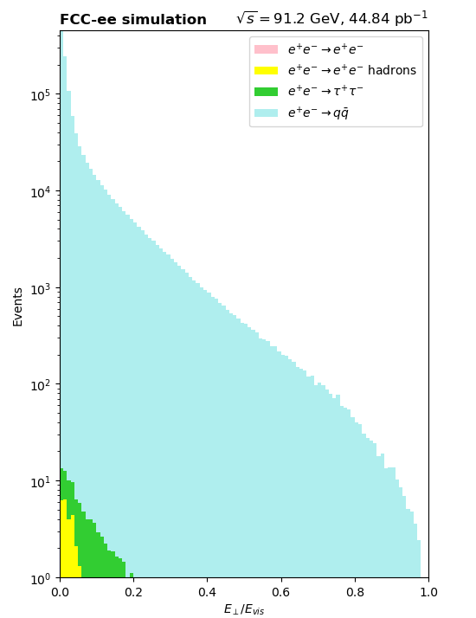
Transverse Energy Imbalance (N-1 Plot)
Again we can see how the differences in the filters impacted the amount of background, to the point that there is no visible e⁺e⁻.
Improvements in the detector also justify the smoothness of the curve going up to 1.0.

Slide 12
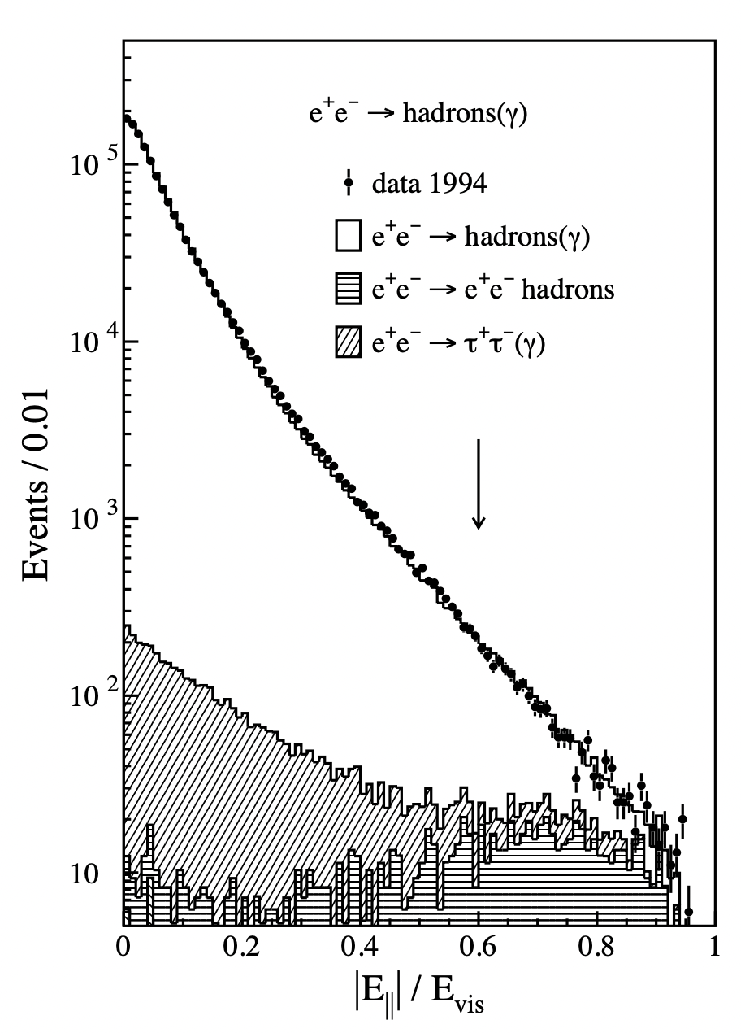
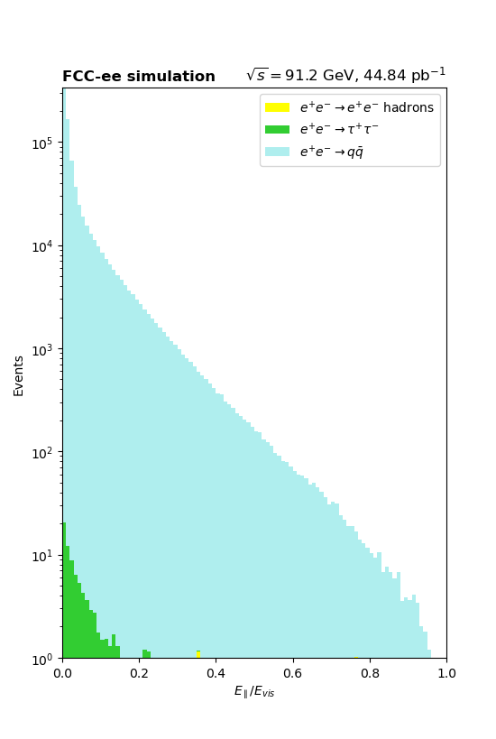
Longitudinal Energy Imbalance (N-1 Plot)
Again we can see how the differences in the filters impacted the amount of background, to the point that there is almost no visible two photon background.
Improvements in the detector also justify the smoothness of the curve going up to 1.0.

Slide 13
Optimizing Filters for FCC analysis

Slide 14
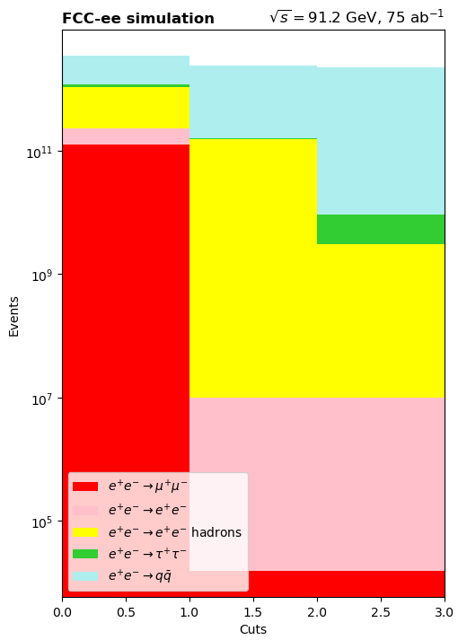
Cuts Utilized
The number of particles per event, Nparticles, is required to be Nparticles ≥10
The total energy observed in the detector, Evis, normalised to the centre-of-mass energy must satisfy Evis/√s > 0.248
Note: The transverse and longitudinal energy imbalance were NOT cut on, as these variables were used in the A LEP experiment to eliminate detector noise, something that could not be properly simulated in MC for FCC
Sample/ Cut | Hadrons | 𝛍⁺𝛍⁻ | e⁺e⁻ | 𝛕⁺𝛕⁻ | e⁺e⁻ hadrons
Initial | 2.3086×10¹² | 1.2675×10¹¹ | 1.0966×10¹¹ | 1.2750×10¹¹ | 8.5255×10¹¹
Cut 1 | 2.3026×10¹² | 0 | 9.7594×10⁶ | 6.2406×10⁹ | 1.5291×10¹¹
Cut 2 | 2.2972×10¹² | 0 | 9.7594×10⁶ | 6.2404×10⁹ | 2.8987×10⁹

Slide 15
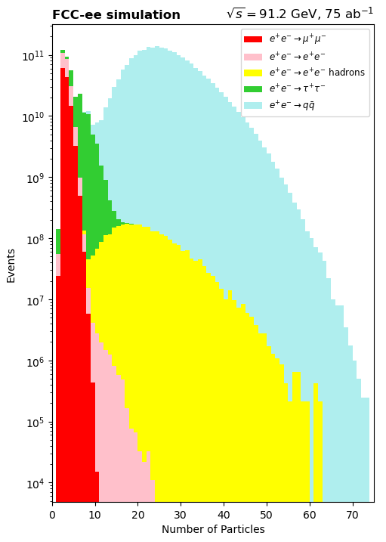
Number of Particles/Clusters (N-1 plot)
Number of Particles/Clusters ≥ 10
 | Before Cut | After Cut | Retained
# Signal Events | 2.3086×10¹² | 2.3026×10¹² | 99.738814%
# Background Events | 1.2165×10¹¹ | 1.5916×10¹¹ | 13.083866%

Slide 16
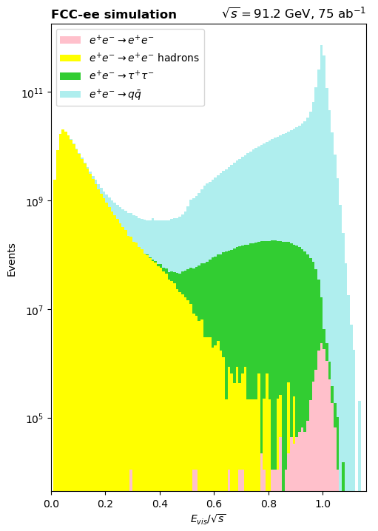
Normalized Scalar Energy (N-1 Plot)
Normalized scalar energy > 0.248
 | Before Cut | After Cut | Retained
# Signal Events | 2.3026×10¹² | 2.2972×10¹² | 99.765934%
# Background Events | 1.5916×10¹¹ | 9.1488×10⁹ | 5.7481814%

Slide 17
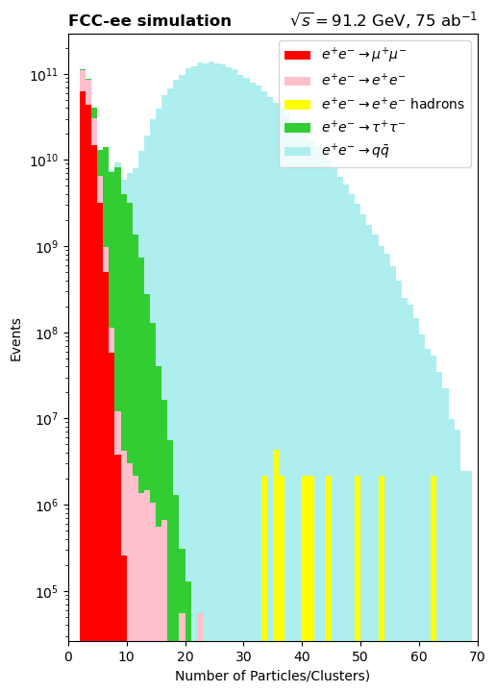
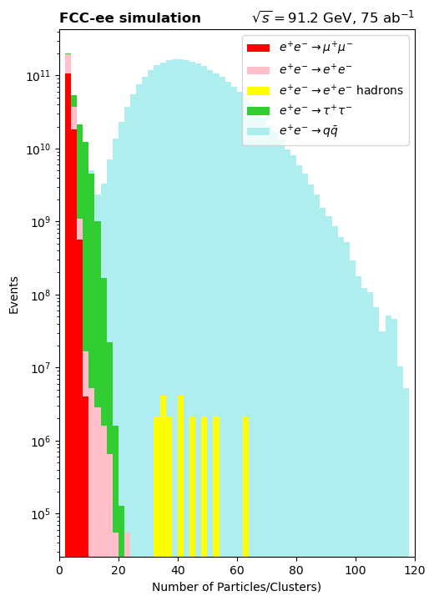
Event Generator Discrepancy
Background: Whizard Samples
Signal: KKMC/Whizard
Determine source of discrepancy between event generators
KKMC Whizard
Has significant impact on optimal cut parameters

Slide 18
Assessing Uncertainties

Slide 19
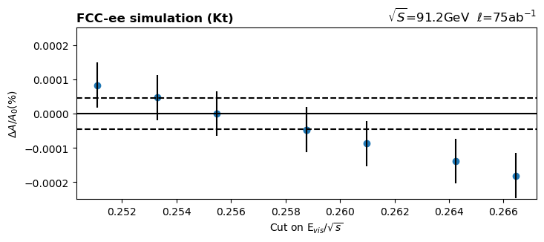
Uncertainty Plots

Slide 20
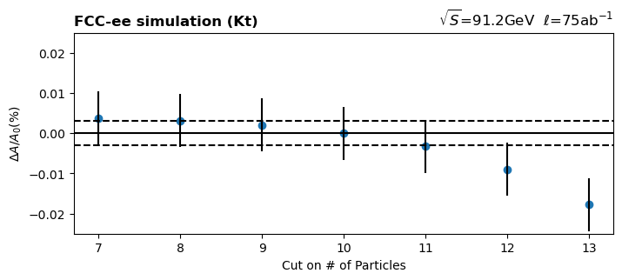
Uncertainty Plots

Slide 21
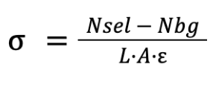
Calculating Hadronic Cross-Section
Nsig = Number of signal events after all cuts
No = Number of signal events before all cuts
Nsel = Number of signal + background events after all cuts
Nbg = Number of background events after all cuts
A = Acceptance
L = Luminosity
ε = Efficiency (taken to be 1)
Nsel - Nbg = 2.297386×10¹² events
L = 75 ab⁻¹
A = (99.513 ± 0.002) %
𝝈 = (30781.6 ± 0.9) pb

Slide 22

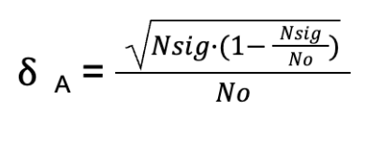

Sources of Uncertainty
Nsig = Number of signal events after all cuts
No = Number of signal events before all cuts
Nsel = Number of signal + background events after all cuts
Nbg = Number of background events after all cuts
A = Acceptance
L = Luminosity
ε = Efficiency (taken to be 1)
Data Statistics
Statistical Uncertainty on Acceptance
Luminosity Uncertainty

Slide 23
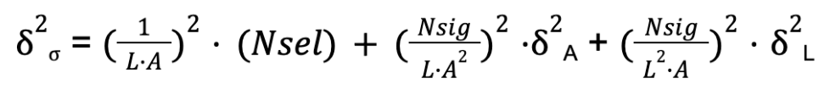
Total Uncertainty
Nsig = Number of signal events after all cuts
No = Number of signal events before all cuts
Nsel = Number of signal + background events after all cuts
Nbg = Number of background events after all cuts
A = Acceptance
L = Luminosity
ε = Efficiency (taken to be 1)
Source | Absolute Uncertainty [pb] | Relative (%)
Statistics | 0.02 | 7×10⁻⁵
Statistical Uncertainty on Acceptance | 0.7 | 2×10⁻³
Luminosity | 0.7 | 2×10⁻³
Total | 0.9 | 3×10⁻³

Slide 24
Conclusion
FCC-ee allows for cross section measurement ___ orders of magnitude more precise
The improved energy resolution allows FCC to have much cleaner representation of the visible energy.
The differences between event generators still needs to be studied.
Explore detector deadzone impact on cosΘ, cross section error (financially feasible?)
MIT engaging in push for US participation in FCC research while training future generation of physicists

Slide 25
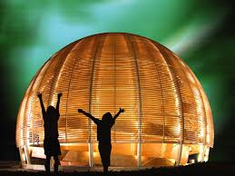
Thank You!

