Slide 1
Mechanical Integration of the IDEA detectors in the FCC-ee interaction region
Fabrizio Palla¹
Manuela Boscolo ², Filippo Bosi ¹, Francesco Fransesini ², Stefano Lauciani ²
¹INFN Sezione di Pisa, Italy
²INFN Laboratori Nazionali di Frascati (RM), Italy
First Annual U.S. Future Circular Collider Workshop
BNL, April 24-26, 2023

Slide 2
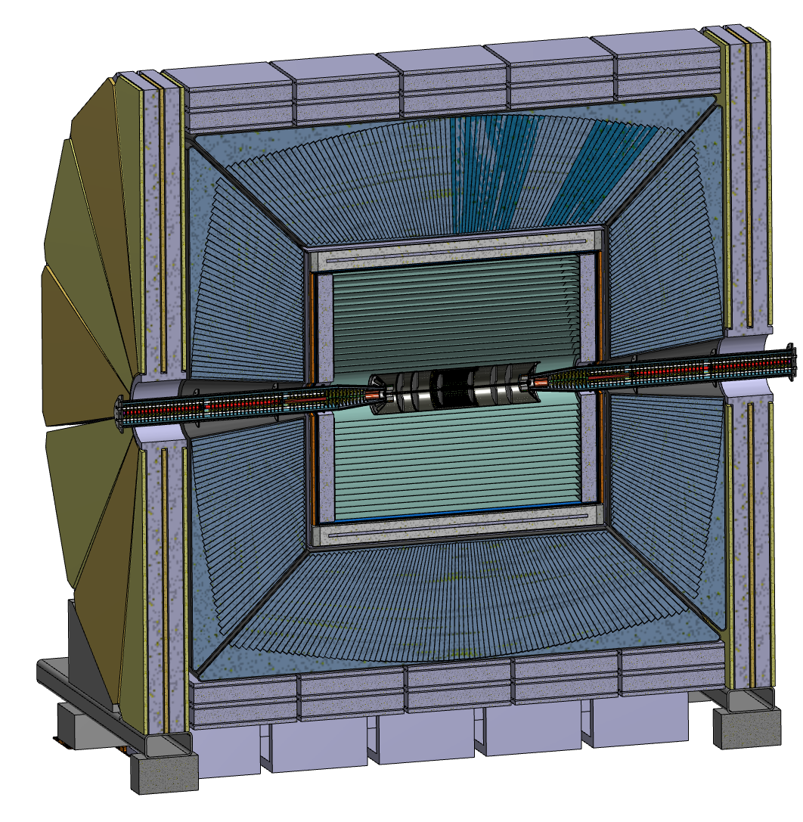
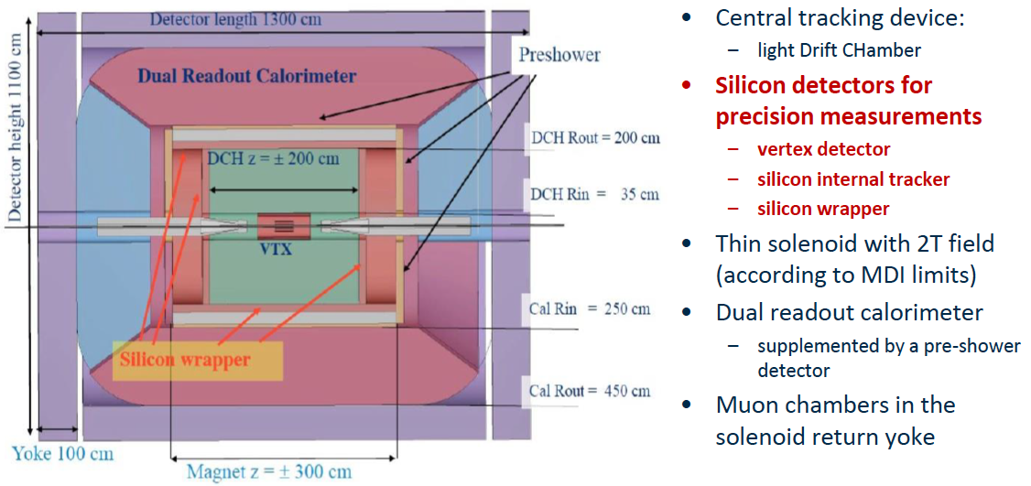
The IDEA Concept
See talk by P. Azzi and N. De Filippis in the “Detector”
parallel session

Slide 3
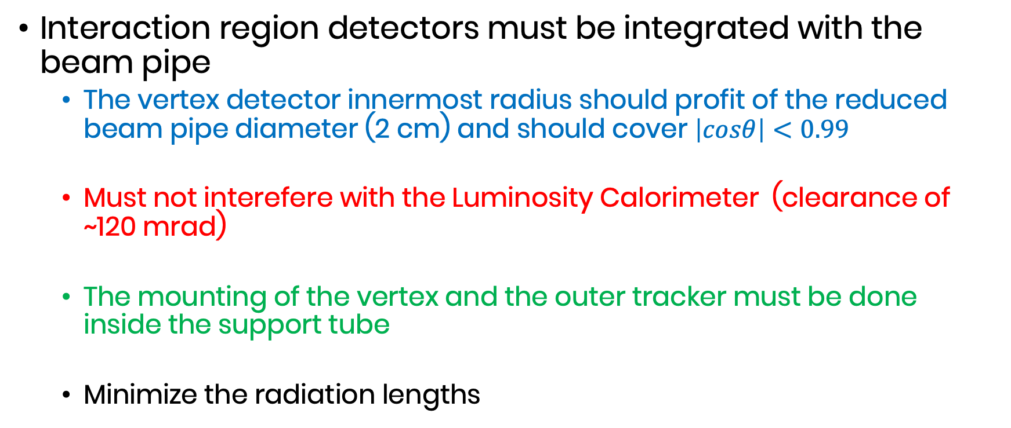
Requirements
Interaction region detectors must be integrated with the beam pipe
  The vertex detector innermost radius should profit of the reduced beam pipe diameter (2 cm) and should cover $\left|cosθ\right|<0.99$
  Must not interefere with the Luminosity Calorimeter (clearance of ~120 mrad)
  The mounting of the vertex and the outer tracker must be done inside the support tube
  Minimize the radiation lengths

Slide 4
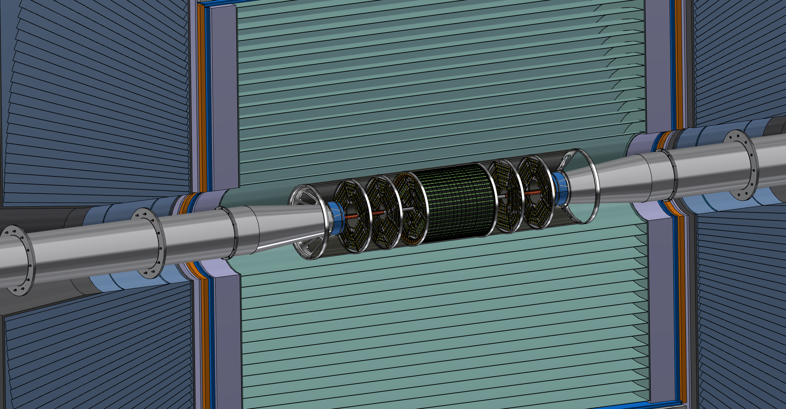
Vertex and Outer Trackers
See talk by M. Boscolo for the interaction region layout
Inside the same volume of the support tube that holds also the LumiCal
  Vertex detector supported by the beam pipe
  Outer Tracker (1 barrel and 6 disks) fixed to the support tube
Minimal number of detector module variants
  One module type only for the Vertex
  One module type only for the Outer barrel and disks

Slide 5
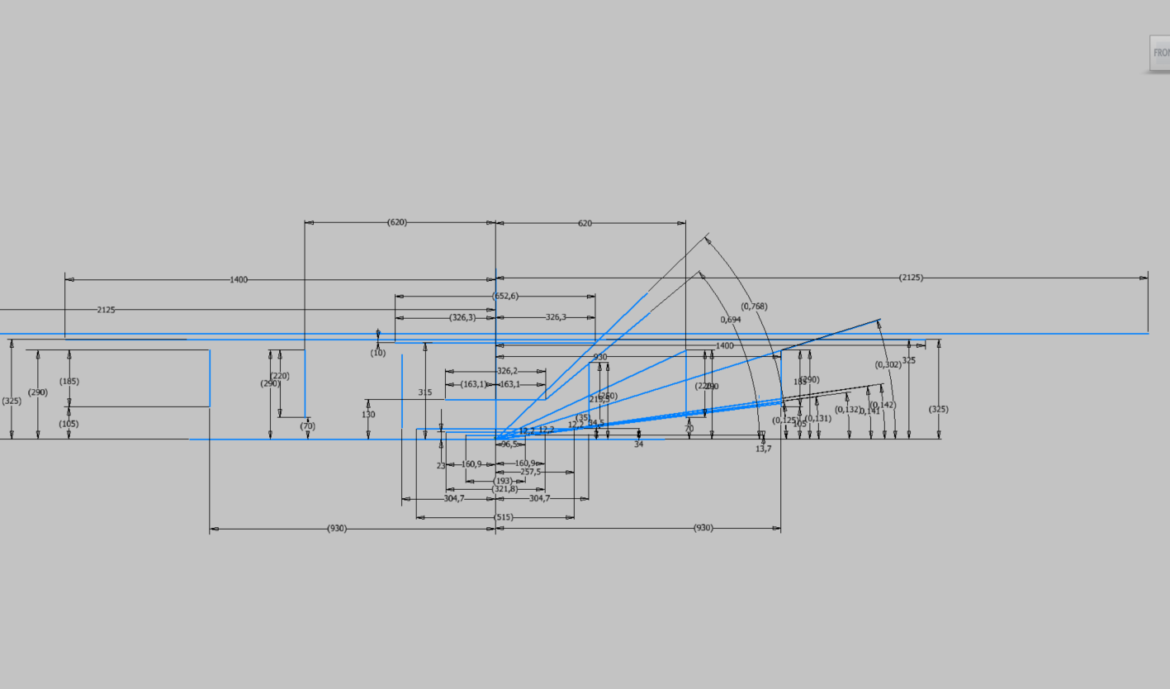
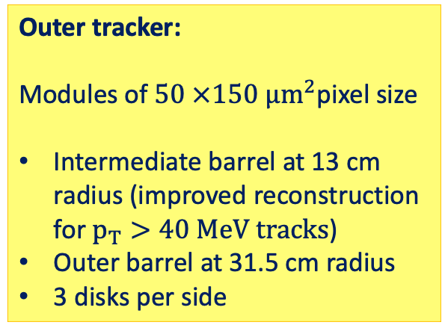
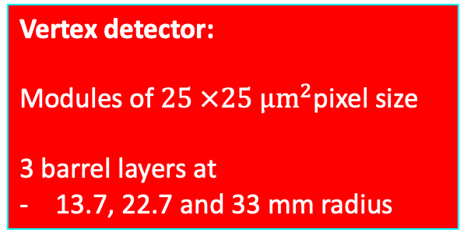
Conceptual Tracker layout
Outer tracker:
Modules of $50 ×150 µm^{2}$pixel size
Intermediate barrel at 13 cm radius (improved reconstruction for$p_{T}>40 MeV tracks$)
Outer barrel at 31.5 cm radius
3 disks per side
EXSTERNAL CILINDER
OUTER TRACKER
MEDIUM TRACKER
DRIFT CHAMBER
DISK 3
DISK 1
DISK 3
Vertex detector:
Modules of $25 ×25 µm^{2}$pixel size
3 barrel layers at
13.7, 22.7 and 33 mm radius
DISK 2
INNER TRACKER
DISK 2
DISK 1

Slide 6
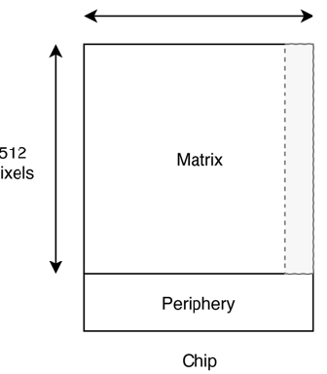
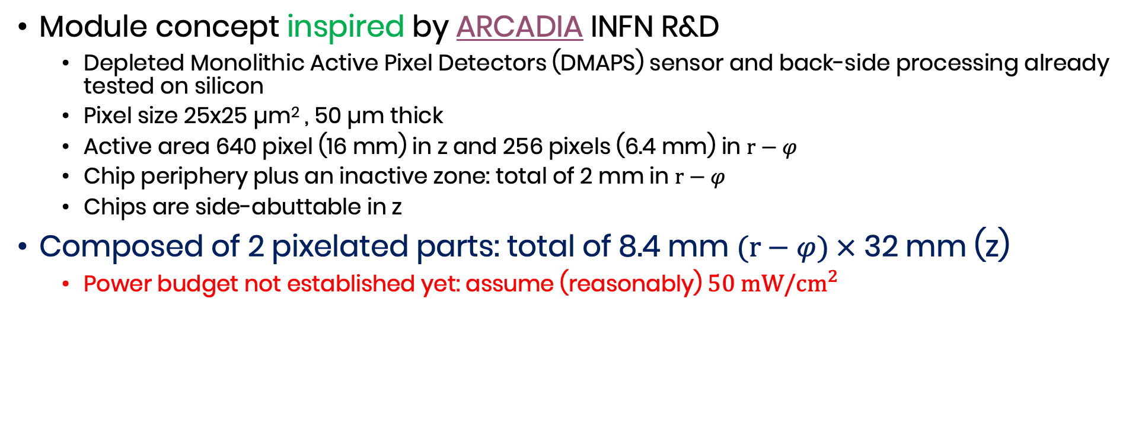
Vertex detector modules
Module concept inspired by ARCADIA INFN R&D
  Depleted Monolithic Active Pixel Detectors (DMAPS) sensor and back-side processing already tested on silicon
  Pixel size 25x25 µm² , 50 µm thick
  Active area 640 pixel (16 mm) in z and 256 pixels (6.4 mm) in $r−φ$
  Chip periphery plus an inactive zone: total of 2 mm in $r−φ$
  Chips are side-abuttable in z
Composed of 2 pixelated parts: total of 8.4 mm $(r−φ) ×$ 32 mm (z)
  Power budget not established yet: assume (reasonably) $50 mW/{cm}^{2}$
z 640 pixel
32 mm
Chip 1
Chip 2
R-phi 256 pixel
8.4 mm
Readout

Slide 7
Layer 1
15 overlapping staves of 6 modules each
Pinwheel geometry: all modules at the same (smallest) radius
Power budget ~12 W
Total weight ~22 grams
Total thickness 0.25% X₀
Silicon: 0.053% X₀
Power and readout bus: 0.056% X₀

Slide 8
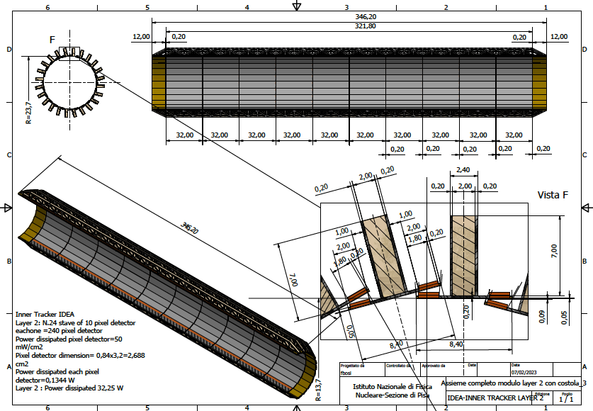
Layer 2
24 overlapping staves of 10 modules each
Pinwheel geometry
Counter-rotated wrt layer 1 to mitigate charge-asymmetry effects in track reconstruction
Power budget
~32 W
Total weight ~63 grams
Total thickness 0.25% X₀

Slide 9
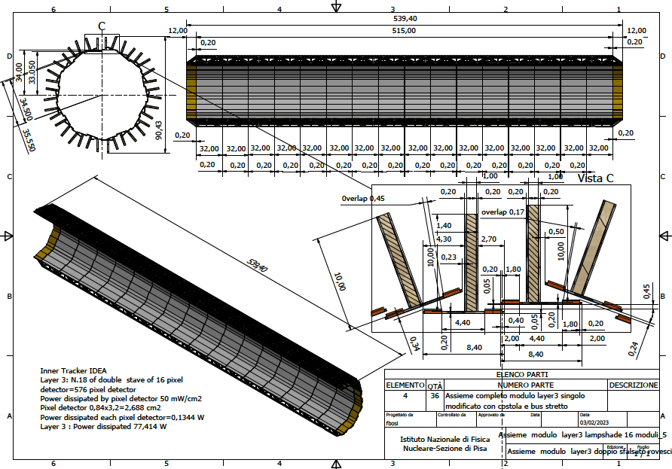
Layer 3
18 overlapping staves of double 16 modules each
Lampshade geometry.
Charge symmetric track reconstruction
Total weight ~150 grams
Total thickness 0.25% X₀
Power budget
~77 W

Slide 10
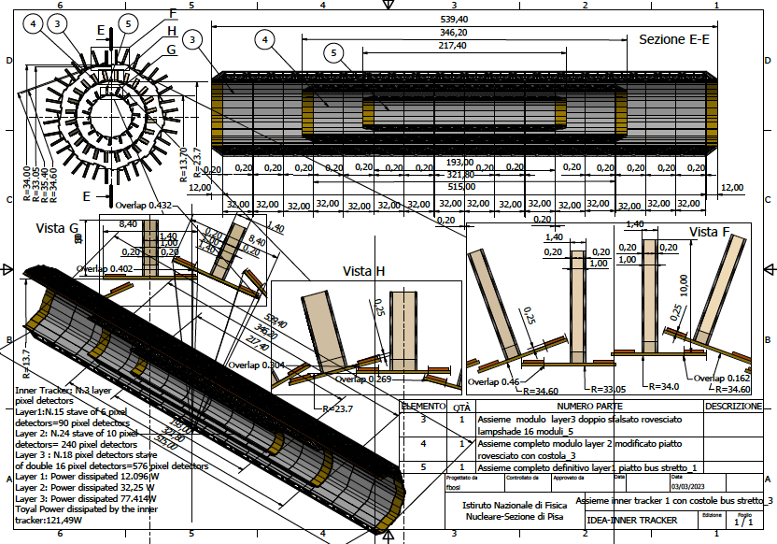
Overall Vertex layout
Total power ~120 W – Air cooled
Total weight ~230 grams

Slide 11
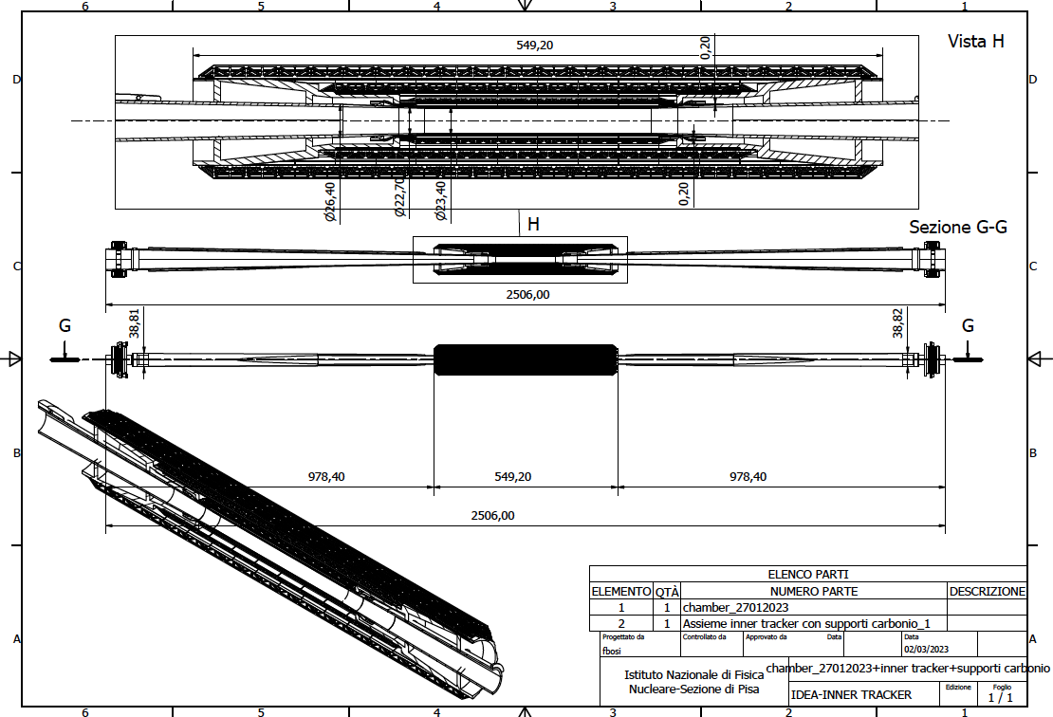
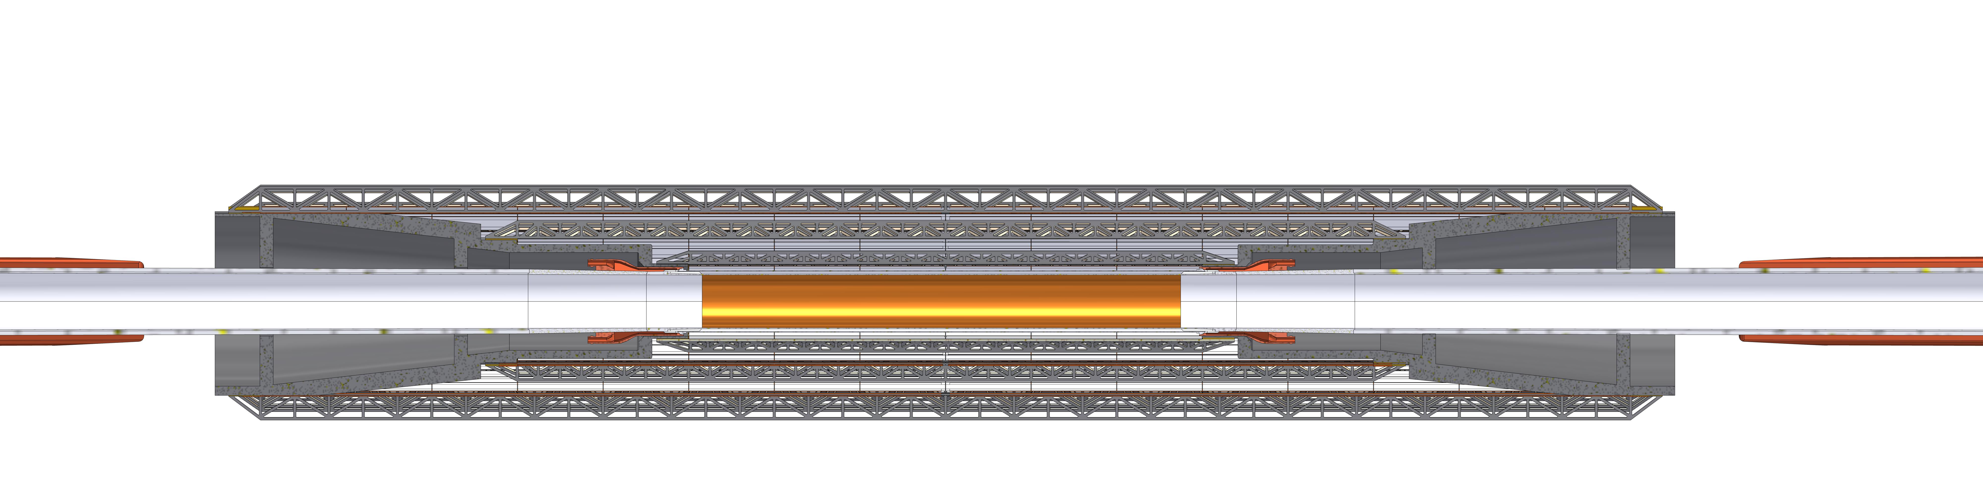
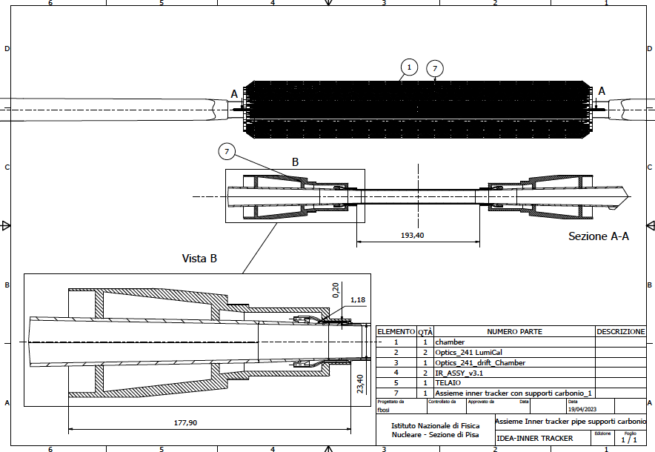
Vertex detector supporting conical structure
Weight ~ 460 grams

Slide 12
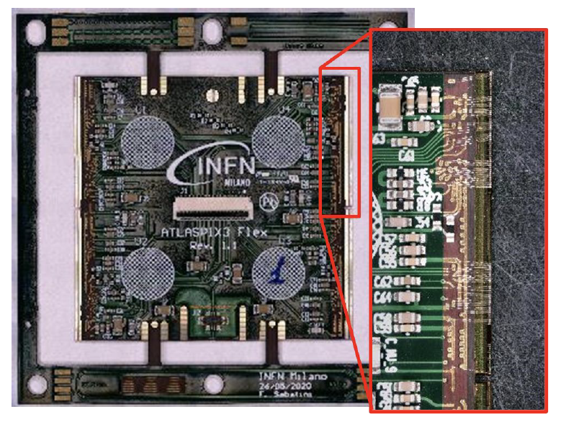
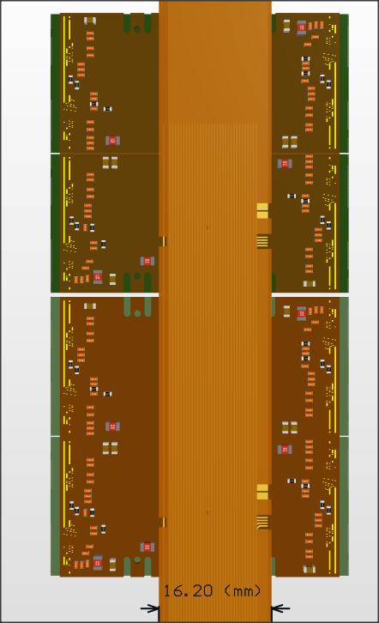

Outer layers modules
Based on ATLASPIX3 R&D
  DMAPS
  50 x 150 µm²
  Up to 1.28 Gb/s downlink
  TSI 180 nm process
  132 columns of 372 pixels
  Active (total) length (r-phi x z)
    18.6 (21) mm x 19.8 (20.2) mm
  Module is made of 2x2 chips – total length:
    size 42.2 mm x 40.6 mm
  Power budget not established yet:
    assume $100 mW/{cm}^{2}$
Power
HV
Data IN/OUT

Slide 13
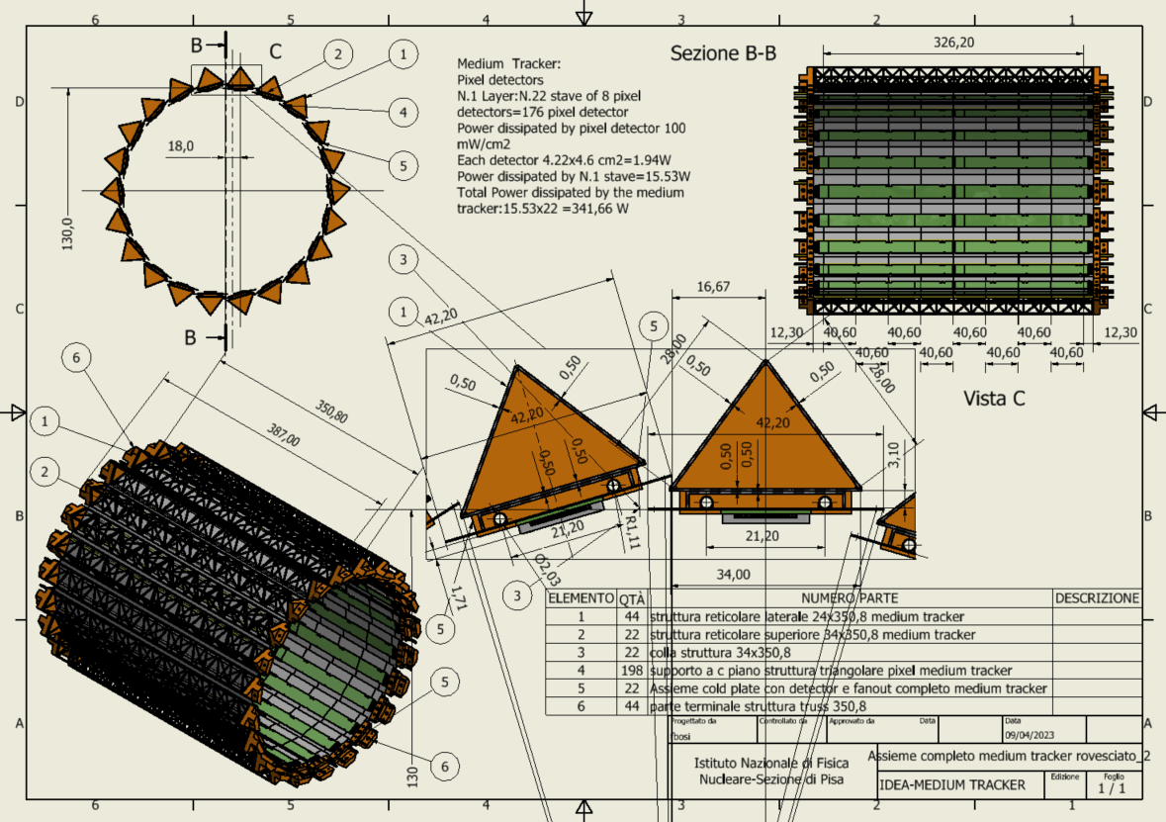
Intermediate Tracker Barrel
At 13 cm radius
22 staves of 8 modules each.
Lightweight reticular support structure (ALICE/Belle-II like)
Readout chips either side
Power budget
~342 W
Total weight ~1 kg
Water cooled (2 pipes of 2 mm diameter)

Slide 14
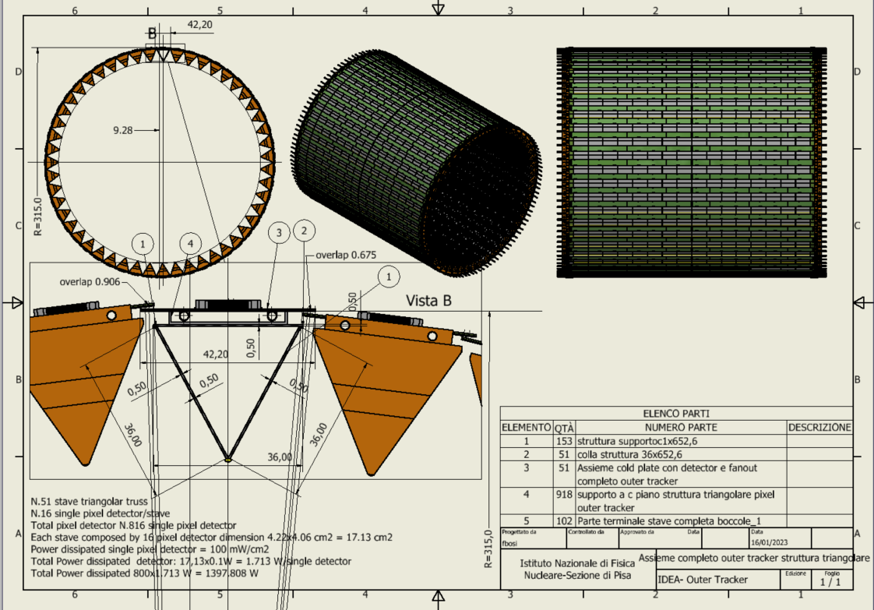
Outer Tracker Barrel
At 31.5 cm radius
51 staves of 16 modules each
Lightweight reticular support structure (ALICE/Belle-II like)
Total weight ~3.7 kg
Readout chips either side
Power budget
~1400 W
Water cooled (2 pipes of 2 mm diameter)
Notes:
NB. Qui la struttura reticolare deve stare giù perché sennò non si riesce ad ottenere il raggio esterno più grande e vicino alla DCH.

Slide 15
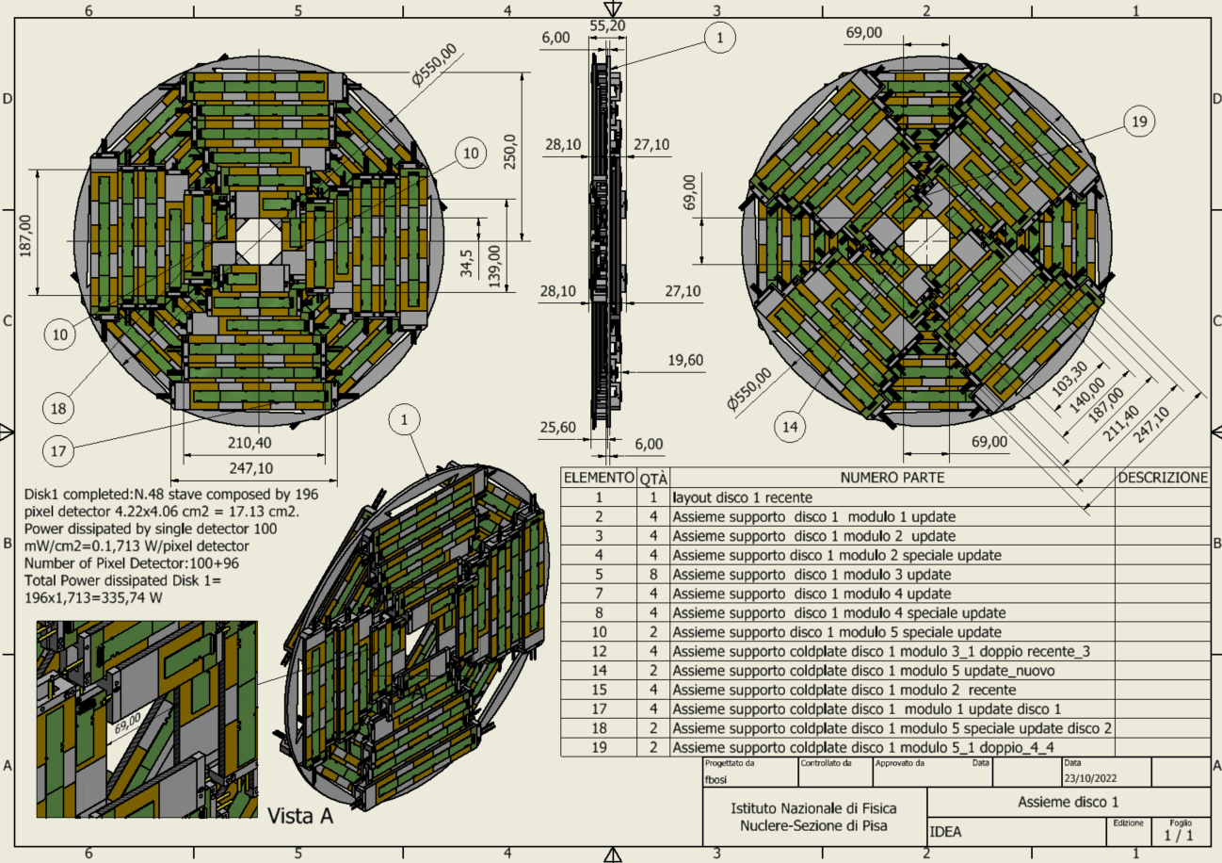
Outer Tracker Disk 1
2 sides (front and back) each with 4 petals.
One petal is made of different staves of overlapping modules
Total modules per disk: 196
Total weight ~850 grams
Power budget ~ 336 W
Cooling using 1 water pipe (2 mm diameter)
Similar geometry for the other two disks (only change the inner radius)

Slide 16
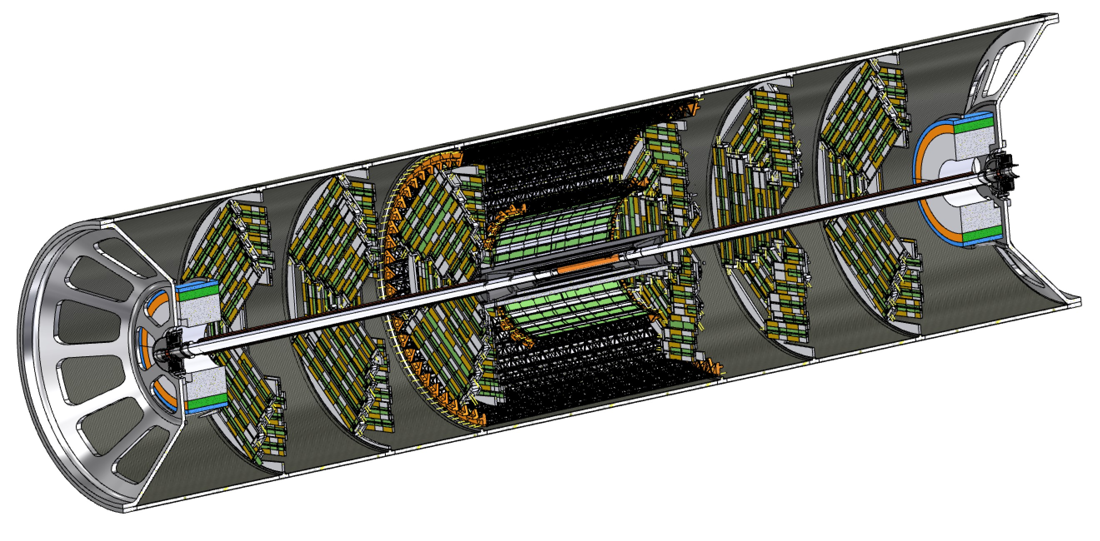
Support cylinder
All elements in the interaction region (Vertex, Tracker and LumiCal) are mounted rigidly on a support cylinder that guarantees mechanical stability and alignment
  Once the structure is assembled it is slided inside the rest of the detector

Slide 17
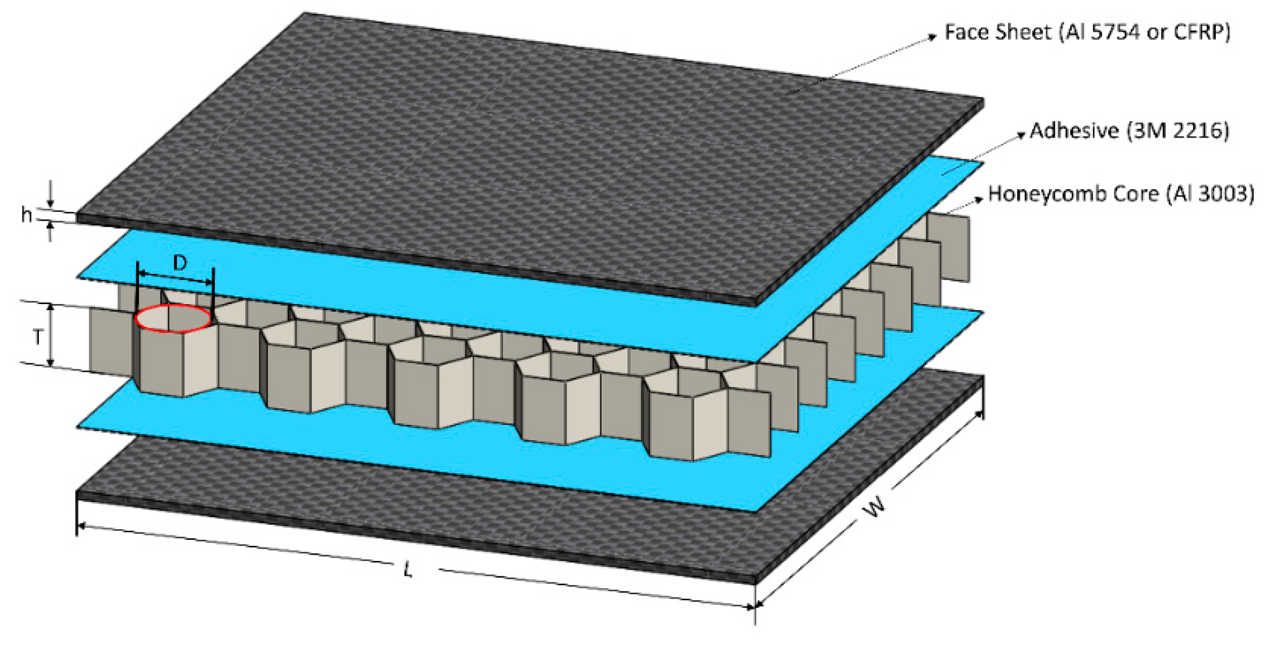
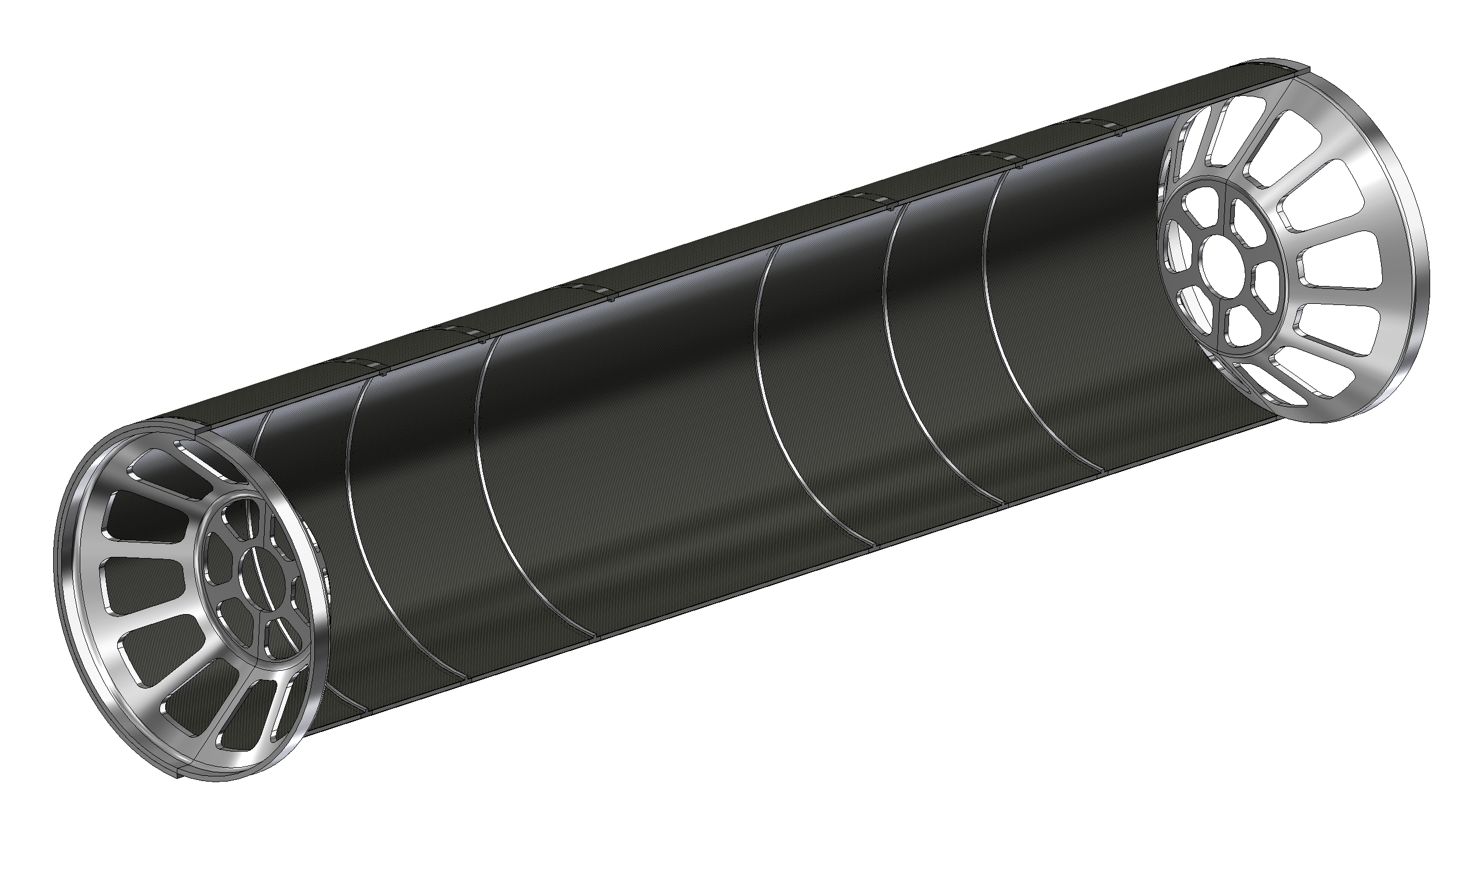
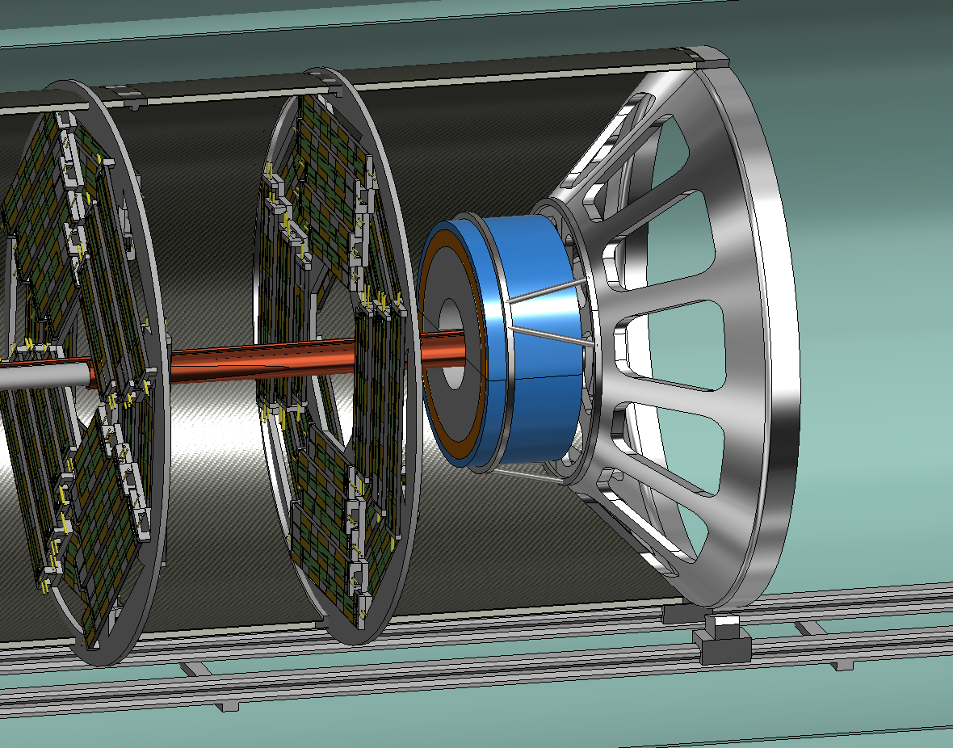
Support tube – description
The structure is made with a multiple layer structure:
1mm Carbon Fibre + 4mm Honeycomb + 1mm Carbon Fibre
6 reinforcement ribs to support of the disks
Split in two halves to simplify the assembly procedure
The Aluminum endcaps support the LumiCal and the beampipe
Supporting system of the LumiCal under study
Aluminium endcaps
Aluminium ribs

Slide 18
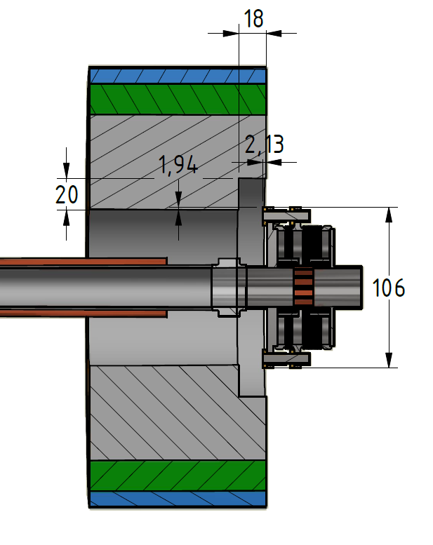
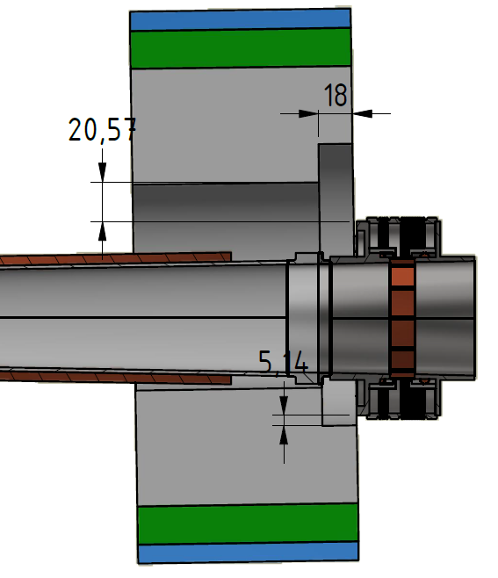
LumiCal integration
Currently under study the possibility to include LumiCal as a single object
The main modification consists into the creation of an annulus:
  18 mm along z (a multiple of 3.5 mm W (1X0) + 1.0 mm gap for Si pads)
  20 mm along the radius of the Lumical
A different design is being evaluated as different cut dimension or a conical cut on the LumiCal shape

Slide 19
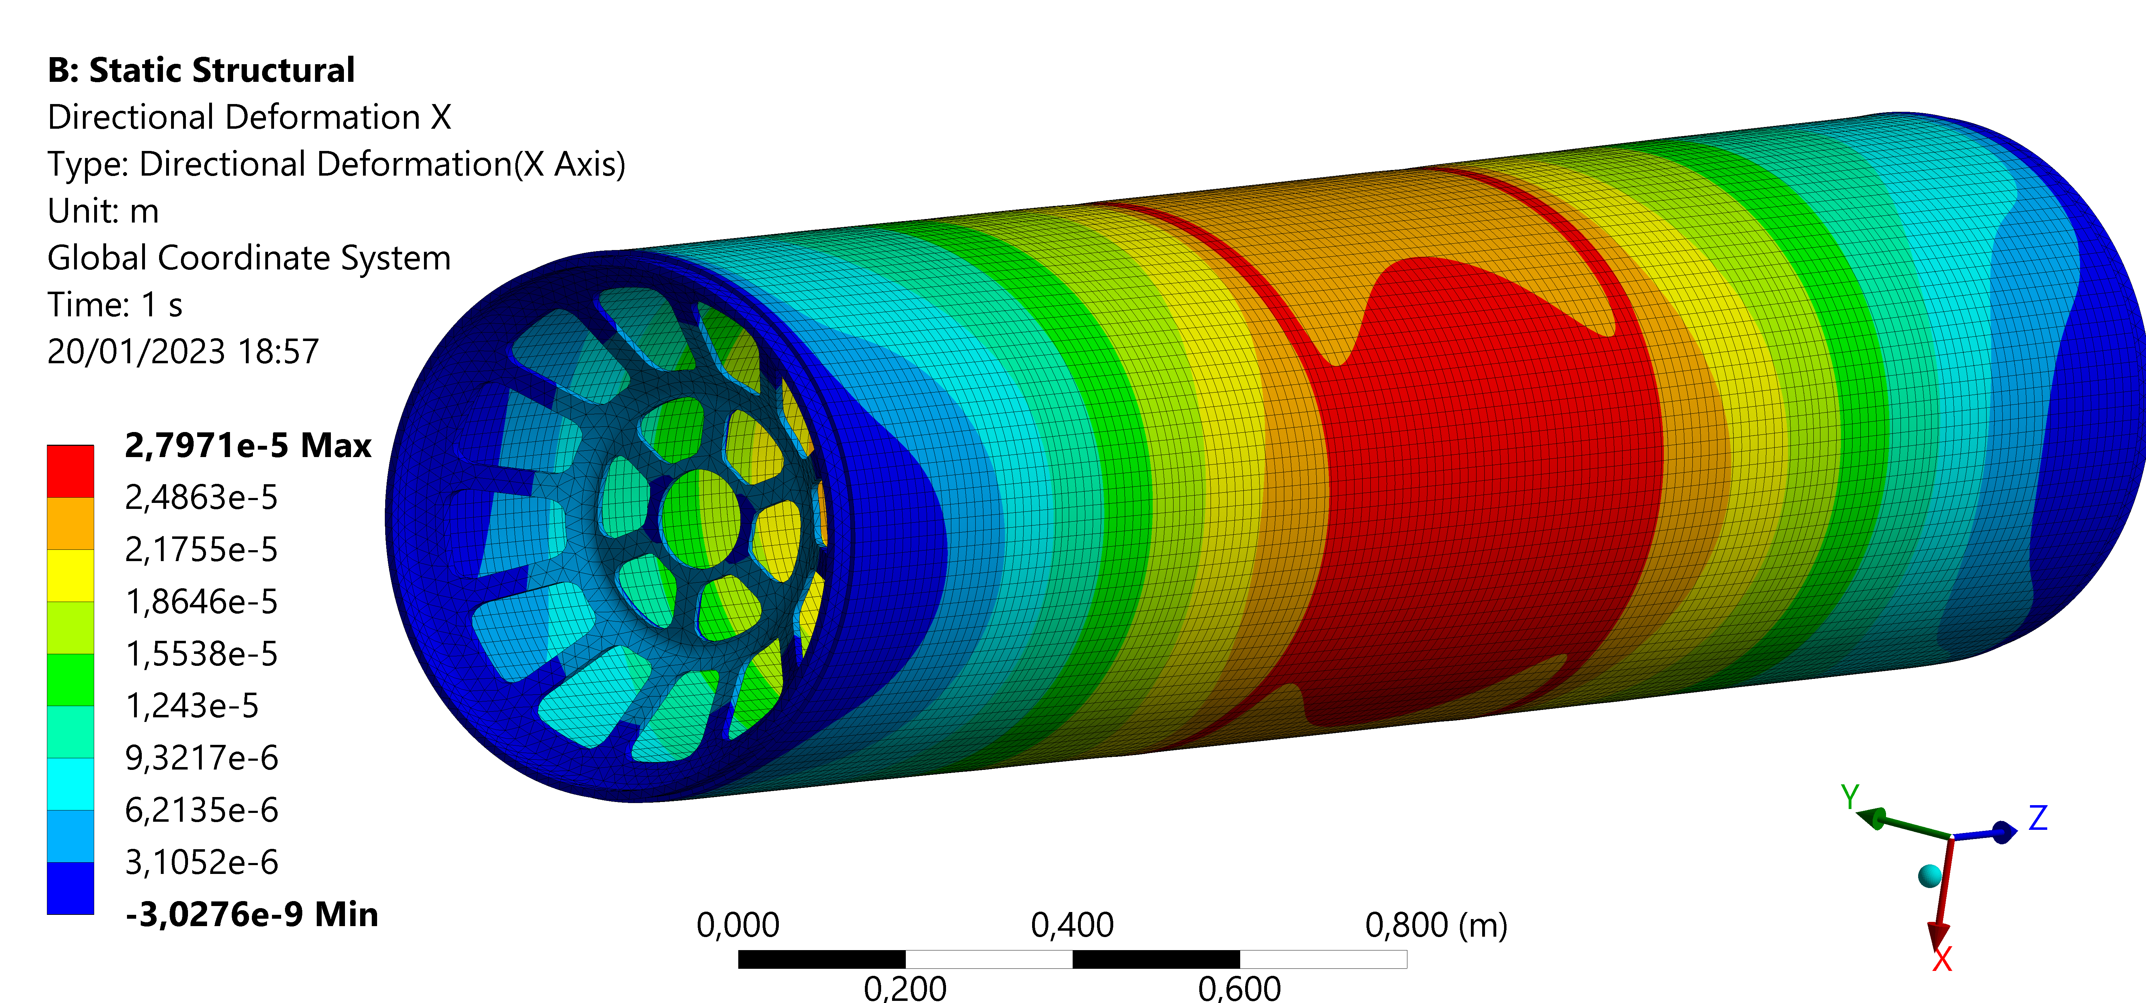
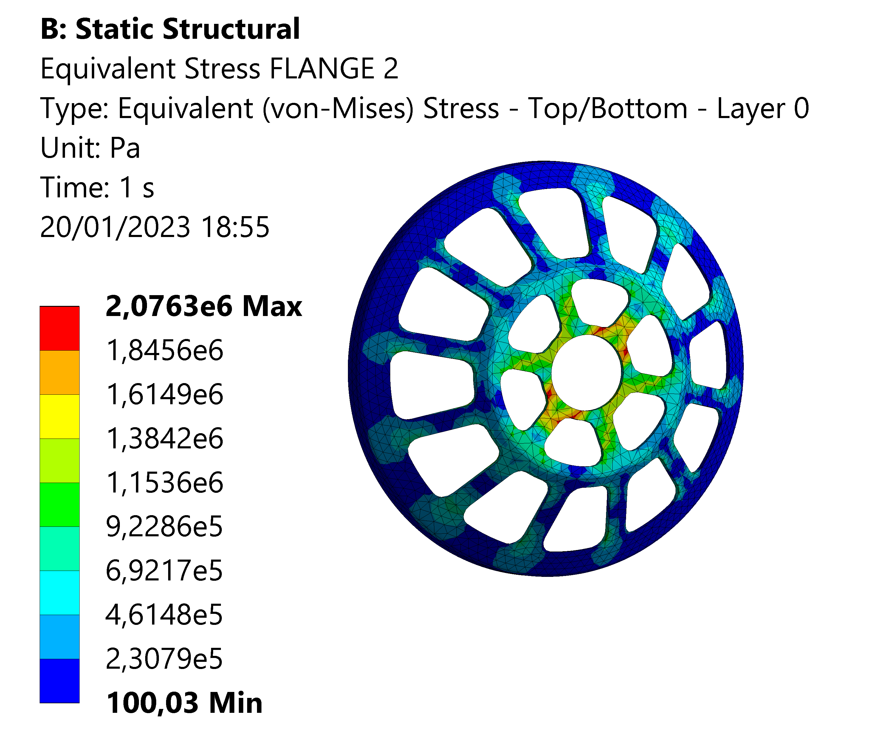
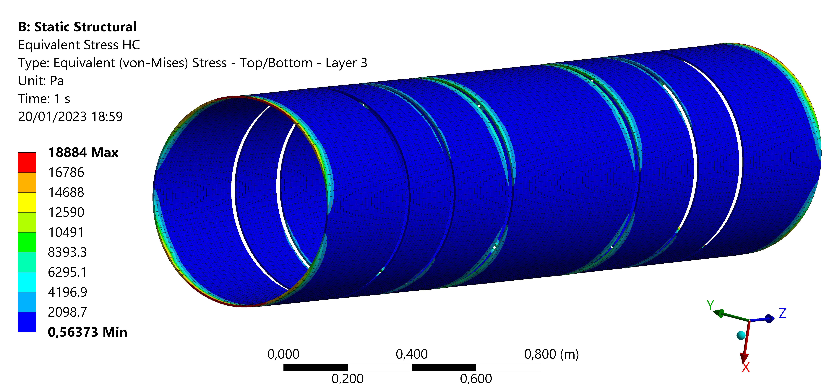
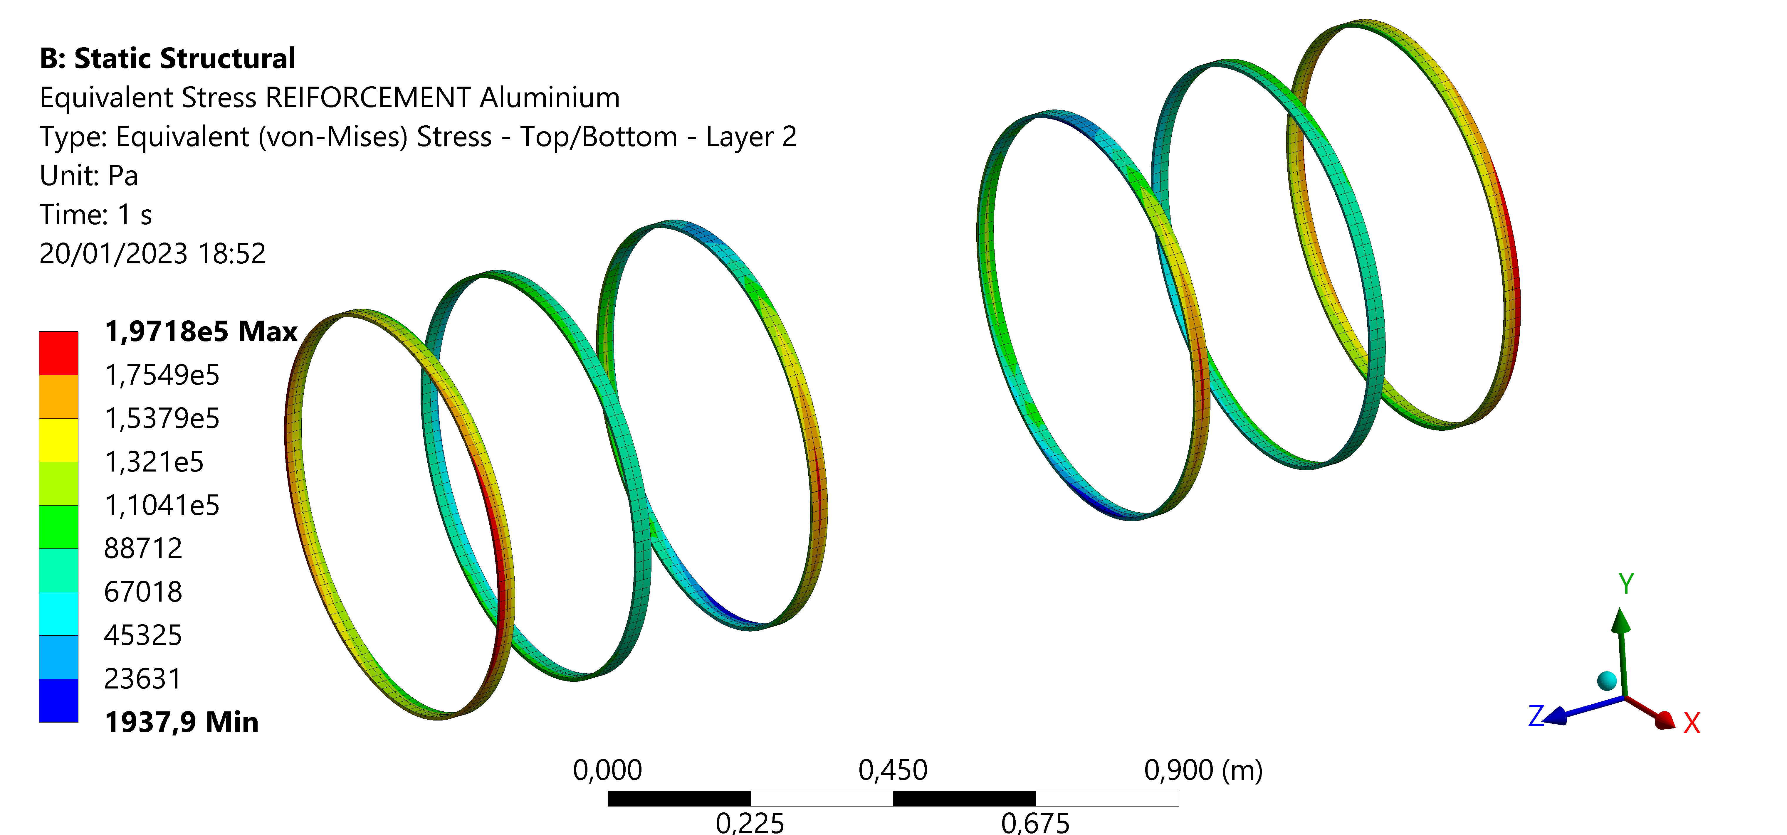
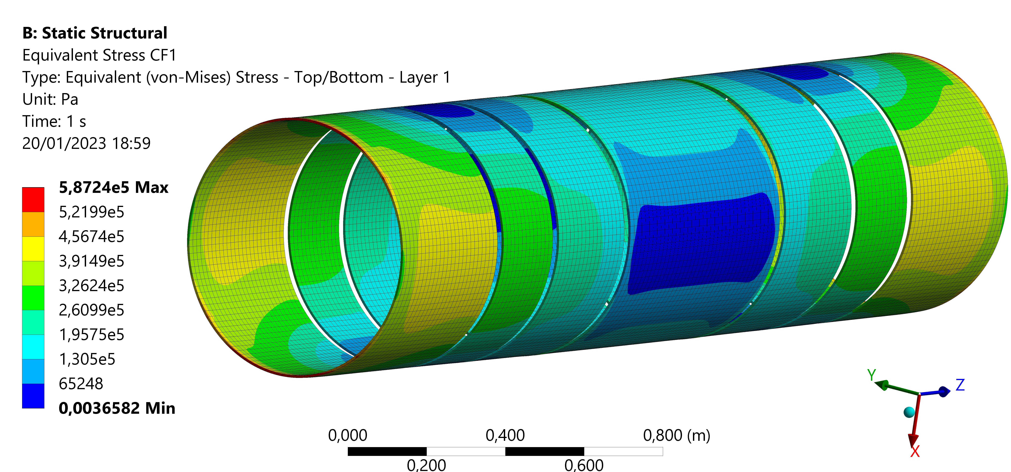
Support tube – Structural analysis – results
 | Maximum stress [MPa]
Aluminium flanges | 2.70
Aluminium ribs | 0.20
Honeycomb | 0.02
Carbon fiber | 0.50
 | Maximum displacement X [µm]
Aluminium flanges | 13
Aluminium ribs | 22
Composite | 23

Slide 20
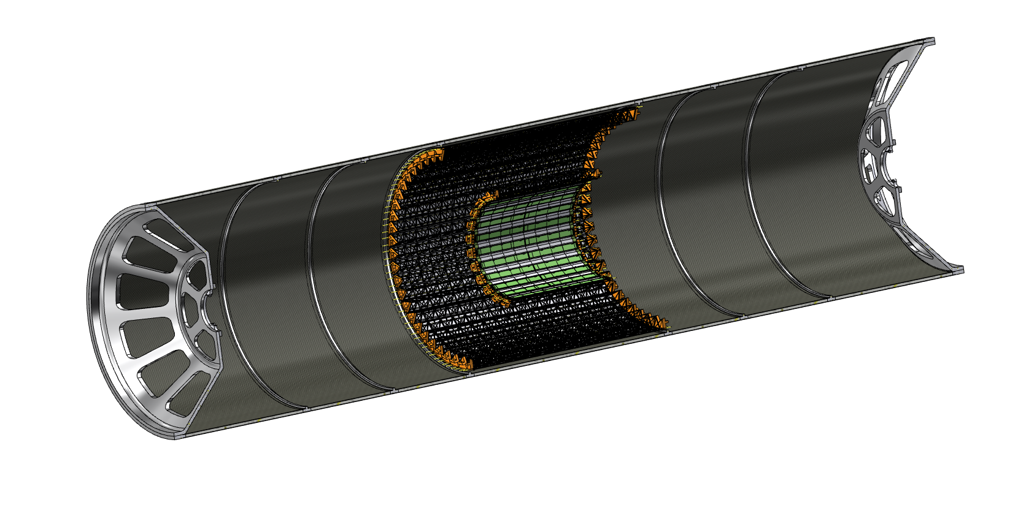
Assembly sequence

Slide 21
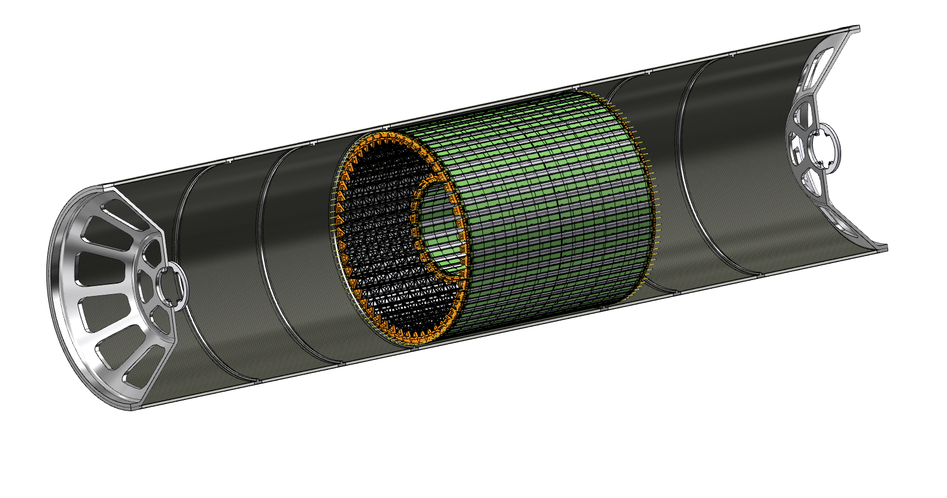

Slide 22
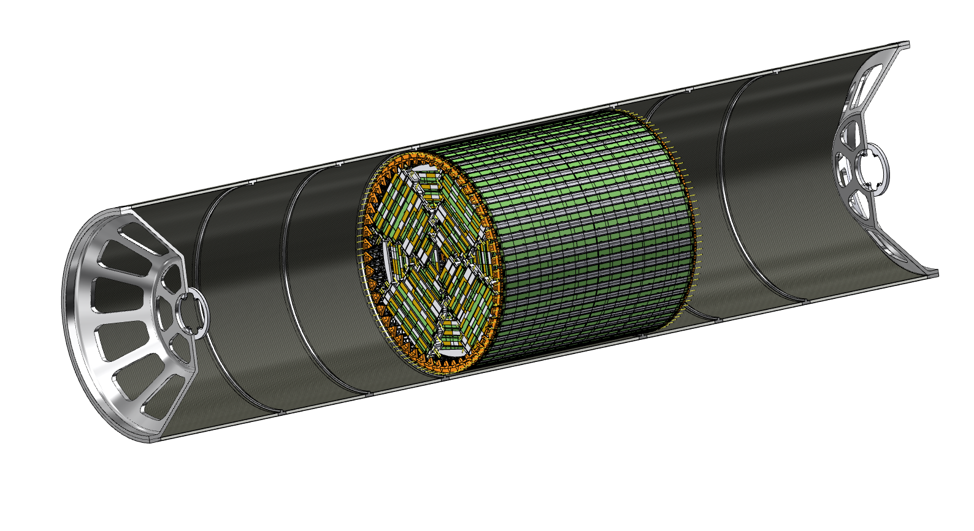

Slide 23
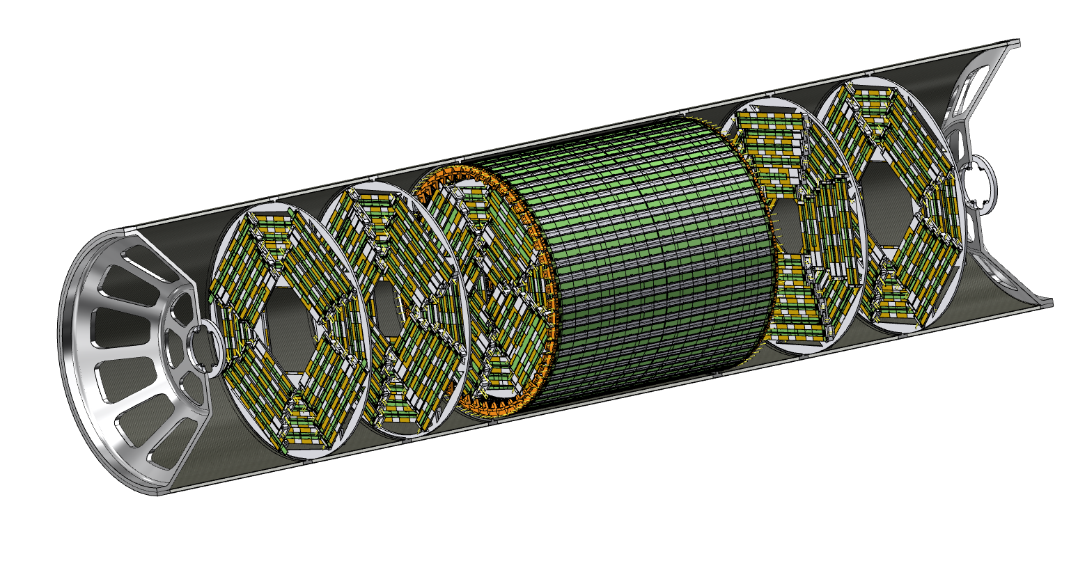

Slide 24
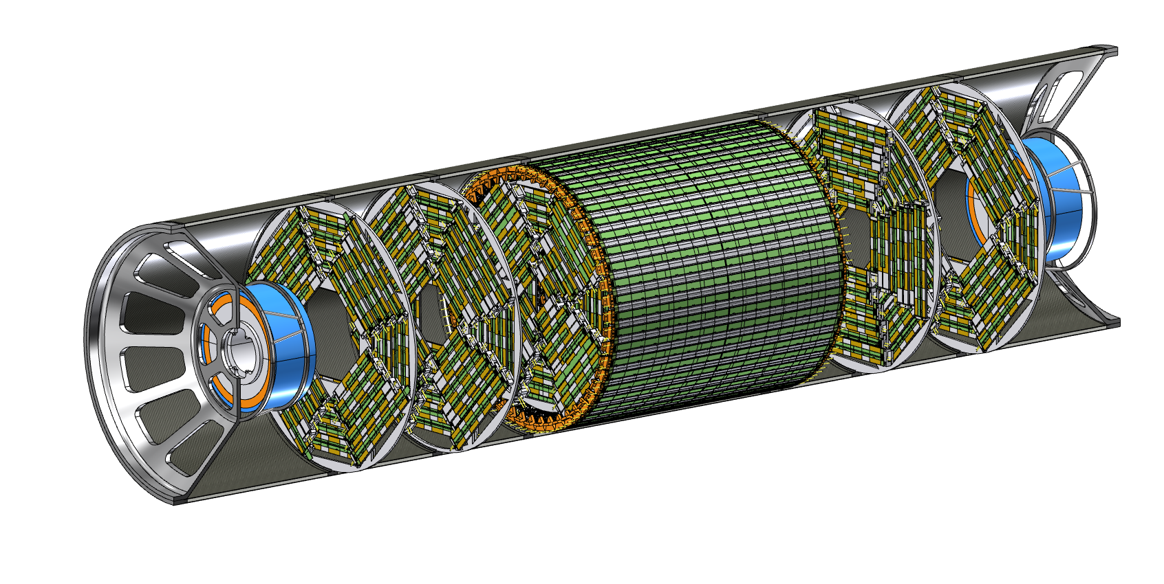

Slide 25
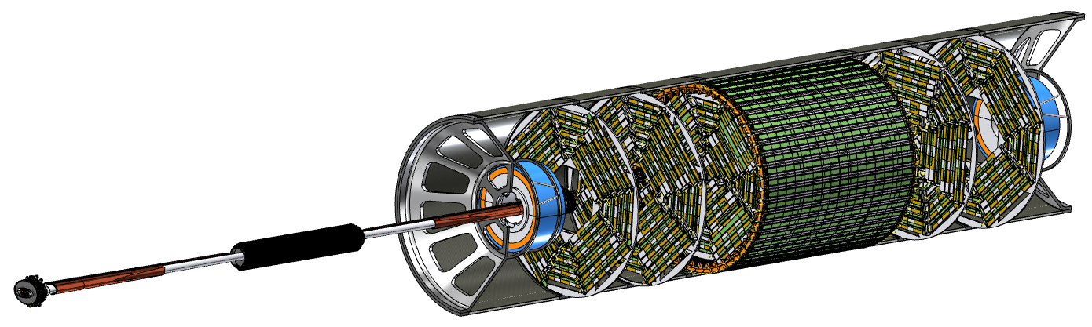

Slide 26
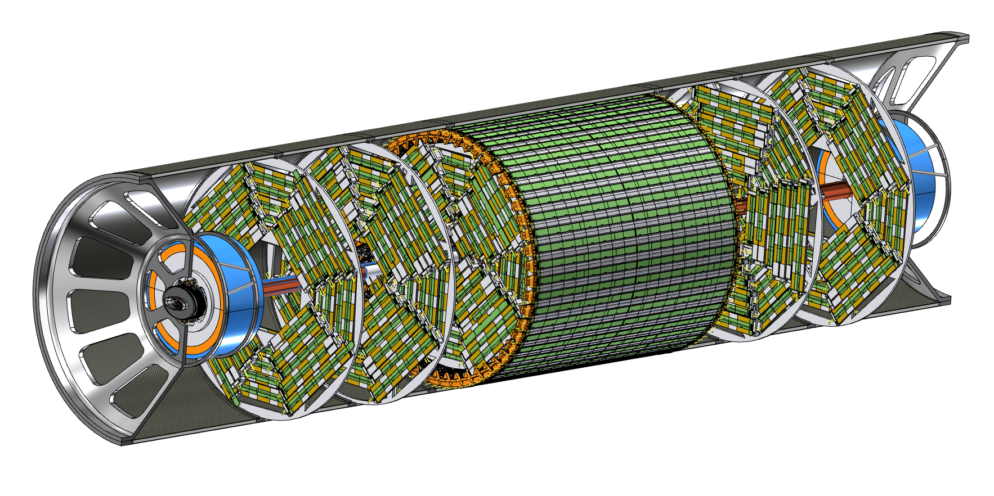

Slide 27
General integration

Slide 28
Conclusions
A first layout of the interaction region with LumiCal, vertex and outer tracker of the IDEA detector is being engineered
  Feasibility studies of integration successfully done including mounting sequence
Next steps:
  Vertex detector
    Study the routing of the services (readout and power cables)
    Dimensioning the air cooling system
  Outer Tracker
    Study the routing of the services (readout and power cables, cooling manifolds)
  Lumical
    Engineering and assembly
  Tracker support tube
    Study the anchoring to the detector
  Insert the layout in the GEANT simulation ongoing

Slide 29
Thank you for your attention

Slide 30
Backup

Slide 31
Half-ladder layout – layer 1
96.5 mm
Chip 1
Chip 2
Chip 1
Chip 2
Chip 1
Chip 2
8.4 mm
0.2 mm
0.1 mm
z=0
Layer 1 ladders are placed at 13.7 mm radius

Slide 32
Half-ladder layout – layer 2
160.9 mm
8.4 mm
Chip 1
Chip 2
Chip 1
Chip 2
Chip 1
Chip 2
Chip 1
Chip 2
Chip 1
Chip 2
8.4 mm
0.1 mm
0.2 mm
z=0
Layer 2 ladders are placed at 22.7 mm radius

Slide 33
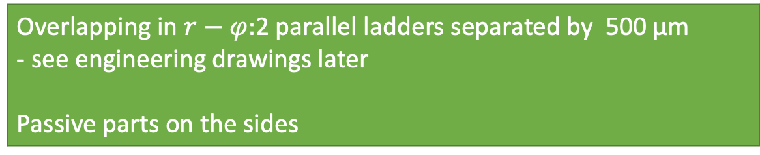
Half ladder layout – layer 3
257.5 mm
Chip 1
Chip 2
Chip 1
Chip 2
Chip 1
Chip 2
Chip 1
Chip 2
Chip 1
Chip 2
Chip 1
Chip 2
Chip 1
Chip 2
Chip 1
Chip 2
16.3 mm
Chip 1
Chip 2
Chip 1
Chip 2
Chip 1
Chip 2
Chip 1
Chip 2
Chip 1
Chip 2
Chip 1
Chip 2
Chip 1
Chip 2
Chip 1
Chip 2
0.2 mm
0.2 mm
0.2 mm
0.2 mm
0.2 mm
0.2 mm
0.2 mm
0.2 mm
z=0
z=0
z=0
Overlapping in $r−φ:$2 parallel ladders separated by 500 µm
- see engineering drawings later
Passive parts on the sides
Layer 3 ladders are placed between 30.5 and 35.55 mm radius

Slide 34
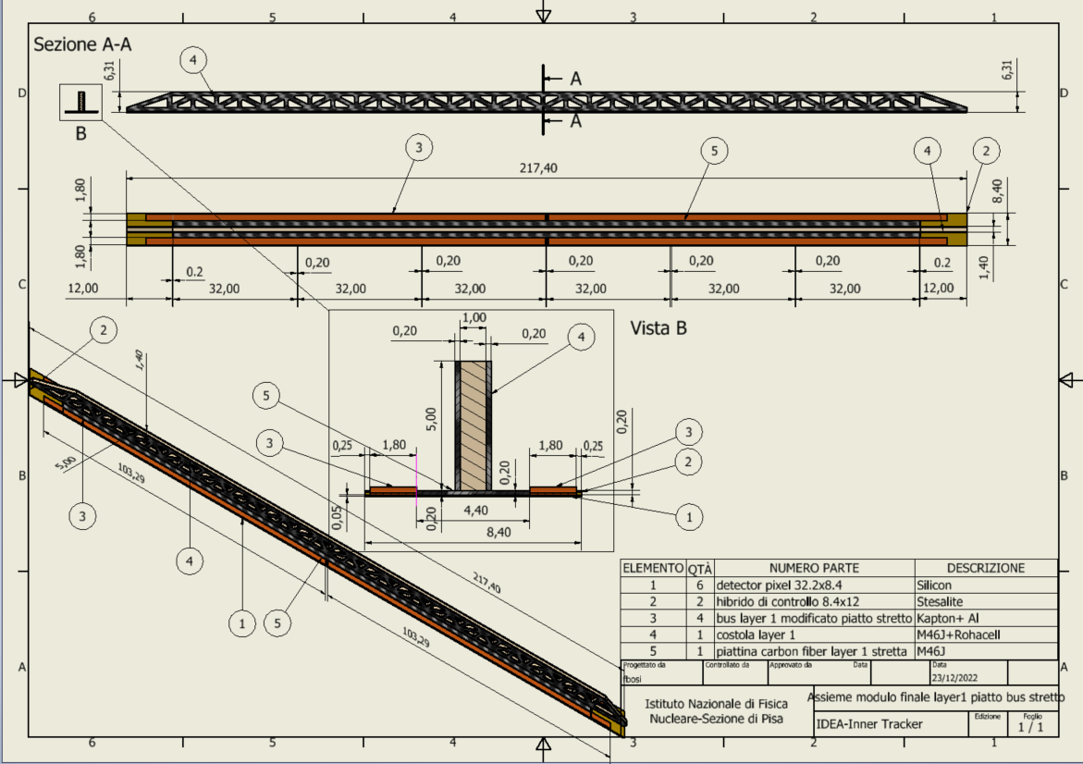
Layer 1 stave detail
Reticular lightweight support to provide stiffness
Thin carbon fiber walls interleaved with Rohacell
2 buses (data and power) 1.8 mm wide and 250 µm thick (50 µm Al, 200 µm kapton) per side
Sensors facing interaction point w/o any other material in front
Readout chips either sides
Air cooled

Slide 36
Vertex on the beam-pipe

Slide 37
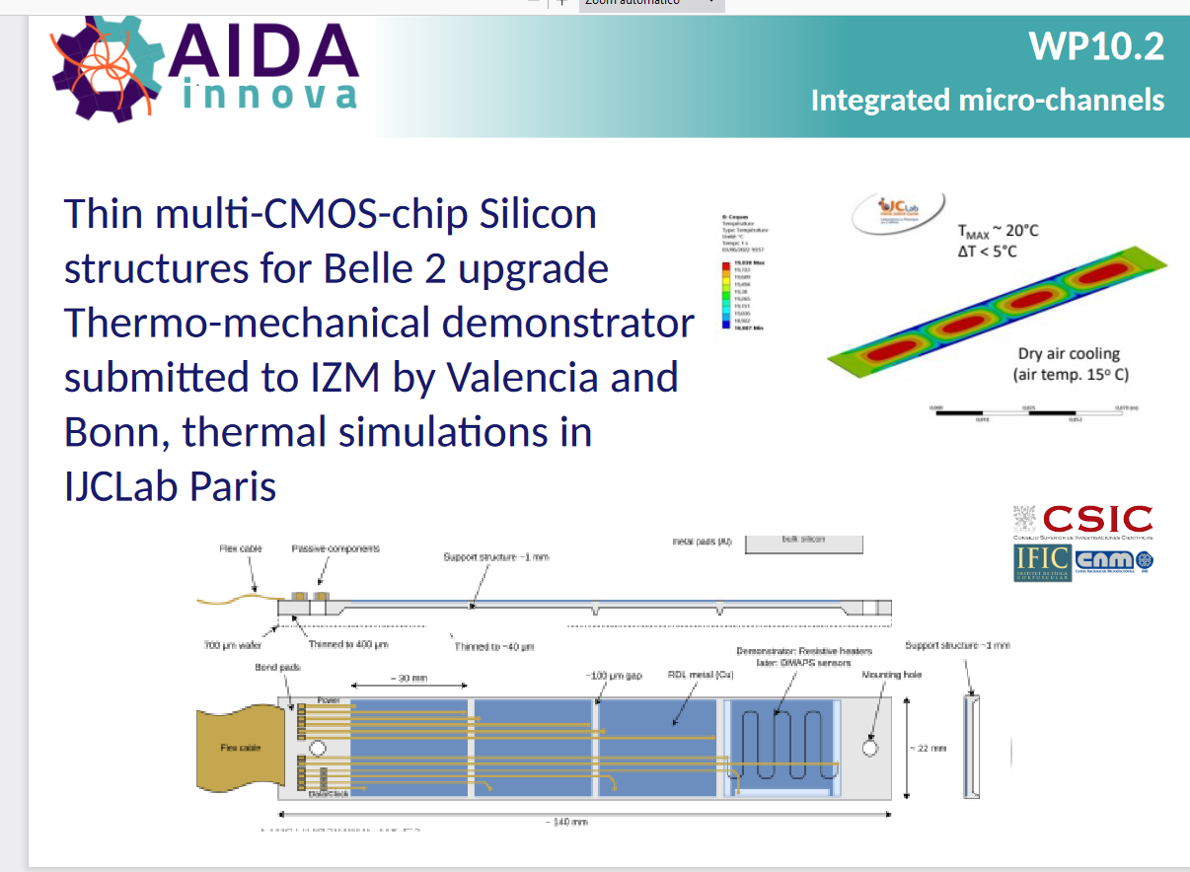
Air cooling for Belle-II upgrade

Slide 38
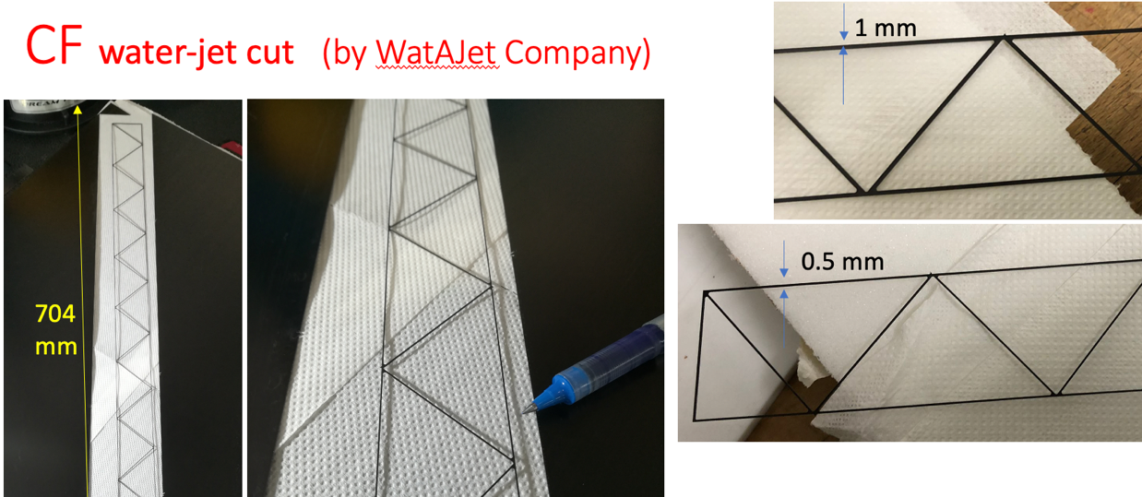
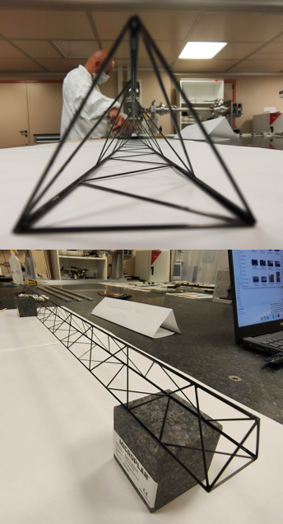
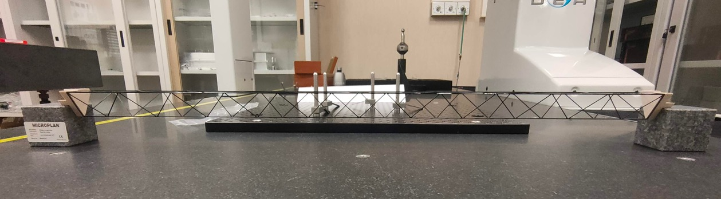
Similar structure of Belle-II oVTX L5

Slide 39
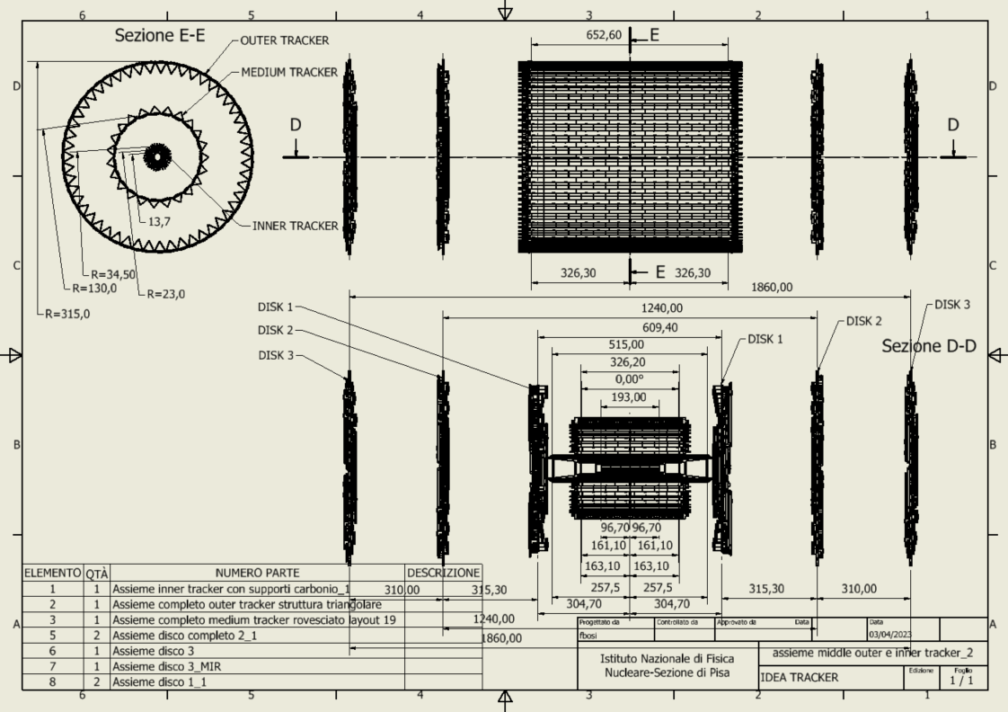
Overall layout

Slide 40
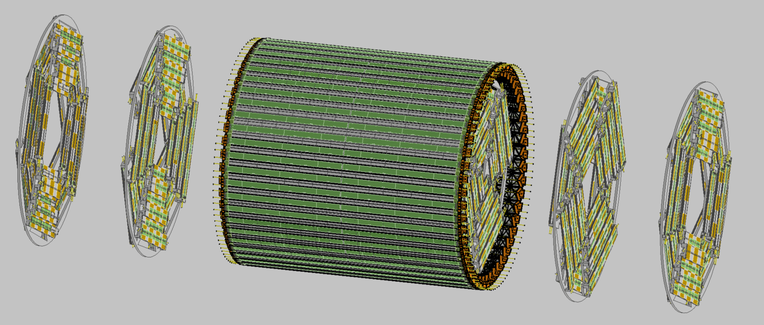

Slide 41
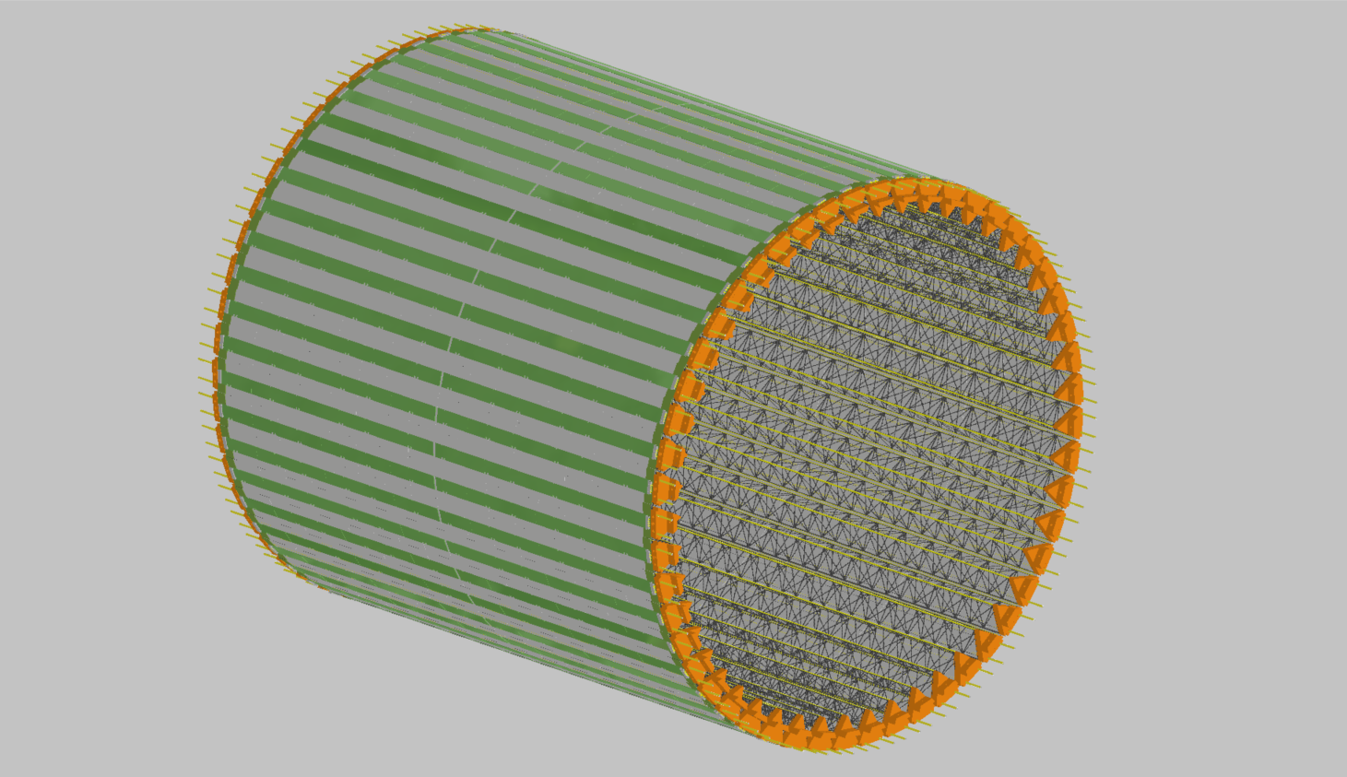
OUTER TRACKER

Slide 42
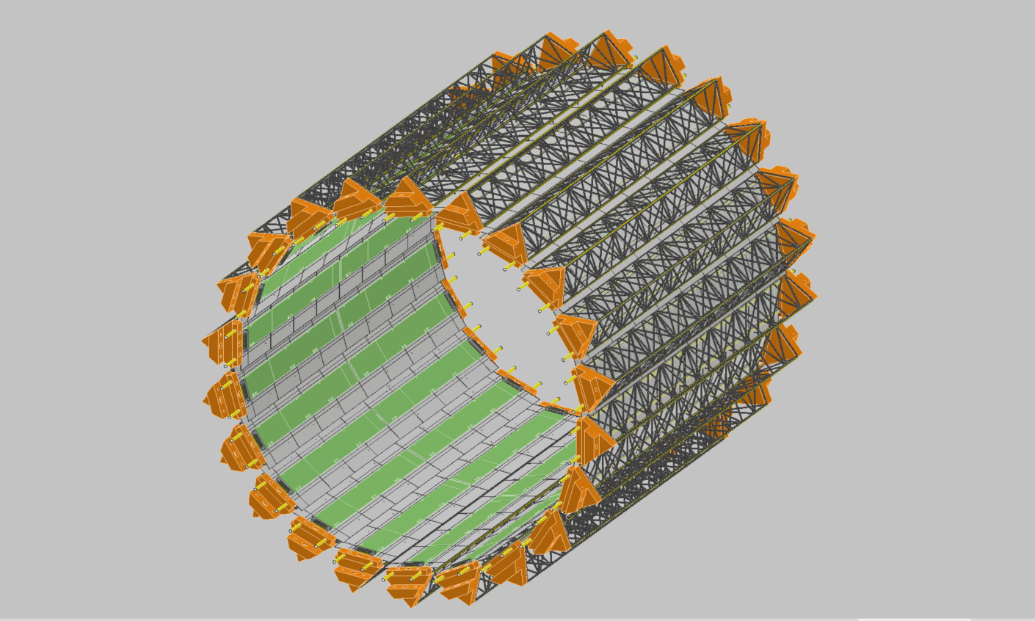
MEDIUM TRACKER

Slide 43
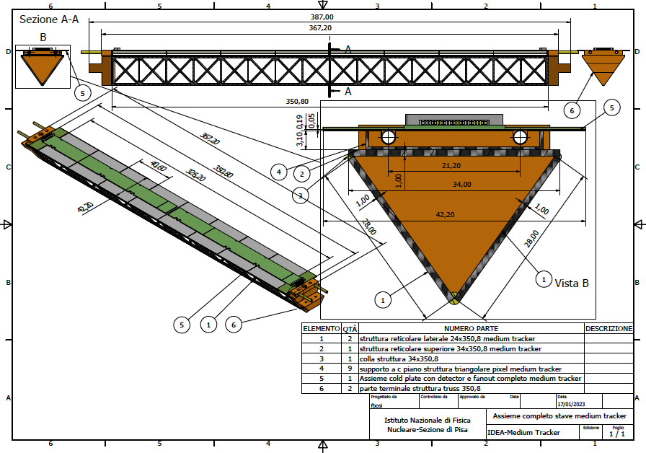

Stave detail

Slide 44

DISK 2

Slide 45

DISK 3

Slide 46



Typical disk module stave
Front
Upper modules
Electrical bus
Carbon fibre spacer
Cooling pipes
Lower modules
Carbon fibre pacers
Back

Slide 47

Support tube – Updated structural analysis
The aim of this analysis is to calculate the stress and displacement in each part of the cylinder (Al reinforcement, carbon fiber, honeycomb).
It is necessary to set:
Chamber | 50 kg
LumiCal | 70 kg + 70 kg
Disk | 52 kg
Outer tracker | 11
Medium tracker | 3
Including estimates of the services running from the detectors to the end of the support tube
Constraint configuration → double fixed ends
Loads configuration
Loads applied to remote point to distribute
Carbon fiber/ honeycomb creation → layered section

Slide 48


Loads configuration
Layered section

Slide 49



Support tube – Rail
SECTION
The support tube needs to be inserted into the main detector; the idea is to use a rail, starting from the outside of the detector to allow the sliding of the cylinder.
To assure a good precision and appropriate support it is necessary to use the linear bearings; different types are available, the choice has to be made considering:
Required positioning precision
Weight of the whole structure
Necessary degrees of freedom

Slide 50

Under study:
Rail support
Rail anchoring
Rails length
Geometry of the rail section
Linear bearing type
Positioning system
To continue the design, it is necessary to know:
Allowable anchoring point from detector side
Allowable space (internal detector diameter and geometry)

Slide 51


LumiCal – Support proposal
LumiCal are held by the two support tube endcaps.
A hexapod structure allows to limit the axial footprint.
Hexapod positioner has 6 DOF and high-precision positioning (μm).
Actuators could be manual or automatic for a remote positioning.
The adoption of this solution depends on many factor:
Active or passive alignment system
Detection positioning system
Actuator system (manual, pneumatic, piezoelectric, step-motor, etc.)
Anchoring system

Slide 52


Slide 53


Slide 54




Low impedance vacuum chamber
warm and cooled
Bellows
Transition
Inlet/outlet for paraffin cooling (copper)
Two halves AlBeMet pipe
  Inner radius 10 mm
  Outer radius 11.7 mm
Electron Beam Welding
Thick copper deposition
Geometry studied to integrate the central chamber with the vertex detector
Starting from 90 mm to 1190 mm from IP
The cooling is based on an asymmetric solution, using the 50 mrad cone as the cutting profile, to assure the respect of the spatial constraint due to the LumiCal requirement.
Material | thickness
AlBeMet162 (62% Be and 38% Al alloy) | 0.35 mm
Paraffin (coolant) | 1 mm
AlBeMet162 | 0.35 mm
Au | 5 μm
To reduce the cooling material, the design provides five channels for each side; in this way is possible to use the needed quantity of coolant and reduce the material, creating a light structure.
Notes:
central chamber we are working at the moment

