Slide 1
22-04 Lubricant irradiation for HL-LHC jacks
Dominika Senajova, Sonia Allegretti
08/12/2022

Slide 2
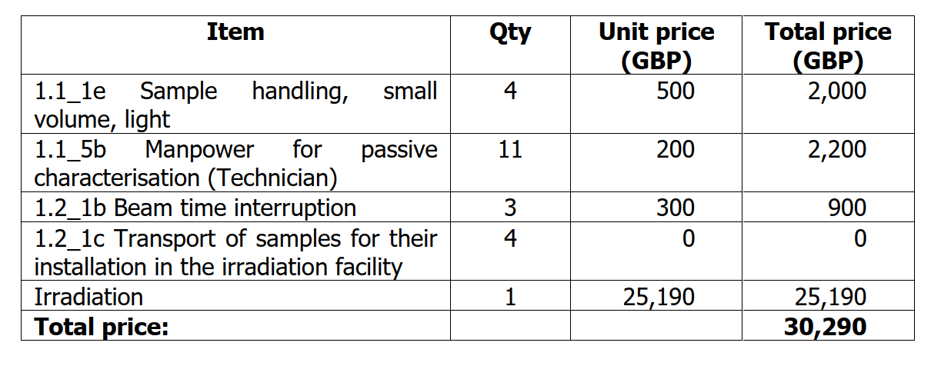
Irradiation campaign status
  Gamma-ray irradiation at STERIS in DE:
    11 types of lubricants from 4 suppliers : Moresco, Lubrilog, DuPont (Molykote) and Shell
    Irradiation up to 10MGy (4 dose points: 1, 2, 5 and 10 MGy). Dose rate 5kG/h
  Quote
    Budget: 30,290 GBP ( possible shipping fees of 1400 GBP). Duration 3-6 months.
    Missing 1 product from Lubrilog (to be delivered by mid-end of February). Shipping containers available.
    DAI can be launched already (we’ll ask for a new quote in case the lubricant is late)

Slide 3
Testing plan and schedule
Planned tests
Friction coefficient under high load to check whether the grease is still a good lubricant
  + Friction after prolongated static period
Infrared spectroscopy to detect potential molecular changes
  + Oxidation resistance study
Total acid number to limit the risk of corrosion
Cone penetration (aka consistency) to check whether the grease will stay in place
Rheological measurements to assess how grease reacts to stress
Tests integrated in the scope of Dominika’s PhD: 6-12 months of testing foreseen, depending on the method and access to instruments
More precise planning in 2-3 weeks

