Slide 1
HL-LHC Jack
Batch#1 - Jack tests Results
Mateusz Sosin / Michel Noir
BE-GM-HPA
18/01/2023

Slide 2
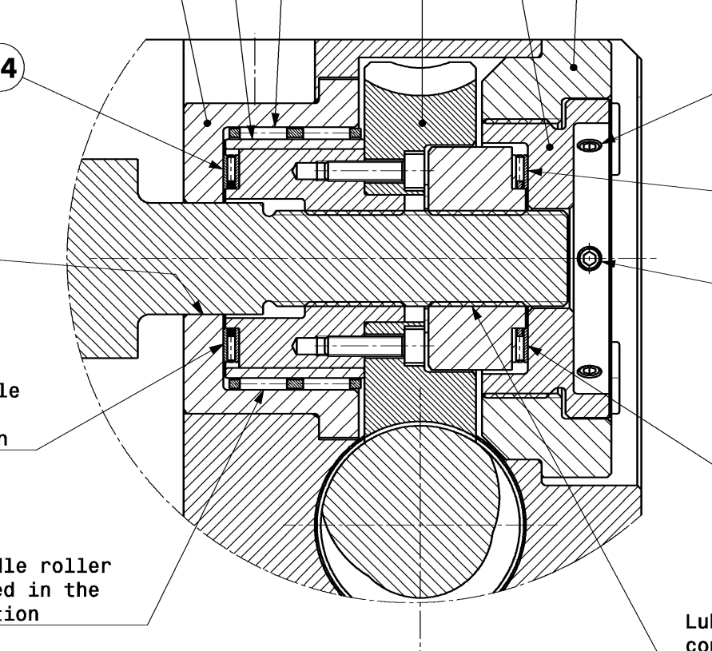
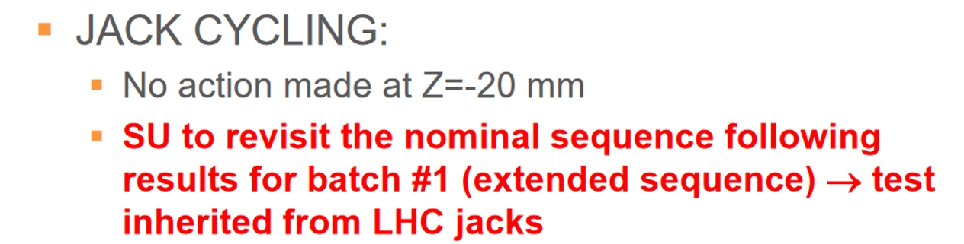
Cycling test
Following tests:
Assembly procedure (tightening) adjusted following CERN jack feedback + tests at Unior
Is cycling necessary for batch #2 ? Current : 100% sampling / reduced load (25kN)

Slide 3
Cycling test

Slide 4
Cycling test
Following tests:
SU position is to do 5 cycles at 25kN for Batch#2
  Initial Wear-in
  Good distribution of the grease
  Avoid damage of thread.

Slide 5
RAM Backlash → Radial Free play
Following tests:
Measurements performed on top nut and push-pull ring → to be kept ?
Acceptable value to be defined
Sampling for batch 2 : 100%

Slide 6
RAM Backlash → Radial Free play

Slide 7
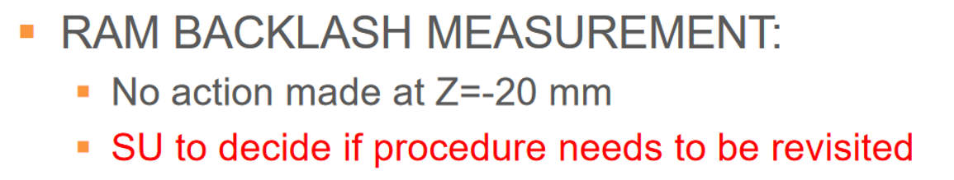
RAM Backlash → Radial Free play
Following tests:
Specification initial value is 20µm → not fully reached by Batch#1
This value might need to be revised regarding to safety (uncontrolled magnet position after quench)
Proposal to set parameter of axial free play of 50µm at top ball bearing interface (in Z+20mm configuration).
CERN prototype version test made at 500KG …

Slide 8
Gear Backlash
Following tests:
Acceptable value to be defined – maxi recording 21µm (85°)
Discussion about ring angular backlash – modification necessary ?
Sampling for batch 2 : 100%

Slide 9
Gear Backlash - Nominal

Slide 10
Gear Backlash – If ring angular backlash is supressed

Slide 11
Gear Backlash
Acceptable value to be defined :
  Basing on the tolerance of the worm gear manufacturer, backlash shall be maxi 6°
  Measurement maximal value is 85° (CERN prototype was 10° (with detectable motion of 2µm))
  SU proposes the following budget:
    Acceptable value corresponds to 5 µm (20°)
    An additional margin of 2µm is inherent of the test (motion detection – 8°)
      → Maximal acceptable value shall be 28° → Acceptance criterion : 30°
Discussion about ring angular backlash – modification necessary ?
Sampling for batch 2 : 100%
21µm (85°) of the backlash might indicate that tolerances are not fulfilled or issues in assembly procedure exists.

Slide 12
Actuation torque under 110% load

Slide 13
Actuation torque under 110% load

Slide 14
Actuation torque under 110% load
Following tests:
High disparity of torques - Expected torque computed by Tuukka was 9.3 N.m
Admissible value for input torque ?
Is structural gear integrity warranted ?

Slide 15
Resolution test
Y direction : 1µm displacement is possible in all configurations
Z direction:
Resolution for +Z actuation:
 |  | +Z Actuation Resolution [µm]
Y Position [mm] | Z Position [mm] | CERN - Z20 | SN01 - Z20 | SN02 - Z20 | SN03 - Z20
-7.3 | 20 |  | 28 | 32 | 16
0 | 20 | 16 | 22 | 32 | 18
7.3 | 20 | 20 | 30 | 37 | 18
-7.3 | 0 |  | 18 | 32 | 23
0 | 0 | 16 | 18 | 30 | 20
7.3 | 0 | 20 | 32 | 22 | 26
Resolution for -Z actuation:
 |  | Resolution [µm]
Y Position | Z Position | CERN - Z20 | SN01 - Z20 | SN02 - Z20 | SN03 - Z20
-7.3 | 20 |  | 8 | 8 | 6
0 | 20 | 4 | 4 | 10 | 6
7.3 | 20 | 4 | 4 | 8 | 6
-7.3 | 0 |  | 4 | 8 | 6
0 | 0 | 4 | 4 | 10 | 6
7.3 | 0 | 4 | 4 | 10 | 6

Slide 16
AoB
Remarks of Unior on all jacks that tightening of POS 30 (7.5N.m) has an important impact on actuation torque
Assembly procedure for the pre-stress nut has been modified during tests to try to decrease wormgear backlash

