Slide 1

HL-LHC motorized jacks
Progress meeting #25
Jaime Pérez Espinós
HL-LHC progress meeting – 19/01/23

Slide 2
Last news and sequence of actions
06/12/22: acceptance tests of batch #1 finalized → first report delivered by M. Noir;
08/12/22: discussion on acceptance tests of batch #1 during the HL-LHC jacks progess meeting #24 Jacks (see minutes) → some values out of requirement → decision to have an ad-hoc meeting to define strategy wrt NCs;
12/12/22: ad-hoc meeting for NCs → following decisions are taken:
  NCR will be written with corresponding investigation of root causes and an action plan to solve the corresponding NCs and prevent future ones;
  UNIOR will be informed that the OK for the manufacturing of batch #2 is postponed until some investigations are finished (hopefully by end-January ‘23);
  The project accepts a delay on the supply of batch #2 according to the time cumulated for the reply to UNIOR;
16/12/22: meeting with UNIOR to inform about decisions, next steps and their agreement to strategy → OK given by UNIOR;
19/12/22:
  submission for approval of NCR LHC-HQHL-QN-0001 v.0.1 "NCR - Deviations found during Site Acceptance Test of Batch #1” (EDMS #;
  Start of acceptance tests after re-assembly process of jack #1;
18/01/23: finalization and report of acceptance and semi-functional tests following dismounting and re-assembly of jack #1 delivered by UNIOR → presentation and discussion on them is the main topic for today’s meeting

Slide 3
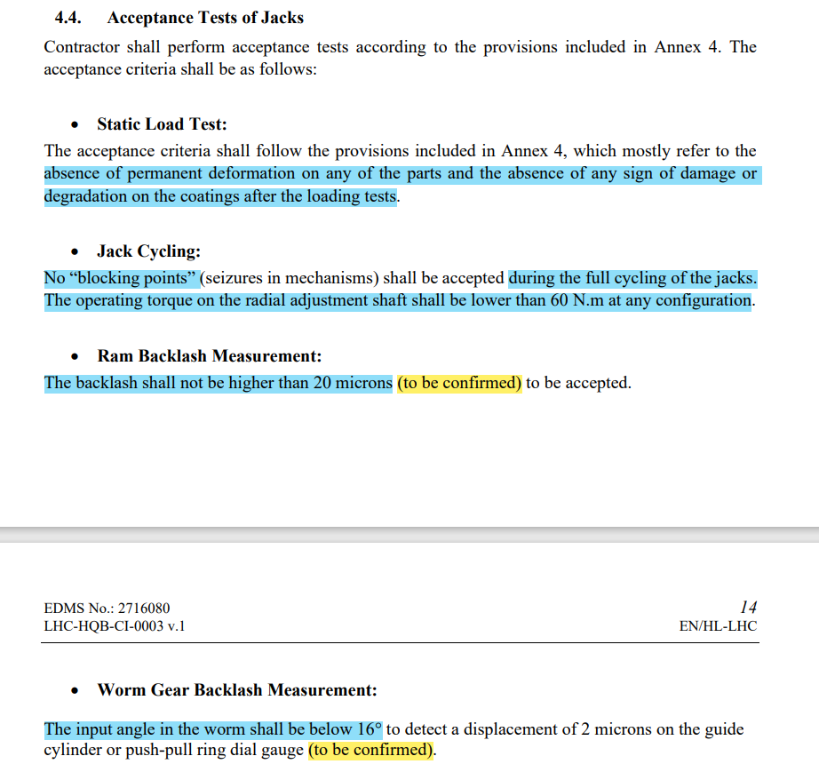
OK
OK
CERN: action to propose new acceptance criterion for batch #2
UNIOR: written agreement of acceptance criterion for batch #2
Measurement methodology and acceptance criterion are to be confirmed → CANNOT BE USED TO REJECT THE JACKS OF BATCH #1
CERN: action to clarify measurement methodology and acceptance criterion (compatible with clearance level between ram and guide cylinder) for batch #2; removal of TBC from tech. spec.
UNIOR: written agreement of acceptance criterion for batch #2
Acceptance criterion is to be confirmed → CANNOT BE USED TO REJECT THE JACKS OF BATCH #1
CERN: action to clarify acceptance criterion for batch #2; removal of TBC from tech. spec.; clarification of assembly procedure or explicit reference to assembly procedure from worm-gear supplier
UNIOR: written agreement of acceptance criterion for batch #2; assembly process definition and pre-test (TBC)

Slide 4
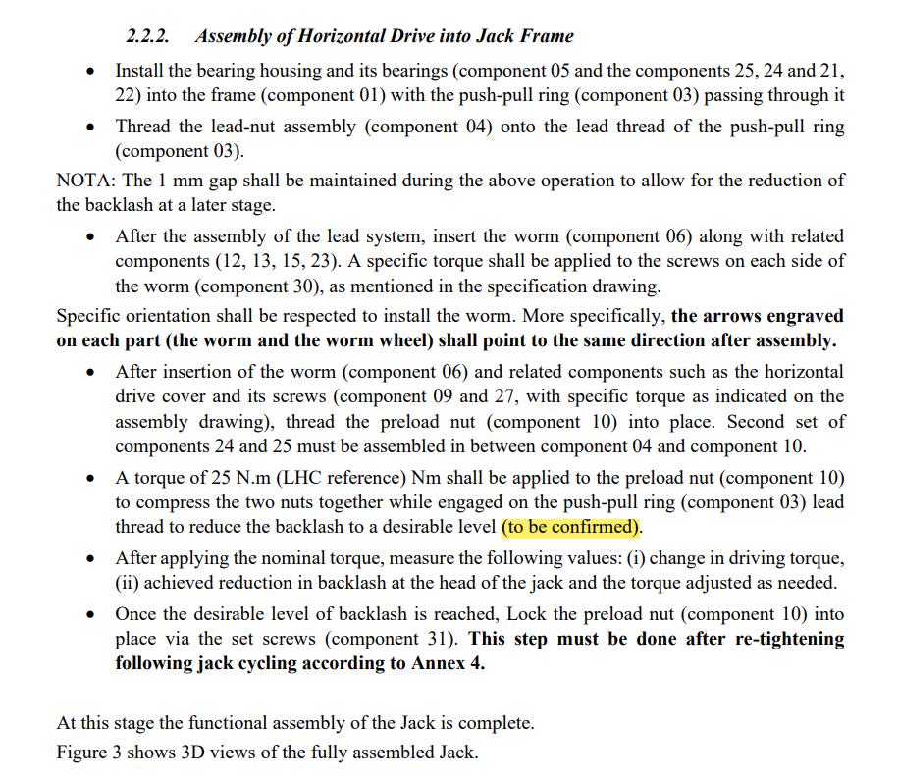
How to clarify better? Inputs to be given by Tuukka (from design point of view), Simon and Patrick (from assembly experience)

Slide 5
All TBCs must be removed from the tech. spec.

Slide 6
Central jack

Slide 7
Actions

Slide 8
Actions linked to lubrication
Provide you with technical documentation on Moresco grease (Dominika) DONE
  Ask different suppliers about suitability of Moresco solution, and about the most adapted consistency, RG-42R-1 or RG-42R-2 (Tuukka) DONE
Organize a meeting with Tukka/Simon to decide on the Moresco consistency (Dominika) -> if no essential difference is observed or doubts remain, then RG-42R-1 is the reference DONE
  Provide Matteo/Dominika with reference of grease used on closed constructions of jack bearings and components. If available, provide also recommendations from suppliers for open construction (Tuukka) DONE
Provide Simon with 100g of either grease (Dominika) DONE → TYPE RG-42R-2
Ask Moresco for free samples of RG-42R-1, RG-42R-2 and GK-1 or 2. If needed, ask for a quote (Matteo) DONE
Ask Lubrilog for suitable products, ask for free samples, or ask for a quote if needed (Dominika) DONE
Draft an irradiation test specification (Matteo) MOSTLY DONE BUT details concerning containers and greases not yet receptioned are still to be integrated
Buy G Rapid paste, 2nd paste + Molykote BR2 Plus if Mateusz wants to collaborate (Jaime? Mateusz? Dominika? – Expected cost < 350 CHF, we can take care of this if you give us a budget code) DONE
  Confirm 2nd paste option (Jaime) DONE (no 2nd paste is finally chosen as chemical composition of proposals is not well adapted)
Finalise the test specification document (Jaime + R2M + Mateusz?) TO BE STARTED ONCE THE DRAFT FOR THE IRRADIATION TEST SPEC. IS COMPLETE
Ask for quote for irradiation test (Matteo) DONE (one quotation is already received and used as reference for cost estimation)
Agree on cost split (Jaime + STI + Mateusz?) DONE
  Depending on need, type and number of tests on Molykote BR2 Plus, PETAMO GHY 133 N, MORESCO RG-42R-1 and/or -2 DONE
Prepare samples (R2M) NOT STARTED
- The technical specification for the irradiation of greases for the HL-LHC jacks is finished except for the details concerning the containers.
- The project is “blocked” due to difficulties with the procurement of the sample containers. The resolution of the problem is ongoing. → CONTAINERS AND REMAINING GREASES (ORGANISED THROUGH R2M) TO ARRIVE AT CERN BY MID-NOVEMBER

Slide 9
Thank you for your attention

