Slide 1
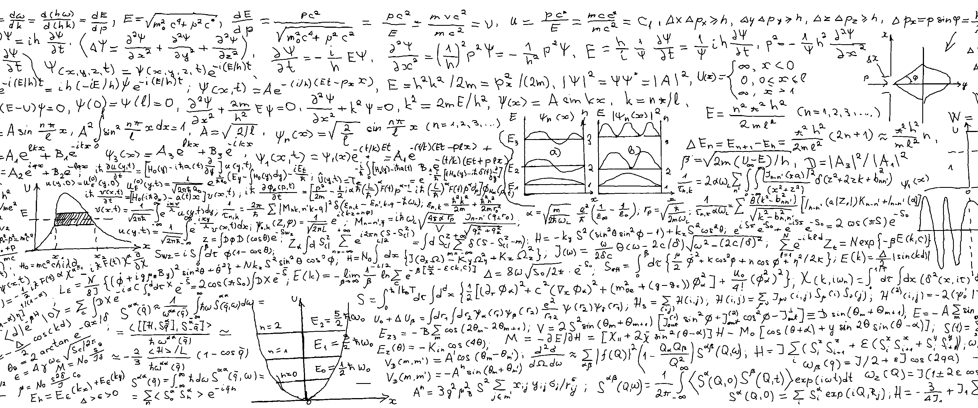





Track reconstruction with a quantum algorithm
Davide Nicotra
Notes:
- Reduce the text to 1/2

Slide 2
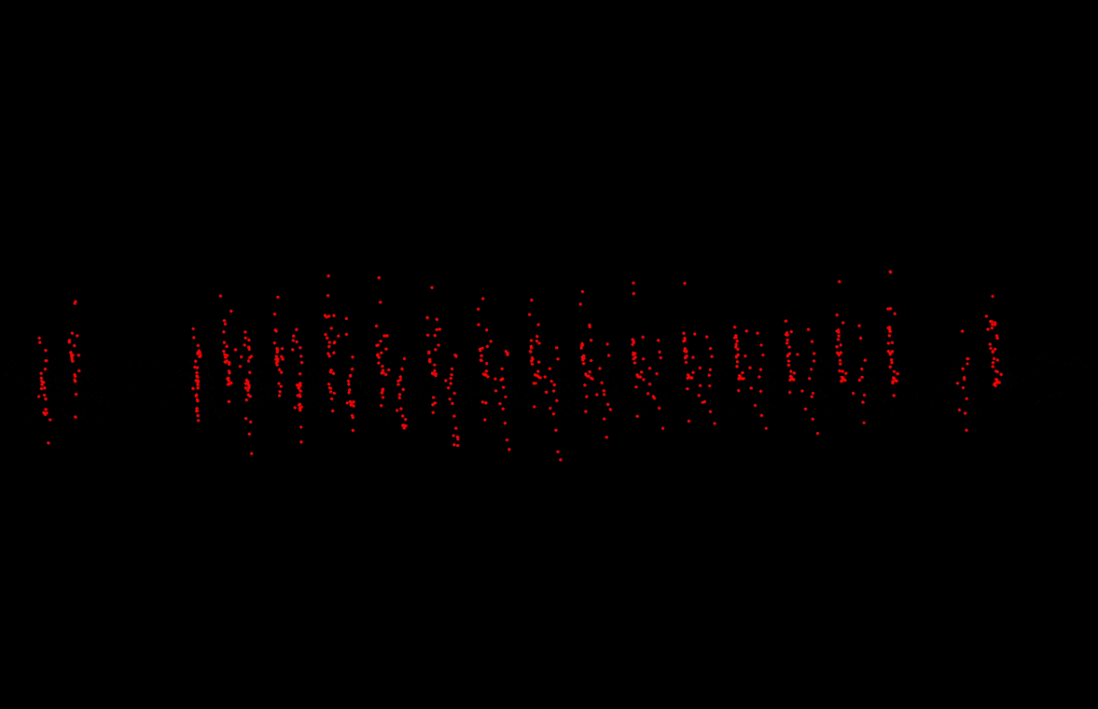
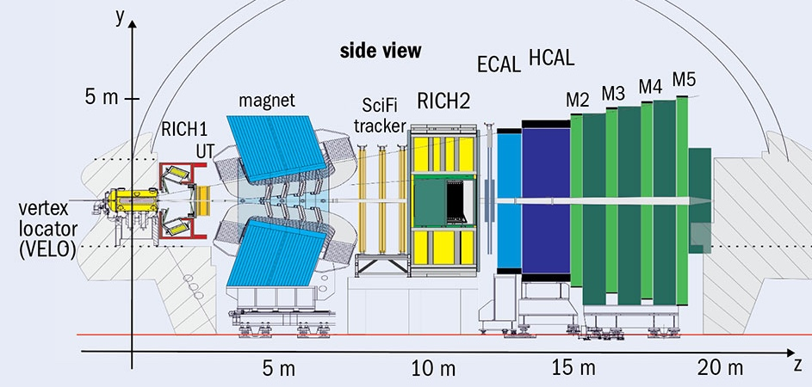

Connecting dots in the LHCb VELO
Charged particles leave hits in the VELO.
Reconstruction of the tracks crucial step of the LHCb pipeline.
The most computationally expensive algorithm at trigger level.
Here
Notes:
Make picture bottom larger
Straight tracks only say it
Animation larger (full page)
Say it quick

Slide 3
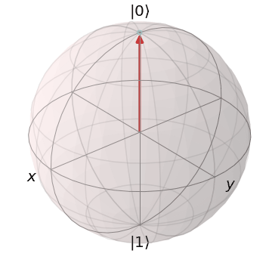

Quantum Computing
Using a system of qubits to perform calculations
A replacement for CPUs and GPUs
The ultimate parallel computing tool (entanglement)
Speed-up for any algorithm
$$\left|ψ\right\rangle =α\left|0\right\rangle +β|1⟩$$
$$\left|ψ\right\rangle =α\left|00\right\rangle +β\left|01\right\rangle +γ\left|10\right\rangle +δ|11⟩$$
$$…$$
$$n−qubits→2^{n}$$
Notes:
This would require 2/3 slides
We want to rewrite tracking in such a way it is “compatible” with quantum computing
Skip intro di QC
Maybe put it to the slides
Skip pros cons

Slide 4
Quantum Computing
Using a system of qubits to perform calculations
A replacement for CPUs and GPUs
The ultimate parallel computing tool (entanglement)
Speed-up for any algorithm
$$\left|ψ\right\rangle =α\left|0\right\rangle +β|1⟩$$
$$\left|ψ\right\rangle =α\left|00\right\rangle +β\left|01\right\rangle +γ\left|10\right\rangle +δ|11⟩$$
$$…$$
$$n−qubits→2^{n}$$
Notes:
This would require 2/3 slides
We want to rewrite tracking in such a way it is “compatible” with quantum computing
Skip intro di QC
Maybe put it to the slides
Skip pros cons

Slide 5
Quantum Computing
Using a system of qubits to perform calculations
A replacement for CPUs and GPUs
The ultimate parallel computing tool (entanglement)
Speed-up for any algorithm
$$\left|ψ\right\rangle =α\left|0\right\rangle +β|1⟩$$
$$\left|ψ\right\rangle =α\left|00\right\rangle +β\left|01\right\rangle +γ\left|10\right\rangle +δ|11⟩$$
$$…$$
$$n−qubits→2^{n}$$
Notes:
This would require 2/3 slides
We want to rewrite tracking in such a way it is “compatible” with quantum computing
Skip intro di QC
Maybe put it to the slides
Skip pros cons

Slide 6
Quantum Computing
Using a system of qubits to perform calculations
A replacement for CPUs and GPUs
The ultimate parallel computing tool (entanglement)
Speed-up for any algorithm
$$\left|ψ\right\rangle =α\left|0\right\rangle +β|1⟩$$
$$\left|ψ\right\rangle =α\left|00\right\rangle +β\left|01\right\rangle +γ\left|10\right\rangle +δ|11⟩$$
$$…$$
$$n−qubits→2^{n}$$
Notes:
This would require 2/3 slides
We want to rewrite tracking in such a way it is “compatible” with quantum computing
Skip intro di QC
Maybe put it to the slides
Skip pros cons

Slide 7
Quantum Computing
Using a system of qubits to perform calculations
A highly specific tool to solve certain kind of problems (hopefully) with a speed-up
$$\left|ψ\right\rangle =α\left|0\right\rangle +β|1⟩$$
$$\left|ψ\right\rangle =α\left|00\right\rangle +β\left|01\right\rangle +γ\left|10\right\rangle +δ|11⟩$$
$$…$$
$$n−qubits→2^{n}$$
Notes:
This would require 2/3 slides
We want to rewrite tracking in such a way it is “compatible” with quantum computing
Skip intro di QC
Maybe put it to the slides
Skip pros cons

Slide 8


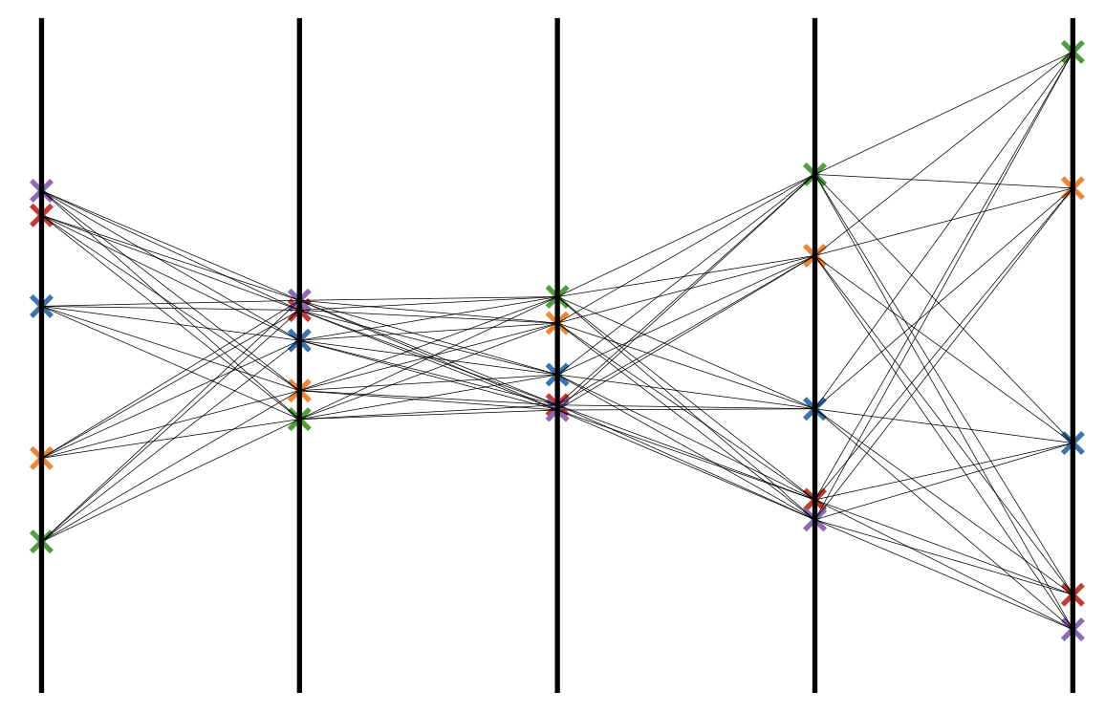
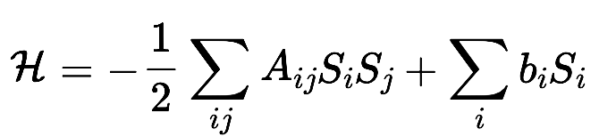

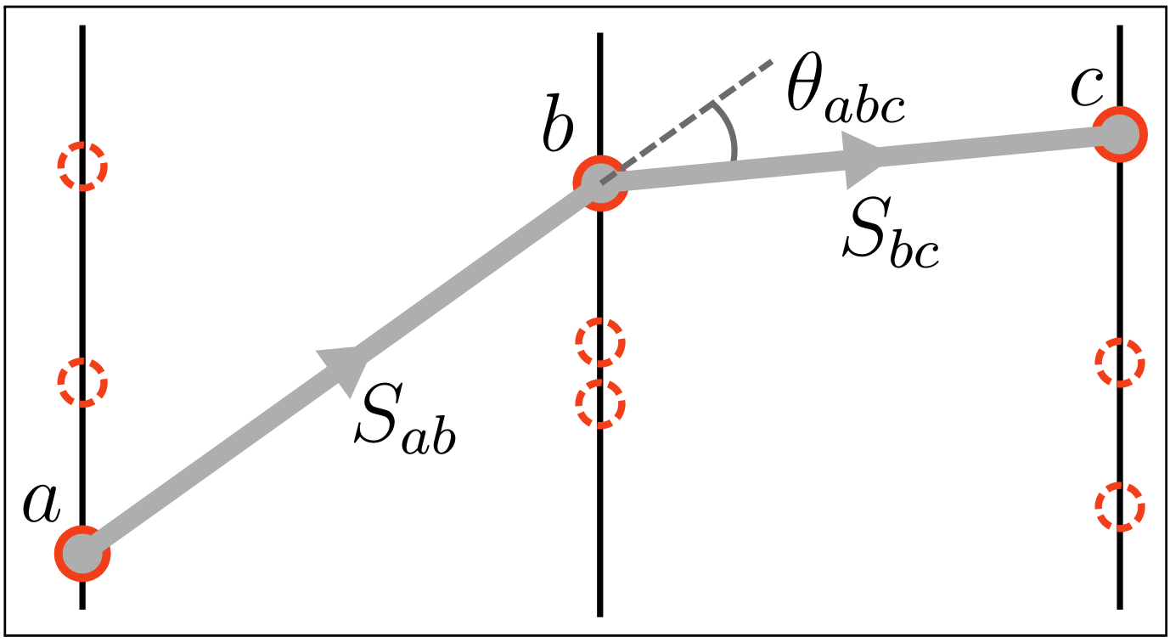



A quantum algorithm for tracking
From Hits to an Ising-like Hamiltonian
$$S_{j}$$
Inspired by Denby-Peterson^{[1]} model
Candidate doublets constructed
$N=(\#Layers−1) × \#Particles^{2}$
$$S_{i}$$
M
A
T
H
Notes:
Picture larger, less text
Formula bigger
- Add the formula for number of doublts here

Slide 9
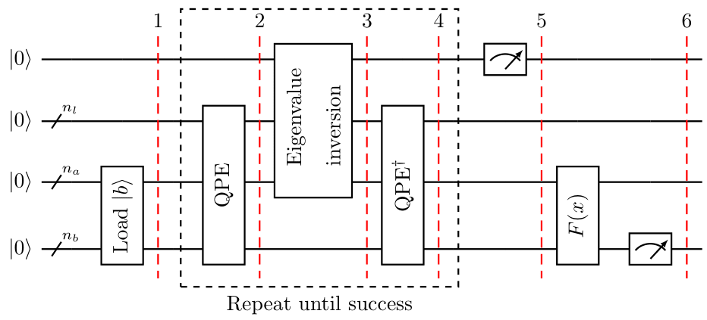

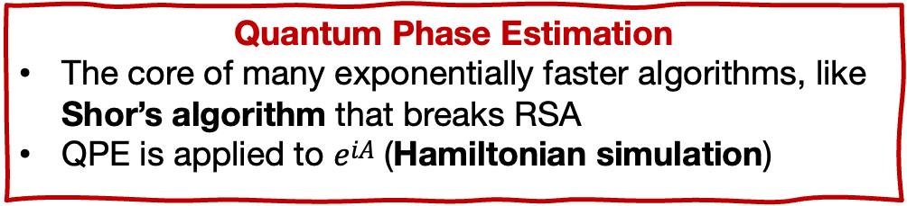
A quantum algorithm for tracking
Quantum Algorithm for Systems of Linear Equations
Also called Harrow-Hassadim-Lloyd (HHL) algorithm
  State preparation (loading $|b⟩$)
  Quantum Phase Estimation
  Inversion
  Quantum Phase Estimation$^{†}$
  Measurement
Under certain conditions
  Classical $O\left(N\right)$
  Quantum $O\left(\log{N}\right)$
Exponential speed-up!
Quantum Phase Estimation
The core of many exponentially faster algorithms, like Shor’s algorithm that breaks RSA
QPE is applied to $e^{iA}$ (Hamiltonian simulation)
Notes:
Reduce QPE explaination

Slide 10
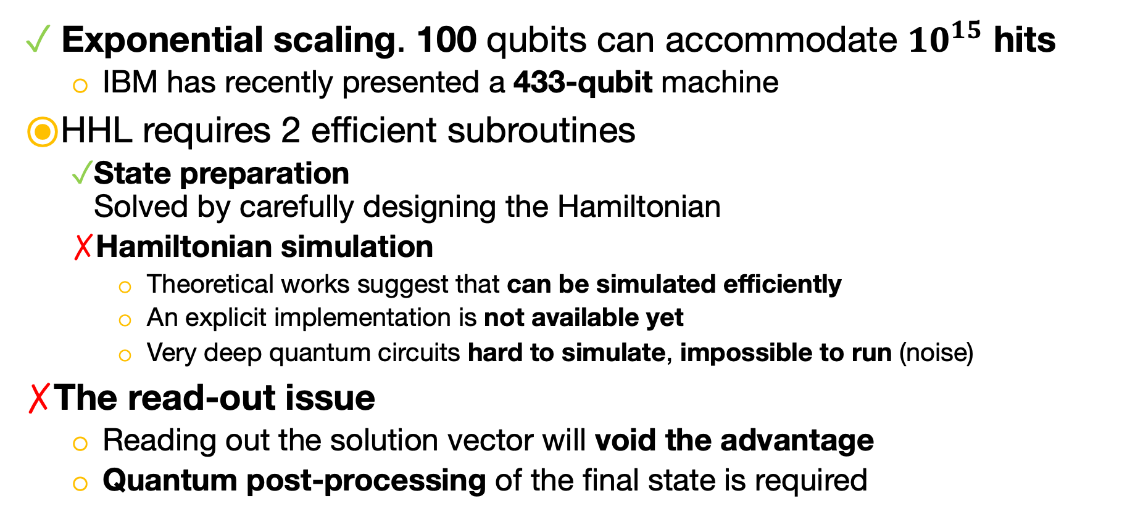
Pros and Cons of HHL
Exponential scaling. 100 qubits can accommodate ${10}^{15}$ hits
  IBM has recently presented a 433-qubit machine
HHL requires 2 efficient subroutines
  State preparation
  Solved by carefully designing the Hamiltonian
  Hamiltonian simulation
    Theoretical works suggest that can be simulated efficiently
    An explicit implementation is not available yet
    Very deep quantum circuits hard to simulate, impossible to run (noise)
The read-out issue
  Reading out the solution vector will void the advantage
  Quantum post-processing of the final state is required
Notes:
Mention the limit of circuit depth + coherence time
Stick to the point!!

Slide 11
Does it work?

Slide 12
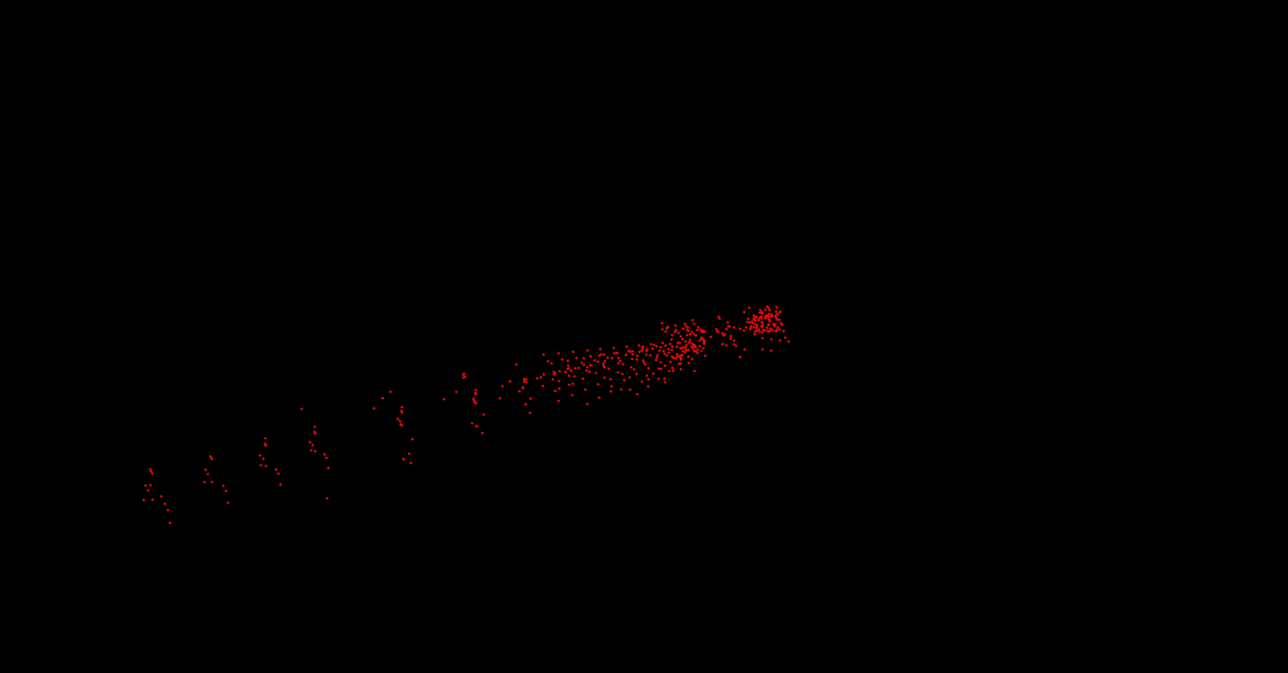

Animation
LHCb Simulated Event
1 collision event
Half of the VELO
$$B_{s}→φφ$$
To validate our new Hamiltonian approach, HHL has been replaced with a classical linear solver
LHCb events on quantum simulator/hardware is not possible yet.
  Circuit too deep
  Hardware too noisy
Notes:
Say that we have 1 collision event

Slide 13

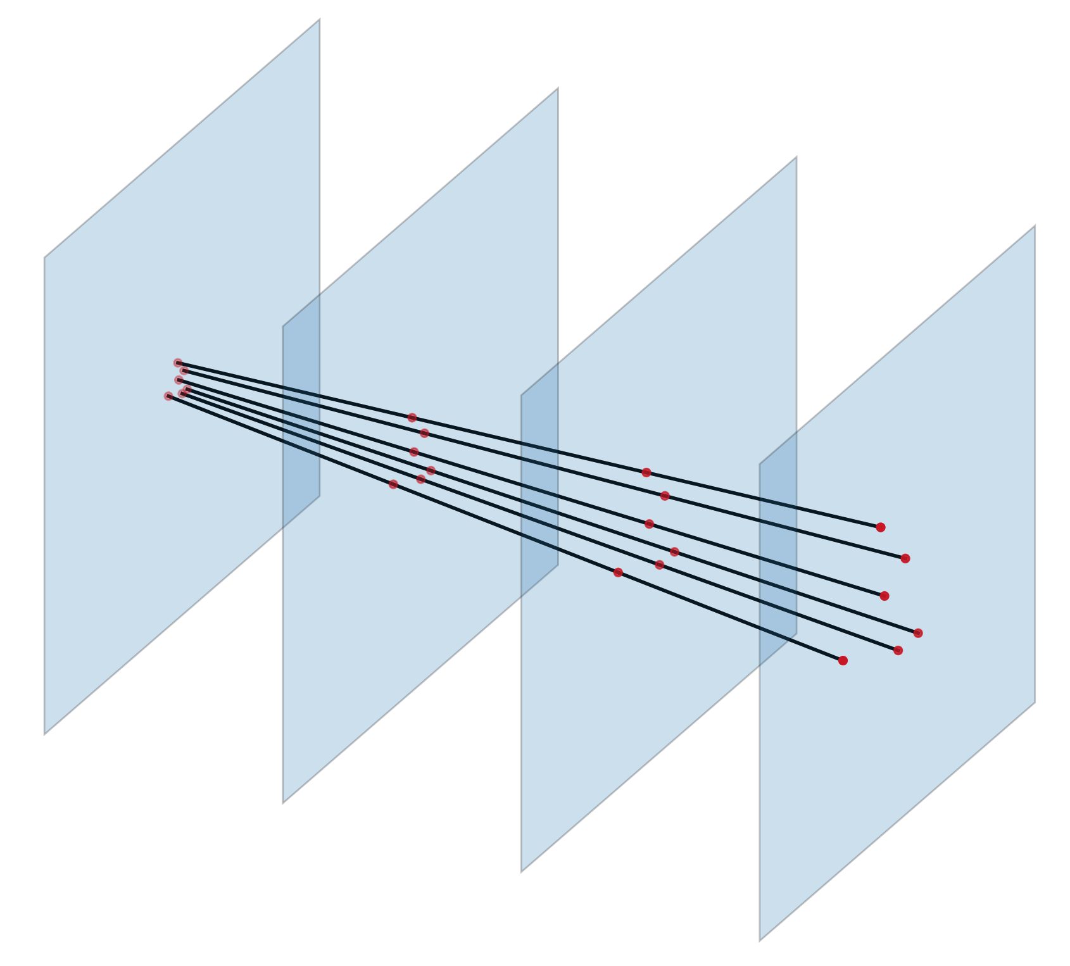
Tracking performances
6 particles – 4 layers detector
quantum simulation
Test the HHL algorithm
Smaller events with quantum simulator
Validate the Hamiltonian
LHCb simulated events with a classical solver
Took 2 days to complete
Notes:
2 main messages
- We cannot test on actual event because too big
we tested smaller event on simulators and it works
Hardwere testing is not possible because of Hamiltonian simulations
Thicker points and lines
Remove first 2 bullets say it in previous slide. Simply say that on hardware is not possible yet.
Put a huge circuit in backup
Make point 2 very clear

Slide 14
Thank you
Questions?

Slide 15
Conclusions
New track reco algorithm based on Ising-like Hamiltonian
  Tested and validated classically on LHCb simulated events
  Good performance!
First track reco algorithm based on the HHL quantum algorithm
  Tested on smaller events
Still many open challenges
  Efficient Hamiltonian simulation
  Quantum Post-processing
  Hardware implementation
A paper draft on these results will be ready soon… stay tuned!
Notes:
Split the results on classical and the actual quantum implementation

Slide 16
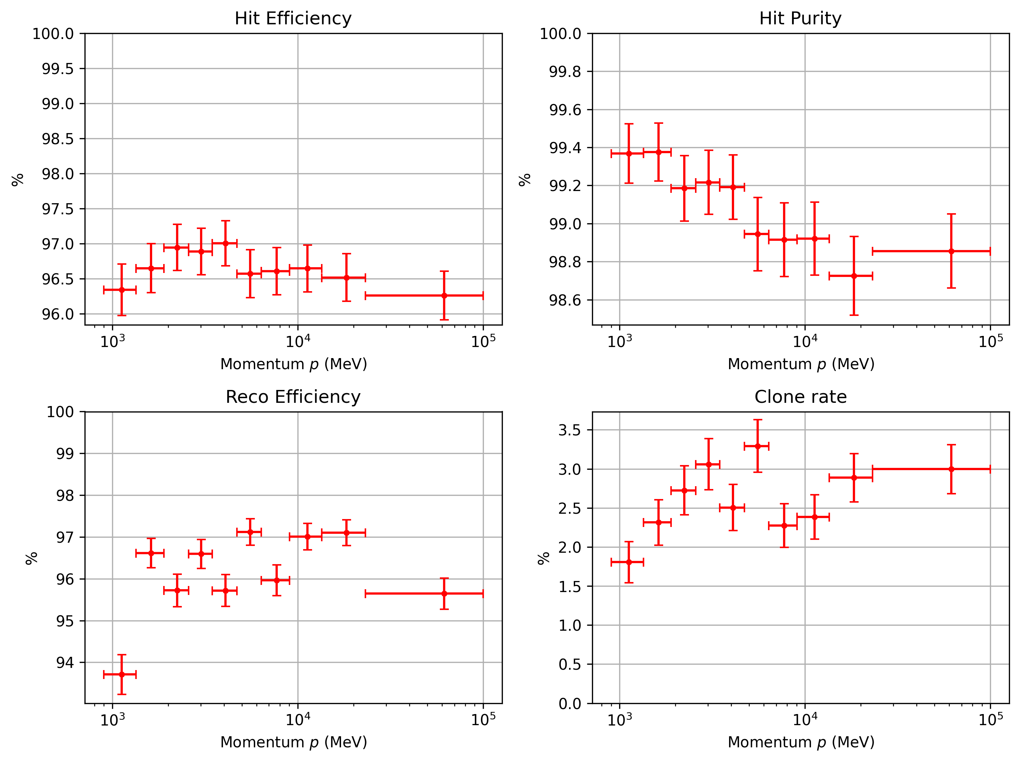
Tracking performances
Very good performance
Close to state of the art
Integrated fake rate: 4.3%
Notes:
Only as a function of momentum
Make clear that this is not quantum implementation
Start the plot form 1gev
Just show efficiency

Slide 17
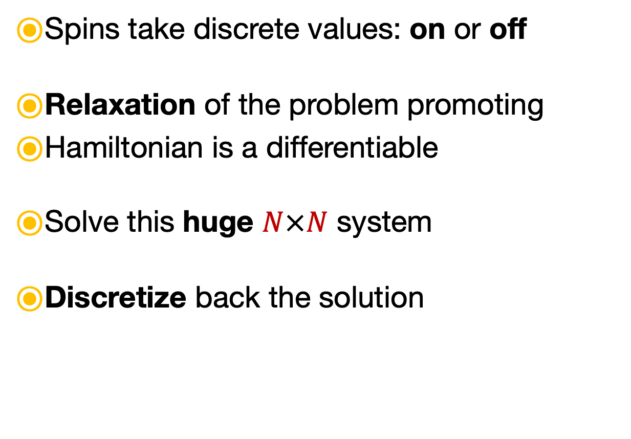

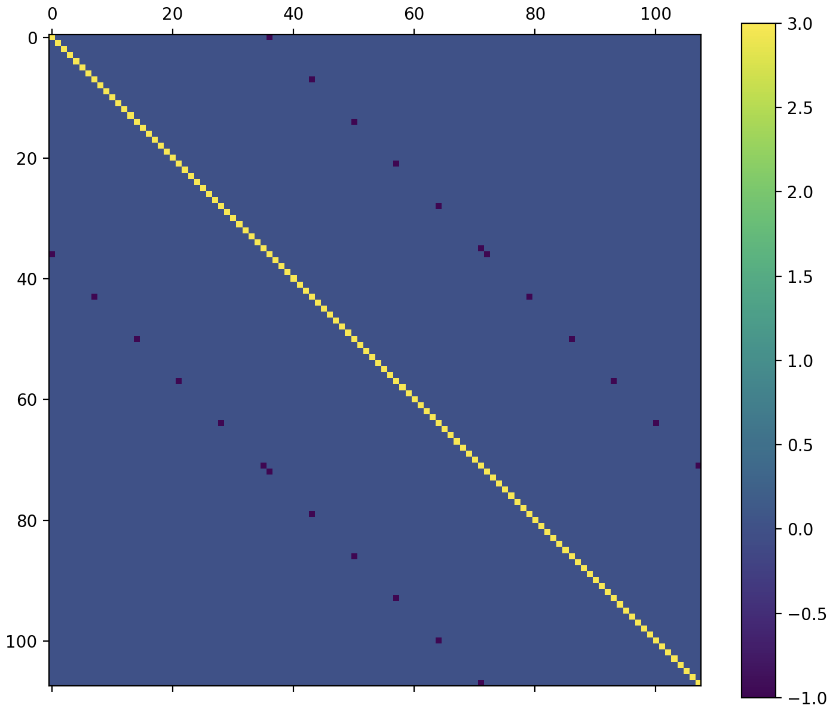

A quantum algorithm for tracking
From Ising to an Linear Algebra
$$S_{j}$$
Spins take discrete values: on or off
Relaxation of the problem promoting
Hamiltonian is a differentiable
Solve this huge $N×N$ system
Discretize back the solution
$$S_{i}$$
$$N=\#Layers × \#Particles^{2}$$
Notes:
Add the scaling
Add picture matrix
Maybe remove matrix and put the same picture of previous slide

Slide 18
Backup

Slide 19
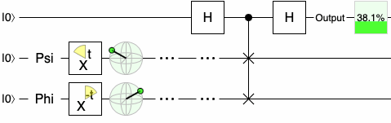
QC example - swap test
Pros
Complexity scales exponentially better for some problems
Active field of research (theory and hardware)
Potentially powerful for optimization and simulation
Cons
A concrete useful application is yet to be found
Developing algorithms is extremelly hard
https://quantumalgorithmzoo.org/
Current quantum hardware is not mature enough:
Limited access to noisy qubits ~100

Slide 21
Connecting dots in the LHCb VELO
Charged particles produced in the proton-proton collisions leave hits crossing the layers of the LHCb Vertex Locator.
The reconstruction of the tracks of the particles is a crucial step of the LHCb pipeline.
The most computationally expensive algorithm at trigger level.
In the VELO the effect of the magnetic
field is negligible: straight tracks.
Here
Notes:
Make picture bottom larger
Straight tracks only say it

Slide 22
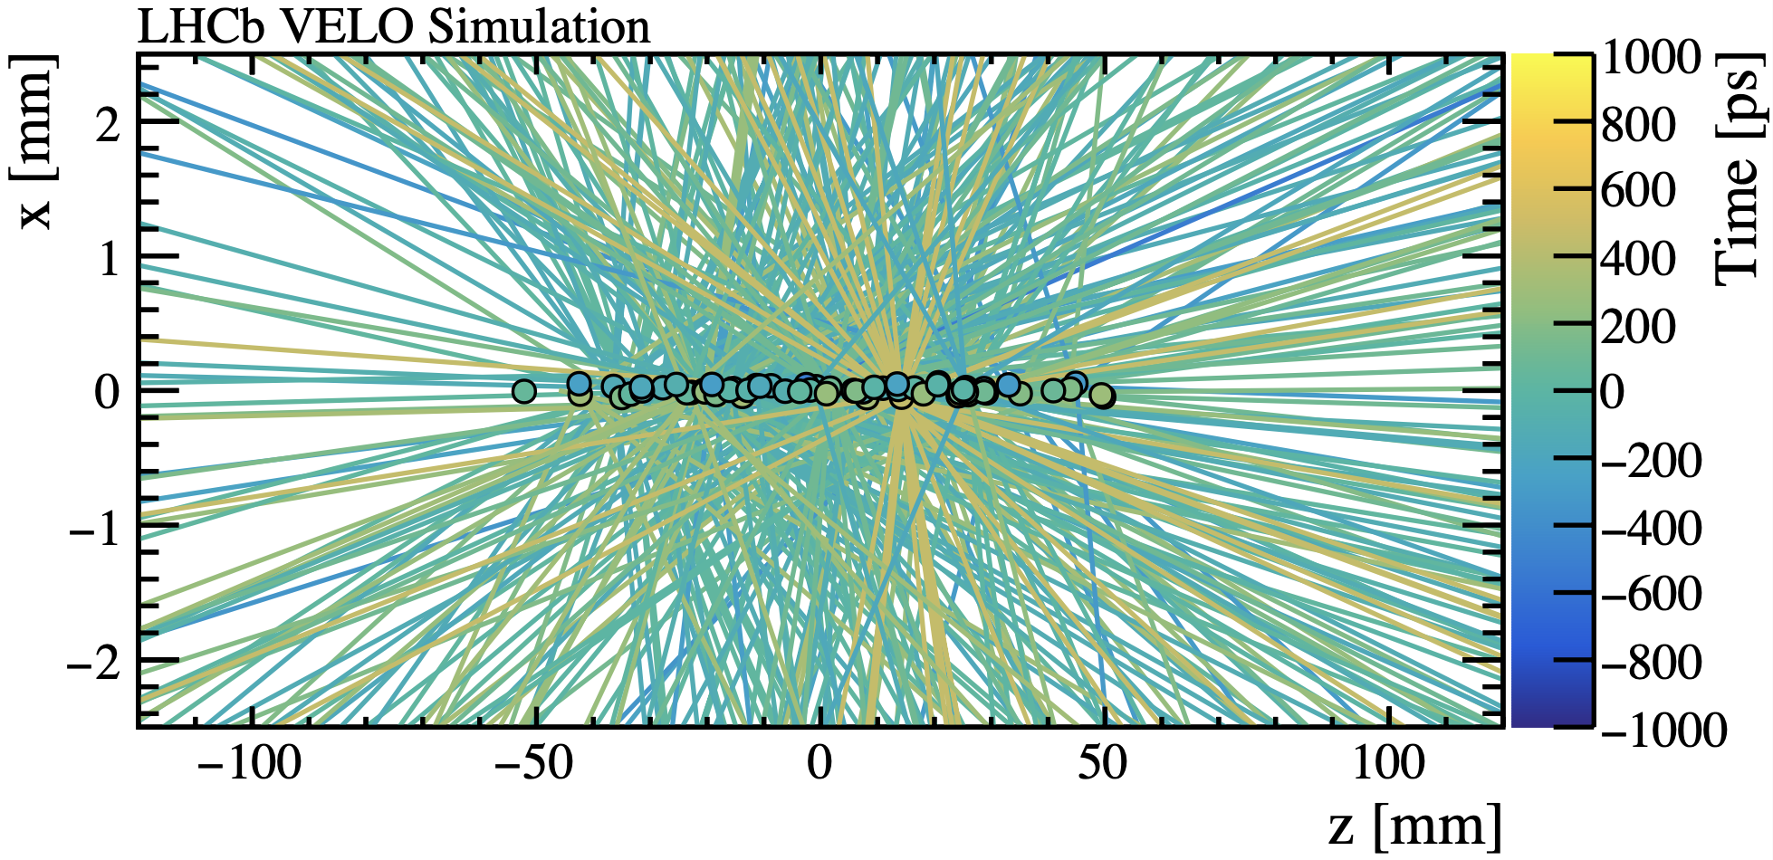
Tracking challenges in HL-LHC
Current number of interactions per bunch crossing: ~1.6
The LHCb detector is going to face a substantial boost in luminosity that will increase the complexity of tracking
  10x more vertices multiplicity
  10x more particles multiplicity
New algorithms will be required
to deal with the new operating
conditions
Can quantum computing play a role?
Courtesy of Robbert Geertsema
Notes:
Simplify the bunch crossing concept

Slide 23
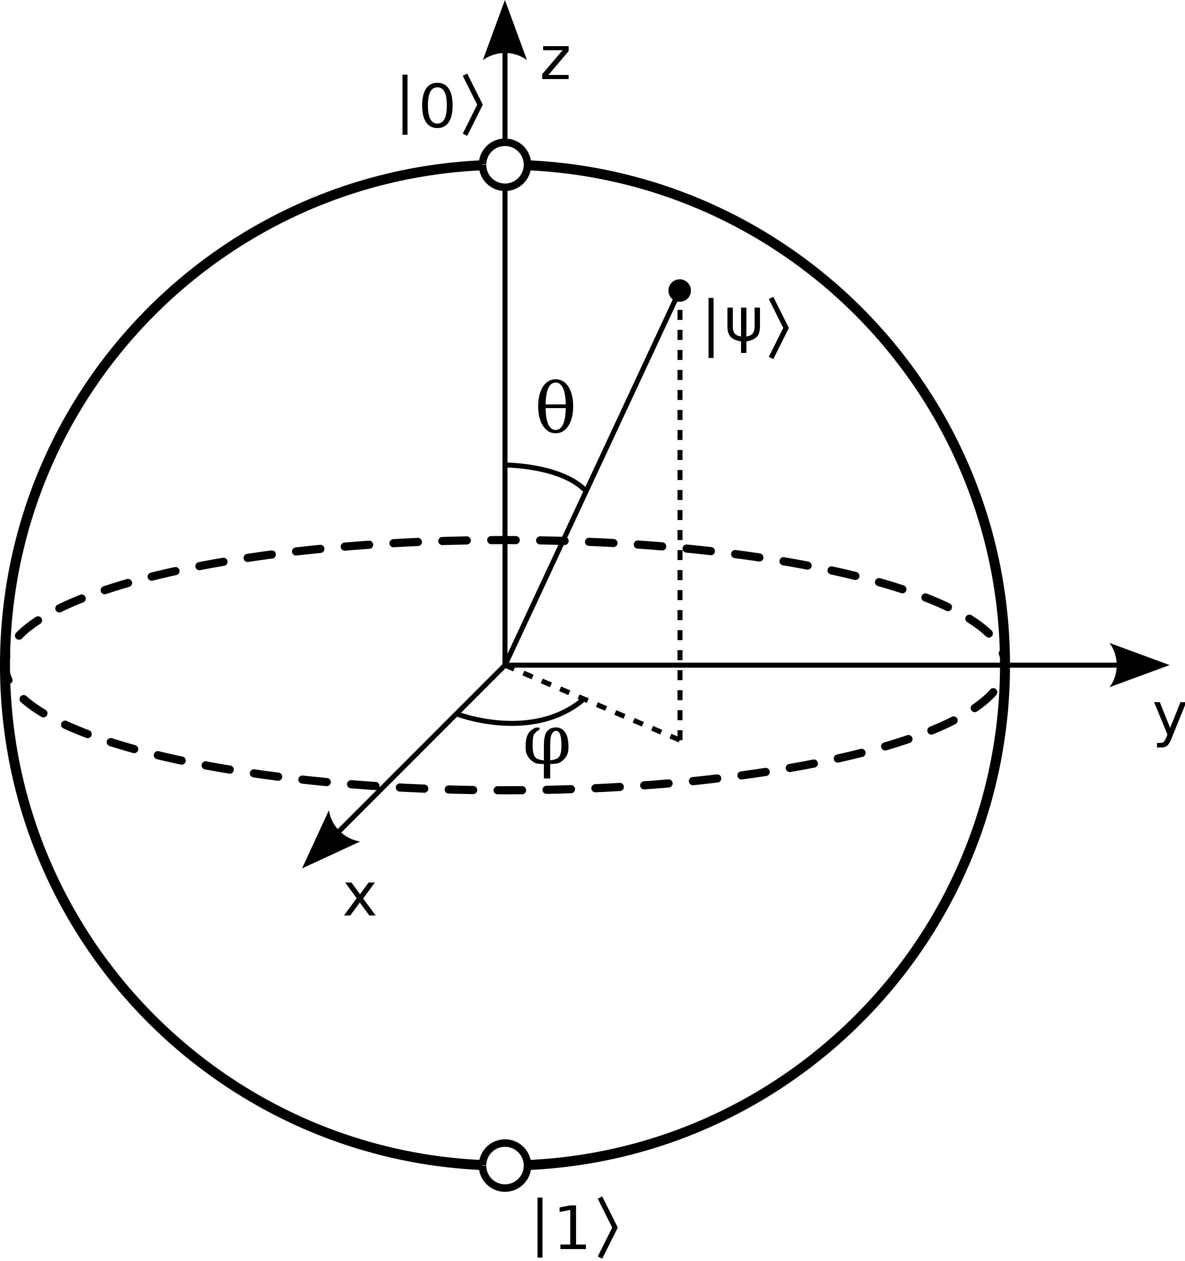
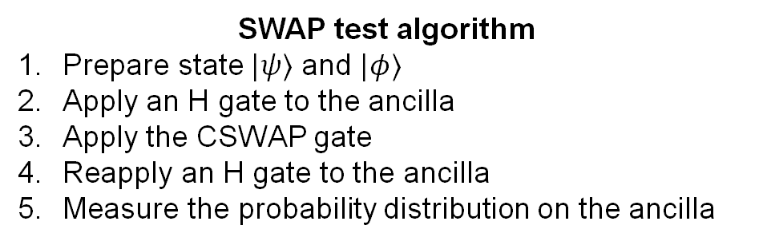

Quantum Computing
Using a quantum system as a fancy calculator
Example: computing the overlap between two quantum states
SWAP test algorithm
Prepare state $|ψ⟩$ and $|φ⟩$
Apply an H gate to the ancilla
Apply the CSWAP gate
Reapply an H gate to the ancilla
Measure the probability distribution on the ancilla
$$P\left(0\right)= \frac{1}{2}(1−{\left|\left\langle ψ | φ\right\rangle \right|}^{2})$$
Complexity scales exponentially better than classical for some problems
Extremelly active field of research in the last few years (theory and hardware)
Potentially a very powerful tool for optimization and simulation tasks
A concrete useful application is yet to be found
Developing algorithms is extremelly hard
Only a few of them are know https://quantumalgorithmzoo.org/
Current quantum hardware is not mature enough:
Limited access to (a few) noisy qubits
Notes:
This would require 2/3 slides
We want to rewrite tracking in such a way it is “compatible” with quantum computing
Skip intro di QC

Slide 24
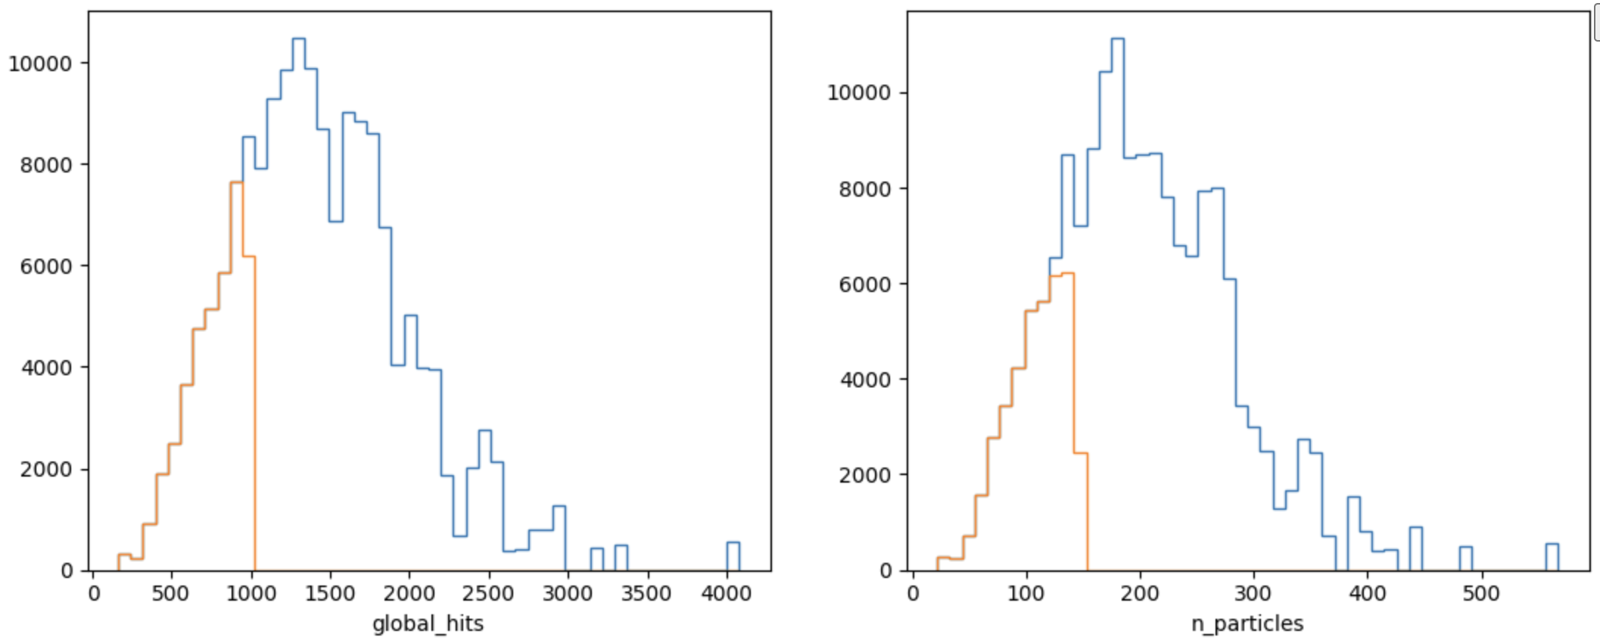
N. hits and particles

Slide 25
Tracking challenges in HL-LHC
Number of collisions per crossing: ~7
Substantial boost in luminosity in the future
  10x more collisions
  10x more particles
New algorithms will be required
to deal with the new operating
conditions
Can quantum computing play a role?
Courtesy of Robbert Geertsema
Notes:
Simplify the bunch crossing concept
1.6 run1
7 run 3
10xrun3 hl
Maybe get rid of first 2 bulll

