Slide 1
Particle accelerators and their medical applications
Varchaswi K S Kashyap
School of Physical Sciences
National Institute of Science Education and Research (NISER) Bhubaneswar

Slide 2
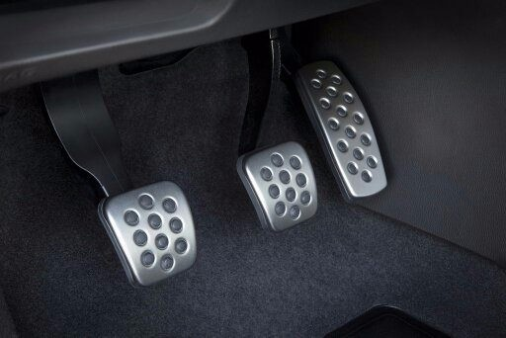
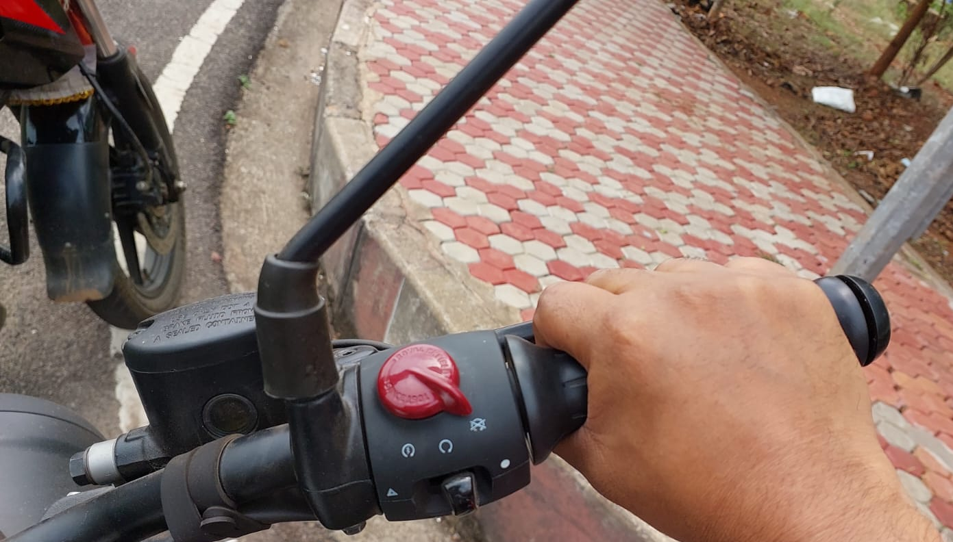
What are accelerators?
Accelerators are devices that increase the velocity/speed of objects at rest or in motion.
Accelerator | Driving Lessons Online UK (teachable.com)

Slide 3
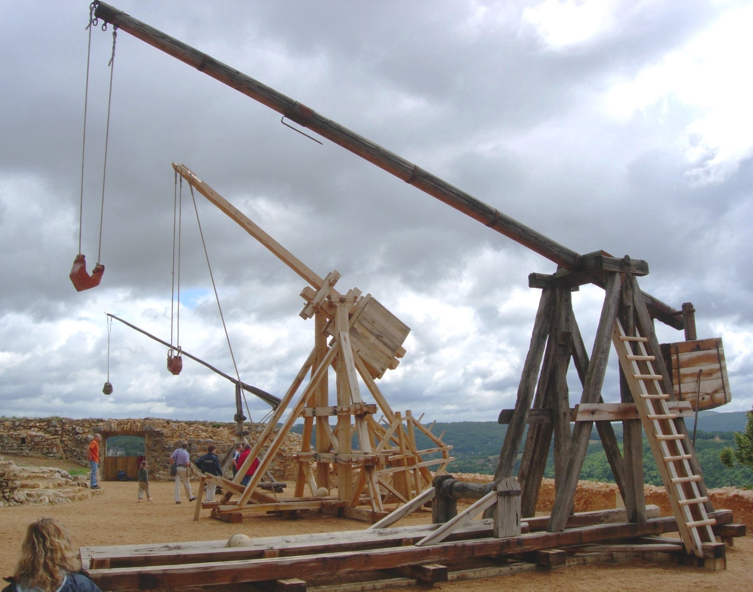
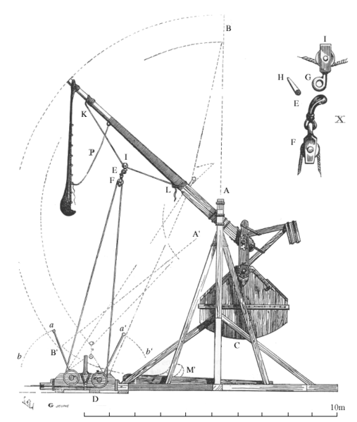
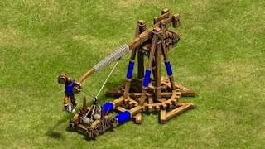
COUNTER-WEIGHT TREBUCHET
Are these
accelerators?
Picture of several counter-weight trebuchets
Source: Wikipedia
A screenshot in AOE2 from the internet
Source: Wikipedia

Slide 4
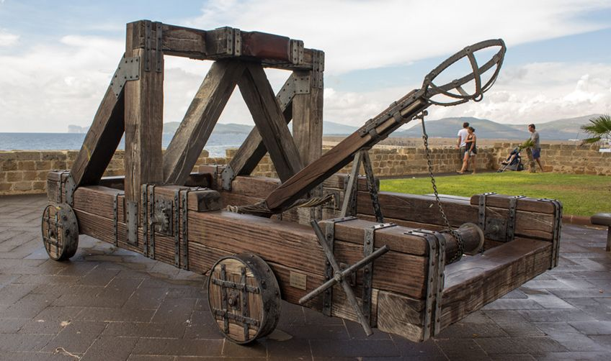
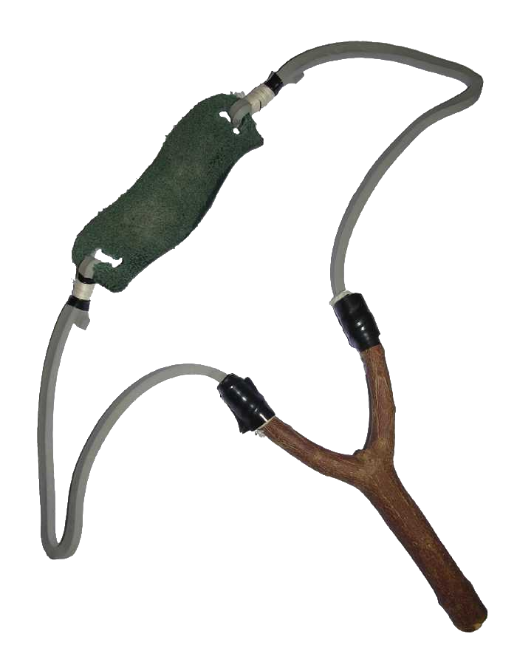
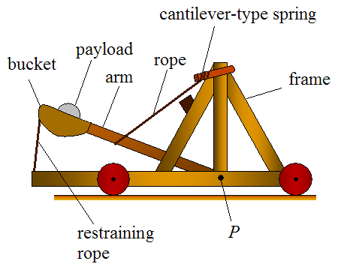
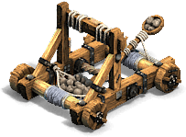
ONAGER/MANGONEL
SLINGSHOT
A picture of an onager
Source: I Have You Now: The Onager, a double-edged sword (armadaihaveyounow.blogspot.com)
Source: Wikipedia
Are these
accelerators?
Source: Wikipedia
A picture of an onager as modelled in AOE2

Slide 5
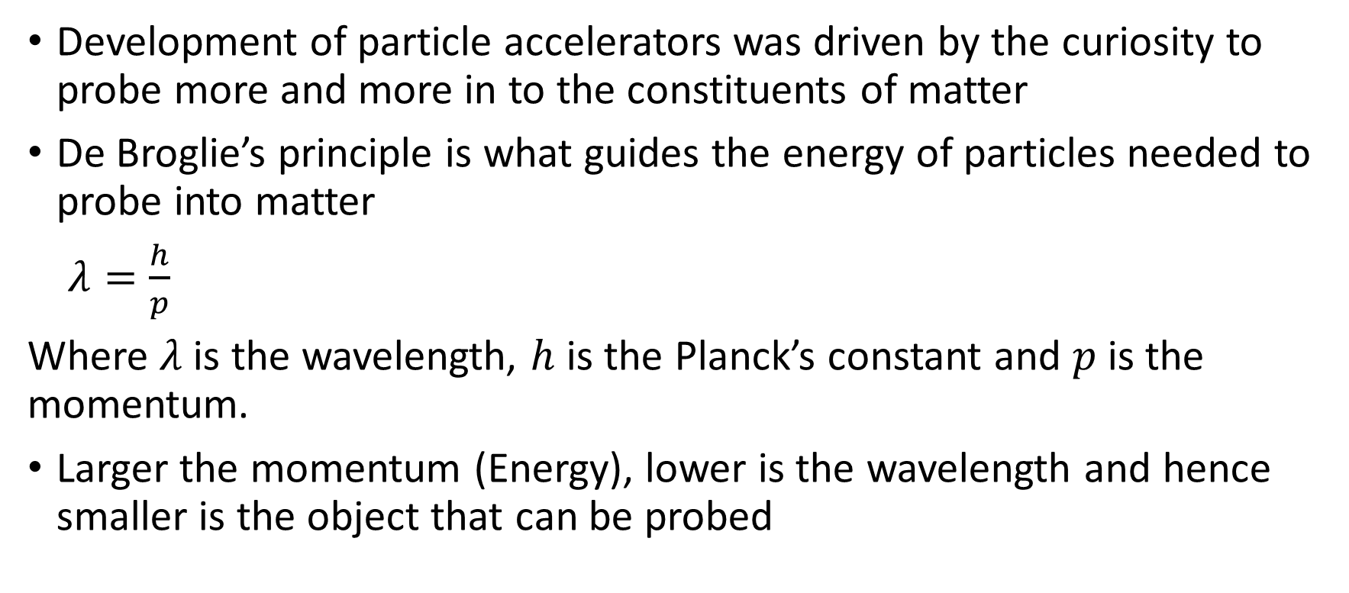
Particle accelerators in physics and their need
Development of particle accelerators was driven by the curiosity to probe more and more in to the constituents of matter
De Broglie’s principle is what guides the energy of particles needed to probe into matter
$λ=\frac{h}{p}$
Where $λ$ is the wavelength, $h$ is the Planck’s constant and $p$ is the momentum.
Larger the momentum (Energy), lower is the wavelength and hence smaller is the object that can be probed
Dimension to be probed | 1 Å (Atomic size) | 1 fm (Nuclear size)
Energy of electron required | ~150 eV | ~ 1 TeV

Slide 6
Have you come across any particle accelerators in your daily life?

Slide 7
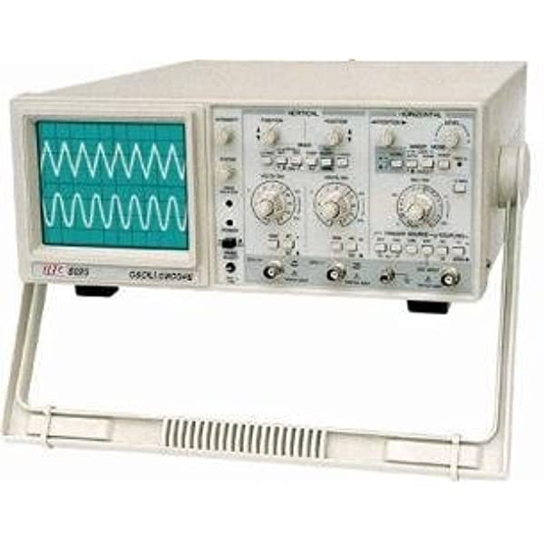
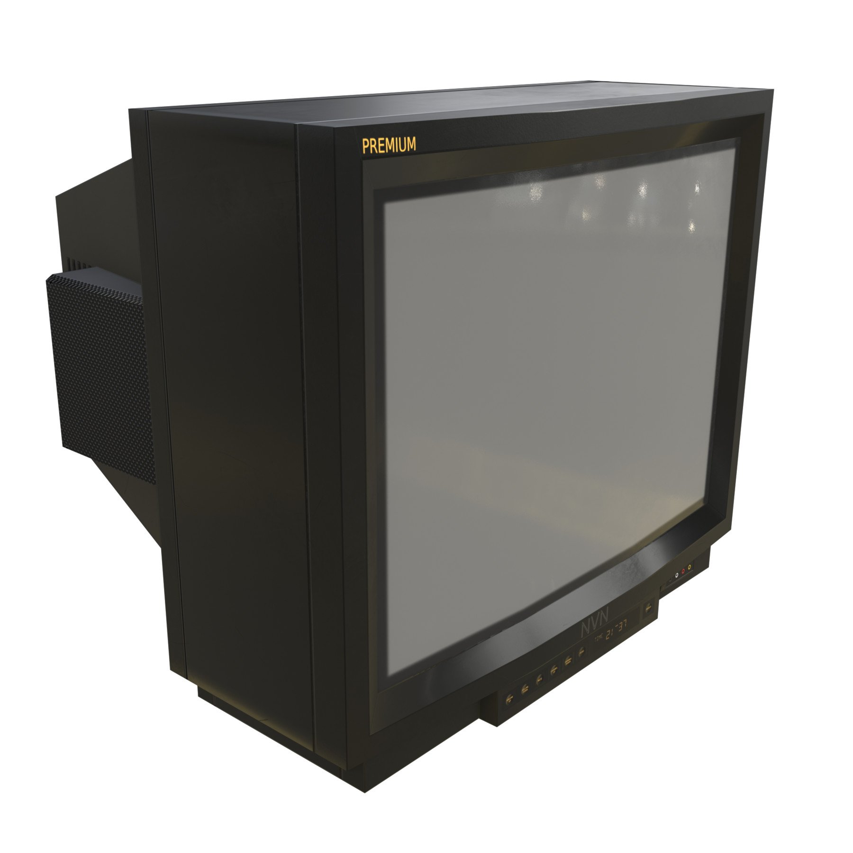
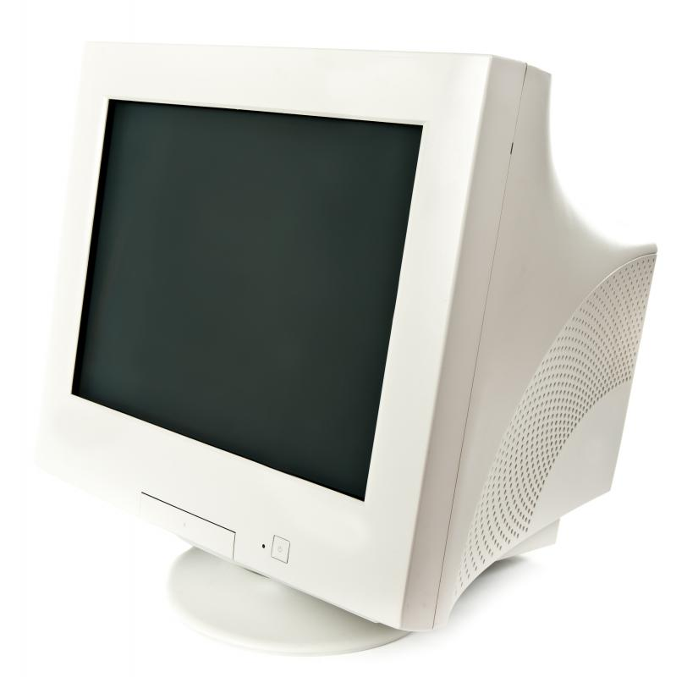
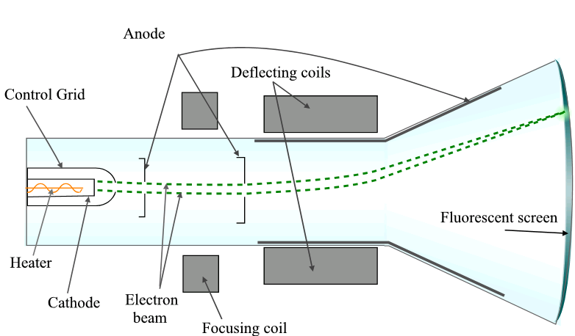
What about these?
CR Oscilloscope
CRT television
CRT monitor
They have small accelerators that can accelerate electrons up to few keV

Slide 8
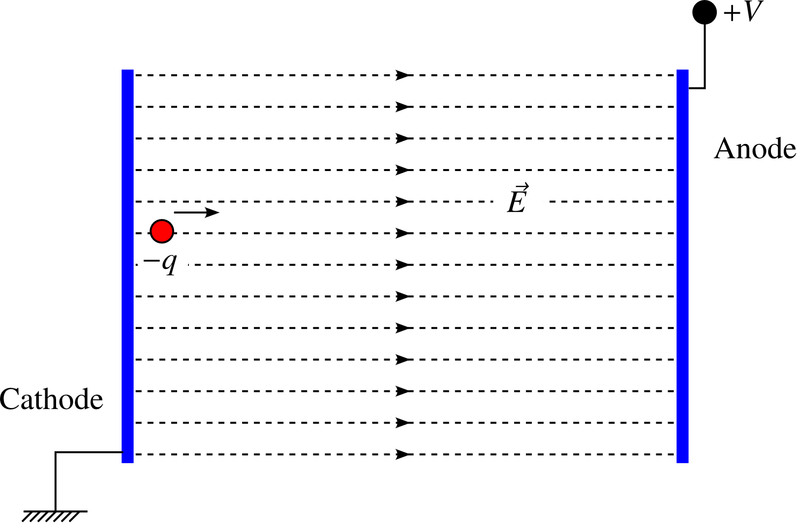
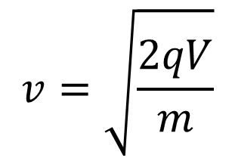
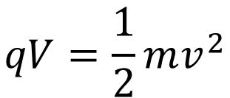

Kinetic energy of a charged particle in an electric field
$$\text{K}\text{.}\text{E}\text{ = }qV$$
Speed of the particle is given by
$$qV=\frac{1}{2}mv^{2}$$
$$v=\sqrt{\frac{2qV}{m}}$$

Slide 9
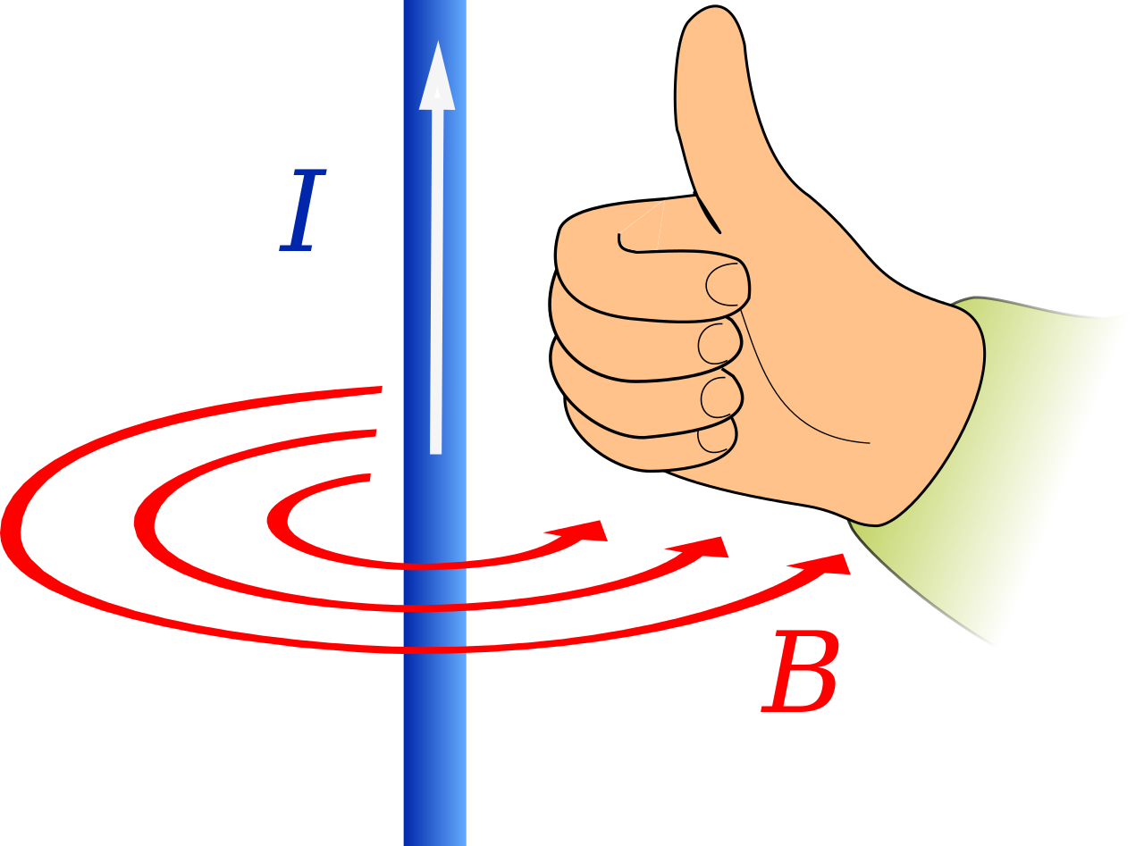
Ampere’s law
Source:
Jfmelero - Own work, CC BY-SA 4.0, https://commons.wikimedia.org/w/index.php?curid=3634402

Slide 10
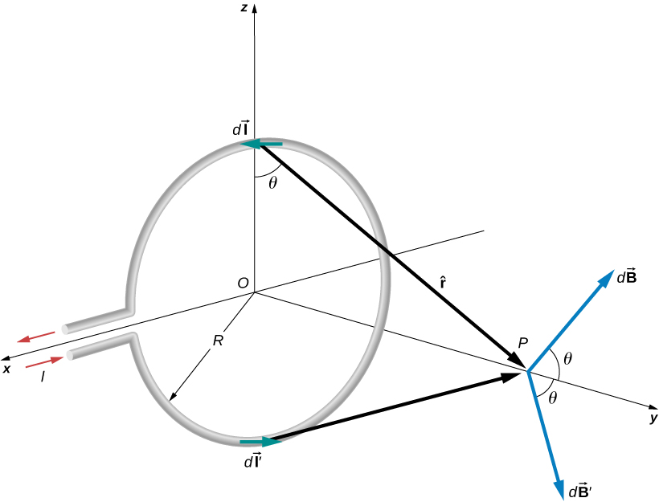

Ampere’s law
Biot-Savart‘s law
$$dB=\frac{μ_{0}}{4π}\frac{I dl\sin{θ}}{r^{2}}$$
Source:
Magnetic Field of a Current Loop. Authored by: OpenStax College. Located at: https://openstax.org/books/university-physics-volume-2/pages/12-4-magnetic-field-of-a-current-loop.
Source:
Jfmelero - Own work, CC BY-SA 4.0, https://commons.wikimedia.org/w/index.php?curid=3634402

Slide 11
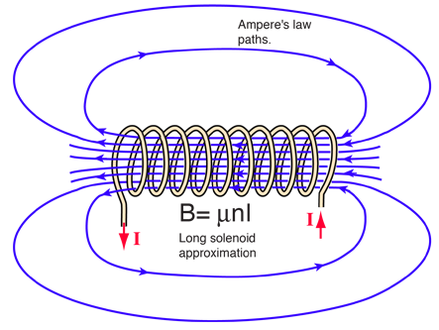
Ampere’s law
Solenoid
Biot-Savart‘s law
$$dB=\frac{μ_{0}}{4π}\frac{I dl\sin{θ}}{r^{2}}$$
Source: http://hyperphysics.phy-astr.gsu.edu/hbase/magnetic/solenoid.html
Source:
Magnetic Field of a Current Loop. Authored by: OpenStax College. Located at: https://openstax.org/books/university-physics-volume-2/pages/12-4-magnetic-field-of-a-current-loop.
Source:
Jfmelero - Own work, CC BY-SA 4.0, https://commons.wikimedia.org/w/index.php?curid=3634402

Slide 12
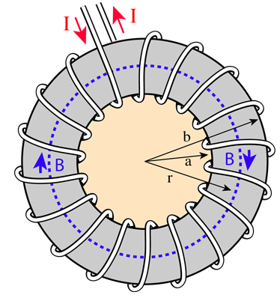
Ampere’s law
Solenoid
Biot-Savart‘s law
$$dB=\frac{μ_{0}}{4π}\frac{I dl\sin{θ}}{r^{2}}$$
Source: http://hyperphysics.phy-astr.gsu.edu/hbase/magnetic/solenoid.html
Source:
Magnetic Field of a Current Loop. Authored by: OpenStax College. Located at: https://openstax.org/books/university-physics-volume-2/pages/12-4-magnetic-field-of-a-current-loop.
Source:
Jfmelero - Own work, CC BY-SA 4.0, https://commons.wikimedia.org/w/index.php?curid=3634402
Toroid

Slide 13
Types of accelerators
Electrostatic accelerators
Cockroft – Walton accelerator
Van de Graaff accelerator
Induction accelerators
Induction Linear accelerator
Betatron
Radio-Frequency (RF) accelerators
RF Linac
RF quadrupole
Pelletron
Cyclotron
Microtron
Synchrotron

Slide 14
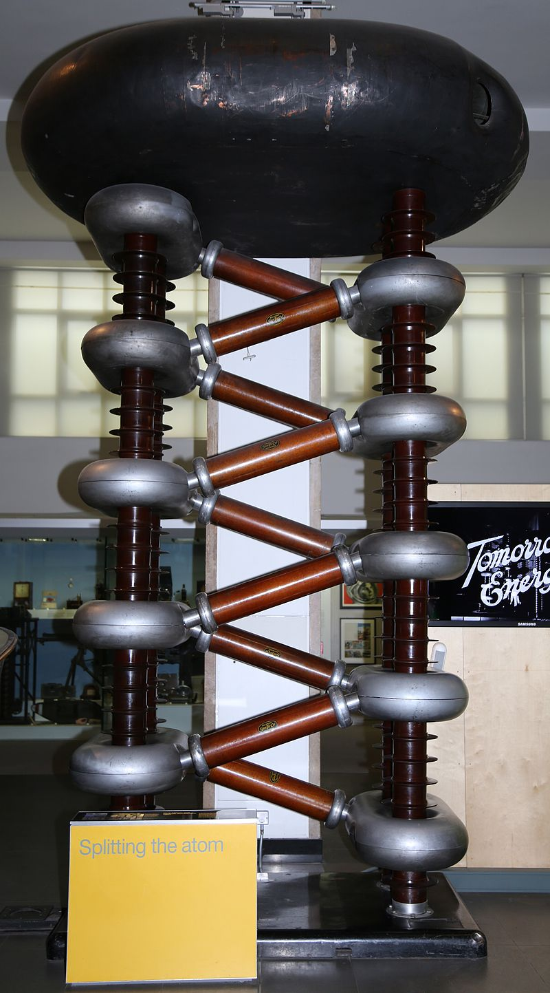
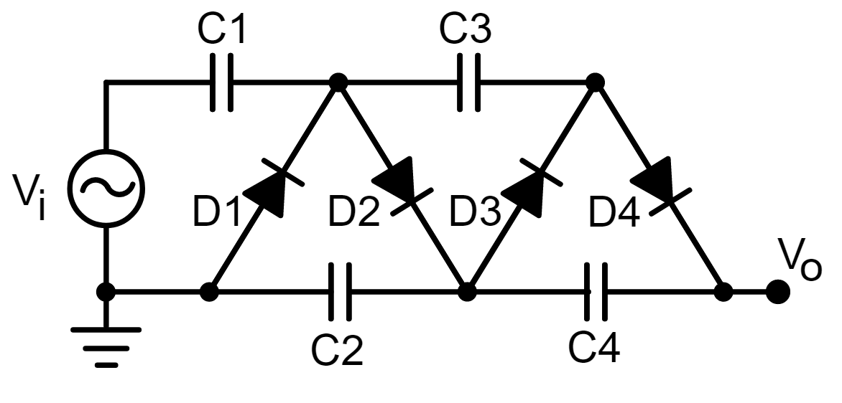
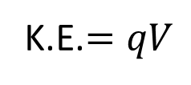
Cockroft – Walton accelerator
Converts AC voltage to very high DC voltage
Simple in principle and less bulky compared to transformers
Voltages can be tapped at different levels
Source: Wikipedia
K.E.$=qV$

Slide 15
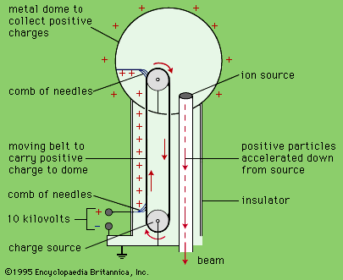
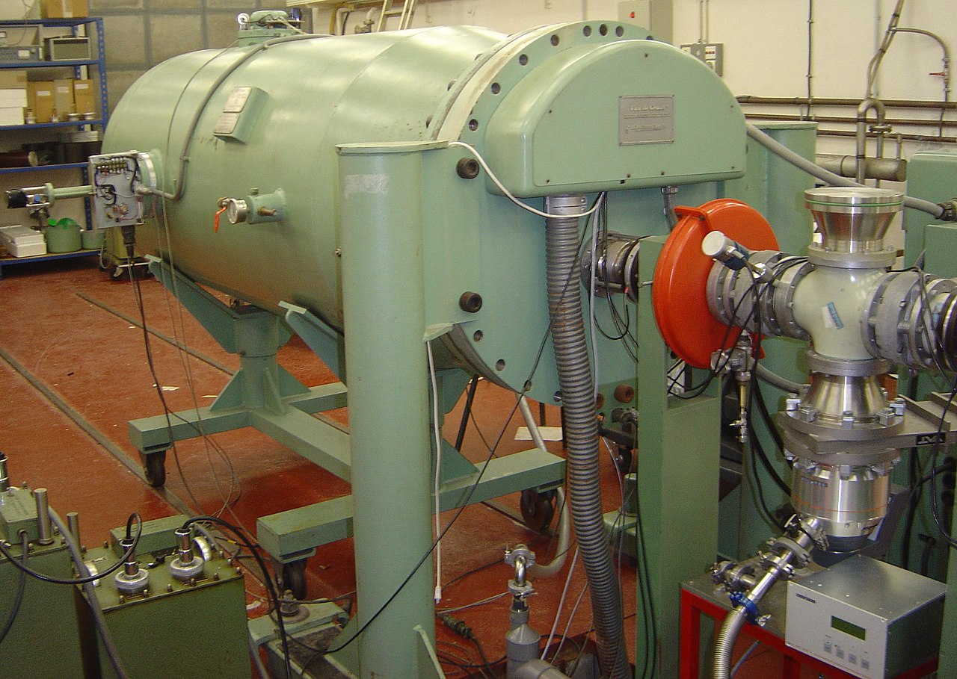
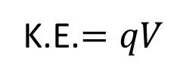
Van de Graaff accelerator
Voltages of the order of a few MV can be achieved.
A high voltage supply provides charges to be transported to the metal dome
Charges are collected in a metal dome over time
The potential difference between the dome and the ground can be used to accelerate particles
A Pelletron is very similar to the Van de Graaff having a metal belt with pellets instead of a rubber belt.
A Van de Graaff particle accelerator in a pressurized tank at Pierre and Marie Curie University, Paris (Source: Wikipedia, Copyright © 2004 David Monniaux)
K.E.$=qV$

Slide 16
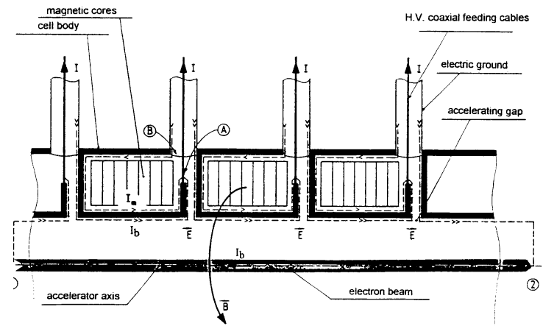
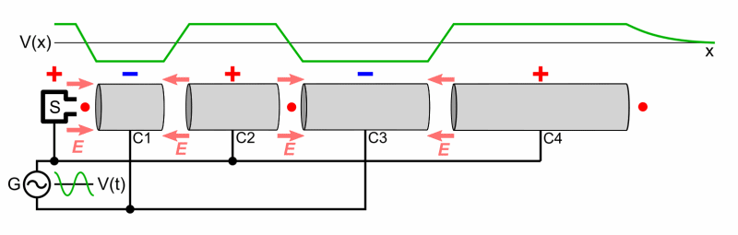

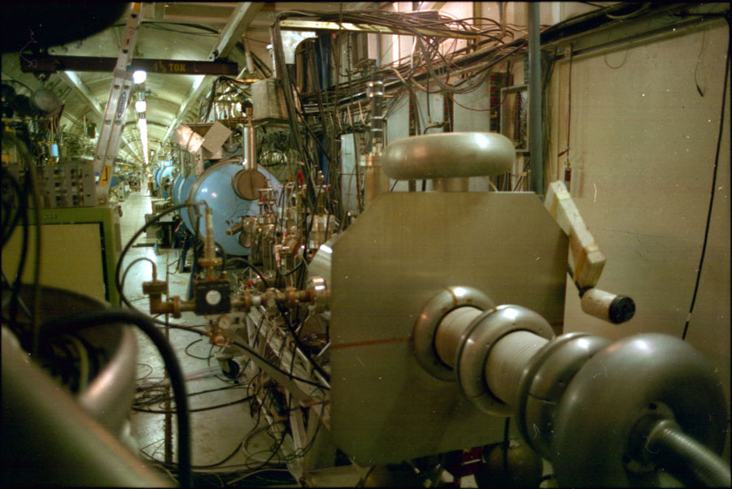
Linear accelerator
RF LINAC (Image credit: Wikipedia)
INDUCTION LINAC (Image credit: INDUCTION, J De Mascureau, 1996)
The Stanford University superconducting linear accelerator, housed on campus below the Hansen Labs until 2007. This facility is separate from SLAC
(Image credit: Wikipedia)
RF LINAC | INDUCTION LINAC
Smaller length | Longer length
Higher acceleration gradient | Lower acceleration gradient
Requires lower power | Requires higher power
Low current and short pulse duration | High current and longer pulse duration

Slide 17
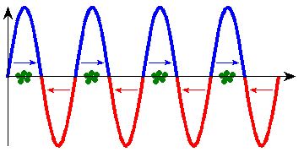
Linear accelerator (LINAC) contd.
RF LINAC configurations
Standing wave
Travelling wave
Image credit: By Patrick87 - https://commons.wikimedia.org/w/index.php?curid=29590284

Slide 18
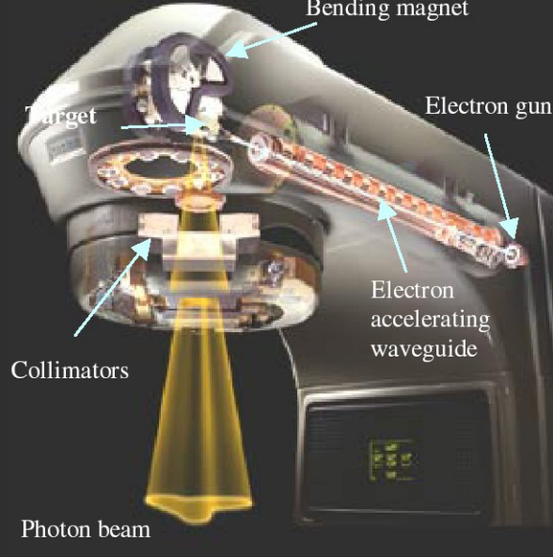
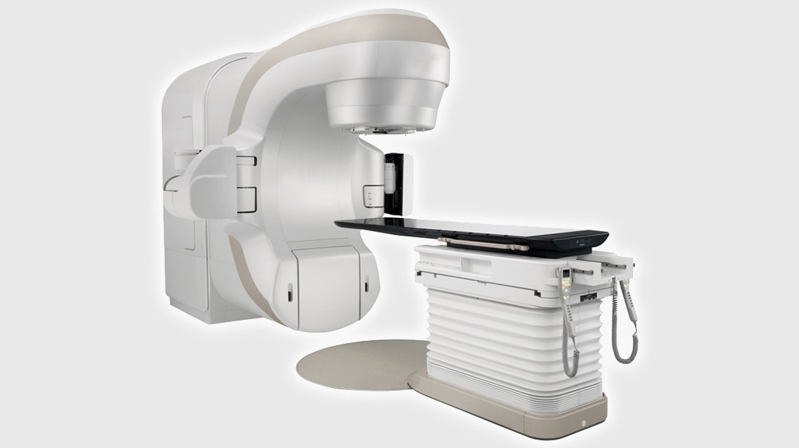
Medical LINAC
Image credit: www.iaea.org
Image credit: Medical Linear Accelerators in Radiation Therapy, Presentation by Haijun Song, Ph.D. Dept. of Radiation Oncology Duke University Medical Cente

Slide 19
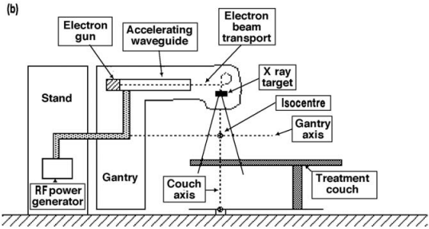
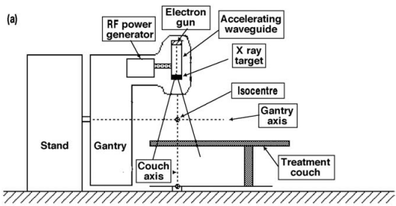
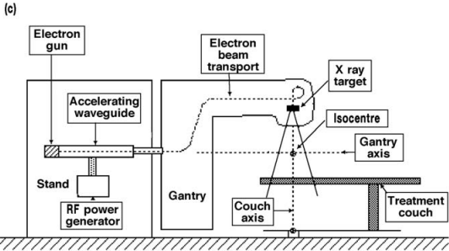
Medical LINAC configurations
Both X-rays and
electrons (upto MV)
RF power generator is in the gantry stand and waveguide is in the gantry directed towards the target above the patient
Only X-rays
Both X-rays and
electrons (upto MV)
RF power generator and waveguide are both in the gantry and the waveguide is directed straight towards the patient
Image credit: Treatment machines for external beam radiotherapy, E.B. Podgorsak, Department of Medical Physics, McGill University Health Centre, Montreal, Quebec, Canada
Both RF power generator and waveguide are in the gantry stand. The electrons have to be transported to the target.

Slide 20
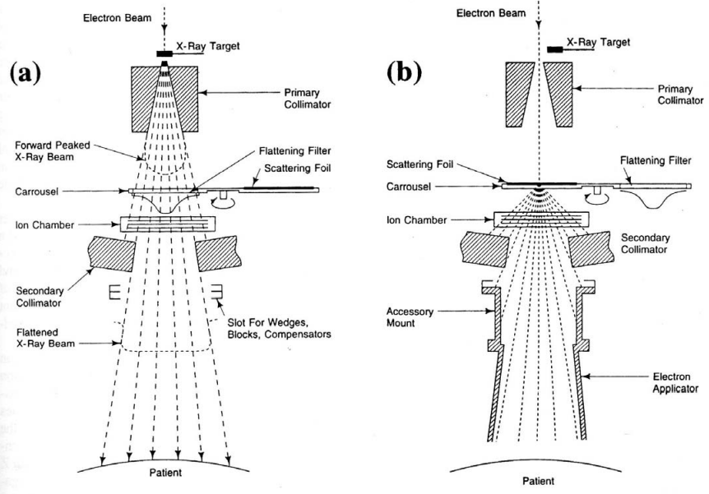
Medical LINAC configurations contd.
Image credit: Medical Linear Accelerators in Radiation Therapy, Presentation by Haijun Song, Ph.D. Dept. of Radiation Oncology Duke University Medical Centre

Slide 21
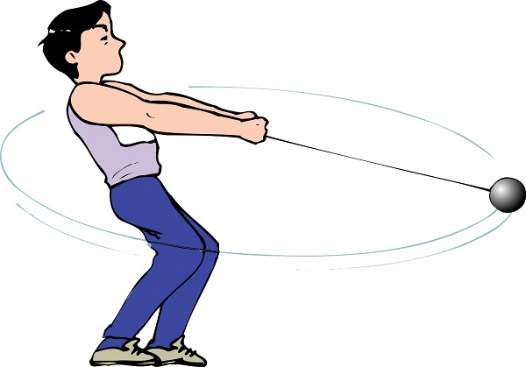
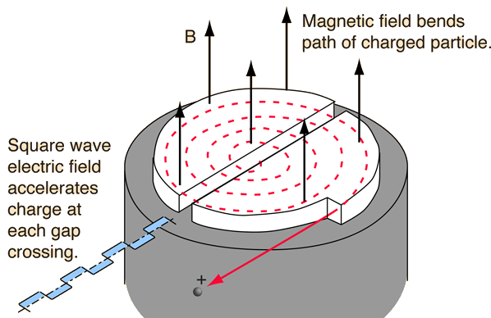
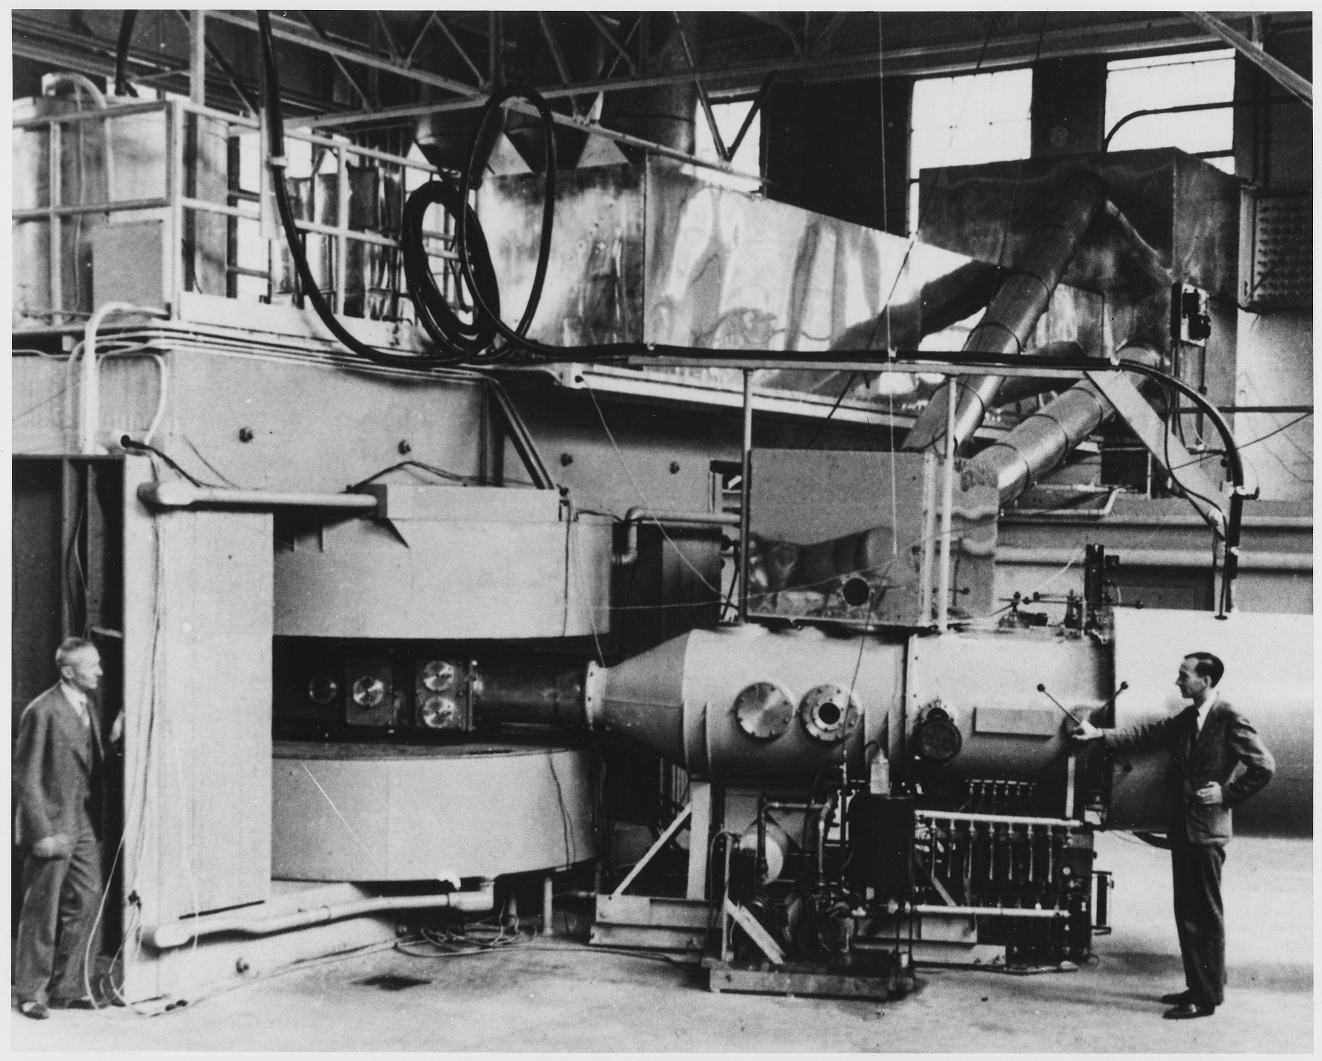

Cyclotron
$$T=\frac{2πm}{Bqv}$$
Image credit:
Hammer Throw - How to Play? (tutorialspoint.com)
Image credit: Cyclotron (gsu.edu)
Lawrence's 60-inch cyclotron, with magnet poles 60 inches (5 feet, 1.5 meters) in diameter, at the University of California Lawrence Radiation Laboratory, Berkeley, in August, 1939. Image credit: Wikipedia

Slide 22
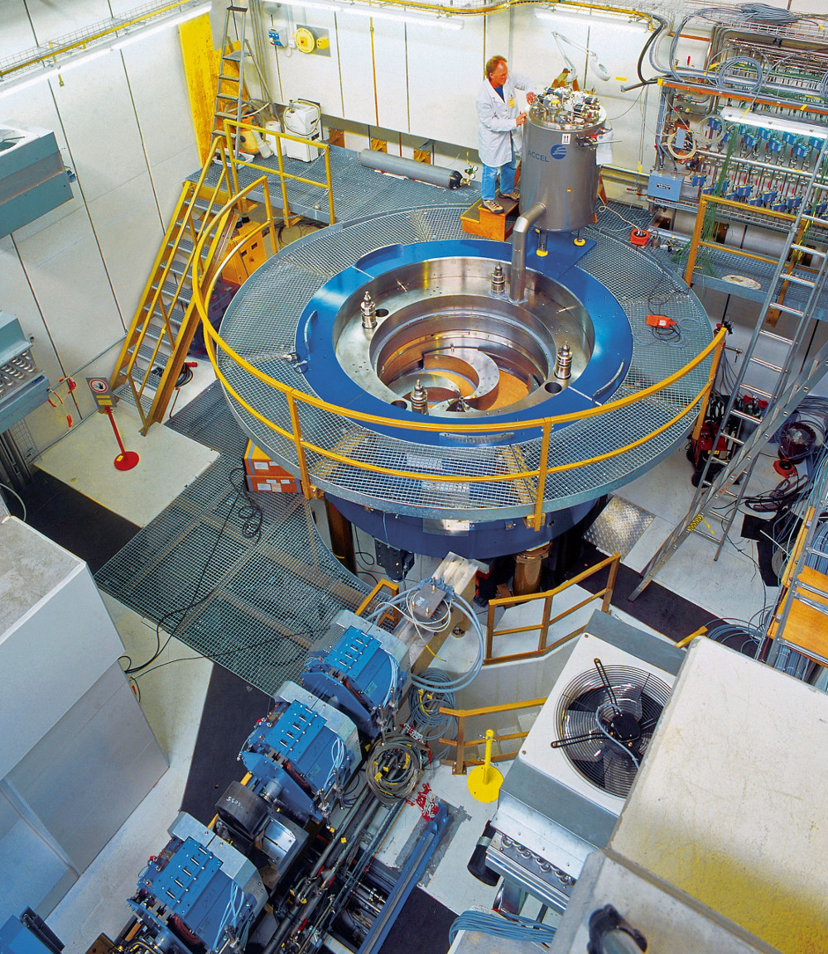
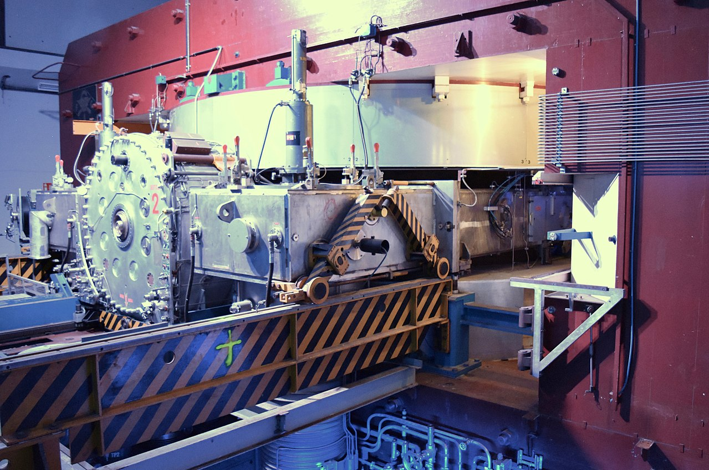
What to do if particle becomes relativistic?
Iso-cyclotron (Isochronous)
Keep frequency constant and vary the magnetic field
Synchro-cyclotron
Keep magnetic field constant and vary the frequency
Image credit:
COMET Cyclotron | CPT | Paul Scherrer Institut (PSI)
Image source: Wikipedia

Slide 23
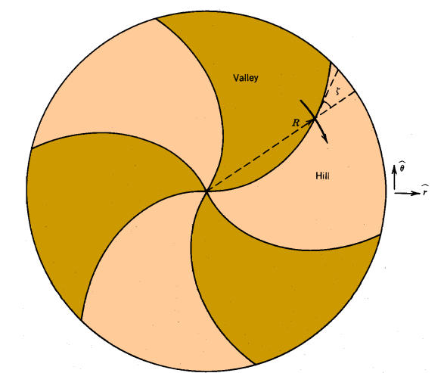
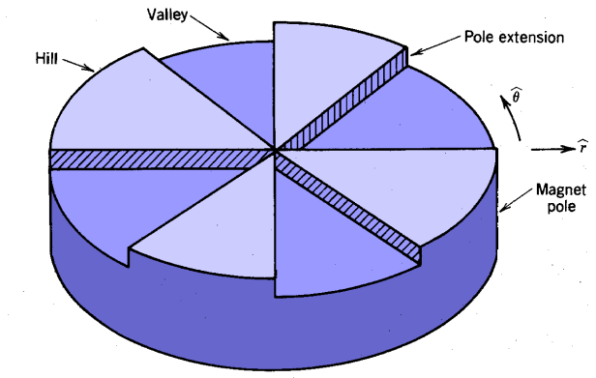
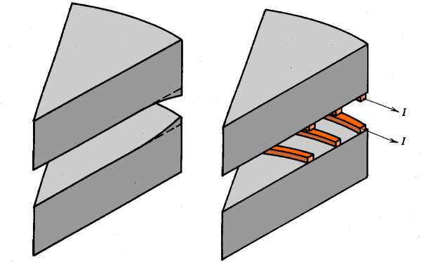
What to do if particle becomes relativistic?
Iso-cyclotron (Isochronous)
Keep frequency constant and vary the magnetic field
Alias: Azimuthal varying field cyclotron
Image credit: http://www.geology.wisc.edu/~johnf/g777/Misc/chap15.pdf

Slide 24
What to do if particle becomes relativistic?
Synchro-cyclotron
Keep magnetic field constant and vary the frequency
Higher energy achievable
Lower average beam current
Compact dimension
Image credit: Wikipedia

Slide 25
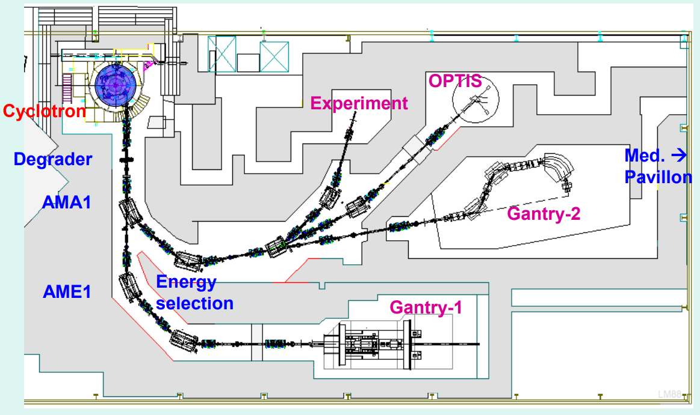
Layout of a cyclotron complex for proton therapy
PSI
Image credit: Accelerators for proton therapy, Presentation by, Marco Schippers, PSI - JUAS

Slide 26
What if both the frequency and magnetic field can be changed?

Slide 27
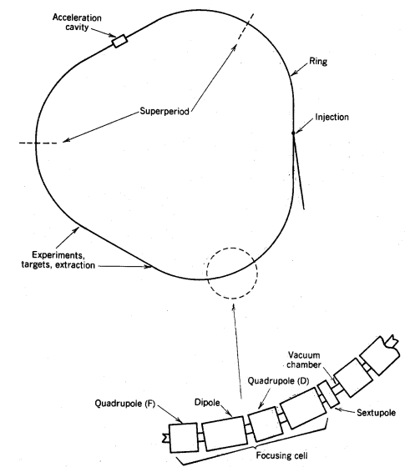
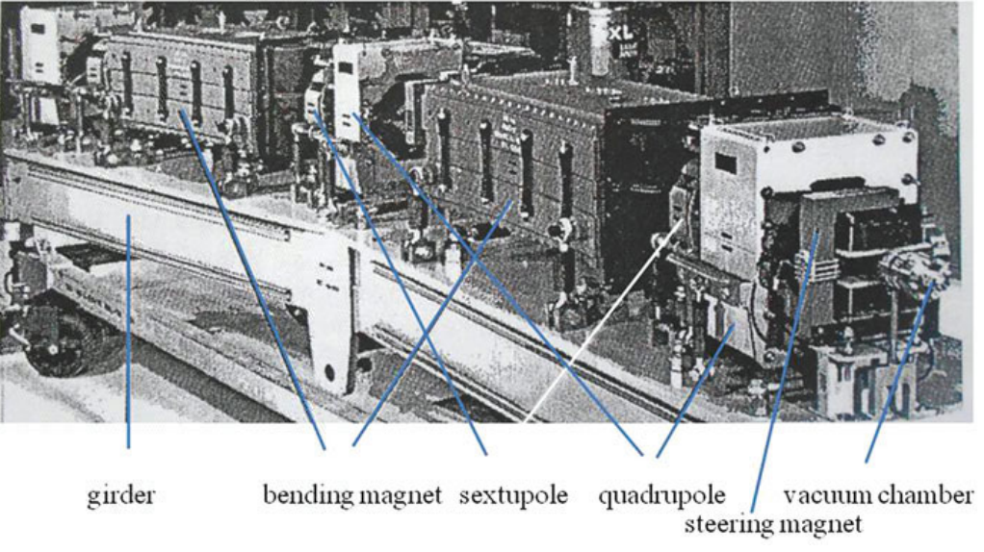
Synchrotron
Image credit: Particle Accelerator Physics, Helmut Wiedemann, 4th edition, Springer
Image credit: http://www.geology.wisc.edu/~johnf/g777/Misc/chap15.pdf

Slide 28
Particle accelerators and medical use
Particle | Accelerator | Energy | Use
Electron | LINAC | ~6-25 MeV | Cancer treatment
X-rays | LINAC | ~6 MeV | Cancer treatment
 | Synchrotron | ~100s of keV | Imaging - coronary angiography, bronchography, mammography, computed tomography, x-ray microscopy
Proton | Cyclotron | ~20-100 MeV | Radioactive assay preparation for PET, SPECT scanning
 | Synchrocyclotron | ~250 MeV | Cancer treatment
Carbon | Synchrotron | ~400 MeV/u | Cancer treatment

Slide 29
How do you get free electrons?

Slide 30
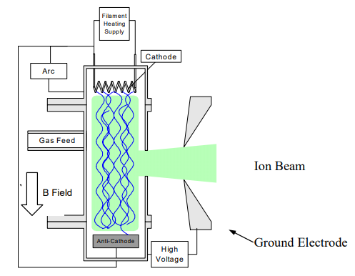

Particle sources?
Photocathode based electron source.
Image credit: Electron sources for accelerators Carlos Hernandez-Garcia, Patrick G. O’Shea, and Marcy L. Stutzman, Physics Today, February 2008 (Volume 61, Issue 2).
Penning ion source
Image source: electron and ion sources for particle accelerators R. Scrivens

Slide 31
Thank you.
Hope you’ve all been accelerated!!

Slide 32


Some questions to think about
Q1: Can you design a multistage accelerator using the gravitational force?
Q2: Is it possible to calculate the electric field at the centre of a Toroid?
Q3: Suppose you want to build a LINAC to accelerate protons to energies of 1 TeV. How long would it have to be?
Q4: What is fundamental? Force/field or the particle charge?
OR

