Slide 1


Vortical effects in chiral band structures
Swadeepan Nanda (snanda3@uh.edu)
University of Houston, Houston, TX
Physics Research day, 18 Feb, 2023
S Nanda, P Hosur arXiv:2206.14194

Slide 2
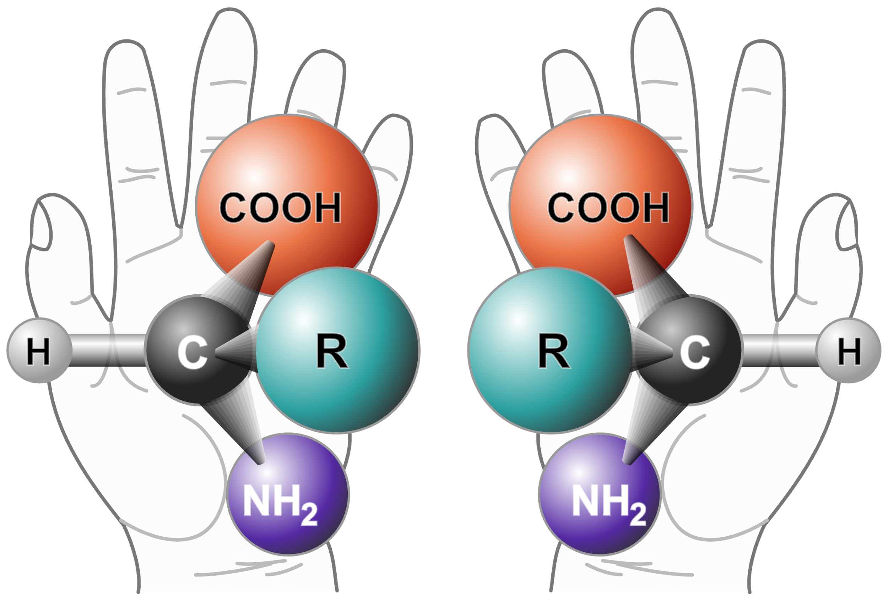
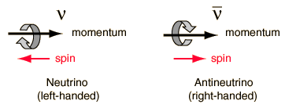

Chirality:
Non-superimposable mirror image $→$ Breaks all mirror symmetry, i.e., parity
Credit: Wikipedia

Slide 3
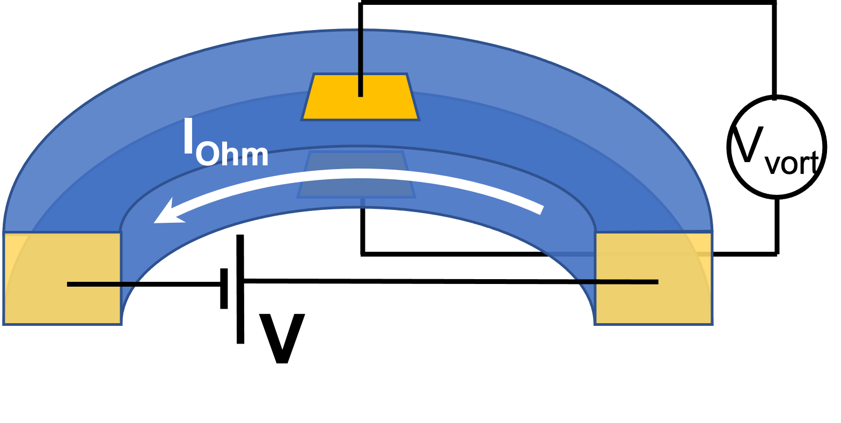



Vortical effect:
$$J^{z}$$
$$Ω$$
$$J^{z}∝Ω$$
Axial current due to vortex in chiral fluid (vorticity $𝓥$ =$\frac{1}{2}$ $∇×v ≠0$)

Slide 4
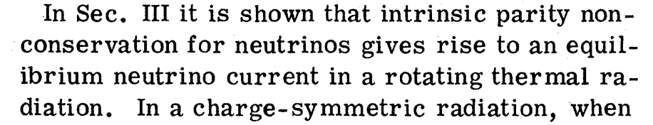
Motivation:
Alexander Vilenkin Phys. Rev. D 20, 1807, 1979
Q. WHAT ABOUT CONTINUOUS BAND STRUCTURE?

Slide 5
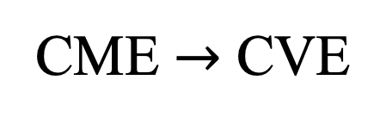
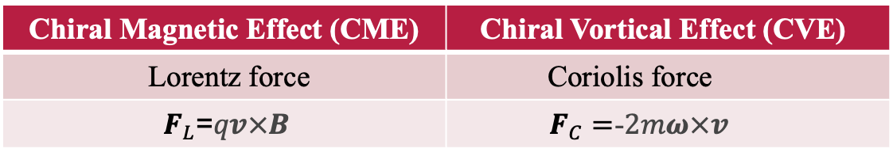
CME $→$ CVE
Axial current due to an external magnetic field – Chiral Magnetic Effect
Kenji Fukushima, Dmitri E. Kharzeev, and Harmen J. Warringa
Phys. Rev. D 78, 074033
Chiral Magnetic Effect (CME) | Chiral Vortical Effect (CVE)
Lorentz force | Coriolis force
$F_{L}$=$qv×B$ | $F_{C}=$-$2mω×v$
Q. CAN WE HAVE SIMILAR EFFECT DUE TO THE ROTATION?

Slide 6
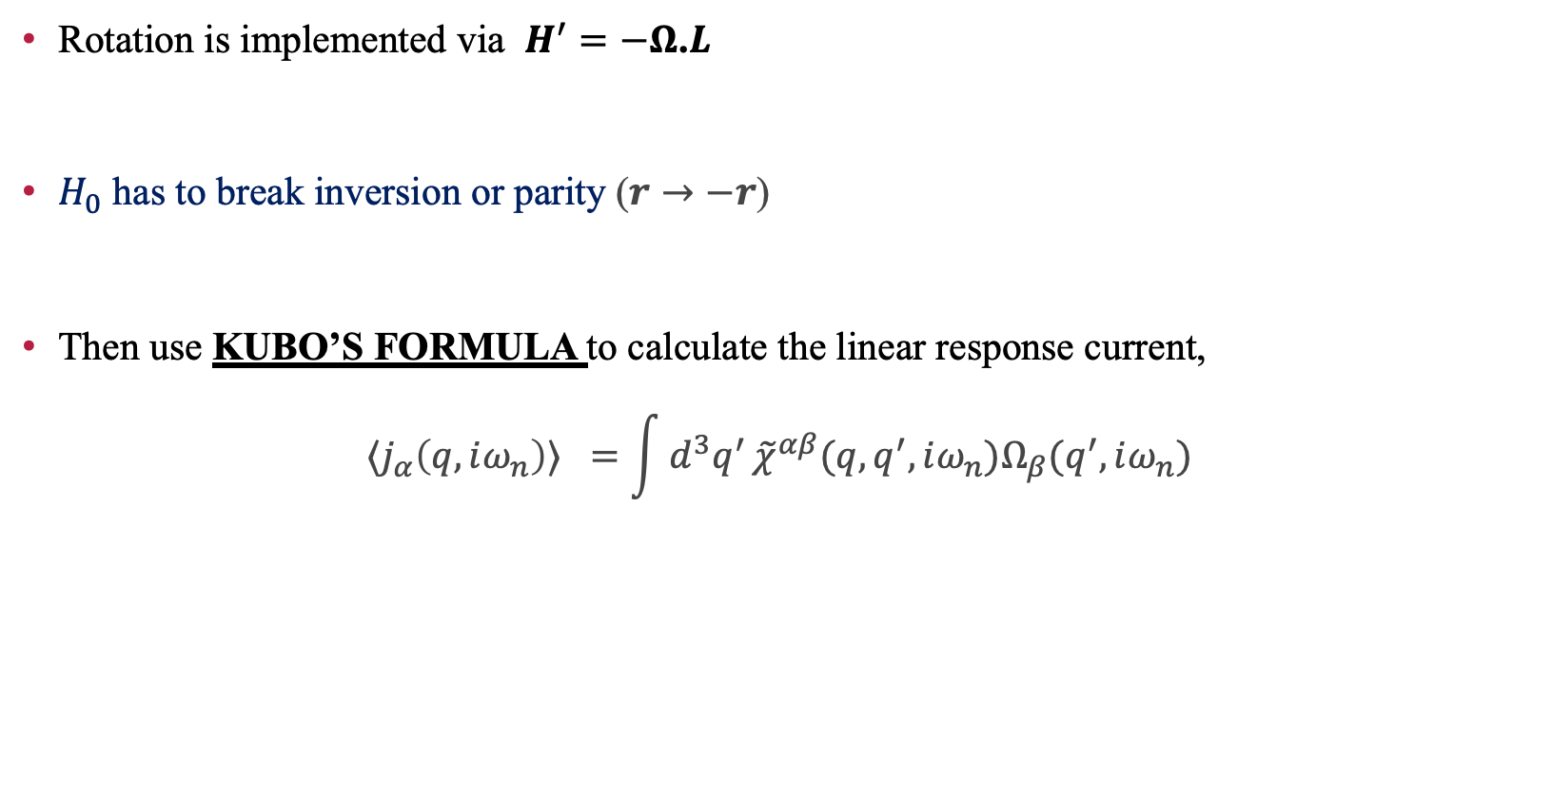
The Hamiltonian:
Rotation is implemented via $H^{′}=−Ω$.$L$
$H_{0}$ has to break inversion or parity ($r→−r$)
Then use KUBO’S FORMULA to calculate the linear response current,
$$⟨j_{α}\left(q,iω_{n}\right)⟩ =\int{d^{3}q^{′}}{\tilde{χ}}^{αβ}(q,q^{′},iω_{n})Ω_{β}(q^{′},iω_{n})$$

Slide 7
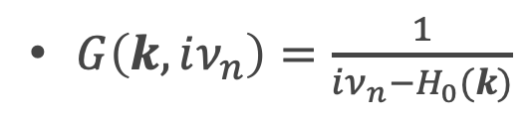
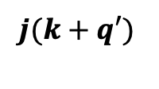




Response tensor ${\tilde{χ}}^{αβ}$ is
${\tilde{χ}}^{αβ}=T\sum_{k, iν_{n}}{tr[j_{α}\left(k+q^{′}\right)G\left(k,iν_{n}\right)L_{β}\left(q,q^{′}\right)G(k+q^{′},iν_{n}+iω_{n})]}$
$$G(k,iν_{n})$$
$$q′, iω_{n}$$
$$q,iω_{n}$$
$$j(k+q′)$$
$$L(q′;q)$$
$G(k+q′,iν_{n}$+ $iωn)$
$G\left(k,iν_{n}\right)=\frac{1}{iν_{n}−H_{0}(k)}$

Slide 8






Limits:
After taking $iω_{n}→ω+i0^{+}$, integrating over q’, the retarded response function looks like
$χ^{αβ}(q,ω)$ $=\int{d^{3}q′{\tilde{χ}}^{αβ}(q,q^{′},iω_{n}→ω+i0^{+})}$
$$χ^{αβ}(q,0)$$
$χ^{αβ}(0,0)$
Static limit
$χ^{αβ}(q,ω)$
$$χ^{αβ}(0,ω)$$
$χ^{αβ}(0,0)$
Uniform limit

Slide 9
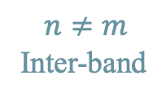

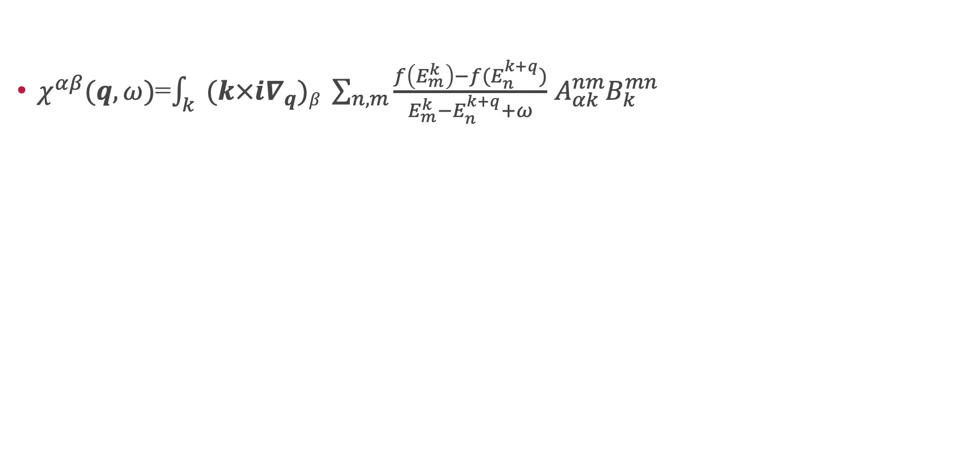

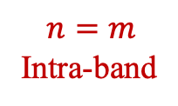
Gyrotropic Vortical effect:
$χ^{αβ}(q,ω)$=$\int_{k}{(k×i∇_{q})β \sum_{n,m}{\frac{f\left(E_{m}^{k}\right)−f(E_{n}^{k+q})}{E_{m}^{k}−E_{n}^{k+q}+ω}}}$ $A_{αk}^{nm}B_{k}^{mn}$
$$n=m$$
Intra-band
$$n≠m$$
Inter-band
Static limit | Uniform limit
CVE | Gyrotropic Vortical Effect (GVE)
Intra-band + Inter-band Previously known | Inter-band only Proposed new effect

Slide 10

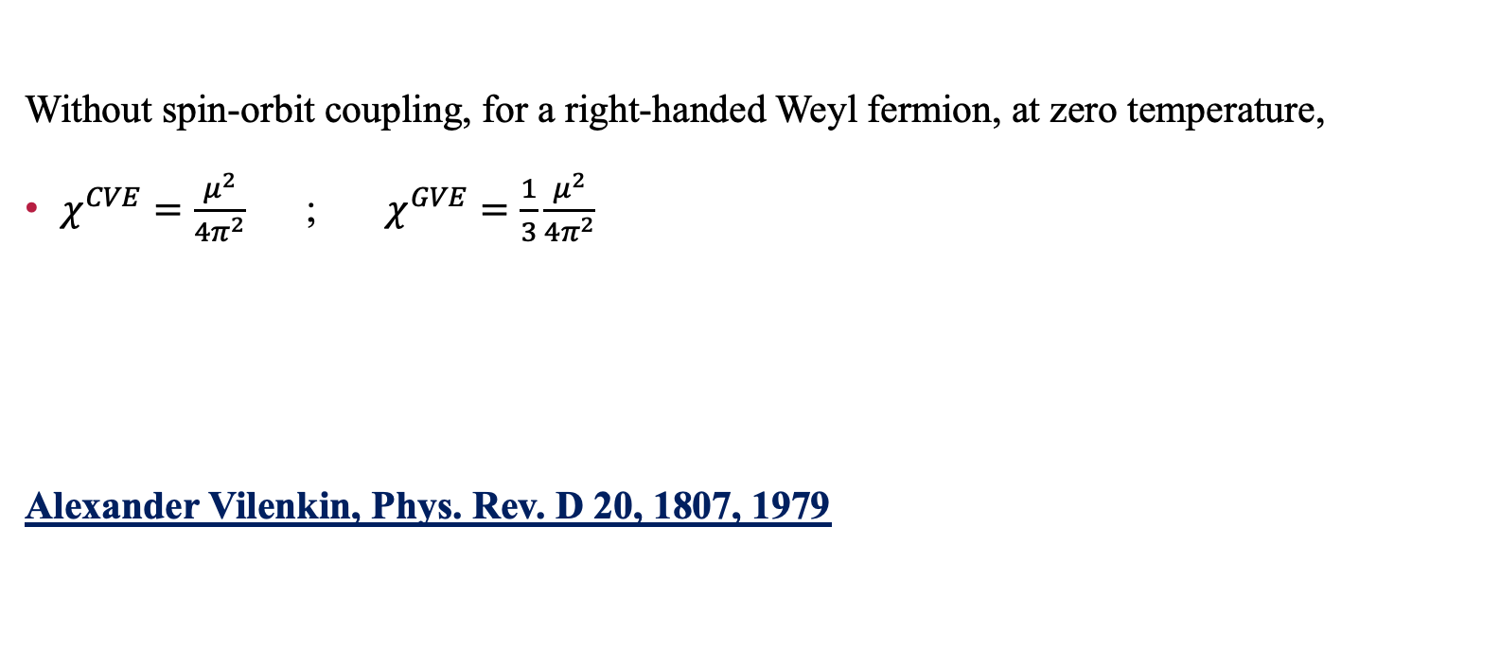
Result and Discussion:
Without spin-orbit coupling, for a right-handed Weyl fermion, at zero temperature,
$χ^{CVE}=\frac{μ^{2}}{4π^{2}}$; $χ^{GVE}=\frac{1}{3}\frac{μ^{2}}{4π^{2}}$
Alexander Vilenkin, Phys. Rev. D 20, 1807, 1979

Slide 11
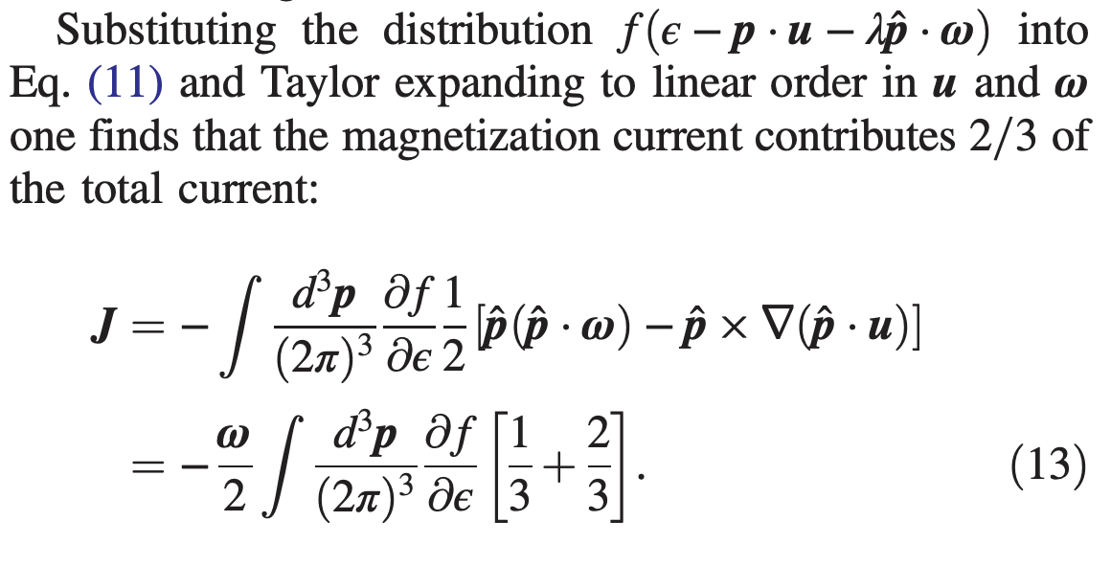
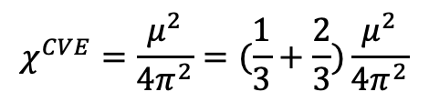
$$χ^{CVE}=\frac{μ^{2}}{4π^{2}}=(\frac{1}{3}+\frac{2}{3})\frac{μ^{2}}{4π^{2}}$$
Liouville term
Magnetization term
Jing-Yuan Chen, Dam T. Son, Mikhail A. Stephanov, Ho-Ung Yee, and Yi Yin, Phys. Rev. Lett. 113, 182302, 2014

Slide 12

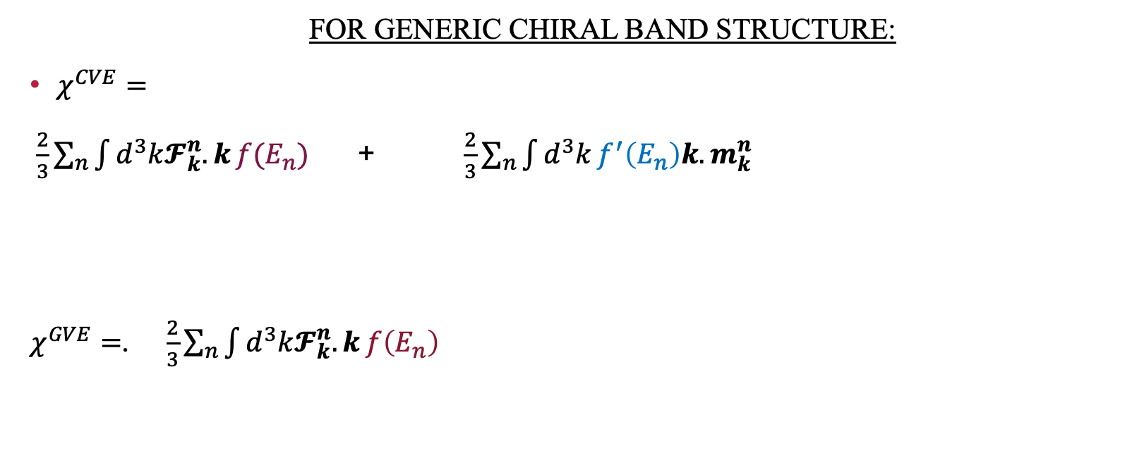
FOR GENERIC CHIRAL BAND STRUCTURE:
$χ^{CVE}=$
$\frac{2}{3}\sum_{n}{\int{d^{3}k𝓕_{k}^{n}.k}}f(E_{n})$ + $\frac{2}{3}\sum_{n}{\int{d^{3}k}f^{′}\left(E_{n}\right)k.m_{k}^{n}}$
$χ^{GVE}=$. $\frac{2}{3}\sum_{n}{\int{d^{3}k𝓕_{k}^{n}.k}}f\left(E_{n}\right)$
Inter-band (Liouville term)
Intra-band (Magnetization term)
${ m}_{k}^{n}$ is the orbital moment

Slide 13
Summary:
We have considered two different limits of the vortical effect, in the static limit we recovered the well-known CVE and in the uniform limit we get a new effect which we dub the GVE.
THANK YOU

Slide 15
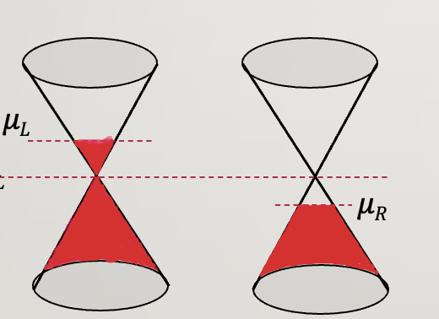
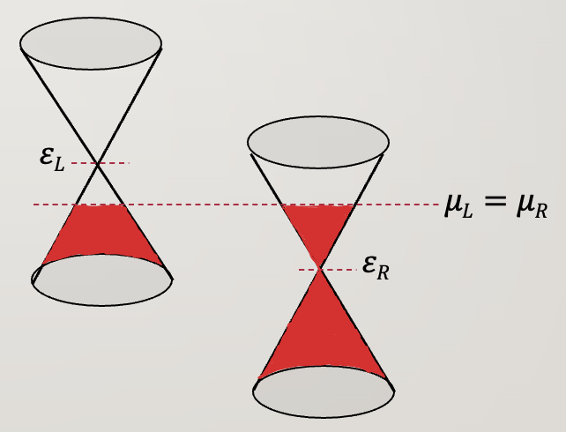
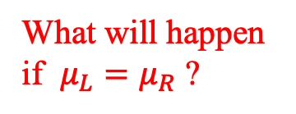
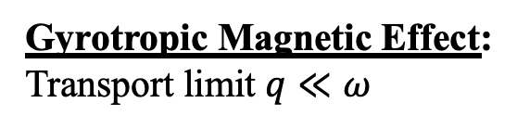
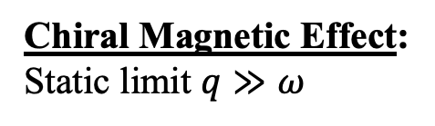
BACKGROUND AND MOTIVATION:
Chiral Magnetic Effect:
Static limit $q≫ω$
Gyrotropic Magnetic Effect:
Transport limit $q≪ω$
What will happen if $μ_{L}=μ_{R}$ ?
Out of equilibrium, steady state response to external static magnetic field driven by chirality imbalance.
Non-zero current only in transport limit
Gyrotropic Magnetic Effect and the Magnetic Moment on the Fermi Surface, Phys. Rev. Lett. 116, 077201

Slide 16
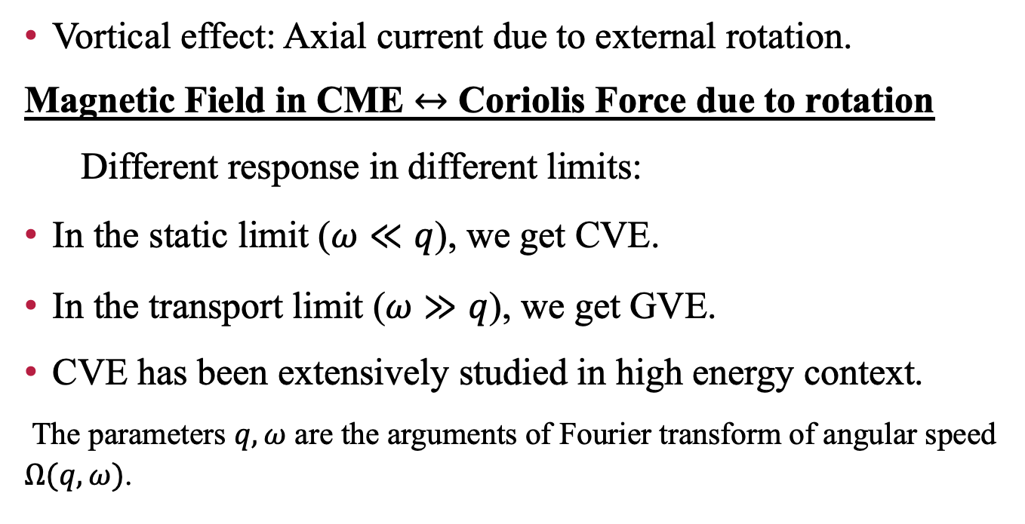

VORTICAL EFFECTS:
Vortical effect: Axial current due to external rotation.
Magnetic Field in CME $↔$ Coriolis Force due to rotation
Different response in different limits:
In the static limit ($ω≪q$), we get CVE.
In the transport limit ($ω≫q$), we get GVE.
CVE has been extensively studied in high energy context.
The parameters $q,ω$ are the arguments of Fourier transform of angular speed $Ω(q,ω)$.
$$J^{z}$$
$$Ω$$
$$J^{z}∝Ω$$

Slide 17

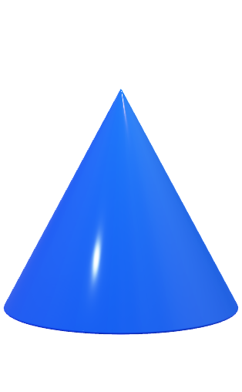


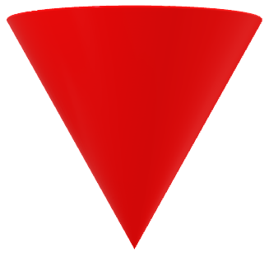


‘Topologically protected’ band
crossings
Breaks either time-reversal($τ$) or inversion ($𝒫$) or $combined 𝒫τ$symmetry
Const $k_{z}$surface
Weyl nodes
$$E(k)$$
$$k_{y}$$
$$k_{x}$$

Slide 18

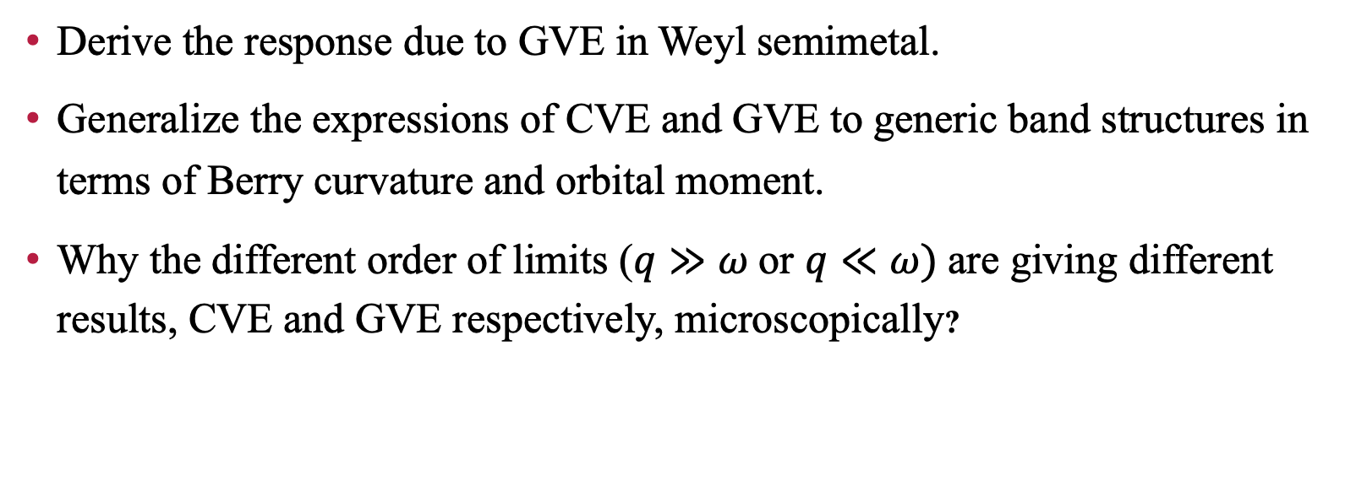
goal:
Derive the response due to GVE in Weyl semimetal.
Generalize the expressions of CVE and GVE to generic band structures in terms of Berry curvature and orbital moment.
Why the different order of limits ($q$ $≫ω$or $q≪ω)$are giving different results, CVE and GVE respectively, microscopically?

Slide 19
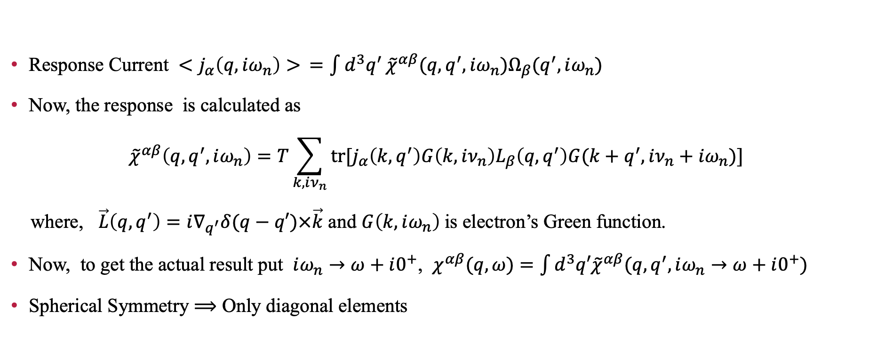
Brief pathway:
Response Current $<j_{α}\left(q,iω_{n}\right)> =\int{d^{3}q^{′}}{\tilde{χ}}^{αβ}(q,q^{′},iω_{n})Ω_{β}(q^{′},iω_{n})$
Now, the response is calculated as
$${\tilde{χ}}^{αβ}\left(q,q^{′},iω_{n}\right)=T\sum_{k, iν_{n}}{tr[j_{α}\left(k,q^{′}\right)G\left(k,iν_{n}\right)L_{β}\left(q,q^{′}\right)G(k+q^{′},iν_{n}+iω_{n})]}$$
where, $\vec{L}\left(q,q^{′}\right)=i∇_{q^{′}}δ(q−q′)×\vec{k}$ and $G\left(k,iω_{n}\right)$is electron’s Green function.
Now, to get the actual result put $iω_{n}→ω+i0^{+}$, $χ^{αβ}(q,ω)$ $=\int{d^{3}q′{\tilde{χ}}^{αβ}(q,q^{′},iω_{n}→ω+i0^{+})}$
Spherical Symmetry $⟹$ Only diagonal elements

Slide 20
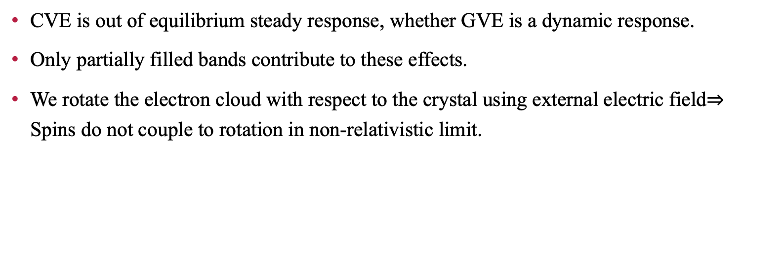
DISCUSSION :
CVE is out of equilibrium steady response, whether GVE is a dynamic response.
Only partially filled bands contribute to these effects.
We rotate the electron cloud with respect to the crystal using external electric field$⇒$ Spins do not couple to rotation in non-relativistic limit.

Slide 21
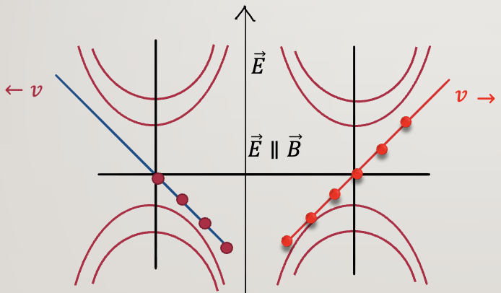
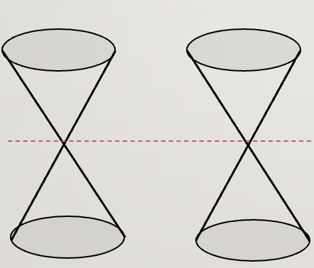
CHIRAL ANOMALY:
NON-CONSERVATION OF ELECTRIC CHARGE
ALONG A PARTICULAR DIRECTION
IN EXTERNAL EM FIELD
BANDS TOUCH AT DISTINCT K-POINTS
THESE POINTS ALWAYS APPEAR IN PAIRS

Slide 22
Questions:
Calculate axial current due to rotation in chiral band structure.
Why does the different order of limits (q ≫ ω or q≪ ω) give different results, microscopically?
Vortical effects in chiral band structures, arXiv:2206.14194

