Slide 1


RIXS studies on Two-dimensional Magnetic Materials
Research day 2023
Chamini Shammi Pathiraja¹, Jayajeewana Neranjana¹, Yi-De Chuang², Yu Cheng Shao³,
Byron Freelon¹
1. Department of Physics and Texas Center for Superconductivity, University of Houston
2. Advanced Light source, Lawrence Berkeley National Laboratory
3. National synchrotron radiation research center, Taiwan

Slide 2
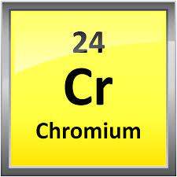
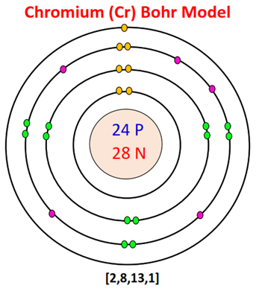
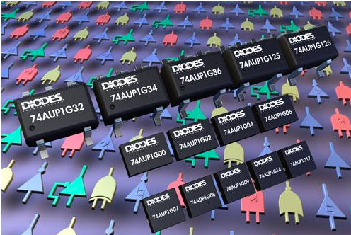

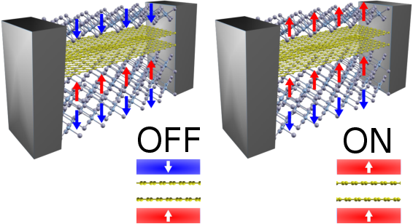
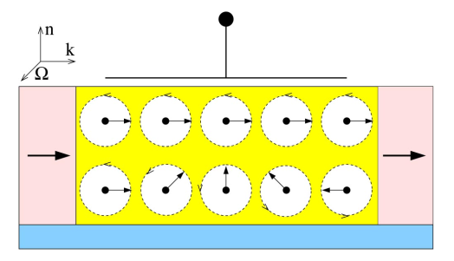
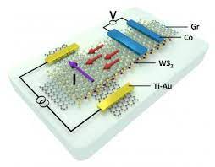
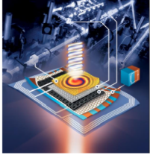
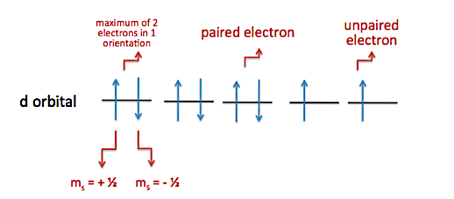




What is Spin :
Applications
Spin logic switches
Fridge Magnets
ON
OFF
Spin valves
SFET
Optical modulators
$$Cr⇒ {1s}^{2} {2s}^{2}{ 2p}^{6} {3s}^{2}{ 3p}^{6} {4s}^{1}{3d}^{5}$$
Spin transistors
Valleytronics

Slide 3
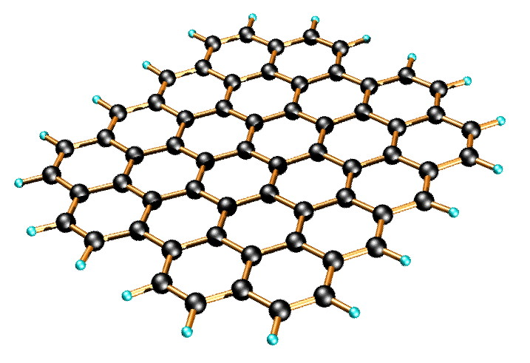
Two-dimensional (2D) van der Waals (vdW) materials :
In 2004, graphene was fabricated via scotch tape exfoliation ;
First Two-Dimensional (2D) semiconductor material
Layered material arranged in a honeycomb-like pattern
Unique structural, mechanical and electronic properties
Shows magnetism in ground states
Crystal structure of graphene¹
As a result of finding other layered materials, Magnetism up to monolayer in CrI₃ was discovered in 2017.³
Nature, 2017, v. 546 n. 7657, p. 270-284
Notes:
************************************************************
Graphite -3D ->its usefulness as an instrument for writing comes from the fact that graphite is made out of stacks of graphene layers that are weakly coupled by van der Waals forces. Hence, when one presses a pencil against a sheet of paper, one is actually producing graphene stacks and, somewhere among them, there could be individual graphene layers

Slide 4
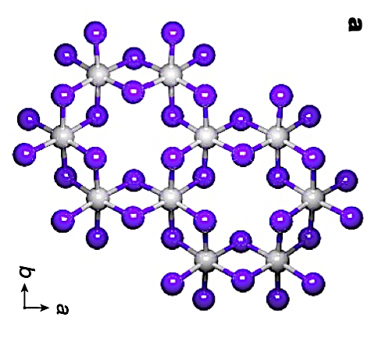
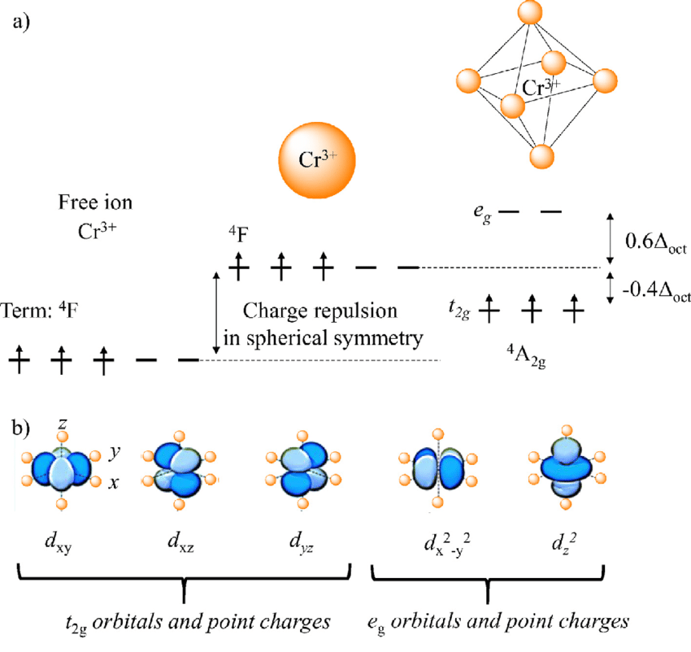
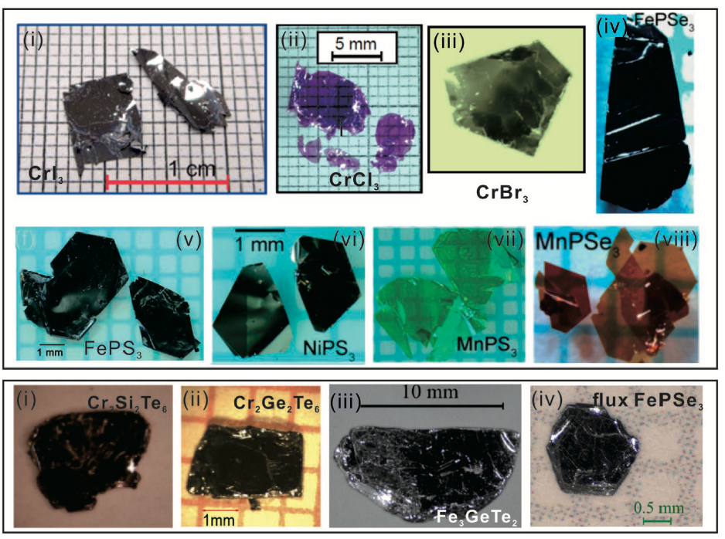
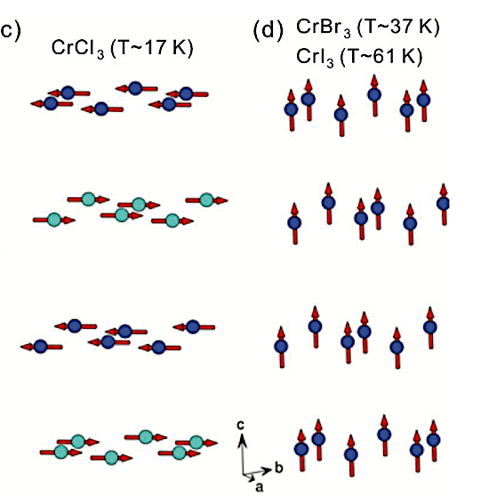
Chromium Trihalides CrX₃ (X = Cl, Br, I):
Layer dependent magnetism
  monolayer – Ferromagnetic (FM)
  bilayer – Antiferromagnetic (AFM)
bulk - CrCl₃ – AFM, CrBr₃ – FM, CrI₃ – FM
Crystallographic phase transitions
CrCl₃ – 240 K
CrBr₃ – 420 K
CrI₃ – 200 K

Slide 5
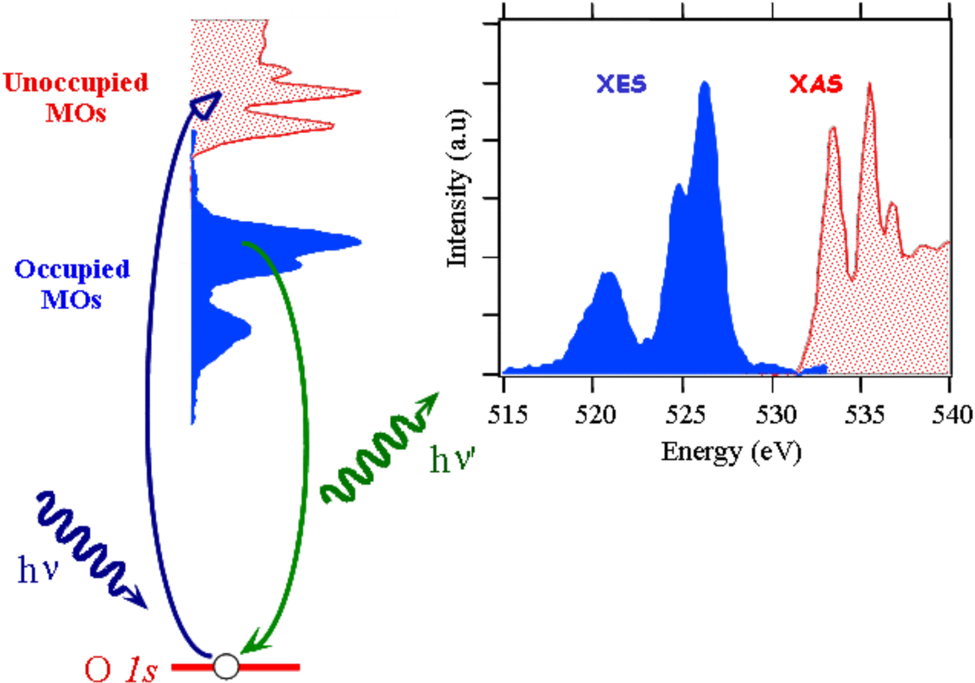

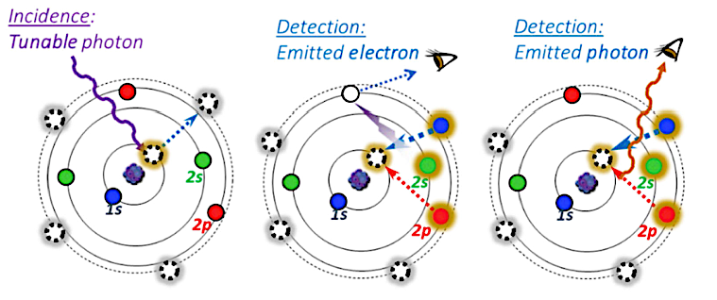



X-Ray Absorption (XAS) and X-Ray Emission (XES) Spectroscopy:
Incidence :
tunable photon
Unoccupied MO
Absorption edge
3
2
1
Occupied MO
Detection :
Emitted photon.
h𝝂’
h𝝂’
3
2
h𝝂
1
2p⁶ 3d³
-> 2p⁵ 3d⁴
-> 2p⁶ 3d³
Soft-x-ray spectroscopy probes nanomaterial-based devices
J. Am. Chem. Soc., 128, 5001 (2006).

Slide 6
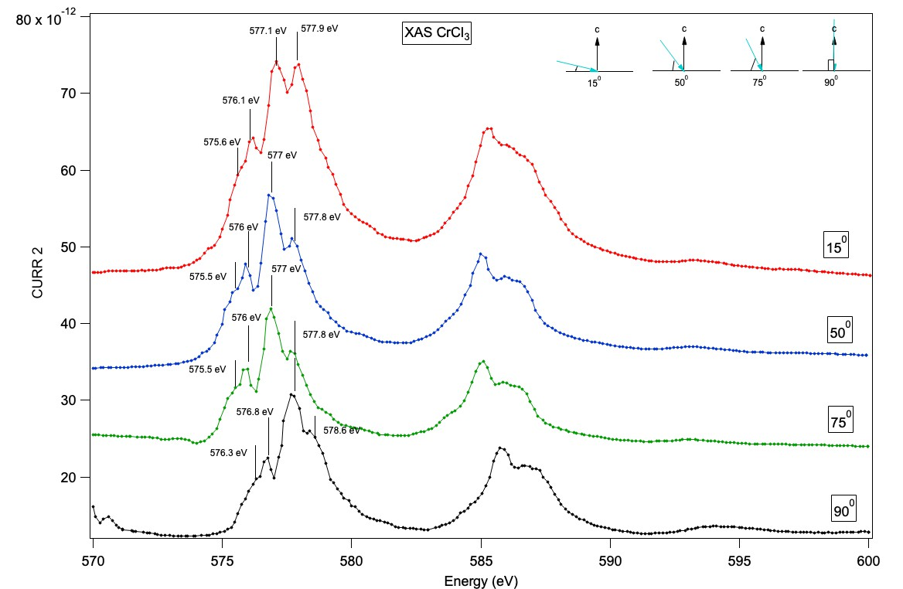
X-ray Absorption Spectroscopy :
c
h𝝂’
h𝝂
θ
Experimental set up

Slide 7
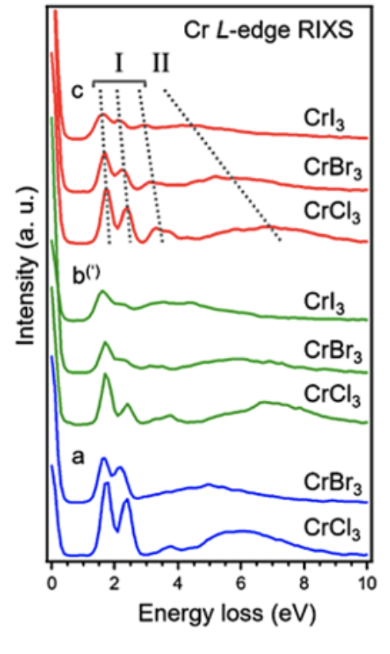
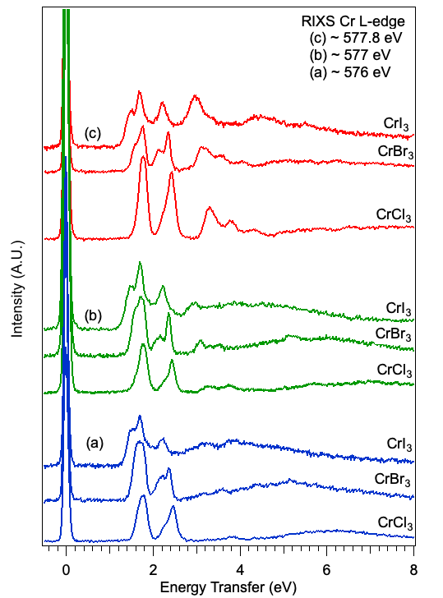
RIXS measurements on CrX₃ (X=Cl, Br and I) :
Preliminary RIXS Data:
From Advanced Light Source
Res. ~0.3 eV
High Resolution data:
BESSY II
Res. ~120 meV

Slide 8
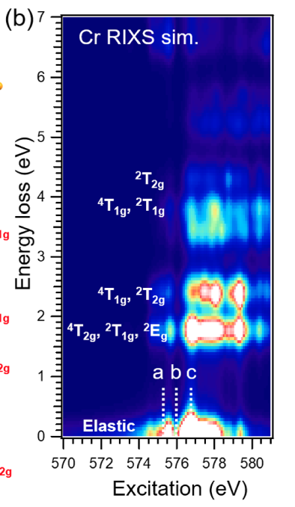
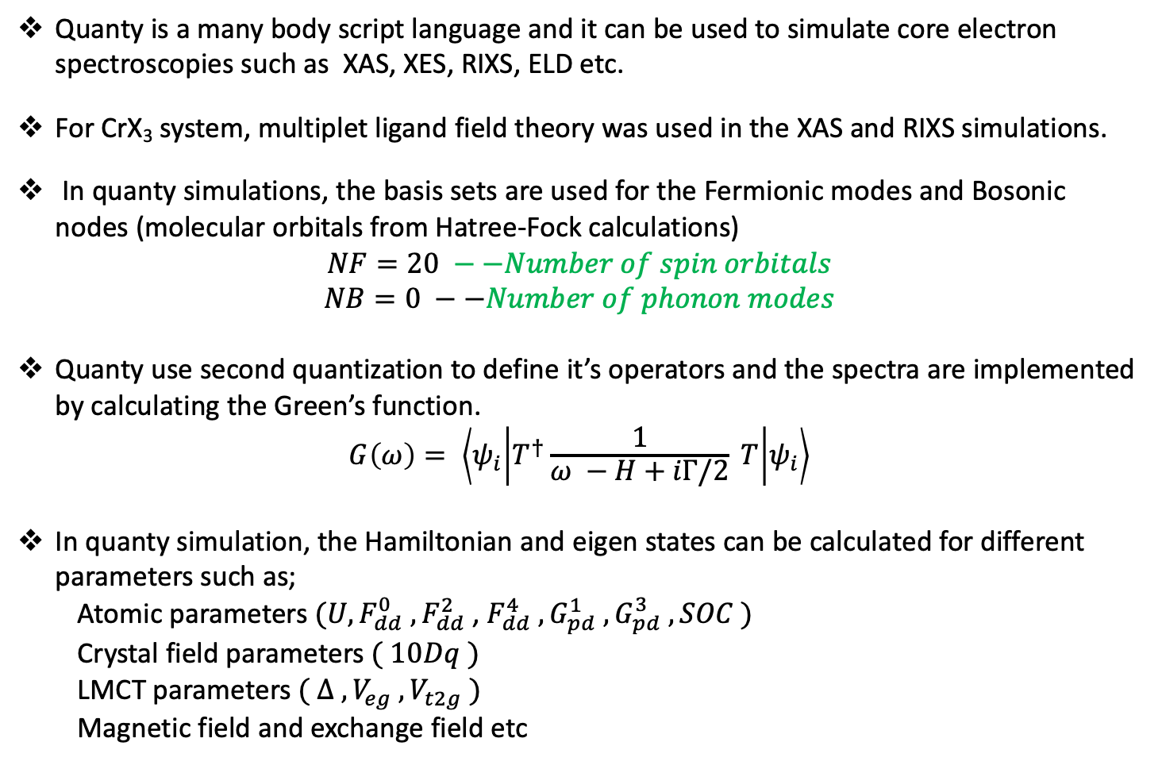
Atomic Multiplet Calculation (Quanty) :
Quanty is a many body script language and it can be used to simulate core electron spectroscopies such as XAS, XES, RIXS, ELD etc.
For CrX₃ system, multiplet ligand field theory was used in the XAS and RIXS simulations.
In quanty simulations, the basis sets are used for the Fermionic modes and Bosonic nodes (molecular orbitals from Hatree-Fock calculations)
$$NF=20 −−Number of spin orbitals$$
$$NB=0 −−Number of phonon modes$$
Quanty use second quantization to define it’s operators and the spectra are implemented by calculating the Green’s function.
$$G\left(ω\right)= \left\langle ψ_{i} | T^{†}\frac{1}{ω −H+iΓ/2} T | ψ_{i}\right\rangle$$
In quanty simulation, the Hamiltonian and eigen states can be calculated for different parameters such as;
  Atomic parameters $(U, {F_{dd}^{0} , F}_{dd}^{2}$ , $F_{dd}^{4} ,G_{pd}^{1} ,G_{pd}^{3} , SOC )$
  Crystal field parameters $( 10Dq )$
  LMCT parameters $( Δ , V_{eg} , V_{t2g} )$
  Magnetic field and exchange field etc

Slide 9
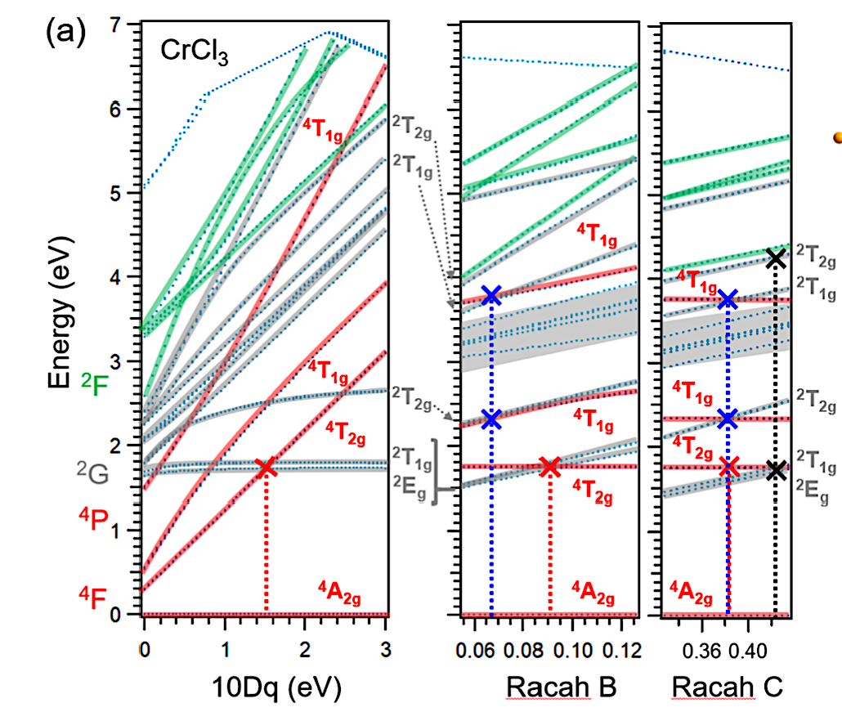
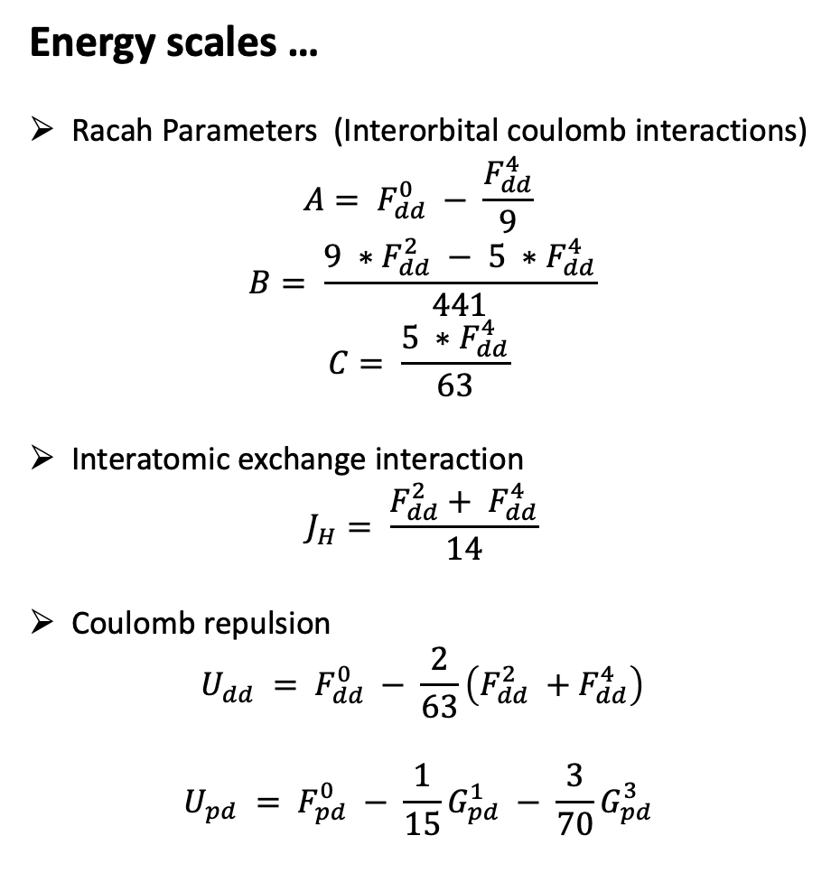
Calculating energy scales:
Energy scales …
Racah Parameters (Interorbital coulomb interactions)
$$A= F_{dd}^{0} − \frac{F_{dd}^{4}}{9}$$
$$B= \frac{{9 ∗F}_{dd}^{2} − {5 ∗F}_{dd}^{4}}{441}$$
$$C= \frac{{5 ∗F}_{dd}^{4}}{63}$$
Interatomic exchange interaction
$$J_{H}= \frac{F_{dd}^{2}+ F_{dd}^{4}}{14}$$
Coulomb repulsion
$$U_{dd} = F_{dd}^{0} − \frac{2}{63}\left(F_{dd}^{2} +F_{dd}^{4}\right)$$
$$U_{pd} = F_{pd}^{0} − \frac{1}{15}G_{pd}^{1} − \frac{3}{70}G_{pd}^{3}$$

Slide 10
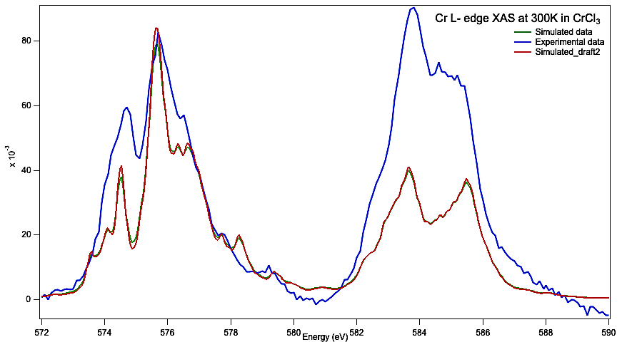
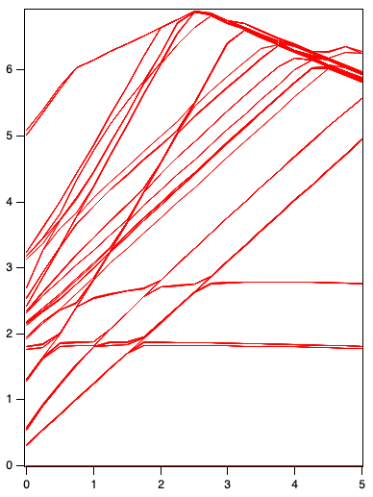
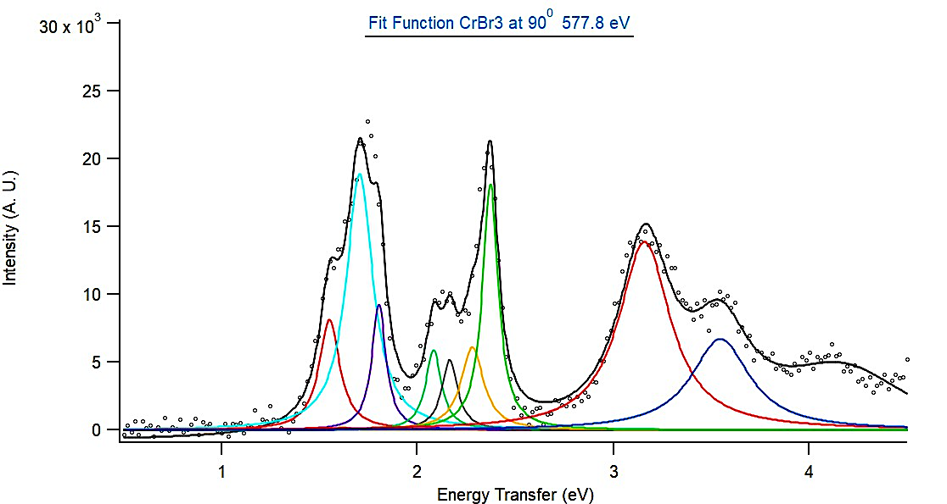
High resolution data analysis :

Slide 11




Conclusion :
CrX₃ (X=Cl, Br and I) are becoming great potential candidates for spintronics and magnetoelectronic devices.
RIXS is a much more accurate approach to obtain key energy scales than XAS and optical spectras.
Using Quanty ELDs, we can reliably extract these energy scales and reconstruct RIXS spectra.
Acknowledgement :
Funding : NSF
Synchrotron radiation facilities :

Slide 12

THANK YOU …
QUESTIONS ?

Slide 13
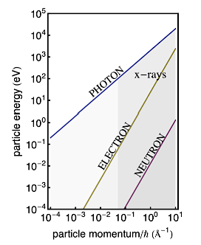
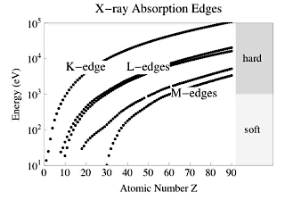
Why RIXS:
When comparing to other scattering techniques, RIXS has number of unique features.
RIXS exploits both the energy and momentum dependence of the photon scattering cross-section.
RIXS can probe a very broad class of intrinsic excitations of the system under study
RIXS can utilize the polarization of the photon.
RIXS is element and orbital speciﬁc.
RIXS is bulk sensitive.
RIXS needs only small sample volumes.
1. DOI: 10.1103/RevModPhys.83.705 · Source: arXiv
Notes:
In principle RIXS can probe a very broad class of intrinsic excitations of the system under study as long as these excitations are overall charge neutral. This is because in RIXS, the scattered photons do not add or remove from the system.
Comparing the energies of a neutron, electron, and photon an x-ray photon has much more energy. The range of energies and momenta that can be transferred in a scattering event is much larger in x-rays. For instance, unlike photon scattering experiments with visible or infrared light, RIXS can probe the full dispersion of low energy excitations in solids.
3. The nature of the excitations created in the materials can be identified through the polarization analysis of the incident and scattered photons. The polarization change of a photon is related to an angular momentum change. Conservation of angular momentum means that any angular momentum lost by the scattered photons has been transferred to elementary excitations in the solid.
4. RIXS can excite electrons by tuning the incident photon energy to speciﬁc atomic transitions of the diﬀerent types of atoms in a material. These edges are known as absorption edges. K-> exciting 1s core electrons, L -> n=2 shell and M -> n=3 shell.
5. the penetration depth of resonant x-ray photons is material and scattering geometry-speciﬁc, but typically is on the order of a few
µm for photons of 10 keV in the hard x-ray regime, and on the order of 0.1 µm for photons of 1 keV in the soft x-ray regime.
6. the photon-matter interaction is relatively strong, compared to for instance the neutron-matter interaction strength. In addition, photon sources deliver many orders of magnitude more particles per second, in a much smaller spot, than do neutron sources. These facts make RIXS possible on very small volume samples, thin ﬁlms, and nano-objects, in addition to bulk single crystal or powder samples.

Slide 14
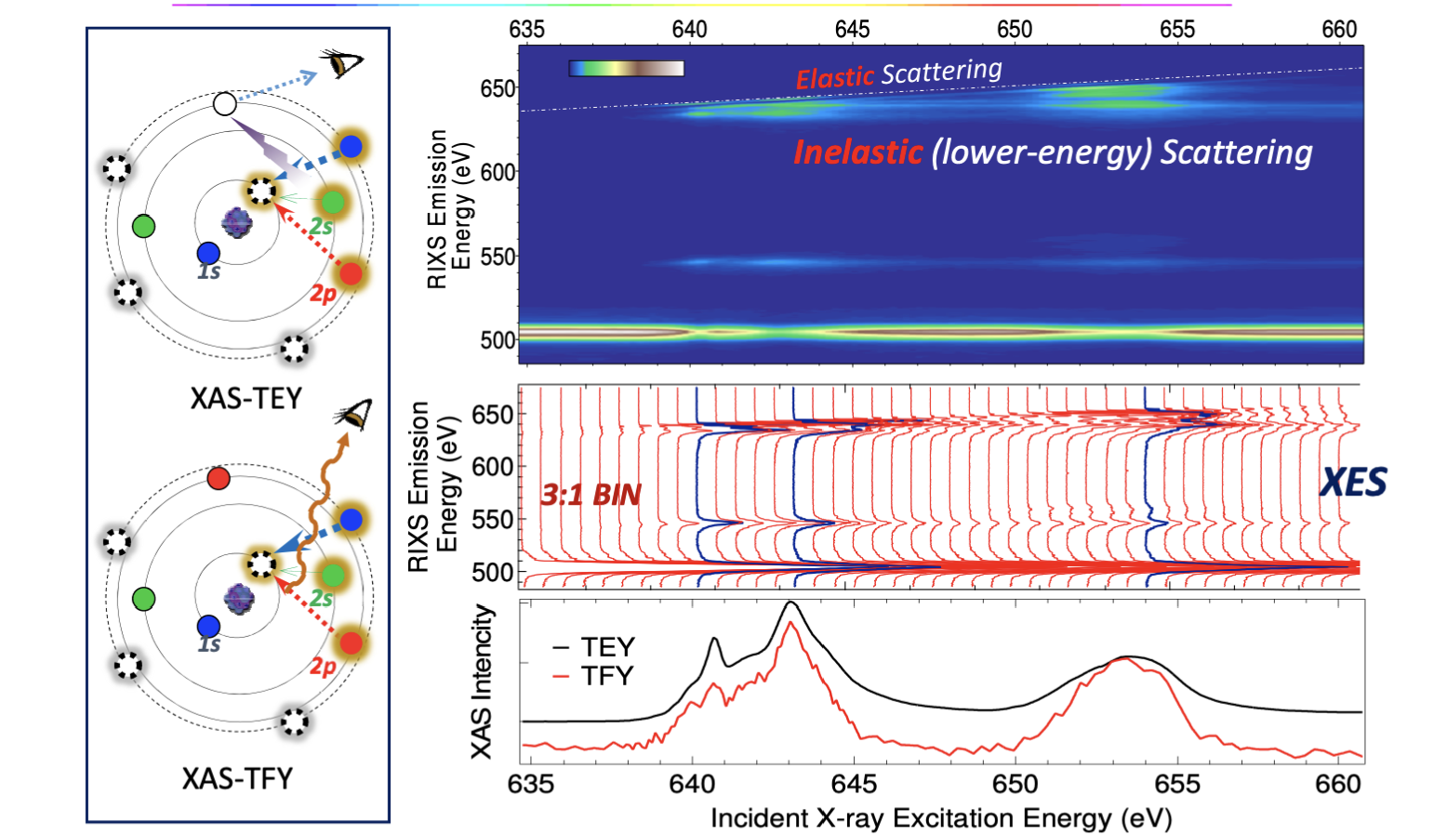
From XAS to Resonant Inelastic X-ray Scattering (RIXS) . . .
Detection :
Emitted photon.
Elastic scattering
3
2
1
Inelastic scattering :
D-d excitations
Charge transfer
Magnons
Phonons
Video : A "slow" explanation of XAS and RIXS through simplified Atomic Schematic
Notes:
It is a photon-in photon-out spectroscopy for which one can, in principle, measure the energy, momentum, and polarization change of the scattered photon. The change in energy, momentum, and polarization of the photon are transferred to intrinsic excitations of the material under study and thus RIXS provides information about those excitations. RIXS is a resonant technique in which the energy of the incident photon is chosen such that it coincides with, and hence resonates with, one of the atomic x-ray transitions of the system. The resonance can greatly enhance the inelastic scattering cross section, sometimes by many orders of magnitude, and oﬀers a unique way to probe charge, magnetic, and orbital degrees of freedom on selective atomic sites in a crystal.
50 meV –phonons
500 meV – magnons
1.5-2 – dd excitations
Greater – charge transfer excitations

Slide 15
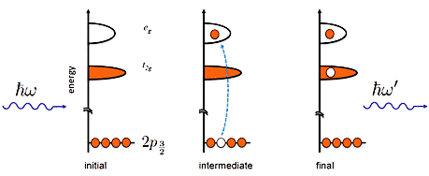


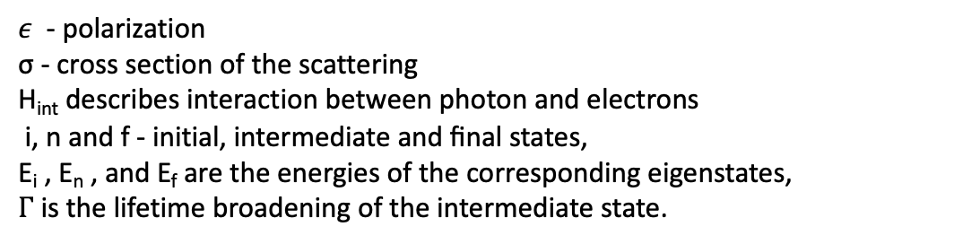








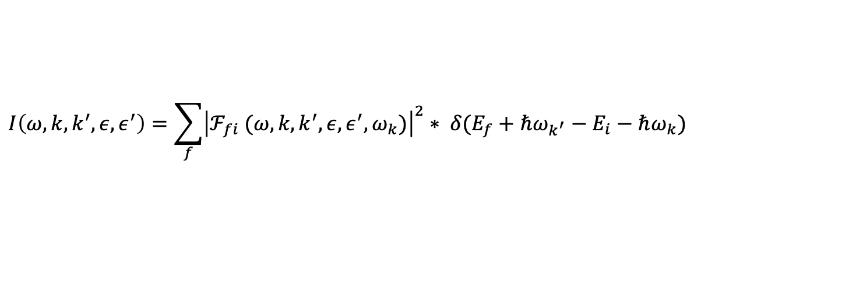

What is RIXS:
Kramers - Heisenberg cross section :
$ε$ - polarization
σ - cross section of the scattering
H_{int} describes interaction between photon and electrons
i, n and f - initial, intermediate and ﬁnal states,
E_{i} , E_{n} , and E_{f} are the energies of the corresponding eigenstates,
$Γ$is the lifetime broadening of the intermediate state.
$$\frac{d^{2}σ}{dΩdω} ∝.{\left|<f{|H}_{int}|i> + \sum_{|n>}{\frac{<f\left|H_{int}\left|n><n\right|H_{int}\right|i>}{E_{i}+{ℏω}_{i}−E_{n}+iΓ}}\right|}^{2}$$
RIXS Intensity (scattering amplitude) :
$$I\left(ω,k,k^{′},ε,ε^{′}\right)=\sum_{f}{{\left|ℱ_{fi} (ω,k,k^{′},ε,ε^{′},ω_{k})\right|}^{2}∗ δ(E_{f}+{ℏω}_{k^{′}}−E_{i}−{ℏω}_{k})}$$
$$e_{g}$$
$$t_{2g}$$
$${ℏω}_{k}$$
$${ℏω}_{k^{′}}$$
$$Ω$$
$$ω$$
$${2p}_{3/2}$$
$$initial$$
$$intermidiate$$
$$final$$
p. 2315-2366. Cham: Springer International Publishing, 2020.
RevModPhys.83.705 · Source: arXiv
Notes:
To develop the theory of RIXS, we ﬁrst need to derive the Hamiltonian that describes the interaction of the incident X-ray beam with the electrons in the sample. The interaction terms in this Hamiltonian are small, Therefore they can be treated as a perturbation up to the second order. We need to go to second or-
der because two interactions are needed: one to create the core hole, and one for the subsequent radiative de- Excitation.,Then, we obtain the Kramers-Heisenberg formula, which describes RIXS very well.
Ω and ω are the incident and emitted X-ray energies
Fermi level eF , and in the ﬁnal state a 2 p electron made a radiative transition to the 1 s state.
Therefore the emitted photon was observed at ( eF - eL ) , where eF - eL corresponds to the binding energy of the 2 p electron.
After considering all the electron-photon interactions and other dynamics, we can derive the RIXS intensity in general and can be written in terms of a scattering amplitude as :
The energy and momentum of the excitation is determined by the diﬀerence in photon energy hωk − hωk’ and momentum hk’ − hk, respectively. delta function enforces energy conservation and the amplitude Ff g (k, k , , , ωk ) reﬂects which excitations are probed and how.( for instance, the spectral weights of ﬁnal state excitations depend on the polarization vectors, e and e’ of the incoming and outgoing x-rays, respectively. )
***********************
when the emitted-photon energy is the same as that of the incident-photon energy , the spectrum is called ‘‘Rayleigh scattering’’ or ‘‘resonant elastic x-ray scattering,’’ while for omega~= little omwga, it is called ‘‘resonant inelastic x-ray scattering (RIXS)

Slide 16
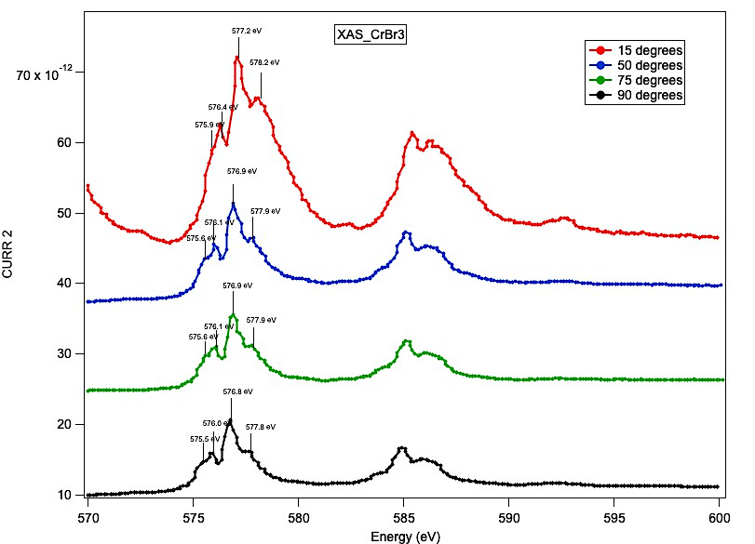
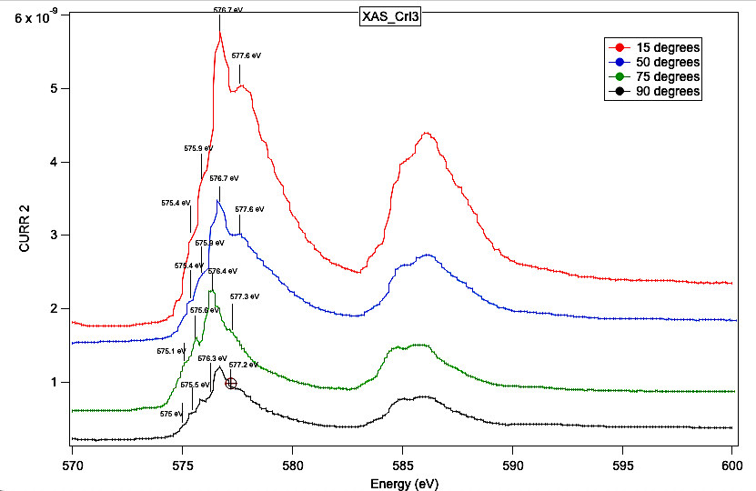
Comparing X-ray Absorption Spectroscopy of CrX₃ (X = Cl, Br, I) :

Slide 17
RIXS studies of VI₃ VBr₃:
Two-Dimensional van der Waals material
Ferromagnetic (FM) with S = 1
Easily cleavable
Curie temperatures Tc are higher than CrX₃ (80 and 98 K for VCl₃ and VI₃ monolayers, respectively).
VI₃ is a Mott insulator which exhibits a SPT from monoclinic to rhombohedral at 79 K
Long-range FM ordering appears at Tc ≈ 50 K.
Plan to perform series of RIXS measurements on VX₃ at the ALS qRIXS end station in order to obtain a comparison with the S=3/2 CrX₃ systems.
We anticipate that RIXS will allow informative direct comparisons between Mott insulators and the metallic 2D magnets.
Currently, we have the access to high quality VI₃ single crystals through the commercial laboratories.

