Slide 1
Theory of Conventional Superconductivity at the surface of a Type-I Weyl Semimetal
Aymen

Slide 2
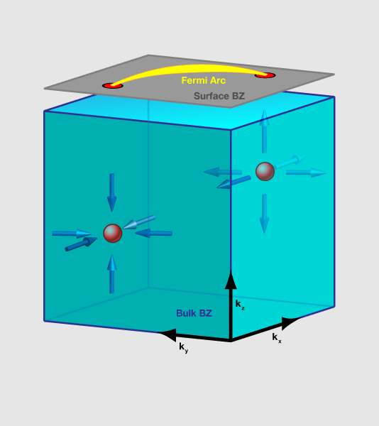
Weyl Semimetal
Discrete band touchings in the bulk : Weyl points (Topologically protected)
Require inversion symmetry or time-reversal symmetry to be broken.
Low energy dispersion around Weyl points resemble a quasi-Weyl fermion.
Zero energy states on the surface: Fermi arcs.

Slide 3
Big Picture
Bulk physics: Well understood
Surface physics: Doesn’t have a well-defined Hamiltonian so more intractable.
Fermi arcs bleed into the bulk
Workaround: Use Green’s functions.

Slide 4
Motivation
Superconductivity depends on the density of states and number of dimensions.
For Weyl semimetal
Bulk
dimensionality(3D) -> high
density of states -> low.
Surface
dimensionality(2D) -> low
density of states -> high
(Because Fermi Arcs)
Goal: determine whether the surface or bulk effects dominate
Recent experiments have shown presence of superconductivity on the surface

Slide 5


Setup
Assume attractive Hubbard interaction and pair hopping at each site.
The large-N approximation will give us the mean field result.
$$↑$$
$$↓$$
Surface of a Weyl Semimetal with electrons near the spin reversed Fermi arcs forming Cooper pairs.

Slide 6

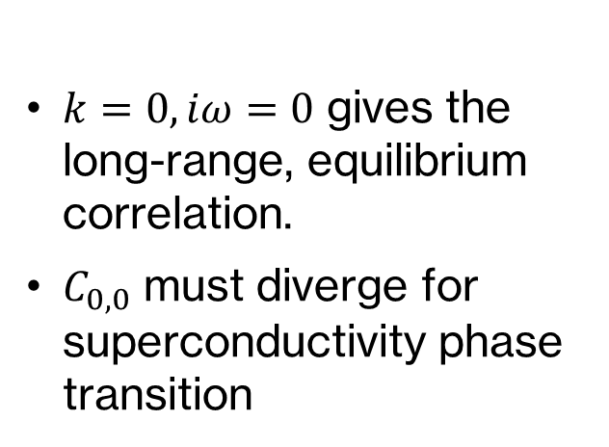
Calculation
$k=0, iω=0$ gives the long-range, equilibrium correlation.
$C_{0,0}$ must diverge for superconductivity phase transition

Slide 7
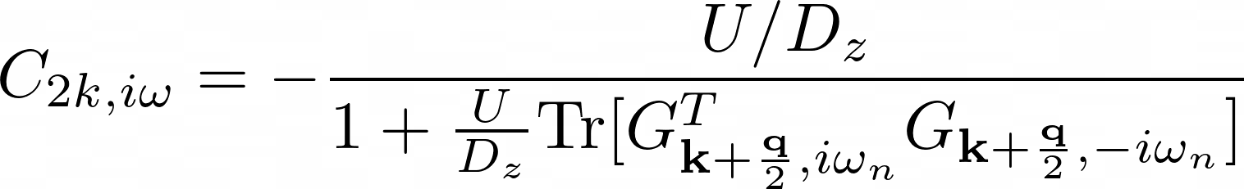

Sum over bubble diagrams, which is equivalent to mean-field approximation due to large-N approximation
C has to diverge for the instability.
+
$$C=$$
+
+…

Slide 8








$$k+\frac{q}{2},iω$$
Second Order Diagram
$$σ,n$$
$σ′,n$’
$$2k,0$$
$$2k,0$$
$$−σ,n$$
$−σ′,n$’
$$k−\frac{q}{2},−iω$$

Slide 9
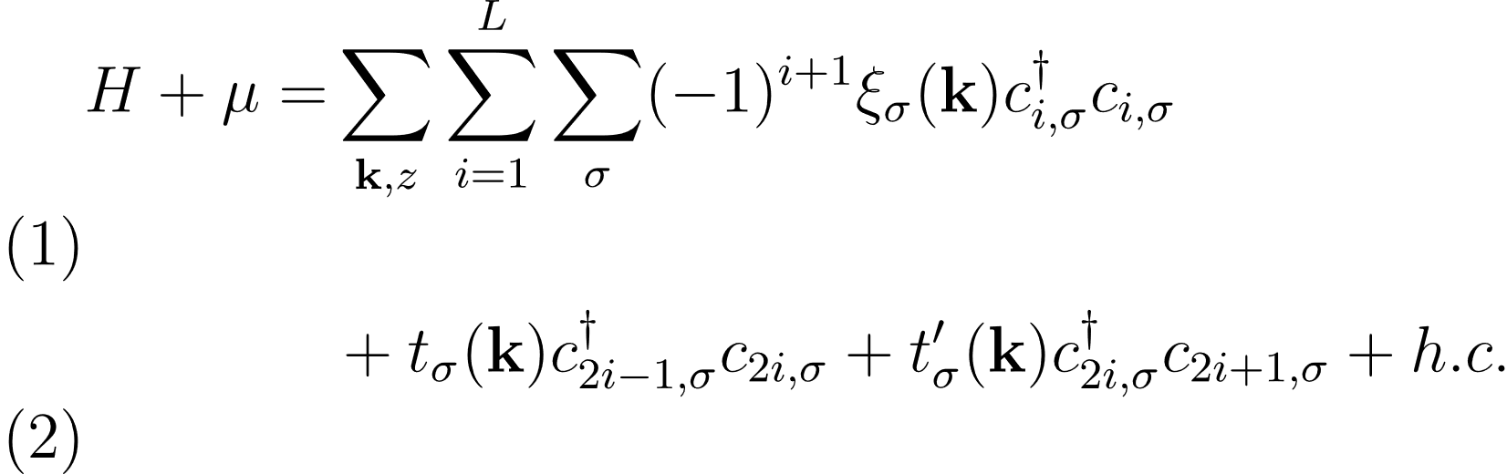



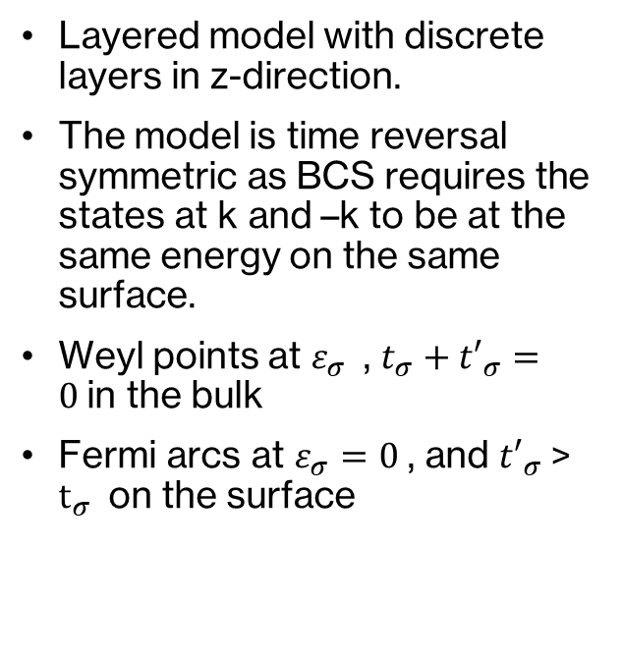





Model
Layered model with discrete layers in z-direction.
The model is time reversal symmetric as BCS requires the states at k and –k to be at the same energy on the same surface.
Weyl points at $ε_{σ}$, $t_{σ}+{t′}_{σ}=0$in the bulk
Fermi arcs at $ε_{σ}=0$, and ${t′}_{σ}$> $t_{σ}$on the surface
k_{y}
k_{x}
$$K_{3}$$
$${FA}_{↓}$$
$$K_{4}$$
$$K_{1}$$
$${FA}_{↑}$$
$$K_{2}$$
z
$$t_{σ}$$
$${t′}_{σ}$$

Slide 10
Surface Green’s Function
Branch cuts -> Effects due to the bulk
Poles -> Effects due to Fermi arcs on surface

Slide 11
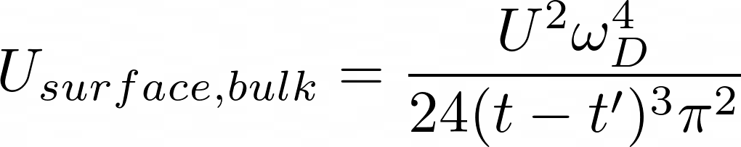
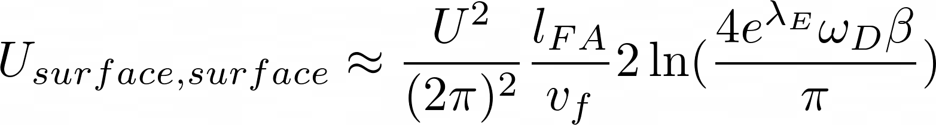

Slide 12
Experiments
NbP : Type – I Weyl semimetal
Superconductivity found in 6.2% of powdered sample between 6-9K (Baenitz et al.)
Superconductivity found in powdered sample at 7.5 K (Kumar et. al.)
Possible explanations for low superconducting sample :
- Surface superconductivity
- Conversion to Type-II Weyl semimetal

Slide 13
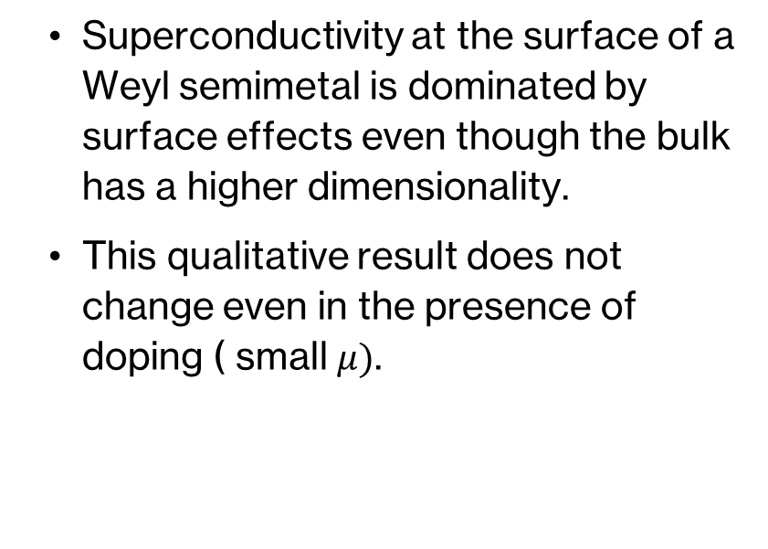
Conclusion
Superconductivity at the surface of a Weyl semimetal is dominated by surface effects even though the bulk has a higher dimensionality.
This qualitative result does not change even in the presence of doping ( small $μ)$.

