Slide 1


Extreme value statistics of community detection in complex networks with Reduced network extremal ensemble learning (RenEEL)
Tania Ghosh^{1,2}
R. K. P Zia^{1,3}
Kevin E. Bassler^{1,2}
¹Department of physics, University of Houston, Houston, Texas
²Texas Center for Superconductivity, University of Houston, Houston, Texas
³Department of Physics, Virginia Tech, Blacksburg, VA

Slide 2
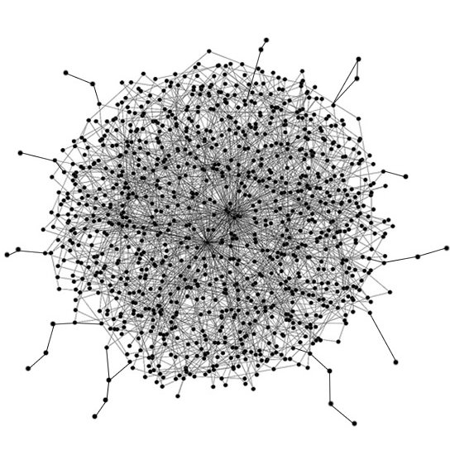

How do we begin to analyze this?
Is there any structure?
How does one define structure?
Panahi, Aliakbar. (2017). Big Data Visualization Platform for Mixed Reality. 10.13140/RG.2.2.30707.27686.

Slide 3
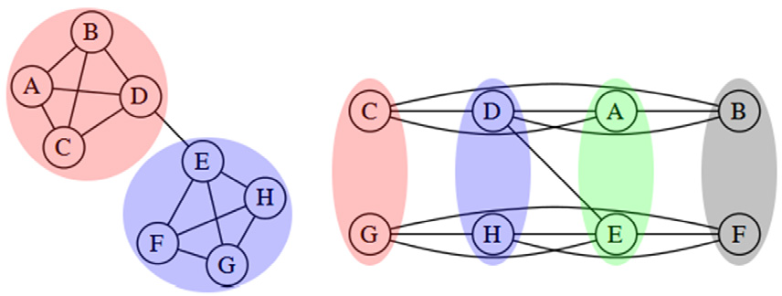
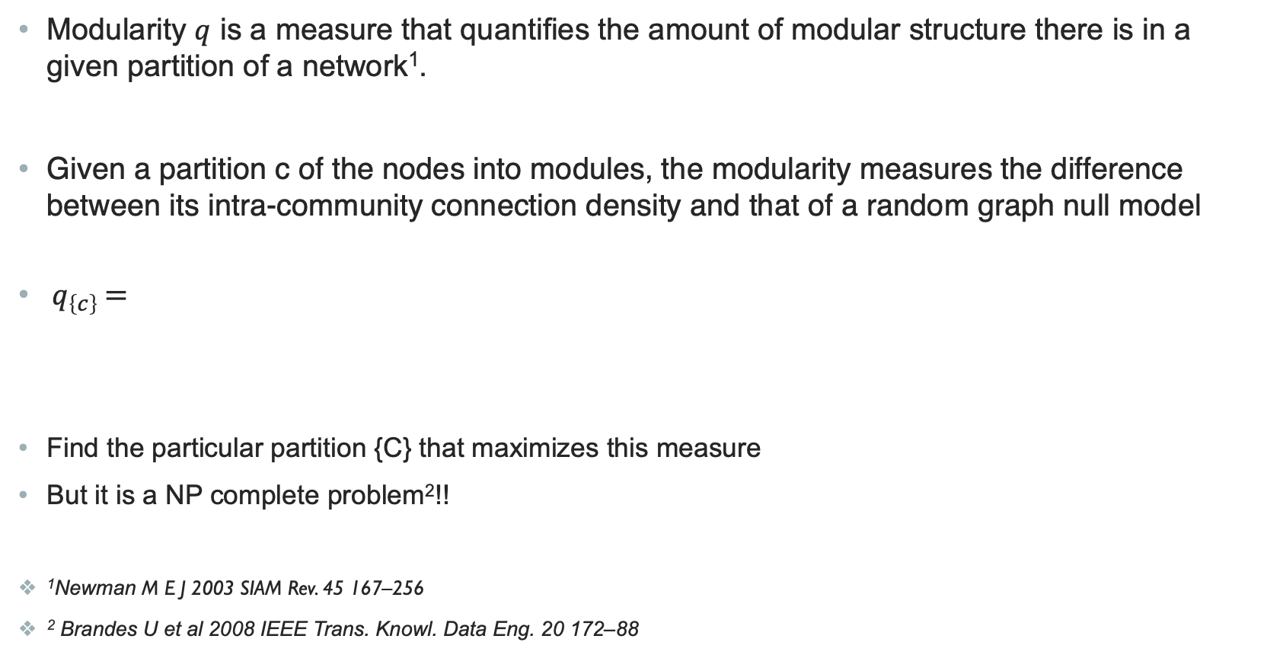
Finding Community structure
Modularity $q$ is a measure that quantifies the amount of modular structure there is in a given partition of a network¹.
Given a partition c of the nodes into modules, the modularity measures the difference between its intra-community connection density and that of a random graph null model
$q_{\left\{c\right\}}$ $=$
Find the particular partition {C} that maximizes this measure
But it is a NP complete problem²!!
¹Newman M E J 2003 SIAM Rev. 45 167–256
² Brandes U et al 2008 IEEE Trans. Knowl. Data Eng. 20 172–88
the fraction of links
inside communities
-
the expected fraction if all links
of the network were randomly
placed

Slide 4
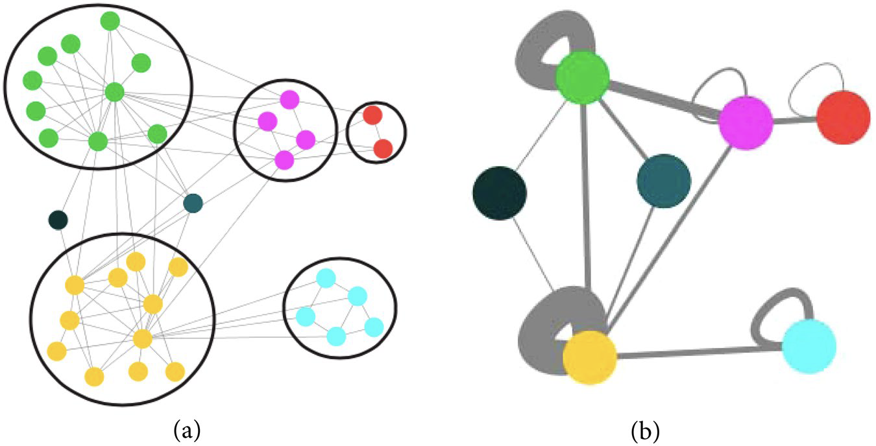
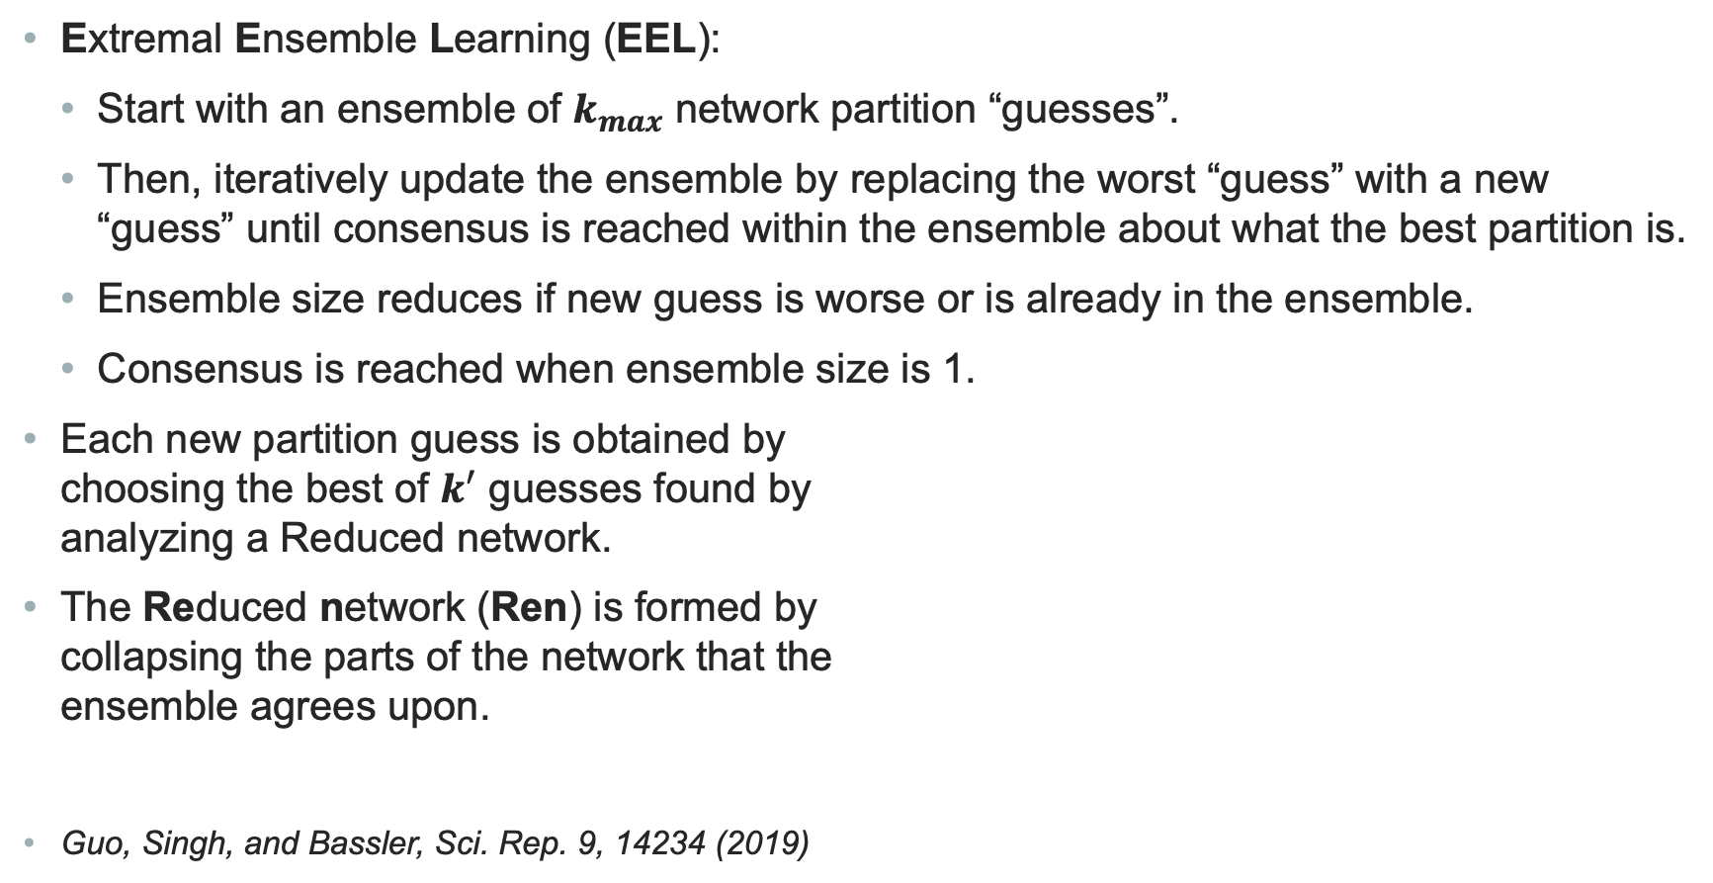
RenEEL Algorithm for Community Detection in a Network
Extremal Ensemble Learning (EEL):
  Start with an ensemble of $k_{max}$ network partition “guesses”.
  Then, iteratively update the ensemble by replacing the worst “guess” with a new “guess” until consensus is reached within the ensemble about what the best partition is.
  Ensemble size reduces if new guess is worse or is already in the ensemble.
  Consensus is reached when ensemble size is 1.
Each new partition guess is obtained by choosing the best of $k^{′}$ guesses found by analyzing a Reduced network.
The Reduced network (Ren) is formed by collapsing the parts of the network that the ensemble agrees upon.
Guo, Singh, and Bassler, Sci. Rep. 9, 14234 (2019)

Slide 5
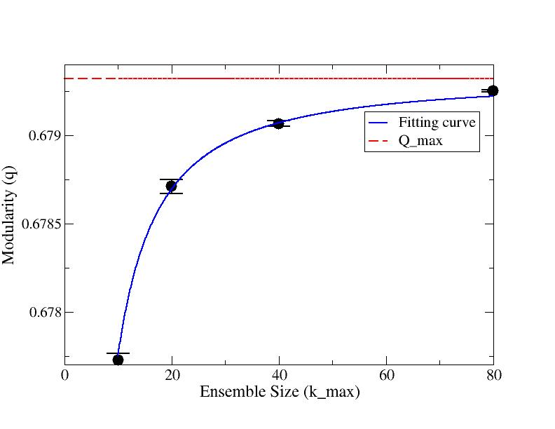
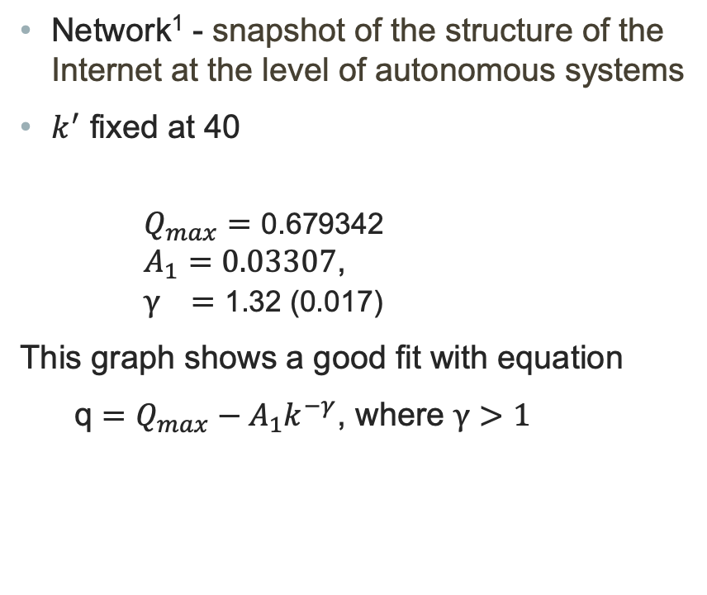
Study of Modularity value varying $k_{max}$
Network¹ - snapshot of the structure of the Internet at the level of autonomous systems
$k^{′}$ fixed at 40
$Q_{max}=\text{0.679342}$ $A_{1}=0.03307$, $γ =\text{1.32 (0.017)}$
This graph shows a good fit with equation
q $=Q_{max}−A_{1}k^{−γ}$, where $γ>1$
¹https://www.cc.gatech.edu/dimacs10/

Slide 6
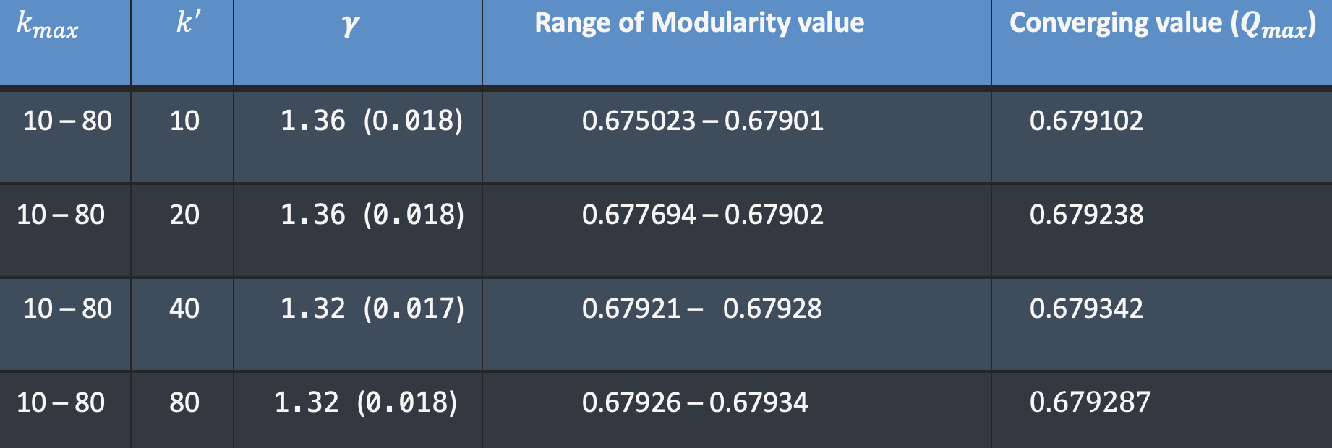
Results varying $k_{max}$
Network¹ Internet Autonomous System
Table no 1
¹ https://www.cc.gatech.edu/dimacs10/

Slide 7
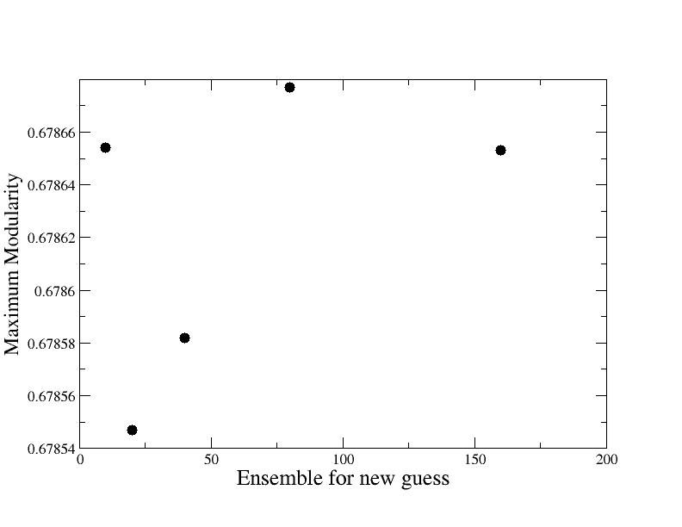
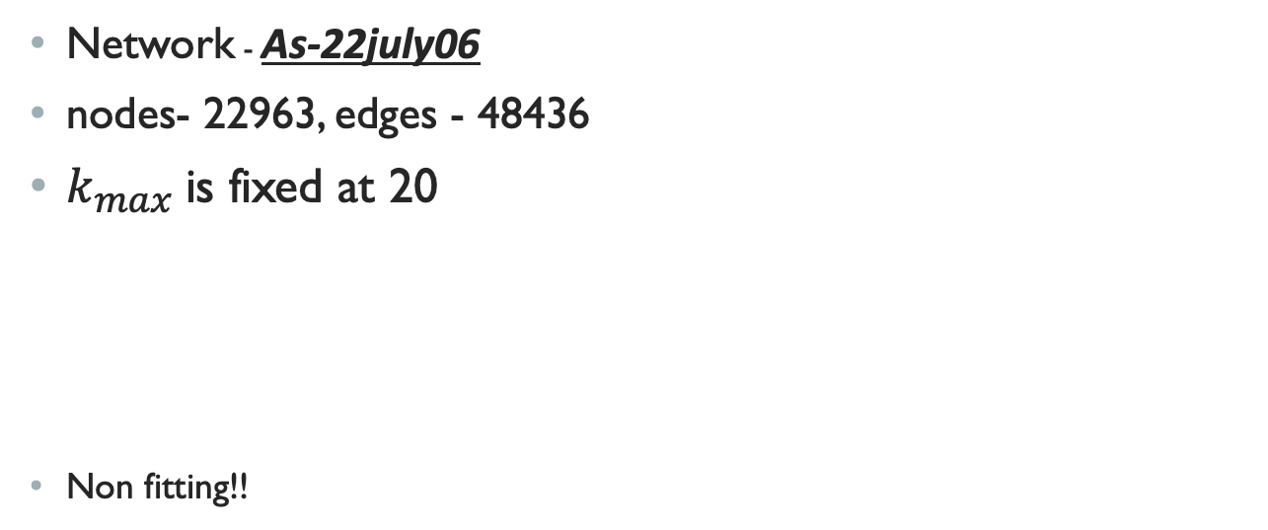
Study of Modularity value varying $k^{′}$
Network - As-22july06
nodes- 22963, edges - 48436
$k_{max}$is fixed at 20
Non fitting!!

Slide 8
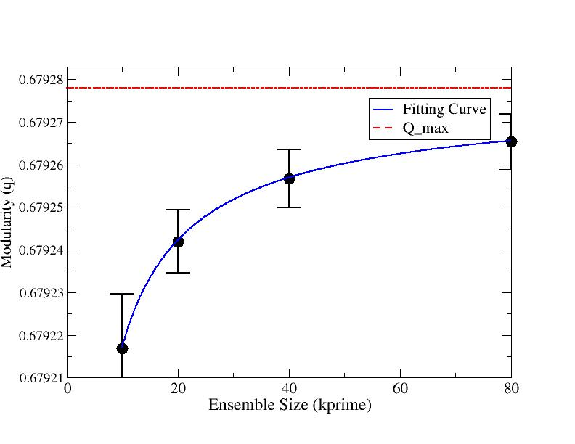
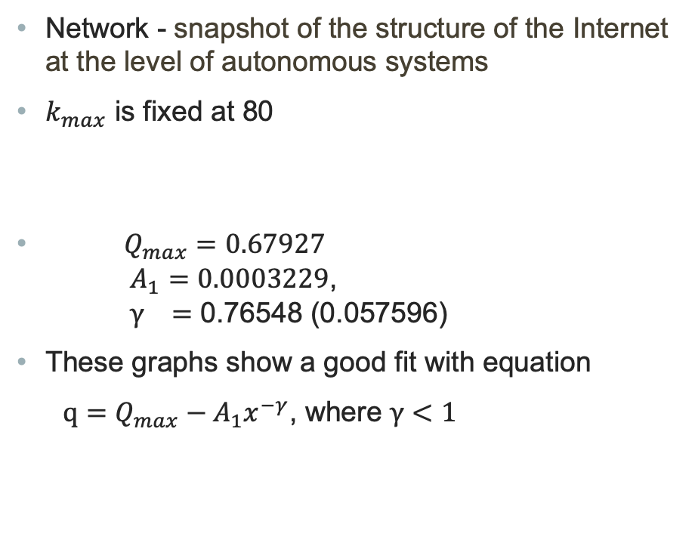
Study of Modularity value varying $k^{′}$
Network - snapshot of the structure of the Internet at the level of autonomous systems
$k_{max}$ is fixed at 80
$Q_{max}=0.67927$ $A_{1}=0.0003229$, $γ =$ 0.76548 (0.057596)
These graphs show a good fit with equation
$q=Q_{max}−A_{1}x^{−γ}$, where $γ<1$
¹https://www.cc.gatech.edu/dimacs10/

Slide 9
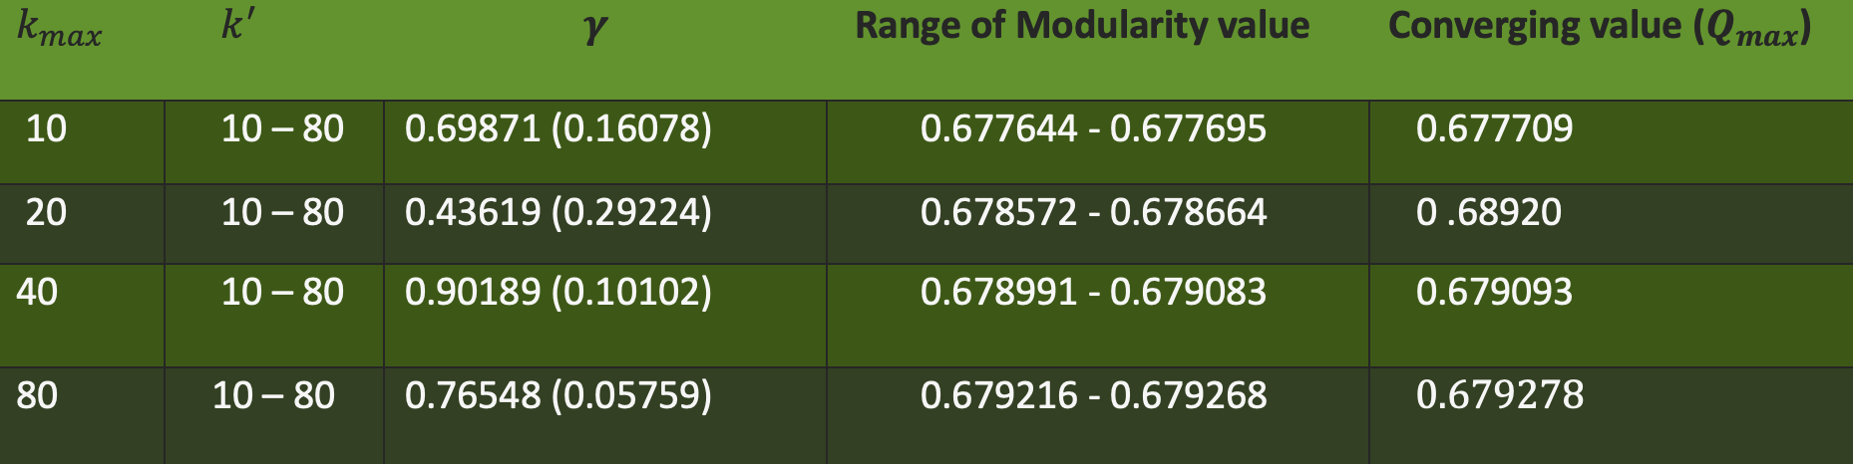
Results varying $k^{′}$
Network¹ Internet Autonomous System
Table – 2
¹ https://www.cc.gatech.edu/dimacs10/

Slide 10

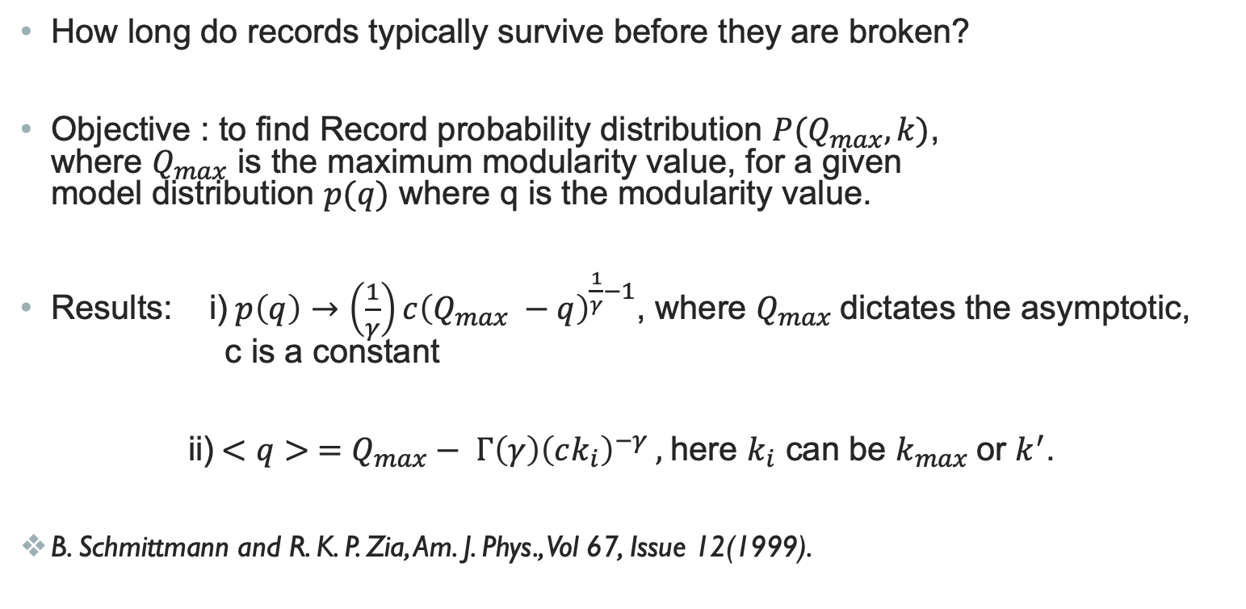
Extreme Value statistics
How long do records typically survive before they are broken?​
Objective : to find Record probability distribution $P(Q_{max},k)$, where $Q_{max}$ is the maximum modularity value, for a given model distribution $p(q)$ where q is the modularity value.
​
Results: i)​$p\left(q\right)→\left(\frac{1}{γ}\right)c{\left(Q_{max} −q\right)}^{\frac{1}{γ}−1}$, where $Q_{max} \text{​}$dictates the asymptotic, c is a constant
ii)$<q> =Q_{max}− Γ\left(γ\right){\left(ck_{i}\right)}^{−γ} ,$here $k_{i}$ can be $k_{max}$or $k^{′}$.
B. Schmittmann and R. K. P. Zia, Am. J. Phys., Vol 67, Issue 12(1999).

Slide 11
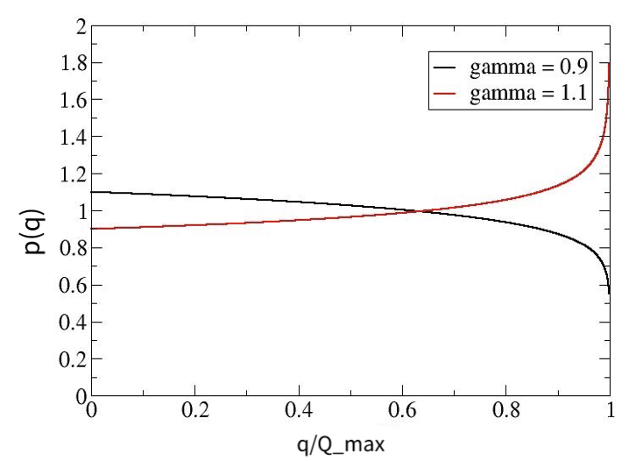
Probability distribution : $p\left(q\right)$
When $k_{max}$ is varied, $p(q)$ is peaked near $Q_{max}$ !
When $k^{′}$ is varied, $p(q)$ has a minimum near $Q_{max}$
Increasing $k_{max}$ is more likely to find high values of $q$
Spend computing resources to increase $k_{max}$ not $k^{′}$ !
Fig : $p\left(q\right)→\left(\frac{1}{γ}\right)c{\left(Qmax−q\right)}^{\frac{1}{γ}−1}$ for different values of $γ$

Slide 12
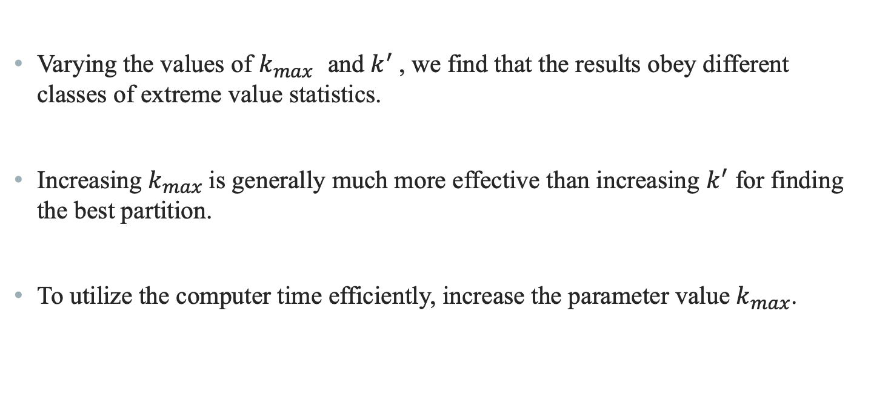
Conclusion
Varying the values of $k_{max}$ and $k^{′}$, we find that the results obey different classes of extreme value statistics.
Increasing $k_{max}$is generally much more effective than increasing $k^{′}$ for finding the best partition.
To utilize the computer time efficiently, increase the parameter value $k_{max}$.

Slide 13
Thank You!

Slide 15
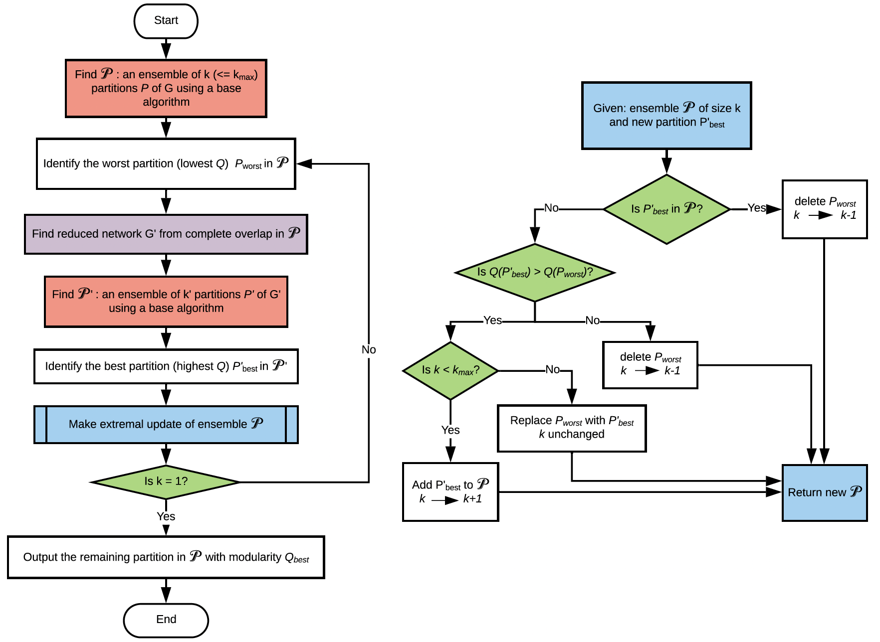
RenEEL scheme
Guo, Singh, and Bassler, Sci. Rep. 9, 14234 (2019)

Slide 16
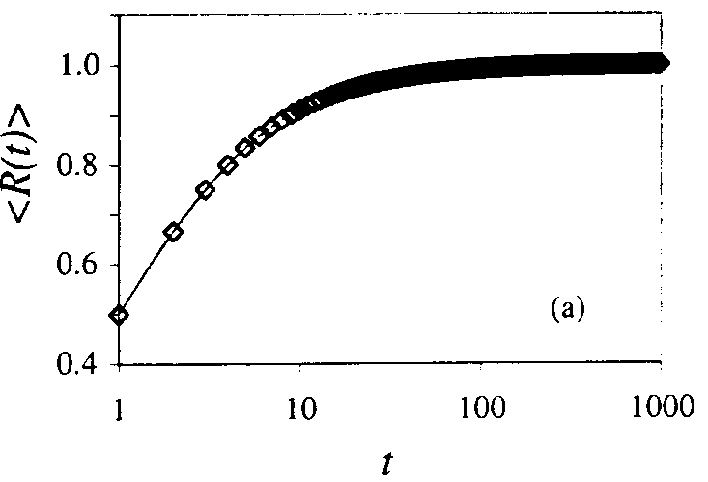
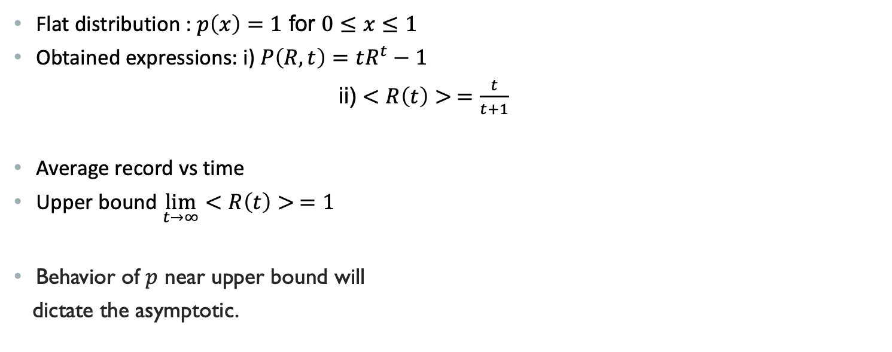

Study of $<R\left(t\right)>$ for an exactly solvable Example​
Flat distribution :​ $p\left(x\right)=1$ for $0≤x≤1$
Obtained expressions: ​i) $P\left(R,t\right)=tR^{t}−1$
  ii) $<R\left(t\right)> =\frac{t}{t+1}$
​Average record vs time
Upper bound $\lim_{t→∞}{<R\left(t\right)> =1}$
Behavior of $p$ near upper bound will
dictate the asymptotic.

Slide 17
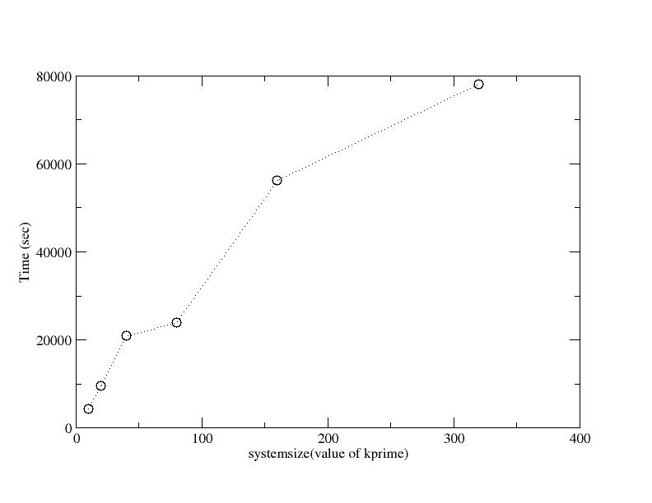

Slide 18
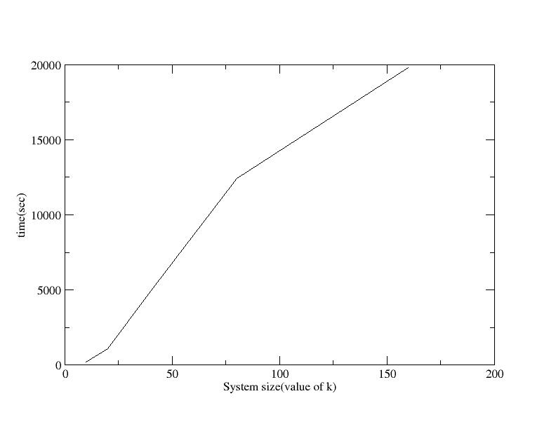

Slide 19
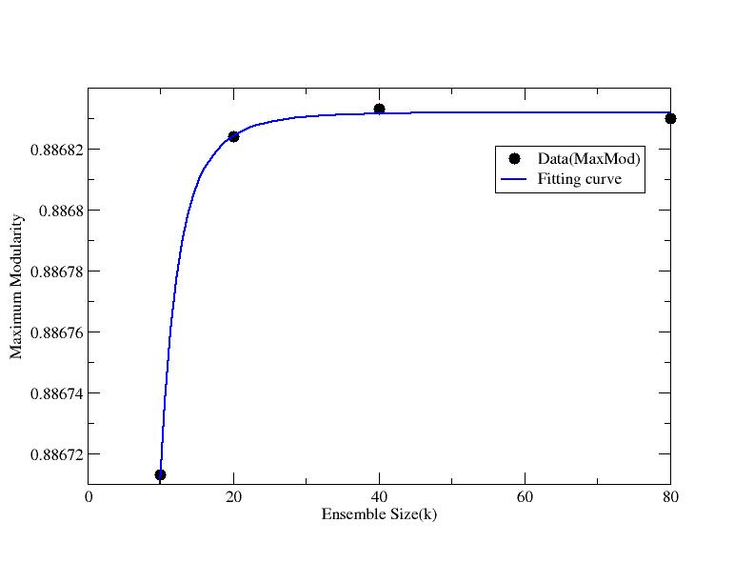
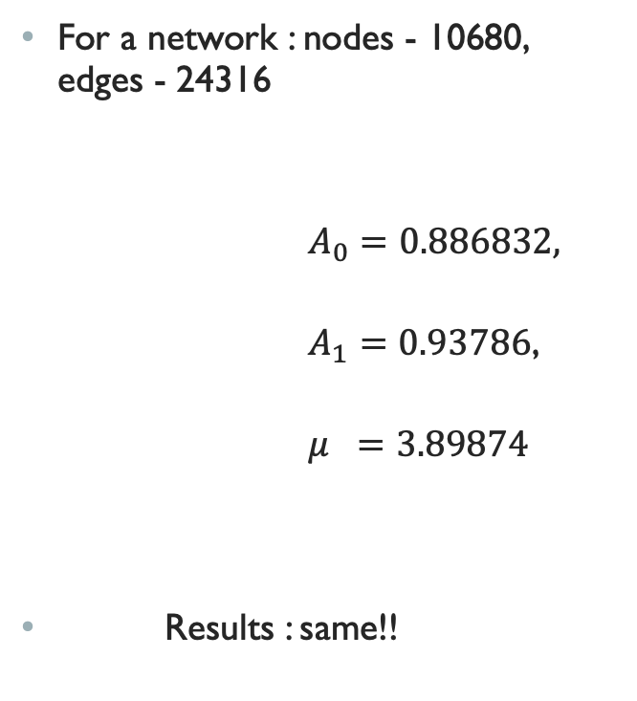
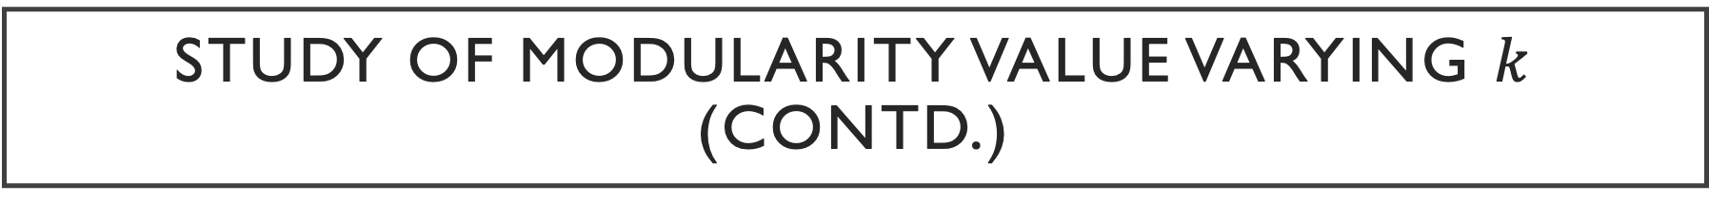
Study of Modularity value varying $k$ (contd.)
For a network : nodes - 10680, edges - 24316
$A_{0}=0.886832,$
$A_{1}=0.93786$,
$μ =3.89874$
Results : same!!

Slide 20
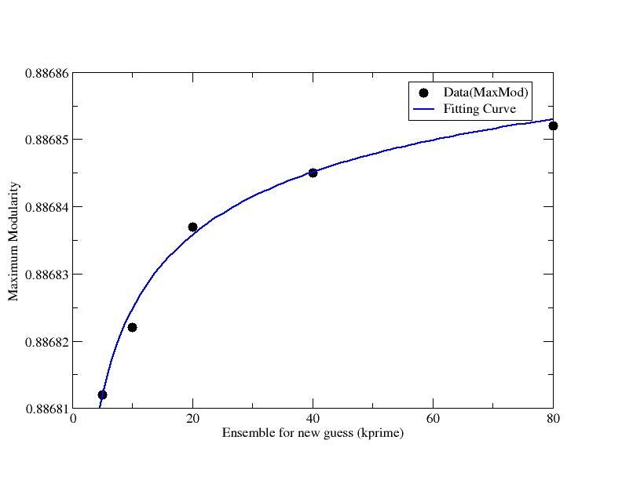


Study of Modularity value varying $k^{′}$ (contd.)
For the second network
$A_{0}=0.886896,$
$A_{1}=0.00012469$,
$μ =0.24286$
Result : same!!

