Slide 1
U N I V E R S I T Y of H O U S T O N
College of Natural Sciences and Mathematics
LIMITED FREQUENCY BANDWIDTH ON THE INVERSE SCATTERING SERIES AND THE EFFECTS ON SEISMIC PROCESSING GOALS
by
Ms. Ana Gonzalez
Dr. Mark Meier
Research day 2023
Department of Physics

Slide 2
U N I V E R S I T Y of H O U S T O N
College of Natural Sciences and Mathematics
Background
Energy/Hydrocarbon
Exploration
55 % Energy world consumption comes from oil/gas production
Seismic surveys
Primary tool for geologist to get a picture of the subsurface and locate hydrocarbons
Increases probability of hydrocarbon findings and revenues
Accurate Seismic data processing
Decreases losses of hundreds of millions of Dollar per dry hole
Interface/Reflector location and medium properties

Slide 3
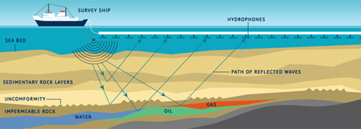
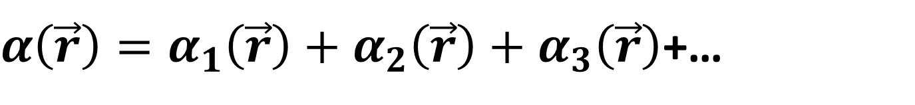
U N I V E R S I T Y of H O U S T O N
College of Natural Sciences and Mathematics
Background
Seismic Data Processing
α: perturbation parameter
Inverse Scattering Theory
Locate Hydrocarbons
$α\left(\vec{r}\right)=α_{1}\left(\vec{r}\right)+α_{2}\left(\vec{r}\right)+α_{3}\left(\vec{r}\right)$+…

Slide 4
U N I V E R S I T Y of H O U S T O N
College of Natural Sciences and Mathematics
Statement of the problem
Objective
Determine the effects of limited frequency bandwidth in the inverse scattering series and examine the impact of improved bandwidth in achieving seismic processing goals.

Slide 5







U N I V E R S I T Y of H O U S T O N
College of Natural Sciences and Mathematics
Inverse Scattering Series
$${\left(ψ_{s}\right)}_{ms }= {\left(G_{o}^{+}V_{1}P_{o}\right)}_{ms}$$
$${\left(G_{o}^{+}V_{2}P_{o}\right)}_{ms}=−{\left(G_{o}^{+}V_{1}G_{o}^{+}V_{1}P_{o}\right)}_{ms}$$
$${\left(G_{o}^{+}V_{3}P_{o}\right)}_{ms}=−{\left(G_{o}^{+}V_{1}G_{o}^{+}V_{2}P_{o}\right)}_{ms}−{\left(G_{o}^{+}V_{2}G_{o}^{+}V_{1}P_{o}\right)}_{ms}$$
$${\left(ψ_{s}\right)}_{ms }= G_{o}^{+}{V_{1}AG}_{o}^{+}$$
$$V_{1}\left(\vec{r}\right)=k^{2}α_{1}\left(\vec{r}\right)$$
* Assumption: Homogeneous, acoustic medium (no absorption or dispersion) with constant density, varying velocity.
Analytical method /numerical evaluation (Python)
* One interface
* Assuming plane waves propagating in one-dimension, normal incidence
* Reference medium with defined velocity Co.
All frequencies available
Low frequencies missing (LFM)
High frequencies missing (HFM)
Limited bandwidth frequency (w₁ → w₂)
$$V_{2}\left(\vec{r}\right)=k^{2}α_{2}\left(\vec{r}\right)$$
$$V_{3}\left(\vec{r}\right)=k^{2}α_{3}\left(\vec{r}\right)$$
$$α_{1}$$
$$α_{2}$$
$α\left(\vec{r}\right)=α_{1}\left(\vec{r}\right)+α_{2}\left(\vec{r}\right)+α_{3}\left(\vec{r}\right)$+…
Error analysis
Weglein et al, 1981.
Weglein et al, 2003.

Slide 6
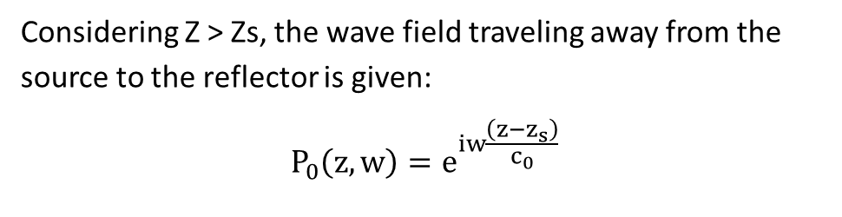
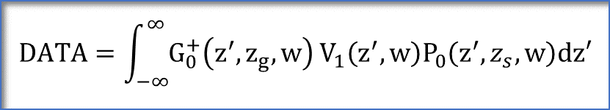
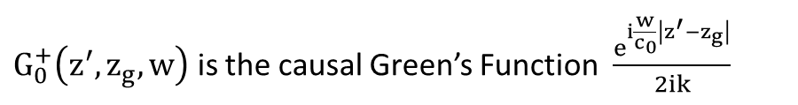





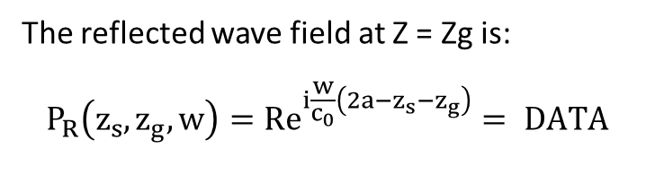
U N I V E R S I T Y of H O U S T O N
College of Natural Sciences and Mathematics
Determining α₁ analytically for an active source with all frequencies available
$G_{0}^{+}\left(z^{′},z_{g},w\right)$ is the causal Green’s Function $\frac{e^{i\frac{w}{c_{0}}\left|z^{′}−z_{g}\right|}}{2ik}$
$V_{1}\left(z^{′},w\right)=k^{2}α_{1}\left(z′\right)$
$$z^{′}> z_{g}$$
Considering Z > Zs, the wave field traveling away from the source to the reflector is given:
$$P_{0}\left(z, w\right)=e^{iw\frac{\left(z−z_{s}\right)}{c_{0}}}$$
$$z^{′}> z_{s}$$
The reflected wave field at Z = Zg is:
$$P_{R}\left(z_{s},z_{g},w\right)=Re^{i\frac{w}{c_{0}}\left(2a−z_{s}−z_{g}\right)}= DATA$$
According to inverse scattering series the recorded data for the linear inverse problem at Z = Zg is:
$$DATA=\int_{−∞}^{∞}{G_{0}^{+}\left(z^{′},z_{g},w\right)}V_{1}\left(z^{′},w\right)P_{0}\left(z^{′},z_{s},w\right)dz′$$
Fourier transforming from Z to Kz
$$\tilde{α_{1}}\left(k_{z}\right)=−\frac{4i}{k_{z}}Re^{−ik_{z}a}$$
Inverse Fourier transforming from Kz to Z
Weglein et al, 1981.
Weglein et al, 2003.
$${ α}_{1}\left(z\right)=4R H\left(z−a\right)$$

Slide 7
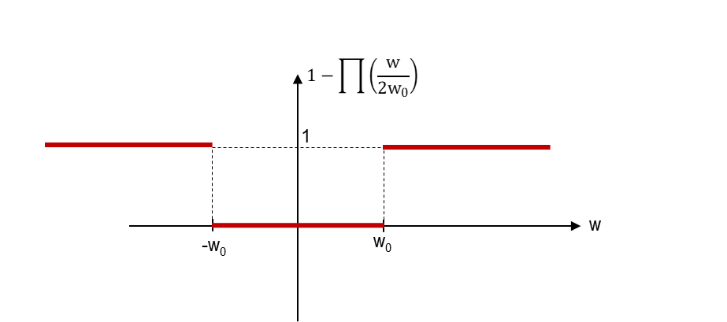
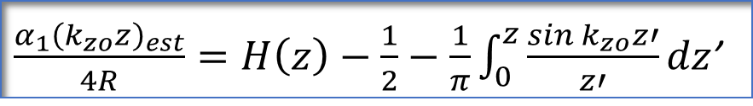
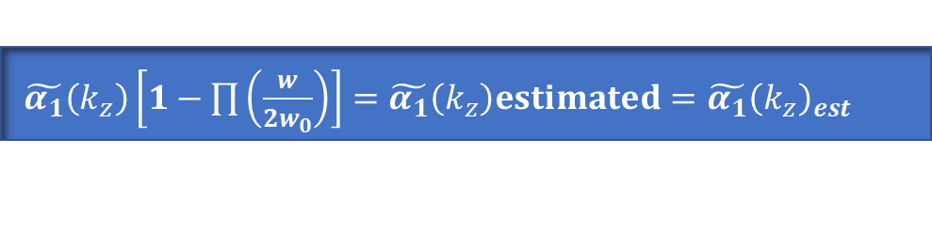
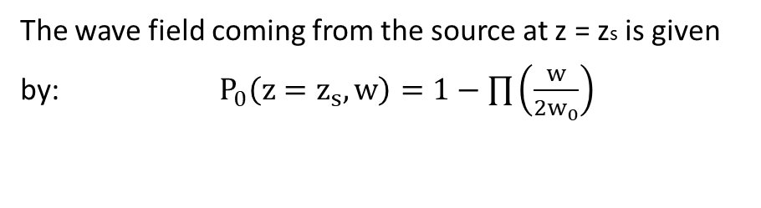
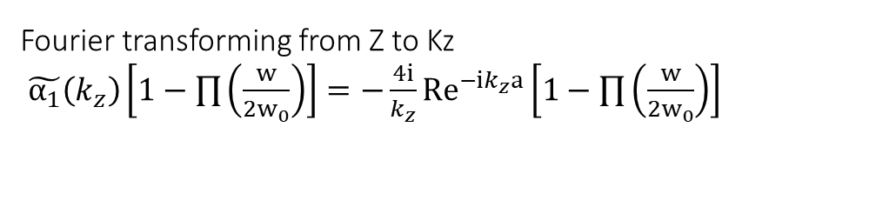
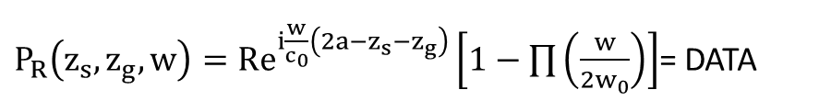
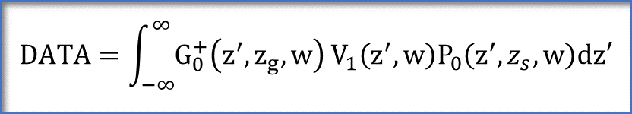
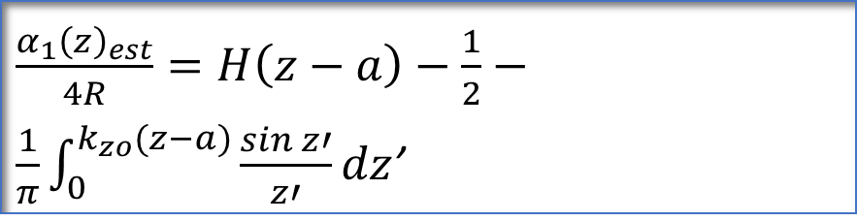
U N I V E R S I T Y of H O U S T O N
College of Natural Sciences and Mathematics
Determining α₁ analytically for an active source with Low frequencies Missing (LFM)
$$DATA=\int_{−∞}^{∞}{G_{0}^{+}\left(z^{′},z_{g},w\right)}V_{1}\left(z^{′},w\right)P_{0}\left(z^{′},z_{s},w\right)dz′$$
Fourier transforming from Z to Kz
$\tilde{α_{1}}\left(k_{z}\right)\left[1−\prod{\left(\frac{w}{2w_{0}}\right)}\right]=−\frac{4i}{k_{z}}Re^{−ik_{z}a}\left[1−\prod{\left(\frac{w}{2w_{0}}\right)}\right]$
The wave field coming from the source at z = zs is given by:$P_{0}\left(z=z_{s}, w\right)=1−\prod{\left(\frac{w}{2w_{0}}\right)}$
$\tilde{α_{1}}\left(k_{z}\right)\left[1−\prod{\left(\frac{w}{2w_{0}}\right)}\right]=\tilde{α_{1}}\left(k_{z}\right)estimated=\tilde{α_{1}}{\left(k_{z}\right)}_{est}$
Inverse Fourier transforming from Kz to Z
$\frac{α_{1}{\left(k_{zo}z\right)}_{est}}{4R}=H\left(z\right)−\frac{1}{2}−\frac{1}{π}\int_{0}^{z}{\frac{\sin{k_{zo}z′}}{z′}}dz$’
$\frac{α_{1}{\left(z\right)}_{est}}{4R}=H\left(z−a\right)−\frac{1}{2}−\frac{1}{π}\int_{0}^{k_{zo}(z−a)}{\frac{\sin{z′}}{z′}}dz$’
$P_{R}\left(z_{s},z_{g},w\right)=Re^{i\frac{w}{c_{0}}\left(2a−z_{s}−z_{g}\right)}\left[1−\prod{\left(\frac{w}{2w_{0}}\right)}\right]$= DATA

Slide 8
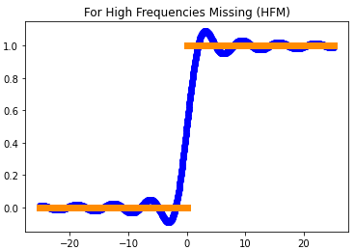
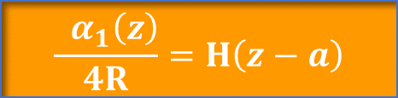

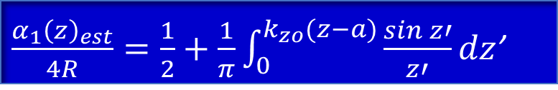
U N I V E R S I T Y of H O U S T O N
College of Natural Sciences and Mathematics
Analysis for α₁ with an active source with HFM
$$\frac{{ α}_{1}\left(z\right)}{4R}=H\left(z−a\right)$$
$\frac{α_{1}{\left(z\right)}_{est}}{4R}=\frac{1}{2}+\frac{1}{π}\int_{0}^{k_{zo}(z−a)}{\frac{\sin{z′}}{z′}}dz$’
$$k_{zo}(z−a)$$

Slide 9
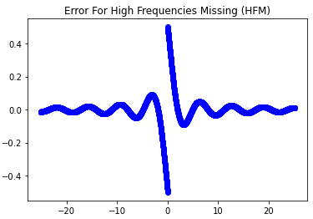

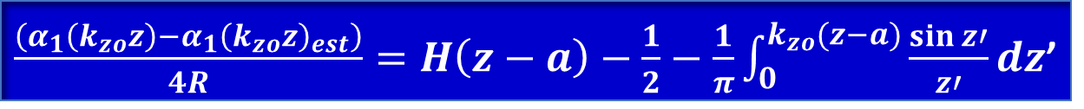
U N I V E R S I T Y of H O U S T O N
College of Natural Sciences and Mathematics
Analysis for α₁ with an active source with HFM
$\frac{\left(α_{1}\left(k_{zo}z\right)−α_{1}{\left(k_{zo}z\right)}_{est}\right)}{4R}=H\left(z−a\right)−\frac{1}{2}−\frac{1}{π}\int_{0}^{k_{zo}(z−a)}{\frac{\sin{z′}}{z′}}dz$’
$$k_{zo}(z−a)$$

Slide 10
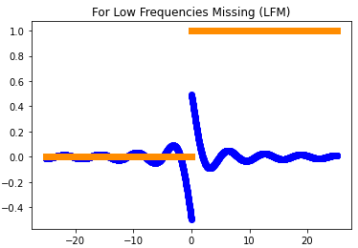

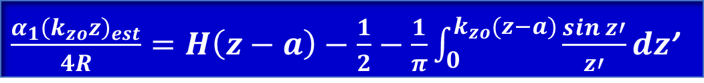

U N I V E R S I T Y of H O U S T O N
College of Natural Sciences and Mathematics
Analysis for α₁ with an active source with LFM
$$\frac{{ α}_{1}\left(z\right)}{4R}=H\left(z−a\right)$$
$\frac{α_{1}{\left(k_{zo}z\right)}_{est}}{4R}=H\left(z−a\right)−\frac{1}{2}−\frac{1}{π}\int_{0}^{k_{zo}(z−a)}{\frac{\sin{z′}}{z′}}dz$’
$$k_{zo}(z−a)$$

Slide 11
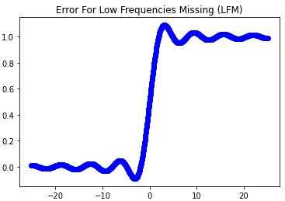
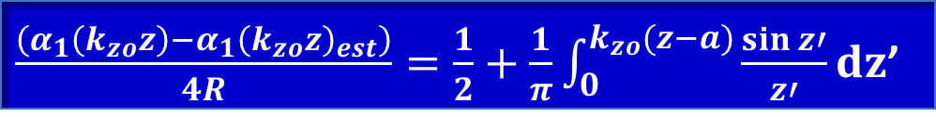

U N I V E R S I T Y of H O U S T O N
College of Natural Sciences and Mathematics
Analysis for α₁ with an active source with LFM
$\frac{\left(α_{1}\left(k_{zo}z\right)−α_{1}{\left(k_{zo}z\right)}_{est}\right)}{4R}=\frac{1}{2}+\frac{1}{π}\int_{0}^{k_{zo}(z−a)}{\frac{\sin{z′}}{z′}}dz$’
$$k_{zo}(z−a)$$

Slide 12
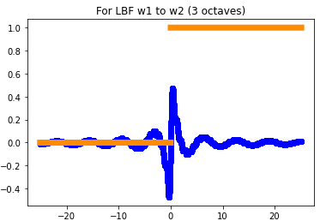
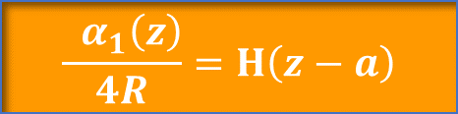

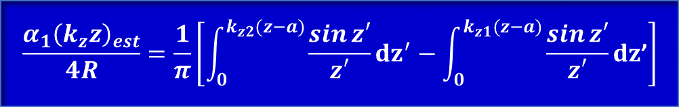
U N I V E R S I T Y of H O U S T O N
College of Natural Sciences and Mathematics
Analysis for α₁ with an active source with limited bandwidth frequencies (w₁ – w₂), 3 octaves
$$\frac{{ α}_{1}\left(z\right)}{4R}=H\left(z−a\right)$$
$$\frac{α_{1}{\left(k_{z}z\right)}_{est}}{4R}=\frac{1}{π}\left[\int_{0}^{k_{z2}(z−a)}{\frac{\sin{z′}}{z′}}dz^{′}−\int_{0}^{k_{z1}(z−a)}{\frac{\sin{z′}}{z′}}dz\text{’}\right]$$
$$k_{zo}(z−a)$$

Slide 13
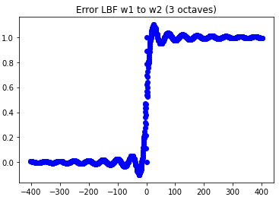

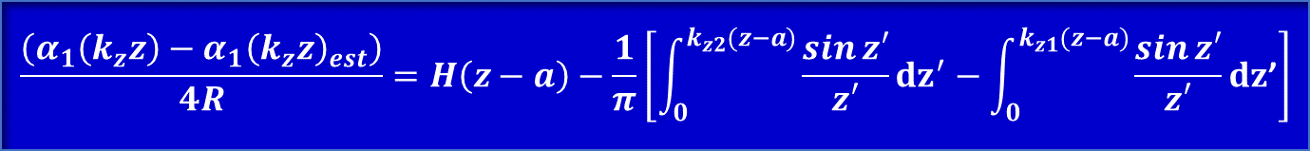
U N I V E R S I T Y of H O U S T O N
College of Natural Sciences and Mathematics
Analysis for α₁ with an active source with limited bandwidth frequencies (w₁ – w₂)
$$\frac{\left(α_{1}\left(k_{z}z\right)−α_{1}{\left(k_{z}z\right)}_{est}\right)}{4R}=H\left(z−a\right)−\frac{1}{π}\left[\int_{0}^{k_{z2}(z−a)}{\frac{\sin{z′}}{z′}}dz^{′}−\int_{0}^{k_{z1}(z−a)}{\frac{\sin{z′}}{z′}}dz\text{’}\right]$$
$$k_{zo}(z−a)$$

Slide 14
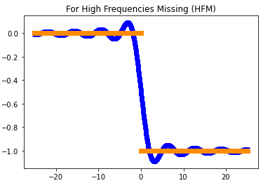


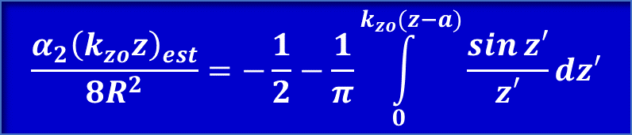
U N I V E R S I T Y of H O U S T O N
College of Natural Sciences and Mathematics
Analysis for α₂ with an active source with HFM
$$\frac{α_{2}\left(z\right)=}{8R^{2}}−H\left(z−a\right)$$
$$\frac{α_{2}{\left(k_{zo}z\right)}_{est}}{8R^{2}}=−\frac{1}{2}−\frac{1}{π}\int_{0}^{k_{zo}(z−a)}{\frac{\sin{z′}}{z′}dz′}$$
$$k_{zo}(z−a)$$

Slide 15
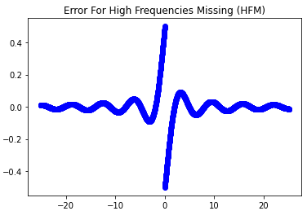

U N I V E R S I T Y of H O U S T O N
College of Natural Sciences and Mathematics
Analysis for α₂ with an active source with HFM
$\frac{\left(α_{2}\left(k_{zo}z\right)−α_{2}{\left(k_{zo}z\right)}_{est}\right)}{8R^{2}}=−H\left(z−a\right)+\frac{1}{2}+\frac{1}{π}\int_{0}^{k_{zo}(z−a)}{\frac{\sin{z′}}{z′}}dz$’
$$k_{zo}(z−a)$$

Slide 16
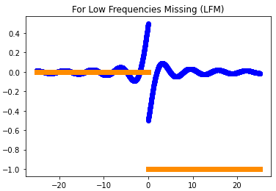


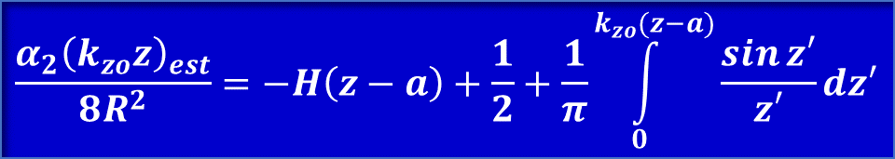
U N I V E R S I T Y of H O U S T O N
College of Natural Sciences and Mathematics
Analysis for α₂ with an active source with LFM
$$\frac{α_{2}\left(z\right)=}{8R^{2}}−H\left(z−a\right)$$
$$\frac{α_{2}{\left(k_{zo}z\right)}_{est}}{8R^{2}}=−H\left(z−a\right)+\frac{1}{2}+\frac{1}{π}\int_{0}^{k_{zo}(z−a)}{\frac{\sin{z′}}{z′}dz′}$$
$$k_{zo}(z−a)$$

Slide 17
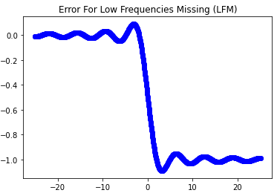

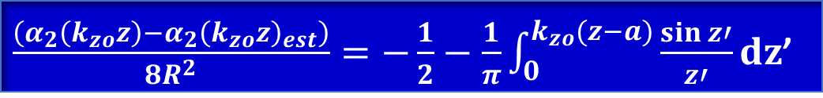
U N I V E R S I T Y of H O U S T O N
College of Natural Sciences and Mathematics
Analysis for α₂ with an active source with LFM
$\frac{\left(α_{2}\left(k_{zo}z\right)−α_{2}{\left(k_{zo}z\right)}_{est}\right)}{8R^{2}}=−\frac{1}{2}−\frac{1}{π}\int_{0}^{k_{zo}(z−a)}{\frac{\sin{z′}}{z′}}dz$’
$$k_{zo}(z−a)$$

Slide 18
U N I V E R S I T Y of H O U S T O N
College of Natural Sciences and Mathematics
Summary
For an acoustic model medium with constant density and varying velocity, 1-D normal incidence plane wave, and one interface:
α₁ and α₂ cannot be fully determined when frequencies are missing, but portions of α₁ and α₂ can be determined which are defined as α_{1est} and α_{2est}.
The error is defined as the difference between α₁ and α_{1est}, and as the difference between α₂ and α_{2est}, respectively; and for both:
if only high frequencies are missing, the error is largest near the interface and decreases going away from the interface,
  if low frequencies are missing, the error is increasing approaching the interface and remains large going deeper from the interface,
  the same behavior is observed for three octave bandwidth.
A band limited source restricts solutions to α_{1est} and α_{2est} affecting the accuracy of seismic inversion. Improving low frequency bandwidth has the greatest benefit. Though still under study, it appears band limit effects for seismic imaging and internal multiple removal are considerably less and are absent for surface multiple removal.

Slide 19
U N I V E R S I T Y of H O U S T O N
College of Natural Sciences and Mathematics
References
[1] Moses, H. E., 1956. Calculation of scattering potential from reflection coefficients. Phys. Rev. 102 559–67
[2] Prosser, R. T., 1969. Formal solutions of inverse scattering problems J. Math. Phys. 10 1819–22
[3] Razavy,M.,1975. Determination of the wave velocity in an inhomogeneous medium from reflection data J. Acoust.Soc. Am. 58 956–63
[4] Weglein, A. B., Boyse, W. E. and Anderson, J. E., 1981. Obtaining three-dimensional velocity information directly
from reflection seismic data: an inverse scattering formalism. Geophysics 46 1116–20
[5] Stolt, R. H. and Jacobs, B., 1980. Inversion of seismic data in a laterally heterogeneous medium. SEP Rep. 24 135–52
[6] Weglein, A. B., 2021. Scattering Theory Spring course. University of Houston.
[7] Weglein, A. B., Araujo, F. V., Carvalho, P. M., Stolt, R. H., Matson, K. H., Coates, R. T., Corrigan, D., Foster, D. J., Sgaw, S. A. and Zhang, H., 2003. Inverse Scattering series and seismic exploration. Inverse problems, 19: R27-R83.
[8] Weglein, A. B., Gasparotto, F. A., Carvalho, P. M. and Stolt, R. H., 1997. An inverse scattering series method for
attenuating multiples in seismic reflection data. Geophysics 62 1975–89
[9] Bracewell, R.N. (1978). The Fourier Transform and Its Applications. Second Edition, McGraw-Hill Book Company, New York, 444 p.
[10] Shaw, S. A., Weglein, A. B., Foster, D. J., Matson, K. H. and Keys, R. G., 2004. Isolation of a leading order depth imaging series and analysis of its convergence properties. J. Seismic Explor., 13: 157-195.
[11] Clayton, R. W. and Stolt, R. H., 1981. A Born–WKBJ inversion method for acoustic reflection data. Geophys. Soc.Explor. Geophys. 46 1559–67
[12] Stolt, R. H. and Weglein, A. B., 1985. Migration and inversion of seismic data. Geophysics 50 2458–72

