Slide 1

Entanglement Entropy in proton-proton collisions
Alek Hutson
Advisor: Dr. Rene Bellwied
University of Houston
February 18, 2023

Slide 2
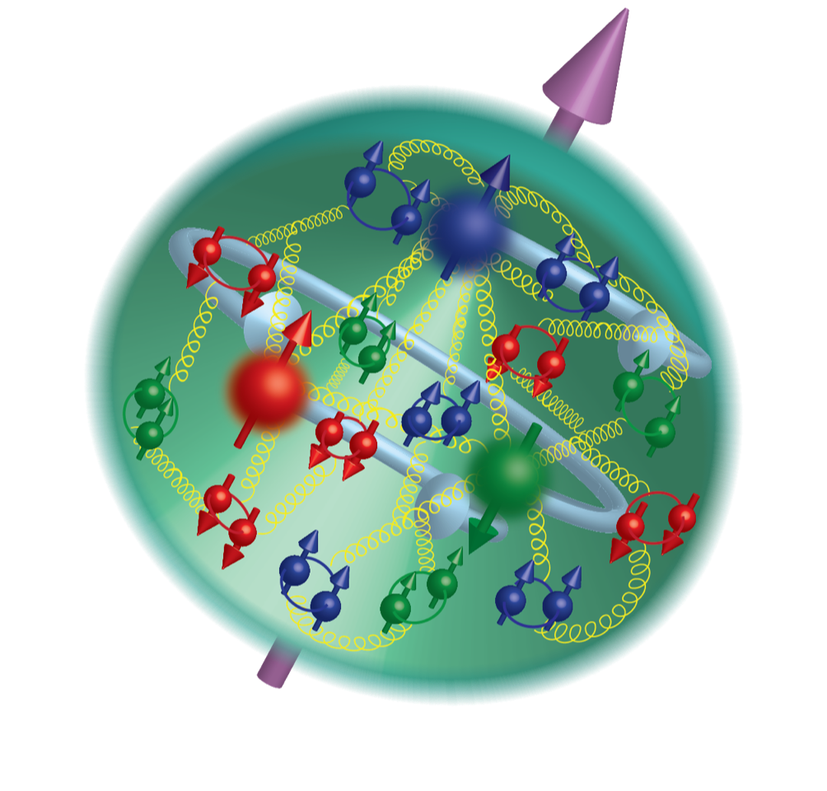
Proton Structure
Quarks:
Gluons
Valence quarks are the three subatomic particles responsible for the electric properties of a proton. Two up quarks carry an electric charge of +2/3 and one down quark -1/3, to make +1 elementary charge.
Color is a “charge” associated with the strong nuclear force. Quarks also carry a color in such a way that a color neutral state is formed between valence quarks.
Quarks belong to a class of elementary particles called fermions, which are characterized by their half-integer spin. Therefore, these quarks also contribute to the spin of a proton.
Valence quarks interact through the exchange of gluons. This exchange generates a force called the “strong force”. This is the force which binds the valence quarks together.
Gluons are the smallest and most abundant constituents of the proton. Their combined effects contribute to the overall properties and structure of the proton.
Sea Quarks:
Other quarks called sea quarks are formed and annihilated within the proton. This process is facilitated by the combined field of the gluons.
This behavior further complicates the proton’s structure. However, these quarks always form color neutral states that do not have an effect on the overall wavefunction of the proton.
Argonne National Laboratory. "3D Structure of Protons and Neutrons." Argonne National Laboratory, U.S. Department of Energy, n.d., https://www.anl.gov/phy/3d-structure-of-protons-and-neutrons.

Slide 3
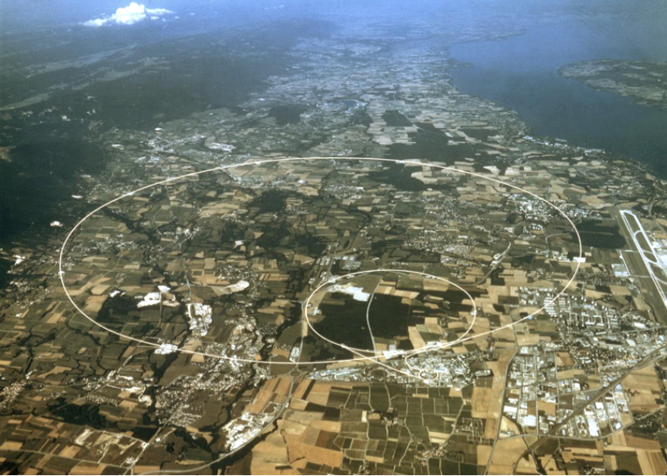
The Large Hadron Collider
We can further understand the complex structure of protons using particle colliders. These colliders generate a highly energetic and violent interaction which breaks the confinement of the proton. This process generates new particles and, in some cases, even new states of matter.
The Large Hadron Collider (LHC) located Geneva Switzerland is 27 km in circumference and sits 100 m underground.
Ionized nuclei are columnated into two beams and accelerated to speeds around 99% the speed of light.
Ion beams are then crossed at interaction points where detectors can measure particles produced in collisions.

Slide 4
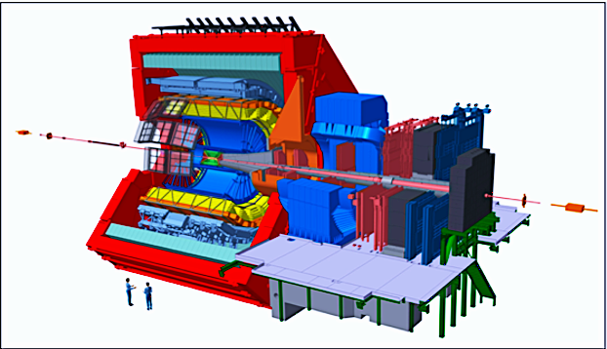
Experimental Setup ALICE
Measurements on charged particles produced in collisions are taken using the ALICE (A Large Ion Collider Experiment) detector.
The primary subsystem used in this measurement is the Time Projection Chamber (TPC).
The TPC is responsible for charged particle tracking.
As charged particles traverse through the TPC gas is ionized resulting in clusters of electrons which drift to the edge of the detector.
Measuring these electrons allows us to reconstruct the track and find the geometric location of the particle as they traverse the chamber.
TPC

Slide 5
Evolution of p-p collisions
Protons sped to near the speed of light collide in such a way that the gluons and quarks within each proton can interact.
At high enough energies, after the collision, protons “melt” and enter a new phase of matter called the quark gluon plasma (QGP).
The QGP (consisting of deconfined quarks and gluons) quickly equilibrates, then expands, cooling as it does so.
This deconfined state of matter is extremely short lived (~10⁻²² s).
Once the QGP is cool enough such that the binding energy of quarks overcomes the energy of the surrounding heat bath, quarks bind together forming color neutral hadrons.
This process is known as hadronization.
Once hadrons are produced, they traverse the various subsystems depositing energy into detectors for us to measure.
The most important measurement for this analysis is the pseudo-rapidity which is related to the geometric angle of flight.
Detector
DATA
Pseudorapidity

Slide 6
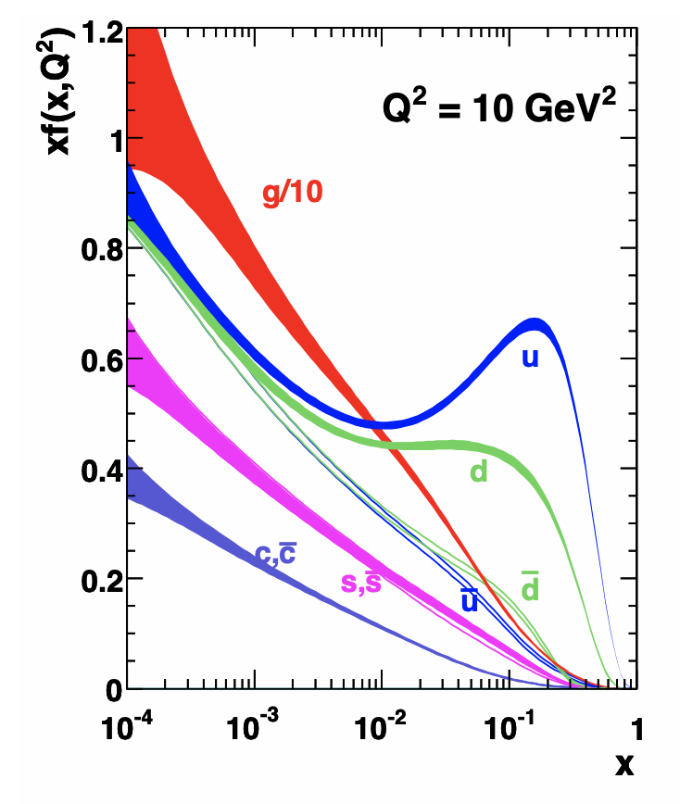
Bjorken-x
The Bjorken-x is the key kinematic variable used in this analysis to map particles in the initial state to a spatial region in the final state.
Bjorken-x represents the fraction of the proton’s momentum carried by a struck parton.
At very low-x the protons wavefunction is dominated by gluons. Meaning that all the interactions in the low-x limit are gluon-gluon interactions.
For an initial understanding of entanglement, it is helpful to restrict our study to this region where the wavefunction is much simpler.
A gluon with some fractional momentum x annihilates with another gluon to form a produced hadron at some rapidity y.
The rapidity of the hadron can be thought of as an angle at which the hadron travels in relation to the beam.
x
A. D. Martin, W. J. Stirling, R. S. Thorne, and G. Watt, Eur. Phys. J. C63, 189 (2009), arXiv:0901.0002 [hep-ph].

Slide 7
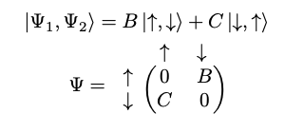

Entanglement
Entanglement is a phenomena unique to quantum particles and was first discovered by Albert Einstein, Boris Podolsky, and Nathan Rosen in 1935. Einstein once described quantum entanglement as ”spooky action at a distance”.
In a system of entangled particles, I can make a measurement on a particle and immediately know the value that same measurement would have on another particle, despite the distance between them. The states of these particles are correlated in such a way that their states cannot be described independently.
The classic example is that of a system of two fermions. We can place these particles in a configuration in which the probability of both having the same spin is 0. Therefore in knowing the state of one you would know the state of both.

Slide 8
Entropy
Entanglement Entropy (initial-state)
Entanglement entropy is a measure of the amount of entanglement between two or more quantum systems.
It quantifies the amount of information that is shared between particles (partons) and can be used to characterize their degree of correlation.
A proton represents a pure state; meaning the partons are fully correlated and maximally entangled.
During the collision, the portion of partons that interact with the other proton (A) become “disentangled” (decoherence) from the remainder of the proton (B). This in turn generates an entropy proportional to the number of partons involved in the interaction (A).
Gibbs Entropy (final-state)
Gibbs entropy is a thermodynamic quantity that measures the degree of disorder, or randomness, in a system.
This is calculated using a probability distribution of the number of microstates. In this case the number of hadrons
The more hadrons produced the higher the entropy.
While the Gibbs entropy is defined under different context than entanglement entropy, each of these definitions attempts to quantify the disorder of the system. And each is proportional to the number of particles.
Recently it has been postulated that the entropy generated in the initial collision may drive the thermodynamic properties and therefore the entropy of the final state.
A
Currently there is no quantum description of the collision evolution, instead thermodynamic models are used. The goal of this analysis is to show that entanglement survives the system evolution and these two entropies can be related, even to the extent that their values should be equal. This would demonstrate that we are not dealing with a thermal system but rather a quantum many body system that appears thermal.
B
B

Slide 9
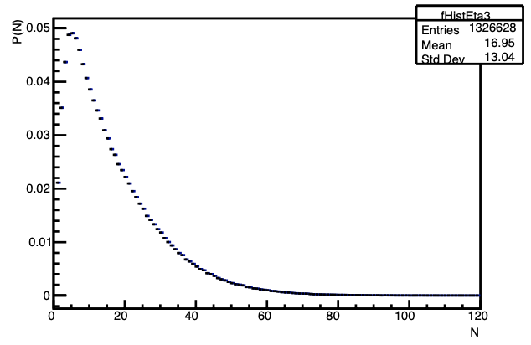


Calculating entropy in the final state
The final state entropy is calculated based on the multiplicity distribution of final state hadrons produced after hadronization occurs.
We start by measuring all produced charged particles in a given rapidity region. Finally, we will measure the Gibbs entropy of the particle distribution over this given rapidity range:
We will use these bounds to integrate over in order to obtain the initial entropy with which we would like to compare. We find x using the following relation borrowed from DIS theory:
Normalized multiplicity distribution of charged particles in p-p data at √s=13 TeV for |η|<1

Slide 10


Calculating an initial-state entropy
If we restrict ourselves to a region dominated by gluons we can use a simple relation to calculate the entanglement entropy, needing only the number of gluons that exist in the interaction region.
Using the results of deep inelastic scattering theorists are able to produce Parton Density Functions (PDF’s) which quantify the number density of partons as a function of x.
I can therefore calculate the number of gluons by integrating these pdf’s in the following way:
x

Slide 11
Results
As we move to lower x where the number of gluons grows so does the entropy.
Initial and final state entropies become closer together as we go to lower x where our equations are valid.
This effect is not seen in a particular model where entanglement is not considered.
Going forward we want to probe further into the lower x regime.

Slide 12
Conclusion
It has been demonstrated that entanglement may give rise to the thermal-like behavior of the QGP and the final-state particle yields (supported by measurements in CMS data).
Measuring at higher energies will produce lower x particles at higher multiplicities driving up the entropy as one might expect.
Finally, similar measurements should be made in various collisions systems and in various kinematic regions for comparison.

