Slide 1
Preliminary findings from YETS 22-23 tunnel inspections.
G. Aparicio, WP15
27/01/2023

Slide 2
Scope
Checks on equipment installation:
  Measurements of the height of the grouts of all the jacks installed in P5 Long Straight Sections Right and Left.
  Check on the installation of the vacuum control boxes (VRJA, VRTA, VRJNA..) in P5.
  Check of the overpressure protection in the UJ56.
Civil Engineering checks and findings:
  Measurements of the dimensions of the trench below the QRL all along the Long Straight Sections in P1 and P5.
  Measurements of the dimensions of the blockhouse of P5 Long Straight Sections Right and Left (in collaboration with WP8).
  Identification of the position of the manhole located in the RZ54.
  Check on the discontinuities found in the CE P5 3D models.

Slide 3
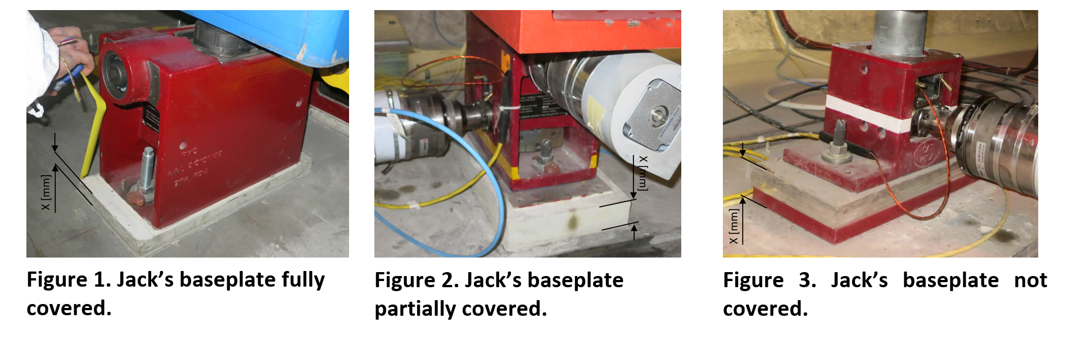
Measurements of the height of the grouts of all the jacks installed in P5 Right and Left.
Visit report: Jack’s grout measurements: EDMS 2814507

Slide 4
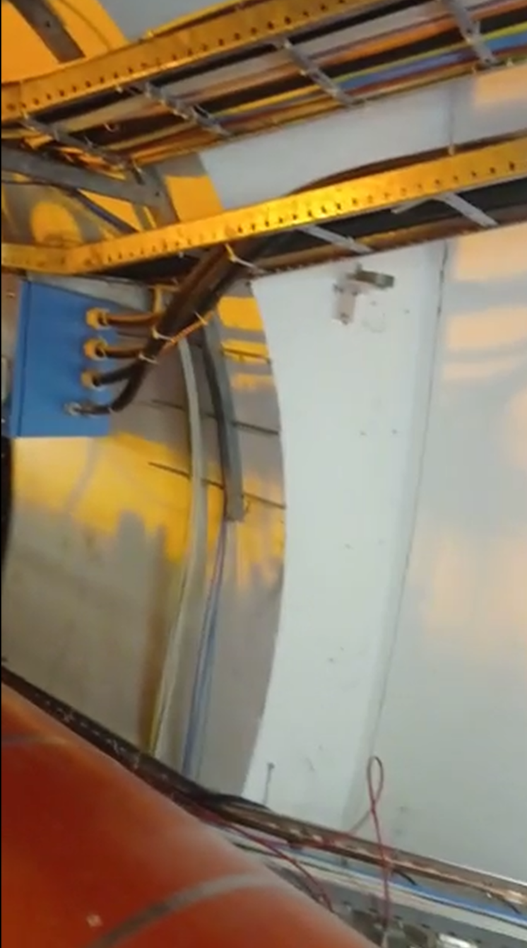
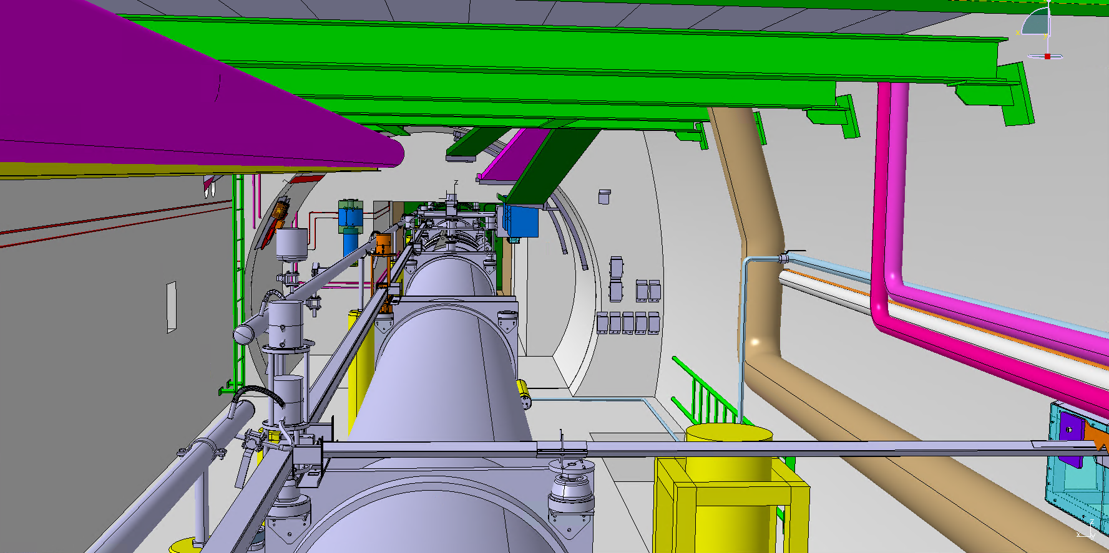
Check on the installation of the vacuum control boxes in P5 Right and Left
5R
Ongoing

Slide 5
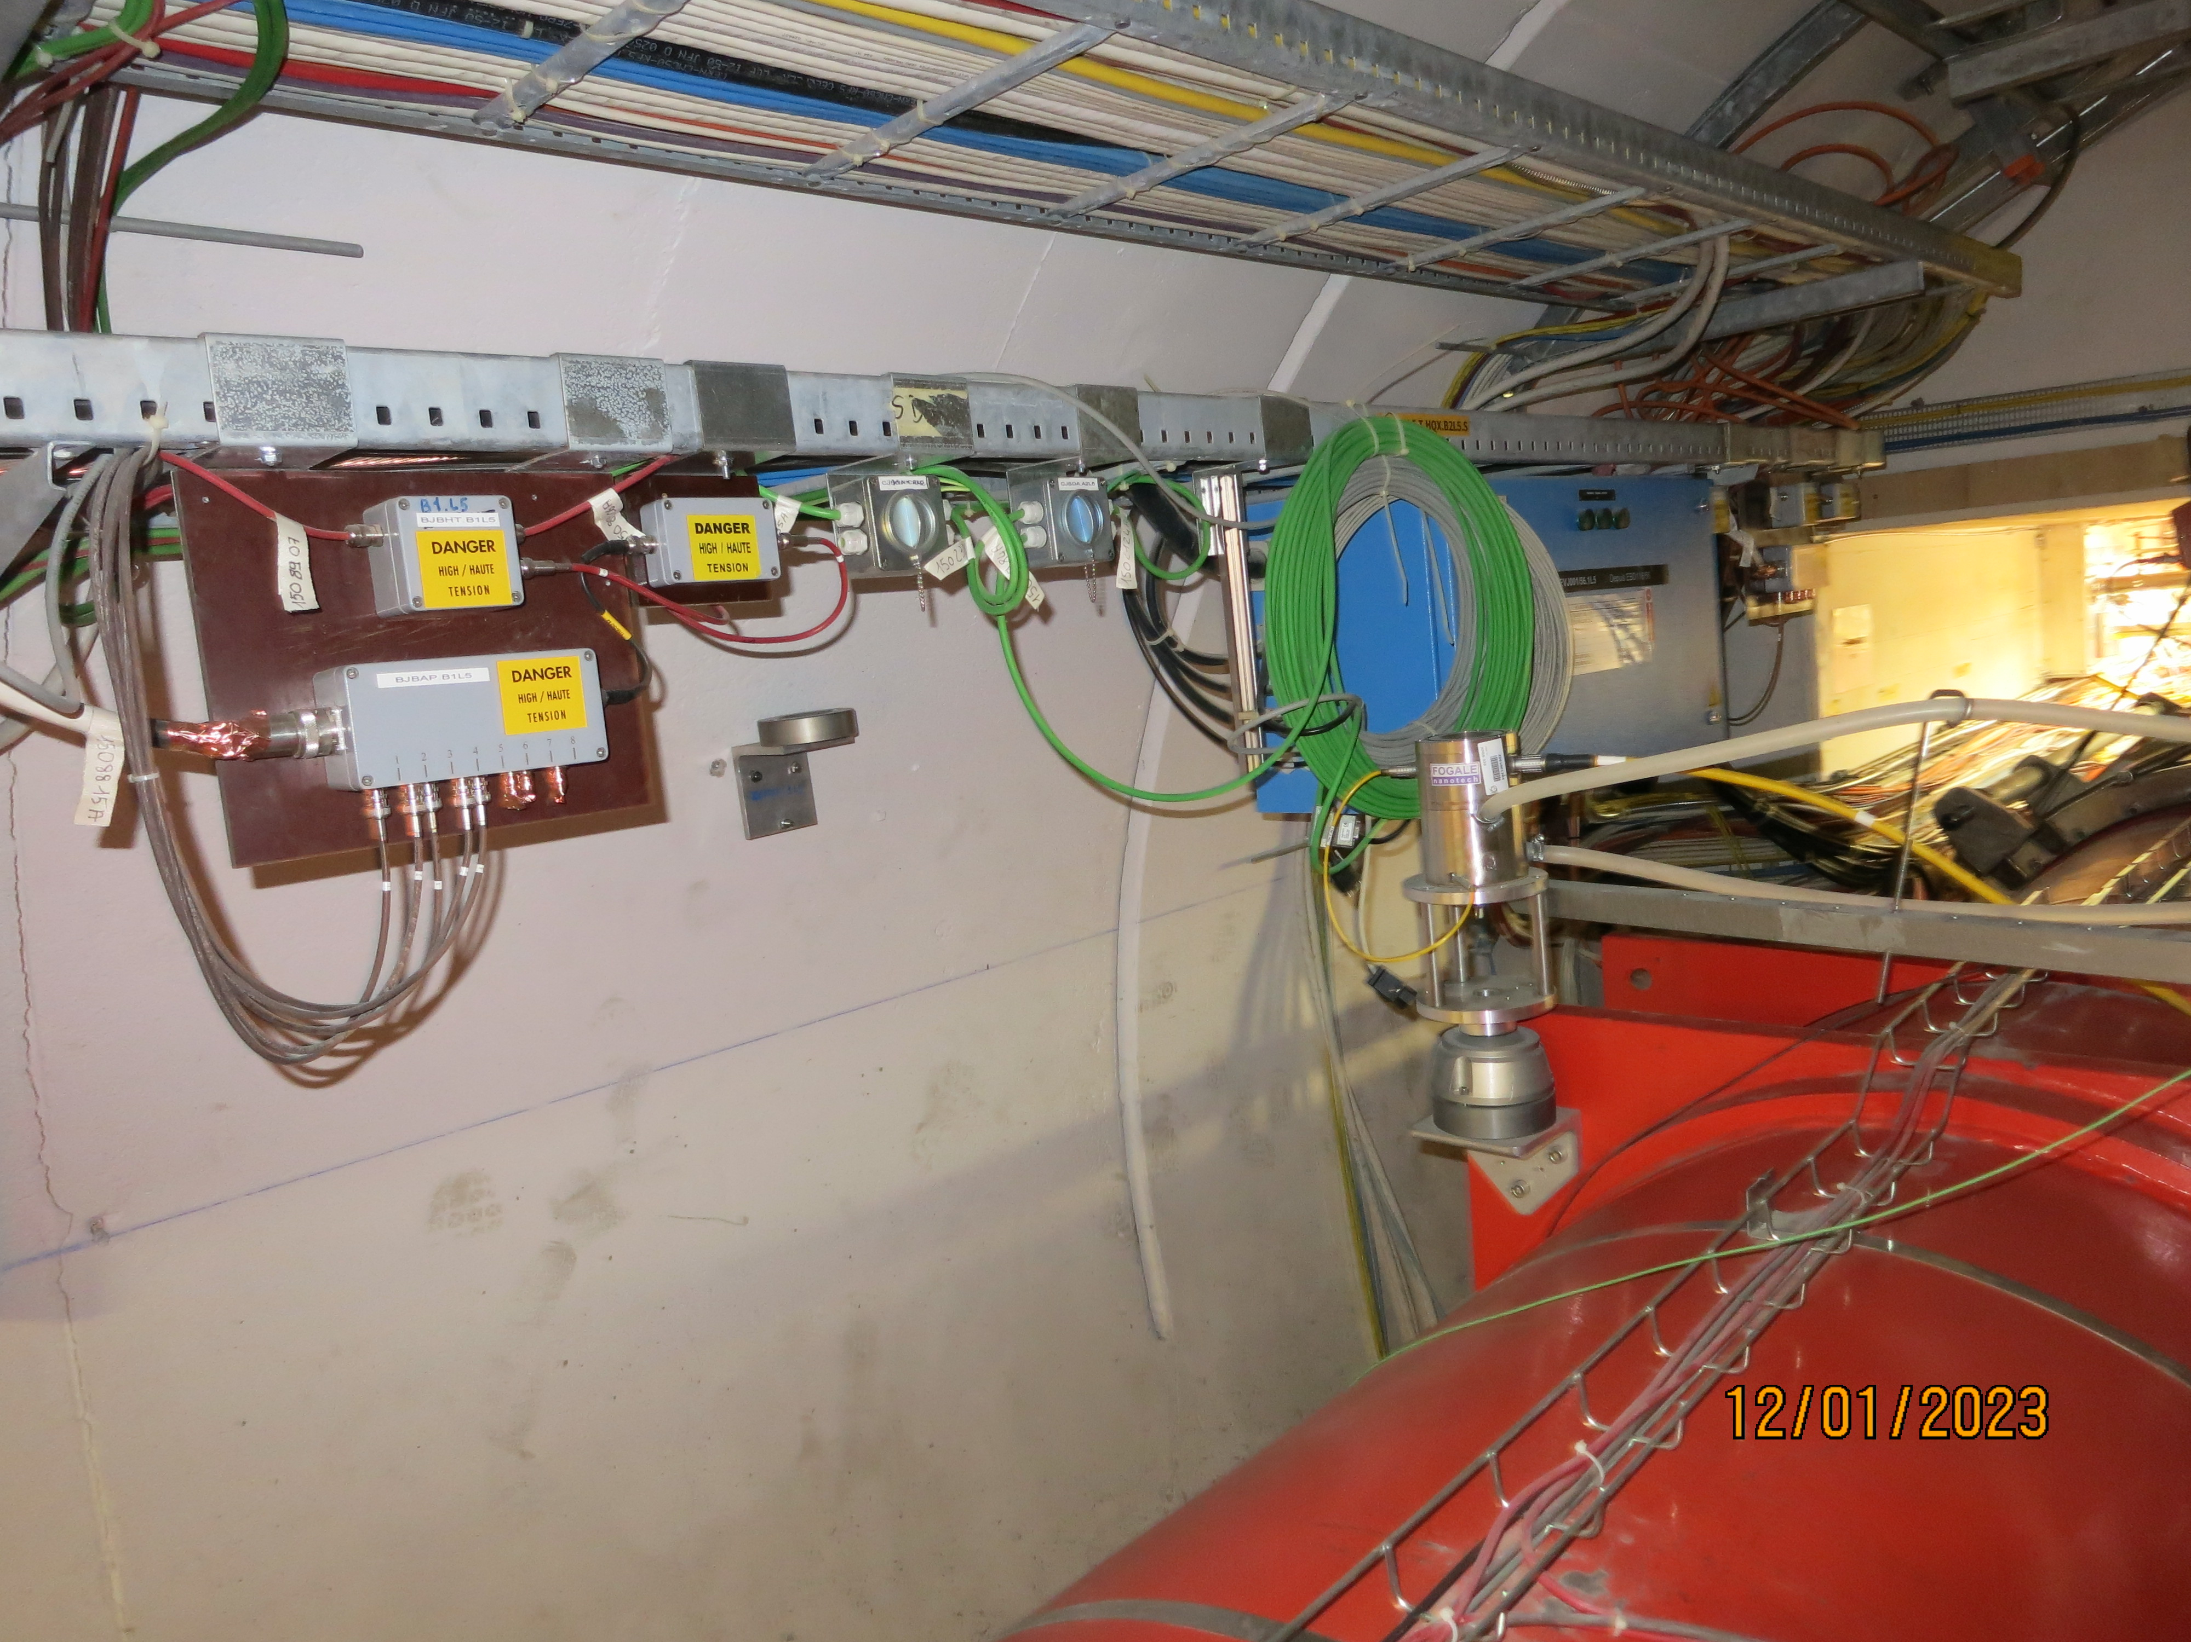
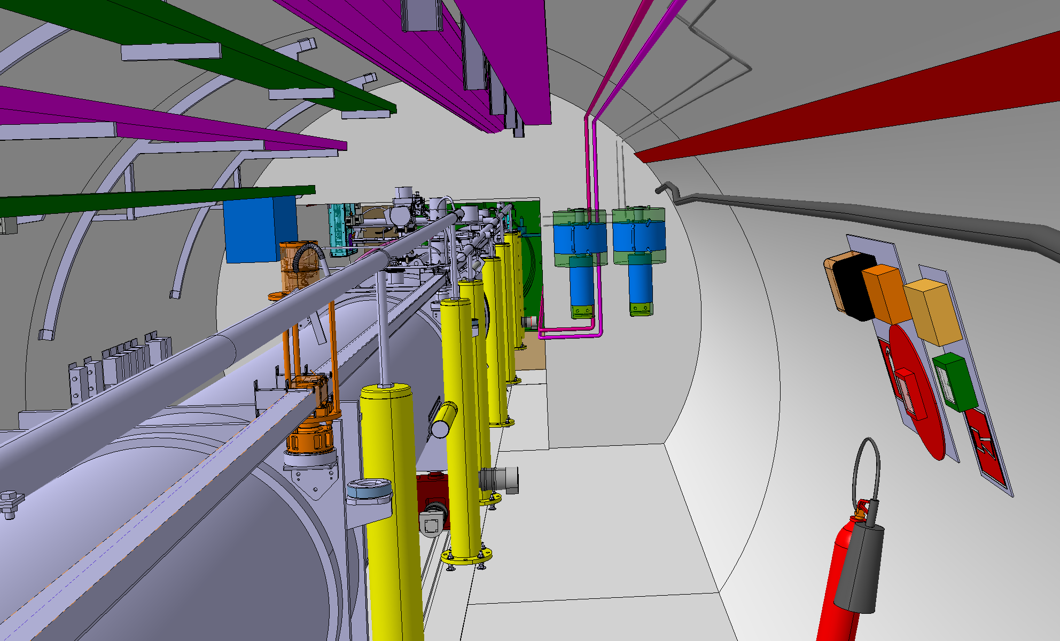
Check on the installation of the vacuum control boxes in P5 Right and Left
5L
Ongoing

Slide 6
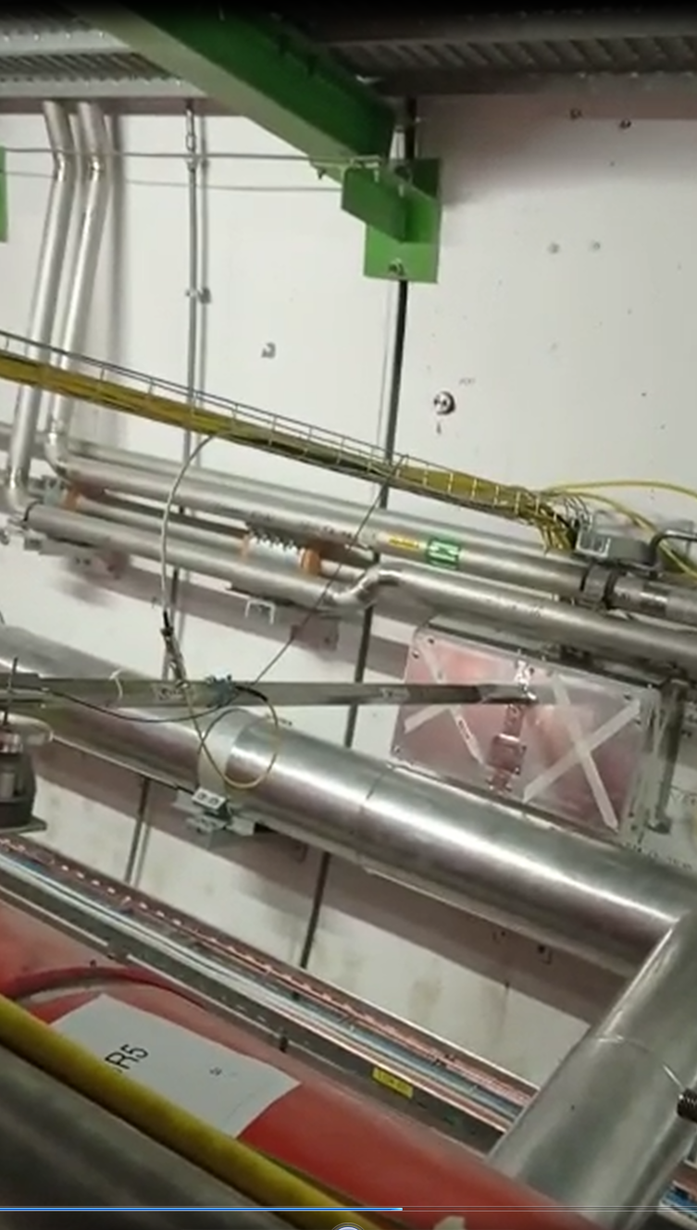
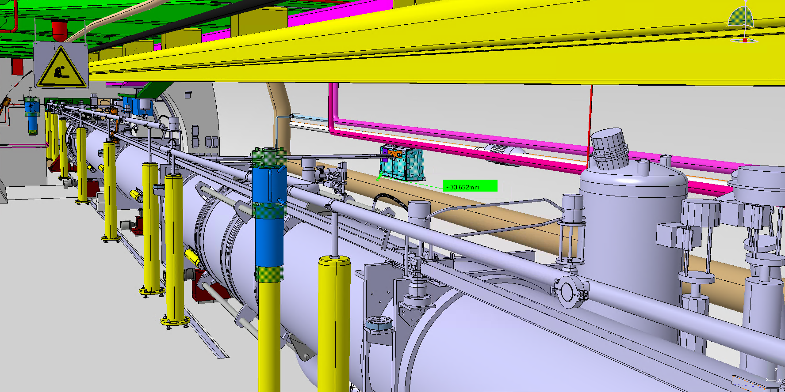
Check of the survey overpressure protection
Ongoing

Slide 7
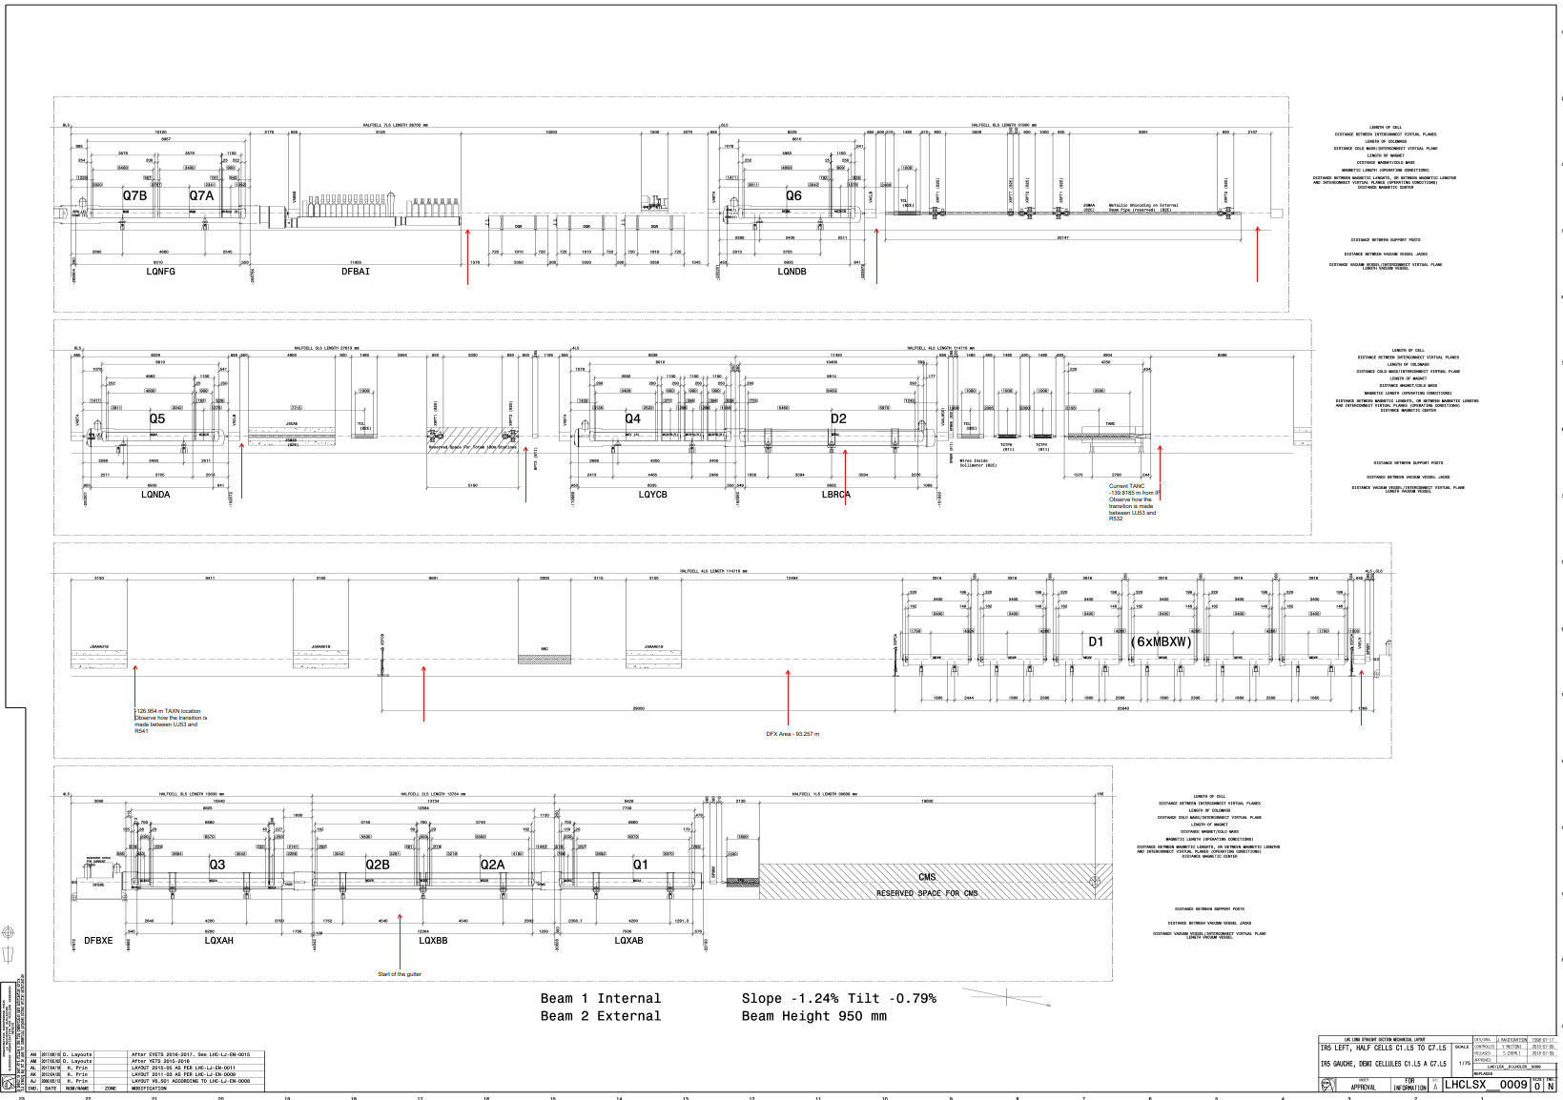
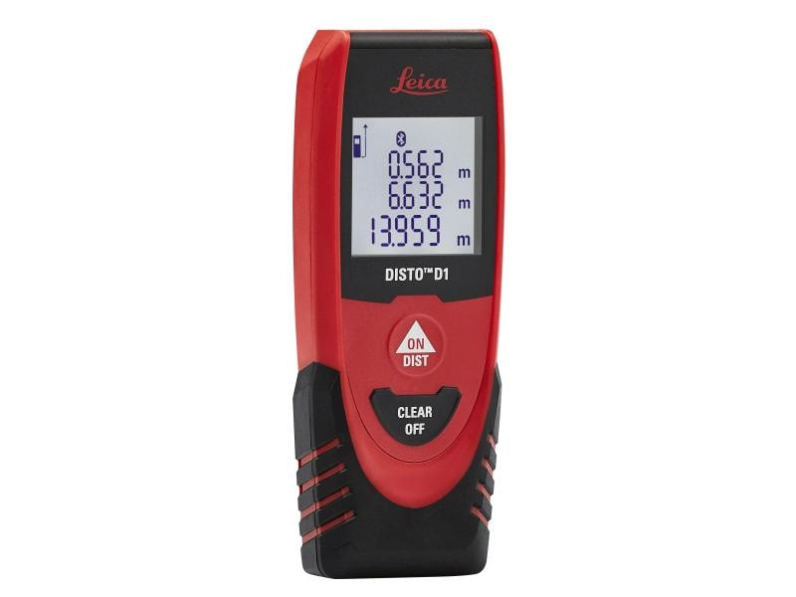
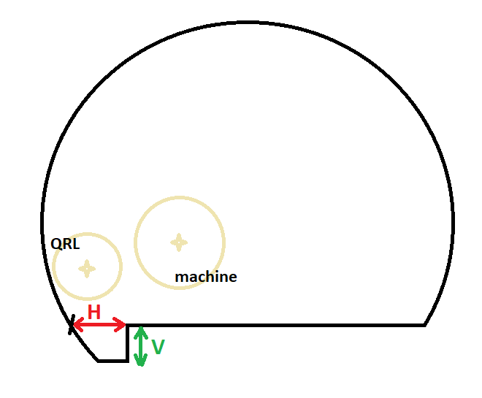
Civil Engineering checks and findings: measurements of the trench below the QRL (1/4)
5R
P5 Right
Description |  | DCUM [m] To be verified with the pictures taken. | Vertical Measurement [m] |  |  |  | 3D models [m] | Horizontal Measurement [m] |  |  |  | 3D models [m]
 |  |  | 1st | 2nd | 3rd | Average |  | 1st | 2nd | 3rd | Average
R562 | Gutter start after DFBXB | 54.882 | - | - | - | #DIV/0! | 0.465 | - | - | - | #DIV/0! | UJ56 0.715 / R571 0.796
UJ57 | After D1 | 84.548 | 0.473 | 0.469 | 0.469 | 0.470 | 0.465 | 0.926 | 0.942 | 0.930 | 0.933 | 0.929
R571 | Between the 1 & 2 concrete shielding | 98.65 & 117.55 | 0.454 | 0.451 | 0.453 | 0.453 | 0.465 / 0.447 | 0.911 | 0.916 | 0.932 | 0.920 | 0.956 / 0.788
 | Between the 2 & 3 concrete shielding | 117.55 & 130.15 | 0.462 | 0.46 | 0.464 | 0.462 | 0.402 | 0.772 | 0.772 | 0.753 | 0.766 | 0.758
 | Just before TANAR | 140.25 | 0.461 | 0.464 | 0.464 | 0.463 | 0.400 | 0.762 | 0.778 | 0.747 | 0.762 | 0.749
 | Between the central jack in D2 | 157.9 | 0.470 | 0.482 | 0.485 | 0.479 | 0.400 | 0.751 | 0.759 | 0.739 | 0.750 | 0.717
 | After Q4 | 172.688 | 0.467 | 0.469 | 0.474 | 0.470 | 0.400 | 0.726 | 0.742 | 0.734 | 0.734 | 0.753
 | Just before Q5 | 192.072 | 0.470 | 0.747 | 0.478 | 0.565 | 0.400 | 0.736 | 0.759 | 0.773 | 0.756 | 0.742
 | After Q5 | 200.301 | 0.468 | 0.465 | 0.464 | 0.466 | 0.400 | 0.716 | 0.733 | 0.716 | 0.722 | 0.723
R572 | Q7 First jack | 261.679 | 0.428 | 0.425 | 0.420 | 0.424 | 0.400 | 0.792 | 0.803 | 0.805 | 0.800 | 0.737

Slide 8
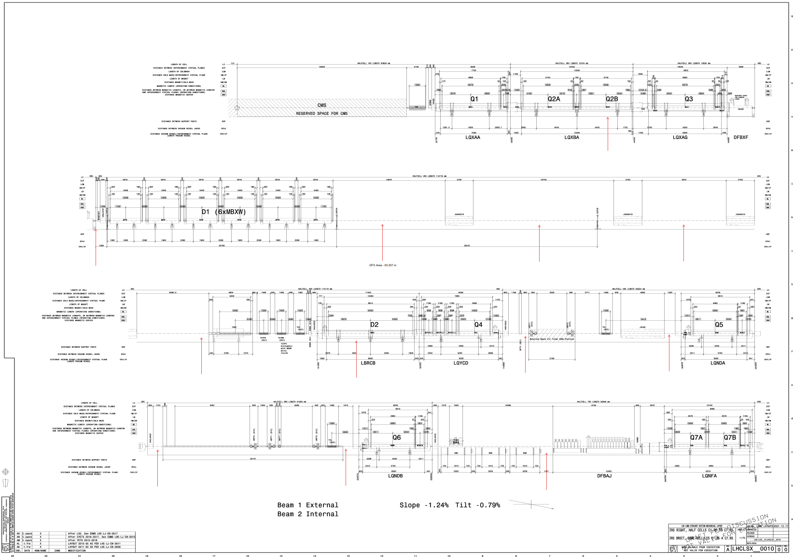
Civil Engineering checks and findings: measurements of the trench below the QRL (2/4)
5L
P5 Left
Description |  | DCUM [m] To be verified with the pictures taken. | Vertical Measurement [m] |  |  |  | 3D models [m] | Horizontal Measurement [m] |  |  |  | 3D models [m]
 |  |  | 1st | 2nd | 3rd | Average |  | 1st | 2nd | 3rd | Average
R541 | Gutter start after DFBXB | -54.882 | 0.499 | 0.493 | 0.494 | 0.495 | RZ54 0.400 / R541 0.400 | 0.774 | 0.772 | 0.768 | 0.771 | 0.738
 | After D1 | -84.548 | 0.499 | 0.492 | 0.497 | 0.496 | 0.400 | 0.761 | 0.769 | 0.759 | 0.763 | 0.687
 | Between the 1 & 2 concrete shielding | -98.65 & -117.55 | 0.497 | 0.498 | 0.497 | 0.497 | 0.400 | 0.740 | 0.739 | 0.716 | 0.732 | 0.757
UJ53 | Between the 2 & 3 concrete shielding | -117.55 & -130.15 | 0.465 | 0.467 | 0.465 | 0.466 | 0.410 | 0.765 | 0.768 | 0.784 | 0.772 | 0.682
 | Just before TANAL | -140.25 | 0.471 | 0.469 | 0.469 | 0.470 | 0.410 | 0.803 | 0.800 | 0.801 | 0.801 | 0.685
R532 | Between the central jack in D2 | -157.9 | 0.488 | 0.485 | 0.479 | 0.484 | 0.400 | 0.779 | 0.791 | 0.780 | 0.783 | 0.747
 | After Q4 | -172.688 | 0.495 | 0.498 | 0.500 | 0.498 | 0.400 | 0.761 | 0.794 | 0.780 | 0.778 | 0.781
 | Just before Q5 | -192.072 | 0.496 | 0.494 | 0.499 | 0.496 | 0.400 | 0.742 | 0.737 | 0.756 | 0.745 | 0.742
 | After Q5 | -200.301 | 0.472 | 0.474 | 0.481 | 0.476 | 0.400 | 0.676 | 0.693 | 0.698 | 0.689 | 0.774
R531 | Q7 First jack | -261.679 | 0.497 | 0.497 | 0.497 | 0.497 | 0.400 | 0.756 | 0.756 | 0.752 | 0.755 | 0.812

Slide 9
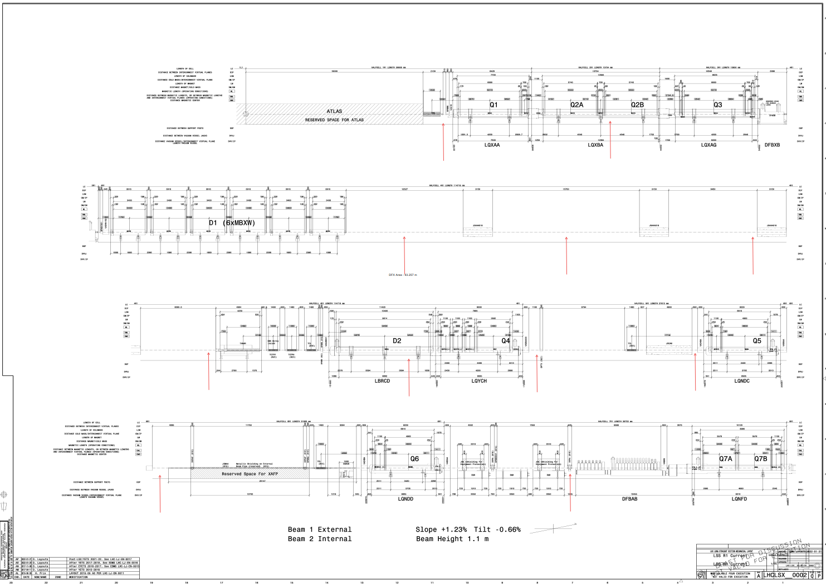
Civil Engineering checks and findings: measurements of the trench below the QRL (3/4)
1R
P1 Right
Description | DCUM [m] To be verified with the pictures taken. | Vertical Measurement [m] |  |  |  | 3D models [mm] | Horizontal Measurement [m] |  |  |  | 3D models [mm]
 |  | 1st | 2nd | 3rd | Average |  | 1st | 2nd | 3rd | Average
Gutter start after DFBXB | 54.882 | 0.467 | 0.459 | 0.461 | 0.462 |  | 0.732 | 0.737 | 0.745 | 0.738
After D1 | 84.548 | 0.467 | 0.456 | 0.453 | 0.459 |  | 0.836 | 0.845 | 0.845 | 0.842
Between the 1 & 2 concrete shielding | 98.65 & 117.55 | 0.464 | 0.459 | 0.455 | 0.459 |  | 0.888 | 0.832 | 0.841 | 0.854
Between the 2 & 3 concrete shielding | 117.55 & 130.15 | 0.458 | 0.452 | 0.446 | 0.452 |  | 0.826 | 0.814 | 0.829 | 0.823
Just before TANAR | 140.25 | 0.462 | 0.455 | 0.449 | 0.455 |  | 0.834 | 0.833 | 0.845 | 0.837
Between the central jack in D2 | 157.9 | 0.510 | 0.490 | 0.485 | 0.495 |  | 0.836 | 0.838 | 0.839 | 0.838
After Q4 | 172.688 | 0.477 | 0.484 | 0.483 | 0.481 |  | 0.888 | 0.889 | 0.889 | 0.889
Just before Q5 | 192.072 | 0.467 | 0.469 | 0.471 | 0.469 |  | 0.823 | 0.833 | 0.833 | 0.830
After Q5 | 200.301 | 0.481 | 0.480 | 0.483 | 0.481 |  | 0.863 | 0.875 | 0.862 | 0.867
Q7 First jack | 261.679 | 0.458 | 0.474 | 0.462 | 0.465 |  | 0.827 | 0.811 | 0.832 | 0.823
Ongoing
Ongoing

Slide 10
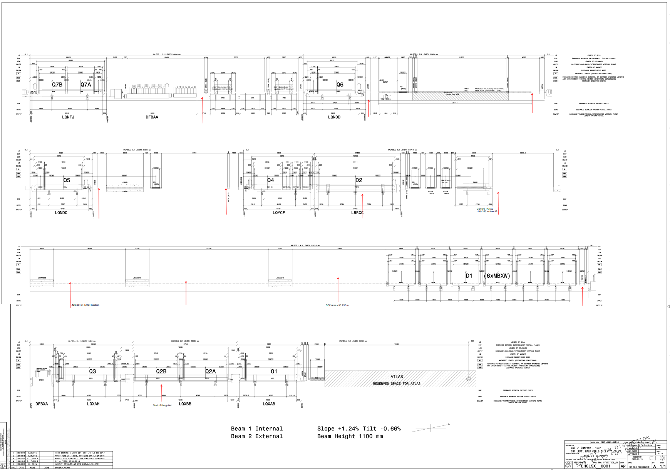
Civil Engineering checks and findings: measurements of the trench below the QRL (4/4)
1L
P1 Left
Description | DCUM [m] To be verified with the pictures taken. | Vertical Measurement [m] |  |  |  | 3D models [mm] | Horizontal Measurement [m] |  |  |  | 3D models [mm]
 |  | 1st | 2nd | 3rd | Average |  | 1st | 2nd | 3rd | Average
Gutter start after DFBXB | 26600.9112 | 0.451 | 0.458 | 0.465 | 0.458 |  | 0.727 | 0.727 | 0.727 | 0.727
After D1 | 26574.2112 | 0.491 | 0.481 | 0.501 | 0.491 |  | 0.886 | 0.877 | 0.886 | 0.883
Between the 1 & 2 concrete shielding | 26560.2332 & 26541.3332 | 0.465 | 0.462 | 0.462 | 0.463 |  | 0.869 | 0.839 | 0.852 | 0.853
Between the 2 & 3 concrete shielding | 26541.3332 & 26528.7332 | 0.463 | 0.466 | 0.468 | 0.466 |  | 0.917 | 0.893 | 0.888 | 0.899
Just before TANAL | 26518.6332 | 0.489 | 0.499 | 0.484 | 0.491 |  | 0.921 | 0.895 | 0.900 | 0.905
Between the central jack in D2 | 26500.9832 | 0.476 | 0.451 | 0.459 | 0.462 |  | 0.901 | 0.867 | 0.876 | 0.881
After Q4 | 26486.1952 | 0.461 | 0.455 | 0.448 | 0.455 |  | 0.822 | 0.810 | 0.806 | 0.813
Just before Q5 | 26466.2042 | 0.469 | 0.469 | 0.465 | 0.468 |  | 0.873 | 0.889 | 0.958 | 0.907
After | 26457.9752 | 0.459 | 0.449 | 0.457 | 0.455 |  | 0.786 | 0.769 | 0.761 | 0.772
Q7 First jack | 26397.5542 | 0.460 | 0.469 | 0.455 | 0.461 |  | 0.848 | 0.849 | 0.828 | 0.842
Ongoing
Ongoing

Slide 11
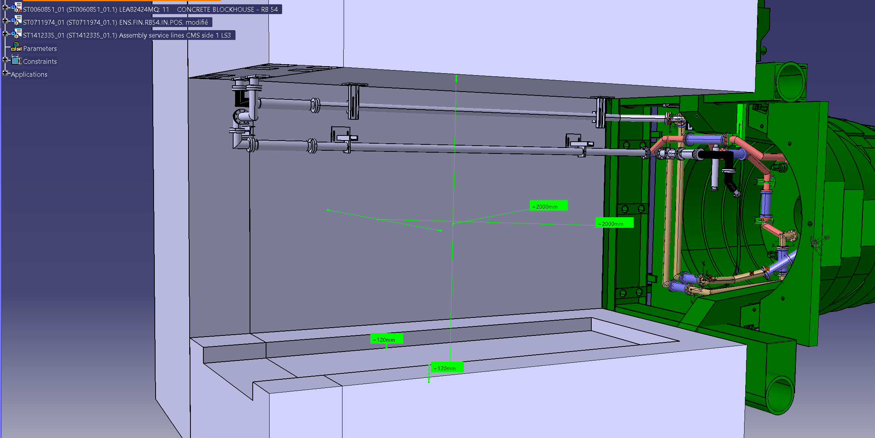
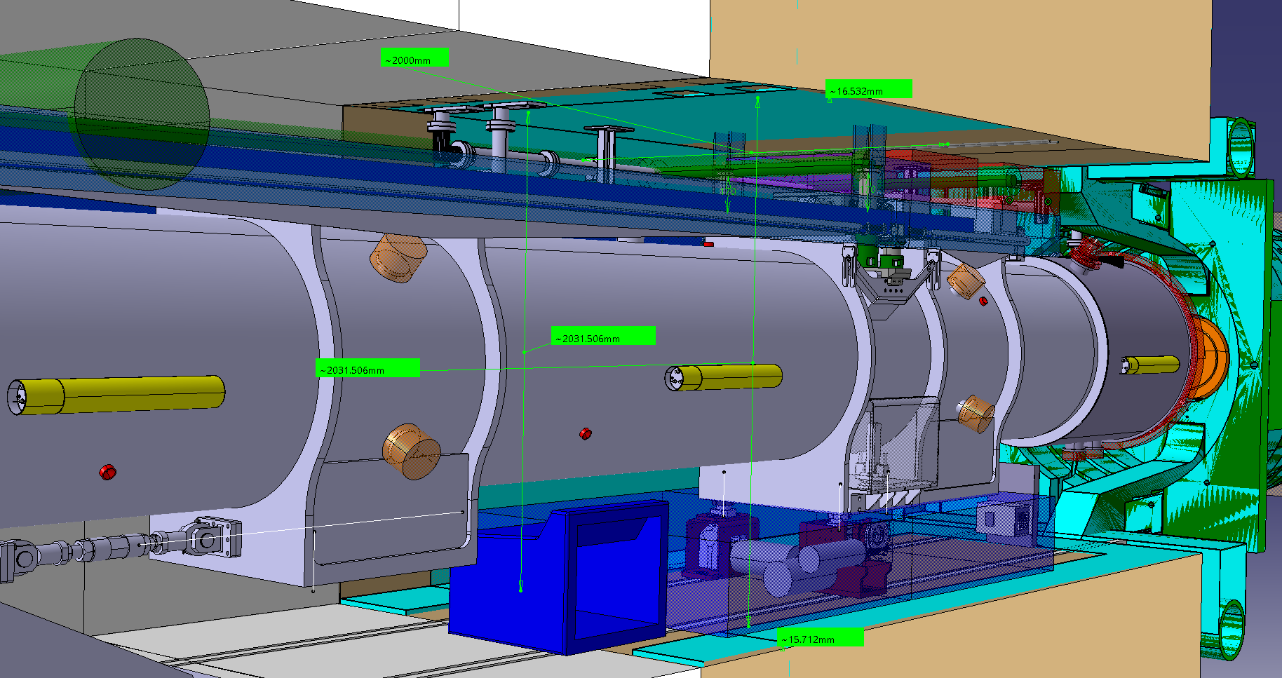
Measurements of the blockhouse (1/2)
5L
P5 Left
Longitudinal distance from the IP wall [mm] | Vertical Measurement [mm] |  |  | 3D models [mm] | Horizontal Measurement [mm] |  |  | 3D models [mm]
 | 1st | 2nd | Average |  | 1st | 2nd | Average
500 | 1997.0 | - | 1997.0 |  | 2002.0 | - | 2002
1650 | 2021.0 | 2022.0 | 2021.5 |  | 2001.0 | 2002.0 | 2001.5
2500 | 2033.0 | 2034.0 | 2033.5 |  | 2002.0 | 2002.0 | 2002
3500 | 2026.0 | 2018.0 | 2022.0 |  | 1991.0 | - | 1991
4500 | 2000.0 | 2000.0 | 2000.0 |  | 1997.0 | - | 1997
Ongoing
Ongoing
CMS / WP8: Ideal blockhouse - 2mx2m
CE / WP15
LEA82424MQ: 11 CONCRETE BLOCKHOUSE - RB 54 - ST0060851_01
Nez R542 - 1503 zero sur R542 - ST0437899_01

Slide 12
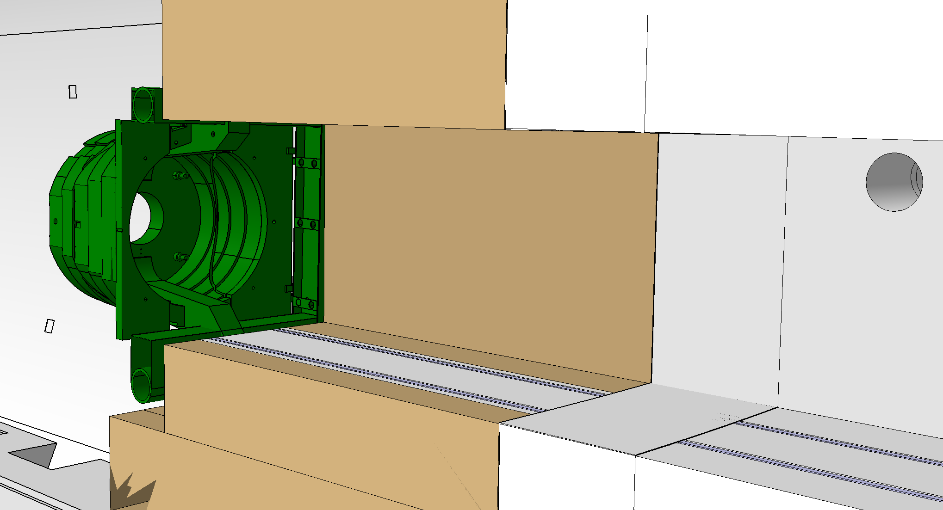
Measurements of the blockhouse (2/2)
5L
P5 Right
Longitudinal distance from the IP wall [mm] | Vertical Measurement [mm] |  |  | 3D models [mm] | Horizontal Measurement [mm] |  |  | 3D models [mm]
 | 1st | 2nd | Average |  | 1st | 2nd | Average
500 | 2004.0 | 1997.0 | 2000.5 |  | 2001.0 | 2001.0 | 2001
1700 | 2013.0 | 2012.0 | 2012.5 |  | 2006.0 | 2005.0 | 2005.5
2500 | 2008.0 | 2008.0 | 2008.0 |  | 2007.0 | 2009.0 | 2008
3500 | 2001.0 | 2001.0 | 2001.0 |  | 2001.0 | 2000.0 | 2000.5
4500 | 2018.0 | 2016.0 | 2017.0 |  | 2001.0 | 1997.0 | 1999
Ongoing
Ongoing
CE / WP15
R561 - 1503 Ensemble complet – ST0438580_01

Slide 13
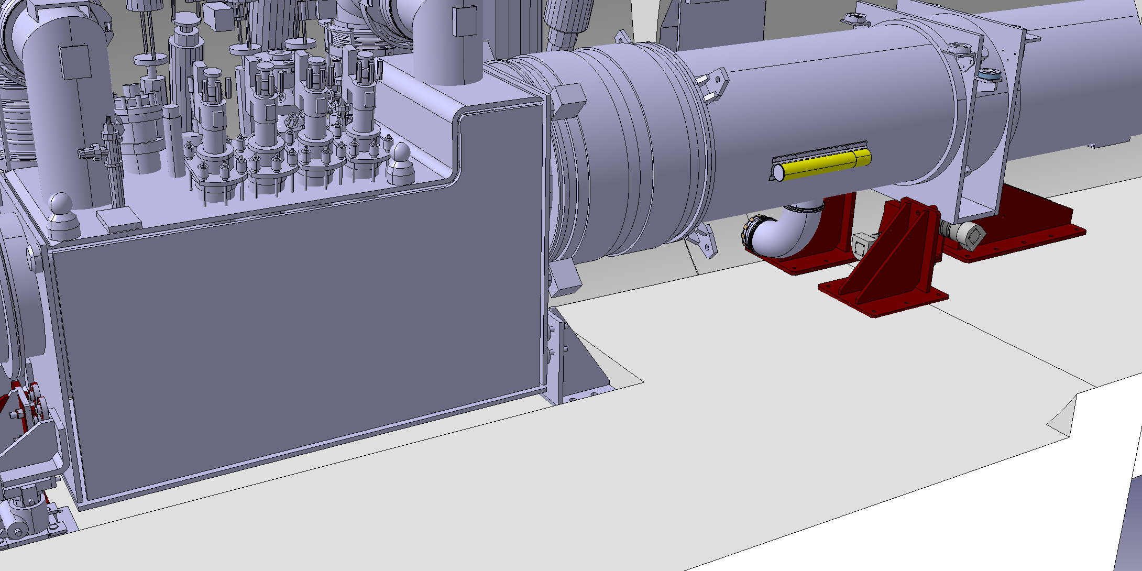
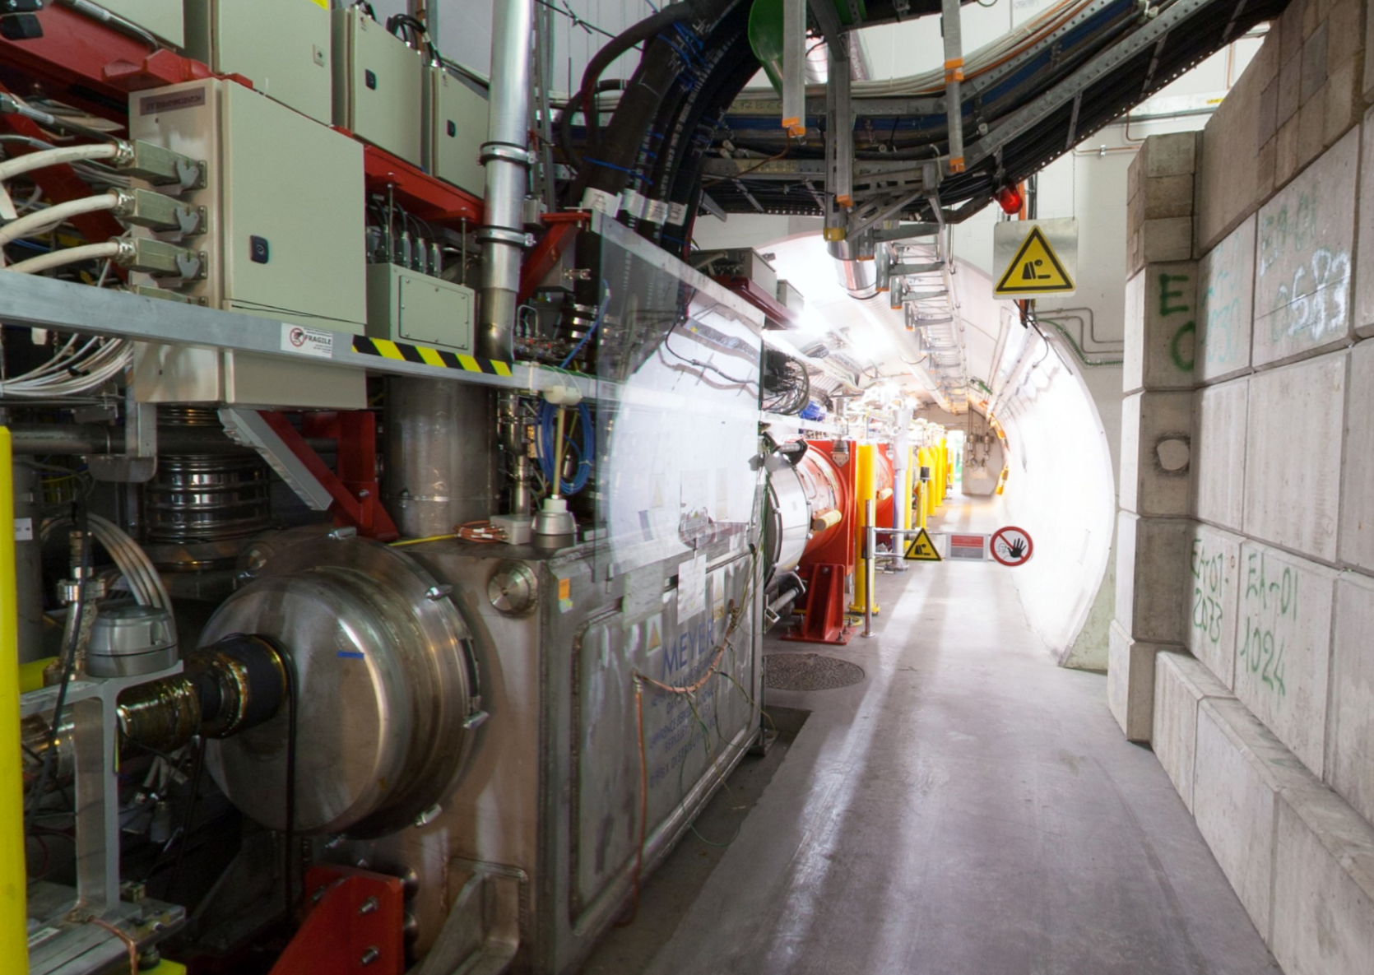
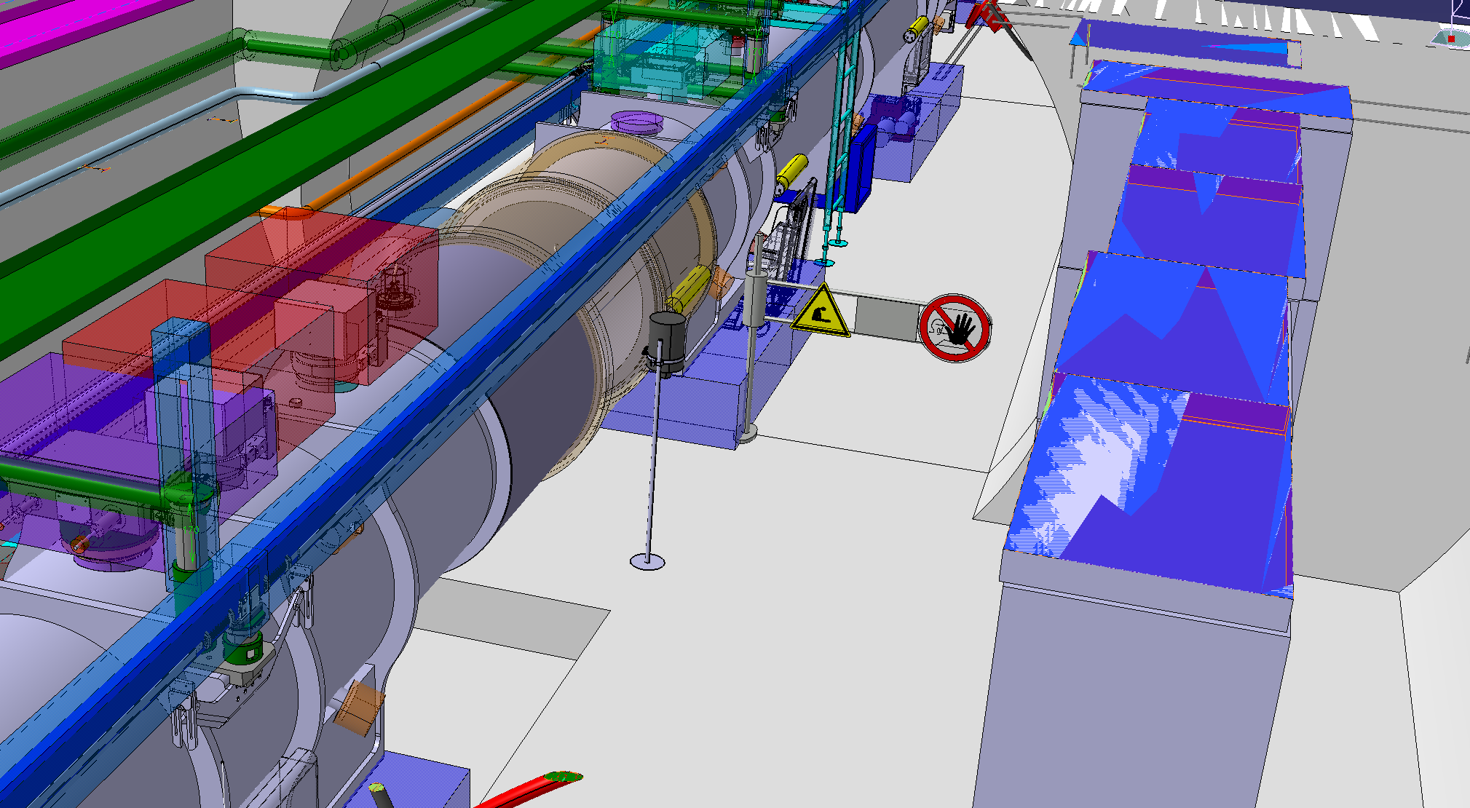
Identification of the position of the manhole located in the RZ54
5L
Ongoing
RZ54 - LHC machine
RZ54
RZ54 - HL-LHC machine

Slide 14
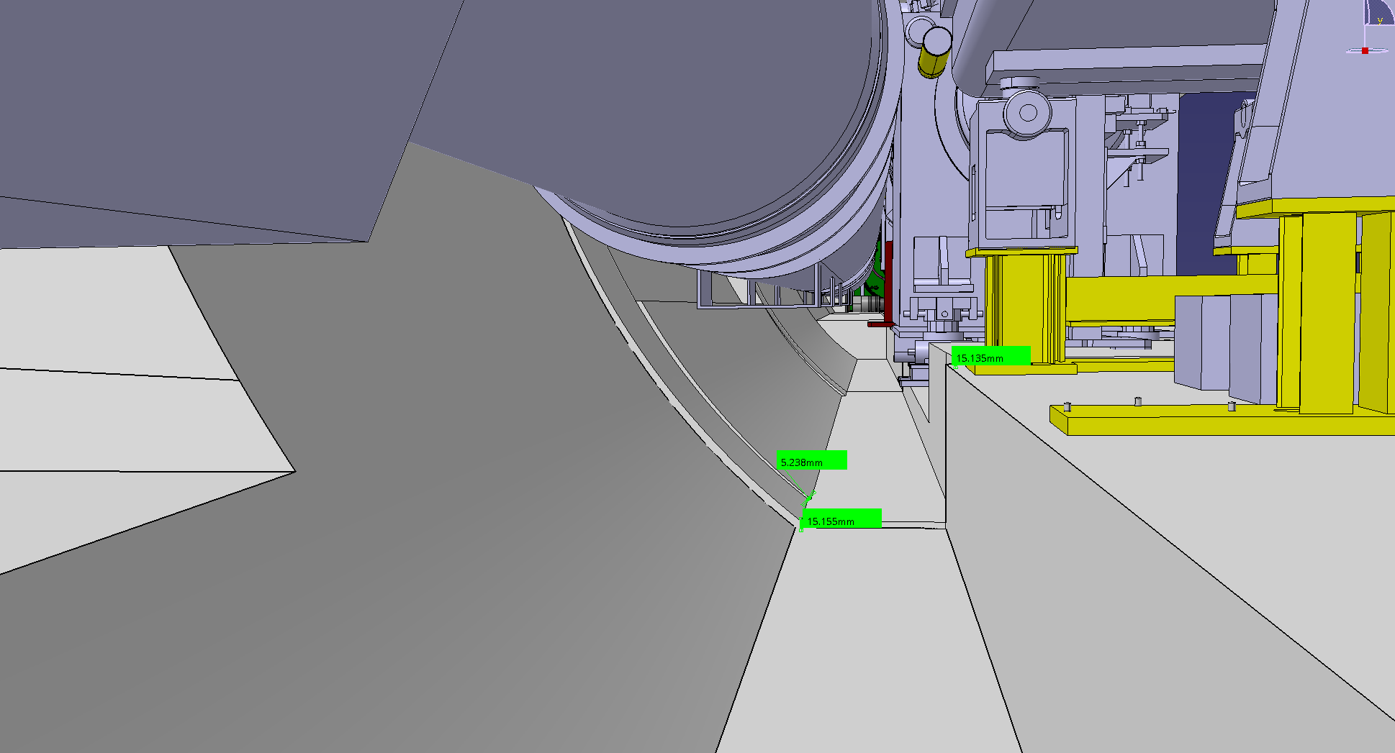
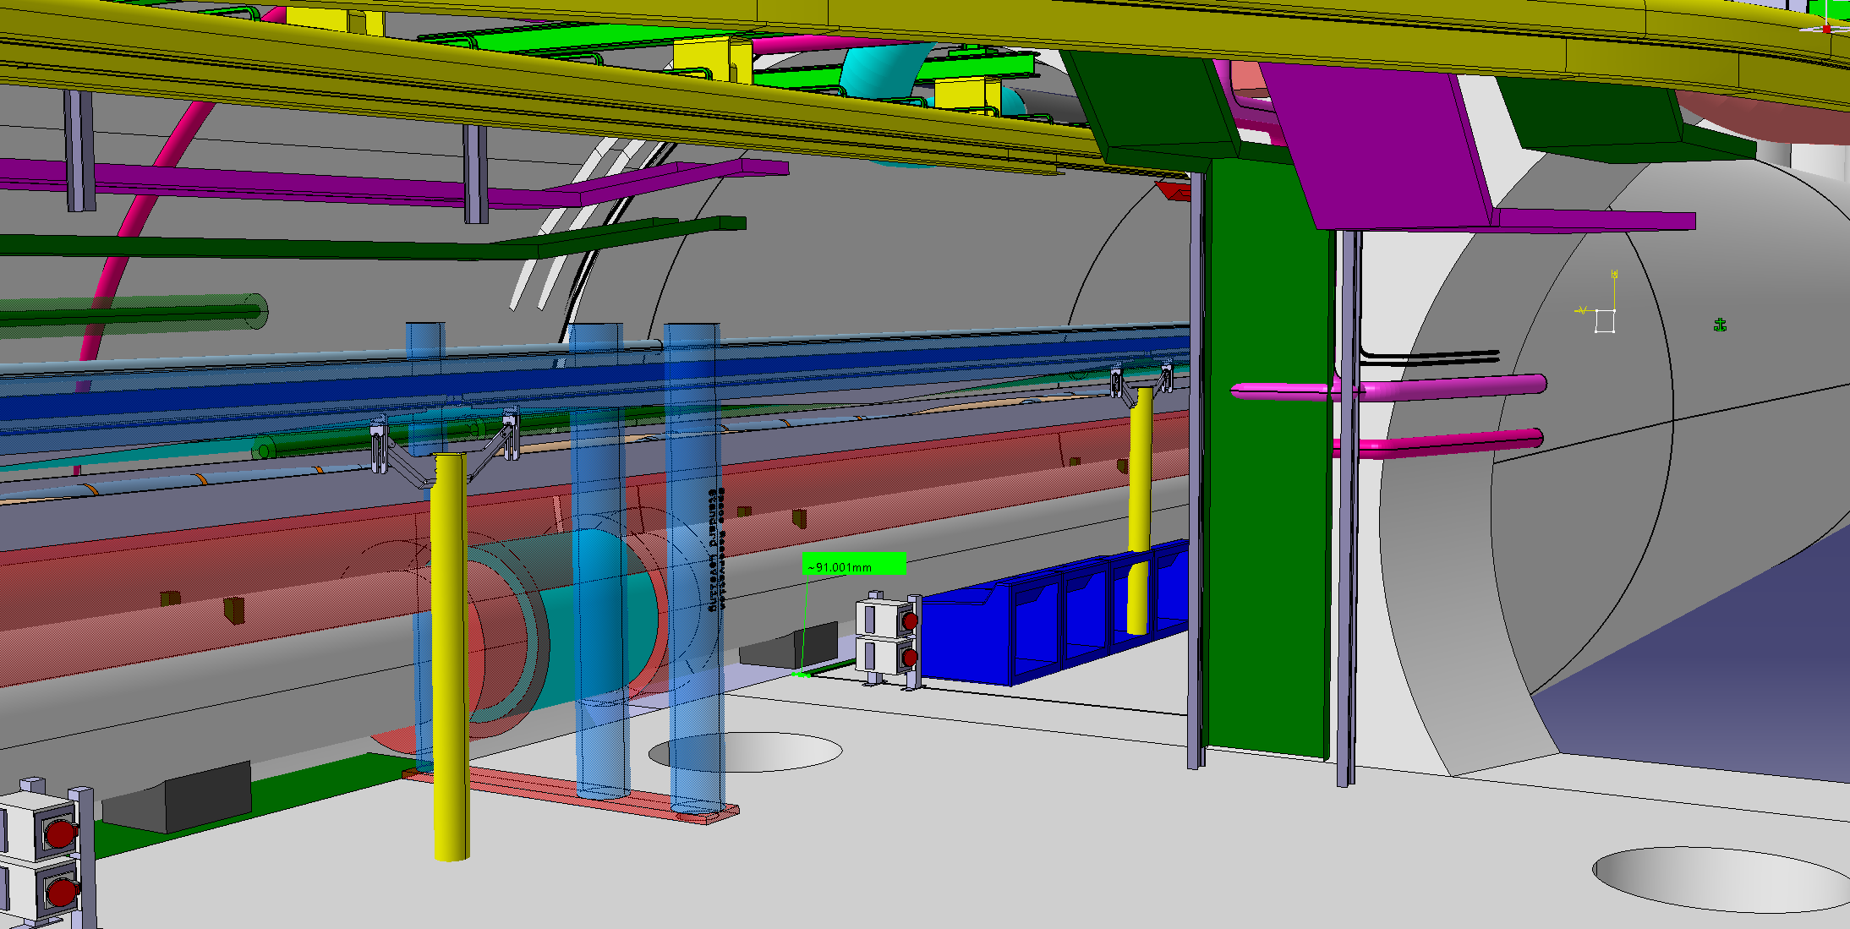
Check on the discontinuities found in the CE 3D models
5L
Ongoing
UPS – R541 – RZ54
UJ53

