Slide 1
RD51 Common Project
Atsuhiko Ochi
02/03/2023 DRD1 kick-off meeting

Slide 2
Overview of RD51 Common Projects
The RD51 Common Project Funding is intended to support a project cost in the areas of common interest to the RD51/MPGD community
  Technology R&D projects towards developments of novel techniques, improvements of existing technologies, characterization methods and dedicated tools;
  Development and optimization of MPGDs for novel applications;
  Improvement of the MPGD technology transfer to industry.
  The program will fund only generic projects – not ones related to experiments.
Transversal collaborations among groups from different countries, experiments, physics areas of interest encouraged and supported by RD51
Started since 2011
24 projects are approved in these 12 years.

Slide 3
RD51 Common Project list
Year | Title | Contact person
2011 | A low mass microbulk with real XY strips structure | Theo Geralis
 | MPGDs technology laboratory for training, development, fabrication, applications and innovation | Rafael Gutierrez
 | Thin and high-pitch laser-etched mesh manufacturing and bulking | Paul Colas
 | Development of innovative resistive GEM alpha detectors for earthquakes | Guy Paic
 | Large-area THGEM detector evaluation with SRS electronics | Amos Breskin
2012 | R&D on large area GEMs for the ALICE TPC upgrade | Chilo Garabatos Cuadrado
 | High resolution UV scanner for MPGD applications | Dezso Varga
2014 | Measurement and calculation of ion mobility of some gas mixtures of interest | Chilo Garabatos
 | Fast Timing for High-Rate Environments: A Micromegas Solution | Sebastian White
 | Development of a novel Micro Pattern Gaseous Detector for Cosmic Ray Muon Tomography | Paolo Iengo
2016 | Sampling Calorimetry with Resistive Anode MPGDs (SCREAM) | Maximilien Chedeville
 | New Scintillating gases and structures for next-generation scintillation-based gaseous detector | Diego Gonzalez Diaz
2017 | Development of modular multilayer GEM units | Alexander Milov
2018 | Modular & General purpose Ultra Low Mass GEM Based Beam Monitors | Gabriele Croci
 | DLC based electrodes for future resistive MPGDs | Yi Zhou
 | Study of negative ion mobility and ion diffusion for Negative Ion TPCs | André Cortez
2019 | Discharge Consortium in quest for Spark-Less-Avalanche-Microstructures | Piotr Gasik
 | Pixelated resistive bulk Micromegas with integrated electronics | Fabrizio Petrucci
 | Resistive materials and resistive-MPGD concepts & technologies | Shikma Bressler
2020 | Optical readout studies for negative ion TPCs | Florian M. Brunbauer
 | Large area high-granularity segmented mesh microbulk forfuture rare event searches | Javier Galan
2021 | Comprehensive studies of the glass, ceramic- and kapton-THGEMs in high- and low-pressure TPCs | Pawel Majewski
 | Development for Resistive MPGD Calorimeter with timing measurement | Piet Verwillligen
2022 | Study of MPGD performance in liquefied noble gases | Vitaly Chepel

Slide 4
Collaborative work between different institutes
More than 3 institutes should be joined in one project.
  It makes good connections between different institutes in the RD51 collaborators in world wide
For example; SCREAM project (2018 CP project)
  Collaborative work between
    IN2P3/LAPP (France) → Readout, Electrical tests
    NCSR (Greece) → Detector caractarization
    Saclay (France) → Test infrastructures
    Weizmann (Israel) → Detector design, production
    U. Aveiro (Portgal) → Detector development, simulation
    U. Coimbra (Portgal) → Test beam, detector development

Slide 5
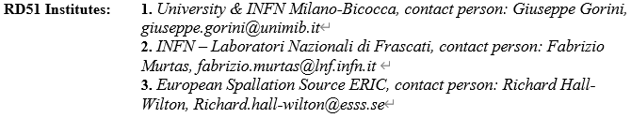
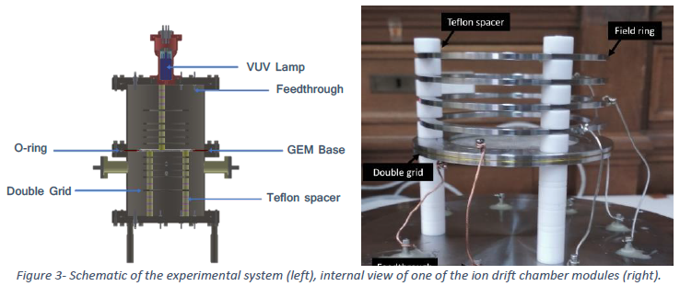
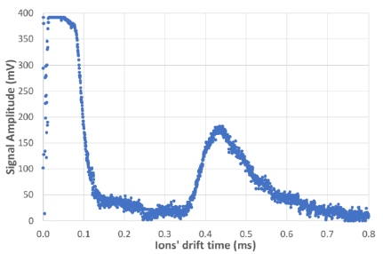
Highlights of the Blue sky
Study of negative ion mobility and ion diffusion for Negative Ion TPCs (2018-)
Schematic diagram of the working principle of this system.
Typical time-of-arrival spectra in pure CF4 for a VGEM of 35V, a E/N of 30 Td and 8 Torr of total pressure at room temperature.

Slide 6
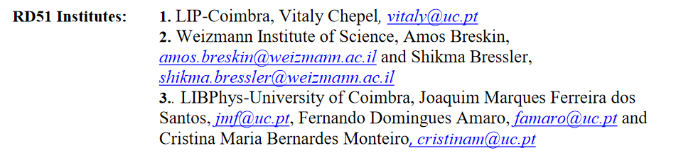
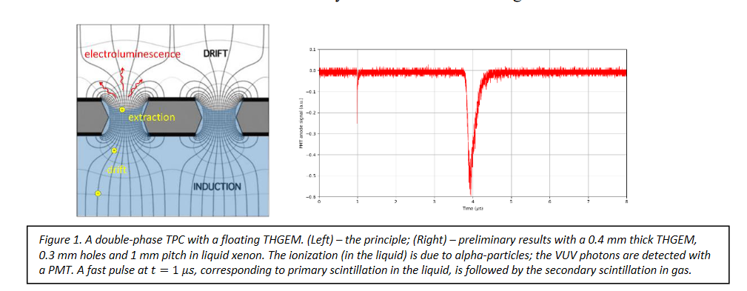
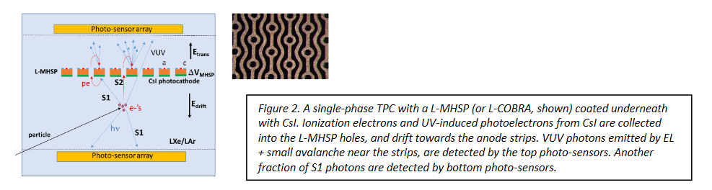
Highlights of the Blue sky
Study of MPGD performance in liquefied noble gases (2022-)

Slide 7
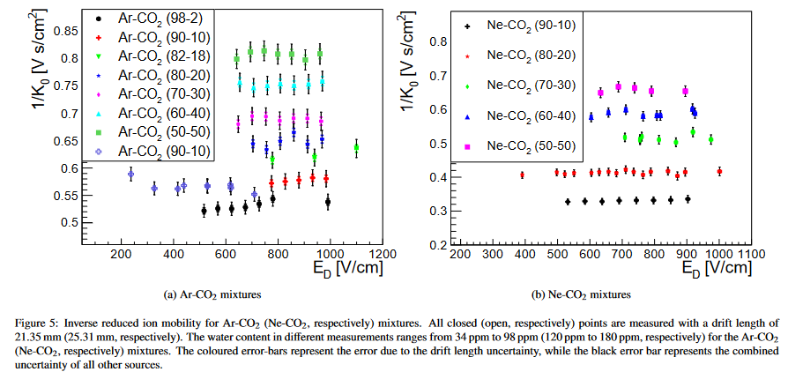
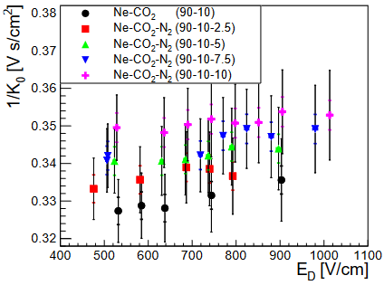
Highlight the support to basic activities of common interest
Measurement and calculation of ion mobility of some gas mixtures of interest (2014-)
RD51 Institutes:
1. GSI, contact person: Chilo Garabatos, chilo.garabatos.cuadrado@cern.ch
2. LIP Coimbra (Portugal), contact person: André Cortez, andre.cortez@coimbra.lip.pt
3. University of Bursa (Turkey), Rob Veenhof, rob.veenhof@cern.ch
4. VECC, Kolkata (India), Tapan Nayak, tapan.nayak@cern.ch
[ArXiv:1804.10288v2]

Slide 8
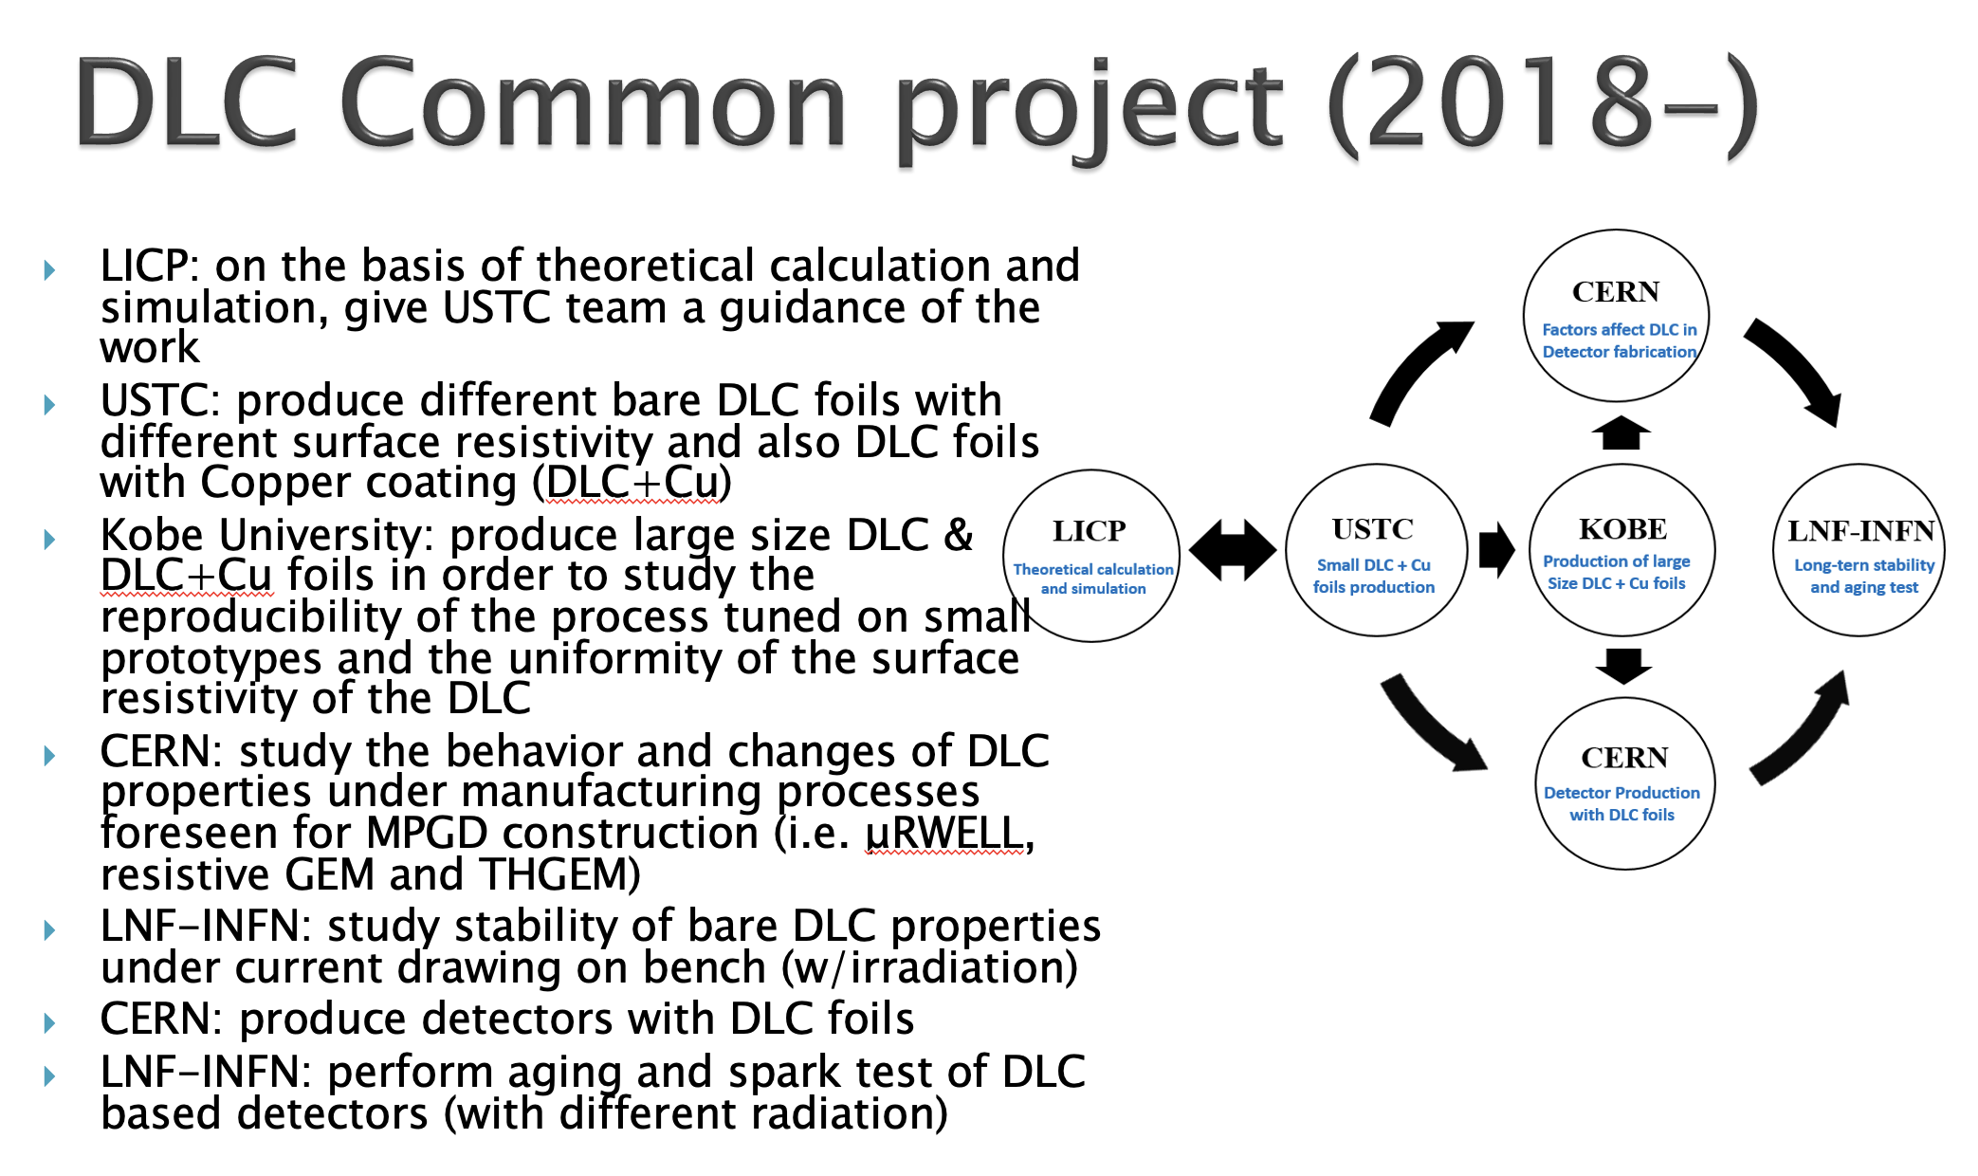
Highlight the clustering research teams
Clustering group working on the same fields to increase the impact
Now Resistive DLC electrodes are grown to one
of common technology in MPGD community

Slide 9
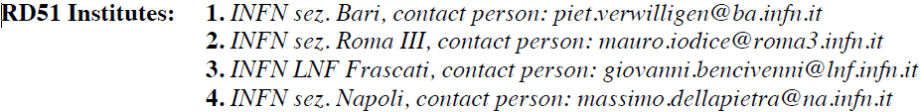
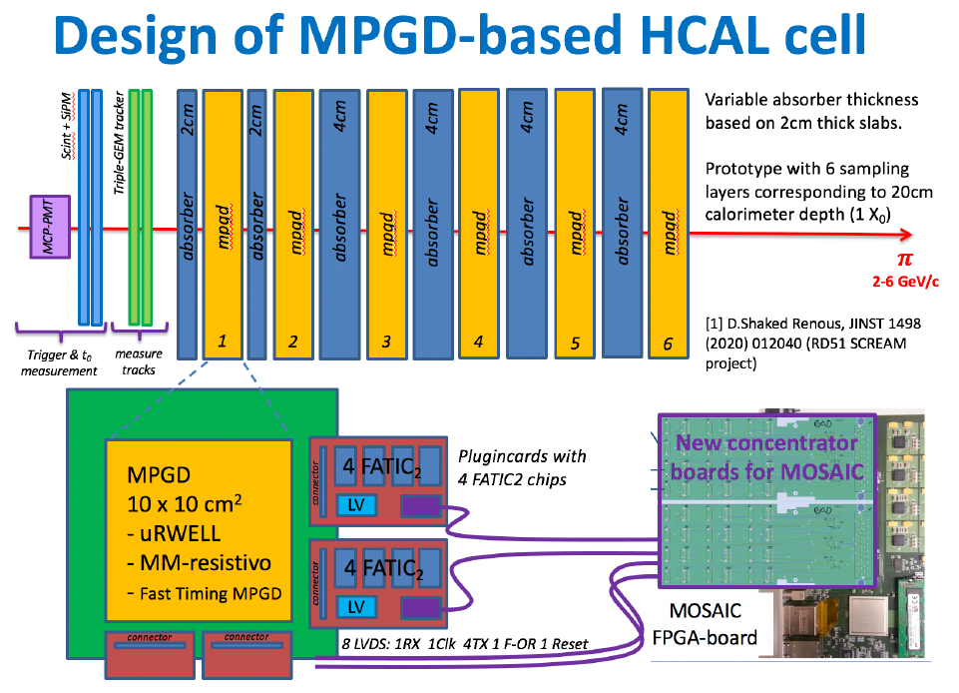
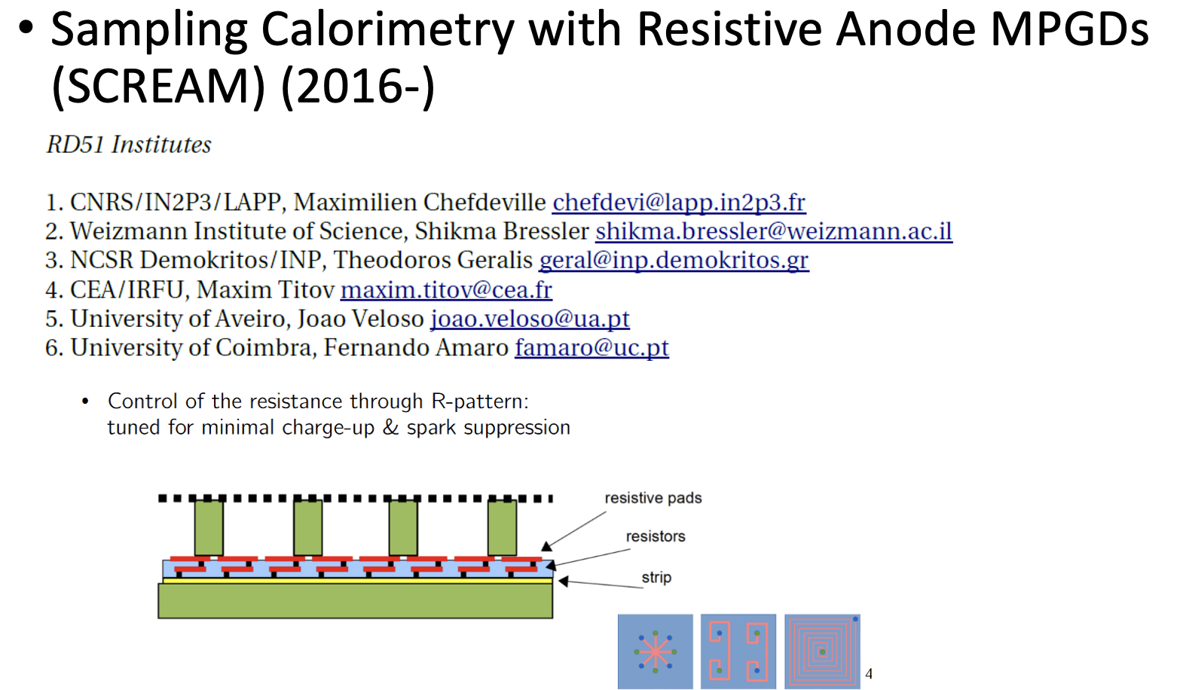
Connections & Synergies between CPs
Development of Resistive MPGD Calorimeter with timing measurement (2021-)

Slide 10
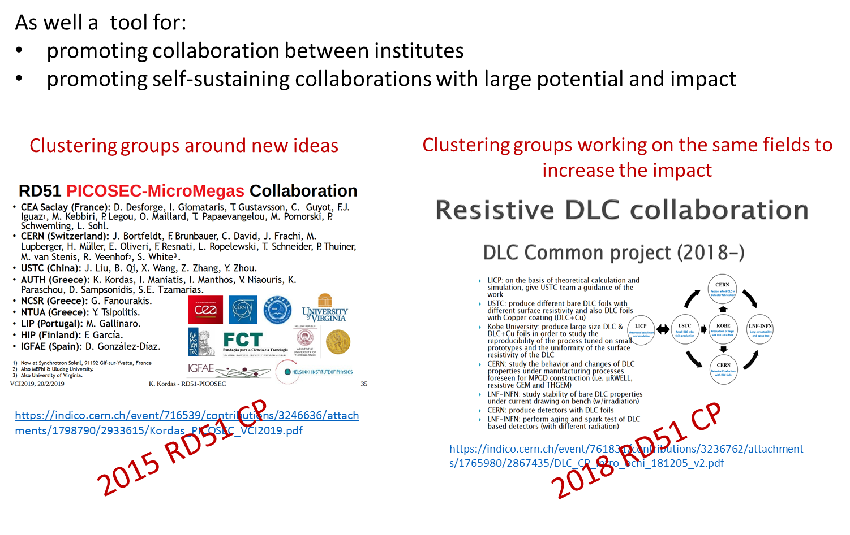
Highlight the seed of long term collaboration and activities
promoting collaboration between institutes
promoting self-sustaining collaborations with large potential and impact

Slide 11
Conclusion
The RD51 Common Project Funding is intended to support a project (not only cost) in the areas of common interest to the RD51/MPGD community
RD51 CP supports blue sky projects, basic activities of common interests, clustering research items and seeds of long term activities.
Transversal collaborations among groups from different countries, experiments, physics areas of interest encouraged
We strongly believe that RD51 CP structure should be implemented in DRD1.

