Slide 1
TPCs
DRD1 survey analysis
F. Garcia
(Uni Helsinki)

Slide 2
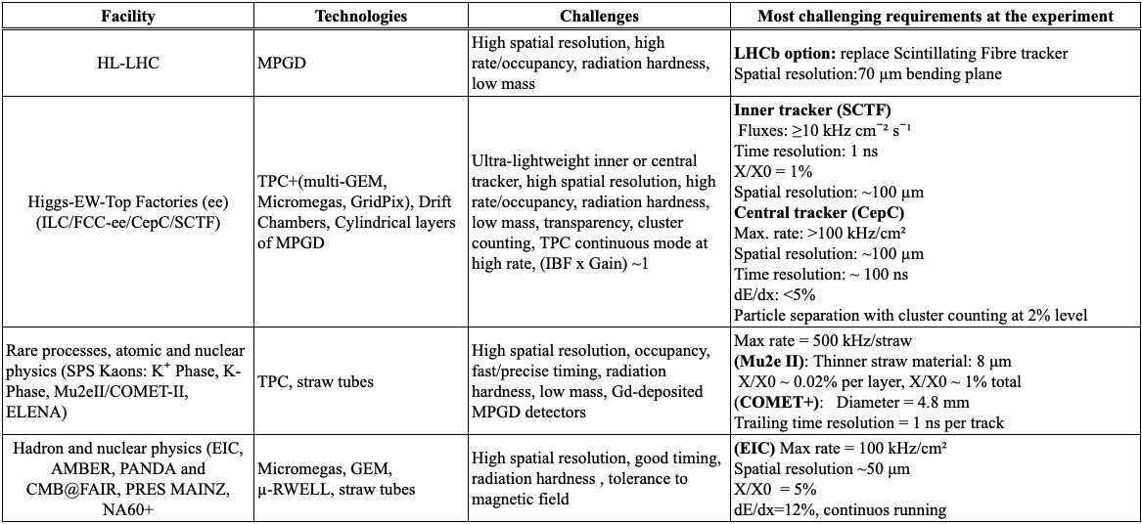

Slide 3
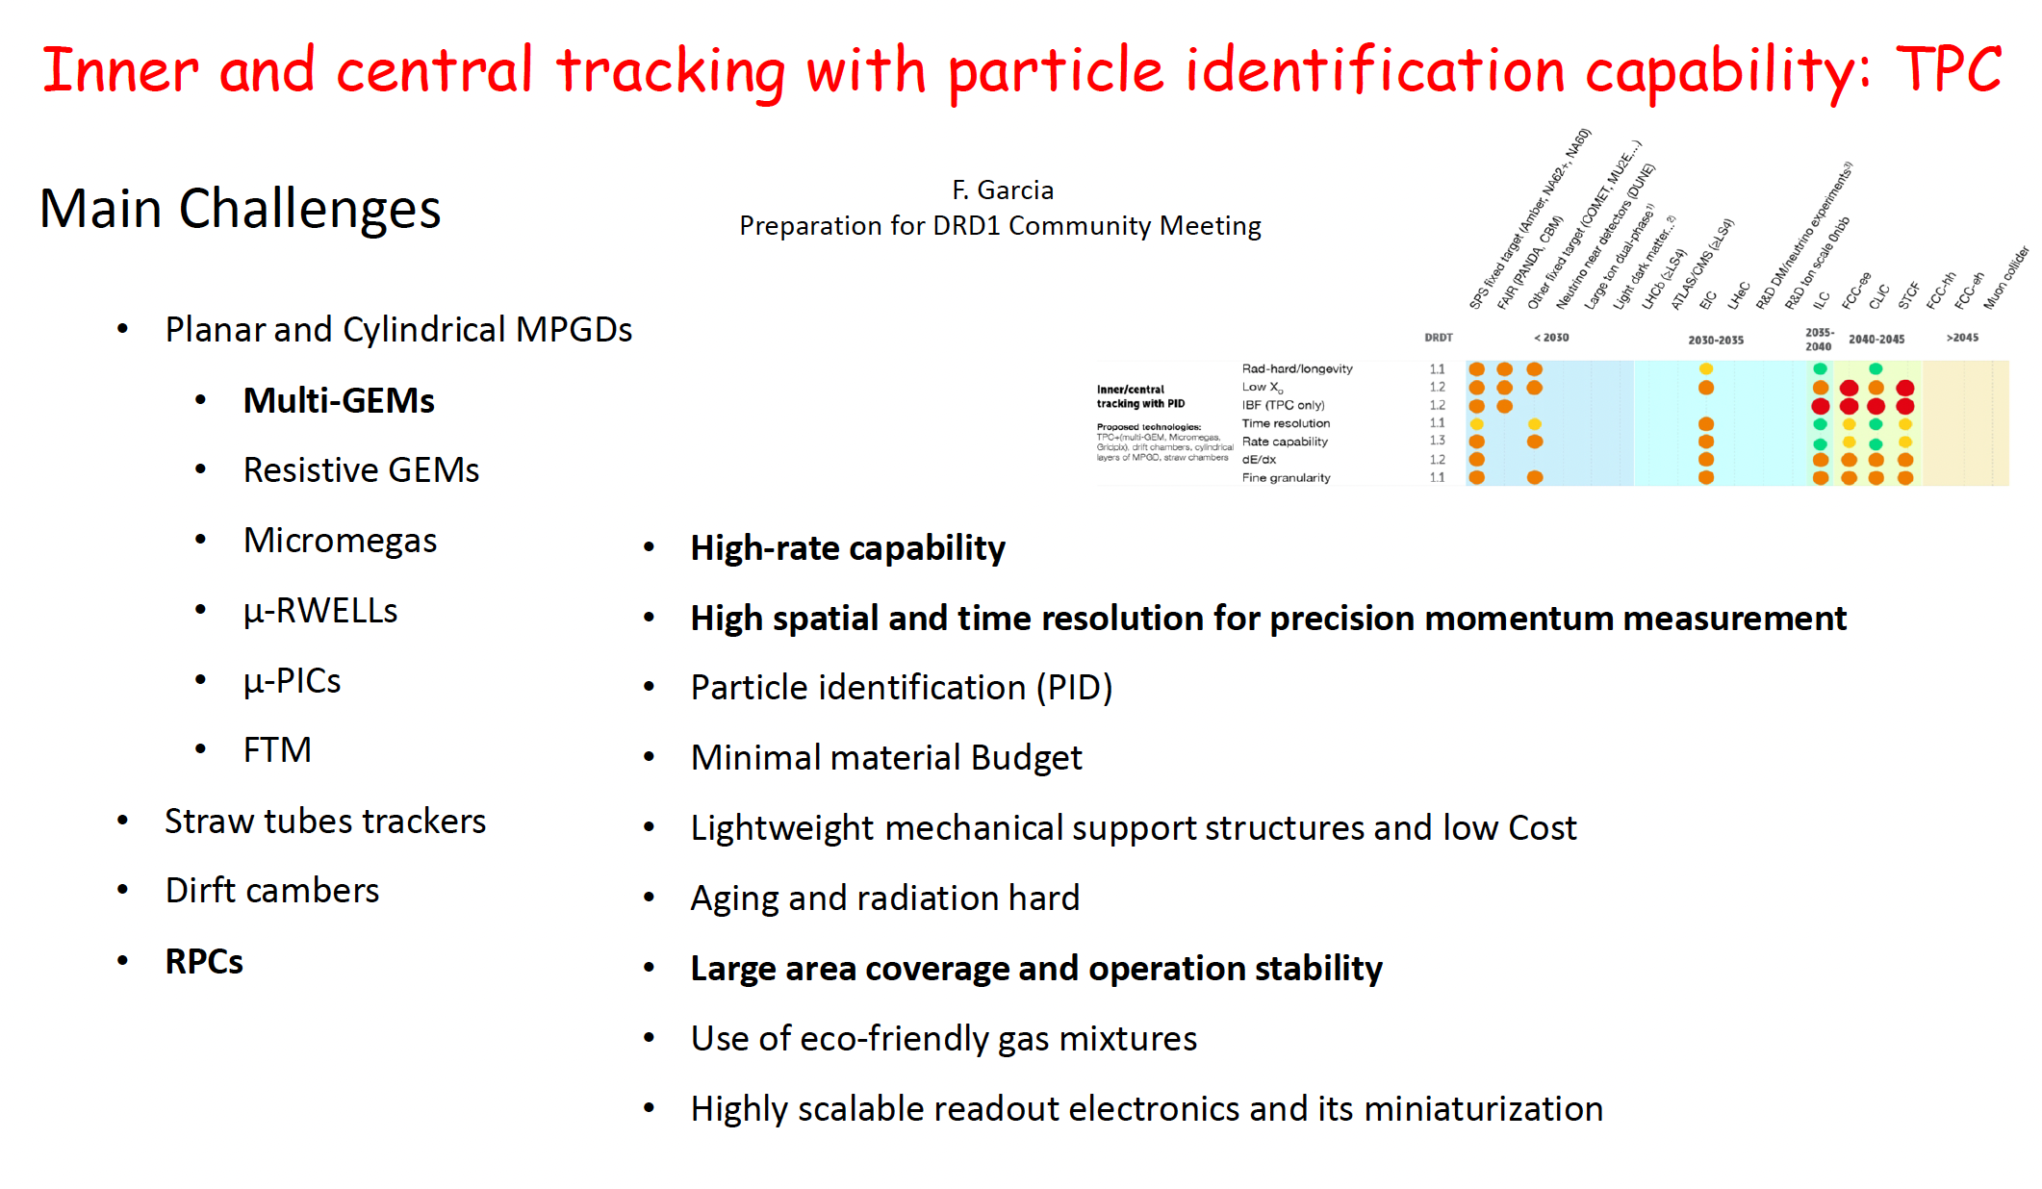

Slide 4
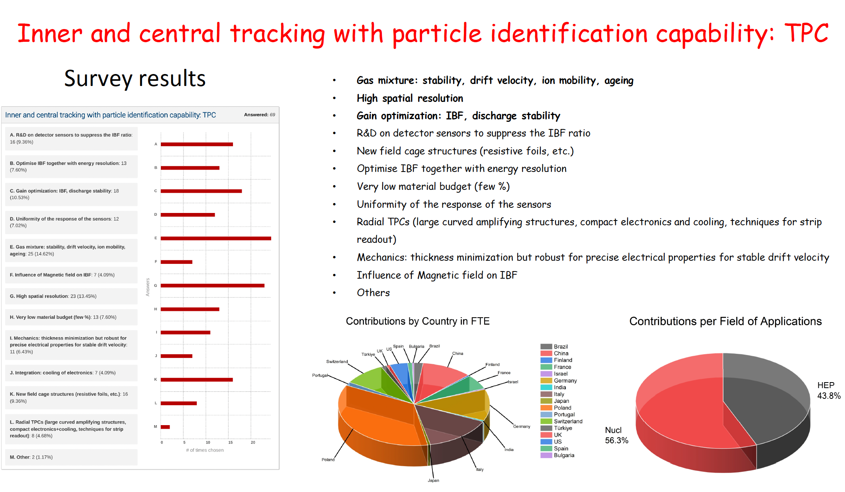

Slide 5
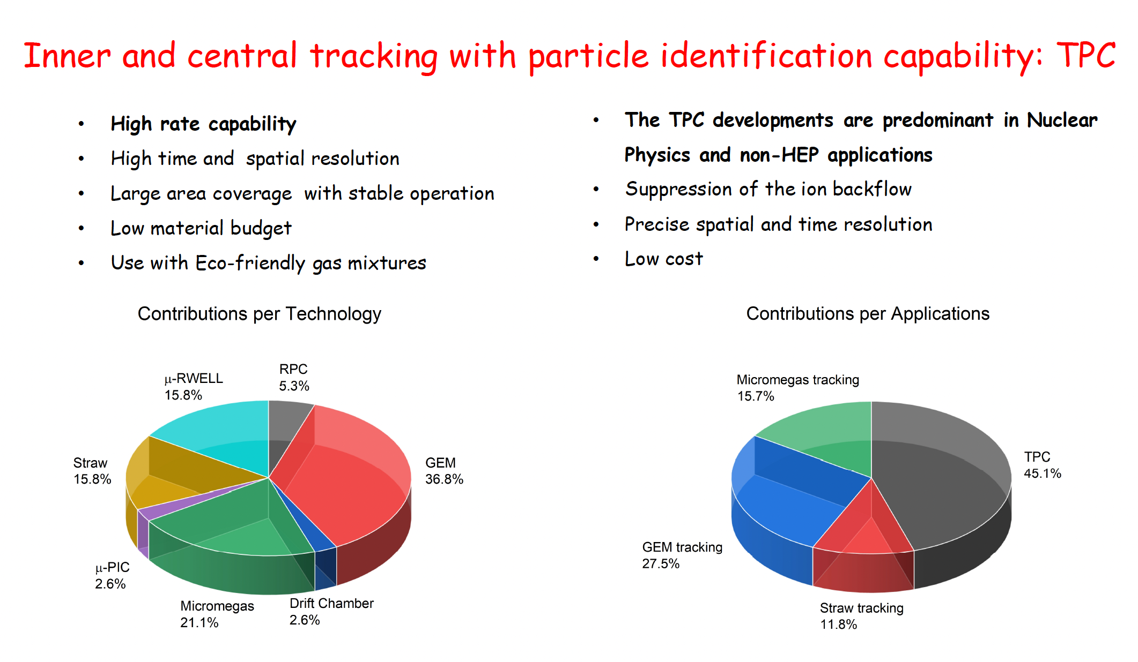

Slide 6
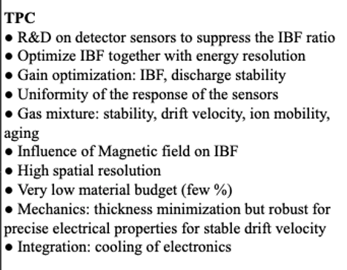
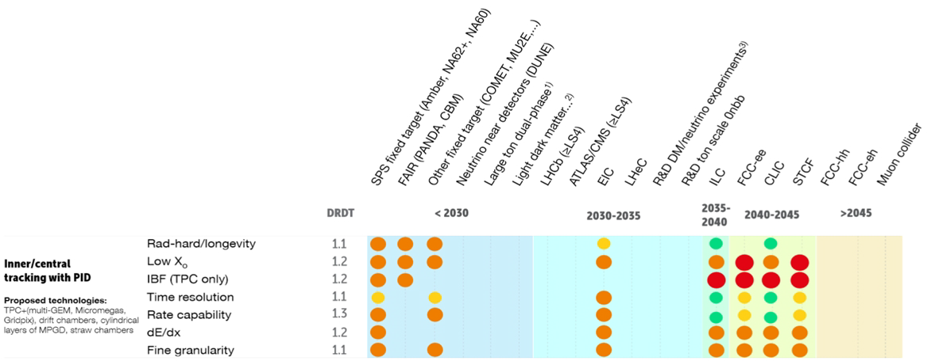
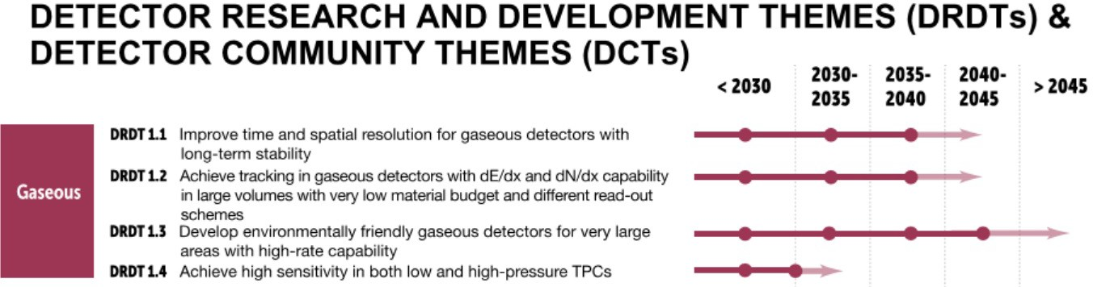
Possible synergies
  IBF reduction (together with other operational parameters optimisation)
    MPGD amplification technology
    Multi-MPGD stacks and hybrids
    Gating (eg. CEPC)
  Pad vs. Pixel TPC
    InGrid developments
  Mechanical structure, static distortions
    Minimise insensitive area
    Laser systems
  Low-power FEE development
    Low-power ASICs, continues vs pulsed operation
    Cooling
  Active target TPCs (current focus on the MPGD readout, many challenges to address)
    High pile-up, space charge (fluctuations)
    Final resolution of the reaction characteristic
    High dynamic range

