Slide 1
TPCs for Rare Event Searches
(‘Rare Decays’ for ECFA)
WG2-applications
(TPC survey)
Diego González Díaz,
01-02-2023
(DRD1 community meeting)

Slide 2
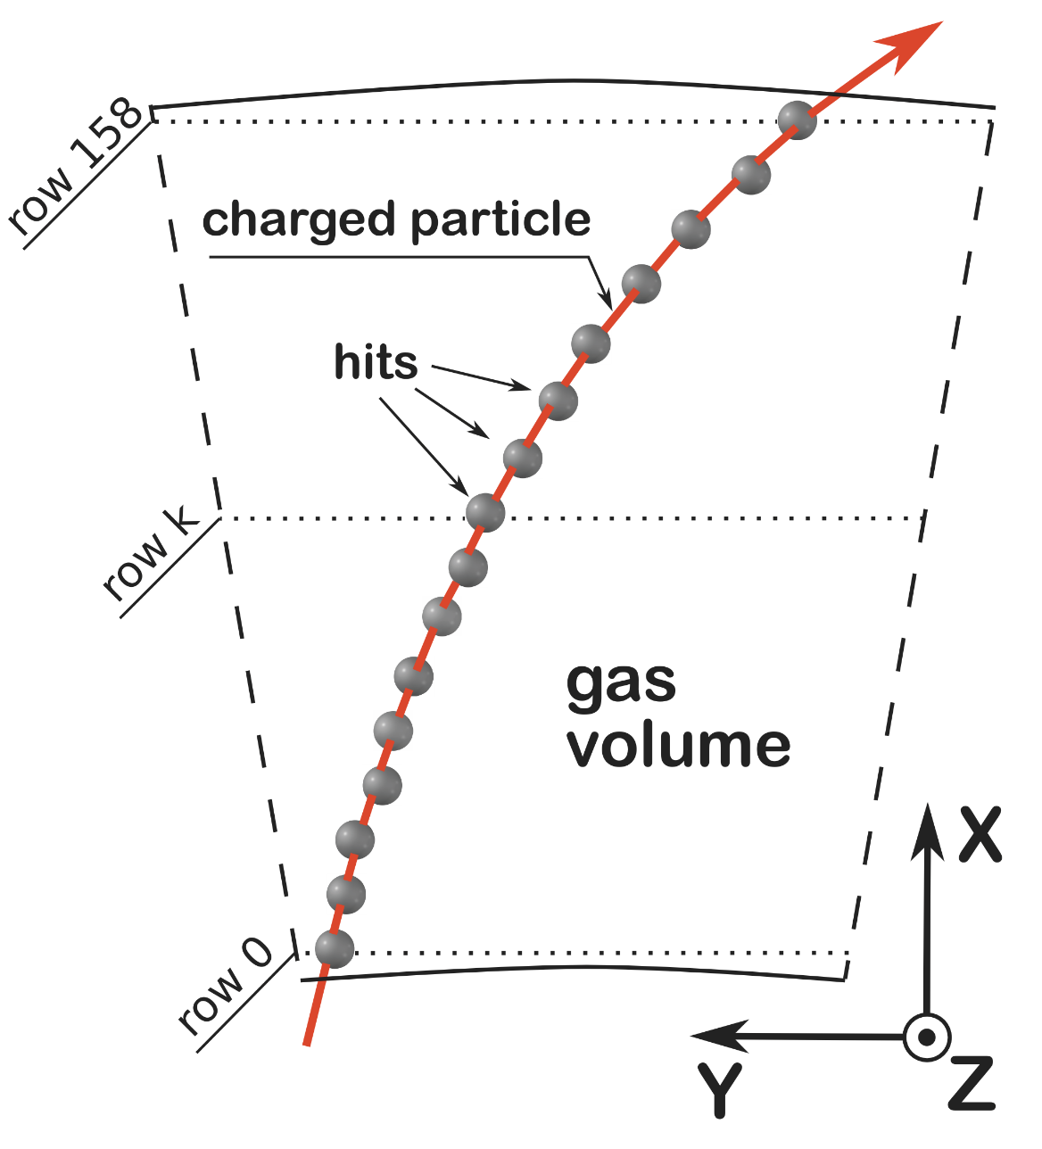
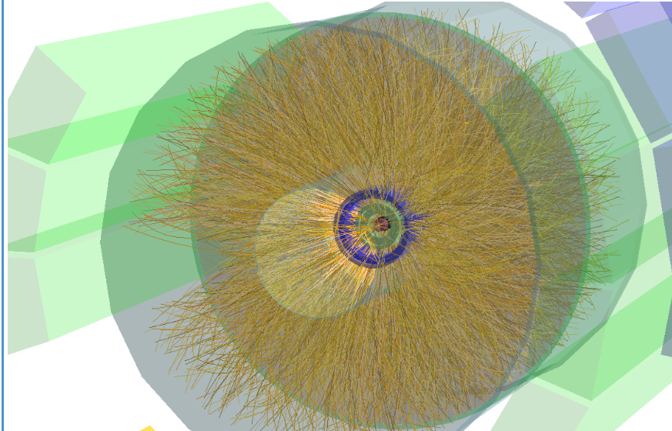
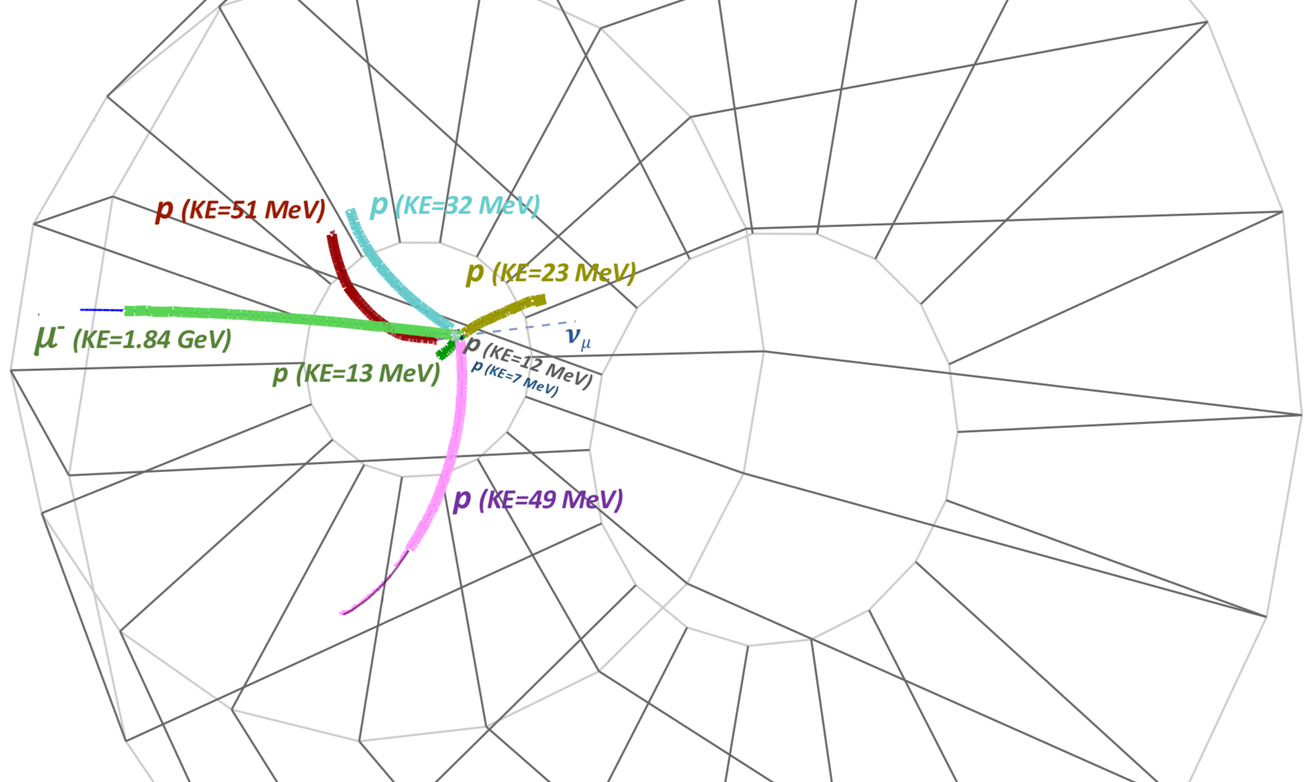
TPCs for Rare Event Searches
(‘Rare Decays’ for ECFA)
WG2-applications
(TPC survey)
Diego González Díaz,
01-02-2023
(DRD1 community meeting)
TPC for Tracking
TPC for Rare Events
‘TPC == single reconstruction-tool’
ALICE
TPCs for:
i) neutrino-interaction
ii) active targets for nuclear
reactions
‘TPC == tracker of a spectrometer’

Slide 3
TPCs for Rare Event Searches
(‘Rare Decays’ for ECFA)
WG2-applications
(TPC survey)
Diego González Díaz,
01-02-2023
(DRD1 community meeting)
TPC for Tracking
TPC for Rare Events
I draw the line here (does not agree with all the opinions in survey!)
‘TPC == single reconstruction-tool’
ALICE
TPCs for:
i) neutrino-interaction
ii) active targets for nuclear
reactions
‘TPC == tracker of a spectrometer’

Slide 4
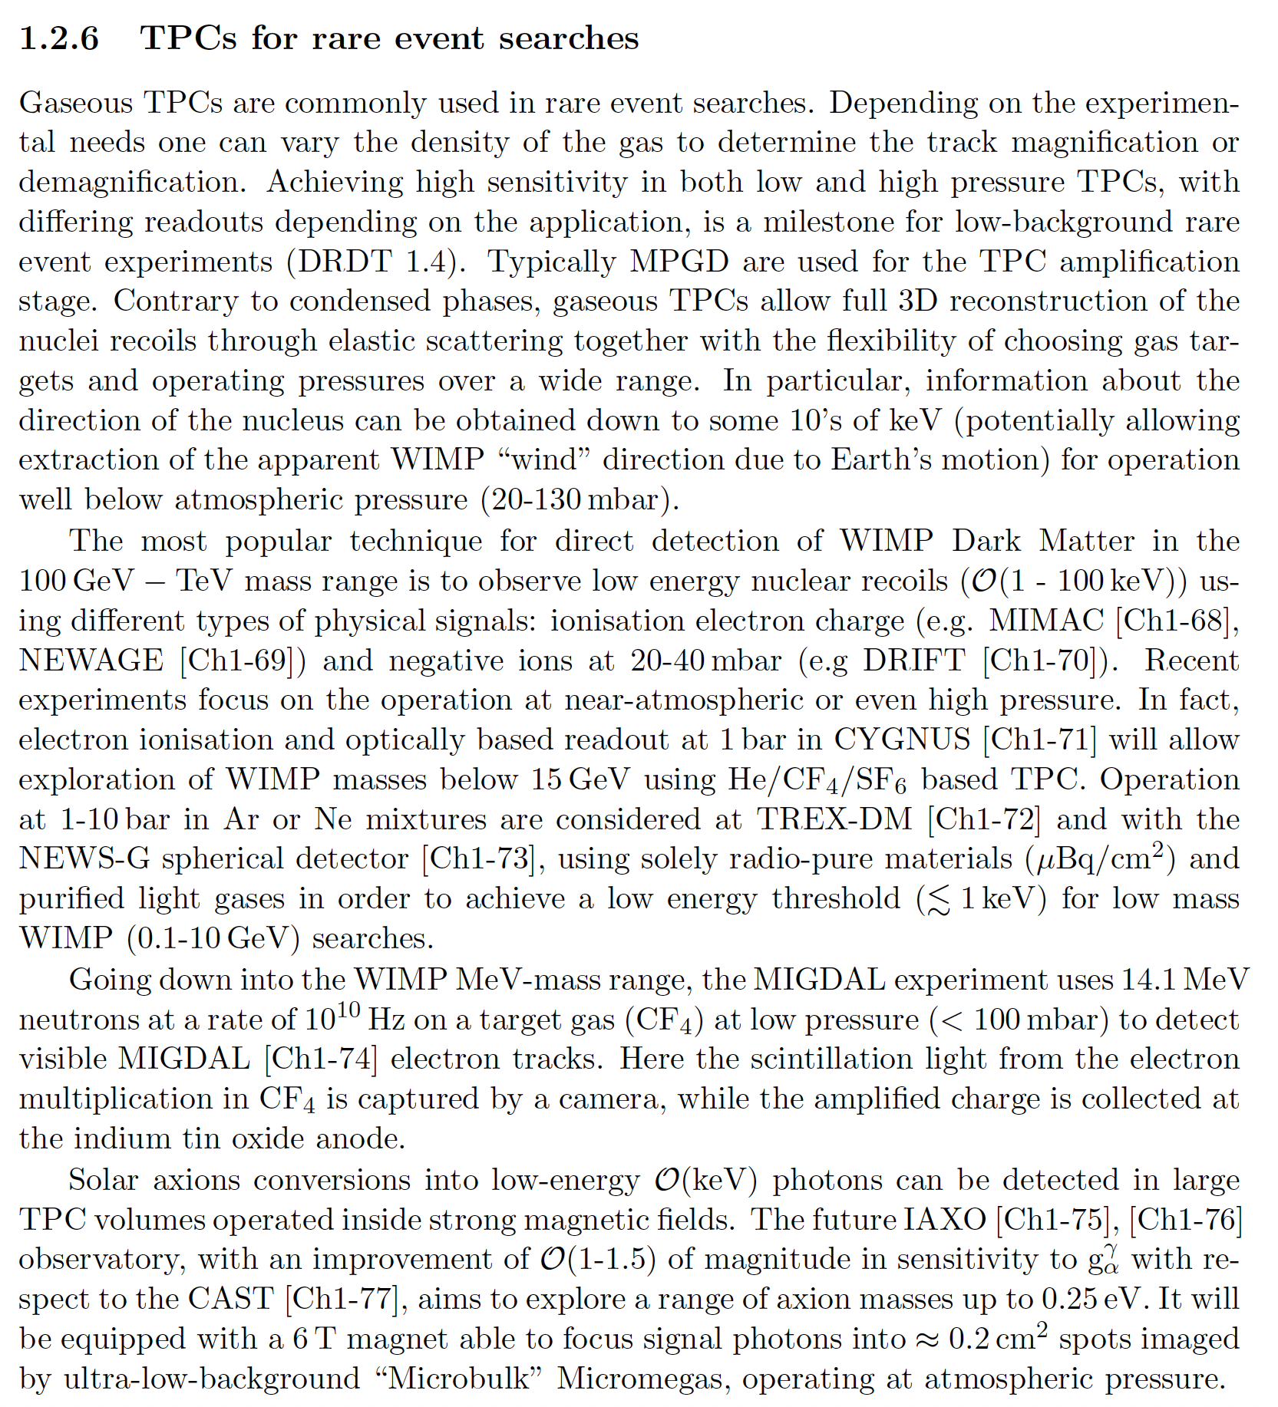
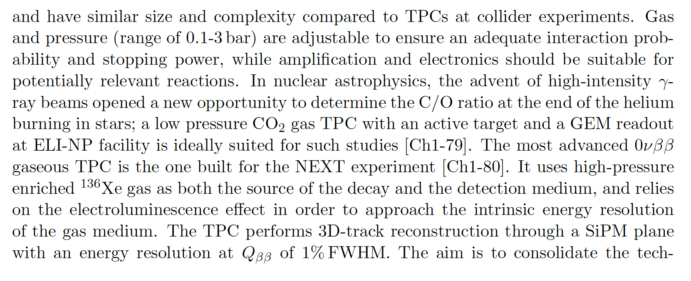
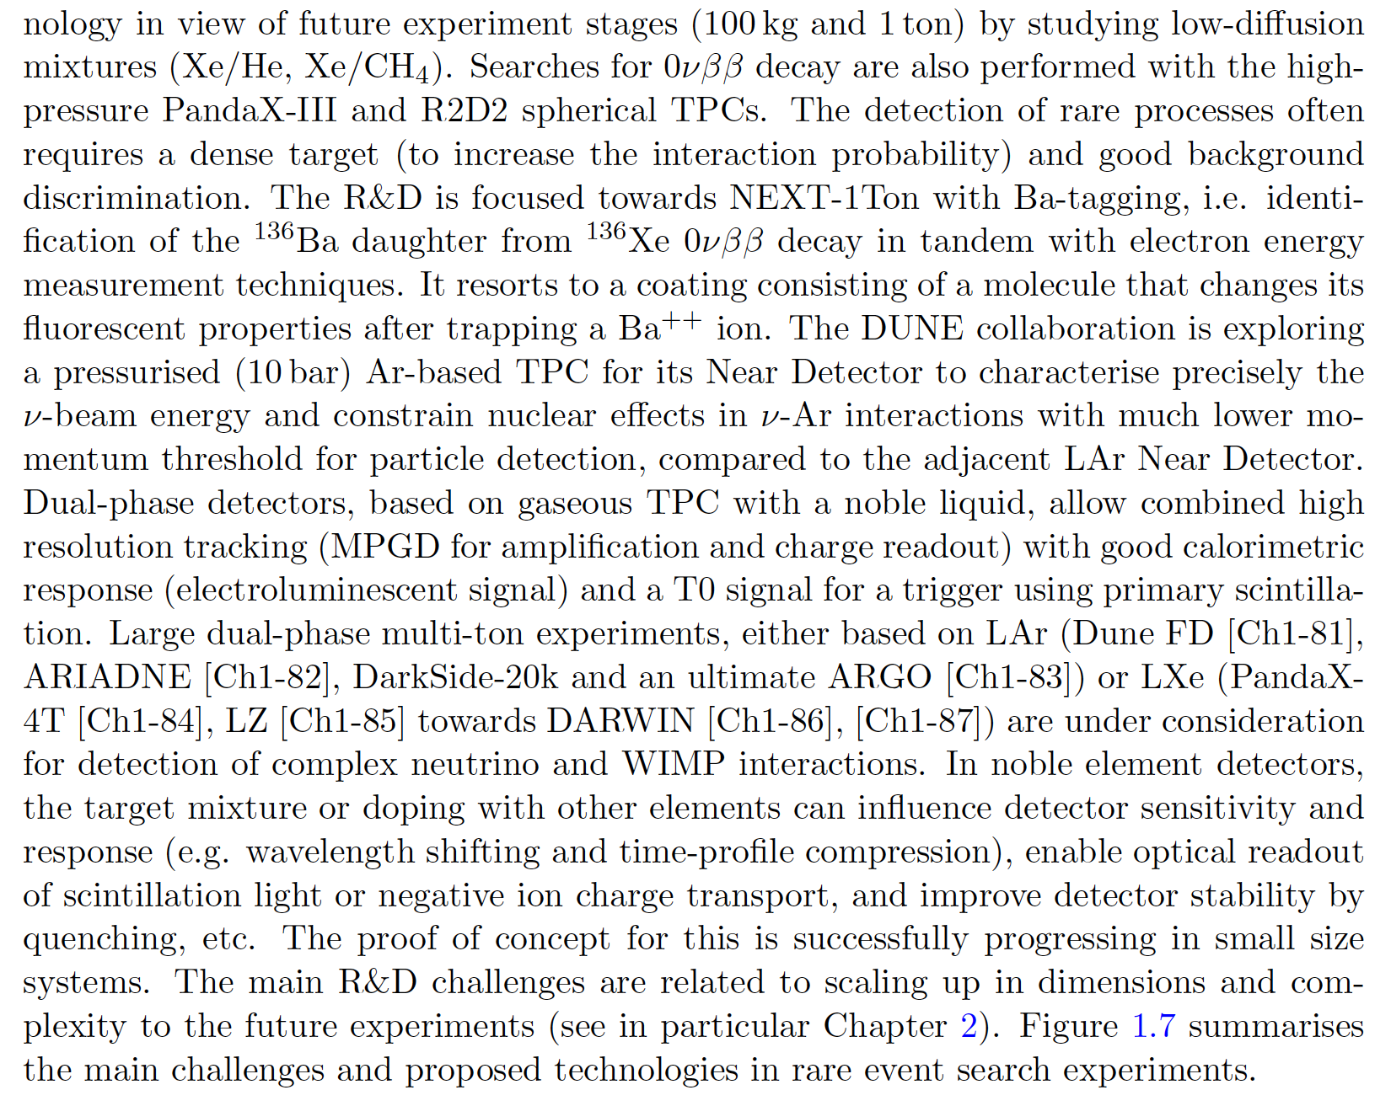
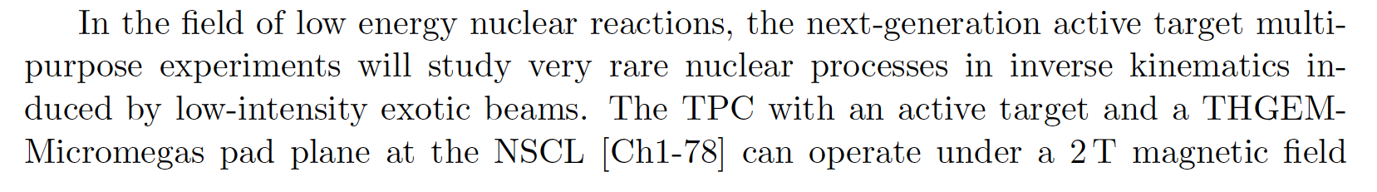
I. Challenges (from ECFA)
WG2-applications
(TPC survey)
DRDT 1.4 - Achieve high sensitivity in both low and high-pressure TPCs
sensitivity across
pressure and mixture
new gases
and mixtures
keV-threshold
at least
dual-phase optimization

Slide 5
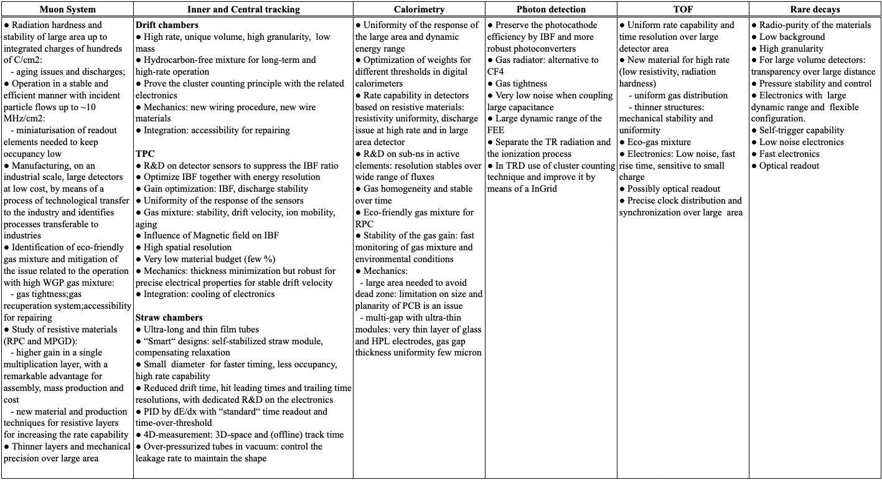
II. R&D topics given in survey for TPCs for Rare Events (‘Rare Decays’)
WG2-applications
(TPC survey)
we asked the community about these topics!

Slide 6
III. TPCs for Rare Events (stats)
main applications
WG2-applications
(TPC survey)
countries
Australia: 1(x4, joint australian survey)
China: 2
Czech Republic: 0 (+1, re-assigned from tracking TPC)
Finland: 1(-1, assigned to tracking TPC)
France: 1(+1, re-assigned from tracking TPC)
Germany: 2
Hungary: 0 (+1 , showed interest after Feb 15th)
Israel: 2
Italy: 5
Japan: 1
Poland: 1
Portugal: 1
Spain: 2 (+1 , showed interest after Feb 15th)
Switzerland: 2
Turkey: 2
UK: 1 (+2 , showed interest after Feb 15th)
US: 1(+1, re-assigned from tracking TPC)
(+6, showed interest after Feb 15th)
direct dark matter detection
direct dark matter detection (with directionality)
neutron detection (with directionality)
X-ray polarimetry
neutrino oscillations (gas)
neutrino oscillations (dual-phase)
neutrinoless double-beta decay
solar axions
nuclear interactions (active target) and decays
X-17 boson studies
WG2-applications
(TPC survey)
24 + 1x4 (+2)(+10) /69 submissions

Slide 7
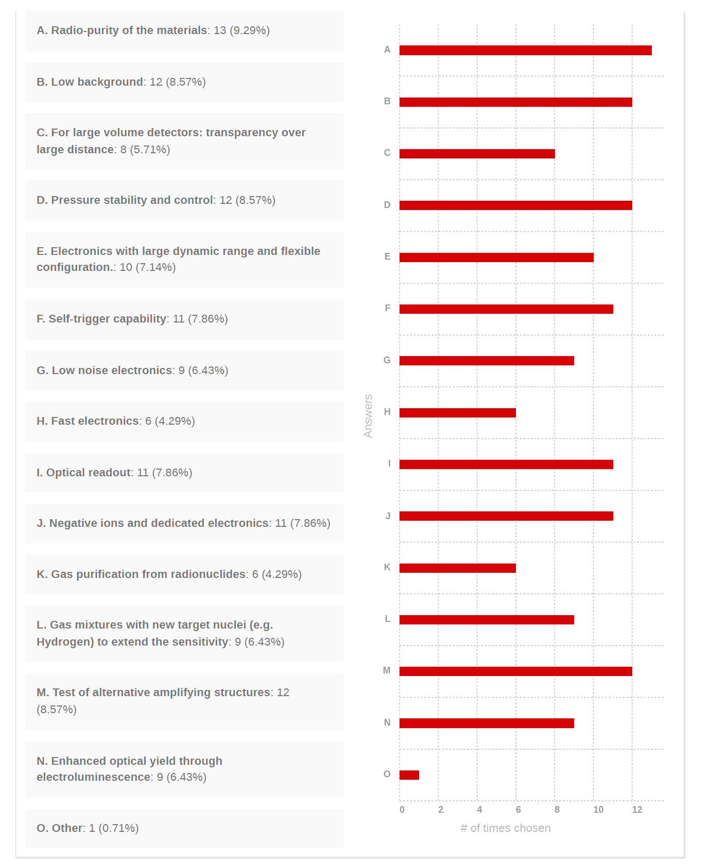
III. TPCs for Rare Events (stats)
R&D topics
WG2-applications
(TPC survey)
countries
Australia: 1(x4, joint australian survey)
China: 2
Czech Republic: 0 (+1, re-assigned from tracking TPC)
Finland: 1(-1, assigned to tracking TPC)
France: 1(+1, re-assigned from tracking TPC)
Germany: 2
Hungary: 0 (+1 , showed interest after Feb 15th)
Israel: 2
Italy: 5
Japan: 1
Poland: 1
Portugal: 1
Spain: 2 (+1 , showed interest after Feb 15th)
Switzerland: 2
Turkey: 2
UK: 1 (+2 , showed interest after Feb 15th)
US: 1(+1, re-assigned from tracking TPC)
(+6, showed interest after Feb 15th)
WG2-applications
(TPC survey)
24 + 1x4 (+2)(+10) /69 submissions

Slide 8
III. TPCs for Rare Events (stats)
very balanced choice of topics except for 2!
(expected)
R&D topics
WG2-applications
(TPC survey)
countries
Australia: 1(x4, joint australian survey)
China: 2
Czech Republic: 0 (+1, re-assigned from tracking TPC)
Finland: 1(-1, assigned to tracking TPC)
France: 1(+1, re-assigned from tracking TPC)
Germany: 2
Hungary: 0 (+1 , showed interest after Feb 15th)
Israel: 2
Italy: 5
Japan: 1
Poland: 1
Portugal: 1
Spain: 2 (+1 , showed interest after Feb 15th)
Switzerland: 2
Turkey: 2
UK: 1 (+2 , showed interest after Feb 15th)
US: 1(+1, re-assigned from tracking TPC)
(+6, showed interest after Feb 15th)
WG2-applications
(TPC survey)
24 + 1x4 (+2)(+10) /69 submissions

Slide 9
III. TPCs for Rare Events (ECFA matching and considerations)
WG2-applications
(TPC survey)
‘Rare decays’ probably not the best choice of words.
The matching with ECFA is very strong (except for the ‘low power’ item [?]).
There is a blurry line between TPCs for rare events, neutrino physics, nuclear physics and HEP. We need to consider this carefully. The line can be practically drawn in between tracking TPCs and all the rest. But not everybody feels the same.
20/28 of the groups are engaged or planning to apply for funds.
Given the large feedback obtained from other TPC groups after the survey deadline had passed, the number of active institutes will certainly be above 35.

Slide 10
III. TPCs for Rare Events (ECFA matching and considerations)
WG2-applications
(TPC survey)
‘Rare decays’ probably not the best choice of words.
The matching with ECFA is very strong (except for the ‘low power’ item [?]).
There is a blurry line between TPCs for rare events, neutrino physics, nuclear physics and HEP. We need to consider this carefully. The line can be practically drawn in between tracking TPCs and all the rest. But not everybody feels the same.
20/28 of the groups are engaged or planning to apply for funds.
Given the large feedback obtained from other TPC groups after the survey deadline had passed, the number of active institutes will certainly be above 35.

Slide 11
IV. TPCs for Rare Events (feedback to the process)
WG2-applications
(TPC survey)
a diverse community where most players are already active and doing something (and often, quite different)
A. Assets that give support to the collaboration: - Low and high pressure techniques.
- High gas-purity techniques (monitoring and control).
- Underground Facilities and radiopurity techniques.
- Low-outgassing and sealing techniques.
- Neutron beams and neutron generators.
- GridPix.
B. Assets that the collaboration can support with: - R&D on ad-hoc structures (e.g., radiopure and with enhanced properties for negative-ion amplification, scintillation, etc…)
- A stable GridPix production and readout line, accessible to users.
- A high-purity facility in connection with scintillation, attachment and outgassing studies.
C. Synergies: - Large-volume tracking TPCs (separate R&Ds but encourage synergies!)
- High spatial sampling and spatial resolution (tracking detectors).
- Optical and negative-ion simulations.
- Neutron and very-low-energy X-ray detection with directional information.

Slide 12
IV. TPCs for Rare Events (feedback to the process)
WG2-applications
(TPC survey)
1. Negative ion TPCs (gas mixtures, structures, electronics, simulation)*
2. Optical readout (gas mixtures, scintillation studies, structures, sensors, simulation)
3. Charge readout at the physical limit (down to single-electron counting, Fano energy resolution, Penning mixtures….)
clear groups / work packages
4. Dual-phase readouts (overlap with DRD2)
5. High performing TPCs for specific scientific goals (low-threshold / high sampling / high energy resolution / optimization for pressure far from atmospheric conditions)
6. Radiopurity (structures, gases, materials, methods)
7. New gas mixtures and eco-gases.
*note: a lot of interest in negative ion TPCs but the use case and capabilities of the groups not fully clear.

