Slide 1
Possible Common SW Developments
Several Common Topics:
  Maintenance, Development & Support of Existing Software
    Here should think also about documentation, training & dissemination
    All technologies are interested: Wires, TPC, RPC, MPGD
  Simulation of Resistive Elements, Simulation of Large Gain
    Mostly MPGD, RPC
  Measurement of (Eco-)Gas cross-sections, Database
    All technologies are interested: Wires, TPC, RPC, MPGD
  Simulation of Discharges, Understand Ion & Photon Physics
    Technologies are interested in this for different reasons:
    E.g. Wires (for Ageing), MPGD (maximum gain, discharges, correct signal shape), TPC (optical readout: scintillation), RPC (Dark Rate)

Slide 2
Maintenance & Development of Software Tools
We should make a distinction between:
  SW tools used to simulate response of a (Physics) Experiment
  SW tools used to simulate the physics processes in detectors
  SW tools usef for the design of detectors and electronics (CAD)
For the (1) & (3):
  Core SW is typically not written / maintained by our community
  E.g. GEANT4, ILCSoft/Marlin, Key4HEP
  we could think of grouping best practices, example procedures, increase exchange between different experiments/communities
  Common acquisition of licenses? Few CERN based licenses available (e.g. ANSYS,COMSOL)
For the (2):
  Core SW is written / maintained by our community
  Examples: Heed, Magboltz, Garfield++, NeBEM
  Development & Maintenance are often multi-decade one-man projects – sensible to single point of failure
    Many persons already pensionned or about to pension … actions to be taken!
  Action should be taken to ensure:
    SW can be continued to be developed (modern programming languages)
    SW can be maintained / supported by larger group of people
    SW should be modernized to take profit of contemporary computing (GPU, Multi-Thread)
  Training, Training, Training! … in common with WG8 – specific simulation training/schools

Slide 3
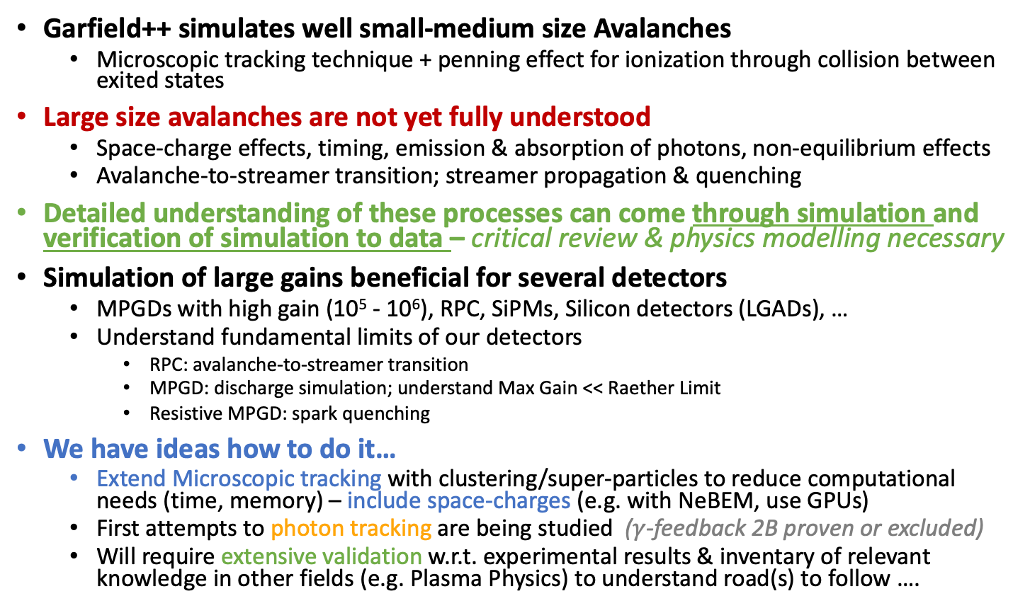
Behaviour & Simulation of Large Avalanches - Discharges
Garfield++ simulates well small-medium size Avalanches
  Microscopic tracking technique + penning effect for ionization through collision between exited states
Large size avalanches are not yet fully understood
  Space-charge effects, timing, emission & absorption of photons, non-equilibrium effects
  Avalanche-to-streamer transition; streamer propagation & quenching
Detailed understanding of these processes can come through simulation and verification of simulation to data – critical review & physics modelling necessary
Simulation of large gains beneficial for several detectors
  MPGDs with high gain (10⁵ - 10⁶), RPC, SiPMs, Silicon detectors (LGADs), …
  Understand fundamental limits of our detectors
    RPC: avalanche-to-streamer transition
    MPGD: discharge simulation; understand Max Gain << Raether Limit
    Resistive MPGD: spark quenching
We have ideas how to do it…
  Extend Microscopic tracking with clustering/super-particles to reduce computational needs (time, memory) – include space-charges (e.g. with NeBEM, use GPUs)
  First attempts to photon tracking are being studied ($γ$-feedback 2B proven or excluded)
  Will require extensive validation w.r.t. experimental results & inventary of relevant knowledge in other fields (e.g. Plasma Physics) to understand road(s) to follow ….

Slide 4
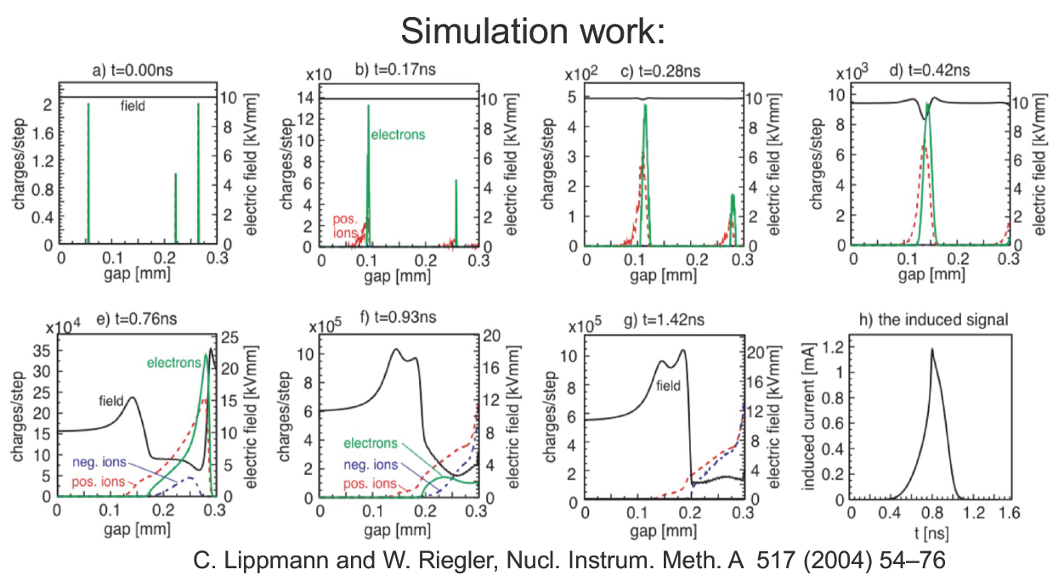
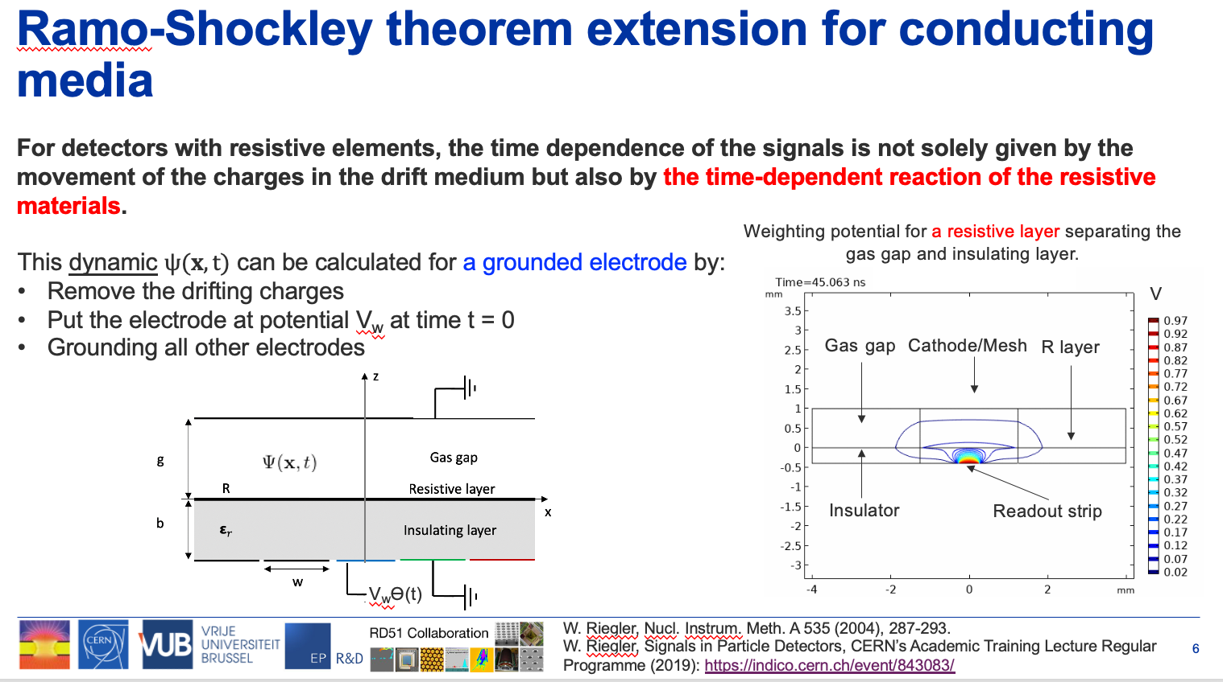
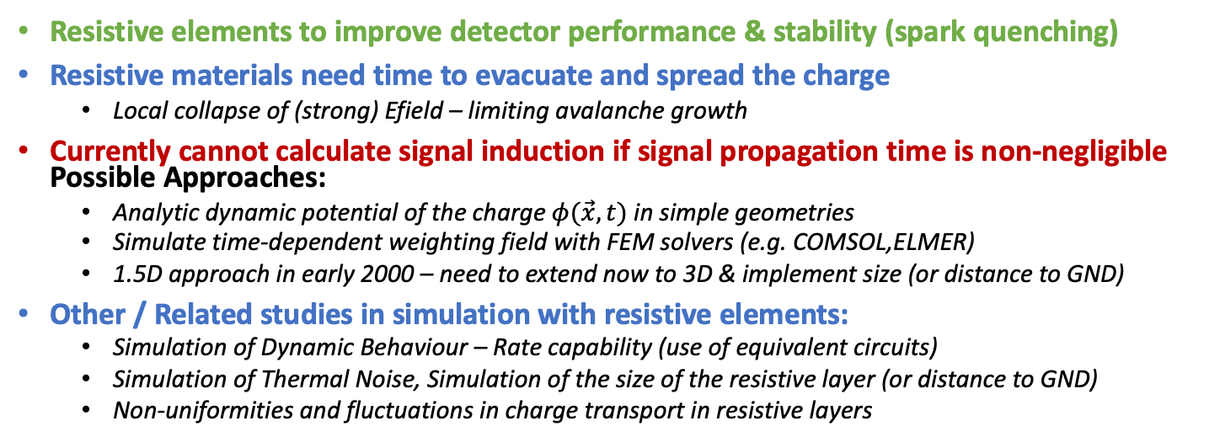
Simulation of Resistive Elements
Resistive elements to improve detector performance & stability (spark quenching)
Resistive materials need time to evacuate and spread the charge
  Local collapse of (strong) Efield – limiting avalanche growth
Currently cannot calculate signal induction if signal propagation time is non-negligible Possible Approaches:
  Analytic dynamic potential of the charge $φ(\vec{x},t)$ in simple geometries
  Simulate time-dependent weighting field with FEM solvers (e.g. COMSOL,ELMER)
  1.5D approach in early 2000 – need to extend now to 3D & implement size (or distance to GND)
Other / Related studies in simulation with resistive elements:
  Simulation of Dynamic Behaviour – Rate capability (use of equivalent circuits)
  Simulation of Thermal Noise, Simulation of the size of the resistive layer (or distance to GND)
  Non-uniformities and fluctuations in charge transport in resistive layers
D.Janssens – MPGD2022 conference

Slide 5

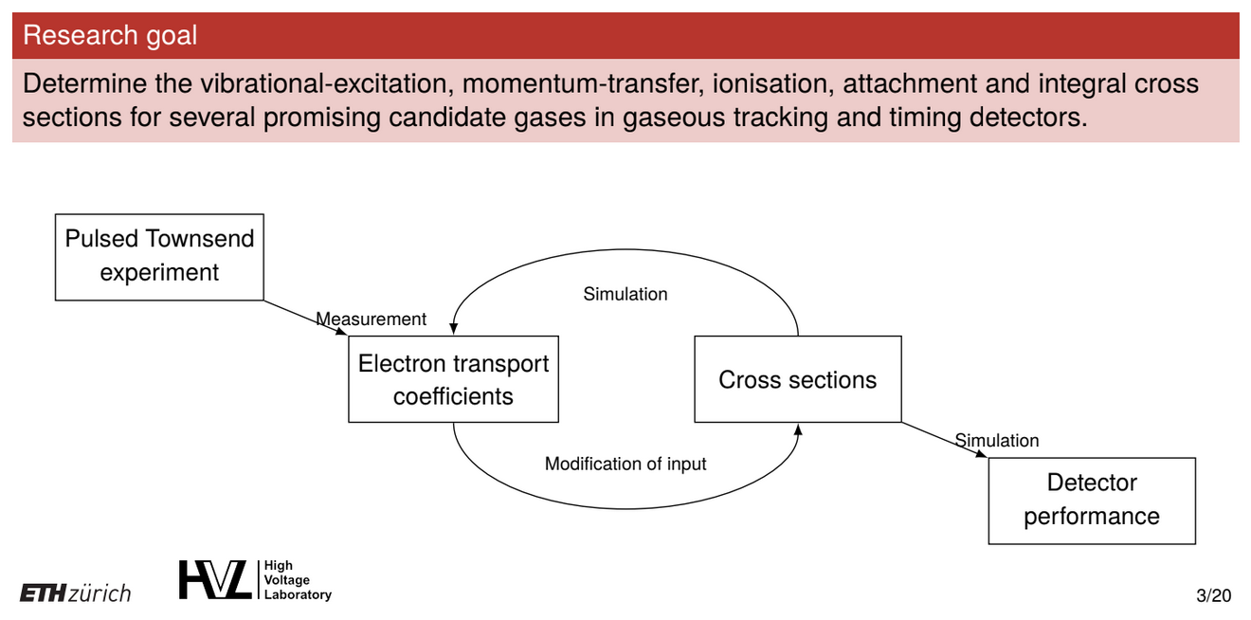
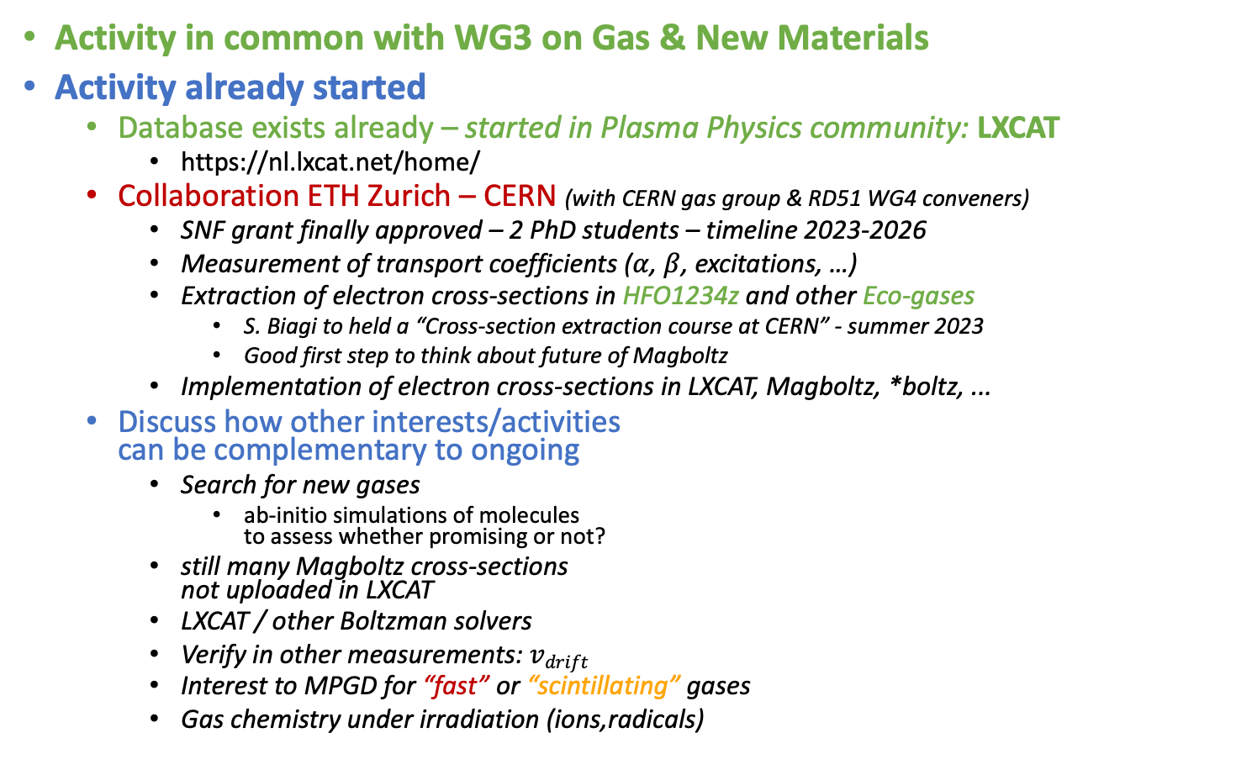
Study & Extraction of Gas Properties & Database
Activity in common with WG3 on Gas & New Materials
Activity already started
  Database exists already – started in Plasma Physics community: LXCAT
    https://nl.lxcat.net/home/
  Collaboration ETH Zurich – CERN (with CERN gas group & RD51 WG4 conveners)
    SNF grant finally approved – 2 PhD students – timeline 2023-2026
    Measurement of transport coefficients ($α$, $β$, excitations, …)
    Extraction of electron cross-sections in HFO1234z and other Eco-gases
      S. Biagi to held a “Cross-section extraction course at CERN” - summer 2023
      Good first step to think about future of Magboltz
    Implementation of electron cross-sections in LXCAT, Magboltz, *boltz, ...
  Discuss how other interests/activities
  can be complementary to ongoing
    Search for new gases
      ab-initio simulations of molecules
      to assess whether promising or not?
    still many Magboltz cross-sections
    not uploaded in LXCAT
    LXCAT / other Boltzman solvers
    Verify in other measurements: $vdrift$
    Interest to MPGD for “fast” or “scintillating” gases
    Gas chemistry under irradiation (ions,radicals)
M.Metting van Rijn

Slide 6
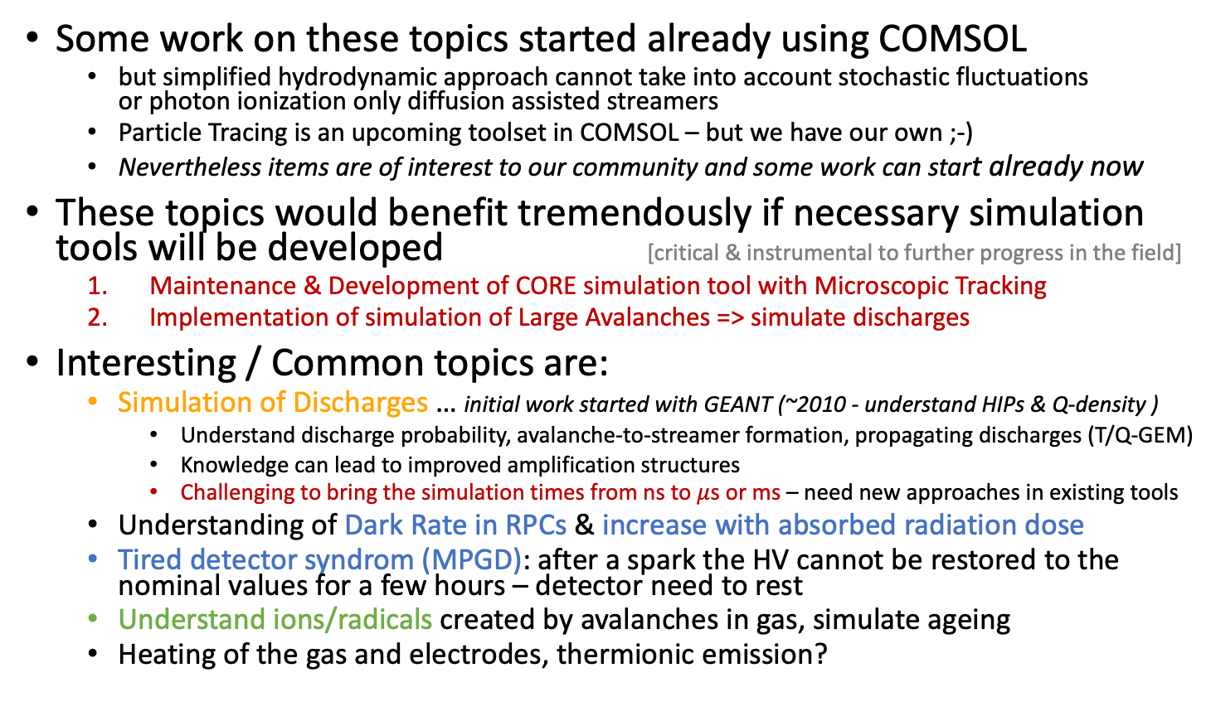
Modelling & Simulation of Ageing, Dark Rate, Tired-detector syndrom
Some work on these topics started already using COMSOL
  but simplified hydrodynamic approach cannot take into account stochastic fluctuations
  or photon ionization only diffusion assisted streamers
  Particle Tracing is an upcoming toolset in COMSOL – but we have our own ;-)
  Nevertheless items are of interest to our community and some work can start already now
These topics would benefit tremendously if necessary simulation tools will be developed [critical & instrumental to further progress in the field]
  Maintenance & Development of CORE simulation tool with Microscopic Tracking
  Implementation of simulation of Large Avalanches => simulate discharges
Interesting / Common topics are:
  Simulation of Discharges … initial work started with GEANT (~2010 - understand HIPs & Q-density )
    Understand discharge probability, avalanche-to-streamer formation, propagating discharges (T/Q-GEM)
    Knowledge can lead to improved amplification structures
    Challenging to bring the simulation times from ns to $μ$s or ms – need new approaches in existing tools
  Understanding of Dark Rate in RPCs & increase with absorbed radiation dose
  Tired detector syndrom (MPGD): after a spark the HV cannot be restored to the nominal values for a few hours – detector need to rest
  Understand ions/radicals created by avalanches in gas, simulate ageing
  Heating of the gas and electrodes, thermionic emission?

Slide 7
Technology Specific Developments
Some aspects of Simulation are currently not developed, but can be developed in the near future if there is need
Should be pushed forward by the Technology that requires it
Can find support / knowledge exchange with more ”core” SW-tools development team(s)
Can group expertise in WG4 by meetings & coordination
Should ensure DRD1 management to ”encourage” inclusion of Simulation / SW Development Tasks in Application WP
Examples can be:
  Implementation of negative ions (TPCs for rare-event searches)
  Implementation of scintillation & recombination (optical readout)
  Simulation of non-uniformities of resistive materials
  Further development of fast-simulation techniques (for experiments)
  … [please add your favorite topic]

Slide 8
Discussion
Can we group people interested in the following topics?
  Simulation of Large Avalanches with Garfield++
    CORE: Implementation of smart techniques to scale MT to larger gains
    CORE: Explore / Adapt code to run on modern structures (Parallel/GPU)
    CORE: Implementation / exploration of Photon Tracking
    APPL: Simulation of Discharges MPGD – Detector physics RPC
  Simulation of Resistive Elements / Signals in Resistive Detectors
  Study & Extraction of Gas Properties
  Workgroup on Simulation of Ageing, Dark Rate, Discharges tired detector syndrome …
    Will depend on progress made in (1) and on availability of people (consider fundamental to fill first 1-3)
    work can start with hydrodynamic simulations (COMSOL / ELMER)
Requests to the involved institutes :
  We need Experts to coordinate the activity and to supervise tasks
  Can we have support from CERN IT for modern programming & tools (part time ok)?
  Need significant injection PhD students to dedicate substantial time to SW development & Simulation
    How can we connect/reach out to ambitious/strong young people to work on these topics?
    CERN summer student program: 1) introduction to topic 2) selection good students
    Can DRD have funds to support young people for couple of months for project?
How do we go forward?
  Have 1 dedicated WP for CORE Software Tools development?
  Have several topical WPs (e.g. Resistive Detectors, Negative Ion TPC, Optical Readout, Discharges)
  with a substantial simulation Task?

