Slide 1

Helicity and vorticity in heavy-ion collisions and hyperon polarization
Evgeni Kolomeitsev
Matej Bel University, Banska Bystrica, Slovakia
Joint Institute for Nuclear Research, Dubna, Russia
work with Nikita Tsegelnik and Vadim Voronyuk
Phys. Rev. C 107 (2023) 034906
Particles 2023 (2023) 373
arXiv:2305.10792 [nucl-th

Slide 2



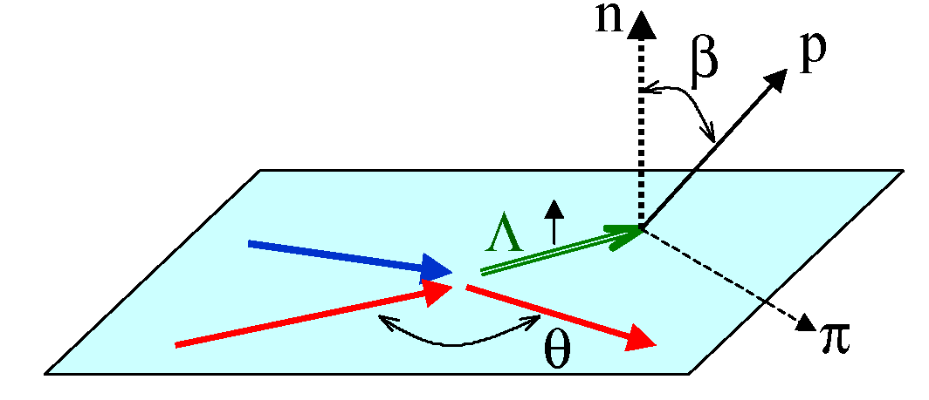
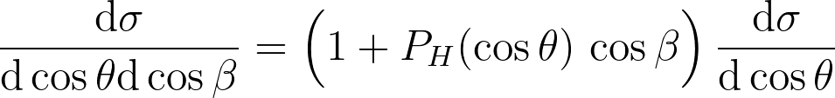
Origin of global polarization in collective processes Initial angular momentum of colliding nuclei
angular momentum
per nucleon
Mechanism of angular-momentum transfer from orbital one to spin
spin S and angular
moment L operators
In equilibrium!
density matrix
hydrodynamic vorticity
elementary processes
Hadronic scattering, e.g., K- N-> π Λ, K-N->π Σ
interference of s- and p-waves

Slide 3
The experimental data of global Λ and anti-Λ polarization
Λ − anti-Λ splitting in
global polarization
L. Adamczyk et al., Nature 548 (2017)
R.A.Yassine et al. (HADES Coll.), Phys.Lett.B 835 (2022)

Slide 4

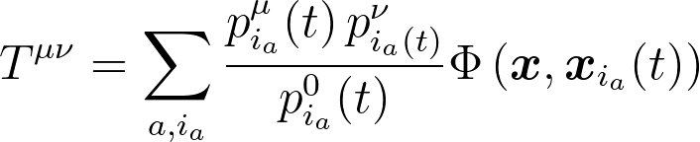

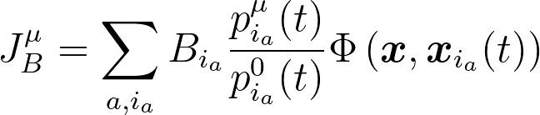

Setup
The Parton-Hadron-String Dynamic model: the generalized off-shell transport equations,
Dynamical Quasi-Particle Model (for partons), FRITIOF Lund (strings breaking)
PYTHIA and JETSET (jet production and fragmentation), Chiral Symmetry Restoration,
Kinetics → fluidization → hydrodynamic quantities
Fluidization criterion:
cells with ε > 0.05 GeV/fm³.
Spectators do not form fluid!
Φ − smearing function
Spectator separation:
||y_{spectator}|−y_{beam}| ≤ 0.27
Fermi motion

Slide 5
Angular momentum transfer
Small b: L is small but large fraction of it can be transferred
Large b: L is big but nuclear overlap is small and less L is transferred
Transferred angular momentum distribution
depends weakly on the collision energy
transition time scale ~10fm/c
similar dependence was derived in [Becattini, Piccinini, Rizzo, PRC77 (2008)]

Slide 6
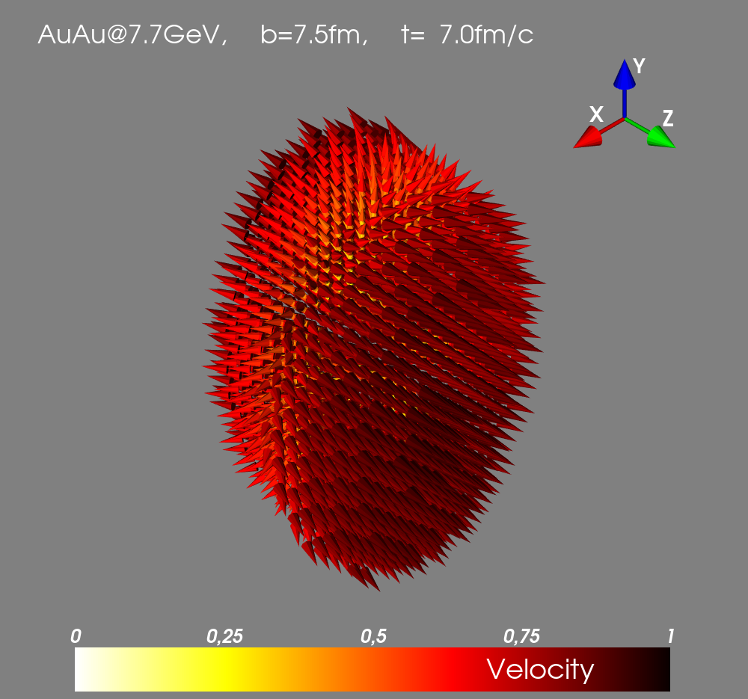
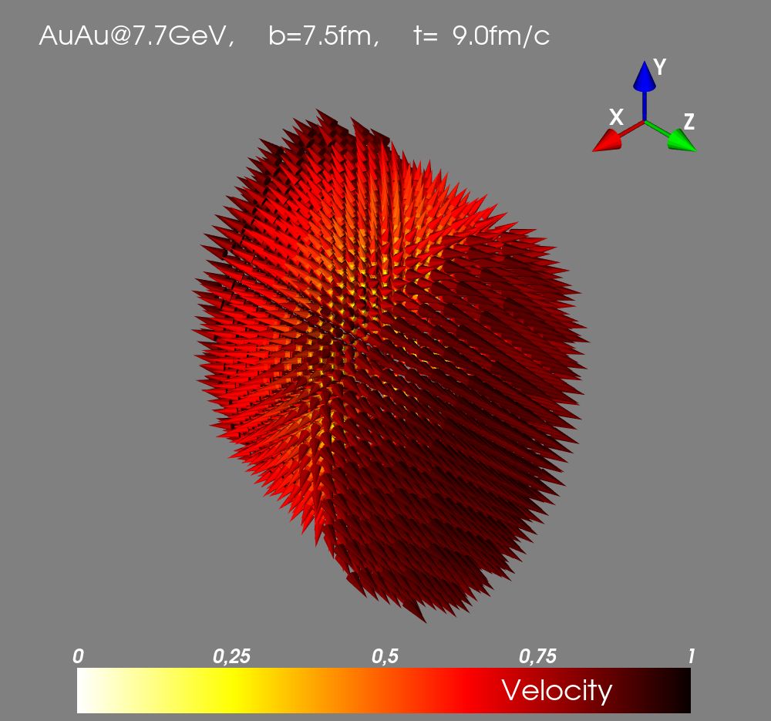
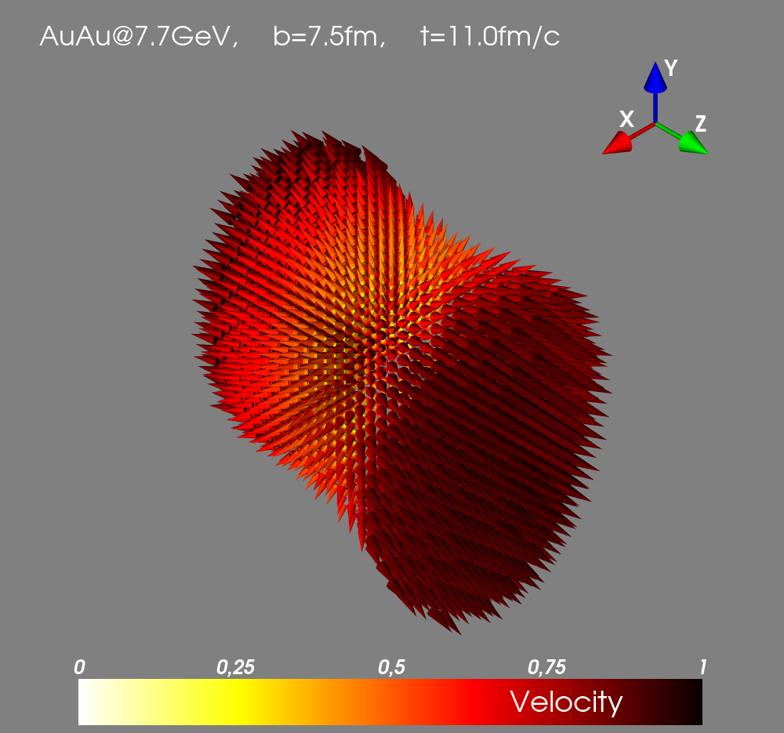
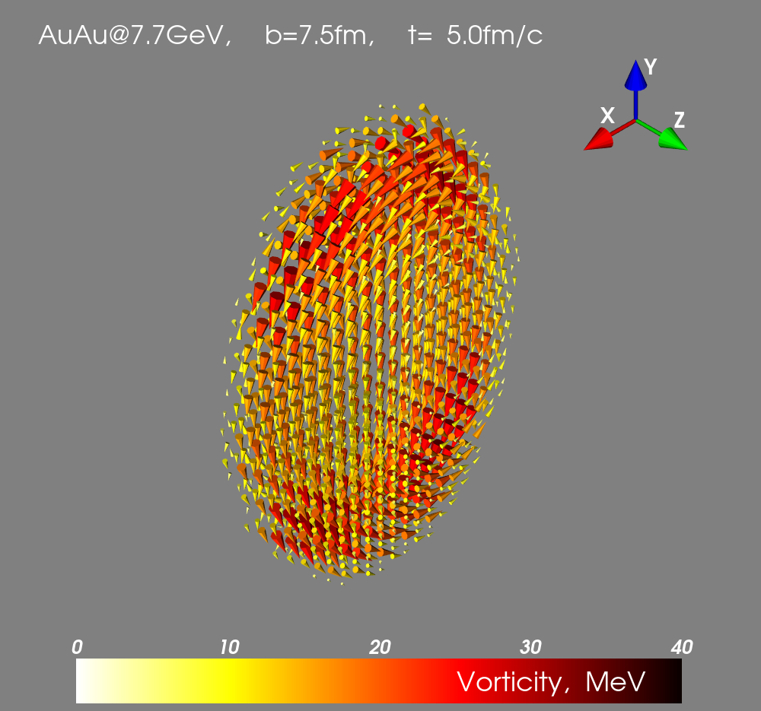
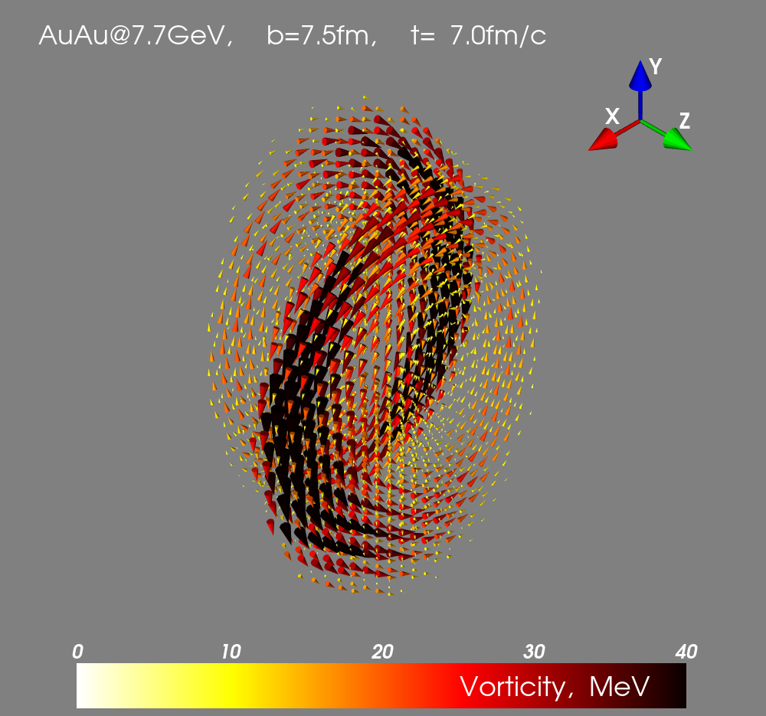
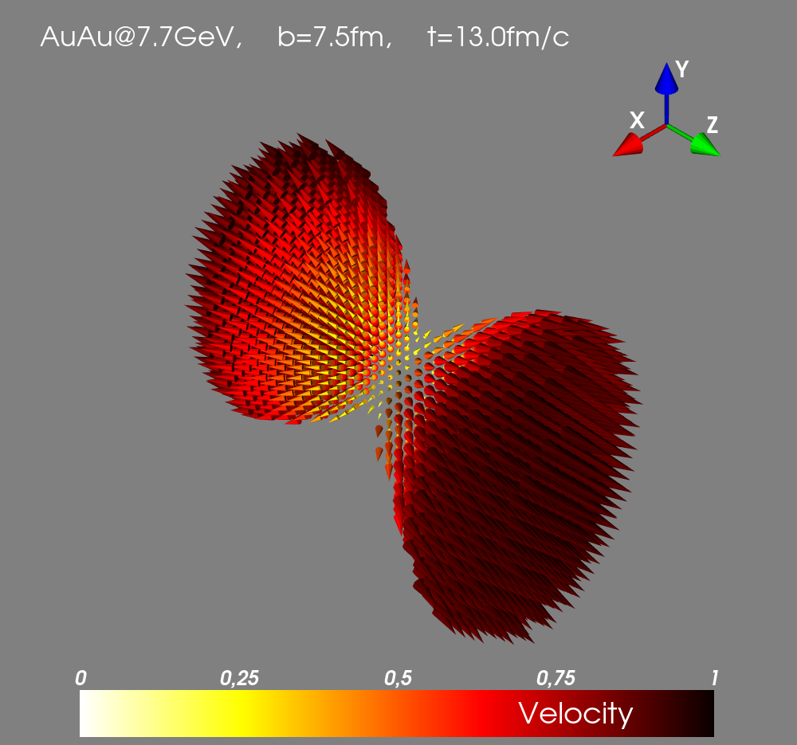
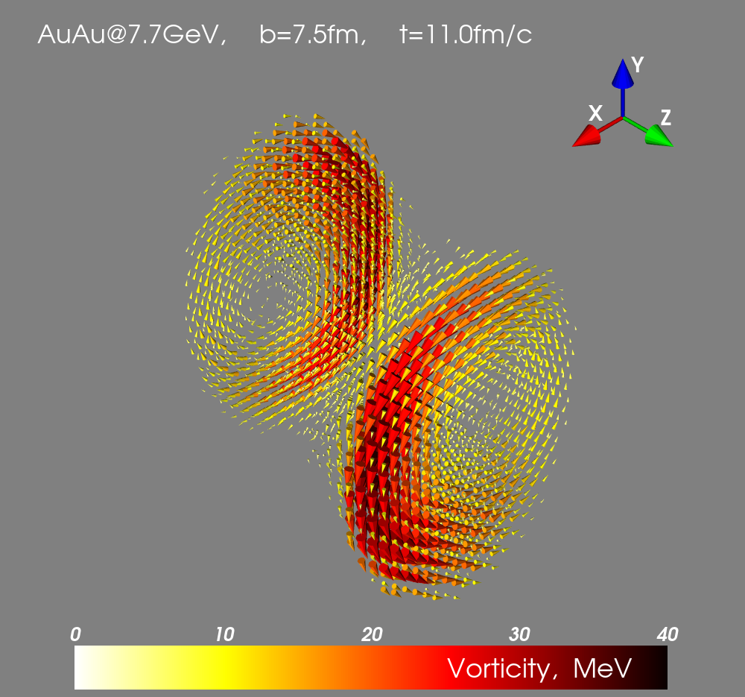
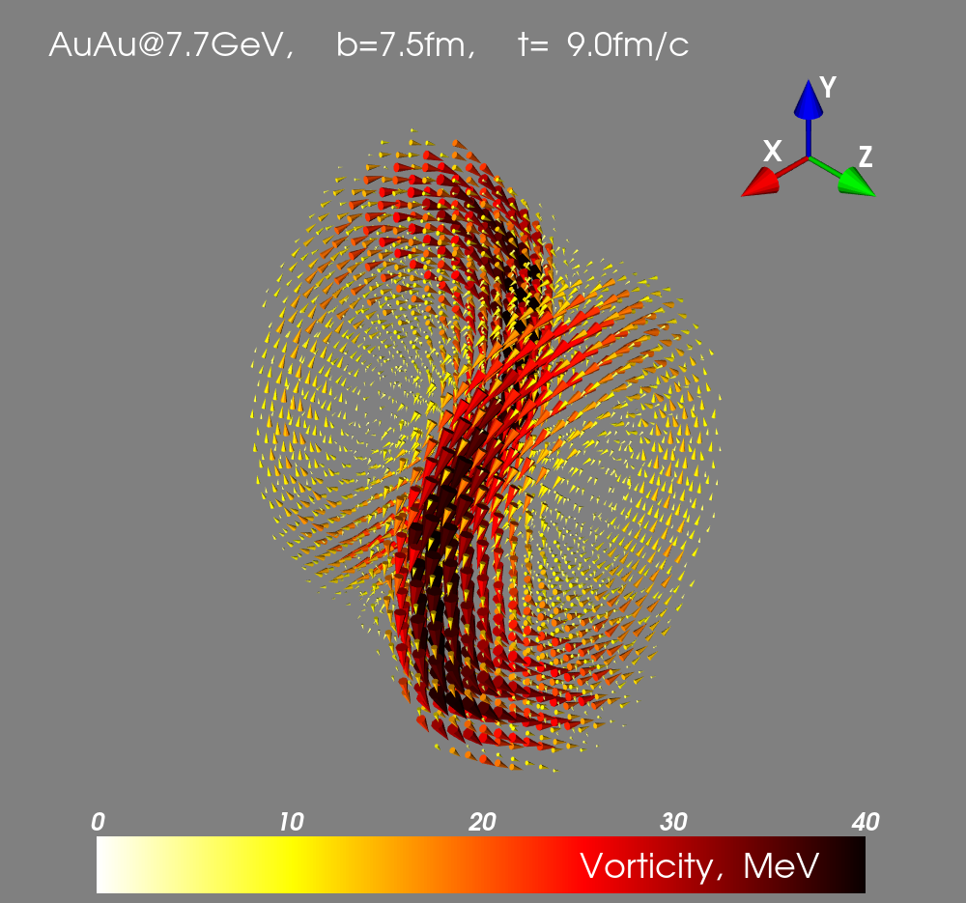
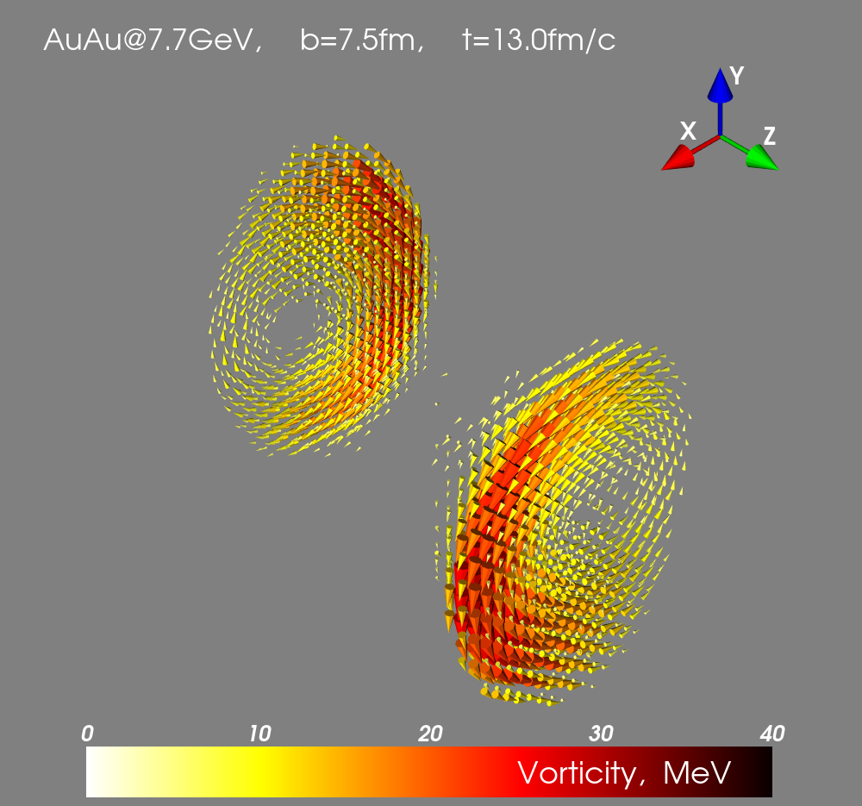

Velocity and vorticity fields
Hydrodynamic velocity field
Hydrodynamic vorticity field

Slide 7

Yu.B. Ivanov, A.A. Soldatov predicted in [PRC97 (2018)] within the 3-fluid hydro model the formation of vortex rings
Vorticity field
y=0
Au+Au @ 7.7 GeV
b=7.5 fm
Vortex rings
t=11 fm/c

Slide 8



Hyperon and Anti-hyperon production
Exp: NA49 PRL 94 (2005) 192301
central Pb+Pb collisions at energy 40AGeV
Theory:

Slide 9
Dynamics of hyperon production
hyperons
anti-hyperons
Two main sources for hyperons and only one for antihyperons.
Different thermodynamic conditions for particles and antiparticles→ different polarization!

Slide 10
Polarization source

Slide 11
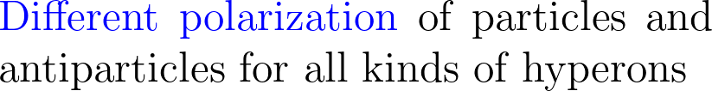
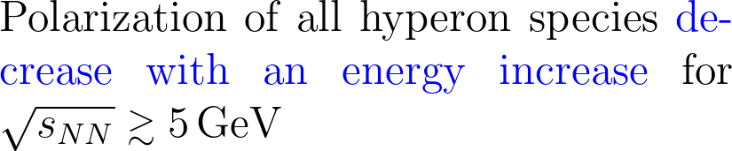
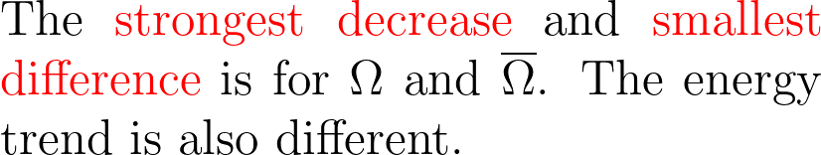
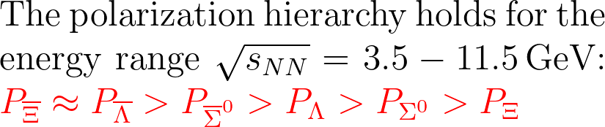
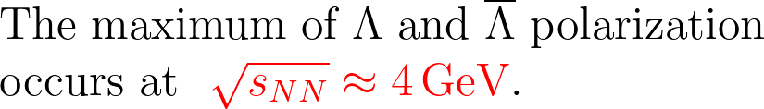
Hyperon Polarization

Slide 12
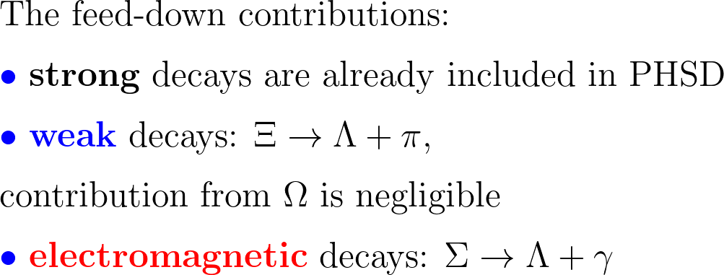
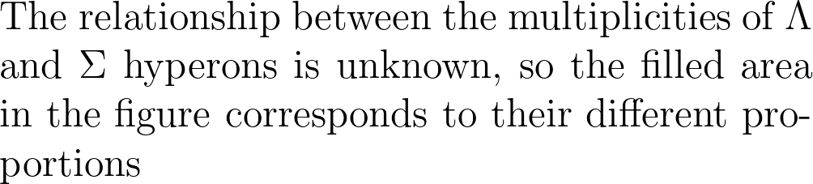
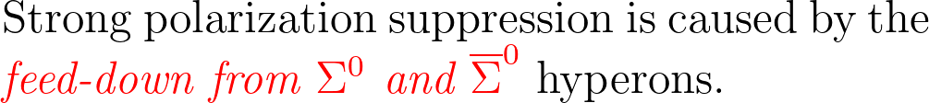
Feed-down effects

Slide 13
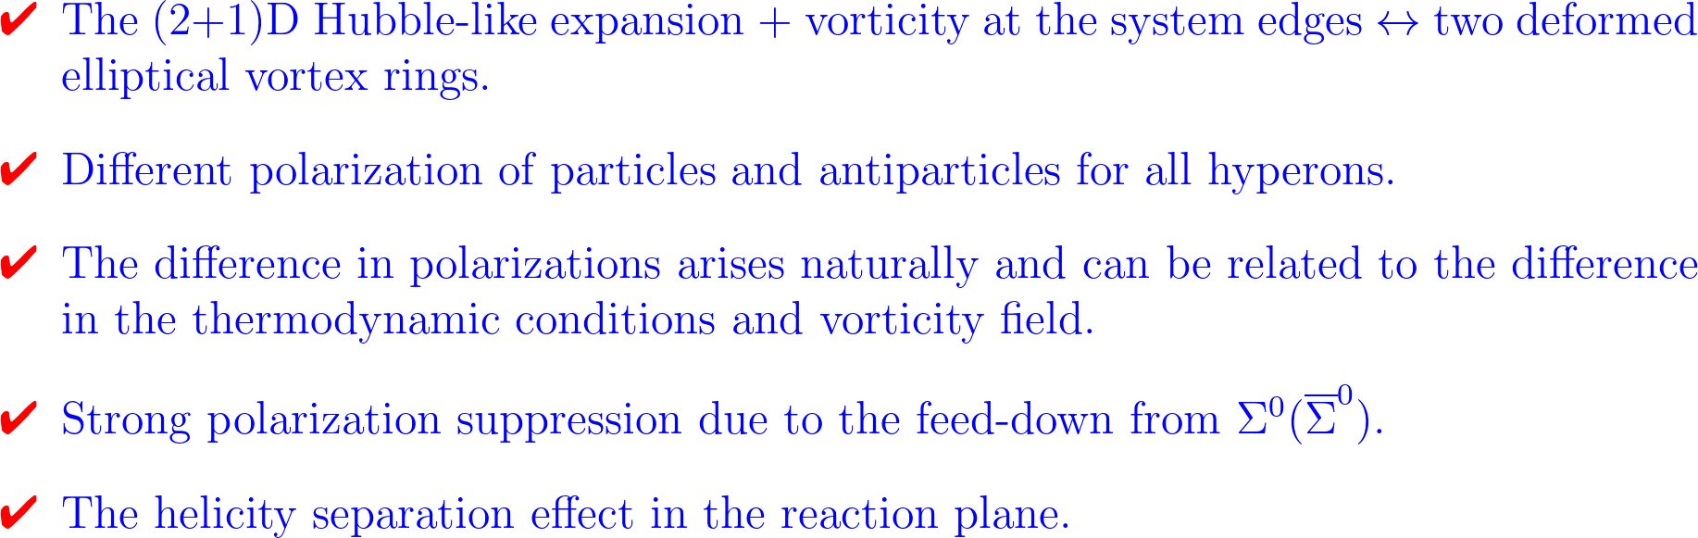
Conclusion

