Slide 1
MC Generator Level Fits of Cross Section and Masses in Chargino Production
Tim Barklow (SLAC)
Mar 10, 2011

Slide 2
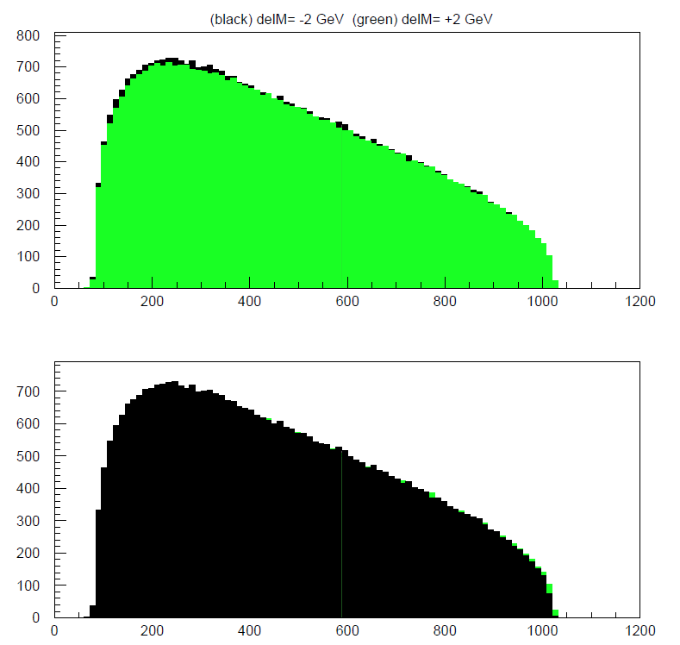

Slide 3
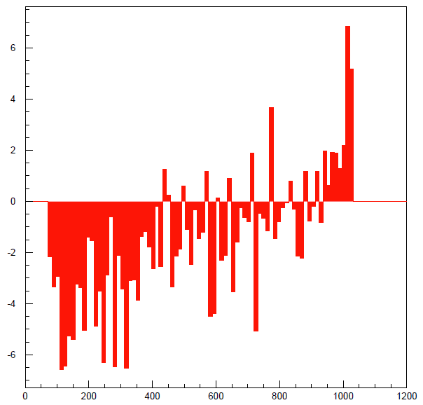

Slide 5
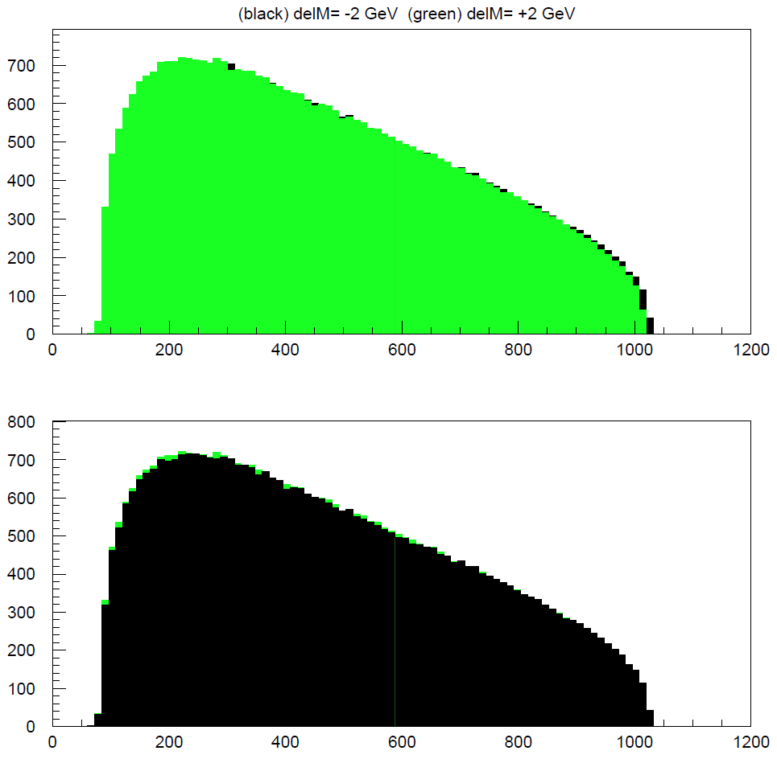

Slide 6
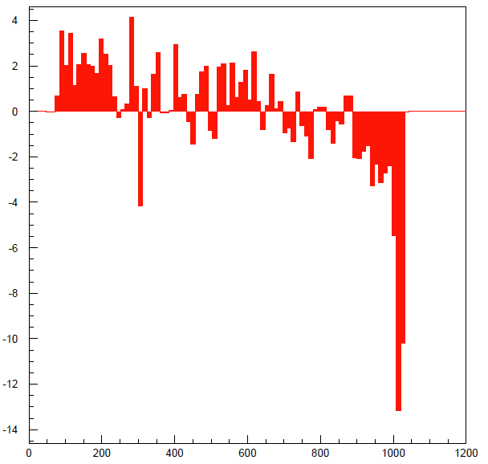

Slide 8
Minimum Set of MC Samples

Slide 9
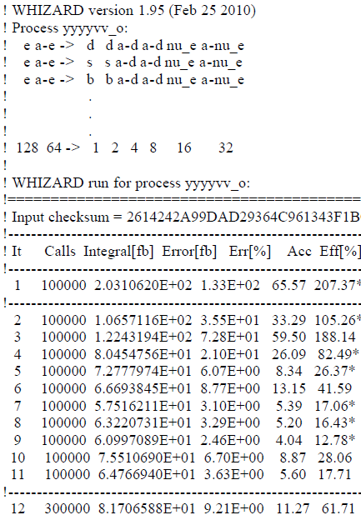
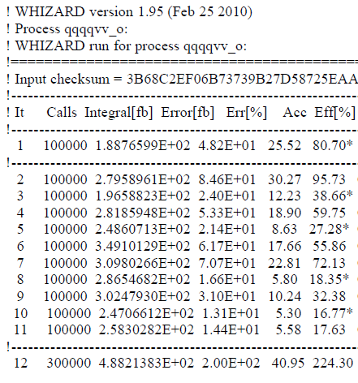

Slide 10
Incorporating Detector Effects

