Slide 1
FastMC Studies of Detector Effects
Tim Barklow (SLAC)
Apr 08, 2011

Slide 2
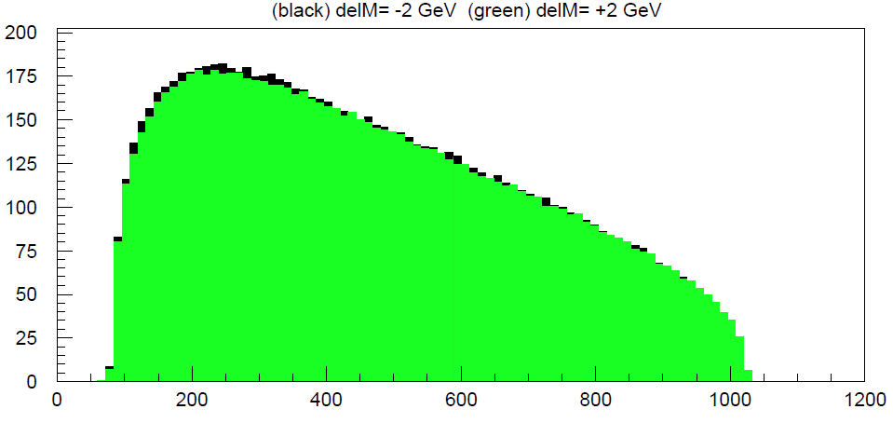
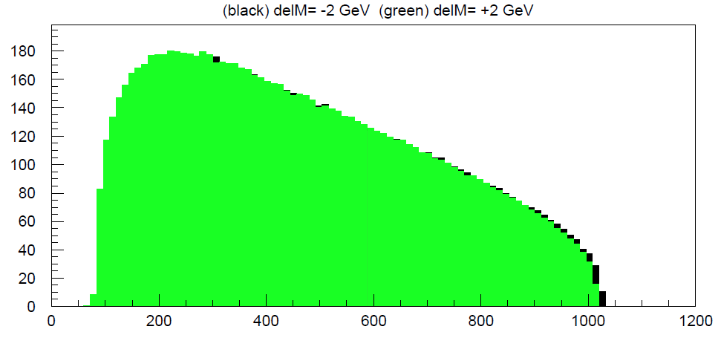
Chargino Production

Slide 3
Neutralino Production

Slide 4
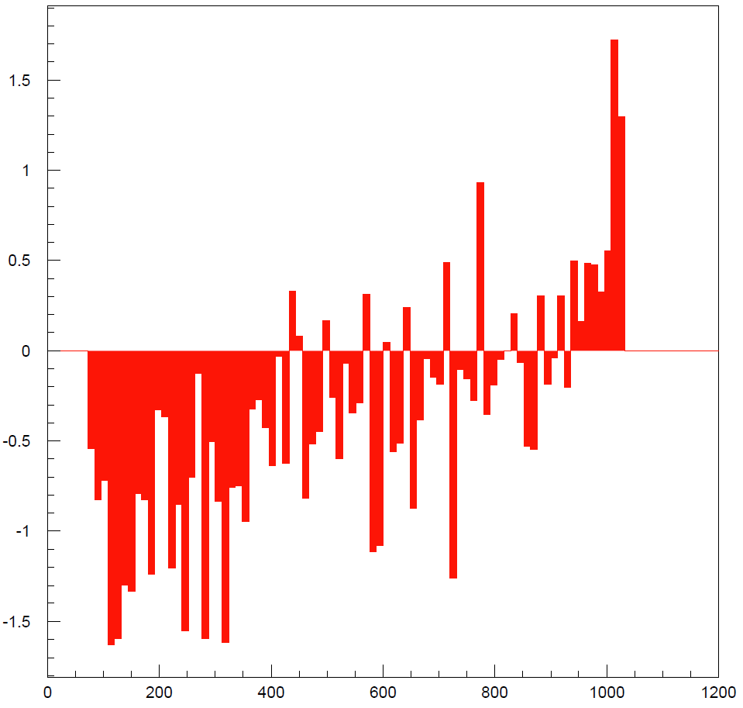

Slide 6
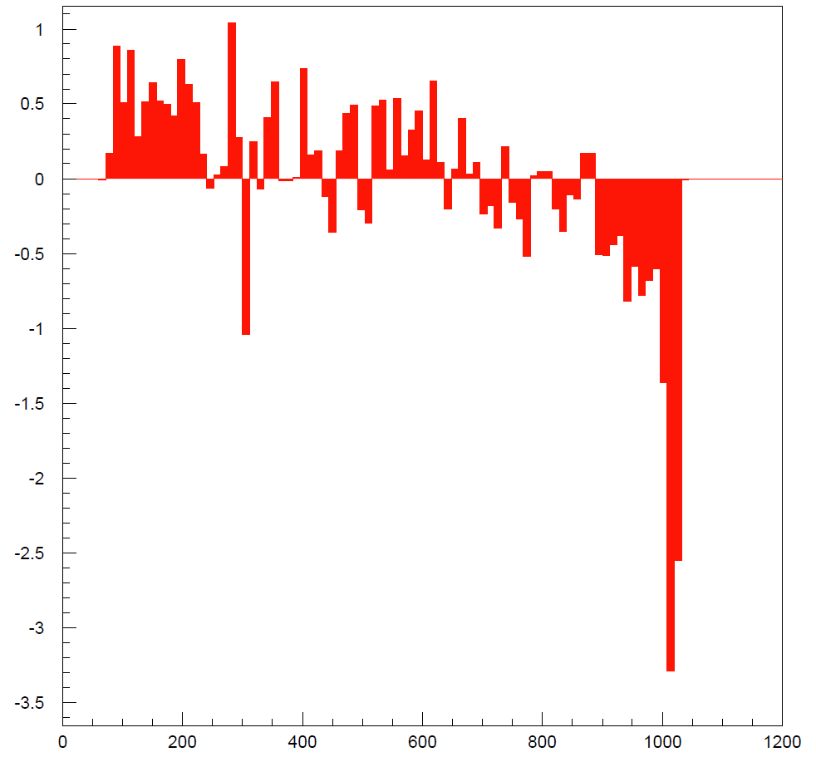

Slide 8
Incorporating Detector Effects

Slide 9
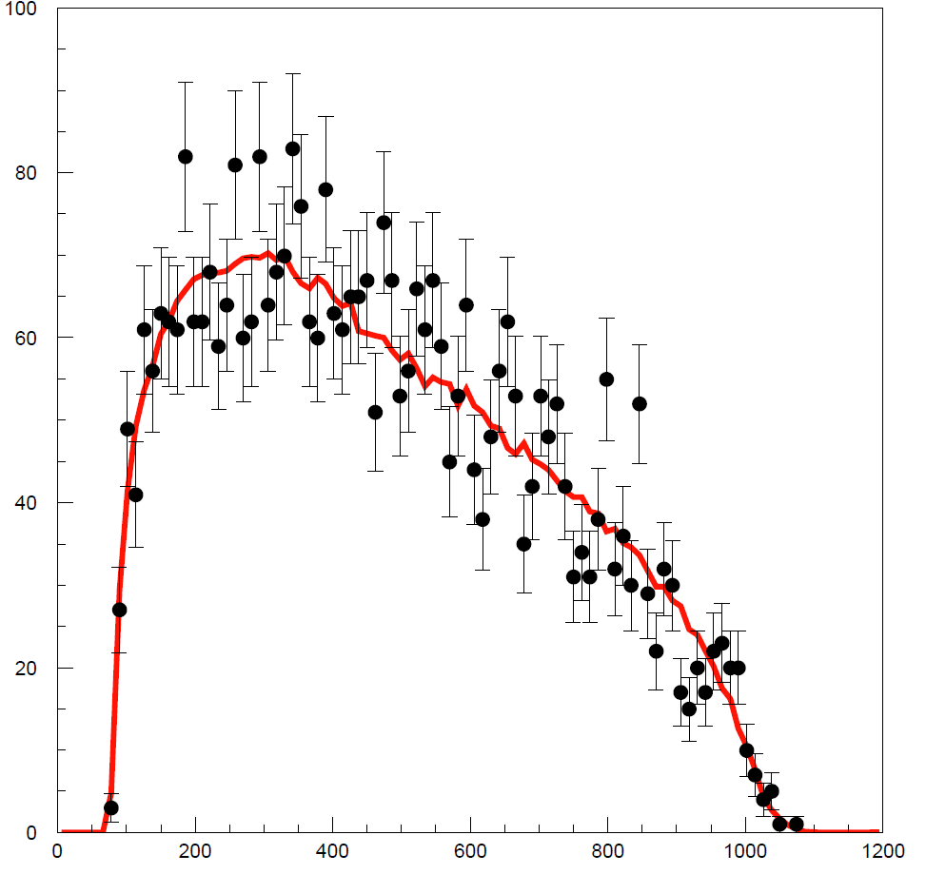
FastMC Simulation

Slide 10
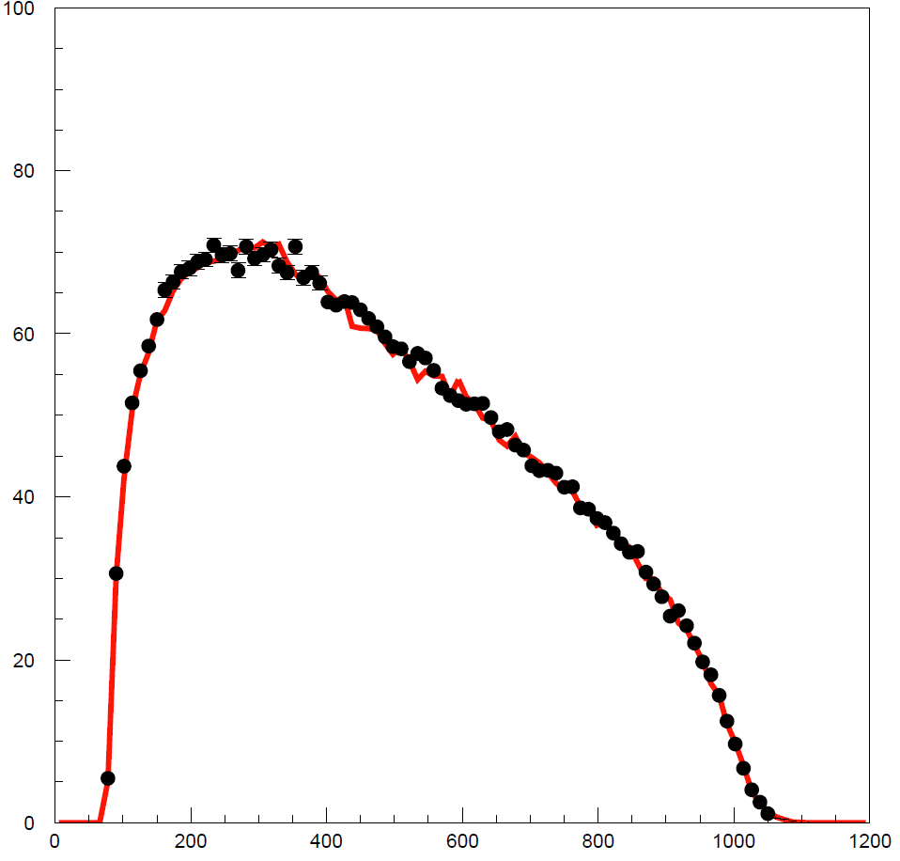
FastMC Simulation

Slide 11
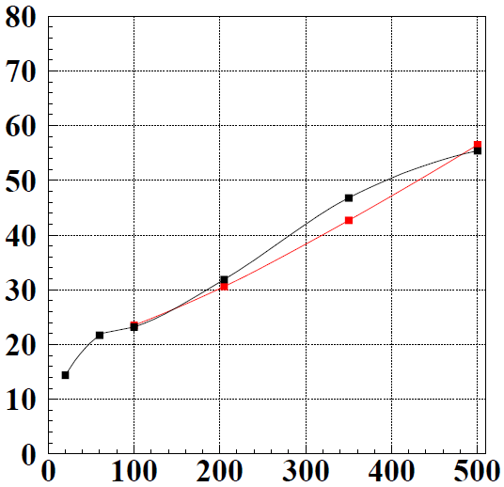
FastMC Response Light quark jets ee→qq
PandoraPFA v02-01
FASTMC with
E_{cm} (GeV)
E_{cm} (GeV)

Slide 12
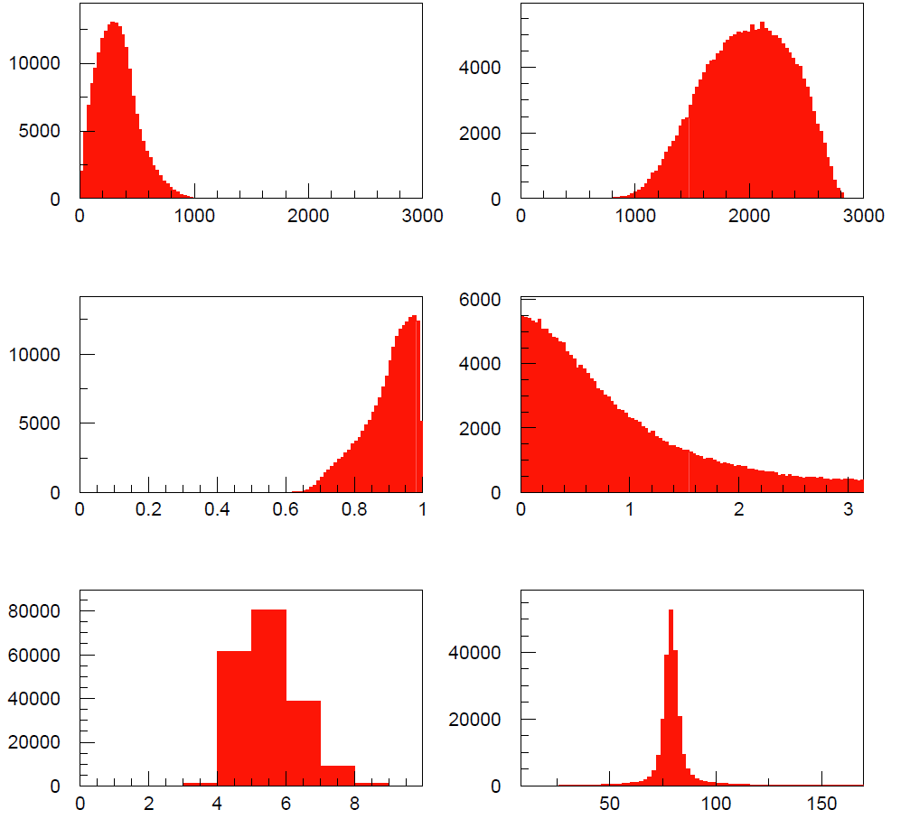

Slide 13
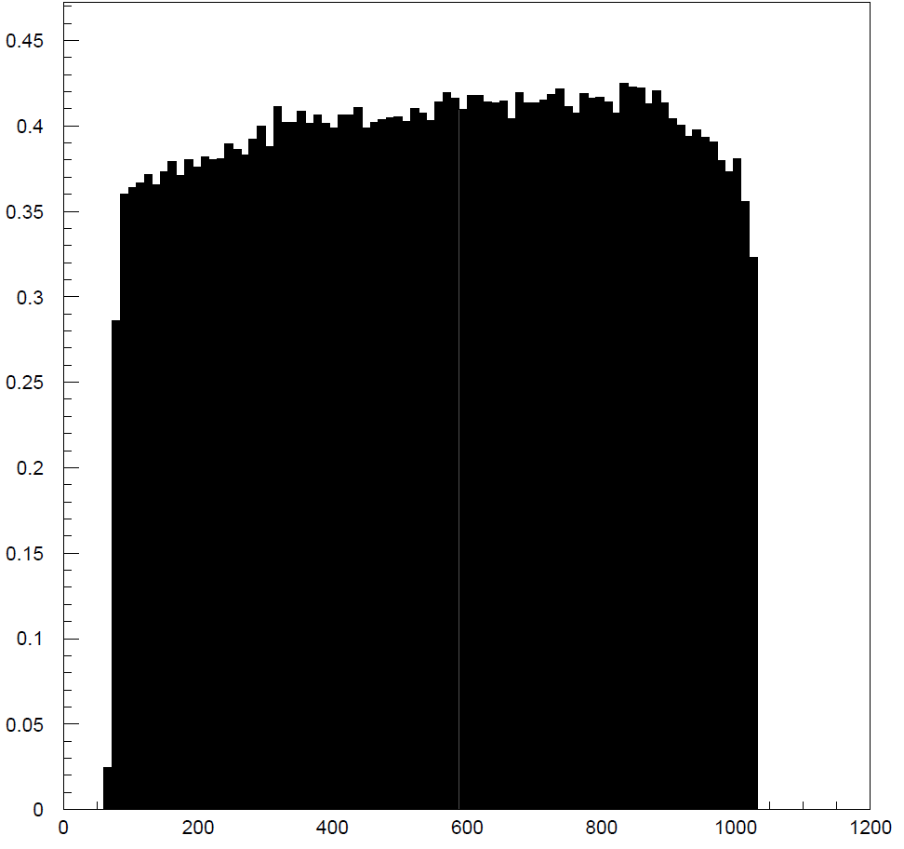

Slide 14
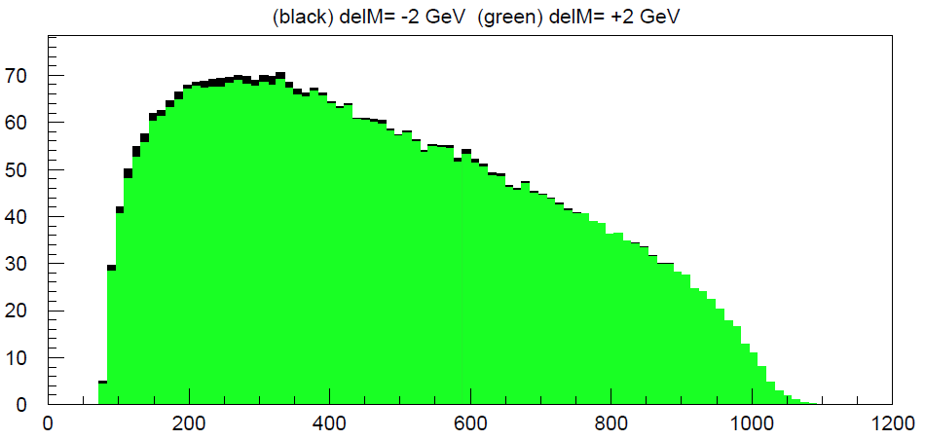
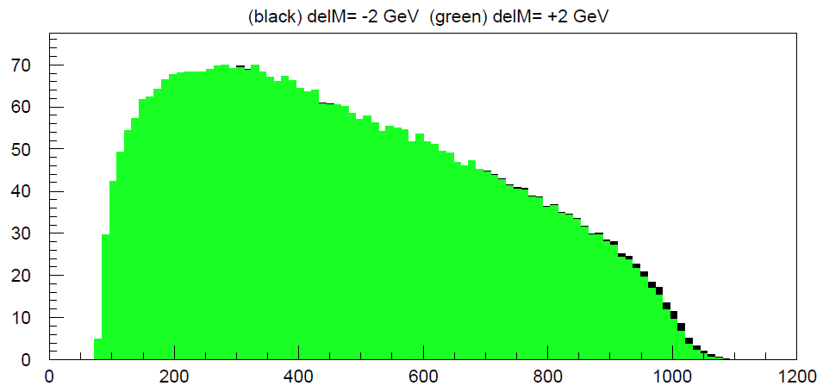
FastMC Simulation

Slide 15
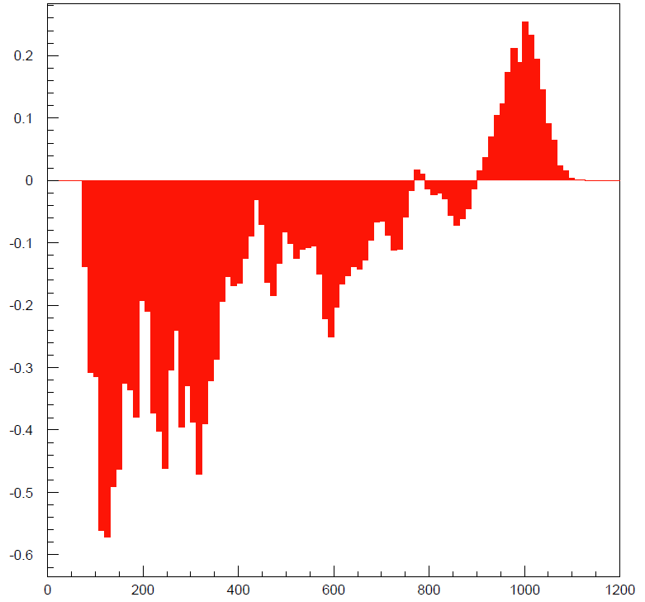
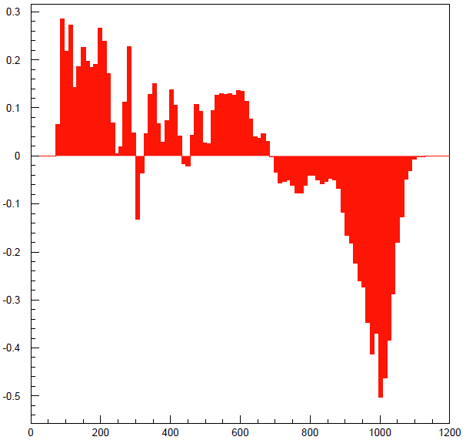

Slide 16
Minimum Set of MC Samples

