Slide 1

BNL FCCee H$→$Inv Plans
Christian Weber
Diallo Boye
Gabriele D’Amen
Kétévi Assamagan
Scott Snyder
January 30th, 2023

Slide 2
FCCee plans
Currently pursuing a Laboratory Directed Research and Development Program,
covers three-year period (October 2022- September 2025)
Augments FCC accelerator studies at BNL:
Study FCC-ee detector development and optimization, with focus
  on tracking and timing detectors
  noble-liquid based calorimetry
  data-acquisition architecture
By using Higgs boson property studies:
  Higgs decay into charm quarks
  Higgs self couplings (& other BSM HH couplings, EFT)
  Higgs to invisible / dark sector
While considering Interaction Region magnet design constraints

Slide 3
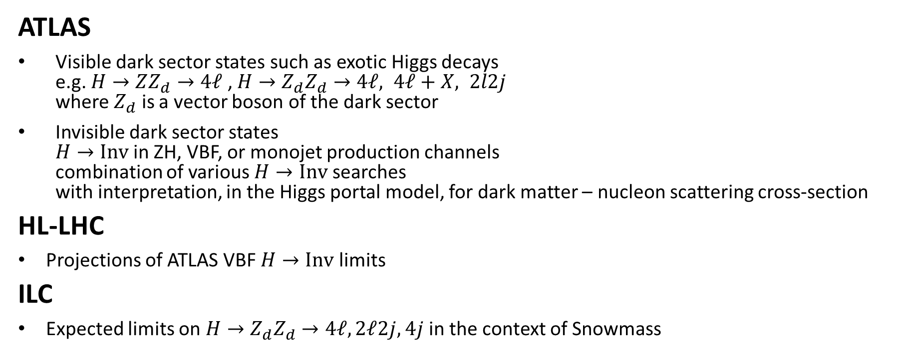
Experience in dark sector searches at LHC and beyond
ATLAS
Visible dark sector states such as exotic Higgs decays
e.g. $H→ZZ_{d}→4ℓ$ , $H→Z_{d}Z_{d}→4ℓ, 4ℓ+X, 2l2j$
where $Z_{d}$ is a vector boson of the dark sector
Invisible dark sector states
$H→Inv$ in ZH, VBF, or monojet production channels
combination of various $H→Inv$ searches
with interpretation, in the Higgs portal model, for dark matter – nucleon scattering cross-section
HL-LHC
Projections of ATLAS VBF $H→Inv$ limits
ILC
Expected limits on $H→Z_{d}Z_{d}→4ℓ,2ℓ2j,4j$ in the context of Snowmass

Slide 4
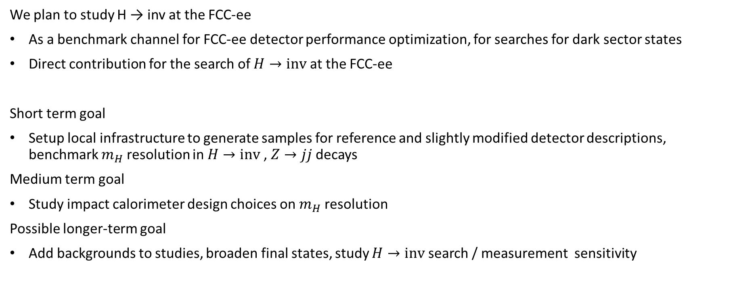
Beyond the LHC
We plan to study H → inv at the FCC-ee
As a benchmark channel for FCC-ee detector performance optimization, for searches for dark sector states
Direct contribution for the search of $H→inv$ at the FCC-ee
Short term goal
Setup local infrastructure to generate samples for reference and slightly modified detector descriptions, benchmark $m_{H}$ resolution in $H→inv$, $Z→jj$decays
Medium term goal
Study impact calorimeter design choices on $m_{H}$ resolution
Possible longer-term goal
Add backgrounds to studies, broaden final states, study $H→inv$ search / measurement sensitivity

Slide 5
End of Presentation!

