Slide 1





Particle therapy masterclass
Therapy planning of TG119 & liver
University of pavia – PV INFN - CNAO
S.Rahmoun, liceo scientifico Cairoli, vigevano, on behalf of PTMC-Pavia

Slide 2
Table of content
ABSTRACT
C PHANTOM
LIVER
CONCLUSION (for each case)

Slide 3
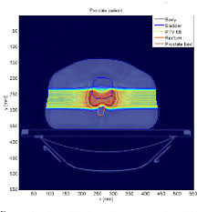
abstract
We have conducted different simulation modelling several treatment plans taking into account TG119 phantom and one clinical case (liver tumor).
We have planned treatments considering different particle beams made by photons, protons and carbons ions, changing the gantry angles.

Slide 4
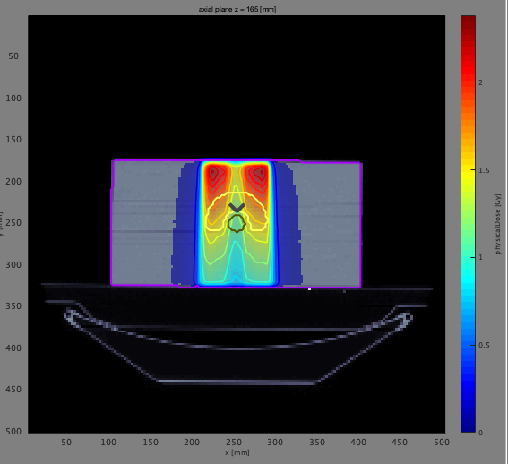
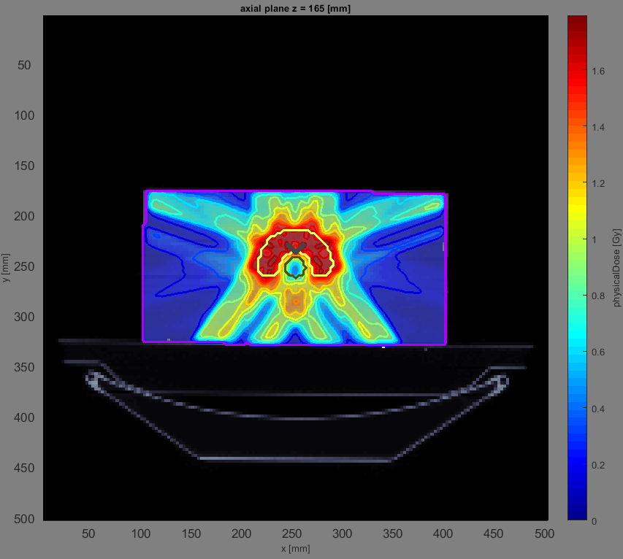
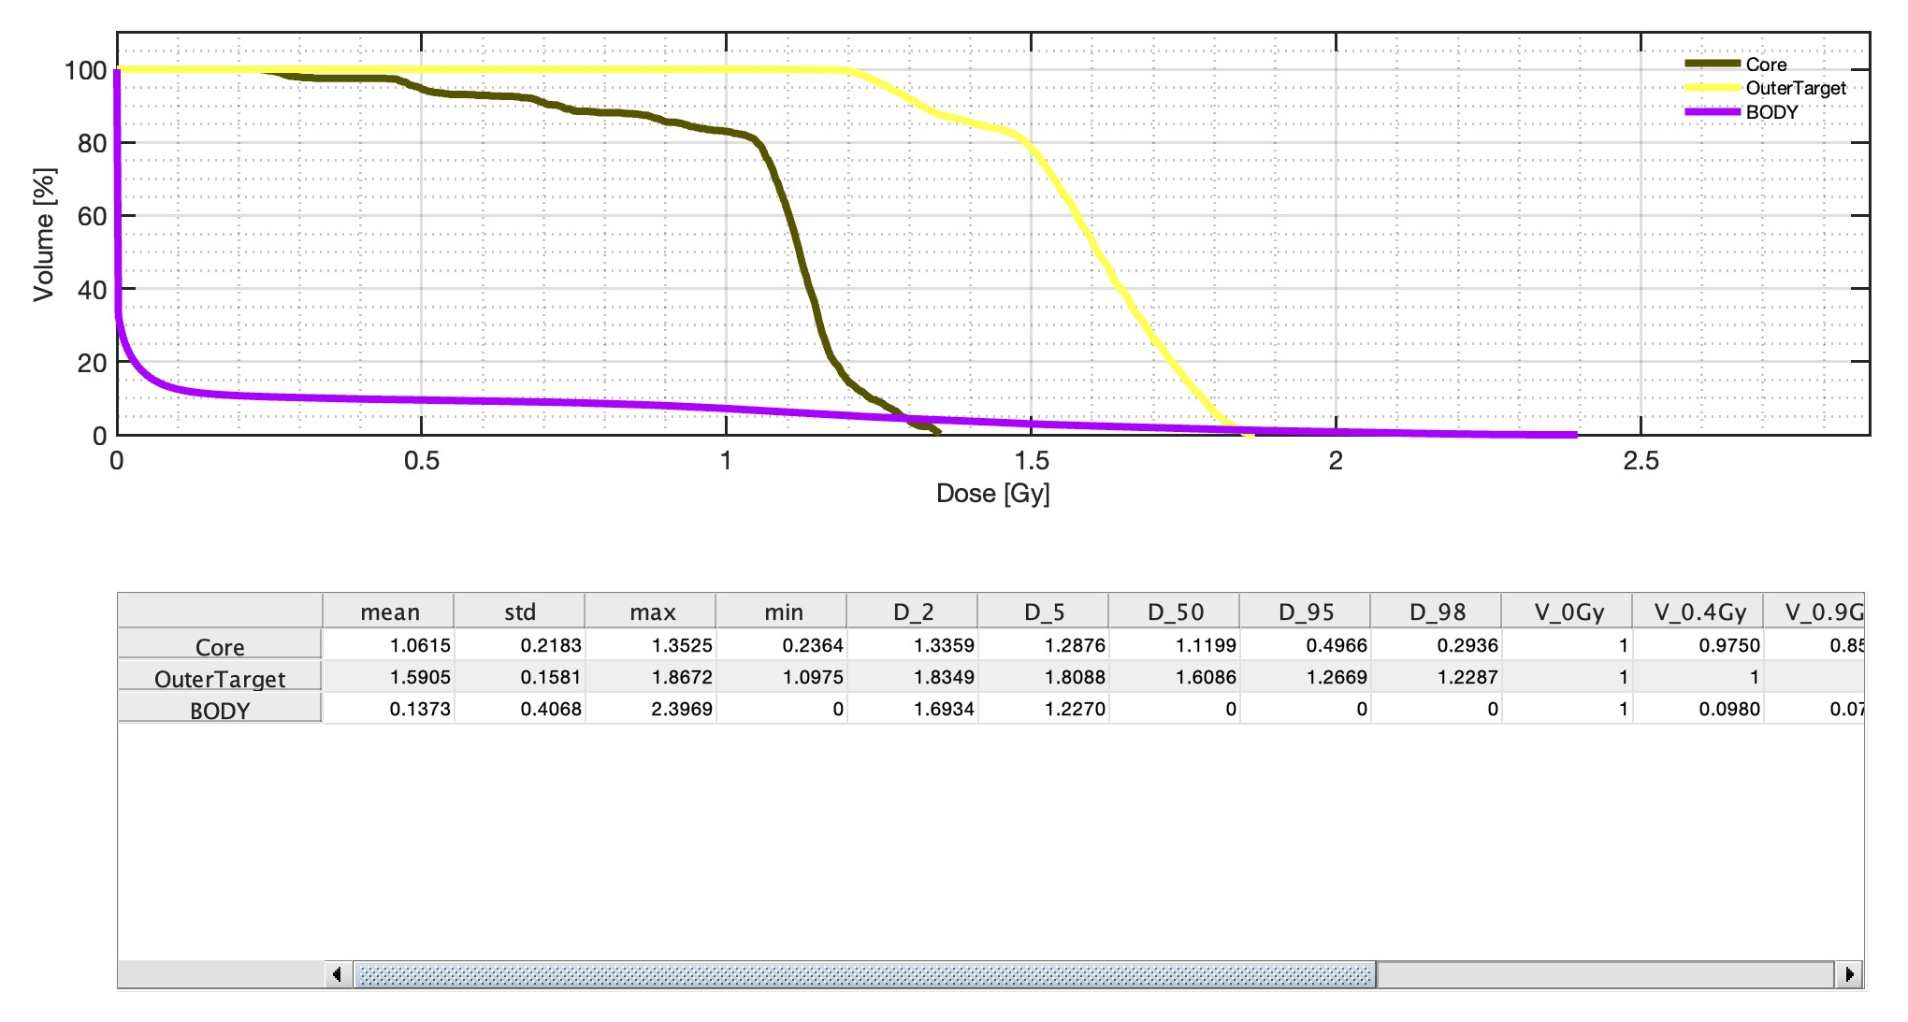
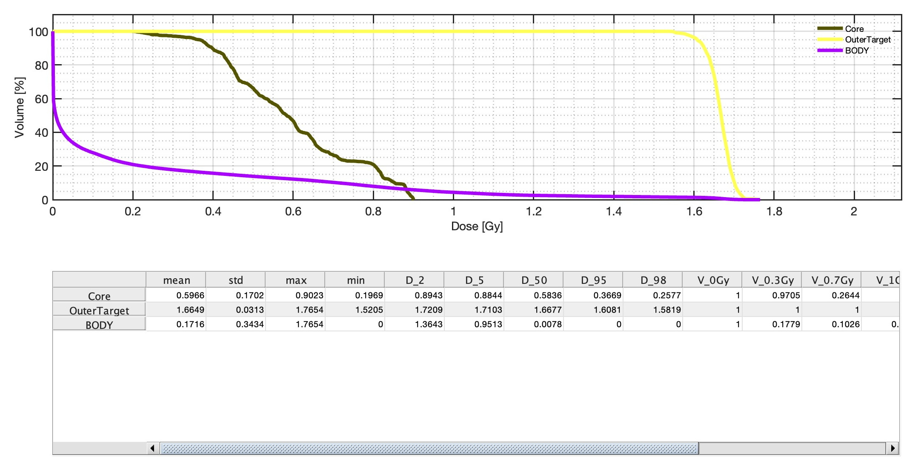
C phantom
We considered TG119 phantom.
First we planned photon treatments considering:
(1) one single beam and
(2) five equispaced beams.
As showed in the dose maps and in the DVHs, the second plan delivers better (more uniformly) the dose in the target plus it spares better (less physical dose) to one of the OAR (core)

Slide 5
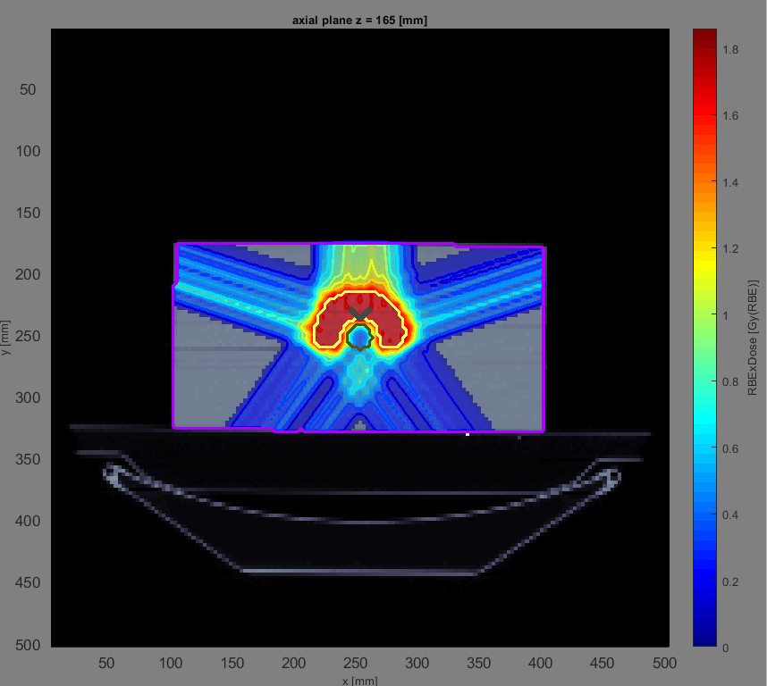
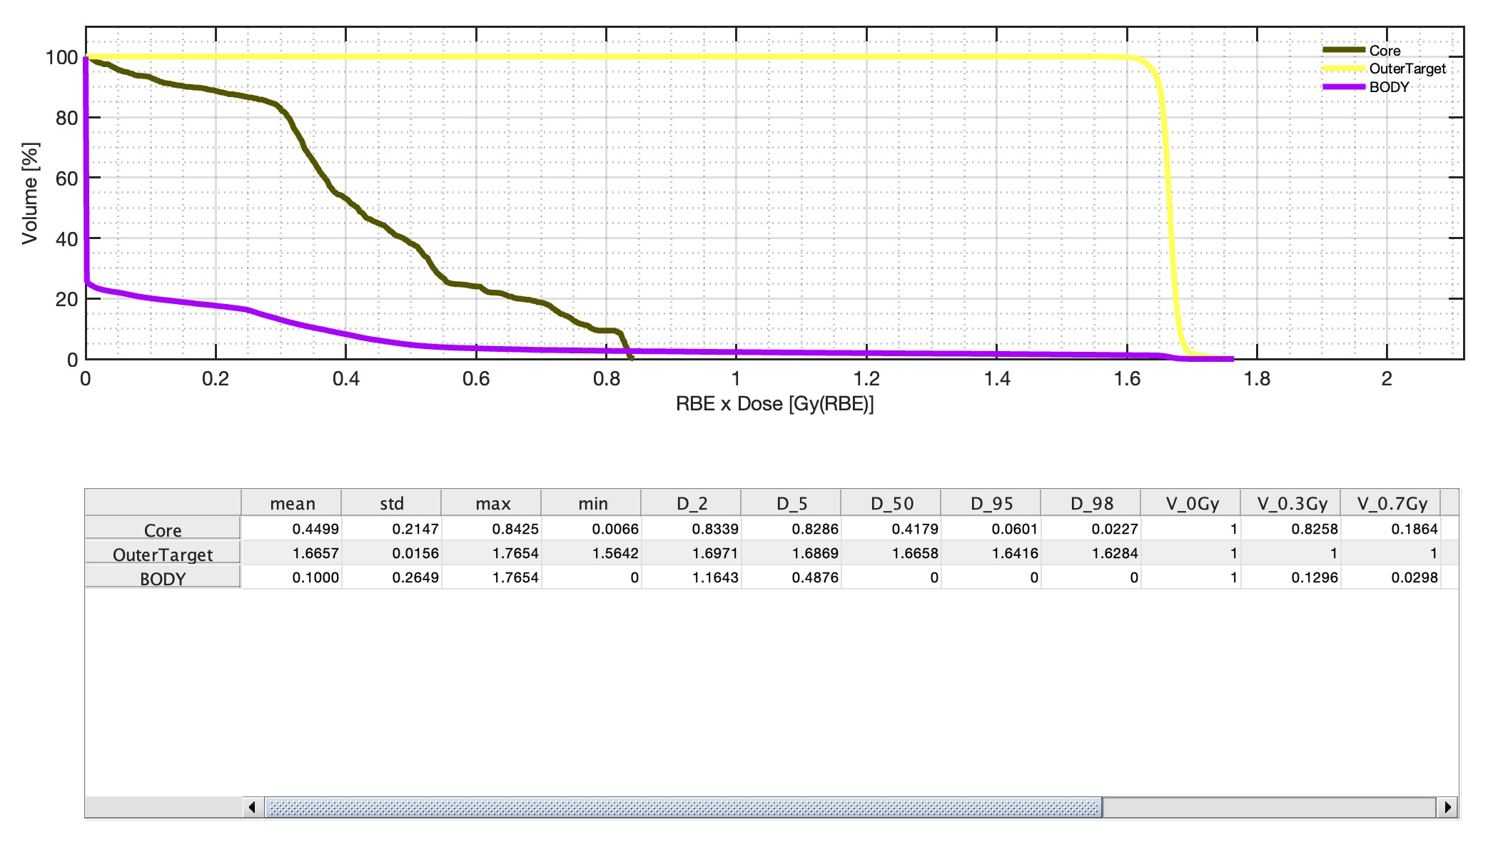
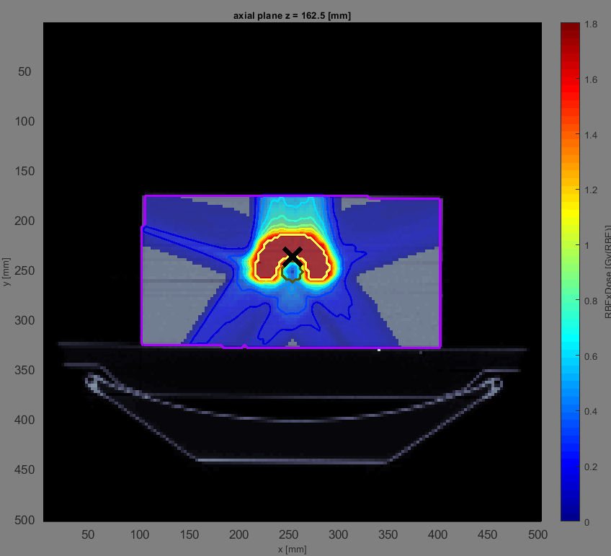
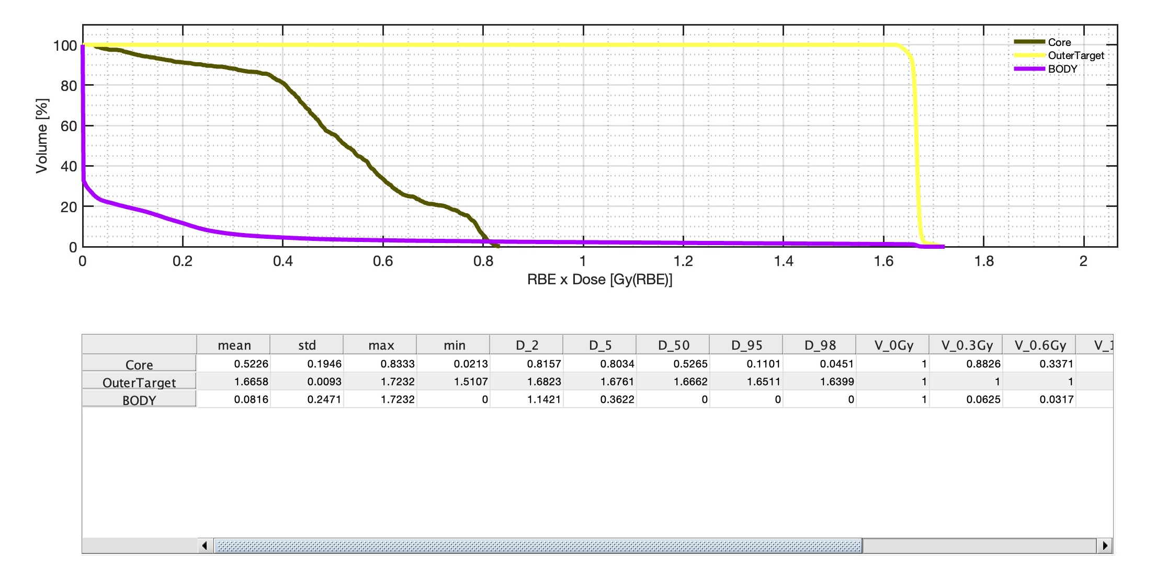
C phantom
We considered TG119 phantom.
We planned other three different treatment plans considering 5 equispaced beams. We took into account (i) photons, (ii) protons, (iii) carbon ions.
Both dose maps and DVH show an improvement in dose delivery in the target volume… despite it is quite modest (see table after) but…

Slide 6
C PHANTOM
List of all the organs present in the C Phantom classified as organs at risk (OAR) or target and the obtained doses (mean, max, min) for the 3 plans with 5 beams
Organ | Classification | 5 beams photons | 5 beams protons | 5 beams C-ions
Outer Target | TARGET | 1.7, 1.8, 1.5 | 1.7, 1.8, 1.6 | 1.7, 1.7, 1.5
Core | OAR | 0.6, 0.9, 0.2 | 0.4, 0.8, 0.0 | 0.5, 0.8, 0.0
Body | OAR | 0.2, 1.8, 0 | 0.1, 1.8, 0 | 0.0, 1.7, 0
… protons and C-ions perform better (“less“ doses) than photons in the OARs (core and/or body)

Slide 7
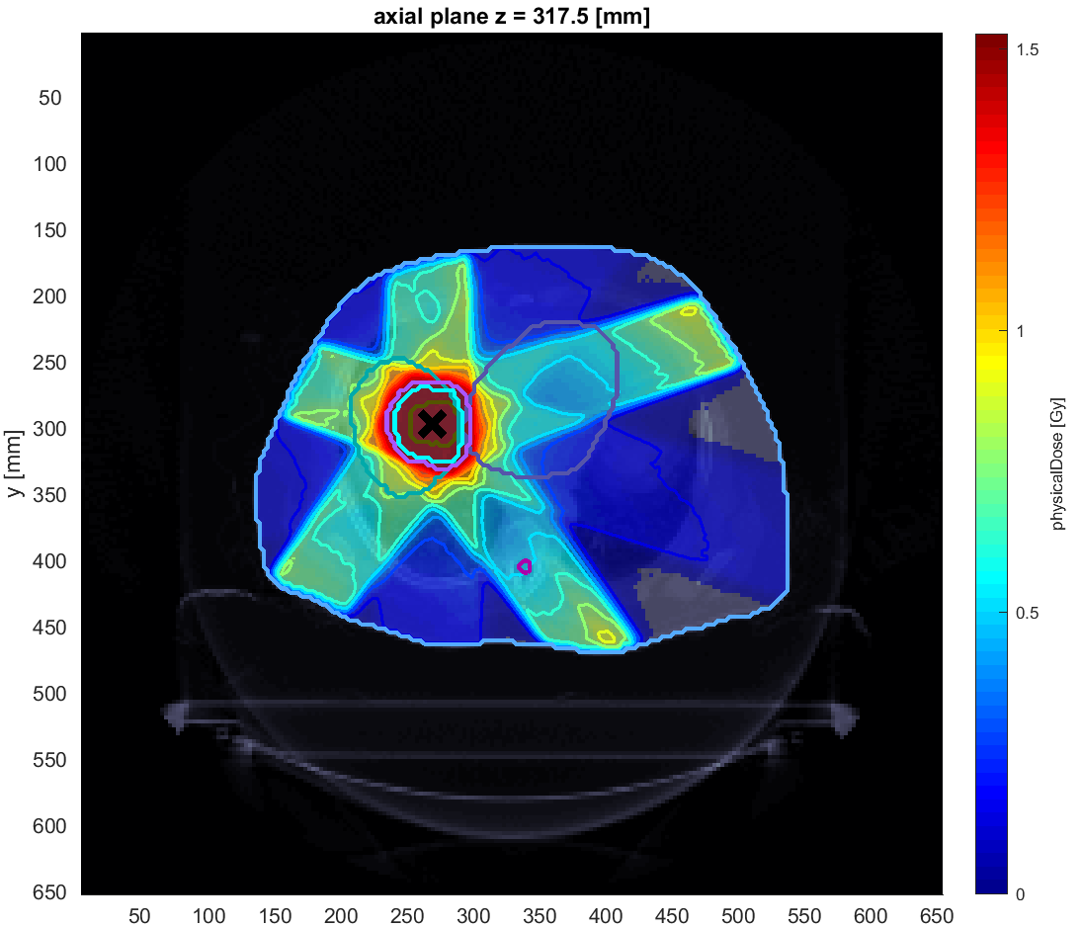
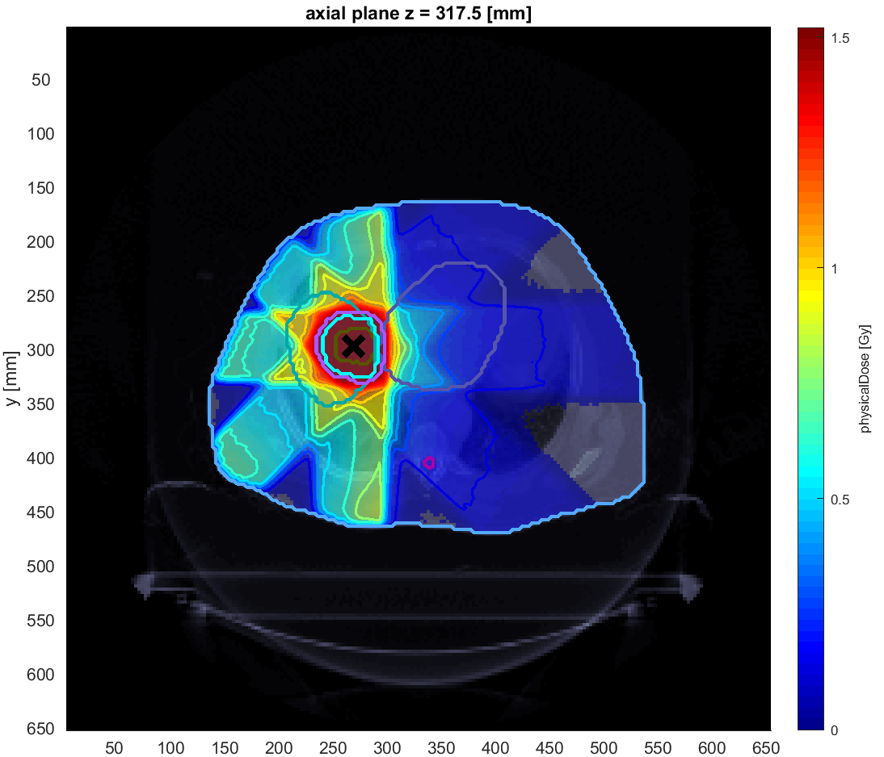
Comparison for PHOTONS EQUISPACED VERSUS 180°-360° for liver case
Equispaced photons treatment
0° 72° 144° 216° 288°
Equispaced (180°-360°) photons treatment
180° 216° 252° 288° 360°

Slide 8
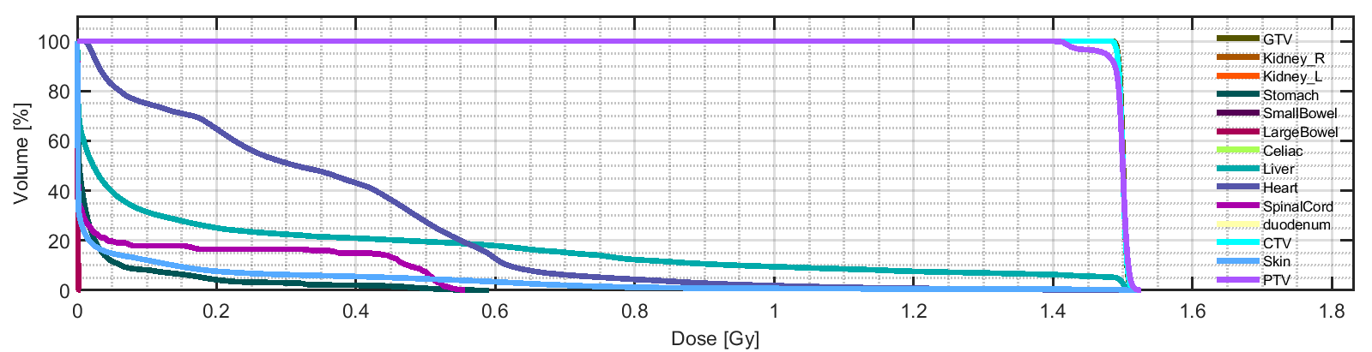
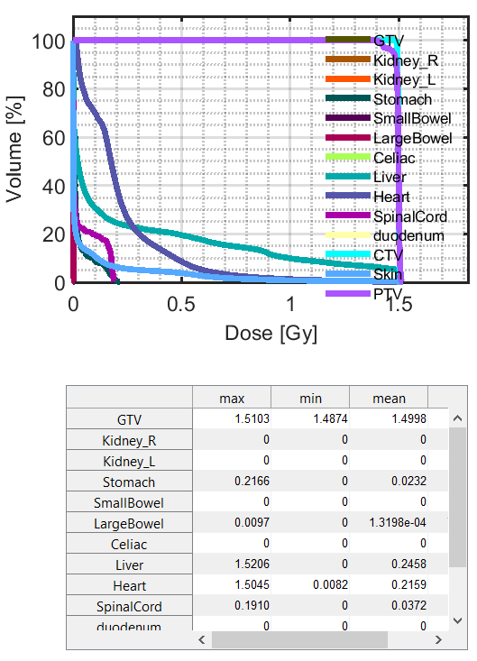
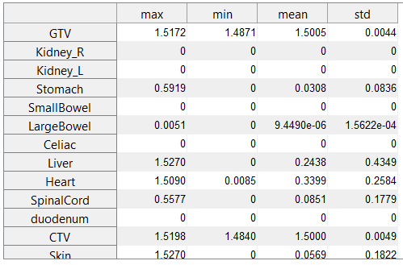
Comparison for PHOTONS EQUISPACED VERSUS 180°-360° for liver case
Equispaced (0° - 360°) photons treatment
Equispaced (180°-360°) photons treatment

Slide 9
Comparison for PHOTONS EQUISPACED VERSUS 180°-360° for liver case
Due to the asimmetric anatomical position of the liver (and thus of the tumour), the second plan (5 beams on the right side of the patient) performs better compared to the first one in some OAR (more than on the TARGETs…) => better preservation of the normal tissues/reduction of the probability of secondary tumours
(0° - 360°)
(180° - 360°)

Slide 10
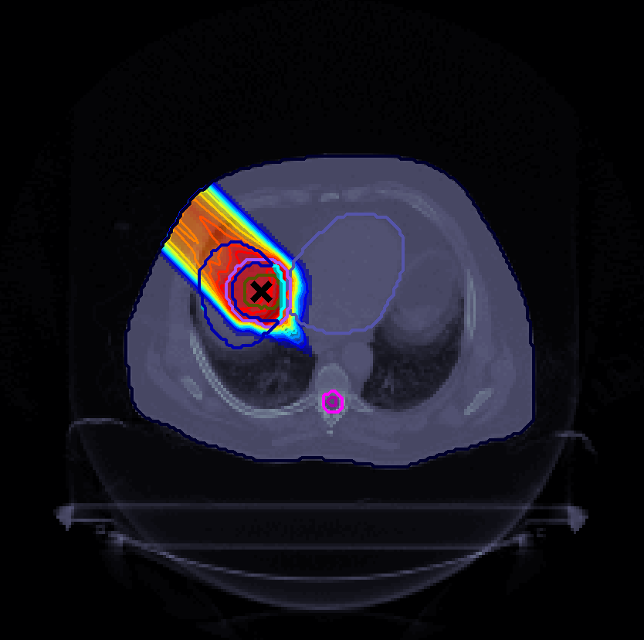
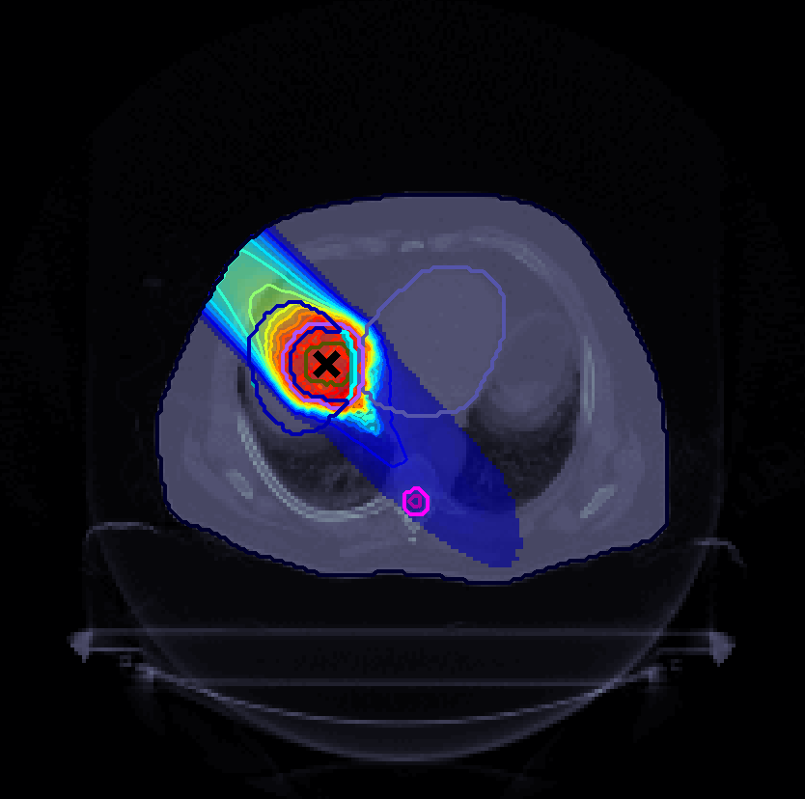
Comparison for PROTON AND CARBON IONS TREATMENT FOR LIVER case
Proton beam at 315°
Carbon-ion beam at 315°

Slide 11
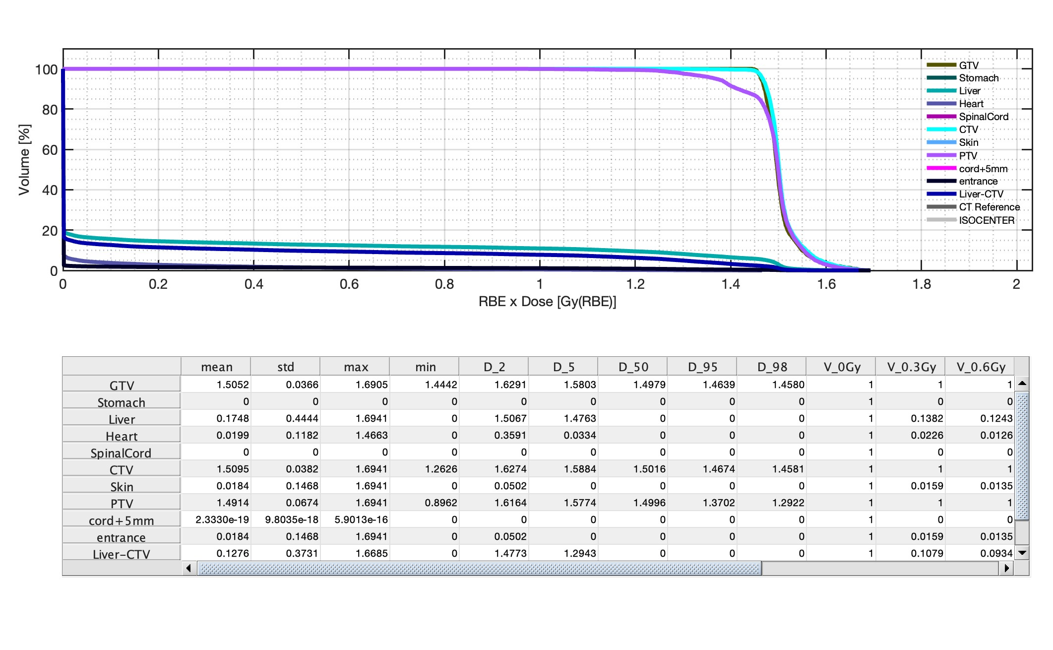
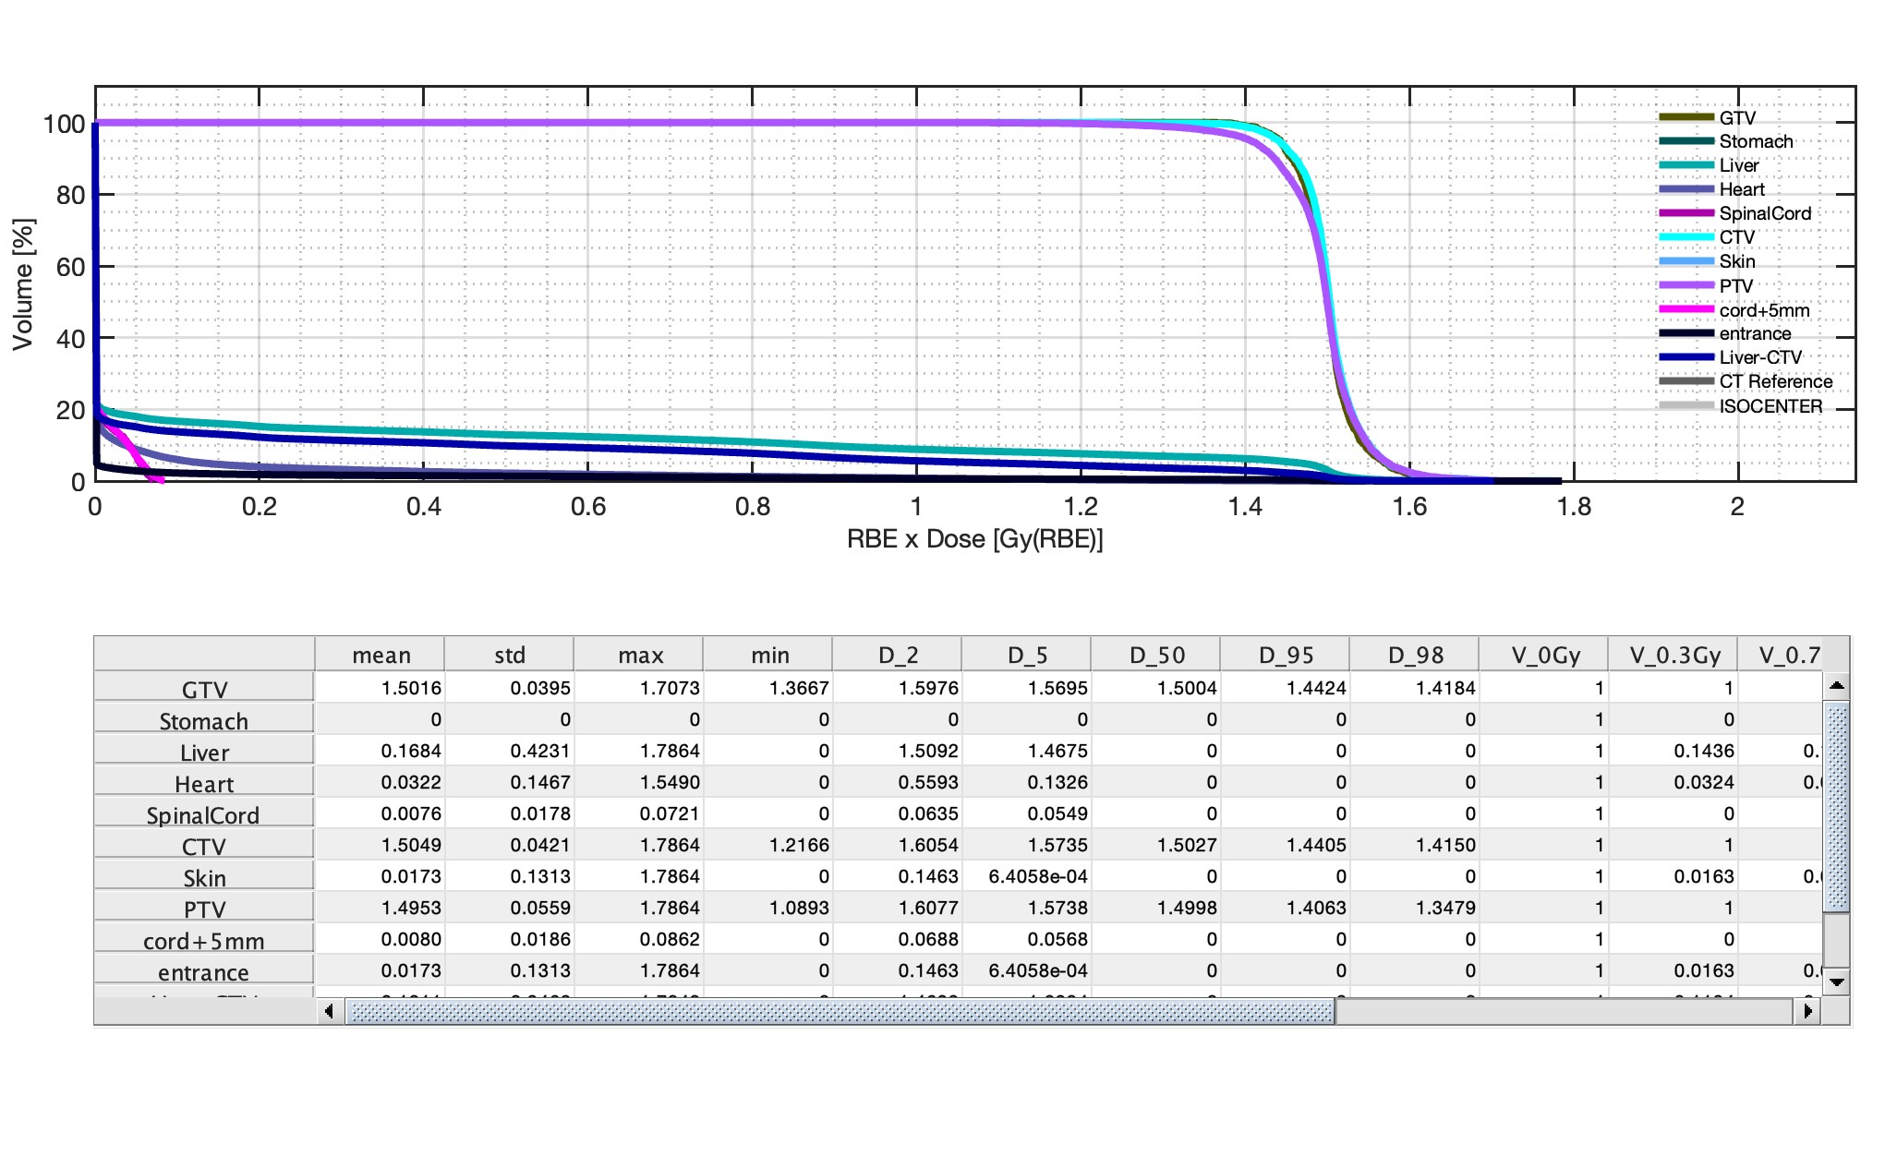
Comparison for PROTON AND CARBON IONS TREATMENT FOR LIVER case
Proton beam at 315°
Carbon-ion beam at 315°
Both protons and C-ions deliver a very homogeneous dose in the TARGETs

Slide 12
Comparison for PROTON AND CARBON IONS TREATMENT FOR LIVER case
Proton beam at 315°
Carbon-ion beam at 315°
Due to the fragmentation, C-ions leads to a measurable dose to the spinal cord, completely absent in the proton plan

Slide 13
Thank you for your attention

