Slide 1
Quantum entanglement and Indistinguishability
Merton 20/03/2023
Vlatko Vedral

Slide 2
Entangled versus Separable
States like these can be created by LOCC (sometimes also stated that they can never lead to any information processing advantage over classical systems – but this is not clear)
Modi, Brodutch, Cable, Paterek, and Vedral, Rev. Mod. Phys. (2012).

Slide 3
Witnessing Entanglement
Entangled and distillable
Entangled and
non-distillable
W
Disentangled
(separable)

Slide 4
Bipartite purity based witnesses
For separable states purity of the reduced states A,B is bigger than of the whole state AB:
Tr σ²_{AB} <= Tr σ²_{A} & Tr σ²_{AB} <= Tr σ²_{A}
L. Amico, Rosario Fazio, A. Osterloh, V. Vedral, Rev. Mod. Phys. (2008)

Slide 5
Indistinguishability and entanglement
First quantisation is misleading
Mode entanglement the right way to go (modes are the relevant subsystems)
Note: even the coupling between internal degrees is an effect of particle statistics
Libby Heaney and Vlatko Vedral, Phys. Rev. Lett. 103, 200502 2009

Slide 6
First quantisation confusion
There is no spatial entanglement here!
In other words, any operator correlation: <AB>=<A><B>

Slide 7
Second Quantisation
In order to study entanglement of identical particles
need to talk about modes – second quantisation.
But, we need to be careful about superselections!
(this is different to symmetrisation, anti-symmetrisation
where there is no entanglement to access in the first place)
Jacob Dunningham and Vlatko Vedral, Phys. Rev. Lett. 99, 180404 2007

Slide 8
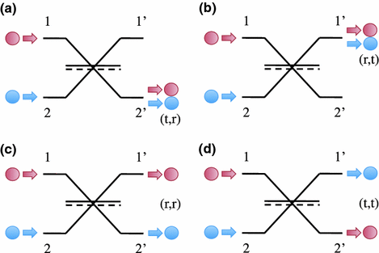
Hong Ou Mandel

Slide 9
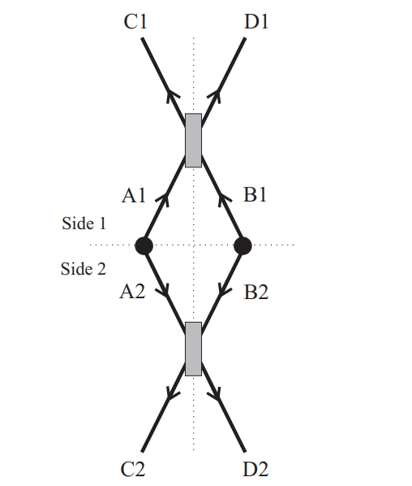
Photon Entanglement
A1 and A2 initially entangled (internal degrees) as well as B1 and B2. Triplet (A1 and B1; A2 and B2) leads to bunching, singlet to antibunching.
Looking at correlations between bunching and anti-bunching on the sides 1 and 2 gives us complete information about all purities.
N. Paunković, Y. Omar, S. Bose, and V. Vedral, Phys. Rev. Lett. 88 2002

Slide 10
Hanbury-Brown Twiss
θ
Intensity
Correlation
d
L
Originally proposed to measure stellar angular width
θ = d/L = λ/l_{c}

Slide 11
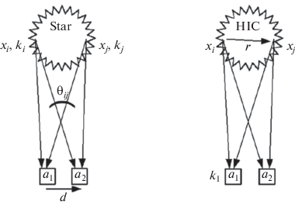
Femtoscopy
But can be used for nuclear size measurements (25 orders of magnitude difference!)
k₂
Michael Annan Lisa, Scott Pratt, Ron Soltz, Urs Wiedemann, Annual Review of Nuclear and Particle Science 55:357-402 (2005)

Slide 12
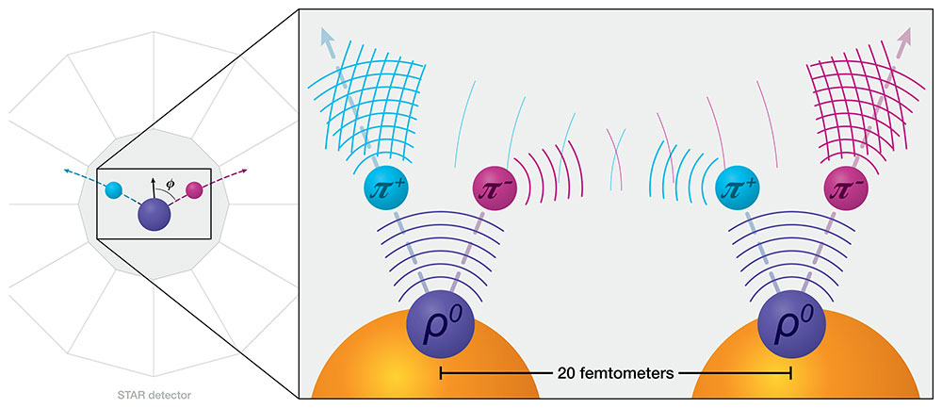
Pion Entanglement – HOM meets HBT
|π⁺π⁻ > + |π⁻π⁺ > |π⁺π⁻ > + |π⁻π⁺ >
Entanglement is needed to explain the statistics of detection correlations.
STAR Collaboration, Sci. Adv. 9, eabq3903 (2023)

Slide 13
The crux of the matter
The interference between detectors occurs when π⁺ and π⁻ are detected in each detector.
There are two indistinguishable ways in which this can happen (unlike when the pions have the same charge).
|A(π⁺π⁻ ; π⁻π⁺) + A(π⁻π⁺ ; π⁺π⁻)|² = 1 + cos (k Δr)
G. Goldhaber, S. Goldhaber, W. Lee, and A. Pais, Phys. Bev. 120, 300 (1960).

Slide 14
Summary
Particle Statistics can be used to create/witness entanglement
Confirming entanglement this way, rules out separable states, but of course, does not rule out all hidden variables.
The problem in many systems is to test concepts related to locality (to close loopholes).

