Slide 1


From small pieces to big achievements
How we achieved big discoveries by using simple phenomena
9 / 2 / 2023
Maniatis Giannis

Slide 2
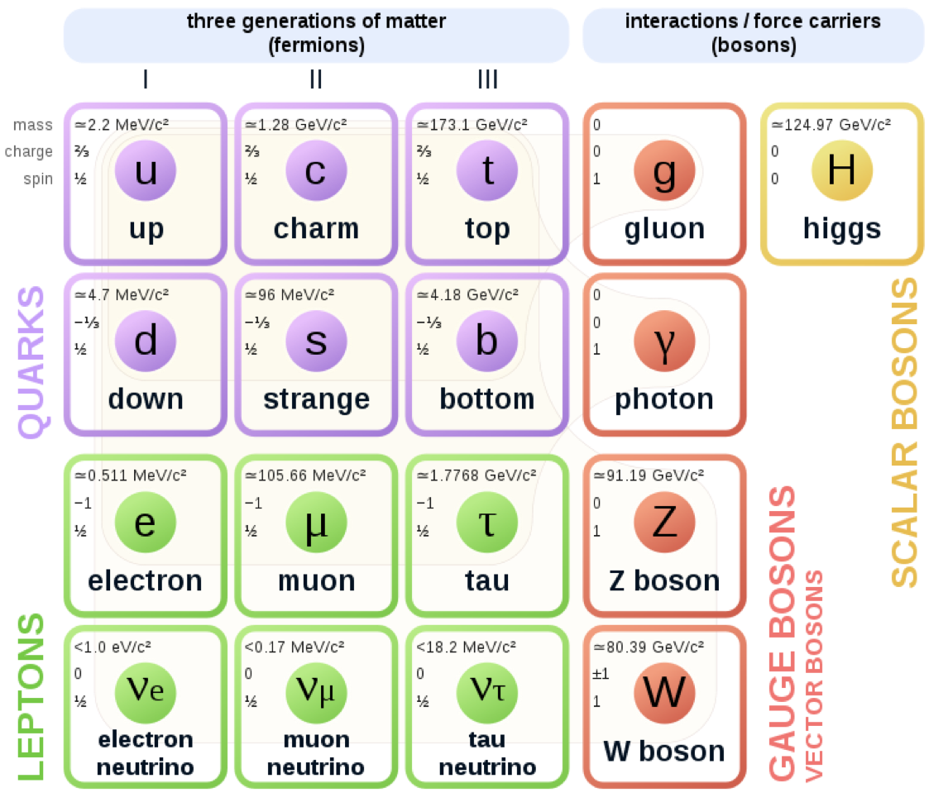
  The Standard Model
Our world consists of particles and fields
    The particles have different masses
    Some of them can live alone some not
    Interact differently
To discover new heavier particles we have
to use our knowledge from all these parts
of our model

Slide 3
A puzzle game for the discovery

Slide 4
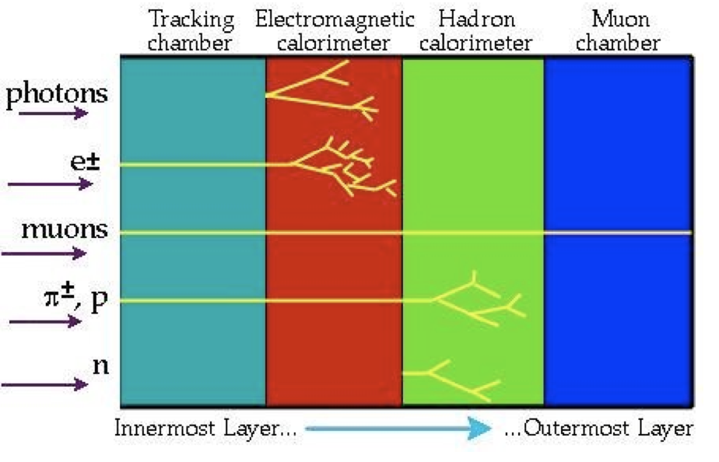

Pieces of the puzzle
Different pieces need different identification methods
    Scillicons for the charged particles
    Electromagnetic calorimeter for e and photons
    Hadronic calorimeter for the hadrons π, n ..
    Muon spectrometer for the μ
Muon are the most penetrating

Slide 5
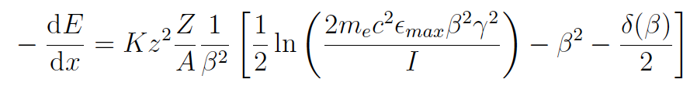
Interaction with the matter
The charged particles interact with the traversing matter (Bethe-Bloch)
    Imagine a ball diving into a jar of honey
We are using the phenomenon
While a charged particle traversing the matter:
    Interacts with matter’s atoms or the free electrons
        Losses energy
        But the energy cannot disappear!
        Other particles gain of the loss

Slide 6
From a muon to avalanches
If we force all the particles to move what will happen?
    Lets insert some electric force …
    All electrons are affected by the electric force
    Their kinetic energy increases
    They could ionise neutral gas atoms
      Multiplication of this process starts a
      cascade - avalanche
    The movement of these electrons
    induces signals!
A passing muon can start a domino of electrons’ interaction
—> Signals!

Slide 7
Gaseous detectors
Several types of gaseous detectors
    Multi Wire Proportional Detectors
    Micro Pattern Gaseous Detectors
These avalanches can helps us to identify:
    Where the traversing particle came from
    When the traversing particle passed

Slide 8
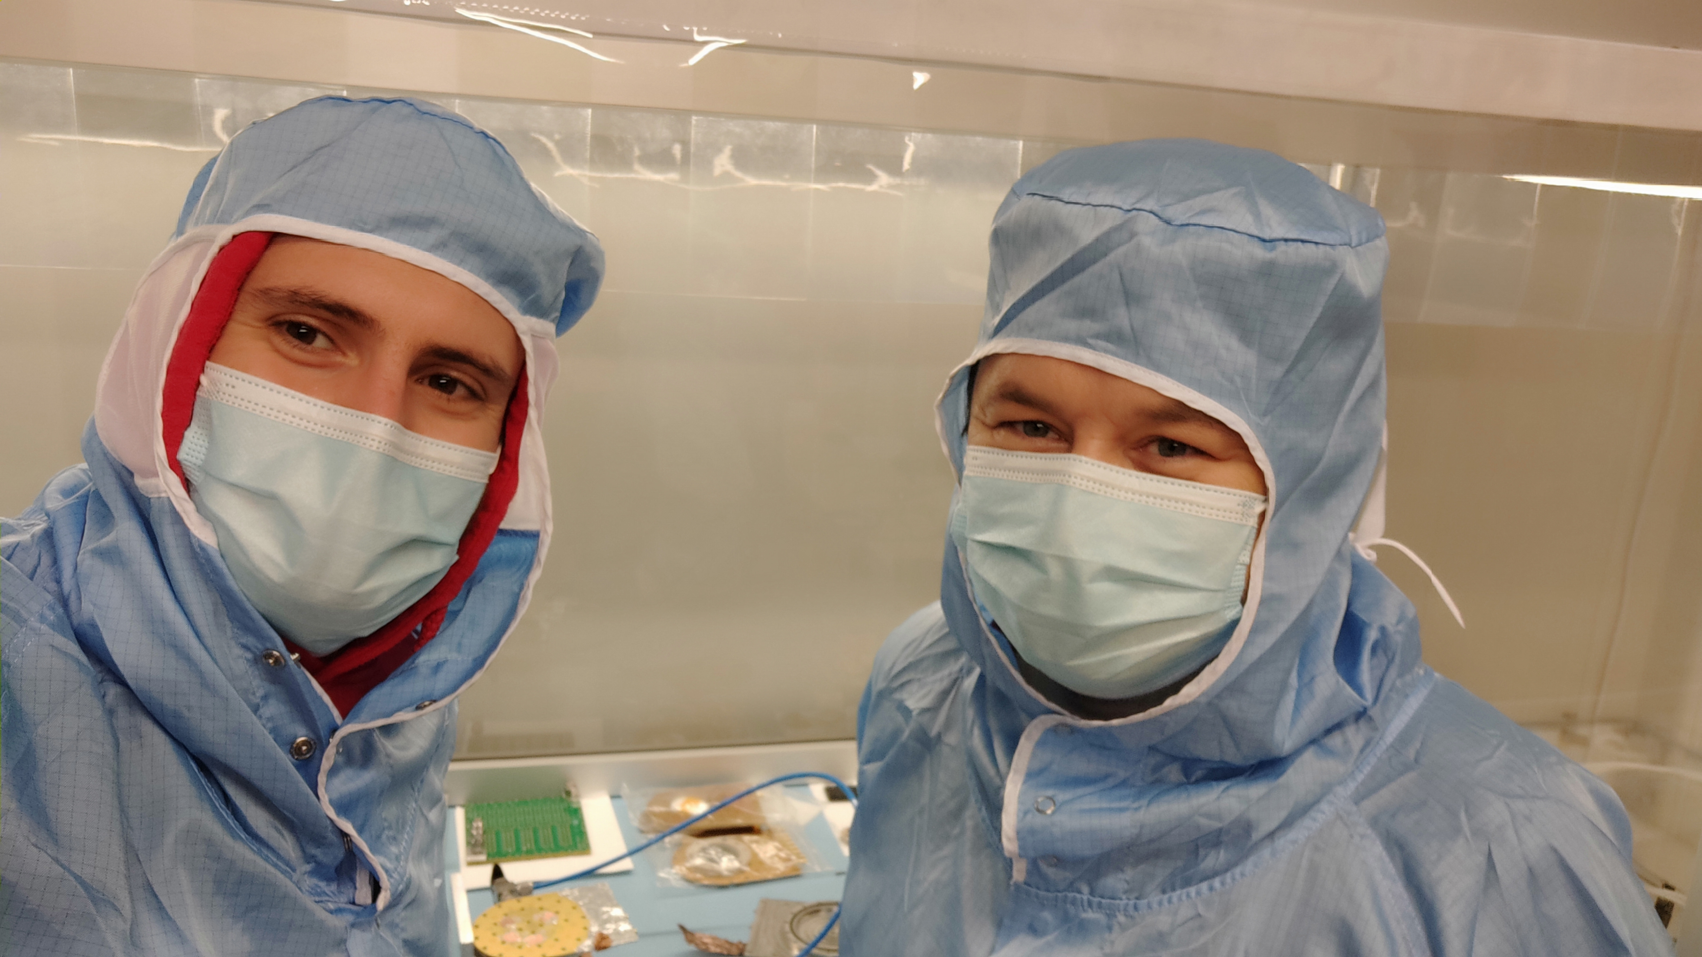
Why to use gaseous detectors
Cheaper construnction
    No need for special materials
    Just exploit the several physical phenomena
        Interaction of muons with the matter
        Movements of charged particles in gaseous
        Signal induction
    No need for special facilities
    Spatial resolution ~ μm —> 10^-6 —> 0.000001 m !
    Time resolution ~ ps —>10^-12 —> 0.000000000001 s!

Slide 9
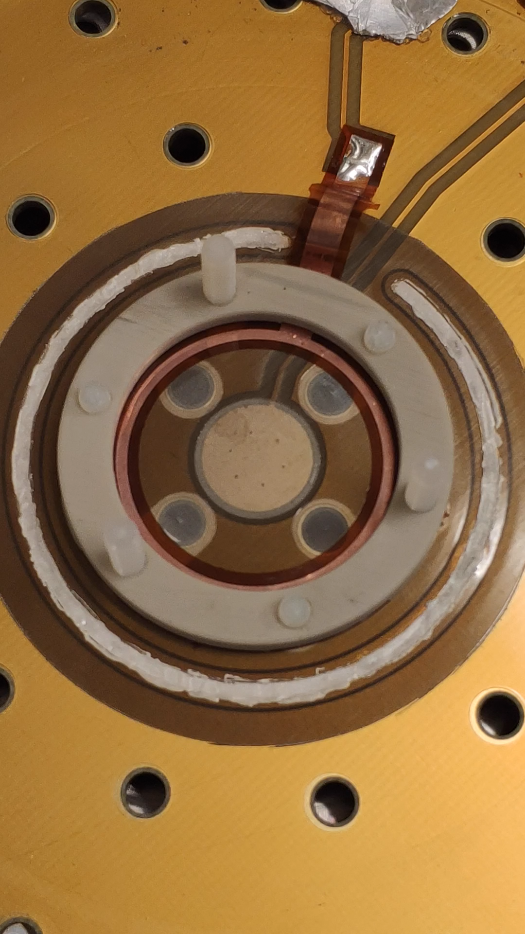
Why to use gaseous detectors
Cheaper construnction
    No need for special materials
    Just exploit the several physical phenomena
        Interaction of muons with the matter
        Movements of charged particles in gaseous
        Signal induction
    No need for special facilities
    Spatial resolution ~ μm —> 10^-6 —> 0.000001 m !
    Time resolution ~ ps —>10^-12 —> 0.000000000001 s!

Slide 10
Israel and gaseous detectors
Israel has supported the development of the gaseous detectors
Big Wheels of the ATLAS experiment where constructed and validated in Israel
Commitment to maintain and operate
them
Construction of the New Small Wheels
Development of new generations of gaseous
detectors

Slide 11
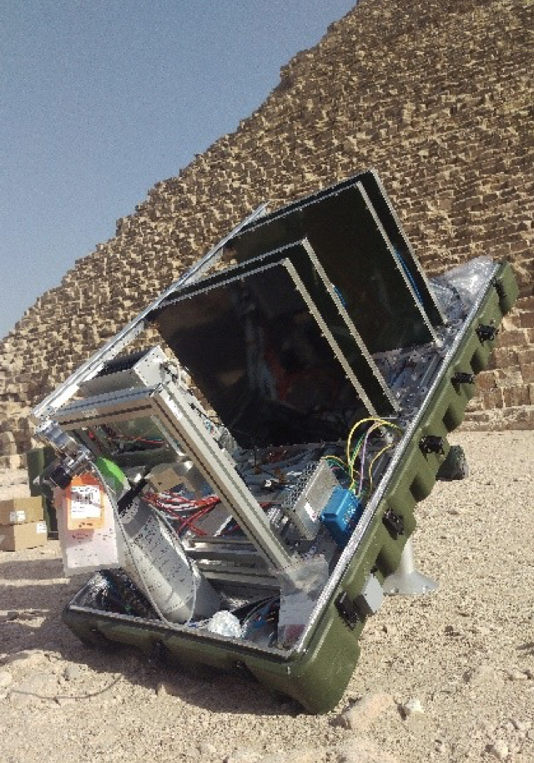
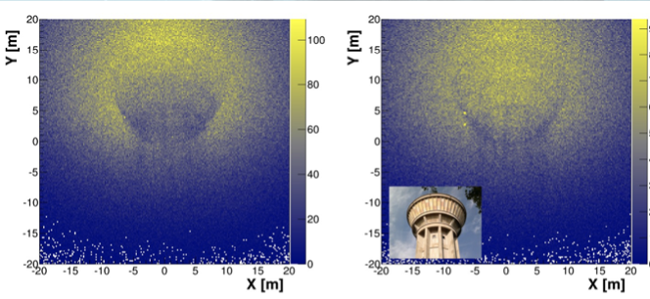
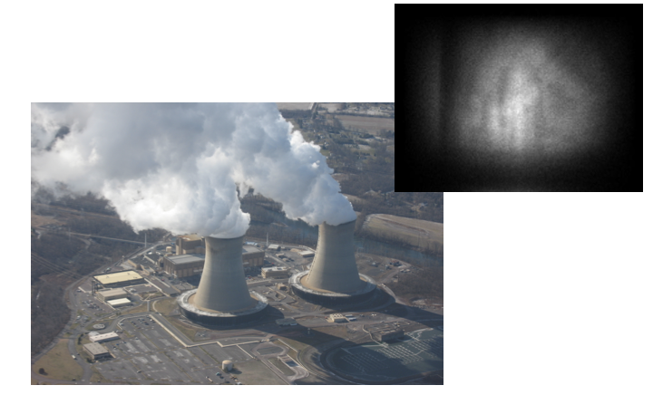
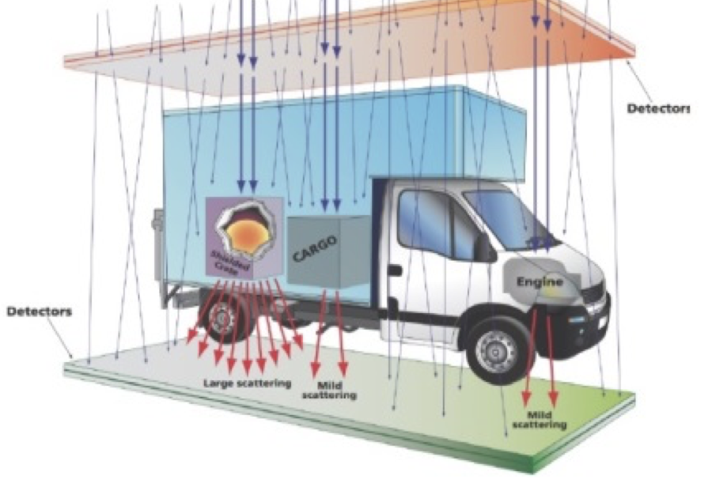
Gaseous detectors out of HEP
Tomography:
    Archeology
    Nuclear safety
    Geotechnics
    Homeland security
    Fire alarms

Slide 12
Thank you!

