Slide 1
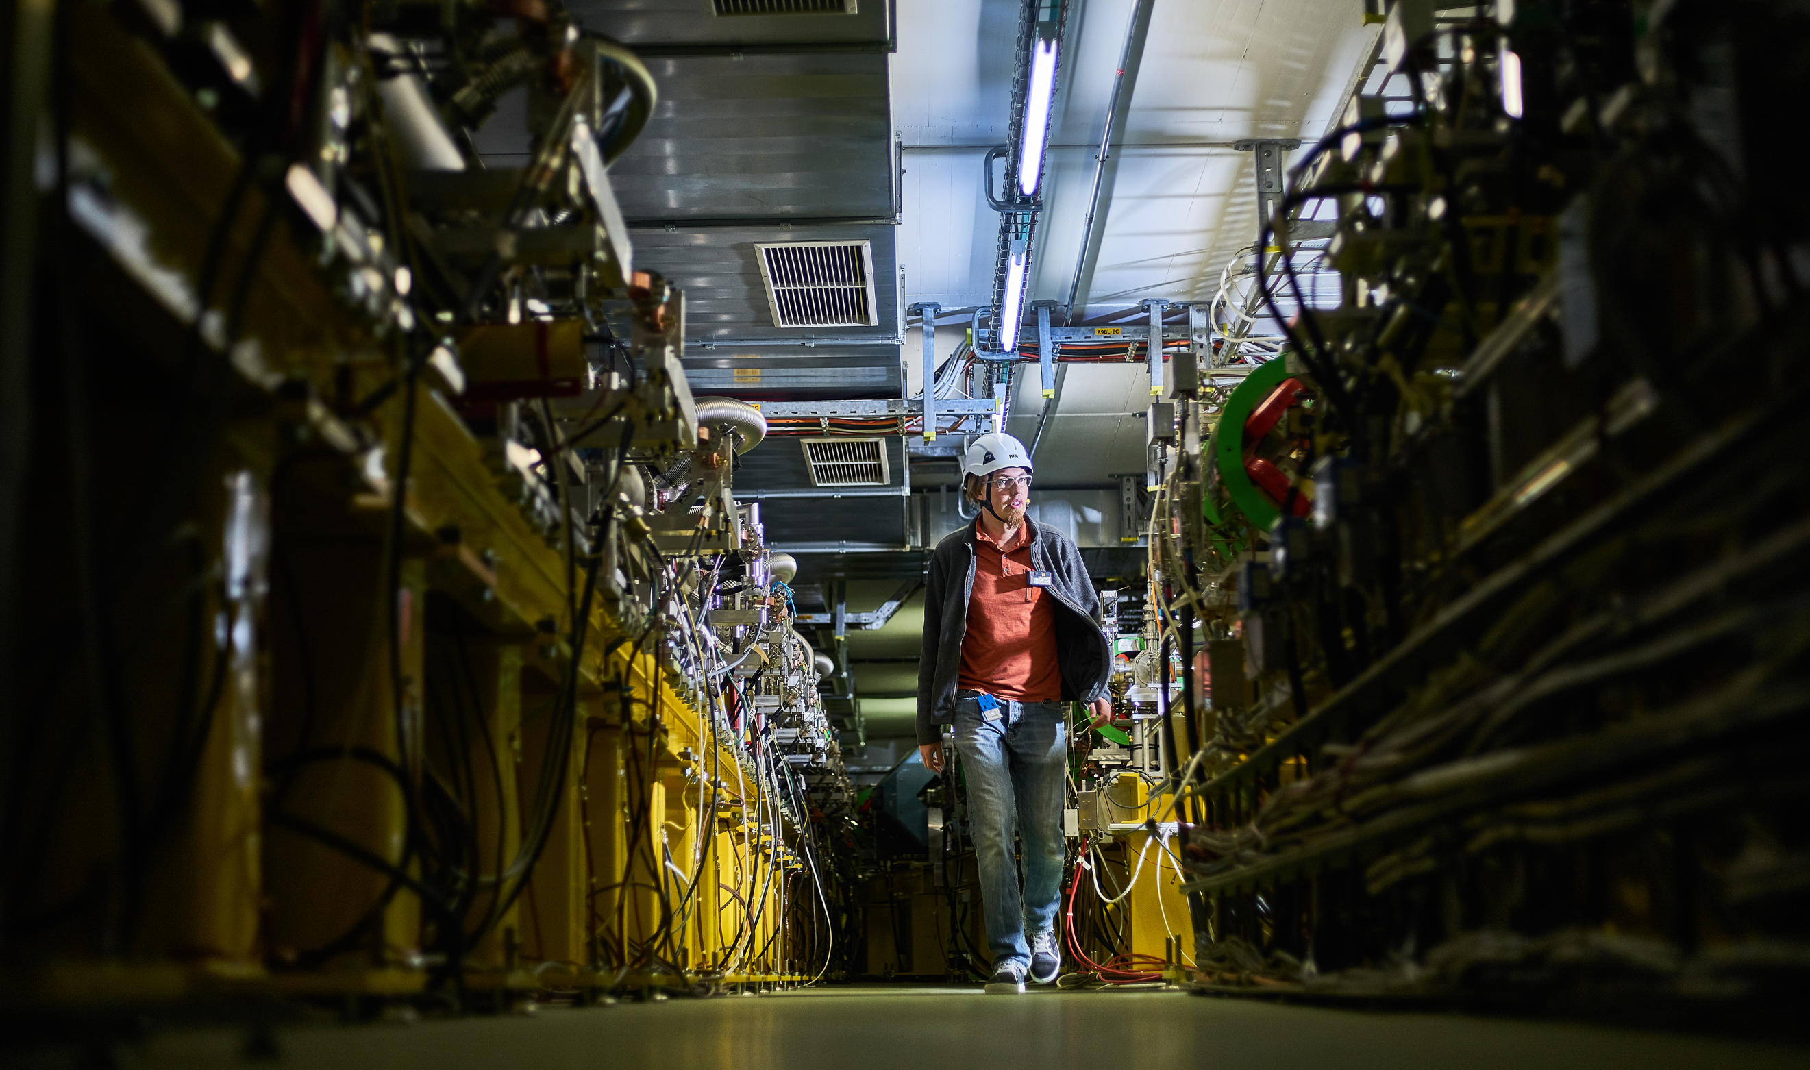
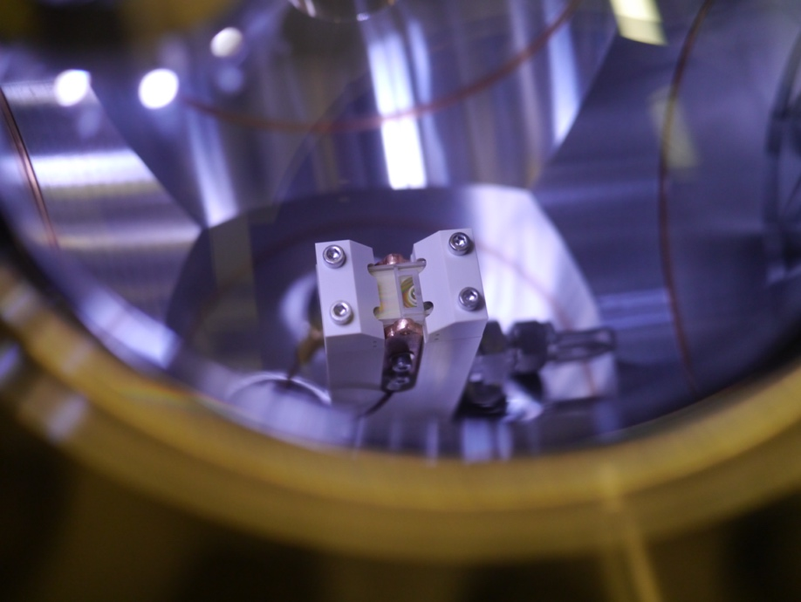
CLEAR Scientific Board Meeting - Introduction
R. Corsini
CERN Linear
Electron Accelerator
for Research

Slide 2
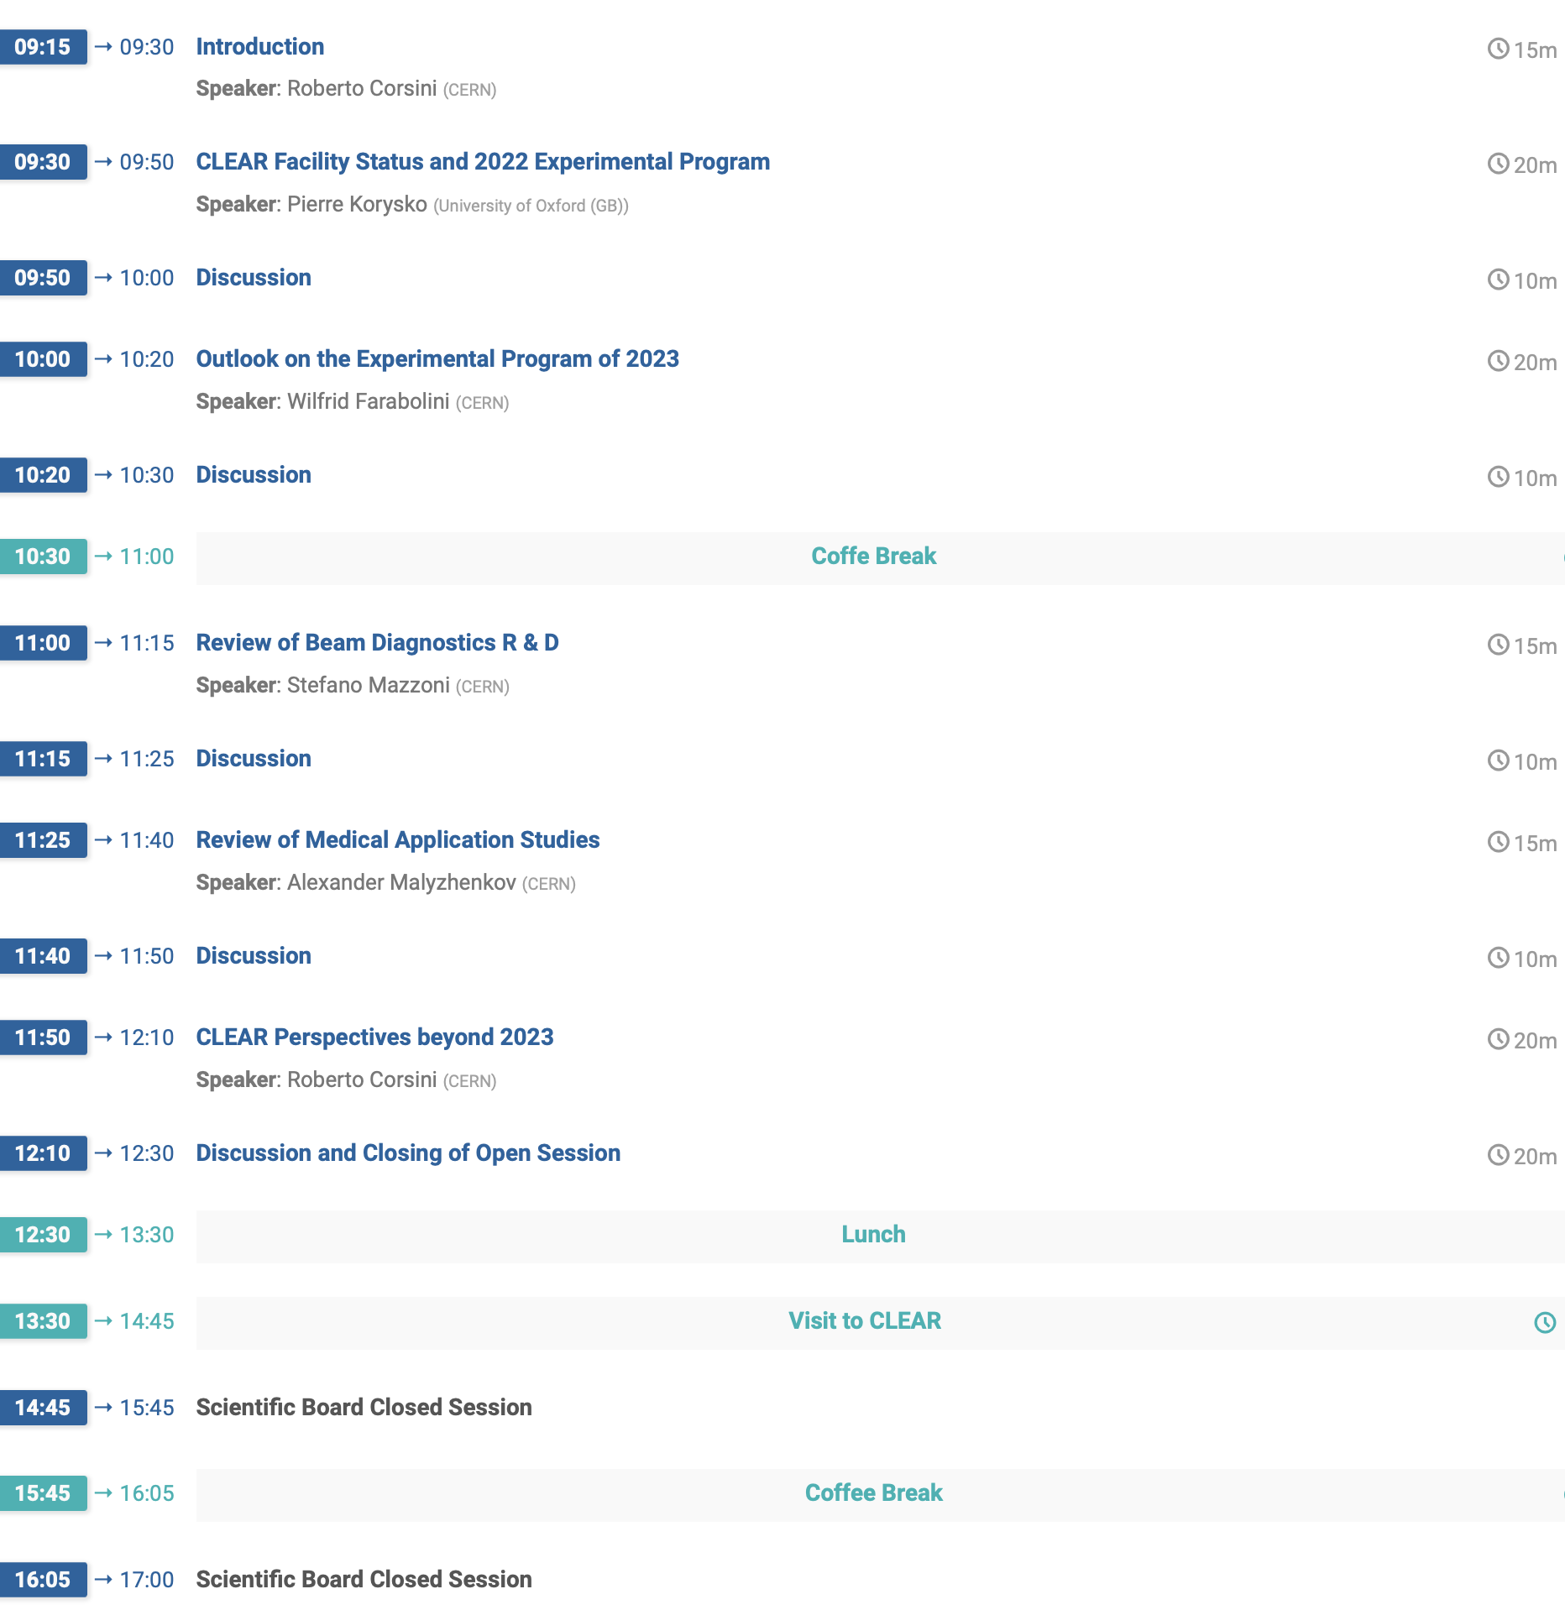
CSB Meeting Program

Slide 3
CLEAR Scientific Board
The CLEAR Scientific Board (CSB) periodically reviews the progress of the experimental program, steers the experimental program and gives recommendations on proposed experiments and activities on the basis of their scientific interest and the availability of the facility. The Scientific Board members participate to the formal approval process of the beam time requests.
Members:
Giovanni ANELLI (CERN)
Hans BRAUN (PSI)
Philip BURROWS (JAI/Oxford U.) chair
Roberto CORSINI (CERN) ex officio
Ilias EFTHYMIOPOULOS (CERN)
Angeles FAUS-GOLFE (CNRS/In2p3-Orsay)
Massimo FERRARIO (INFN-LNF)
Eugenia HATZIANGELI (CERN)
Giuseppe LERNER (CERN)
Steinar STAPNES (CERN)
Marie-Catherine VOZENIN (UNIL/CHUV)
- The CSB will act in concertation with the local CLEAR Technical Board (CTB), responsible for assessing the technical, safety and radioprotection aspects of each proposal before the experiments are submitted for final approval to the CSB and to the safety/RP representatives, and for the detailed beam time scheduling.
- The CSB will meet once per year, before the start of operation (in February/March) in order to assess the execution of the experimental program in the previous year, examine the new experiment proposals received until then and give recommendations on the new year experimental program, indicating priorities if needed. The formal approval of each individual request for beam time is done through a remote procedure, and further proposals, received after the CSB yearly meeting, will be accepted during the year following such procedure.

Slide 4
CSB Meeting - Mandate
This meeting is focused on the specific charge:
Review and assess the past CLEAR experimental programme, with particular focus on the one executed last year.
Review the 2023 experimental program, as defined by the user proposals received so far and the extrapolation of past experiments, and give recommendations on most relevant directions or activities to be followed.
Make suggestions on the best ways to handle priorities and optimize beam time allocation.
It would be also appreciated an initial assessment on consolidation and upgrade plans and potential evolution of the facility activities.

Slide 5
The CERN Linear Electron Accelerator for Research (CLEAR)
Scientific and strategic goals:
Providing a test facility at CERN with high availability, easy access and high quality e- beams.
  Performing R&D on accelerator components, including beam instrumentation prototyping and high gradient RF technology
  Providing an irradiation facility with high-energy electrons, e.g. for testing electronic components in collaboration with ESA or for medical purposes(VHEE/FLASH)
  Performing R&D on novel accelerating techniques – electron driven plasma and THz acceleration.
Maintaining CERN and European expertise for electron linacs linked to future collider studies
Using CLEAR as a training infrastructure for the next generation of accelerator scientists and engineers.
CLEAR is a versatile 200 MeV electron linac + a 20 m experimental beamline, operated at CERN as a multi-purpose user facility.

Slide 6
CLEAR Timeline
Approved in December 2016, as a 2 + 2 years program
Started operation in August 2017
Reviewed and extended until 2020 in February 2019
Operation extended in 2021 and possibly beyond, with independent budget included in the new CERN Medium Term Plan 2021-2025 (approved by the CERN Council in September 2020)
CERN internal review, 16 March 2021 → confirmed, approved to end 2025

Slide 7
Main activities
Beam Diagnostics R&D SY/BI is our main interface, collaboration with external institutes, or other CERN projects mainly through them
Medical Activities Main collaborator is CHUV-Lausanne, but independent collaborations exist with several other institutes/firms
Irradiation Similar to beam diag R&D, our main interface is the R2E team
at CERN – collaboration with others (e.g., ESA) handled jointly
Advanced acceleration Two main “clients” so far: CLIC and AWAKE,
plus the Plasma Lens Collaboration lead by Oslo University
Others We routinely receive (and follow) beam time requests in many different fields, different from the above.

Slide 8
Operation
CLEAR is a stand-alone installation, thus operation during general stops of the global CERN accelerator complex, including long shut-downs, is possible.
CLEAR is operated for 30 to 40 weeks/year – typically from March to December,
often 2-3 weeks stop in summer.
  Operation organized over 2 shifts, roughly during working hours, 5 days/week
  No night shifts or week-end running (apart few exceptions)
  Sometimes remotely supervised operation in nights/week-ends (low-charge irradiation – none in 2020)
Current operating team:
1 Staff, 1 associate, 1 fellow, 2 PhD students, 1 part-time associate (in remote)
Support from CERN services and groups on technical systems, in general on best effort basis and subject to priorities
Detailed weekly activities organized at the Monday operation meeting (often followed by access in the hall) and coordinated by a weekly supervisor (member of the operation team)

Slide 9
Access to beam time
Any user willing to access the facility has to fill-up a beam time request form (https://clear.cern/content/beam-time-request), specifying:
  Experiment description, scientific aim and justification
  Needed beam parameters
  Experimental apparatus and logistics, safety aspects
In general, some iterations between the operation team and the requester are needed (before or after receiving the form) in order to clarify requirements and understand goals.
The CLEAR Technical Board is responsible to give the final authorization and allocate the beam time in the schedule, after checking technical feasibility and scientific interest and safety and RP issues, following guidelines by the CLEAR Scientific Board
The CLEAR Scientific Board members are also involved in the formal approval procedure for each beam time request, which is carried out using the CERN EDMS infrastructure
User teams often ask for beam time for an activity a few times during a year, and often over 2 or more years. Beam time requests beyond 1 year require to fill out a new form

Slide 10
CLEAR Technical Board
The CLEAR Technical Board (CTB) is responsible for assessing the technical, safety and radioprotection aspects of each proposal before the experiments are submitted for final approval to the CSB and the safety and RP representatives, and follows-up the beam time scheduling.
Members:
Roberto CORSINI (BE-ABP), Facility Coordinator
Davide GAMBA (BE-ABP) Facility Safety Officer (ad-interim), Technical Support
Markus WIDORSKI (HSE-RP), Radio Protection Officer
Wilfrid FARABOLINI (BE-ABP), Beam Expert, Operation
Pierre KORYSKO (BE-ABP and Oxford University), Beam Expert, Operation
Kyrre SJOBAK (BE-ABP and Oslo University) Beam Expert and User Representative
Stefano Mazzoni (SY-BI), User Representative

Slide 11
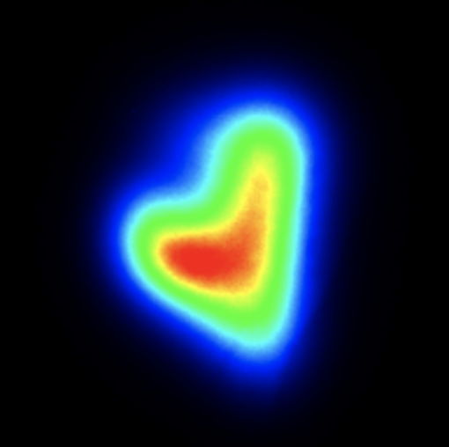
Thanks for your attention!

Slide 12
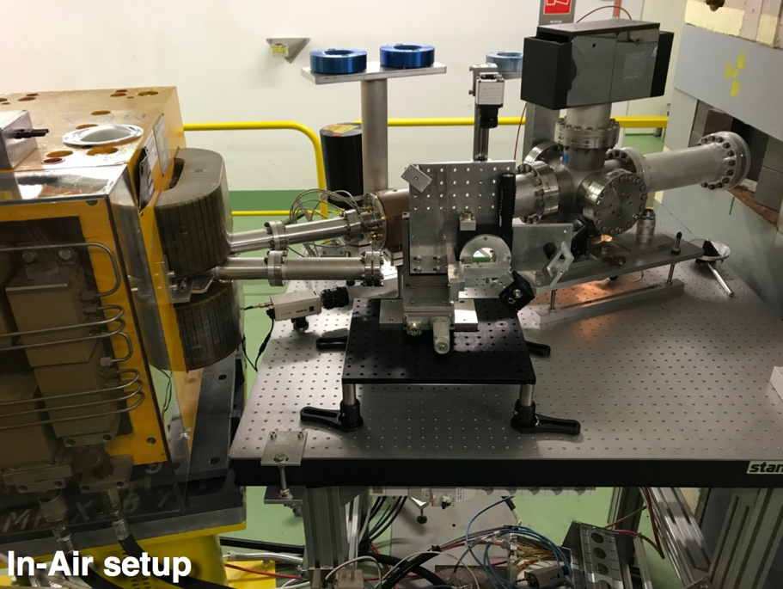
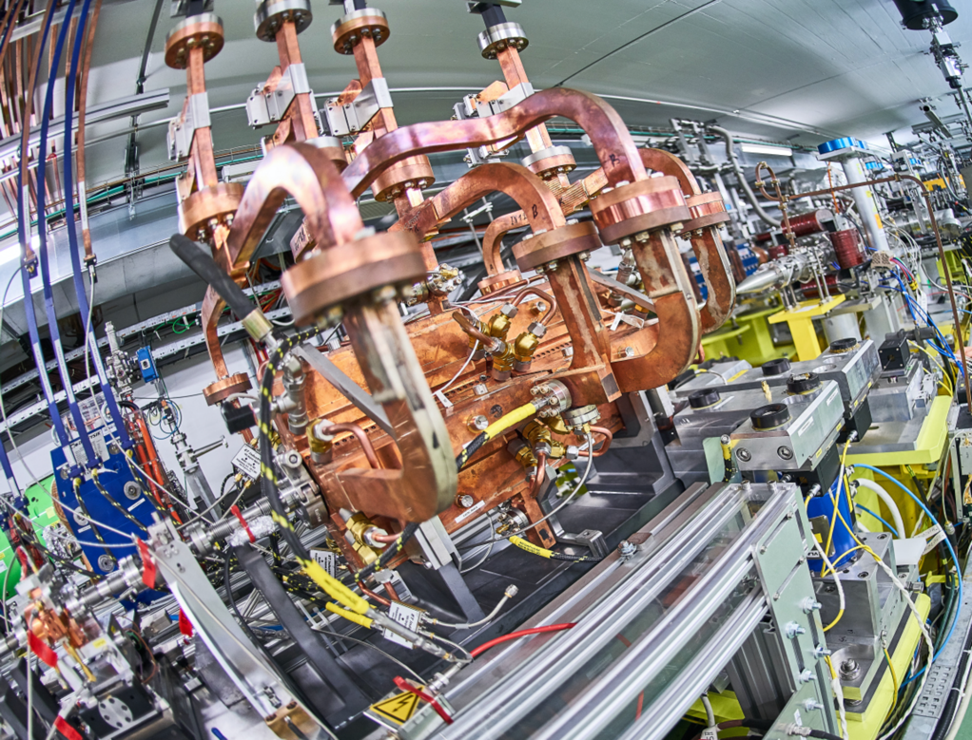


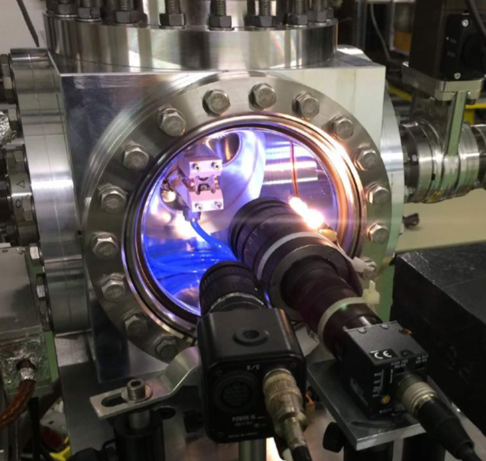
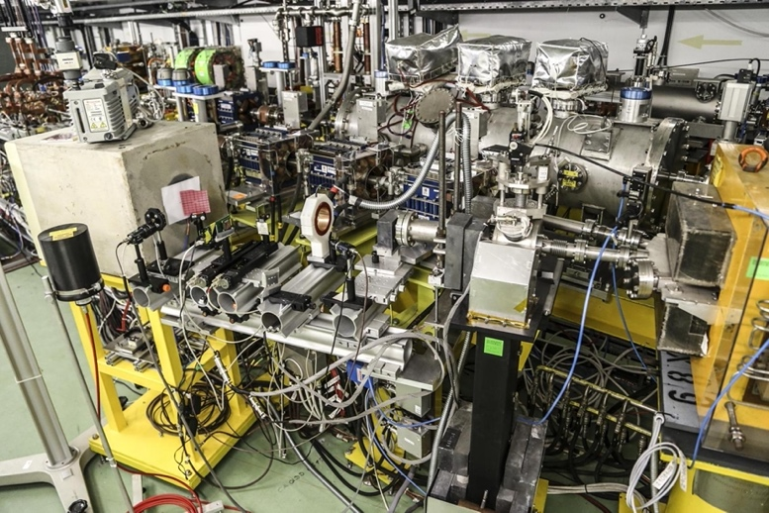
CLEAR Layout & main installations
In-air test stand
Testing ground for beam diagnostics R&D and THz radiation studies
Irradiation for medical and other applications
CLIC Test-Stand
High-gradient and linear colliders R&D
CALIFES
electron linac
Flexible accelerator providing 200 MeV electron beams to all CLEAR users
The Plasma
Lens Experiment
Novel concepts of plasma-based focusing and acceleration
VESPER
Beam irradiation facility for studies on radiation damage of electronics and medical applications

Slide 13
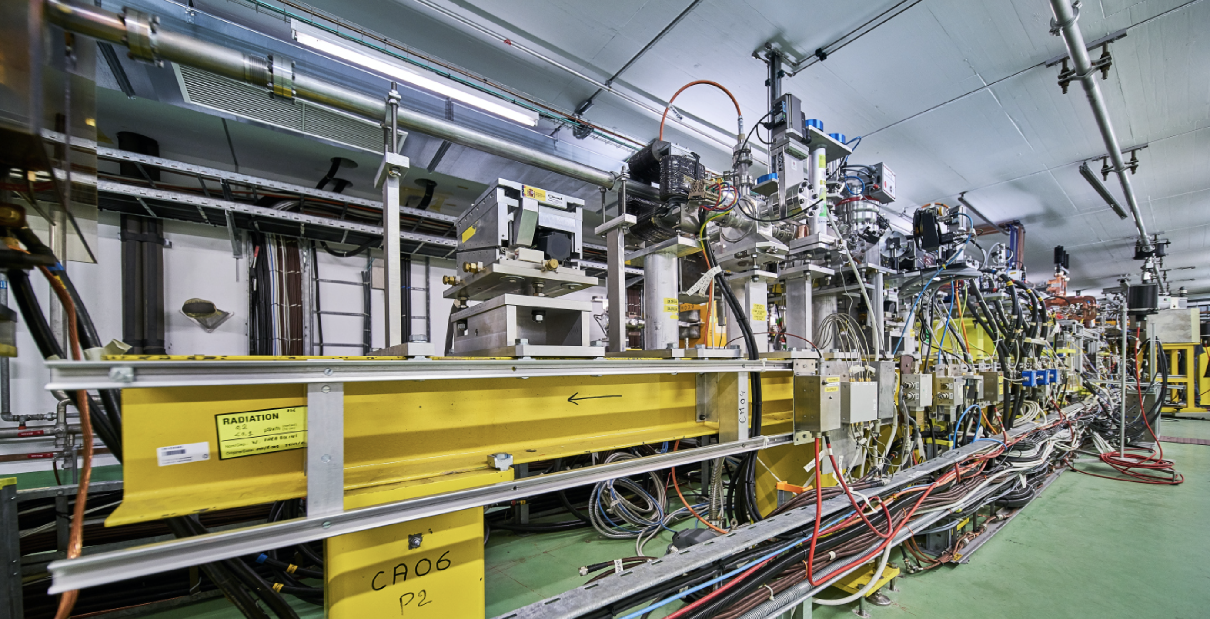
CLEAR Beam Parameters
Extended parameter range and performances since 2017
Short bunches
High charge
Large energy range
Stability, beam sizes,…
Beam parameter | Range
Energy | 30 – 230 MeV
Energy Spread | < 0.2 % rms (< 1 MeV FWHM)
Bunch Length | 0.1 ps – 10 ps rms
Bunch Charge | 5 pC – 3 nC
Number of bunches per pulse | 1 to ~150
Maximum total pulse charge | 80 nC
Normalized emittances | 3 μm to 30 μm (bunch charge dependent)
Repetition rate | 0.8 to 10 Hz
Bunch spacing | 1.5 GHz or 3 GHz

Slide 14
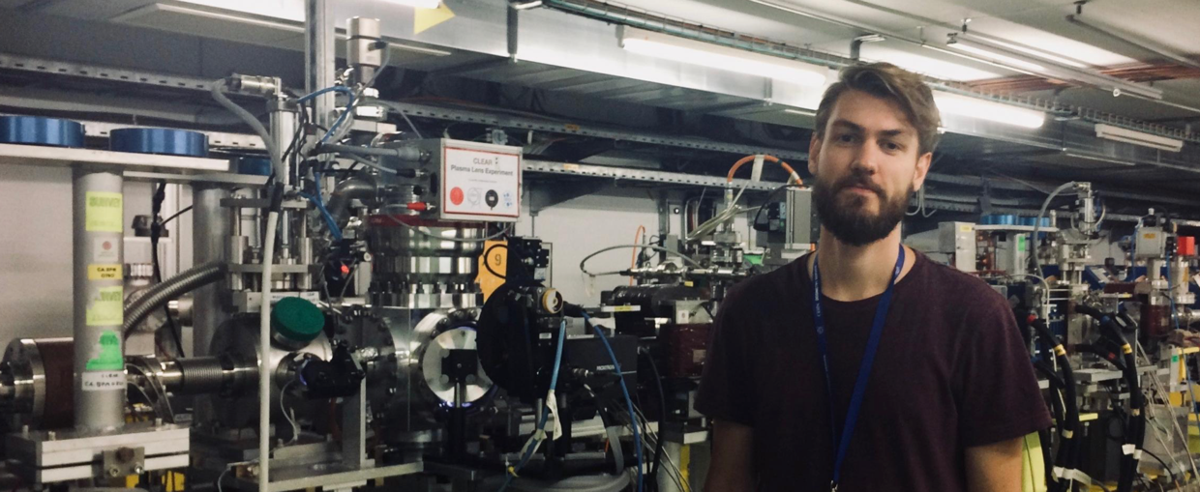
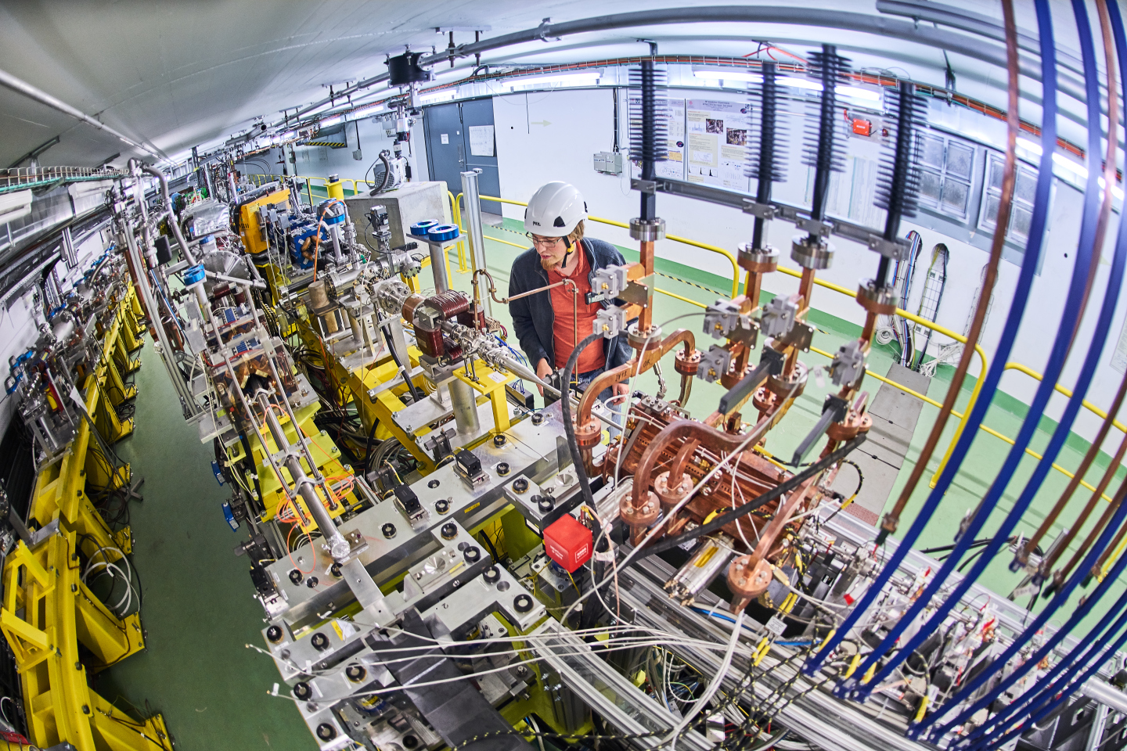
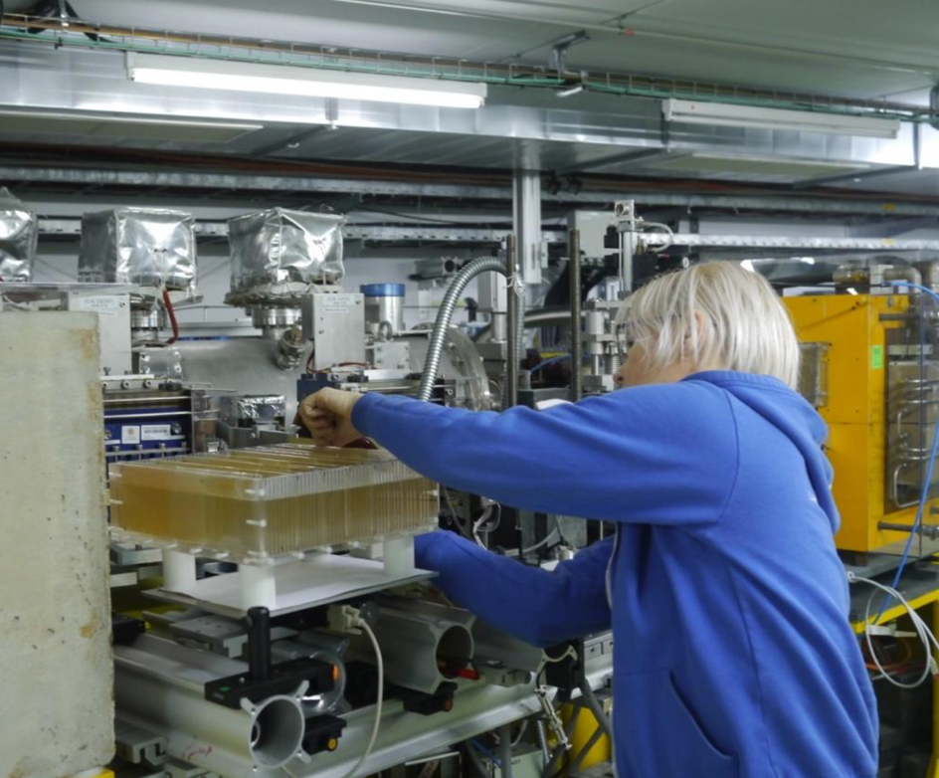
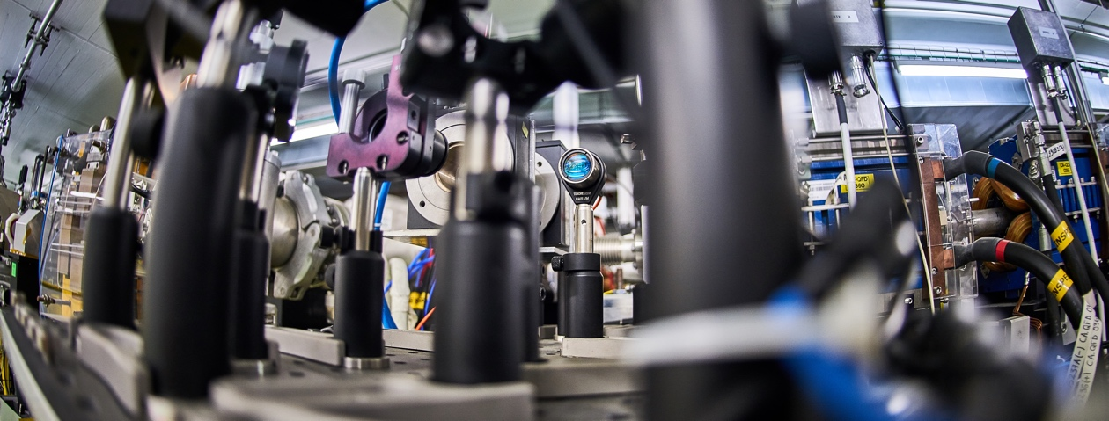
CLEAR operation 2017-2020
Start with beam August 2017
  19 weeks of operation in 2017
  36 weeks in 2018
  38 weeks in 2019
  34 weeks in 2020
  35 weeks in 2021
  40 weeks in 2022
Due to Covid-19 related measures, 2020 2021 activities were impacted, and mainly limited to CERN users

Slide 15
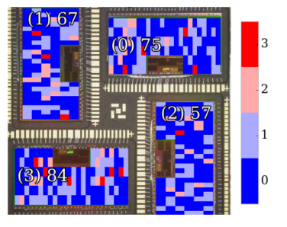
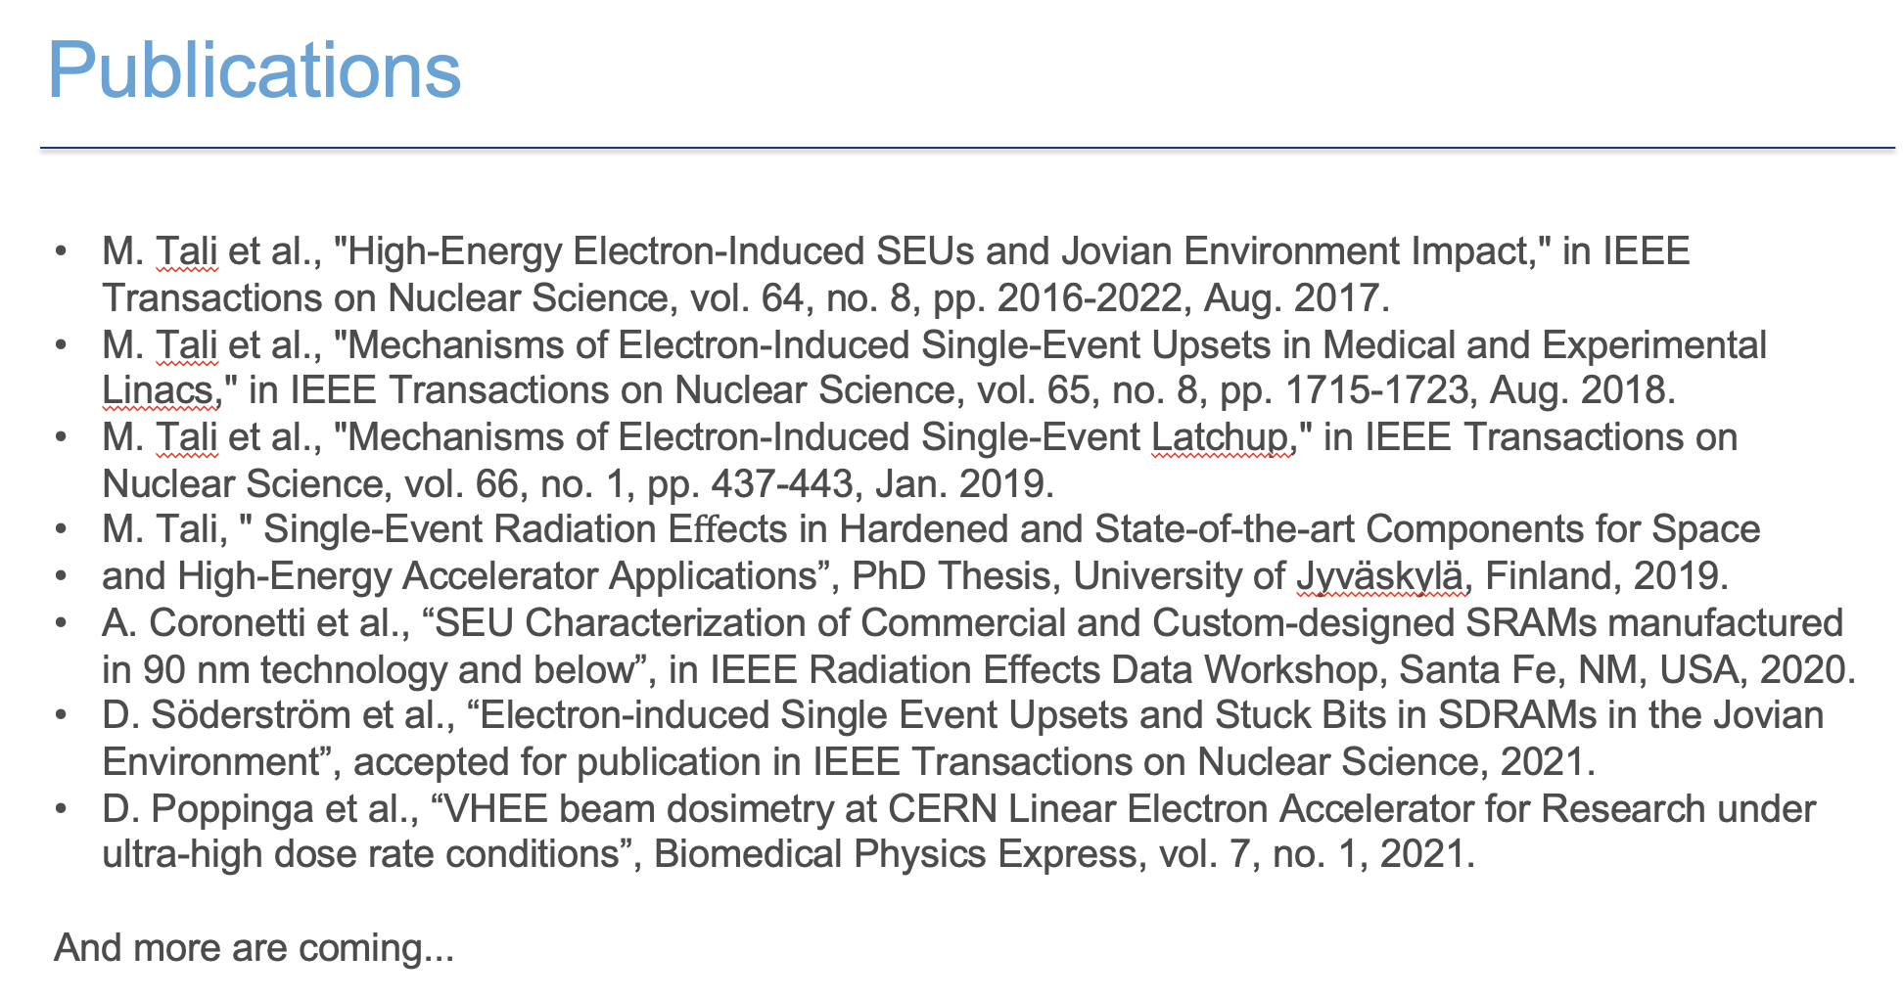
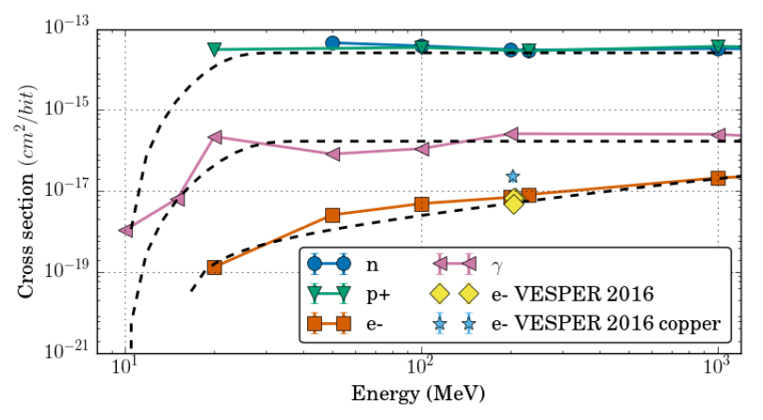
Irradiation on electronics
CLEAR has been central to R2E activities over the last 5 years
Initial interest for Jovian environment space missions (JUICE from ESA)
Electron-induced effects in electronics are not as well explored as those from ions, protons or neutrons. CLEAR is central to the investigation of these effects.
It enabled studying key radiation effects that it was not possible to study elsewhere
Explored electron-induced single-event effects over a wider range of energy than what can be achieved in medical LINACs.
Enabled first ever observation and demonstration that HEE can trigger SEL in SRAM.
It enabled studying displacement damage effects in a short time and with low level of activation
Allowed studies on HEE SEU, SEL, stuck bits…
S. Coronetti
  ESA Monitor
  (reference chip, 250 nm)

Slide 16
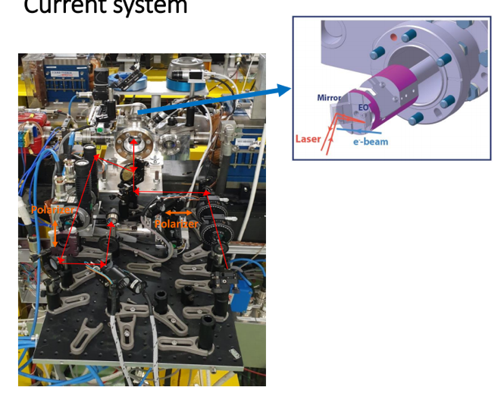
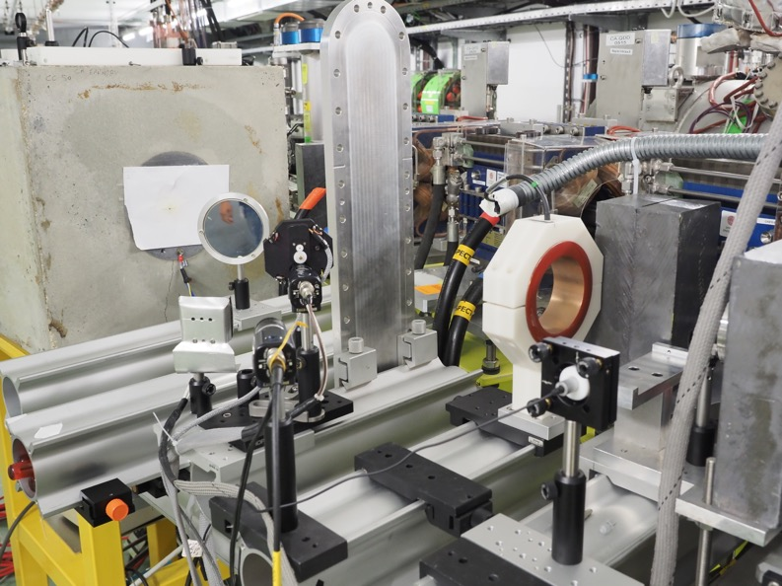
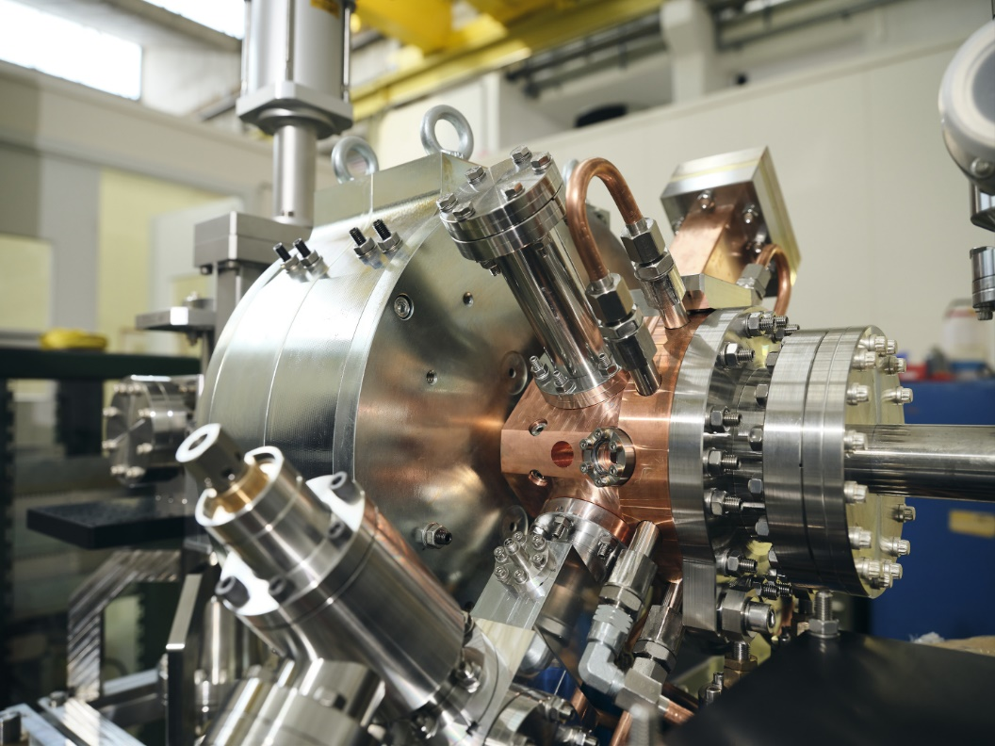
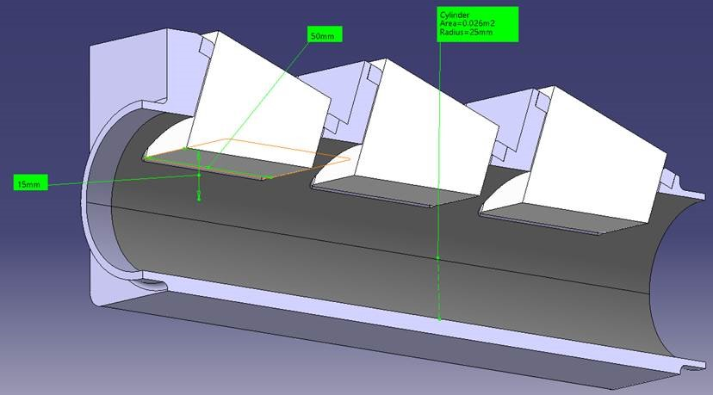
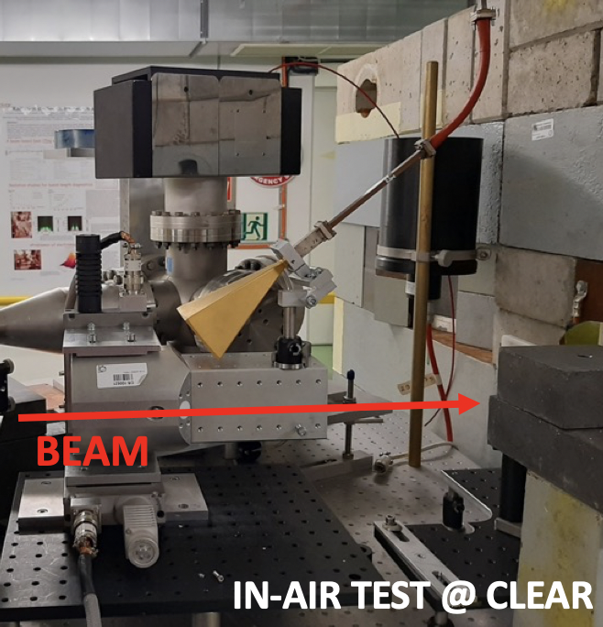
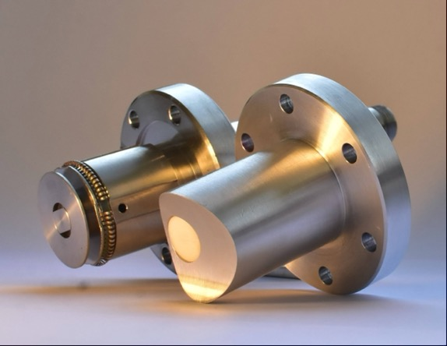
AWAKE
E. Gschwendtner
Charge calibration measurements of the AWAKE spectrometer scintillating screen/camera combination performed in 2017, 2018, 2019
Bunch length monitors:
EOS and ChhDR
Cherenkov BPMs
Beam Screen Survival Tests in Rubidium
Common development of novel electron source
CLIC-AWAKE-CLEAR

Slide 17
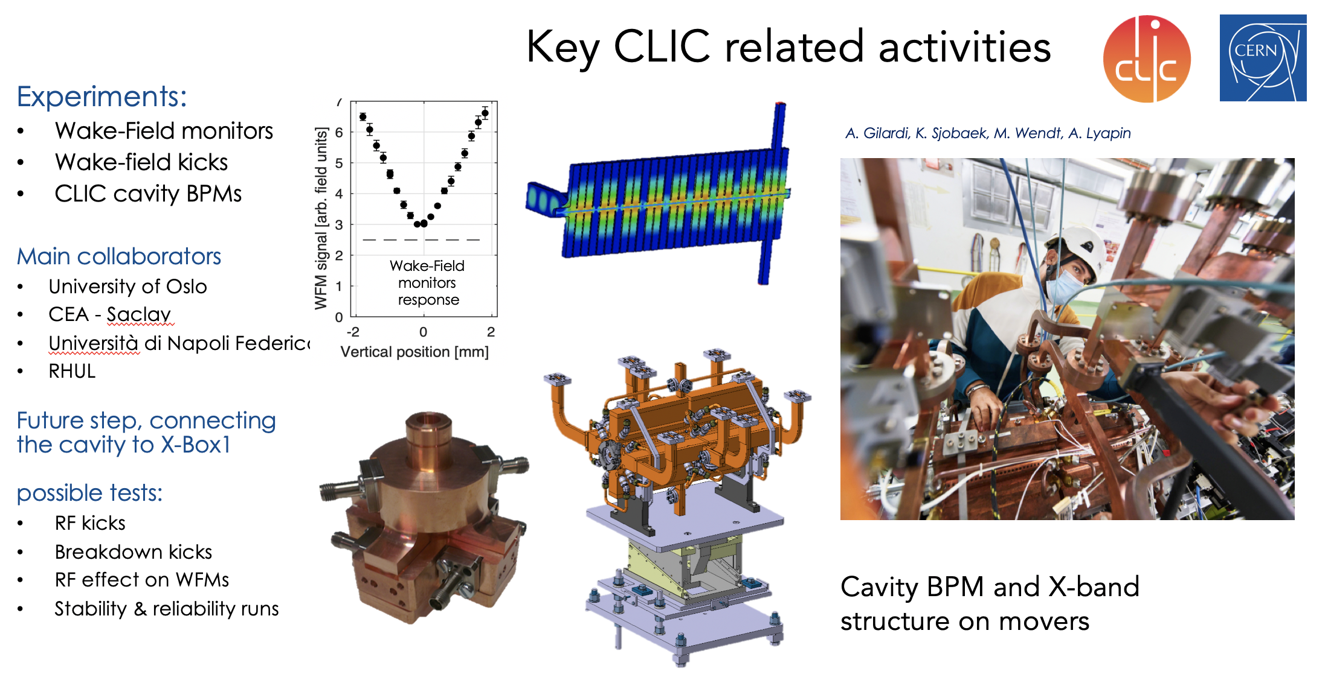
CLIC
S. Stapnes

Slide 18
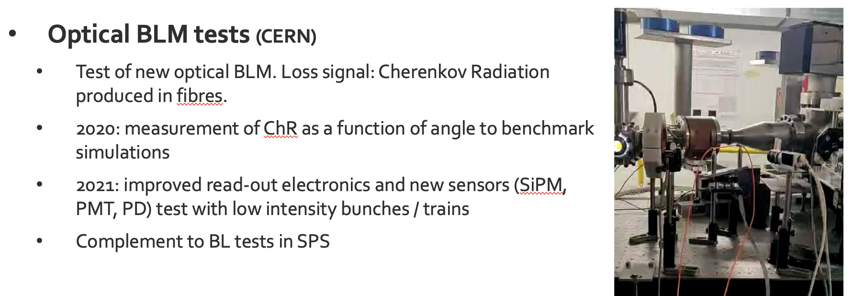
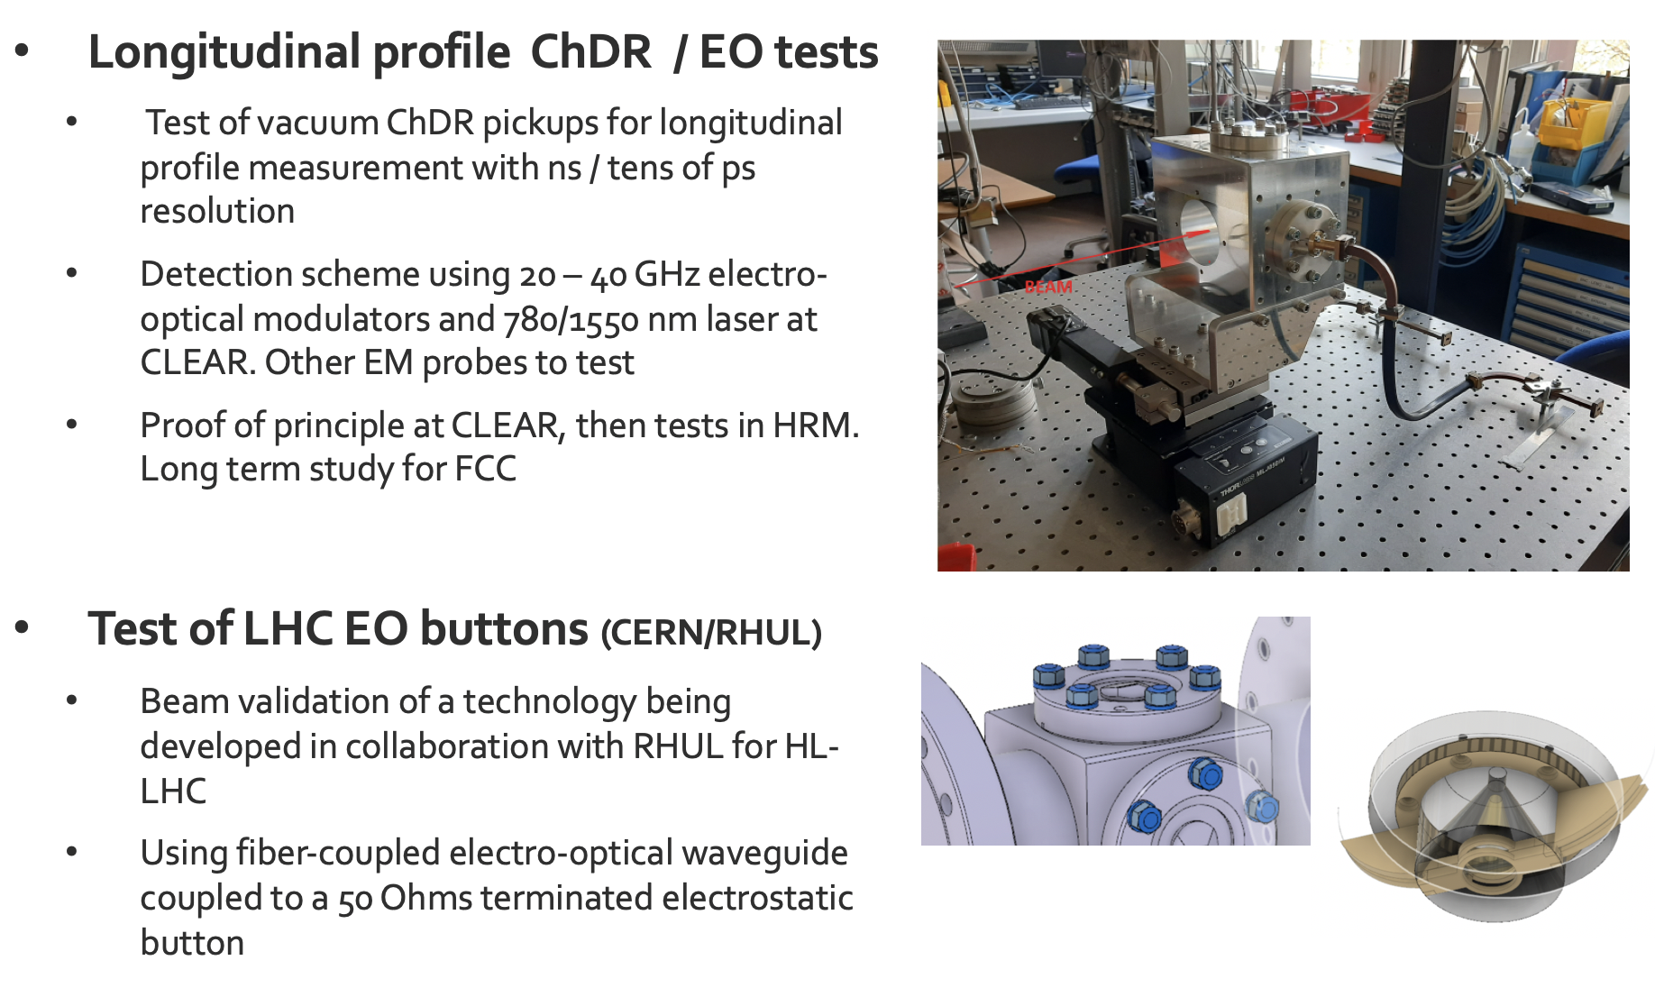
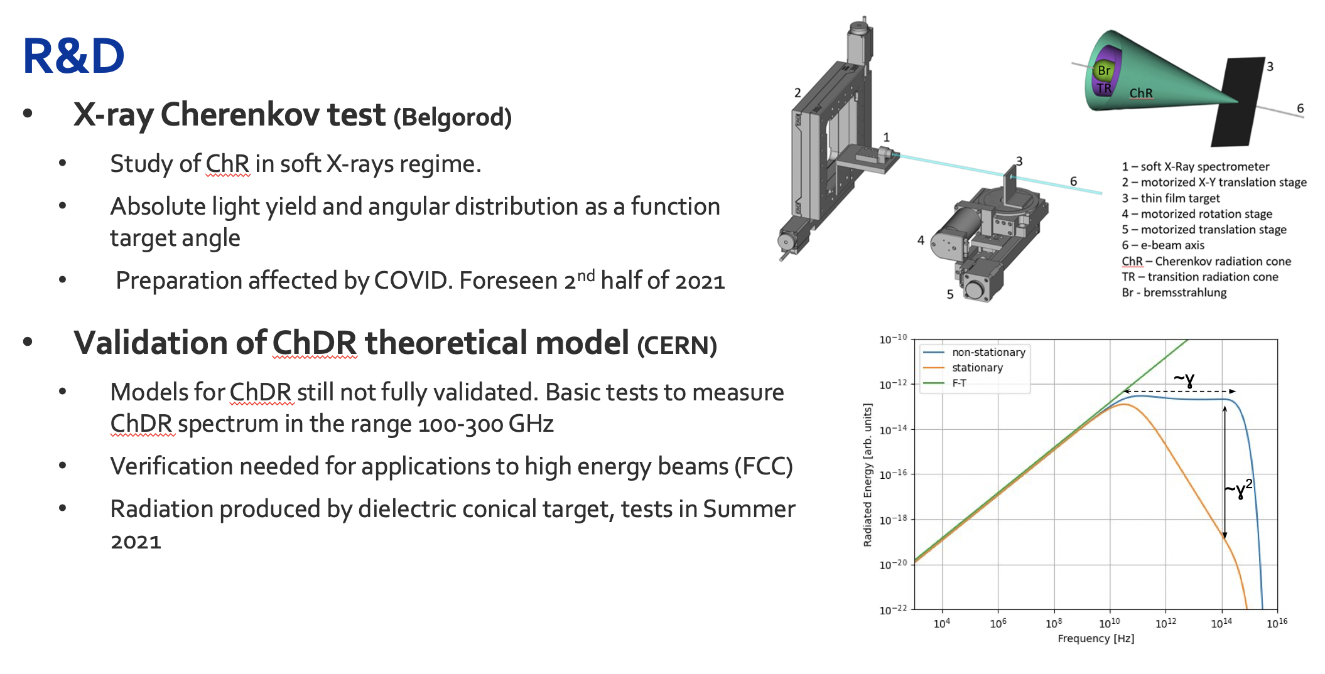
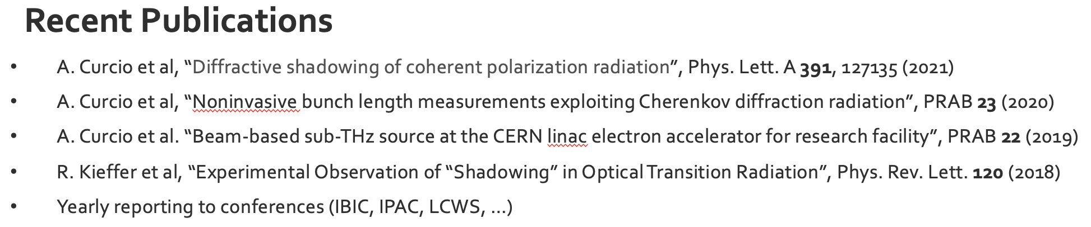
Other Beam Instrumentation activities
S. Mazzoni

Slide 19
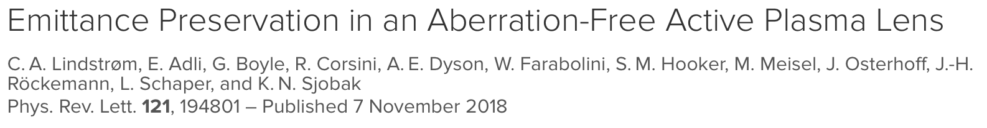
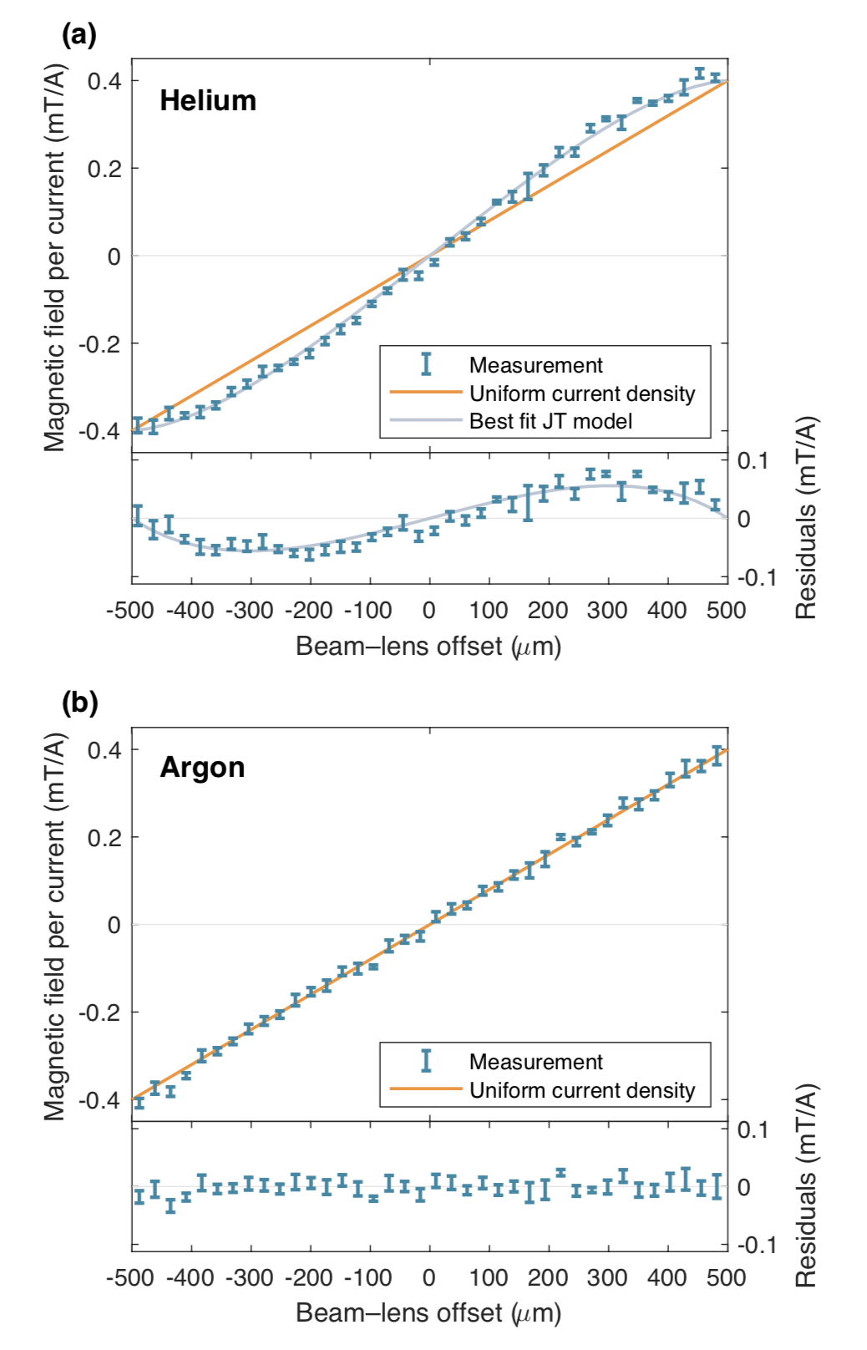
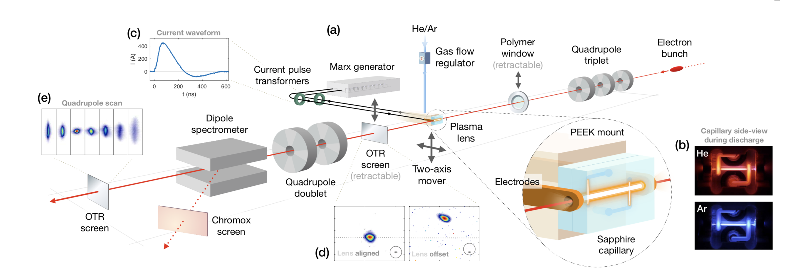
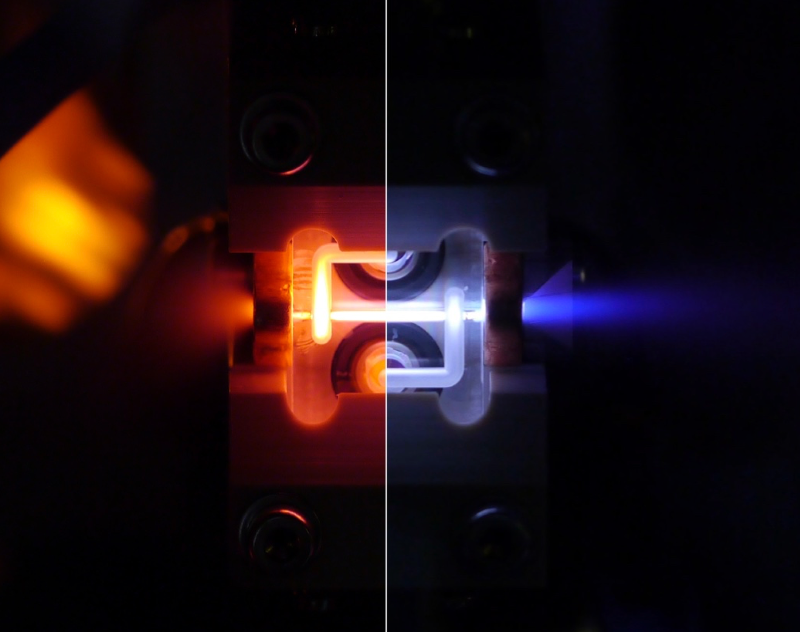
The Plasma lens experiment
Lead by Univ. of Oslo, in collaboration with CERN, Desy and Oxford Univ.
Helium
Argon
Emittance preservation in an active plasma lens demonstrated for the first time with the use of an argon-based discharge capillary.
Direct measurements of magnetic fields across the full aperture showed linearity in argon and nonlinearity in helium.
Quadrupole scans demonstrated expected emittance preservation and growth (respectively) consistent with the measured field profiles.
October 2019 – record magnetic field gradient of 5.2 kT/m !

Slide 20
VHEE at CERN – Background & Motivation
The idea of investigating the use of very high-energy electron (VHEE) beams (50-250 MeV) for RT recently gained interest, since electrons at these energies can travel deep into the patient.
Potential advantages:
  Depth – dose profile for electrons better than the quasi-exponential decay given by X-rays
  Charged particles like electrons may be focused and steered in ways that are not possible with X-rays
  Electron beams rather unsensitive to tissue inhomogeneities
  Electron accelerators comparatively more compact, simpler and cheaper than proton/ion machines
This last advantage is now especially true given the recent advancements on high-gradient acceleration, e.g. X-band CLIC technology.
Ultra-high dose rate (above 100 Gy/s) radiation delivery, termed FLASH radiotherapy, showed normal tissue sparing capabilities, without compromising tumor control. Electron linacs can relatively easily reach the high beam currents needed for FLASH treatment of large fields.
→ Exploit CERN expertise in accelerators, especially the one on high-gradient electron machines developed by the CLIC study. The CLEAR user facility offers as well a unique opportunity for experimental VHEE and FLASH studies with a high-current 200 MeV e- beam.

Slide 21
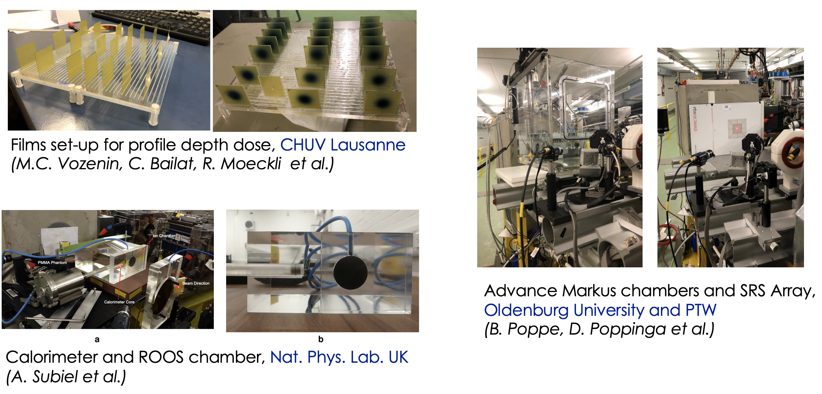
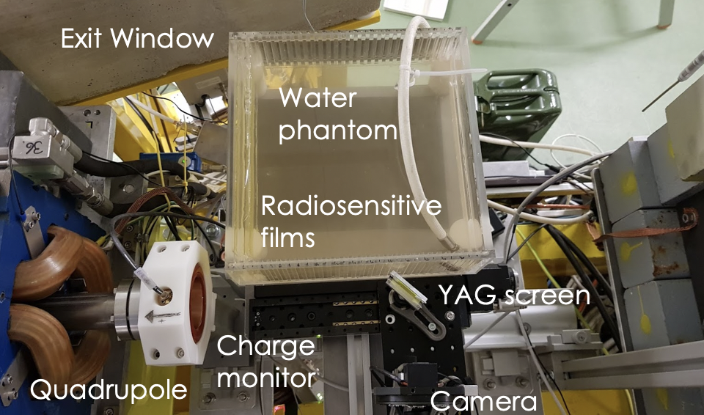
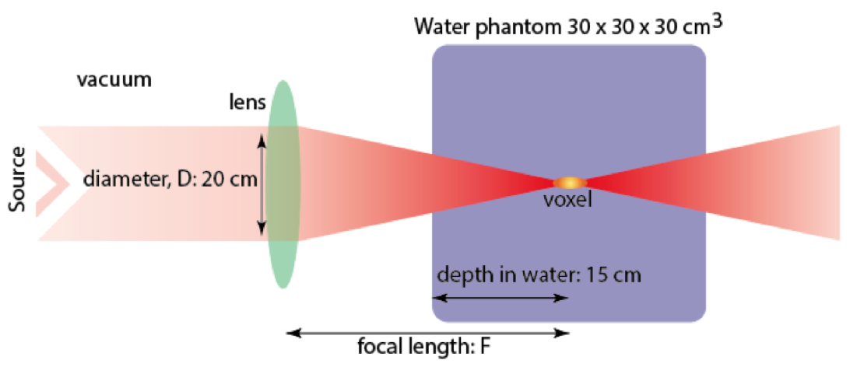
VHEE/FLASH activities in CLEAR
  High dose rate dosimetry
Calibration of operational medical dosimeters – nonlinear effects with high-dose short pulses
Verification of FLASH effect using biological dosimeters
Experimental verification of dose deposition profiles in water phantoms
Demonstration of “Bragg-like peak” deposition with focused beams
Aim:
Focus the beam on the tumour to minimize the dose on the nearby healthy tissues
Strathclyde and Manchester

Slide 22
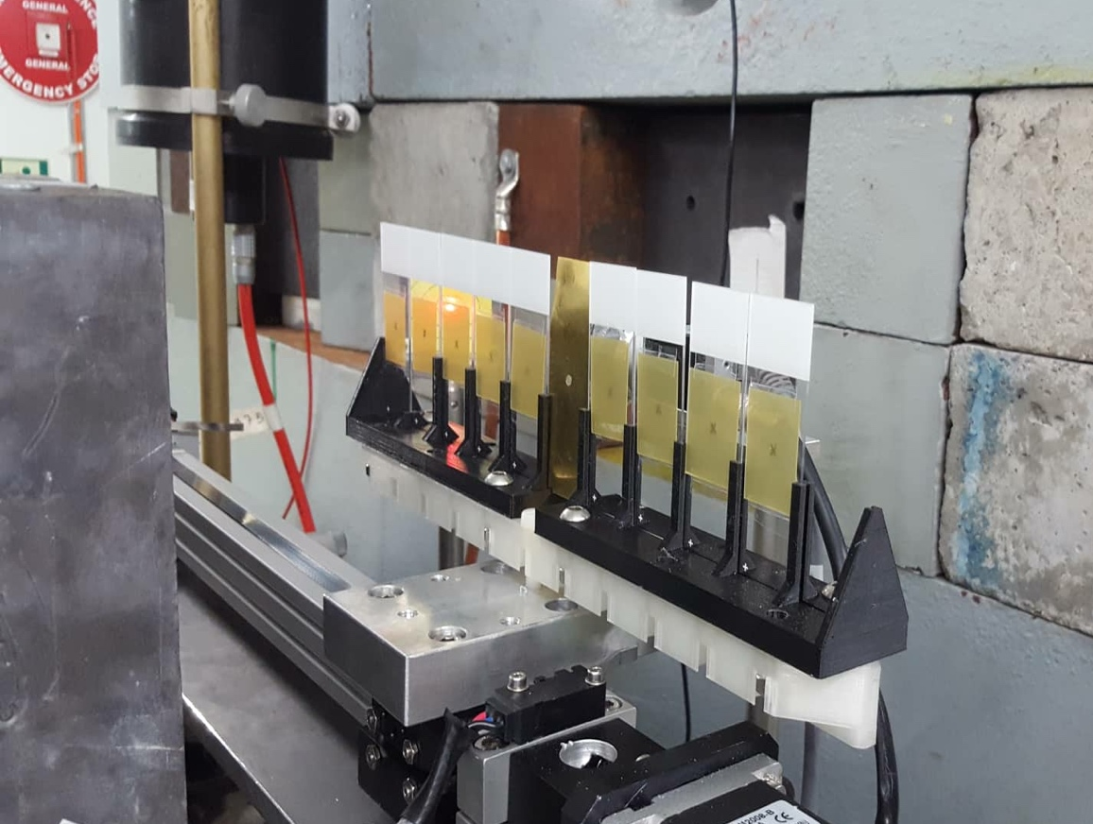
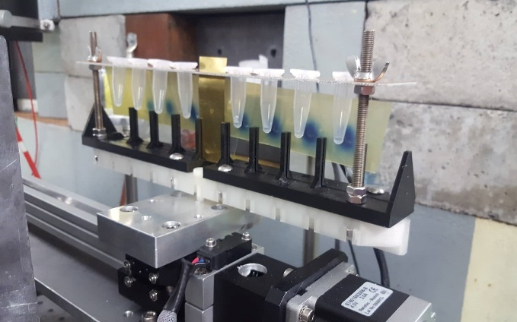
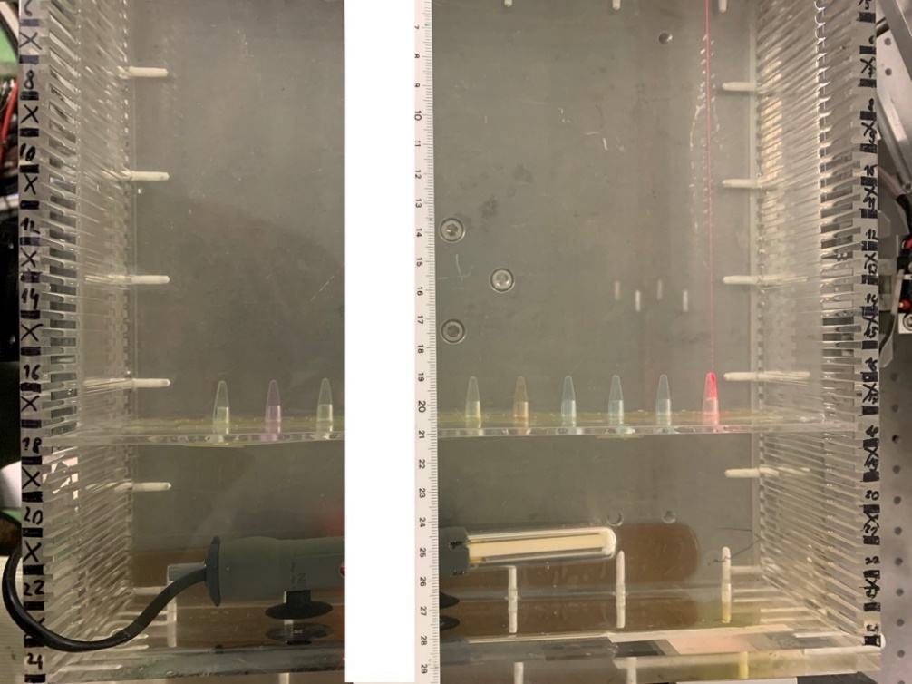
  Biological effects of high dose rates
Left: dry plasmid samples on glass microscope slides.
Right: wet plasmid samples in Eppendorf tubes.
EBT-XD film placed behind samples, Manchester University
(K. Small, R. Jones et al.)
Set-up in the water tank. Zebra fish eggs, alanine pellets, gafchromic films,
CHUV Lausanne
(M.C. Vozenin, C. Bailat, R. Moeckli et al.)

Slide 23
Some recent radiotherapy-related publications based on CLEAR experiments
VHEE in CLEAR – References
A. Lagdza, R. Jones et al., Influence of heterogeneous media on Very High Energy Electron (VHEE) dose penetration and a Monte Carlo-based comparison with existing radiotherapy modalities, Nuclear Inst. and Methods in Physics Research, B, 482 (2020) 70-81.
K. Small, R. Jones et al., Evaluating Very High Energy Electron RBE from nanodosimetric pBR322 plasmid DNA damage, Nature Scientific Reports, Nature Sci. Rep. 11, 3341 (2021).
M. McManus, A. Subiel, The challenge of ionisation chamber dosimetry in ultra-short pulsed high dose-rate Very High Energy Electron beams, Nature Scientific Reports (2020) 10-9089.
D. Poppinga et al., VHEE beam dosimetry at CERN Linear Electron Accelerator for Research under ultra-high dose rate conditions, 2021 Biomed. Phys. Eng. Express 7 015012.
K. Kokurewicz, E. Brunetti, A. Curcio et al., An experimental study of the dose distribution of focused very high energy electron (VHEE) beams for radiotherapy, Nature Commun. Phys. 4, 33 (2021).

Slide 24
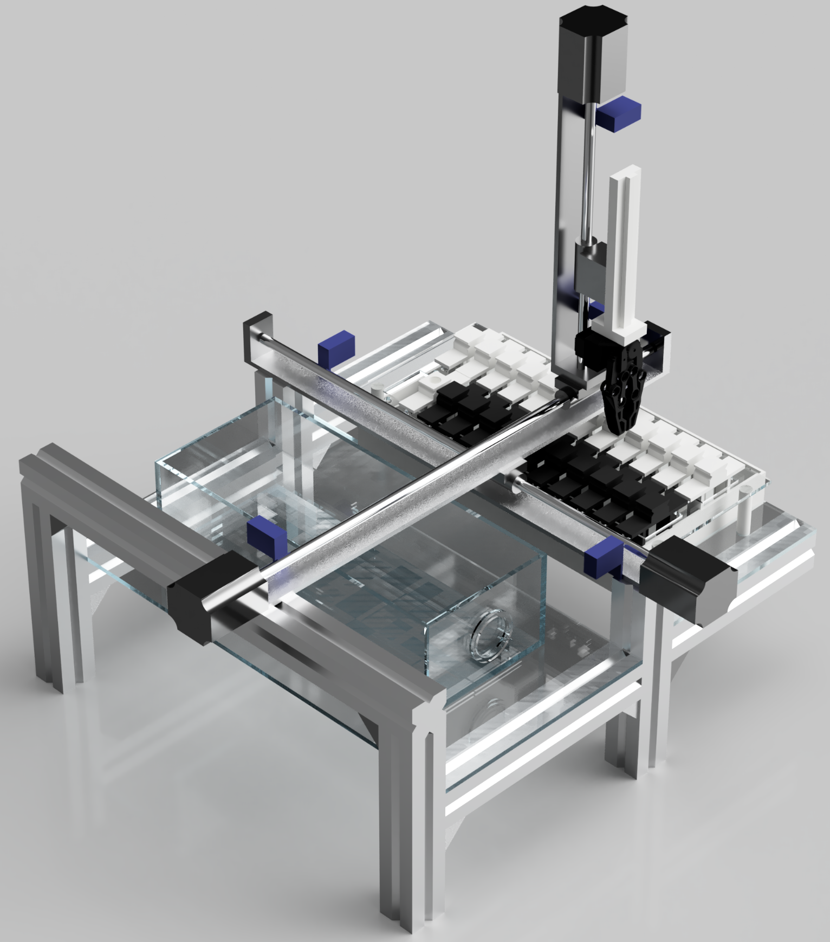
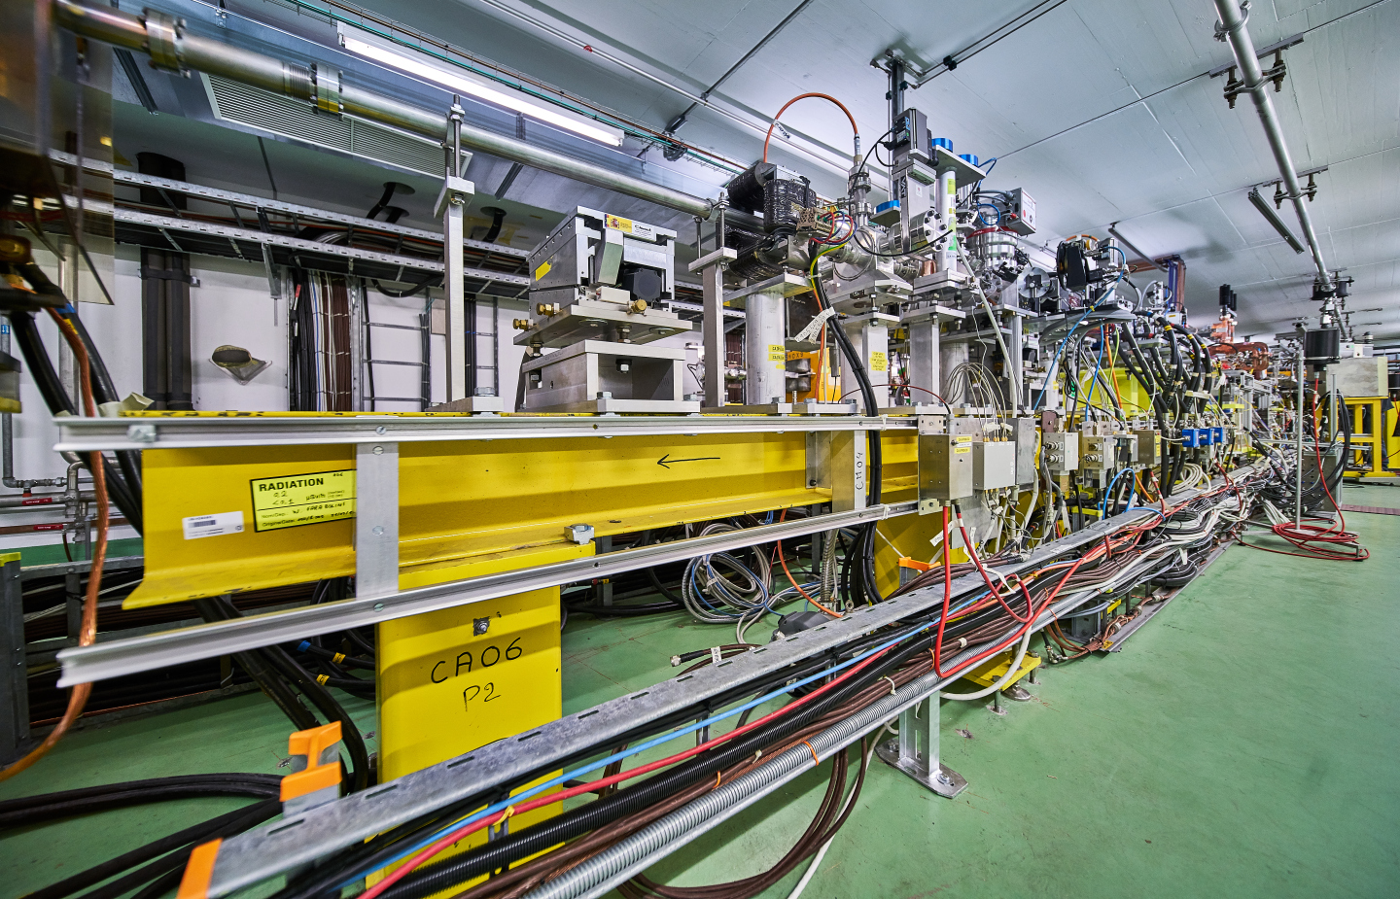
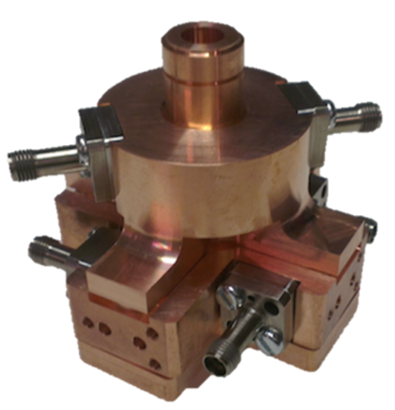
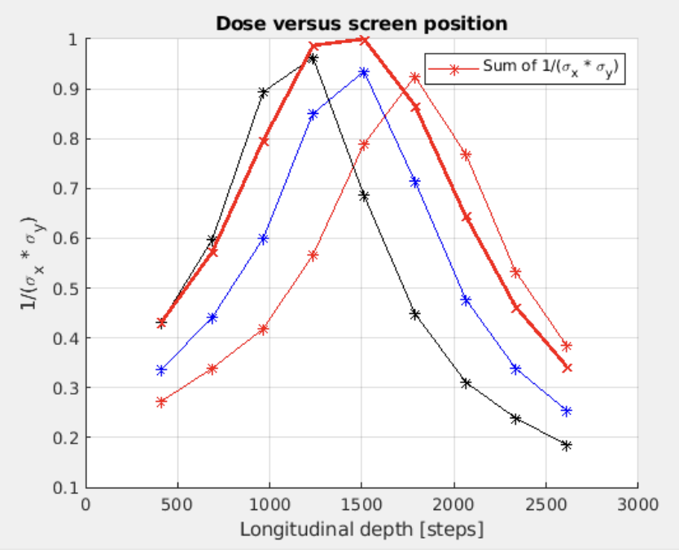
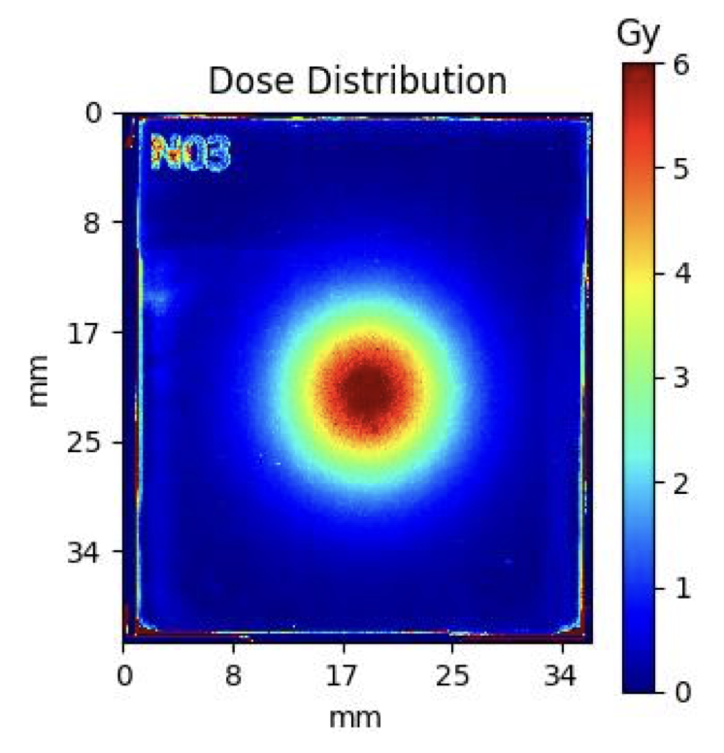
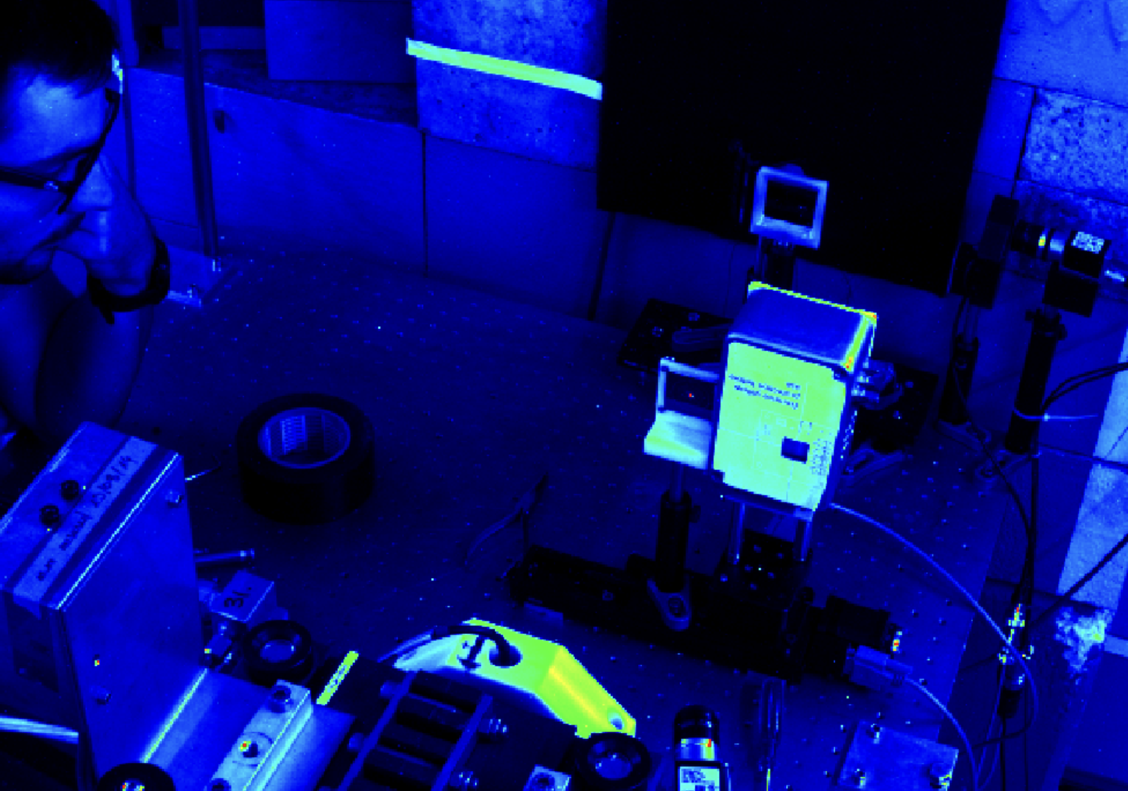
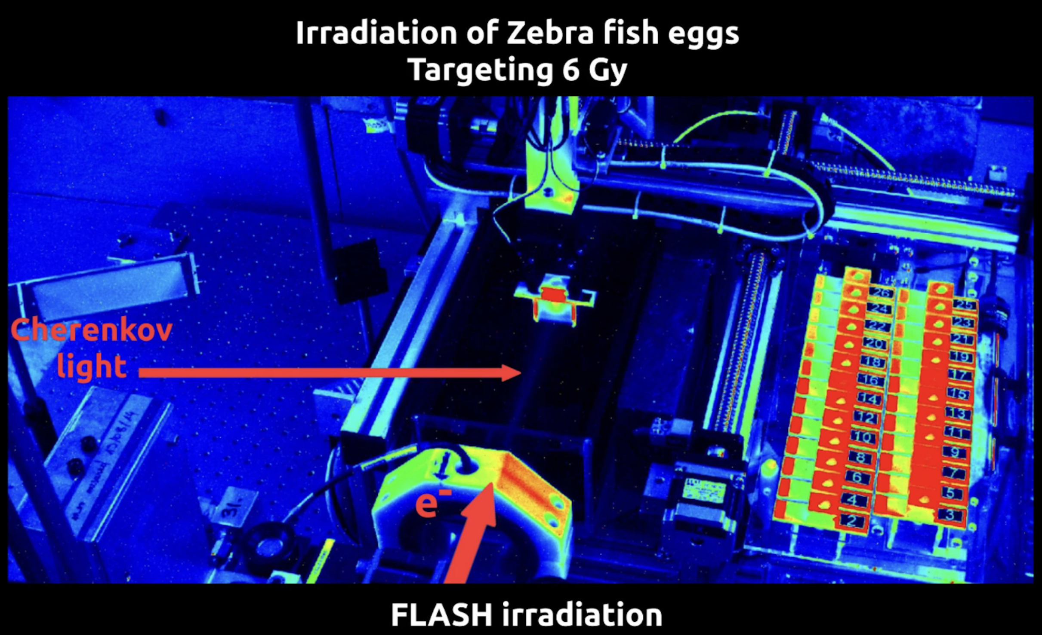
CLEAR Operation 2022 – Some Highlights
Beam Diagnostics R&D
C-Robot
used for samples
manipulation
CLIC high resolution
BPMs
Medical
Applications
Cherenkov Diffraction Radiation studies (beam position and bunch length monitors)
  20 Experiments
  About 15 User Groups internal/external
  More than 13 external collaborating institutes
  Beam from March 1st to December 12th
  (with 3 weeks summer stop)
  40 weeks expected before shutdown
Beam Profiler detector for the LUXE experiment
Ultra-High Dose Rate
(FLASH) dosimetry:
Films, Alanin, Fibers…
Use of focused beams for Radiotherapy
(localized dose deposition)
Chemistry and Biology FLASH experiments
H₂O₂ production – Plasmids – Zebra Fish Eggs

Slide 25
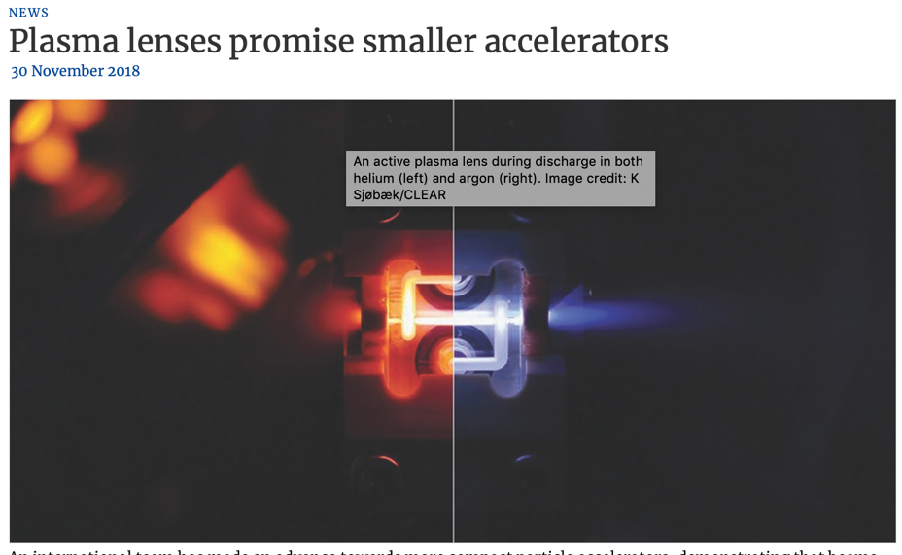
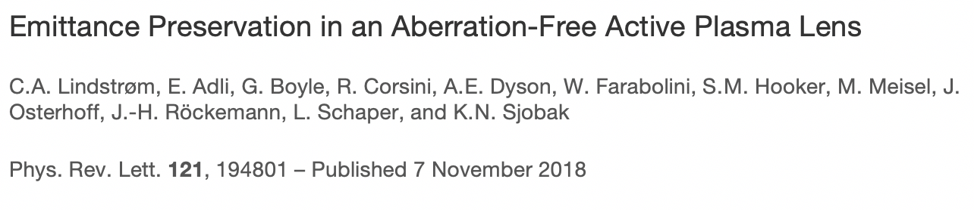
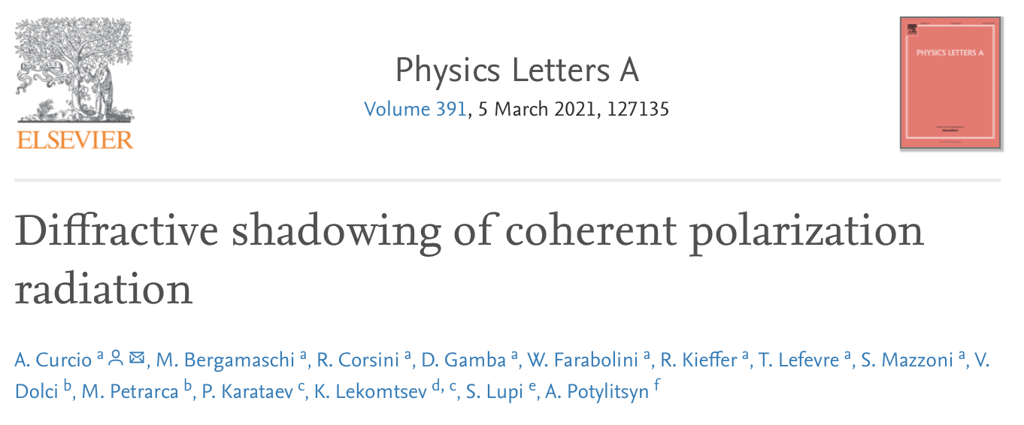
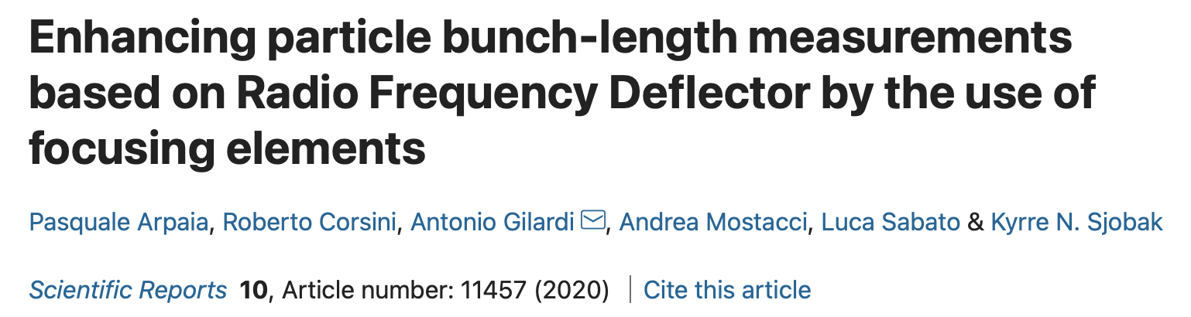
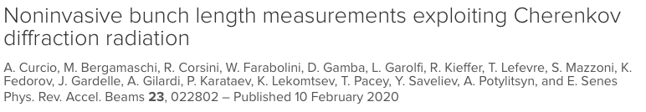
CLEAR scientific output
24 scientific papers published
  14 on peer-reviewed Journals, 10 in Conference Proceedings
Many oral presentations/posters in Conferences and Workshops
Full documentation in: https://clear.cern/content/publications

Slide 26
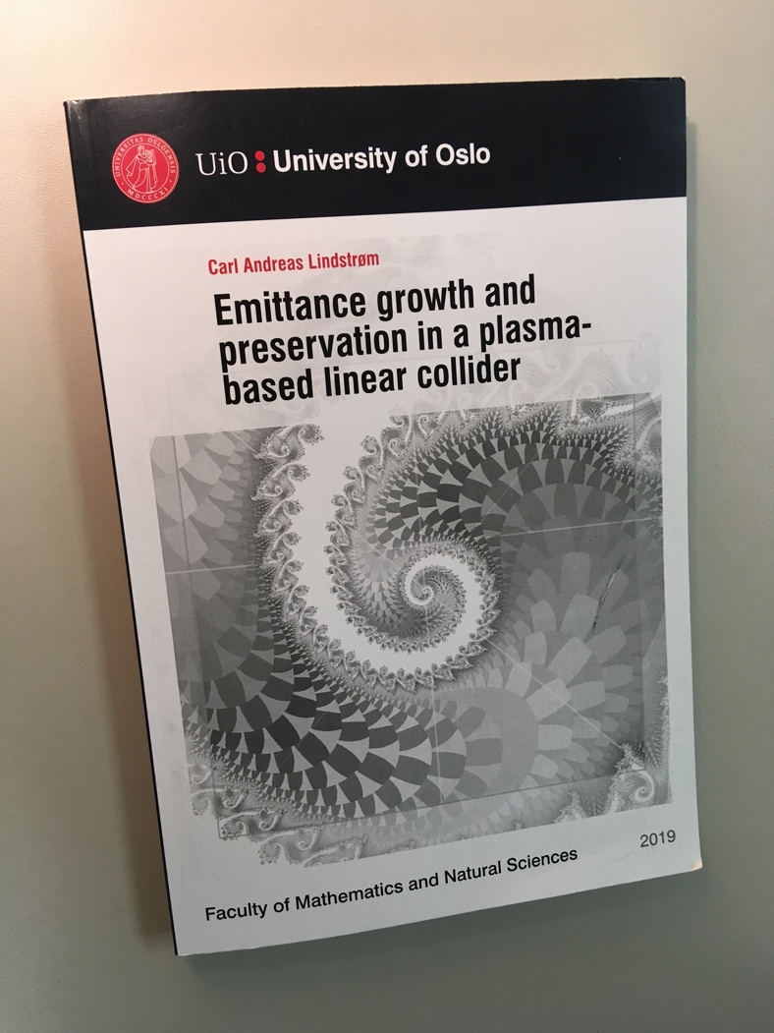


Education and Training
PhD
Thesis
with experimental
work in CLEAR
✓
✓
✓
✓
✓
✓
Luke Aidan Dyks
University of Oxford
Novel acceleration technique studies in the CLEAR user Facility and its potential future upgrades
Supervisor: P. Burrows
JUAS Practical Work, and also…
Several Master Thesis
Trainees and summer students

Slide 27








Recent Press Statements

