Slide 1
Review of beam diagnostics R&D @ CLEAR
S. Mazzoni for the BI teams
CLEAR scientific board meeting, 1/2/2023

Slide 2
BI R&D @ CLEAR in 2022
Optical BLM tests (U. Huddersfield)
ChDR BPM tests (U. Oxford)
ChDR – based bunch length measurement (U. Manchester)
Electro optical sampling of ChDR (TU. Vienna)
Rad-hard fibres tests for FLASH and CERN Exp. Areas

Slide 3
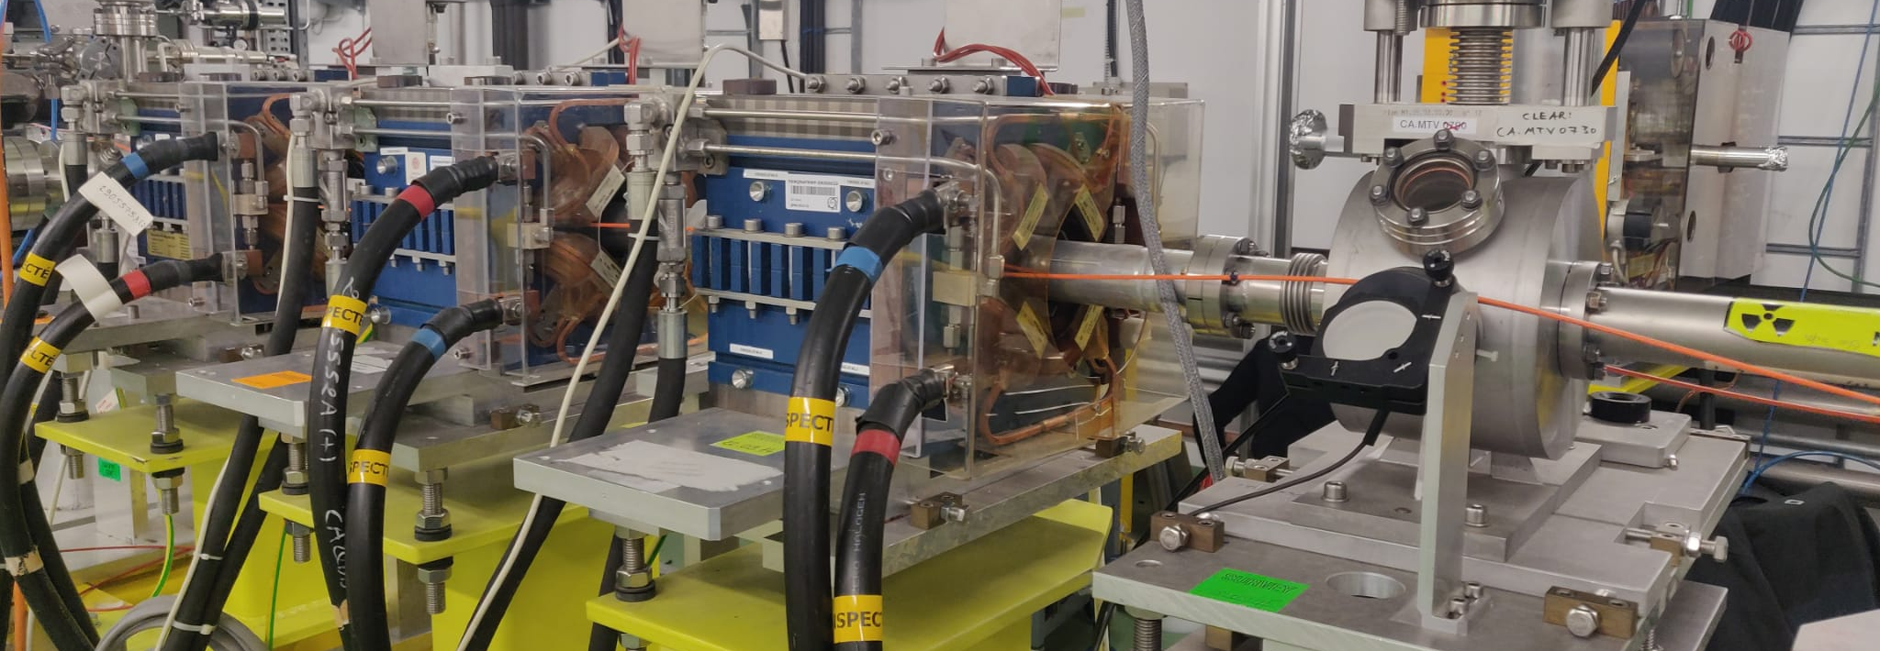
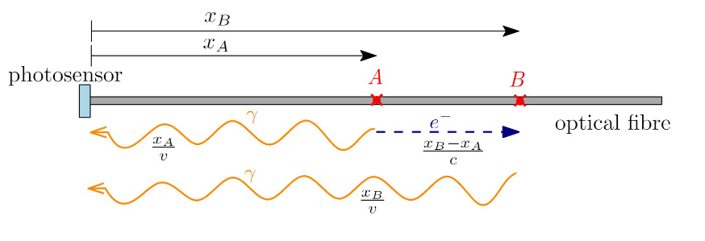
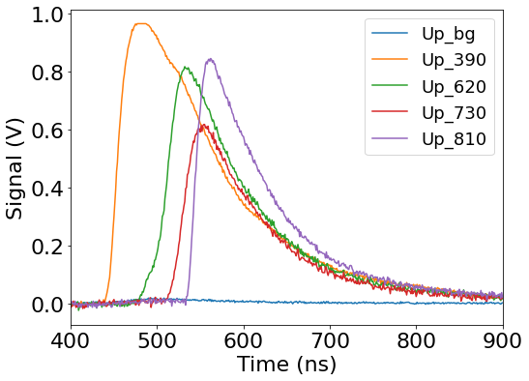
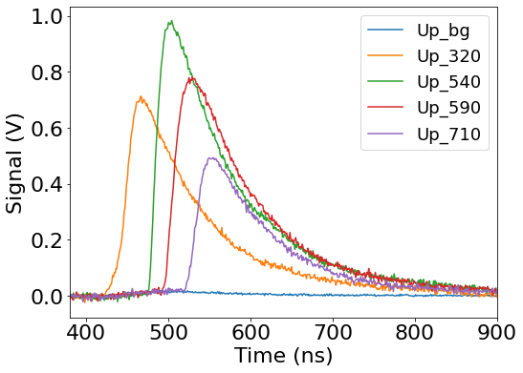
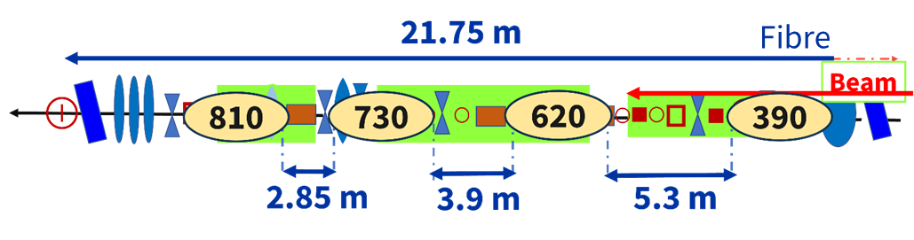
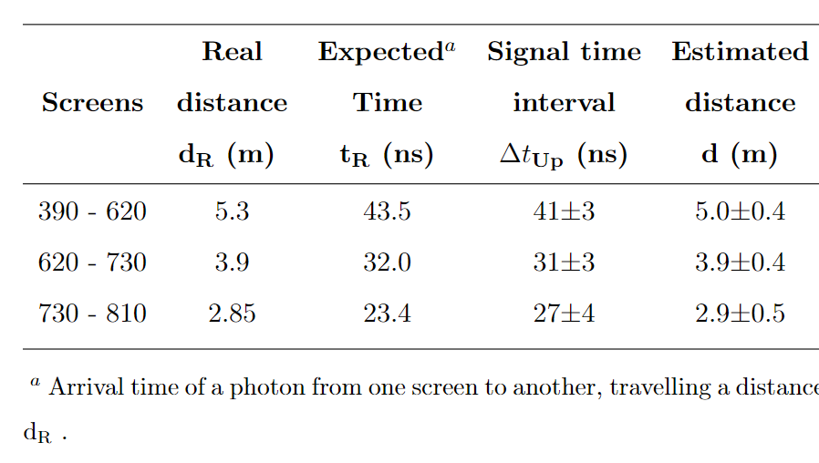
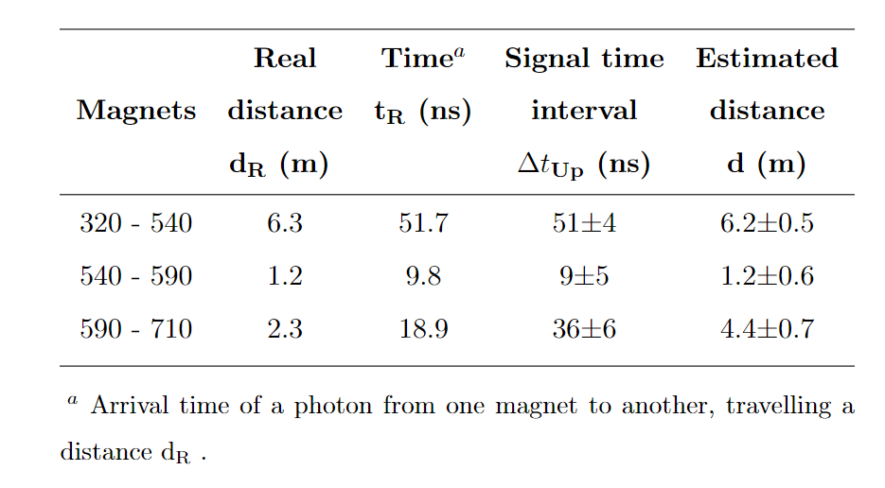
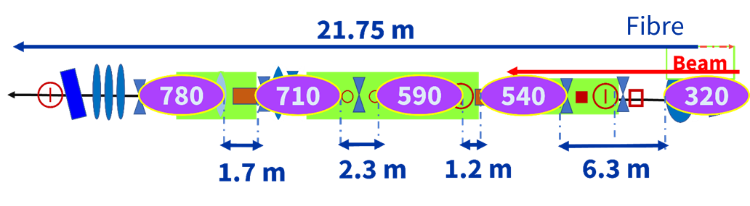


Loss detection and localization by Cherenkov oBLM
PhD thesis of S. Benitez (U. Huddersfield)
Calculation method: Upstream relative arrival times comparison
$$∆t= \frac{∆x}{c}\left(n+1\right)$$
$$n=1.46$$
30 bunches
30 bunches
Losses produced by screen insertion and steering magnets along the line.
Screen locations
Steering magnet locations
Further steps about the localization of SPS beam losses are being investigated.

Slide 4
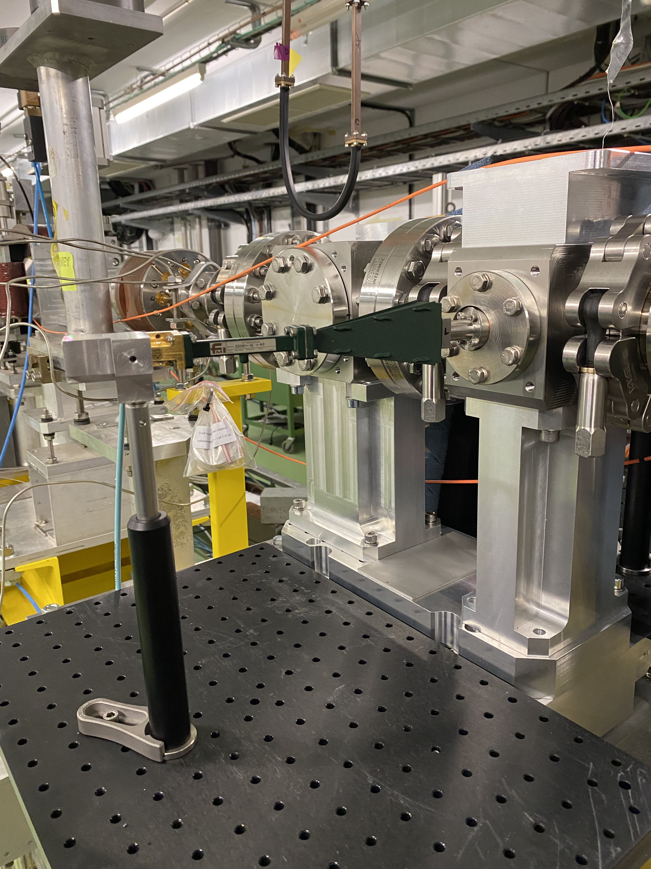
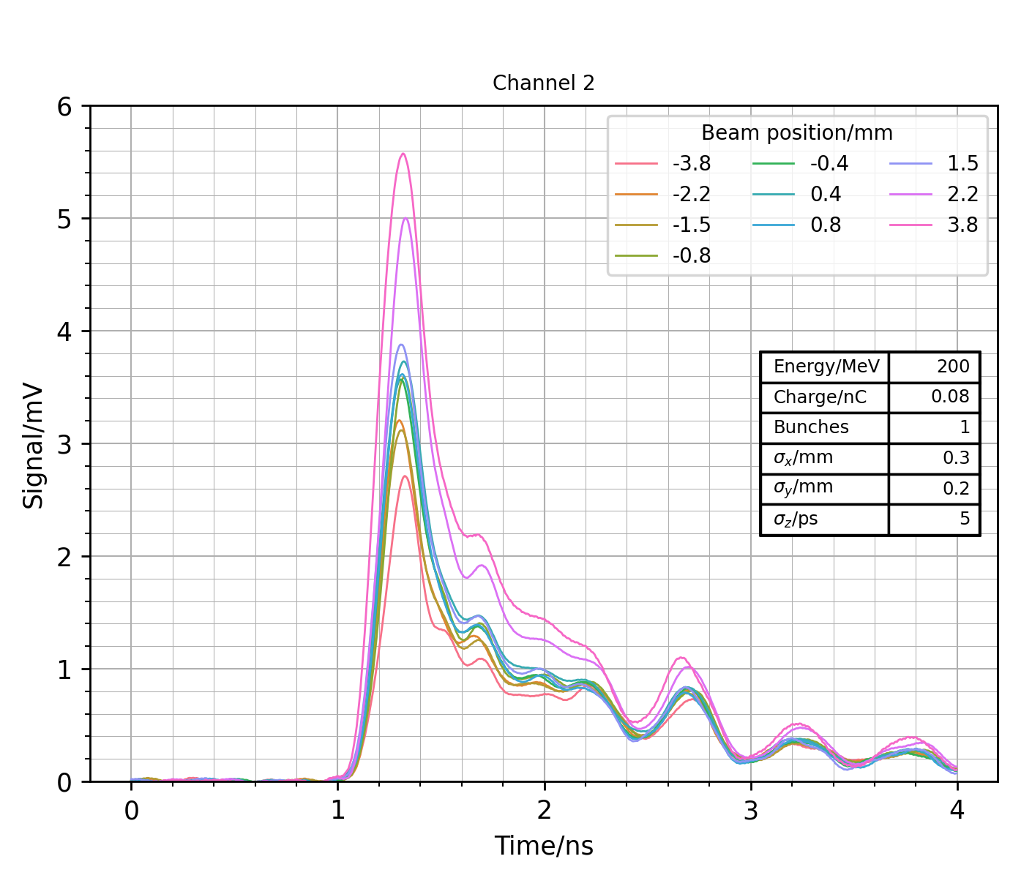
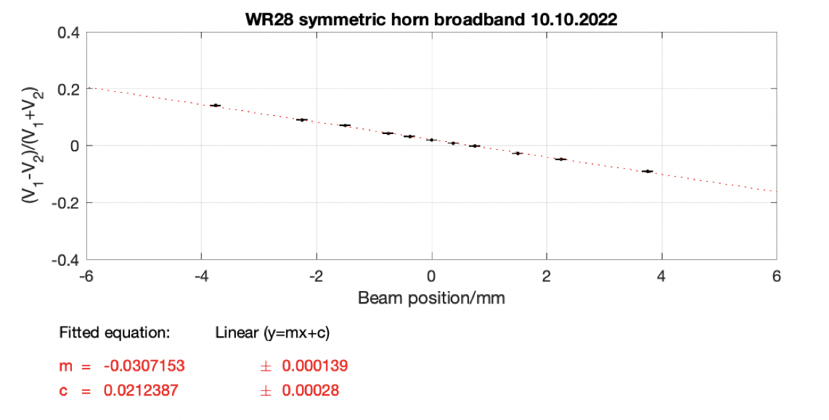
ChDR BPM tests
PhD thesis of C. Pakuza (U. Oxford)
Test of horizontal plane of AWAKE ChDR BPM PUs in-vacuum in location ~7m upstream of THz setup
Characterization of PUs with signal processing at three different frequency ranges: 26.5-40 GHz, 50-75 GHz, 75-110 GHz
Example set-up and signals with Ka band (26.5-40 GHz) detection, and the difference over sum of the input voltage to the Schottky diodes.
Sensitivity 3.1 %/mm

Slide 5
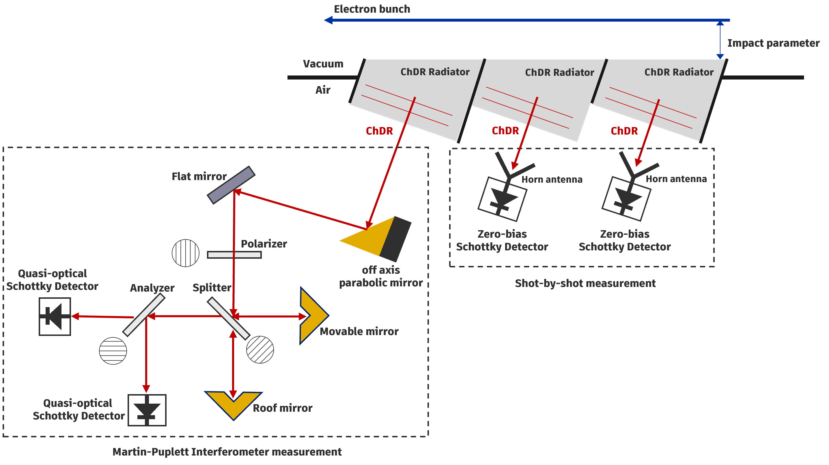
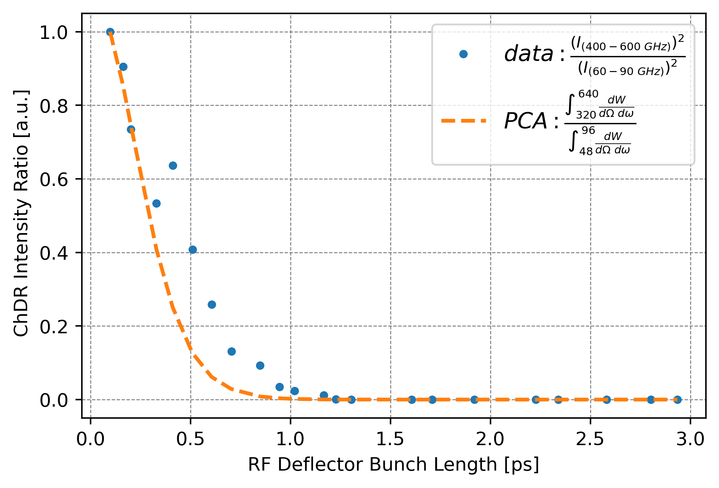
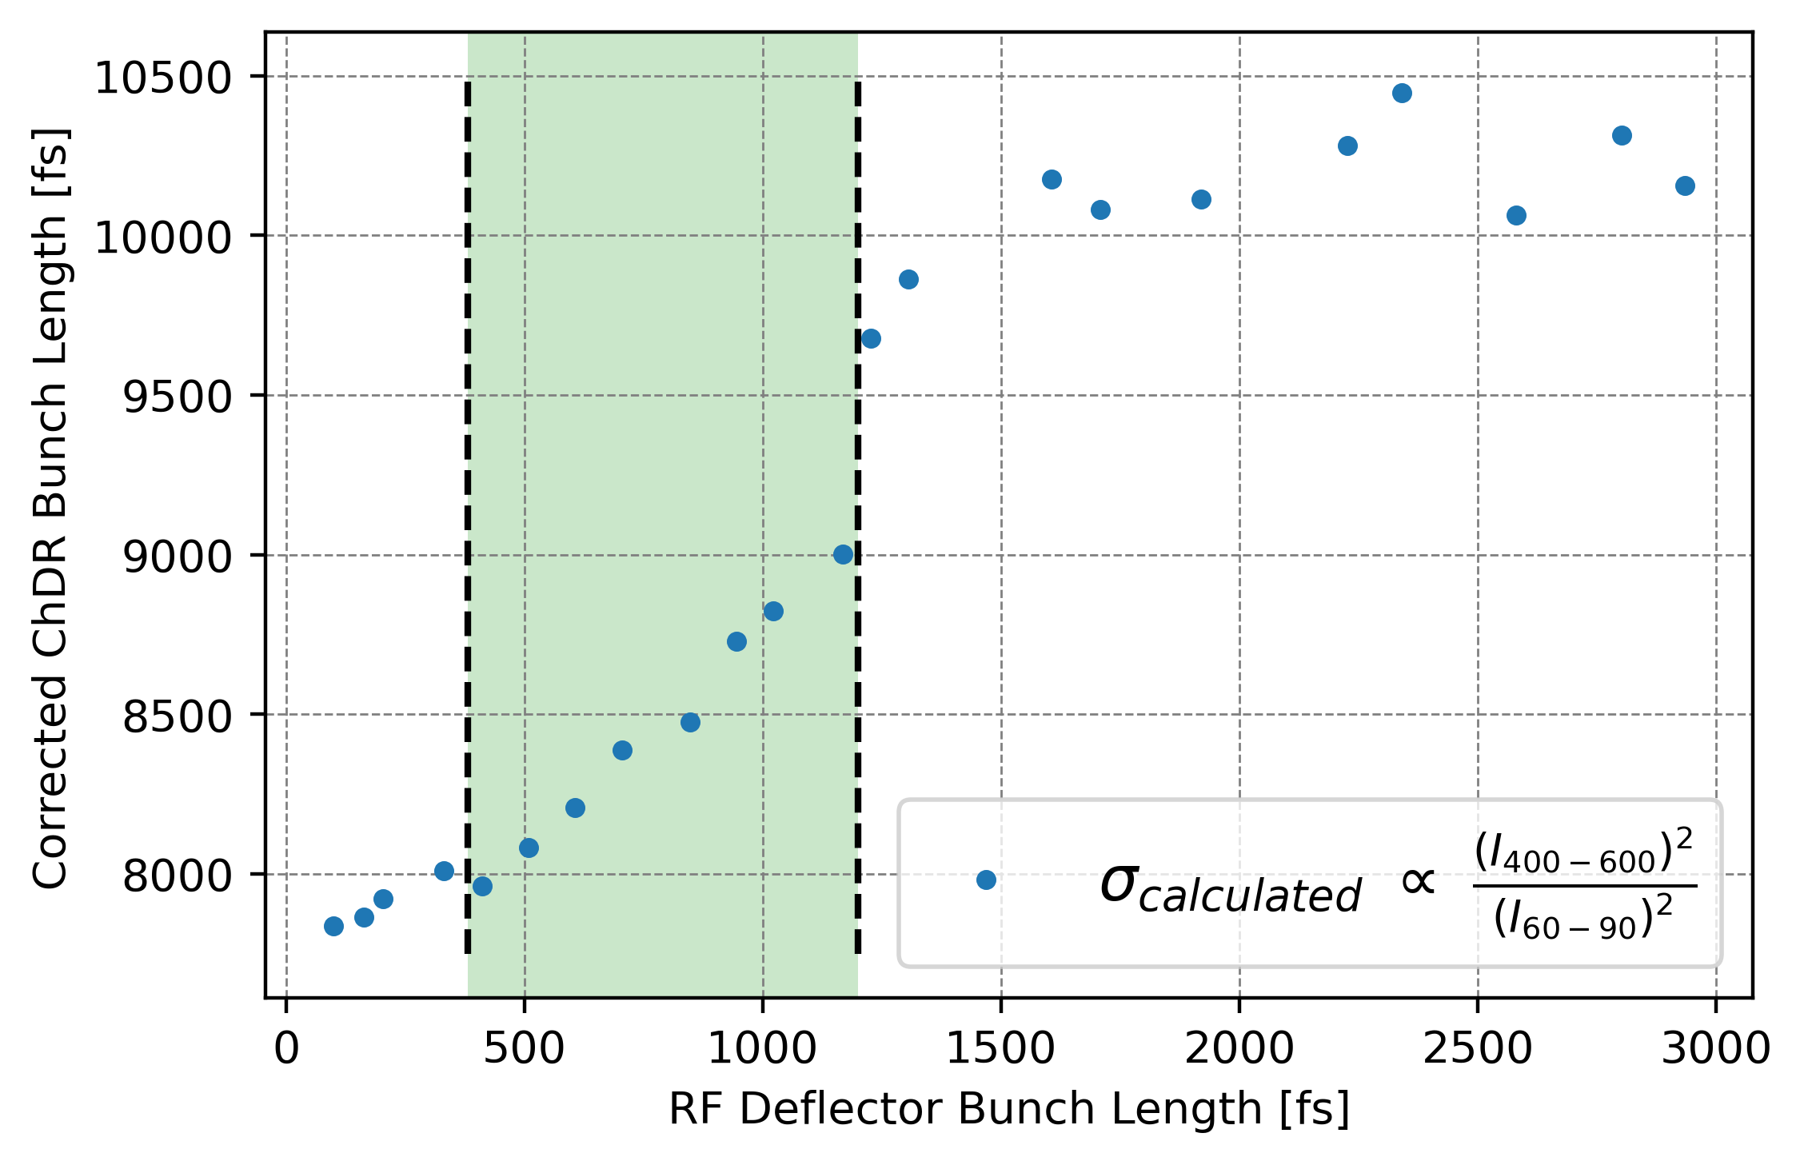
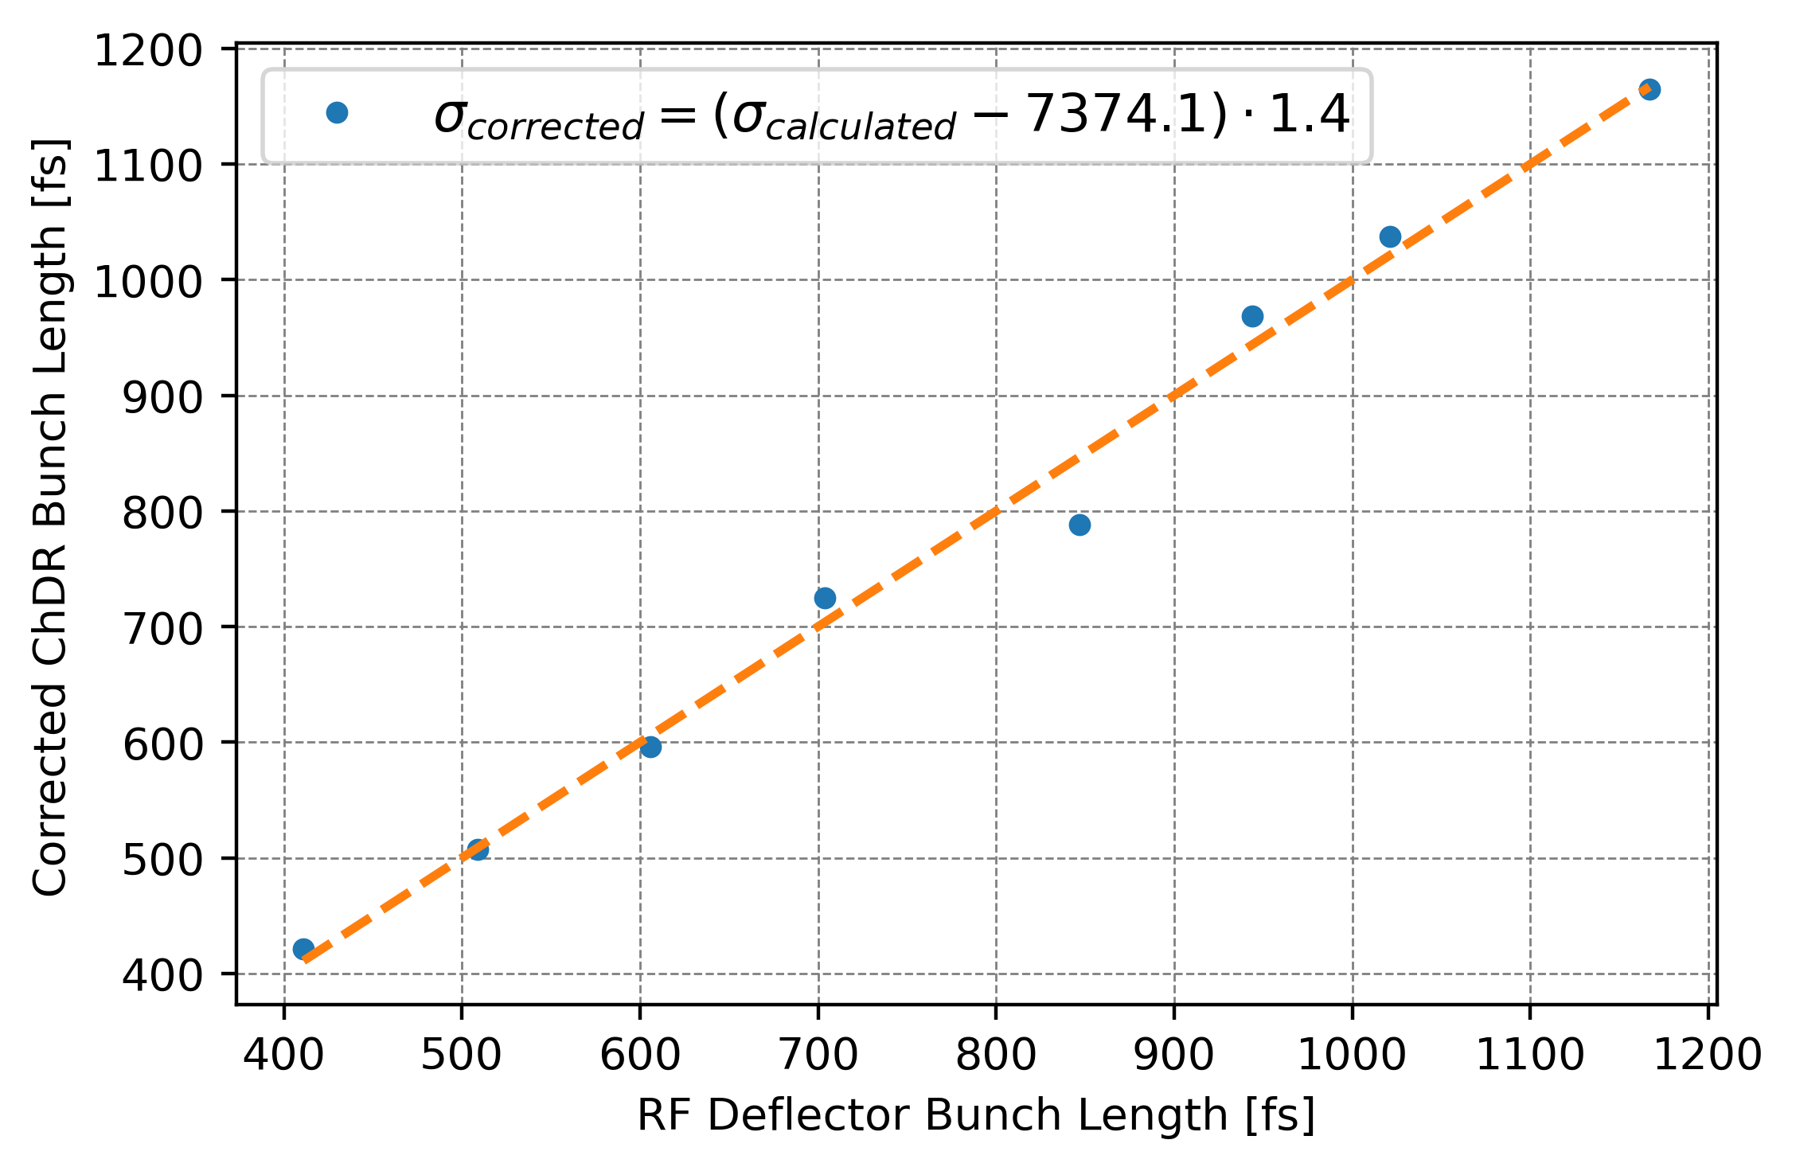
ChDR bunch length monitor for AWAKE run 2
PhD thesis of C. Davut, U. Manchester
RMS bunch length measurement using 2 different Schottky detectors working in different frequency bands (WR-12 (60-90) GHz & WR-1.9 (400-600 GHz))

Slide 6
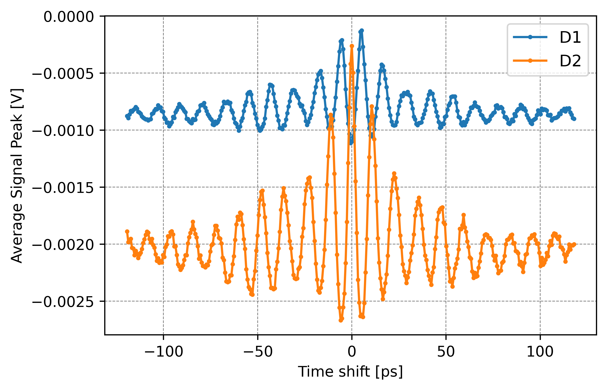
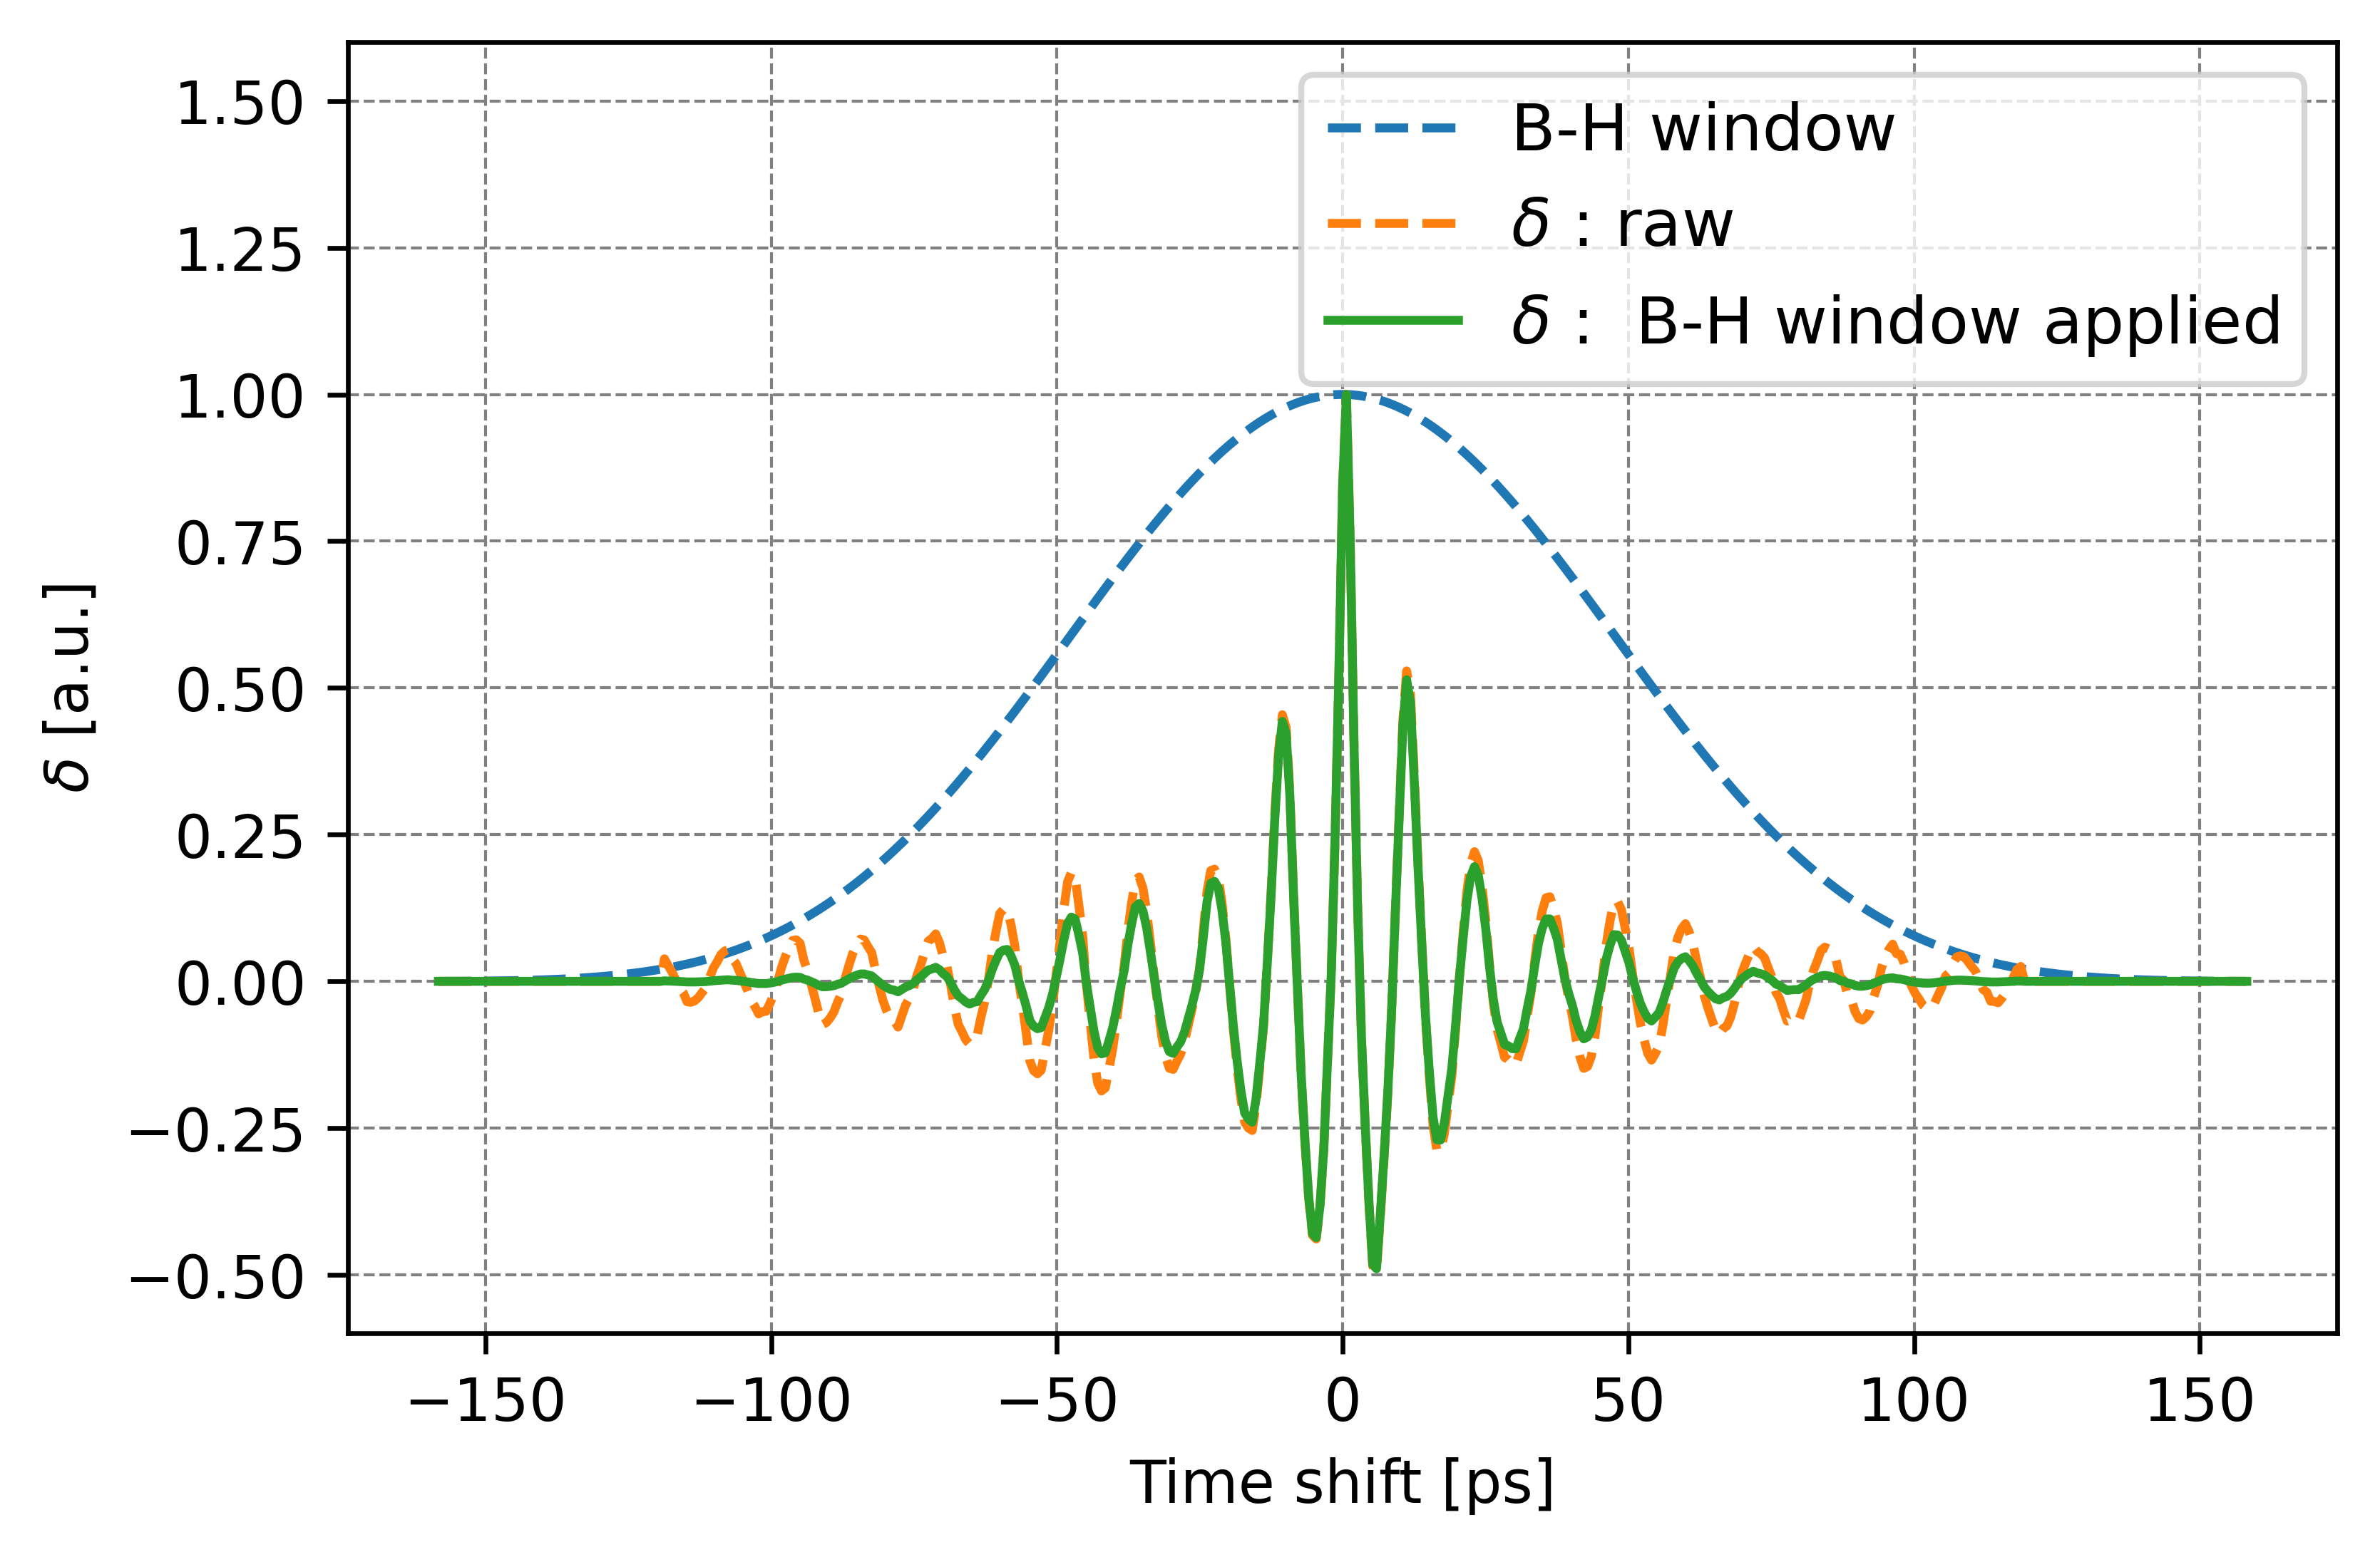
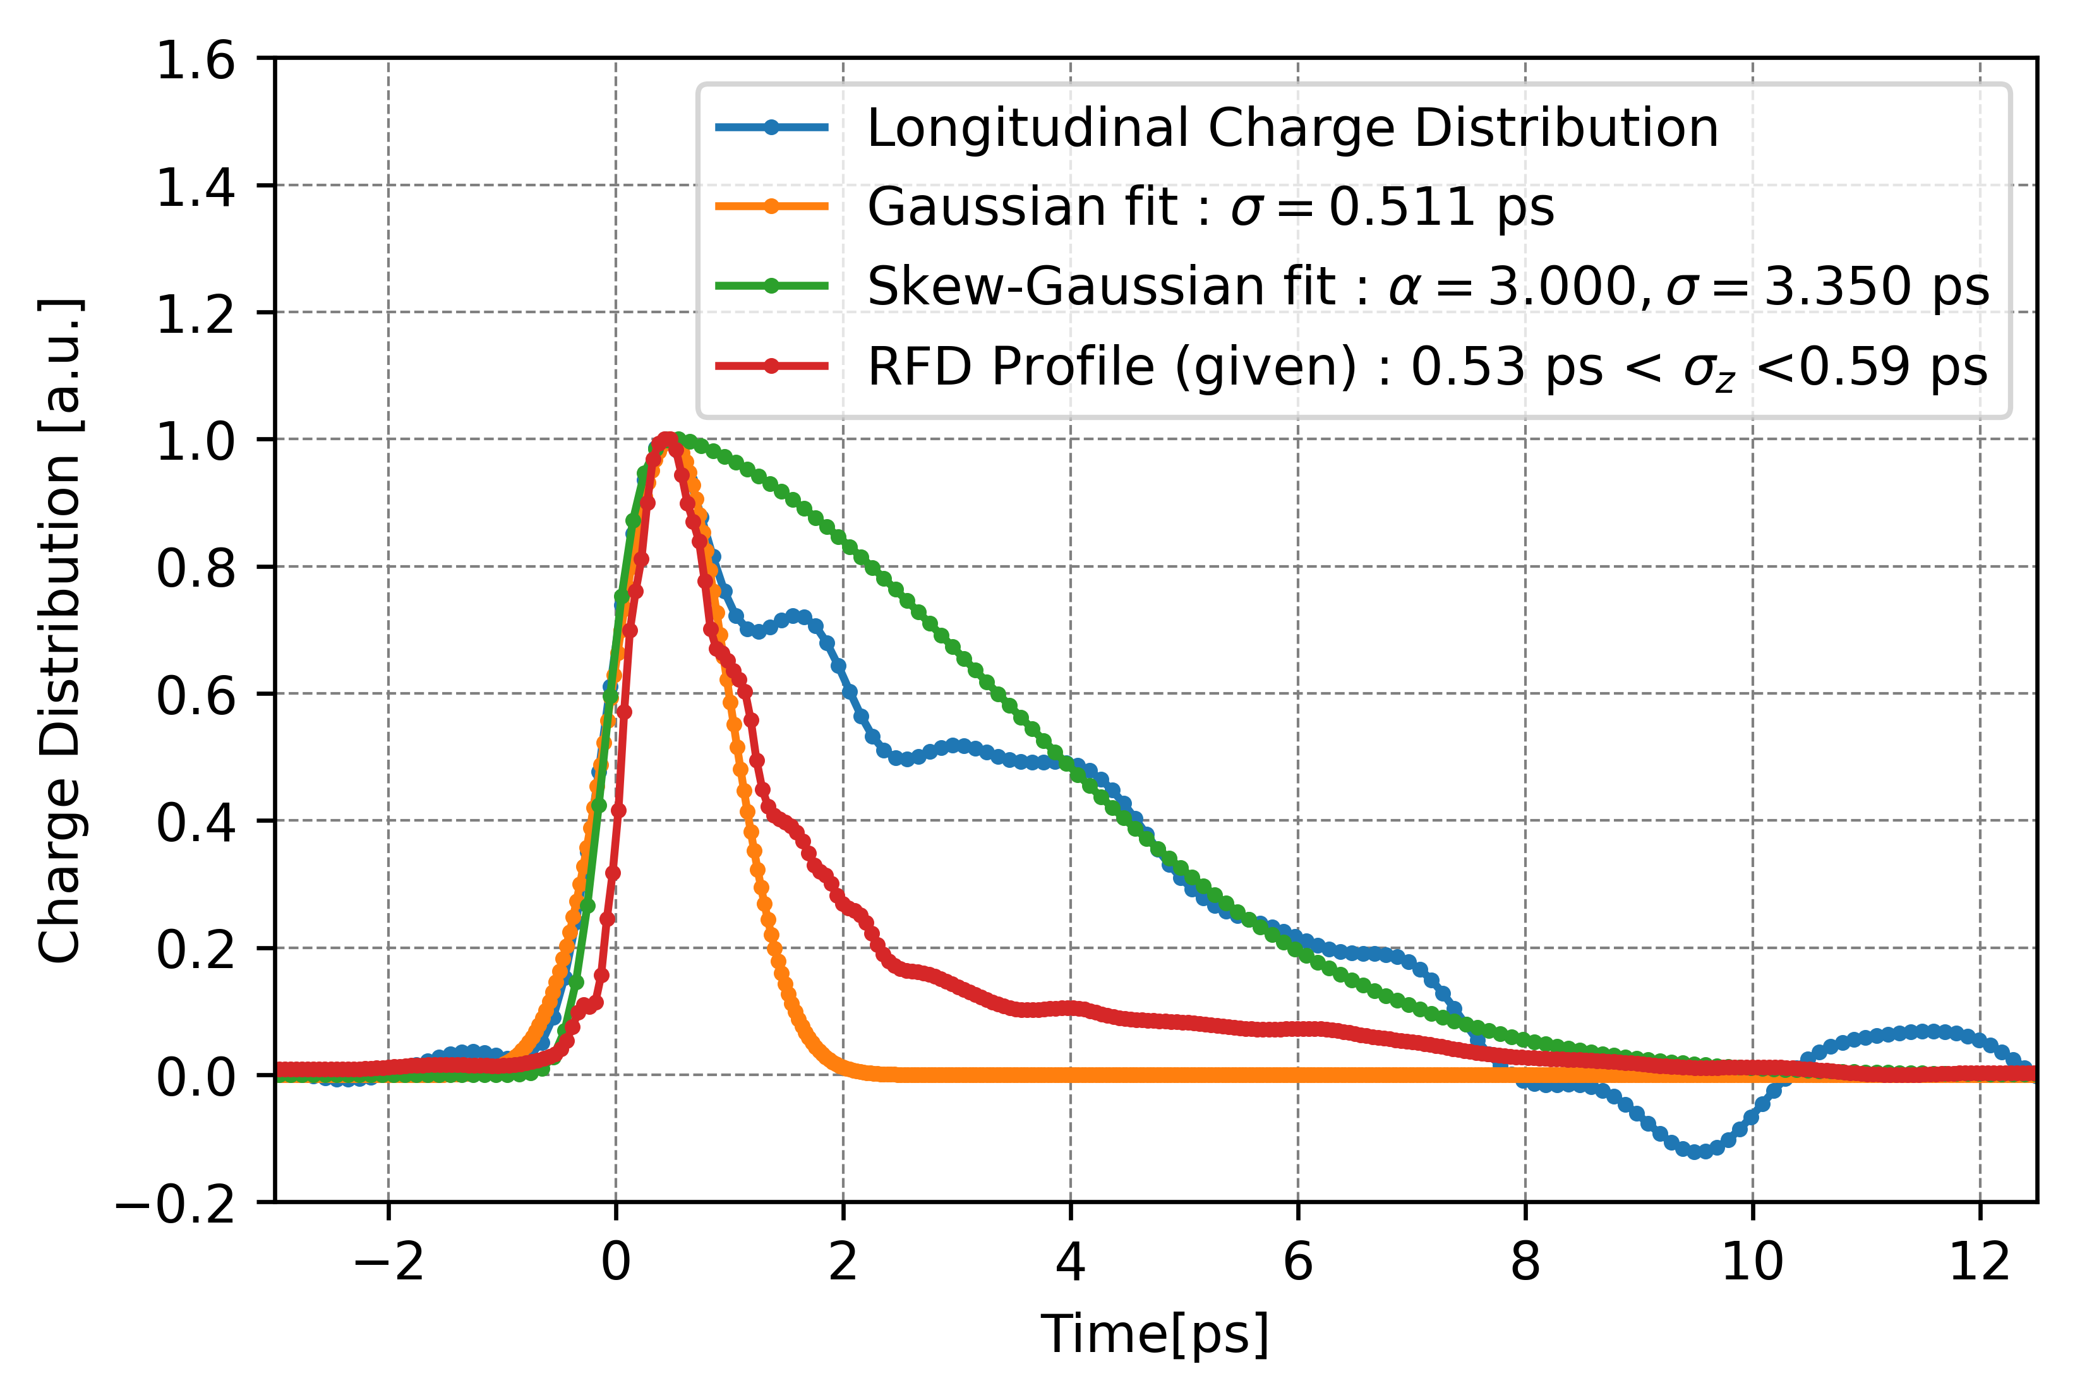
ChDR bunch length monitor for AWAKE run 2
PhD thesis of C. Davut, U. Manchester
Martin – Puplett Interferometer scan with 0.5 ps electron bunch @5 mm impact parameter
Frequency Selective Surface (>80 GHz high pass filter) used to prevent low frequency domination of the ChDR spectrum.

Slide 7
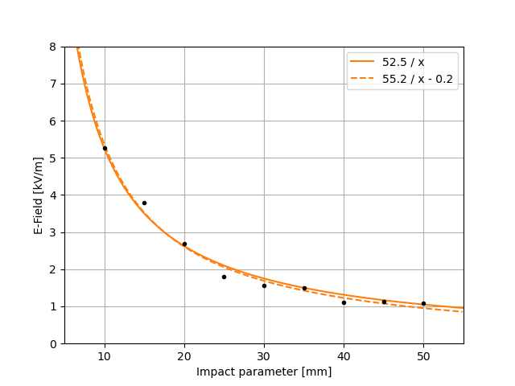
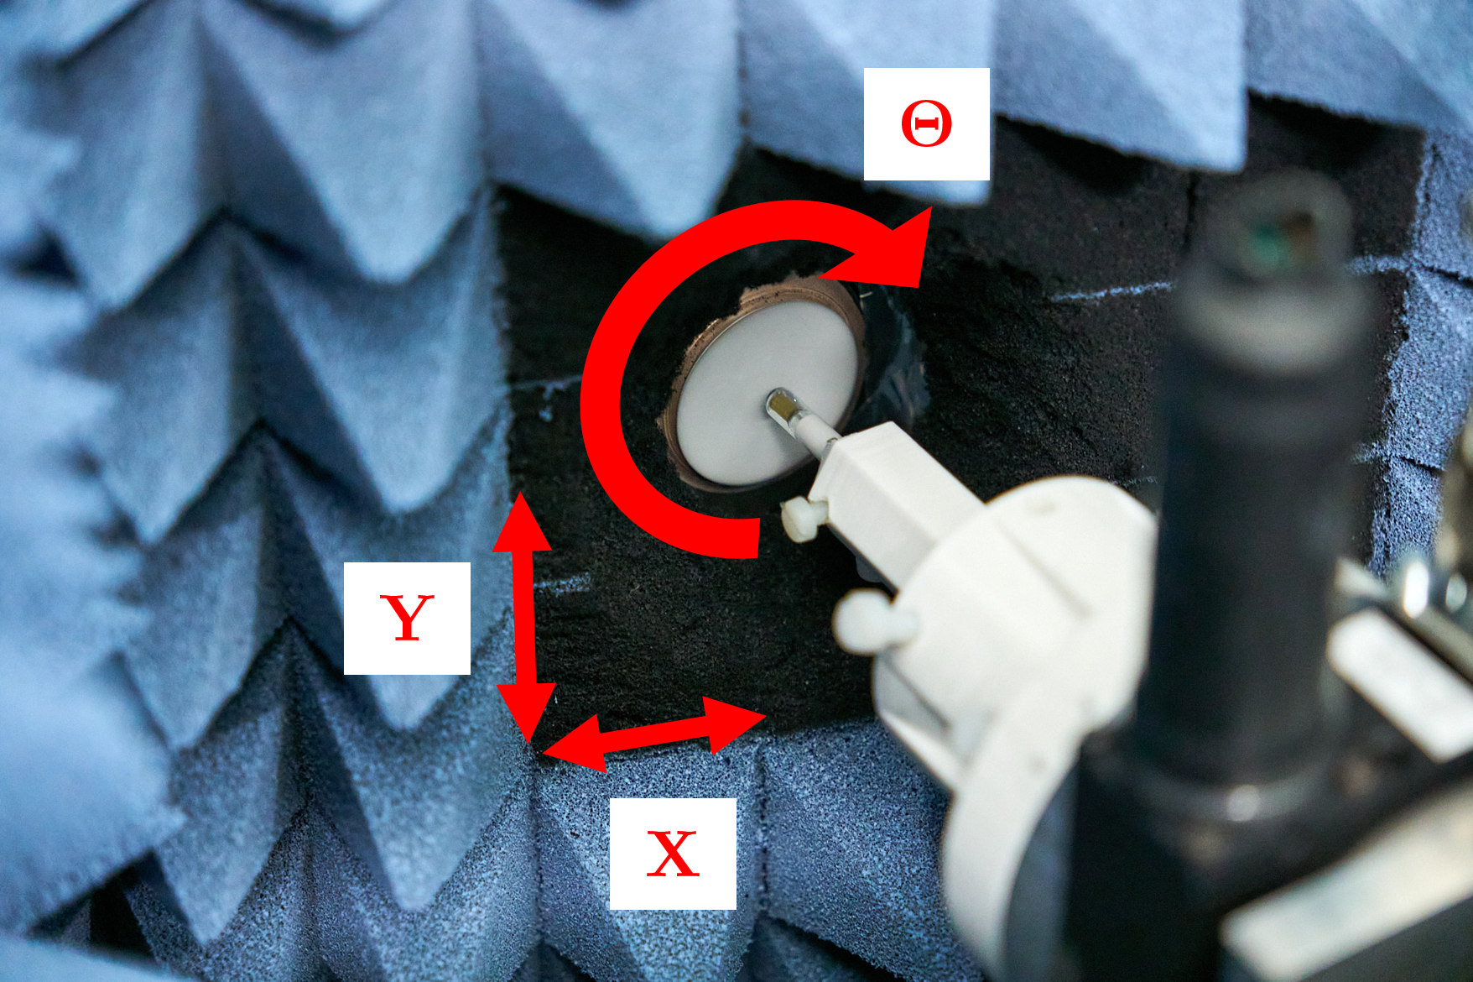
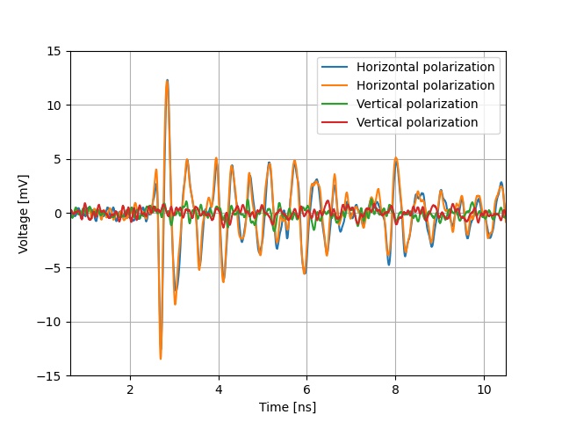
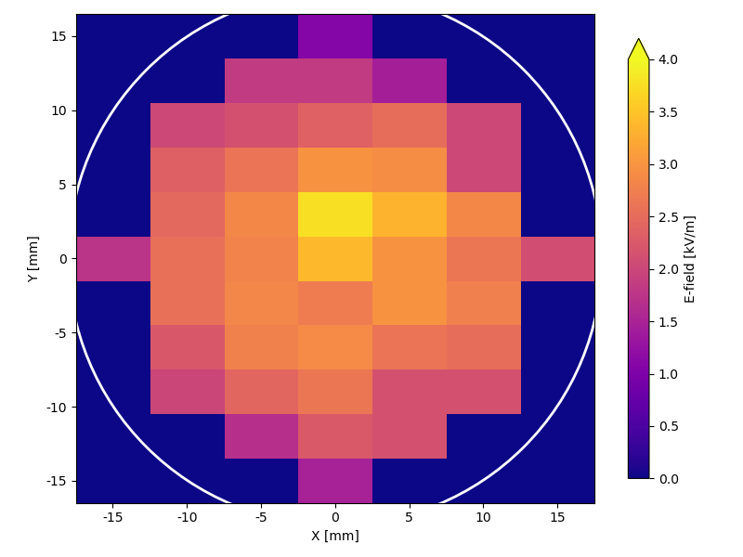
ChDR with Electro-Optical probes
PhD thesis of A. Schloegelhofer, TU. Vienna
Characterization of ChDR from an 36 mm diameter Alumina radiator using
EO-probes from KAPTEOS (BW up to 10 GHZ)
Successfully measured:
Lower limit for the absolute e-field strength
→ benchmarking CST simulations
Linear polarization of ChDR travelling through radiator
e-field distribution on radiator surface
Low cut-off frequency of 36 mm diameter radiator
Impact parameter dependence at low frequencies

Slide 8
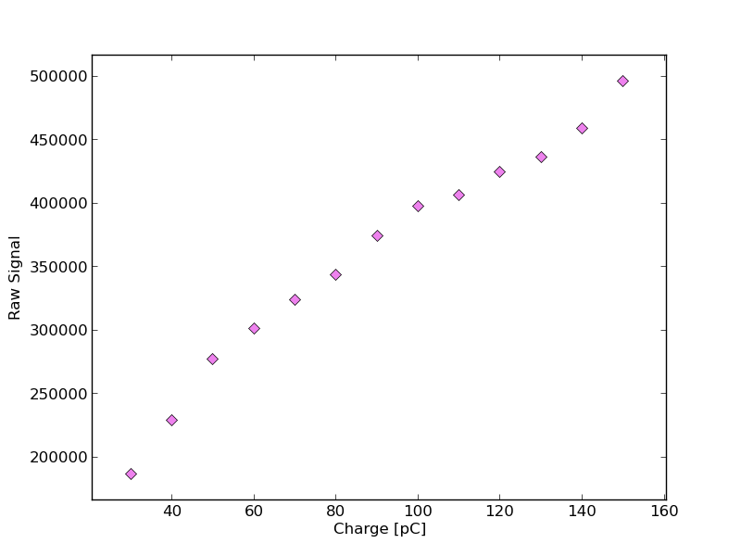
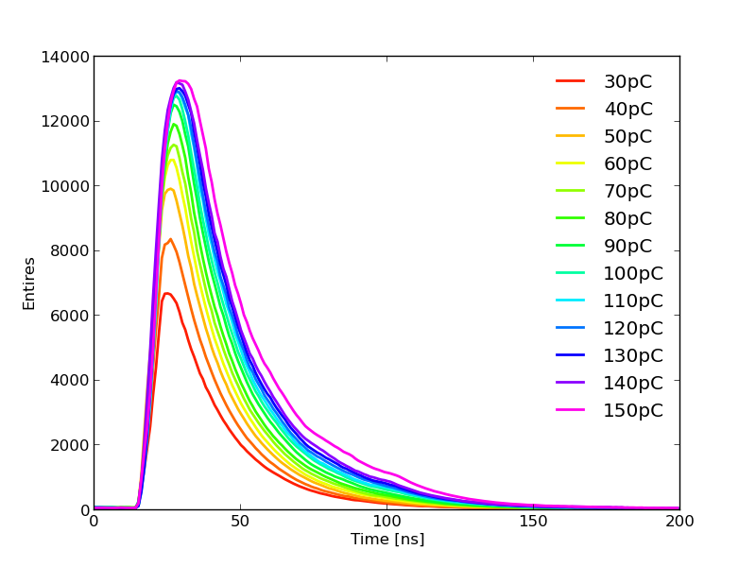
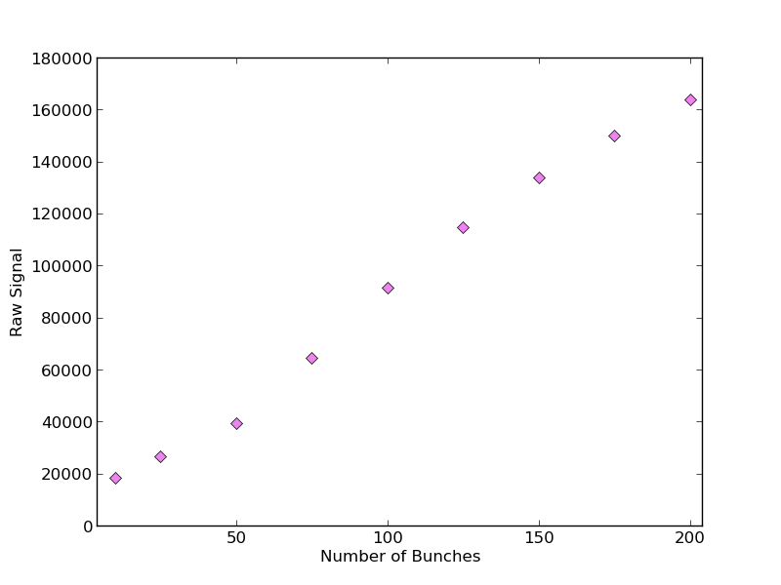
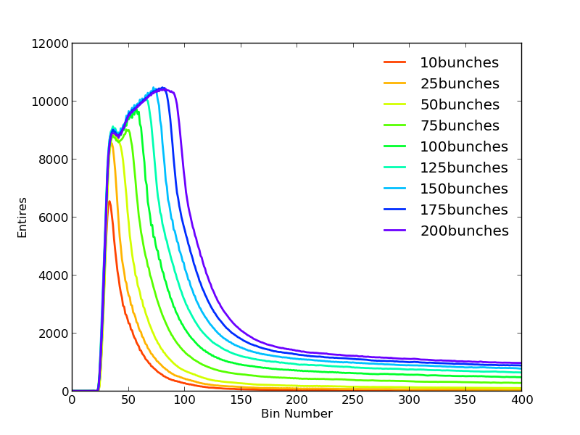
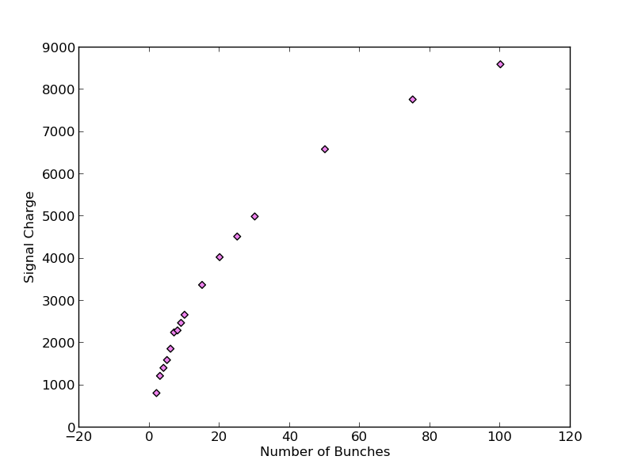
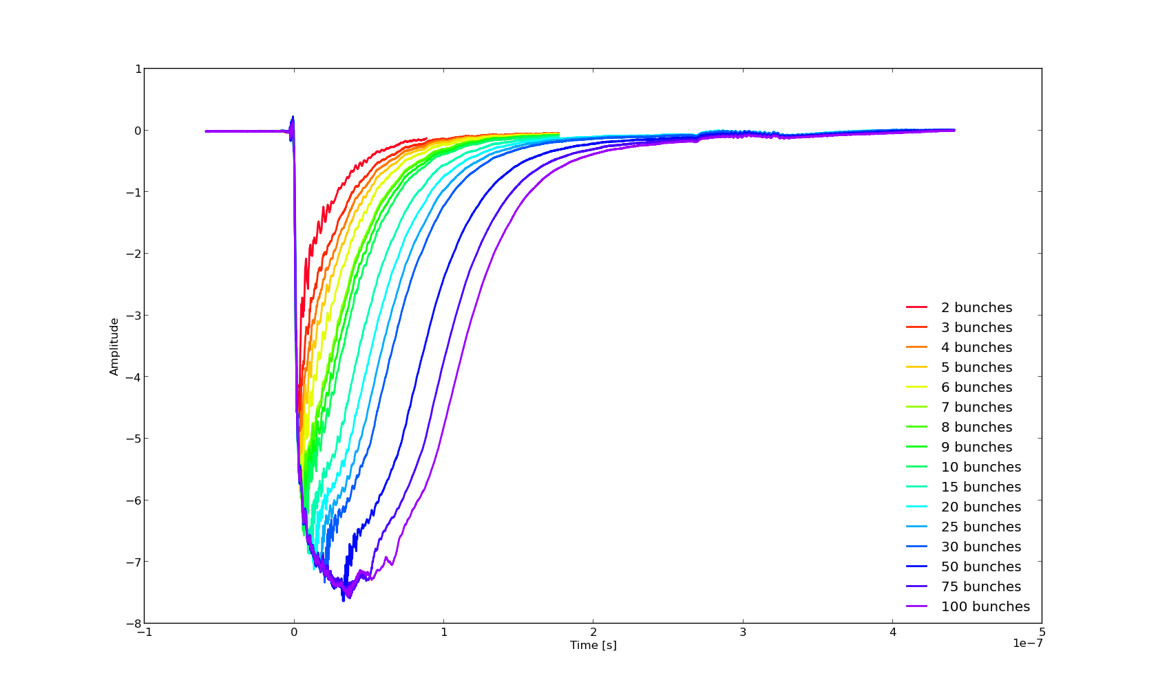
Silica Fibre tests for FLASH Therapy Beam Instrumentation
200𝜇m Diameter FIbre
E. Buchanan, I. O. Ruiz and J. Bateman
Tested different radiation-hard optical fibres
  Silica fibres with varied diameters
  Glass capillaries filled with liquid scintillators
Coupled to si-pm and pmt
Single bunch and multi bunch scans
Saturation occurs during multi bunch scans
Repeated measurements using optical filters and saturation still occurs
si-pm
si-pm
PMT

Slide 9
BI tests in 2023
Beam Time Requests for BI tests in 2023 have been submitted:
  ChDR BPM follow-up
  Electro-optical sampling of ChDR
  ChDR Bunch length follow-up (interferometer scans)
  EOSD tests in air (two proposals from CERN and KIT)
For second half of CLEAR operation year:
  oBLM follow-up
  cavity BPM studies (A. Lyapin, RHUL)
CLEAR remains an essential facility for instrument development and formation of students !

