Slide 1

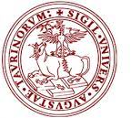





Particle therapy masterclass - Torino
TORINO
28 February 2024
Universita’ degli studi di torino,
Roberto Sacchi
Istituto nazionale di fisica nucleare
Elisa Fiorina, Simona Giordanengo
CITTA’ della SALUTE e DELLA SCIENZA - AIFM
Elena gallio

Slide 2
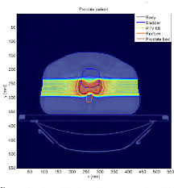
3 exercices
BOXPHANTOM
TG119
PROSTATE

Slide 3
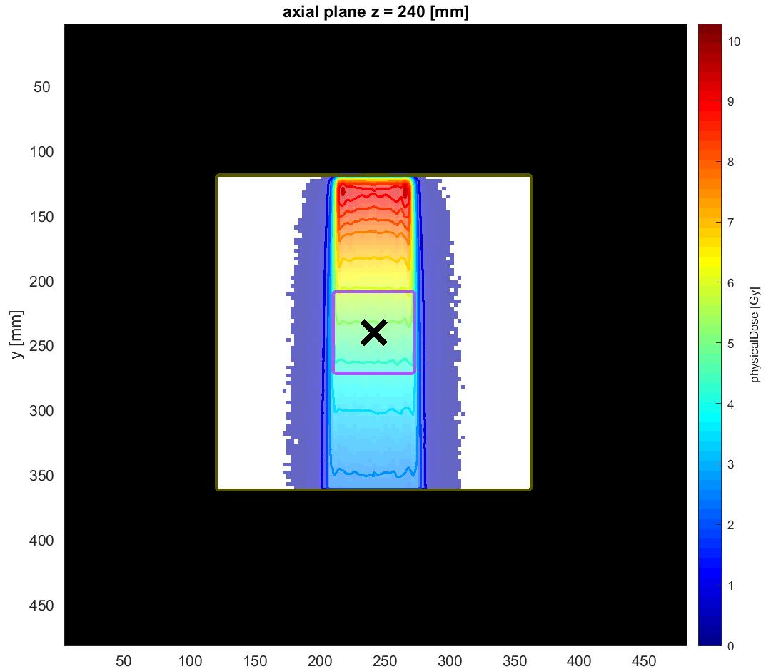
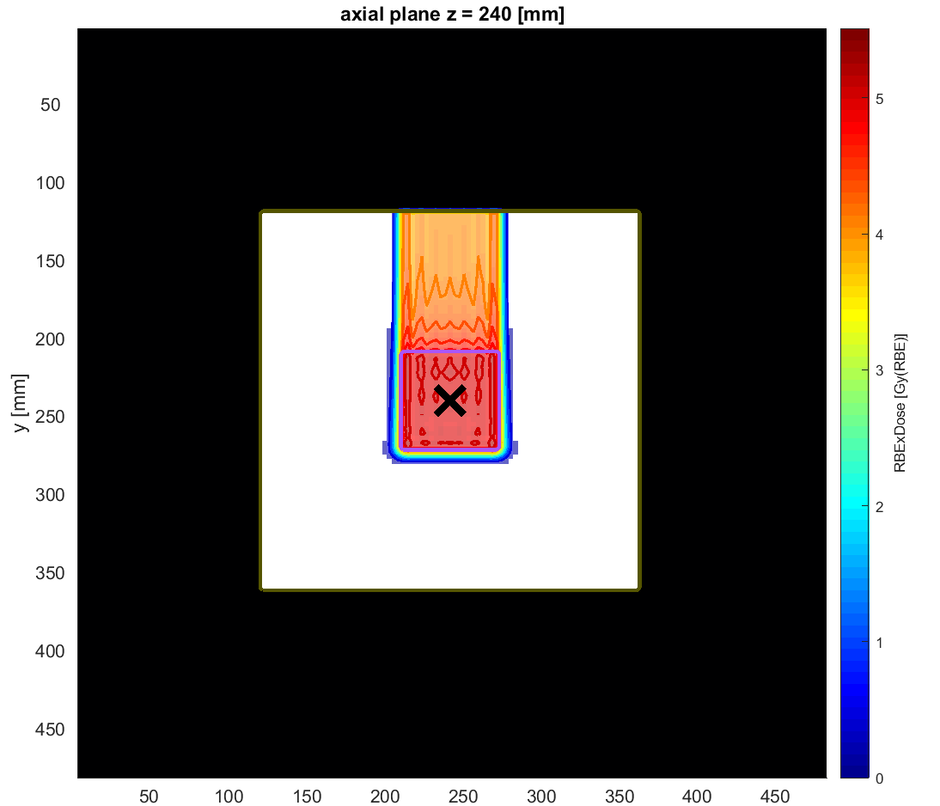
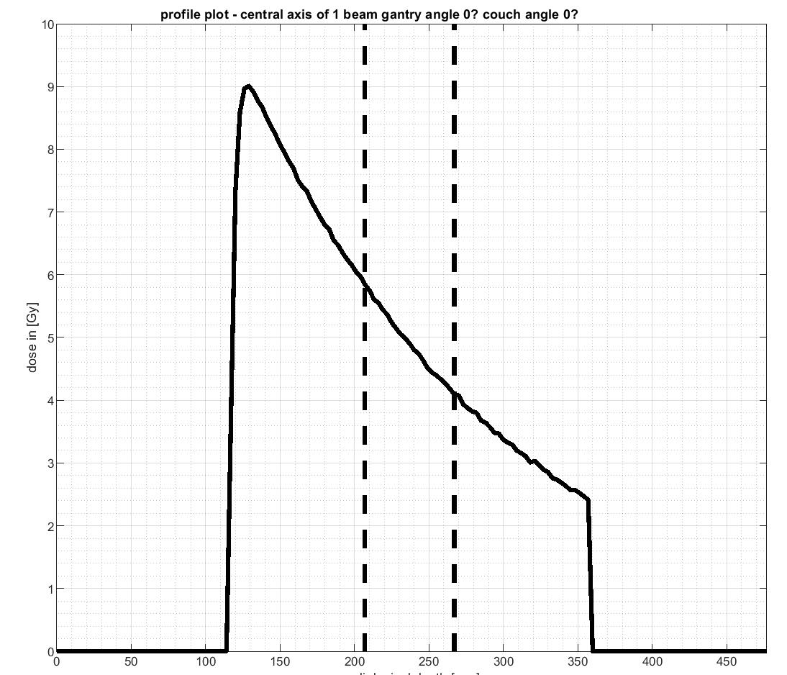
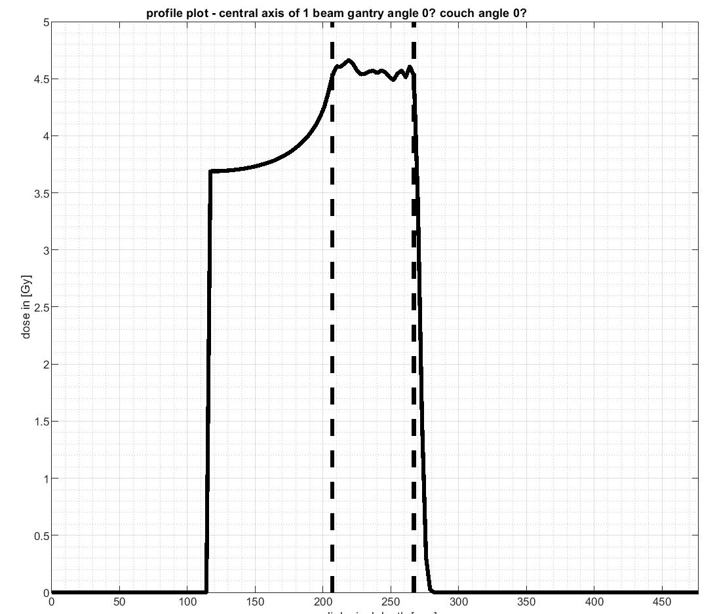
BOX PHANTOM
PHOTONS
Dose distribution
PROTONS
TARGET
y [mm]
y [mm]
Gantry angles: 0°
Constraints:
Dose to the
target = 5 Gy
Maximum dose
to the OAR = 2 Gy
OAR
z [mm]
Profile plot
z [mm]
Spread Out Bragg Peak
Dose [Gy]
Dose [Gy]
Radiological depth [mm]
Radiological depth [mm]

Slide 4
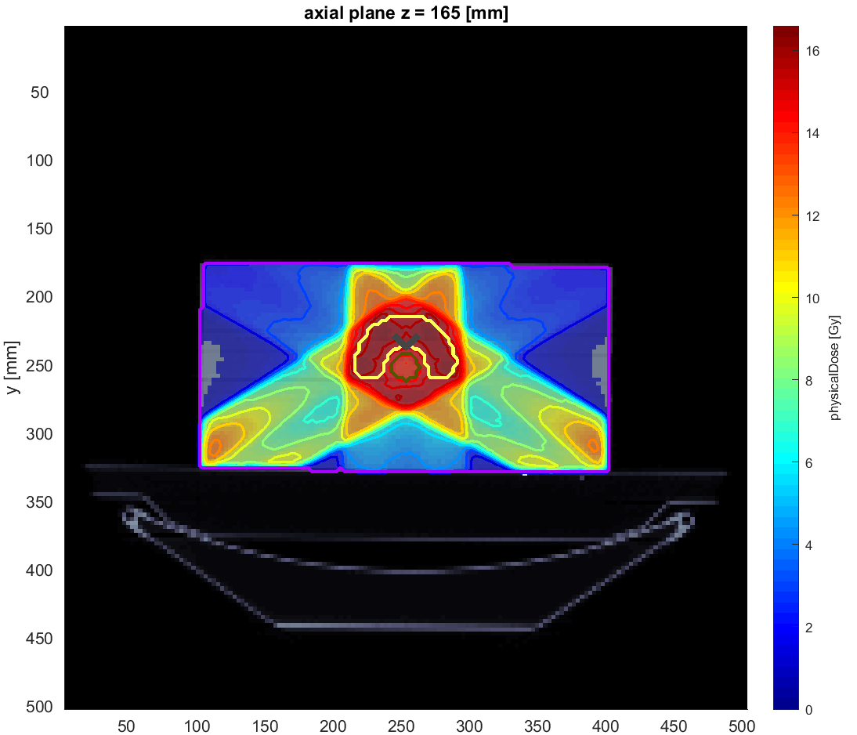
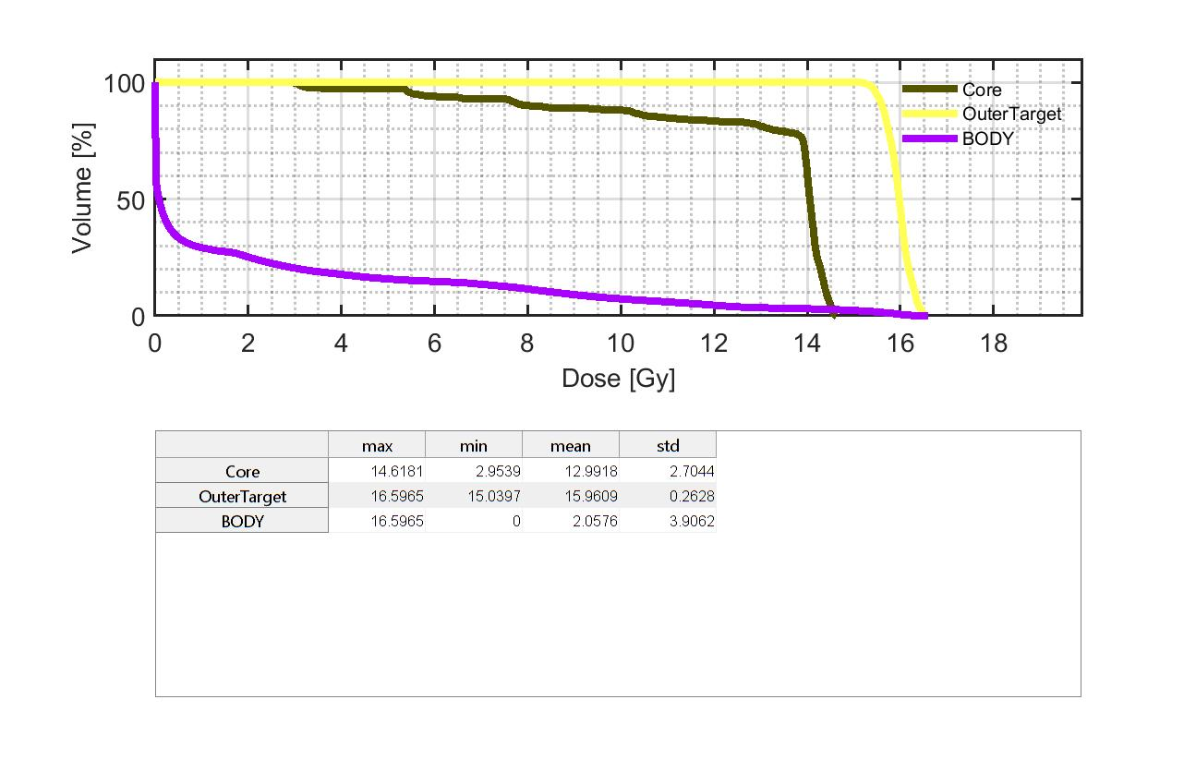
PHANTOM TG 119
PHOTONS
Constraints:
Dose to the target = 16 Gy
Maximum dose to the OAR = 14 Gy
Gantry angles: 0° - 120° - 240°
DVH
TARGET = VERTEBRA
y [mm]
OAR = SPINAL CORD
l
> 14 Gy
~ 16 Gy
z [mm]
l

Slide 5
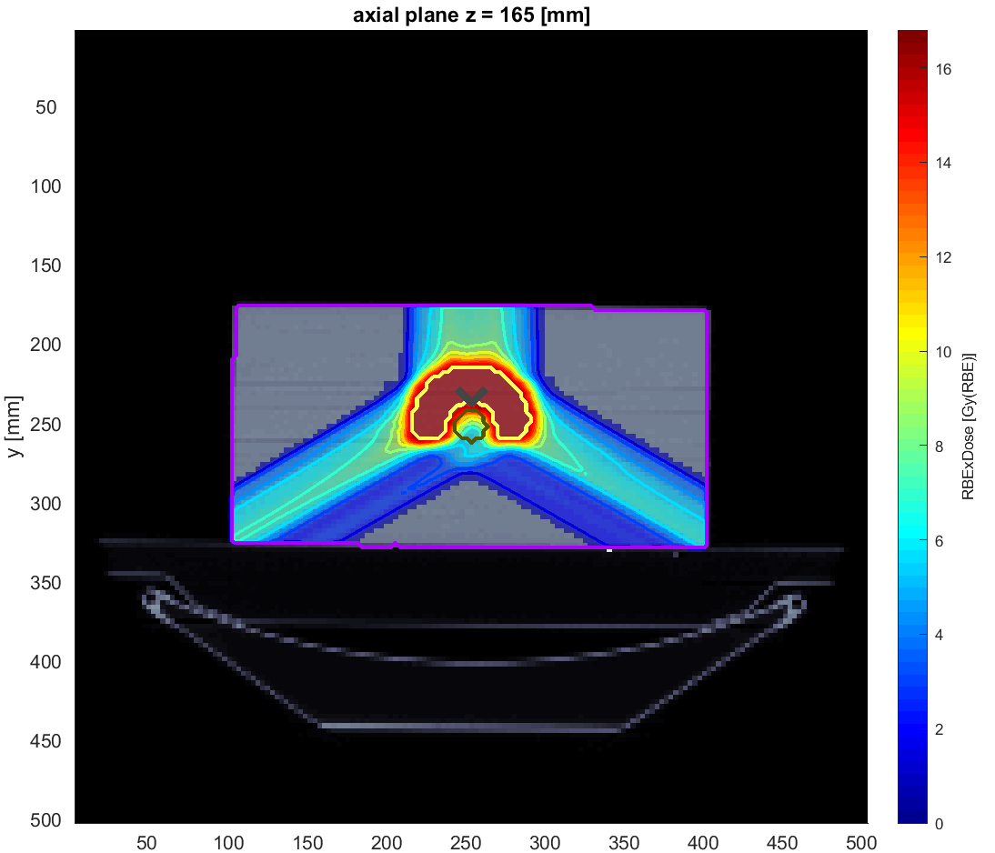
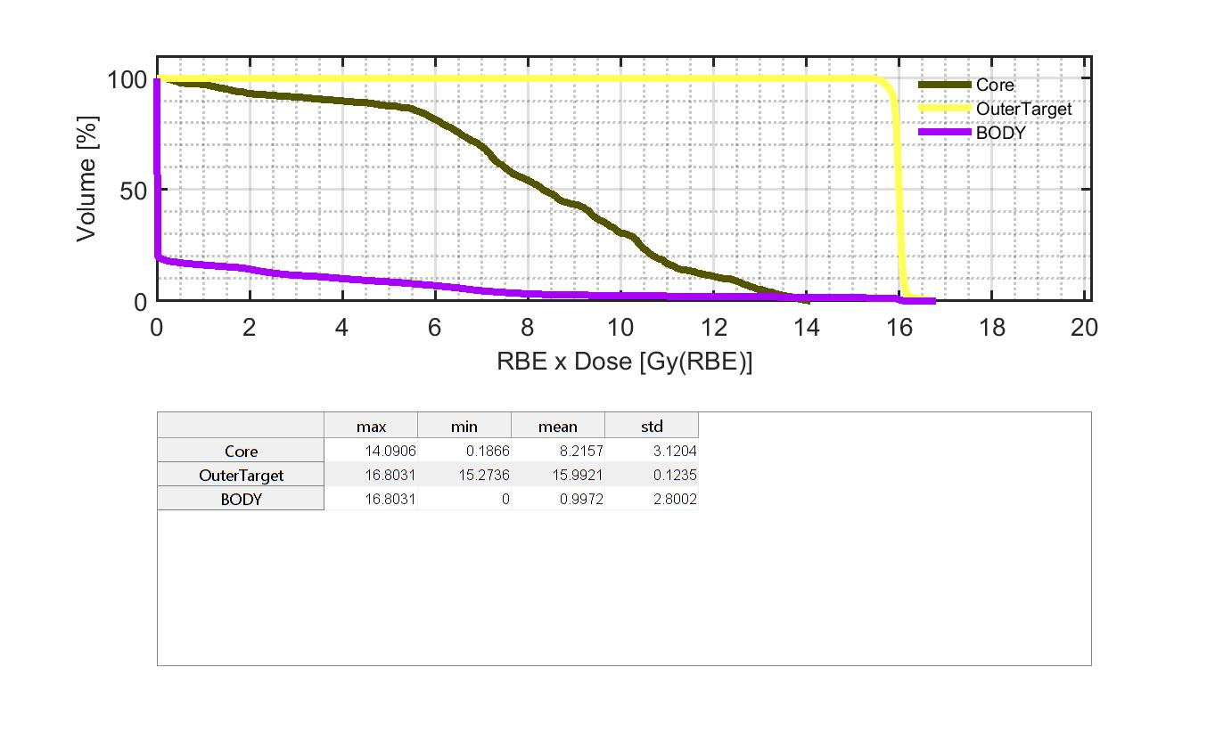
PHANTOM TG 119
PROTONS
Constraints:
Dose to the target = 16 Gy
Maximum dose to the OAR = 14 Gy
Gantry angles: 0° - 120° - 240°
DVH
TARGET = VERTEBRA
y [mm]
OAR = SPINAL CORD
~ 14 Gy
~ 16 Gy
z [mm]
l
l

Slide 6
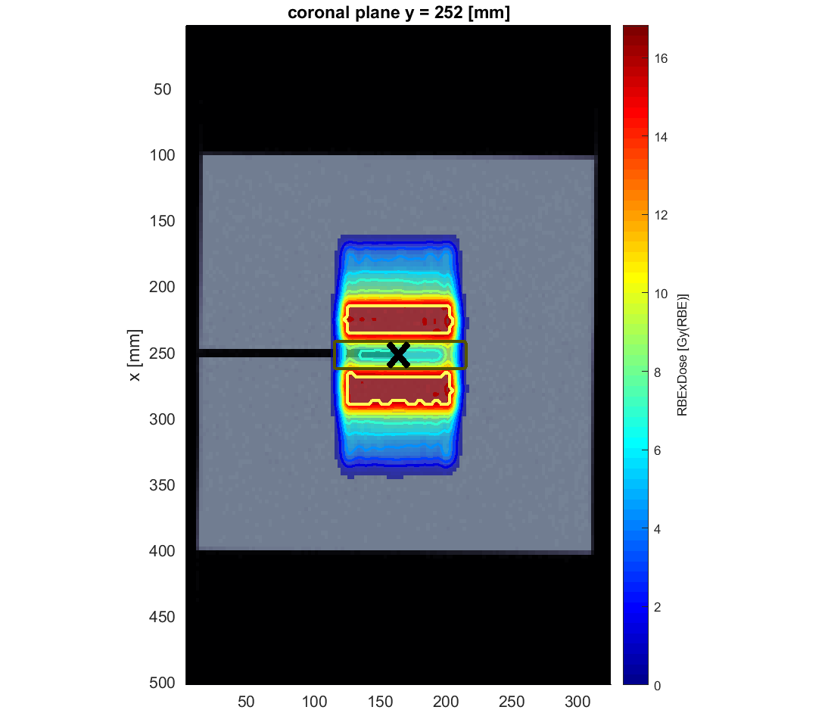
Minimum dose to Spinal cord
Dose to the target = 16 Gy
Maximum dose to the OAR = 12 Gy
Best optimization with max Dose OAR = 12 Gy

Slide 7
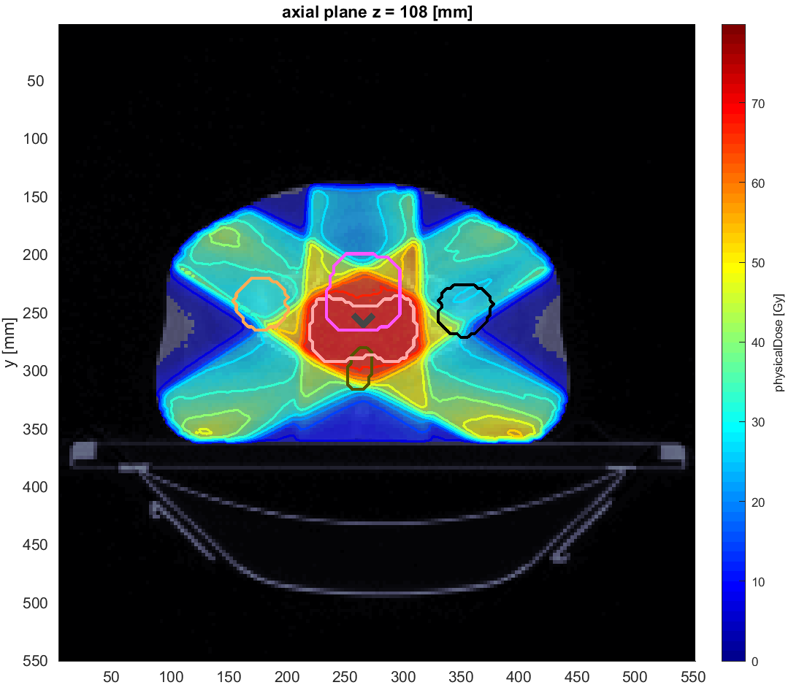
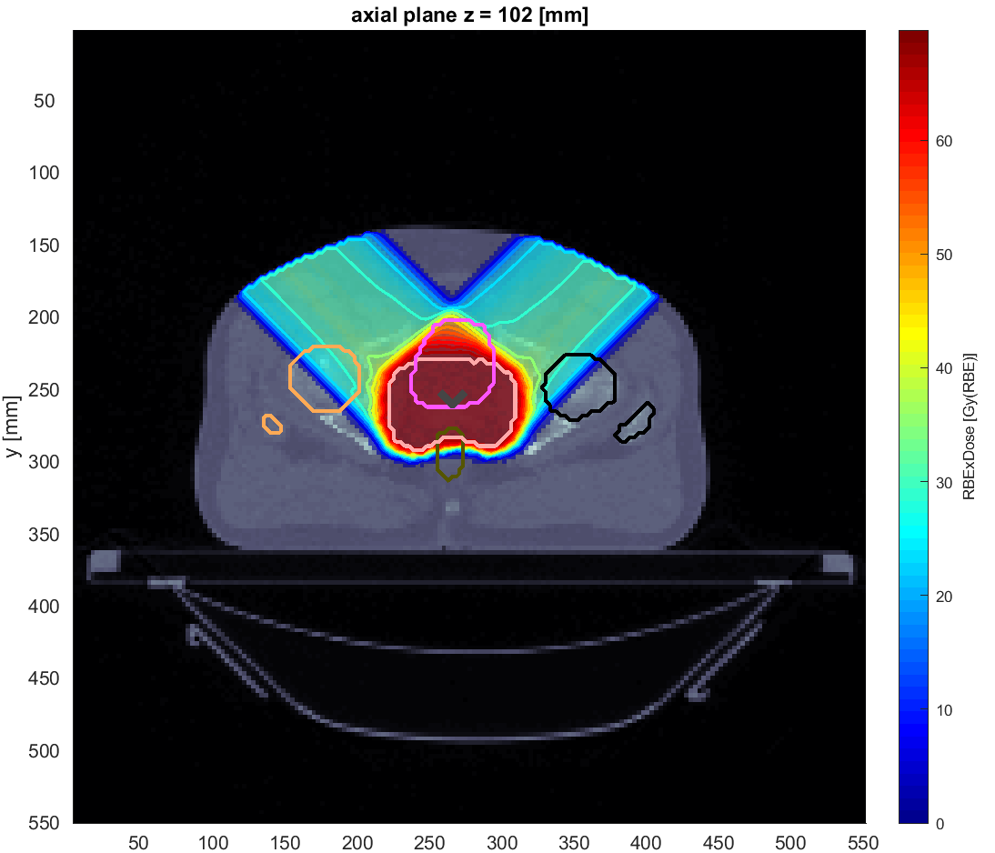
PROSTATE
Constraints:
Dose to the target = 68 Gy
PHOTONS
PROTONS
Gantry angles: 0° - 60° - 120° - 240° - 300°
Gantry angles: 45° - 315°
TARGET = PROSTATE
TARGET = PROSTATE
y [mm]
y [mm]
z [mm]
z [mm]

Slide 8
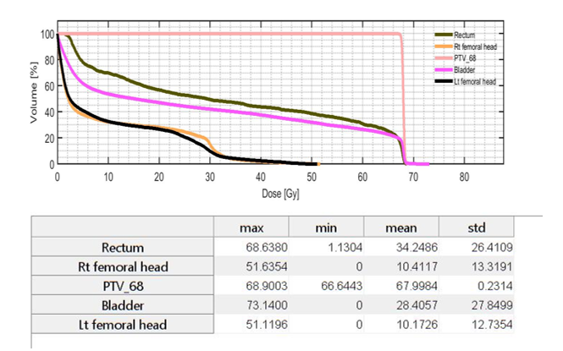
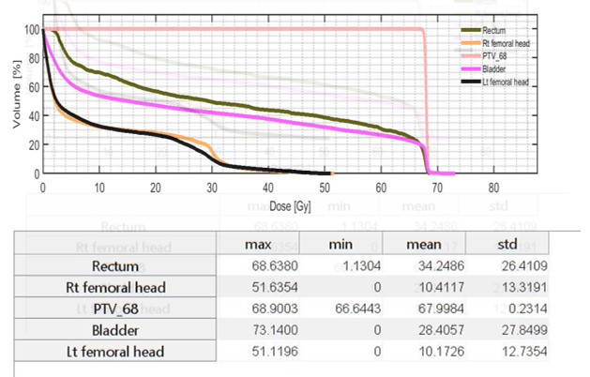
PROSTATE
Constraints:
Dose to the target = 68 Gy
PHOTONS
PROTONS
Gantry angles: 0° - 60° - 120° - 240° - 300°
Gantry angles: 45° - 315°

Slide 9
SCHOOLS
32 STUDENTS
Liceo Vasco Beccaria Govone
Edoardo Agnelli
IIS Copernico Luxemburg
Liceo scientifico Maria Curie
Edoardo Agnelli
L.S.GALILEO FERRARIS
Liceo Classico Vittorio Alfieri
Liceo Avogadro Biella
Liceo Augusto Monti di Chieri
IIS Primo Levi
Convitto Nazionale Umberto I
Liceo Valsalice
LIceo Carlo Cattaneo
ITIS Amedeo Avogadro
I.S A.Einstein
Matilde Digeronimo
Luca Rinaldi
Giulia Petrini
Sofia Torres
Chiara Gioannini
Sara Stefanelli
Elena Porporato
Carlo Cocirio
Gabriele Di Stefano
ELISABETTA CASETTI
LUCA NASCIMBENE
Viola Ferretti
Marta Vallero
Carlo Caligaris
Lucia Imarisio
Filippo Salmi
Dorotea Maffei
Alessandro Perino
Pietro Perio
Andrea Santarcangelo
Francesco Battaglia
Umberto Cantini
William Gentilini
Hu Jia Wei Federico
Francesca Irrera
Matteo Damiani
Cesare Maria Rayneri
Michela Cerutti
Alexander Kharitonov
Amanda Arteaga
Peter Cameron Curry
Luca Saccotelli
Matteo Maggiorotti
Riccardo Tollemeto
Tommaso Carè

Slide 10

Thank you for your attention

