Slide 1
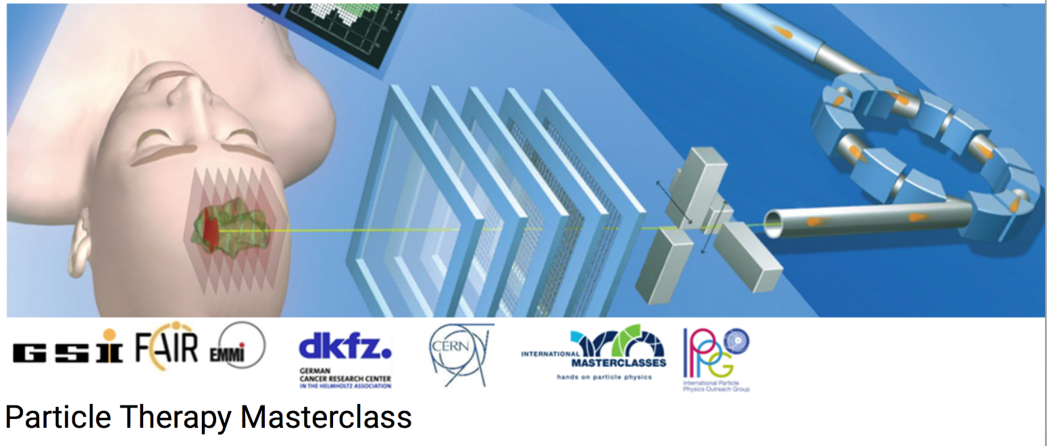

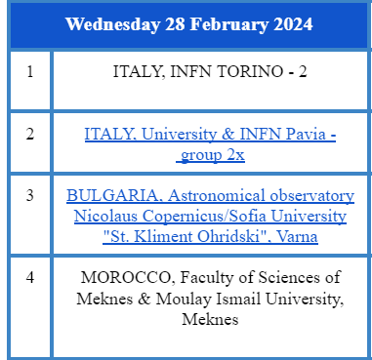
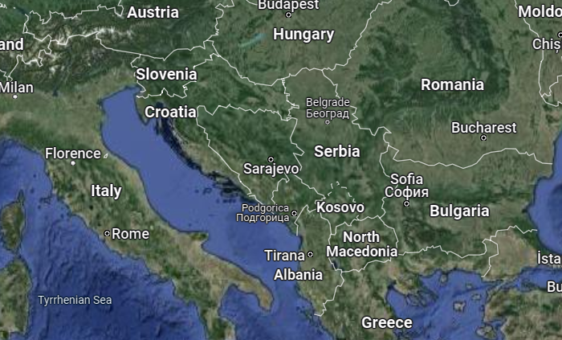
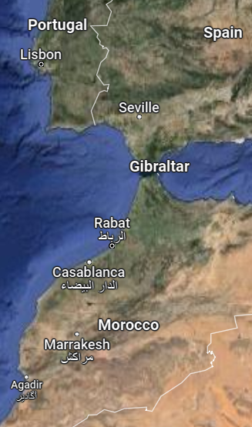

PTMC Video Conference 28 February 2024
PARTICLE THERAPY MASTERCLASS

Slide 2
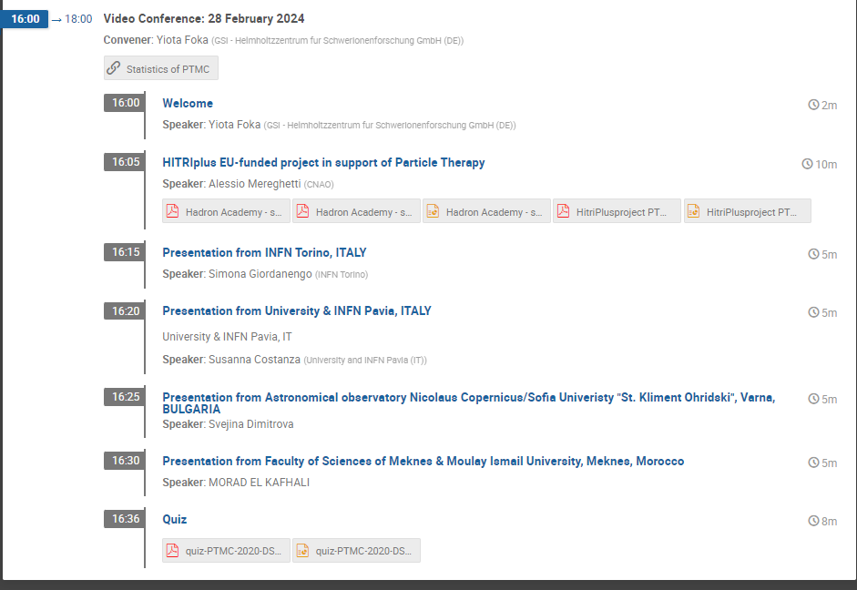
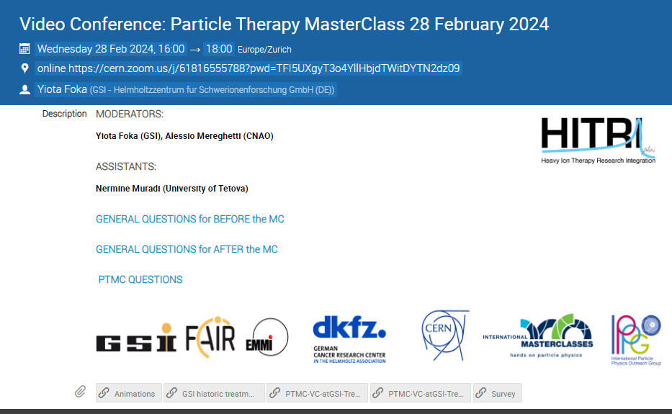
PTMC Video Conference 28 February 2024
https://indico.cern.ch/event/1246649/
Moderators: Yiota Foka (GSI), Alessio Mereghetti (CNAO)

