Slide 1
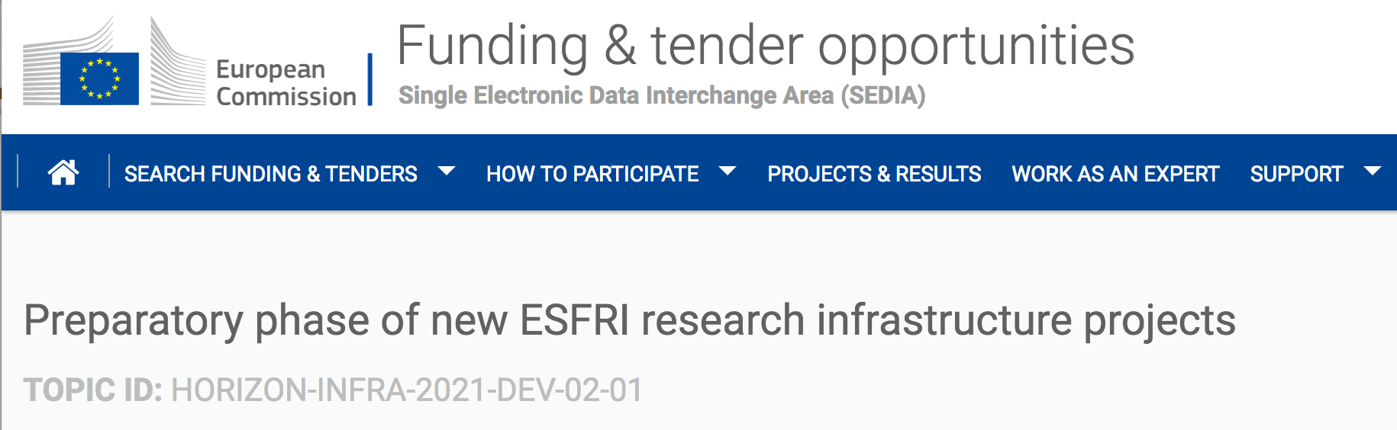




INFRA-DEV Horizon
Preparatory Phase for ET
M. Martínez
Civil Engineering meeting
CERN, 3rd Feb 2023

Slide 2
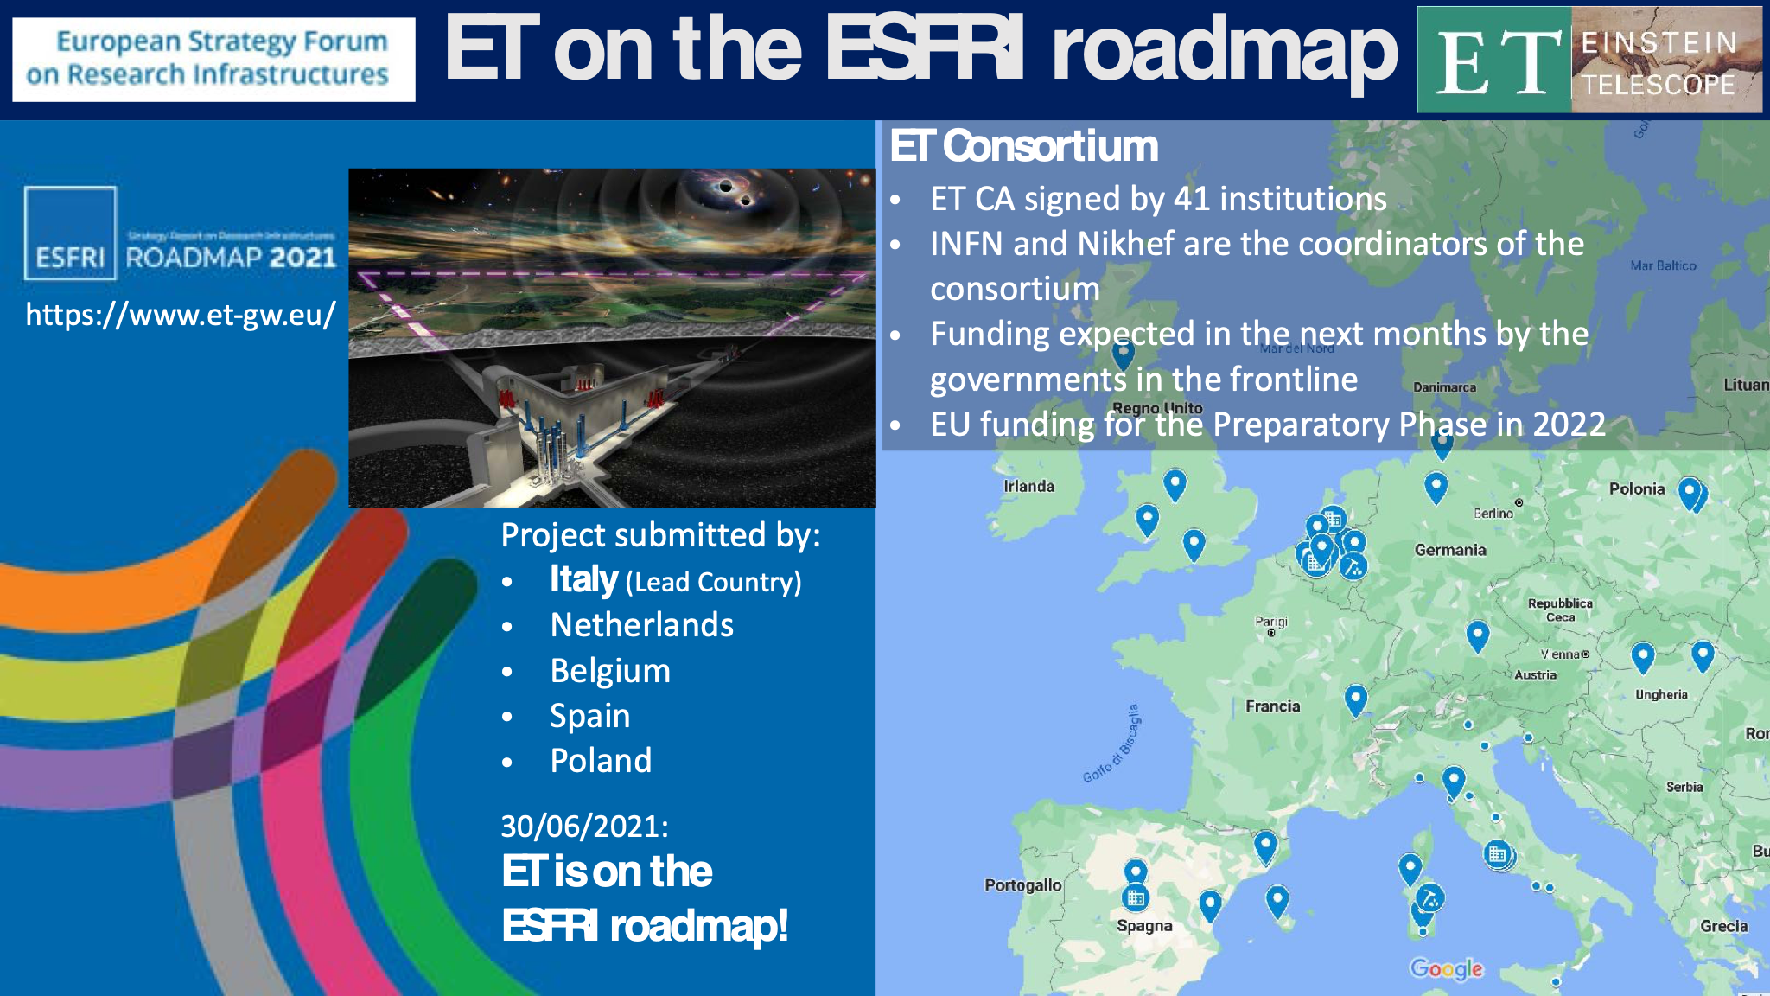

Slide 3
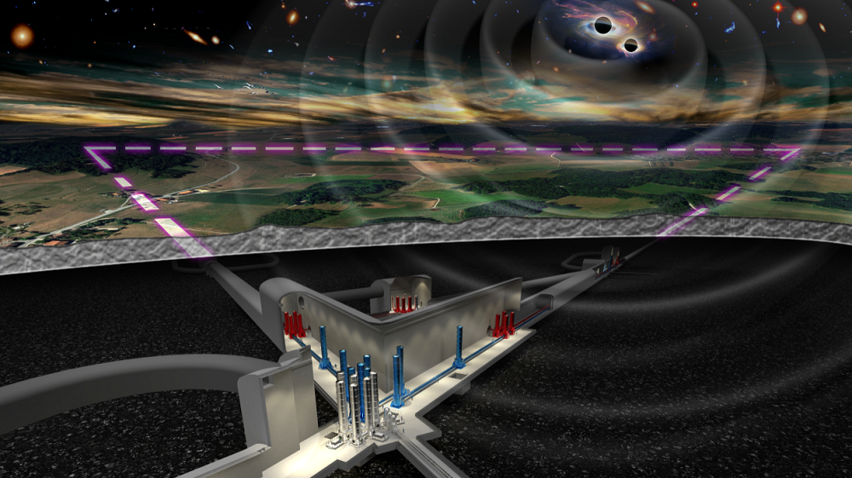
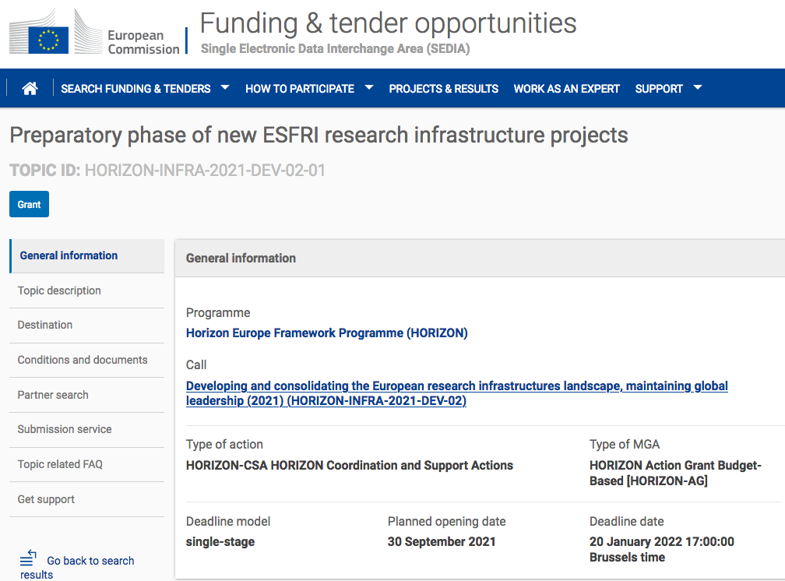
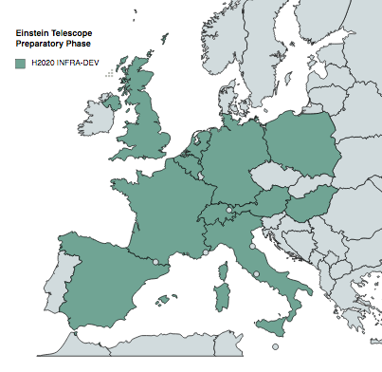
Einstein Telescope as ESFRI
2000M€ project
Horizon-INFRA-2021
Goals for ET Preparatory Phase
Governance
Financial architecture/plan/framework
ET legal entity
Final ET design and cost evaluation
Site or sites selection
Construction funding
User services
Computing model
Sustainability
12M€
(total value)
3.45M€
(approved)
Einstein Telescope Preparatory Phase (ET-PP) in 2022 – 2026
HORIZON-INFRA-DEV EU Project coordinated by IFAE
→ Project started 1st September 2022 (https://etpp.ifae.es)

Slide 4
List of Partners & Third Parties
COUNTRY | Partners
AUSTRIA | U. LEOBEN
BELGIUM | U. ANTWERPEN
BELGIUM | U. LOUVAIN
EGO | EGO
FRANCE | CNRS
GERMANY | DESY
HUNGARY | WIGNER RCP
ITALY | INFN
THE NETHERLANDS | NIKHEF
POLAND | U. WARSAW
SPAIN | IFAE BSC-CNS (affiliated)
SWITZERLAND (associated partner) | U. GENEVA
UK | UKRI CARDIFF (affiliated) GLASGOW (affiliated)
ET-PP Horizon EU
COUNTRY | Third parties
GERMANY | RWTH (Aachen), AEI (MPI), LUH (Hannover)
THE NETHERLANDS | VU (AMSTERDAM), UM (MAASTRICHT)
SPAIN | ICCUB (Barcelona), UV (Valencia), UIB (Mallorca) CDTI (Madrid)
(as submitted to Brussels)

Slide 5
Work Packages (WPs)
WP1 Coordination and Management
WP2 Organization, Governance and Legal Aspects
WP3 Financial Architecture
WP4 Site Preparation
WP5 Project Office / Engineering Dept.
WP6 Technical Design
WP7 Transfer of Technology
WP8 Computing and Data Access
WP9 Sustainable Development Strategy
WP10 Education, Outreach and Citizen Engagement
WPs were defined to cover the main
INFRA-DEV missions and to address explicitly
ESFRI recommendations

Slide 6
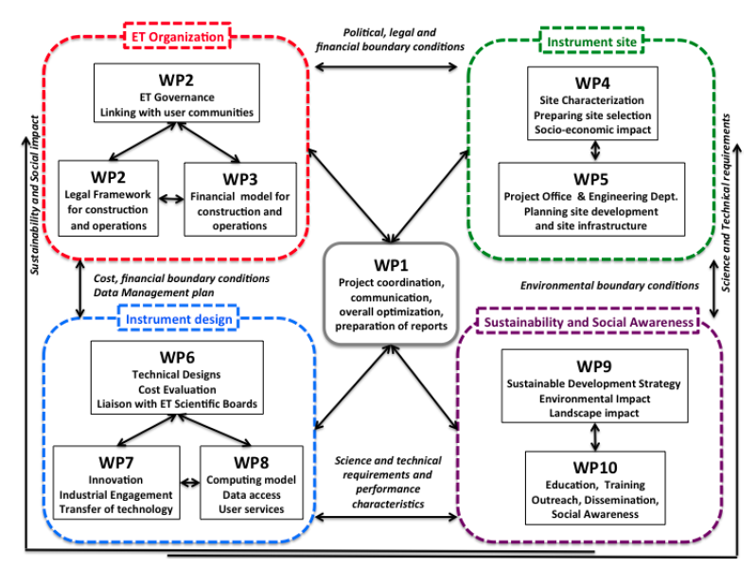
ET-PP

Slide 7
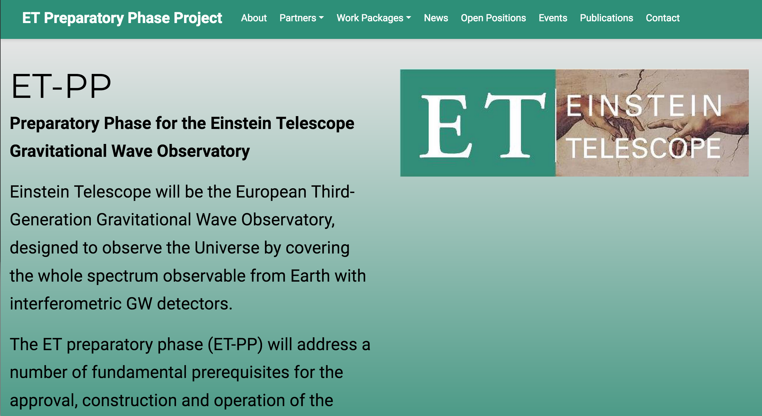
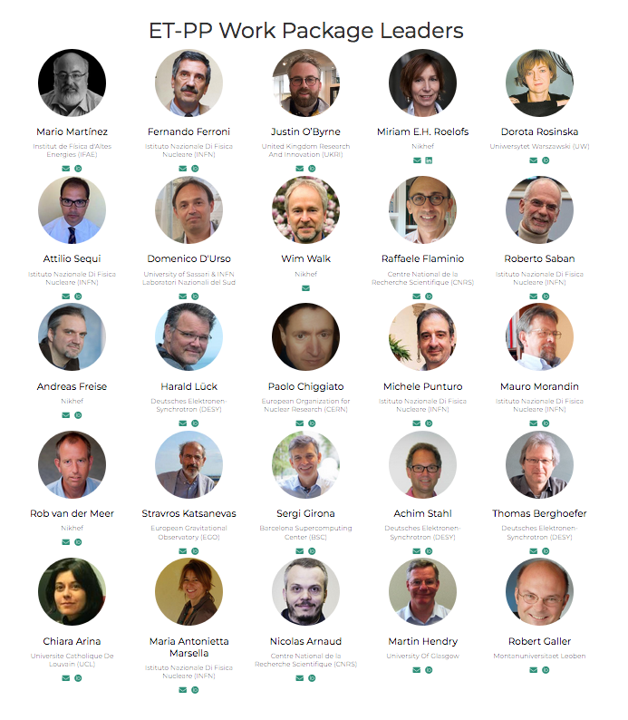
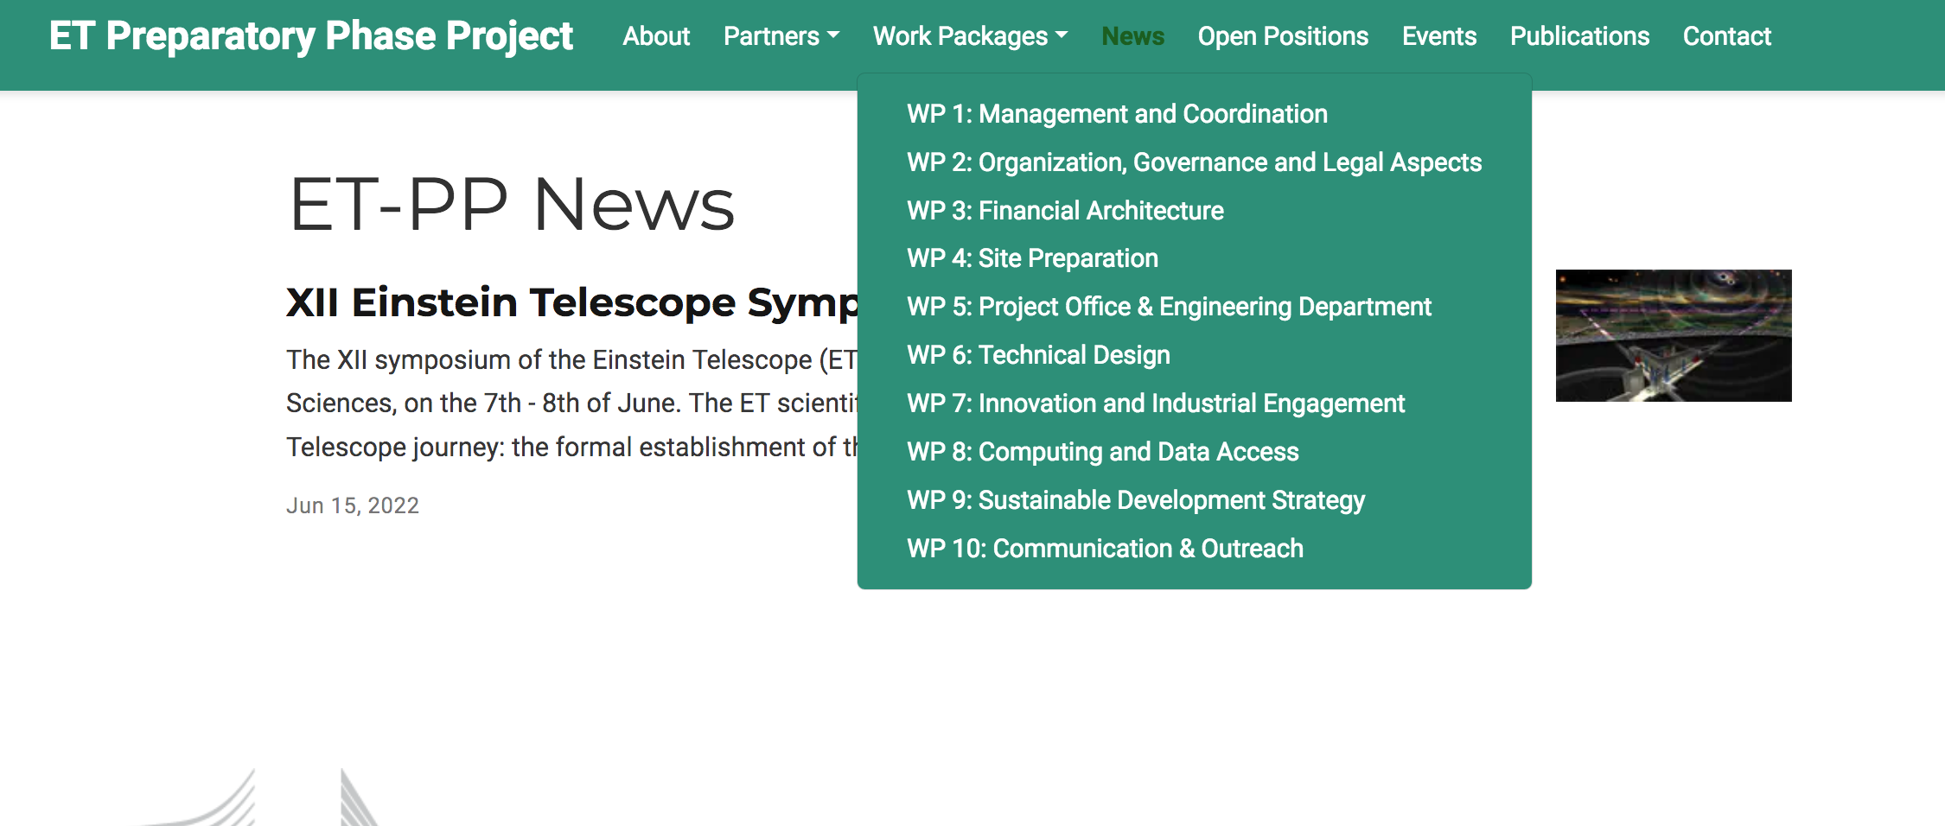
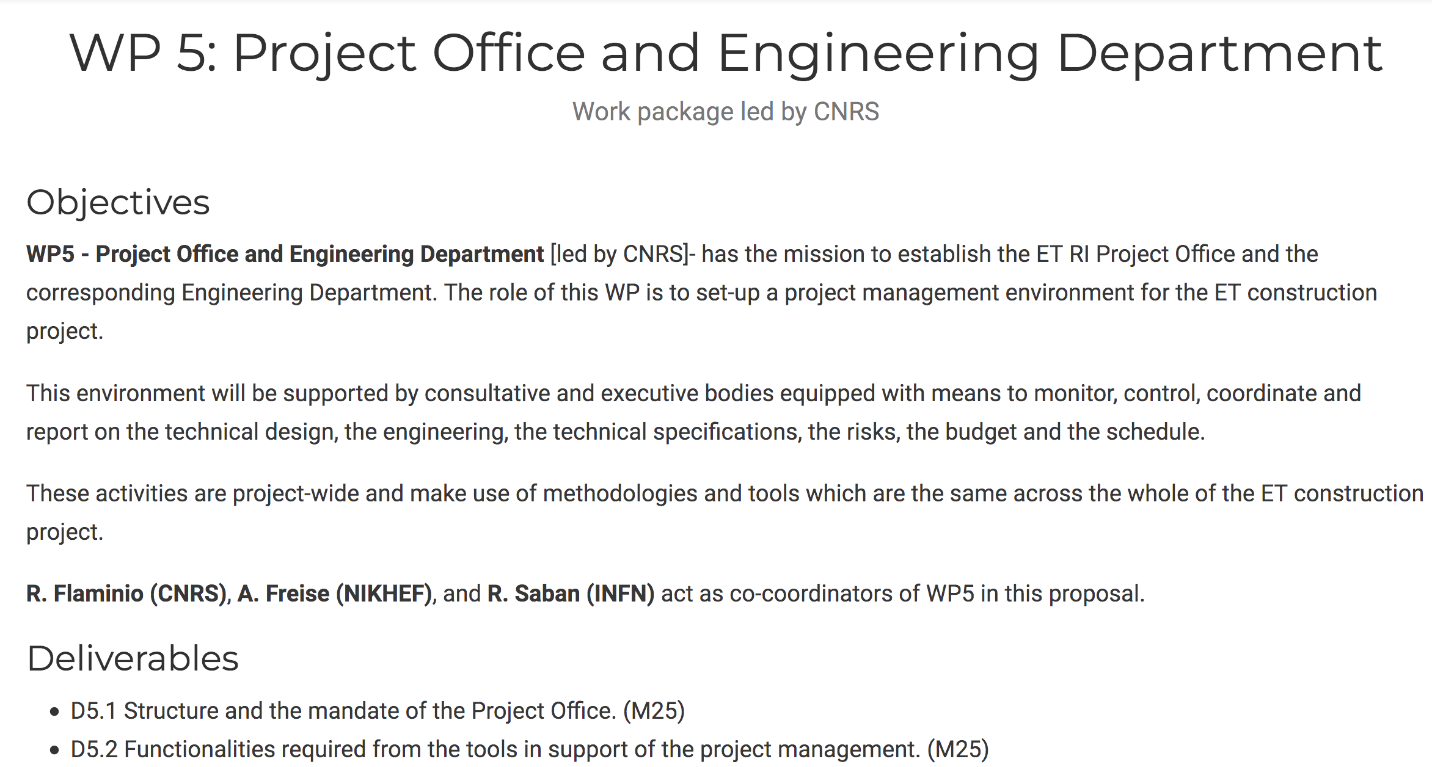
ET-PP web online https://etpp.ifae.es
Will be portal for all the ET-PP
information
15/11/22

Slide 8
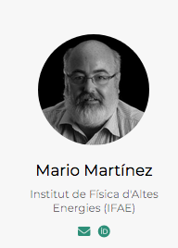
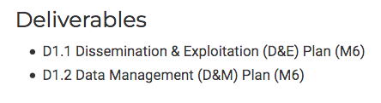
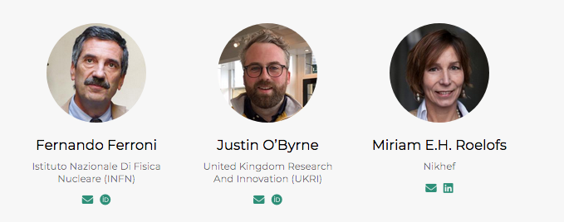
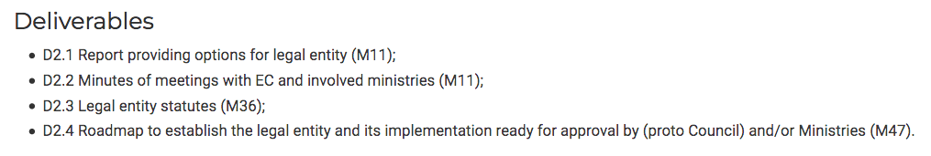
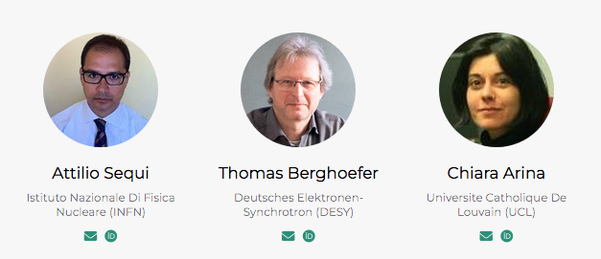
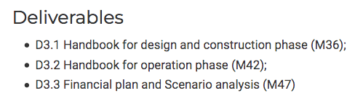
WP missions (1/5)
WP1 Coordination and Management
  Management
  Coordination
WP2 Organization, Governance and Legal Aspects
  ET Internal Organization
  Legal Framework
  Enlargement of the ET Consortium
  Political convergence
  Connection to other observatories and communities
  RI layout, Strategic issues and international networking
WP3 Financial Architecture
  Cost evaluation
  Cost Sharing
  In-kind Contributions
  Define immediate financial tools

Slide 9
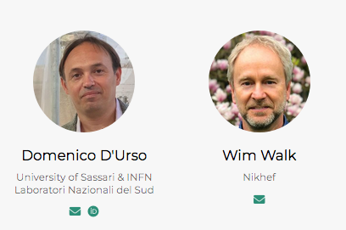
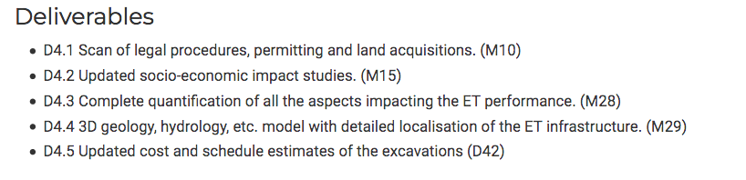
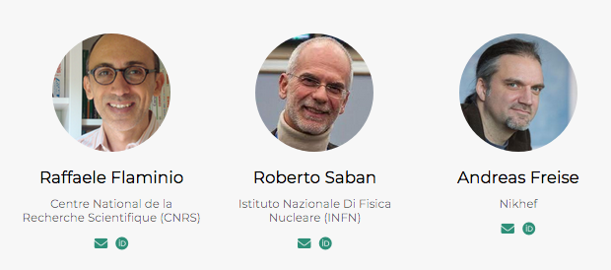
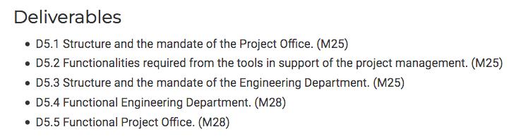
WP missions (2/5)
WP4 Site Preparation
  Site scientific evaluation
  Socio-economic impact
  Legal/Financial aspects of the RI implementation
  Mediation planning
WP5 Project Office / Engineering Dept.
  Technical Coordination of the Project
  Human resources qualification
  Strategic decisions making process
  Planning
  Preparation for Production
  Industrial Partnerships
  Risk Management

Slide 10
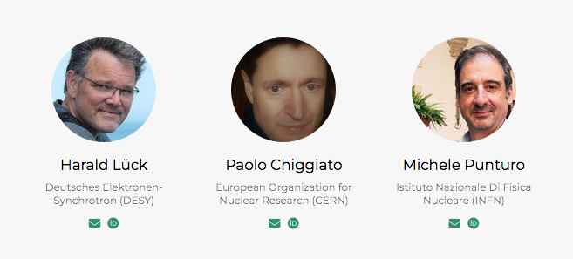
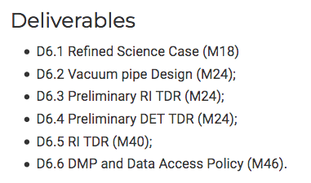
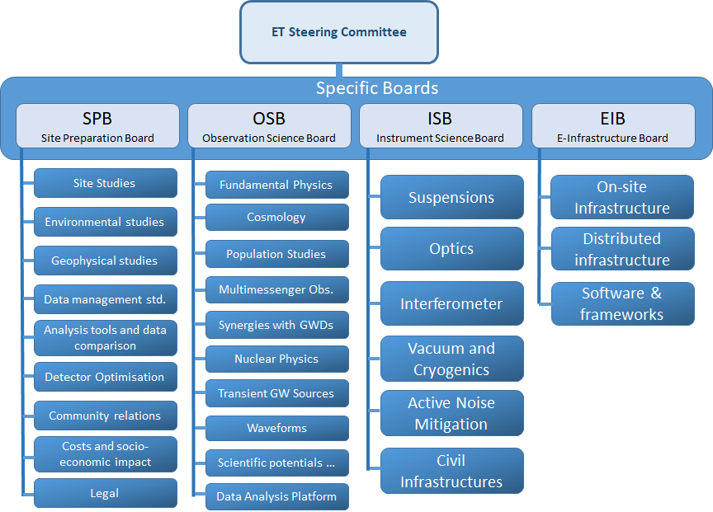
WP missions (3/5)
WP6 Technical Design
  Infrastructure Technical Design
  Experiment Technical Design
  Scientific impact
  Open Data Access and Services
As expected there is a strong synergy
with existing ET internal organization
→ Seeking for the best coordination !
We also involved external experts with
huge experience from CERN

Slide 11
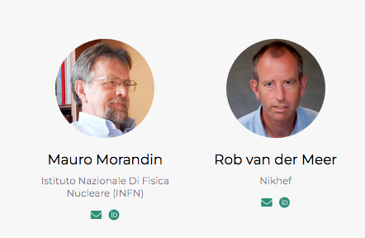
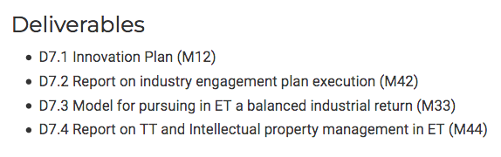
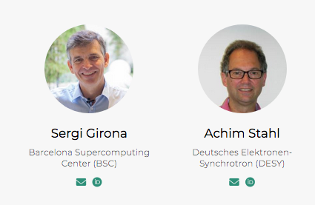
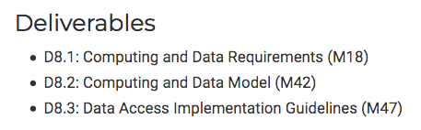
WP missions (4/5)
WP7 Transfer of Technology
  Promotion of Innovative technologies
  Liaison with industries, industrial returns
  Intellectual Property
WP8 Computing and Data Access
  Computing model
  Computing Resources
  T0 Data Center
  Data Preservation

Slide 12
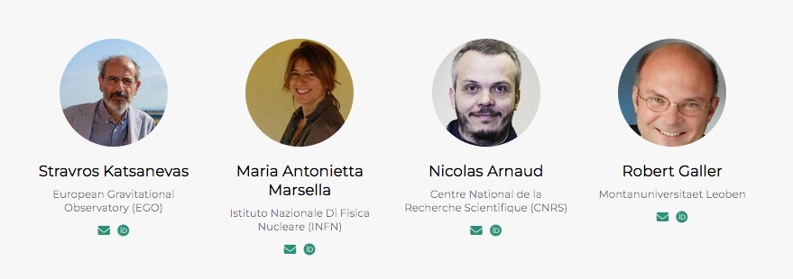
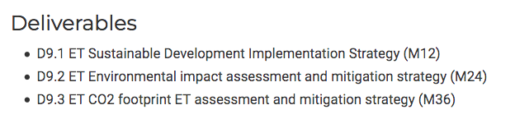
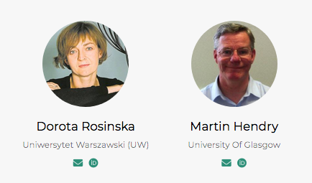
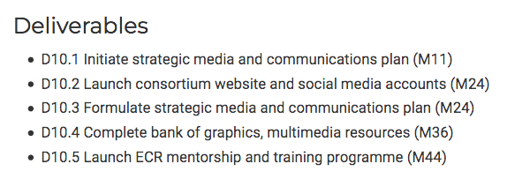
WP missions (5/5)
WP9 Sustainable Development Strategy
  Low Carbon footprint
  Liaison with Climate Change and Geoscience
  Landscape and Environmental impact
  Transportation
WP10 Education, Outreach and Citizen Engagement
  School Education Program
  Dissemination and communication
  Mentoring and Training
  Diversity and Inclusion
  Early Career Scientists

Slide 13
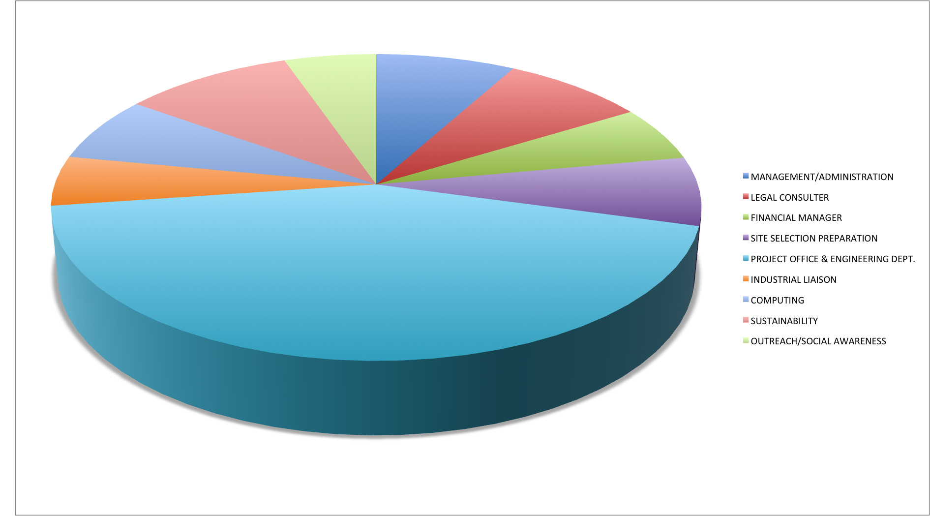
Budget allocation
A large fraction devoted to the creating of the Project Office/ Engineering Department (44%)
Significant funding for expert consulting on legal and financial aspects,
socio-economic impacts, and site selection related studies
Significant funding for sustainability studies
Funding for ET-PP management, KTT, Computing model, and Outreach/Communication
Position | ASSIGNMENT
Technical Coordinator | INFN (IN-KIND)
Systems Engineering | NIKHEF (IN-KIND)
Parameters, layout, risk Manager | CNRS (INFRA-DEV)
Software Engineer | CNRS (INFRA-DEV)
Civil Engineer | NIKHEF (INFRA-DEV)
Vacuum Engineer | CNRS (INFRA-DEV)
Integration and Technical Infrastructures Engineer | INFN (INFRA-DEV)
Head Project Office | INFN (IN-KIND)
Head Engineering Department | NIKHEF (IN-KIND)
Project Office/Engineering Dept.
  Technical Coordinator (in-kind)
  System Engineering (in-kind)
  Parameters, Layout, Risk Manager
  Software Engineer
  Civil Engineering
  Vacuum Engineer
  Integration and Technical
  Infrastructures Engineer
Design of the vacuum system by CERN
(in-kind funding included for first year)

Slide 14
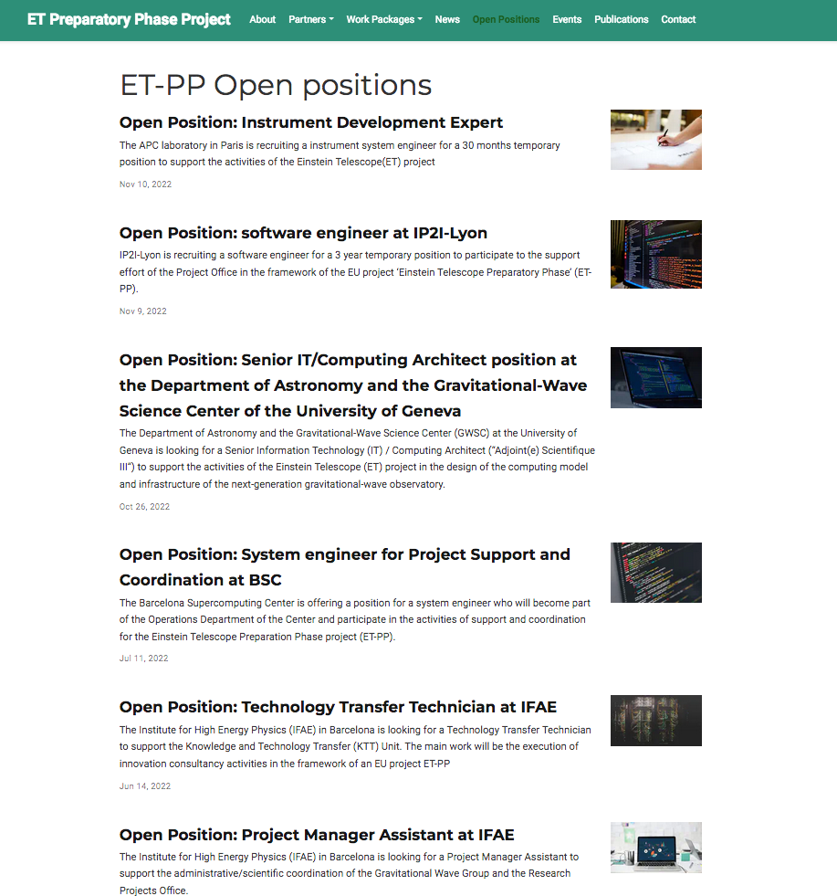
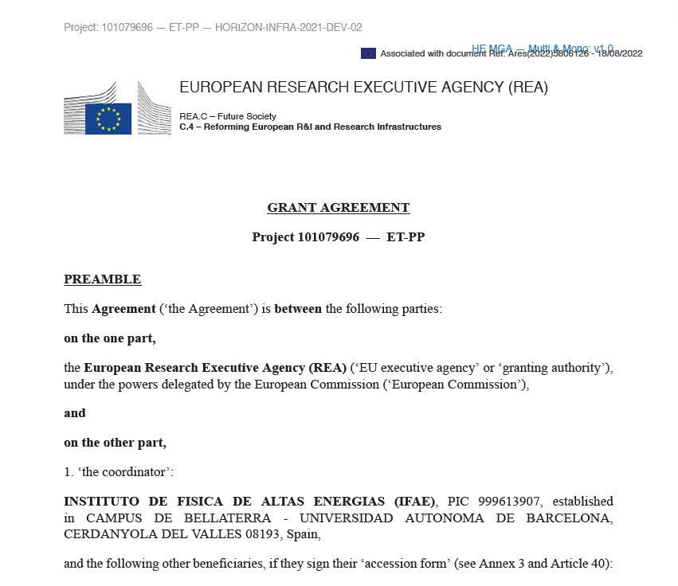
Grant Agreement finally signed
with EC by middle August 2022
Concluding now the Collaborative
Agreement among partners
Budget being now executed
A number of open positions
are advertised in ET-PP page
→ More to come

Slide 15

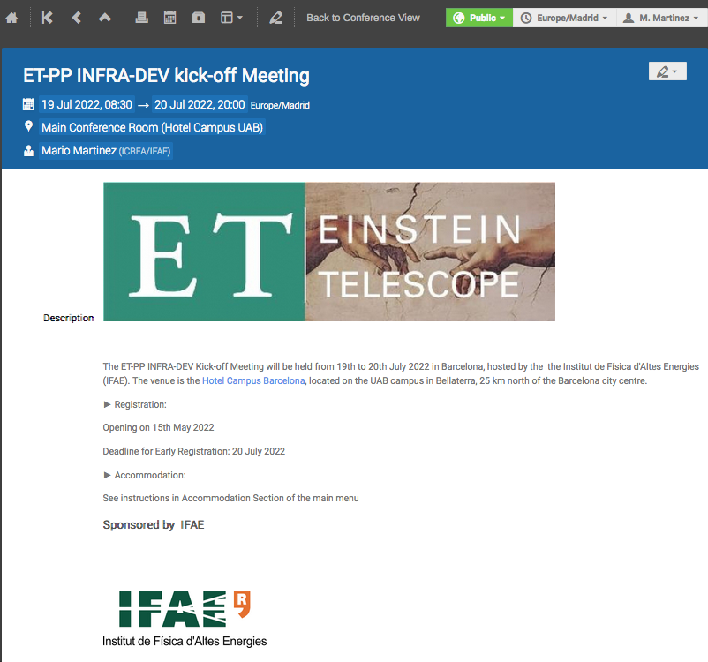
INFRA-DEV Kick-off meeting
July 19th – 20th 2022 @ Barcelona
We had an in-person 2 days meeting of ET management & INFRA-DEV WP coordinators
WP-WP discussions taking place during first day followed by plenary reports and plan drawing/discussions the second day
Dedicated slot for BSR and presence of BGR
Dedicated slot on ET-PP Collaborative Agreement & EC Reporting details
https://indico.ifae.es/event/1393
Running biweekly zoom meetings since then
All hands in-person meeting @ BCN foreseen for early summer 2023 (covered by ET-PP funds)

Slide 16
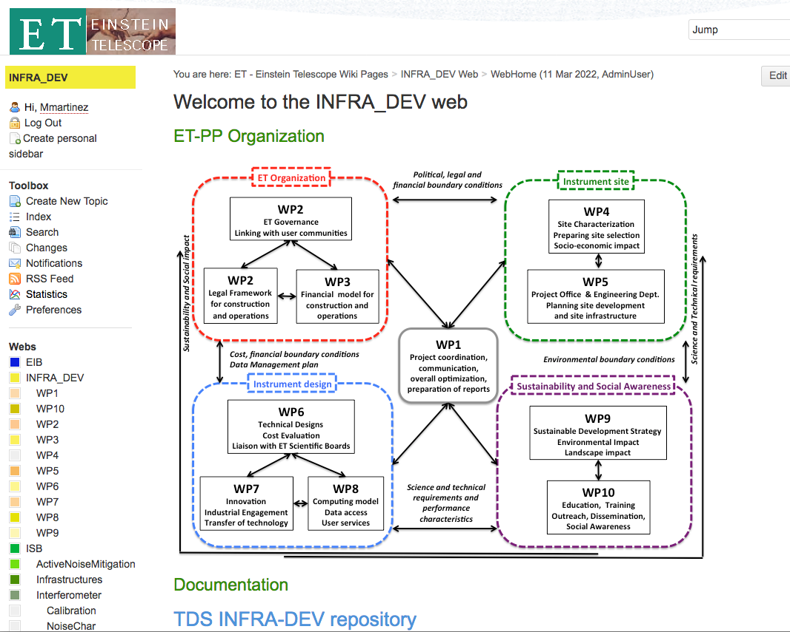
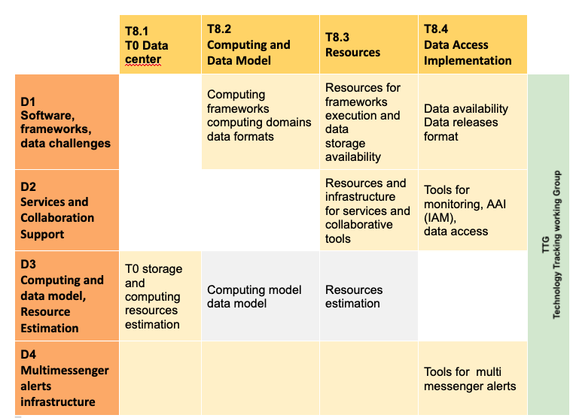
ET-PP after submission
ET-PP started already to work without waiting for the EC resolution
  Running ET-PP coordinating meetings
  First Common Document repository in place @ EGO (TDS + Wiki)
  Exploring CERN management tools actively
    At the moment being evaluated in WP5/7
  ET bylaws in place
  ET Collaboration in place
Ongoing WP and WP-WP interactions
  Collecting information on governance and financial models from other organizations
  (CERN, SKA, ESS,…)
  Building the WP teams
  Establishing regular meetings
  SWOT analyses
  Mapping Tasks with ET Divisions
  ET Collaboration – ET Observatory relationship
Example: WP8 Tasks and EIB Divisions

Slide 17
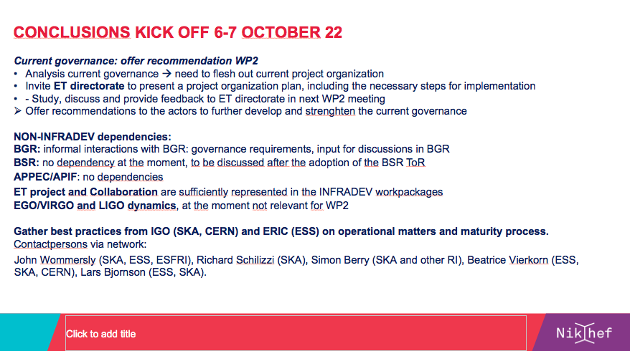
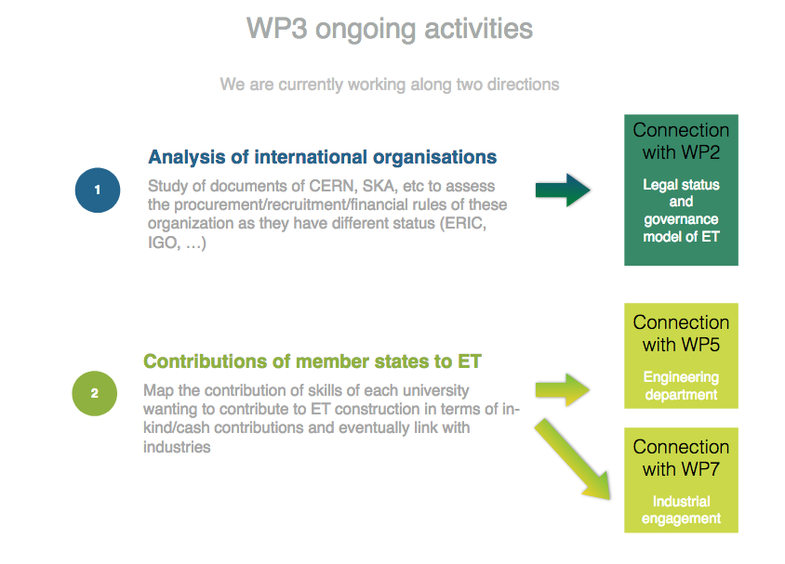
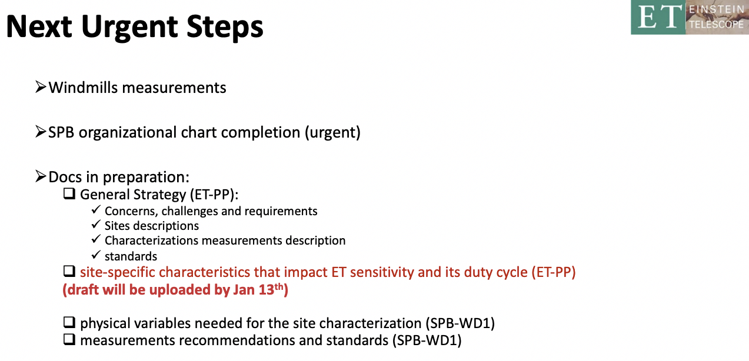
Few recent examples
WP2
This is to give you the flavour
lots of work is on going in
the exploration of Governance
and Financial Models
Also in the area of ET Project and Site preparation WP
WP3
WP4

Slide 18
ET-PP Deliverables for 2023
WP1
  ET-PP Dissemination and Exploitation plan (Feb 2023)
  ET-PP Data Management Plan (Feb 2023)
WP2
  Report providing options for legal entity (July 2023)
  Minutes of meeting with EC and involved ministres (July 2023)
WP3
  Financial model for immediate needs (NEW 2023)
WP4
  Scan of legal procedures, permitting and land acquisitions (June 2023)
  Updated socio-economic impact studies (November 2023)
WP5
WP6
WP7
  Innovation Plan (July 2023)
WP8
WP9
WP10
  Initiate strategic media and communication plan (July 2023)

Slide 19
Random final notes
ET-PP INFRA-DEV Horizon EU project on the run with 3.45M€
  Mission to facilitate the definition of a well organized and well functioning ET Project and timely decisions (lots of work ahead of us)
  Putting together a Governance structure heavily inspired by the (successful) CERN model → adequate for a 2B€ project.
  Defining the required tools / repositories adequate for a 2B€ project.
  Funding Agencies recommend to learn from other ESFRI lessons and avoid known/old mistakes
  Funding Agencies very sensitivity to delays as (too often) happens in other ESFRI endeavours
Four years ahead of us to define many important aspects of the ET project and to take important decisions
  Within ET-PP, most emphasis in defining a functional Project Office and Engineering Department, Governance, Legalities and Site Preparation
  Other important aspects include financial model, sustainability, industrial returns and social awareness….
  Key presence of CERN experience
  Crucial to marry ET-PP WPs and ET Boards realities, deliverables, milestones
  ET site characterization / cost estimates needed soon
  Delivery of a preliminary “TDR” in 2 years is main mission of ET Collaboration

Slide 20
Thanks for your attention

