Slide 1
03/02/2023 – Einstein Telescope Civil Engineering
Costing Methodology of CERN Future Studies
Liam Bromiley SCE-DOD-FS

Slide 2
Items
Purpose
Methods
Cost estimate variability
Additional engineering costs
Inflation & Currency
FIDIC Contract
FCC Study example
Project Breakdown Structure

Slide 3
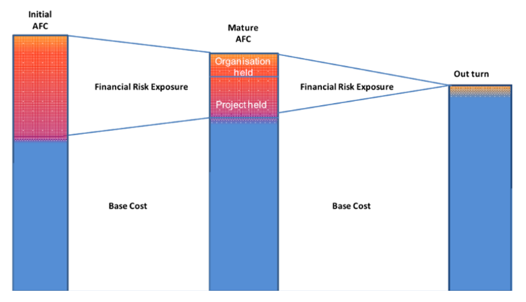
Purpose
Necessary but extremely difficult
To support the business case of projects
To facilitate investment decisions
For budget, schedule and resource planning
The results of which have significant influence on the future of a project or organisation

Slide 4
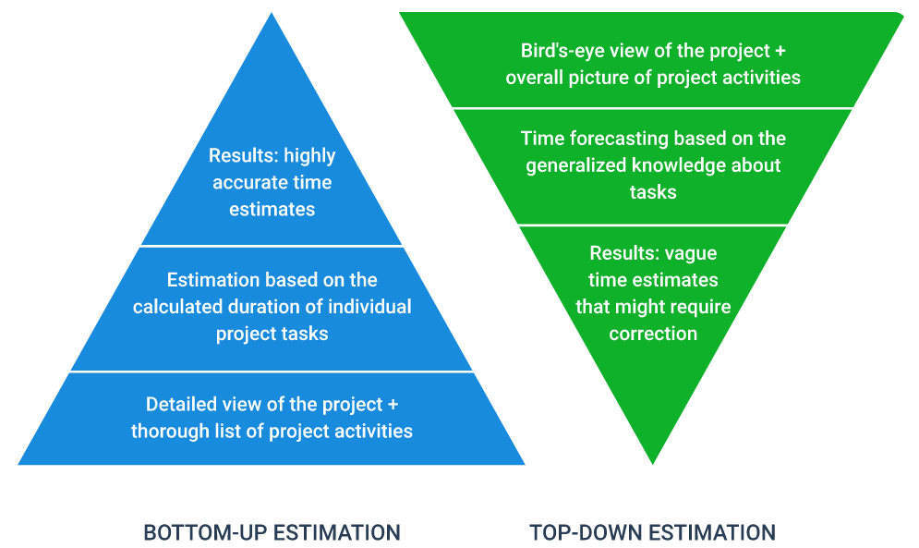
Methods
Comparative
Find similar projects and compare actual and predicted costs.
Consider project attributes, inflation and technological improvements.
Not recommended!
Top Down
Estimate from previous experience.
Consider size and duration of project.
Bottom Up
Develop Bill of Quantities or activity schedule.
Consider the services of external consultant.

Slide 5
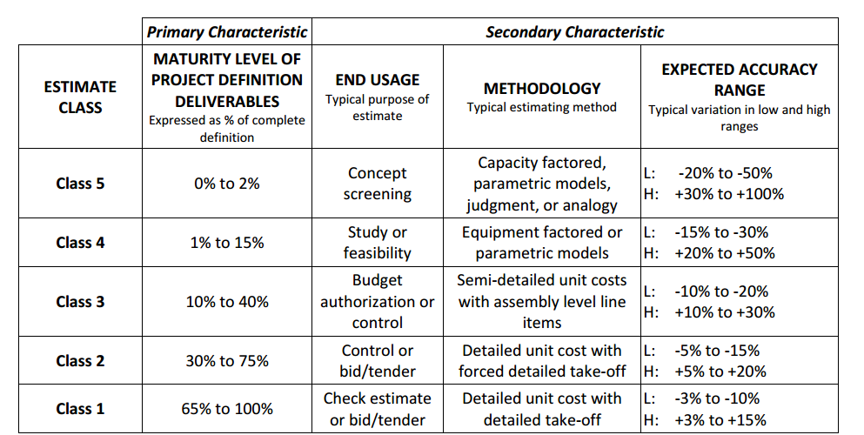
Future Studies Methodology
Pre-Feasibility
+100%
Feasibility
+50%
Concept Design
+30%
Technical Design
+20%
Construction
+15%
Project phases and typical upper level of cost uncertainty
Cost uncertainty decreases with project development
+100% > +15%
Maturity level dictates cost class
Christensen, P, Dysert, LR, Bates, J, Burton, D, Creese, RC & Hollmann, J, 2016.
Cost Estimate Classification System - as applied in engineering, procurement, and construction

Slide 6
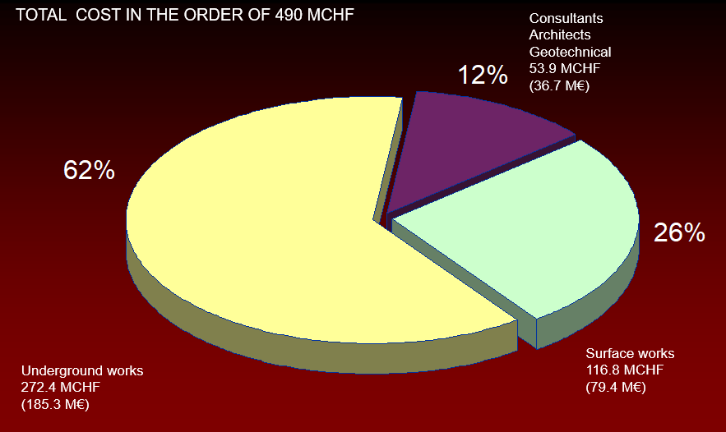
LHC Civil Engineering Costs

Slide 7
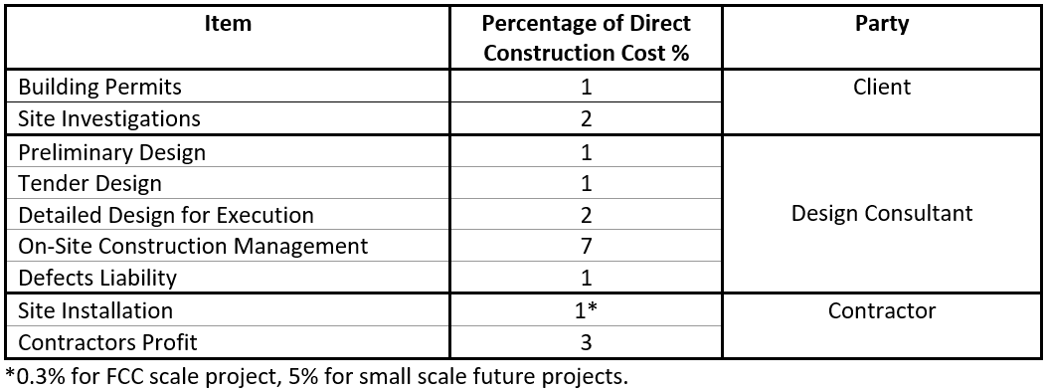
Additional Engineering Costs
Costs added to the direct costs for civil engineering tasks.
Comparative between estimates from different consultants

Slide 8
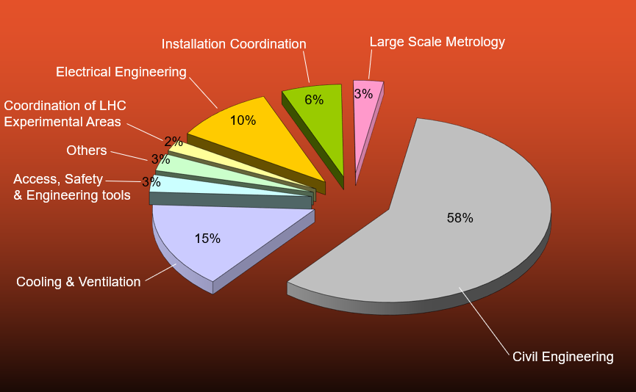
LHC Total Infrastructure Costs
At CERN Civil Engineering is a member of a larger infrastructure group where all technical aspects are considered and developed.

Slide 9
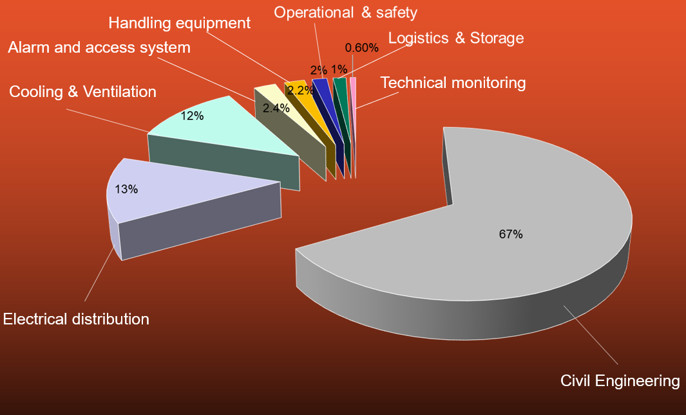
Hi-Luminosity LHC Upgrade Costs

Slide 10
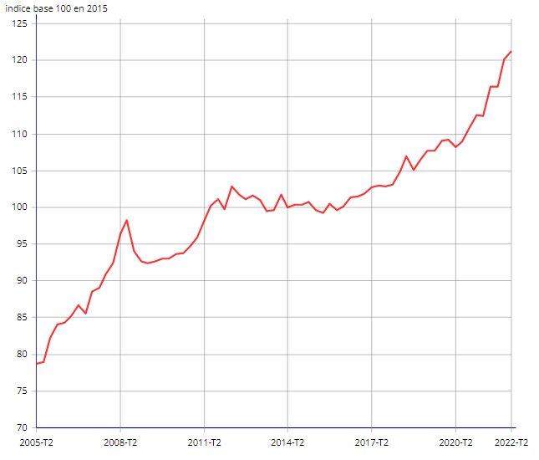
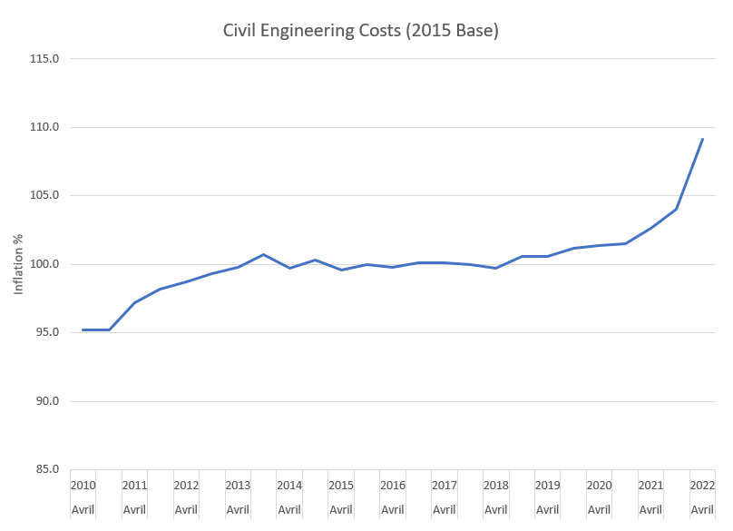
Inflation & Currency
Inflation hard to predict
CERN experiences variation of two currencies
Euro vs CHF conversions
French Construction Inflation
Swiss Construction Inflation
https://www.bfs.admin.ch/bfs/fr/home/statistiques/prix/prix-construction/indice-prix-construction.html
https://www.insee.fr/fr/statistiques/2015347#graphique-figure1

Slide 11
FIDIC Contract
FIDIC – International Federation of Consulting Engineers
CERN used a modified version of FIDIC, “Conditions of Contract for Works of Civil Engineering Construction” 4th Edition, or “The Red Book”. Re-measurement type of contract.
Was well suited to the LHC type of construction for the following reasons :
  Well recognised contract documents for International Projects
  Suitable for projects where main responsibility for the design lies with the Client (or his Engineer).
  Work done is measured, payment via Bill of Quantities
  Scope to modify the works via Variation Orders
  Adjudication Process for Claims & Disputes

Slide 12
FIDIC Contract - LHC Results
Adjudication procedure was deemed a great success.
A panel of 5 “experts” agreed with the Contractors.
3 disputes were referred to the panel (2 with the Contractors and 1 with the Consultants).
Several disputes settled without need for Adjudication because one party “feared losing control”.
Decisions made very quickly (within 2 months) in accordance with Contract.
Each adjudication cost less than 1.5% of the adjudicated amount.
All disputes during LHC construction have been resolved.
No Arbitrations.

Slide 13
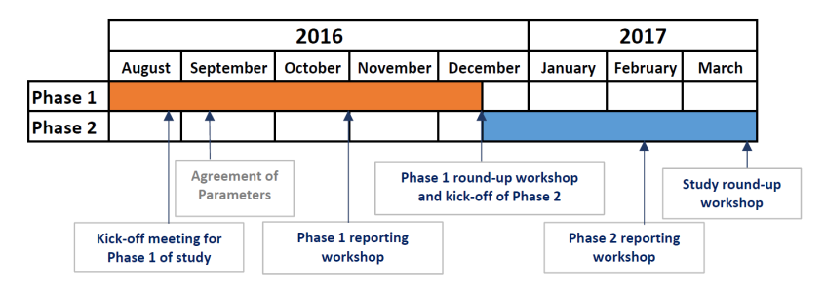
FCC Feasibility Study - CDR
Phase 1 – Baseline cost and schedule.
  Preliminary estimate produced
  Full list of structures
  Adjustable cost model
  Preliminary risk register
Phase 2 – Alternative options and schedule update.
  Options to be costed individually
  FCC examples – Double tunnel, shallow option, inclined access tunnels, alternative tunnel, shaft, or cavern dimensions
Phase 3 – Optional phase of updates and refinements.
  Final refinements ahead of CDR

Slide 14
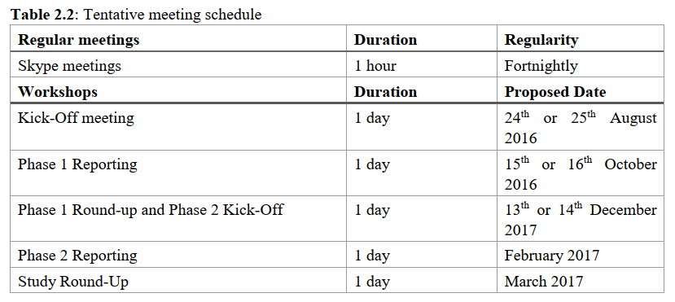
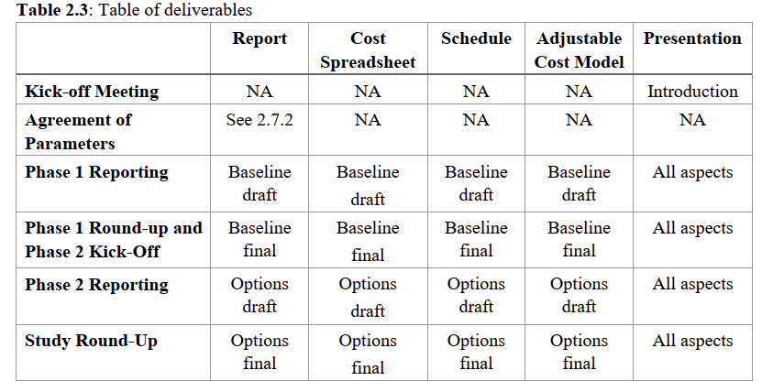
FCC Feasibility Study – Meetings and Deliverables

Slide 15
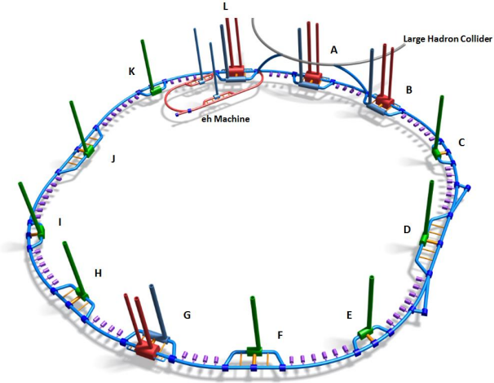
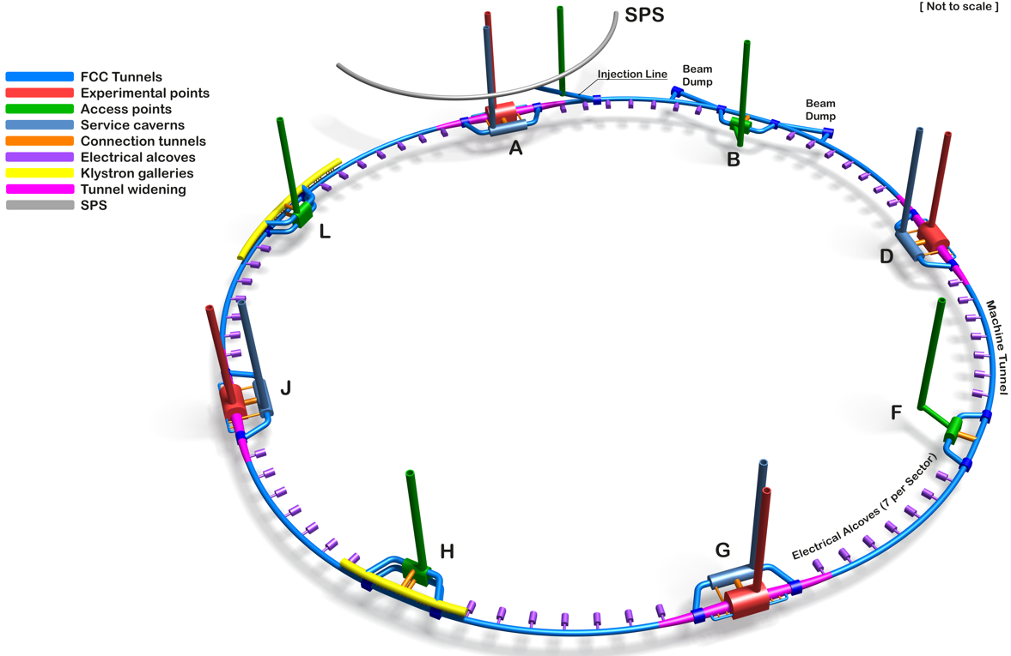
FCC Feasibility Study – Post CDR
Further development post CDR
Requires a freeze of a baseline design
Updated cost and schedule for mid-term review

Slide 16
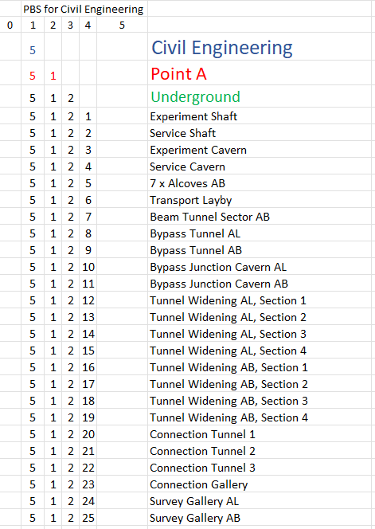
Product Breakdown Schedule - FCC
Breakdown of all component pieces of a project
Level of granularity can be chosen depending on stage of project
Credit: Angel Navascues Cornago

Slide 17
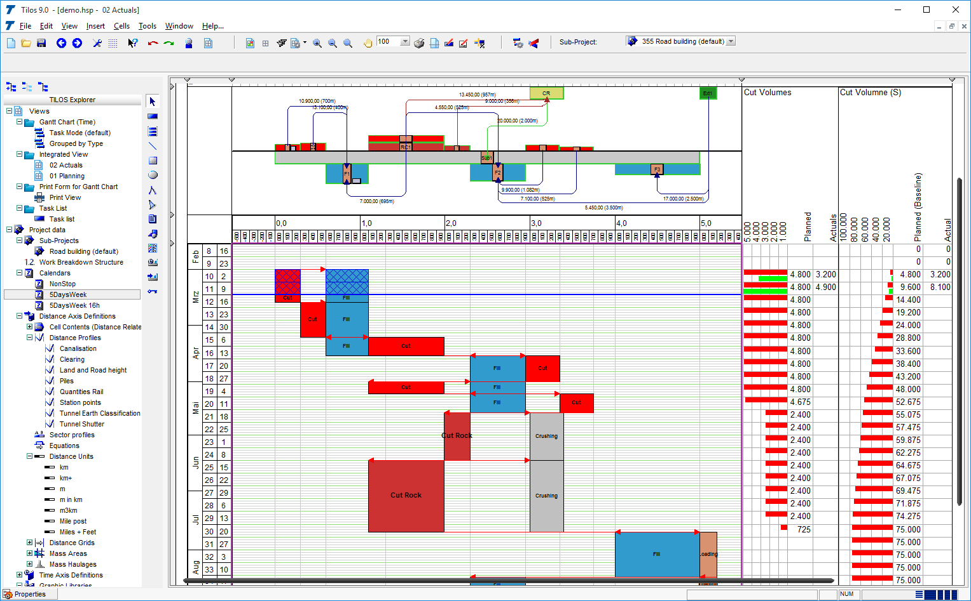
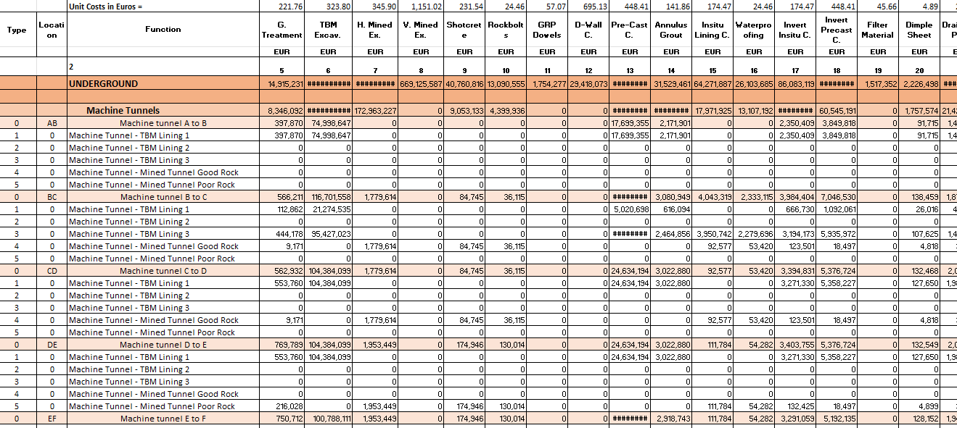
Cost Outputs
Excel Spreadsheets - CDR
TILOS - Future

