Slide 1
Final Focus Design of CLIC BDS at 7 TeV
Enrico Manosperti
27/01/2023

Slide 2
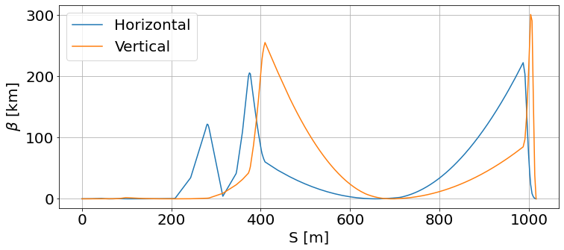
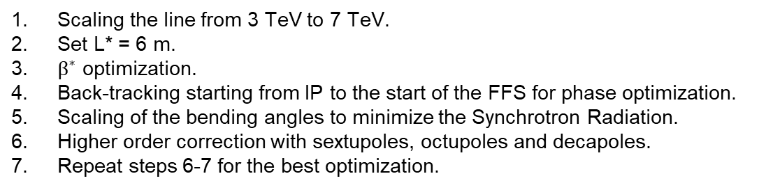
Steps
Scaling the line from 3 TeV to 7 TeV.
Set L* = 6 m.
$β^{∗}$ optimization.
Back-tracking starting from IP to the start of the FFS for phase optimization.
Scaling of the bending angles to minimize the Synchrotron Radiation.
Higher order correction with sextupoles, octupoles and decapoles.
Repeat steps 6-7 for the best optimization.

Slide 3
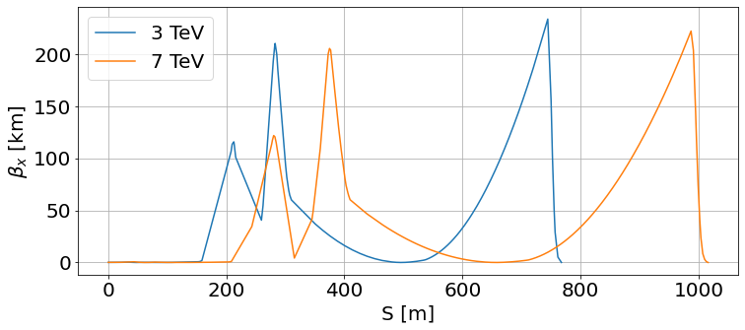
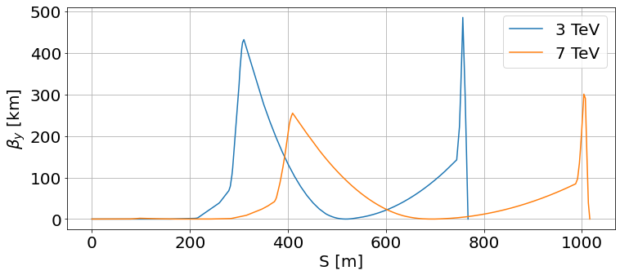
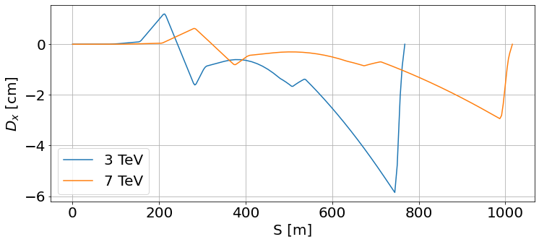
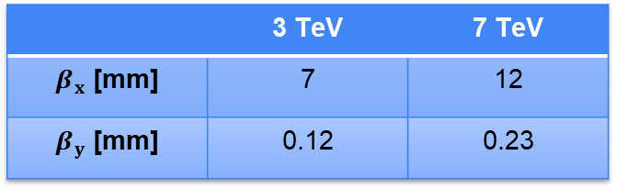
FFS design
 | 3 TeV | 7 TeV
$β_{x}$ [mm] | 7 | 12
$β_{y}$ [mm] | 0.12 | 0.23

Slide 4
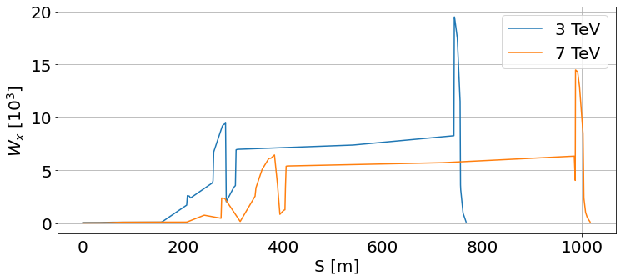
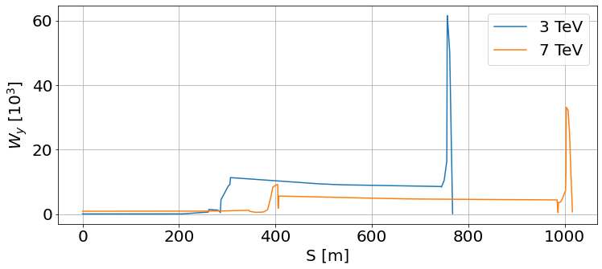
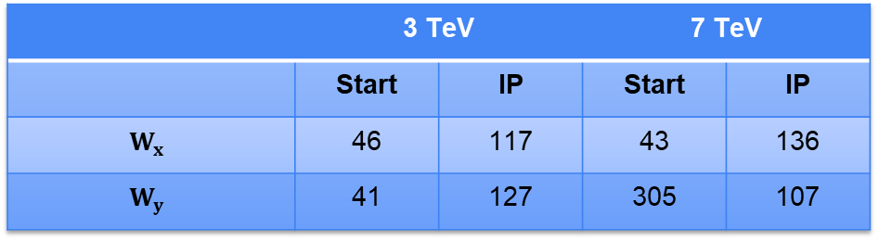
Chromatic amplitude function
 | 3 TeV |  | 7 TeV
 | Start | IP | Start | IP
$$W_{x}$$ | 46 | 117 | 43 | 136
$$W_{y}$$ | 41 | 127 | 305 | 107

Slide 5
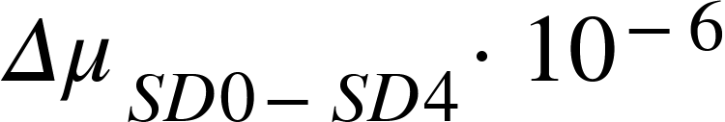
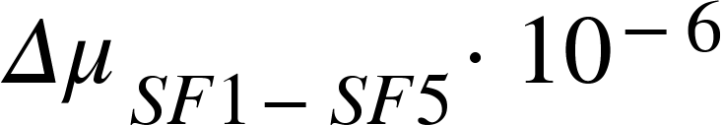
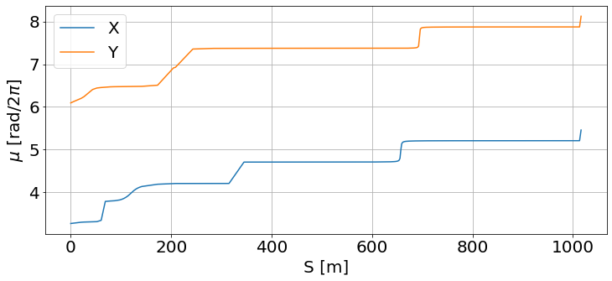
Phase advance between sextupoles
7 TeV
NAME | MUX | MUY | DX
SF6 | 4.210007 | 7.368486 | 0.006002
SD5 | 4.709885 | 7.371364 | -0.003903
SF5 | 4.709943 | 7.371535 | -0.006423
SD4 | 4.709971 | 7.371549 | -0.004604
SF1 | 5.209940 | 7.871527 | -0.029300
SD0 | 5.209965 | 7.871547 | -0.011337
 | X | Y | X | Y
7 TeV | 5.6 | 2 | 3.1 | 8.6
3 TeV | 8.2 | 2.8 | -3.7 | -10
3 TeV
NAME | MUX | MUY | DX
SF6 | 4.100513 | 7.326341 | 0.009224
SD5 | 4.600407 | 7.329715 | -0.006268
SF5 | 4.600447 | 7.329896 | -0.012160
SD4 | 4.600480 | 7.329934 | -0.007246
SF1 | 5.100451 | 7.829906 | -0.027325
SD0 | 5.100472 | 7.829931 | -0.010574

Slide 6
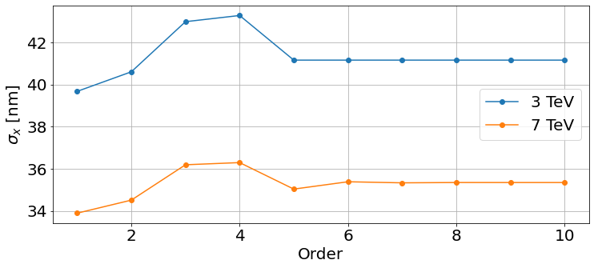
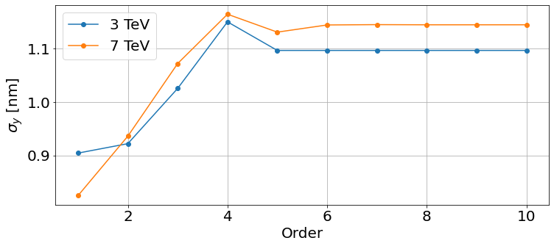
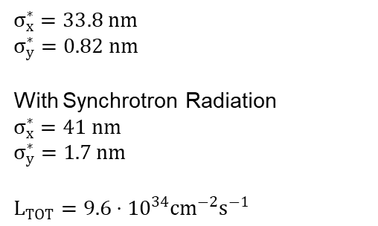
Beam size and Luminosity
$$σ_{x}^{∗}=33.8 nm$$
$$σ_{y}^{∗}=0.82 nm$$
With Synchrotron Radiation
$$σ_{x}^{∗}=41 nm$$
$$σ_{y}^{∗}=1.7 nm$$
$$L_{TOT}=9.6⋅{10}^{34}cm^{−2}s^{−1}$$

Slide 7
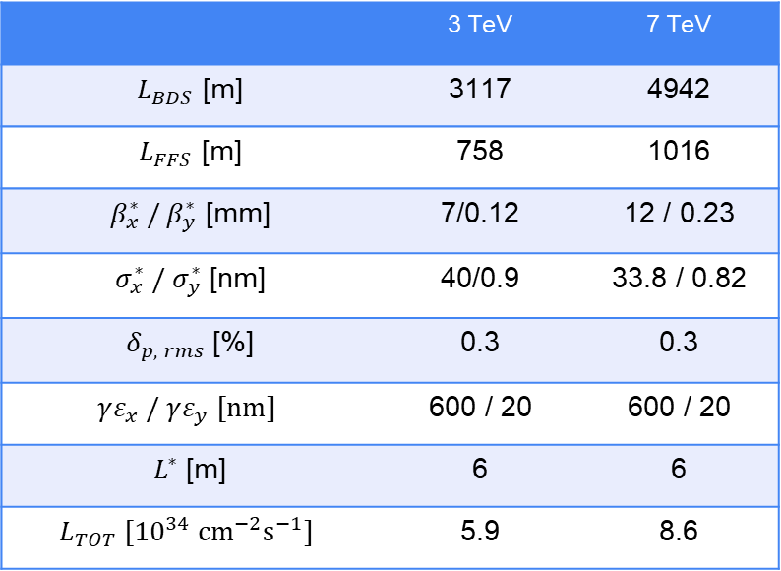
Full BDS Parameters
 | 3 TeV | 7 TeV
$L_{BDS}$ [m] | 3117 | 4942
$L_{FFS}$ [m] | 758 | 1016
$β_{x}^{∗} / β_{y}^{∗}$ [mm] | 7/0.12 | 12 / 0.23
$σ_{x}^{∗} / σ_{y}^{∗}$ [nm] | 40/0.9 | 33.8 / 0.82
$δ_{p, rms}$ [%] | 0.3 | 0.3
$$γε_{x} / γε_{y} [nm]$$ | 600 / 20 | 600 / 20
$L^{∗}$ [m] | 6 | 6
$$L_{TOT} [{10}^{34} cm^{−2}s^{−1}]$$ | 5.9 | 8.6

Slide 8
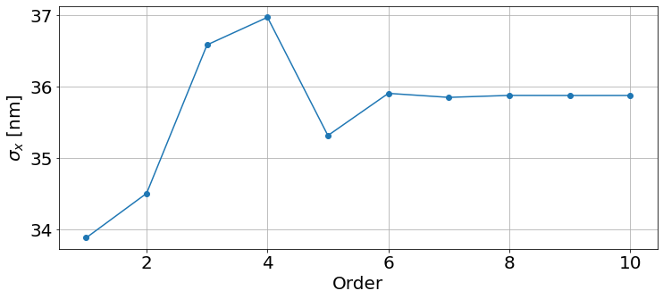
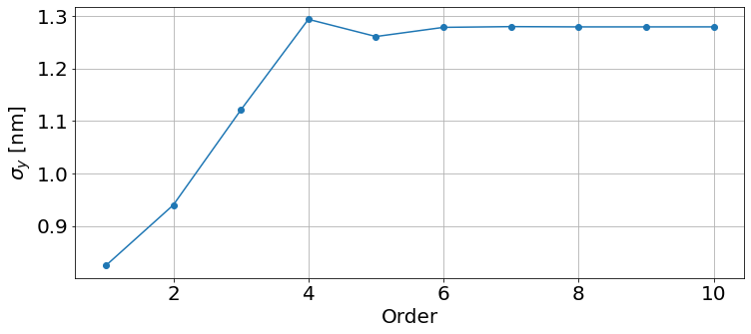
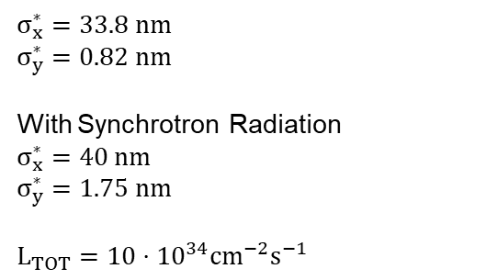
Alternative beam size
$$σ_{x}^{∗}=33.8 nm$$
$$σ_{y}^{∗}=0.82 nm$$
With Synchrotron Radiation
$$σ_{x}^{∗}=40 nm$$
$$σ_{y}^{∗}=1.75 nm$$
$$L_{TOT}=10⋅{10}^{34}cm^{−2}s^{−1}$$

