Slide 1
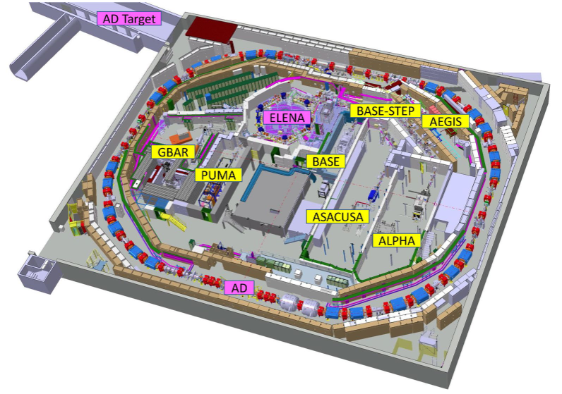
AD/ELENA run 2022 …and Plans for 2023
The Good and the Bad in 2022
Plans for 2023
ACKNOWLEDGEMENTS: D. Gamba, F. Asvesta, Y. Dutheil, S. Albright, H. Damerau, A. Lasheen,
R. Ramjiawan, S. Rey and many more colleagues for the material provided!
ADUC Meeting – Feb. 7, 2023 Lars Varming Jorgensen for the AD/ELENA team

Slide 2
The situation a year ago – end 2021 run
Beams close to design values were delivered to happy users!
Items that required improvement:
  Consolidate/improve instrumentation: availability and accuracy a generic issue from FTA to AD/ELENA to LNE, e.g. BPMs in FTA line? IPM in AD? Intensity in ELENA?
  Monitoring/logging: for detecting and promptly acting on degradation, e.g. PS extraction
  Collect/use references: for critical systems such as s-cooling
  Tooling: e.g. for transport optimization or for following hardware drifts
  Reduce radiation levels: e.g. p losses in FTA, shielding of AEgIS experimental area
  Recover pre-LS2 pbar/p yield
Hunting for even higher performance:
  Increase p intensity/quality in PS: coupled bunch instability in PS limited the p intensity to about 1500e10 p/cycle. To check if p bunch length should be reduced (or not)
  Improve AD/ELENA deceleration efficiencies
  Improve stability: mainly at AD target and extraction, other sources to be found
  Improve repetition rate: AD cycle length, improve PS super-cycle composition

Slide 3
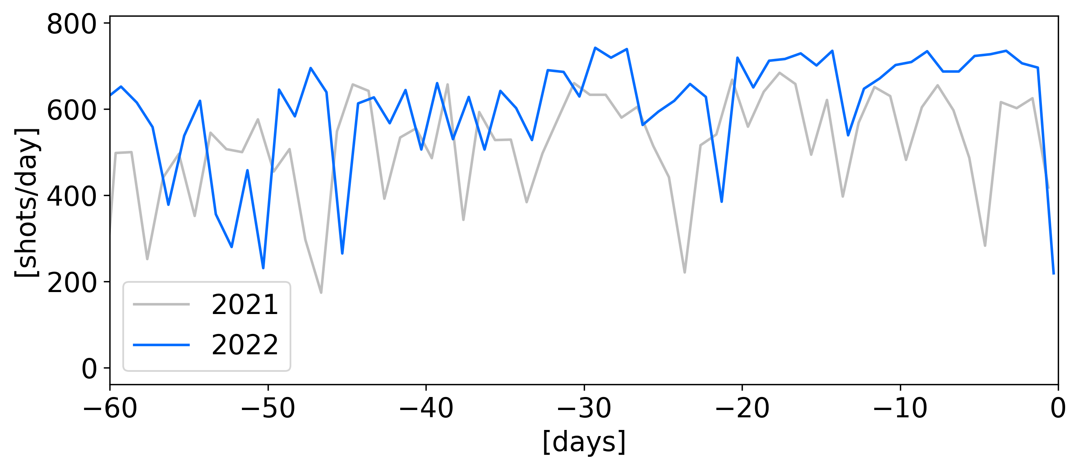
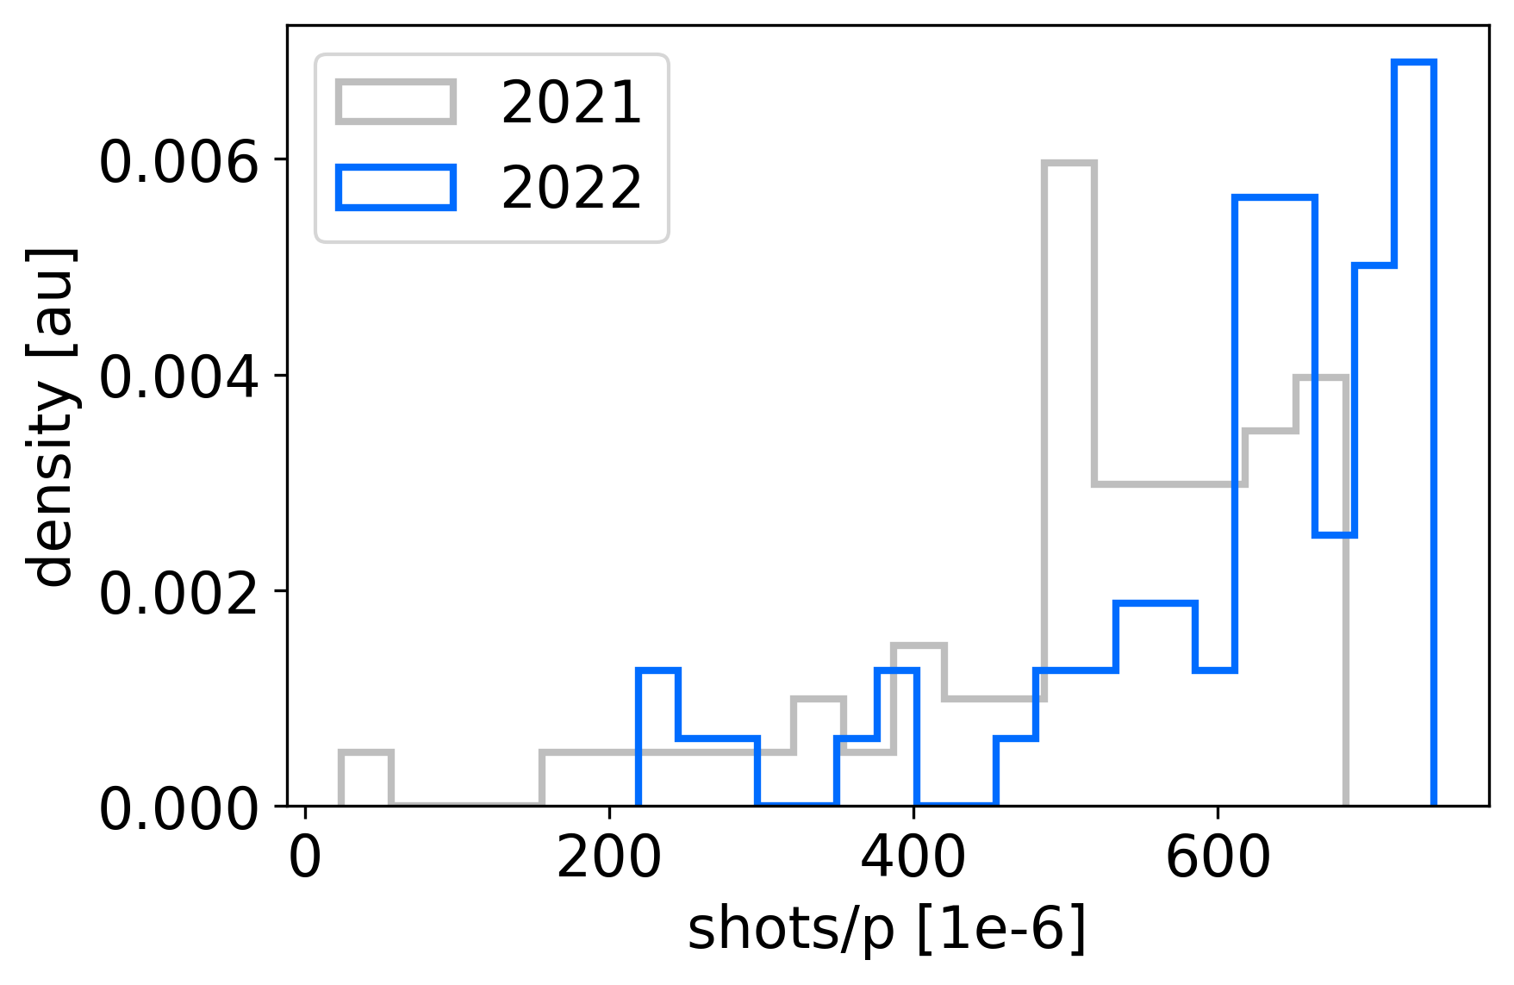
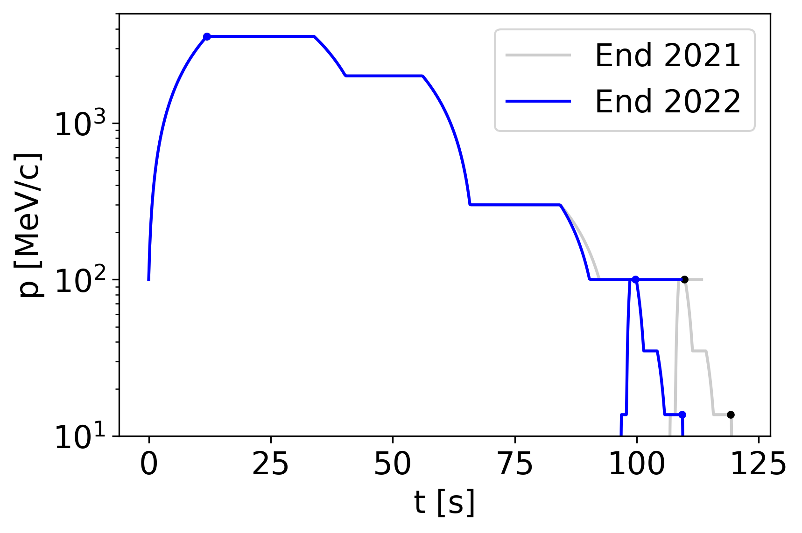
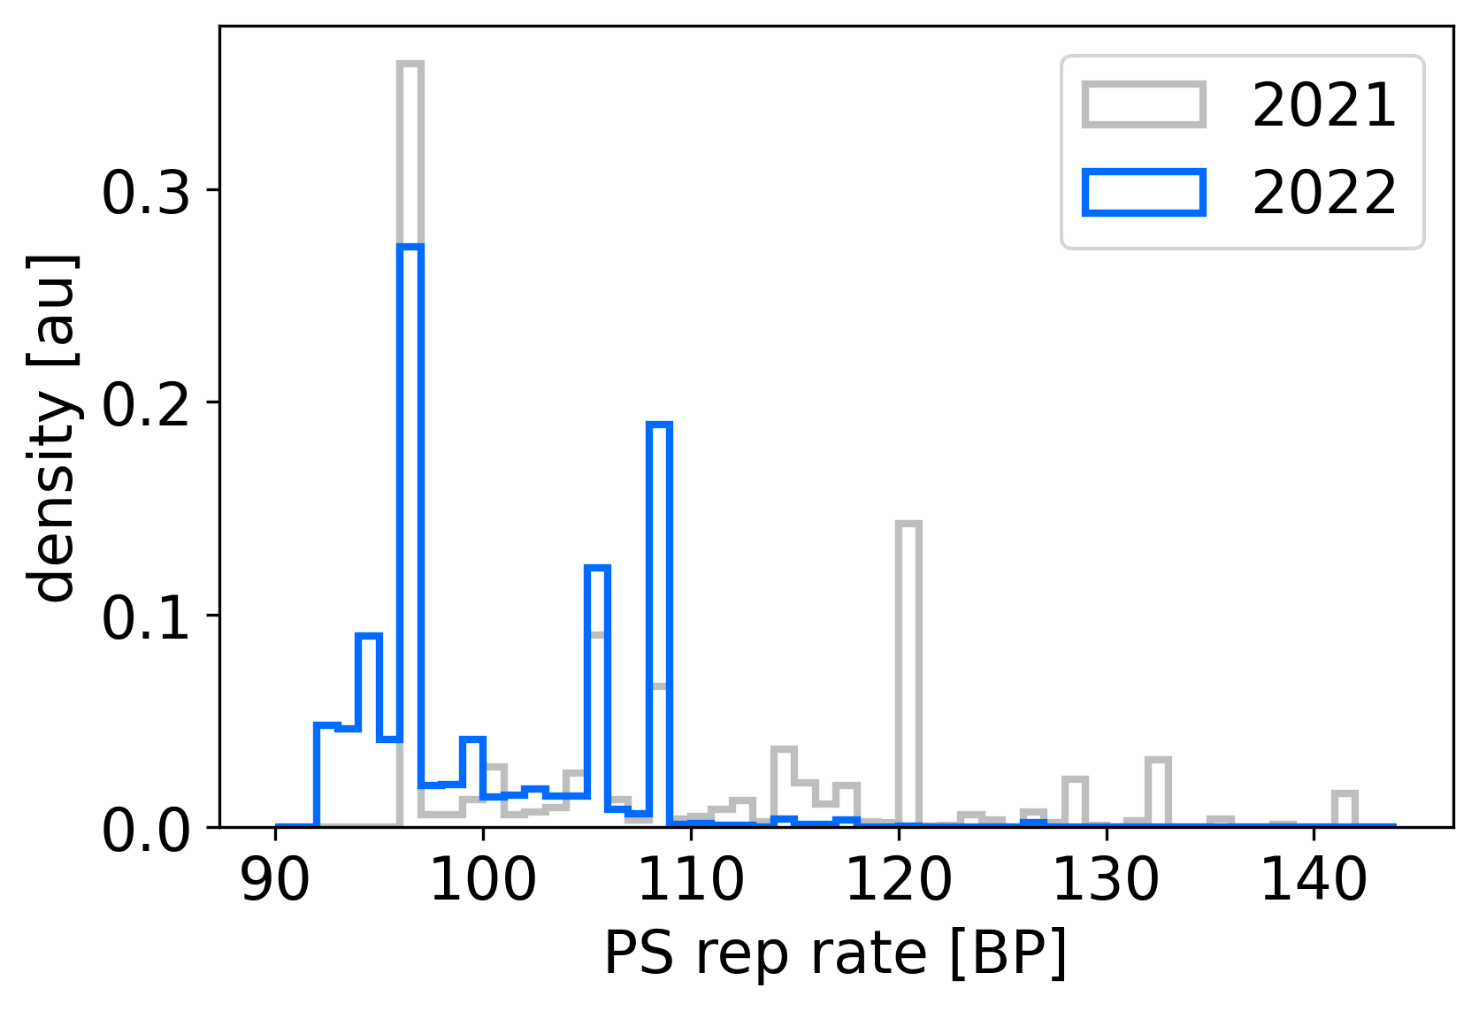
2022 - AD/ELENA Repetition Rate
Number of daily good pbar shots (>10% than nominal intensity) per day extracted from ELENA
  On average, 514 shots/day in 2021, 606 shots/day in 2022; to be compared to target of about 650 shots/day
KPI
KPI
[days from end of the run]
AD extraction anticipated by 10 s! but AD cycle total length reduced by ~4 s
  Had to wait for ELENA ejection before new AD cycle: experiments sensitive to AD magnetic field ramping up!
On the PS side, still some room for improvement:
  ~10% potential cycles lost in 2021, and ~7% in 2022 (computed over the last 60 days of operation). Experiments ask also for regular repetition rate
PS rep. period [BP]
Notes:
AD cycle reduced by 113304 to 109104, but AD extraction anticipated by 10 seconds!
2021: lost 3477 shots wrt to all 34013 and ideal 12203 shots, i.e. 10.22% to gain
2022: lost 2628 shots wrt to all 35844 and ideal 1747 shots, i.e. 7.33% to gain

Slide 4
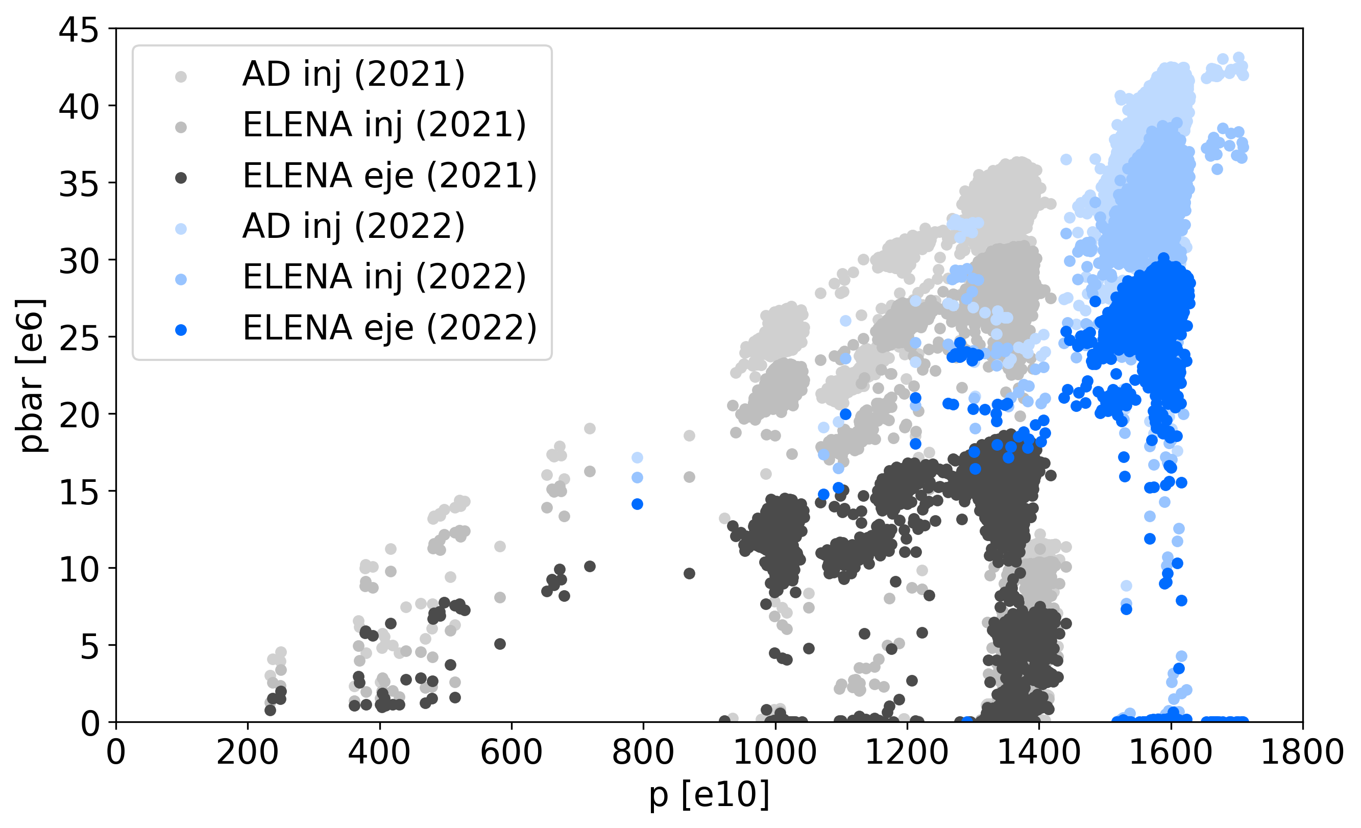
AD/ELENA Intensity/Transmission
Overall performance: pbar per proton on target
  Looking last ~20 days of operation for 2021 and 2022
  Warning! In 2021 (and most of 2022) we were fooled by ~40% overestimate of beam intensity at ELENA ejection! Still uncertainties on pbar intensity measurement!
KPI
*
Still something to gain
in tranmission!
2022 LNE goal
(based on previous intensity estimate…)
*
Design
* All ELENA eje data presented here was rescaled to match the latest calibration estimate
Overall: another excellent year for AD/ELENA with performance improvements!
  Still need to work on stability, repetition rate, and transmission…

Slide 5
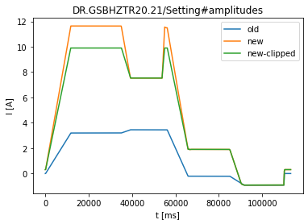
Power Converter Reliability
AD Dipole Trim (BHZ-Trim) PC failure end of April
  EPC did not manage to get it back online
    Old equipment, difficult to diagnose
    (See details at IEFC meeting #306)
  Found a patch using all orbit correctors
    Managed to conclude the run in this state, but
    we should get back to the nominal setup!
Main Quadrupoles (QMAIN)
  Several trips especially during summer time
  Interventions to improve reliability often resulted in different machine
    (typically, different tune): not straightforward to debug
Horn power converters not able to sustaining max voltage (sparks!)
  Weakness in the design identified, but probably just a single bad cubicle.
  Issues with communication/trips being investigated
More and more urgent to think about anticipating(?) the powering consolidation?
PC max

Slide 6
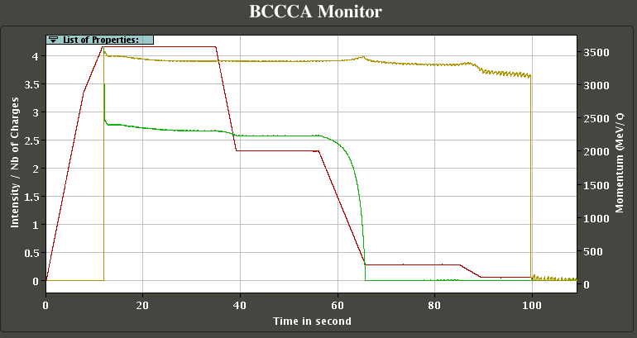
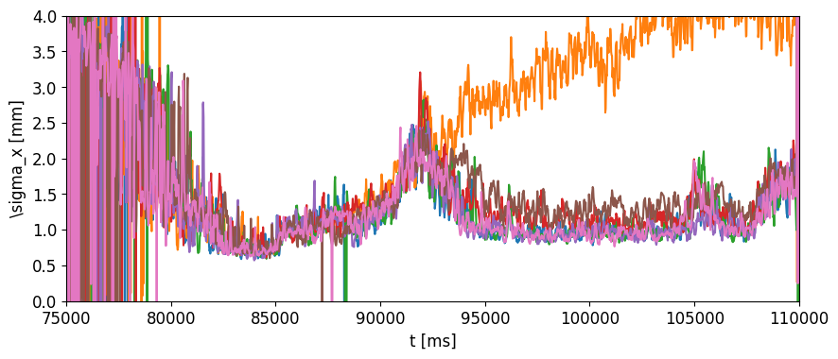
Instrumentation Reliability and Accuracy
AD BCCCA stopped working
  Started the year in degrated mode
    Had to find a workaround to make it work
  Finally unusable in October
    Cross-calibrated an RF signal using historical
    data as temporary replacement
      Only works for bunched beam, and is not self-calibrated
Intensity monitor in ELENA ejection line turned out to be wrong by ~40%!
  We must improve! This is the primary information we provide to our users.
AD IPM only partially operational
  Still, it allowed us to see that transverse cooling at 100 MeV/c is done in 5 s instead of 15 s
  We should get this instrument fully operational: it will be a game changer!
300 MeV/c
ramp
100 MeV/c
RF ON
Bad settings!
Horizontal beam size as a function of time while scanning on e-pbar alignment
Best settings?

Slide 7
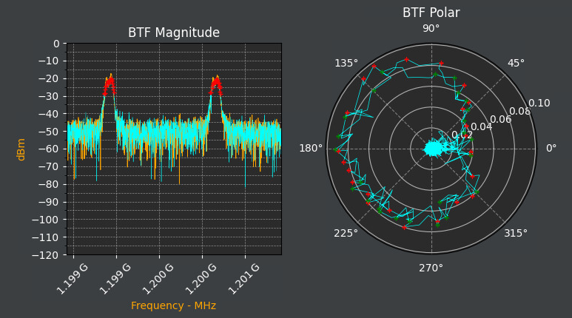
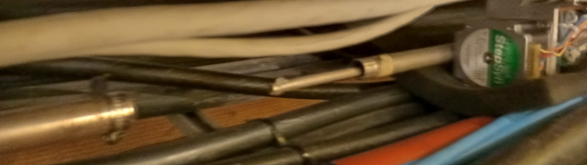
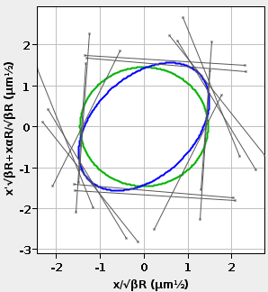
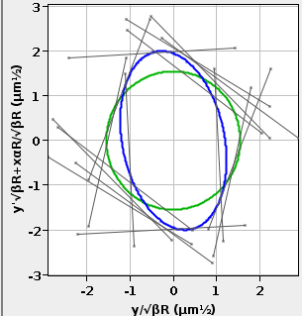
Work on Machine Understanding and Documentation during 2022
Weekly MDs with biweekly discussions (see wikis)
  Investigate hardware issues/limitations
    E.g. AD bunch rotation
  LSA tools debugging
    E.g. LLRF makerules, cycle setting management
  Setup of new beamlines
    Successfully sent beam to PUMA and STEP!
  Take machine references
    E.g. s-cooling
  Improve perfomance
    … still, mainly to follow hardware drifts
Improve logging of machine performance
  Setup of BPT page for AD/ELENA
Still missing (among others)
  Improve emittance at ELENA extraction
    Still x2 bigger than design values
    Very limited time invested on this
  ELENA B-Train (operational, but not used):
    No time, but also doesn’t seem to be a limitation
S-cooling automatic BTF measurements
Trombone disconnection during scans
H: 2.1 um
V: 2.4 um
Emittance measurement in LNE lines

Slide 8
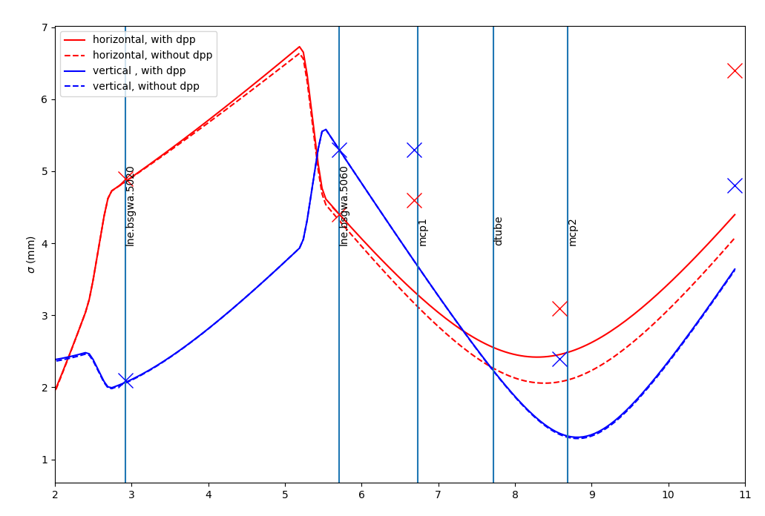
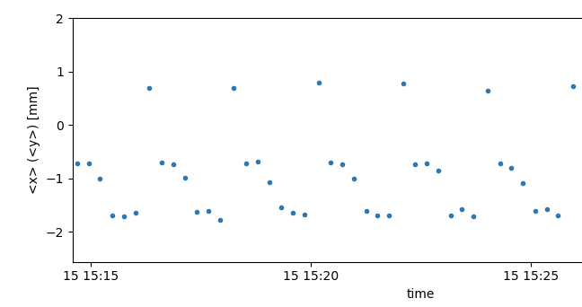
Beam Delivery to Users
Transport through the LNE lines is very stable and reproducible
  Only minor cabling mistakes on new lines commissioned this year: once fixed, using design optics
Impact of stray magnetic fields:
  From other experiments:
    We would benefit from magnetic shielding of some transfer lines
    ABT effort on the modelling and possibly automatic correction
  From AD:
    “wasting” ~5% of AD cycling time to wait for ELENA ejection before starting a new cycle, such as to ensure reproducible transport
Close collaboration with users to respond to their needs
  Experiments benefit from support by CERN expertise beyond the delivery point!
ASACUSA2 transfer line – BSGW0546
pbar
Mean x position [mm]
Measured beam size
H-
AD magnetic cycle!
CERN detectors
GBAR’s detectors

Slide 9
Status compared to a year ago
Areas that require improvement:
  Consolidate/improve instrumentation: Many steps done, still work to do, +BCCCA reliability must be addressed!
  Monitoring/logging: BPT put in place, opening the room for easier performance analysis
  Collect/use references: work on s-cooling ongoing, several references taken for efficient 2023 restart?!
  Tooling: mainly concentrating on status/diagnostics (new Vistar, Live Schottky, Inspector panels,…), still need to spend more time on “correction” (eventually feedback) tools
  Reduce radiation levels: plans to improve RP shielding around AEgIS
  Recover pre-LS2 pbar/p yield: some improvement, probably not yet there
  +Hardware Reliability!: Powering!, Instrumentation!
Hunting for even higher performance:
  Increase p intensity/quality in PS: limited by radiation levels in AEgIS
  Improve AD/ELENA deceleration efficiencies: >80% reached, but difficult to maintain it!
  Improve stability: too little time available to work on this
  Improve repetition rate (+stability):
    10% AD cycle length reduction!
    Ideally, better matching with PS super-cycle could be improved, or at least stabilized!

Slide 10
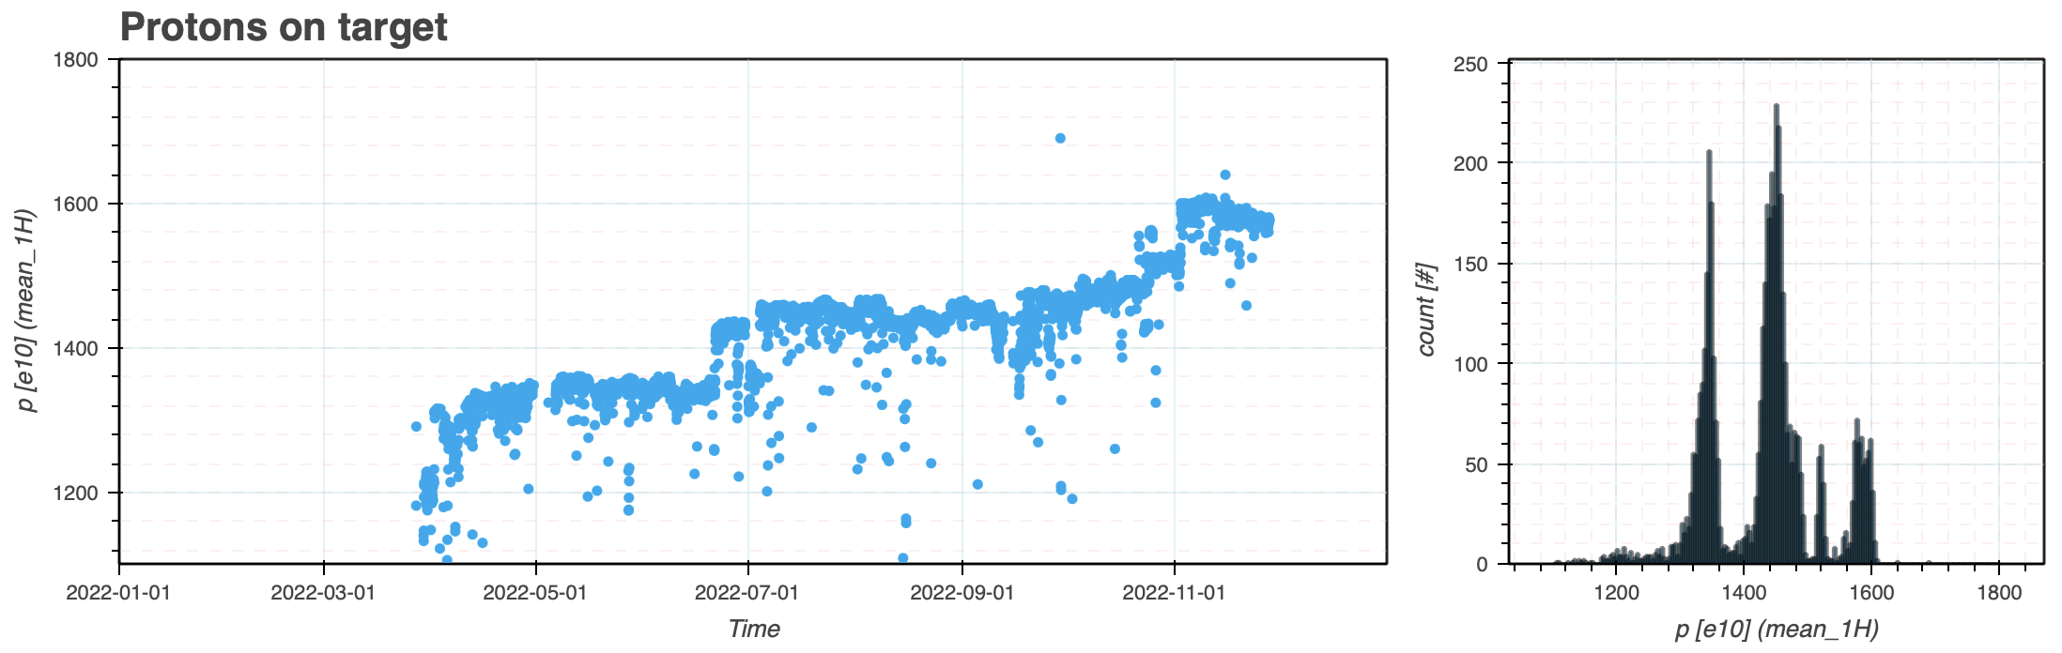
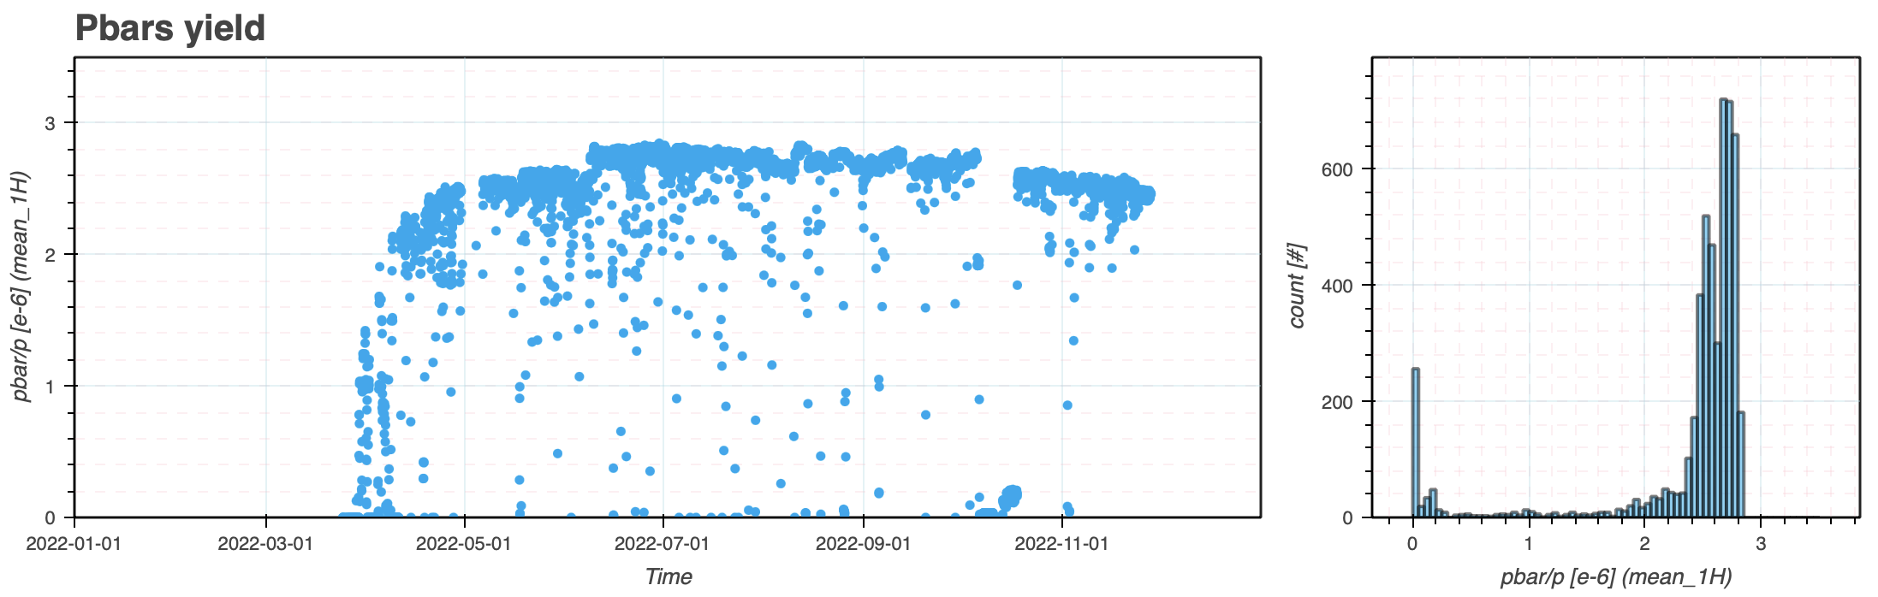
BPT Plots Selection (2022 target)

Slide 11
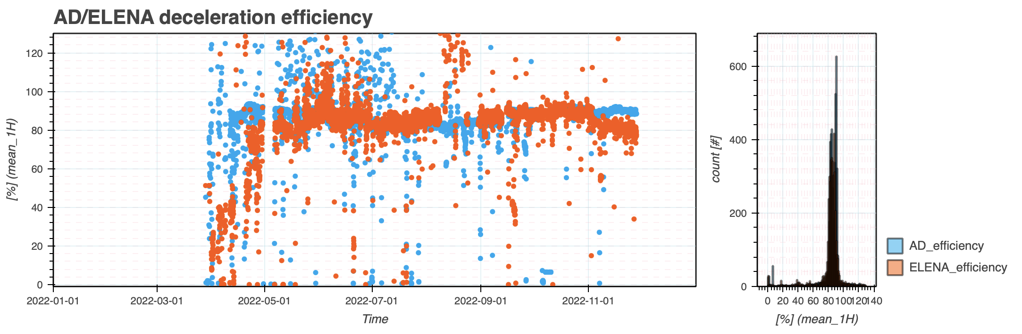
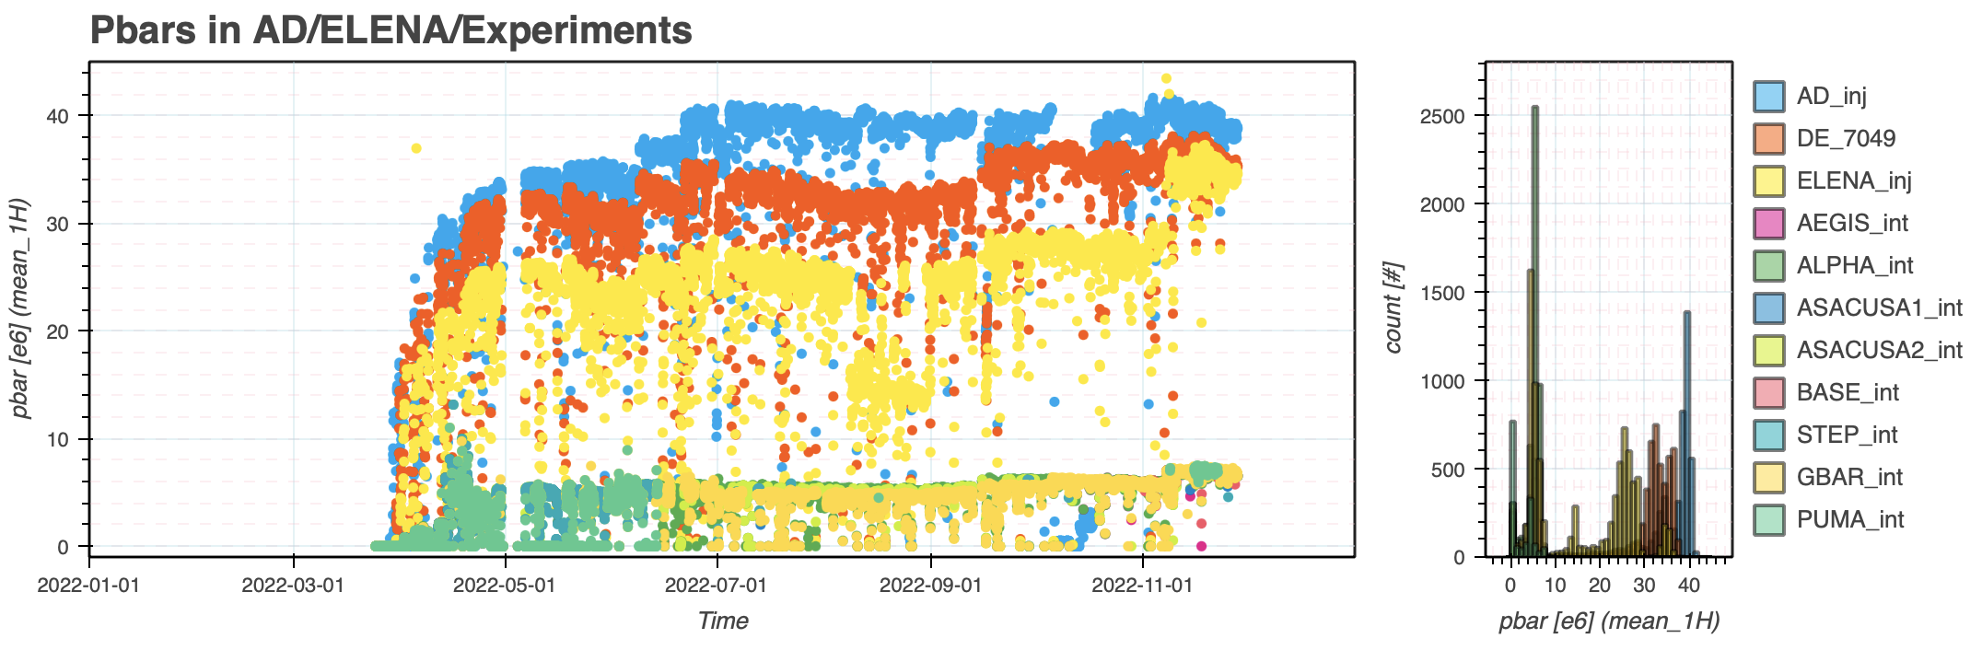
BPT Plots Selection (2022 pbar)

Slide 12
Some other issues
Orbit drifts on AD target: considerable drifts observed
Beam size and proton bunch length on AD target: not studies yet
AD ejection orbit oscillation by septa (and/or other effect?)
Compensation of field lag in AD
Saturation of BPMs at 100 MeV/c in AD
Issues with AD bunch rotation control
AD e-cooler drifts due to vacuum condition and HV sparks
AD e-cooler HV switches problem
Water leaks problems (DI magnets, AD e-cooler)
AD FINEMET cavity issues
…

Slide 13
Plans for 2023
If Okay with experiments, we would like to keep the 8 hour MD every Wednesday?
Injectors Accelerator Schedule 2023:
  Beam on AD target – 27 March
  Pbars to ELENA – 4 May
  Physics start ELENA – 11 May
  End Physics Run – 30 October @06:00

Slide 14
Questions for the users?
Intensity per bunch:
  Do you want more?
  How much more?
    Minimum significant steps when increasing?
    Tolerance on shot to shot variation?
Repetition rate:
  What is the minimum you can take, the max?
  Do you prefer reproducibility to shortest possible?
    (i.e a fixed 135s repetition rate instead of 114s, then 120?)
Transverse emittance:
  We are not nominal there, is it critical?
  What is the max value?
Trajectory stability:
  Do we need to improve?
Bunch distribution:
  Special requests for longer term?
  Dedicated period for 4 users?

Slide 15
Conclusions and a few thoughts
Another excellent year for AD/ELENA!
  Despite several reliability issues and bad surprises
  Thanks to determined and motivated AD/ELENA teams with invaluable support from numerous colleagues from the PS-crew, BI, RF, EPC, MSC, …
A few parting thoughts:
  Reliability:
    Need to (or aim to) avoid working in degraded condition
      key ingredient if we want to profit of feedback/automation tools
    Advancing consolidation plans? More support/time allocated from equipment owners to improve availability (e.g. PC, instrumentation, …)
  Stability:
    Studying transmission drifts and find ways to compensate/stabilize
    It includes rep-rate, mainly from PS super-cycle composition
  Understanding target/injection area:
    Must be a joint effort STI-OP-ABT-ABP-BI

Slide 16
Run 2023
AD/ELENA Team and all the fantastic support teams will do our best to make the 2023 run the best year yet!
Thanks!

Slide 18
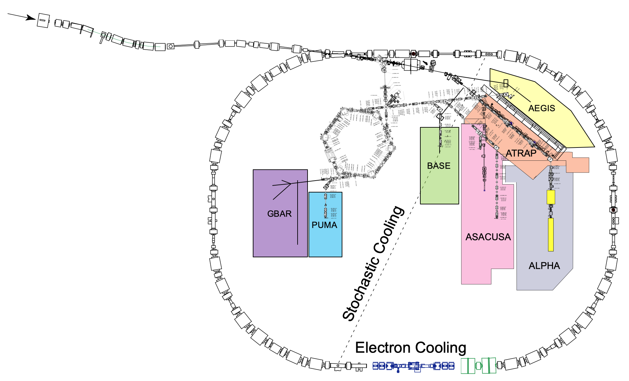
Overview of Beam Instrumentation Improvements wrt 2021
Target BTV
degradation
DE and LNE BCTs
Signal quality (RF)
Calibration (BI)
AD/ELENA scrapers
Control/integration
+ understanding
BCCCA
(DR.CCC1501)
It must work!
FTA
Better BTVs?
BPMs? BLMs?
FTA.BCT9053:
Calibration wrt
other BCTs?
DI BCTs and BTVs
Exploitation of noisy signal
Calibration?! Triggers?!
Neutrals profile
monitor
Replace LNR BTVs:
Mechanical problem
AD IPM:
Radiography planned during YETS 2023
More tests in 2023
Missing/broken/reliability
SEM in LNE lines
AD/ELENA BPM
- Acquisition system issue with change of h
- Consolidation of
head amplifiers
E-cooler BPMs:
Final e- orbit integration
ELENA intensity measurement along cycle missing
ObsBOX-RF? BPM-BI? LPU-RF?
Notes:
(see BI/TB Feb 2022 and IPP Apr 2022)

Slide 19
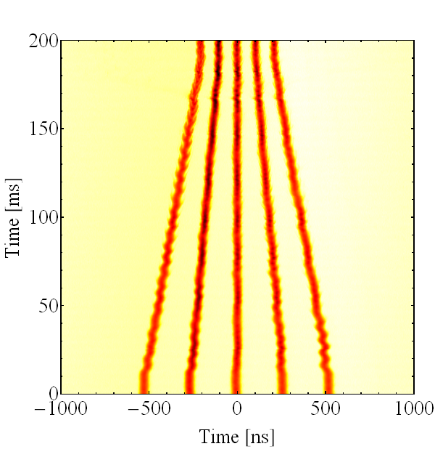
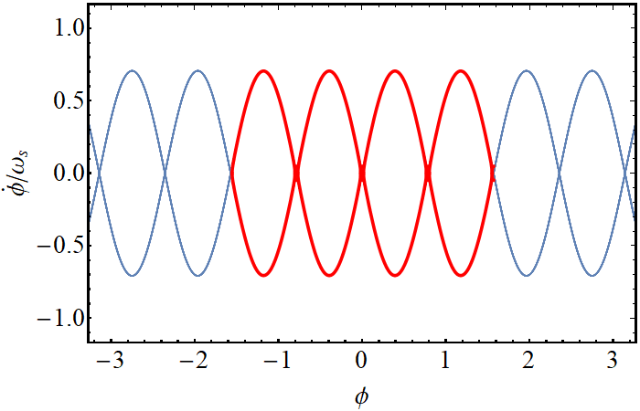
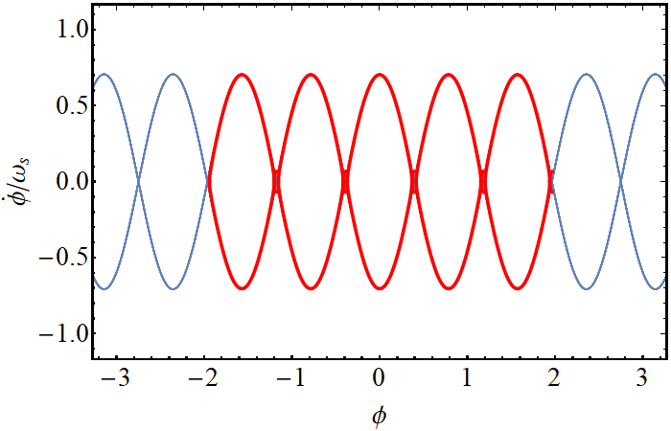
5 bunches operation in PSB and PS
5 p bunches were available at AC times, but not for AD due to conversion of PS complex for LHC
  Limitations removed after LS2 with LIU high brightness capabilities of PSB
Studies ignited by C. Lombard to make 5 bunches back in operation for AD
  In PSB, it required to implement bunch splitting in R3
    Needed to increase longitudinal blow-up to equalise emittance (as for SFTPRO)
    Since R3 has twice the intensity, had to compensate for higher space charge effects by staying at higher injection tunes (4.43 instead of 4.34) and for much longer to equalise emittances (as for LHC)
      Needed to make sure that the resonances overlapped are compensated
  In PS:
    Optimisation of the cycle to reduce losses by OP team
    New sequence of harmonic numbers for up to 5 bunches during batch compression
      It allows to have any number of bunches from 1 to 5 for AD
Excellent work by PSB and PS colleagues, also profiting of LIU effort!

Slide 20
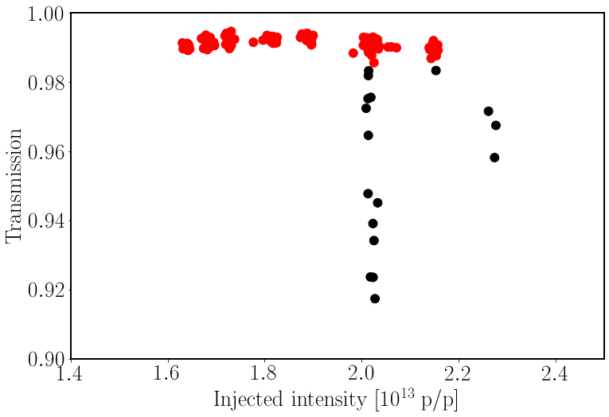
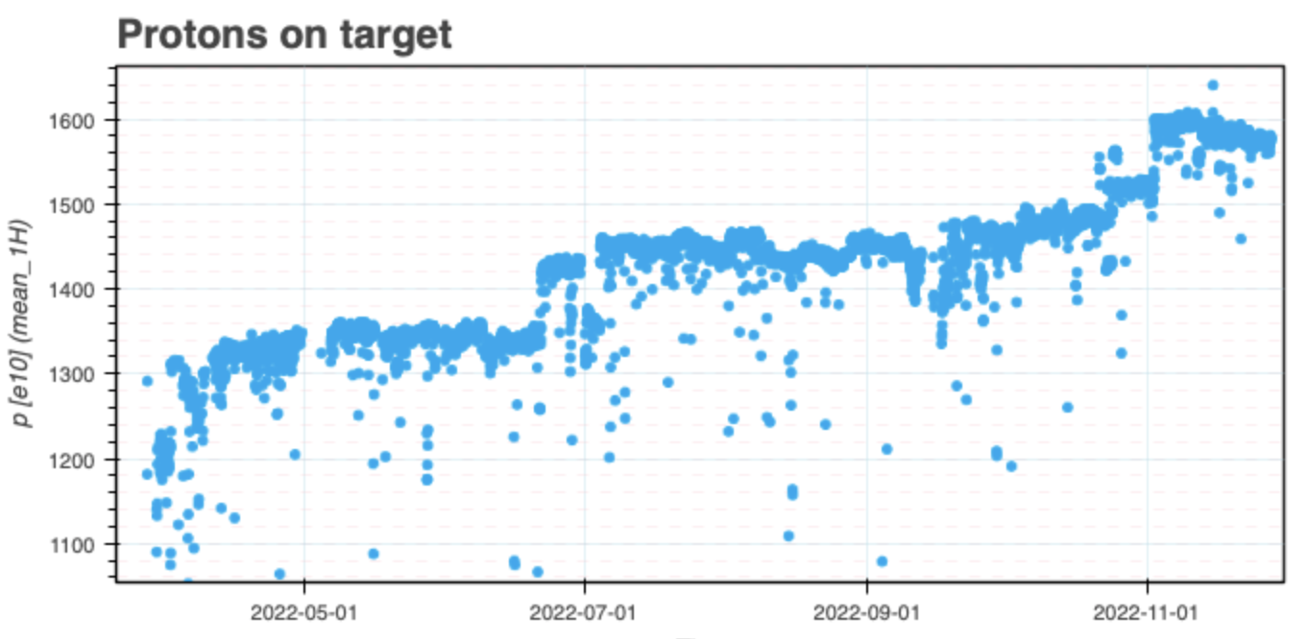
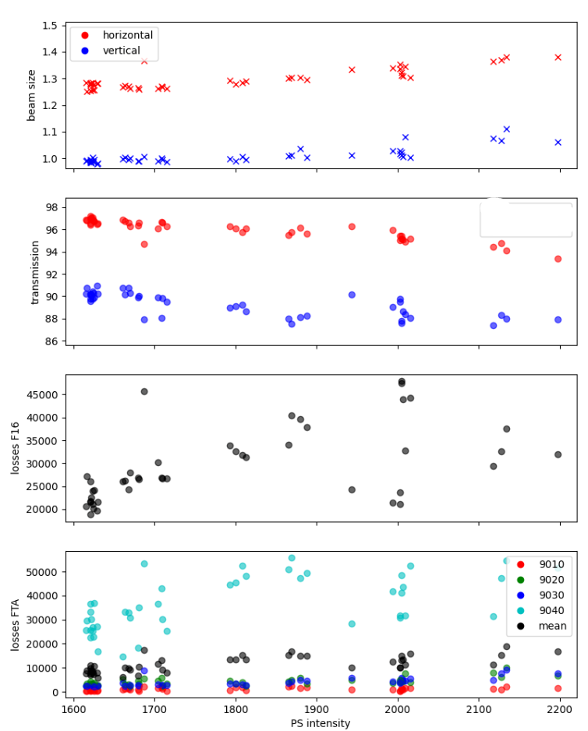
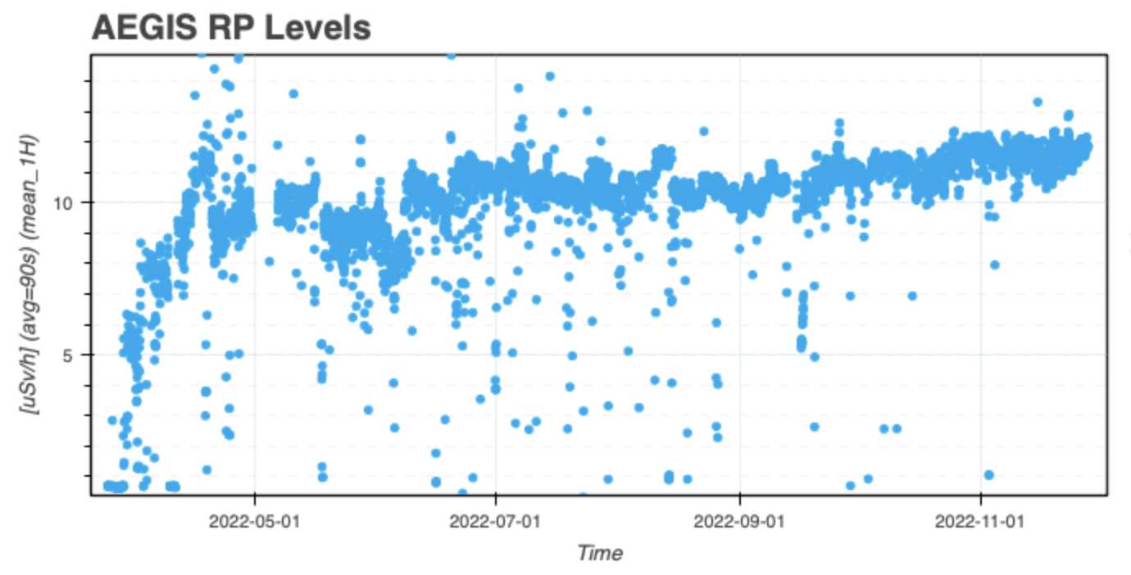
High intensity proton generation
With 5th bunch unlocked the possibility to increase proton intensity (and potentially pbar) by 25%
Tests in the PS ensured to be able to reach up to 2.1e13
No issues observed during p transport test to AD
  No major losses in FTA line
  Minor beam size degradation on the target
In agreement with STI colleagues, proposed to increase
smoothly proton intensity above target design
  Plan endorsed by IEFC 7th Oct 2022 (EDMS 2783690)
  Limited by AEgIS radiation levels!
  Target degradation also to be expected at some point!
Final setup
PS transmission
Losses at transition for I>2.2e13
While optimising PS transmission
to BCT.FTA9012
to BCT.FTA9053
design
PS to AD transmission
limit
p beam size on target
PS intensity [e10]
Excellent work by PS and ABT colleagues!

Slide 21
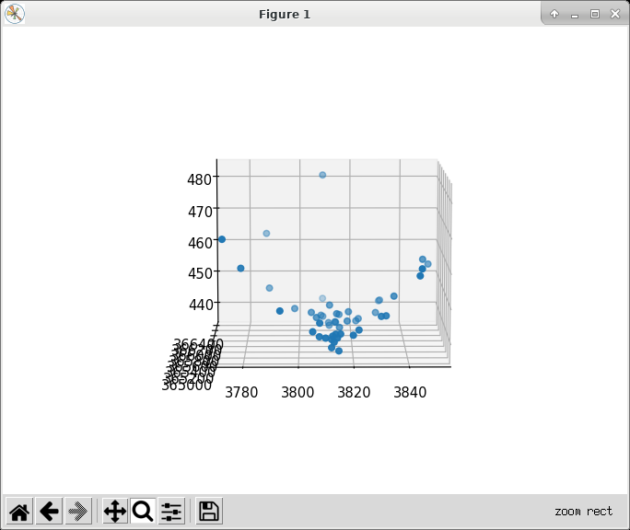
Proton transport and pbar production optimisation
FTA line
AD Target
DI line
AD Ring
Studies on FTA optics and transport
Optimisation of AD Target region
Optimisation of DI line (Target to AD Ring):
  Some tests done using optimiser algorithm;
    But only marginal success due to limited number
    of shots/hour available and limited instrumentation
  Still mainly work for experienced/patient operators:
    We must find a way to setup this line in a way that is
    not based on “try and error”
  Plans by STI and ABT colleagues to work on modelling
  the pbar production and DI line optics/aperture
  Must plan a discussion with BI to see if new/different instrumentation could be useful.
  Concerns about magnets/PC aging!
Kicker
septum

