Slide 1


AD-ELENA
ADUC 7th February 2023
AD facility
Developments - Consolidation
François BUTIN – BE-EA

Slide 2
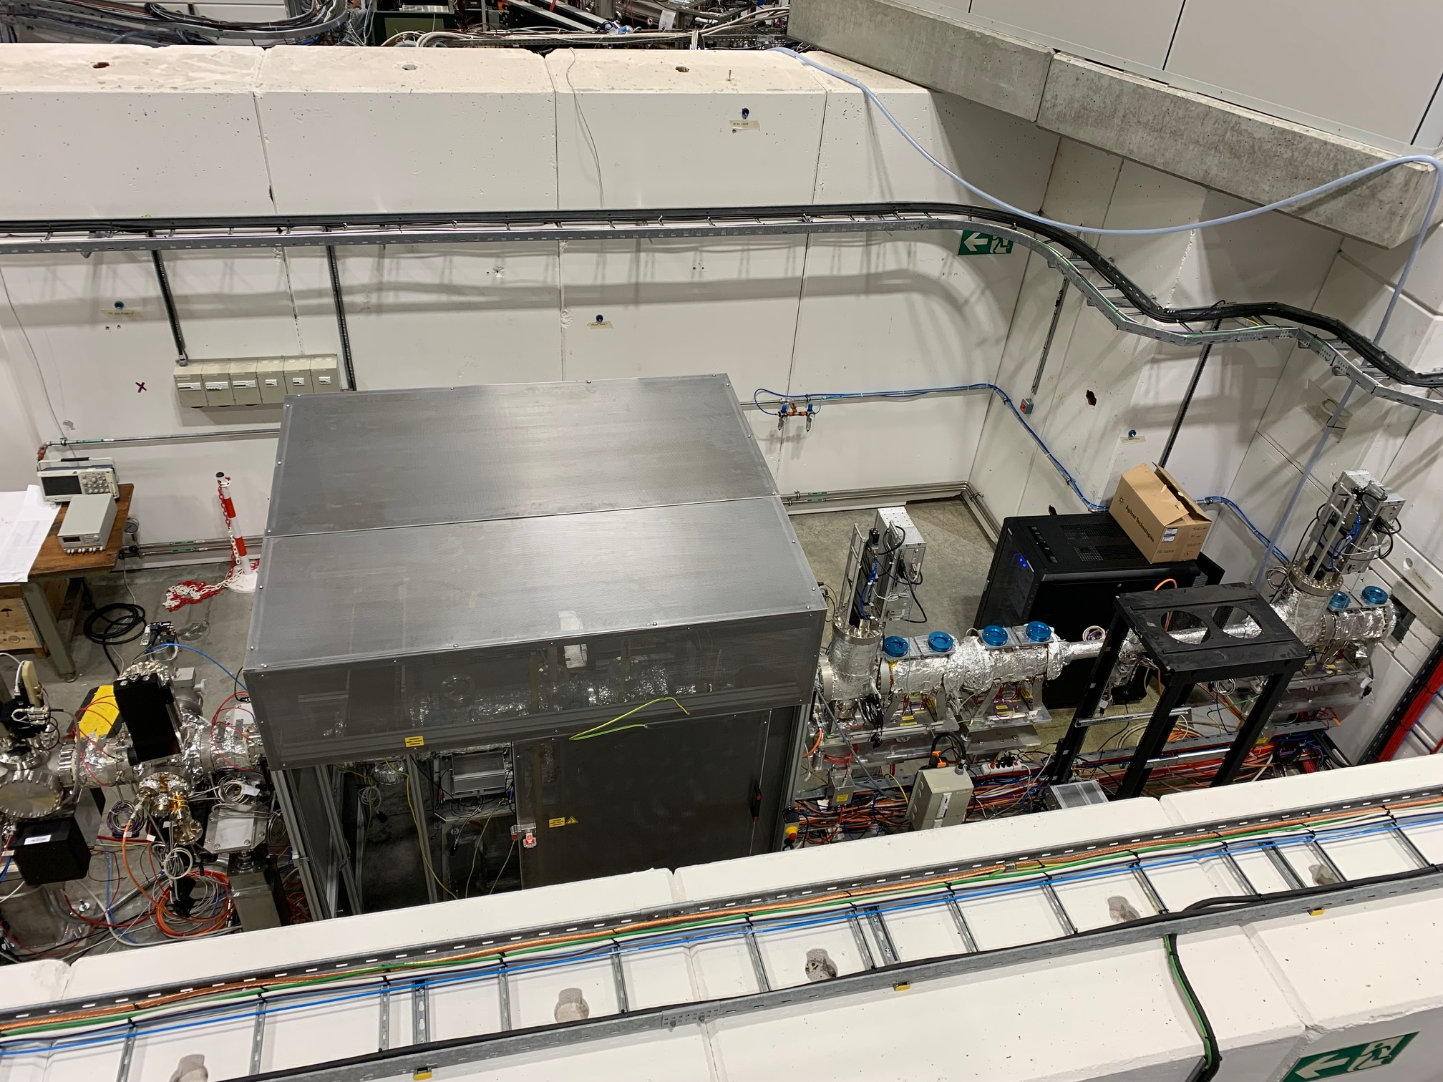
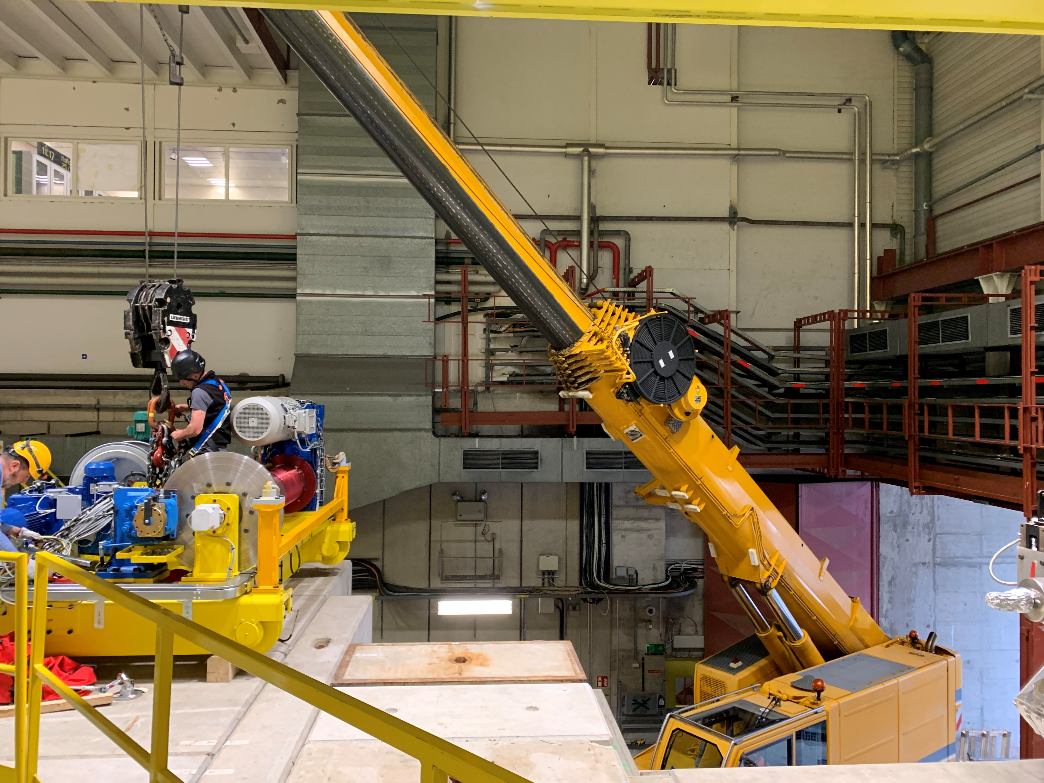
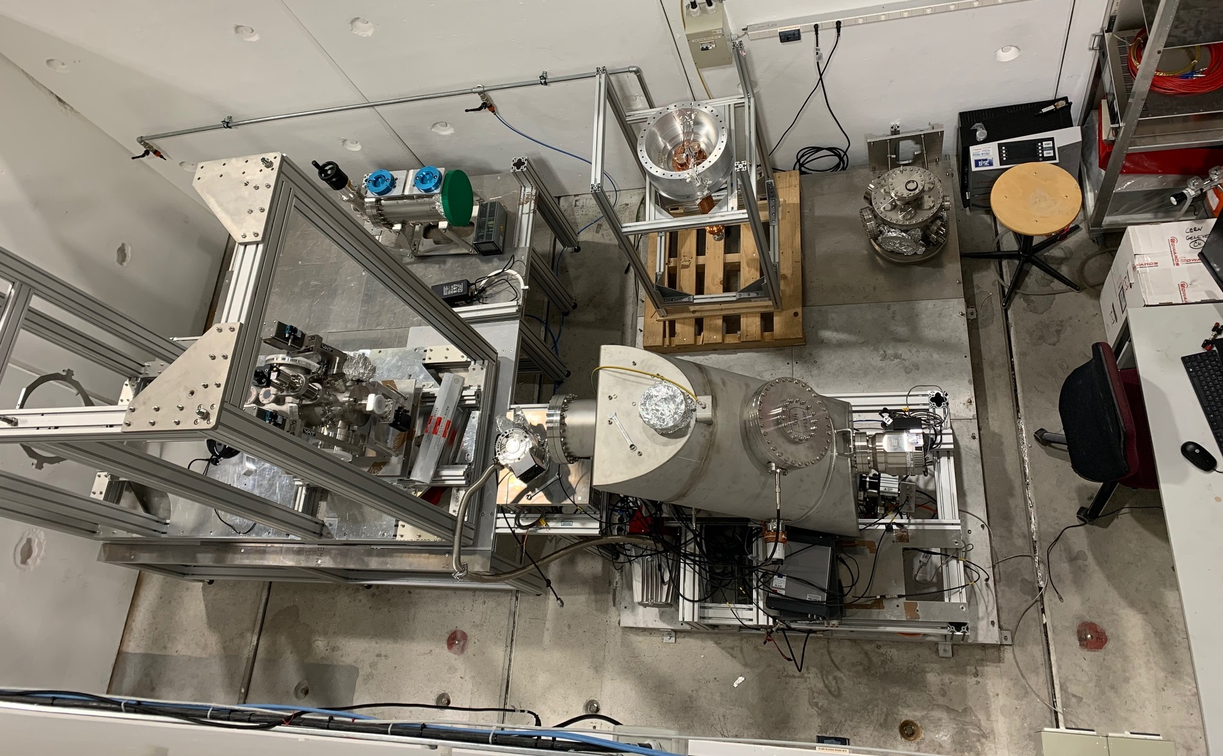
2022 Highlights
ELENA-side crane
+ ramp refurbishment
PUMA exp area +
barracks in 393
BASE-STEP exp area

Slide 3
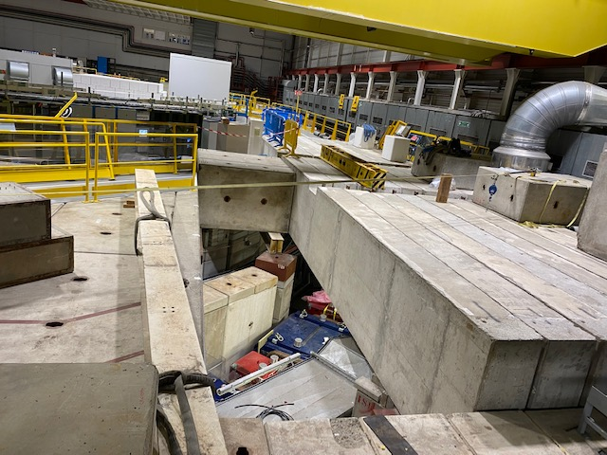
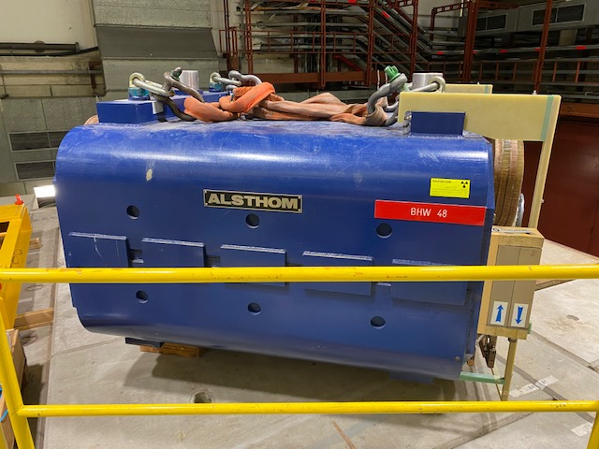
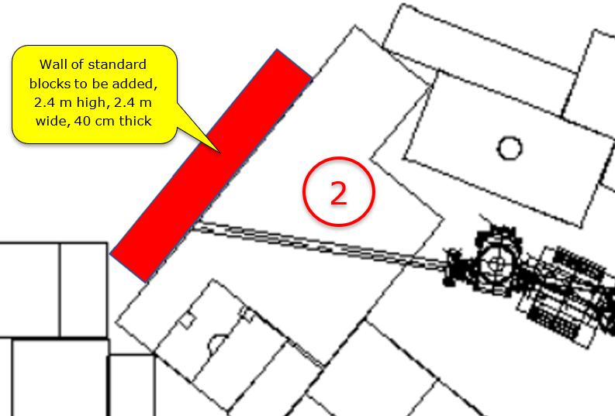
2022-2023 YETS activities
-AD machine:
-2 magnets extracted for refurbishment (BHW48 and QFN16): due back W7
-e-cooler maintenance, replacement of water cooling pipes
-BCCCA repair
-C10 cavities cryo pumping replacement by NEG pumps
-Improvement of AEgIS shielding
-Installation of slits + collimator in target area to reduce radiation at injection (in approval)
AEgIS

Slide 4
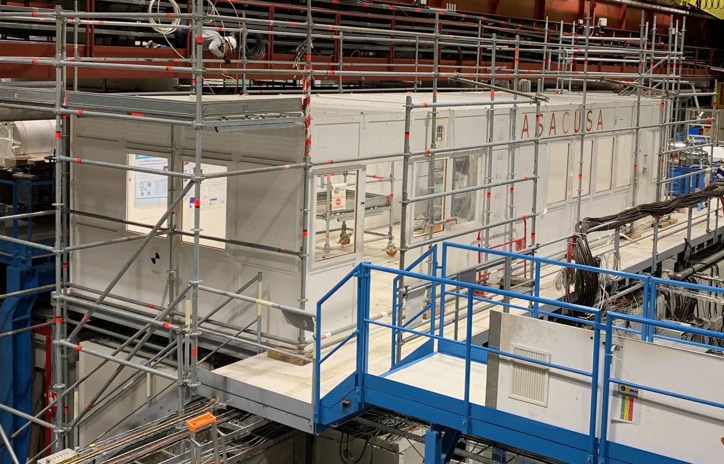
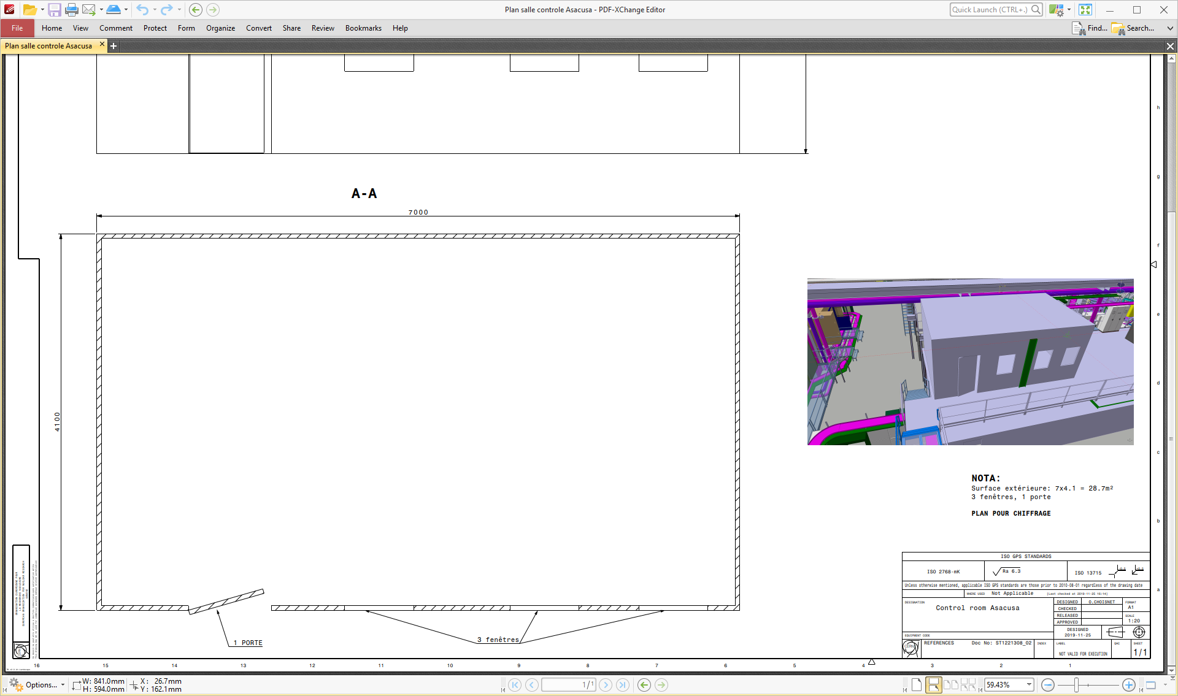
2022-2023 YETS activities
-ELENA ion source:
-Maintenance + replacement of vacuum pumps
-Infrastructure
-ASACUSA barrack replacement (in progress)
-Electrical switchboards maintenance (complete)
-Decabling campaign (in progress)
New ASACUSA barrack

Slide 5
YETS + run services disruptions
YETS is a maintenance period, disruptions to services are unavoidable !
-Cooling water stopped every Xmas break + 1 week end of winter for maintenance (20-24 Feb this year)
-Cryogen fluids distribution stopped during Xmas break + 1 week end of winter or early spring: date still to be confirmed by TE-CRG
-Power distribution stopped for annual mandatory AUG and secured networks tests. This year also refurbishment of ERD5 and ERD6 switchboards caused additional disruptions. Announced early
-Access on the shielding perturbed by magnet extraction / installation
Coming up:
-Major refurbishment of experiments side 50t crane (18th Dec 2023 – 23rd Feb 2024) – lHe delivery for BASE will be arranged
-ALPHA barrack replacement (during next YETS, exact dates TBC)

Slide 6
GHe and LHe distribution limitations
LHe situation:
-Cryoplant can only deliver 20 dewars a week
-Management gave strict rules in terms of quantities and conditions of deliveries to AD experiments
GHe situation:
-Last year global situation drastically limited the amount of available GHe available CERN-wide
-This year availability will approximately be half of «normal» year
-New supply source could be accomodated using gHe recovered from Cryo group
-Billing system could be put in place in case of excessive consumption

Slide 7
AD-CONS project status
-Magnets refurbishment:
-status: Will continue till LS3 included
-Planning: 1-2 magnets extracted for refurbishment every YETS
-Financing: secured
-RF systems:
-Status: C10 cryo pumps vacuum system replaced by NEG pumps
-Next: LLRF + HLRF systems to be upgraded
-Financing is secured
-AD e-cooler:
-Status: project was completely re-organized in 2022, magnetic and vacuum systems designs are complete. Gun and collector designs being improved
-Next: enter call for tender phase for main / long lead items, installation planned LS3
-Financing is secured, but cost increases have to be considered

Slide 8
AD-CONS WP’s (Continued)
-Stochastic cooling:
-Status: New kickers have to be engineered and produced – no design available yet
-Financing: New estimate is needed, not secured yet
-Cooling and ventilation:
-Status: Planned for LS3, not much activity yet.
-Next: Studies expected to start in 2024, and works to take place during LS3
-Financing: Ventilation secured, cooling remains to be secured
-Power convertors:
-Status: ongoing. Injection line optimization proposed (new simpler magnets and power supplies), tender expected to proceed soon
-Next: bulk of spending/installation work in 2023-2024 and after LS3 (mains)
-Financing: only partially secured yet

Slide 9
AD-CONS WP’s (continued)
-AD cranes refurbishment:
-Status: experiment side planned for YETS 2023-2034
-Financing: secured
-Magnetic Horn:
-Status: complete
-Next: power cables and transmission line were mentioned as additional work for 2028-2030
-Financing: to be secured in due time
-Cryo fixed distribution system:
-Status: design showed that LHe consumption would be increased to unacceptable level. Project is stalled, looking for alternatives
-Next: study “light” version, in parallel to a “full Monty” one, with new liquefactor to be installed on AD site
-Financing: secured for “light” version. Liquefactor solution to be studied and costed

Slide 10
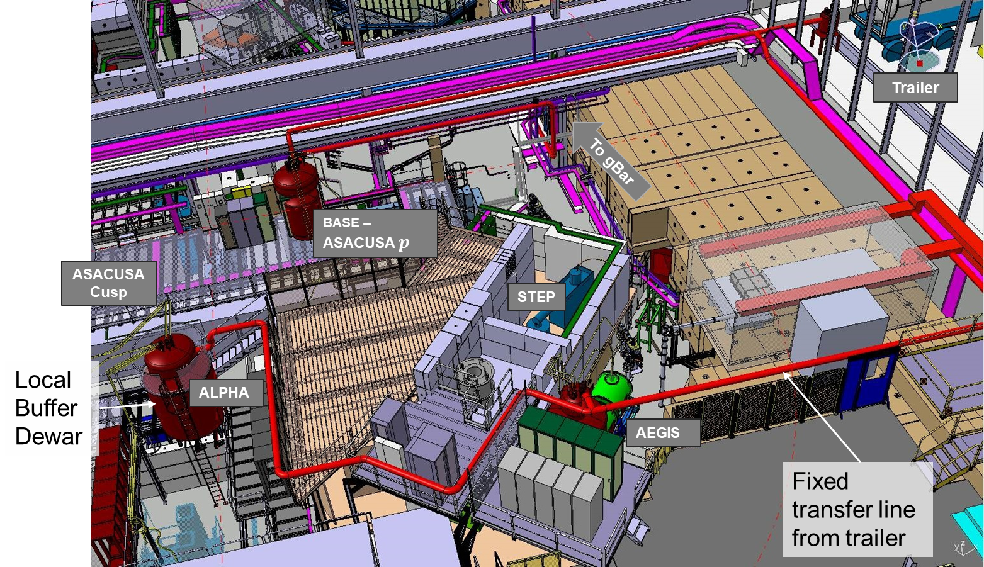
Study of a fixed LHe distribution system
Courtesy:
O. Pirotte
With such a distribution scheme, 45 % of the transferred liquid would be evaporated into gas
--> not affordable for the LHe central liquefier

Slide 11

AD workshop announcement
-CERN management requested the organization of a WS to review the detailed status and prospects for AD/ELENA systems, including main AD-CONS project WP’s.
-Priorities should be established in the light of the anticipated physics program of AD experiments beyond LS3, and the corresponding anticipated needs of AD/ELENA machines operation.
-Date proposed for 16th March, with following agenda:
Introduction: M. Lamont (as ATS director)
Physics program prospects beyond LS3: ADUC chairman, reporting for all existing AD experiments collaborations
Operation views on consolidation and upgrade needs, a new test line for CERN and experiments
Follow-up on JAPW, beam line optics from target to ejection, potential gains
Operation/YETS planning till LS3, Infrastructure, decabling campaign, lHe and gHe distribution limitations
AD/ELENA systems status, improvement needs, consolidation WPs status (including finance situation and timeline)
Overview of AD-CONS finances, details of approved and non-approved WPs

