Slide 1
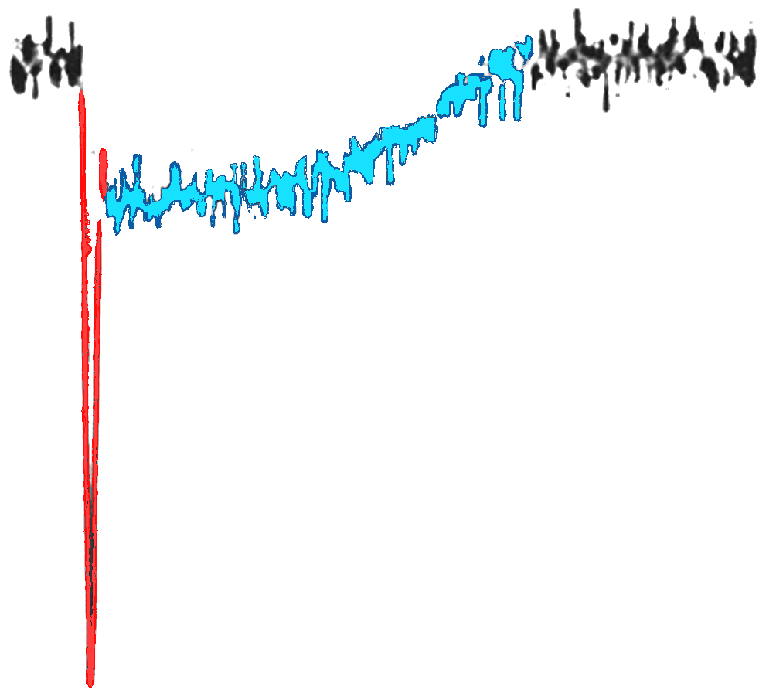

PHENIICS FEST 2023
Thursday, 11th May 2023
R&D for Picosecond Timing with Novel Micromegas Detectors
Alexandra Kallitsopoulou
PhD Student
CEA, IRFU, Université Paris – Saclay
PICOSEC
Micromegas
Thomas Papaevangelou
Notes:
Saisir les champs « Titre », « P. Nom » et « Date.
Laisser ou retirer le bandeau.

Slide 2
Outline
What is our motivation?
The PICOSEC Micromegas Technology
Detector Testing
PICOSEC Signal Processing
Fresh Results
Concluding Remarks

Slide 3
What is our motivation?
Timing with a few 10’s of Picosecond
Large area coverage
Solid State OR Gaseous Detectors
ATLAS LHC Upgrade <μ>=140
High Luminosity LHC:
    On average 140 p-p interactions per
    bunch crossing
    Necessary timing resolution ~20ps
    Clean reconstruction of the events
    Reduction of mixing different events
    due to pile-up
      3D tracking is not enough for
      association with the correct vertex
      Timing can be an extra parameter
Solid state detectors
Avalanche PhotoDiodes: (σ_{t} ~ 20 ps for single cells)
Low Gain Avalanche Diodes (σ_{t} ~ 30 ps)
HV/HR CMOS (σ_{t} ~ 80 ps)
Gaseous detectors
Resistive Plate Chambers (RPCs): (σ_{t} ~ 30 ps)
Micro-Pattern Gaseous Detectors (σ_{t} ~ 1 ns)
PID techniques: Alternatives to RICH methods,
J. Vavra, accepted in NIMA 876, 2017,
https://dx.doi.org/10.1016/j.nima.2017.02.075
      BUT
      Extra detector requirements:
        Large area coverage
        Resistance to aging effects
        Multi-pad readout tracking
Development of new Instrumentation Technology
Notes:
The motivation is to achieve timing with a few 10s of a picosecond. The idea is rising from the need of high-rate experiments to deal with pile-up phenomena.
For example, HL LHC estimates per average of 140 pp interaction per bunch crossing, which means that event reconstruction is not straightforward. The new 4D tracking era can include timing as an extra parameter for triggering or event selection.
But this push to the limits of existing detector designs. We have to be able to scale up the modules, be resistant to aging, and read out multi-channels.
For this, some technologies already have reached a fraction of 20 ps.
For example, Avalanche PD has a big gap and high resistivity they cannot survive at such a high rate.

Slide 4
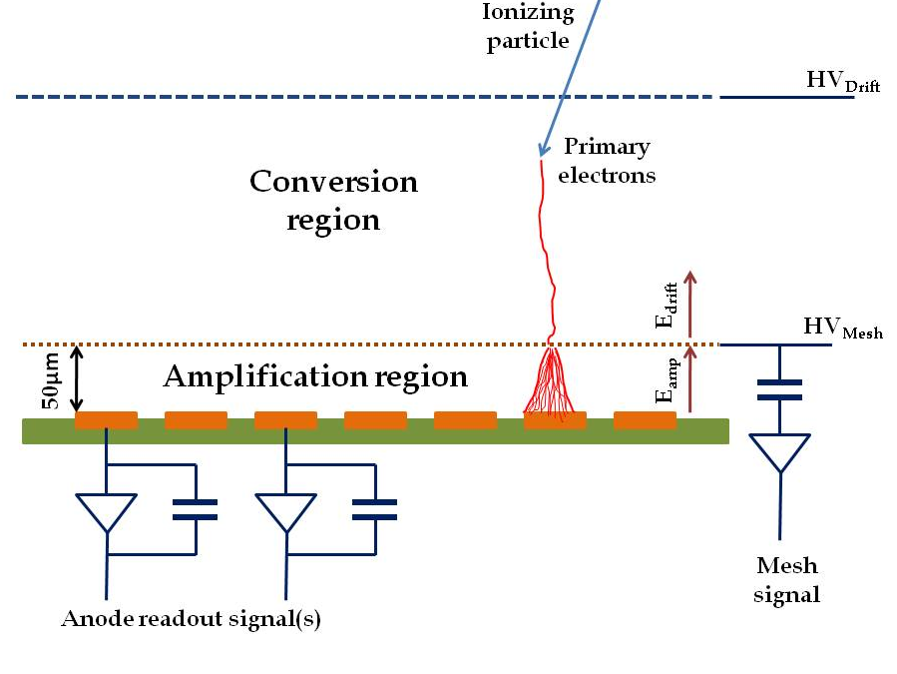
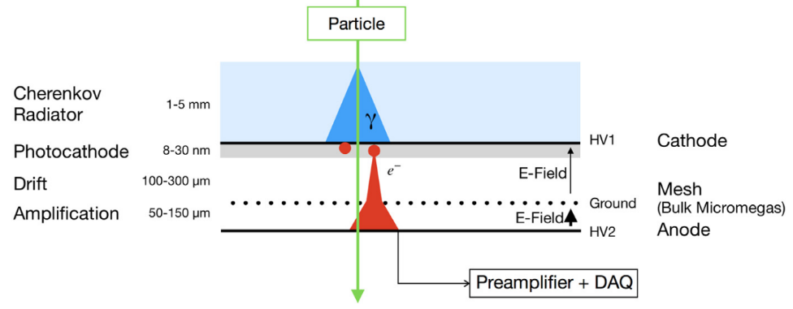
Get to know with PICOSEC MM Detector
Limitations of the Micromegas Timing Potential
  Stochastic nature of ionization
  Randomness of last ionization
  Time jitter of a few ns
The PICOSEC Concept
  Timing with tens of picosecond precision
Modifications in MM Geometry
  Smaller Drift Gap (up to 200μm)
  Elimination of the stochastic nature of ionization
  Higher applied Drift Voltage Pre-avalanche
Y. Giomataris, P. Rebourgeard, J.P. Robert and G. Charpak, “Micromegas: A high-granularity position sensitive gaseous detector for high particle-flux environments”, Nuc. Instrum. Meth. A 376 (1996) 29
Additional Components in MM geometry
  Cherenkov radiator +
  Photocathode (CsI, B4C, Diamond, DLC)
  Prompt photoelectrons
J.Bortfeldt, et al., “PICOSEC: Charged particle timing at sub-25 picosecond precision with a Micromegas based detector”, https://doi.org/10.1016/j.nima.2018.04.033
Notes:
No matter of the wide range of applications that Micromegas detector can be used, when it comes for timing in a picosecond level, it has its limitations.
Those arise from the stochastic nature of ionization. By saying this we mean that when incident radiation enters the active volume of the detector there is a probability of causing an ionization somewhere.
And of course this has a concequence also on the random last ionization. This results to a timing resolution of the order of ns.
In order to achieve the goal of picosecond timing, we apply some modifications in the geometry. Firstly, we reduce the drift gap from 3mm to 200μm, in order to minimize the direct ionization of the incident radiation.
This of course allows us to apply even higher electric field. But somehow we need to ionize the gas.
For this the detector is coupled with a Cherenkov radiator and a photocathode to create prompt photoelectrons in the active volume of the detector. So with this geometry we are able to create pre avalanches early in the drift gap.

Slide 5
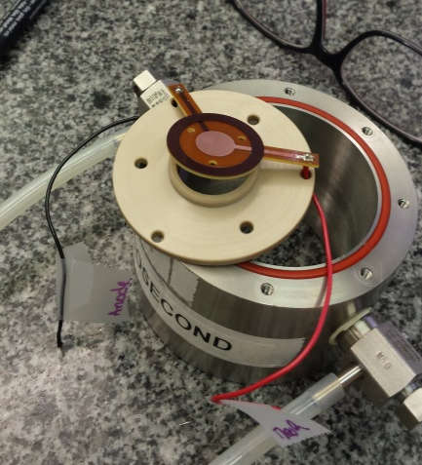
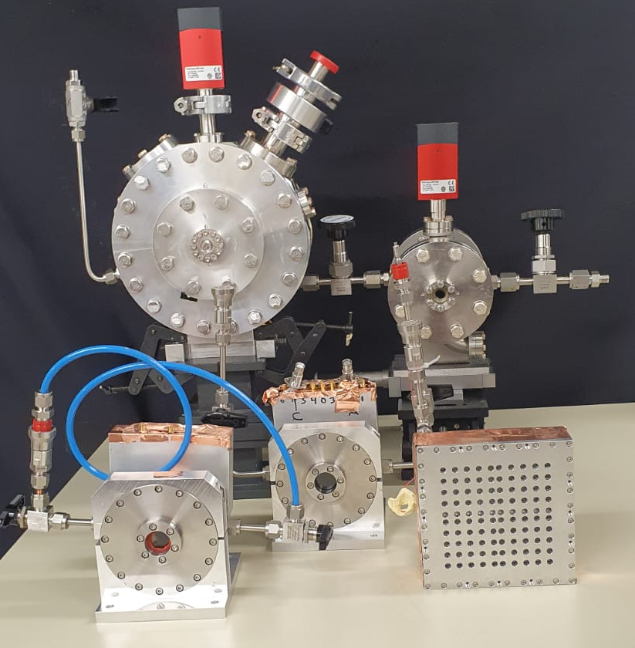
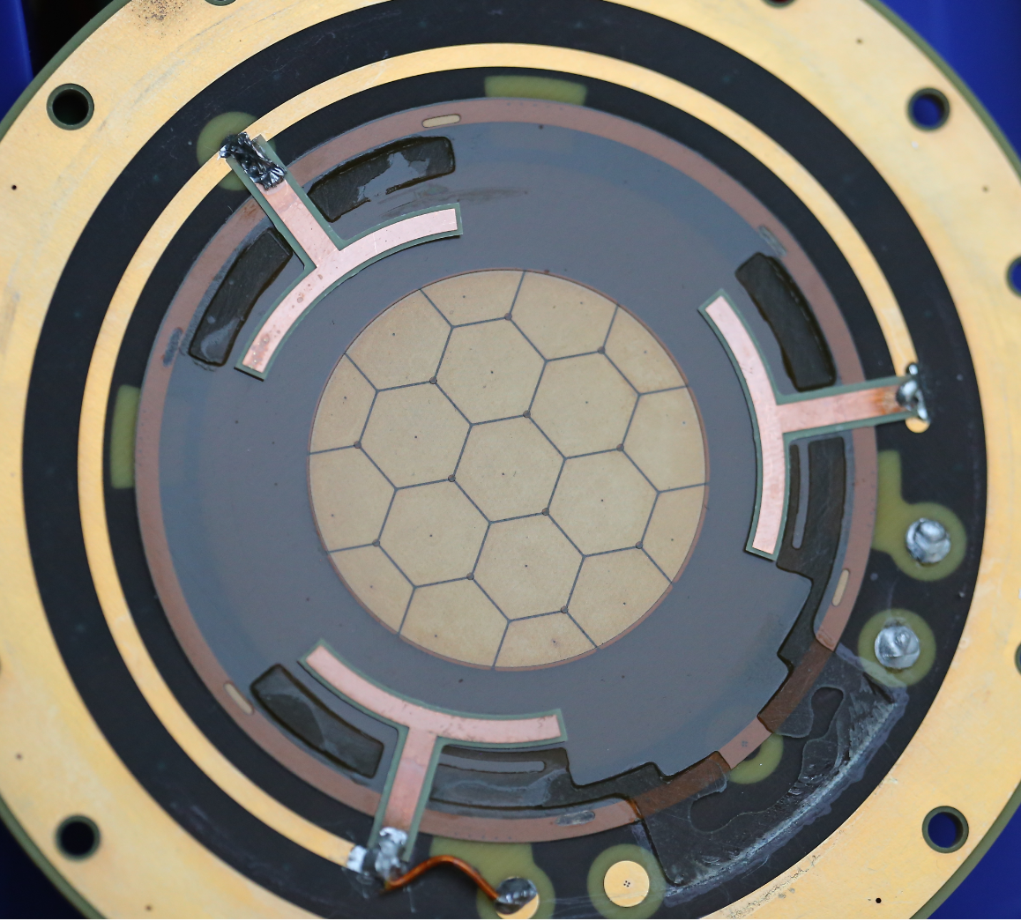
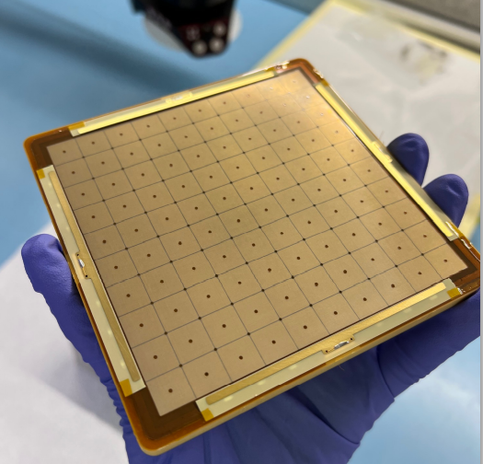
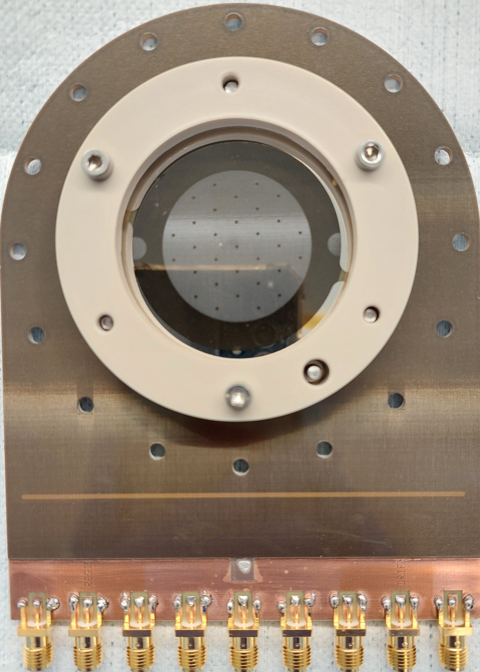
Detector Prototype Evolution
1-ch (∅1cm)
.
Single Pad Prototypes (ø 1cm)
  Proof of concept
  Resistive and non-resistive prototypes
Photocathodes & Crystals:
  MgF2 / Sapphire crystal +
  Metallic (Cr, Al)
  Metallic substrate + CsI
  Metallic substrate + polycrystalline diamond
  DLC
  B4C, Metallic substrate +B4C
Gas : 80% Ne – 10% CF₄-10%C₂H₆
MgF2 crystals with DLC photocathode
Multi-Pad Prototypes
  Hexagonal pads ø 1cm
  Resistive and non resistive prototypes
19-ch (∅ 3.6cm)
100-ch (◻ 1.0 cm)
7-ch (∅ 2.6 cm)
Notes:
To visualize somehow this detector technology, we present here several prototypes that we have tested.
At the beginning for proof of concept we started with small single pad prototypes, of 1cm diameter, and then we moved to larger ones with segmented anodes. From 7 to 19 and now to 100 channels.
The most common crystal we use is MgF2 with CsI photocathode material. But now there are several other options that they are being tested, like for example metallic ones ore B4C, DLC
The gas mixture that is was proven to be suitable for our operation was the COMPASS Gas, consisting of 80%Ne-10%CF4-10%C2H6
All the prototypes are being tested both in laser beams here at CEA and in particle beams @ CERN

Slide 6
Detector Testing
Notes:
The next important step after data taking is how to treat them. Indeed timing measurements demand detailed and precise understanding of the algorithm that we are going to apply

Slide 7
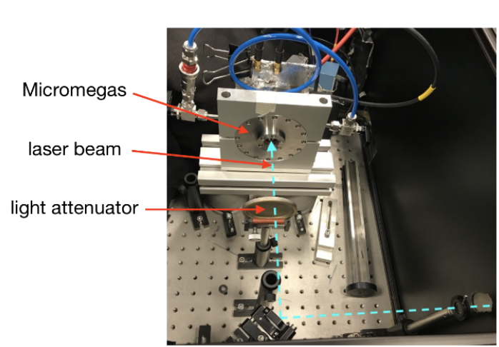
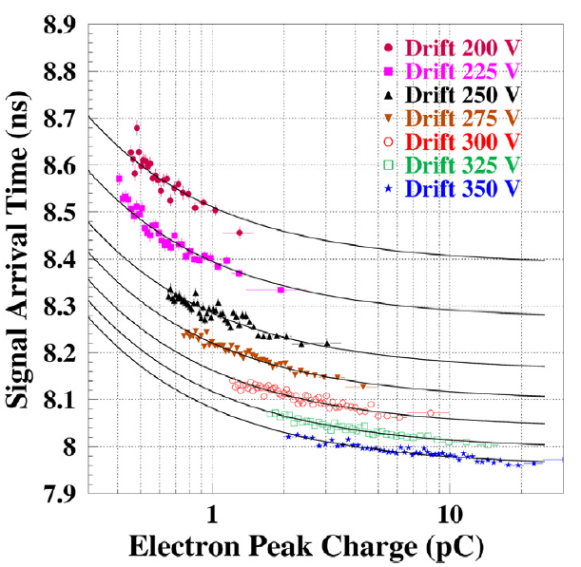
Detector Testing
  Pulsed 120fs UV Laser (IRAMIS/CEA)
    Detector response on controllable
    number of photoelectrons
    Timing single photoelectrons
    Understanding the physics
    dynamics on the detector
    Independent measurements of the photocathode material
  Timing resolution improves with higher drift field &
  smaller gap(<50ps for 120μm for single pe)
J.Borteldt, et al. “PICOSEC: Charged particle timing at sub-25 picosecond precision with a Micromegas based detector”, Nuc. Instrum. Meth. A (2021)https://doi.org/10.1016/j.nima.2018.04.033
Notes:
First investigation of detectors response was made in Laser Test Beam at CEA / IRAMIS facility, where we are able to study even its single photoelectron response
The facility consists of a UV ultra short laser with duration of a few ps to tens of fs and after passing from some optical devices the beam is adjusted to 265nm
And from a pulse picker to adjust the repetition rate to 25kHz . Finally the beam is split two parts where the 1st one is directly lead to photodiode (with rise time <100ps)
And the second one after passing attenuation meshes is directed to the photocathode of PICOSEC
As we said concerning the data taking we need a time reference device with resolution better than the one we want to measure, and attenuator meshes to control the number of pes
Great achievement of those measurements was that we observed some important statements of the detector response.
The dependence of SAT with electron peak charge in different operation Voltages, The grater the drift voltage the smaller the SAT
In parallel it is evident that timing resolution improves with higher field and smaller gap reaching even a resolution of 50 ps for 120μm gap and

Slide 8
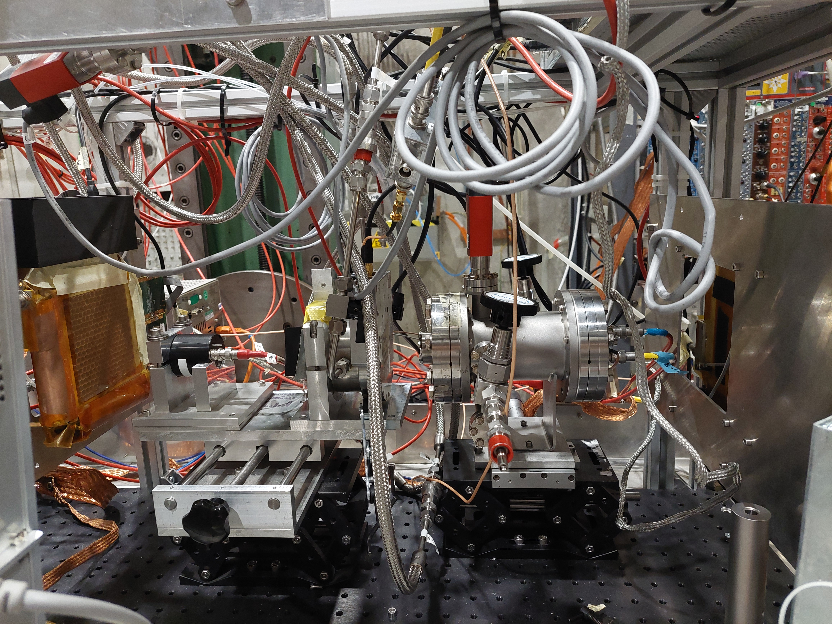
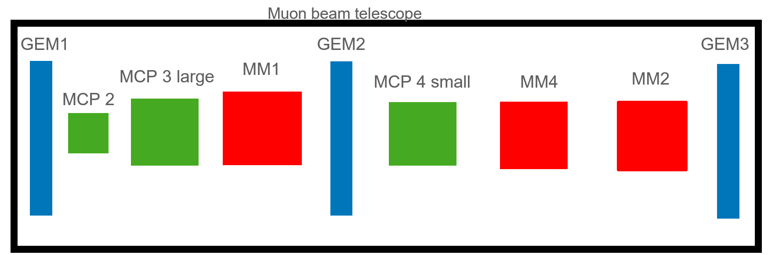
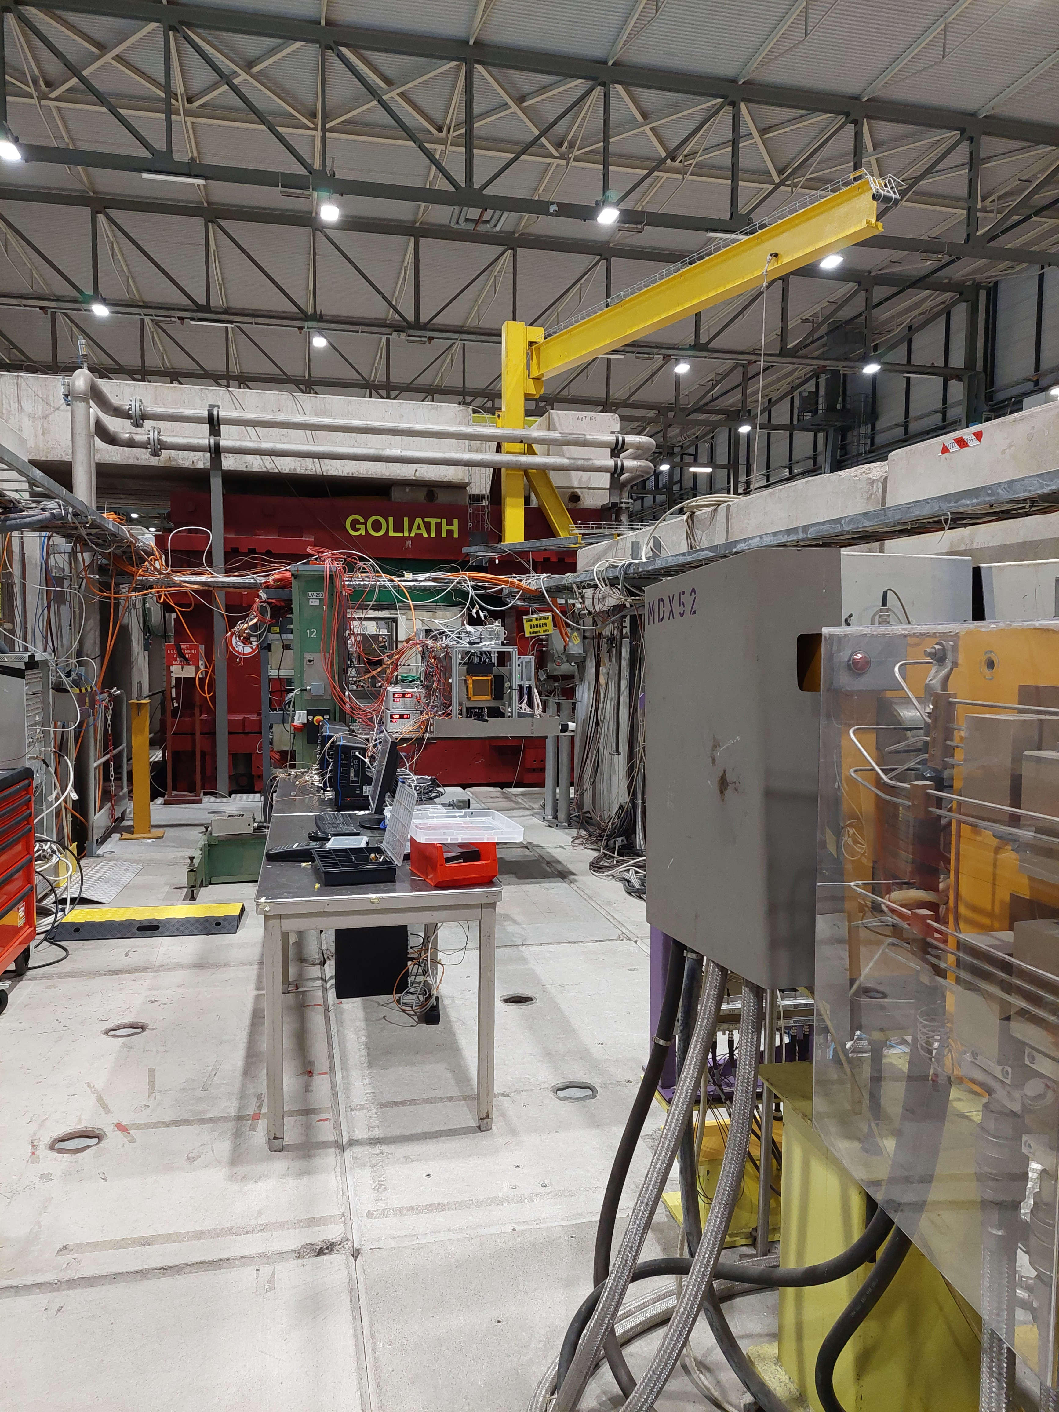
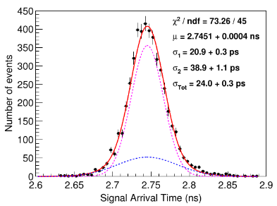
Detector Testing – Particle Beams
Particle Beams @ CERN SPS H4 Beamline
  Muons 80-15 0 GeV
  Photocathode studies ( robustness and efficiency)
The Setup
  Use GEMs for tracking
  Use MCP PMTs as timing reference devices
  and for triggering
  Electronics: CIVIDEC preamp. /
  Customade electronics + LeCroy scopes
11 p.e.
Timing Resolution → RMS of Signal Arrival Time Distribution
J.Borteldt, et al. “PICOSEC: Charged particle timing at sub-25 picosecond precision with a Micromegas based detector”, Nuc. Instrum. Meth. A (2021)https://doi.org/10.1016/j.nima.2018.04.033

Slide 9
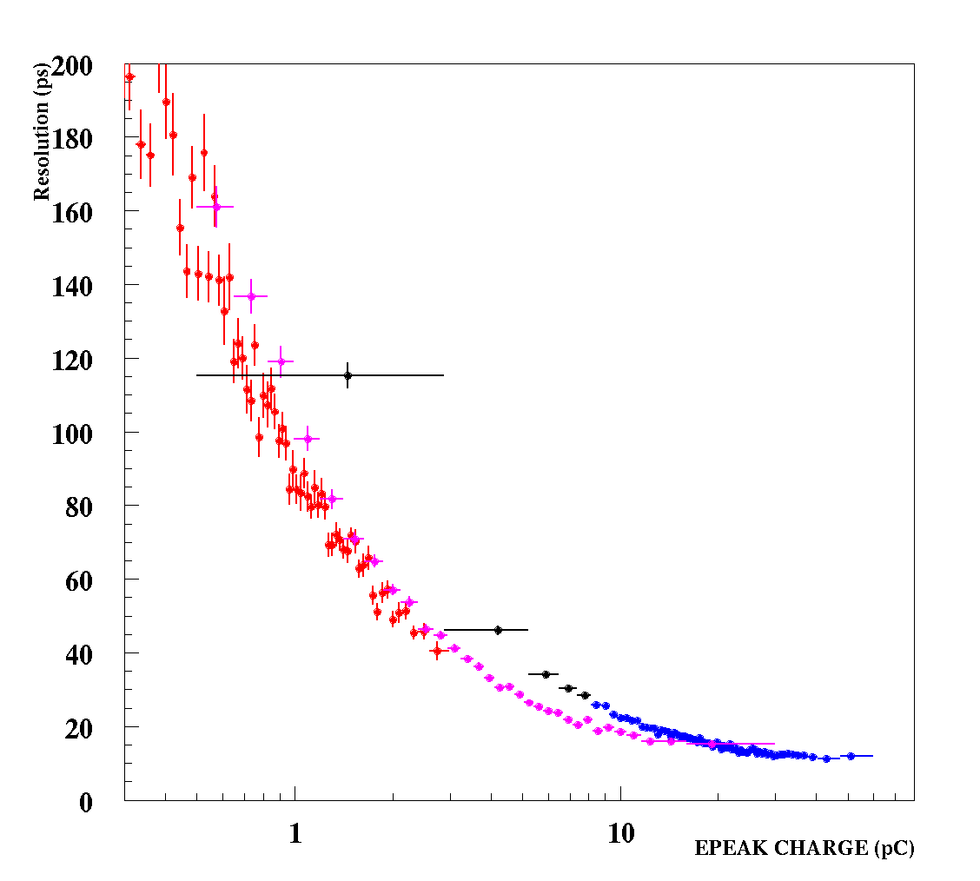
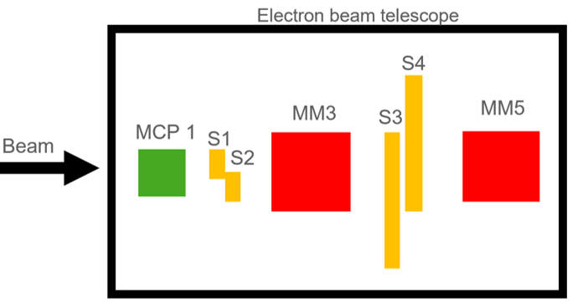
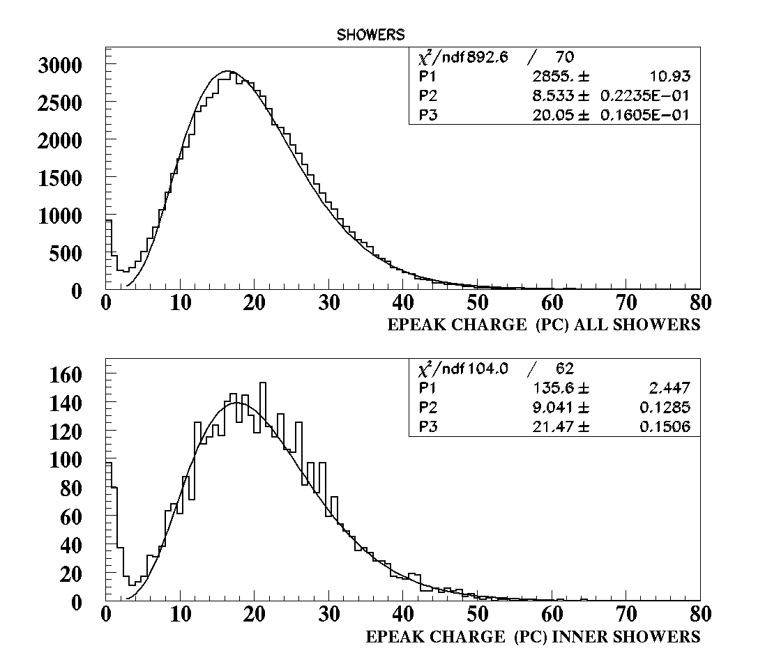
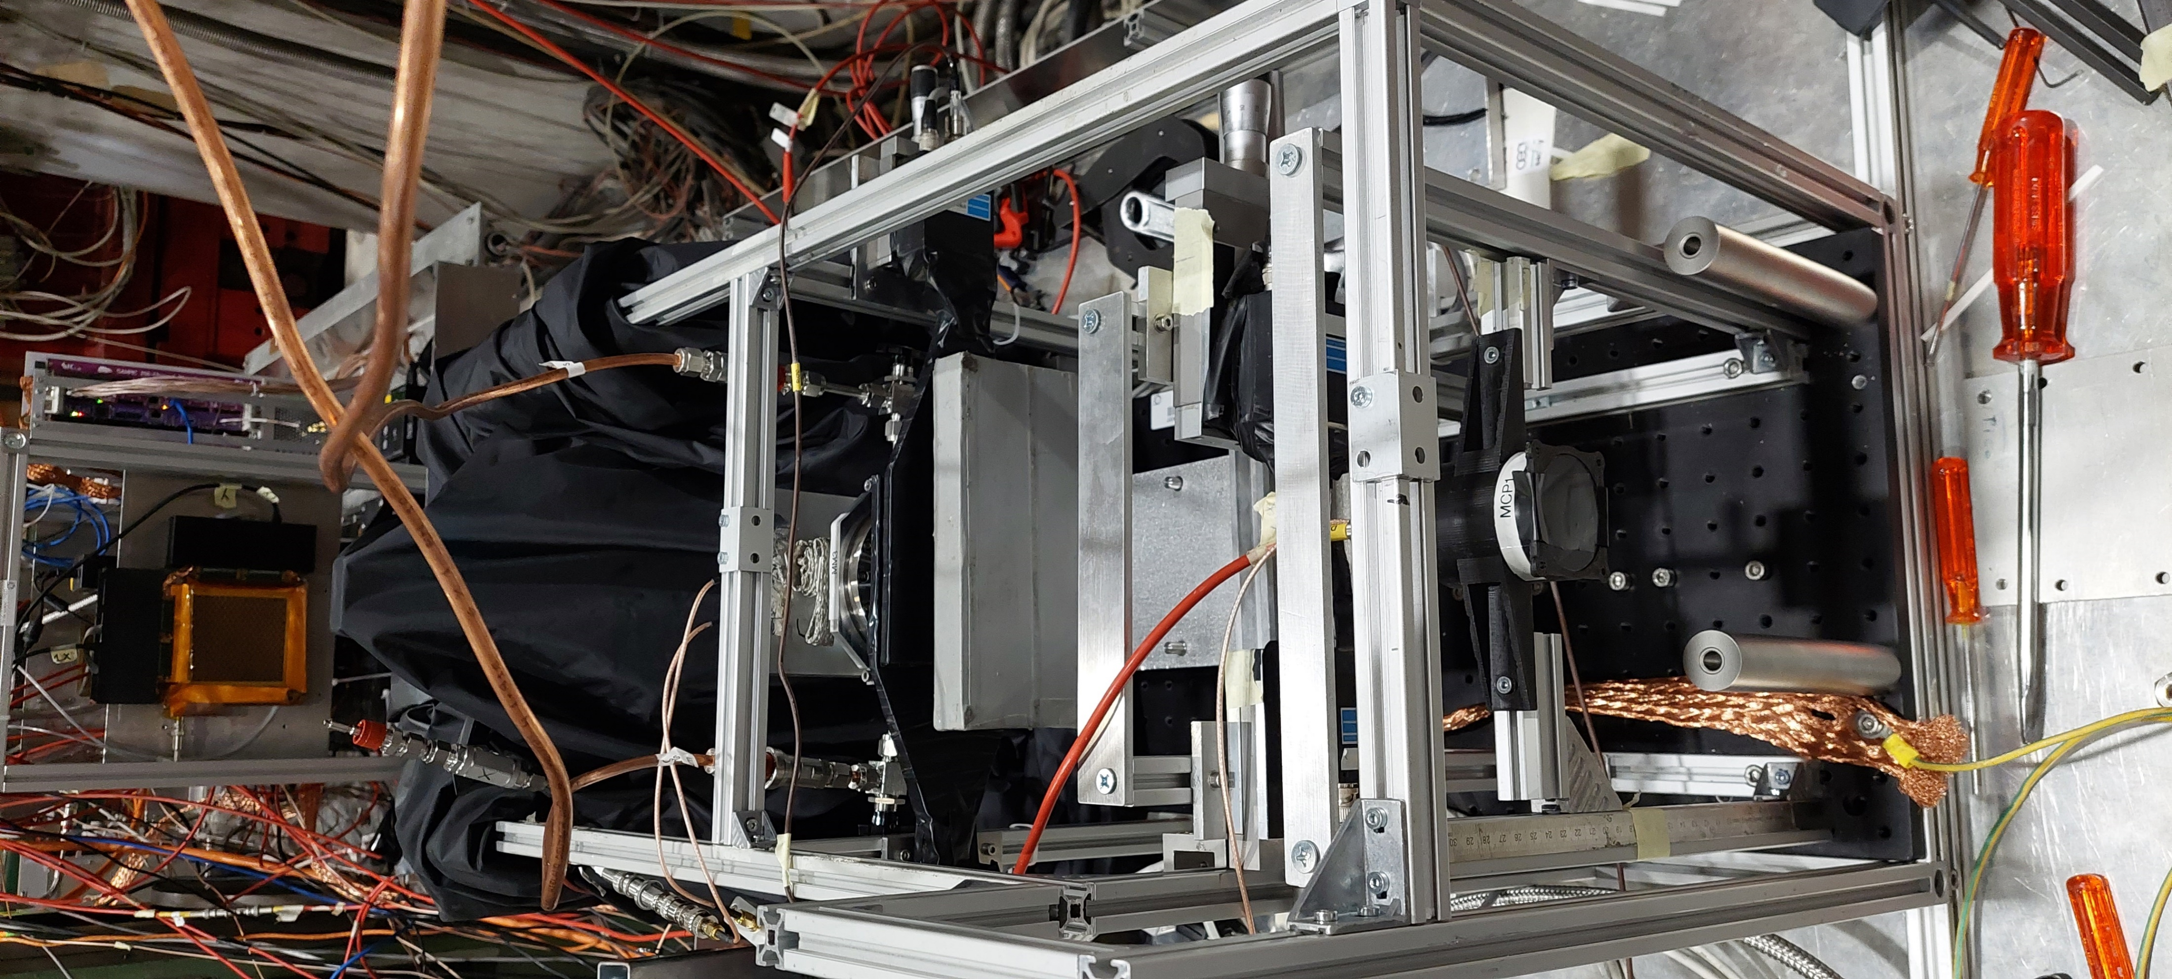
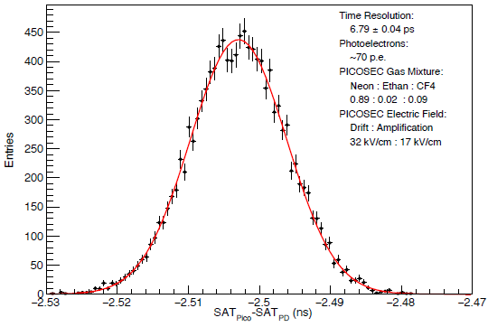
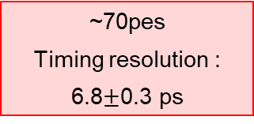
Detector Testing – Particle Beams
Particle Beams @ CERN SPS H4 Beamline
  Electrons 30-80 GeV
PICOSEC MM
PRELIMINARY
VETO scintillators
Absorber Pb (2.5cm)
Absorber
Trigger Scintillator
MCP-PMT time reference device
showering electrons
showering electrons – epeak charge <5 pC
muons
electrons WITHOUT absorber
~70pes
Timing resolution :
6.8$±$0.3 ps
Application Scenario
  Embed in Electromagnetic Calorimeter
  Identify particle showers
13ps
First Indications from laser test measurements @ IRAMIS /CEA

Slide 10
Signal Processing for Timing
Notes:
The next important step after data taking is how to treat them. Indeed timing measurements demand detailed and precise understanding of the algorithm that we are going to apply

Slide 11
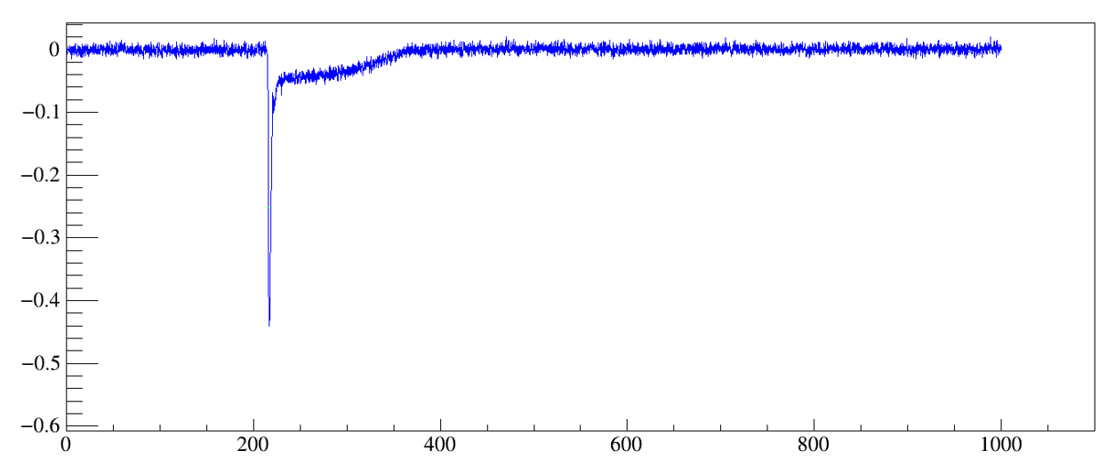
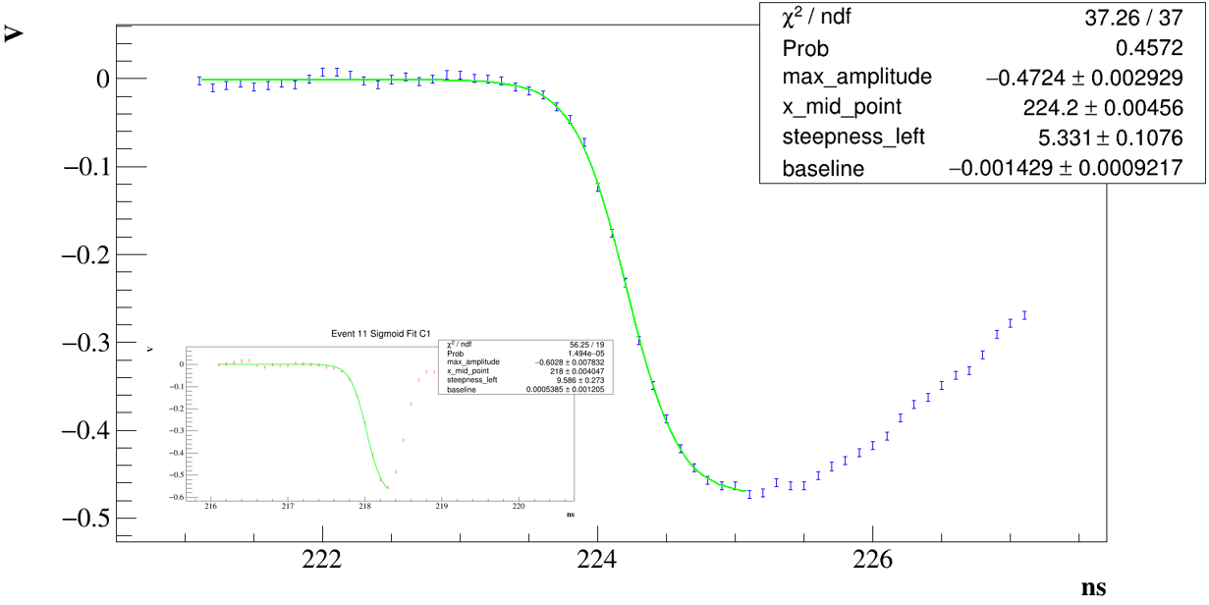
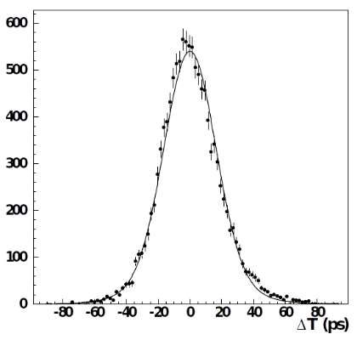
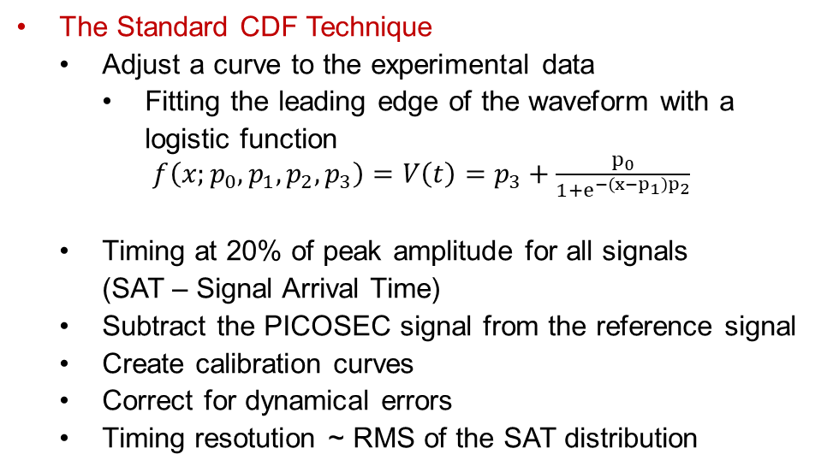
Standard Waveform Analysis
The Standard CDF Technique
  Adjust a curve to the experimental data
    Fitting the leading edge of the waveform with a
    logistic function
    $f\left(x;p_{0}, p_{1},p_{2},p_{3}\right)=V\left(t\right)=p_{3}+\frac{p_{0}}{1+e^{−\left(x−p_{1}\right)p_{2}}}$
  Timing at 20% of peak amplitude for all signals
  (SAT – Signal Arrival Time)
  Subtract the PICOSEC signal from the reference signal
  Create calibration curves
  Correct for dynamical errors
  Timing resotution ~ RMS of the SAT distribution
Ion tail
Electron peak
Notes:
To demonstrate the timing algorithms we are going to use data coming from the Laser Test taken with a single pad prototype, with 119μm drift gap, CsI photocathode and operating in
High field of 525 drift and 275 anode voltage.
The signals of both the picosec and the photodiode can be seen in the upper right. PICOSEC Signal is a two-component signal comprising the fast drifting electron peak and the slow ion tail.
On the other hand, the Photodiode’s signal is more sharp with clear electron peak.
The standard timing algorithm procedure starts by adjusting a curve to both the signals of the photodiode and the PICOSEC, which is the logistic function.
The Signal Arrival Time is extracted by this fit at 20% of peak maximum, and then we subtract PICOSEC Value from the respective photocathode value.
After correcting for dynamical errors we can came up with a SAT distribution, which is fitted with a double Gaussian and its RMS defined the timing resolution, which for this data set is set to 18.3 ps
This procedure and the results we achieved will be our reference analysis, and with this we will compare our new algorithms for their validity and consistency.

Slide 12
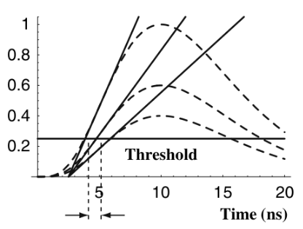
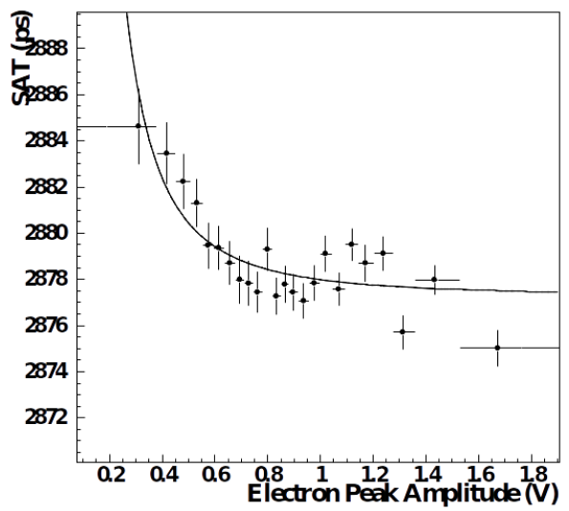
Correcting for Dynamical Errors
Constant Threshold Timing suffers from Time Walk Effect
  Realistic case
  Higher pulses arrive earlier
  Dependence between timing and amplitude size
  The effect can be corrected by the offline analysis
Walter Blum, Werner Riegler, and Luigi Rolandi. Particle Detection
with Drift Chambers. Springer-Verlag Berlin Heidelberg, 2008
In principle, CFD method DOES NOT suffer from time walk effects
  However we observe dependence on signal amplitude
    Its origin has nothing to do with offline analysis procedure BUT
    Results from the microscopic behavior of the avalanche
      Photoelectrons drift with different velocities than the total avalanche
    $g\left(x;a,b,w \right)=a+\frac{b}{w}$
  Calibration curve
    $Corrected SAT =SAT− \frac{a}{{\left(Pulse Amplitude\right)}^{b}}+c$
Notes:
Talking about dynamical errors we mean that the dependence of SAT on the signal amplitude. But in principle the CFD technique does not suffer from time walk effects.
This dependence can be seen by splitting the data into bins of peak size(amplitude or charge), fitting each data set with Gaussian and then by shorting SAT values in rising values of the size.
On the left you can see the results for the data set we used, this small dependence has nothing to do with the offline analysis procedure, but instead it reveals the pulse formation dynamics, and the microscopic behavior of the avalanche, and the fact that the avalanche drifts with different velocity than its electrons individually. Even though we have reduced more the drift gap to create avalanches as early as possile, this is still a remaining effect. For this reason, we parametrize this dependence with a power law and correct for this. While on the other hand the constant thr thechnique truly suffers from time walk effects
And the effect is corrected on the offline analysis.

Slide 13
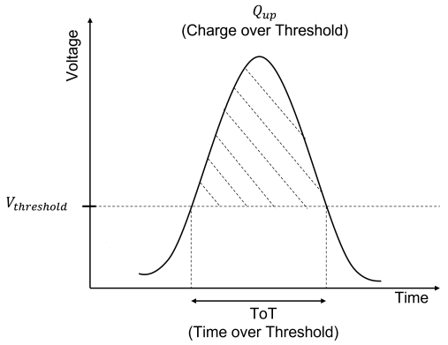
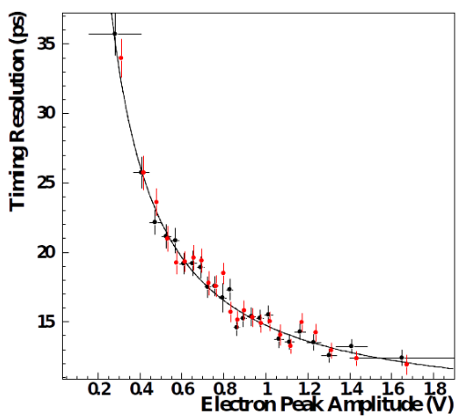
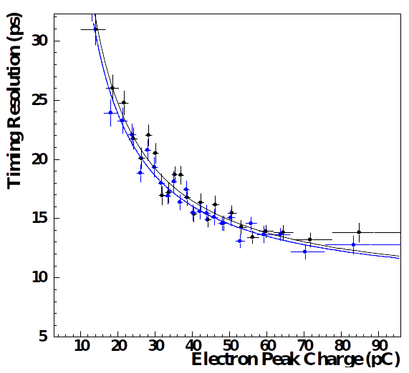
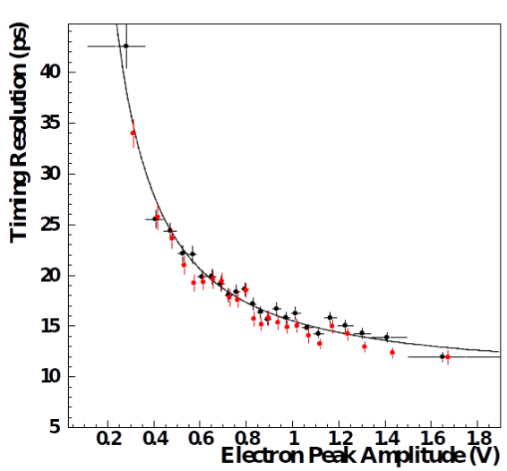
Alternative Timing Techniques
Constant Threshold
  SAT defined @ 100mV
  Parameterization using peak
  amplitude
Charge above Threshold
  Constant threshold+ Using multiple
  higher thresholds
  Alternative method of peak size estimation
Artificial Neural Networks
  SAT defined @ 100mV
  Using the digitized waveform
  to feed an ANN

Slide 14
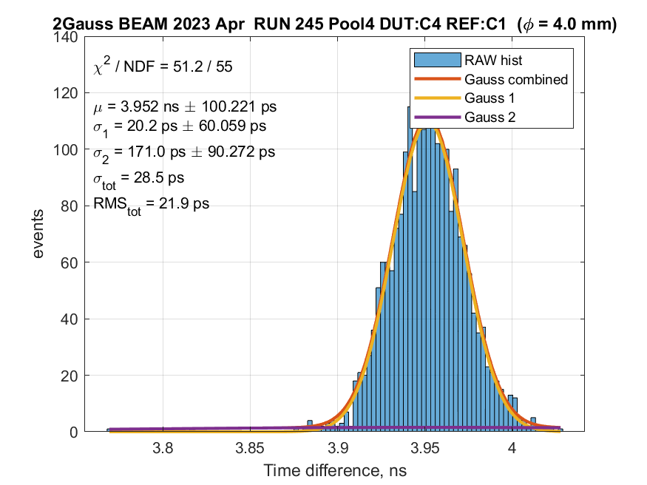
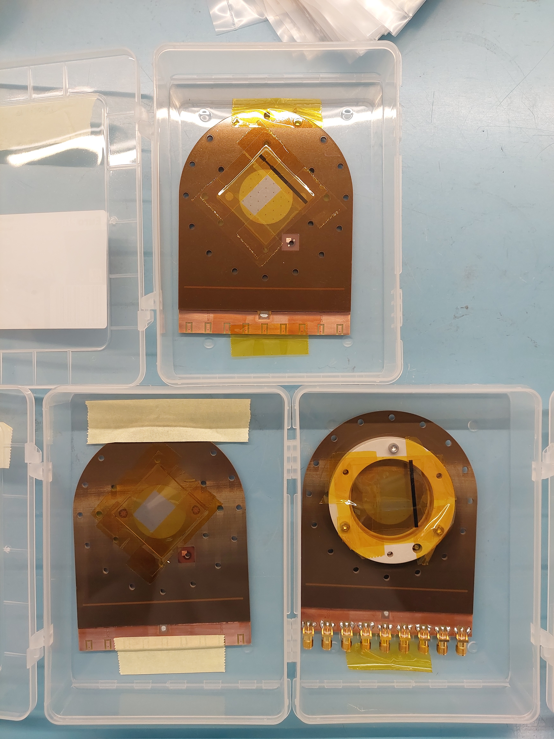
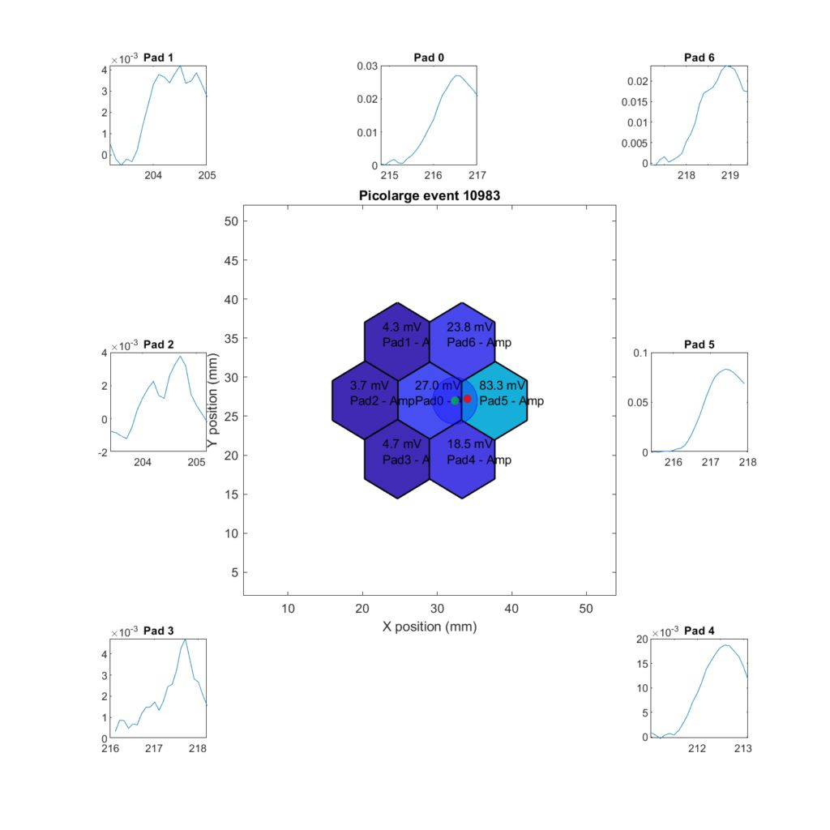
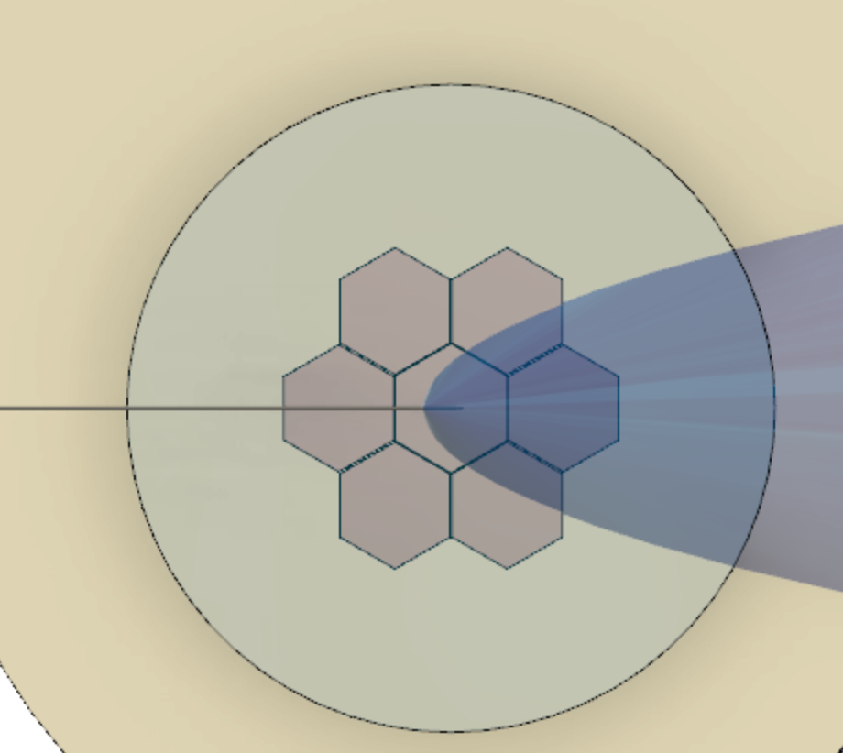
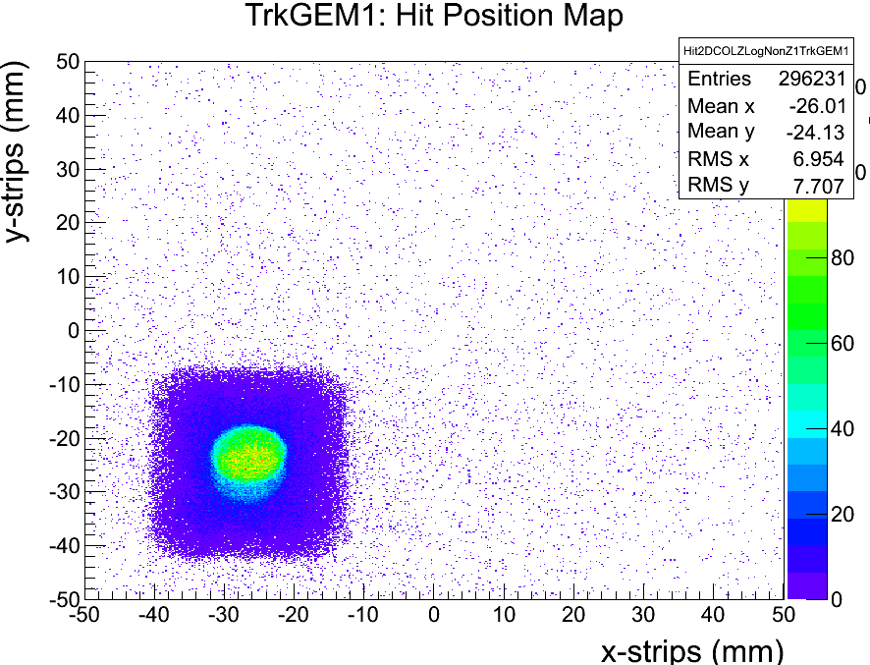
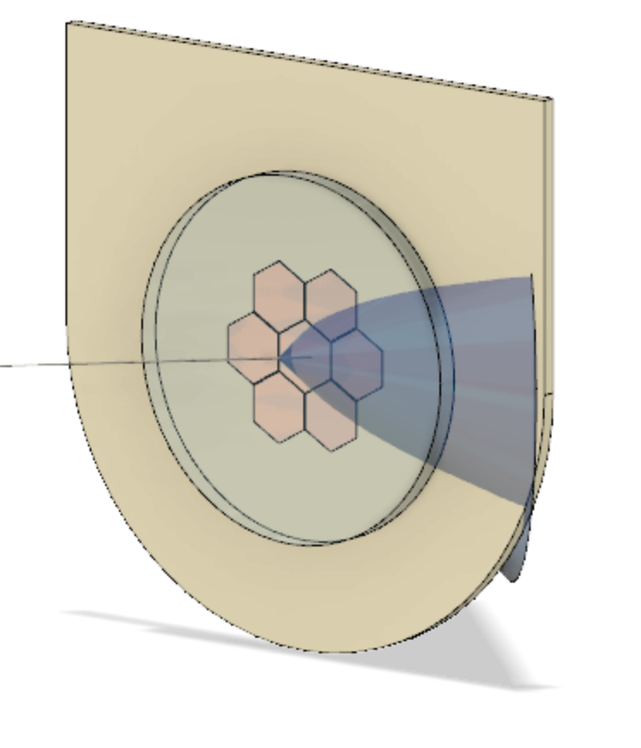
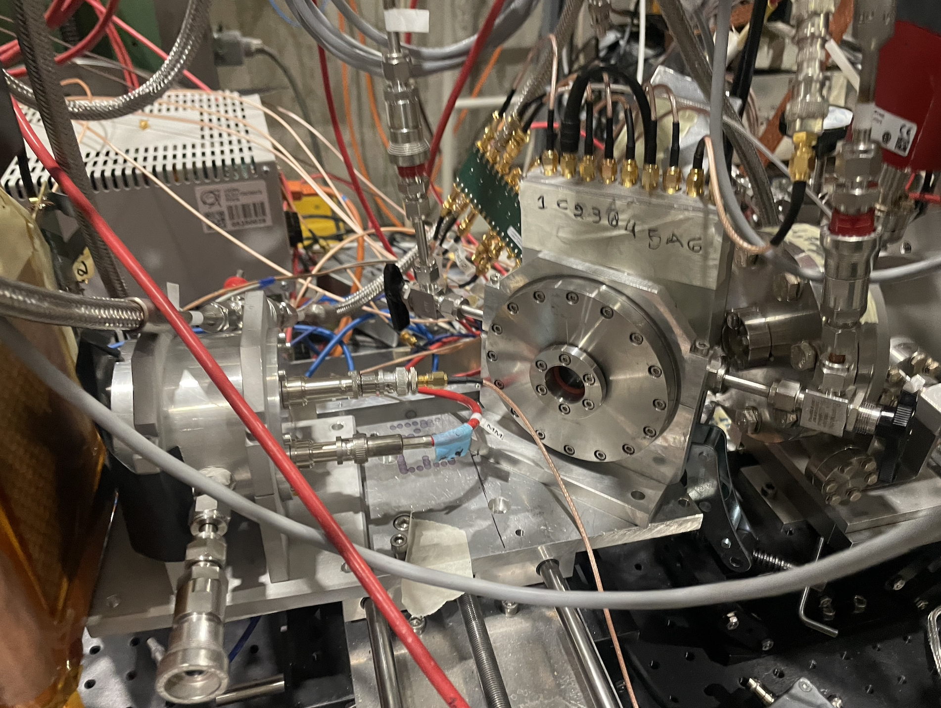
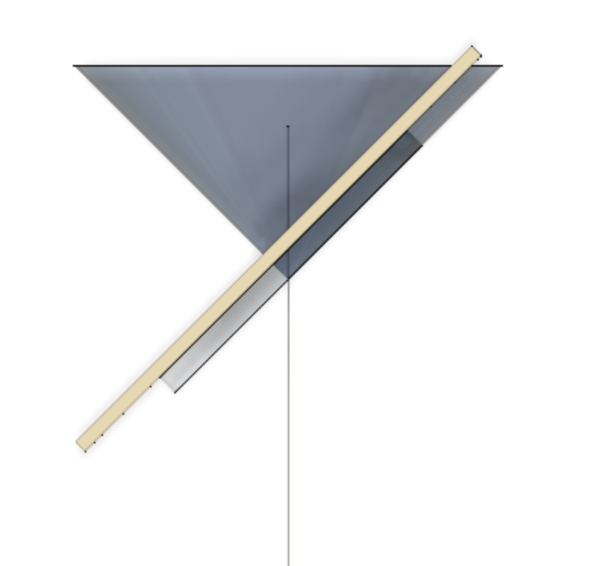
Measurements of Interest and Highlight Preliminary Results
Robust & Efficient Prototypes ~ put a photo of different detectors tested
  Different resistivity values (10 MO, 200kO)
  Different resistivity layer architecture (capacitive sharing)
  Voltage scans → Stable operation voltage at a high rate
  Timing runs on individual pads
  Long scan for uniformity map on amplitude and timing
  Signal Sharing
  Tilted detector relative to beam direction in 45 and 35 degrees
~20ps at
central pad
C550/A275V
Best result
Capacitive sharing
10MO 3 layers

Slide 15
Concluding Remarks

Slide 16
Ongoing Development
Towards an engineered PICOSEC MM module :
multiple directions in detector development
Scalable MM Detector (IRFU/CERN)
  10x10cm2
  Prove the performance in a multichannel setup
  Flatness (Planarity < 10μm)
Pixelated MM Detector
(IJCLab/IRFU/CERN)
  Development of front-end & back-end readout electronics for the prototype (~100 channels )
Physics Studies
(LP2I Bordeaux/ IRFU/ Auth)
  T0 tagger and/or embedded in a calorimeter
  Muon monitoring
  As a photodetector for T0 tagging at the neutrino detector
Robustness & Efficiency (LIST/USTC/CERN)
  Research on various photocathode materials (Replace CsI with B4C, DLC,… )
  Resistive prototypes
Notes:
For the PIMENT project now there are multiple directions

Slide 17
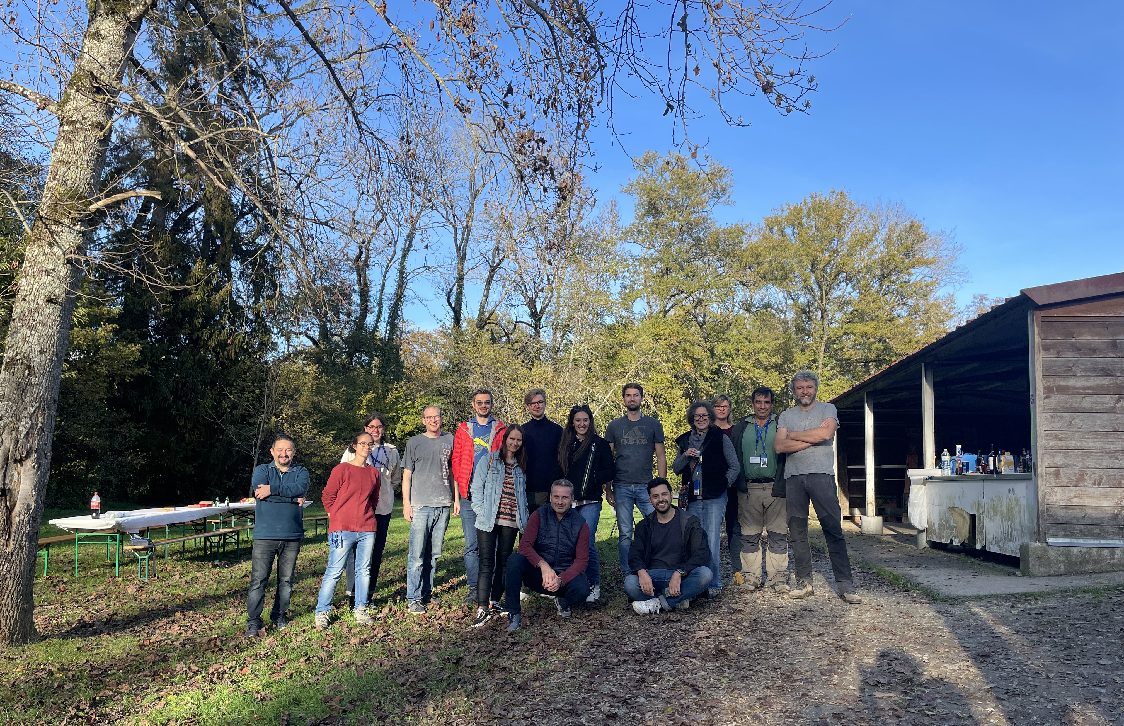
In the end it’s all a matter of timing
Thank you!

Slide 18
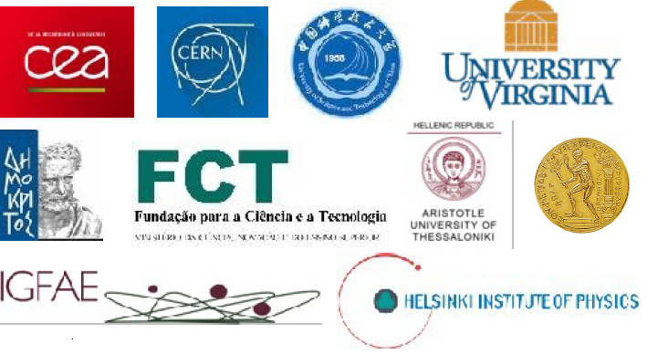
The RD51 “PICOSEC” Collaboration
AUTH (Greece) K. Kordas, C. Lampoudis¹, I. Maniatis⁶, I. Manthos⁵, K. Paraschou, D. Sampsonidis, A. Tsiamis¹, S. E. Tzamarias
CEA - IRFU, LIST, LIDYL (France) S. Aune, D. Desforge, I. Giomataris, T. Gustavsson, F.J. Iguaz, A. Kallitsopoulou, M. Kebbiri, P. Legou, T. Papaevangelou, M. Pomorski, E. Scorsonne, L. Sohl
CERN (Switzerland) J. Bortfeldt², F. Brunbauer, C. David, M. Lupberger², M. Lisowska, H. Müller³, E. Oliveri, F. Resnati, L. Ropelewski, L. Scharenberg, T. Schneider, A. Utrobicic, M. van Stenis, R. Veenhof⁴, S. White
HIP (Finland) F. Garcı́a
LIP (Portugal) M. Gallinaro
NCSR Demokritos, (Greece) G. Fanourakis
NTUA (Greece) Y. Tsipolitis
USTC (Hefei, China) J. Liu, B. Qi, X. Wang,
Z. Zhang, Y. Zhou
(1) Also Center for Interdisciplinary Research and Innovation (CIRI-AUTH), Thessaloniki 57001, Greece.
(2) Now at University of Bonn, D-53115 Bonn, Germany.
(3) Also University of Bonn, D-53115 Bonn, Germany
(4) Also at National Research Nuclear University MEPhI, Kashirskoe Highway 31, Moscow,Russia; and Department of Physics, Uluda University, 16059 Bursa,Turke
(5) Now at University of Birmingham
(6) Now at CERN
10 institutes from 6 countries
44 collaborators

Slide 19
Backup-slides

Slide 20
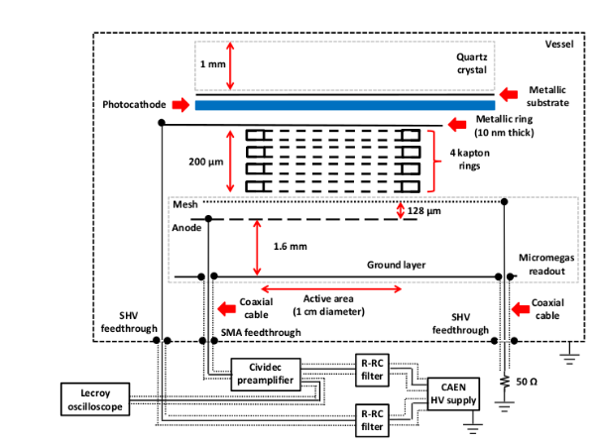
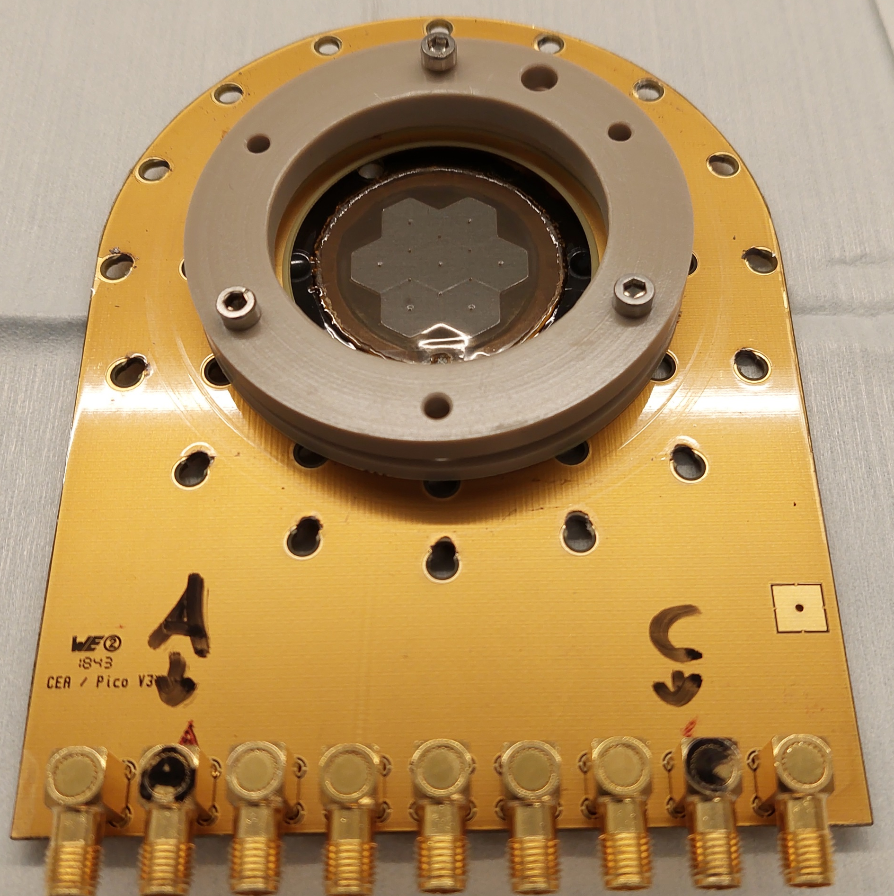
Detector Prototype Evolution
1-ch (∅1cm)
.
Single Pad Prototypes / Microbulk (ø 1cm)
  Proof of concept
  Resistive and non resistive prototypes
Photocathodes:
  MgF2 / Sapphire crystal +
  Metallic (Cr, Al)
  Metallic substrate + CsI
  Metallic substrate + polycrystalline diamond
  DLC
  B4C, Metallic substrate +B4C
Gas : 80% Ne – 10% CF₄-10%C₂H₆
Detector Testing:
  Reference timing detector with
  better precision
  Pulsed laser @ CEA/IRAMIS Facility
  Particle Beams @ CERN –
  muons/pions of 90-150GeV
Multi-Pad Prototypes
  Hexagonal pads ø 1cm
  Resistive and non resistive prototypes
7-ch (∅ 2.6 cm)
19-ch (∅ 3.6cm)
100-ch (◻ 1.0 cm)
Notes:
1st PICOSEC Prototype
Circular geometry(diameter of 1cm)
Without strips
Mesh supported by 6 cylindrical pillars
200μm drift gap
CsI photocathode (18nm thickness )
MgF₂ Cherenkov radiator(3mm thickness)
Our PICOSEC-Prototype
Circular geometry(diameter of 1cm)
Without strips
Mesh supported by 6 cylindrical pillars
119μm drift gap
9mm Chromium layer photocathode
Anode – Drift Voltages → [275,525]V

Slide 21
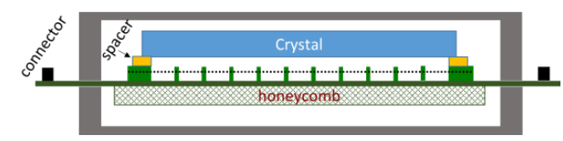
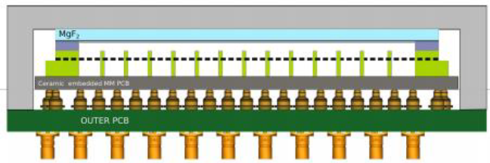
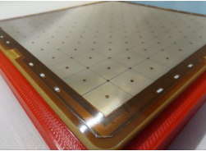
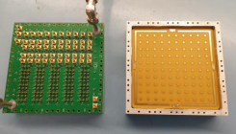
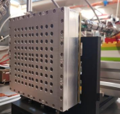
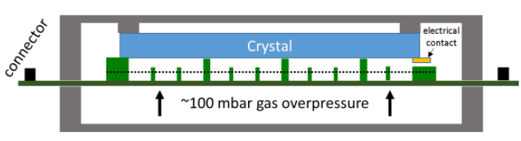
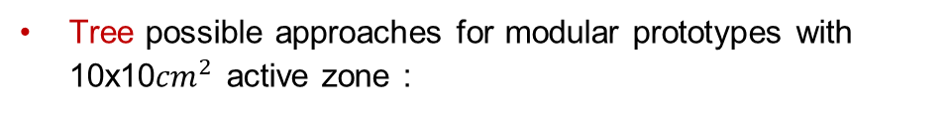
Prototype Scalability
The ATLAS NSW Approach:
  Pillars on MM bulk readout
  Pressing against the marble table
  Backwards with a glued honeycomb layer
Tree possible approaches for modular prototypes with 10x10${cm}^{2}$ active zone :
Rigid, ceramic-core PCB for the MM readout
  Crystal coupled to the PCB with spacers
  MgF2 crystal & MM board will be decoupled from the chamber
  Second PCB will be used for signals towards the amplifiers
Risk to damage the bulk MM
Advantage:
  Low material budget on the detector
  Allow the fabrication of large flat boards
Longer pillars MM module:
  Pressed against Cherenkov radiator
Risk to damage the photocathode
Drawback: Increased detector material → timing layers
Notes:
Investigating new approaches to build large, robust prototypes

Slide 22
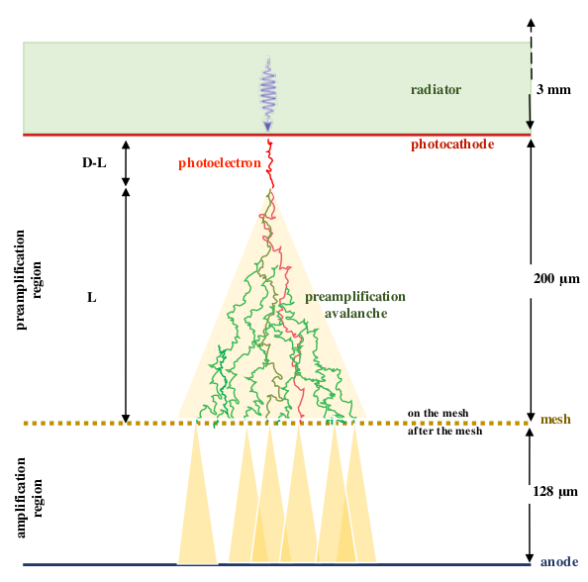

Physics
Synchronous Cherenkov photons
Synchronous Photoelectrons from the photocathode
Photoelectron conversion(Townset Coeff)
Preamplification Avalanche
Transport through the mesh
Amplification Avalanches

Slide 23






Robustness and Efficiency
The importance of planarity
  1st multichannel prototype tested
  19-hexagonal pad prototype, MgF2, CsI, 200μm drift gap
Variation on timing resolution
in different regions on the pad
  Non uniformity of the drift field gap
  Different gain in single pad area
Deformation caused by the
Deformation due to PCB pressure
S. Aune et al, "Timing performance of a multi-pad PICOSEC-Micromegas detector prototype", Nucl. Instrum. Meth.A 993 (2021) 165076, https://doi.org/10.1016/j.nima.2021.165076
Notes:
High Efficiency:
GaN (high number of photoelectrons ➔ modest field) ?? What about that??

Slide 24







Robustness & Efficiency
In the research of photocathode materials
  Standard photocathode: 18nm CsI +3nm Cr ~ 10pe/mip
  CsI sensitive to humidity/ion backflow & sparks
  New materials under test (B4C, DLC, Diamond,
  Metallic – Al, Cr)
MgF2 crystals with DLC photocathode
Results
Florian M. Brunbauer on https://indico.cern.ch/event/852331/contributions/4611230/attachments/2367111/4043506/Picosec-TPCSymposium2021.pdf
B4C 5 times higher q.e. compared to DLC!!

Slide 25








Pixelated PICOSEC Detector
Towards a large scale detector we need to develop appropriate frond-end & back-end electronics ~ 100channels
Recent development @ CERN
  10 ch amplifier boards
Discrete current preamplifiers
  Low noise RMS < 1mV
  High gain >30dB
  Bandwidth > 1GHz
Philippe Legou
(CEA/Saclay)
PRELIMINARY
Timing Resolution:
20.0±0.6 ps
Research on possible usage of customade charge-sensitive amplifiers (Hans Muller/ CERN)
Research on different digitization ways → SAMPIC digitizer (IRFU /CEA)
More info : A. Utrobičić on RD51 collaboration meeting
https://indico.cern.ch/event/1138814/timetable/#20220614.detailed

Slide 26

More info on the contribution by Antonija Utrobicic at the VCI2022 conference: https://indico.cern.ch/event/1044975/contributions/4663685/

