Slide 1
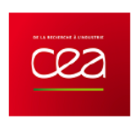


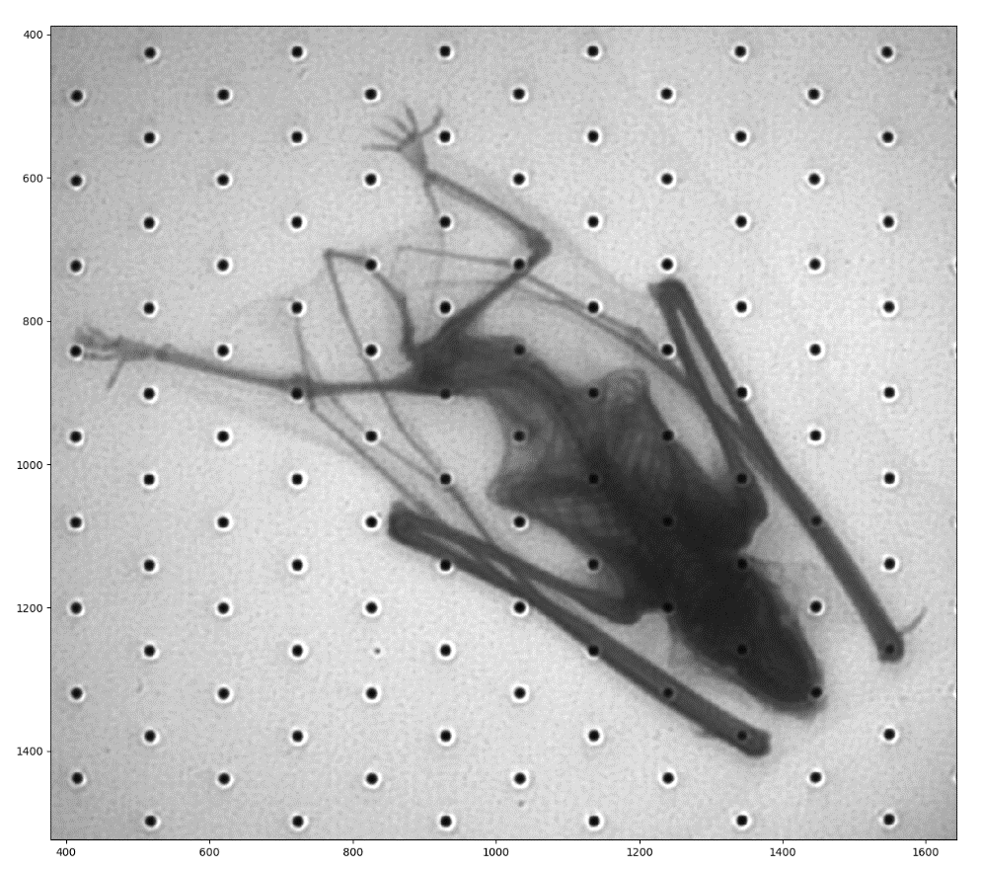
Neutron and beta imaging with Micromegas detectors with optical readout
PHENIICS FEST – 11/05/2023
Antoine Cools
CEA Saclay
1

Slide 2
1.CONTEXT
1.1 Micromegas detector
1.2 Light production mechanisms
2. DETECTOR CHARACTERIZATION WITH X-RAY
2.1 Soleil beam test
3. APPLICATIONS
3.1 B-imaging
3.2 Preliminary results with tritium samples
3.3 Neutron radiography
3.4 Preliminary results with a neutron source
CONCLUSION and PERSPECTIVES
2

Slide 3
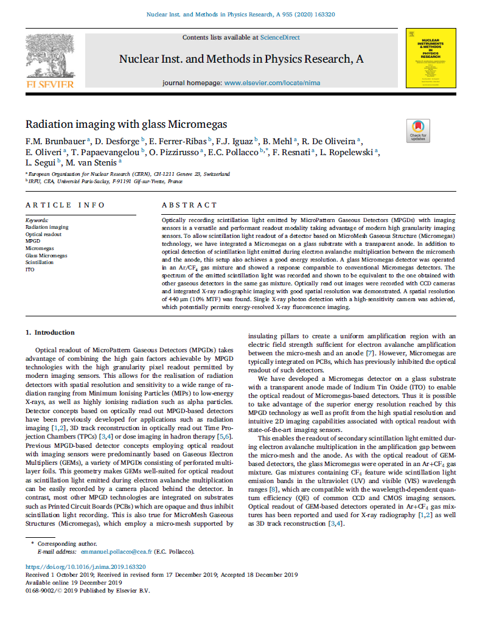
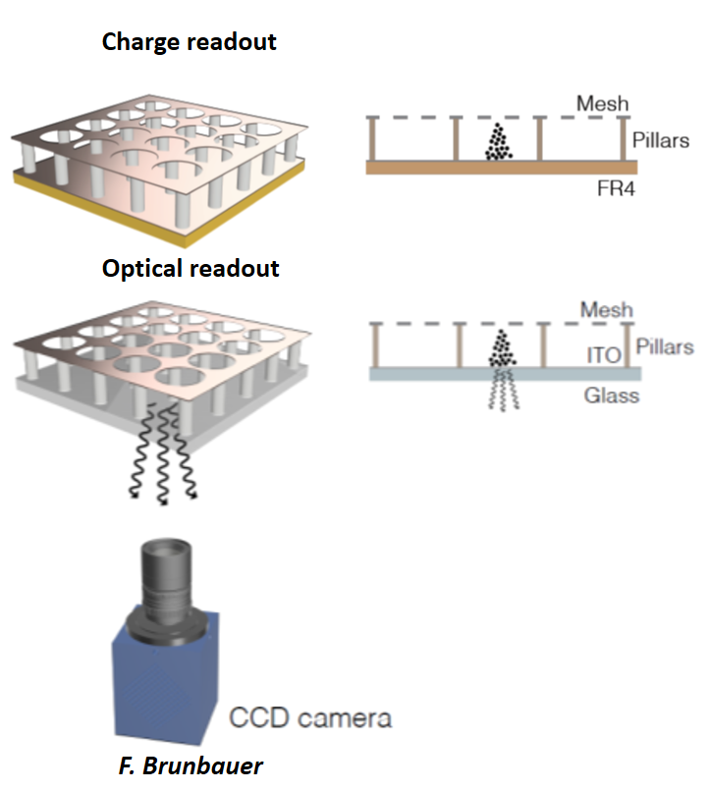
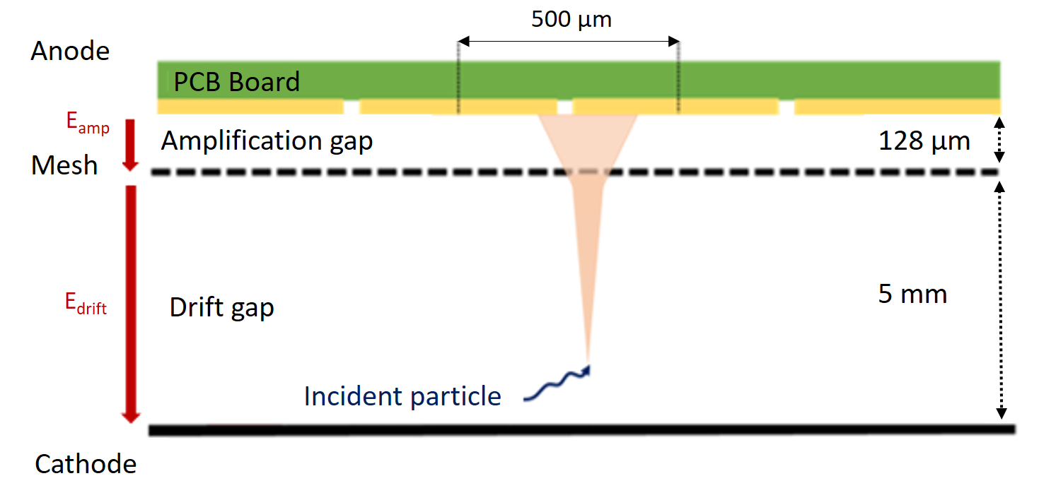
1.1 MICROMEGAS GASEOUS DETECTOR
Advantages:
2D pixelized readout of high granularity
Megapixel resolution from commercial cameras
Integrated imaging approach
Applications:
Real-time neutron imager
β imager for sub-becquerel activity measurements
3

Slide 4
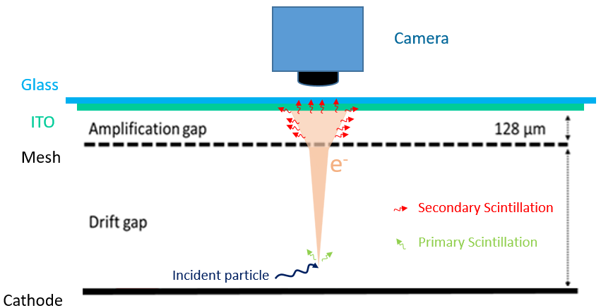
1.2 LIGHT PRODUCTION MECHANISMS
Scintillation
f Fluorescence
Prompt emission of photon after absorption of incident radiation.
(1 ns to 1 µs)
Primary scintillation
Secondary scintillation
Coming from the excitation of the gas due to incident particles.
Coming from avalanche amplification.
Gas mixture : Ar/CF₄
4

Slide 5
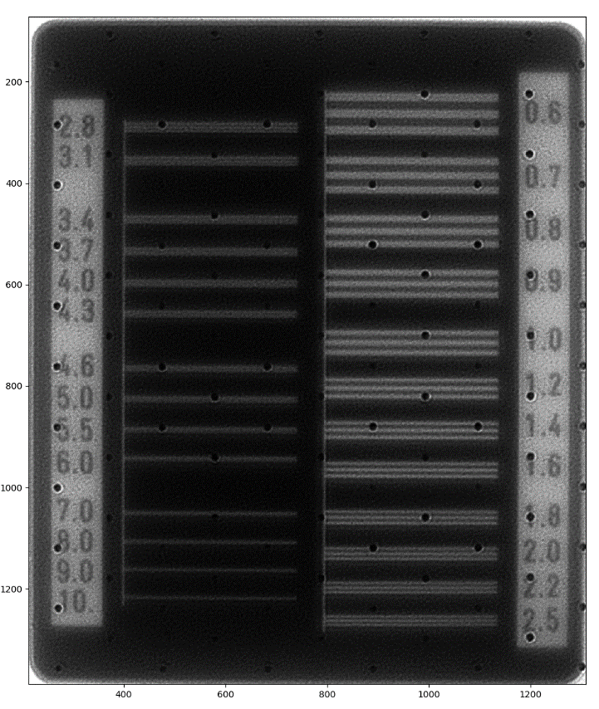
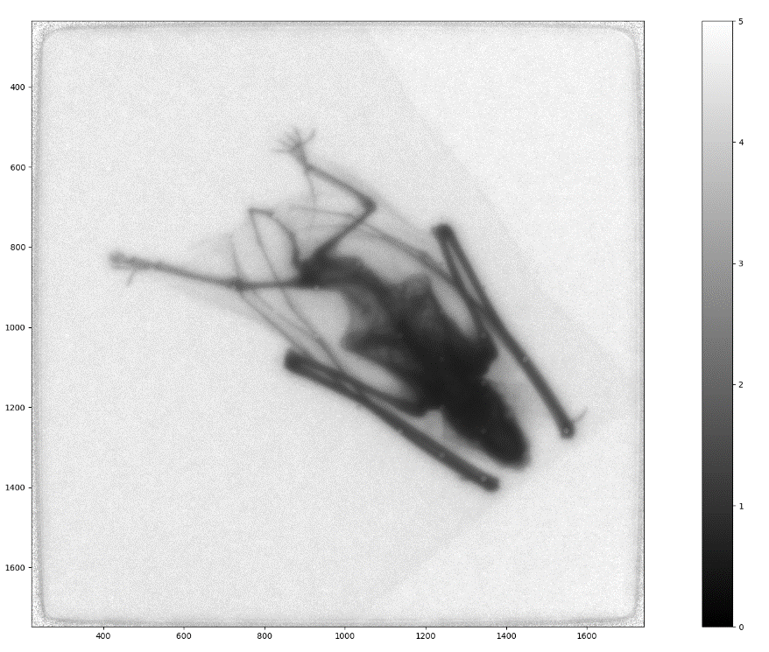
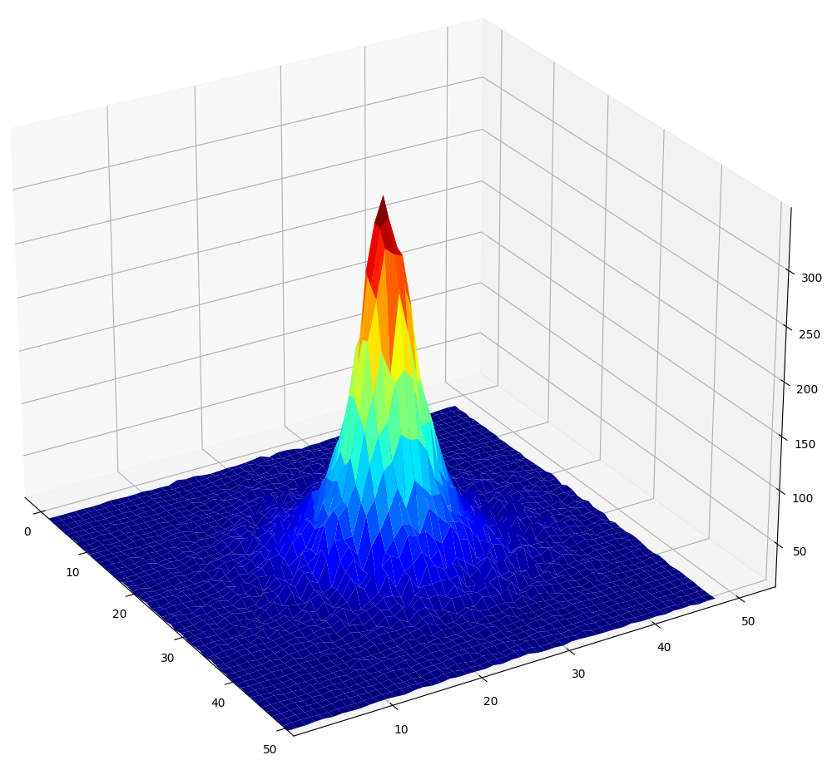
2. DETECTOR CHARACTERIZATION WITH X-RAY SOURCES
2.1 Soleil beam test
5

Slide 6
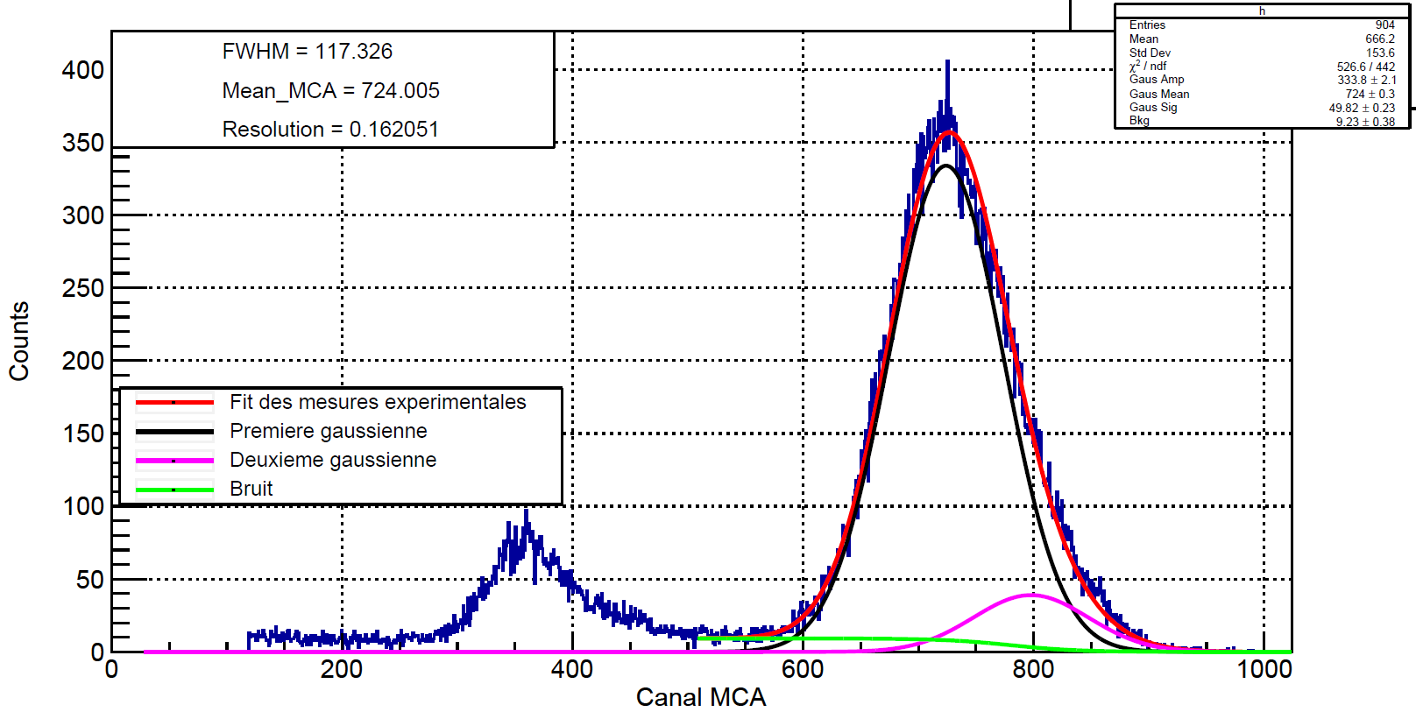
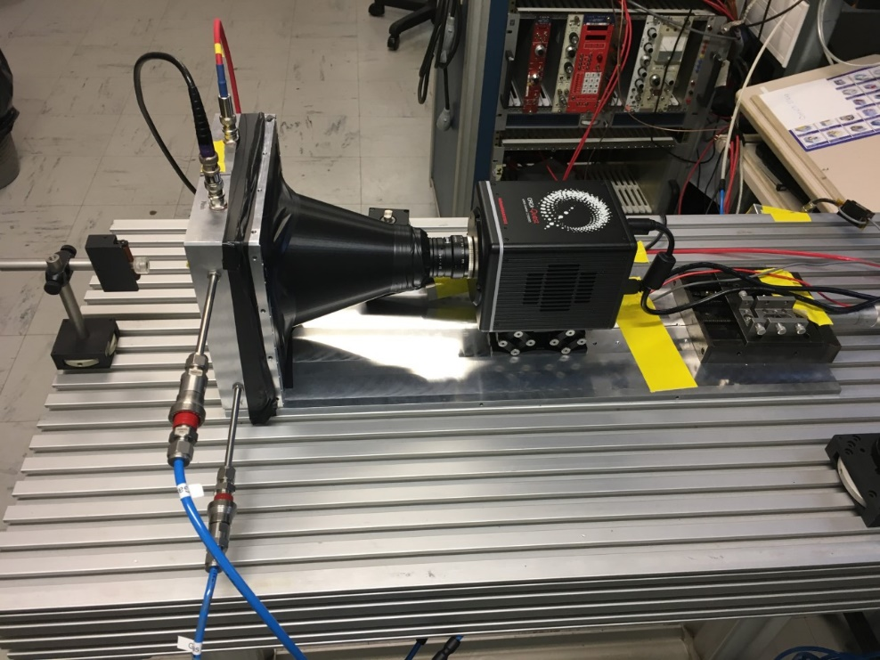
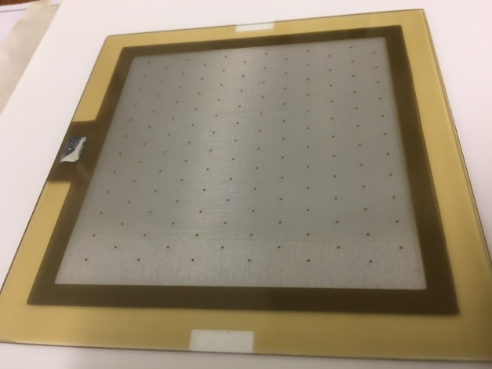
2. DETECTOR CHARACTERIZATION WITH X-RAYS
⁵⁵Fe
Experimental set-up for x-rays
⁵⁵Fe energy spectrum – 5.9 keV
ORCA - Quest qCMOS
Bulk on glass from CERN and IRFU
Charge readout test in Argon+5%Iso:
  gain above 10⁴ and FWHM reaches 16%
Coated glass with 150 nm of ITO (Indium Thin Oxide)
Pillars with hexagonal pattern and large pitch (6 mm)
Lens 25 mm
Cover PLA
Glass Micromegas
S. Aune, T. Benoit, M. Kebbiri
Glass Micromegas
6

Slide 7
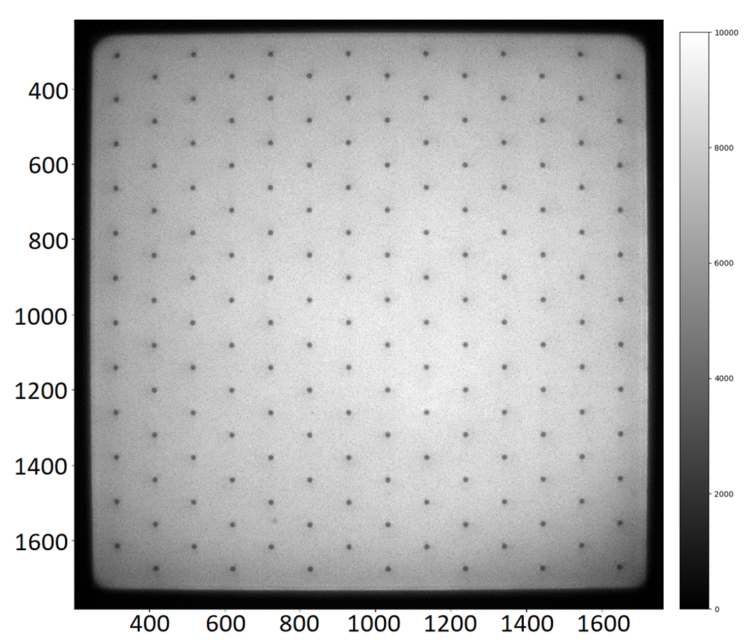
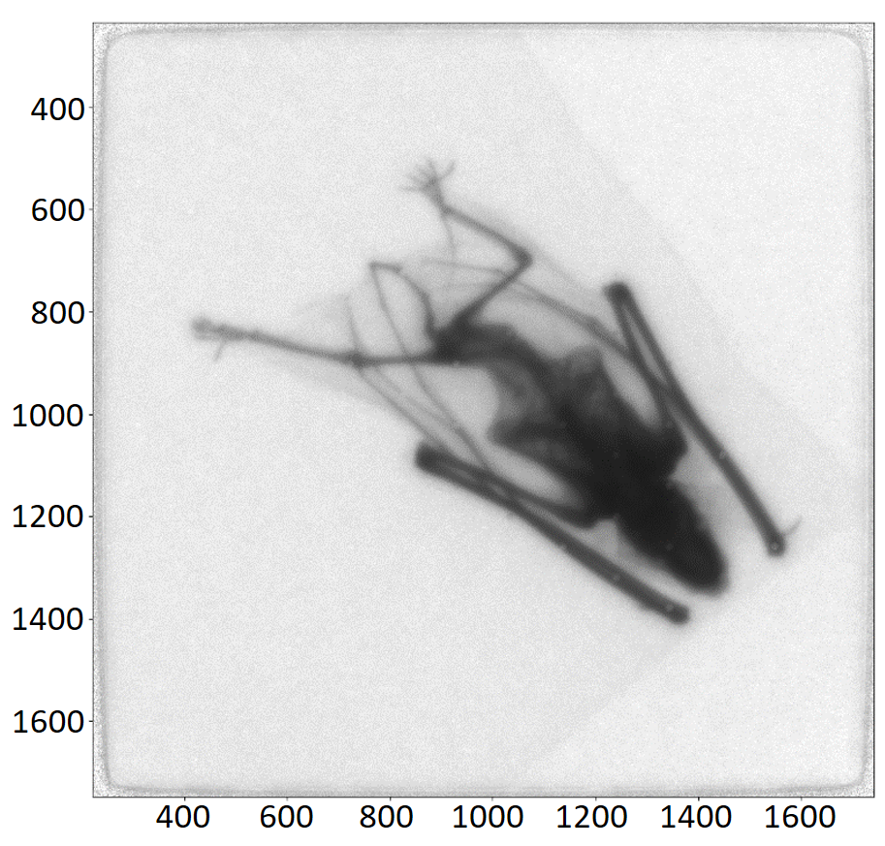
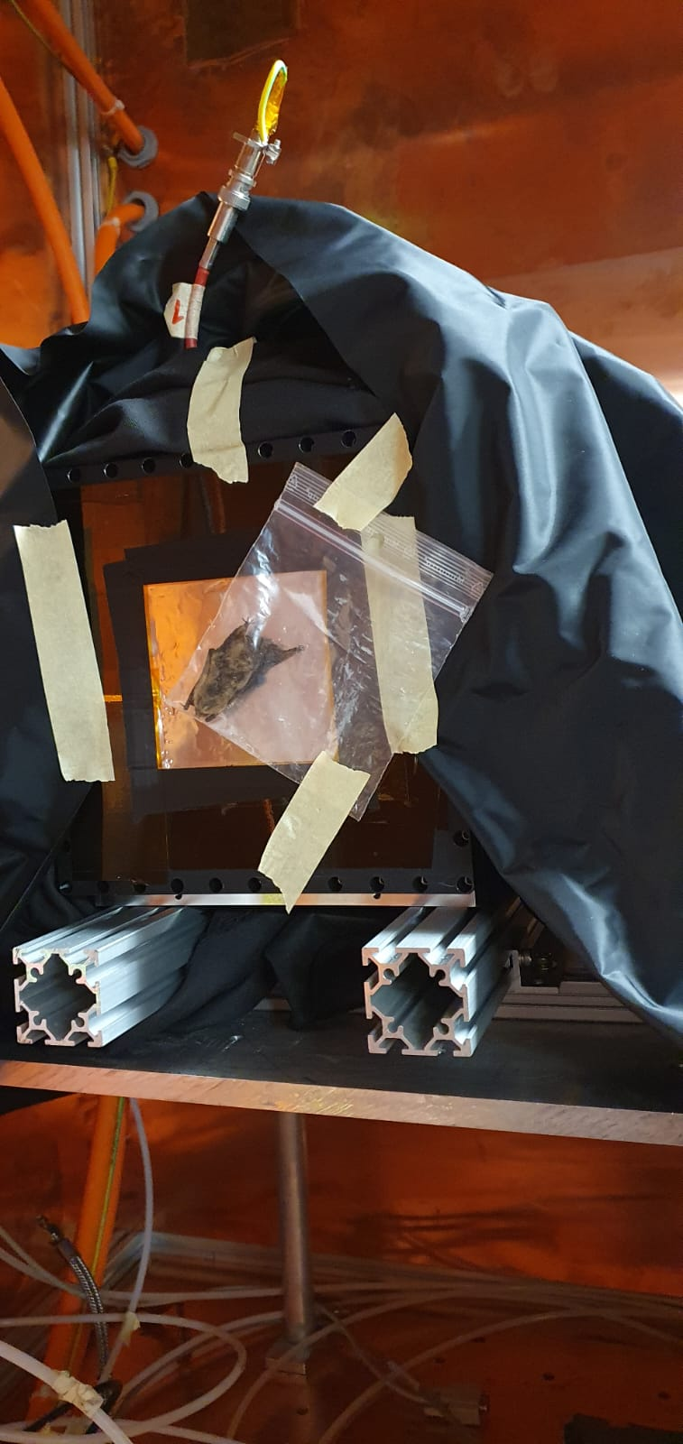
2. DETECTOR CHARACTERIZATION WITH X-RAYS (CERN GDD)
X-ray radiography (20 kV) – Ar/CF₄(20%)
High gain: 1 min exposure time gives images with good contrast
60 sec exposure time bat radiography with simple background suppression and beam profile correction.
7
60 sec full detector image with simple background suppression.

Slide 8
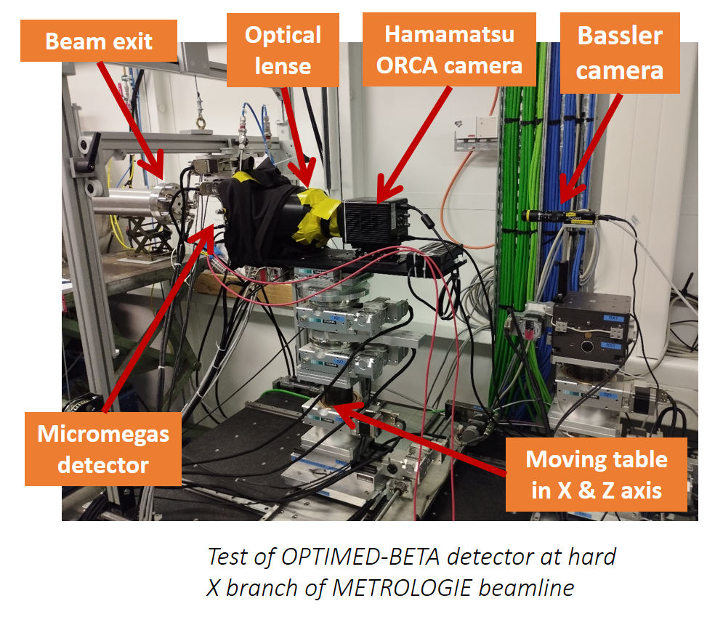
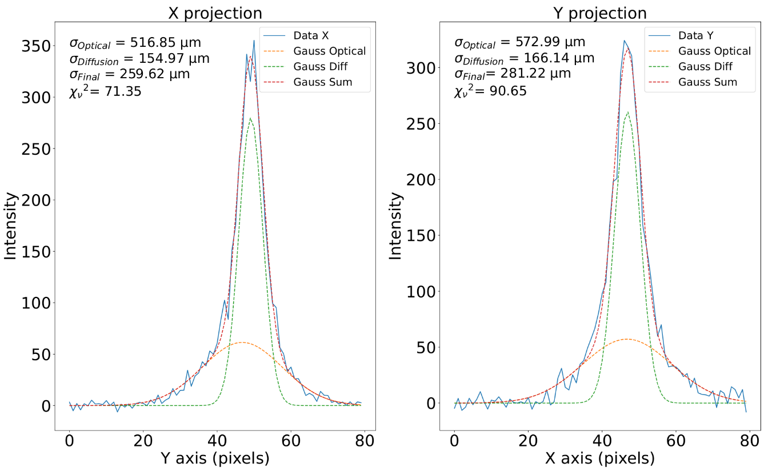
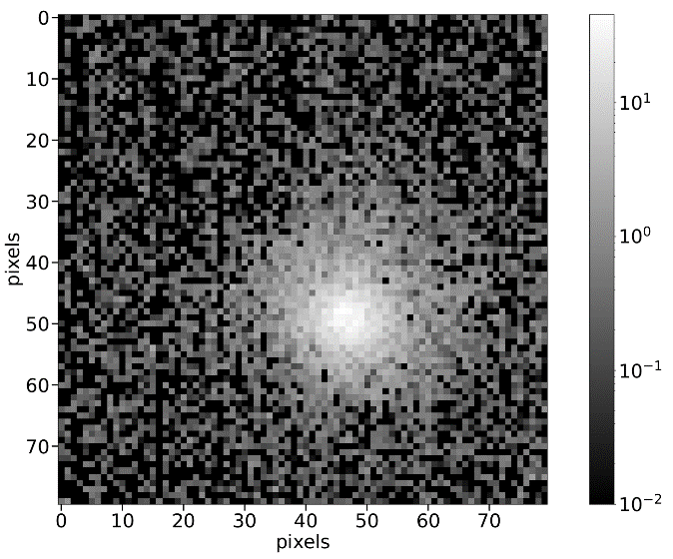
2.1 SOLEIL BEAM TEST
Synchrotron Soleil (4 keV – 15 keV)
Goals
Determination of Point Spread Function (PSF)
Spatial resolution dependence on electric fields
Detector homogeneity
5 x 5 µm beam, Amplification
(Va=400 V, Vd=210 V)
8

Slide 9
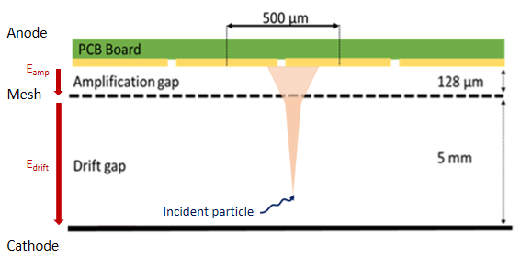
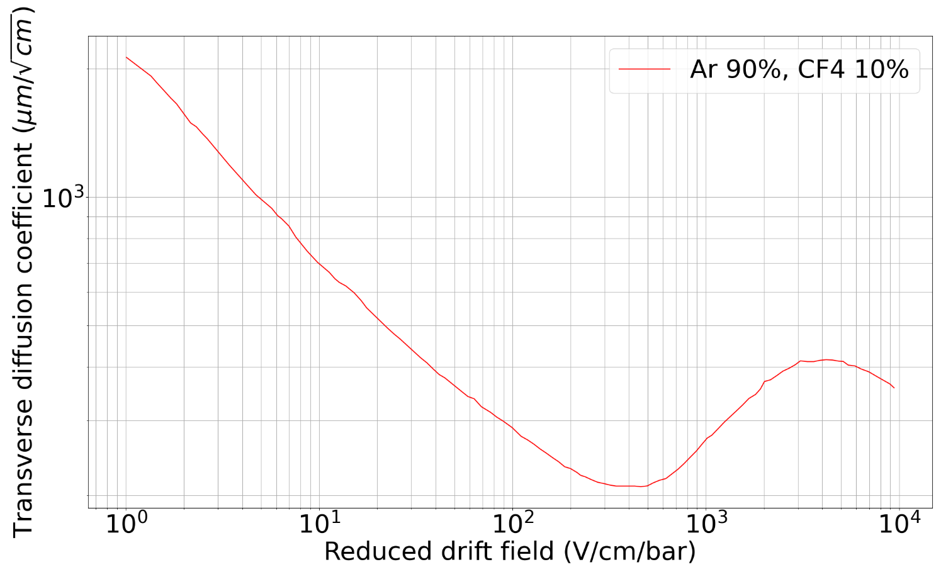
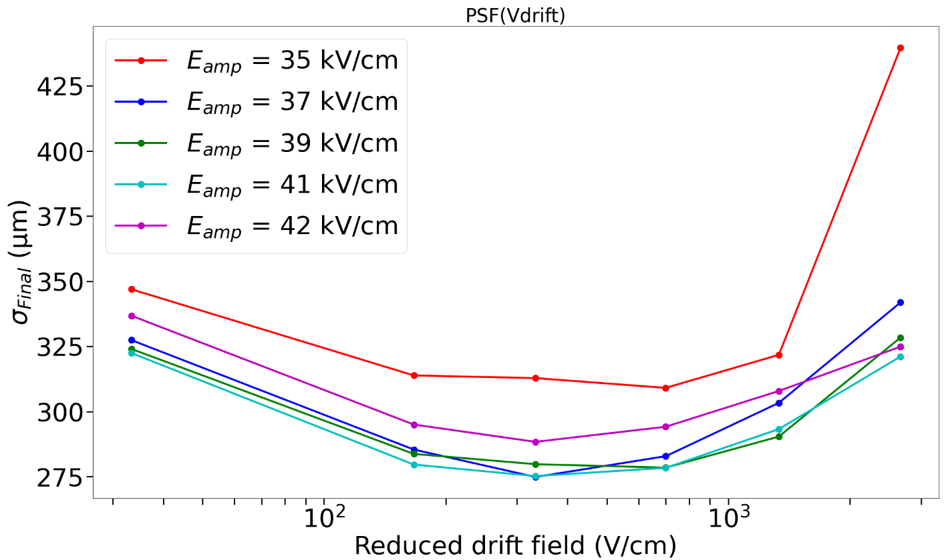
2.1 SOLEIL BEAM TEST
Diffusion
9

Slide 10
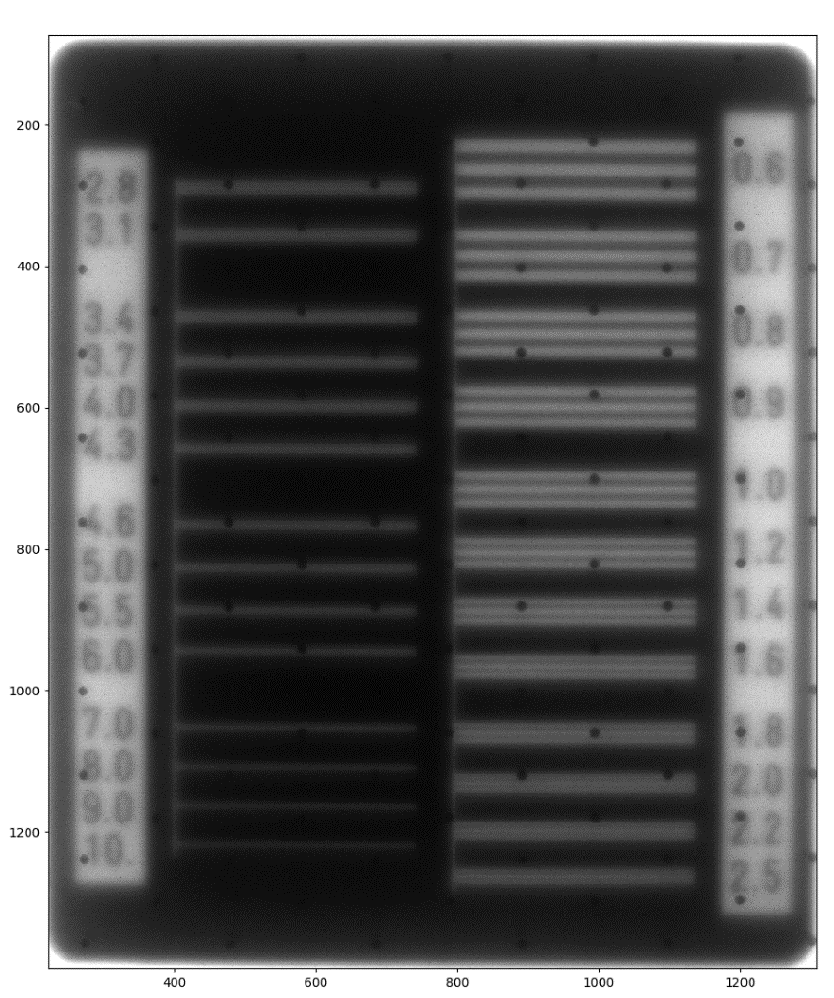
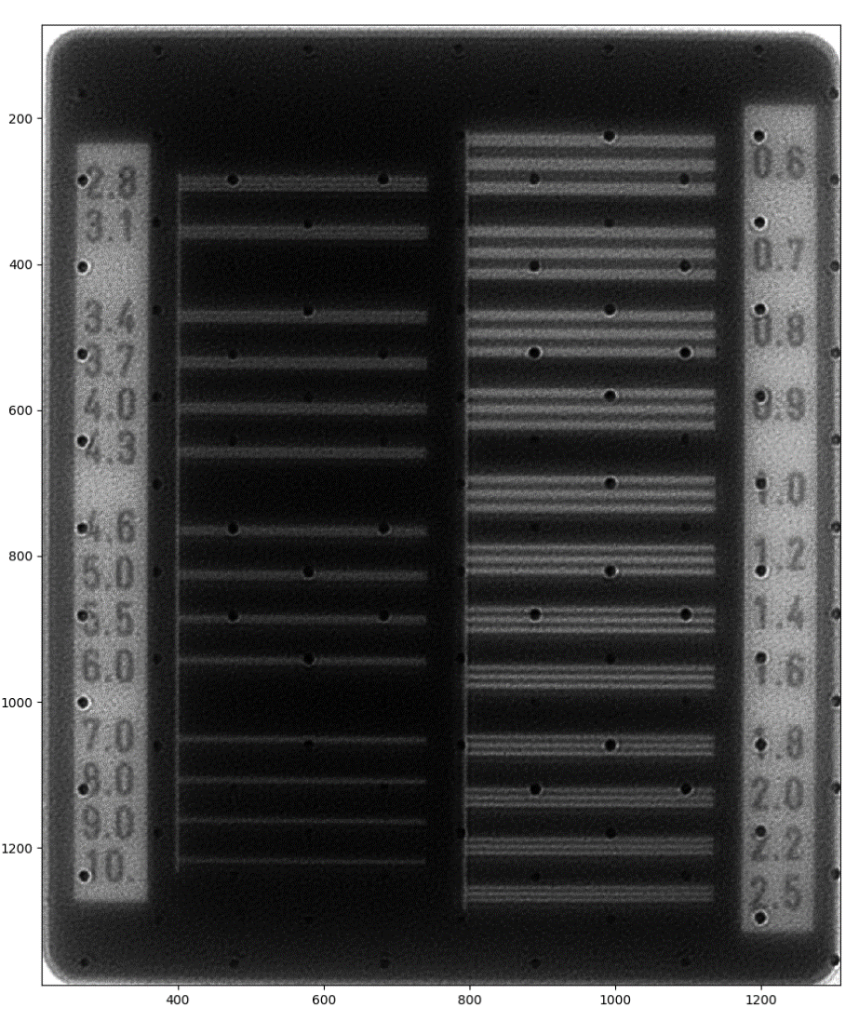
2.1 SOLEIL BEAM TEST
Deconvolution
Deconvolution
PSF
MTF : 800 µm
MTF : 281 µm
10

Slide 11
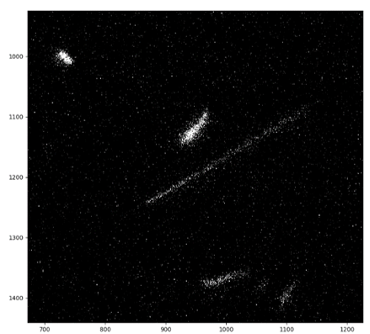
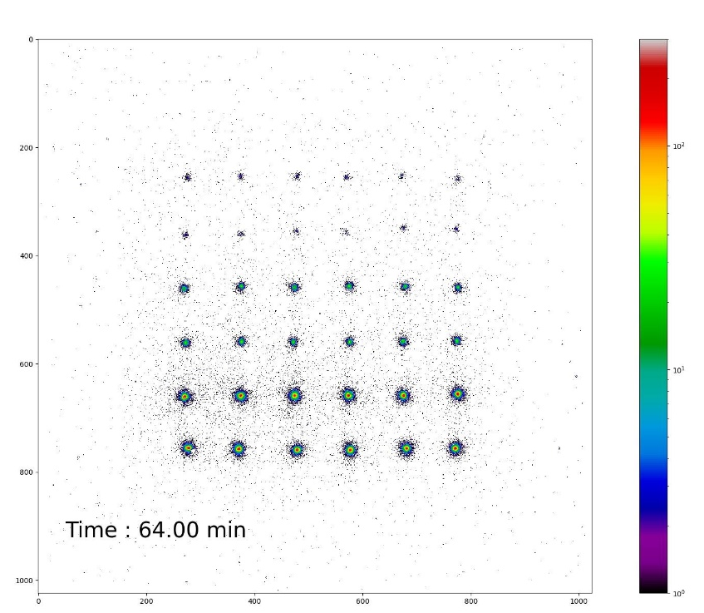
3. APPLICATIONS
3.1 B-imaging
3.2 Preliminary results with tritium samples
3.3 Neutron radiography
3.4 Preliminary results with a neutron source
11

Slide 12
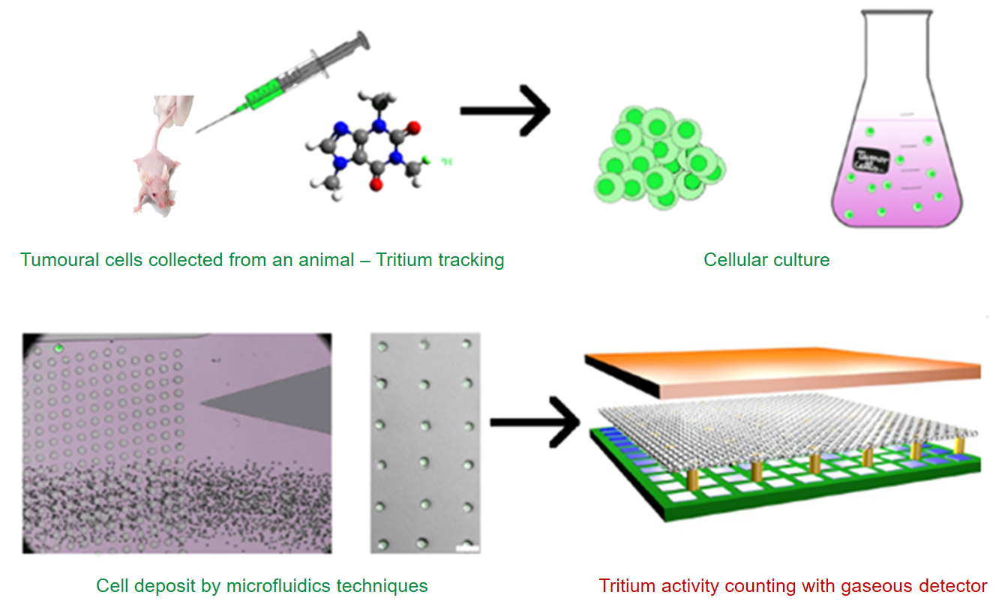
Molecule labelling and tracking with tritium
3.1 Β-IMAGING
Tumor heterogeneity: different cell types inside a tumor
  Heterogeneity effect on drug targeting?
  Develop more efficient drugs
  Requires better detection sensibilities
Pharmaceutical needs at the cell level for drug development:
  Assess the drug distribution among cells
  Evaluate the impact of the cell heterogeneity on drug biodistribution
  At the cell level: Quantification of ³H concentration in single cell samples
12

Slide 13
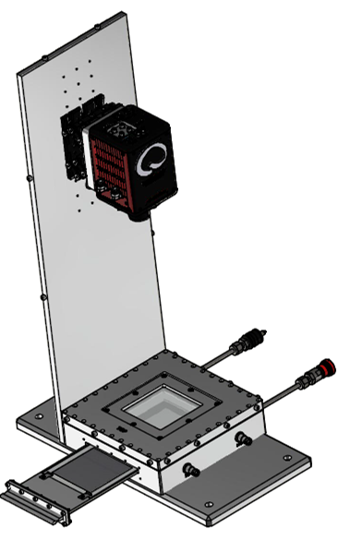
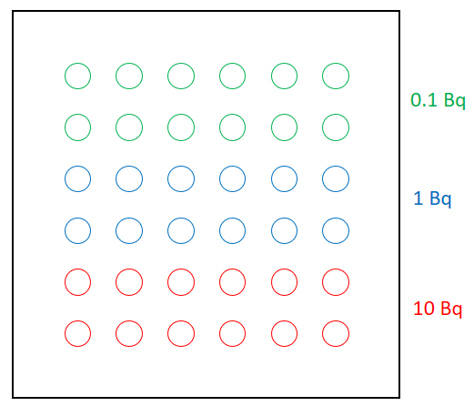
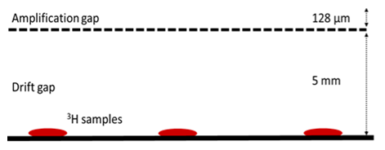
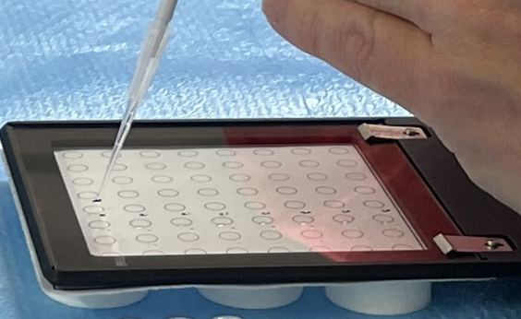
3.2 PRELIMINARY RESULTS WITH TRITIUM SAMPLES
First deposit : tritiated glucose
Camera
Light cover
Glass
VIS light
ITO
Mesh
e⁻
β
Cathode
OPTIMED-BETA set-up scheme
Tritium deposits schema and picture
³H concentration ↔ sample activity (Bq)
Activity measurement limits and dynamic range → Activities: 0.1 Bq, 1 Bq and 10 Bq
13

Slide 14
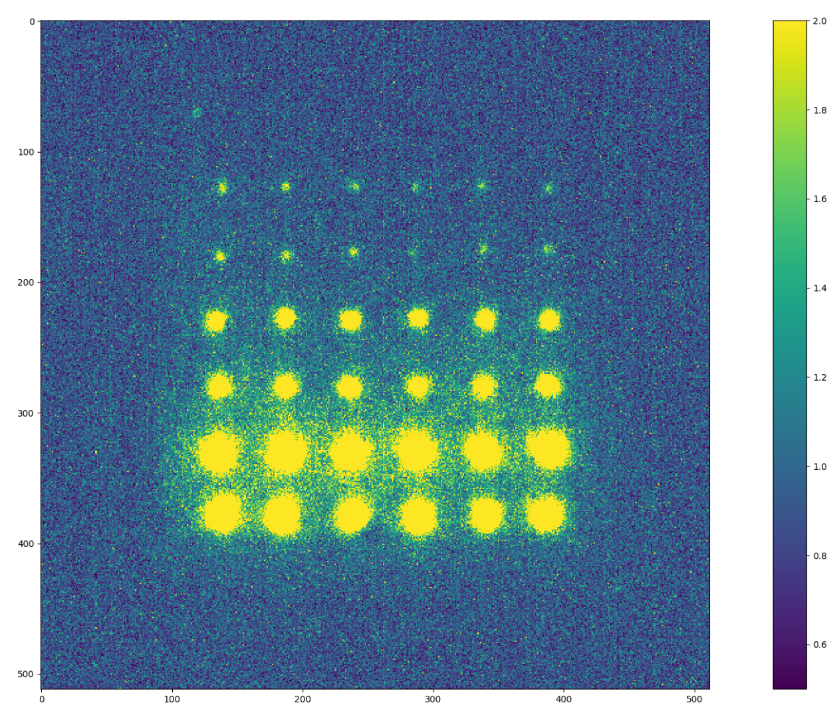
3.2 PRELIMINARY RESULTS WITH TRITIUM SAMPLES
Integration method :
Light intensity profile
All drops positions are well assessed
0.1 Bq drops are close to the background noise
Activity measurement (Bq)
Reference | 9.8 | 1.76 | 0.09
Average | 11.74 | 0.84 | 0.086
σ | 1.28 | 0.18 | 0.026
Matching | 83% | 47% | 95%
720 frames of 5 sec (60 min) added with simple background suppression - 20% of CF4
14

Slide 15
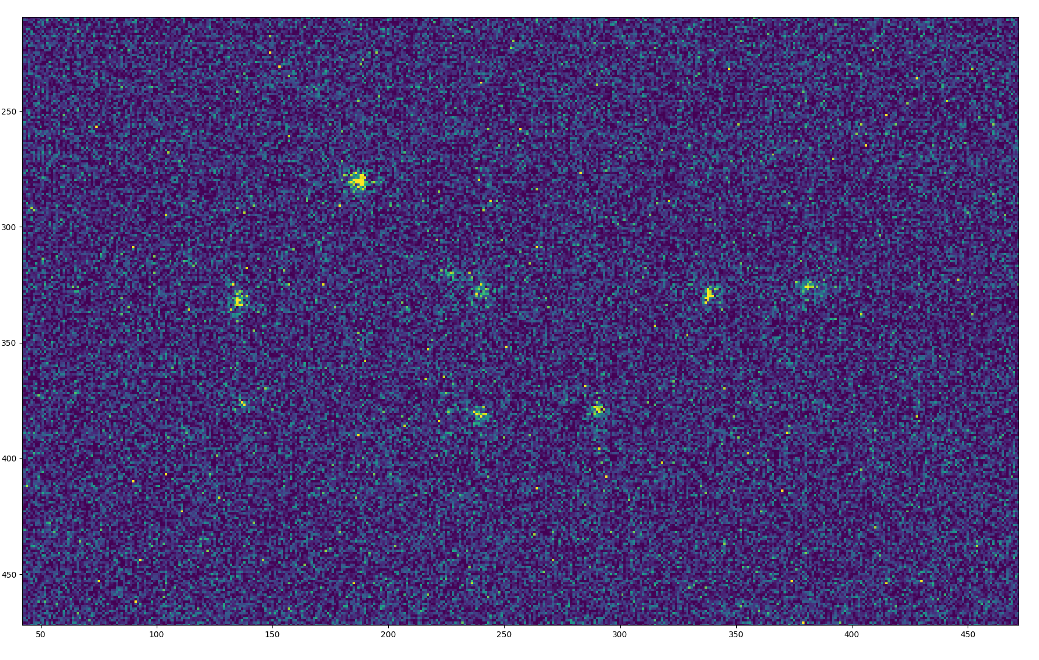
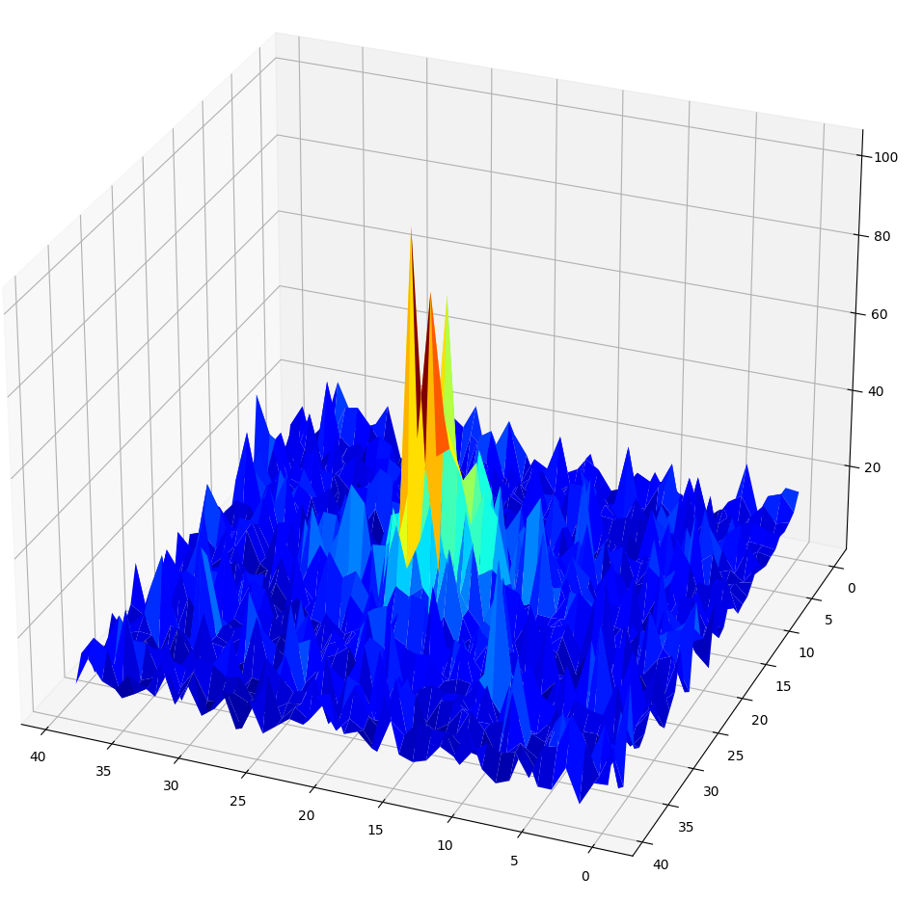
3.2 PRELIMINARY RESULTS WITH TRITIUM SAMPLES
Clustering method :
200 msec frame with single beta events
15

Slide 16
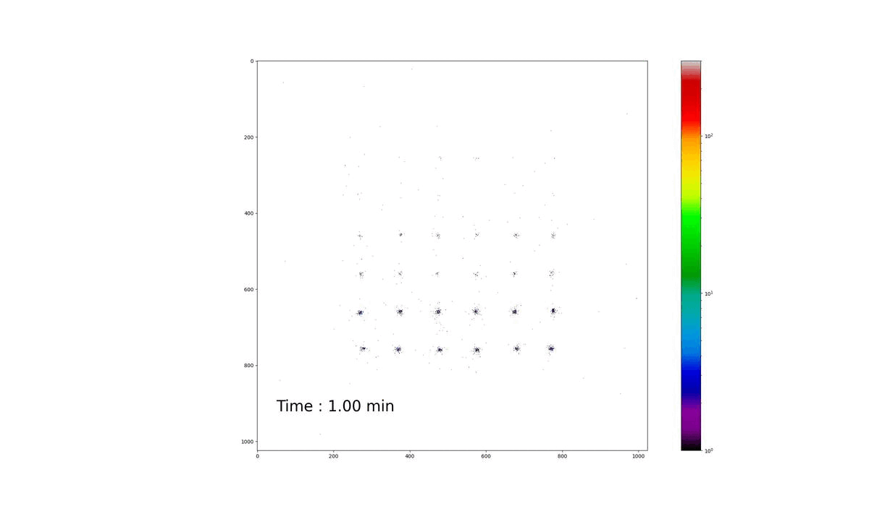
3.2 PRELIMINARY RESULTS WITH TRITIUM SAMPLES
Clustering method :
20000 frames of 200 msec (64 min), individual pixel background thresholding, 20% of CF4
Precise measurement of the drops positions
Better signal-to-noise ratio and counting events capability
16

Slide 17
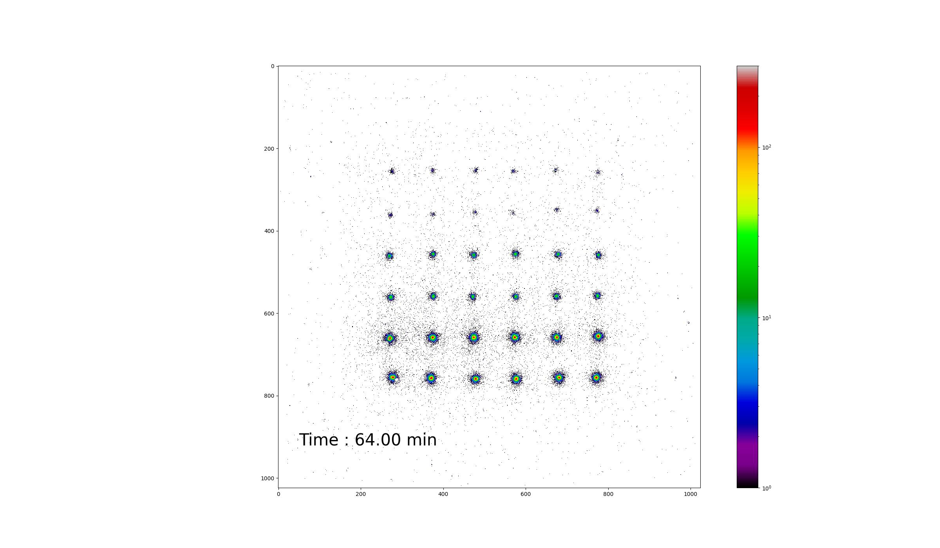
3.2 PRELIMINARY RESULTS WITH TRITIUM SAMPLES
Clustering method :
20000 frames of 200 msec (64 min), individual pixel background thresholding, 20% of CF4
Precise measurement of the drops positions
Better signal-to-noise ratio and counting events capability
17

Slide 18
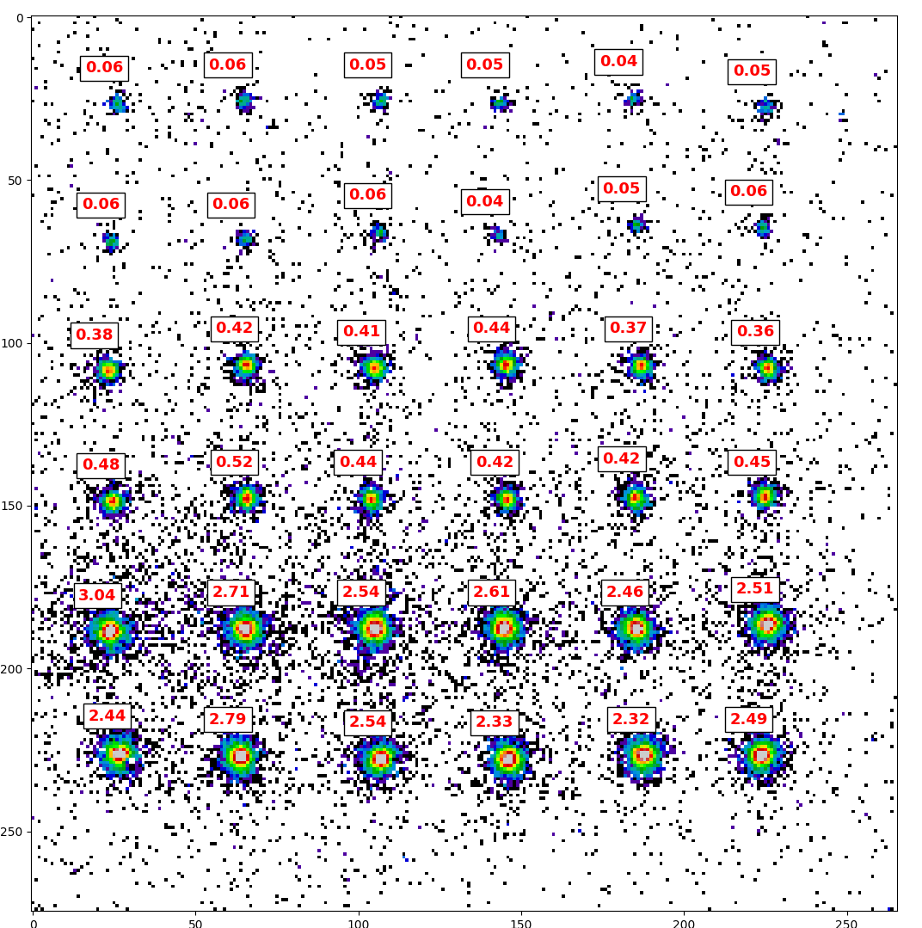
3.2 PRELIMINARY RESULTS WITH TRITIUM SAMPLES
Clustering method :
Activity measurement (Bq)
Reference | 9.8 | 1.76 | 0.09
Measurement | 5.13 | 0.85 | 0.108
σ | 0.38 | 0.088 | 0.014
Matching | 52% | 48% | 83%
18

Slide 19
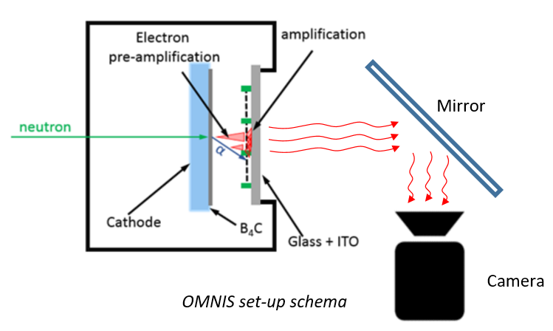
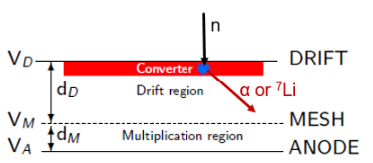
3.3 NEUTRON RADIOGRAPHY
Micromegas-based neutron imager
¹⁰B₄C neutron-to-charge converter
  Thermal neutrons absorbed by 2 µm thin ¹⁰B₄C layer
  Conversion efficiency: 5%
  (α or Li) fragments cause strong ionisation
  Drawback: fragments long range in the gas (5 mm)
Acquisition modes:
  Event-by-event: track reconstruction:
  Potentially higher resolution (100 µm), better ɣ-to-n suppression
  Integrated: real-time radiography:
  Almost no data computation
Boron converter principle
19

Slide 20
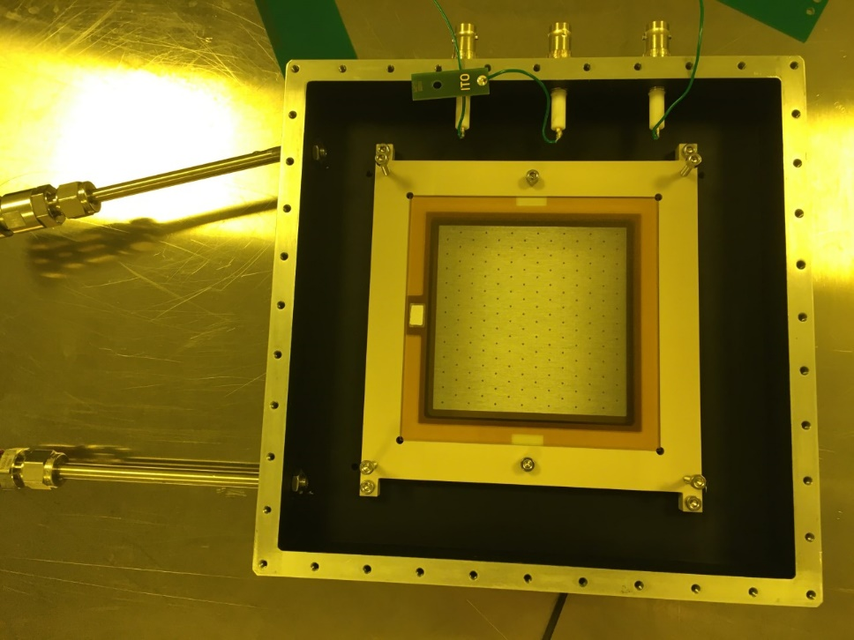
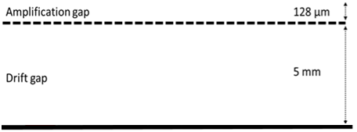
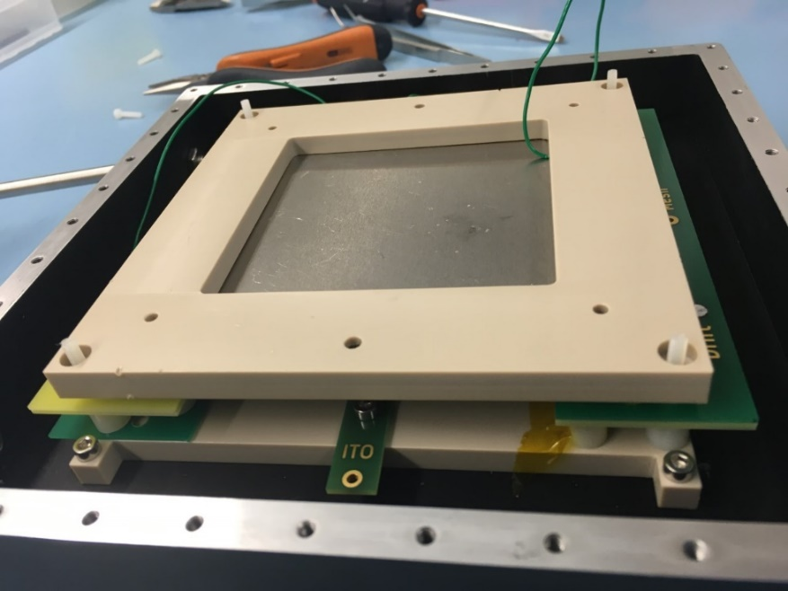
3.4 PRELIMINARY RESULTS WITH A NEUTRON SOURCE
Experimental set-up
Camera
Light cover
Glass
VIS light
ITO
Mesh
e⁻
10 mm
Cathode
α & ⁷Li
B₄C
Slow neutron
Neutron source
OMNIS set-up schema
20

Slide 21
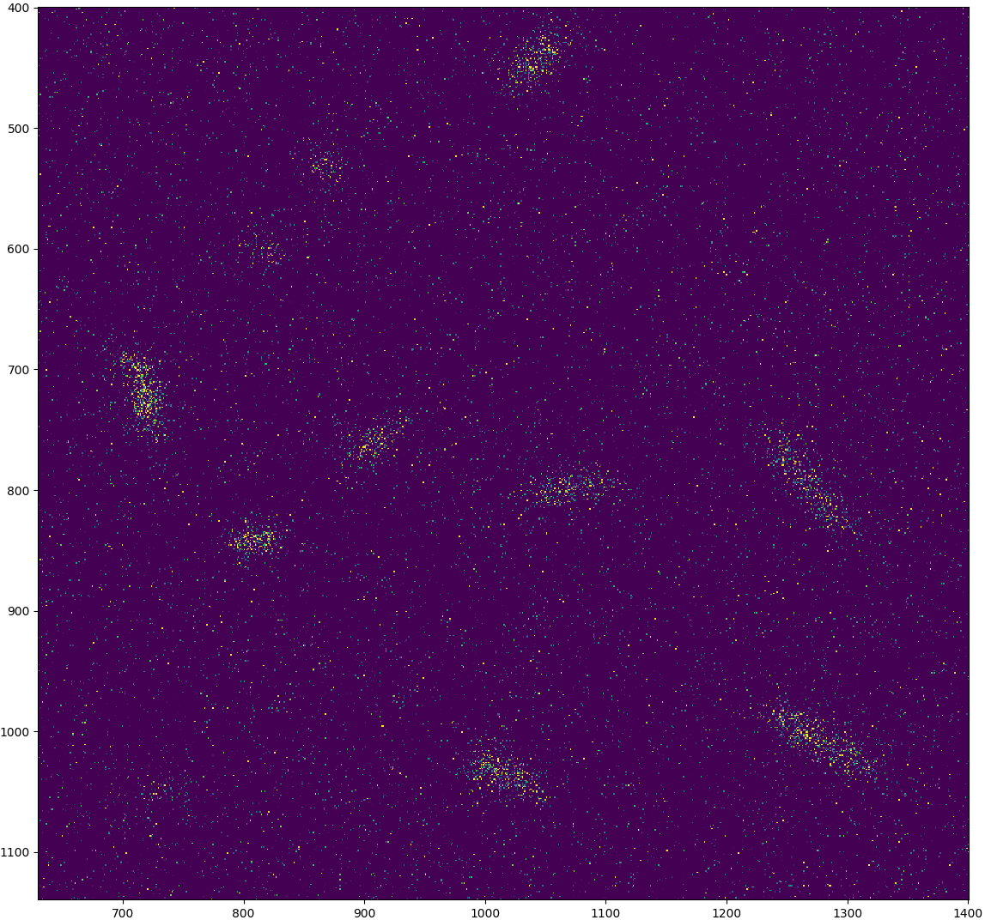
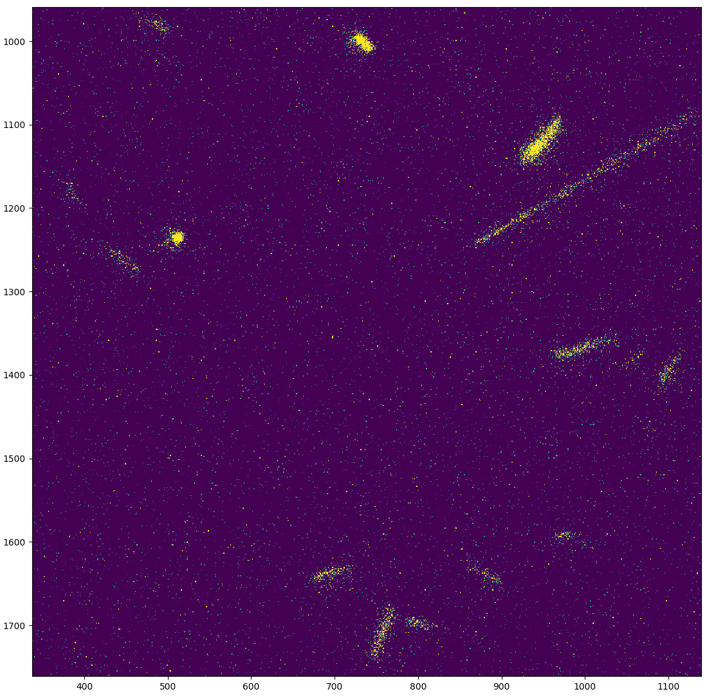
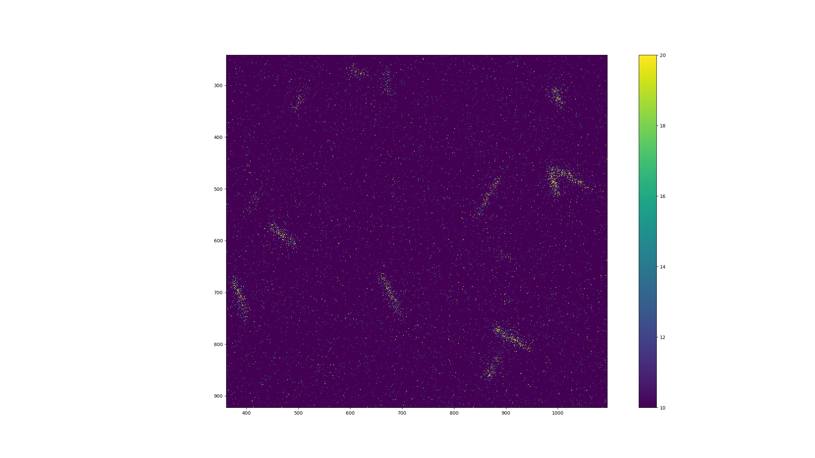
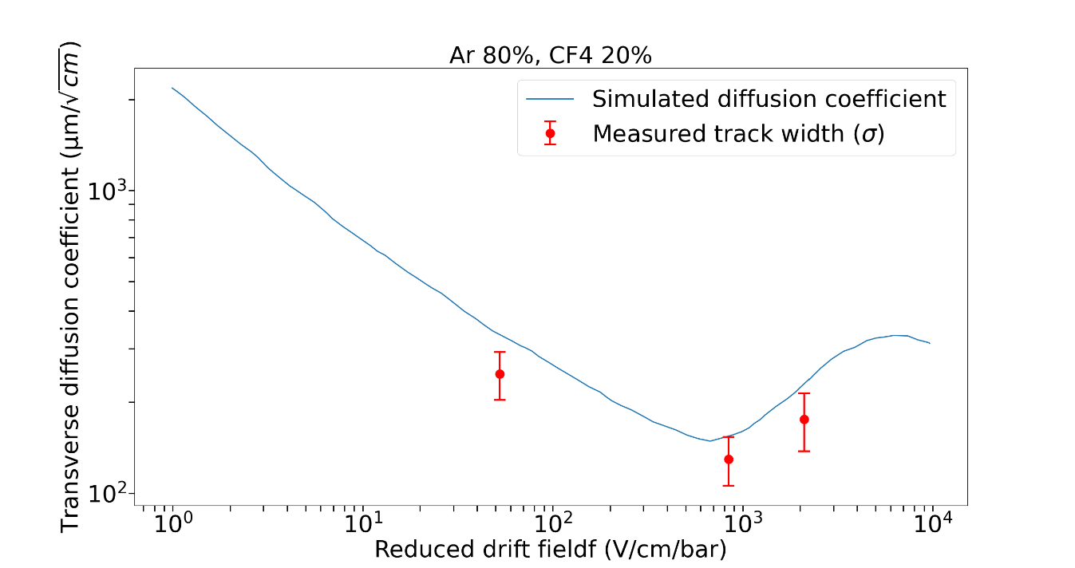
3.4 PRELIMINARY RESULTS WITH A NEUTRON SOURCE
50 V/cm drift field
800 V/cm drift field
2000 V/cm drift field
Drift field affects the diffusion in the gas
Diffusion spreads the light
50 V/cm
2000 V/cm
800 V/cm
21

Slide 22
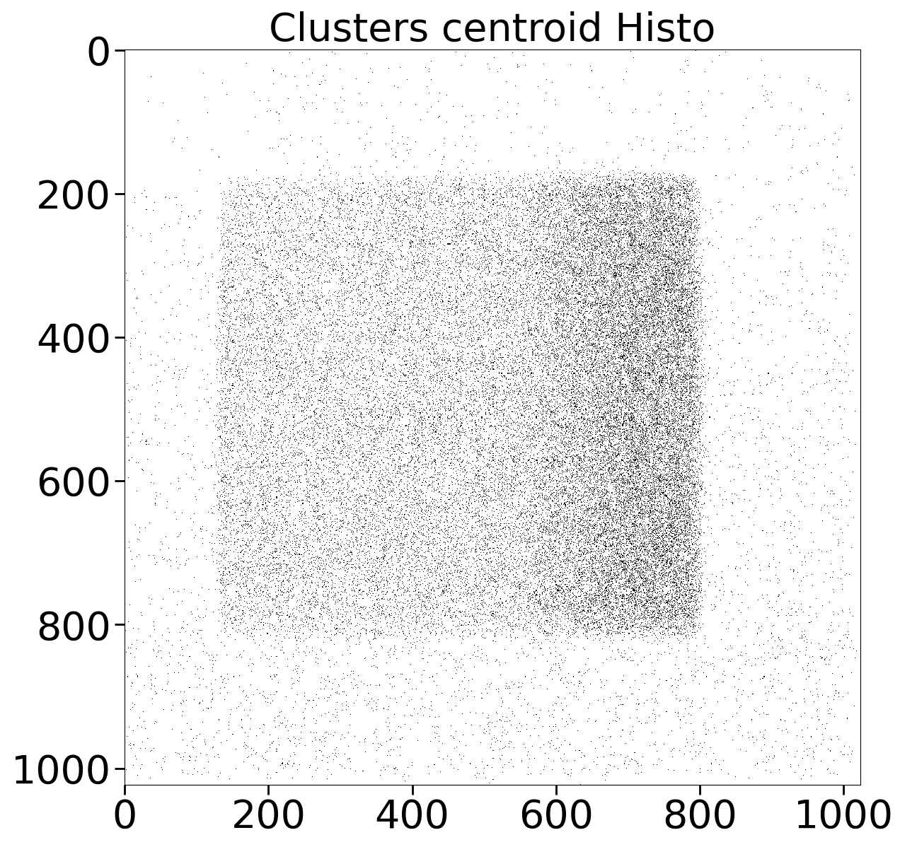
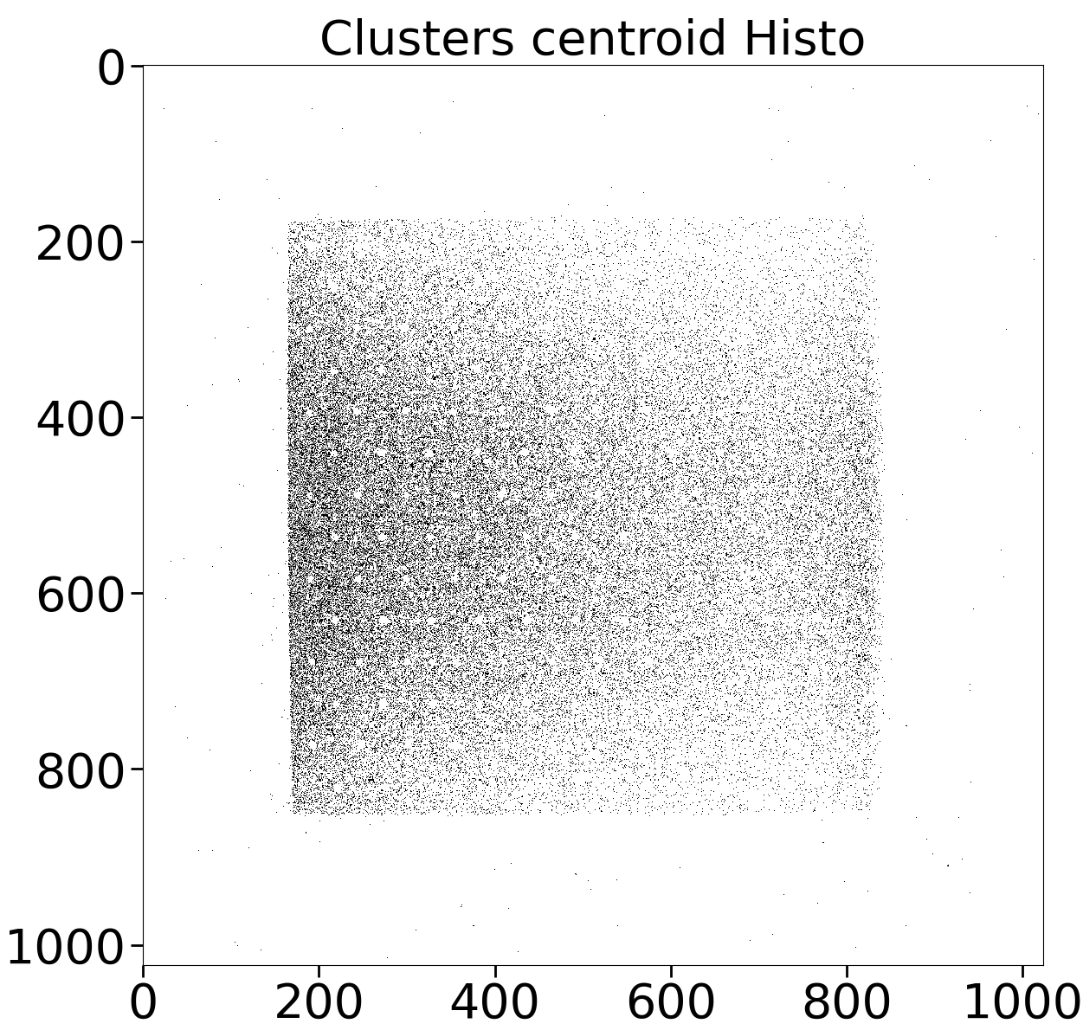
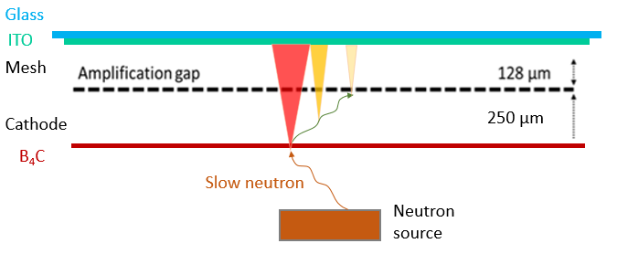
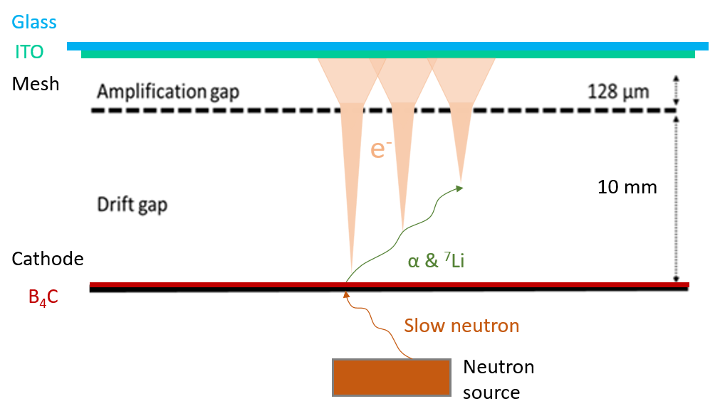
3.4 PRELIMINARY RESULTS WITH A NEUTRON SOURCE
Reconstruction algorithm
10 mm drift gap
250 µm drift gap
22

Slide 23
3.4 PRELIMINARY RESULTS WITH A NEUTRON SOURCE
Reconstruction algorithm
10 mm drift gap
250 µm drift gap
23

Slide 24
CONCLUSION
What I have done
  Detector characterization with X-rays
  Activity measurement on low activity tritiated samples
  Neutron events analysis and reconstruction
Outlook
  Beam test at Soleil accelerator: spatial resolution measurement
  β-imaging: tests on isolated single tumor cells
  Neutron radiography: Irradiation at neutron facilities
Conferences :
Poster at NDIP conference (Troyes, France) https://doi.org/10.1016/j.nima.2022.167910
Presentation at MPGD22 conference (Tel Aviv, Israel) https://doi.org/10.48550/arXiv.2303.17444
Presentation at Animma (Pise, Italy), June 2023
24

Slide 25
THANK YOU
25

Slide 26
BACK UP
26

Slide 27
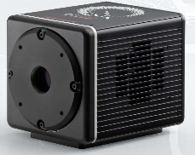



LIGHT DETECTION DEVICES
Hamamatsu CMOS camera
Readout noise
Photon number resolving
Pixels
Number Size
4096 x 2304 4.6 µm x 4.6 µm
Dark current
Cooling Sensor temperature Dark current
Air - 20 °C 0.016 e⁻ /pixels/s
Minimum exposure time
Mode Rate
Standard 1 µs/frame
Ultra quiet 100 ms/frame
27

Slide 28

LIGHT DETECTION
28

Slide 29
Light production mechanisms
Scintillation : excited atoms or molecules emit photons during de-excitation.
Scintillation
Phosphorescence
f Fluorescence
Electroluminescence
: Delayed emission of photons after absorption.
(1 ms to 100 s)
Prompt emission of photon after absorption of incident radiation.
(1 ns to 1 µs)
Electrons with energy lower than ionization threshold just excite atoms or molecules.
Primary scintillation
Secondary scintillation
From the creation of primary electron coming from the excitation of gaz due to incident particles.
From the creation of secondary electrons taking place during avalanche amplification.
Light yield : amount of light determines the signal to noise ratio. It depends on electric field, pressure and gas mixture.
29
Notes:
29

Slide 30

PRELIMINARY RESULTS WITH TRITIUM SAMPLES
β particle range in Ar-Isobutane gas mixture
30

Slide 31



DETECTOR CHARACTERIZATION WITH X-RAYS
X-ray radiography
MTF measurement
60 sec exposure time lead target radiography with simple background suppression.
31

Slide 32

Beta spectrum : CF4
Overall activity : 76 Bq

Slide 33

33

Slide 34



34

Slide 35

35

Slide 36


36

