Slide 1
HV Laboratory updates
Roland Piccin / Francois-Olivier Pincot
TE-MSC-SMT
31/01/2023

Slide 2
Update from the meeting 6/9/2022:
https://indico.cern.ch/event/1193576/

Slide 3
Development plan in a nutshell 2022 – 2024
R1
Characterization of dielectric insulation and components for HFM
R3
CERN-wide support for development of dielectric materials and components
R2
Implementation of novel diagnostic techniques to assess insulation condition
Main key points:
R&D activities focused on the development of high field magnets insulation and components.
Tight link with the Polymer laboratory R&D activities.
Upgrade the HV lab infrastructure and measurement systems
Establish a network within CERN and outside through collaborations. E.g. ITER is partly funding the upgrade of the laboratory.
https://edms.cern.ch/document/2788645/2
06/09/2022
High Voltage Laboratory for SMT – R. Piccin

Slide 4
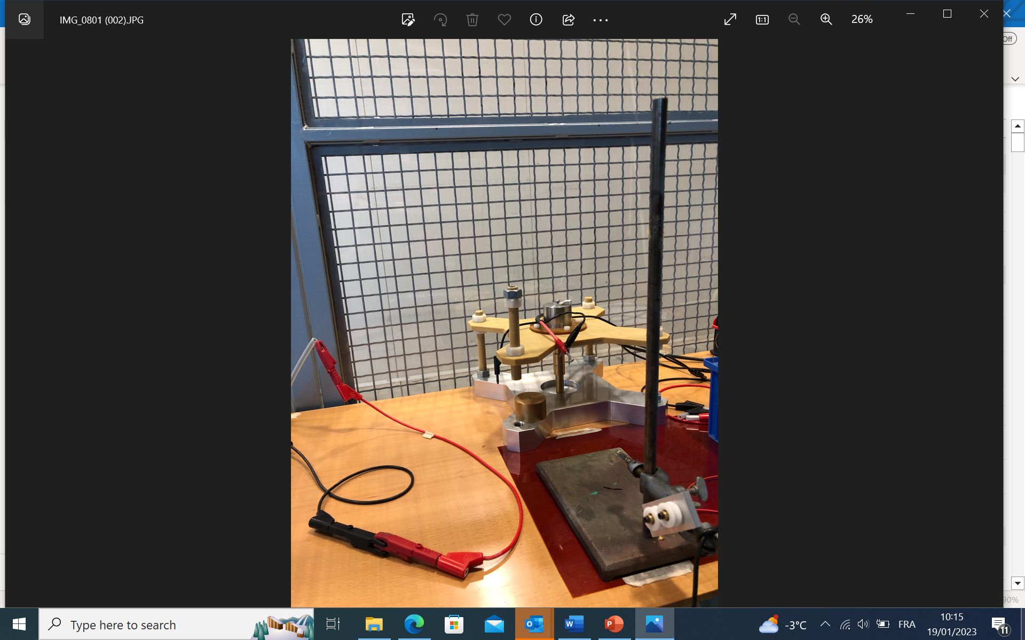
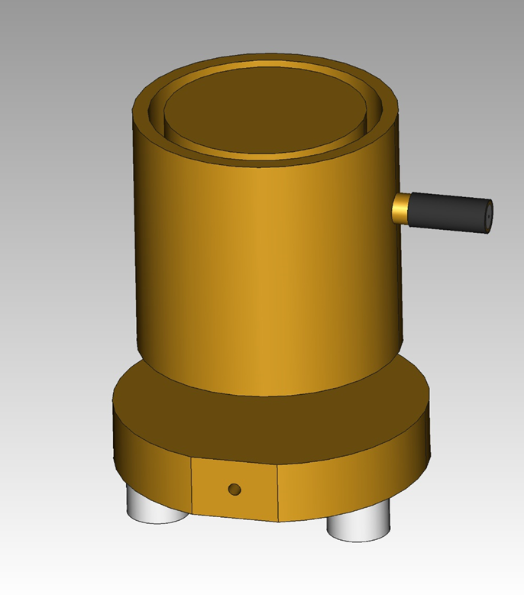
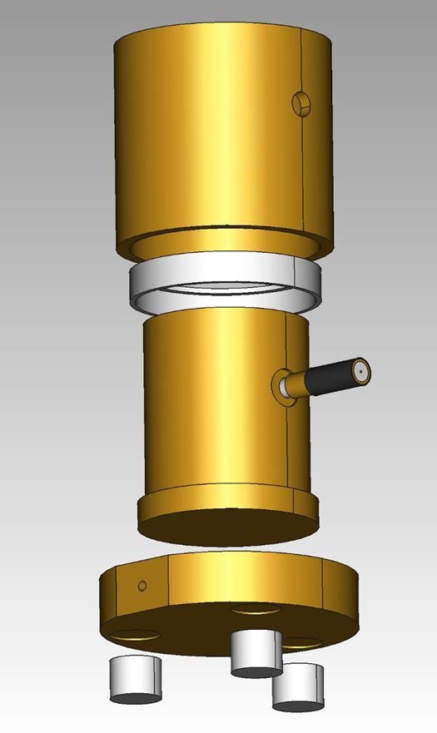
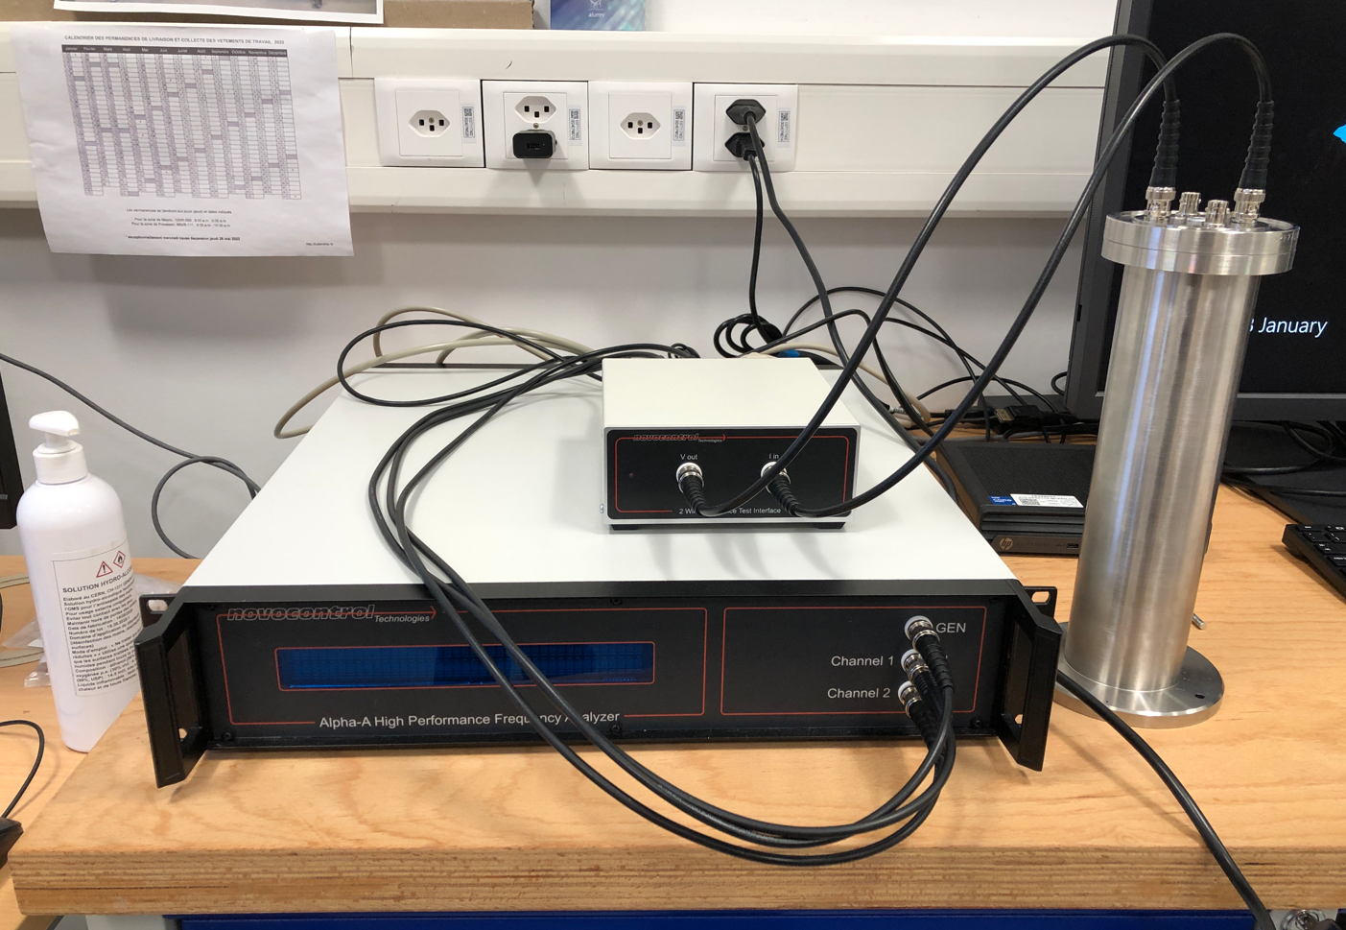
Electrical Testing in the Polymer and HV Labs
Dielectric tests
Resistivity
Dielectric Spectroscopy
DC Dielectric Strength up to 150 kV
AC Dielectric Strength 40 kVrms
Impulse voltage up to 150 kV
Partial discharge
Performance of insulating material
Resistivity
Performance of insulating material
Ageing
Capacitance, polarization, tanδ
Composition of insulating material
Ageing
Effect of environment (e.g., humidity, helium permeation)
Design completed
Received
From Javier Osuna

Slide 5
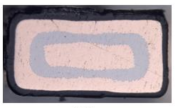
Effect of radiation on dielectric properties of LHC wires
Dielectric spectroscopy and resistivity can be used to characterize radiation-induced ageing.
On-going measurements in collaboration with the University of Bologna on LHC wires.
Courtesy of Simone Suraci & Davide Fabiani – LIMES (Uni Bologna)

Slide 6
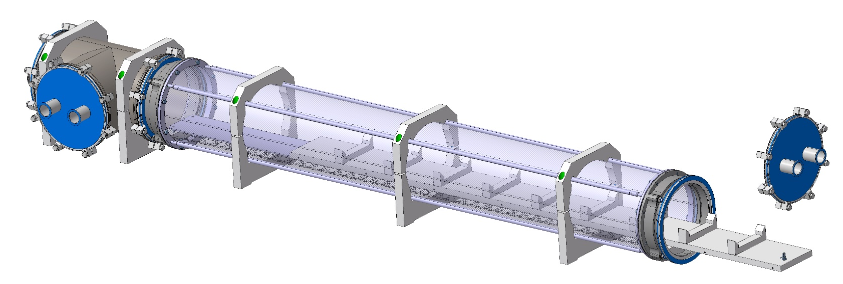
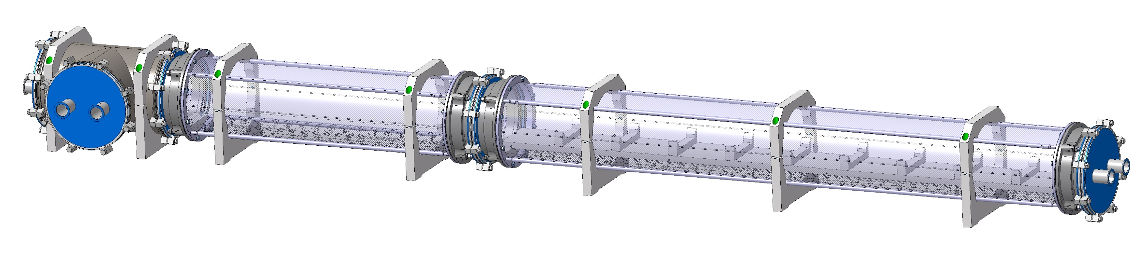
Modular Paschen chamber
    Paschen chamber to easily detect insulation failures, improve QC and for R&D purpose.
      Design finished
      Drawing ongoing
      Able to test large objects like MQXFS coils

Slide 7
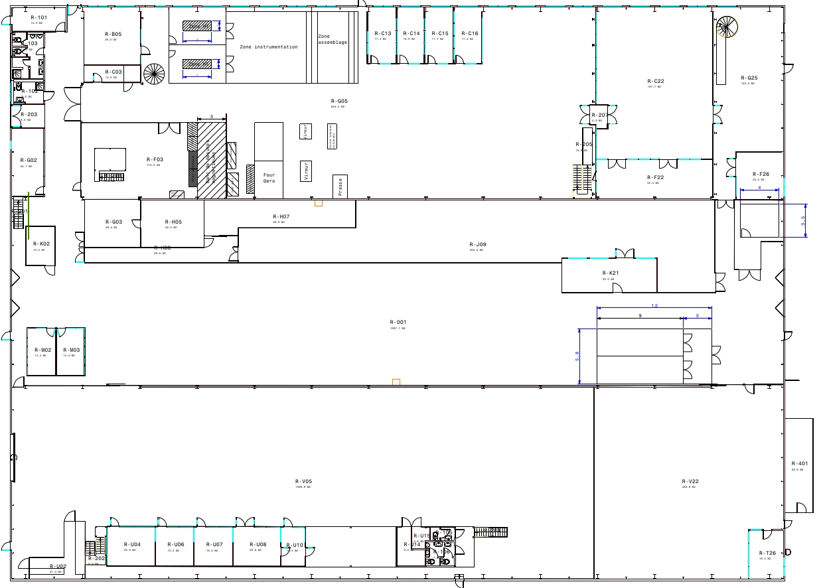
Relocation of the lab
Solution 3
Solution 2
Entrance
The current lab area is not large enough to allow regular HV tests and activities:
The equipment occupies most of the space
No space to test large objects
Current
Solution 1

Slide 8
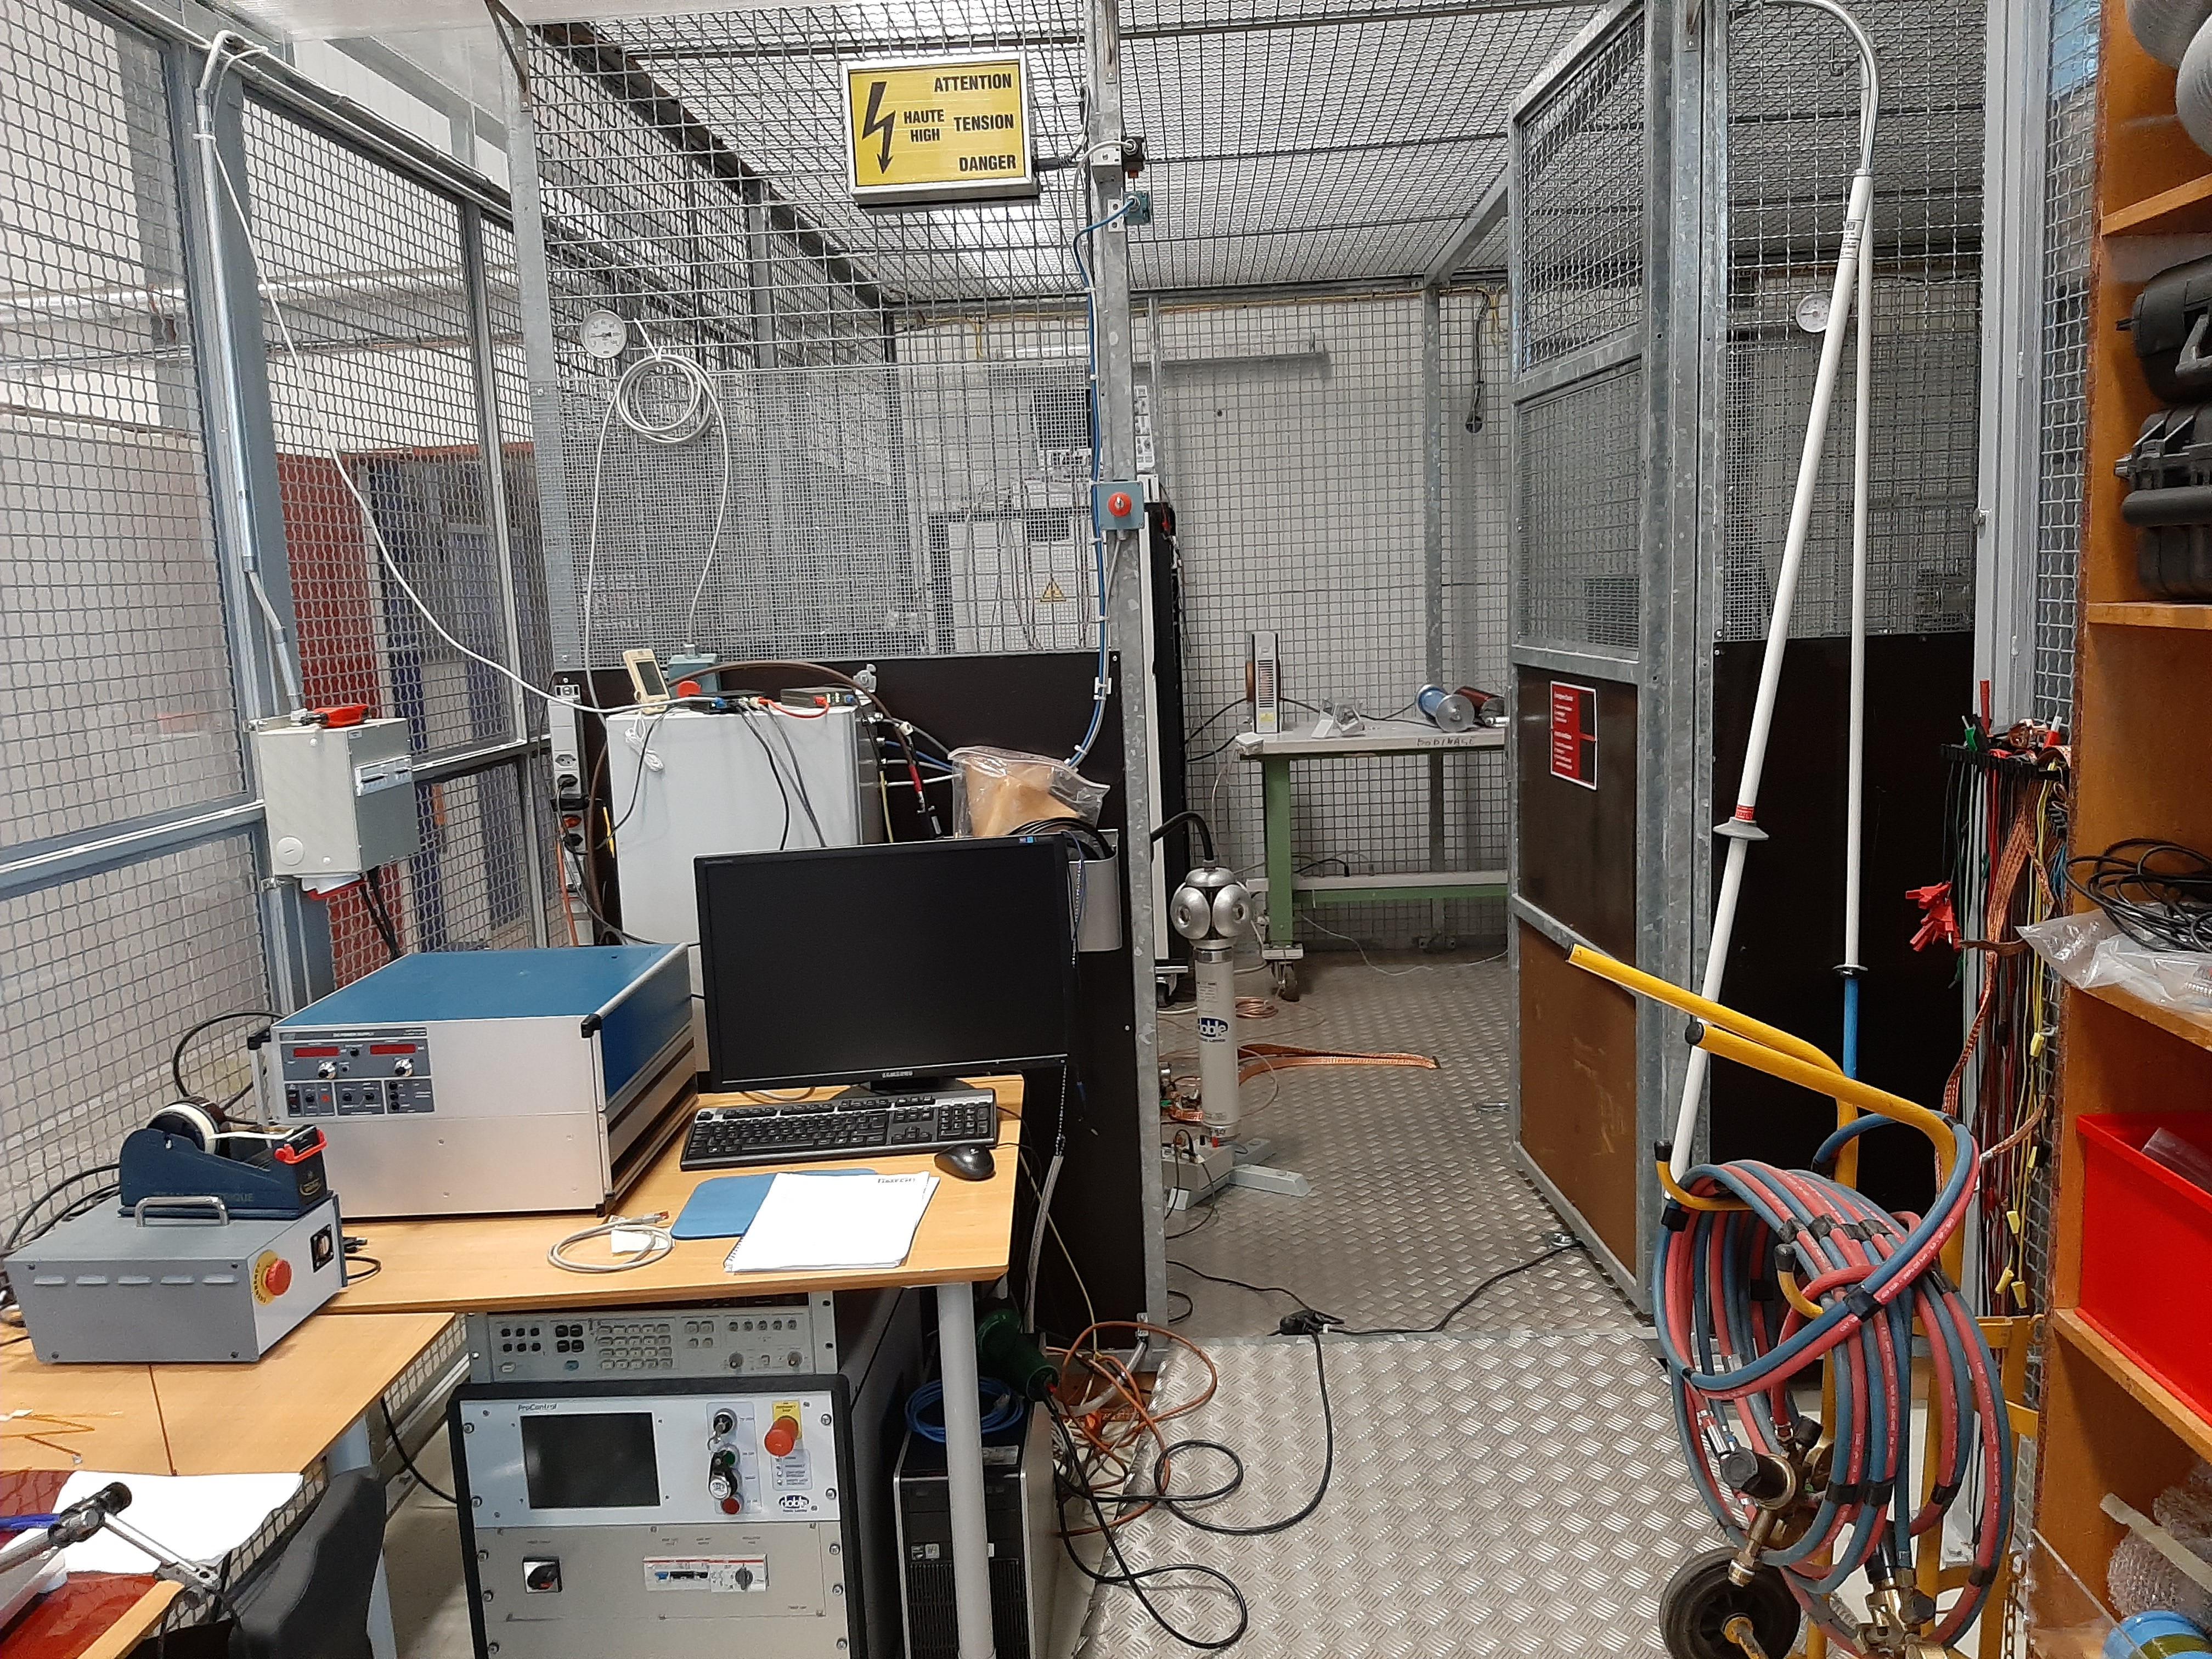
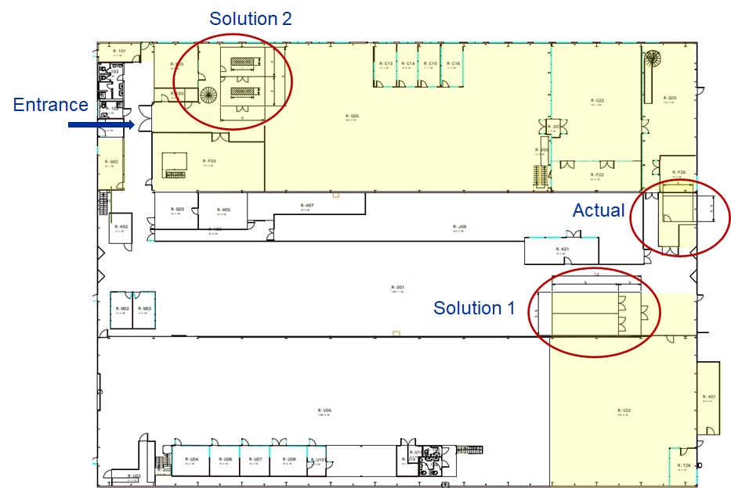
Current HV facility
  Cage in a cage (come from previous storage)
  HV area 14m² (4x3.5)
  Control + storage area 9m²

Slide 9
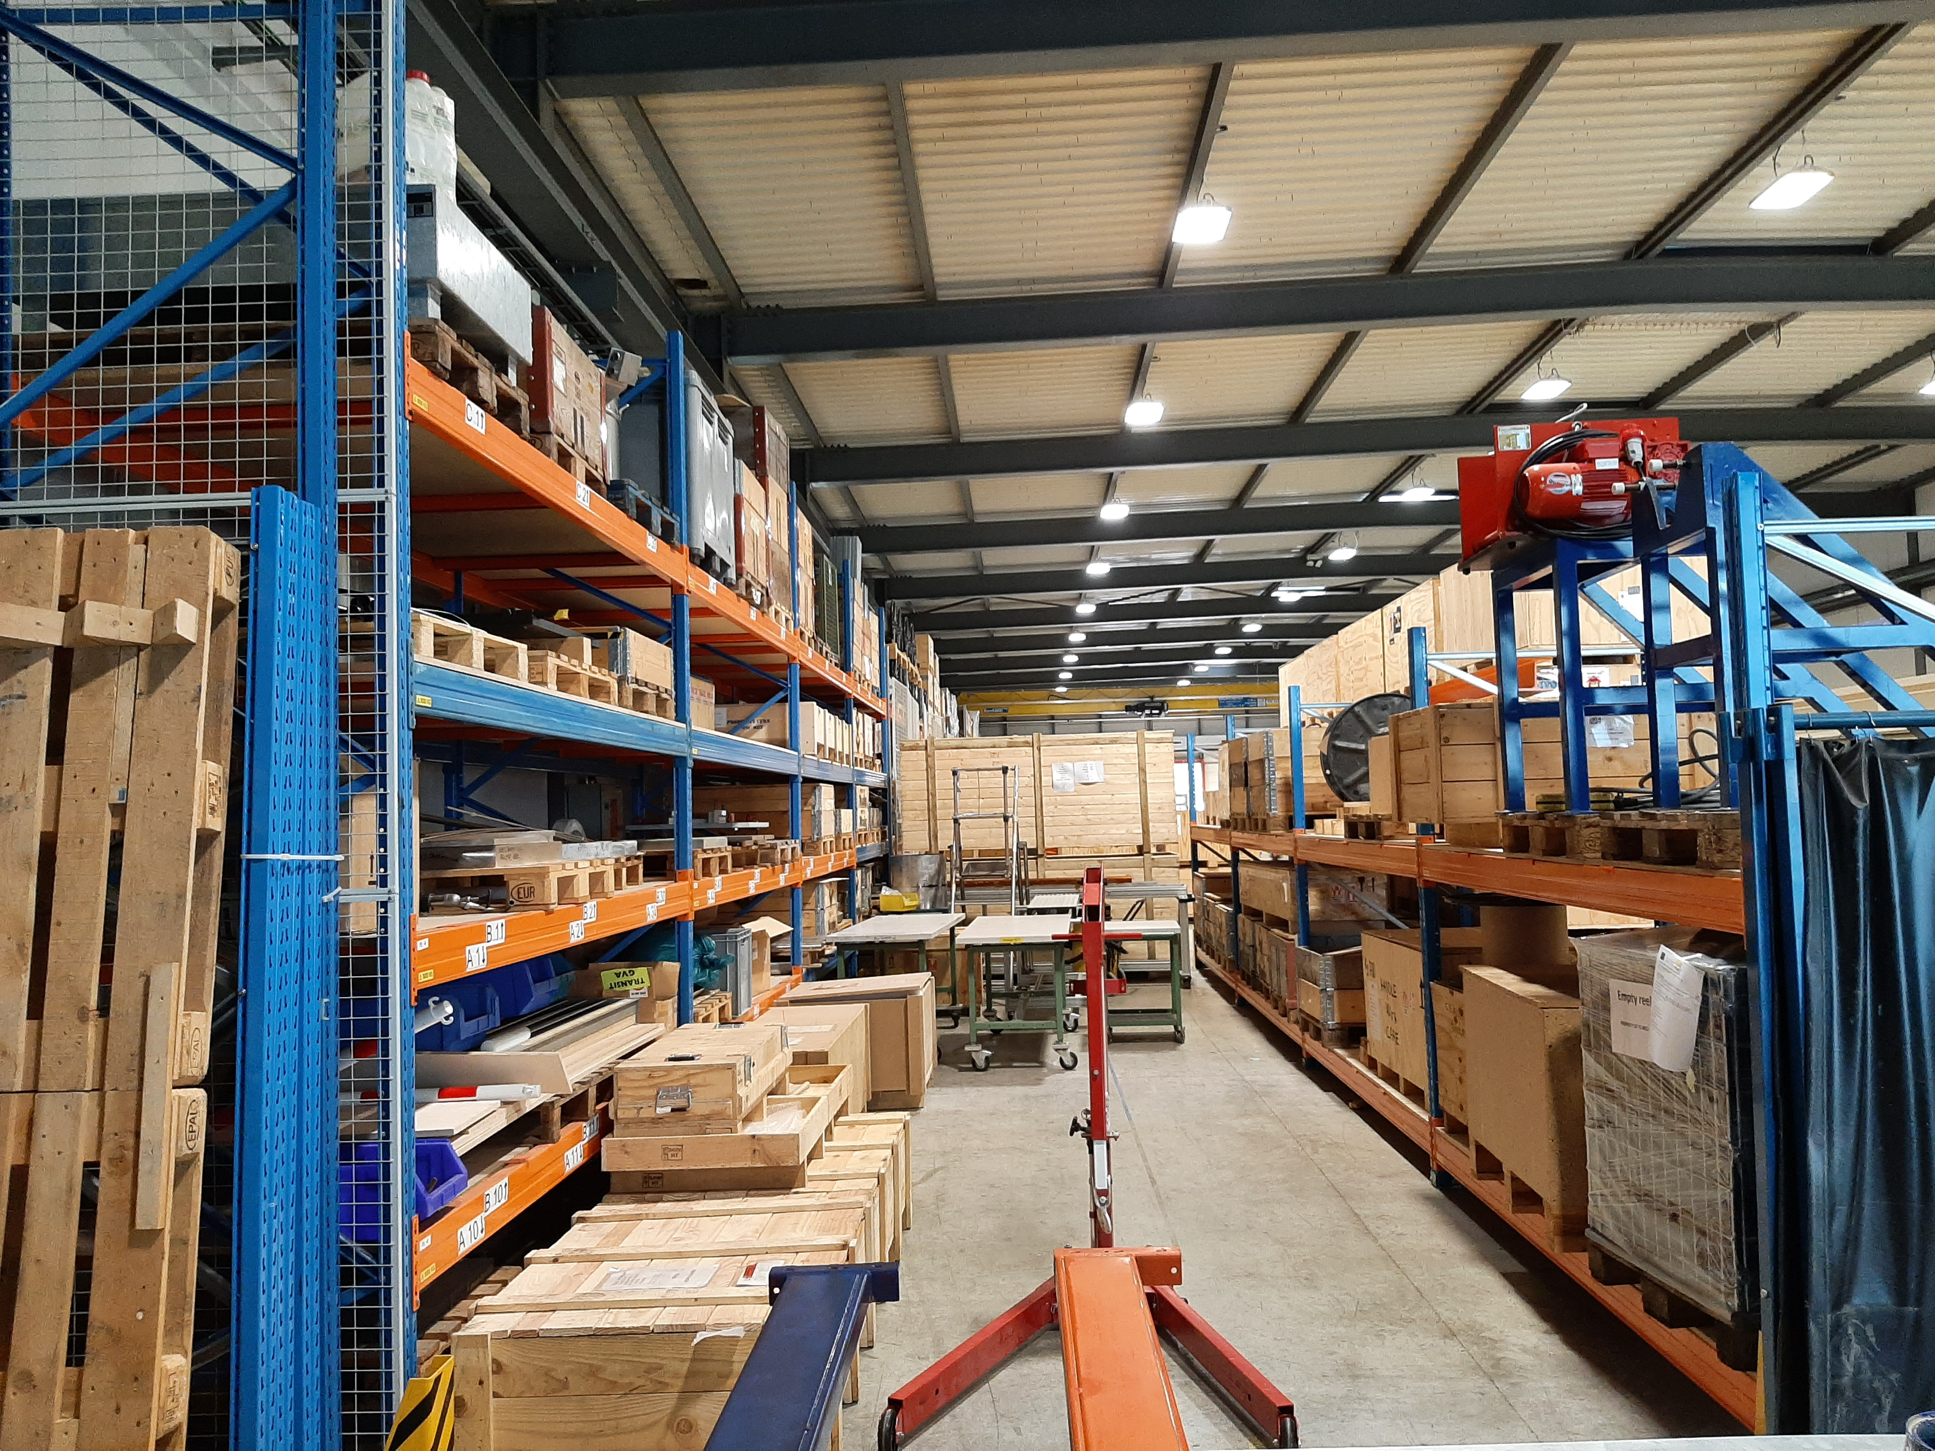

New HV facility: solution 1
  HV area 52 m² (2 times 9x2.9)
  Control + storage area 17.4 m²
  Total 69 m²
  Far from the electrical lab and magnet workshop
  SMT storage to be relocated
  Two sides of the area will not be accessible (narrow space for 150 kV system)
  Potential EMI issues from rotating machines
  Low cost

Slide 10
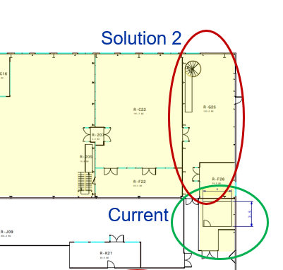
New HV facility: solution 2
  Move office stairs, replace ventilation and pump system on new mezzanine (expensive solution)
  Access through winding area
  Relocate emergency exit
  Potential EMI issues from rotating machines
  No change in magnet workshop

Slide 11
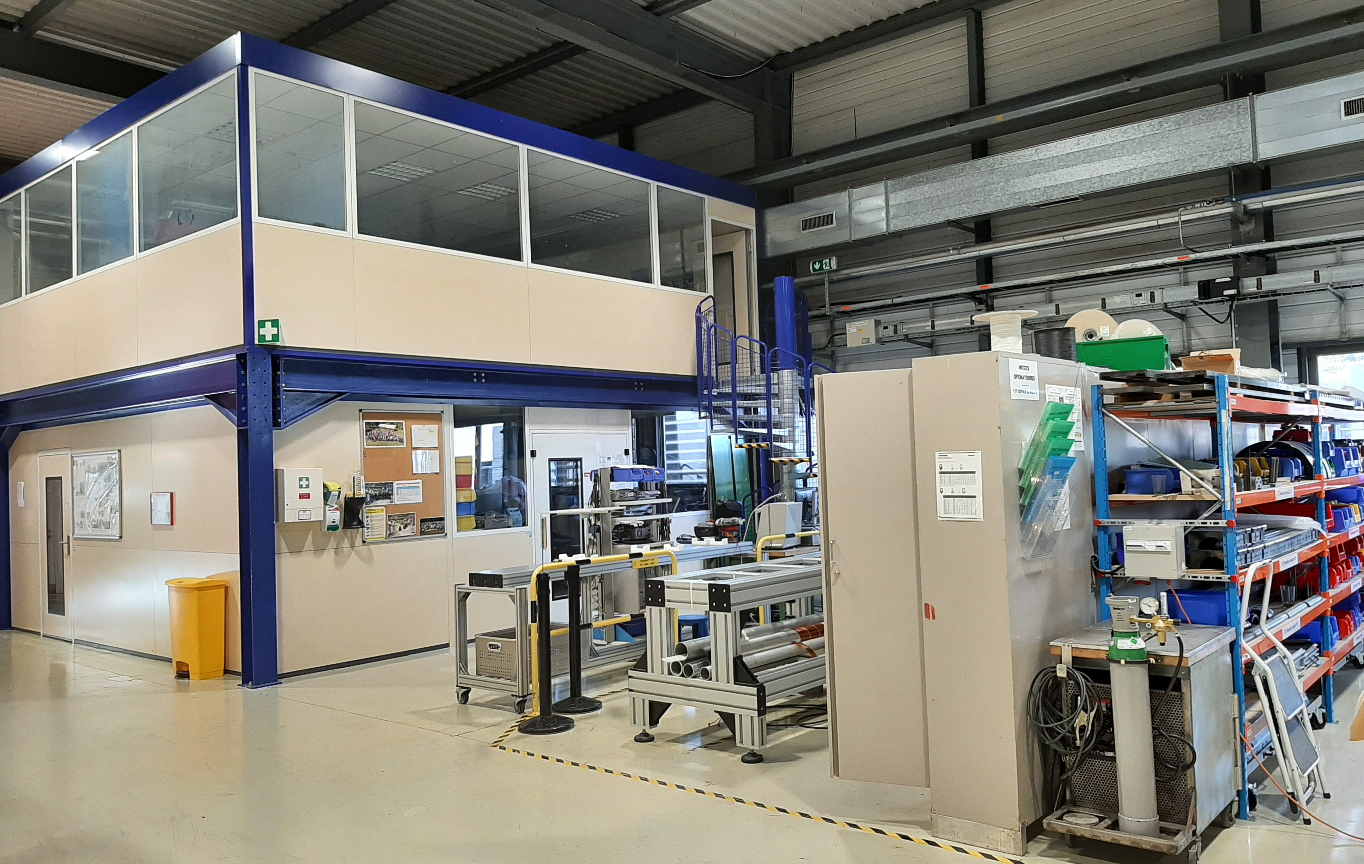
New HV facility: solution 3
  HV area 48 m² (2 times 4x6)
  Control + storage area 18 m²
  Total 66 m² + electrical lab attached
  Except door and stair, no cost from work outside CERN
  Relocate the magnetic measurement and racks
  Move the office stairs
  One common area for electrical & electronics activities
  Integrated in the magnet workshop and near polymer lab

Slide 12
New HV facility: solution 3
Area for electrical tests or assembly
Instrumentation bench moved same area
  927 reorganization proposal
    Chemical hood aligned (work done by SMT 90%)
    3 furnaces in the same area
    Press 300T near the wall
potential new areas for magnetic measurements

