Slide 1
SUMMARY
https://confluence.cern.ch/pages/viewpage.action?pageId=413118479
Questions to address
In your systems how far do you go regarding hardware-abstraction today and what would be your ideal in the future?
How do you arrive from gateware to the FESA / FGC layers?
How do you version gateware and how do you keep compatibility between gateware and driver versions?
How to access deported hardware (for instance DIOT or other remote FEC)?
How do you access hardware in development mode?
How to address the hardware: LUN, slot/subslot, hostname, etc…?
Are there missing features you would recommend adding to Cheby / EDGE?
Do you use HAL to integrate COTS hardware? Would it be interesting to add HAL functions in Cheby?
1

Slide 2
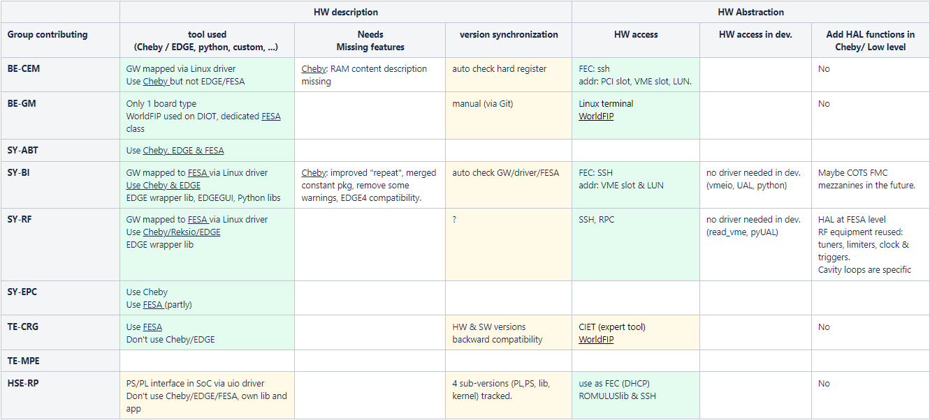
SUMMARY
https://confluence.cern.ch/pages/viewpage.action?pageId=413118479
2

Slide 3

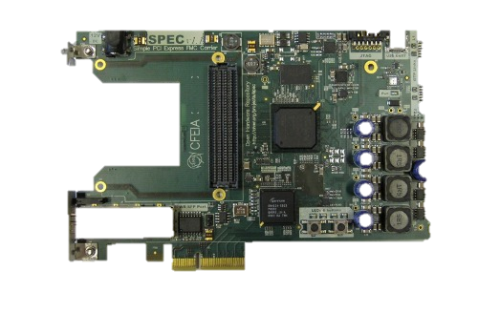
SUMMARY: USE OF TOOLS
https://confluence.cern.ch/pages/viewpage.action?pageId=413118479
HAL
CCDE
FESA:
FEC RT sw
Abstraction
HAL
Edge
Drivers
Python
Hw debugging
Description
Cheby
ToDo:
- RAM content description
- EDGE4 compatibility
- Improved "repeat“
- Merging of constant pkg
- Remove some warnings
- Some abstraction?
RF/BI specific wrapper
Cheby
Memory Maps
CEM, BI, EPC, ABT, RF
HAL
3

Slide 4
SUMMARY: USE OF TOOLS
https://confluence.cern.ch/pages/viewpage.action?pageId=413118479
HAL
FESA / EDGE
ToDo?
CCDE
FESA:
FEC RT sw
BI, RF, ABT, EPC(partly), GM/CRG(WorldFIP)
Abstraction
HAL
Edge
Drivers
Python
Hw debugging
BI, RF, ABT
Description
Cheby
Memory Maps
HAL
4

Slide 5
SUMMARY: USE OF HAL
https://confluence.cern.ch/pages/viewpage.action?pageId=413118479
Unified Lib?
To be discussed in Frontend SW Dev. Forum?
CSS (OASIS)
HAL
CCDE
FESA:
FEC RT sw
Abstraction
CSS (COHAL), ABT, RF
HAL
Edge
Drivers
Python
Hw debugging
Description
Cheby
Memory Maps
BI, SoC users?
HAL
5

Slide 6

Poll
https://eforumconveners.questionpro.com/t/AaTA5Z1eJD
6

