Slide 1

PUMA vacuum system
Jose A. Ferreira
Data contributed by Anke Stoeltzel, Alexandre Obertelli, Alexander Schmidt and Jonas Fischer
14.02.2023

Slide 2

Introduction
Vacuum requirements at PUMA trap
Cryo-pumping
Isotherm measurements
ELENA vacuum layout
ISOLDE vacuum layout
Summary

Slide 3
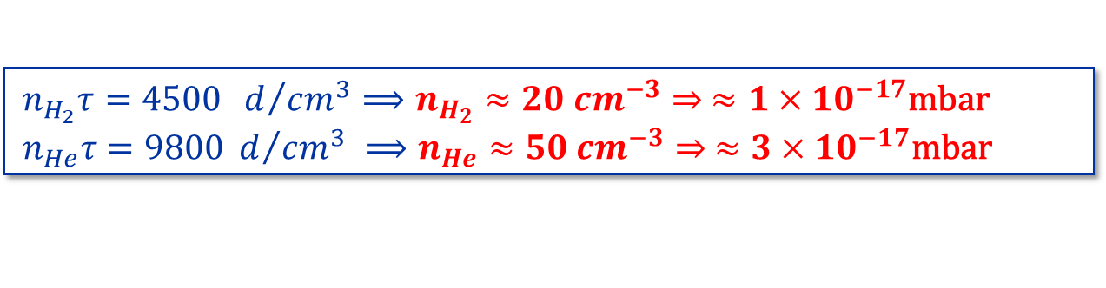
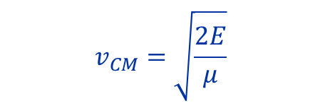
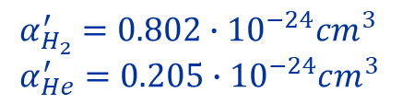
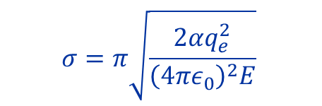
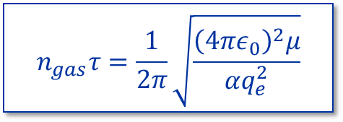
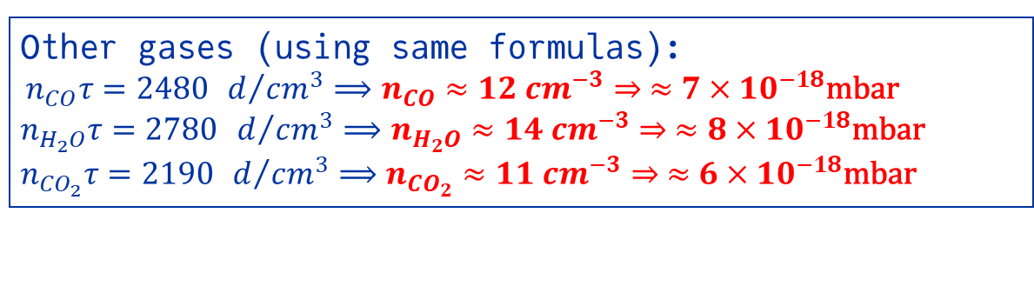
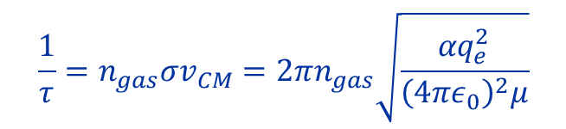


Vacuum requirements at PUMA trap
Langevin cross section (ion-atom interaction) [1]:
$$σ=π\sqrt{\frac{2αq_{e}^{2}}{{\left(4πε_{0}\right)}^{2}E}}$$
$$v_{CM}=\sqrt{\frac{2E}{μ}}$$
$$μ=\frac{m_{1}m_{2}}{m_{1}+m_{2}}$$
$$\frac{1}{τ}=n_{gas}σv_{CM}=2πn_{gas}\sqrt{\frac{αq_{e}^{2}}{{\left(4πε_{0}\right)}^{2}μ}}$$
$$n_{gas}τ=\frac{1}{2π}\sqrt{\frac{{\left(4πε_{0}\right)}^{2}μ}{αq_{e}^{2}}}$$
$$τ>200 d$$
$$α_{H_{2}}^{′}=0.802∙{10}^{−24}cm^{3}$$
$$α_{He}^{′}=0.205∙{10}^{−24}cm^{3}$$
$n_{H_{2}}τ=4500$ $d/{cm^{3}}⟹n_{H_{2}}≈20 cm^{−3}⇒ ≈1×{10}^{−17}\text{mbar}$
$$n_{He}τ=9800 d/{cm^{3}} ⟹n_{He}≈50 cm^{−3}⇒ ≈3×{10}^{−17}\text{mbar}$$
Other gases (using same formulas):
$n_{CO}τ=2480$ $d/{cm^{3}}⟹n_{CO}≈12 cm^{−3}⇒ ≈7×{10}^{−18}\text{mbar}$
$n_{H_{2}O}τ=2780$ $d/{cm^{3}}⟹n_{H_{2}O}≈14 cm^{−3}⇒ ≈8×{10}^{−18}\text{mbar}$
$n_{{CO}_{2}}τ=2190$ $d/{cm^{3}}⟹n_{{CO}_{2}}≈11 cm^{−3}⇒ ≈6×{10}^{−18}\text{mbar}$
[1] X. Fei, Trapping Low-Energy Antiprotons in an Ion Trap., Harvard University, 1990. https://ui.adsabs.harvard.edu/abs/1990PhDT.......101F

Slide 4
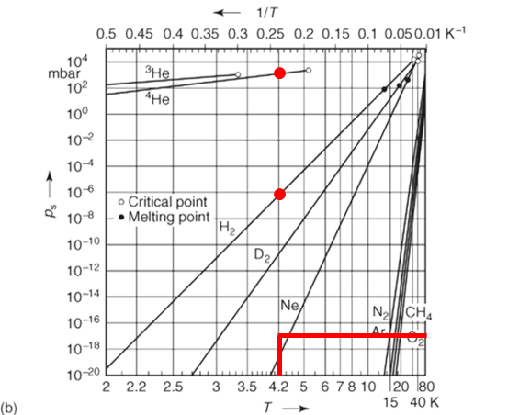
Cryo-pumping
Ref [3]
Except H₂ and He, all the gases have an equilibrium vapour pressure <10⁻¹⁷ mbar at 4.2K
At 4.2K all these gases can be pumped without limit
H₂ and He <1ML for pressure < 10⁻¹⁷ mbar ➔ Adsorption Isotherm
At cryogenic temperature Dubinin-Radushkevich isotherm describes the adsorption process
Open question, is DR isotherm valid at arbitrary low pressure (Henry’s law) [2]?
[2] J.P. Hobson, Journal of Vacuum Science and Technology 3, 281 (1966)
[3] Handbook of Vacuum Technology, 1st ed. (John Wiley & Sons, Ltd, 2016)

Slide 5
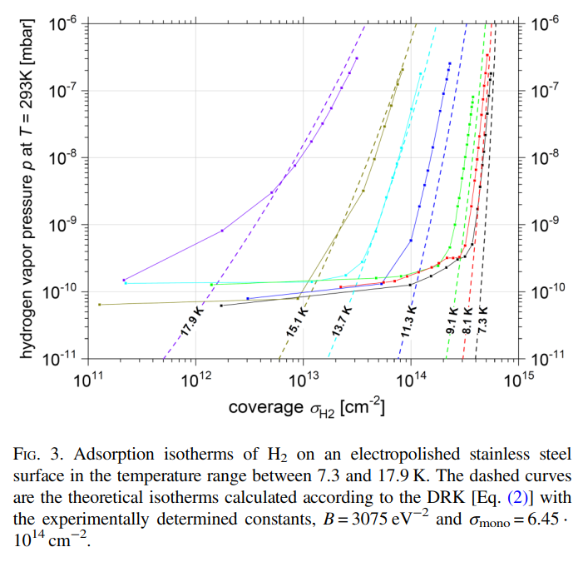
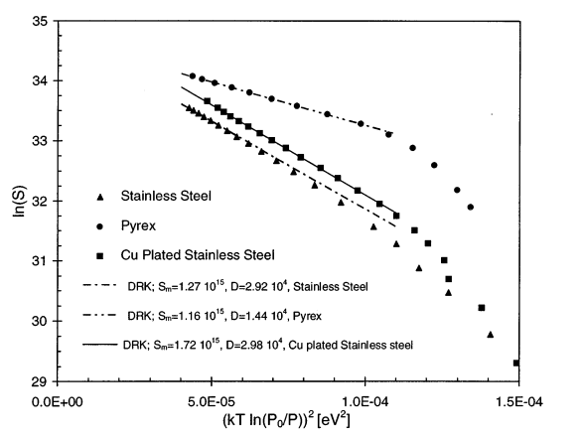
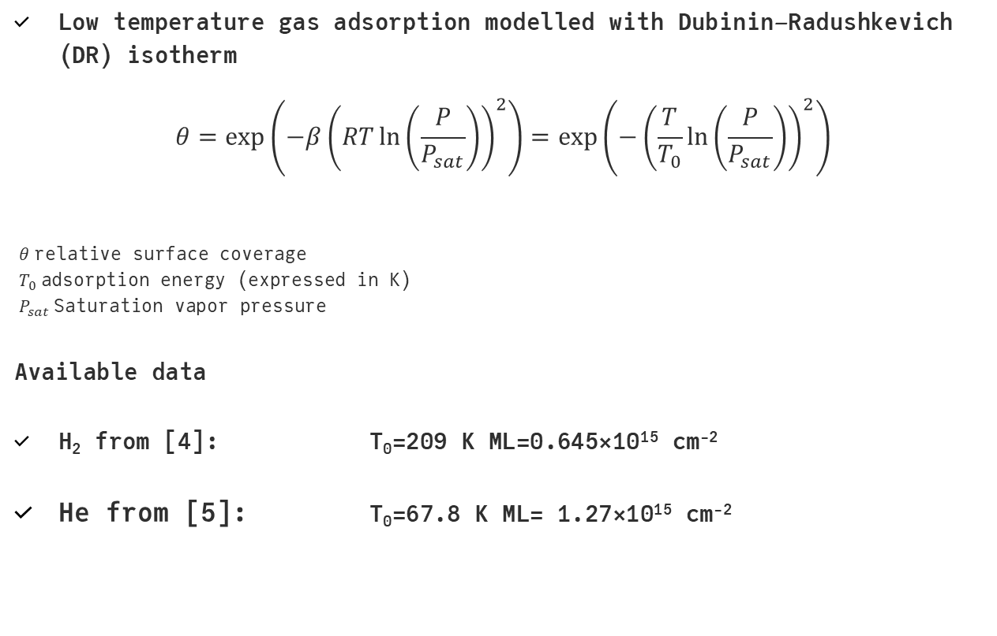
Cryo-pumping
Low temperature gas adsorption modelled with Dubinin–Radushkevich (DR) isotherm
$$θ=\exp\left(−β{\left(RT\ln\left(\frac{P}{P_{sat}}\right)\right)}^{2}\right)=\exp\left(−{\left(\frac{T}{T_{0}}\ln\left(\frac{P}{P_{sat}}\right)\right)}^{2}\right)$$
$$θ \text{relative} \text{surface} \text{coverage} \\ T_{0} \text{adsorption} \text{energy}\text{ (}\text{expressed} \text{in} \text{K}\text{)} \\ P_{sat} \text{Saturation} \text{vapor} \text{pressure}$$
Available data
  H₂ from [4]: T₀=209 K ML=0.645×10¹⁵ cm⁻²
  He from [5]: T₀=67.8 K ML= 1.27×10¹⁵ cm⁻²
[4] F. Chill, S. Wilfert, and L. Bozyk, J. of Vac. Sci. Technol. A 37, 031601 (2019)
[5] E. Wallén, J. Vac. Sci. Technol. A 15, 265 (1997)

Slide 6
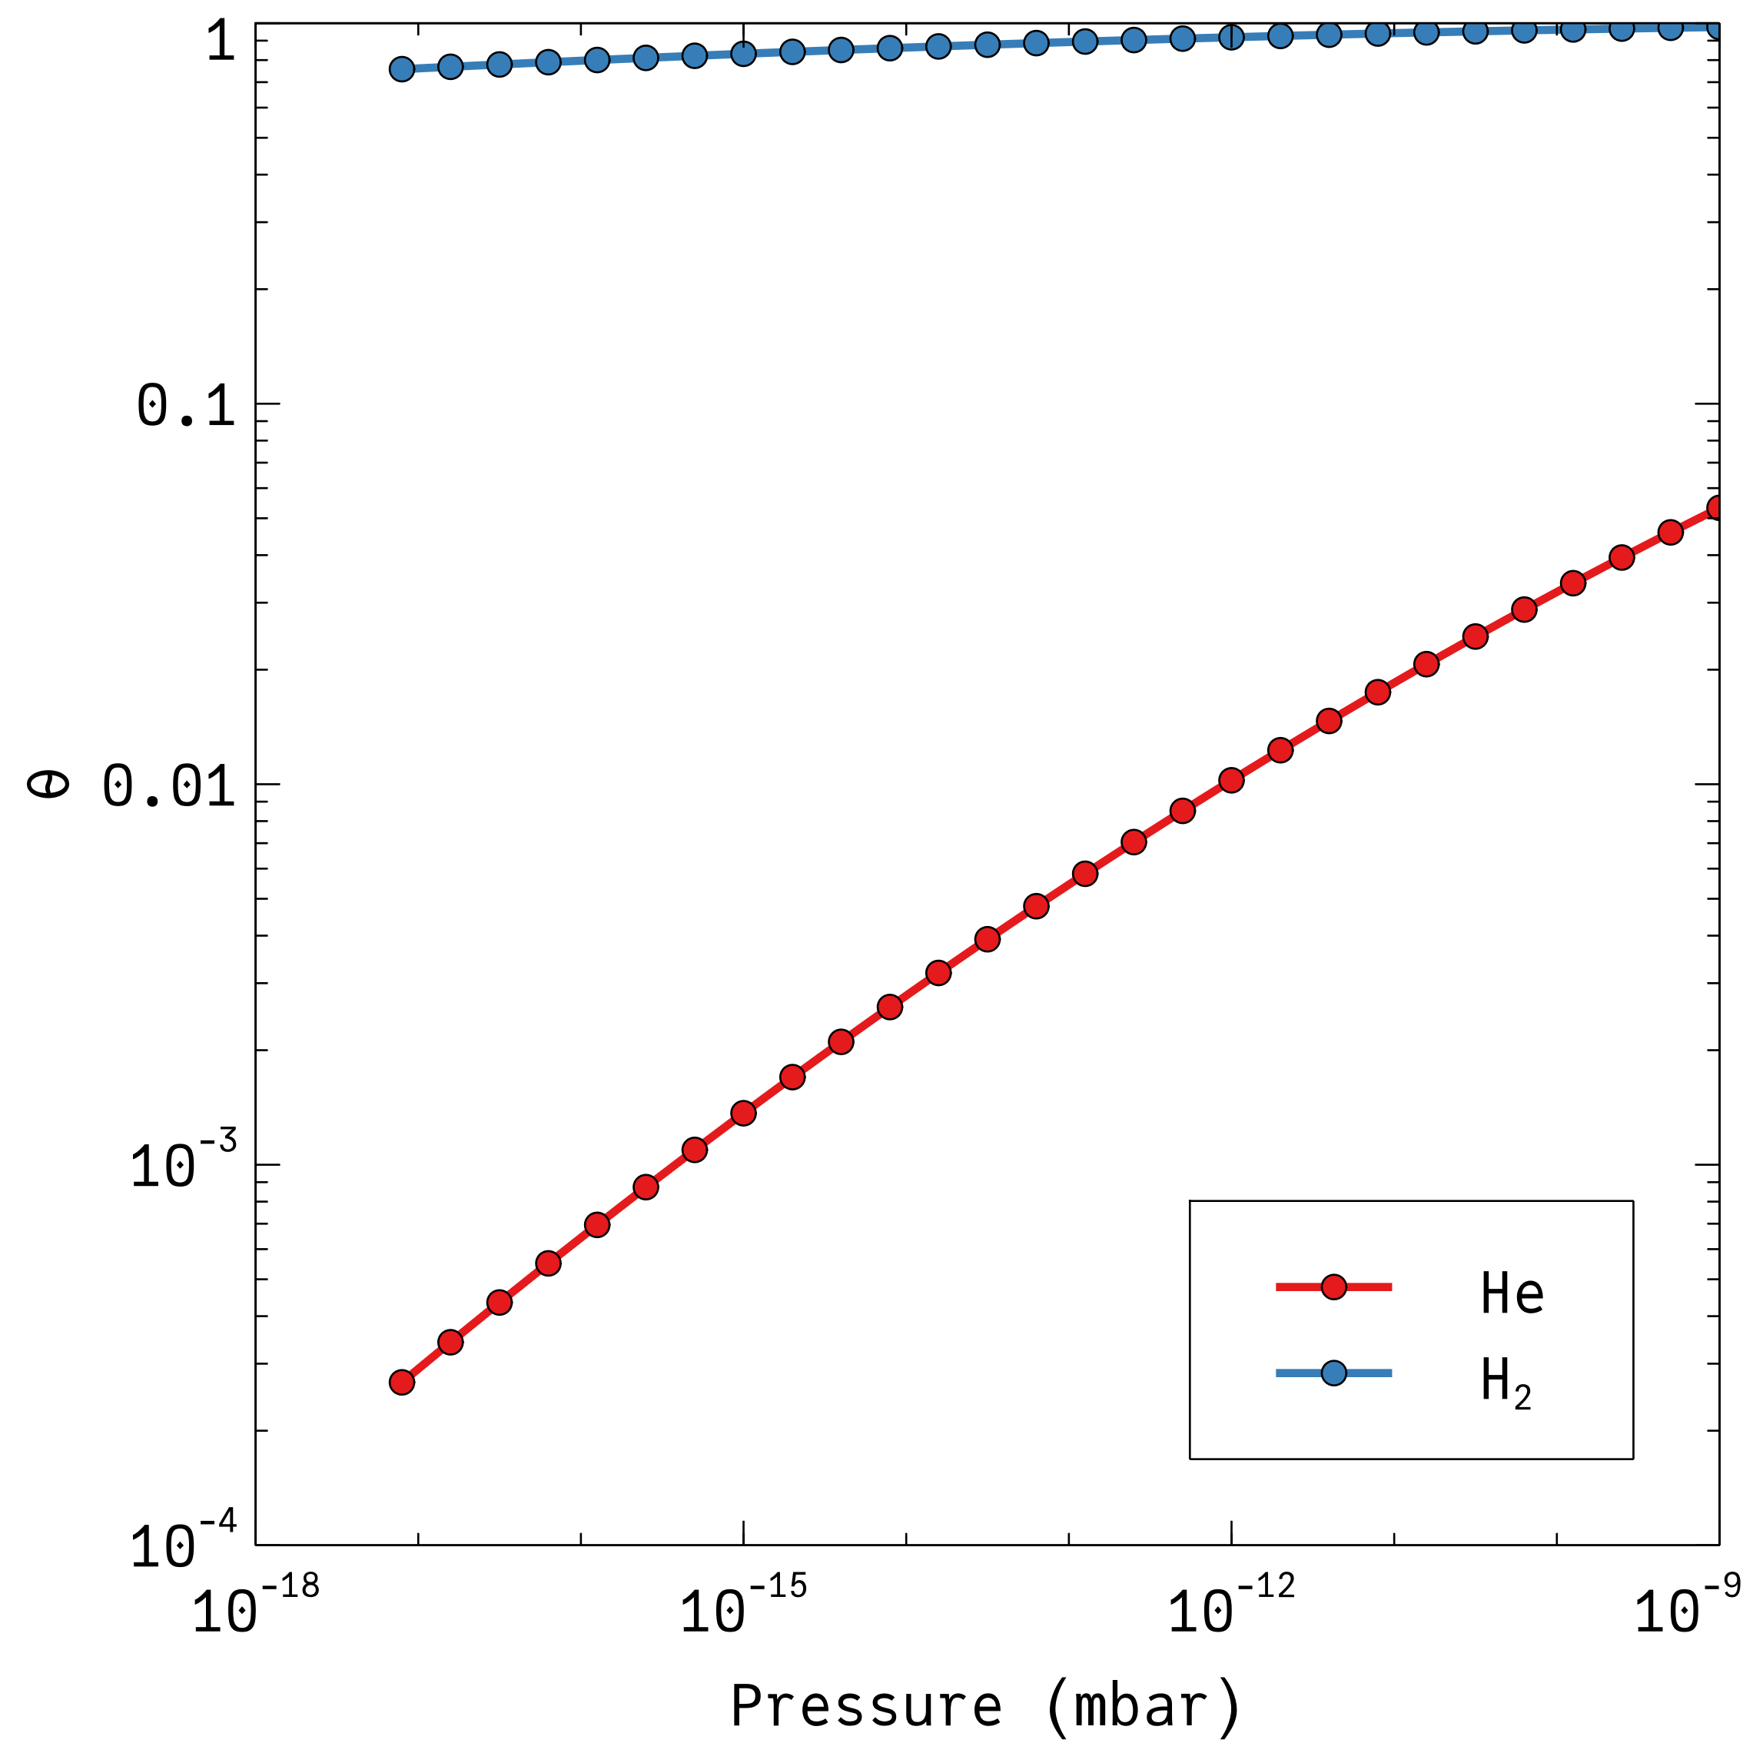

Cryo-pumping
Low temperature gas adsorption modelled with Dubinin–Radushkevich (DR) isotherm
$$θ=\exp\left(−β{\left(RT\ln\left(\frac{P}{P_{sat}}\right)\right)}^{2}\right)=\exp\left(−{\left(\frac{T}{T_{0}}\ln\left(\frac{P}{P_{sat}}\right)\right)}^{2}\right)$$
$$θ \text{relative} \text{surface} \text{coverage} \\ T_{0} \text{adsorption} \text{energy}\text{ (}\text{expressed} \text{in} \text{K}\text{)} \\ P_{sat} \text{Saturation} \text{vapor} \text{pressure}$$
Available data
  H₂ from [4]: T₀=209 K ML=0.645×10¹⁴ cm⁻²
  He from [5]: T₀=67.8 K ML= 1.27×10¹⁵ cm⁻²
[4] F. Chill, S. Wilfert, and L. Bozyk, J. of Vac. Sci. Technol. A 37, 031601 (2019)
[5] E. Wallén, J. Vac. Sci. Technol. A 15, 265 (1997)

Slide 7
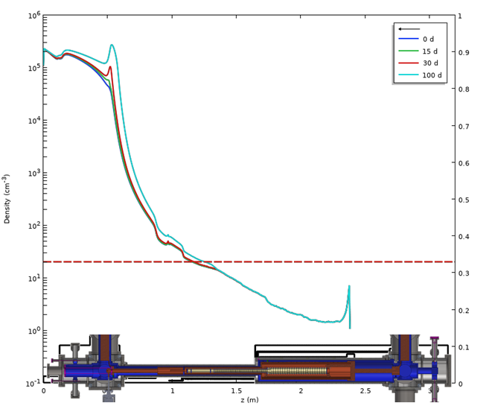
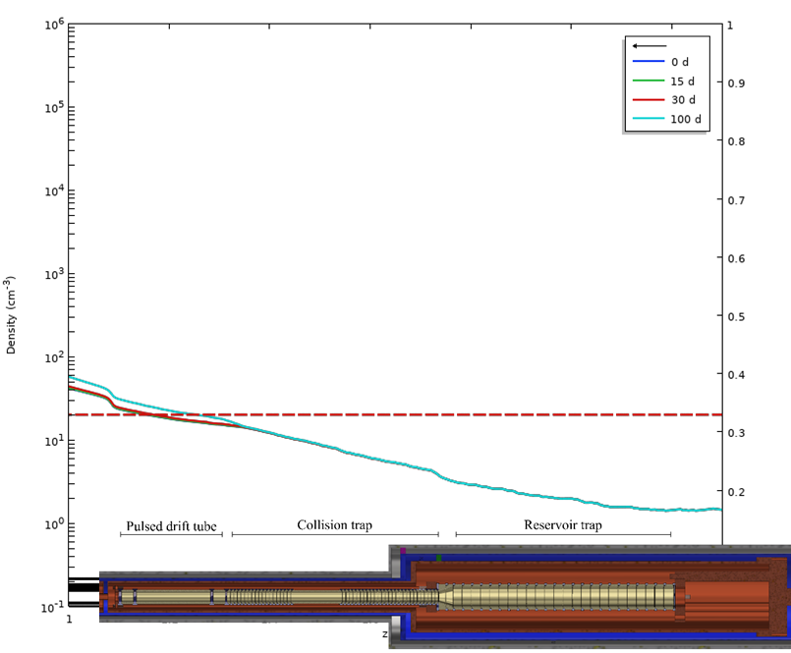
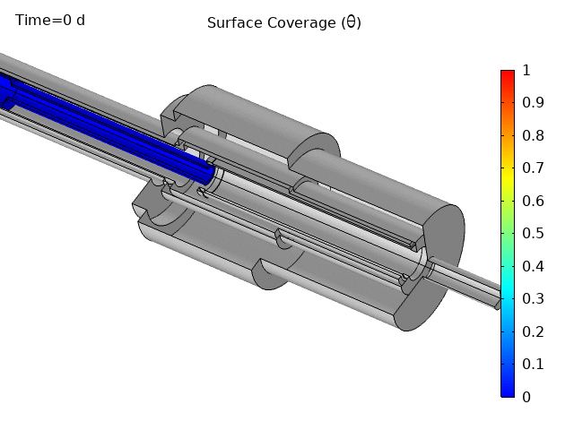
Cryo-pumping H₂
COMSOL model: P_{H2}=10⁻¹¹mbar
Acceptable antiproton lifetime in reservoir trap and collision trap
After 100 days almost no degradation
Target the lowest achievable pressure at the entrance of the trap

Slide 8
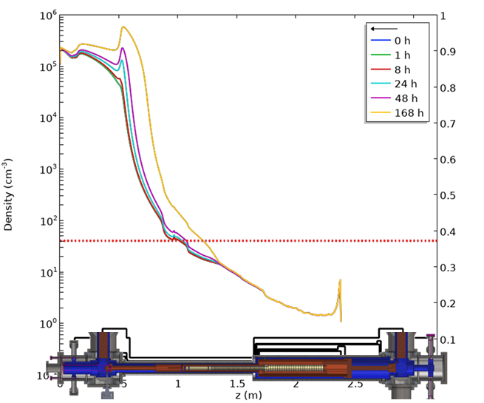
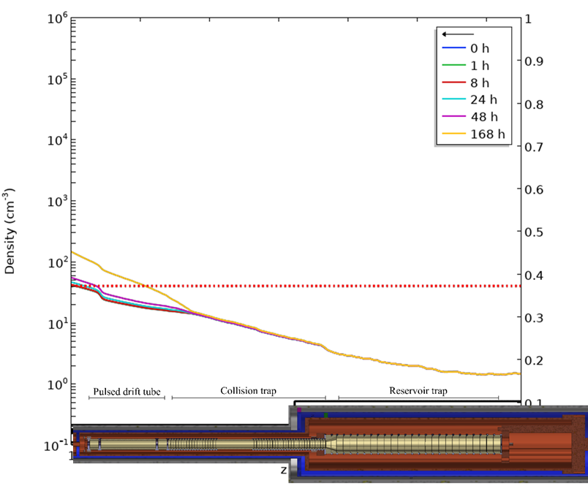
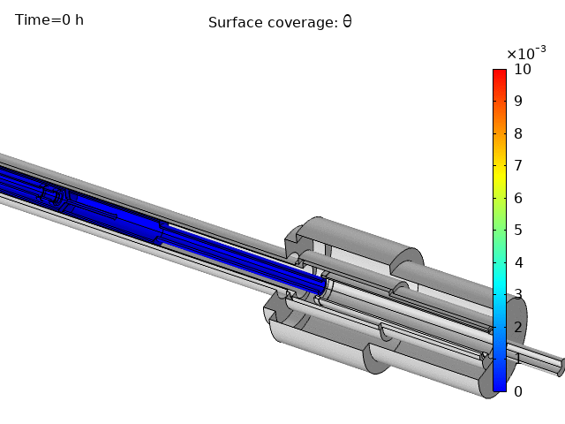
Cryo-pumping He
COMSOL model: P_{He}=10⁻¹¹mbar
Acceptable antiproton lifetime in reservoir trap and collision trap
After 7 days almost no degradation
Acceptable level 2×higher than H₂

Slide 9
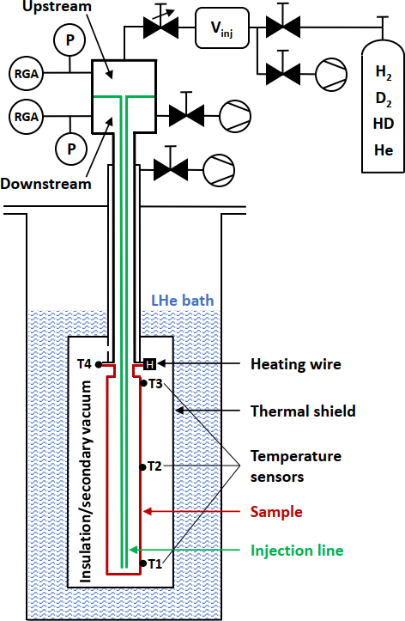
Isotherm measurements
Option 1: Isosteres
(pressure over temperature scans at a constant coverage)
→ several isosteres can be used find the fit parameters of adsorption isotherm models
Option 2: Gas propagation
at constant sample temperature with a continuous injection
→ can be used to test the isotherm parameters in simulations and reproduce the gas propagation
[6] A. Stöltzel, Sub-monolayer adsorption isotherms and gas propagation of H₂ and He in cryogenic copper tubes. https://indico.cern.ch/event/1129799/#1-gas-propagation-in-cryogenic

Slide 10
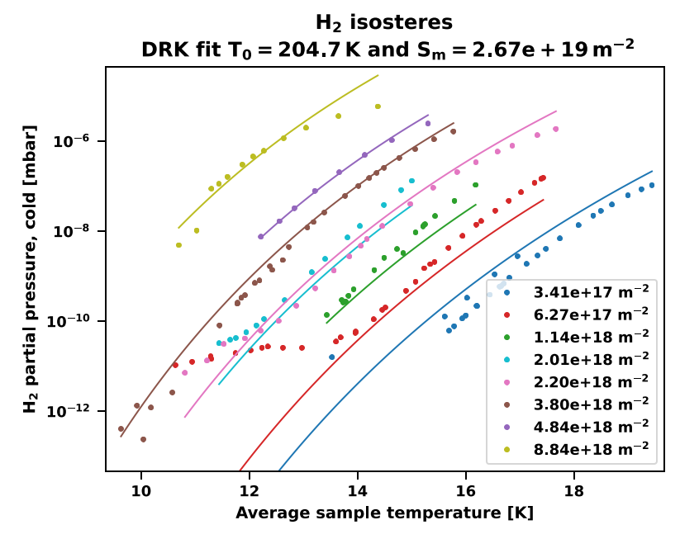
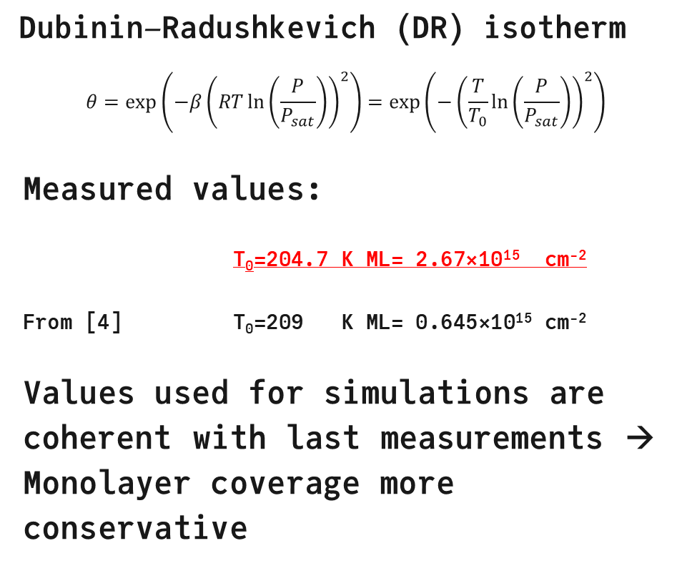
Isotherm measurements: Hydrogen
Dubinin–Radushkevich (DR) isotherm
$$θ=\exp\left(−β{\left(RT\ln\left(\frac{P}{P_{sat}}\right)\right)}^{2}\right)=\exp\left(−{\left(\frac{T}{T_{0}}\ln\left(\frac{P}{P_{sat}}\right)\right)}^{2}\right)$$
Measured values:
T₀=204.7 K ML= 2.67×10¹⁵ cm⁻²
From [4] T₀=209 K ML= 0.645×10¹⁵ cm⁻²
Values used for simulations are coherent with last measurements → Monolayer coverage more conservative

Slide 11
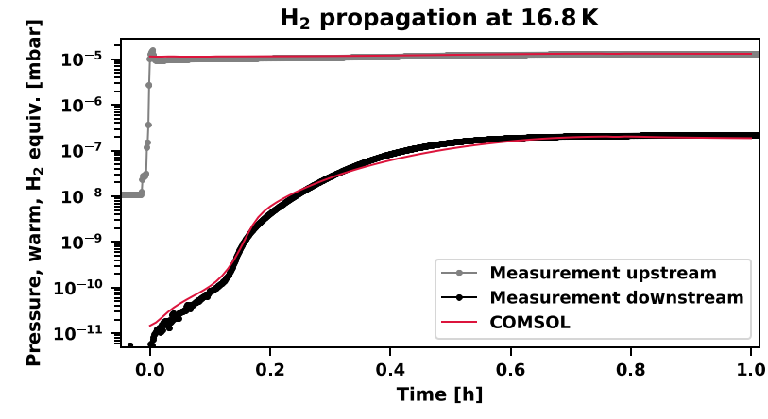
Isotherm measurements: Hydrogen
Dubinin–Radushkevich (DR) isotherm
$$θ=\exp\left(−β{\left(RT\ln\left(\frac{P}{P_{sat}}\right)\right)}^{2}\right)=\exp\left(−{\left(\frac{T}{T_{0}}\ln\left(\frac{P}{P_{sat}}\right)\right)}^{2}\right)$$
Measured values:
T₀=204.7 K ML= 2.67×10¹⁵ cm⁻²
From [4] T₀=209 K ML= 0.645×10¹⁵ cm⁻²
Values used for simulations are coherent with last measurements → Monolayer coverage more conservative

Slide 12
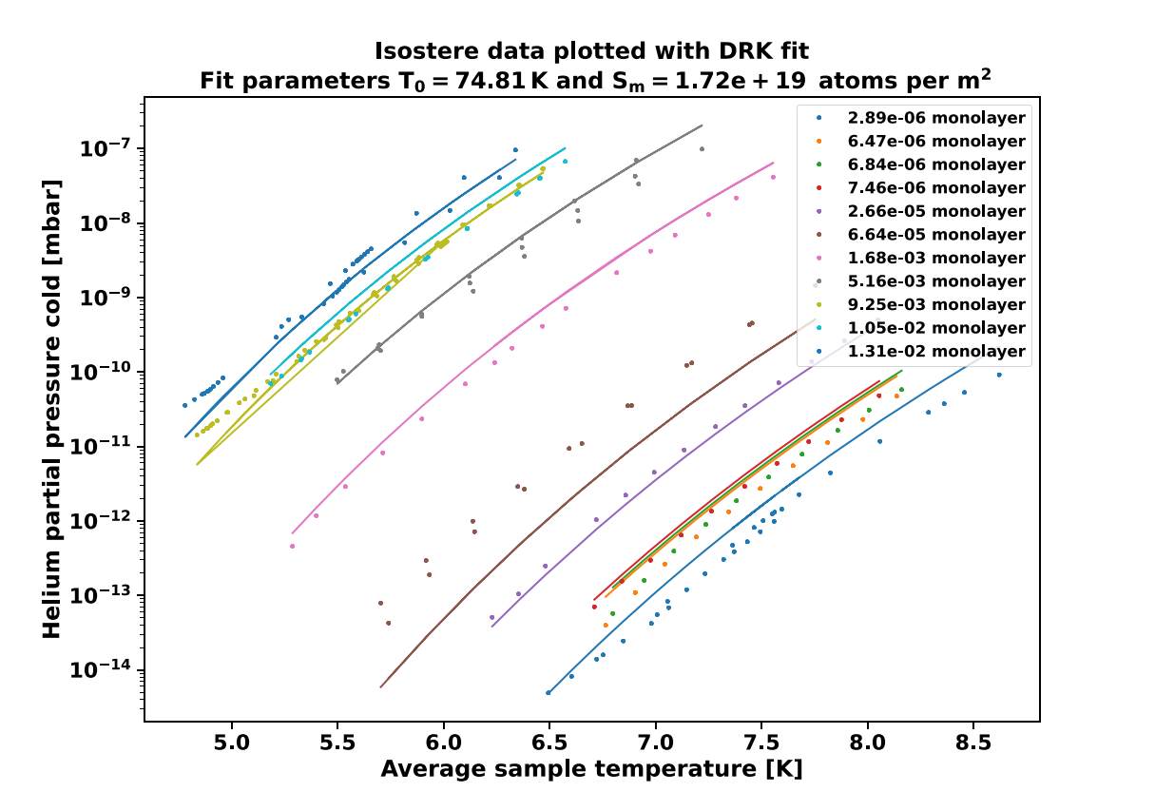
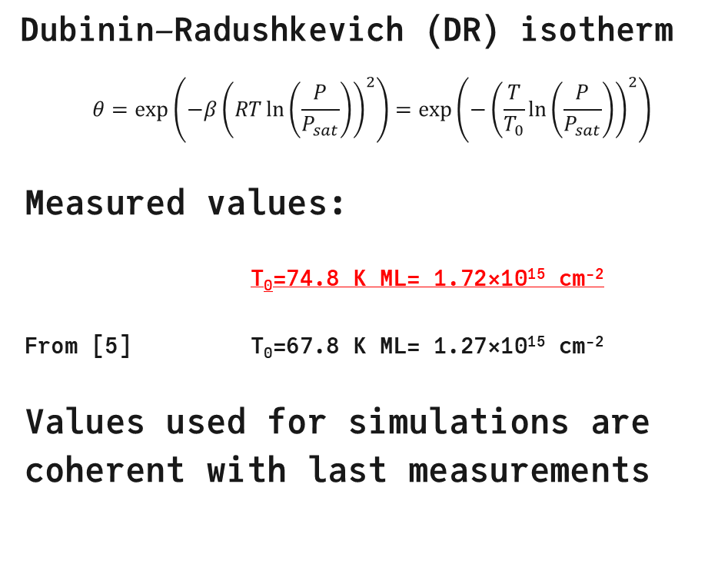
Isotherm measurements: Helium
Dubinin–Radushkevich (DR) isotherm
$$θ=\exp\left(−β{\left(RT\ln\left(\frac{P}{P_{sat}}\right)\right)}^{2}\right)=\exp\left(−{\left(\frac{T}{T_{0}}\ln\left(\frac{P}{P_{sat}}\right)\right)}^{2}\right)$$
Measured values:
T₀=74.8 K ML= 1.72×10¹⁵ cm⁻²
From [5] T₀=67.8 K ML= 1.27×10¹⁵ cm⁻²
Values used for simulations are coherent with last measurements

Slide 13
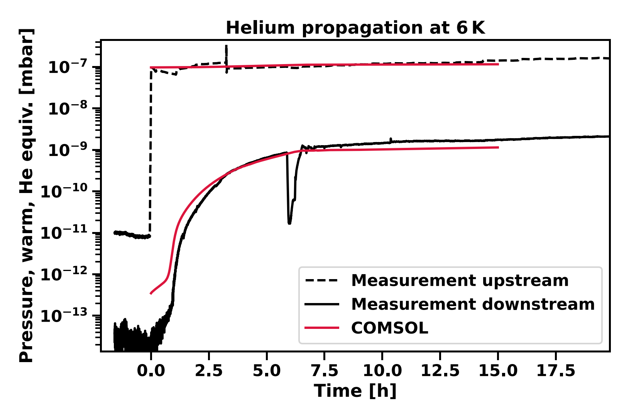
Isotherm measurements: Helium
Dubinin–Radushkevich (DR) isotherm
$$θ=\exp\left(−β{\left(RT\ln\left(\frac{P}{P_{sat}}\right)\right)}^{2}\right)=\exp\left(−{\left(\frac{T}{T_{0}}\ln\left(\frac{P}{P_{sat}}\right)\right)}^{2}\right)$$
Measured values:
T₀=74.8 K ML= 1.72×10¹⁵ cm⁻²
From [5] T₀=67.8 K ML= 1.27×10¹⁵ cm⁻²
Values used for simulations are coherent with last measurements

Slide 14
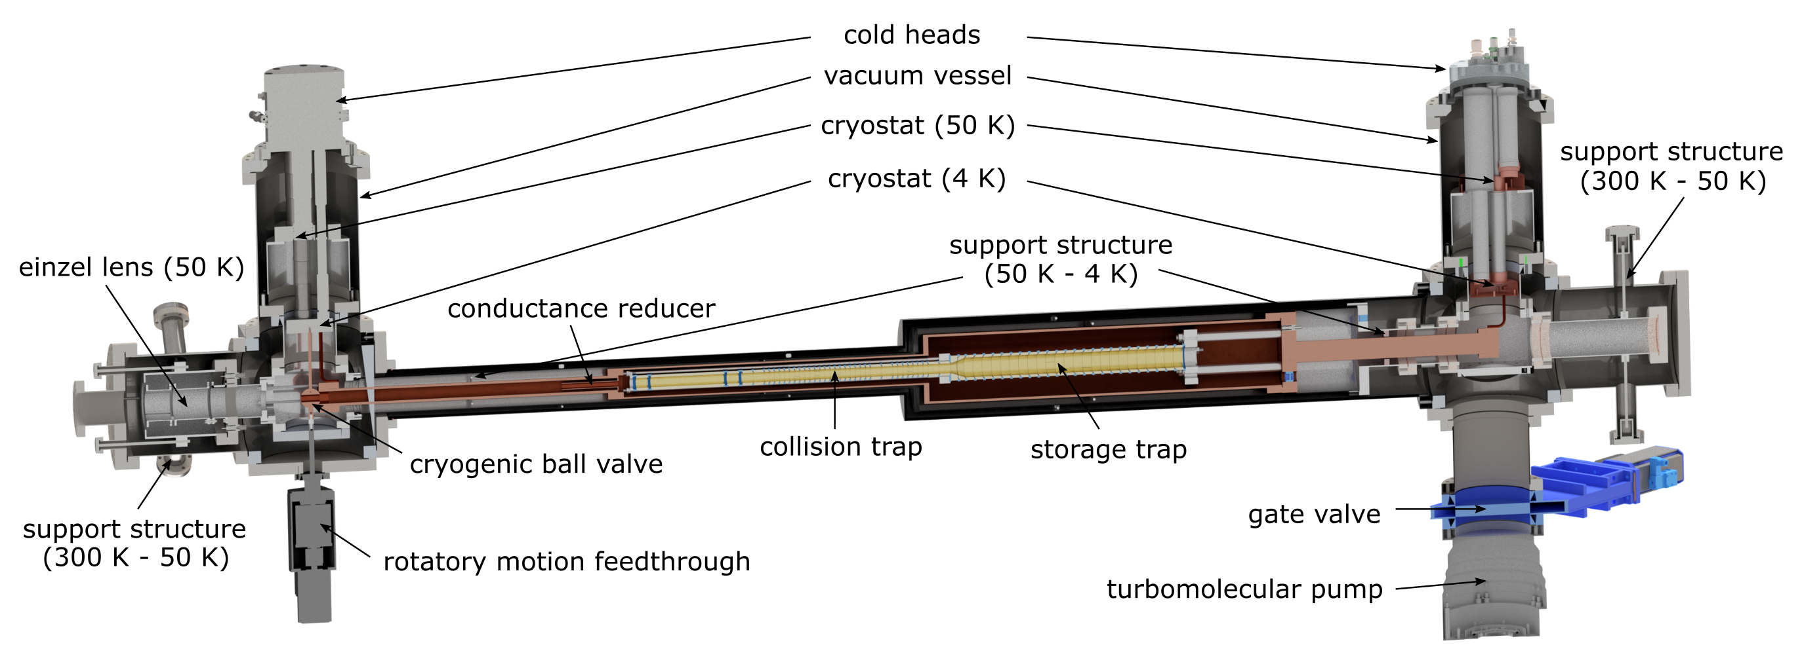
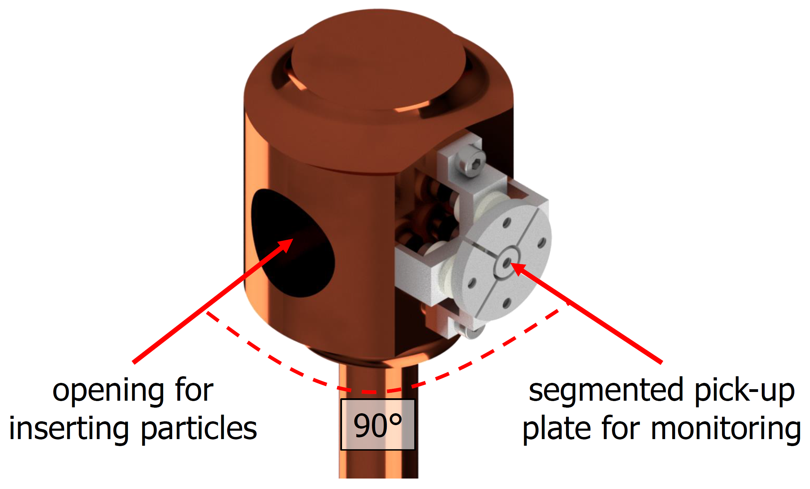
Carbon coating to increase the number of sites ×100 [7]
[7] R. Salemme, et al. "Vacuum Performance of Amorphous Carbon Coating at Cryogenic Temperature with Presence of Proton Beams.“ (IPAC'16), Busan, Korea, May 8-13, 2016
[8] A. Obertelli et al. PUMA, SPSC report on the activities of 2022
Cold shutter to reduce gas flow when not in operation [8]

Slide 15
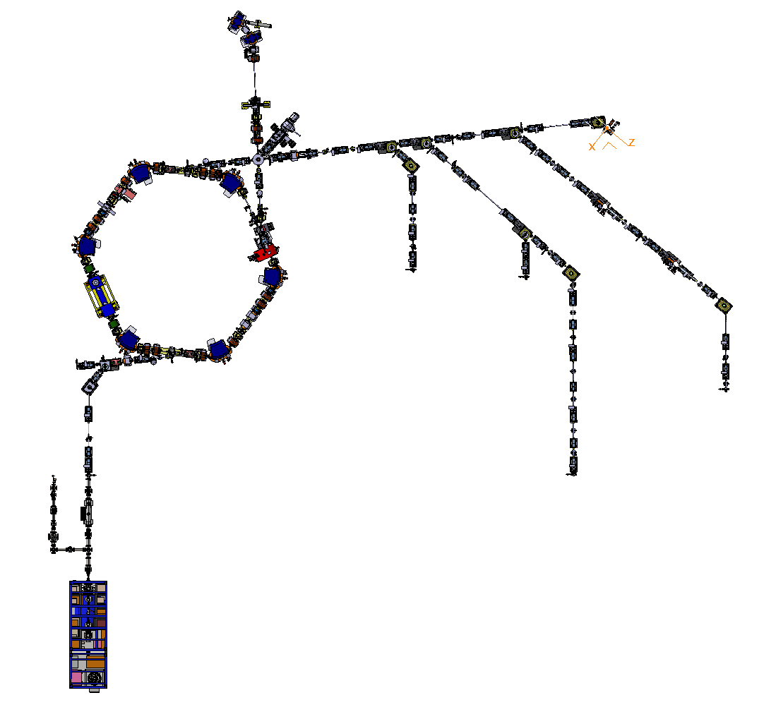

ELENA vacuum layout
ELENA: At the end of LNE51
Pressure at transfer lines ≈10⁻¹⁰ mbar range
Pressure ring <10⁻¹¹ mbar

Slide 16
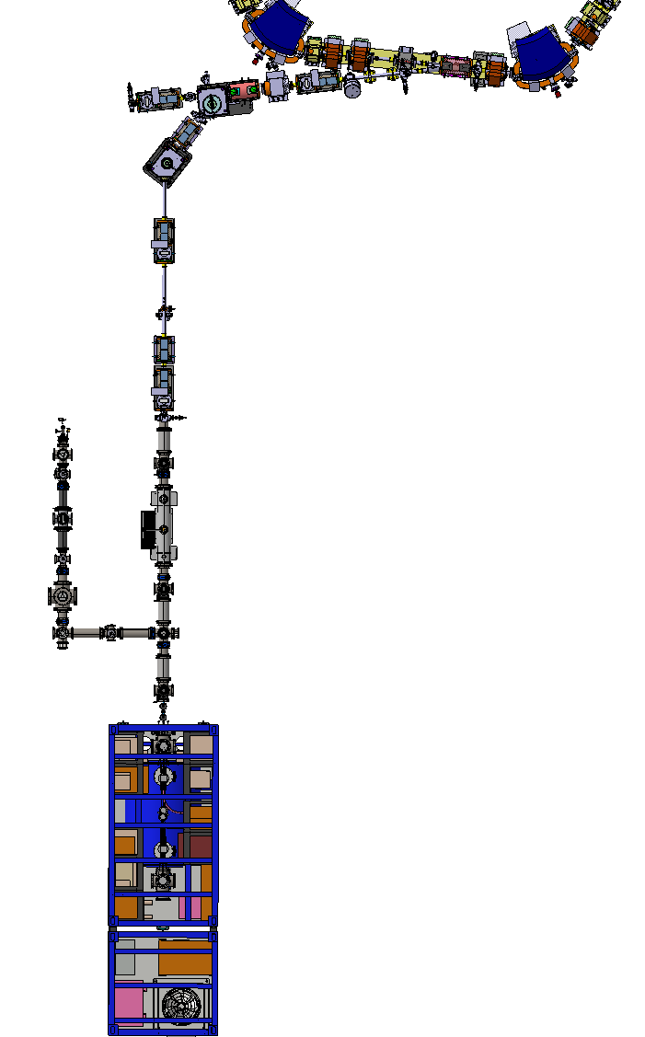
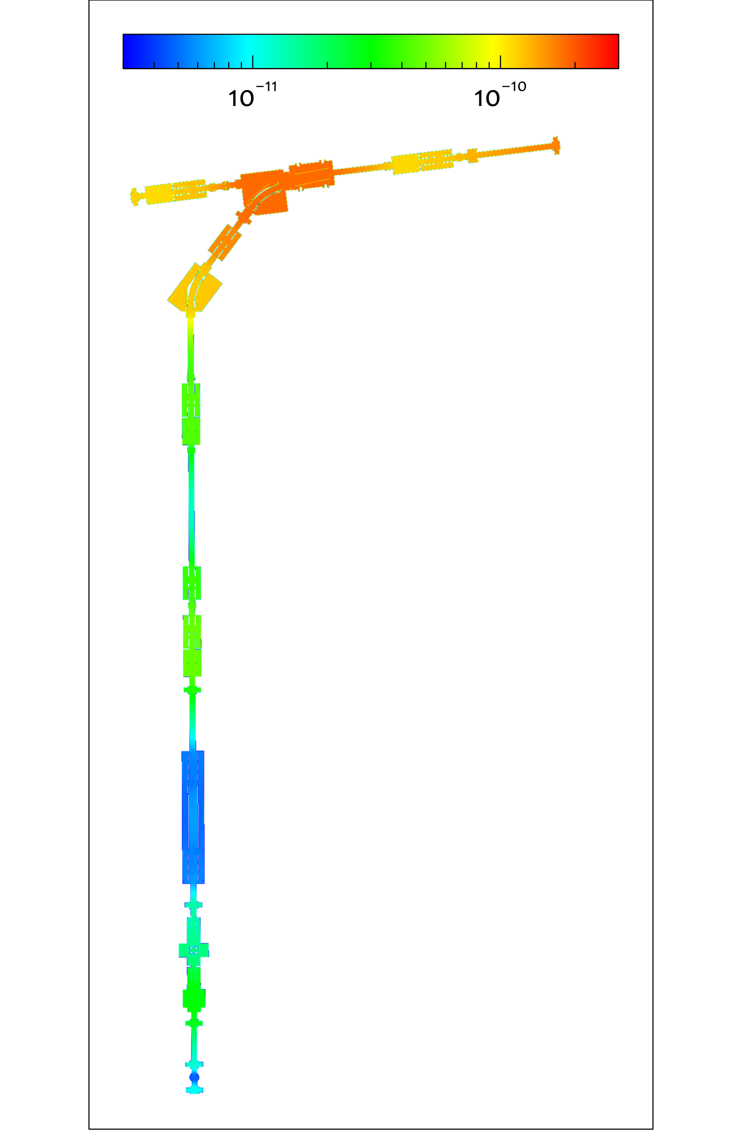
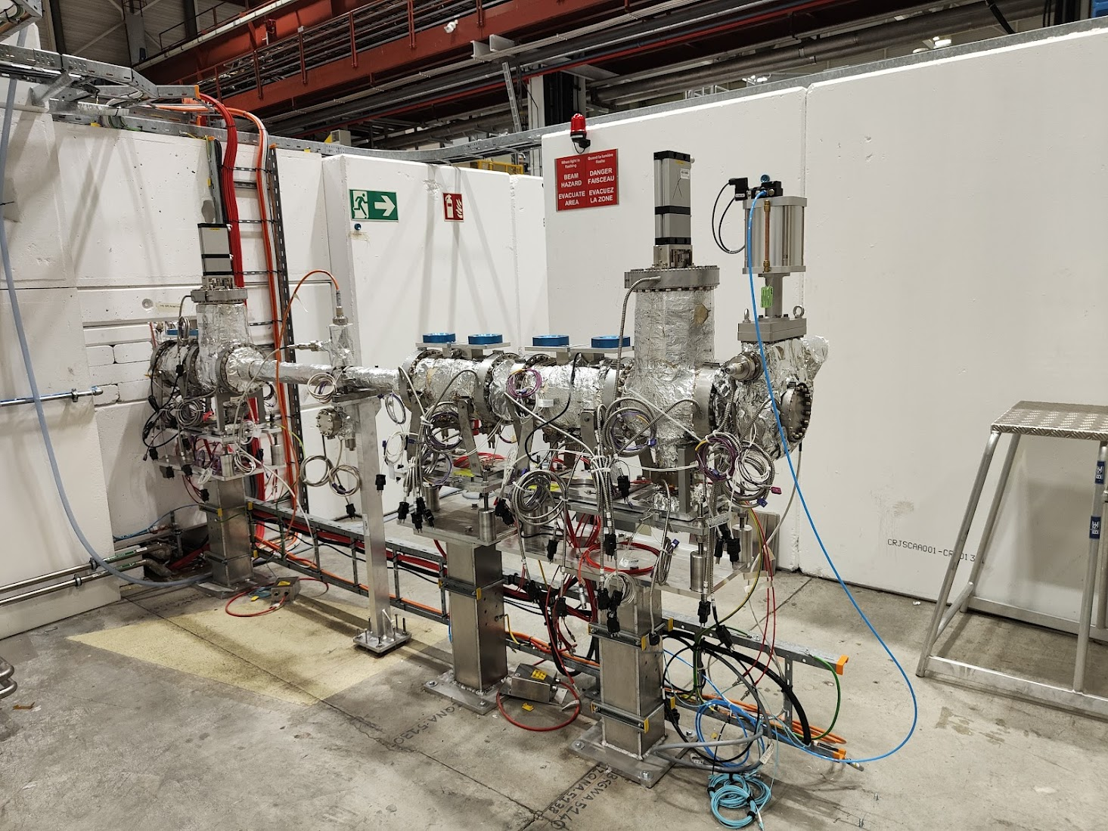
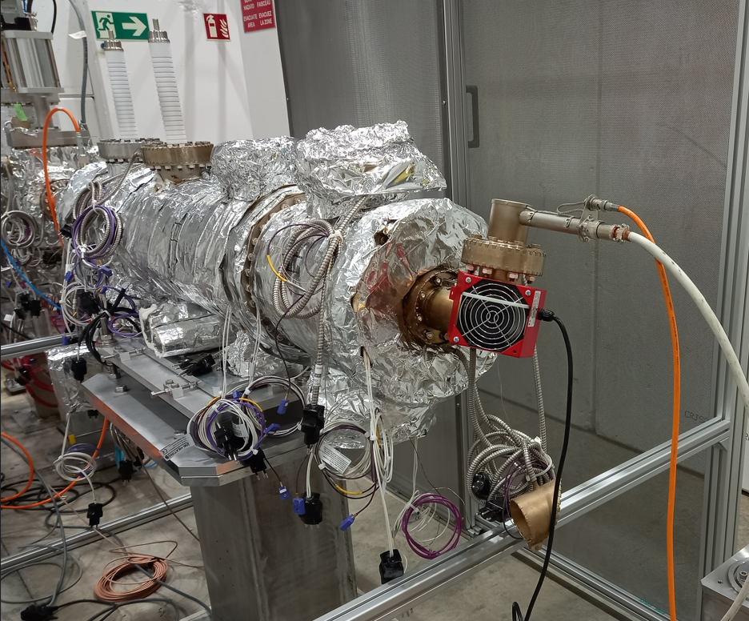
ELENA vacuum layout
≈5×10⁻¹¹ mbar
PUMA trap
PDT and instrumentation
≈1×10⁻¹¹ mbar
Handover point
Offline ion source (RFQ)
≈6×10⁻¹¹ mbar
ELENA ring
LNE50
NEG coatings
≈1.5×10⁻¹¹ mbar
LNE51 (CERN)

Slide 17
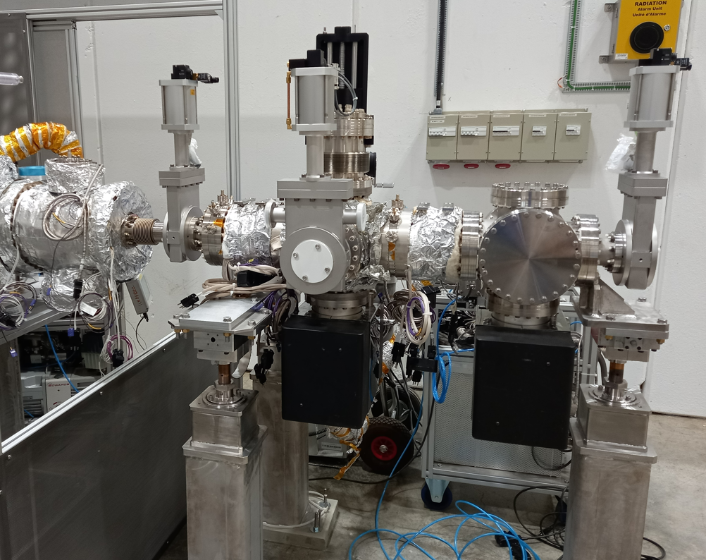
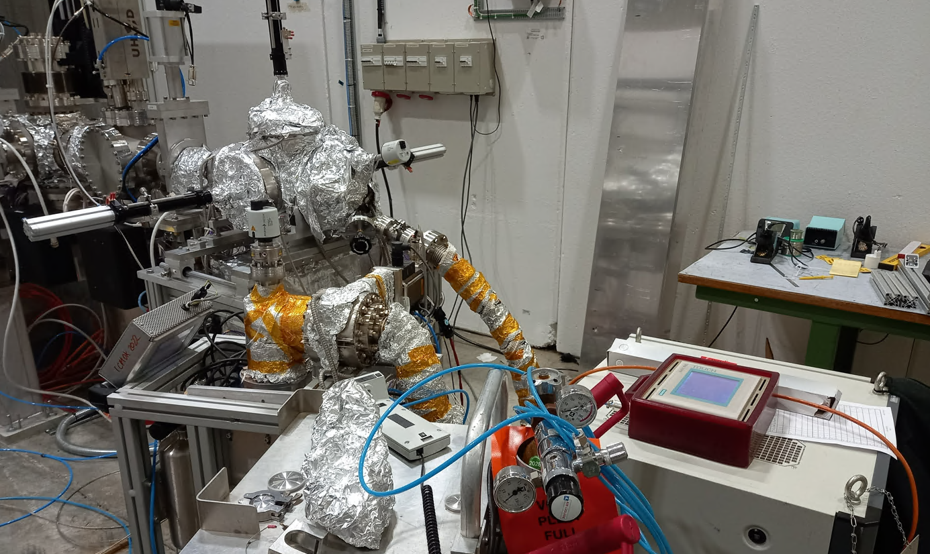
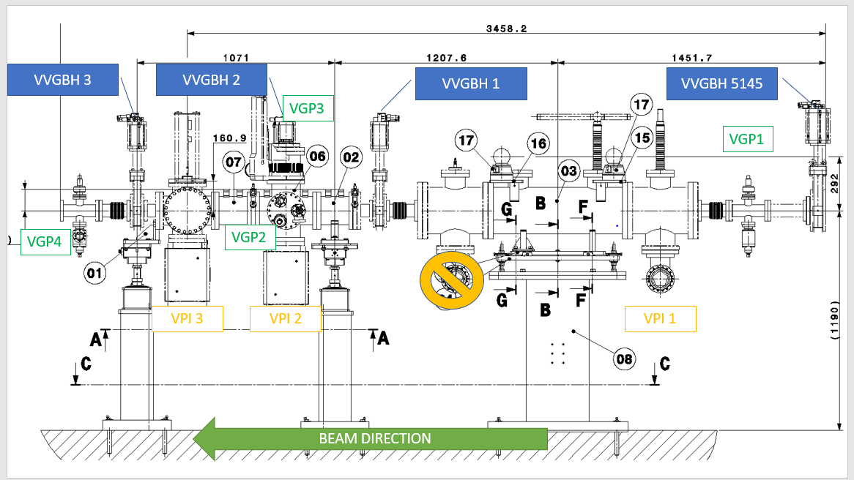
ELENA vacuum layout
Measured ≈5×10⁻¹¹ mbar
PUMA trap
PDT and instrumentation
≈1×10⁻¹¹ mbar
Handover point
Offline ion source (RFQ)
≈6×10⁻¹¹ mbar
ELENA ring
LNE50
NEG coatings
≈1.5×10⁻¹¹ mbar
LNE51 (CERN)

Slide 18
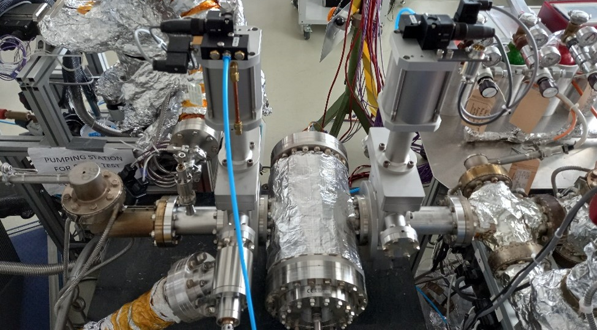
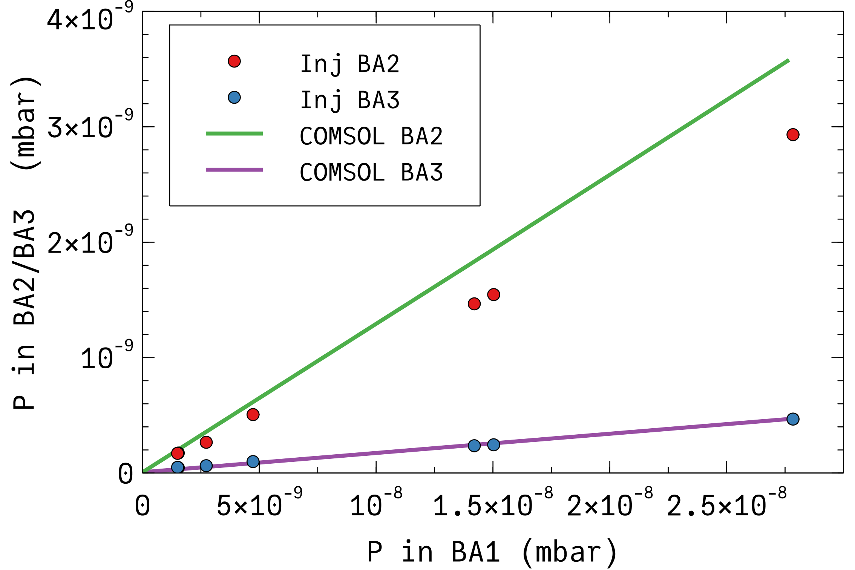
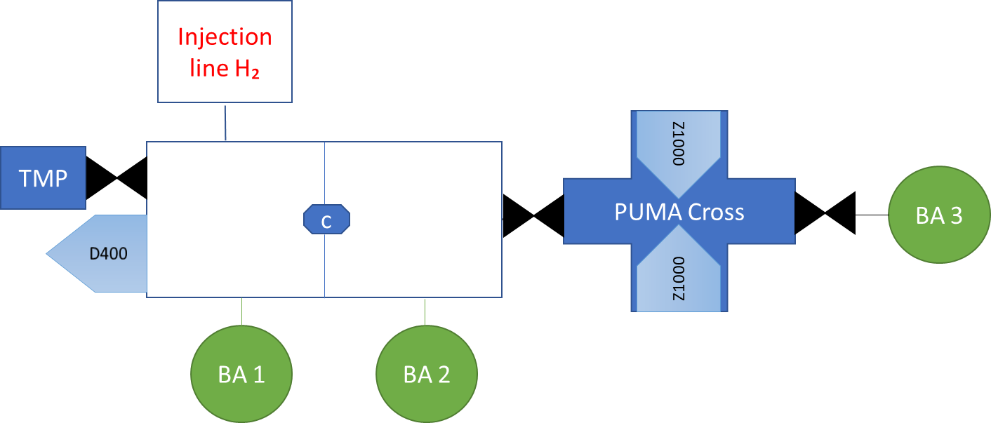
ELENA vacuum layout
COMSOL model to validate assumptions for last chamber
OG of sector valves 3×10⁻⁹ mbar×l/s
NEG coating sticking factor 0.008
H₂ injection results vs simulation
≈1×10⁻¹¹ mbar
≈1×10⁻¹⁰ mbar
≈1.8×10⁻¹¹ mbar

Slide 19
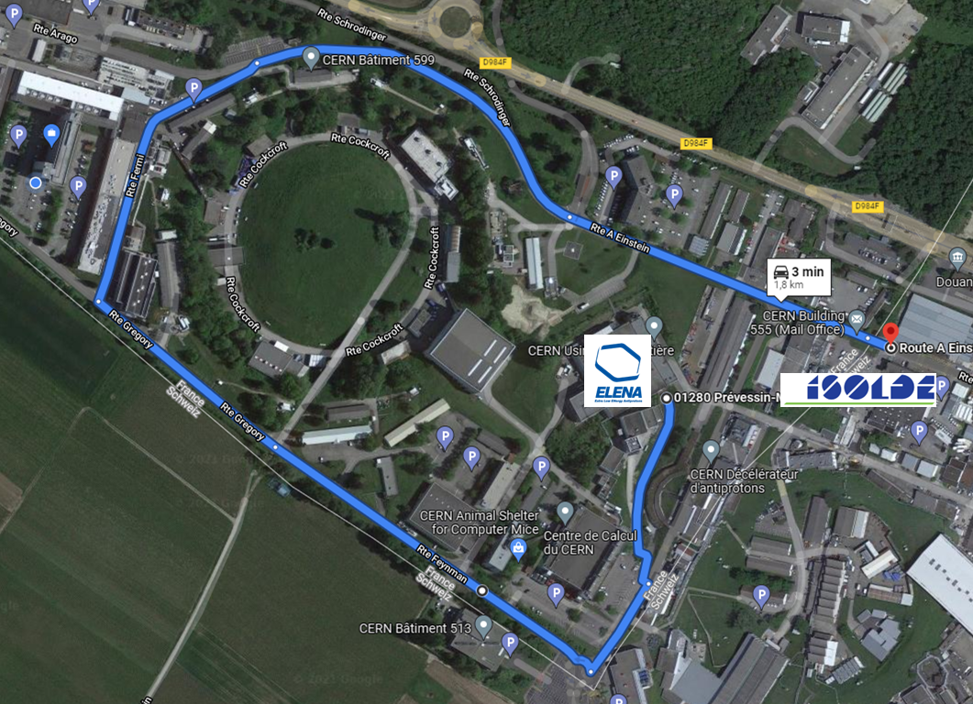
ELENA vacuum layout
PUMA trap
PDT and instrumentation
Handover point
Offline ion source (RFQ)
ELENA ring
LNE50
LNE51 (CERN)

Slide 20

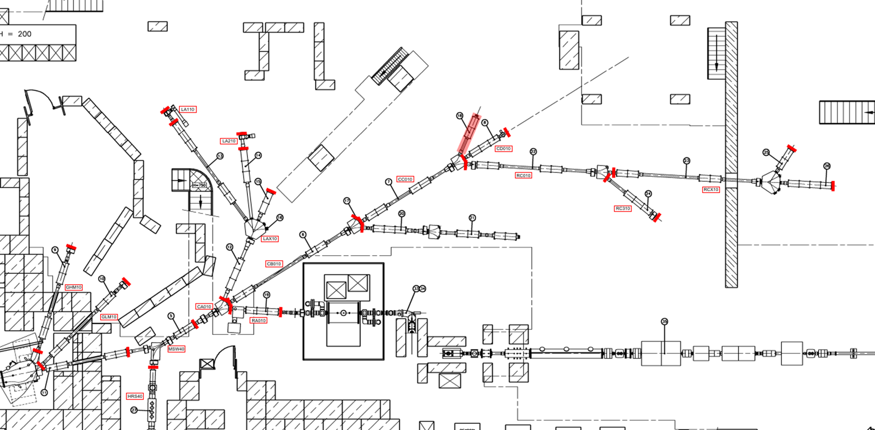
ISOLDE vacuum layout
RC6

Slide 21
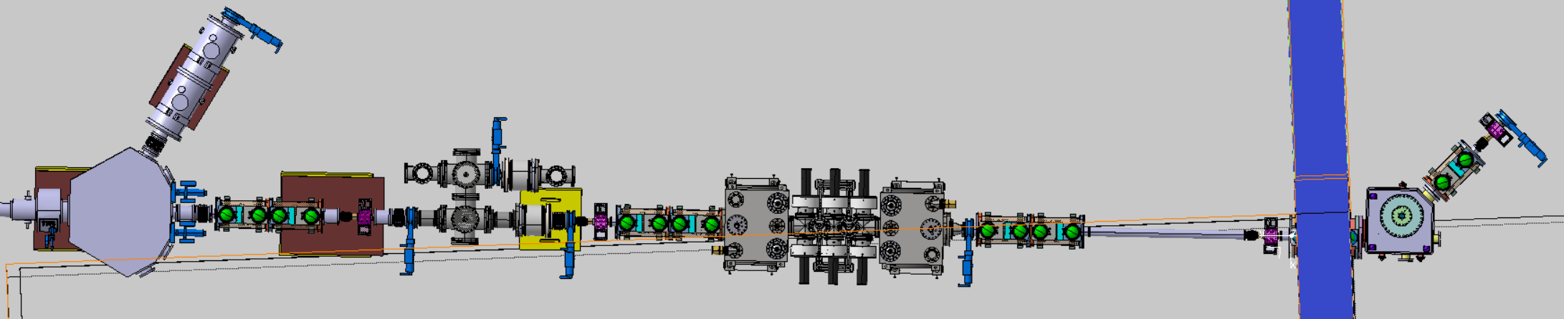
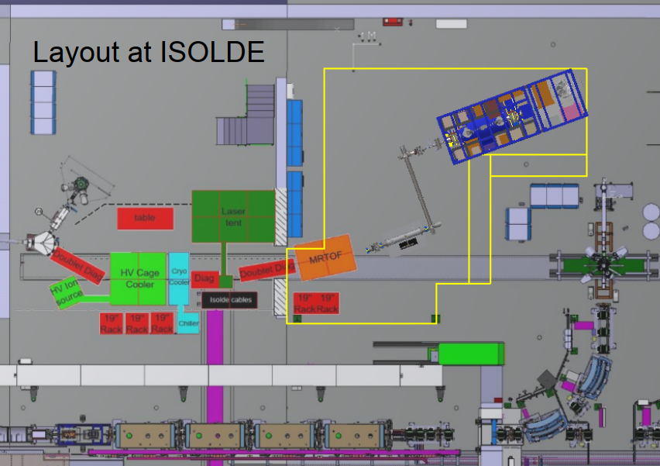
ISOLDE vacuum layout
Ion source
Paul trap
MR-TOF
Handover point
Three sections, ISOLDE, unbaked all metal seals, baked section
The line is under definition
Vacuum system still to be optimized. Some gas sources still to be defined (i.e. diagnostics with limited baking temperature)
Main challenge: pump Helium injected in Paul’s trap
RC6 beam line

Slide 22
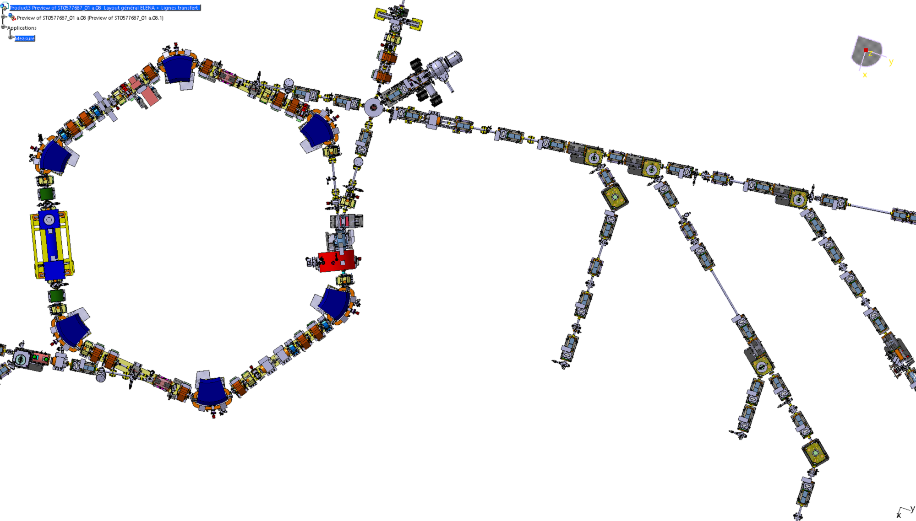
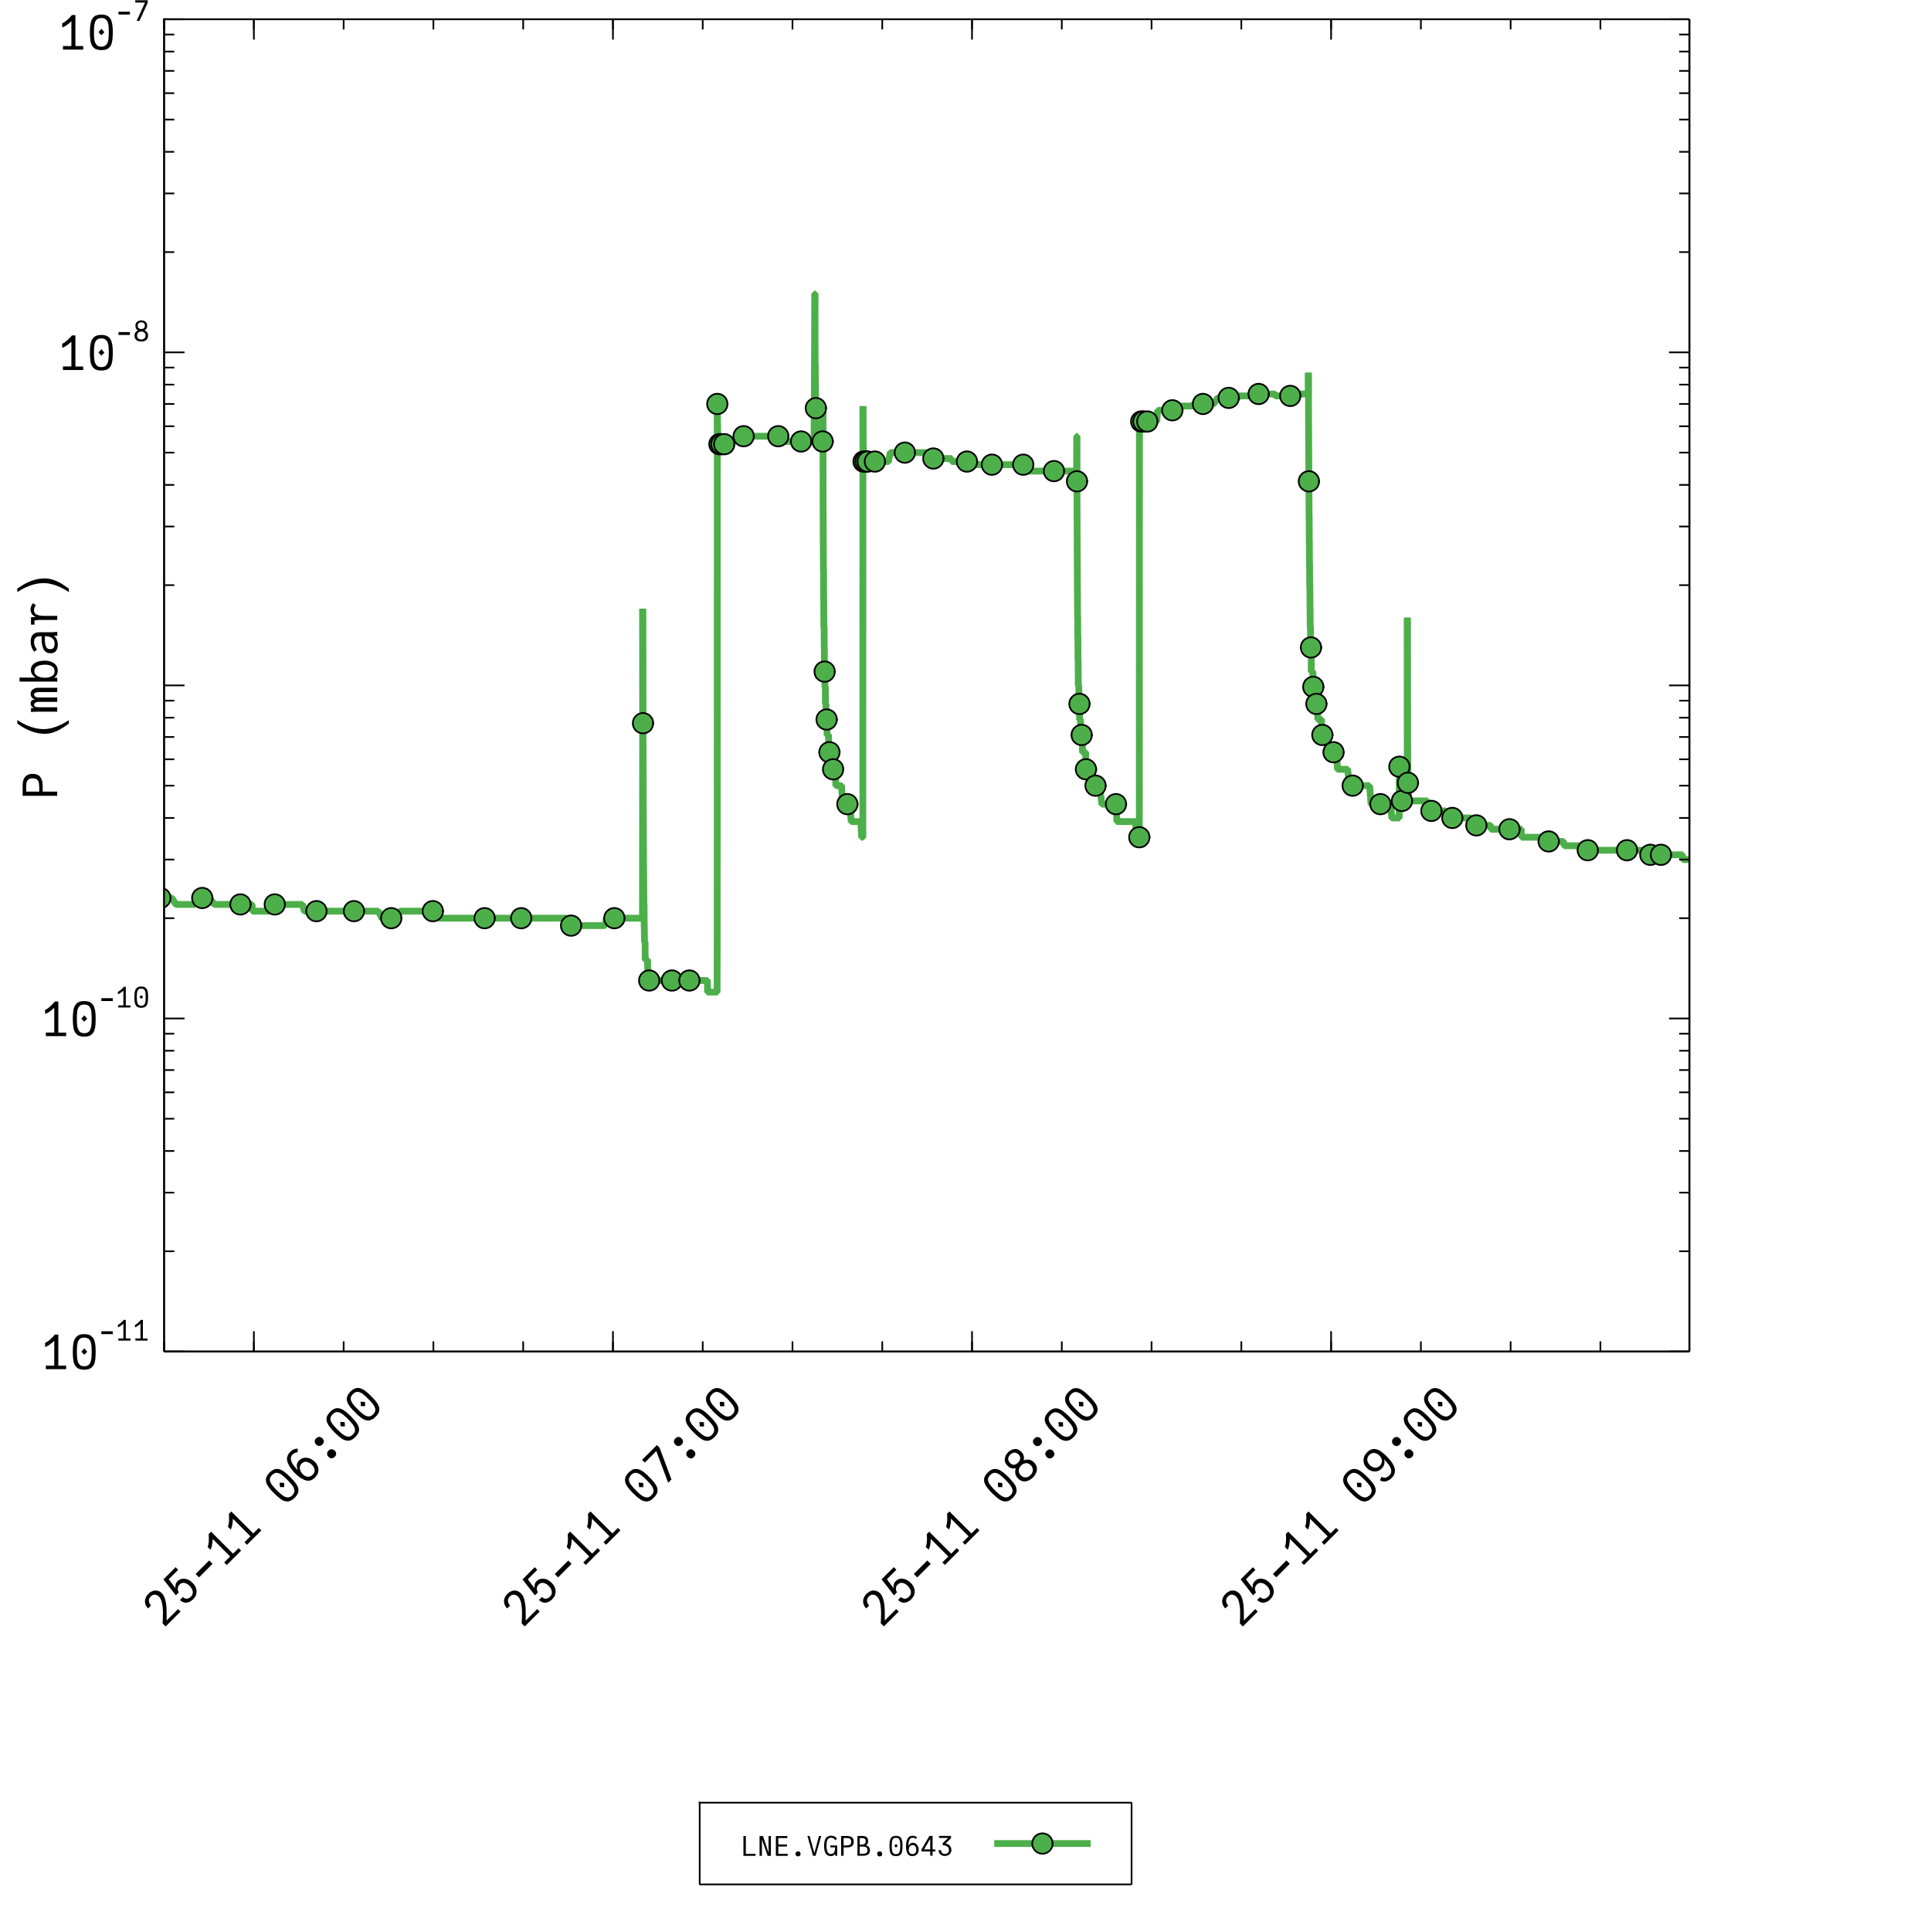
Example Helium propagation
LNE.VGPB.0643
ASACUSA

Slide 23
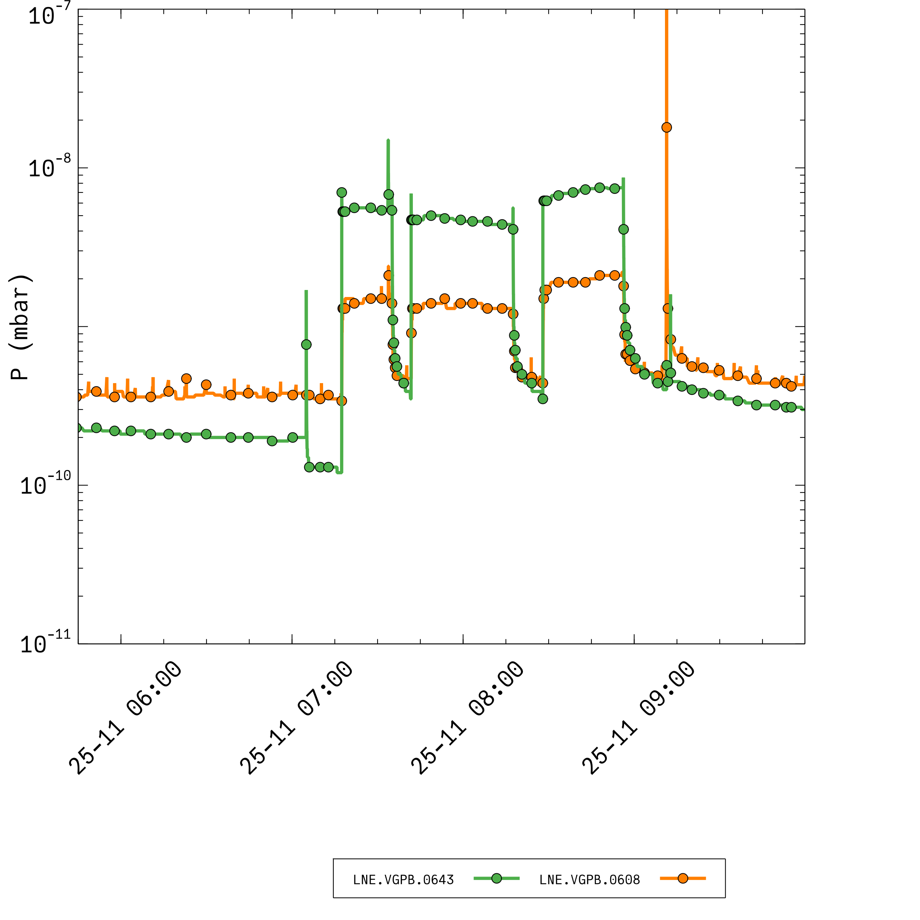
Example Helium propagation
LNE.VGPB.0608
LNE.VGPB.0643
ASACUSA

Slide 24
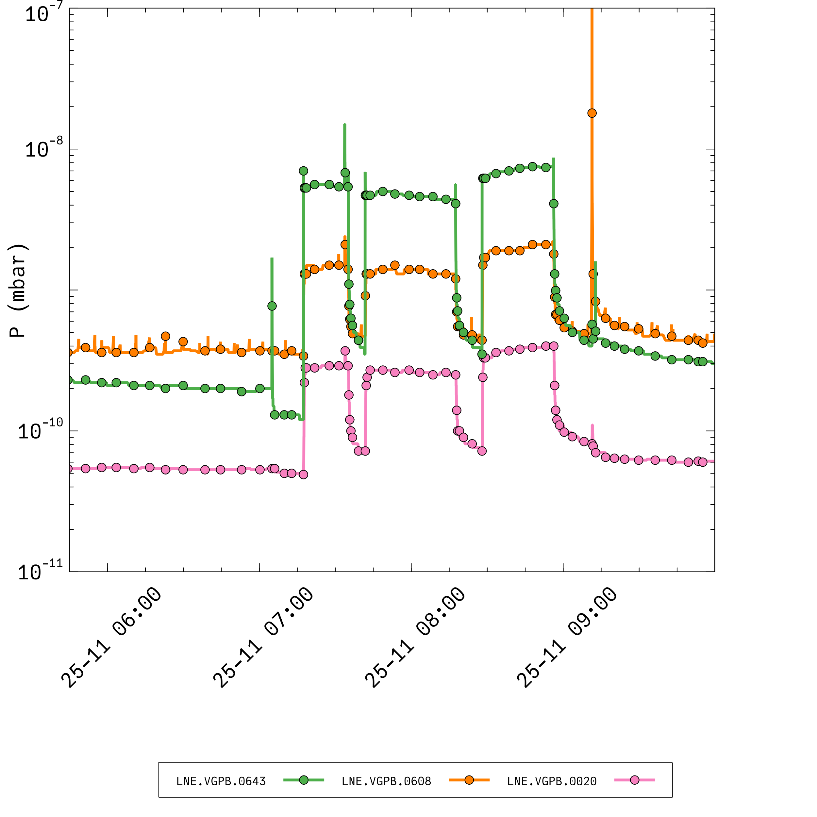
Example Helium propagation
LNE.VGPB.0020
LNE.VGPB.0608
LNE.VGPB.0643
ASACUSA

Slide 25
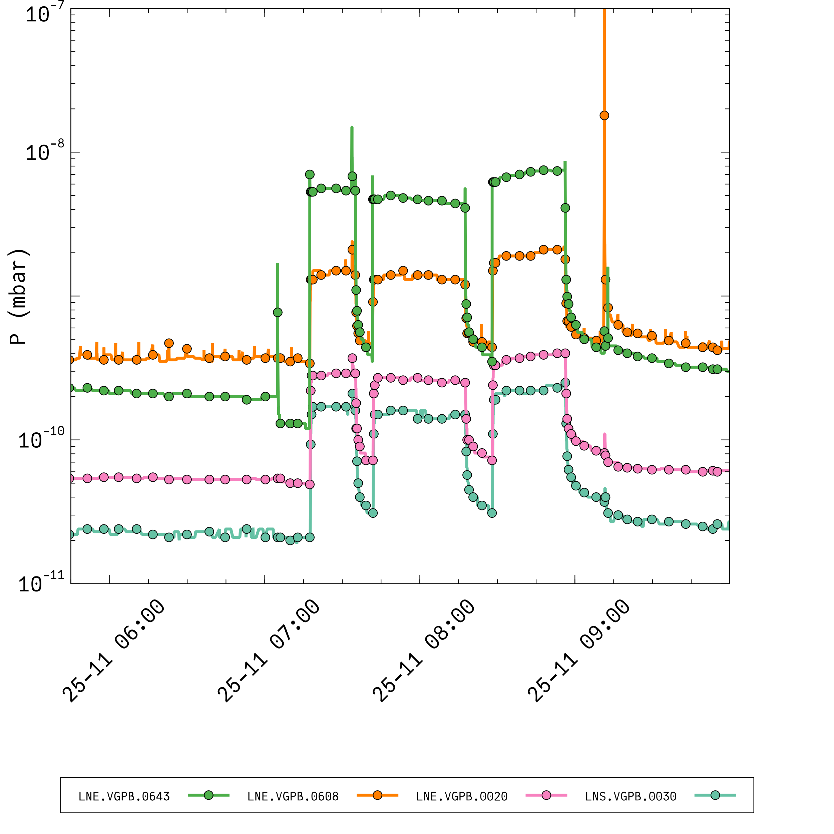
Example Helium propagation
LNS.VGPB.0030
LNE.VGPB.0020
LNE.VGPB.0608
LNE.VGPB.0643
ASACUSA

Slide 26
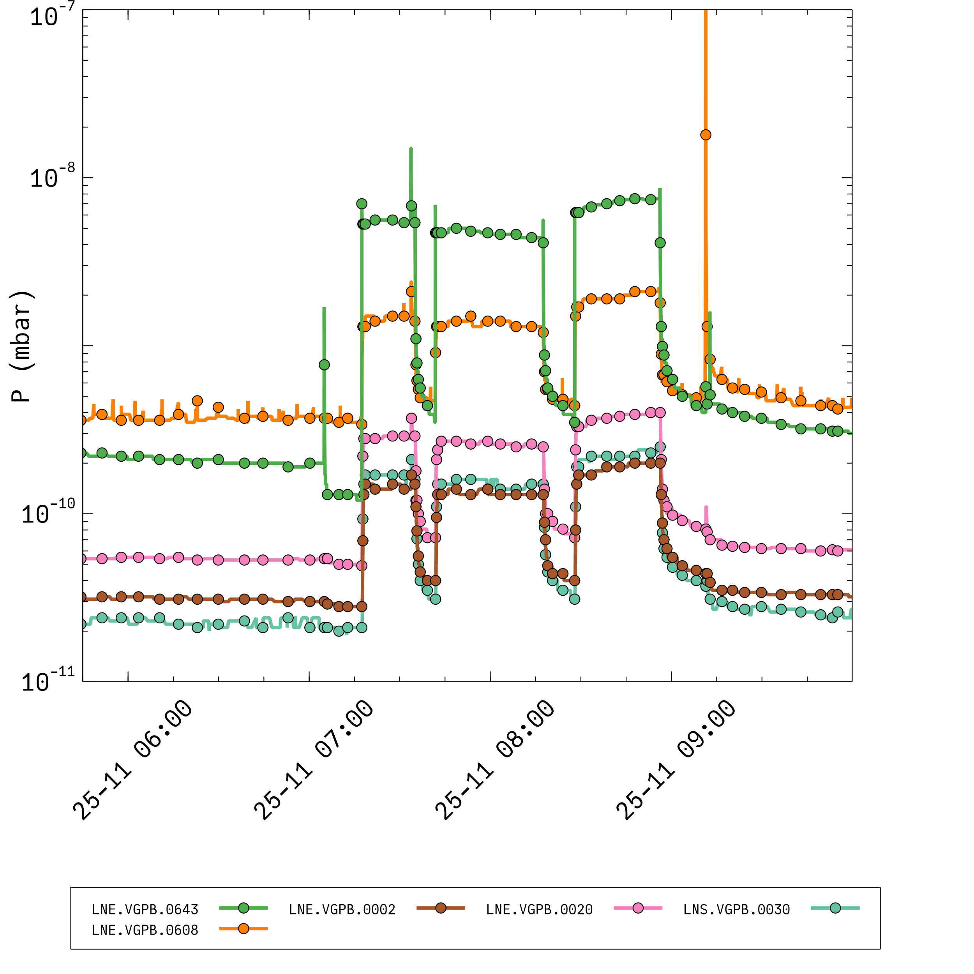
Example Helium propagation
LNS.VGPB.0030
LNE.VGPB.0020
LNE.VGPB.0002
LNE.VGPB.0608
LNE.VGPB.0643
ASACUSA

Slide 27
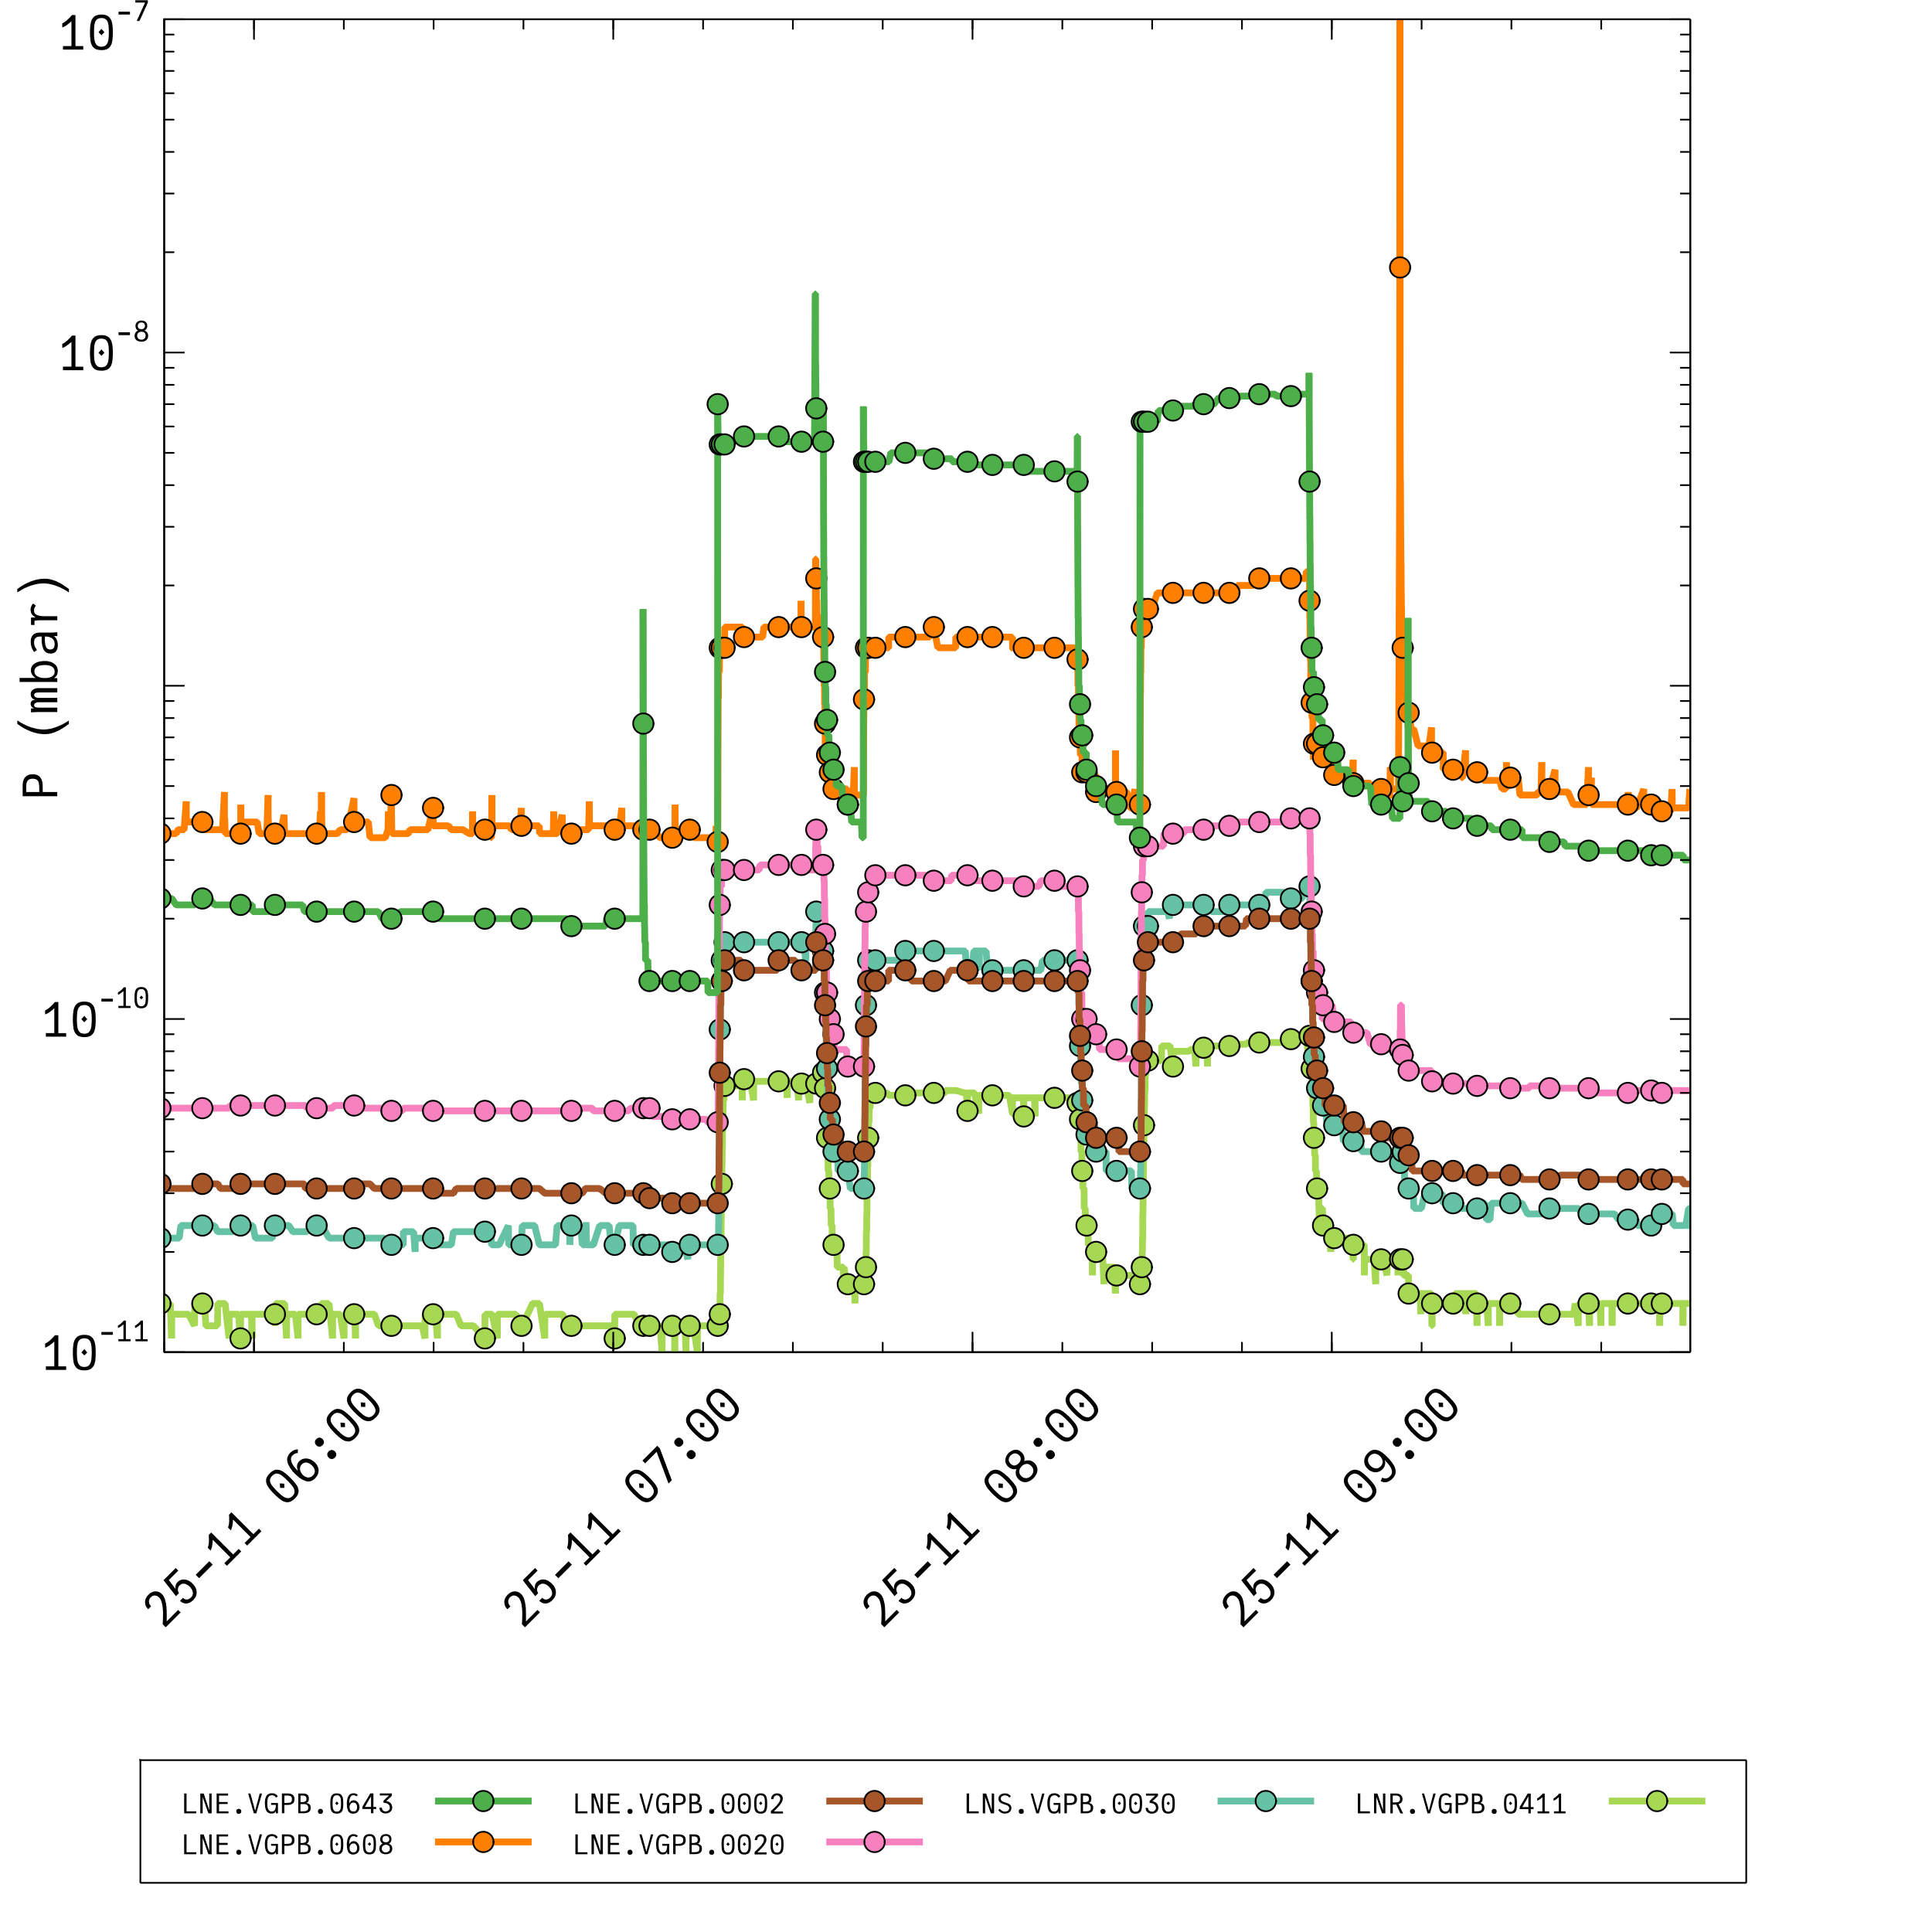
Example Helium propagation
LNS.VGPB.0030
LNE.VGPB.0020
LNE.VGPB.0002
LNE.VGPB.0608
LNR.VGPB.0411
LNE.VGPB.0643
ASACUSA

Slide 28
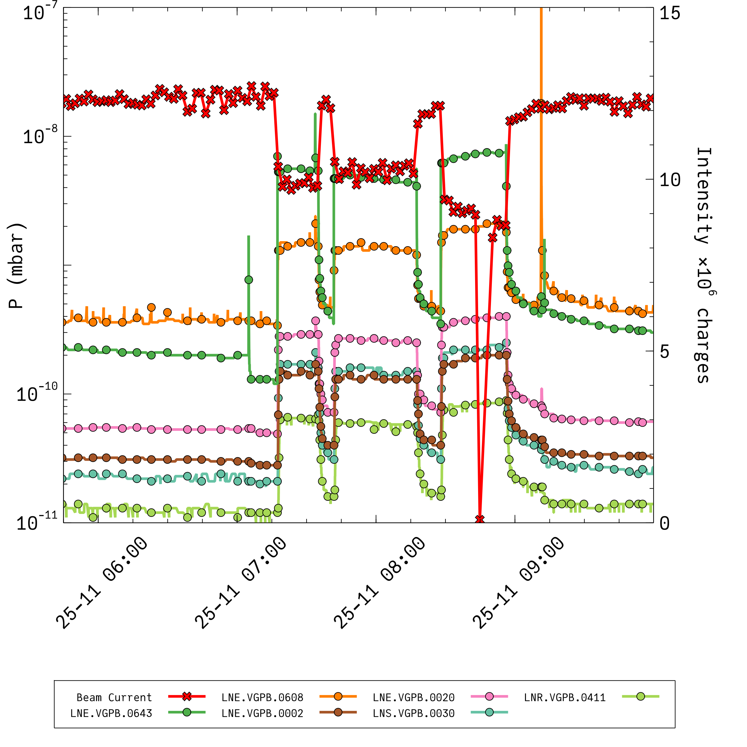
Example Helium propagation
LNS.VGPB.0030
LNE.VGPB.0020
LNE.VGPB.0002
LNE.VGPB.0608
LNR.VGPB.0411
LNE.VGPB.0643
ASACUSA

Slide 29

Example Helium propagation
≈ 20 m between the experiment and the ring
XHV machine not well suited for He pumping (chemical pumping)
7 times higher pressure at ELENA
>20% beam lost
LNS.VGPB.0030
LNE.VGPB.0020
LNE.VGPB.0002
LNE.VGPB.0608
LNR.VGPB.0411
LNE.VGPB.0643
ASACUSA

Slide 30

ISOLDE vacuum layout: MIRACLES at LA2
LA2

Slide 31

ISOLDE vacuum layout: MIRACLES at LA2
Offline ion source
Laser
Injection optics
Paul trap (300K) ➔ 10⁻² mbar
2-keV extraction
Quadrupole bender
30 deg bender
Reacceleration
2 keV → 50 keV
MR-ToF mirror
Optical detection region
MR-ToF mirror

Slide 32



ISOLDE vacuum layout: Helium propagation
Paul trap at 10⁻² mbar
Gas propagation along the line → ≈7×10⁻⁹ mbar at hand over point
Simulation to be cross checked with in situ measurements

Slide 33


ISOLDE vacuum layout
For the design of ISOLDE line main problems to address are outgassing and Helium propagation
Pumping He will require turbopumps (with high compression). Areas with high throughput and areas with limited ultimate He pressure (type of primary pump? ballast? Small booster TMP to increase compression ratio?)
[3] Handbook of Vacuum Technology, 1st ed. (John Wiley & Sons, Ltd, 2016)

Slide 34
Summary
Cryo-pumping concept validated by isotherm measurements. Mitigations (increase number of sites and cold shutter) will help to address the unknown behaviour at very low pressures
ELENA beam transfer line almost completed
Cross in front of PUMA trap validated against previous assumptions
ISOLDE beam line under definition.
Helium propagation can be an issue difficult to handle. Consider positions for extra pumping may be required along the line
Benchmarking of the simulations of MIRACLS at LA2 will help to define the pumping required in the line

Slide 35
Thank you!

