Slide 1





Optimisation of the MIRACLS components for MR-ToF mass separation
Franziska Maria Maier
CERN PhD Student

Slide 2
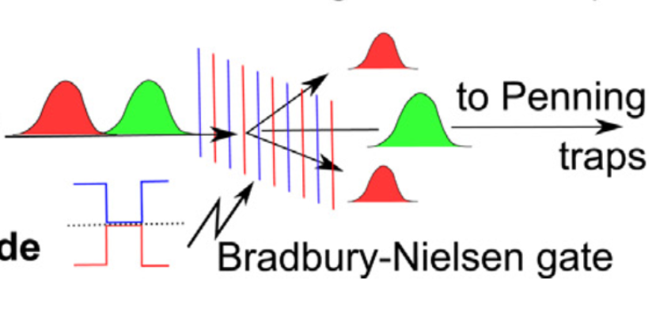
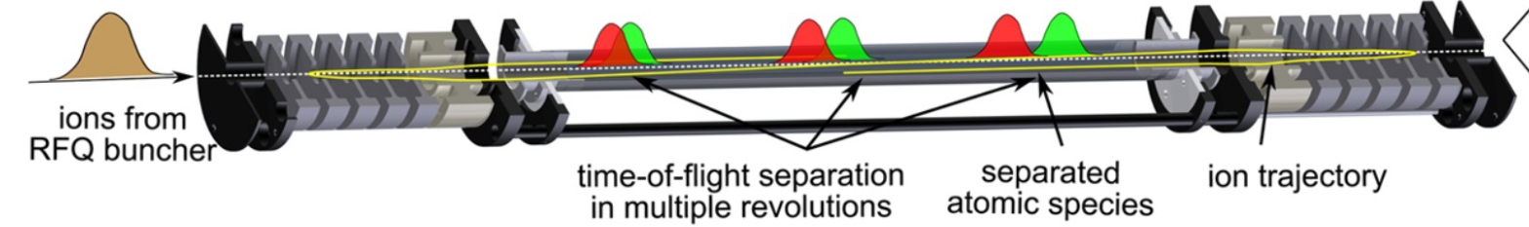
MR-ToF devices are highly selective mass separators.
Downstream experiments
Ion mixture
time-of-flight separation in multiple revolutions
separated ion species
ion trajectory
Fig. courtesy R. Wolf
Notes:
Pps pulse per second

Slide 3
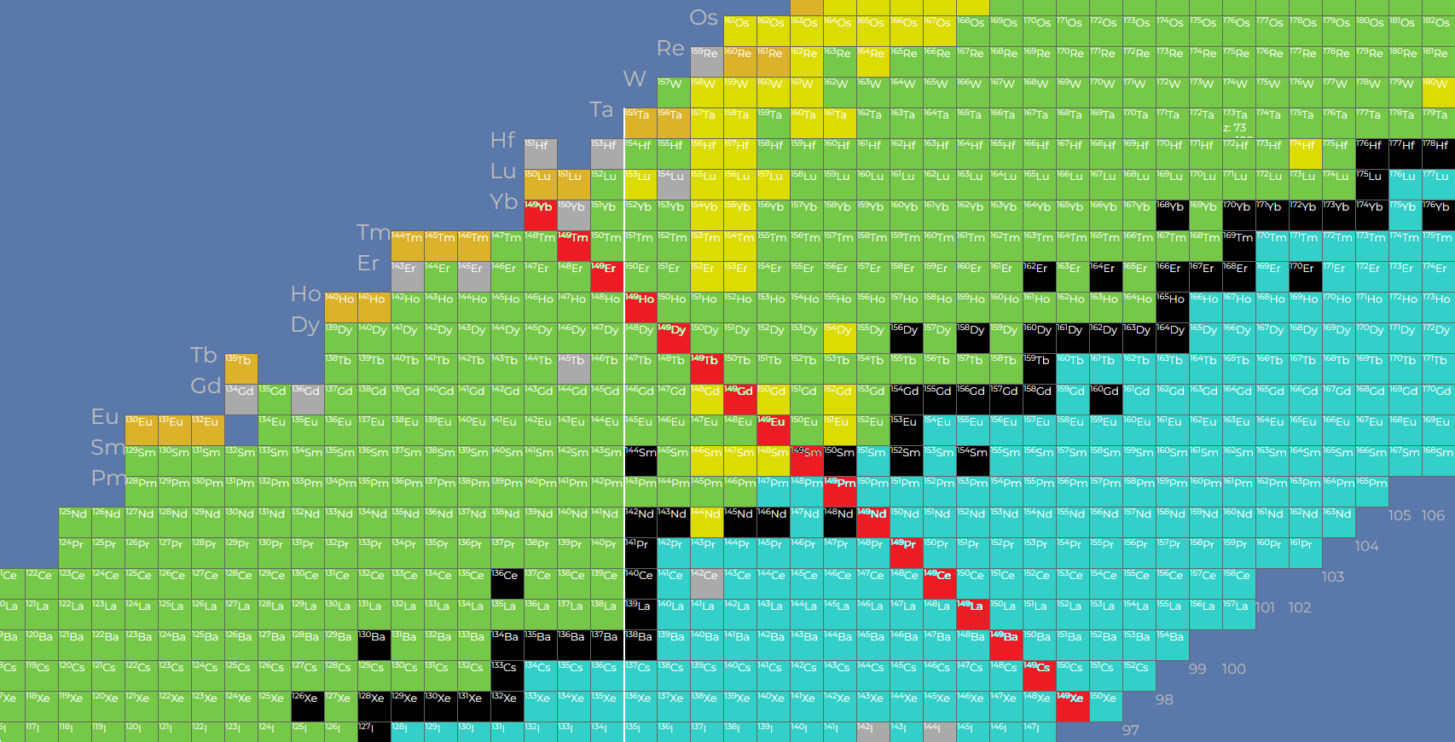
MR-ToF devices are highly selective mass separators.
Downstream experiments
Ion mixture
time-of-flight separation in multiple revolutions
separated ion species
ion trajectory
Fig. courtesy R. Wolf
A=149
Notes:
Pps pulse per second

Slide 4
MR-ToF devices are highly selective mass separators.
Downstream experiments
Ion mixture
time-of-flight separation in multiple revolutions
separated ion species
ion trajectory
Fig. courtesy R. Wolf
 | current MR-ToF devices | MIRACLS 30-keV Device | Magnetic mass separators
R = (2-3) x m/Δm | > 100,000 | > 100,000 | a few 1000
Processing time | (tens of) ms | 3 ms | continuous
Ion flux | ~10³-10⁷ ions/s depending on m/Δm | ~10⁵-10⁹ ions/s depending on m/Δm | 10¹³ pps
Notes:
Pps pulse per second
30,000 for next generation mass separators, CARIBU, SPIRAL2/DESIR, CANREB

Slide 5
MR-ToF devices are highly selective mass separators.
Downstream experiments
Ion mixture
time-of-flight separation in multiple revolutions
separated ion species
ion trajectory
Fig. courtesy R. Wolf
 | current MR-ToF devices | MIRACLS 30-keV Device | Magnetic mass separators
R = (2-3) x m/Δm | >100,000 | > 100,000 | a few 1000
Processing time | (tens of) ms | 3 ms | continuous
Ion flux | ~10³-10⁷ ions/s depending on m/Δm | ~10⁵-10⁹ ions/s depending on m/Δm | 10¹³ pps
Notes:
Pps pulse per second
30,000 for next generation mass separators, CARIBU, SPIRAL2/DESIR, CANREB

Slide 6
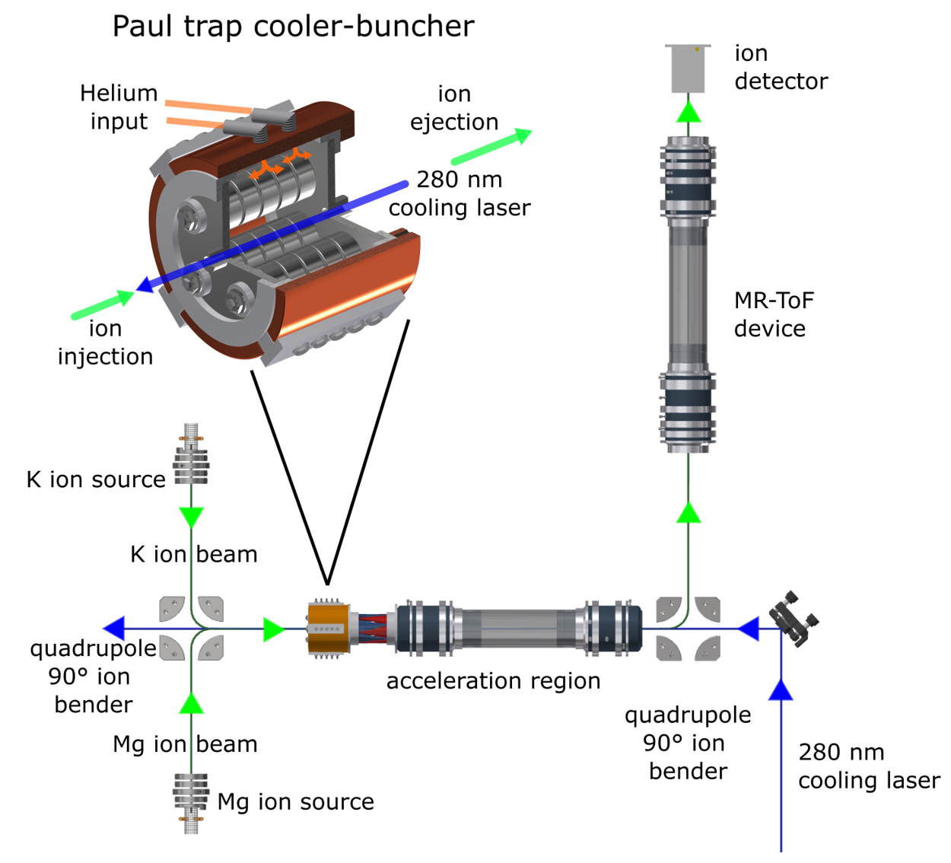
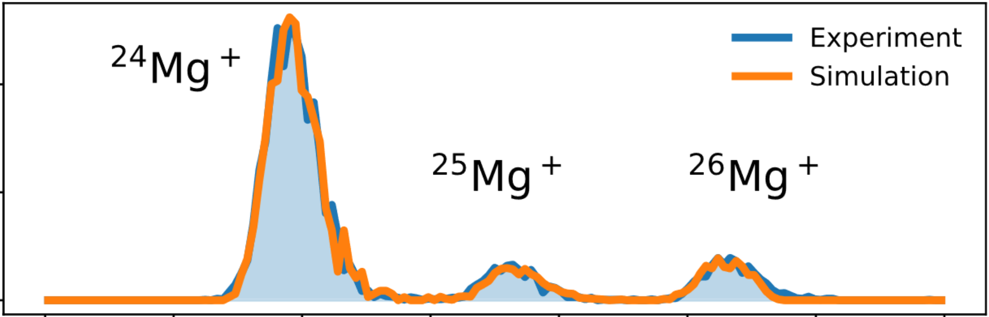
MR-ToF devices require bunched beams.
Paul-trap cooler-buncher installed upstream.
ions
cooling laser
Counts
Time-of-flight
S. Sels, F. Maier et al., Phys. Rev. Research 4, 033229 (2022).
Notes:
Properties of bunched beams define performance of MR-ToF devices , small peak width for fast R sep
Additionally we also see that our simulations of the cooling process are in good agreement with exp. data.

Slide 7
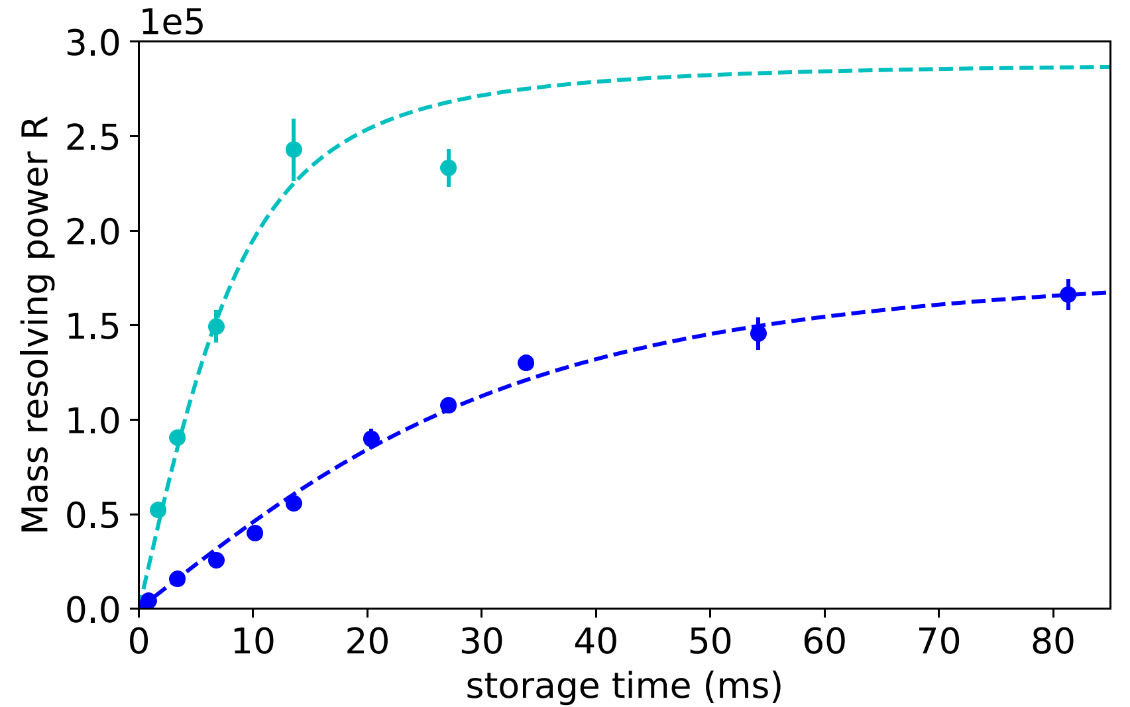
MR-ToF mass resolving power
∆t₀ mainly defines how long it takes to reach given R.
Paul trap setting 1
∆t₀=19 ns
Simulations (dashed) and experiment (points) are in good agreement.
Paul trap setting 2
∆t₀=106 ns

Slide 8
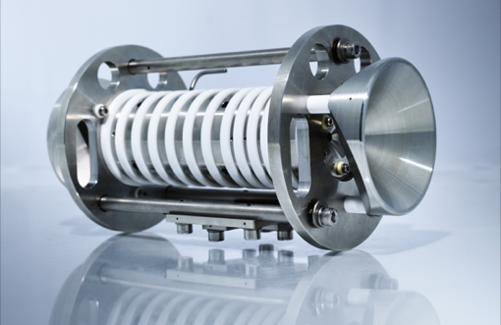
Development of a new Paul trap
Cern photograph, 2021.

Slide 9
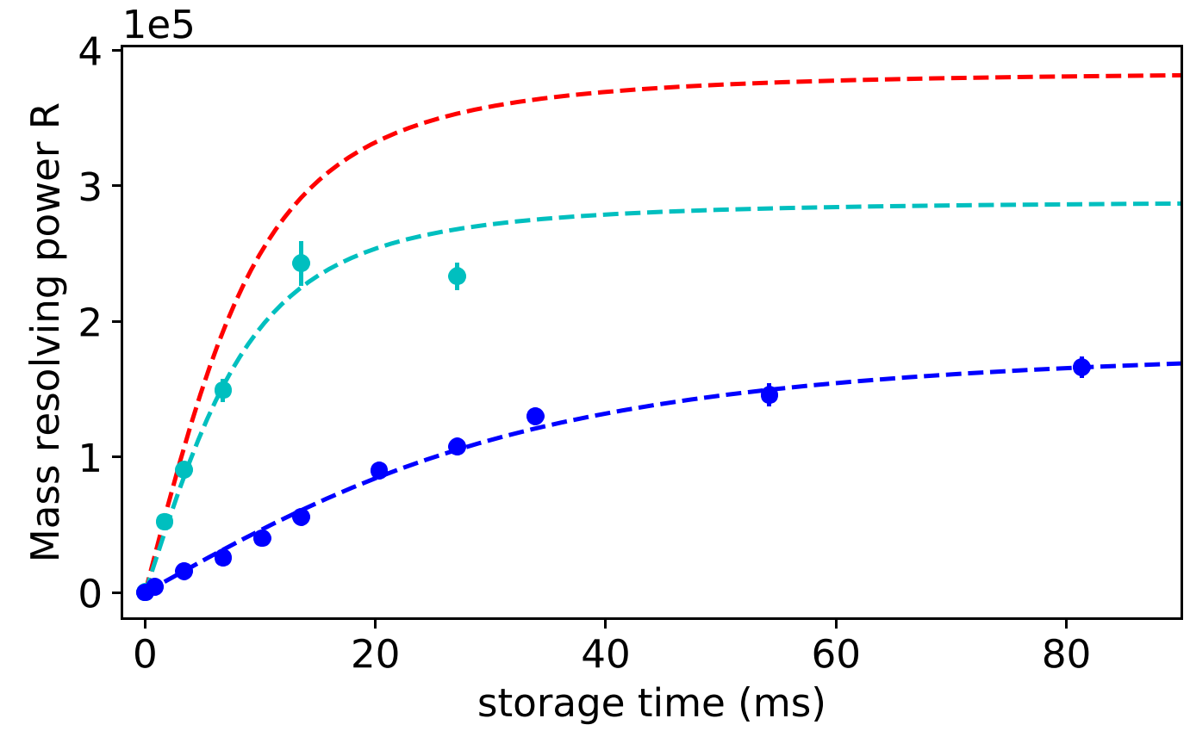
MR-ToF mass resolving power
R=10⁵ is reached in 3 ms.
30-keV
1.5 keV, setting 1
1.5 keV, setting 2

Slide 10
MR-ToF mass resolving power
Finally reachable R is limited by broadening effects of ∆t₀ over revolution number.
30-keV
1.5-keV, settings 2
1.5-keV, settings 1

Slide 11
MR-ToF mass resolving power
30-keV
1.5-keV, settings 2
isobaric pure ¹²⁸Sn
1.5-keV, settings 1
isobaric pure ¹³²Sn
isobaric pure ²⁸⁻³⁴Mg
Notes:
¹³²Sn vs ¹³²Sb:
m/Δm = 40,000
¹³²Sn vs ¹³²Cs:
m/Δm = 12,000
¹³²Sn vs ¹³²Sb:
m/Δm = 94,000
Mg vs Na (A=28-34):
m/Δm < 2,500

Slide 12
MR-ToF devices are highly selective mass separators.
Downstream experiments
Ion mixture
time-of-flight separation in multiple revolutions
separated ion species
ion trajectory
Fig. courtesy R. Wolf
 | current MR-ToF devices | MIRACLS 30-keV Device | Magnetic mass separators
R = (2-3) x m/Δm | > 100,000 | > 100,000 | a few 1000
Processing time | (tens of) ms | 3 ms | continuous
Ion flux | ~10³-10⁷ ions/s depending on m/Δm | ~10⁵-10⁹ ions/s depending on m/Δm | 10¹³ pps
Notes:
Pps pulse per second
30,000 for next generation mass separators, CARIBU, SPIRAL2/DESIR, CANREB

Slide 13
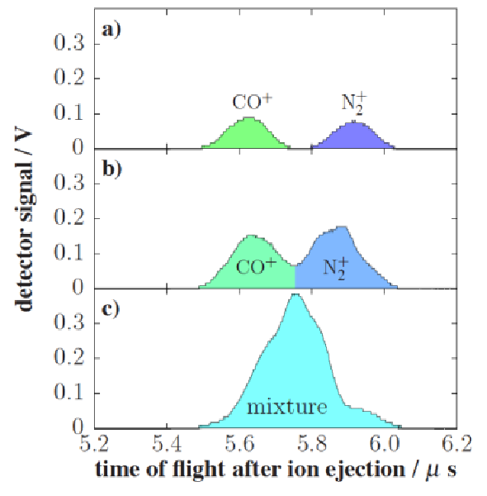
Coulomb interactions limit ion flux.
Experimental studies with m/Δm ≈ 2500:
A few 100 ions/bunch
Peak coalescence effect
Ion throughput is limited.
Counts
Ion intensity
A few 1000 ions/bunch
Time-of-Flight (µs)
L. Schweikhard, X LASNPA, 2013.
Notes:
We see that the limited ion flux is hence a real challenge for MR-ToF device. Before we now tackle this challenge, we will talk about…

Slide 14
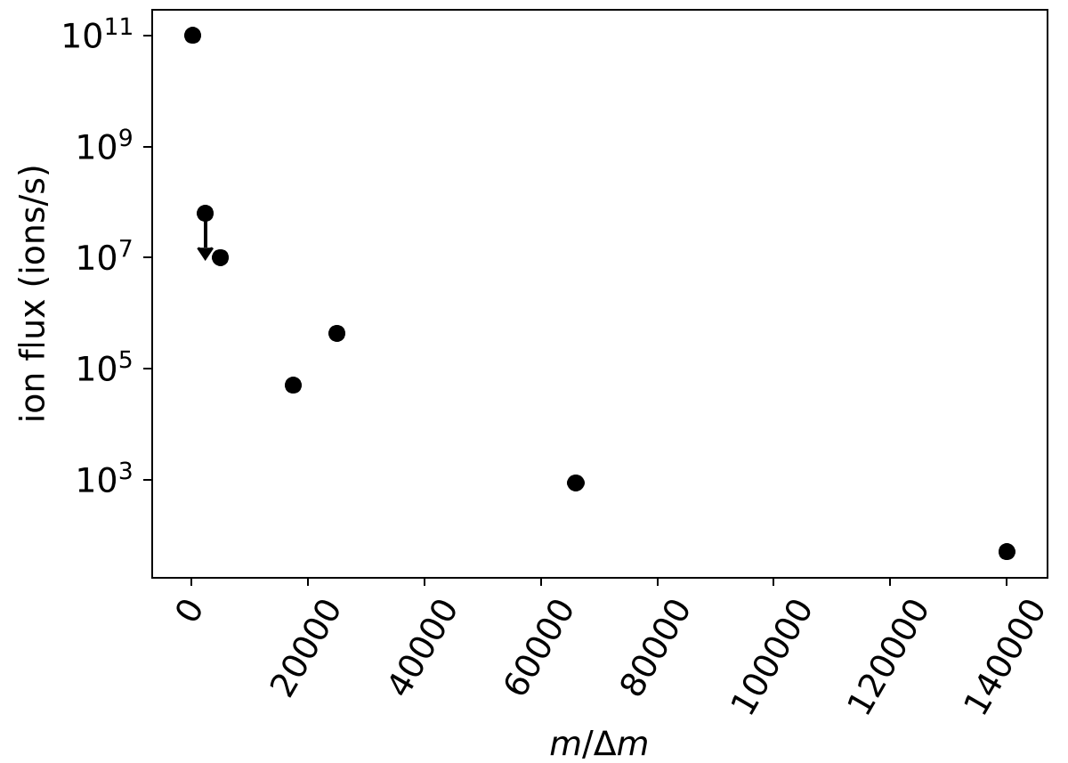
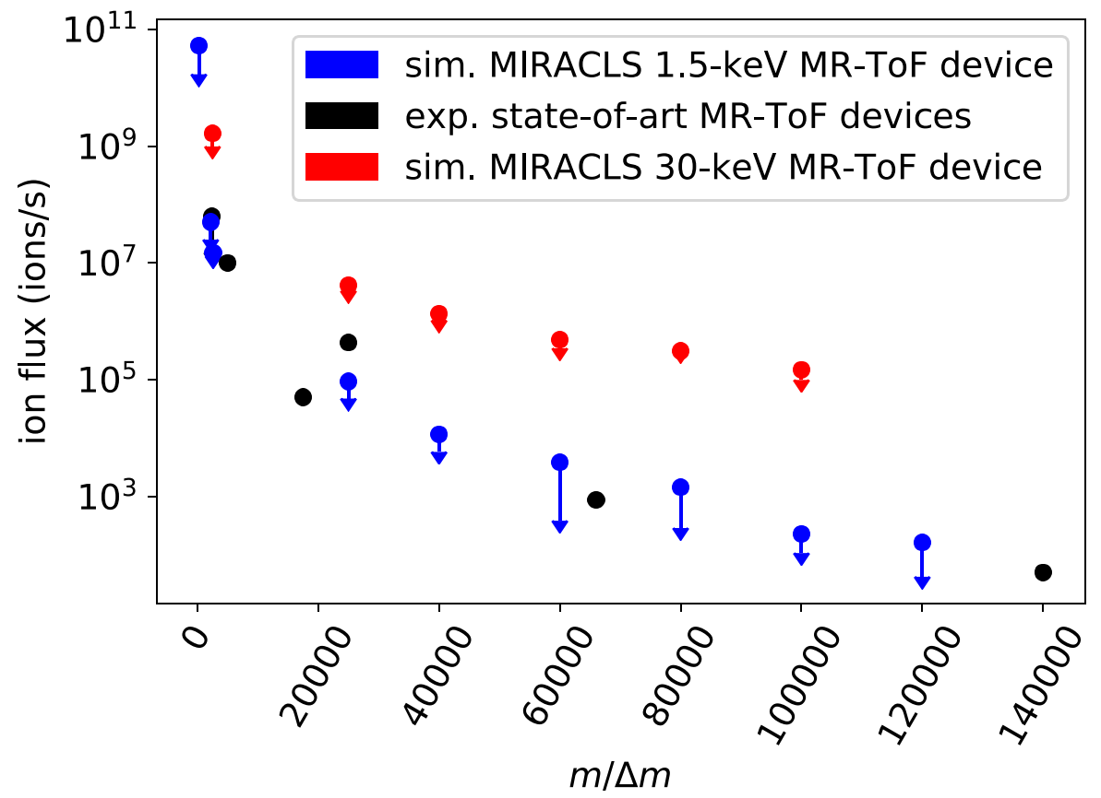
MR-ToF ion flux
Existing low-energy devices
0 20k 40k 60k 80k 100k 120k 140k
m/Δm

Slide 15
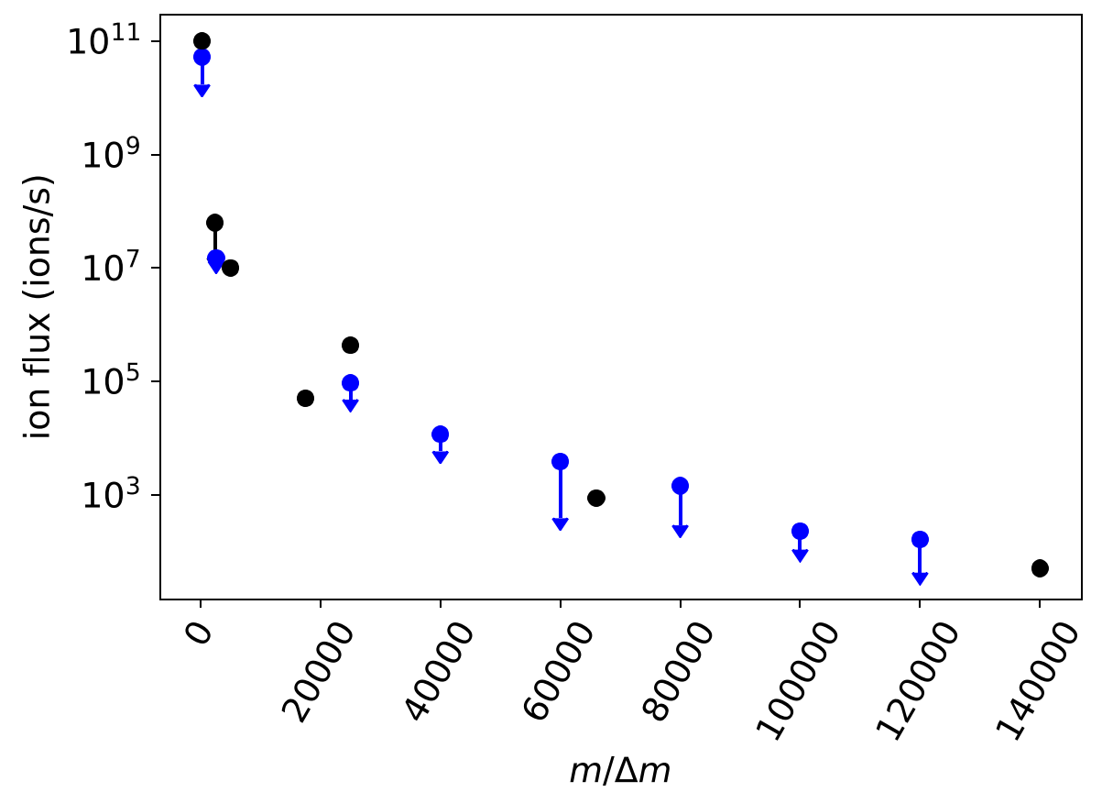
MR-ToF ion flux
Existing low-energy devices
1.5-keV MIRACLS simulated
0 20k 40k 60k 80k 100k 120k 140k
m/Δm

Slide 16
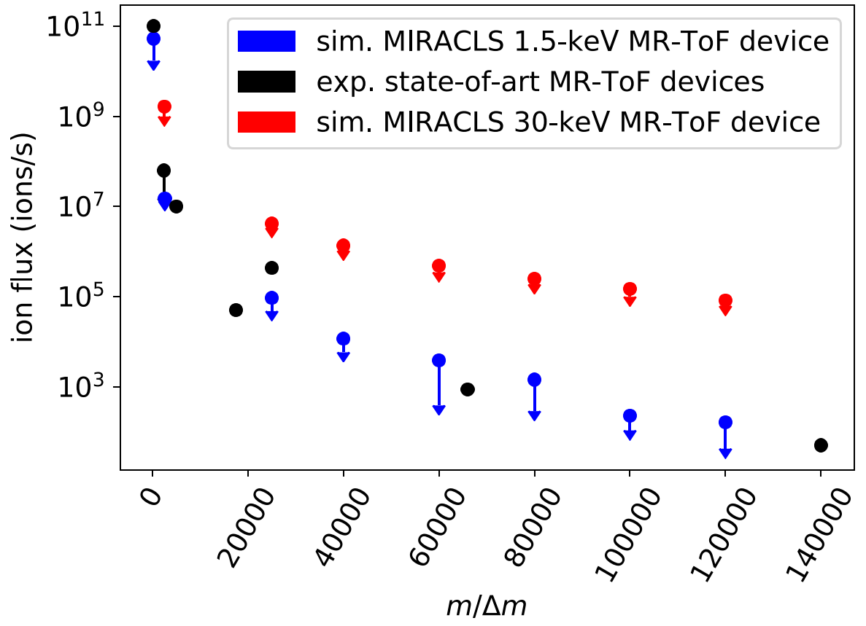
MR-ToF ion flux
Existing low-energy devices
1.5-keV MIRACLS simulated
30-keV MIRACLS simulated
0 20k 40k 60k 80k 100k 120k 140k
0 20k 40k 60k 80k 100k 120k 140k
m/Δm

Slide 17
MR-ToF ion flux
Existing low-energy devices
isobaric pure ²⁸⁻³⁴Mg
1.5-keV MIRACLS simulated
30-keV MIRACLS simulated
isobaric pure ¹³²Sn
isobaric pure ¹²⁸Sn
0 20k 40k 60k 80k 100k 120k 140k
0 20k 40k 60k 80k 100k 120k 140k
m/Δm

Slide 18
Simulation Results
 | MIRACLS 30-keV Device
R = (2-3) x m/Δm | > 100,000
Processing time | 3 ms
Ion flux | > 10⁵-10⁹ ions/s depending on m/Δm

Slide 19
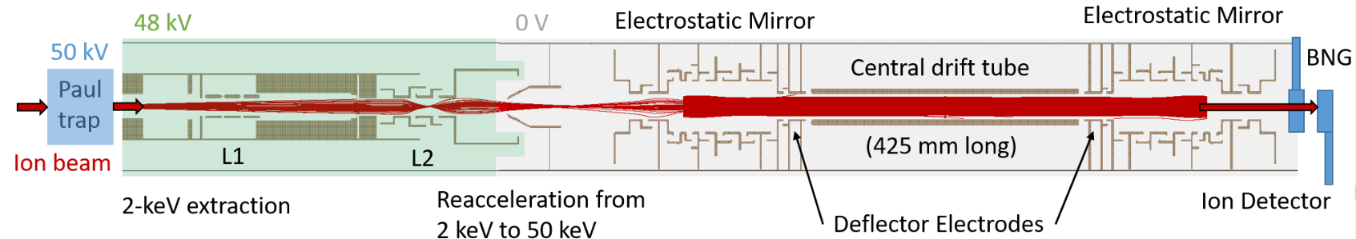
The new ISOLDE MR-ToF mass separator
Floor space: ca. 3 m x 1 m

Slide 20
The new ISOLDE MR-ToF mass separator
Floor space: ca. 3 m x 1 m
Identical to MIRACLS 30-keV MR-ToF device for CLS studies (except of drift tube length and shortened injection optics)
Worldwide first MR-ToF device operating at ion beam energies exceeding a few keV

Slide 21
Summary
 | MIRACLS 30-keV Device
R = (2-3) x m/Δm | > 100,000
Processing time | 3 ms
Ion flux | > 10⁵-10⁹ ions/s depending on m/Δm
Paul trap settings
Injection optics
MR-ToF settings
30-keV beam energy

Slide 22
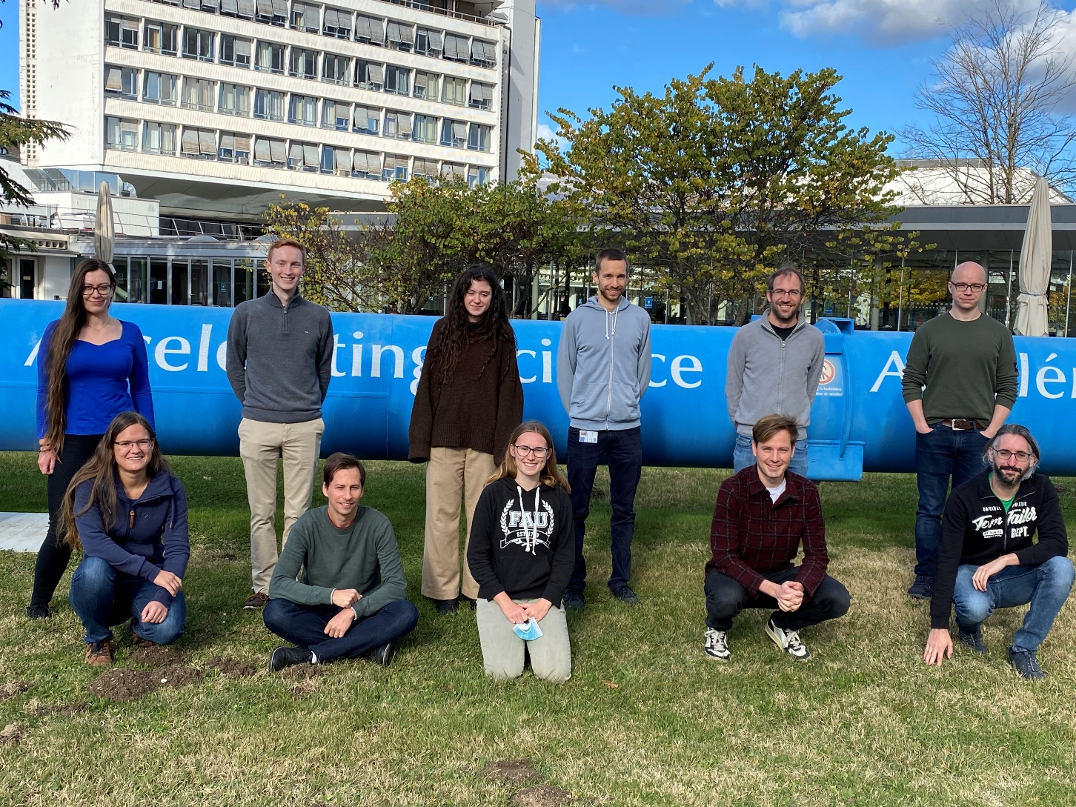

Thanks!
Relevant literature:
S. Sels, F. Maier et al., Phys. Rev. Research 4, 033229 (2022)
F. Maier, M. Vilen et al., NIM A 1048, 167927 (2023).
F. Maier et al, to be submitted to NIM A.
F.M. Maier (CERN, U. Greifswald)
F. Buchinger (McGill University)
L. Croquette (McGill University)
P. Fischer (U. Greifswald)
S. Freeman (CERN)
H. Heylen (CERN)
F. Hummer (CERN, McGill University)
C. Kanitz (CERN)
S. Lechner (CERN, McGill University)
E. Leistenschneider (CERN)
G. Neyens (CERN, KU Leuven)
P. Plattner (CERN)
A. Roitman (McGill University)
M. Rosenbusch (Wako)
L. Schweikhard (U. Greifswald)
S. Sels (CERN)
M. Vilen (CERN)
F. Wienholtz (CERN)
S. Malbrunot-Ettenauer (CERN, TRIUMF, Toronto)
https://miracls.web.cern.ch/

Slide 23
Simulated performance
30-keV, ~300 K
1.5-keV MIRACLS simulated
Existing low-energy devices
30-keV MIRACLS simulated
1.5-keV, Doppler cooling
1.5-keV, ~300 K
0 20k 40k 60k 80k 100k 120k 140k

Slide 24
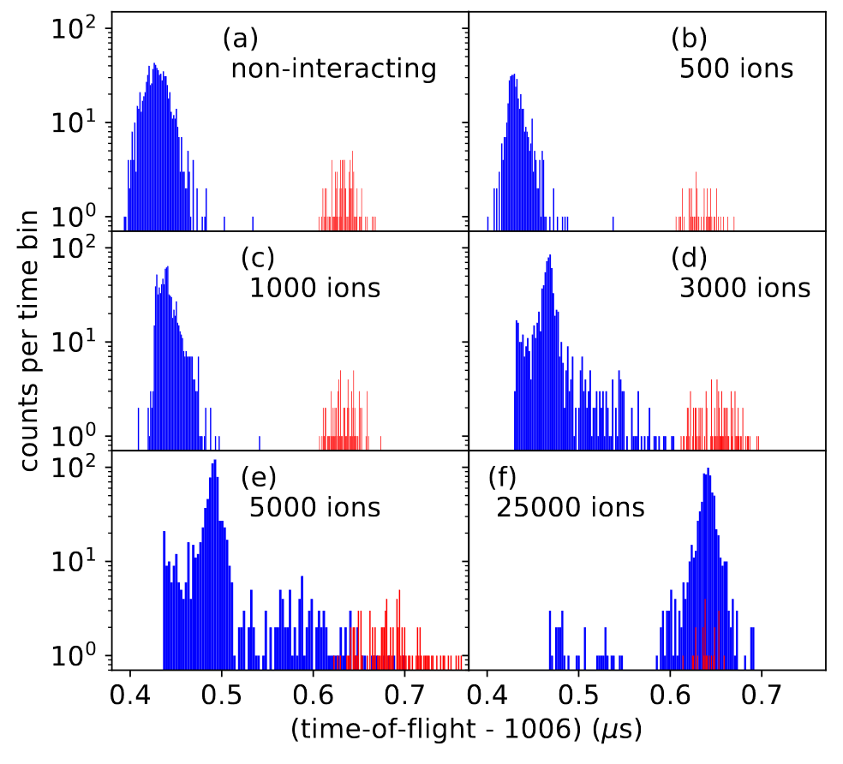
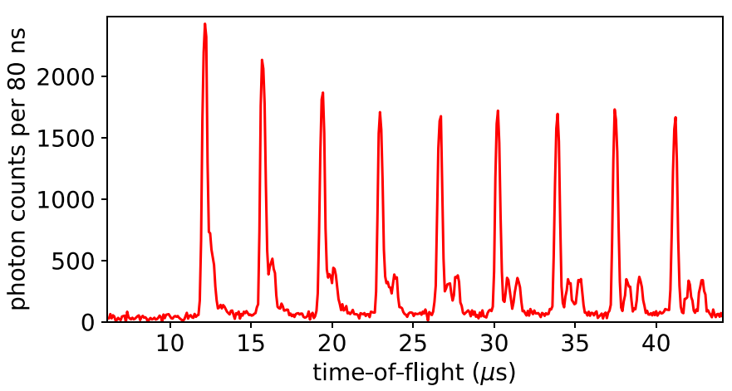
Study of the interaction of two ensembles of different ion species
Simulations with m/Δm ≈ 2500:
Peak coalescence effect
Ion throughput is limited.

Slide 25
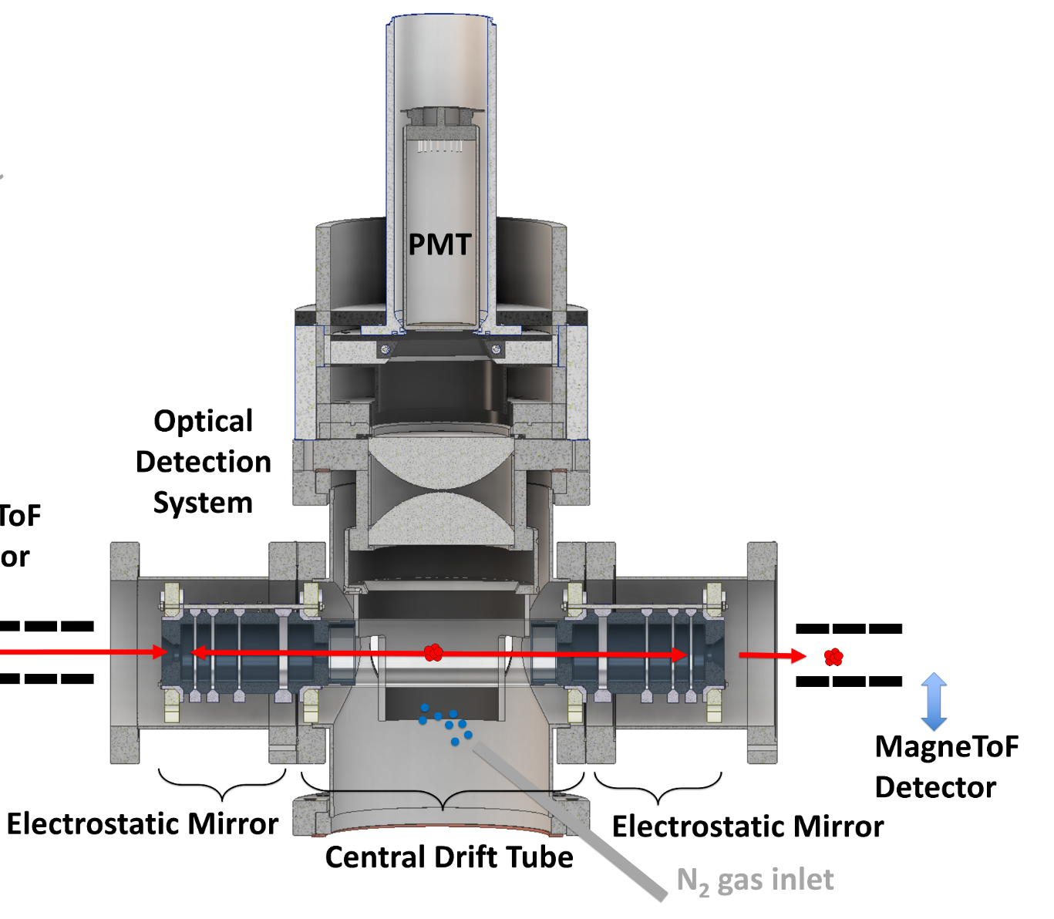
Space charge studies in MIRACLS low-energy setup.
Collisional excitation measurements:
Inelastic collisions between Mg ions and residual gas particles → fluorescence
Notes:
Study large cloud of ions by technique of coll exc.

Slide 26
Collisional excitation measurements
0th
²⁴Mg
1st
²⁵Mg
2nd
4th
3rd
Tracking of the evolution of the ion bunch’s temporal width over revolution number
Understand ion dynamics within MR-ToF device for varying numbers of stored ions
²⁶Mg
S. Lechner et al., Hyperfine Interact. 240, 95 (2019).
F. Hummer, BSc thesis, 2019.

Slide 27
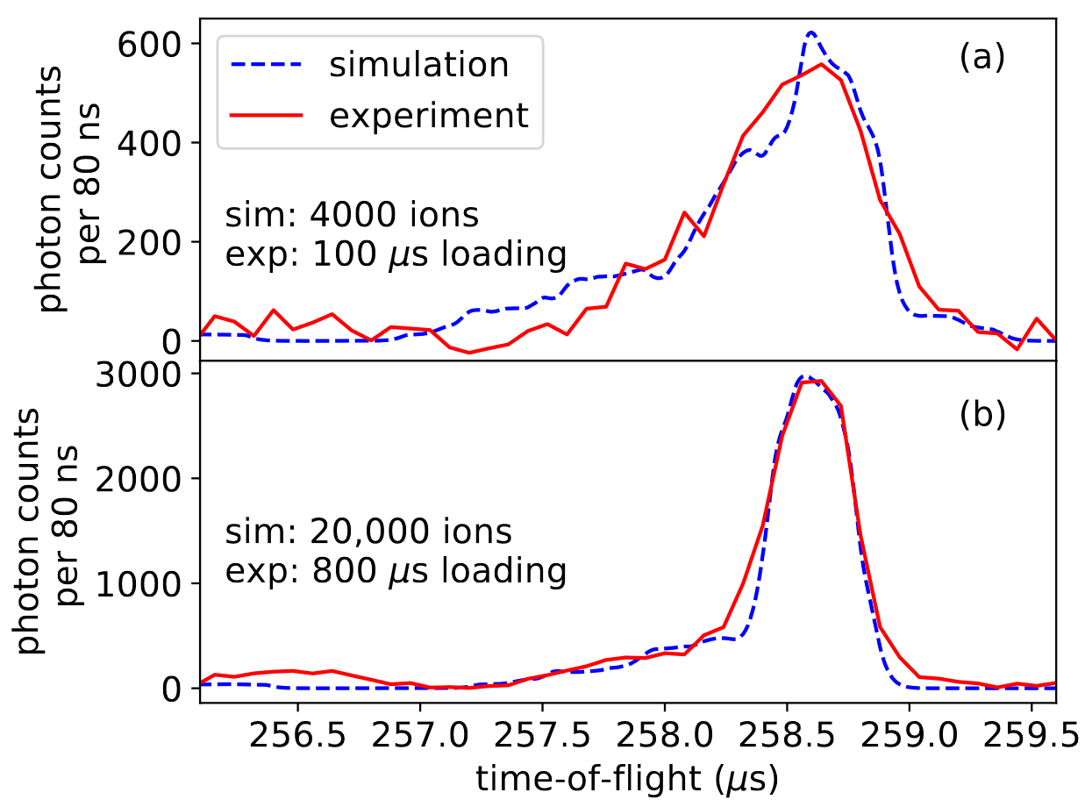
Simulations vs experiment
²⁴Mg⁺, 34th revolution
≈ 4000 ions
Time of flight (µs)
≈ 20,000 ions

Slide 28
Simulations vs experiment
²⁴Mg⁺, 34th revolution
Coulomb interactions influence ion dynamics, e.g. selfbunching effect for large ion densities.
≈ 4000 ions
≈ 20,000 ions
Time of flight (µs)
Notes:
Simulations reproduce space charge effects.

Slide 29
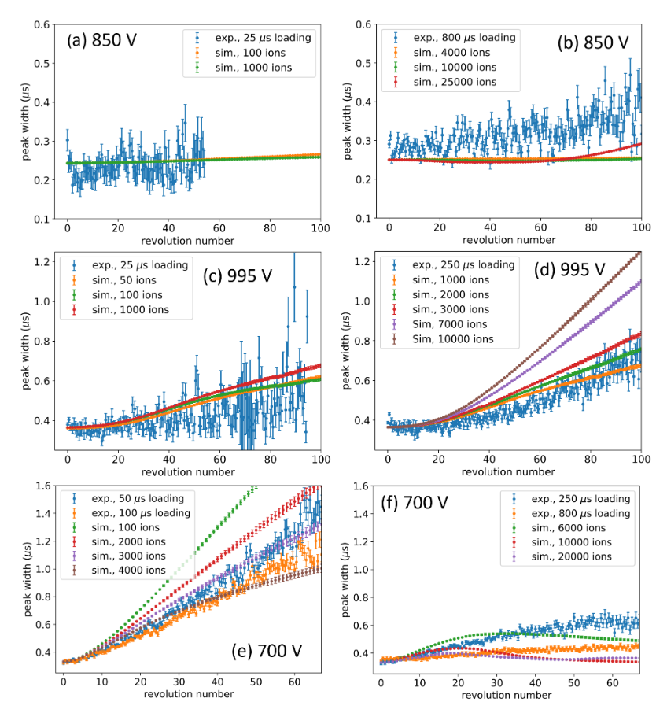
Simulations vs experiment for different operation modes.
Isochronous mode: dt₁/dE ≈ 0
Smallest dispersions/turn
largest mass resolving power
typical mode for mass measurements and separation
low N
high N
Dispersive mode: dt₁/dE < 0
low N
high N
Selfbunching mode: dt₁/dE > 0
high N
low N

Slide 30
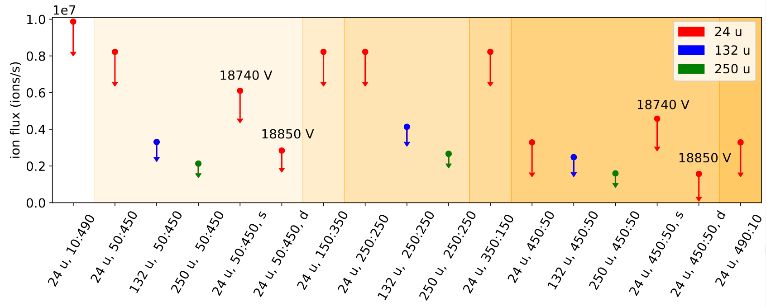
Dependence on mass and abundance ratio is very small.
m/Δm = 25,000

Slide 31
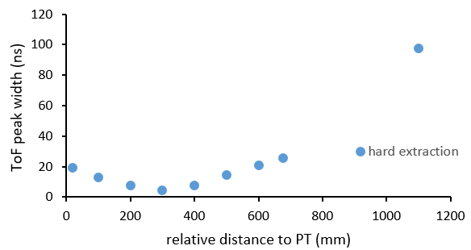
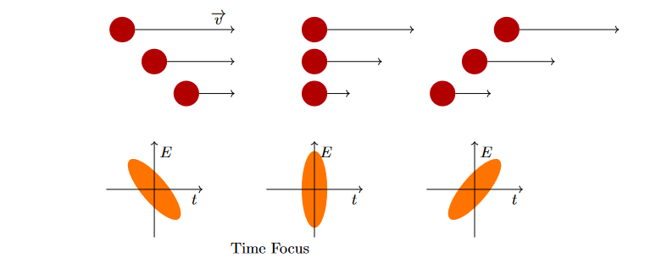
Place MR-ToF device close to ToF focus.
Time focus
Figure courtesy: A. Finlay

Slide 32
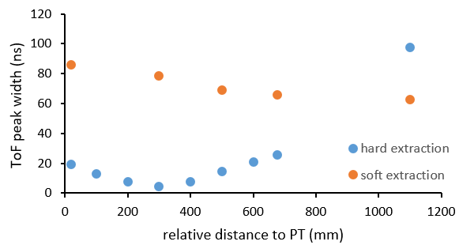
Place MR-ToF device close to ToF focus.

Slide 33
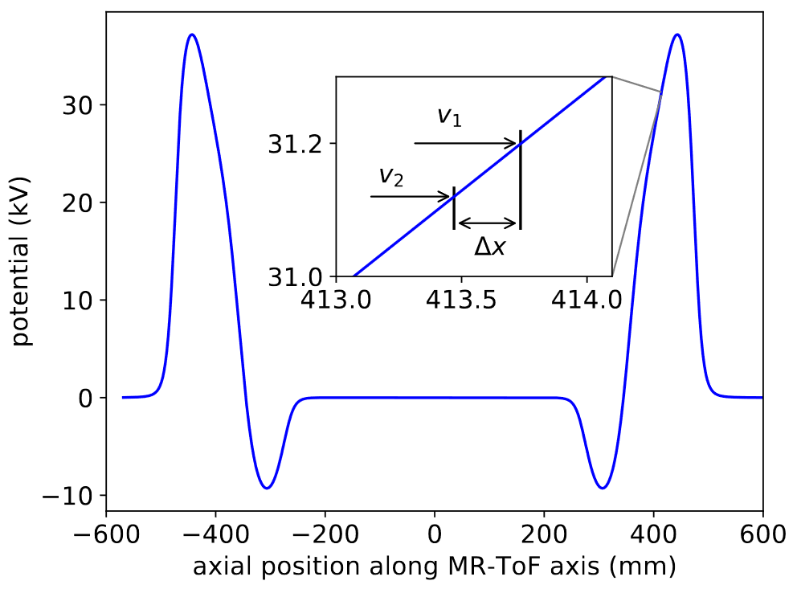
Isochronous operation
Penetration depth difference ∆x needs to allow to achieve dt₁/dE ≈ 0.
Only possible for certain MR-ToF geometries and potential distributions.
Energy spread tolerance: ΔE/E ≈ 1%

Slide 34
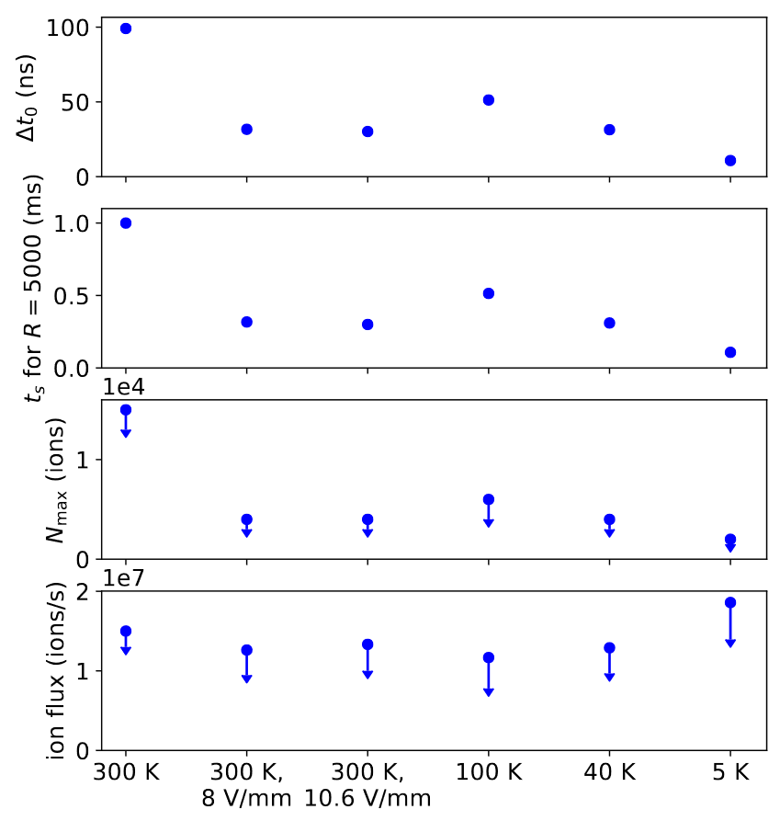
Does faster MR-ToF mass separation increase ion flux?
Exemplary simulation studies with m/Δm=2500, m=24 u, abundance ratio 9:1
Initial time spread ∆t₀ mainly governed by Paul trap preparation
Storage time t_{s} needed to obtain R=5000
Max. ion number N_{max} to be able to mass separate > 93% of the ions
Ion flux = N_{max}/t_{s} (as defined for our purposes)

Slide 35
Does faster MR-ToF mass separation increase ion flux?
Exemplary simulation studies with m/Δm=2500, m=24 u, abundance ratio 9:1
Initial time spread ∆t₀ mainly governed by Paul trap preparation
Storage time t_{s} needed to obtain R=5000
Max. ion number N_{max} to be able to mass separate > 93% of the ions
Ion flux = N_{max}/t_{s} (as defined for our purposes)

Slide 36
Does faster MR-ToF mass separation increase ion flux?
Exemplary simulation studies with m/Δm=2500, m=24 u, abundance ratio 9:1
Initial time spread ∆t₀ mainly governed by Paul trap preparation
Storage time t_{s} needed to obtain R=5000
Max. ion number N_{max} to be able to mass separate > 93% of the ions
Ion flux = N_{max}/t_{s} (as defined for our purposes)

Slide 37

Does faster MR-ToF mass separation increase ion flux?
Exemplary simulation studies with m/Δm=2500, m=24 u, abundance ratio 9:1
Initial time spread ∆t₀ mainly governed by Paul trap preparation
Storage time t_{s} needed to obtain R=5000
Max. ion number N_{max} to be able to mass separate > 93% of the ions
Ion flux = N_{max}/t_{s} (as defined for our purposes)

Slide 38

Does a larger beam energy increase ion flux?
Existing low-energy devices
A=24
A=28-152
A=132
1.5-keV MIRACLS simulated
30-keV MIRACLS simulated
0 20k 40k 60k 80k 100k 120k 140k
0 20k 40k 60k 80k 100k 120k 140k
m/Δm

Slide 39
Important notes
Simulated dispersions/turn are multiplied by factor 3 to achieve a good agreement with exp. data for all shown figures of mass resolving power versus storage time. This mismatch is attributed to residual gas present in the experimental setup but not in the simulations.

