Slide 1


Detecting Axion Dark Matter with Phonons and Magnons
Tanner Trickle
with Andrea Mitridate, Zhengkang Zhang, and Kathryn M. Zurek
PITT IQ Initiative: Axions, Fundamental and Synthetic – April 7th, 2023
[2005.10256] Detectability of Axion Dark Matter with Phonon Polaritons and Magnons (arxiv.org)

Slide 2
Outline
Phonons and magnons for dark matter direct detection
Axion absorption on phonons
Axion absorption on magnons

Slide 3
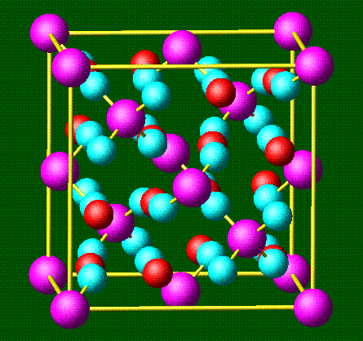


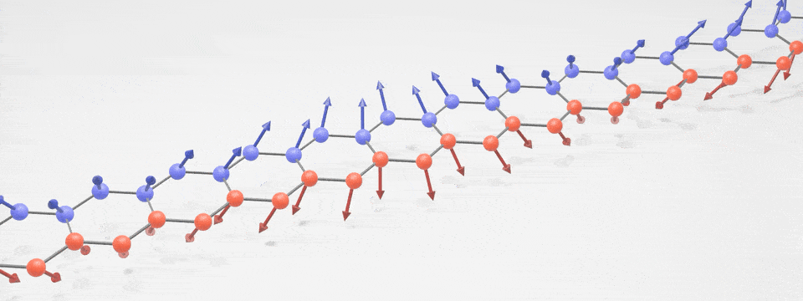


What are phonons and magnons?
Words: Collective motion of ions and spins, respectively
Pictures:
Equations:

Slide 4
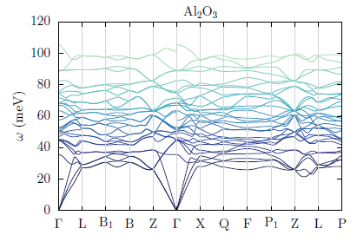
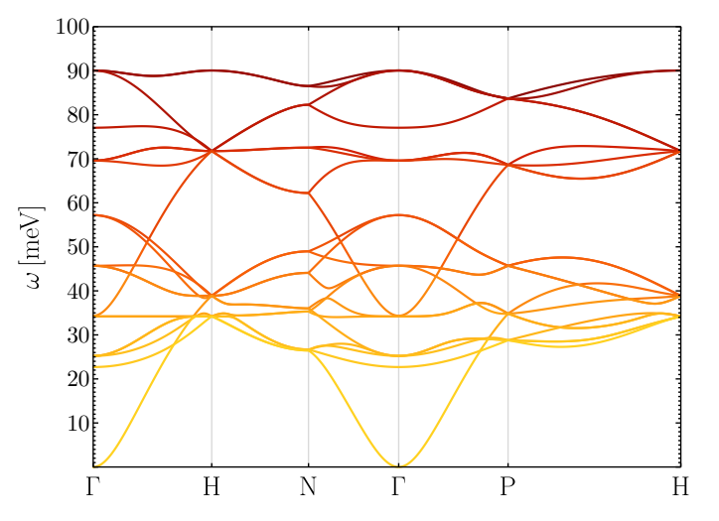
What are phonons and magnons?
Phonons
Magnons

Slide 5
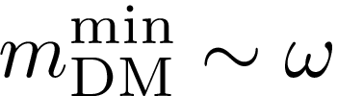
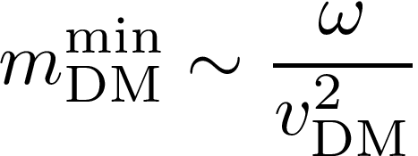
Why are they useful for detection of DM?
Phonons
Magnons
Kinematics
Absorption
Scattering
Lower energy excitations allow searching for lower mass DM

Slide 6




Why are they useful for detection of DM?
Phonons
Magnons
Electronic ionization
XENON
DarkSide
Electronic excitations
DAMIC
SENSEI
SuperCDMS
Edelweiss
CDEX
Collective Excitations
Phonons
Magnons
Axion quasiparticles
???

Slide 7
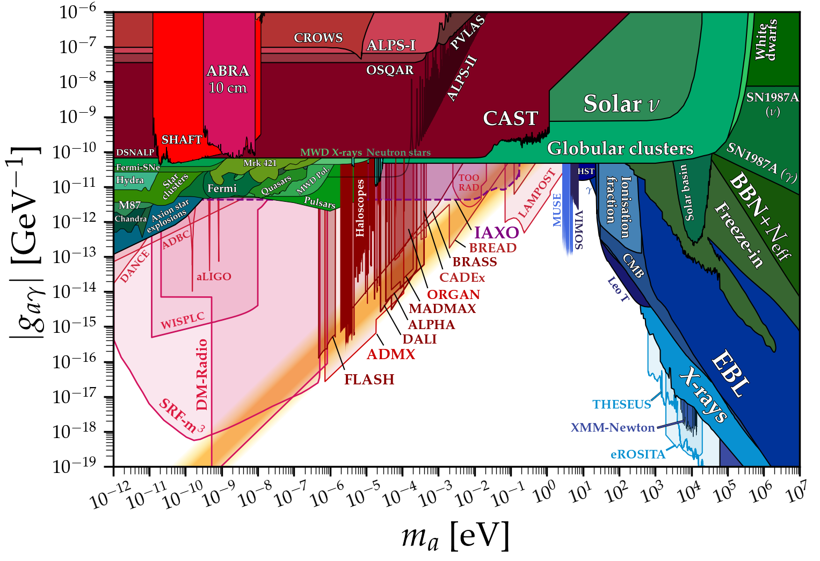

Why are they useful for detection of axions?
Resonant cavities

Slide 8
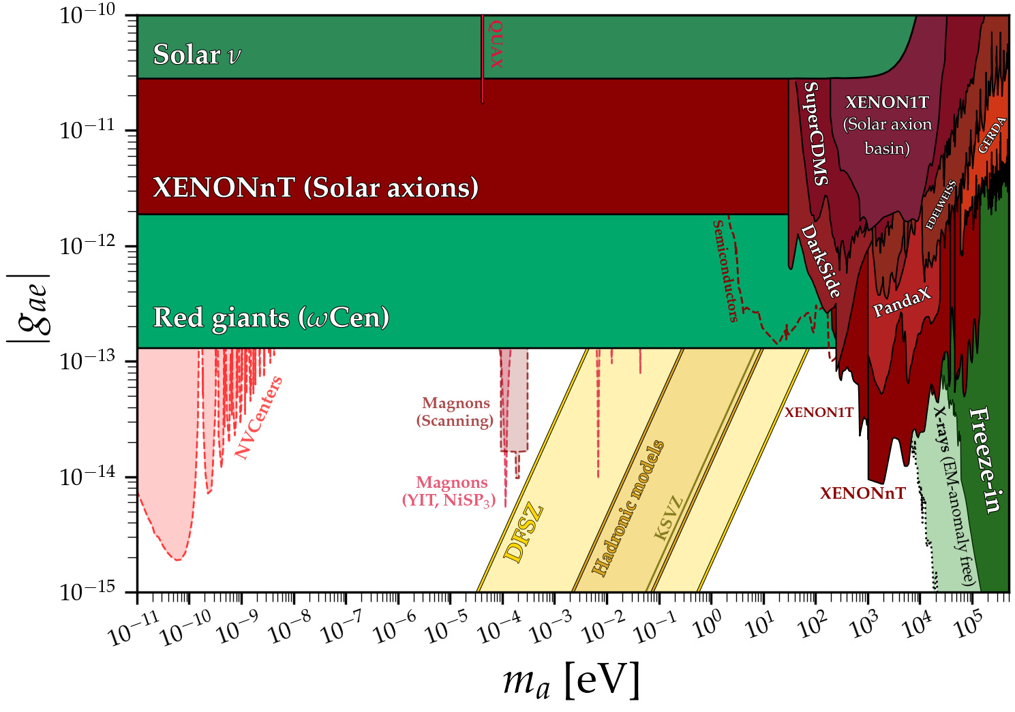

Why are they useful for detection of axions?

Slide 9
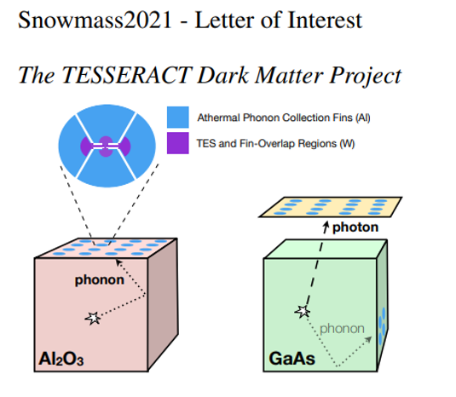
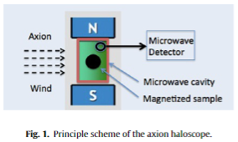

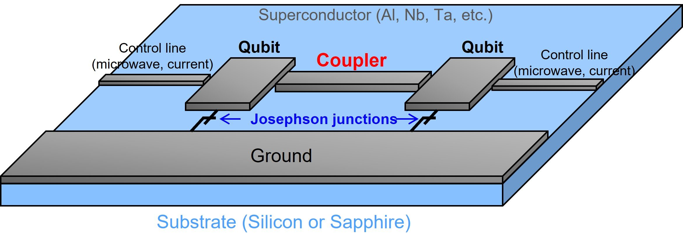
Current Experimental Efforts
QUAX (QUarere Axion eXperiment)
Need non-cavity readout mechanism
Other proposal (photon readout):
[2209.12909] Axion detection with phonon-polaritons revisited (arxiv.org)

Slide 10
Outline
Phonons and magnons for dark matter detection
Axion absorption on phonons
Axion absorption on magnons

Slide 11


The Idea
External electric field creates phonons by shaking dipoles
-
+
-
+

Slide 12
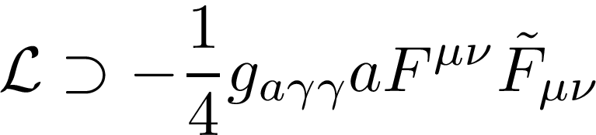
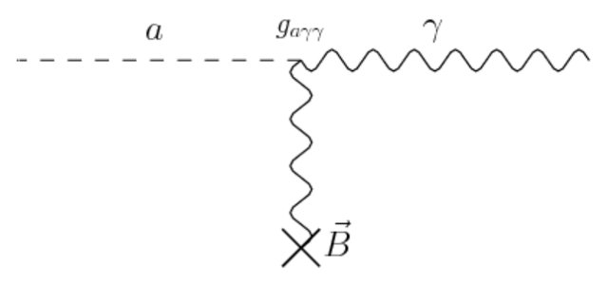


The Idea
External electric field creates phonons by shaking dipoles
In a background magnetic field, axion generates an electric field
Axion converts to electric field, which then causes the dipoles to oscillate.

Slide 13
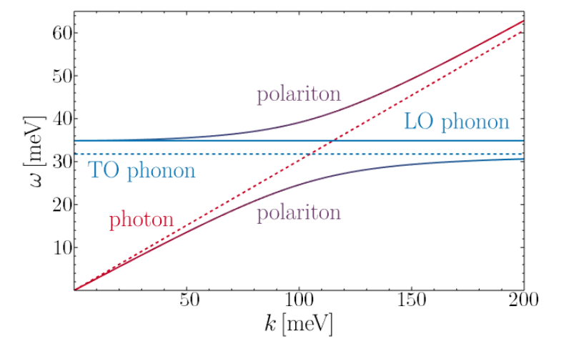
Phonons vs. Phonon-Polaritons
GaAs

Slide 14


Phonons vs. Phonon-Polaritons
GaAs

Slide 15
Single Phonon Absorption Rate: Simple
To compute the absorption rate, just use Fermi’s Golden rule

Slide 16
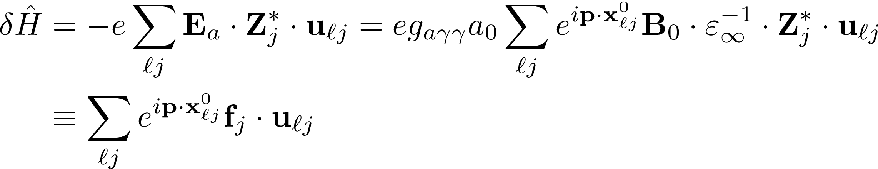
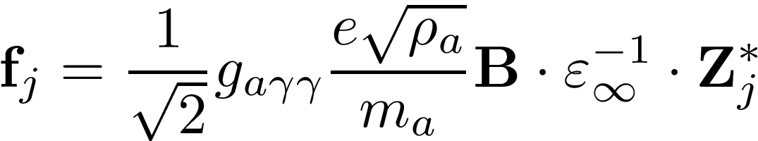
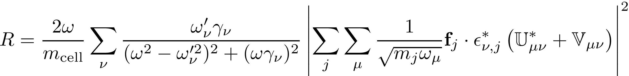
Single Phonon Absorption Rate
Axion -> single phonon-polariton absorption rate per target exposure

Slide 17

Single Phonon Absorption Rate
Polariton/phonon eigensystem – compute from first principles
DFT

Slide 18

Single Phonon Absorption Rate
Polariton width -
DFT

Slide 19
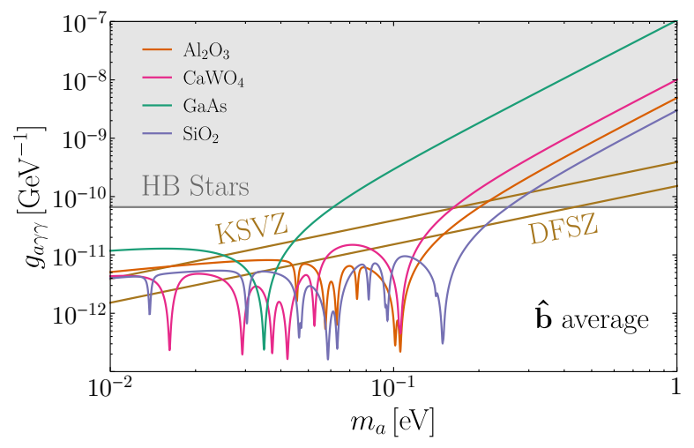
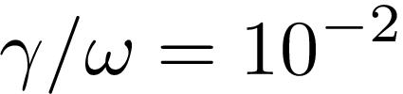
Projected Reach
Averaged over external B field directions
kilogram-year exposure, no backgrounds

Slide 20
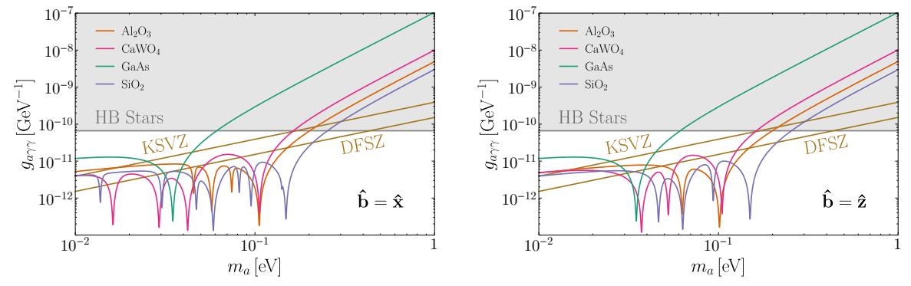
Projected Reach: B field variation
Specific external B field directions
Different resonances appear for different directions
Useful for background mitigation

Slide 21
Outline
Phonons and magnons for dark matter detection
Axion absorption on phonons
Axion absorption on magnons

Slide 22
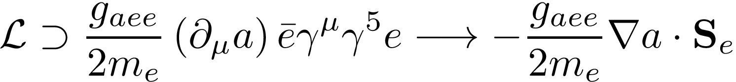
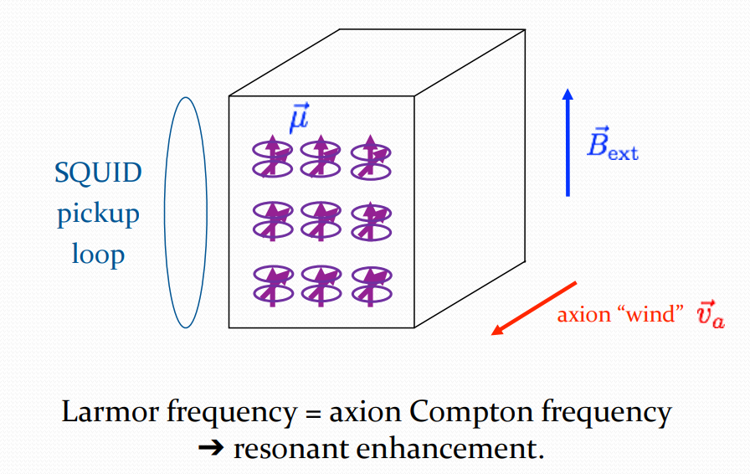
The Idea
CASPEr Wind – but with electrons, no external B field

Slide 23

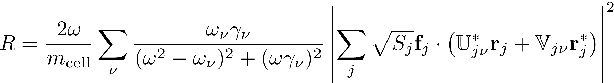

Single Magnon Absorption Rate
“Magnon polarization vectors” – computed from first principles

Slide 24
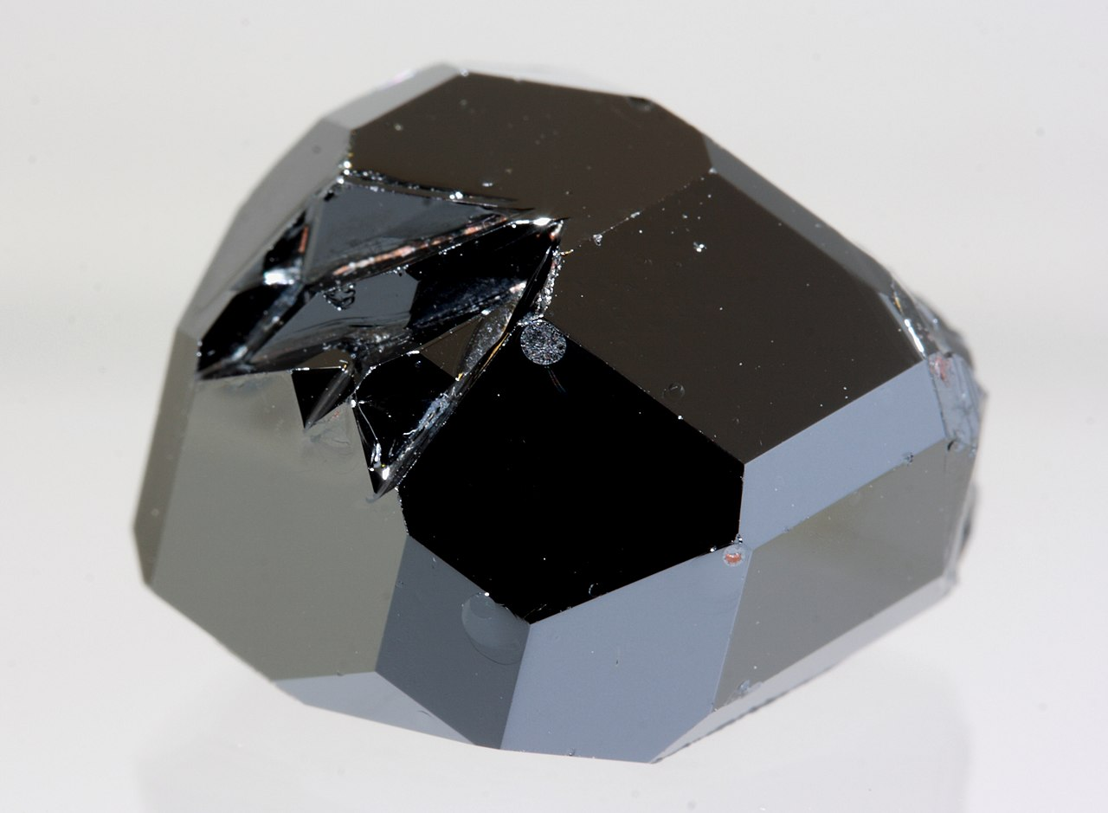
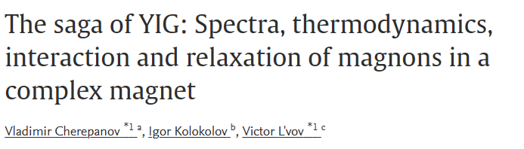
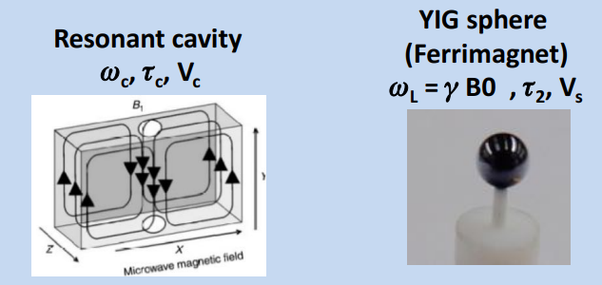
Great! What About YIG?
Used In QUAX

Slide 25

Compute the rate and…

Slide 26
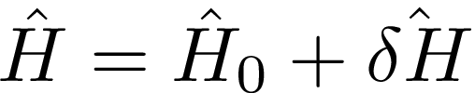
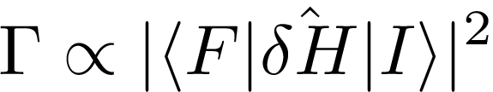


Problem: Selection Rules
Selection rules limit which magnon modes can be excited
If
If then

Slide 27

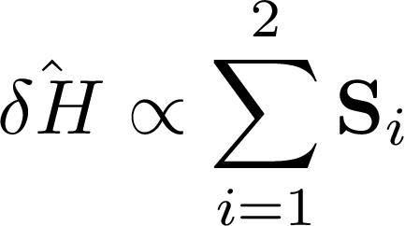
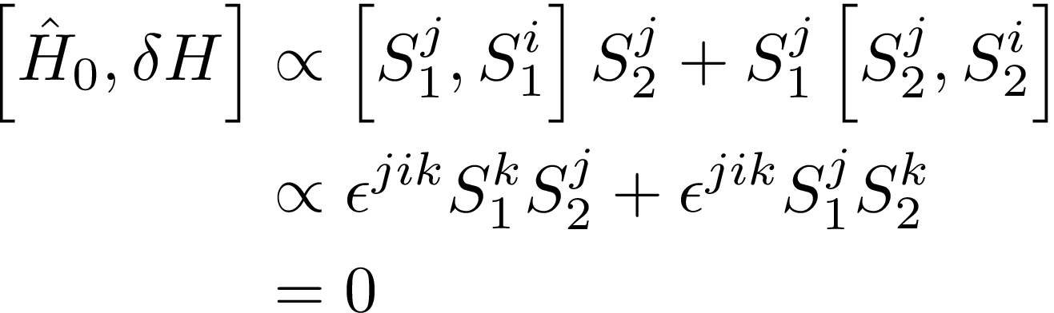
Problem: Selection Rules
Simple, isotropic exchange interactions
Axion coupling to net spin
No absorption on magnons in simple magnets!

Slide 28
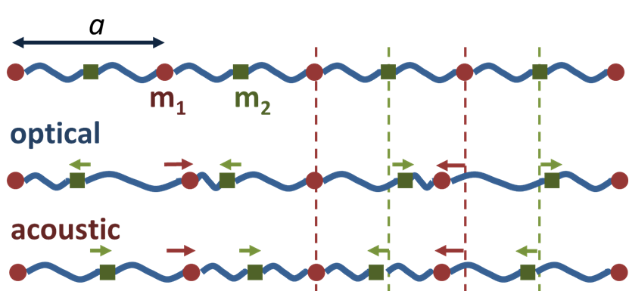
Selection Rules: Intuition
Similar (“coupling to mass”) effect for phonons
Couple to all masses equally → no out-of-phase (optical) response!

Slide 29

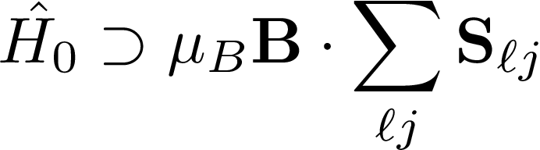
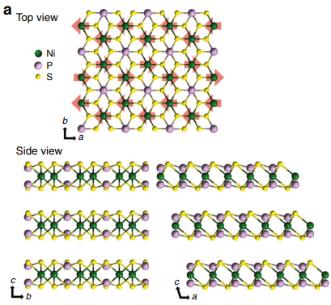
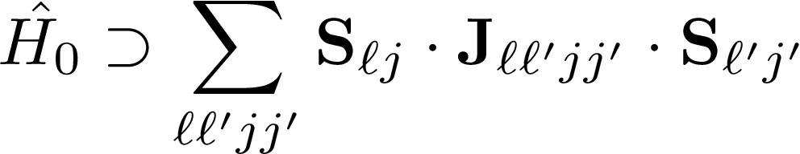

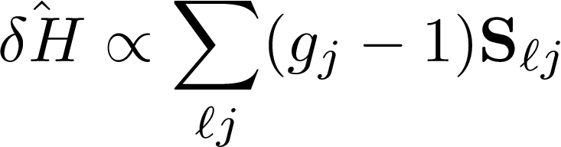
Three Ways Around Selection Rules
External Magnetic Field
2) Anisotropic Exchange Interactions
3) Non-degenerate Lande g factors
NiPS3
Suppression of magnetic ordering in XXZ-type antiferromagnetic monolayer NiPS3 | Nature Communications

Slide 30
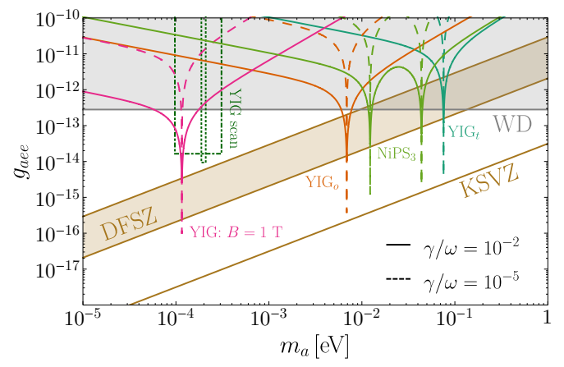
Projected Reach
No backgrounds, kg-yr exposure
YIG – external B, YIG_o/t – nondegenerate g factor, NiPS3 – anisotropic exchange int.
“YIG scan” -
[2001.10666] Detecting Light Boson Dark Matter through Conversion into Magnon (arxiv.org)

Slide 31
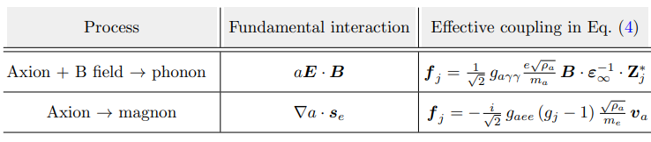
Summary
Collective excitations are an exciting new frontier in direct detection of light dark matter
Phonon and magnon excitations are complementary probes of axions for notoriously difficult axion masses
Questions:
  Paths forward for single magnon readout?
  General EFT framework for absorption on collective excitations?
Thank you!

Slide 32
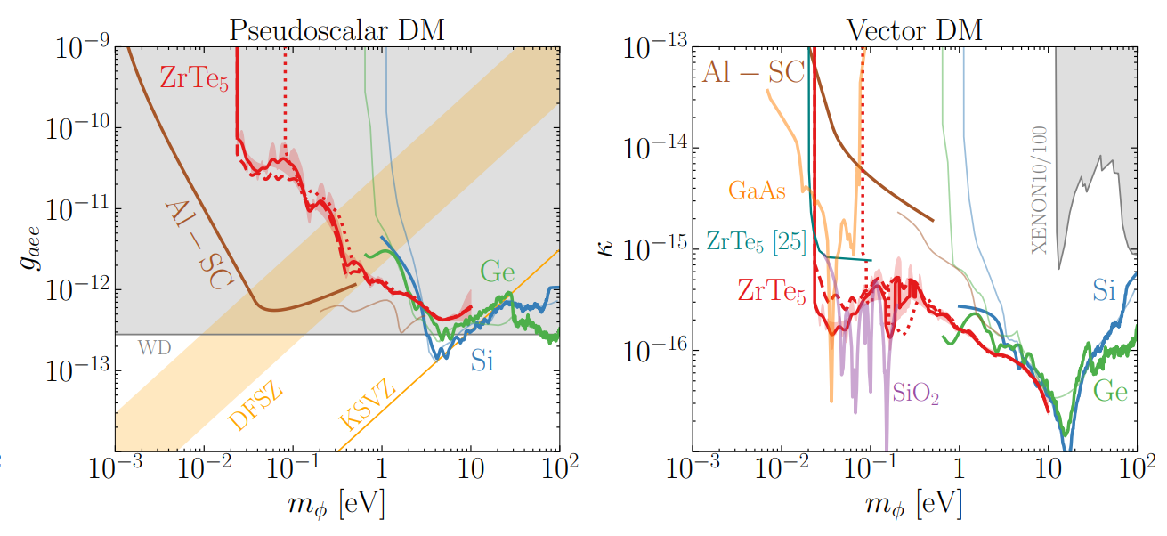
Detecting Axions with Electrons

