Slide 2
TSU/FIB incompatibilities with CIBAB
Nicolas Voumard
27 January 2023

Slide 3
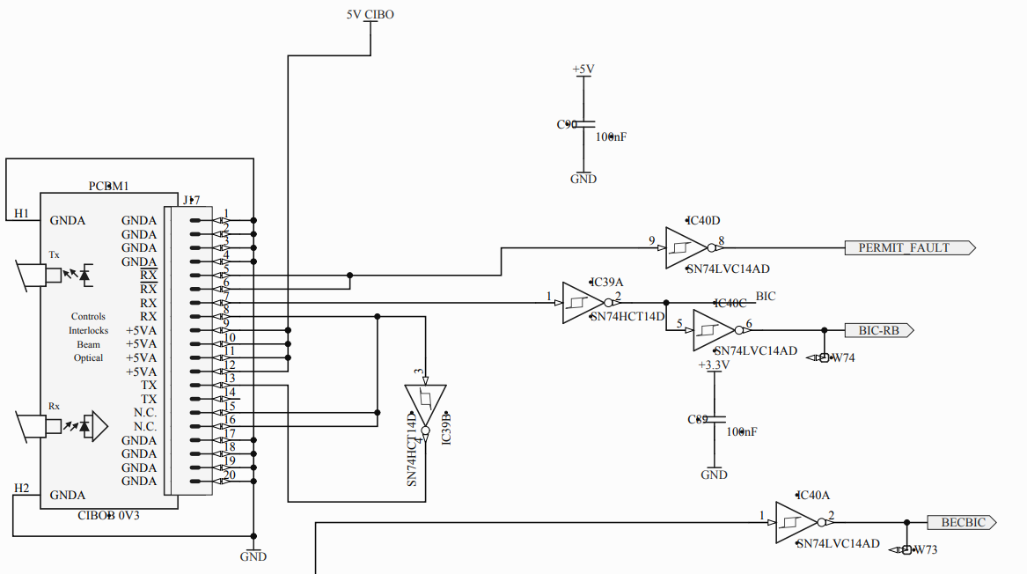
FIB
FIB accepts CIBO and CIBIR
RX/ to FPGA
(PERMIT on CIBIR)
RX to FPGA
(is PERMIT_FAULT on CIBIR)

Slide 4
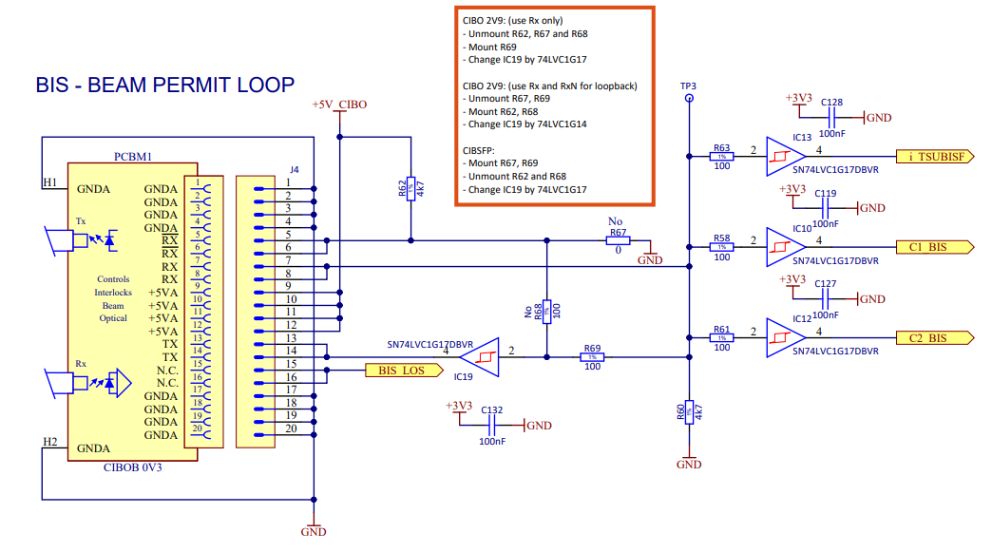
TSU
Only RX connected
RX/ is for loopback only
To FPGA
To CLD1
To CLD2

Slide 5
TSU
Hardware/gateware modifications required for CIBAB
  Hardwarewise:
    Interface is not defined and fixed yet, as SY/ABT understands it…
    Optical interface to be replaced by ???
      Interface like CIBIR more likely preferred
    Interface between CIBAB MUST BE SAFE
      A reliability study must be done.
    Will TE/MPE provide a mezzanine card as it is the case today or do we implement the circuit on our board?
  Gatewarewise:
    No more frequency detection required on our side
    Much simpler implementation
    TE/MPE to validate/review gateware?

Slide 6
TSU
TSU main board:
  https://edms.cern.ch/item/EDA-02715-V3-1/0
TSU Mezzanine card:
  https://edms.cern.ch/item/EDA-02716-V3-0/0
TSU Interface:
  https://edms.cern.ch/item/EDA-02713-V3-0/0
TSU Backplane:
  https://edms.cern.ch/item/EDA-02714-V1-0/0

