Slide 1



PAB 2023
Acceleration of a 100keV Electron Beam by Interaction with a Terahertz Pulse in a Tapered Dielectric-Lined Waveguide
Laurence Nix, Graeme Burt, Rosa Letizia, Steven Jamison, Darren Graham,
Robert Appleby, Morgan Hibberd, Connor Mosley, Joseph Bradbury, Christopher Shaw
www.thzag.uk

Slide 2
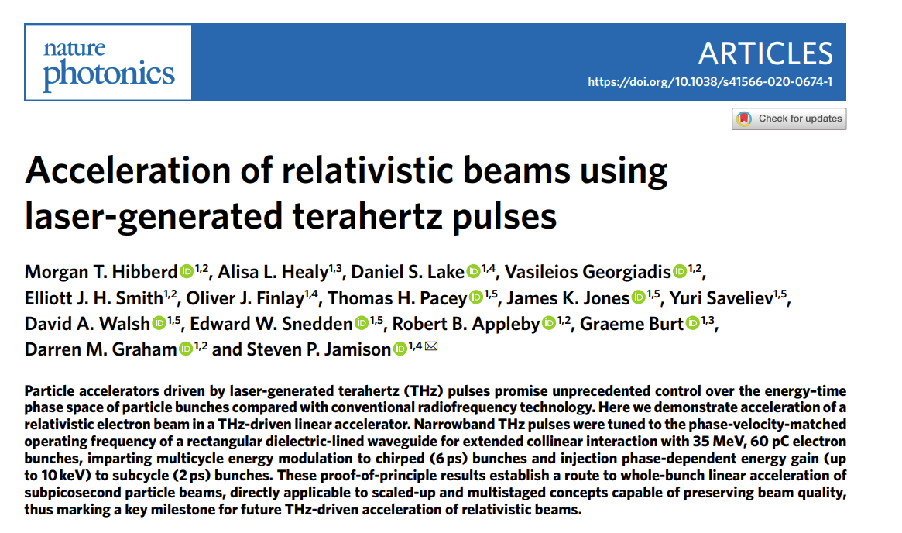
Introduction
Why? Terahertz-driven acceleration is a novel technique that offers good control over the phase-space of particle bunches in compact structures.
How? We match the phase velocity of a THz pulse with the electron beam velocity, keeping the bunch in an accelerating phase as they travel through the waveguide together.
Previous work in our group:
proof-of-concept results with a relativistic beam at the CLARA facility, reported in Nature Photonics.
DLWs designed for deflection
www.thzag.uk

Slide 3
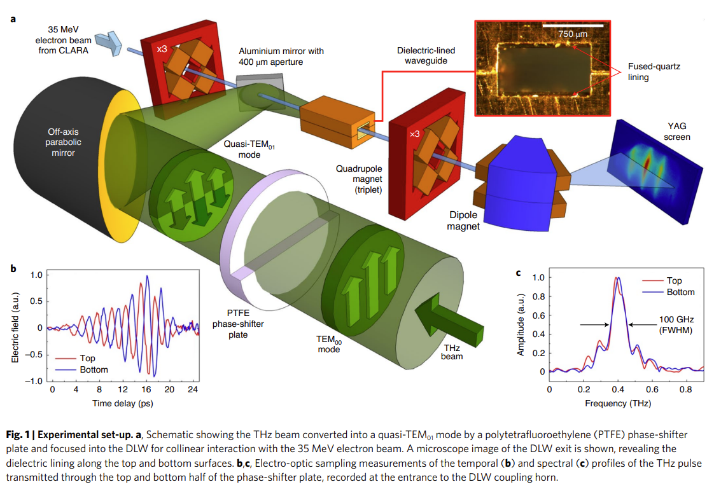
Previous Work – Acceleration of a relativistic beam at the CLARA facility
This shows the experimental set-up used for the Nature paper.
There will be some differences when we test the new design, but the general concept will be similar.

Slide 4
Principles of THz Acceleration in Dielectric-Lined Waveguides (DLW)
copper
dielectric lining
A rectangular DLW supports a type of hybrid mode which has a strong longitudinal field component and, if the dielectric is thick enough, a phase velocity below c.
vacuum
Cross-section of rectangular dielectric-lined waveguide (DLW)
Highly relativistic beam: v_{e} ≈ c, and this doesn’t change much as particles gain energy, so we can find a cross-section where v_{p} = v_{e} and expect fairly low phase-slippage.
100keV beam: The velocity of particles increases by a large amount as they gain energy – so we need to make the phase velocity increase too.

Slide 5
Velocity Matching in DLWs
copper
The phase velocity in a DLW of a fixed height and dielectric thickness can be controlled by choosing its full width w and dielectric width w_{d}
In this case we have a 380µm layer of fused silica in a 1240µm high waveguide (thus leaving a 480µm vacuum gap)*
dielectric lining
Dielectric thickness t_{d}
vacuum
Full height h
Vacuum gap height a
dielectric width w_{d}
Full width w
Geometric variables of DLW cross-section
*these parameters were chosen based on the phase velocity, group velocity, and characteristic impedance of the required mode at 200GHz, with additional limits set by expected electron beam size and availability of dielectric materials

Slide 6
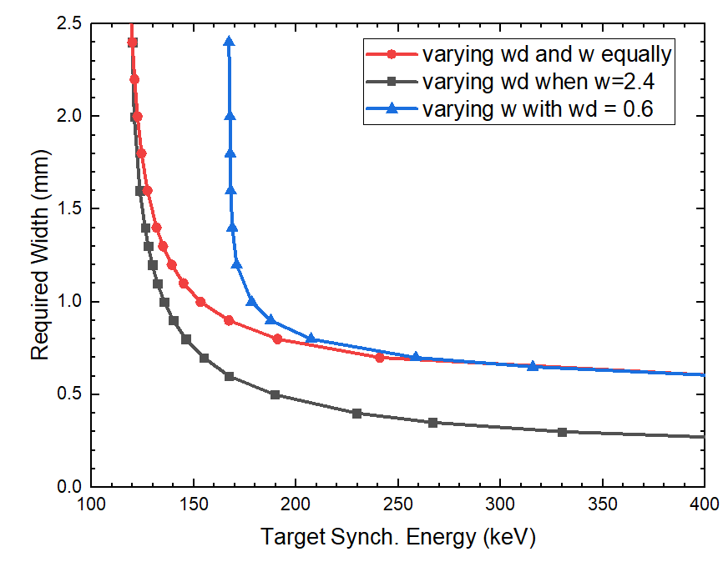
Velocity Matching in DLWs
For a set dielectric thickness, there is a minimum synchronous energy when the required width approaches infinity
In this case, it is around 119keV
We have 100keV electrons, but the minimum phase velocity would synchronise with 119keV – why choose this mismatch?
To lower the minimum v_{sync} we could use a thicker dielectric – but the thicker the dielectric, the lower the on-axis value of accelerating field. Some mismatch is necessary to have decent gradient.
Particles injected ahead of crest will slip back to crest due to the mismatch.
If they gain 19keV from off-crest acceleration by the time they slip back, then they can be synchronised the rest of the way with width tapering.
Using a different dielectric thickness or dielectric constant shifts the position of the graph, but the general shape remains consistent.

Slide 7
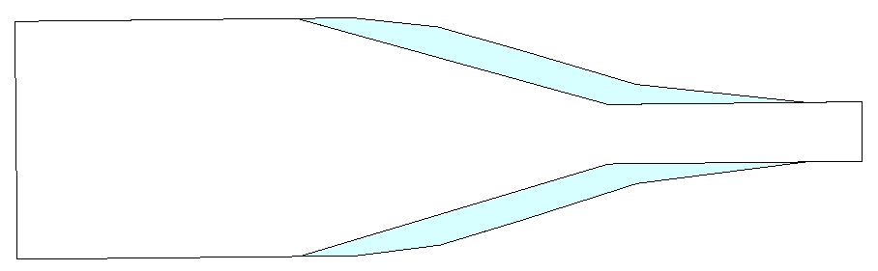
The Tapered Structure - overview
The taper profile is optimised for a specific gradient - the higher gradient, the steeper the taper
Two designs were developed
  One to demonstrate the concept with a higher energy THz pulse (i.e. a pulse energy that is feasible, but not currently available in our lab)
  One to be assembled for experimental testing.
  The physics and design process are largely the same in each case, but with different taper geometries – the former will only be mentioned as a point of comparison to some results highlighted.
Pulse Details
High Energy Theoretical Design - 200GHz, 20µJ delivered over 10 cycles.
Modest Energy Experimental Design – 200GHz, 12µJ over 8 cycles.
Energies here refer to energy in the waveguide (see slides on coupler design for context)
Top-down view of the optimised waveguide
30mm
VACUUM
2.4mm
SILICA
0.6mm

Slide 8
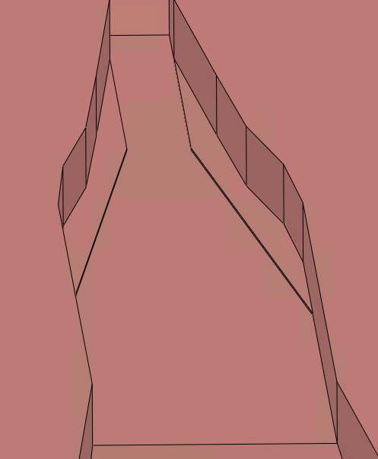
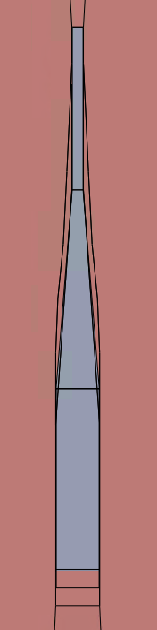
The Tapered Structure - manufacturing
The two halves of the waveguide are to be machined separately.
We keep the dielectric to a single linear taper as it is challenging to cut extremely complex shapes
The metal geometry can be much more complicated
We add a small amount of space and a ridge to aid alignment when fitting the dielectric lining
There is no significant impact on PIC results when these features and modifications are included.
Copper, starting at 2.44mm channel width
Fused Silica
2.4mm starting width

Slide 9
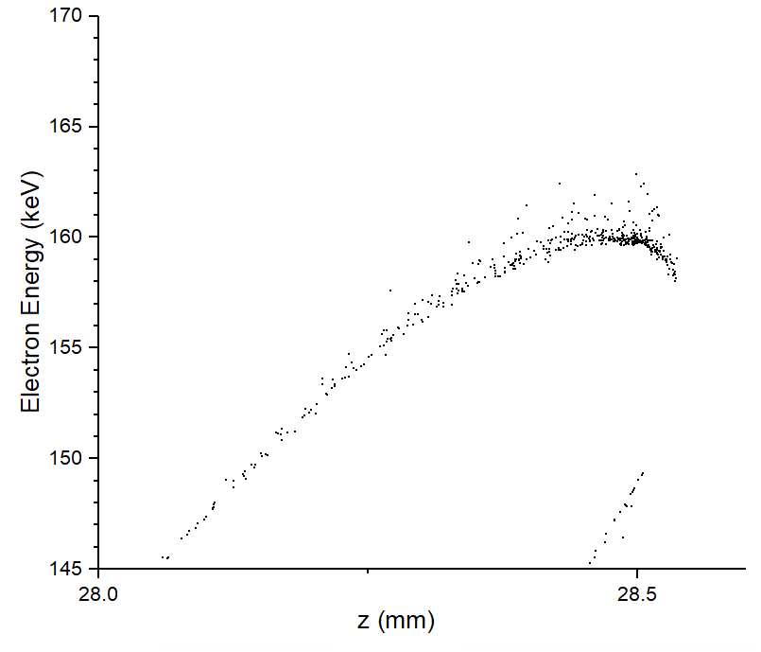
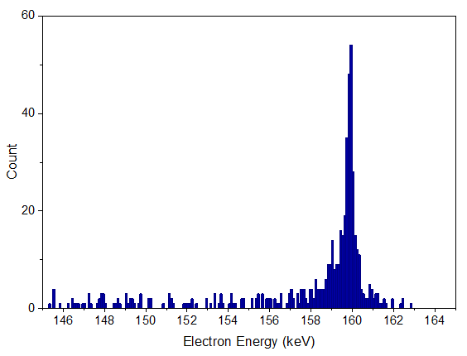
PIC Simulation Results
It is easier to see if we zoom in on just the accelerated portion…
This figure shows the energy and axial position of each macroparticle at a timestep just before the bunch leaves the waveguide.
…or plot the energies as a histogram
We can raise the electron energy to 160keV
For a long bunch, many particles are not captured for acceleration – discussion on capture rate to follow

Slide 10
PIC Simulation Results
Parameter | High Energy Theoretical Design | Modest Energy Experimental Design
Freq. (THz) | 0.2 | 0.2
Pulse Energy in waveguide (µJ) | 20 | 12
Number of cycles | 10 | 8
Apprx. Accel. Bunch Energy (keV) | 200+ | 160
Capture of 0.5fC bunch* | 15% over 170keV** | 18% over 145keV**
Capture of 0.1fC bunch | 25% over 170keV | 35% over 145keV
*capture % increases the shorter the bunch is – see following slide
**these thresholds are slightly arbitrary, as there is no clear line between bunch and tail.

Slide 11
PIC Simulation Results
The capture rate increases as initial bunch length decreases.
We see 35% capture rate of our 0.1fC bunch and only 18% for our 0.5fC bunch – but 18% of 0.5fC is still a lot more absolute charge than 35% of 0.1fC

Slide 12
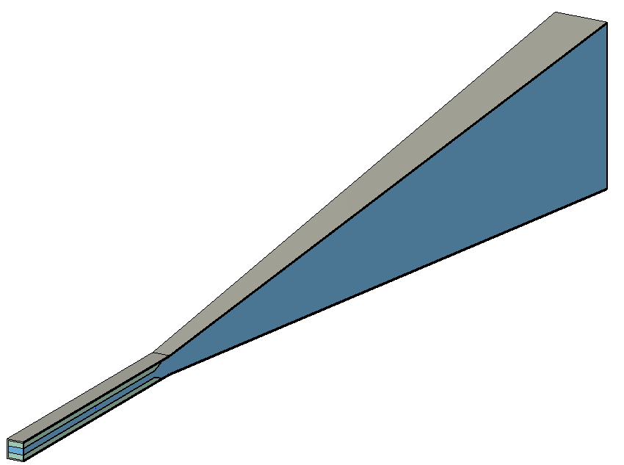
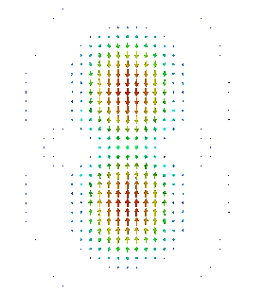
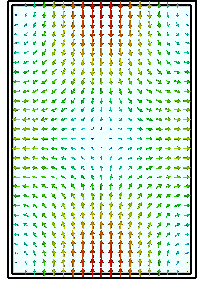
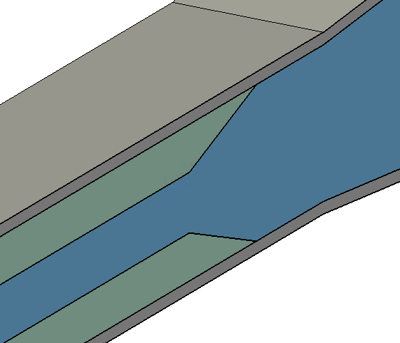
Coupling into the Accelerating Mode
Getting the coupling right takes a two-way process
We can tailor the horn to suit the free space mode available
We can tailor the THz source to suit the modes supported by the horn
Grey – metal
Blue – vacuum
Green – fused silica
Cut-away view of linearly tapered coupler
Comparison of free space pulse and coupler mode
(not to exact scale)
This design is projected to achieve around 65% coupling from source to accelerating mode.
A sloped edge reduces reflection at the boundary between empty waveguide and DLW

Slide 13
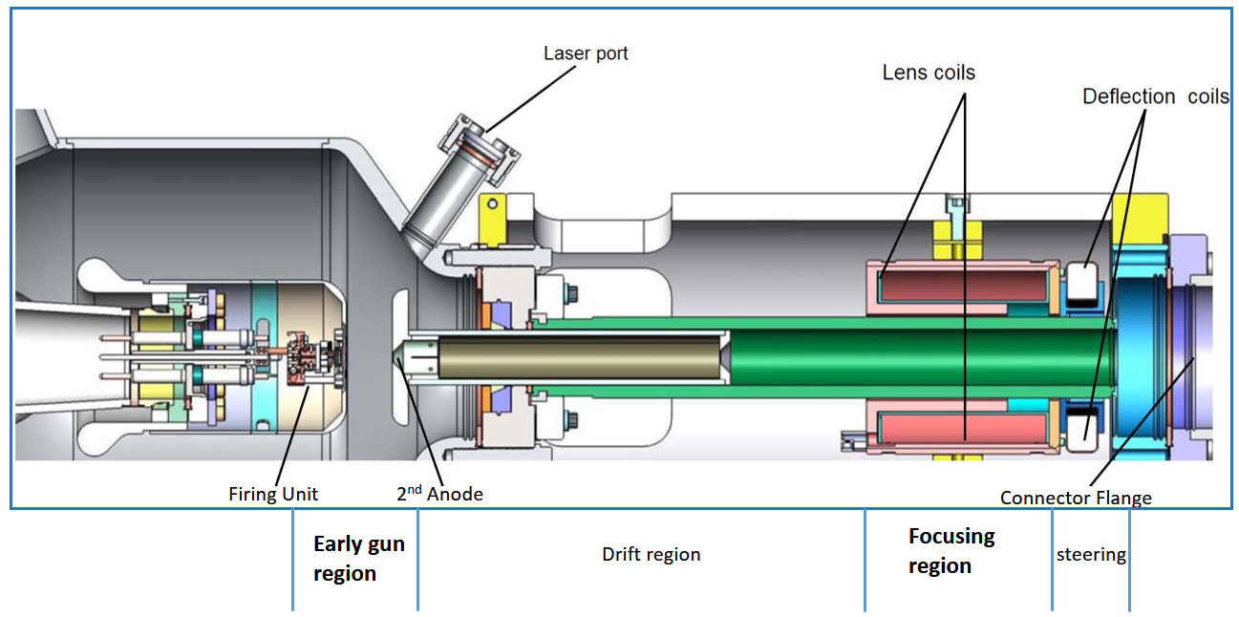
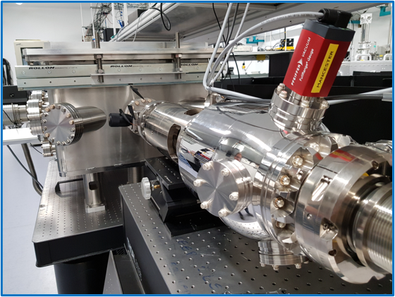
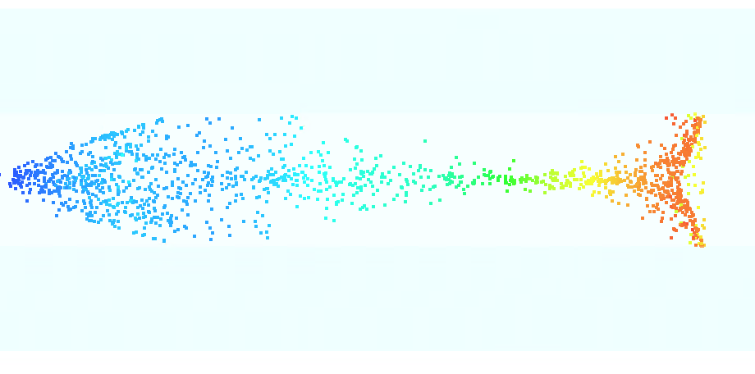

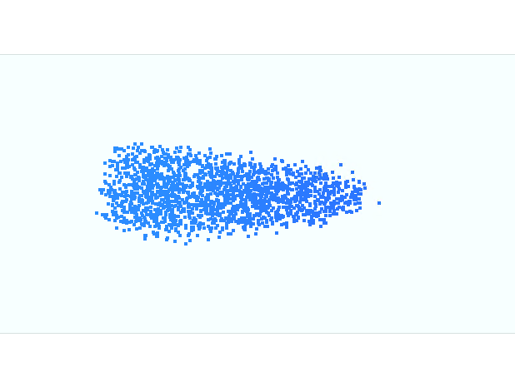
Electron Beam
Input bunches used in PIC simulation come from GPT model matching the 100keV electron gun at Daresbury.
During acceleration, it takes on a fish-like shape with the accelerated portion show in red
y
z
Just inside waveguide
At end, after interaction

Slide 14
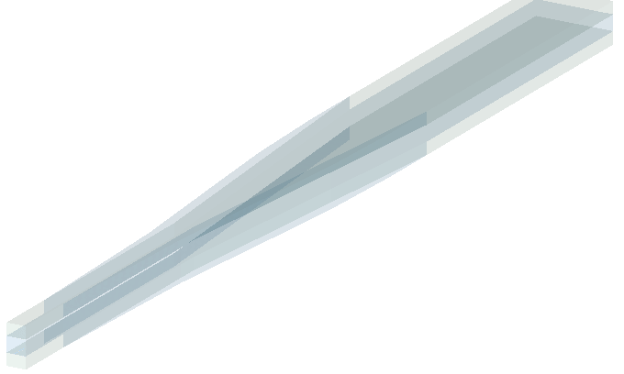
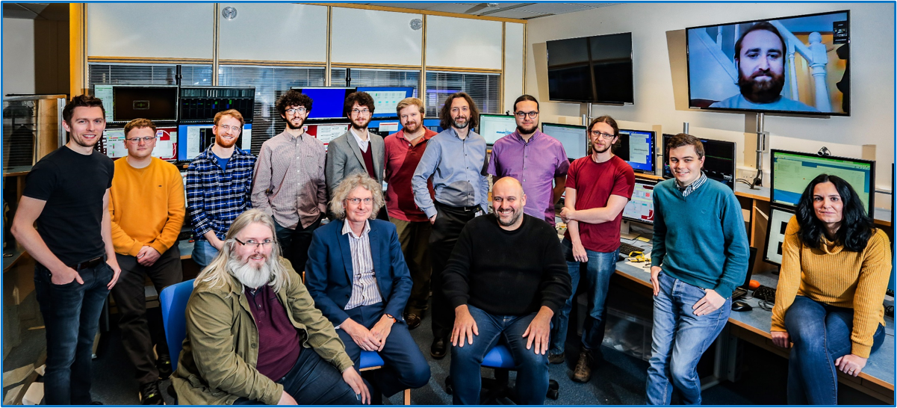


Summary and Next Steps
Main Results:
Design A: acceleration from 100keV to 200keV
Design B: acceleration from 100keV to 160keV
Twin THz spot and corresponding coupler design developed, showing 65% efficiency from source to accelerating mode.
Depending on bunch length, up to 35% capture
Next Steps:
Experimental testing to follow
In depth study of beam dynamics in the system
Investigate option of second stage waveguide
to further accelerate the output from this
waveguide
thzag.uk

