Slide 1
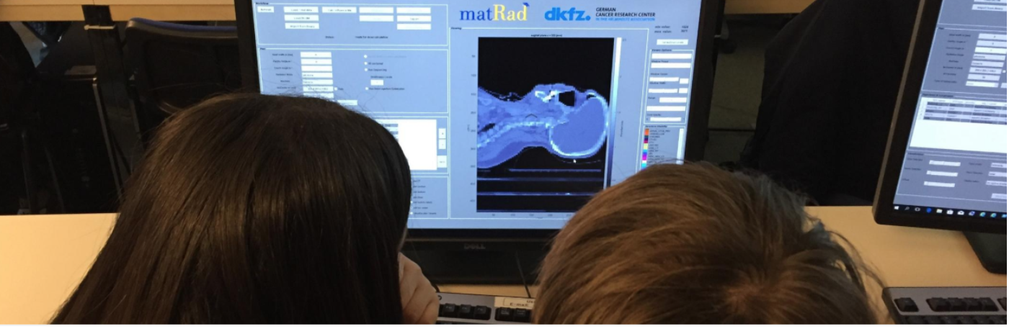



Particle Therapy MasterClass
https://indico.cern.ch/event/840212/
Yiota Foka (GSI/CERN)
on behalf of
IPPOG and IMC Steering Group

Slide 2
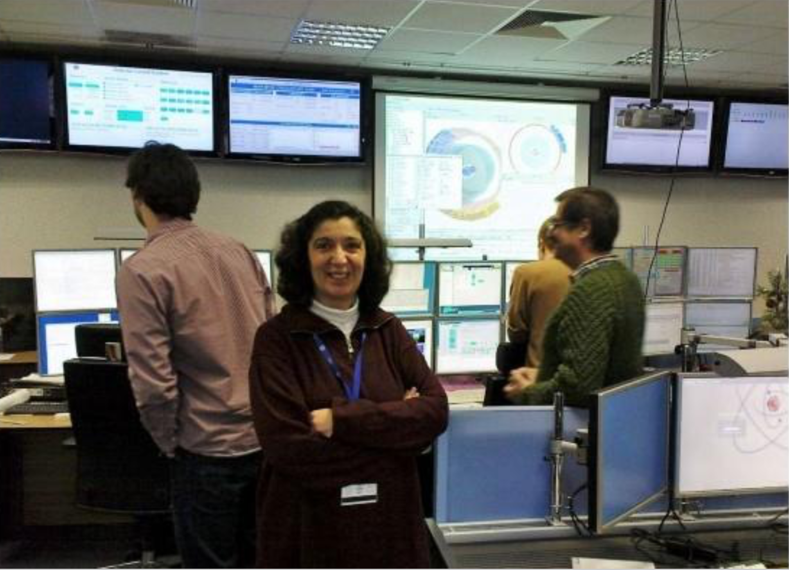
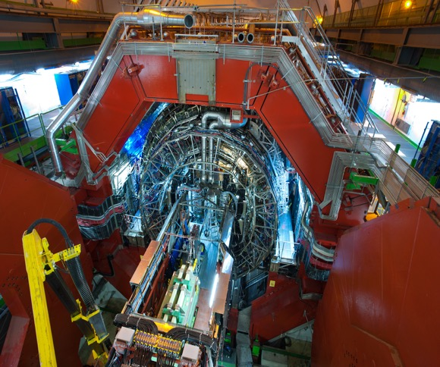
Heavy-ion research and heavy-ion therapy
Heavy-ion Physicist, involved with medical applications of heavy-ions for cancer therapy
Visit at ALICE heavy-ion experiment at CERN and CNAO heavy-ion therapy center

Slide 3
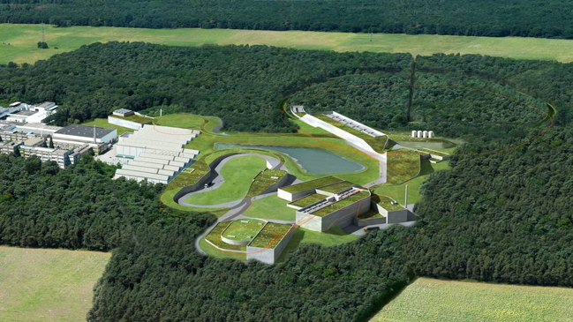
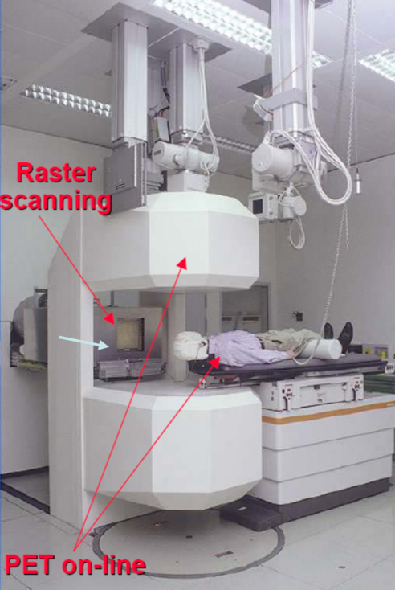
Heavy-ion research and heavy-ion therapy at GSI
Pioneering heavy-ion (carbon) therapy for cancer tumours in Europe

Slide 4
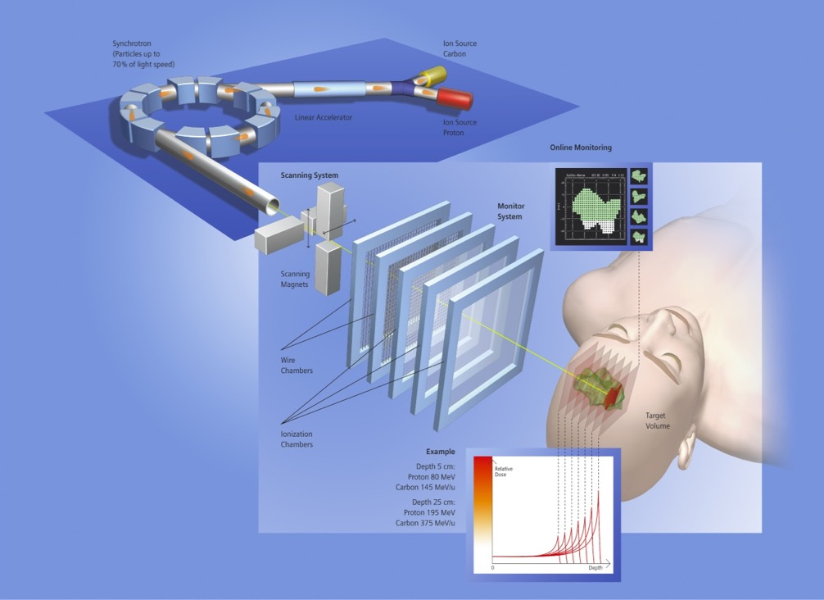
Heavy-ion research and heavy-ion therapy at GSI
Rasterscan Method
Haberer et al., NIM A , 1993
  Implemented in the Heidelberg and Marburg Ion Treatment centers
  (HIT and MIT) in Germany
Haberer et al., NIM A , 1993
Notes:
4

Slide 5
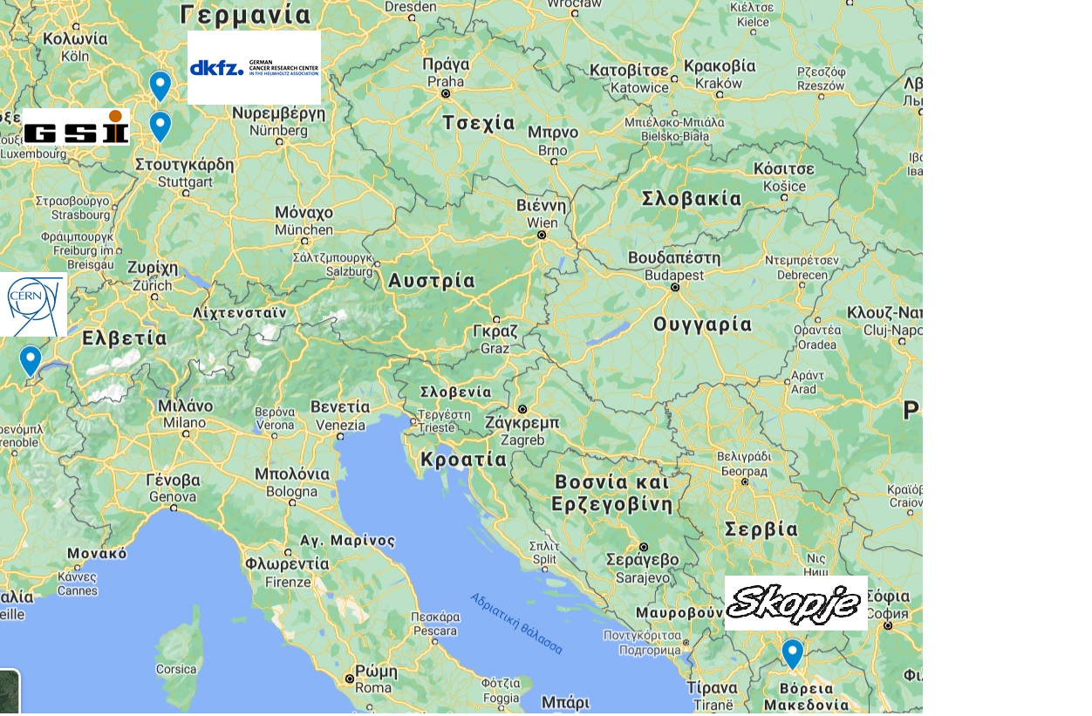

PTMC Participants, 6 March 2021
International MasterClasses
https://physicsmasterclasses.org/

Slide 6
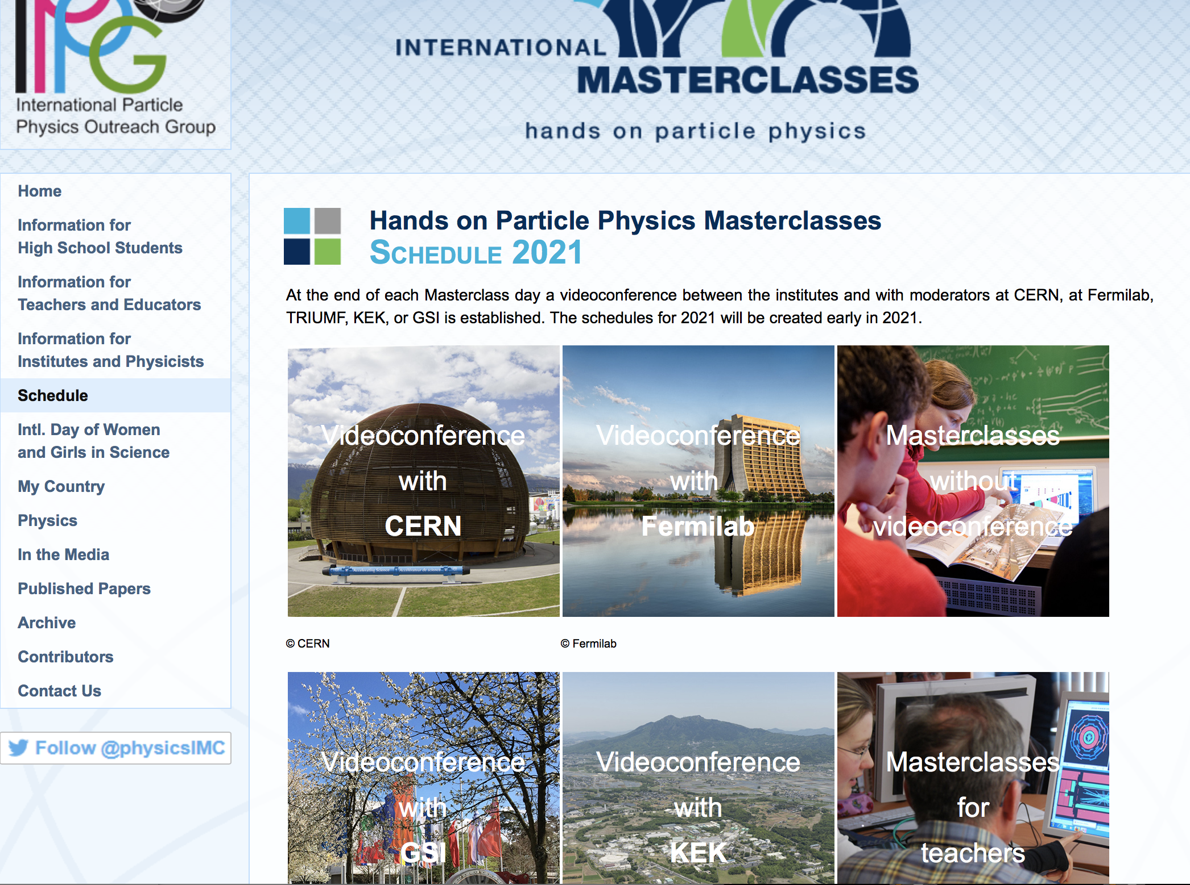
https://physicsmasterclasses.org/

Slide 7
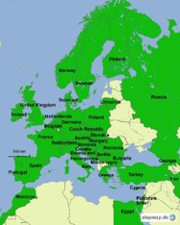
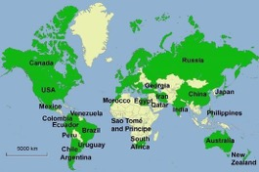

IMC Statistics 2019
Motivate the next generations of scientists !
54 countries
255 institutes
15 000 students
5 weeks in 2019
IMC 2021 :
11.2.2021 – 27.3.2021
Brings scientific methods and real data to schools!
Coordination QuarkNet / TU Dresden
188 institutes (177)
266 LHC Masterclasses (257)
  30 ATLAS W (35)
  101 ATLAS Z (104)
  64 CMS (58)
  41 LHCb (39)
  27 ALICE SP (18)
  3 ALICE R_AA (3)
51 institutes (48)
54 LHC Masterclasses (50)
  22 ATLAS (19)
  32 CMS (31)
(Incl. TRIUMF program)
12 MINERvA Masterclasses
Flagship project of IPPOG, the International Particle Physics Outreach Group

Slide 8

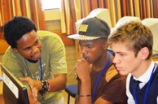
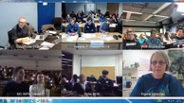
Concept and programme of an IMC day
Scientists for a day !!
Every year, during the months of
February-March
school-children (15-19 year old)
are invited to an institute of their area.
2-5 institutes per day performing the same programme
LOCAL TIME: ACTIVITY
8:30 - 9:00 Registration and Welcome
9:00 - 10:00 Introductory lectures
10:30 - 11:30 Visit of a lab or experiment
12:00 - 13:00 Lunch
13:00 - 15:00 Hands-on session
15:00 - 16:00 Discuss results locally
16:00 - 17:00 Video conference
The aim is to get insight into topics and methods of research

Slide 9

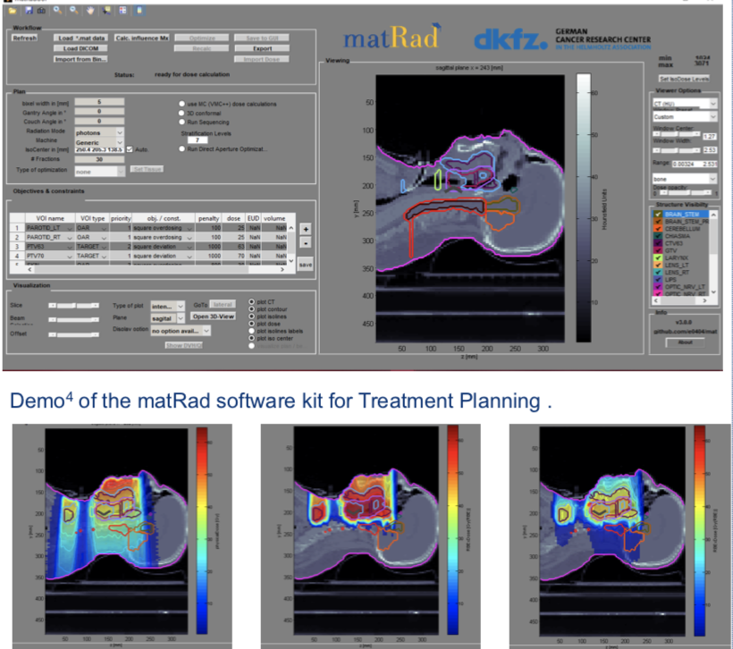
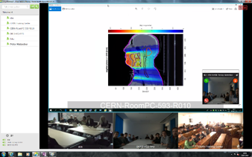
New PTMC and Treatment Planning
Based on professional open source treatment planning: matRad
developed by Heidelberg DKFZ www.matrad.org
Simplified version for PTMC
Using photons, protons and carbon ions

Slide 10
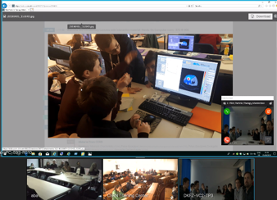
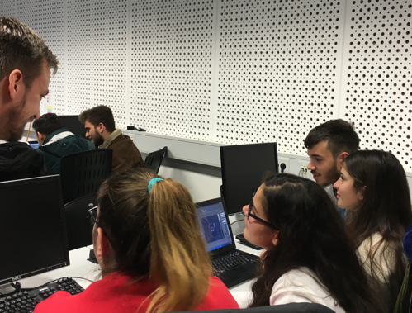

PTMC pilots in 2019
First local test: GSI, 7th February 2019
First international test: CERN, DKFZ, GSI, 5th April 2019
Participation of CURIEosity Team from Crete, Greece
CERN, DKFZ, GSI
Survey: positive results from students
Hope and motivation to contribute
to the fight against cancer

Slide 11
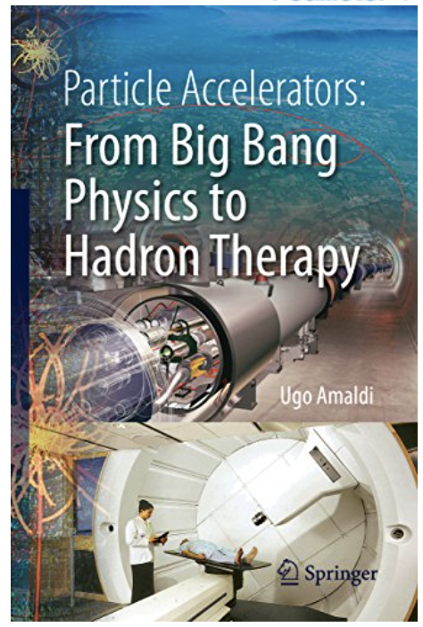
How is physics related to medicine?
What is particle therapy?
How one can use particles for
cancer treatment?
Accelerators for research
and accelerators for
cancer treatment
One of the aims of PTMC:
address such questions

Slide 12
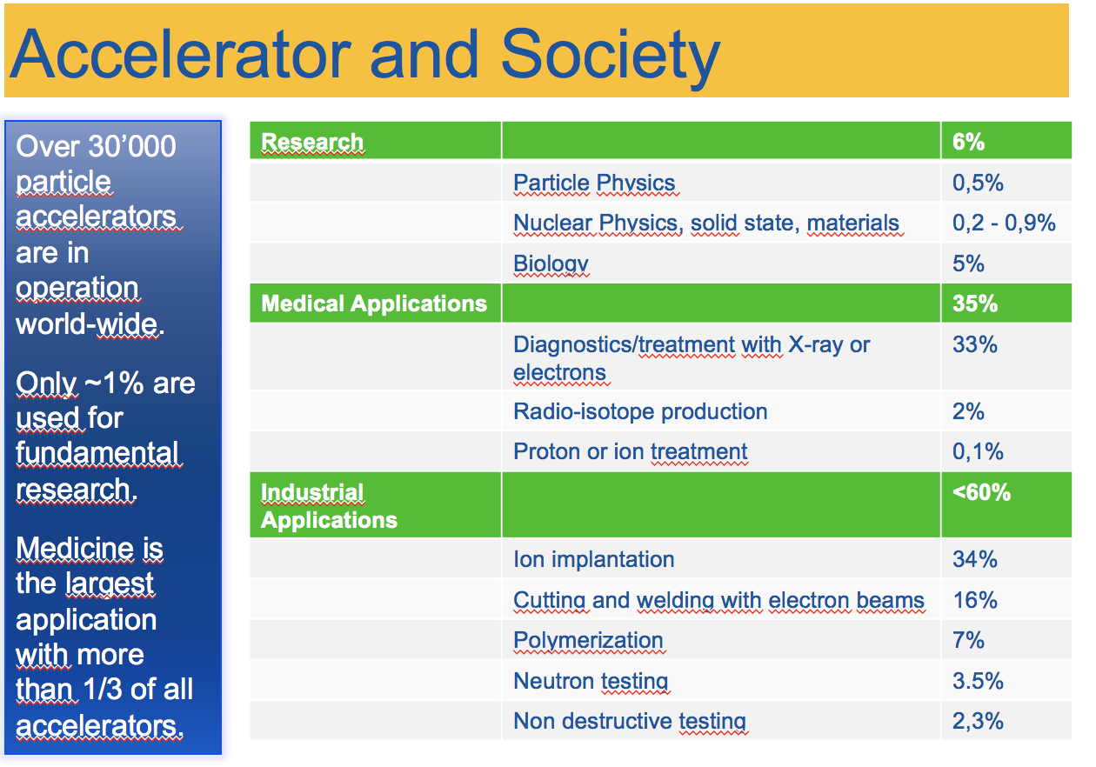

Slide 13
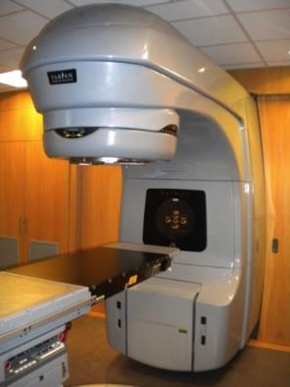
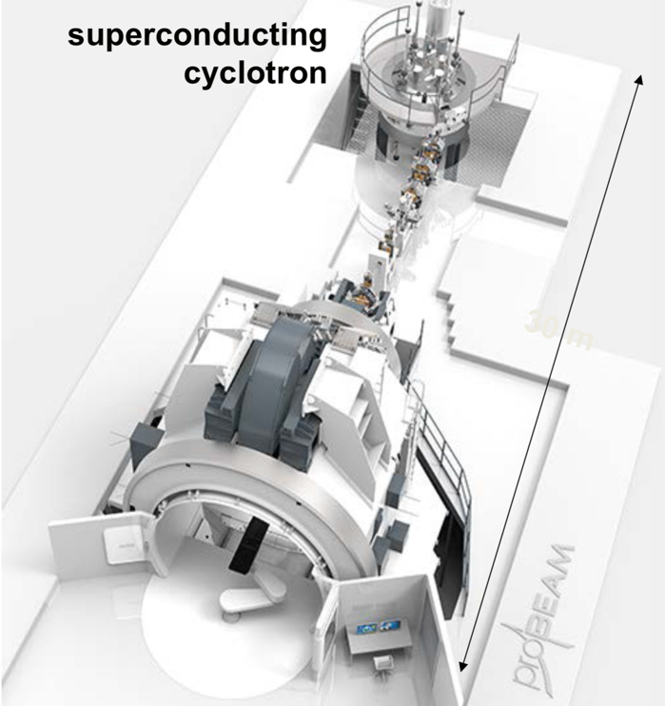
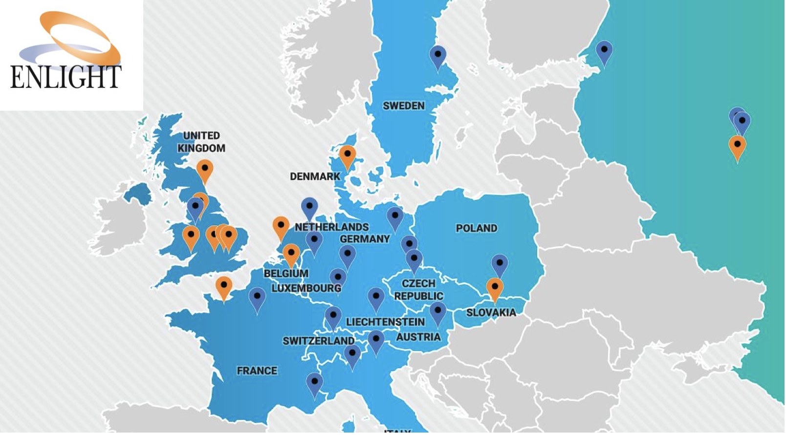
Accelerators for health
Conventional x-ray
Radiotherapy
Particle/Hadron Therapy with protons
Hadron Therapy centers in Europe (2018)

Slide 14
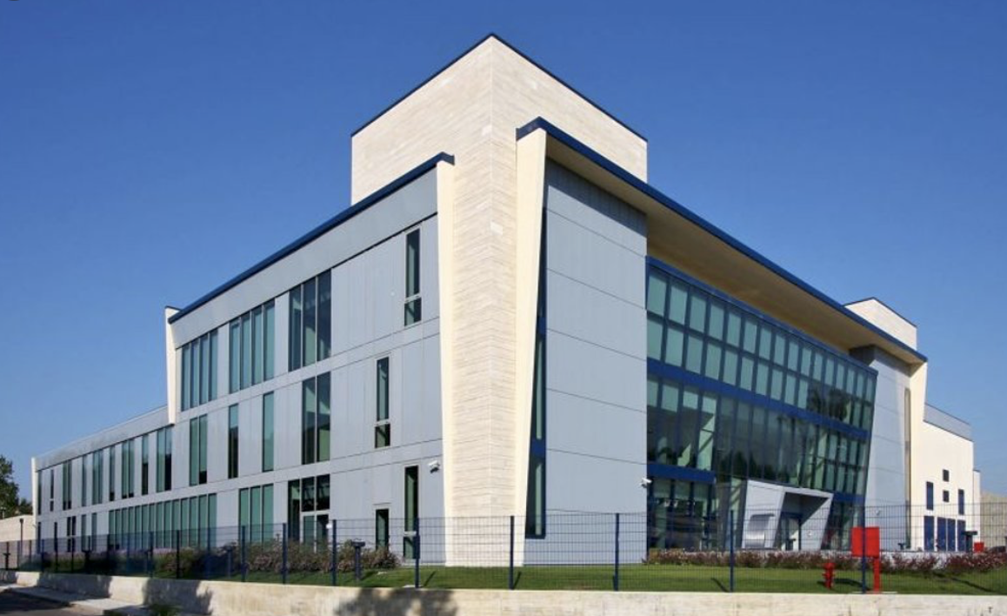
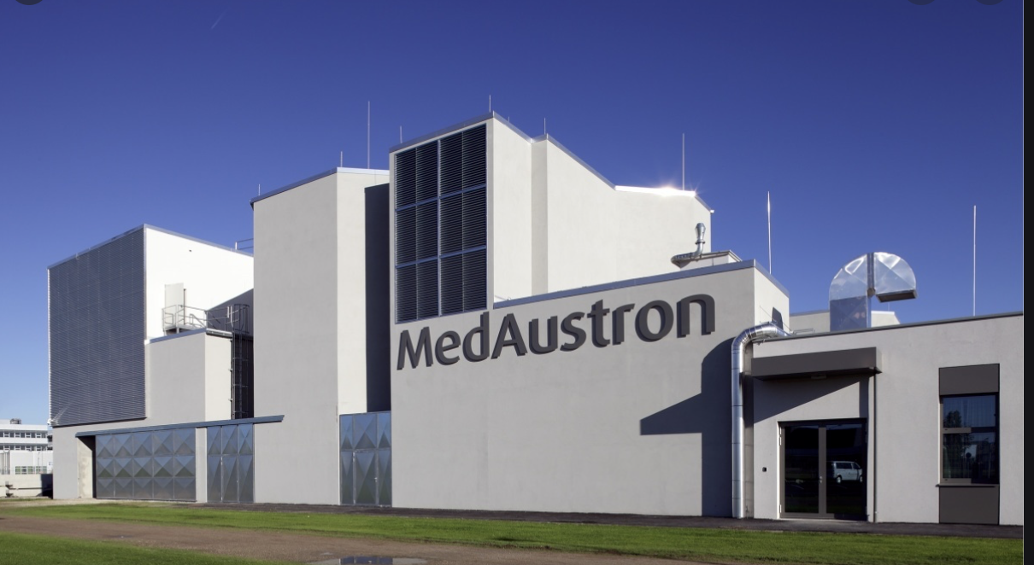
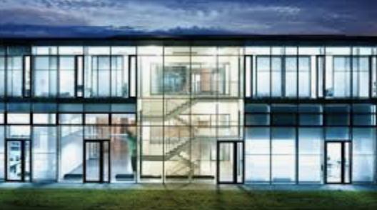
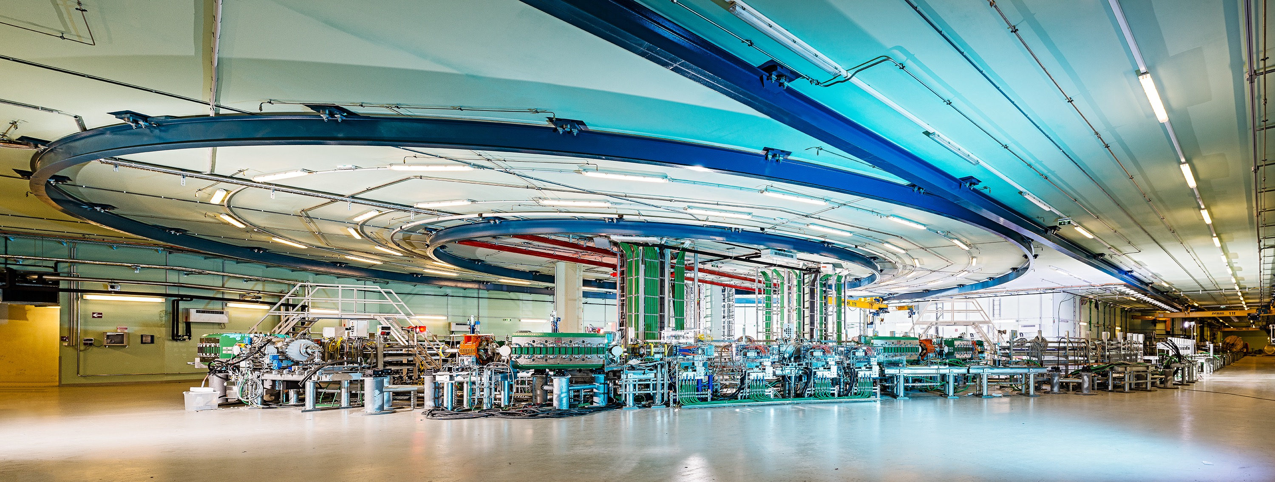
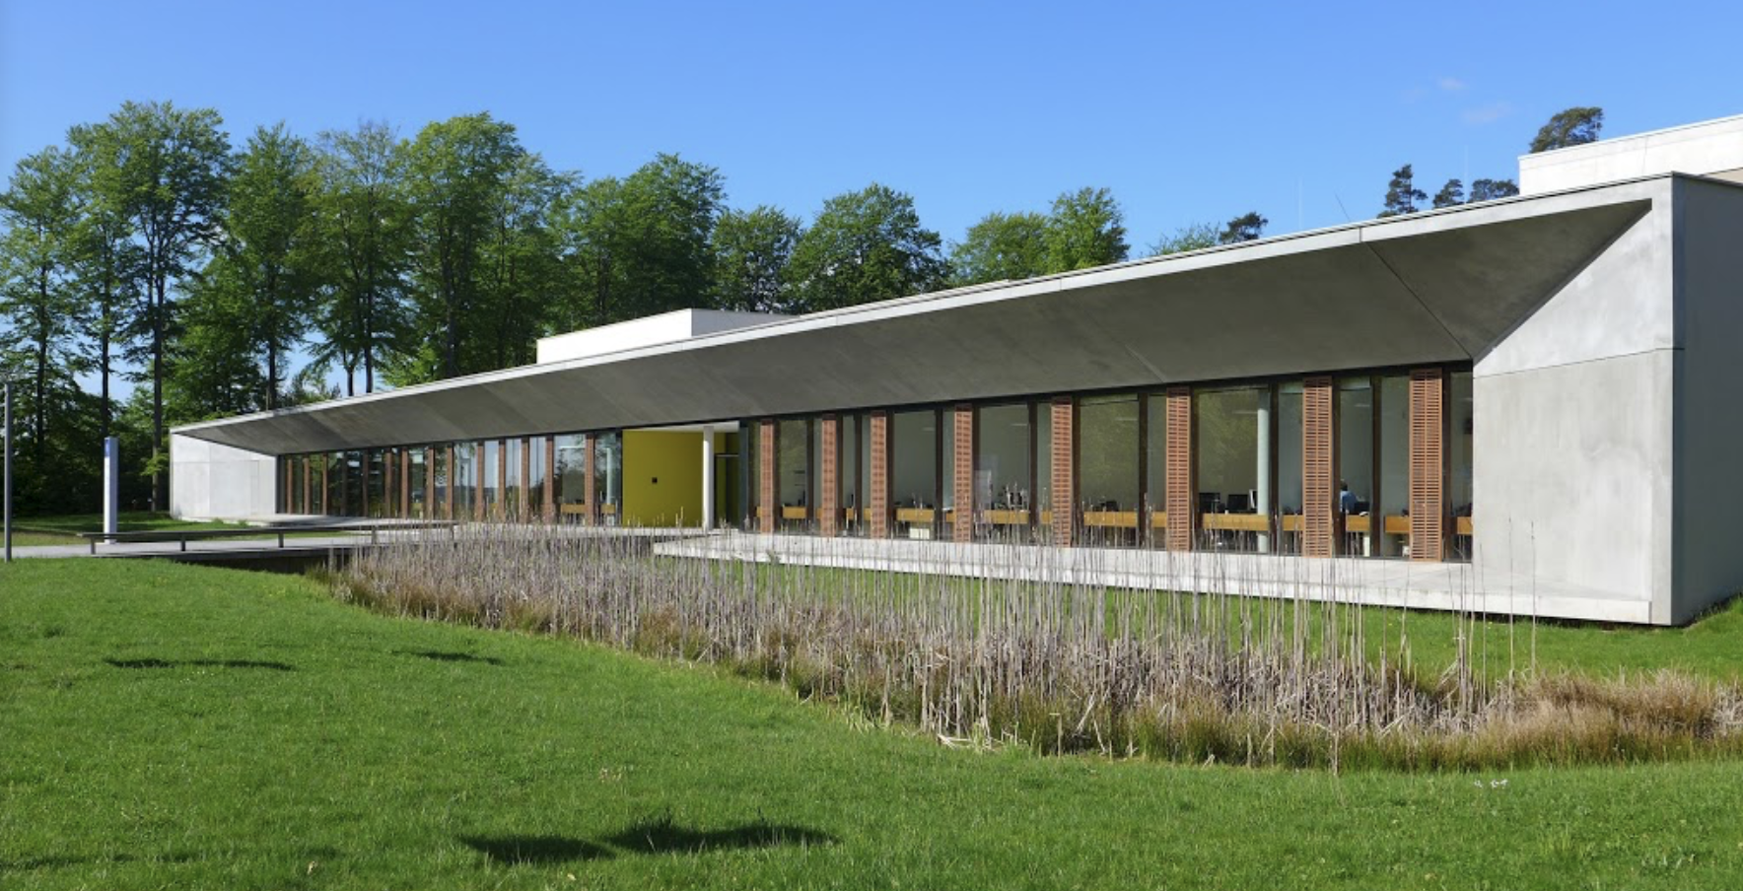
Four carbon-ion cancer therapy centers in Europe
MedAustron, Αustria
CNAO, Ιtaly
HIT, Germany
MIT, Germany

Slide 15

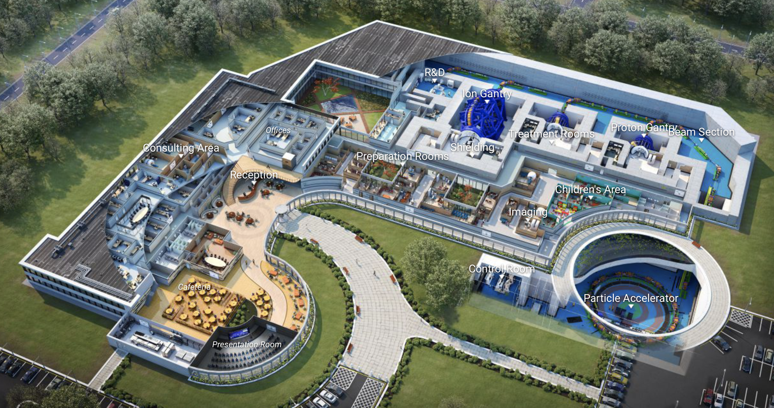
Virtual Hadron Therapy Center

Slide 16
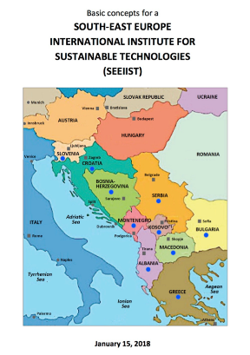
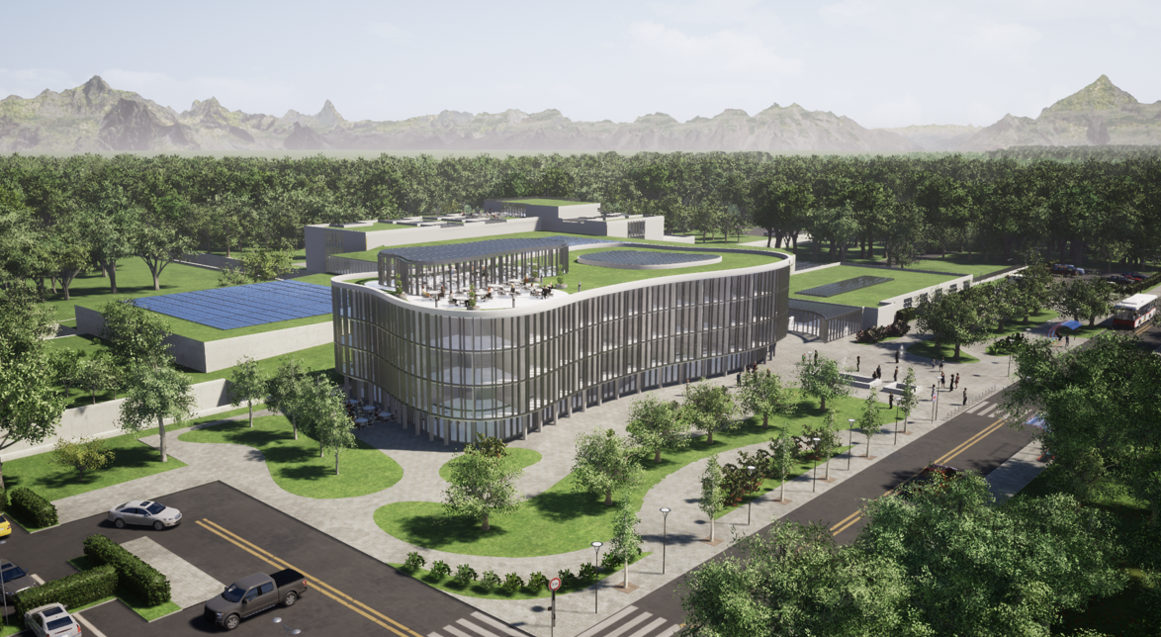
Next generation facility for cancer tumour therapy
and research with heavy-ion beams
Δ. Καπρινης
Proposal for a facility in South East Europe: SEEIIST

Slide 17
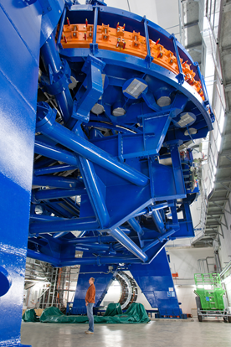
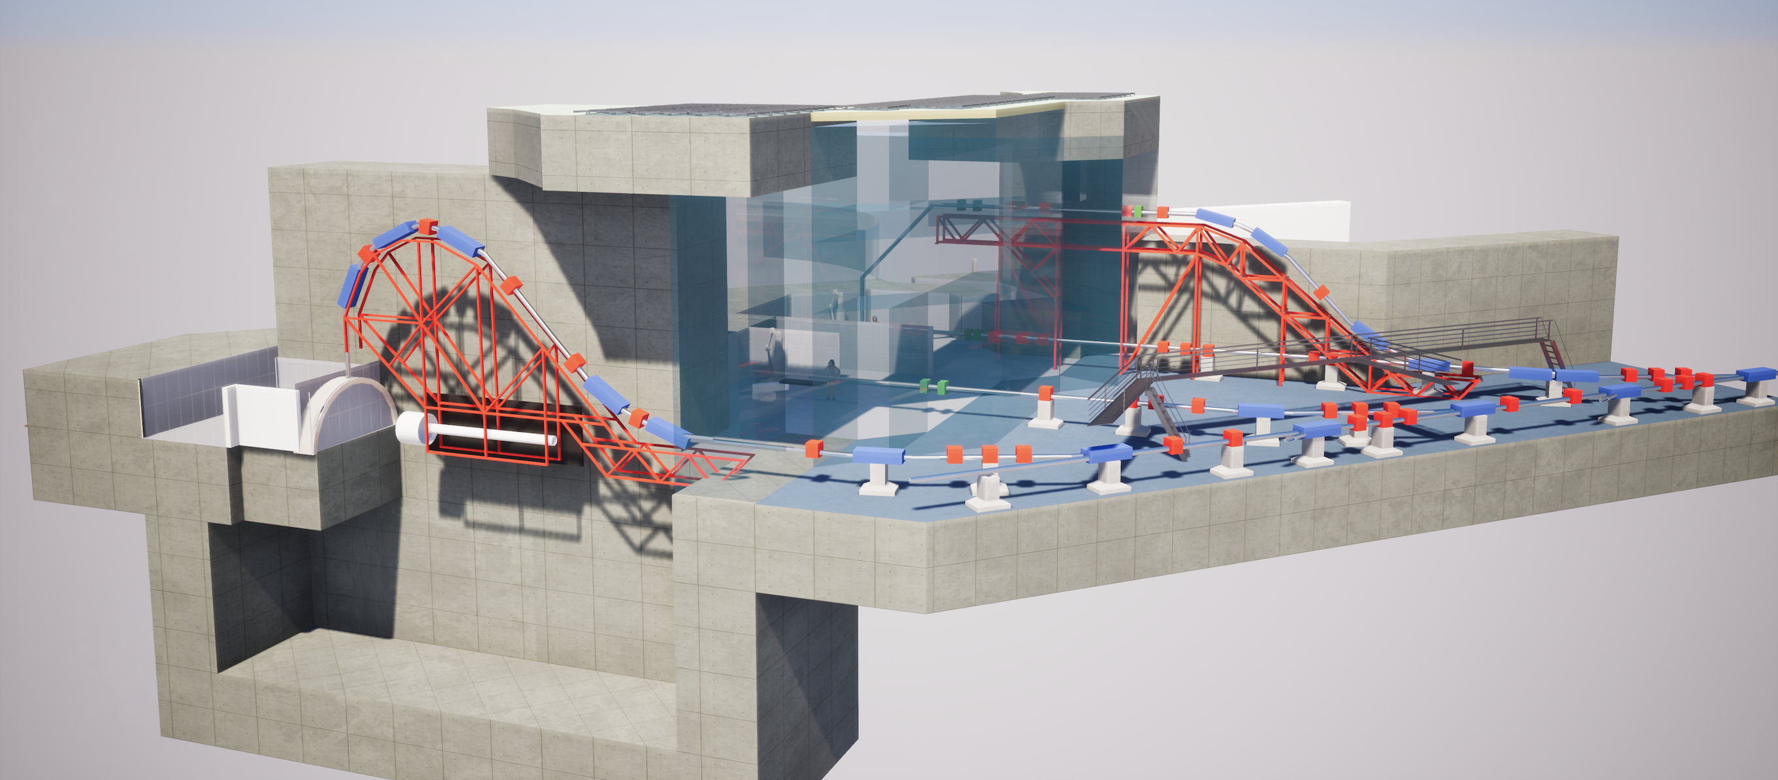
Beam Delivery
Gantry at HIT
Gantry at SEEIIST
40 tons
600 tons

Slide 18
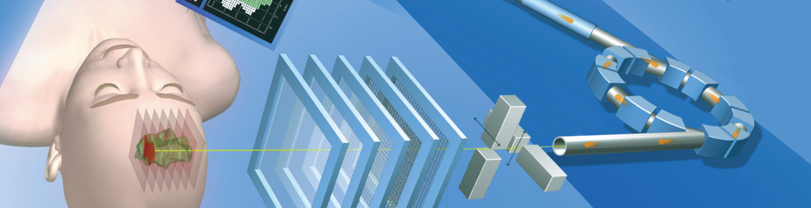
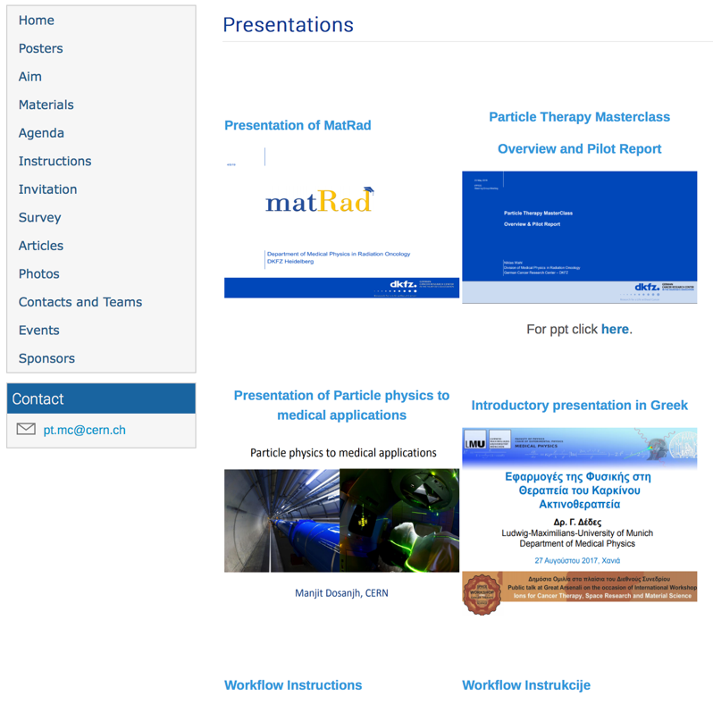
Particle Therapy MasterClass
https://indico.cern.ch/event/840212/
Material in different languages
Animations

Slide 19
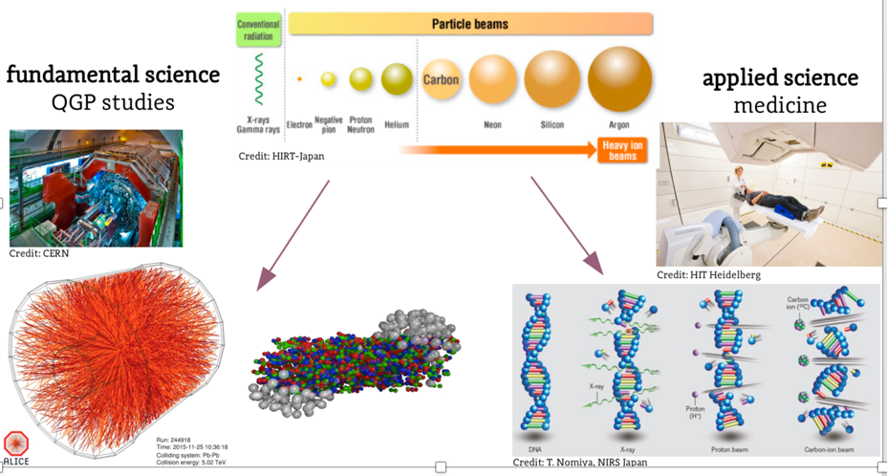
Heavy-ion research and heavy-ion therapy
Pb-Pb at 5.5 TeV
pp at 14 TeV
88-430 MeV/u carbon
50-221 MeV/u protons

Slide 20
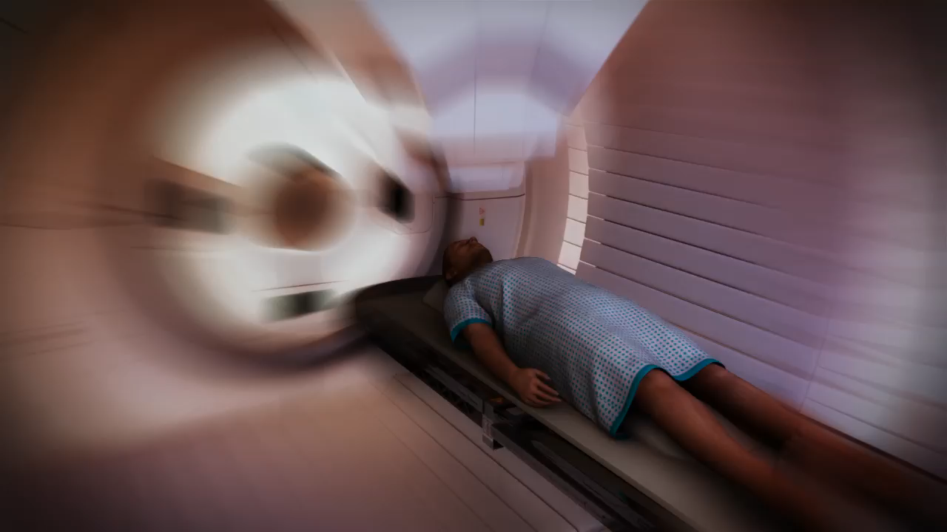
https://indico.cern.ch/event/840212/

