Slide 1
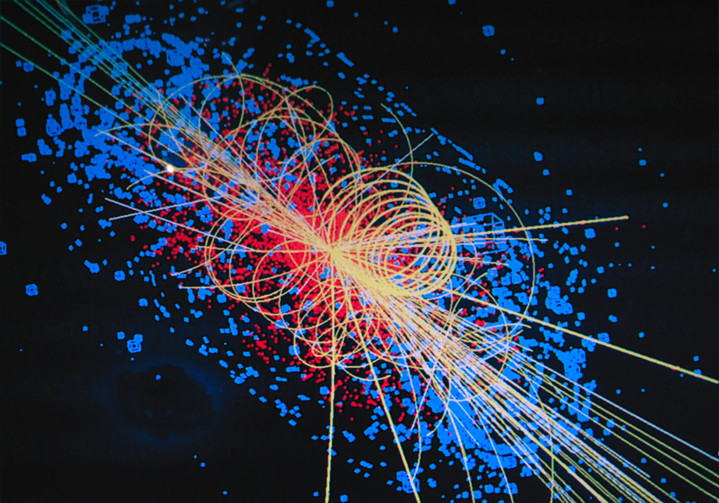





Introduction to
Atomic and Nuclear Physics
What are we made of?

Slide 2
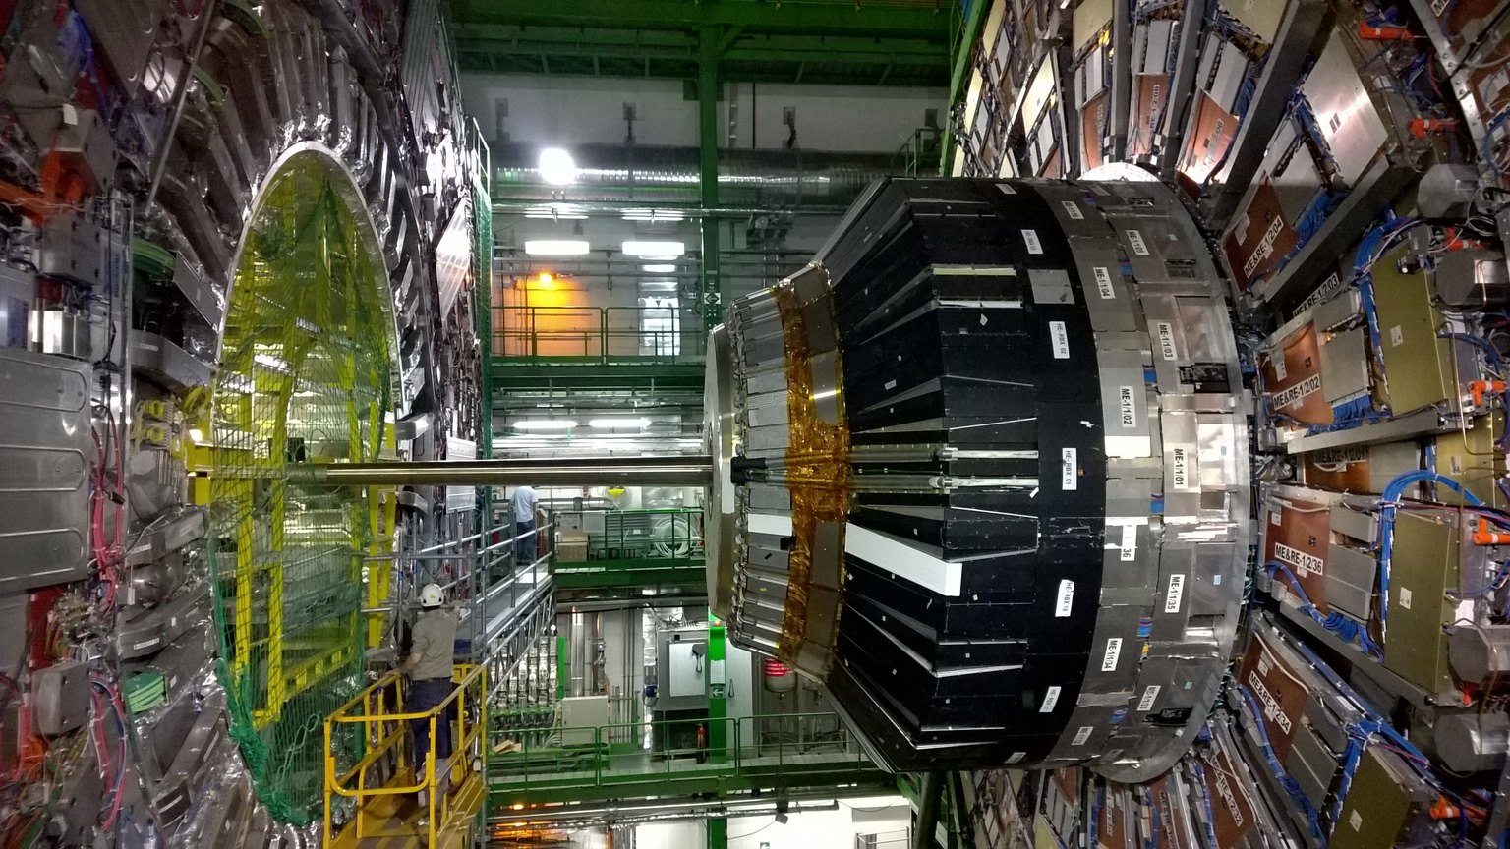
What are we doing here?
Arial
Why CERN? What are you going to learn here?

Slide 3
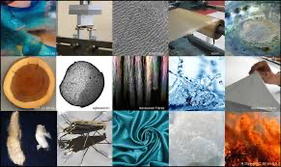
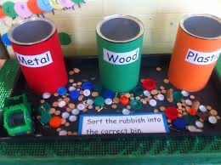
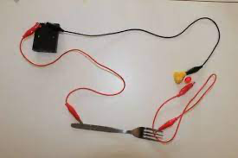

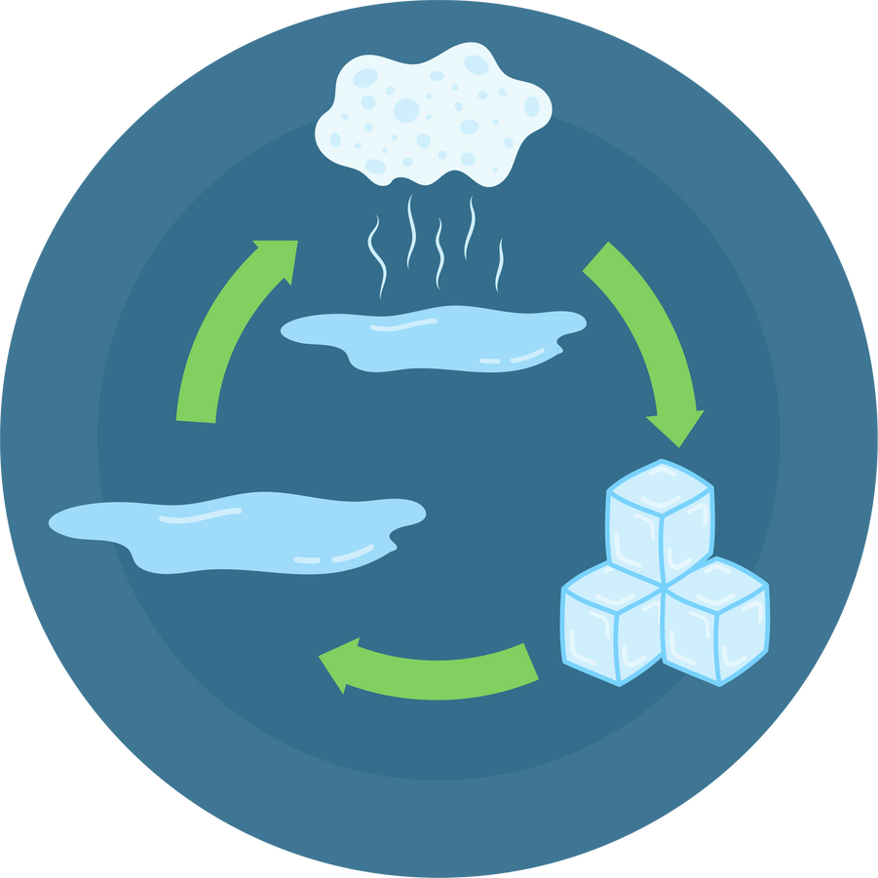
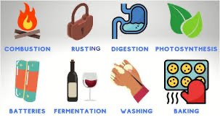
What knowledge are we building on?
Arial
What is everything made of?
How can we group materials?
How can we compare materials?
Where does this go?
How and why do materials change?

Slide 4

There are always more questions ....
Arial
What are materials made from?
Why do different groups of materials have different properties?
Can we rank materials based on particular properties?
Why do different materials react in different ways?
Why are changes of state reversible?

Slide 5
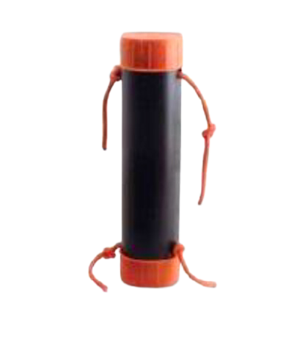
Practical Challenge
Arial
What is inside the tube?
Make a model of what you can't see.

Slide 6
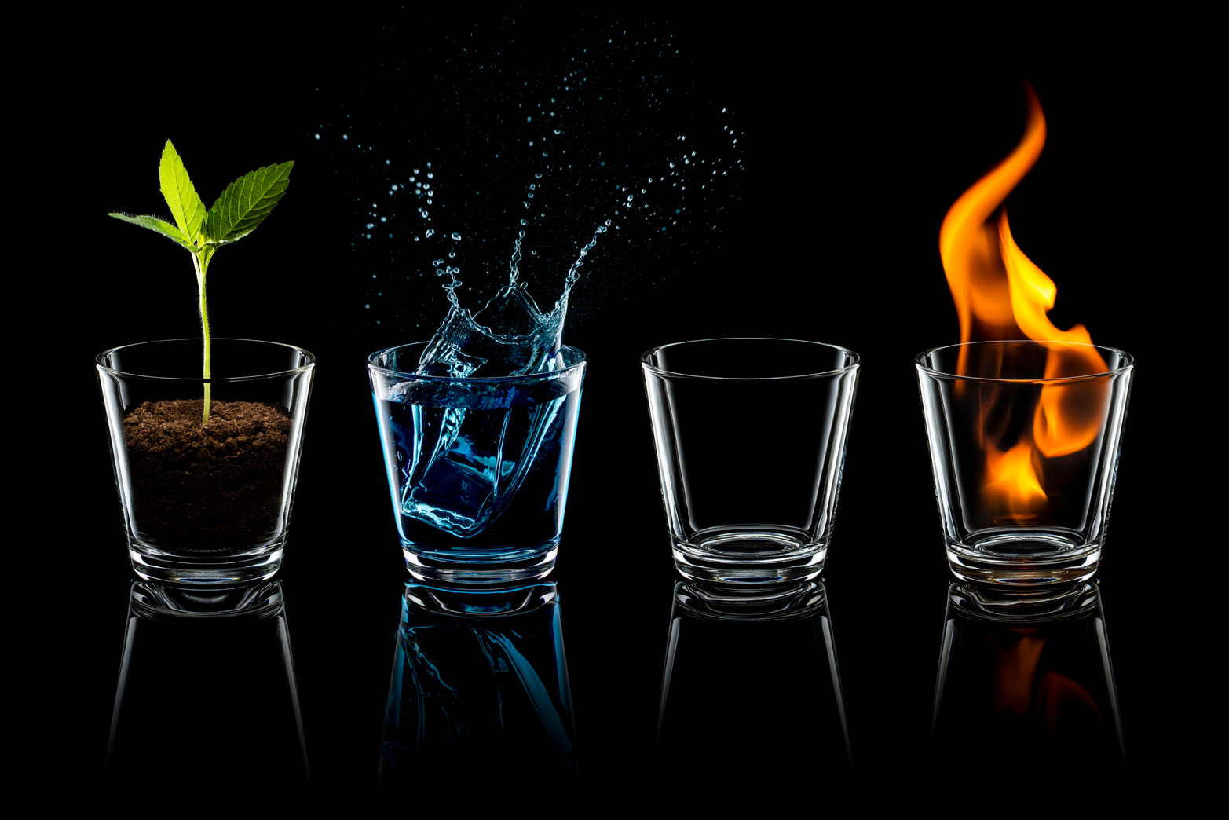
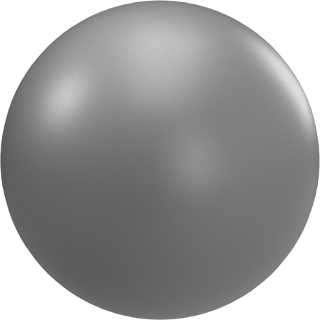

What is matter?
Arial
Four elements Atoms
400BC, Democritus

Slide 7
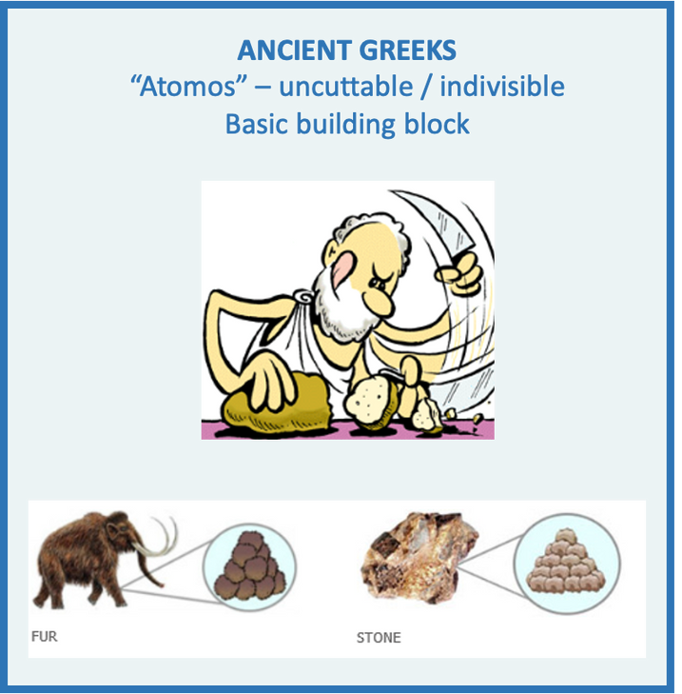
What is the smallest thing?
Arial

Slide 8
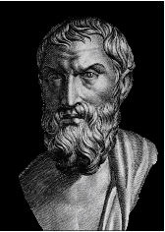
What is the smallest thing?
Arial
“On the Nature of Things” Lucretius - 1st Century BC
"Honey and milk, when they are rolled in the mouth, cause an agreeable sensation to the
tongue. But bitter wormwood and astringent centaury screw the mouth awry with their
nauseating savour. You may readily infer that such substances as agreeably titillate the senses are composed of smooth round atoms. Those that seem bitter and harsh are more tightly compacted of hooked particles and accordingly tear their way to our senses and rend our bodies by their inroads.
Things that seem to us hard and stiff must be composed of deeply indented and hooked atoms
and held firm by their intertangling branches. In the front rank of this class stand diamonds
Liquids, on the other hand, must owe their fluid consistency to atoms that are smooth and round.
For poppy seed can be poured as easily as if it were water; the globules do not hold one another back, and when they are jolted they tend to roll downhill as water does.
A third class is constituted by things such as smoke, cloud and flames.
If their atoms are not all smooth and round, yet they cannot be jagged and intertangled.
They must be such as to prick the body and even to penetrate rocks but not to stick together;
so you can readily grasp that substances hurtful to the senses but not solid are sharp-pointed but
without projections".
ROMANS

Slide 9
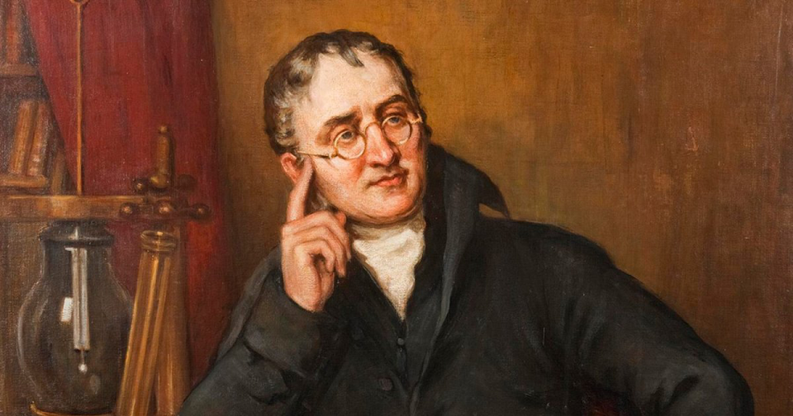
What are atoms?
Arial
Zooming forwards to 1803, the idea of atoms reappears thanks to John Dalton and others:
  Matter is built of atoms,
  Atoms cannot be created nor destroyed,
  Atoms of the same substance are identical,
  Chemical reactions occur when atoms reorganise.

Slide 10
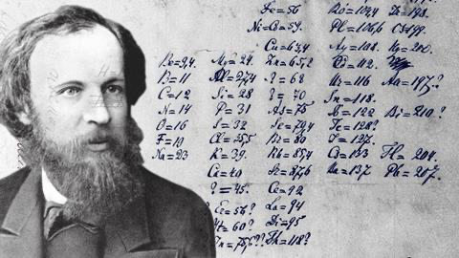
Are all atoms the same?
Arial
In 1869 Dimitri Mendeleev published his periodic table of elements.
  He arranged elements based on atomic masses, and noticed that they exhibit apparent periodicity in their properties.
  He left gaps in places where he thought an undiscovered element may lie…
  If this works, we get a strong hint of the existence
  of some building blocks of atoms!

Slide 11
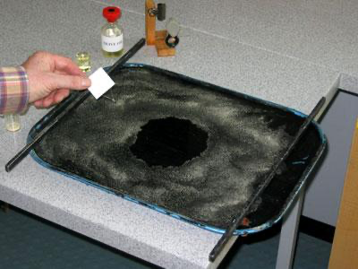
Practical Challenge
Arial
How big are atoms?
Oil Drop Experiment to estimate the size of an atom.

Slide 12
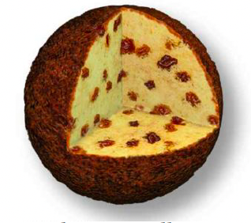
What is the structure of an atom?
Arial
Along came J.J. Thompson
  Positively-charged pudding
  Negatively-charged plums (already called electrons at this time.

Slide 13
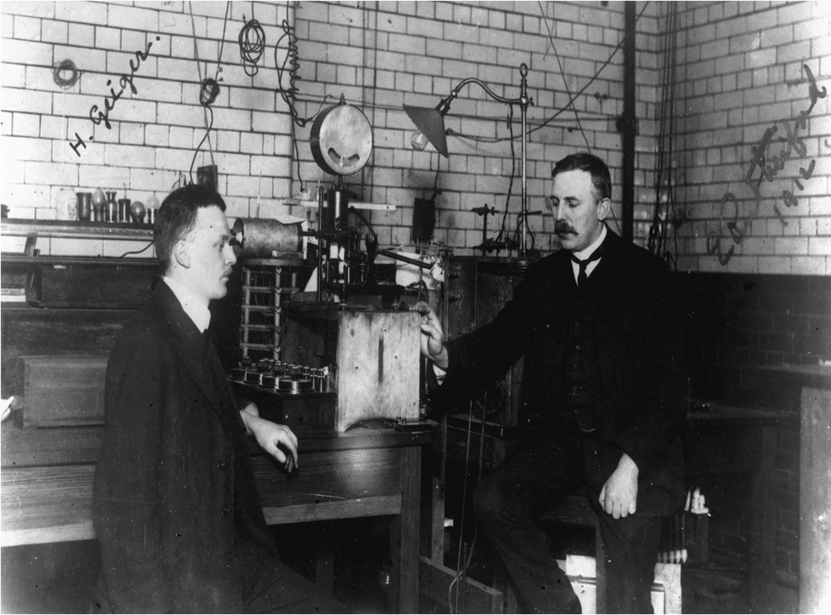
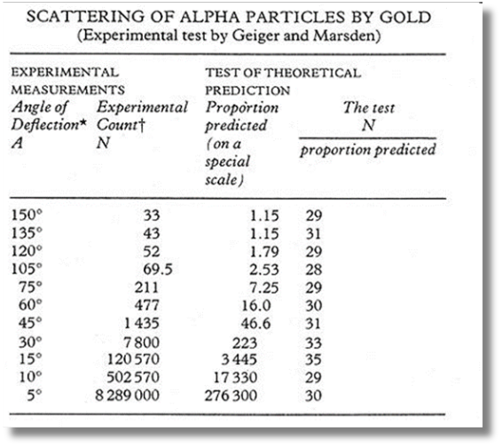

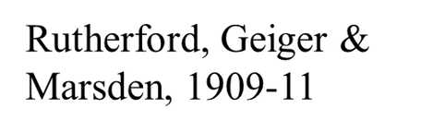
What is the structure of an atom? II
Arial
New evidence from Rutherford’s experiment led to a new model!
Beginning of particle physics

Slide 14
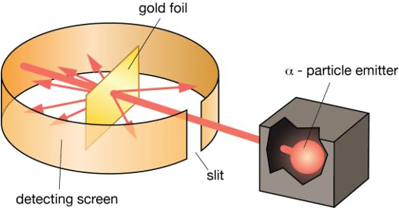
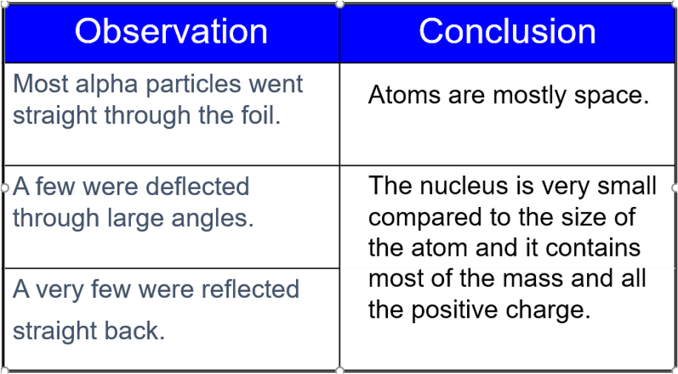
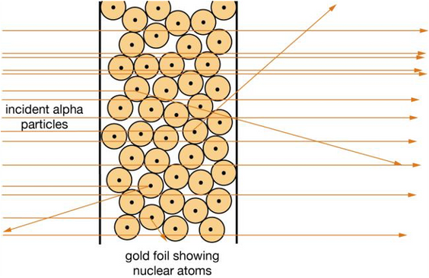
How do we know there is a nucleus?
Arial

Slide 15

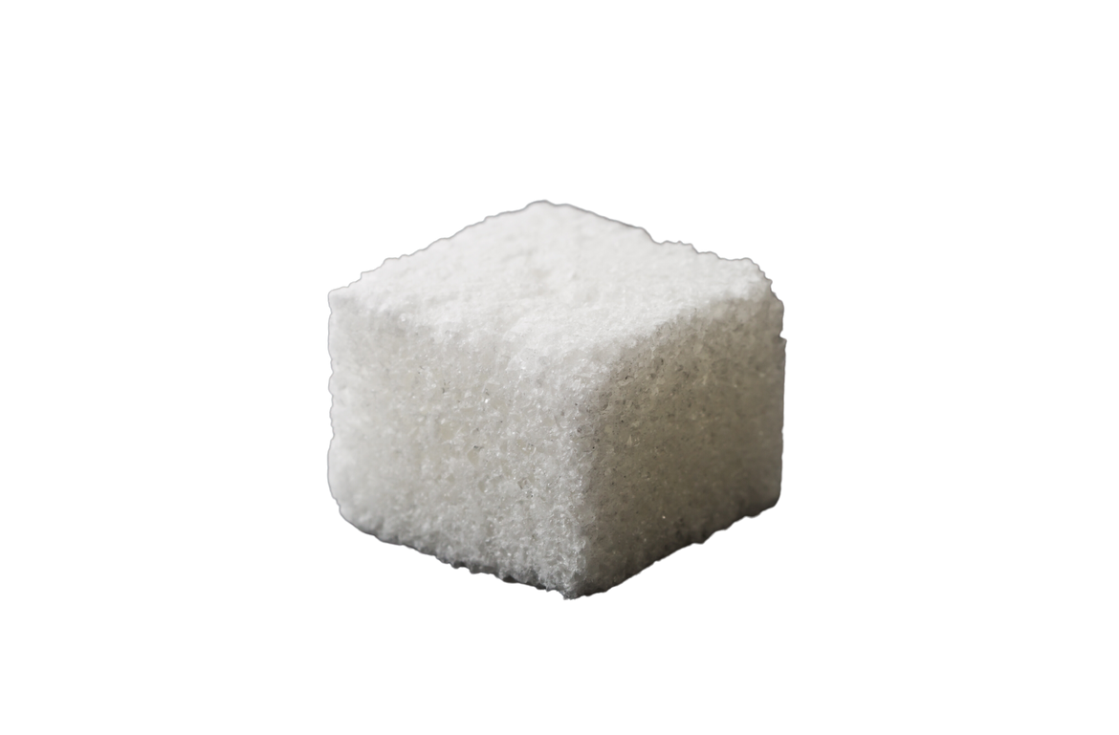
So what is everything made from?
Arial
It's just all empty space!
If you removed all the empty space from the atoms, the human population would fit into the volume of a sugar cube.

Slide 16
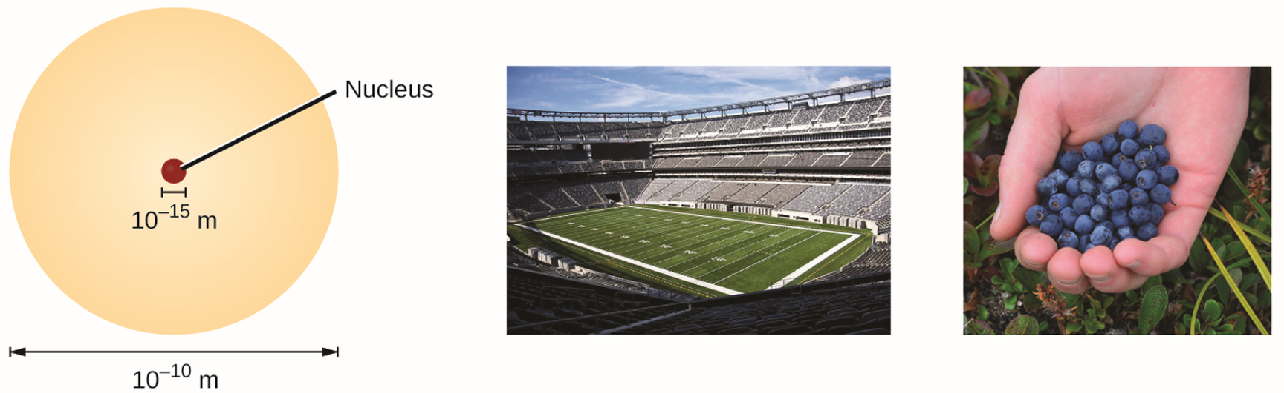
What is the size of the model?
Arial

Slide 17
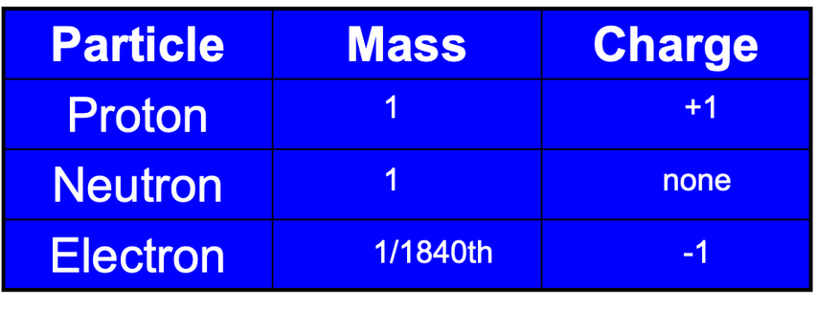
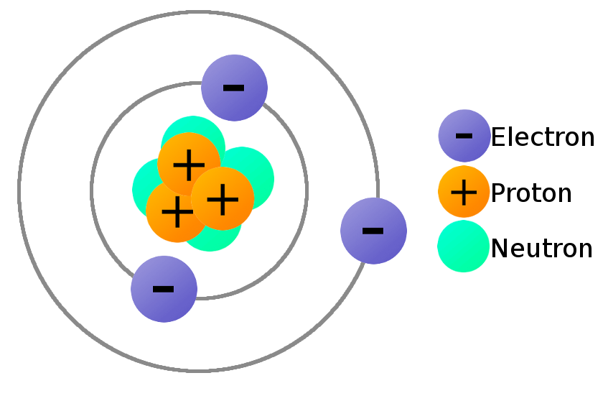
Atomic constituents
Arial
What questions would you ask now?
Nucleus

Slide 18
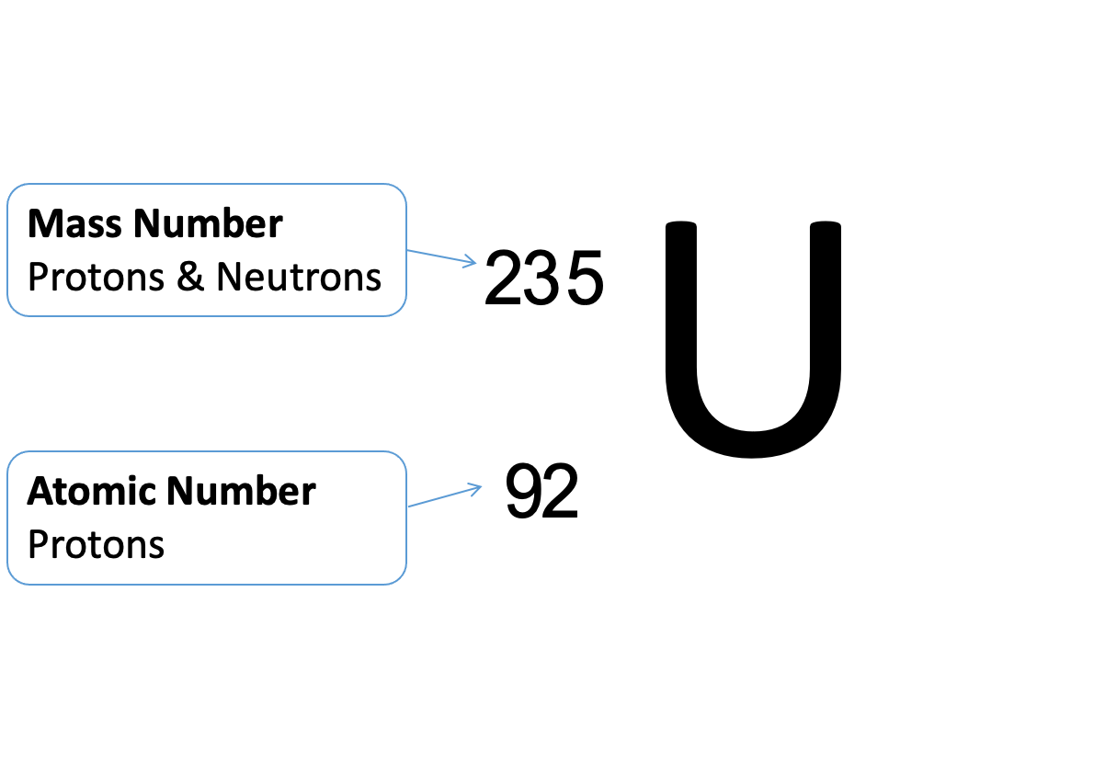
Atomic number and mass number
Arial

Slide 19
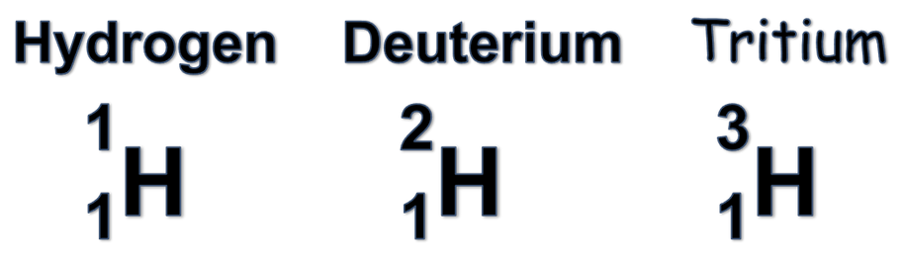
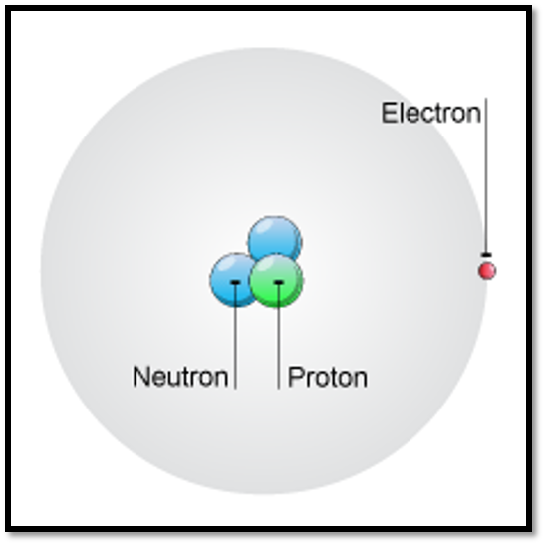
Isotopes
Arial
Isotopes are atoms of the same element (same protons & electrons) with different numbers of neutrons.
This makes them unstable.

Slide 20
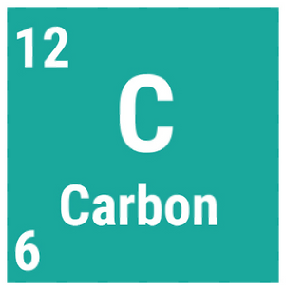
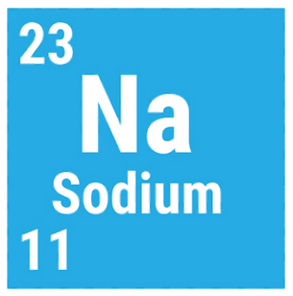
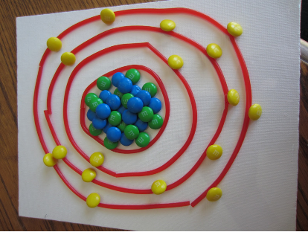
Practical Challenge
Arial
Choose appropriate amounts of sweets
to make a model of the following atoms:
How can we model atoms with sweets?
Remember - in a neutral atom
number of protons = number of electrons
Electrons are arranged in shells – the first has 2, then 8, 8 …

Slide 21
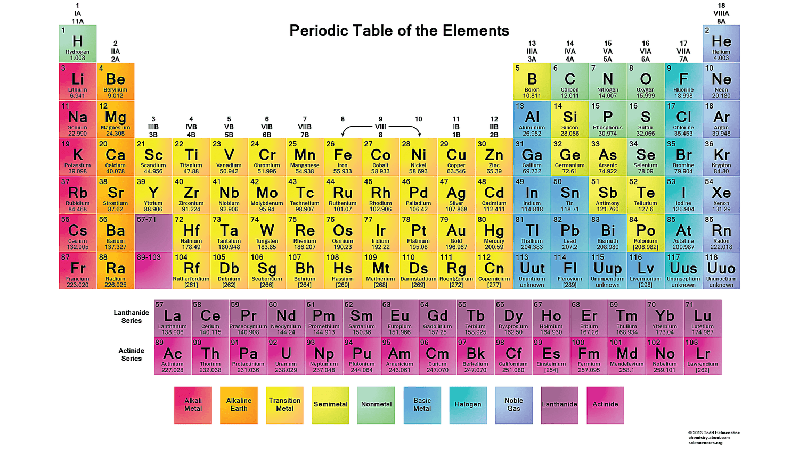

Slide 22

Itch by Simon Mayo
Science is all about being curious and asking questions - each question will lead to hundreds if not thousands more.

Slide 23
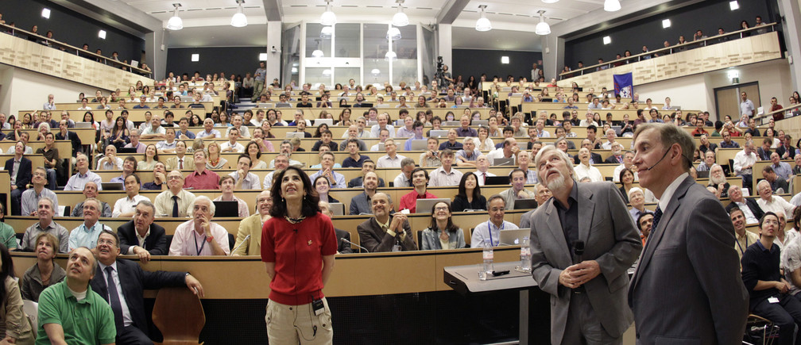
Over 12,200 scientists of 110 nationalities, from institutes in more than 70 countries are asking questions at CERN today.

Slide 24
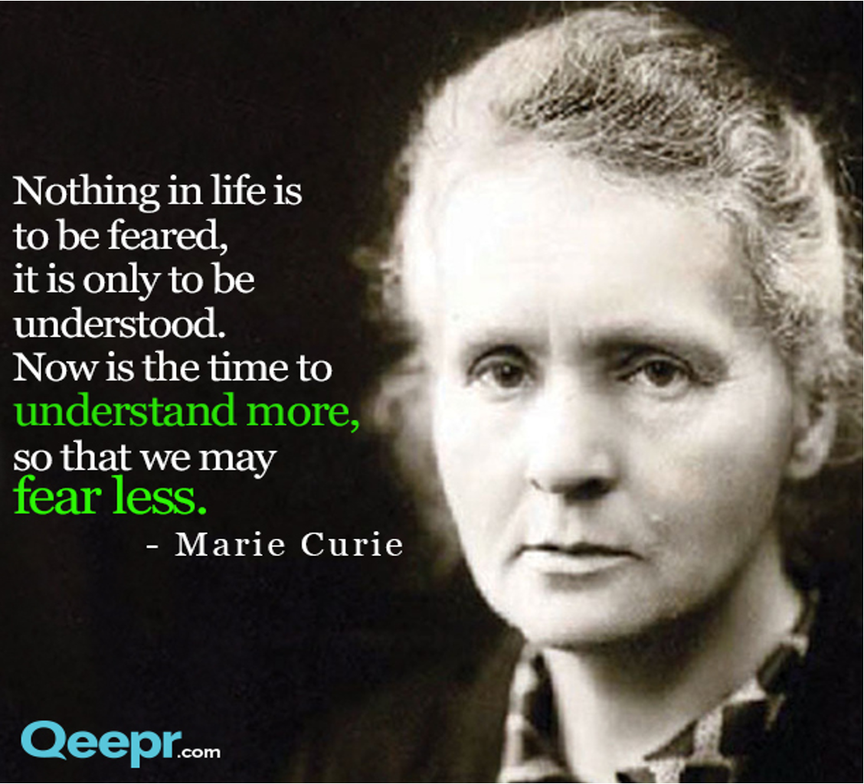

Slide 25
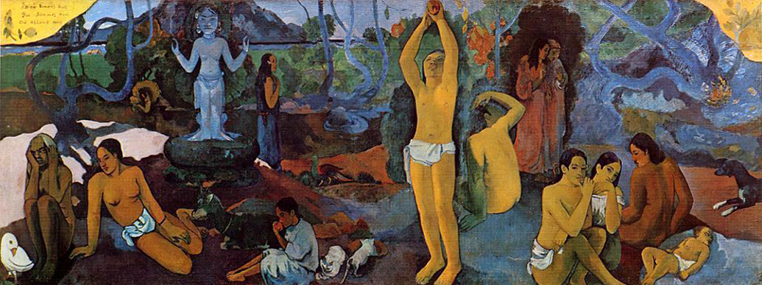
So what questions remain.....
Paul Gauguin, Where do we come from? What are we? Where are we going?
(Museum of Fine Arts, Boston)

